Slide 1
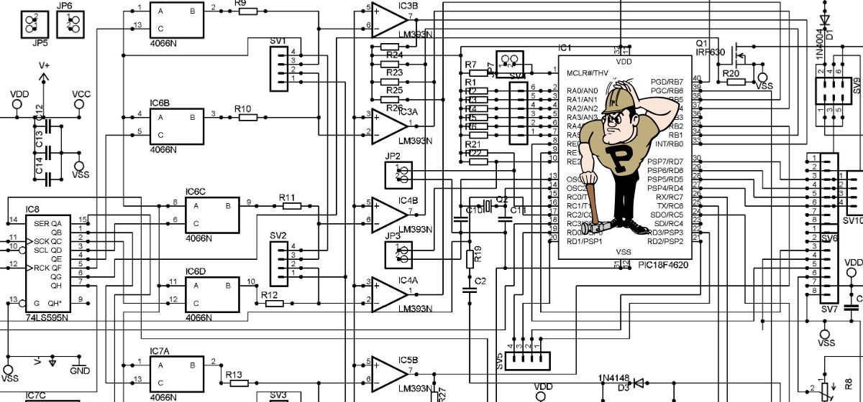
What is computer Science?
Phil Sands
K-12 Outreach Coordinator for Computer Science

Slide 2
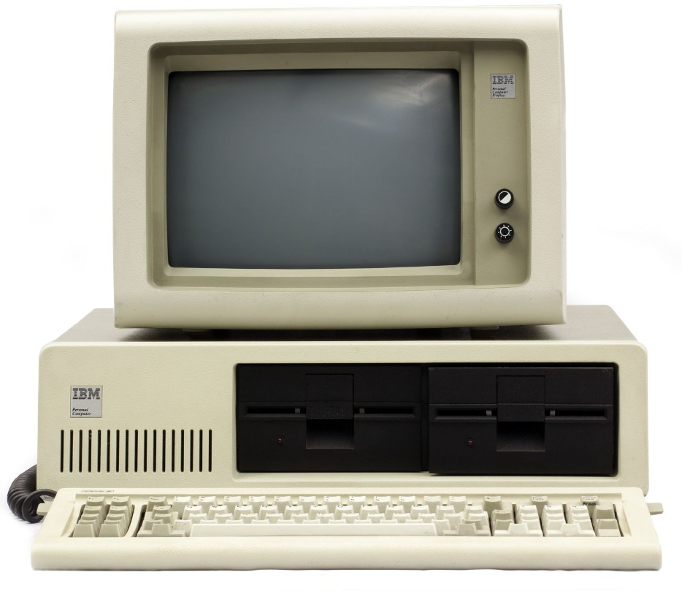
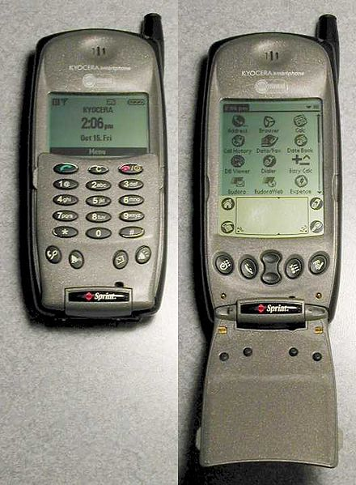
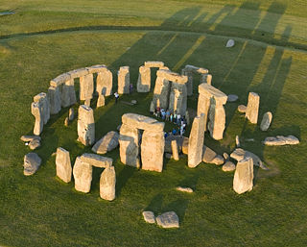
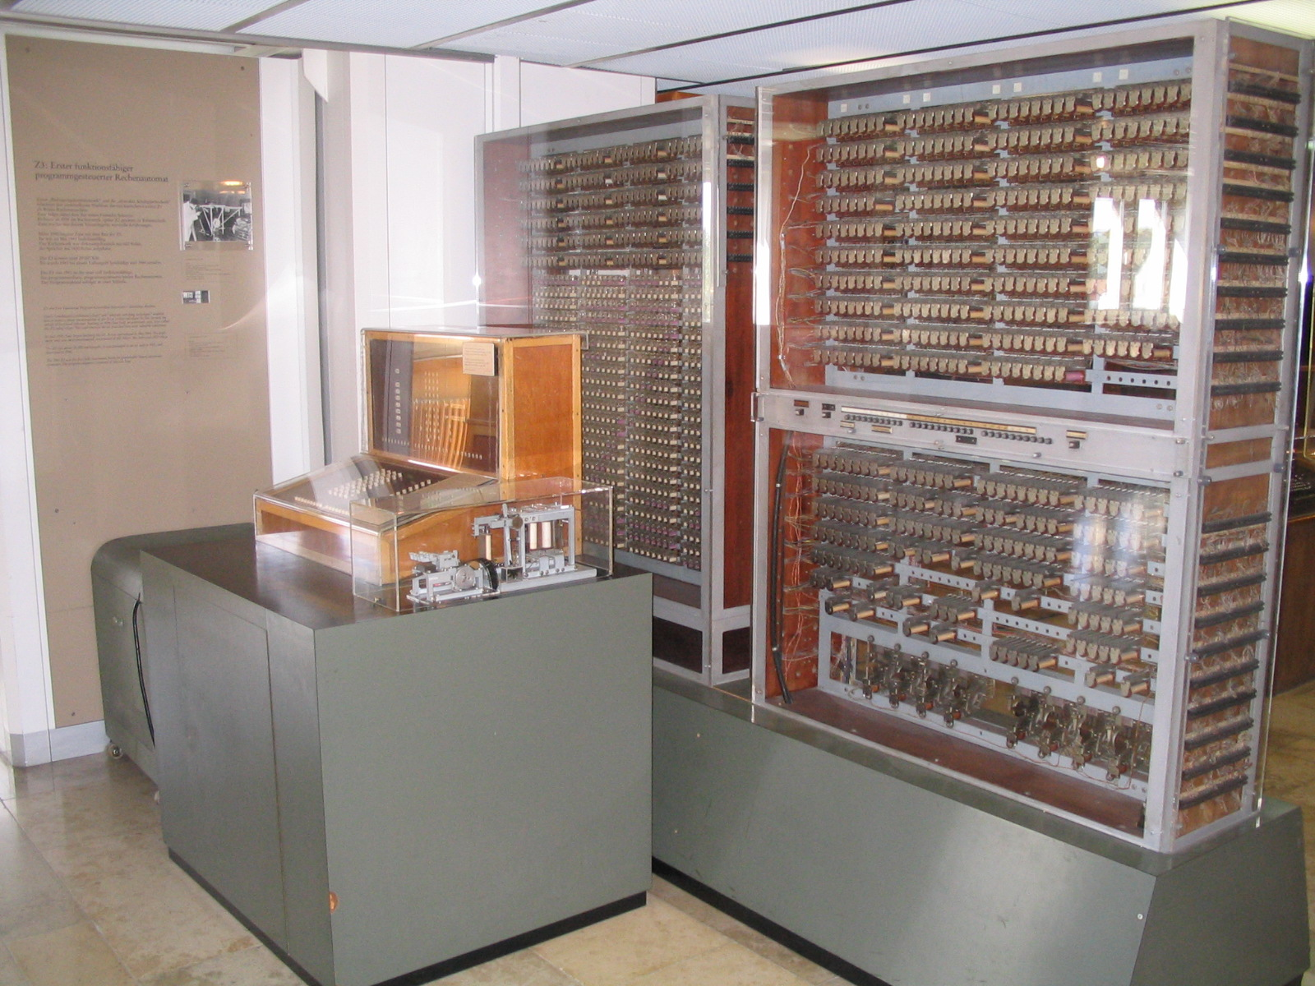
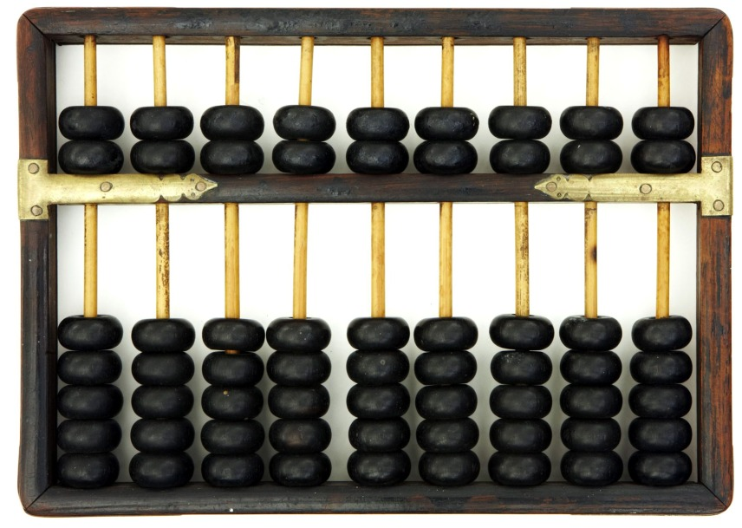
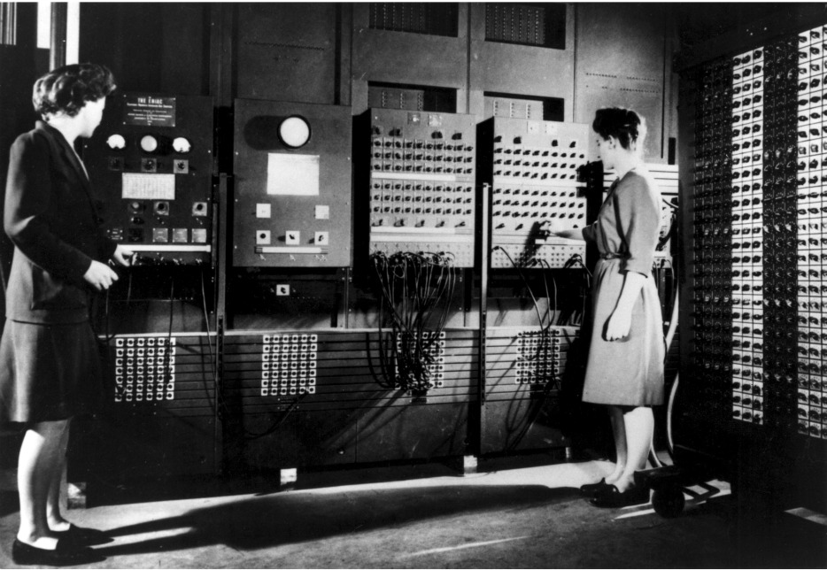
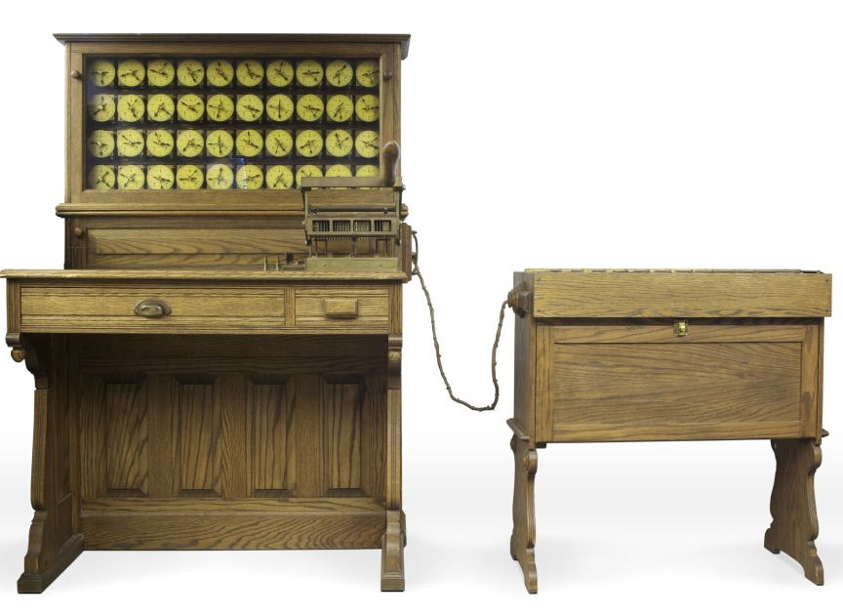
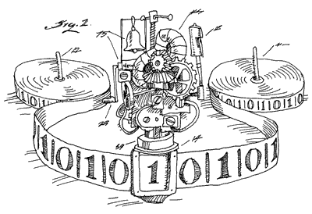
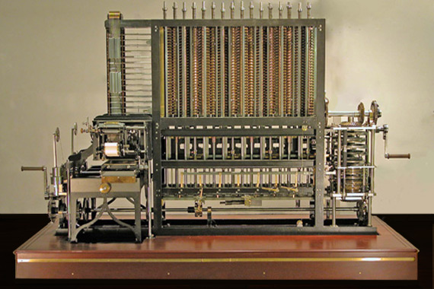
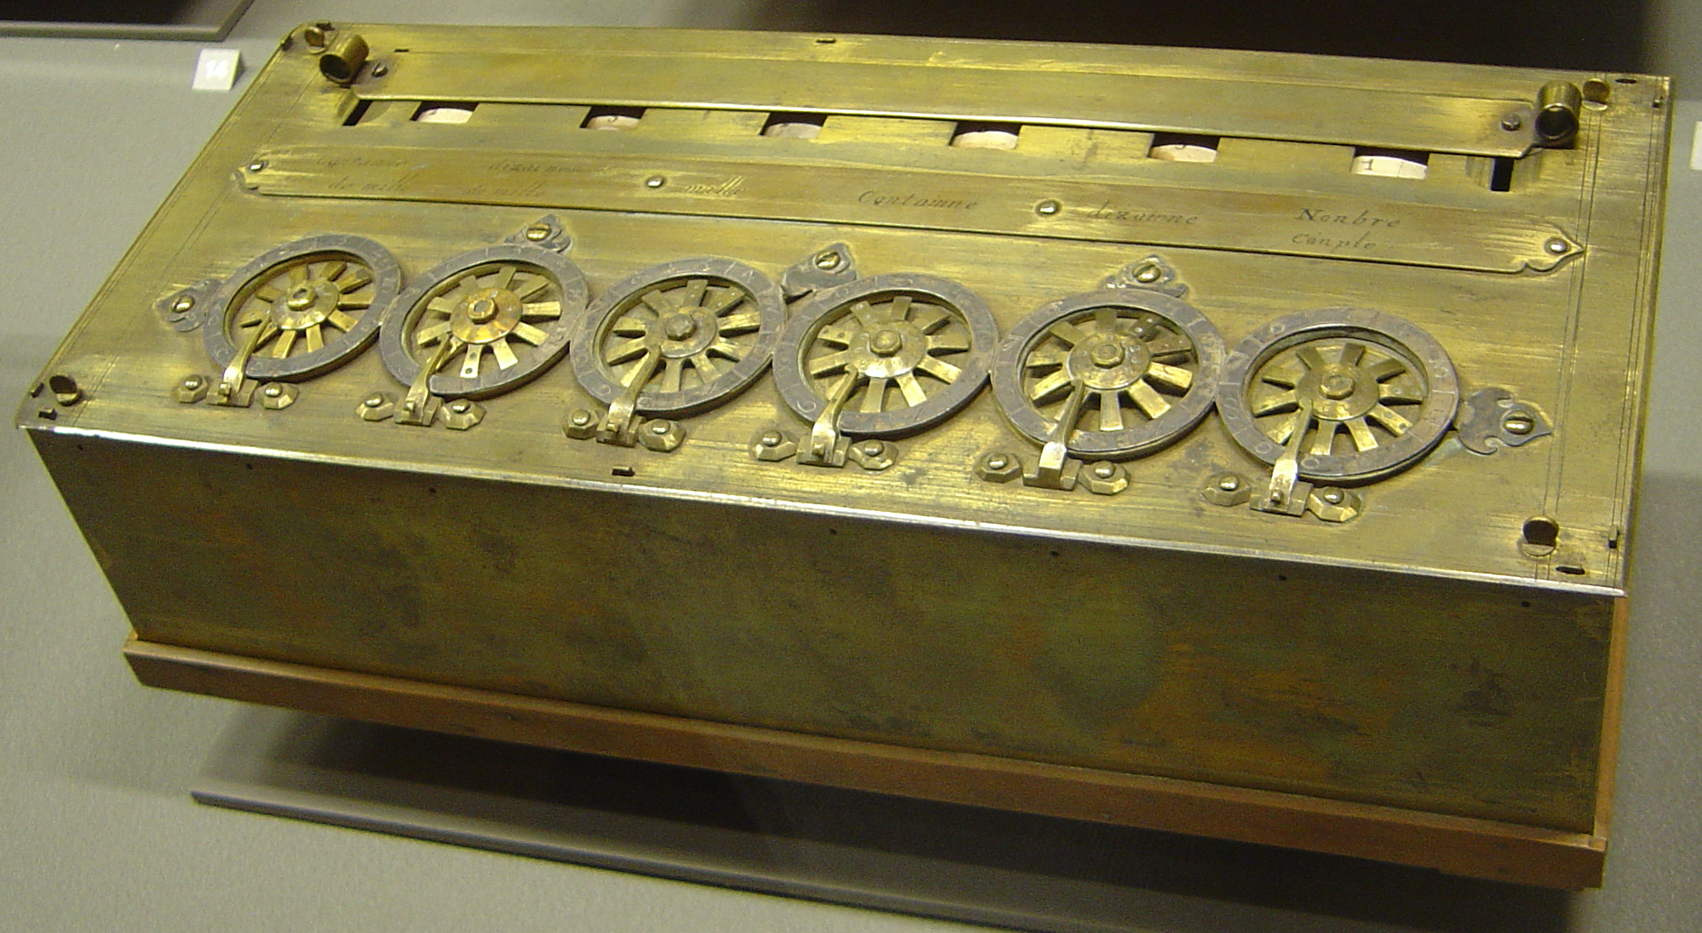
When was the first computer made?
Purdue k-12 Outreach FOR Computer Science
1641 AD
3100 BC
1837 AD
1890 AD
1941 AD
1981 AD
2001 AD
2700 BC
1936 AD
1946 AD
Notes:
Stonehenge – 3100 BC (Used to perform calculations of astral bodies)
Abacus – 2700 BC (First calculator)
Pascaline – 1641 AD (First mechanical calculator; was developed by mathematician Blaise Pascal)
Analytical Engine – 1837 AD (Proposed design for first mechanical programmable computer, not completed; designed by Charles Babbage; programmed with Jacquard loom as suggested by Ada Lovelace)
Hollerith Machine – 1890 AD (Data calculator storing information on punch cards as a result of 1890 census; designed by Herman Hollerith whose company later became IBM)
Turing Machine – 1936 AD (Theoretical machine designed to solve the Entscheidungsproblem regarding the determination of a problem’s “solvability”; designed by Alan Turing)
Z3 – 1941 (First Turing complete electronic computer; designed by Konrad Zuse)
ENIAC – 1946 (First general-purpose electronic computer; designed by John Mauchly and J. Presper Eckert)
IBM PC – 1981 (First commercial personal computer; designed by team led by Don Estridge)
Palm Kyocera 6035 – 2001 AD (First commercial cellular phone with computing capabilities)

Slide 3
How Big Was the first electronic computer?
Purdue k-12 Outreach FOR Computer Science
Dimensions: ~16x8x10 ft³
Weight: 2200 lbs
Cost (1941): $10,000
Cost (2013): ~$1,250,000
Addition: 0.8 seconds
Multiplication: 3.0 seconds
Frequency: 5.3 Hz
Memory: 1408 bits

Slide 4
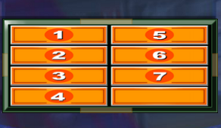
Why were people interested in developing a computer?
Purdue k-12 Outreach FOR Computer Science
FAST COMPUTATION
MODELING & SIMULATION
STORE DATA

Slide 5
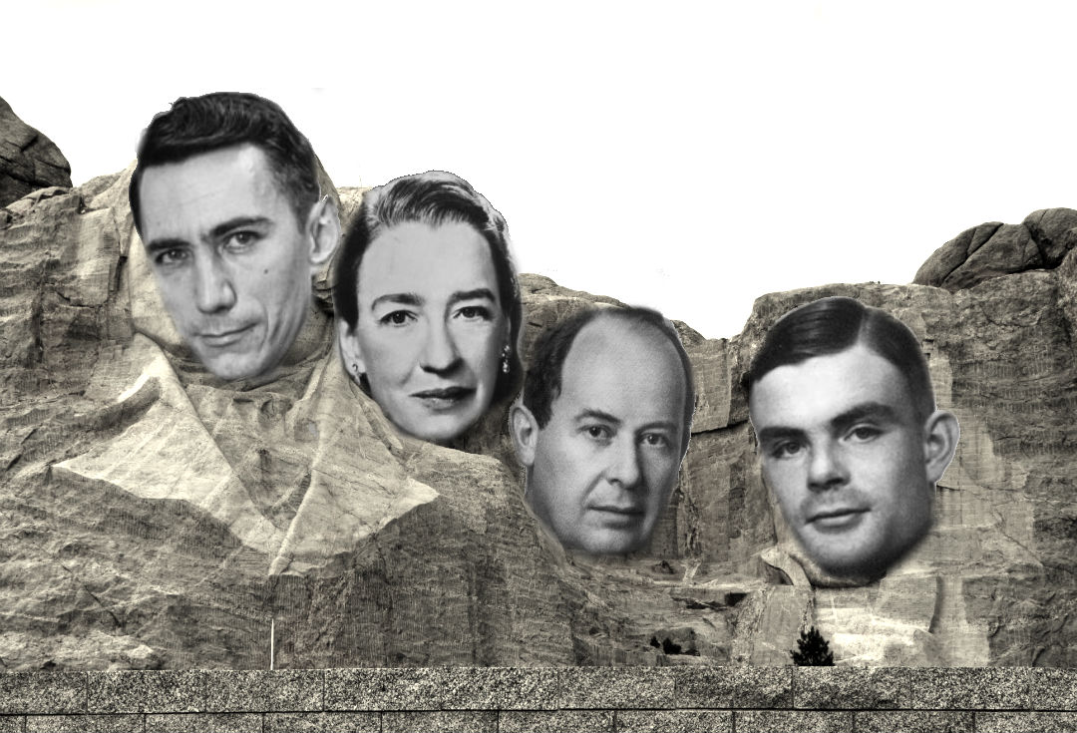
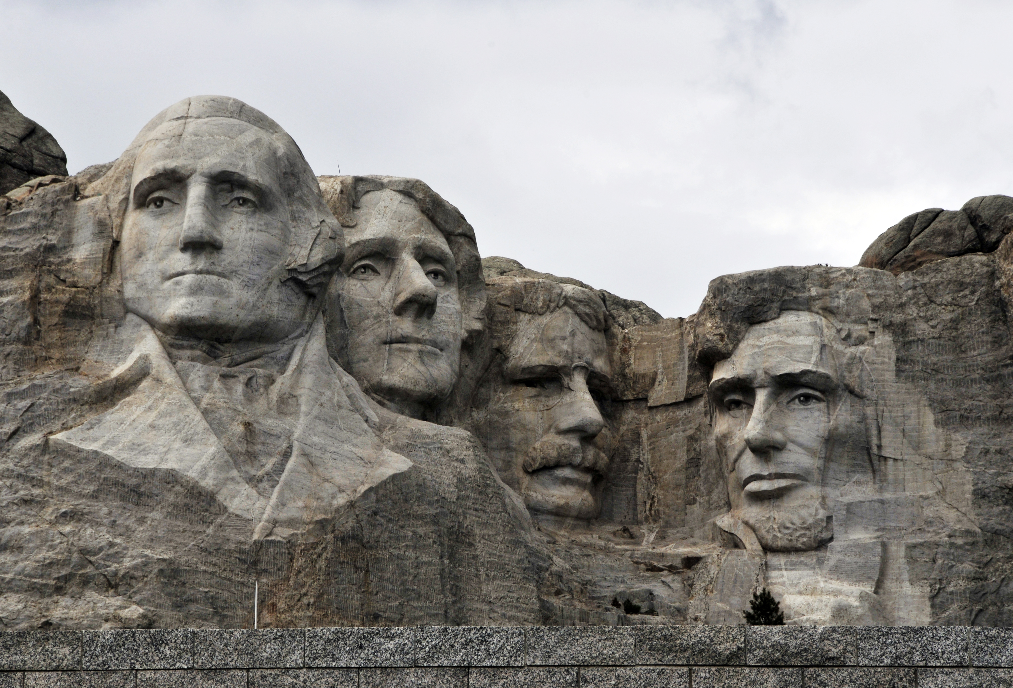
WHO ARE THE IMPORTANT FIGURES IN COMPUTER SCIENCE?
Purdue k-12 Outreach FOR Computer Science
Notes:
L to R: Claude Shannon (Information Theory); Grace Murray Hopper (Compiler); John Von Neumann (Computer Architecture); Alan Turing (Finite State Automata)

Slide 6
What do computer scientists do?
Purdue k-12 Outreach FOR Computer Science
Program computers and devices
Solve problems
Simplify existing solutions to problems
Create models to simulate real life
Abstract complex ideas in multiple layers
Apply mathematical logic to problems in almost any field
Teach computers how to learn
Test programs
Write documents that help explain programs for future programmers
Analyze large sets of data for patterns
Medicine
Education
Physics
Business
Communication
Engineering
Music
Games
Entertainment

Slide 7
What Skills do good computer scientists have?
Purdue k-12 Outreach FOR Computer Science
Problem solving
Logical / algorithmic thinking
Can generalize solutions to fit multiple problems
Math
Technical writing / communication
Design / graphics
Flexibility
Creativity

