Slide 1
Static Analysis
Xiangyu Zhang

Slide 2
Static Analysis Is Considered More Difficult
Difficult to understand
  Data flow analysis framework
    Why it is designed in such a way?
    Is it a magic bullet?
    Guarantees: distributive versus non-distributive?
  Many terms
    Context/flow/path/field-sensitivity
  Complex analysis
    Points-to
Without our efforts on formalizing dynamic analysis, static analysis becomes much more apprehendable

Slide 3
Intuition
Instead of concretely executing the program, let’s statically execute/traverse it
Instead of producing concrete execution states, let’s have abstract state related to the analysis

Slide 4
Analysis: Compute Data Dependence Statically
Let’s use the simplest language first
Program P ::= s
Statement s ::= s1; s2 | x=^{L} y | x =^{L} y op z | x=^{L} c |
if (x^{L}) s1 else s2 |
while (x^{L}) s
Operation op :: = + | - | * | / | > | < | …
Value c :: = 0 | 1 | 2 … | true | false
Variable x, x1, x2, x3

Slide 5
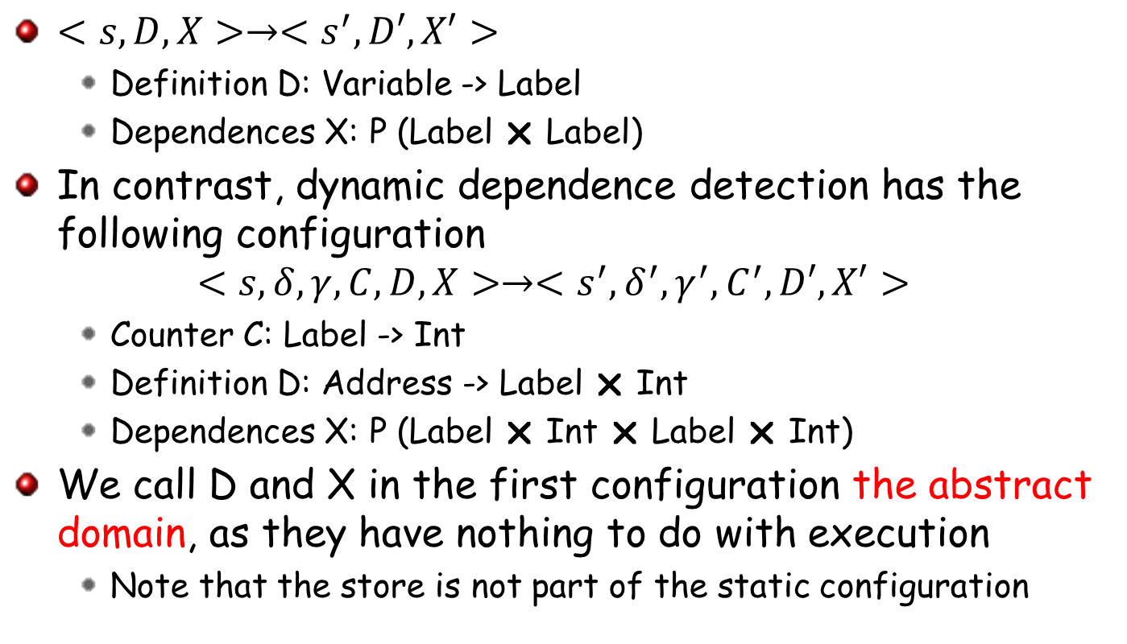
Configuration
$<s,D,X>→<s^{′}, D′,X′>$
  Definition D: Variable -> Label
  Dependences X: P (Label  Label)
In contrast, dynamic dependence detection has the following configuration
$$<s,δ,γ,C,D,X>→<s^{′},δ^{′},γ^{′},C^{′},D′,X′>$$
  Counter C: Label -> Int
  Definition D: Address -> Label  Int
  Dependences X: P (Label  Int  Label  Int)
We call D and X in the first configuration the abstract domain, as they have nothing to do with execution
  Note that the store is not part of the static configuration

Slide 6
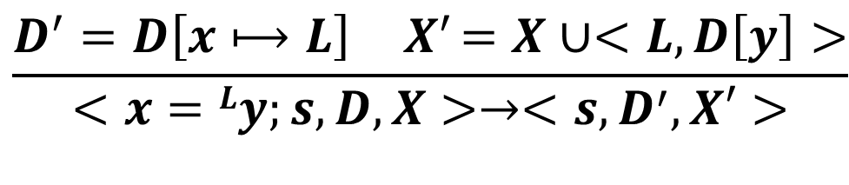
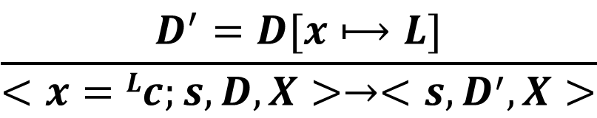
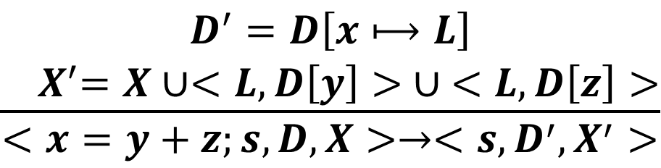
Abstract Semantics
$$\frac{D^{′}=D[x⟼L]}{<x=Lc;s,D,X>→<s,D^{′},X>}$$
Const-Assign
$$\frac{D^{′}=D\left[x⟼L\right]{ X}^{′}=X∪<L,D\left[y\right]>}{<x=Ly;s,D,X>→<s,D^{′},X′>}$$
Copy
$$\frac{\begin{aligned}D^{′}=D\left[x⟼L\right] \\ { X}^{′}=X∪<L,D\left[y\right]> ∪ <L,D\left[z\right]>\end{aligned}}{<x=y+z;s,D,X>→<s,{D^{′}, X}^{′}>}$$
BinOp-Add

Slide 7
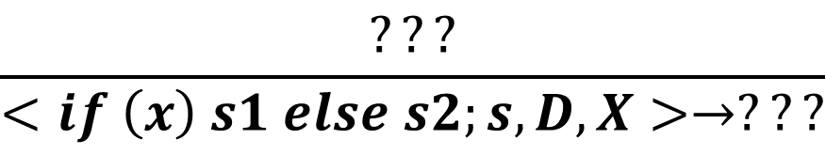
Abstract Semantics
$$\frac{???}{<if \left(x\right) s1 else s2;s,D,X>→???}$$
If
There is no concrete store. We do not know the branch outcomes. What can we do with the conditional statements and loop statements?
Idea: let’s explore all possible branches
  If we have explored a branch with the same (abstract) state, we can skip the branch
  Use a worklist

Slide 8

Configuration
$<V,W,s,D,X>→<V^{′},W^{′},s^{′}, D′,X′>$
  Definition D: Variable -> Label
  Dependences X: P (Label  Label)
  WorkList W: P (Definition Statement)
  Visited V: P (Definition Statement)

Slide 9
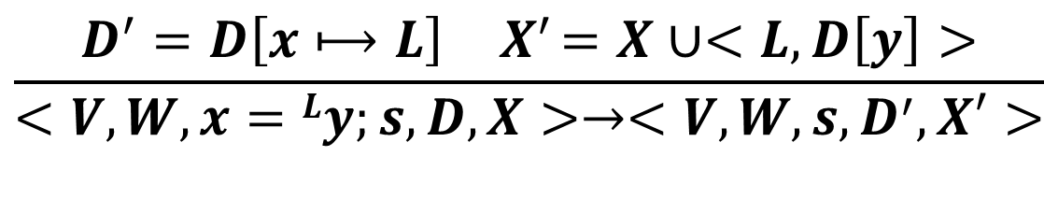
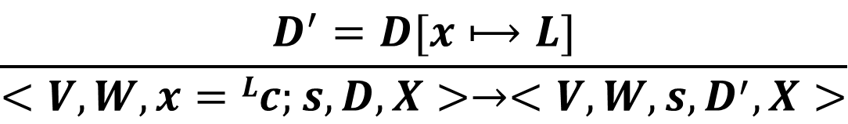
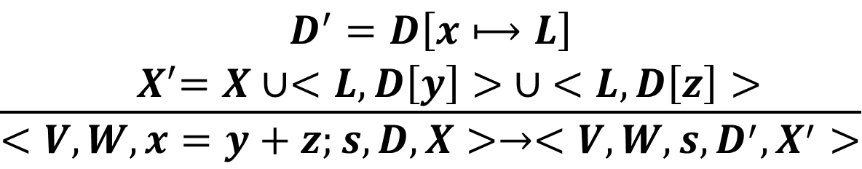
Abstract Semantics
$$\frac{D^{′}=D[x⟼L]}{<V,W,x=Lc;s,D,X>→<V,W,s,D^{′},X>}$$
Const-Assign
$$\frac{D^{′}=D\left[x⟼L\right]{ X}^{′}=X∪<L,D\left[y\right]>}{<V,W,x=Ly;s,D,X>→<V,W,s,D^{′},X′>}$$
Copy
$$\frac{\begin{aligned}D^{′}=D\left[x⟼L\right] \\ { X}^{′}=X∪<L,D\left[y\right]> ∪ <L,D\left[z\right]>\end{aligned}}{<V,W,x=y+z;s,D,X>→<V,W,s,{D^{′}, X}^{′}>}$$
BinOp-Add

Slide 10
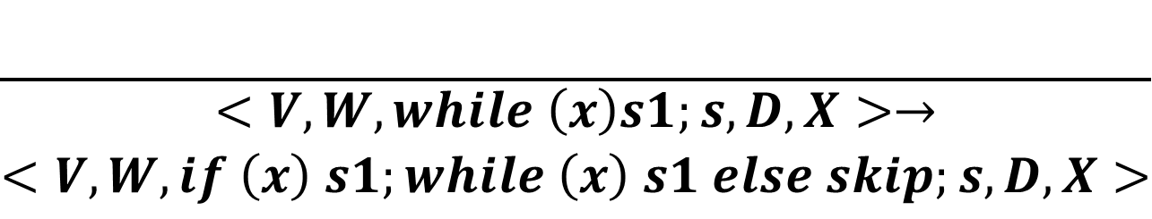
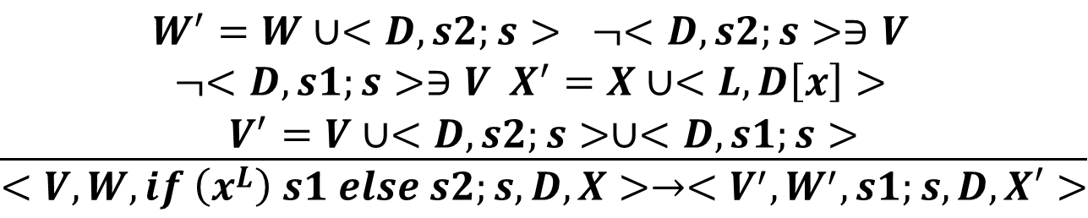
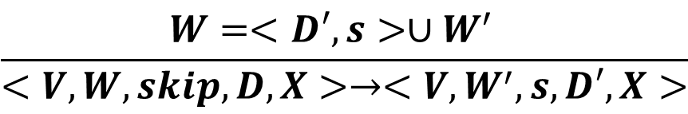
Abstract Semantics
$$\frac{\begin{aligned}W^{′}=W∪<D,s2;s> ¬<D,s2;s>∋V \\ \begin{aligned}¬<D,s1;s>∋V X^{′}=X∪<L,D\left[x\right]> \\ V^{′}=V∪<D,s2;s>∪<D,s1;s>\end{aligned}\end{aligned}}{<V,W,if \left(x^{L}\right) s1 else s2;s,D,X>→<{V^{′}, W}^{′},s1;s,D,X′>}$$
If
$$\frac{}{\begin{aligned}<V,W,while \left(x\right)s1;s,D,X>→ \\ <V,W,if \left(x\right) s1;while \left(x\right) s1 else skip;s,D,X>\end{aligned}}$$
While
$$\frac{W=<D′,s>∪W^{′} }{<V,W,skip,D,X>→<V,W^{′},s,D′,X>}$$
Next-Path

Slide 11
An Example
1: sum=0
2: i=1
3: while ( i<N) do
4: i=i+1
5: sum=sum+i
endwhile
6: print(sum)

Slide 12
Two Importance Properties
Does the analysis terminate
  How does it handle loops?
Is it sound?
  Does it computes what it claims to compute (through a declarative statement)

Slide 13
Property One: Termination
The abstraction domain is finite
  Visited V: P (Definition Statement)
By definition a partial order between the abstract values, called the lattice, and showing that the computed abstract values can only change strict-monotonically, we ensure termination
  Set subsumption

Slide 14
Property Two: Soundness
Declarative statement.
  If there is a path from L1 to L2, L1 defines variable x and L2 uses x, and there is not another definition of x along the path, L1->L2 must be in the computed dependence set.
How to prove?
  Our algorithm never enumerates all paths. Instead, it uses a work-list and may exercise a path from the middle

Slide 15
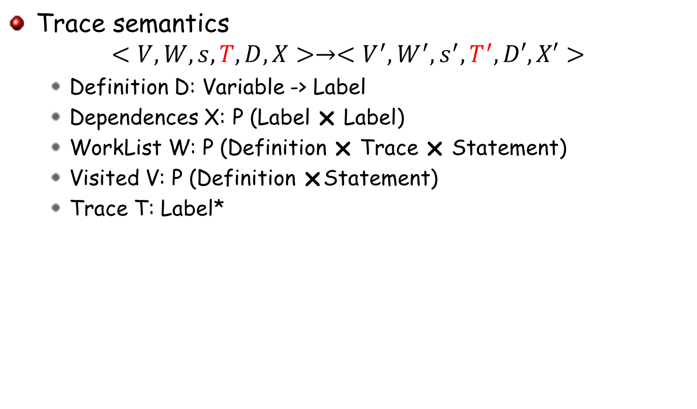
Property Two: Soundness Proof
Trace semantics
$$<V,W,s,T,D,X>→<V^{′},W^{′},s^{′}, T^{′},D′,X′>$$
  Definition D: Variable -> Label
  Dependences X: P (Label  Label)
  WorkList W: P (Definition  Trace  Statement)
  Visited V: P (Definition Statement)
  Trace T: Label*

Slide 16
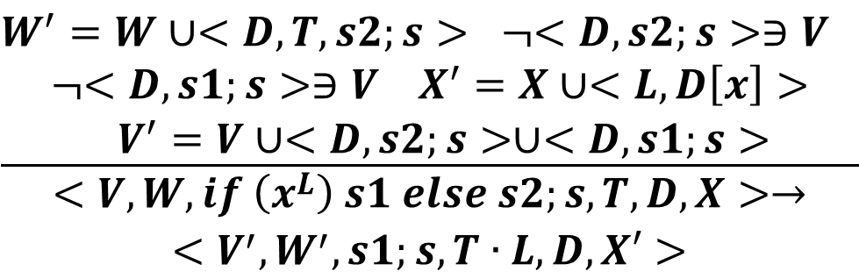
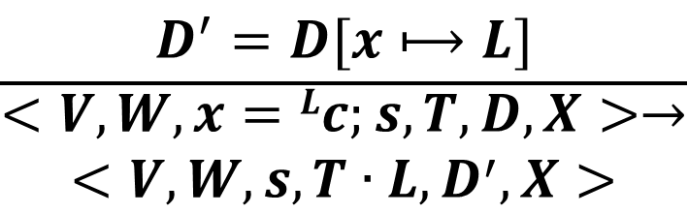
Abstract Semantics
$$\frac{D^{′}=D[x⟼L]}{\begin{aligned}<V,W,x=Lc;s,T,D,X>→ \\ <V,W,s,T∙L, D^{′},X>\end{aligned}}$$
Const-Assign
$$\frac{\begin{aligned}W^{′}=W∪<D,T,s2;s> ¬<D,s2;s>∋V \\ ¬<D,s1;s>∋V X^{′}=X∪<L,D\left[x\right]> \\ V^{′}=V∪<D,s2;s>∪<D,s1;s>\end{aligned}}{\begin{aligned}<V,W,if \left(x^{L}\right) s1 else s2;s,T,D,X>→ \\ <{V^{′}, W}^{′},s1;s,T∙L,D,X′>\end{aligned}}$$
If

Slide 17
Property Two: Soundness Proof
Lemma: If there is a path from L1 to L2, L1 defines variable x and L2 uses x, and there is not another definition of x along the path, the evaluation must generate a trace satisfying the condition (which may not be the specific path though)
  Lemma 1: There must be a trace leading to L1
  Lemma 2: There must be a trace leading from L1 to L2
    Proof by contradiction. If not, the new definition at L1 does not take the branch leading to L2
  Lemma3: There must be a trace leading from L1 to L2 without any redefinition of x.
    Proof by contradiction. Assume all traces from L1 to L2 have redefinition. There must be a predicate preceding the redefinition leading to L2
Given such a trace, it must be D[x]=L1 at L2
  Proof by contradiction
Notes:
Connecting two sub-paths

Slide 18
Way to Improve Our Previous Algorithm
It is too expensive to enumerate individual paths
How about (abstractly) execute both branches of a predicate and aggregate the results before execute the continuation?

Slide 19

Configuration
$<V,W,s,D,X>→<V^{′},W^{′},s^{′}, D′,X′>$
  Definition D: Variable -> P(Label)
  Dependences X: P (Label  Label)
  WorkList W: P (Definition Statement)
  Visited V: P (Definition Statement)

Slide 20
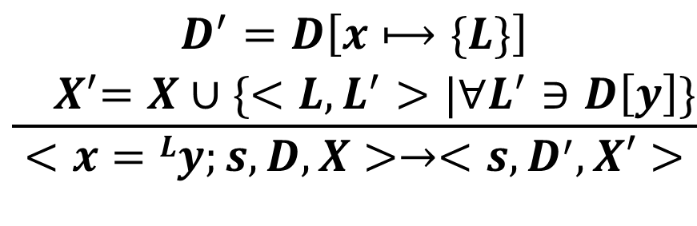
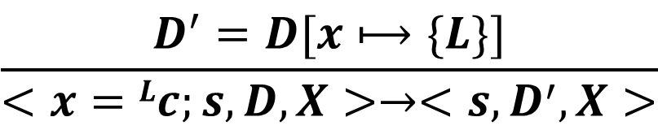
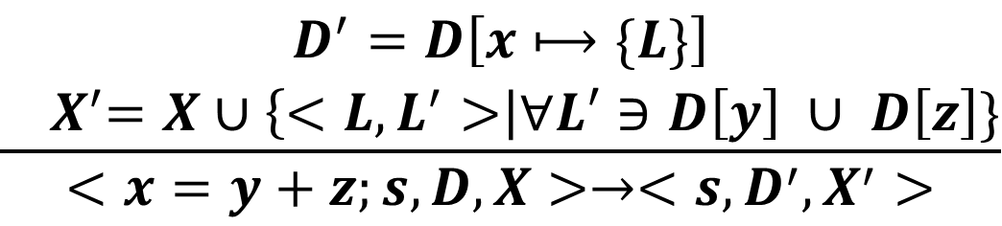
Abstract Semantics
$$\frac{D^{′}=D[x⟼\{L\}]}{<x=Lc;s,D,X>→<s,D^{′},X>}$$
Const-Assign
$$\frac{\begin{aligned}D^{′}=D\left[x⟼\{L\}\right] \\ { X}^{′}=X∪\{<L,L^{′}>|∀L^{′}∋D\left[y\right]\}\end{aligned}}{<x=Ly;s,D,X>→<s,D^{′},X′>}$$
Copy
$$\frac{\begin{aligned}D^{′}=D\left[x⟼\{L\}\right] \\ { X}^{′}=X∪\left\{<L,L^{′}>\right|∀L′∋D\left[y\right] ∪ D\left[z\right]\}\end{aligned}}{<x=y+z;s,D,X>→<s,{D^{′}, X}^{′}>}$$
BinOp-Add

Slide 21
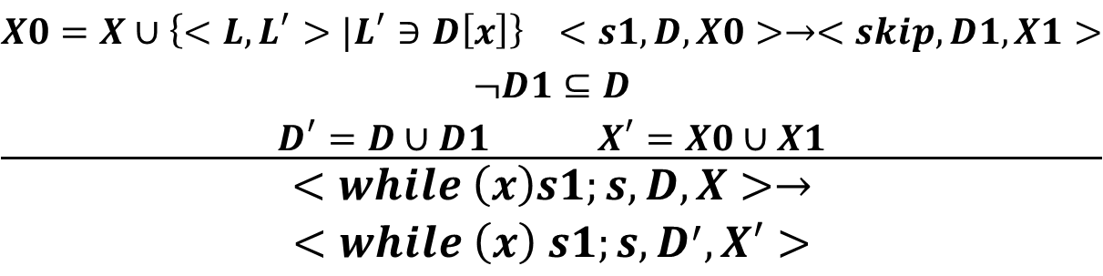
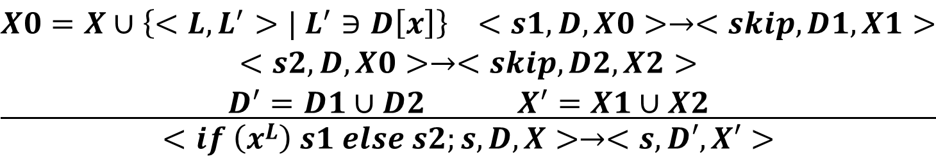
Abstract Semantics
$$\frac{\begin{aligned}X0=X∪\left\{<L,L^{′}>| L^{′}∋D\left[x\right]\right\} <s1,D,X0>→<skip,D1,X1> \\ <s2,D,X0>→<skip,D2,X2> \\ D^{′}=D1∪D2 X^{′}=X1∪X2\end{aligned}}{<if \left(x^{L}\right) s1 else s2;s,D,X>→<s,D′,X′>}$$
If
$$\frac{\begin{aligned}X0=X∪\left\{<L,L^{′}>|L^{′}∋D\left[x\right]\right\} <s1,D,X0>→<skip,D1,X1> \\ ¬D1⊆D \\ D^{′}=D∪D1 X^{′}=X0∪X1\end{aligned}}{\begin{aligned}<while \left(x\right)s1;s,D,X>→ \\ <while \left(x\right) s1;s,D^{′},X′>\end{aligned}}$$
While

Slide 22
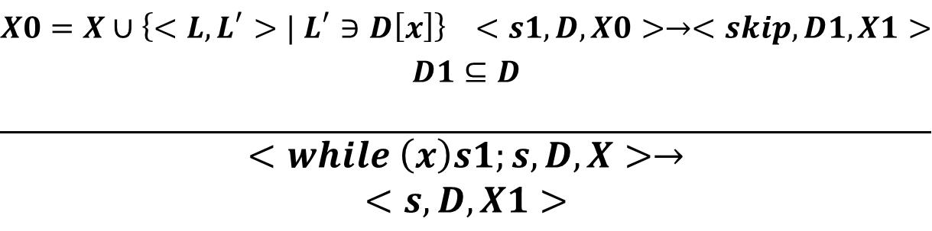
Abstract Semantics
$$\frac{\begin{aligned}X0=X∪\left\{<L,L^{′}>| L^{′}∋D\left[x\right]\right\} <s1,D,X0>→<skip,D1,X1> \\ D1⊆D \\ \end{aligned}}{\begin{aligned}<while \left(x\right)s1;s,D,X>→ \\ <s, D,X1>\end{aligned}}$$
While-Exit

Slide 23
An Example
1: sum=0
2: i=1
3: while ( i<N) do
4: i=i+1
5: sum=sum+i
endwhile
6: print(sum)

Slide 24
Termination and Soundness
Termination can be proved by the monotonic increase of D at while statement(s)
Soundness
  If there is a path from L1 to L2, L1 defines variable x and L2 uses x, and there is not another definition of x along the path, L1->L2 must be in the computed dependence set.
    Proof sketch: for each definition d in D, we associate it with a witness trace. For each step of eval, all the definitions have their witness traces incremented by the step. We define the provenance of d the set of witness traces of d starting from the definition to its deadth (redefinitions). Then prove by contradiction that there is not a witness trace covers both L1 and L2.
Unfortunately, not all the analyses can be optimized by evaluating both branches and then their continuation

Slide 25
Alias Analysis
For each pointer variable, determine the set of global variables and the heap objects that may be pointed-to by the variable
  One of the most important analyses

Slide 26
Heap Language
Program P ::= s
Statement s ::= s1; s2 | x=^{L} y | x =^{L} y op z | x=^{L} c |
x=^{L} &y | (*x)=^{L} y | x=^{L} *y | x=^{L} malloc(y)
if (x^{L}) s1 else s2 |
while (x^{L}) s
Operation op :: = + | - | * | / | > | < | …
Value c :: = 0 | 1 | 2 … | true | false
Address a :: = 0 | 1 | 2…
Variable x, x1, x2, x3
Label L, L1, L2,…

Slide 27
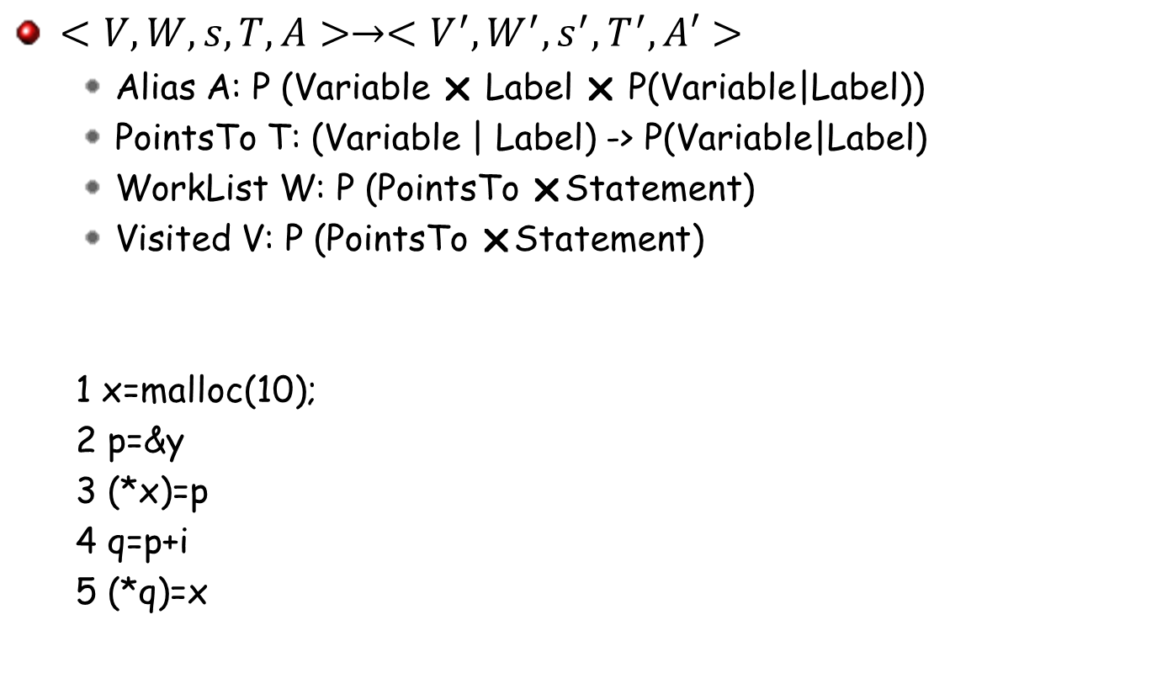
Configuration
$<V,W,s,T,A>→<V^{′},W^{′},s^{′}, T^{′},A′>$
  Alias A: P (Variable  Label  P(Variable|Label))
  PointsTo T: (Variable | Label) -> P(Variable|Label)
  WorkList W: P (PointsTo Statement)
  Visited V: P (PointsTo Statement)
  1 x=malloc(10);
  2 p=&y
  3 (*x)=p
  4 q=p+i
  5 (*q)=x

Slide 28
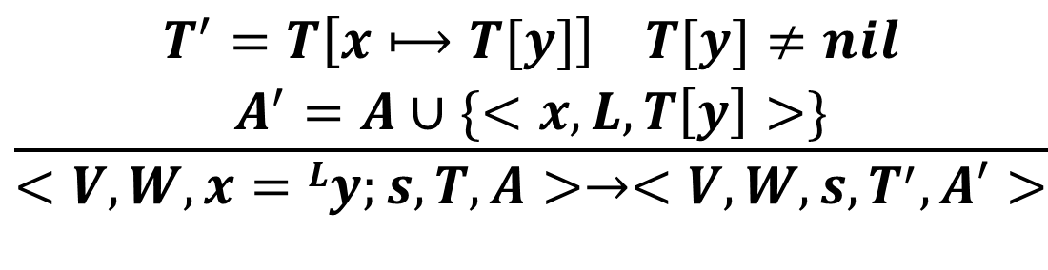
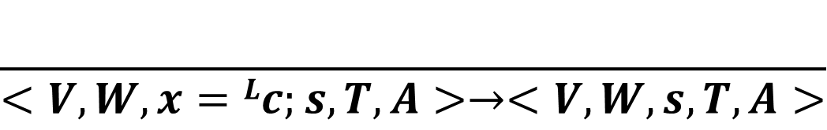
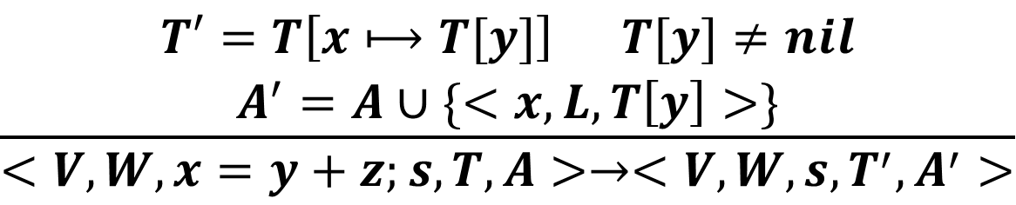
Abstract Semantics
$$\frac{}{<V,W,x=Lc;s,T,A>→<V,W,s,T,A>}$$
Const-Assign
$$\frac{\begin{aligned}T^{′}=T\left[x⟼T[y]\right] T[y]≠nil \\ A^{′}=A∪\{<x,L,T\left[y\right]>\}\end{aligned}}{<V,W,x=Ly;s,T,A>→<V,W,s, T^{′},A′>}$$
Copy
$$\frac{\begin{aligned}T′=T\left[x⟼T[y]\right] T[y]≠nil \\ A^{′}=A∪\{<x,L,T\left[y\right]>\}\end{aligned}}{<V,W,x=y+z;s,T,A>→<V,W,s,T^{′},A^{′}>}$$
BinOp-Add

Slide 29
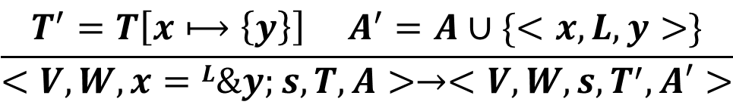
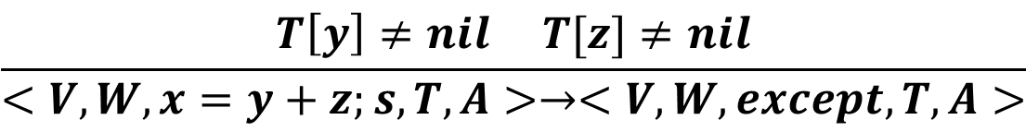
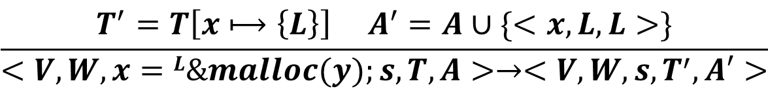
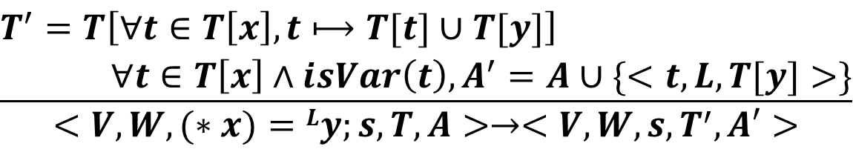
Abstract Semantics
$$\frac{T\left[y\right]≠nil T[z]≠nil}{<V,W,x=y+z;s,T,A>→<V,W,except, T,A>}$$
BinOp-Excp
$$\frac{T^{′}=T\left[x⟼\left\{y\right\}\right] A^{′}=A∪\{<x,L,y>\}}{<V,W,x=L\&y;s,T,A>→<V,W,s, T^{′},A′>}$$
Addr-of
$$\frac{T^{′}=T\left[x⟼\left\{L\right\}\right] A^{′}=A∪\{<x,L,L>\}}{<V,W,x=L\&malloc(y);s,T,A>→<V,W,s, T^{′},A′>}$$
Malloc
$$\frac{\begin{aligned}T^{′}=T\left[∀t∈T\left[x\right]\&,t⟼T[t]∪T[y]\right] \\ ∀t∈T\left[x\right]&∧isVar\left(t\right), A^{′}=A∪\{<t,L,T[y]>\}\end{aligned}}{<V,W,(∗x)=Ly;s,T,A>→<V,W,s, T^{′},A′>}$$
Strong update versus weak update
Pnt-Write

Slide 30
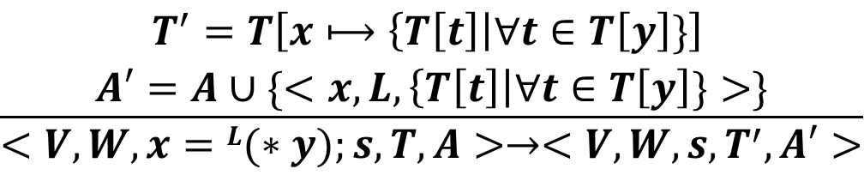
Abstract Semantics
$$\frac{\begin{aligned}T^{′}=T\left[x⟼\left\{T\left[t\right]\right|∀t∈T\left[y\right]\}\right] \\ A′=A∪\{<x,L,\left\{T\left[t\right]\right|∀t∈T\left[y\right]\}>\}\end{aligned}}{<V,W,x=L(∗y);s,T,A>→<V,W,s, T^{′},A′>}$$
Pnt-Read

Slide 31
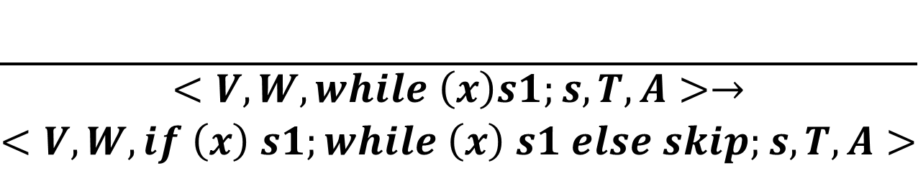
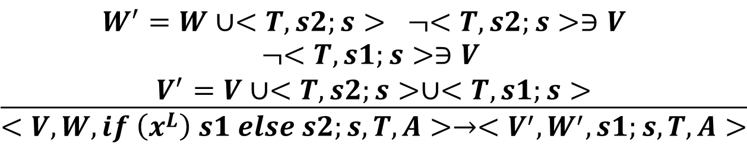
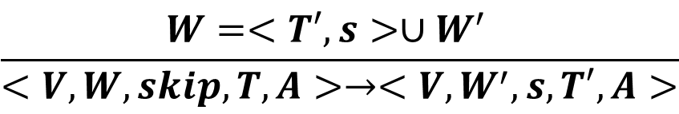
Abstract Semantics
$$\frac{\begin{aligned}W^{′}=W∪<T,s2;s> ¬<T,s2;s>∋V \\ \begin{aligned}¬<T,s1;s>∋V \\ V^{′}=V∪<T,s2;s>∪<T,s1;s>\end{aligned}\end{aligned}}{<V,W,if \left(x^{L}\right) s1 else s2;s,T,A>→<{V^{′}, W}^{′},s1;s,T,A>}$$
If
$$\frac{}{\begin{aligned}<V,W,while \left(x\right)s1;s,T,A>→ \\ <V,W,if \left(x\right) s1;while \left(x\right) s1 else skip;s,T,A>\end{aligned}}$$
While
$$\frac{W=<T′,s>∪W^{′} }{<V,W,skip,T,A>→<V,W^{′},s,T′,A>}$$
Next-Path

Slide 32
Example
1: p=&x
2: q=malloc(10)
3: *q=p
4: t=q+2
5: *t=malloc(5)
6: r=(*t)
7 (*r)=&p

Slide 33
A More Efficient Alias Analysis
Traversing different paths is very expensive
How about we ignore the control flow
  Eliminate strong update
    x =… never overwrites the PointsTo set of x, but rather add to it
    x=&y
    x=&z
    t=x
PointsTo ->: (Variable | Label) X (Variable|Label)
Eg. x -> y (read as x points to y)

Slide 34
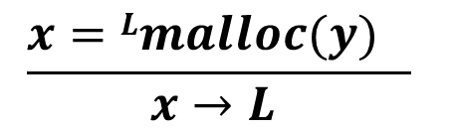
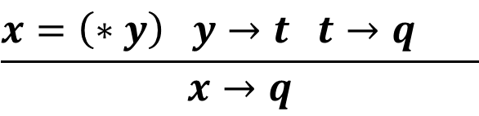
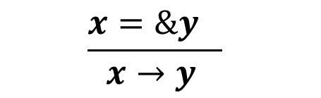
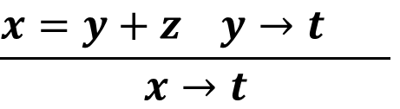
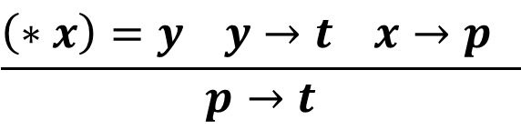
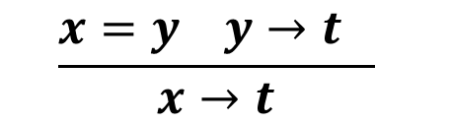
Analysis Rules
$$\frac{x=\&y }{x→y }$$
$$\frac{x=Lmalloc(y) }{x→L }$$
$$\frac{x=y y→t }{x→t}$$
$$\frac{\left(∗x\right)=y y→t x→p }{p→t}$$
$$\frac{x=y+z y→t }{x→t}$$
$$\frac{x=\left(∗y\right) y→t t→q }{x→q}$$

Slide 35
Example
1: p=malloc (10)
2: (*p)=&x
3: q=p+1
4: (*q)=&y
5: r=q+1
6: (*r)= &z
7: i=0;
8: t=p;
9: while (i<3) {
10: z=(*t);
11: t=t+2;
12: i=i+1;
13: }
14: x=(*z);
Notes:
p->1
1->x
q->1
1->y
r->1
1->z
t->1
z->x,y,z => (x=(*z), z->z, z->x) => x->x, (x=(*z), z->z, z->y) => x->y , and x->z

Slide 36
Flow Sensitive and Flow Insensitive Analysis
With and without respecting control flow
The analyses we have learned, except the preceding alias analysis, are flow sensitive
Other flow insensitive analysis
  Type inference

Slide 37
Context Sensitive and Context Insensitive Analysis
Program P ::= Global vd; fd; s
VarDef vd ::= x | vd; x
Function f :: = M(y) { s }
FuncDef fd :: = f | fd; f
FuncId M, M1, M2, …
Statement s ::= s1; s2 | x=^{L} y | x =^{L} y op z | x=^{L} c |
if (x^{L}) s1 else s2 |
while (x^{L}) s | call (M, x) ^{L}
Operation op :: = + | - | * | / | > | < | …
Value c :: = 0 | 1 | 2 … | true | false
Variable x, x1, x2, x3

Slide 38

Semantics
$<s,δ,C,μ>$
  Context C: Label*
  Stack $μ$: Context X Var -> Value
  isGlobal (x): Var -> Bool

Slide 39
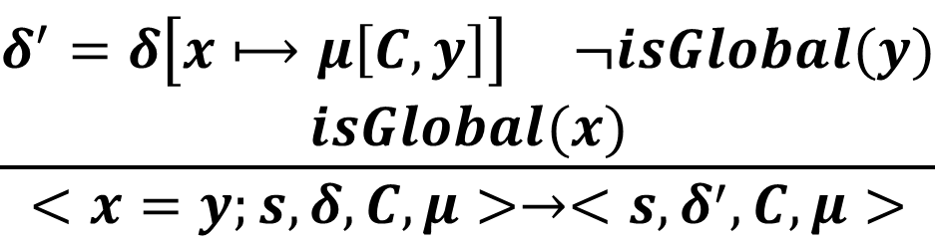
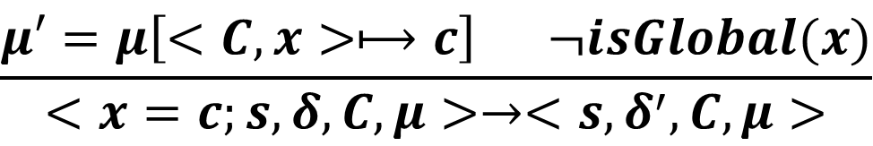
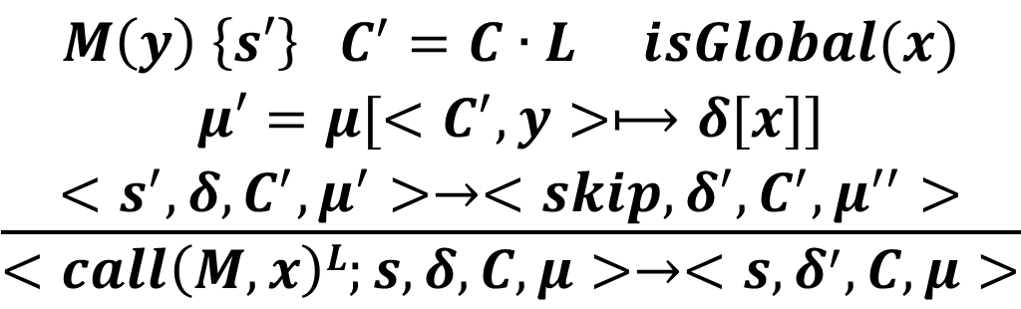
Semantics Rules
$$\frac{μ′=μ\left[<C,x>⟼c\right] ¬isGlobal(x)}{<x=c;s,δ,C,μ>→<s,δ^{′},C,μ>}$$
Local-Const-Assign
$$\frac{\begin{aligned}δ^{′}=δ\left[x⟼μ\left[C,y\right]\right] ¬isGlobal(y) \\ isGlobal(x)\end{aligned}}{<x=y;s,δ,C,μ>→<s,δ^{′},C,μ>}$$
GL-Copy
$$\frac{\begin{aligned}M\left(y\right) \left\{s′\right\} C^{′}=C∙L isGlobal(x) \\ μ′=μ[<C^{′},y>⟼δ[x]] \\ <s^{′},δ,C^{′},μ^{′}>→<skip,δ^{′},C^{′},μ^{′′}>\end{aligned}}{<call\left(M,x\right)L;s,δ,C,μ>→<s,δ^{′},C,μ>}$$
Call

Slide 40
Context Sensitivity in Alias Analysis
A () {
1: B(&x, &y)
2: B(&z, &t)
}
B (p,q) {
10: (*p)=q
}

Slide 41
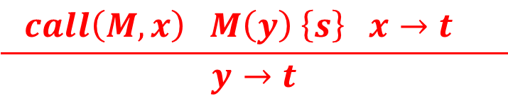
Alias Analysis Rules with Functions
$$\frac{x=\&y }{x→y }$$
$$\frac{x=Lmalloc(y) }{x→L }$$
$$\frac{x=y y→t }{x→t}$$
$$\frac{\left(∗x\right)=y y→t x→p }{p→t}$$
$$\frac{x=y+z y→t }{x→t}$$
$$\frac{x=\left(∗y\right) y→t t→q }{x→q}$$
$$\frac{ call\left(M, x\right) M\left(y\right) \left\{s\right\} x→t }{y→t}$$

Slide 42
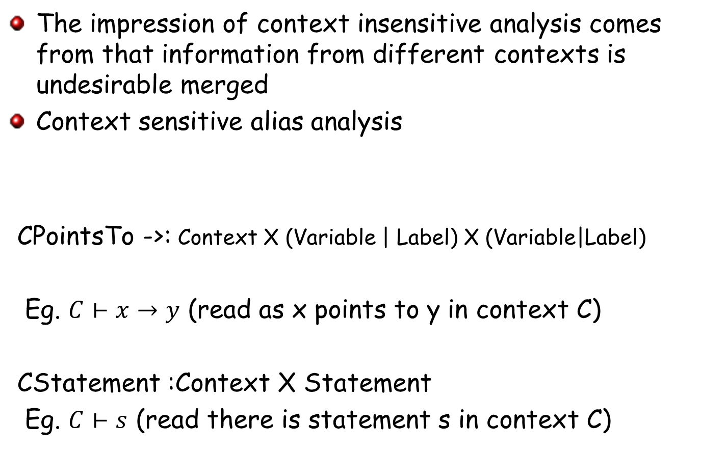
Context Sensitive Alias Analysis
The impression of context insensitive analysis comes from that information from different contexts is undesirable merged
Context sensitive alias analysis
CPointsTo ->: Context X (Variable | Label) X (Variable|Label)
Eg. $C⊢x→y$ (read as x points to y in context C)
CStatement :Context X Statement
Eg. $C⊢s$ (read there is statement s in context C)

Slide 43
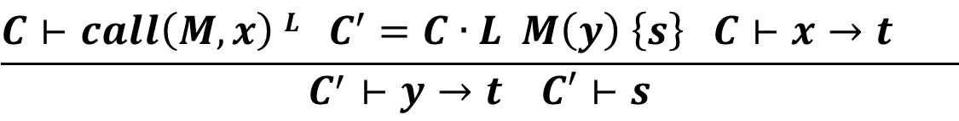
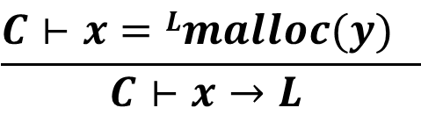
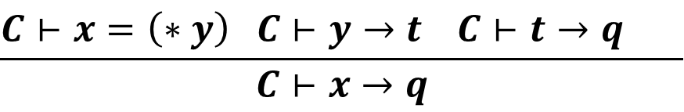
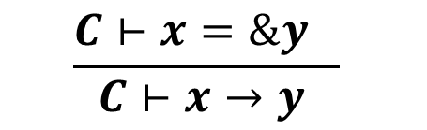






Context Sensitive Alias Analysis
$$\frac{C⊢x=\&y }{C⊢x→y }$$
$$\frac{C⊢x=Lmalloc(y) }{C⊢x→L }$$
$$\frac{C⊢x=y C⊢y→t }{C⊢x→t}$$
$$\frac{C⊢\left(∗x\right)=y C⊢y→t C⊢x→p }{C⊢p→t}$$
$$\frac{C⊢x=y+z C⊢y→t }{C⊢x→t}$$
$$\frac{C⊢x=\left(∗y\right) C⊢y→t C⊢t→q }{C⊢x→q}$$
$$\frac{C⊢call\left(M, x\right) L C^{′}=C∙L M\left(y\right) \left\{s\right\} C⊢x→t }{C^{′}⊢y→t C′⊢s}$$
$$\frac{C⊢s1;s2 }{C⊢s1 C⊢s2}$$
$$\frac{C⊢if \left(x\right) s1 else s2 }{C⊢s1 C⊢s2}$$
$$\frac{C∙L⊢x→t isGlobal(x)}{C⊢x→t}$$

Slide 44
Example
A () {
1. s=t
2: B( )
3: C( )
}
C () {
20: D(&x, &m )
21: t=x
}
B () {
10: D(&x, &y )
11: t=x
}
D (p,q) {
30: (*p)=q
}

Slide 45
Context Sensitivity in Flow Sensitive Static Dependence Analysis
A () {
1: B( )
2: C( )
}
C () {
20: x=…
21: D( )
22: …= x
}
B () {
10: x=…
11: D ( )
12 .. = x
}
D ( ) {
30: y=…
}
How would you design the rules?

Slide 46
Traditional Data Flow Analysis Framework
For each block node n and every variable x AD^{in}[x@n]=Ad_{out}[x@n] = Ø
change = true;
while change do begin
change = false;
for any n and x
AD^{in}[x@n]=
oldvalue = Ad_{out}[x@n] ;
Ad_{out}[x@n] = F(AD^{in}[x@n])
if Ad_{out}[x@n] != oldvalue then change = true;
end
end

Slide 47
Two important ingredients of data flow analysis
Abstract domain
  The results we want to compute by static analysis
Transfer function
  How the abstract values are computed/updated at each relevant instruction
    Need to consider the instruction semantics

Slide 48
Reaching Definition Analysis
Analyze multiple paths at a time and compute aggregate information directly.
  Def_{in}[x@n]: all the possible definitions of x along some path reaching n (before getting through n)
    Def_{in}[x@n]=
  For any x!=y (node n is “y=…”)
    Def_{out}[x@n]=Def_{in}[x@n]
  Def_{out}[y@n]={n}

Slide 49
Example for Computing Dependences
Input (x,y);
if (x<0)
p=-y;
else
p=y;
z=1
while (p!=0)
z=z*x
p=p-1;
Output(z);
Notes:
A scenario includes inputs, machine configurations, etc.

Slide 50
Again, two important properties
Termination
  Semi-lattice
Soundness
  Precision loss by non-distributivity

Slide 51
Semi-lattice
A semi-lattice is a domain of values V and a meet operator ∧ such that,
  ∀ a, b, & c ∈ V :
    1. a ∧ a = a (idempotent)
    2. a ∧ b = b ∧ a (commutative)
    3. a ∧ (b ∧ c) = (a ∧ b) ∧ c (associative)
  ∧ imposes a partial order on V, ∀ a, b, & c ∈ V :
    1. a ≥ b ⇔ a ∧ b = b
    2. a > b ⇔ a ≥ b and a ≠ b
    3. a ≥ b and b ≥ c, then a ≥ c
  A semi-lattice has a top element, denoted T
    1. ∀ a ∈ V, a ≤ T
    2. ∀ a ∈ V, T ∧ a = a

Slide 52
Semi-lattices for previous examples
Def[x@n]: the possible definitions of x at n
{} T
{d₁} {d₂} {d₃}
{d₁, d₂} {d₁, d₃} {d₂, d₃}
{d₁, d₂ , d₃} ⊥
Lattice + monotonicity + finite height = termination

Slide 53
Lost of Precision by Directly Computing Aggregate Information
x=foo();
y=gee();
if (…)
p=&x;
q=&x;
else
p=&y;
q=&y;
*p=*q
*(*p)();
Distributive analysis: the aggregation of individual path analysis results is equivalent to computing the aggregate information directly
  F(a∧b)=F(a)∧F(b)
Notes:
A scenario includes inputs, machine configurations, etc.

Slide 54
Is the Following Analysis Distributive
Constant propagation
  1 V 2 = NonC
if (…)
x=1;
y=2;
else
x=2;
y=1;
z=x+y

Slide 55
Summary
The essence of static analysis is similar to dynamic analysis
  Execute it without the concrete values (abstract interpretation)
  We can express our analysis with abstract semantics just like concrete semantics
    You can implement static analysis just like a dynamic analysis
  Two important properties: termination and soundness
For better scalability, we come up with different approximations
  Merge-before-continue semantics
  Data flow analysis
  Flow insensitive analysis
  Context sensitive versus context insensitive analysis

Slide 56
Static Analysis in Software Security
Buffer overflow vulnerability detection
  Value range analysis
CFI
  The core challenge is points-to analysis
Decompiltation
  A core challenge is type inference
ICC in Android App analysis
  The absence of a global CG
    Can be overcomed by value analysis
Private API invocations in iOS apps
  String value analysis
Access control inconsistencies in Android framework

Slide 57
In-class Exercise 1
Design a range analysis to determine the value range of a variable.
  Determine the abstract domain and the abstract semantics that analyzes individual paths.
  Argue that your analysis terminates in the presence of loops. You can use example if needed.
  Rewrite your analysis in a form that does not need to traverse the individual paths.

Slide 58
In-class Exercise 2
Design an analysis to address the ICC problem in Android app
  Implicit intent and intent filter
  Example
  Sender:
  Intent intent = new Intent(Intent.ACTION_SEND);
  intent.setType("text/plain");
  intent.putExtra(android.content.Intent.EXTRA_TEXT, "Standing on the Moon!");
  startActivity(intent);
  Receiver:
  the Android system searches for all the registered components (through intent filters) for the specific action and data type (in this case an HTTP URI). If only one component is found, that is triggered but when several of them are identified a dialog is presented to the user from which he can make a suitable selection.

Slide 59
Discussion
Tell us about your research problems that are addressed (or can be addressed) by static analysis
Did you formulate it? If not, can you?

