Slide 1
Program Semantics
Xiangyu Zhang

Slide 2
Why Formalization
Analysis != hacking
  Corner cases haven’t been considered
  Work-arounds
  Approximate implementation
Ideally, soundness and completeness
  Soundness – what you implement achieves the goal
  Completeness – you have everything considered
In practice, soundness and completeness cannot be achieved
  Clean-up your thoughts before coding
  Expose problems earlier

Slide 3
Language
Program P ::= s
Statement s ::= s1; s2 | x= y | x = y op z | x= c |
if (x) s1 else s2 |
while (x) s
Operation op :: = + | - | * | / | > | < | …
Value c :: = 0 | 1 | 2 … | true | false
Variable x, x1, x2, x3

Slide 4
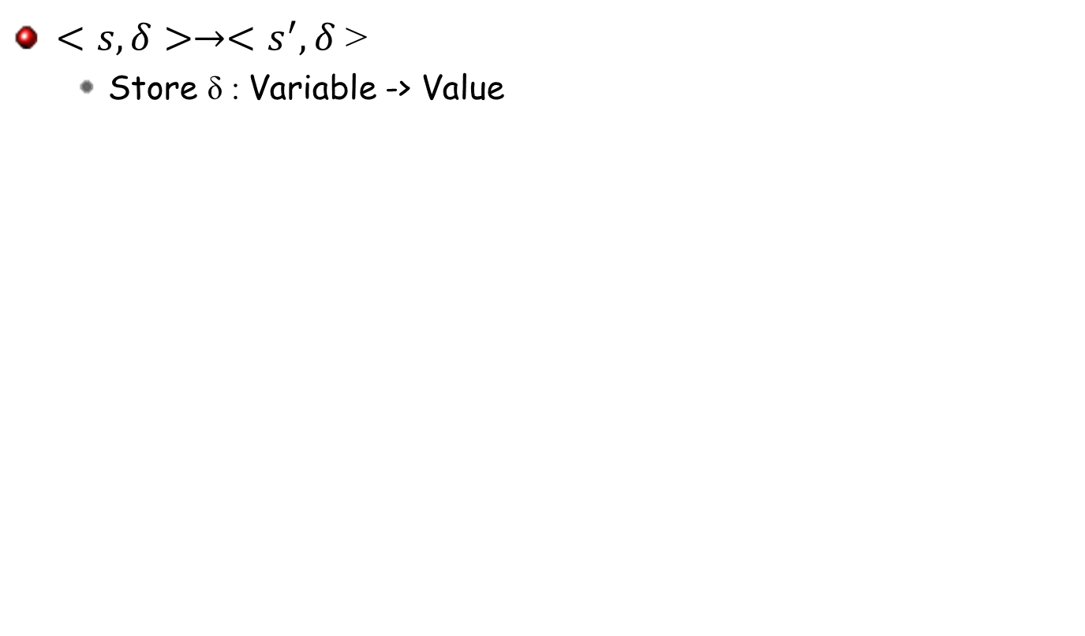
Configuration

Slide 5
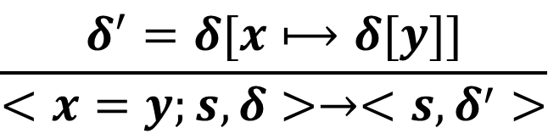
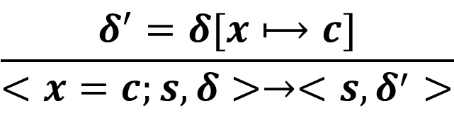
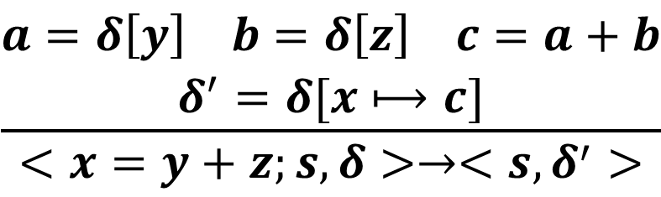
Semantics Rules
$$\frac{δ^{′}=δ[x⟼c]}{<x=c;s,δ>→<s,δ^{′}>}$$
Const-Assign
$$\frac{δ^{′}=δ[x⟼δ[y]]}{<x=y;s,δ>→<s,δ^{′}>}$$
Copy
$$\frac{\begin{aligned}a=δ\left[y\right] b=δ\left[z\right] c=a+b \\ δ^{′}=δ[x⟼c]\end{aligned}}{<x=y+z;s,δ>→<s,δ^{′}>}$$
BinOp-Add

Slide 6
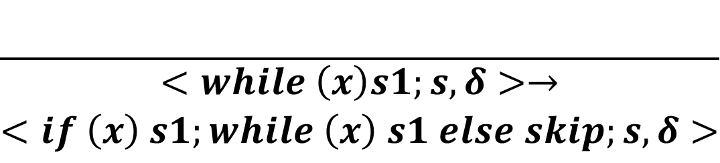
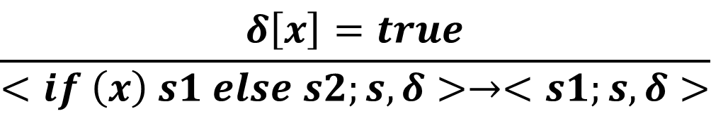
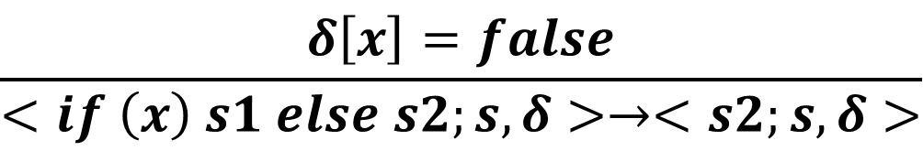
Semantics Rules
$$\frac{δ\left[x\right]=true}{<if \left(x\right) s1 else s2;s,δ>→<s1;s,δ>}$$
If-T
$$\frac{δ\left[x\right]=false}{<if \left(x\right) s1 else s2;s,δ>→<s2;s,δ>}$$
If-F
$$\frac{}{\begin{aligned}<while \left(x\right)s1;s,δ>→ \\ <if \left(x\right) s1;while \left(x\right) s1 else skip;s,δ>\end{aligned}}$$
While

Slide 7
Example
i=0;
sum=0;
N=2;
while (i<N) {
sum=sum+i;
i=i+1;
}

Slide 8
Extend the Language with Pointers
Program P ::= s
Statement s ::= s1; s2 | x= y | x = y op z | x= c |
x= &y | (*x)=y | x= (*y)
if (x) s1 else s2 |
while (x) s
Operation op :: = + | - | * | / | > | < | …
Value c :: = 0 | 1 | 2 … | true | false
Address a :: = 0 | 1 | 2…
Variable x, x1, x2, x3

Slide 9
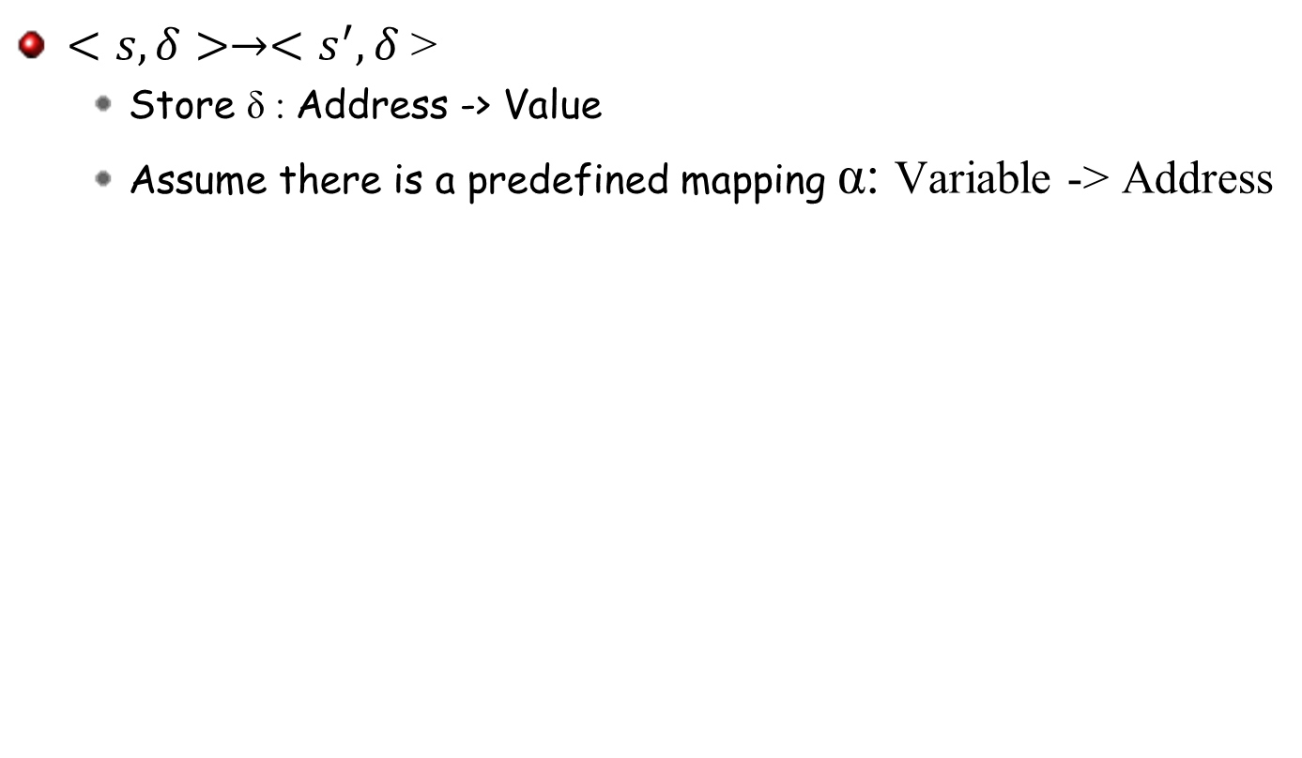
Configuration

Slide 10
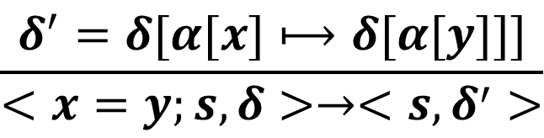
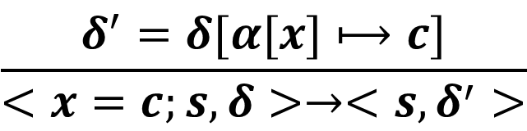
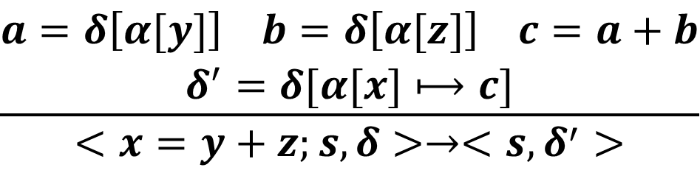
Semantics Rules
$$\frac{δ^{′}=δ[α[x]⟼c]}{<x=c;s,δ>→<s,δ^{′}>}$$
Const-Assign
$$\frac{δ^{′}=δ[α[x]⟼δ[α[y]]]}{<x=y;s,δ>→<s,δ^{′}>}$$
Copy
$$\frac{\begin{aligned}a=δ\left[α[y]\right] b=δ\left[α[z]\right] c=a+b \\ δ^{′}=δ[α[x]⟼c]\end{aligned}}{<x=y+z;s,δ>→<s,δ^{′}>}$$
BinOp-Add

Slide 11
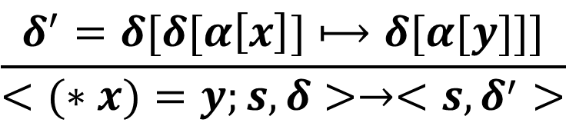
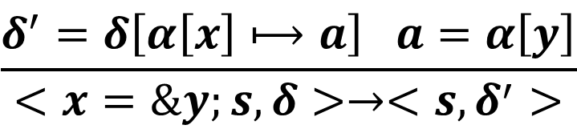
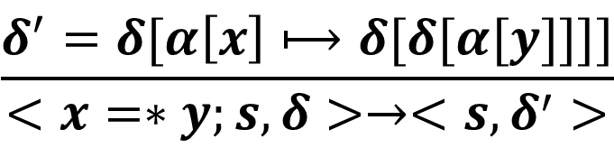
Semantics Rules
$$\frac{δ^{′}=δ\left[α\left[x\right]⟼a\right] a=α\left[y\right]}{<x=\&y;s,δ>→<s,δ^{′}>}$$
Addr-Of
$$\frac{δ^{′}=δ[δ[α\left[x\right]]⟼δ[α[y]]]}{<(∗x)=y;s,δ>→<s,δ^{′}>}$$
Ptr-Write
$$\frac{δ^{′}=δ[α\left[x\right]⟼δ[δ[α[y]]]]}{<x=∗y;s,δ>→<s,δ^{′}>}$$
Ptr-Read

Slide 12
Extend the Language with Heap
Program P ::= s
Statement s ::= s1; s2 | x= y | x = y op z | x= c |
x= &y | (*x)=y | x=(*y) | x=malloc (y)
if (x) s1 else s2 |
while (x) s
Operation op :: = + | - | * | / | > | < | …
Value c :: = 0 | 1 | 2 … | true | false
Address a :: = 0 | 1 | 2…
Variable x, x1, x2, x3

Slide 13
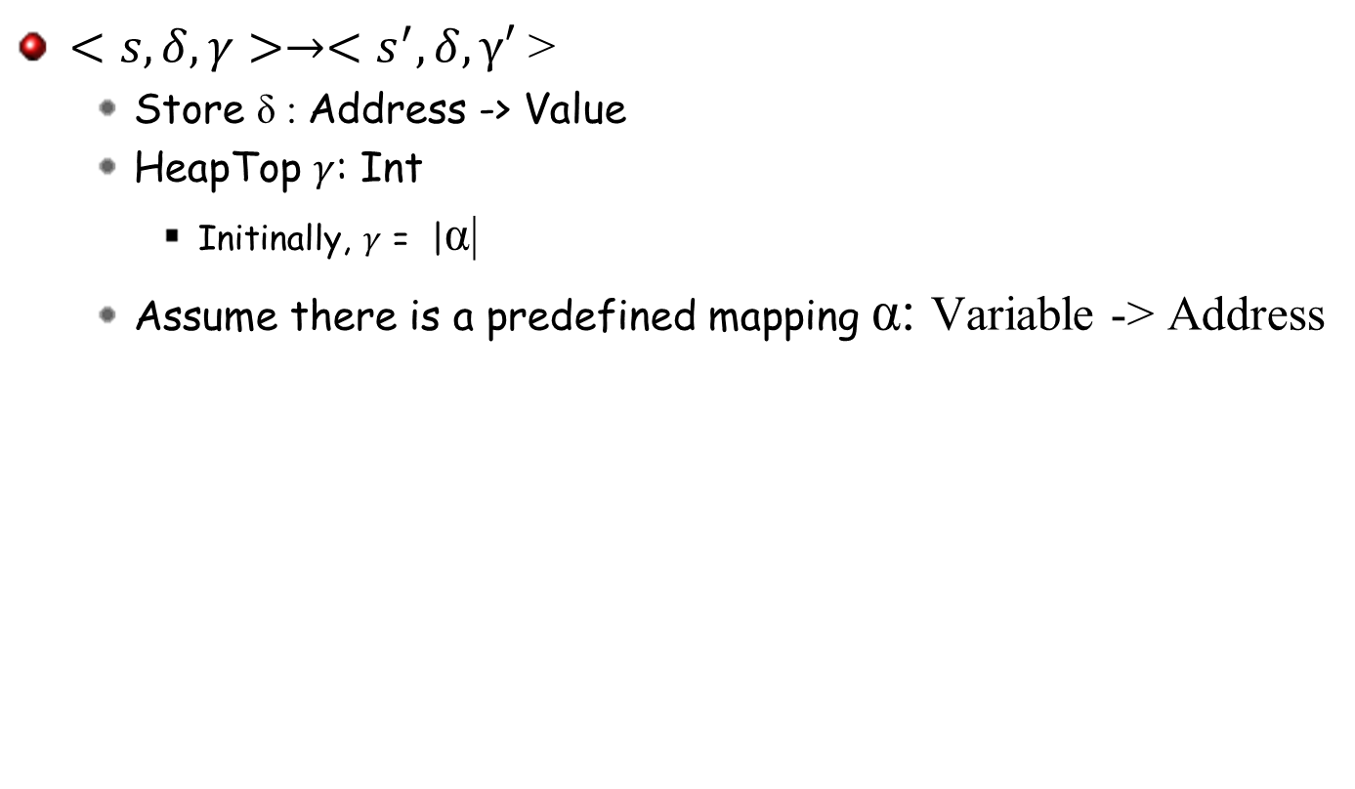
Configuration

Slide 14
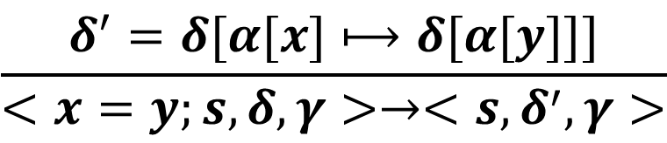
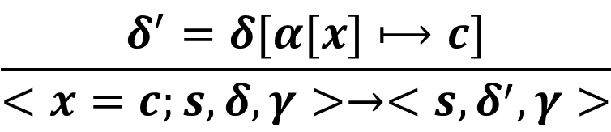
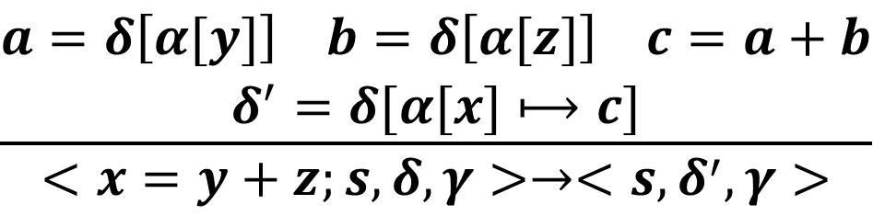
Semantics Rules
$$\frac{δ^{′}=δ[α[x]⟼c]}{<x=c;s,δ,γ>→<s,δ^{′},γ>}$$
Const-Assign
$$\frac{δ^{′}=δ[α[x]⟼δ[α[y]]]}{<x=y;s,δ,γ>→<s,δ^{′},γ>}$$
Copy
$$\frac{\begin{aligned}a=δ\left[α[y]\right] b=δ\left[α[z]\right] c=a+b \\ δ^{′}=δ[α[x]⟼c]\end{aligned}}{<x=y+z;s,δ,γ>→<s,δ^{′},γ>}$$
BinOp-Add

Slide 15
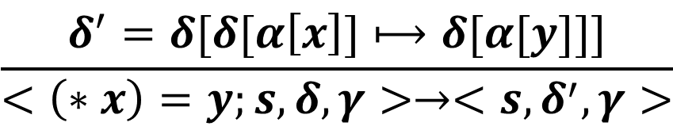
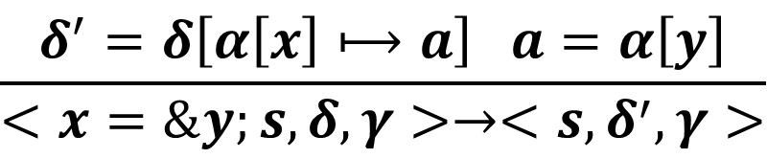
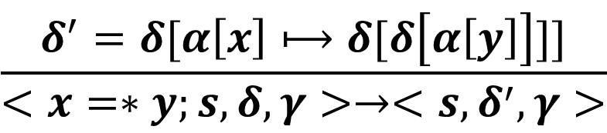
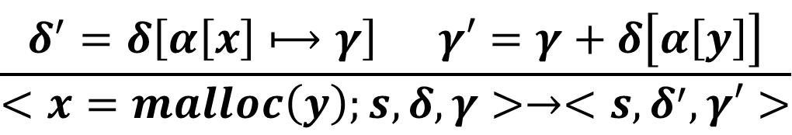
Semantics Rules
$$\frac{δ^{′}=δ\left[α\left[x\right]⟼a\right] a=α\left[y\right]}{<x=\&y;s,δ,γ>→<s,δ^{′},γ>}$$
Addr-Of
$$\frac{δ^{′}=δ[δ[α\left[x\right]]⟼δ[α[y]]]}{<\left(∗x\right)=y;s,δ,γ>→<s,δ^{′},γ>}$$
Ptr-Write
$$\frac{δ^{′}=δ[α\left[x\right]⟼δ[δ\left[α\left[y\right]\right]]]}{<x=∗y;s,δ,γ>→<s,δ^{′},γ>}$$
Ptr-Read
$$\frac{δ^{′}=δ\left[α\left[x\right]⟼γ\right] γ′=γ+δ\left[α\left[y\right]\right]}{<x=malloc\left(y\right);s,δ,γ>→<s,δ^{′},γ′>}$$
Malloc

Slide 16
Extend the Language with Functions
Program P ::= fd; s
Function f :: = M(y) { s }
FuncDef fd :: = f | fd; f
FuncId M, M1, M2, …
Statement s ::= s1; s2 | x= y | x = y op z | x= c |
if (x) s1 else s2 |
while (x) s | call(M, x)
Operation op :: = + | - | * | / | > | < | …
Value c :: = 0 | 1 | 2 … | true | false
Variable x, x1, x2, x3

Slide 17
Formalizing Dynamic Analysis

Slide 18
A Dynamic Checker for Heap Overflow
Check if a heap access dereferences an address beyond the allocated buffer
p=malloc (10);
x=p+2;
q=x+9;
(*q)=…

Slide 19
Heap Language
Program P ::= s
Statement s ::= s1; s2 | x= y | x = y op z | x= c |
x= &y | (*x)=y | x=*y | x=malloc (y)
if (x) s1 else s2 |
while (x) s
Operation op :: = + | - | * | / | > | < | …
Value c :: = 0 | 1 | 2 … | true | false
Address a :: = 0 | 1 | 2…
Variable x, x1, x2, x3

Slide 20
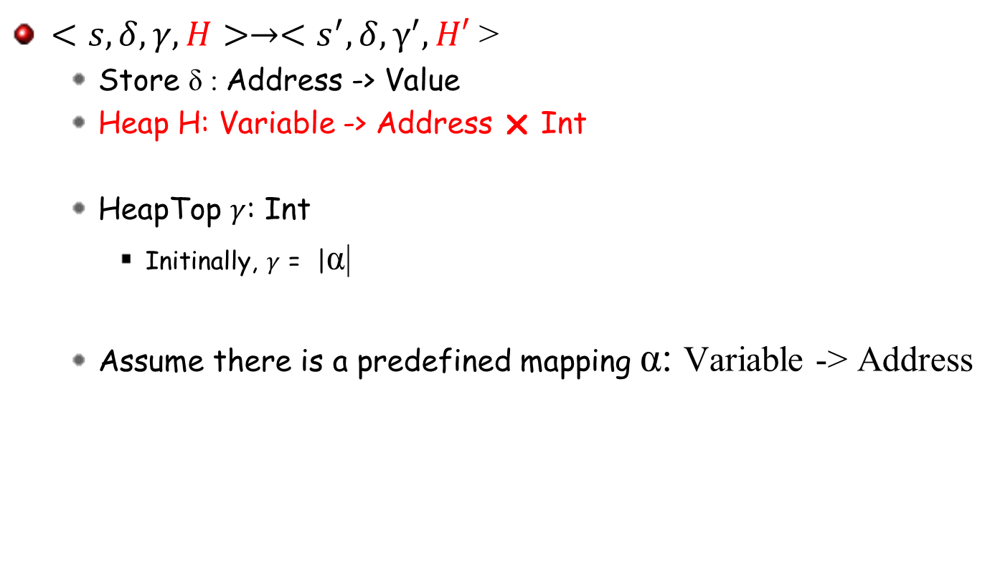
A Plausible Solution - Configuration

Slide 21
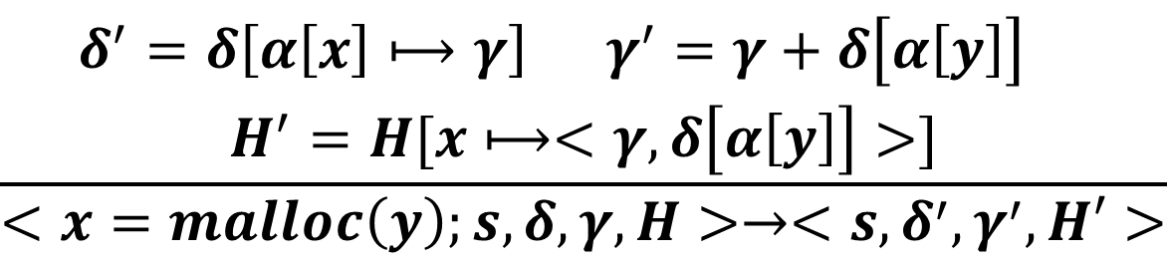
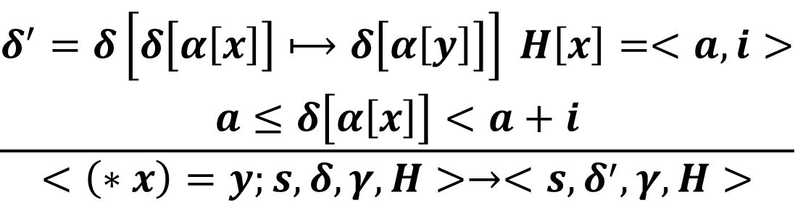
Semantics Rules
$$\frac{\begin{aligned}δ^{′}=δ\left[α\left[x\right]⟼γ\right] γ^{′}=γ+δ\left[α\left[y\right]\right] \\ H^{′}=H[x⟼<γ, δ\left[α\left[y\right]\right]>]\end{aligned}}{<x=malloc\left(y\right);s,δ,γ,H>→<s,δ^{′},γ^{′},H′>}$$
Malloc
$$\frac{\begin{aligned}δ^{′}=δ\left[δ\left[α\left[x\right]\right]⟼δ\left[α\left[y\right]\right]\right] H\left[x\right]=<a,i> \\ a≤δ\left[α\left[x\right]\right]<a+i\end{aligned}}{<\left(∗x\right)=y;s,δ,γ,H>→<s,δ^{′},γ,H>}$$
Ptr-Write

Slide 22
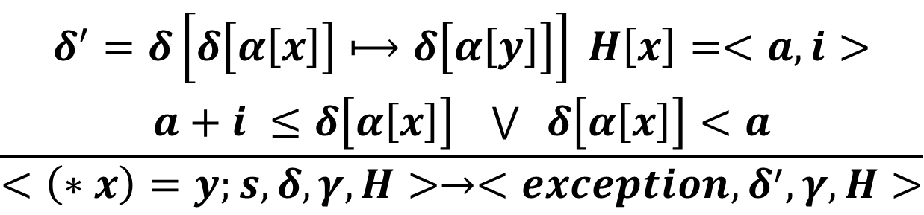
Semantics Rules
$$\frac{\begin{aligned}δ^{′}=δ\left[δ\left[α\left[x\right]\right]⟼δ\left[α\left[y\right]\right]\right] H\left[x\right]=<a,i> \\ a+i ≤δ\left[α\left[x\right]\right] \bigvee{ δ\left[α\left[x\right]\right]}<a\end{aligned}}{<\left(∗x\right)=y;s,δ,γ,H>→<exception,δ^{′},γ,H>}$$
Ptr-Write-Excp

Slide 23
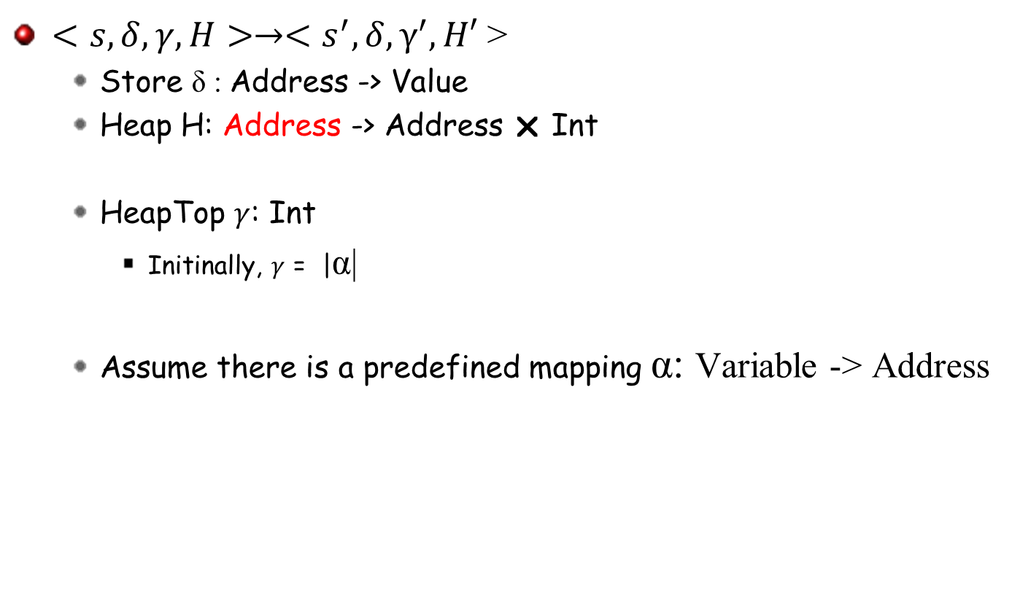
Another Solution - Configuration

Slide 24
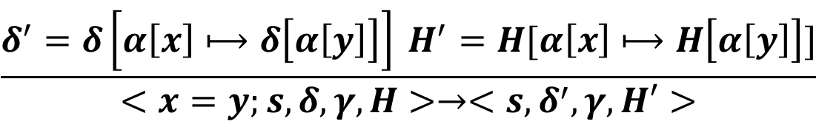
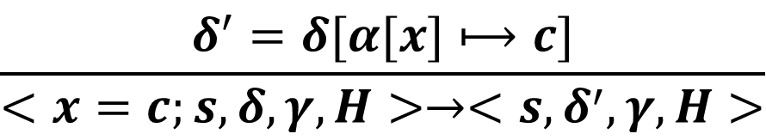
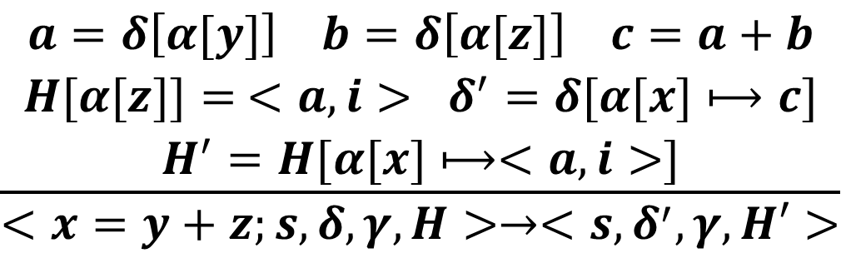
Semantics Rules
$$\frac{δ^{′}=δ[α[x]⟼c]}{<x=c;s,δ,γ,H>→<s,δ^{′},γ,H>}$$
Const-Assign
$$\frac{δ^{′}=δ\left[α\left[x\right]⟼δ\left[α\left[y\right]\right]\right] H^{′}=H[α\left[x\right]⟼H\left[α\left[y\right]\right]]}{<x=y;s,δ,γ,H>→<s,δ^{′},γ,H′>}$$
Copy
$$\frac{\begin{aligned}a=δ\left[α[y]\right] b=δ\left[α[z]\right] c=a+b \\ H[{α[z]]= <a,i> δ}^{′}=δ[α[x]⟼c] \\ H^{′}=H[α[x]⟼<a,i>]\end{aligned}}{<x=y+z;s,δ,γ,H>→<s,δ^{′},γ,H′>}$$
Pnt-Add-z

Slide 25
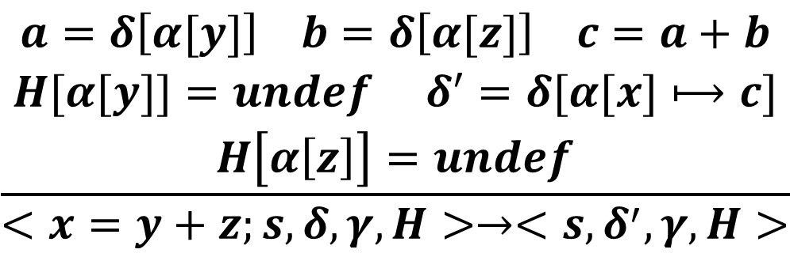
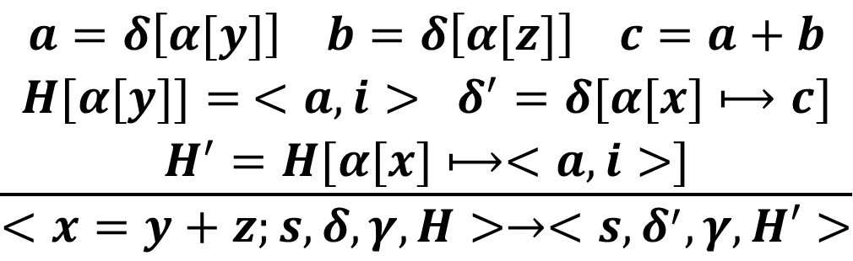
Semantics Rules
$$\frac{\begin{aligned}a=δ\left[α[y]\right] b=δ\left[α[z]\right] c=a+b \\ H[{α[y]]= <a,i> δ}^{′}=δ[α[x]⟼c] \\ H^{′}=H[α[x]⟼<a,i>]\end{aligned}}{<x=y+z;s,δ,γ,H>→<s,δ^{′},γ,H′>}$$
Pnt-Add-y
$$\frac{\begin{aligned}a=δ\left[α[y]\right] b=δ\left[α[z]\right] c=a+b \\ H[{α[y]]=undef δ}^{′}=δ[α[x]⟼c] \\ H\left[α\left[z\right]\right]=undef\end{aligned}}{<x=y+z;s,δ,γ,H>→<s,δ^{′},γ,H>}$$
NonPnt-Add

Slide 26
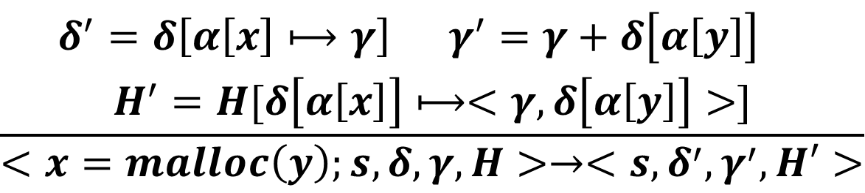
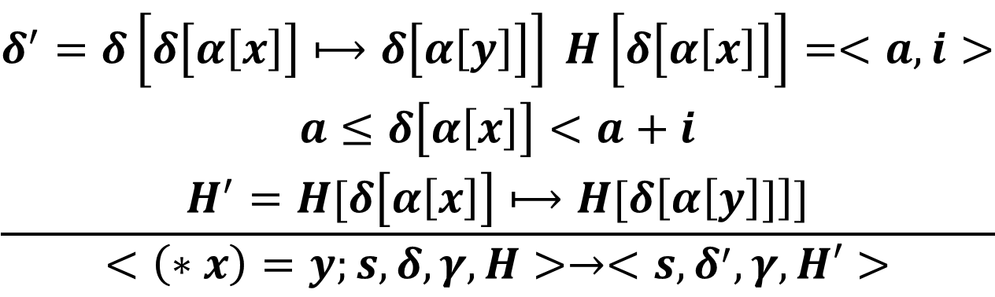
Semantics Rules
$$\frac{\begin{aligned}δ^{′}=δ\left[α\left[x\right]⟼γ\right] γ^{′}=γ+δ\left[α\left[y\right]\right] \\ H^{′}=H[δ\left[α\left[x\right]\right]⟼<γ, δ\left[α\left[y\right]\right]>]\end{aligned}}{<x=malloc\left(y\right);s,δ,γ,H>→<s,δ^{′},γ^{′},H′>}$$
Malloc
$$\frac{\begin{aligned}δ^{′}=δ\left[δ\left[α\left[x\right]\right]⟼δ\left[α\left[y\right]\right]\right] H\left[δ\left[α\left[x\right]\right]\right]=<a,i> \\ a≤δ\left[α\left[x\right]\right]<a+i \\ H^{′}=H[δ\left[α\left[x\right]\right]⟼H[δ\left[α\left[y\right]]\right]]\end{aligned}}{<\left(∗x\right)=y;s,δ,γ,H>→<s,δ^{′},γ,H′>}$$
Ptr-Write

Slide 27
Example Revisit
p=malloc (10);
x=p+2;
q=x+9;
(*q)=…

Slide 28
Soundness Proof
For each memory access, if the address exceeds the bound of the corresponding buffer, the execution must terminate with an exception.
  Prove by induction

Slide 29
In-class Exercise: Enhance the Analysis to Detect Dangling Pointers

Slide 30
In-class Exercise: Dynamic Data Dependence Detection
We aim to detect data dependence on the fly

Slide 31
Heap Language
Program P ::= s
Statement s ::= s1; s2 | x=^{L} y | x =^{L} y op z | x=^{L} c |
x=^{L} &y | (*x)=^{L} y | x=^{L} *y | x=^{L} malloc (y)
if (x^{L}) s1 else s2 |
while (x^{L}) s
Operation op :: = + | - | * | / | > | < | …
Value c :: = 0 | 1 | 2 … | true | false
Address a :: = 0 | 1 | 2…
Variable x, x1, x2, x3
Label L, L1, L2,…

Slide 32

Configuration
$<s,δ,γ,C,D,X>→<s^{′},δ^{′},γ^{′},C^{′},D′,X′>$
  Counter C: Label -> Int
  Definition D: Address -> Label  Int
  Dependences X: P (Label  Int  Label  Int)

Slide 33
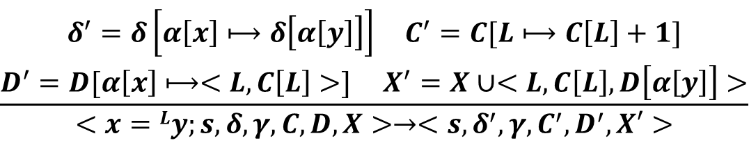
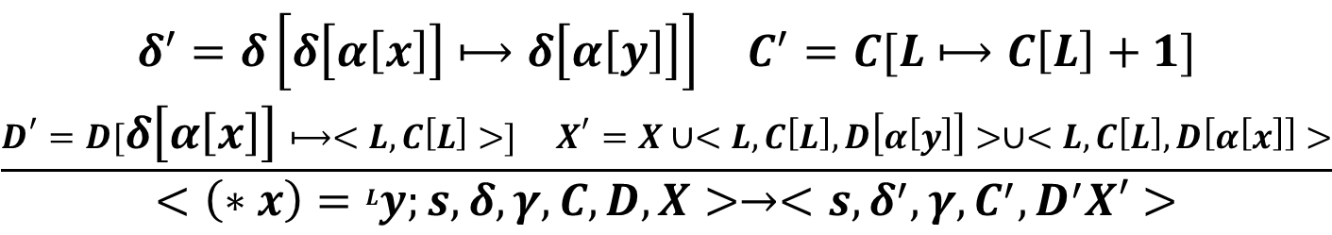
Semantics Rules
$$\frac{\begin{aligned}δ^{′}=δ\left[α\left[x\right]⟼δ\left[α\left[y\right]\right]\right] C^{′}=C[L⟼C\left[L\right]+1] \\ D^{′}=D[α\left[x\right]⟼<L,C\left[L\right]>] X^{′}=X∪<L,C\left[L\right],D\left[α\left[y\right]\right]>\end{aligned}}{<x=Ly;s,δ,γ,C,D,X>→<s,δ^{′},γ,C^{′},D^{′},X′>}$$
Copy
$$\frac{\begin{aligned}δ^{′}=δ\left[δ\left[α\left[x\right]\right]⟼δ\left[α\left[y\right]\right]\right] C^{′}=C[L⟼C\left[L\right]+1] \\ D^{′}=D[δ\left[α\left[x\right]\right]⟼<L,C\left[L\right]>] X^{′}=X∪<L,C\left[L\right],D\left[α\left[y\right]\right]>∪<L,C\left[L\right],D\left[α\left[x\right]\right]>\end{aligned}}{<\left(∗x\right)=Ly;s,δ,γ,C,D,X>→<s,δ^{′},γ,C^{′},D^{′}X′>}$$
Ptr-Write

Slide 34
In-class Exercise: Logging and Replay Semantics

Slide 35
In-class Exercise: Dynamic Control Dependence Detection
We aim to detect dynamic control dependence on the fly

Slide 36
In-class Exercise (hard): Dual Execution Semantics
How to align two executions with slightly different inputs?
  Critical for explaining behavior differences (i.e., trace comparison)

Slide 37
Discussion
Did you formulate your dynamic analysis in your projects?
With what you have learned, can you formulate it now?
What properties do you want to prove regarding your analysis?
Can you prove them now with your formalism

