Slide 1
2. Graphics Primer

Slide 2
Preamble
Computer Graphics vs. Visualization
“Visualization methods transform data into primitives that are rendered using CG techniques”
Today’s objective: understand basic concepts of CG necessary to use a VTK and Paraview (discussed next)

Slide 3
Outline
Graphics Primitives
Colors
Shading
Cameras
Fundamental Techniques

Slide 4
Graphics Primitives
Points
Positions in space
2D(x,y), 3D(x,y,z) coordinates
“0-dimensional” objects

Slide 5
Graphics Primitives
Lines / Curves
1-dimensional objects
Polygonal description (polyline)
piecewise linear

Slide 6
Graphics Primitives
Lines / Curves
1-dimensional objects
Polygonal description (polyline)
piecewise linear

Slide 7
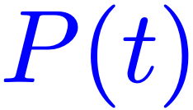
Graphics Primitives
Lines
1-dimensional objects
Parametric description
(e.g., splines)

Slide 8
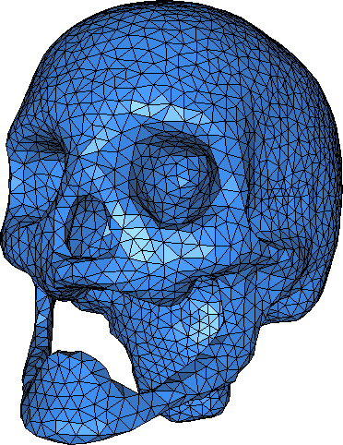
Graphics Primitives
Surfaces
2-dimensional objects (in 3D)
Polygonal description
Triangle mesh (piecewise linear)

Slide 9
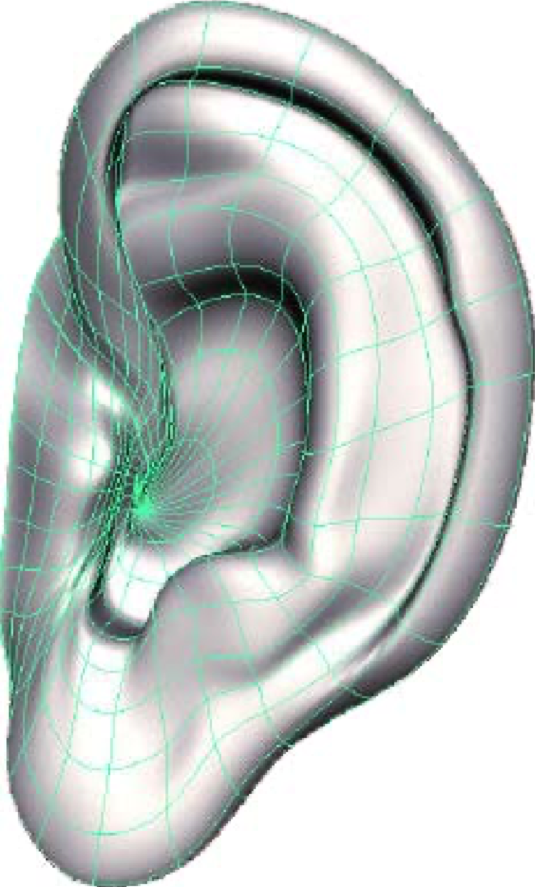
Graphics Primitives
Surfaces
2-dimensional objects
Parametric description
bi-quadratic, bi-cubic, Bezier, splines, NURBS...

Slide 10
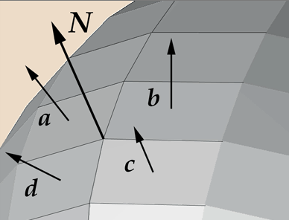
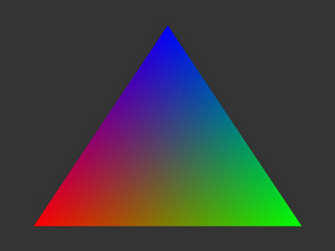
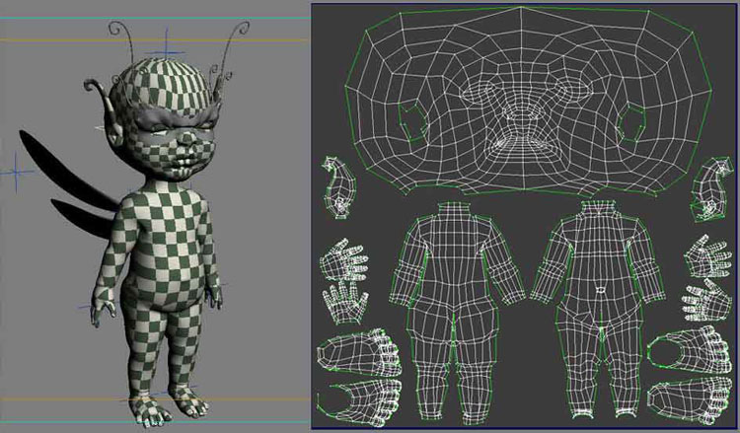
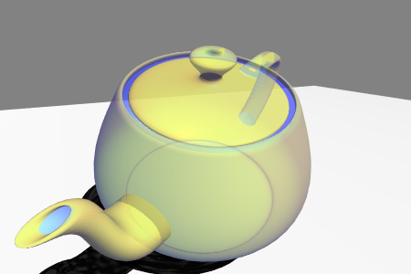
Primitive Attributes
Color
Normal
Opacity
Texture coordinates
Notes:
opacity controls transparency
normal controls how the surface reflects the surrounding light
texture coordinates control how images can be attached to the geometry

Slide 11
Outline
Graphics Primitives
Colors
Shading
Cameras
Fundamental Techniques

Slide 12
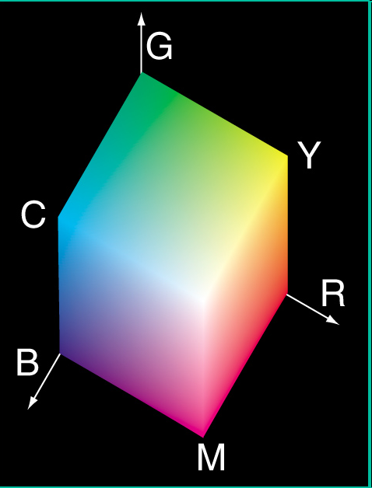
Colors
RGB system
Black | 0,0,0
White | 1,1,1
Red | 1,0,0
Green | 0,1,0
Blue | 0,0,1
Yellow | 1,1,0
Cyan | 0,1,1
Magenta | 1,0,1
Sky Blue | 1/2,1/2, 1

Slide 13
Colors
RGB system encodes colors with 3 scalars: mix of red, green, and blue
Simplified models of human color perception
More on the topic next week!

Slide 14
Outline
Graphics Primitives
Colors
Shading
Rasterization
Cameras
Fundamental Techniques

Slide 15
Shading
Shading reveals the shape of 3D objects through their interaction with light
Shading creates colors as a function of:
surface properties, surface normals, lights
Surfaces show information, lights show surfaces, shading controls how

Slide 16
Shading
Phong lighting model (1975): Light reflected by surface is combination of:
Specular reflection
Diffuse reflection
Ambient reflection
http://en.wikipedia.org/wiki/Phong_shading

Slide 17
Shading
Phong lighting model: Ambient reflection
Light intensity per light source and per color channel
relative contributions
(material specific)

Slide 18
Shading
Phong lighting model: Specular Reflection
mirror-like surfaces
Specular reflection depends on position of the observer relative to light source and surface normal

Slide 19
Shading
Phong lighting model: Specular Reflection

Slide 20
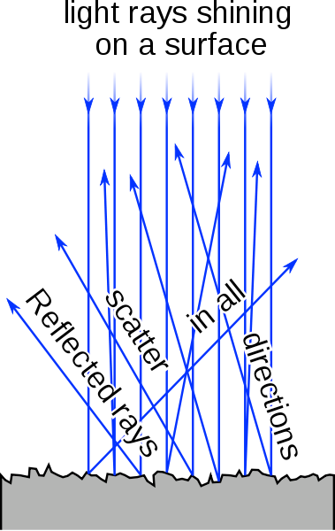
Shading
Phong lighting model: Diffuse Reflection
Non-shiny surfaces
Diffuse reflection depends only on relative position of light source and surface normal.

Slide 21
Shading
Phong lighting model: Diffuse Reflection

Slide 22
Shading
Phong lighting model
sum over all light sources
per color channel
ambient light
diffuse
specular

Slide 23
Outline
Graphics Primitives
Colors
Shading
Cameras
Fundamental Techniques

Slide 24
Rasterization
Putting shaded polygons on screen
Transform geometric primitives into pixels
Lowest level: scan conversion
Bresenham, midpoint algorithms

Slide 25
Rasterization
Putting shaded polygons on screen
Transform geometric primitives into pixels
OpenGL (graphics library) takes care of such operations (under the hood in VTK)

Slide 26
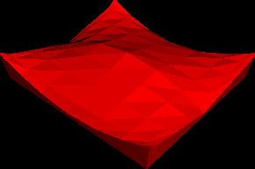
Back to Shading
Flat shading
(Color constant per polygon)

Slide 27
Back to Shading
Gouraud shading (1971)
Shade vertices first, then interpolate* colors
(*) More on interpolation in the coming weeks...

Slide 28
Back to Shading
Phong shading
Interpolate normals and shade every pixel separately
Note: Phong lighting model ≠ Phong shading

Slide 29
Outline
Graphics Primitives
Colors
Shading
Rasterization
Cameras
Fundamental Techniques

Slide 30
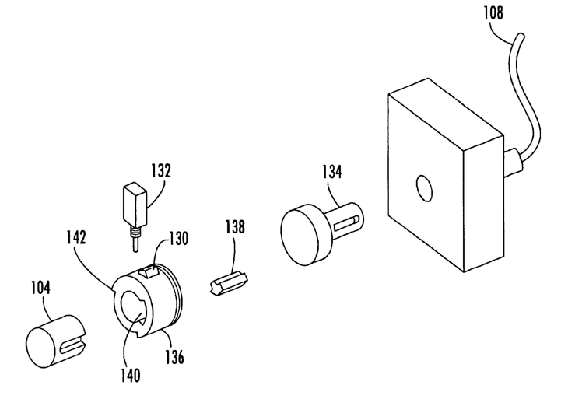
Projections
Orthogonal projection
parallel lines remain parallel
objects do not change size as they get closer
good for checking alignment

Slide 31
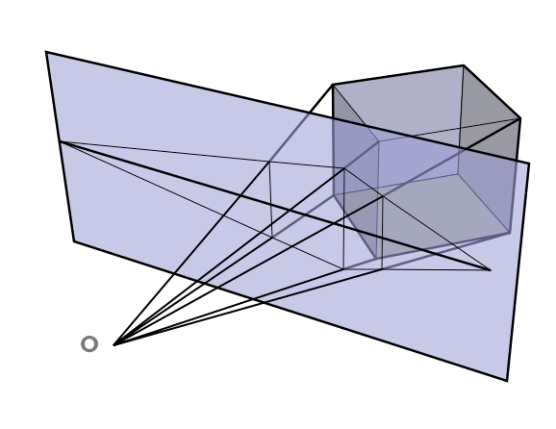
Projections
Perspective projection
parallel lines do not necessarily remain parallel
objects get larger as they get closer
fly-through realism

Slide 32
Camera
View up
Image plane
View angle
Focal point
Direction of
projection
Camera
position
Front clipping plane
Back clipping plane
Only primitives located between front and back clipping planes will be rendered.

Slide 33
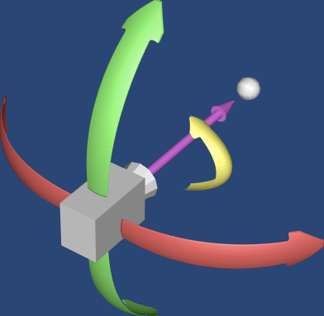
Camera
Degrees of freedom
Elevation
Focal Point
Direction of
projection
Roll
Azimuth

Slide 34
Outline
Graphics Primitives
Colors
Shading
Rasterization
Cameras
Fundamental Techniques

Slide 35
Fundamental Techniques
Z-buffer
Alpha blending
Depth peeling

Slide 36
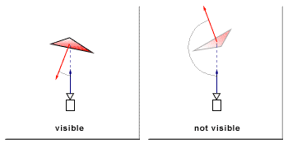
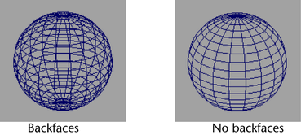
Fundamental Techniques
Back-face culling
Determine whether a polygon is visible (i.e., should be rendered)
Check polygon normal against camera viewing direction: remove polygons that are
If some objects do not show up/are black in your visualization: check your normals!

Slide 37
Fundamental Algorithms
Depth-sort algorithm
Sort all polygons from near to far (z-coordinates)
Resolve ambiguities (overlapping in z)
Scan convert each polygon in ascending order of z coord. (back to front)
See application in Projected Tetrahedron method (Volume Rendering)

Slide 38
Fundamental Techniques
Z-buffer algorithm
Maintain a z-buffer of same resolution as frame buffer
During scan conversion compare z-coord of pixel to be stored with z-coord of current pixel in z-buffer
If new pixel is closer, store value in frame buffer and new z-coord in Z-buffer: objects in foreground occlude/hide objects in background

Slide 39
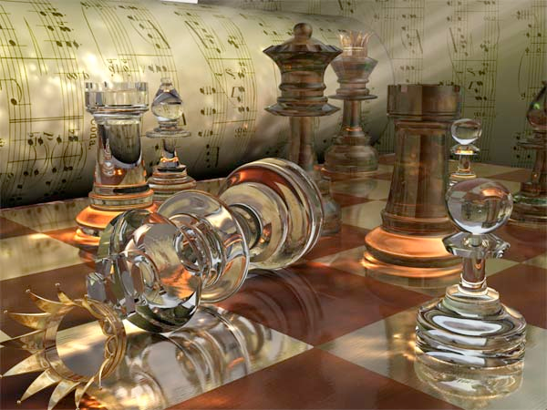
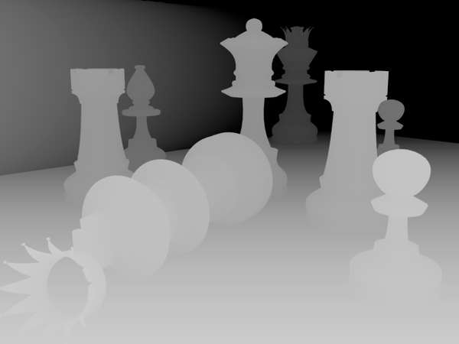
Fundamental Techniques
Z-buffer algorithm to get occlusion right
gray value indicates distance to image plane

Slide 40
Fundamental Techniques
Alpha blending / compositing
Approximate visual appearance of semi-transparent object in front of another object
Implemented with OVER operator
cf = (0,1,0)
af = 0.4
Alpha blending is used in volume rendering and depth peeling. More on this later...
c = af*cf + (1 - af)*ab*cb
a = af + (1 - af)*ab
cb = (1,0,0)
ab = 0.9
c = (0.54,0.4,0)
a = 0.94

Slide 41
Fundamental Techniques
Depth Peeling
Order-independent transparency
Use 2 z-buffers and multiple rendering passes

Slide 42
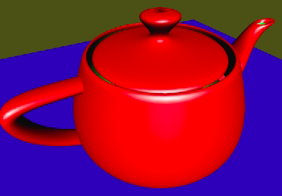
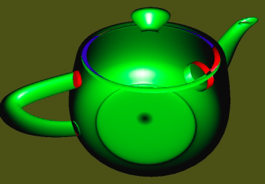
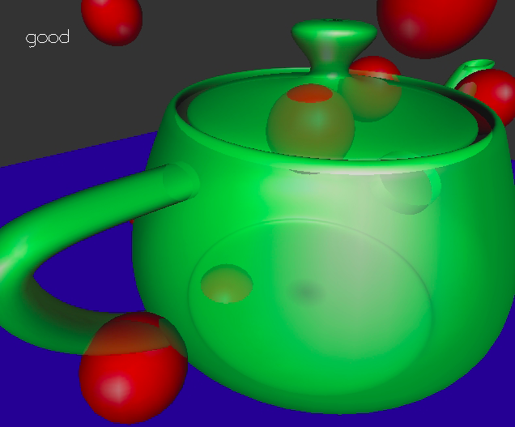
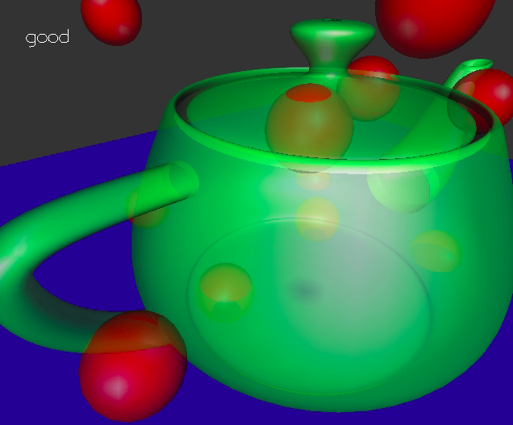
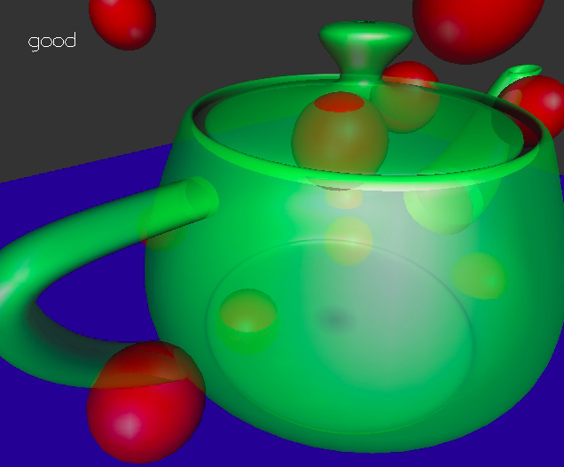
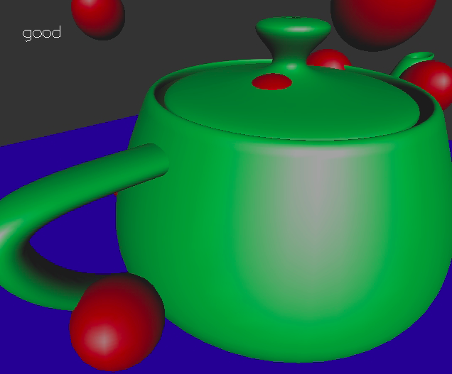
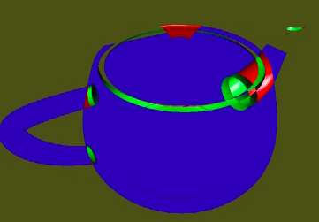
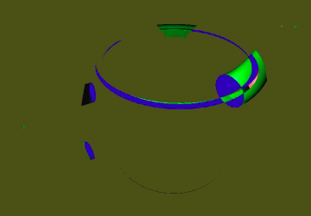
Fundamental Techniques
Depth Peeling
2
4
1
3
2
1
Depth peeling is the only way to get correct transparency results in VTK.
3
4

Slide 43
Fundamental Algorithms
Ray-tracing algorithm
Send ray from pixel into view volume
Determine which surface is struck first
Combined with lighting algorithm.
Ray-tracing is available in Paraview

Slide 44
Homework
Install VTK

