Slide 1
Tensor Field Visualization
11

Slide 2
Outline
Basics of tensor algebra
Tensor glyphs
Hyperstreamlines
DTI visualization

Slide 3
Tensors
p-order tensor in n-space: linear transformation between vector spaces
Special cases:
  0th order tensors: scalars
  1st order tensors: vectors
  2nd order tensor: matrices
In Visualization “tensors” are mostly 2nd order tensors

Slide 4

Tensors
Second order tensors map vectors to vectors
Symmetric / antisymmetric
with
Represented by matrices in cartesian basis
Note: like vectors, tensors exist independently of any basis representation

Slide 5
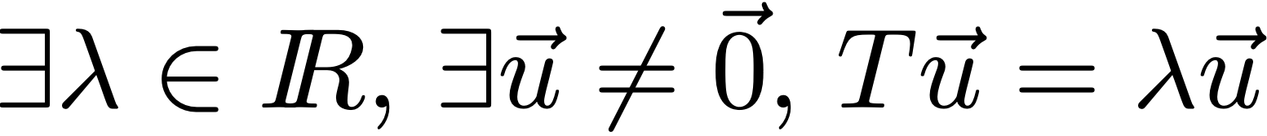
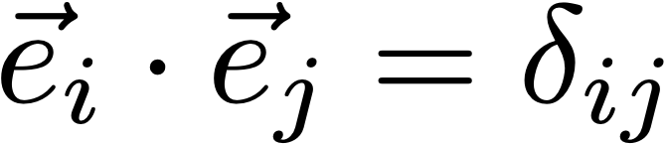
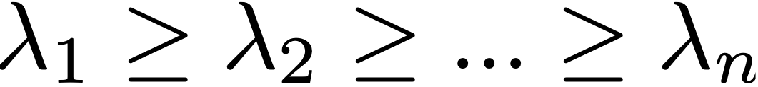
Tensors
Eigenvalues, eigenvectors
Real symmetric tensors: eigenvalues are real and eigenvectors are orthogonal
Sorted eigenvalues
Invariants: quantities (function of the tensor value) independent of reference frame:
  eigenvalues and functions thereof (e.g., trace, determinant)

Slide 6
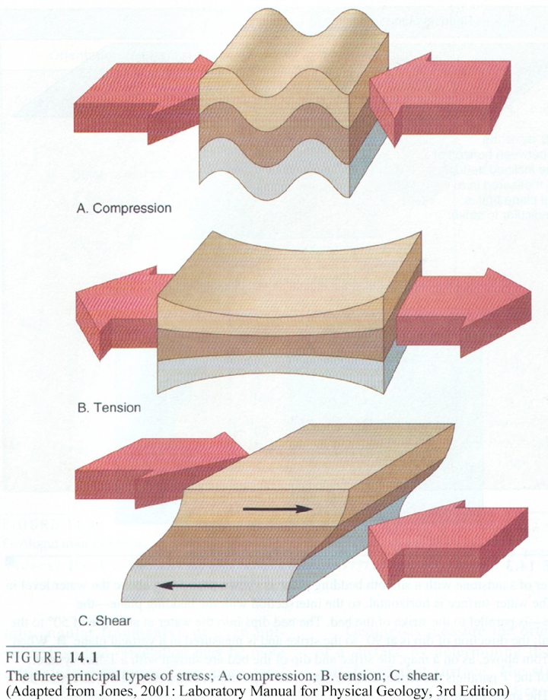
Examples
Forces
  stress: cause of deformation
  strain: deformation description
Derivative
  Jacobian: 1st-order derivative of a vector field
  Hessian: 2nd-order derivative of a scalar field
Diffusion tensor field

Slide 7
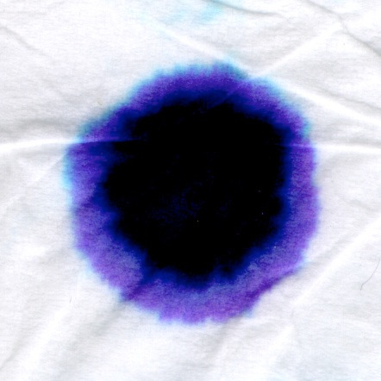
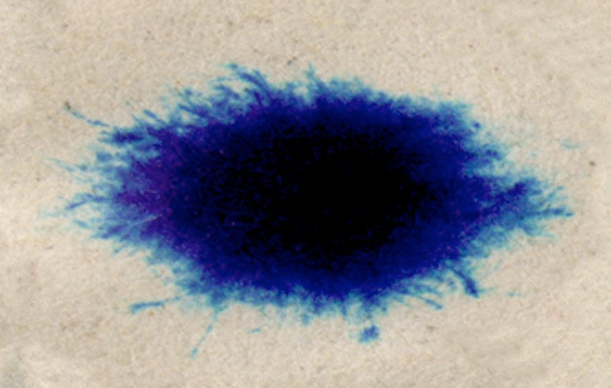
Tensors
Anisotropy characterizes tensor shape
Example: ink diffusion
Kleenex
Newspaper

Slide 8
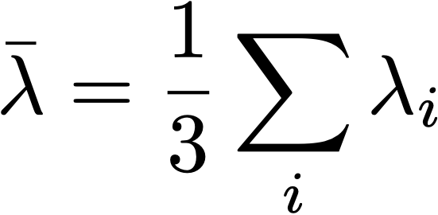

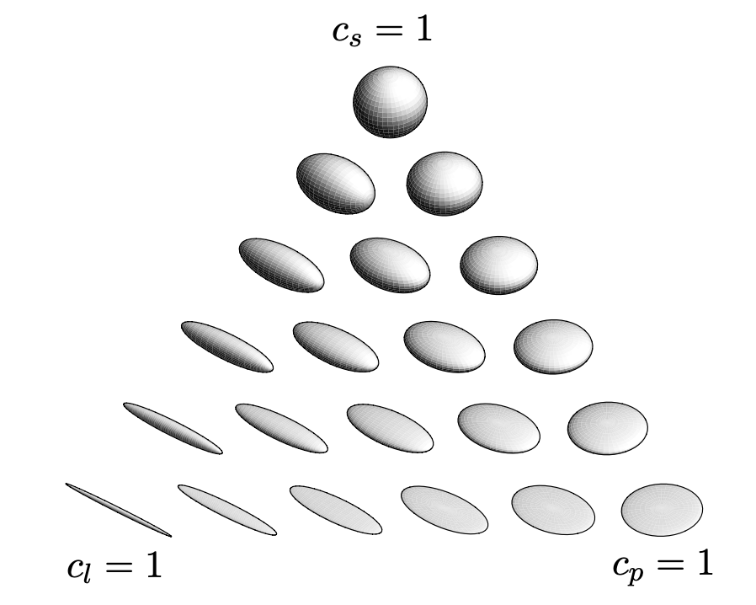

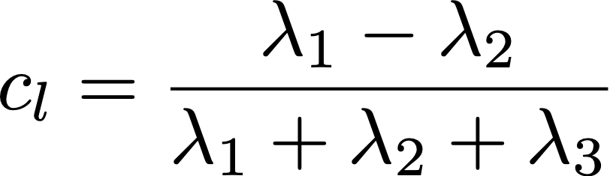
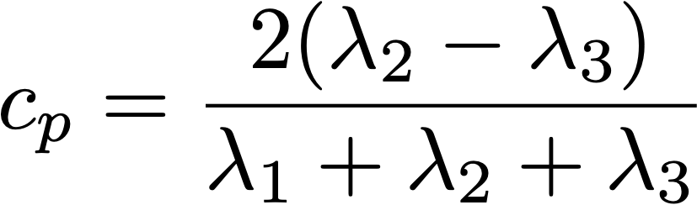
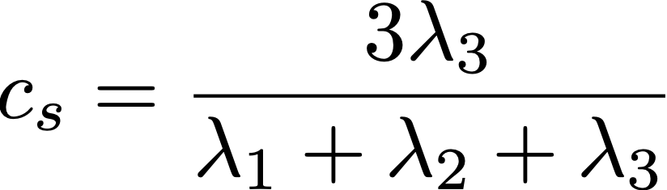
Anisotropy
Eigenvalues:
Deviatoric:
Partial anisotropy:
  linear:
  planar:
  spherical:

Slide 9
Tensors
Eigenvectors: non-oriented directional info.
  Have no intrinsic norm
  Have no intrinsic orientation
Eigenvectors ≠ vectors!
Tensor visualization requires combined visualization of eigenvectors and eigenvalues

Slide 10
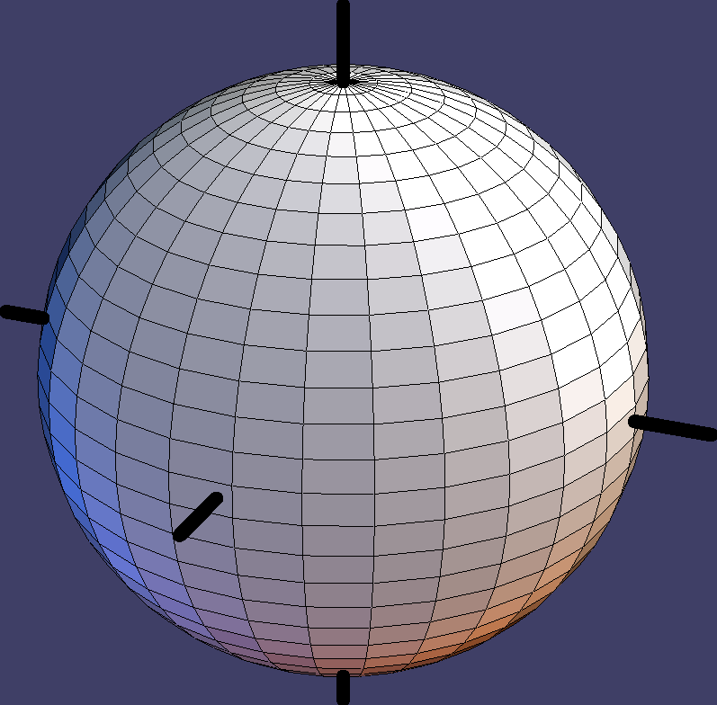
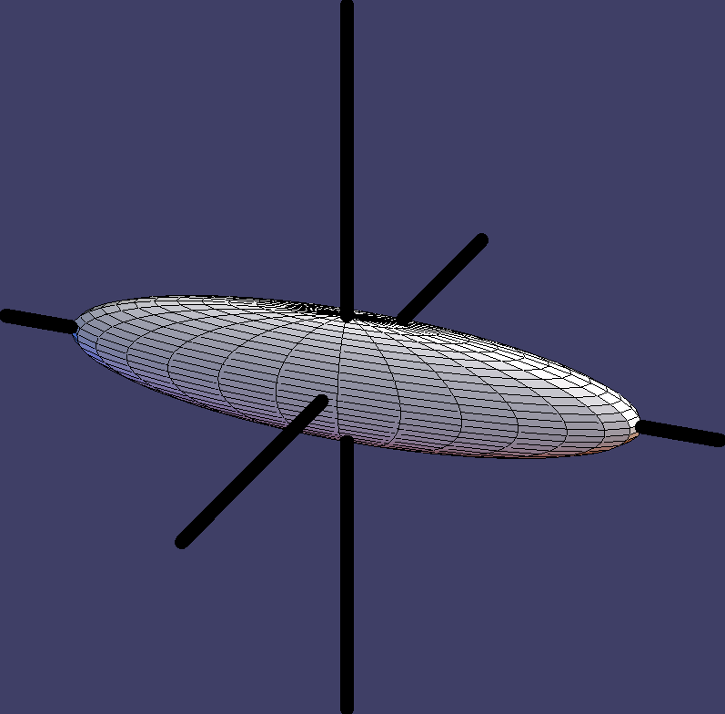
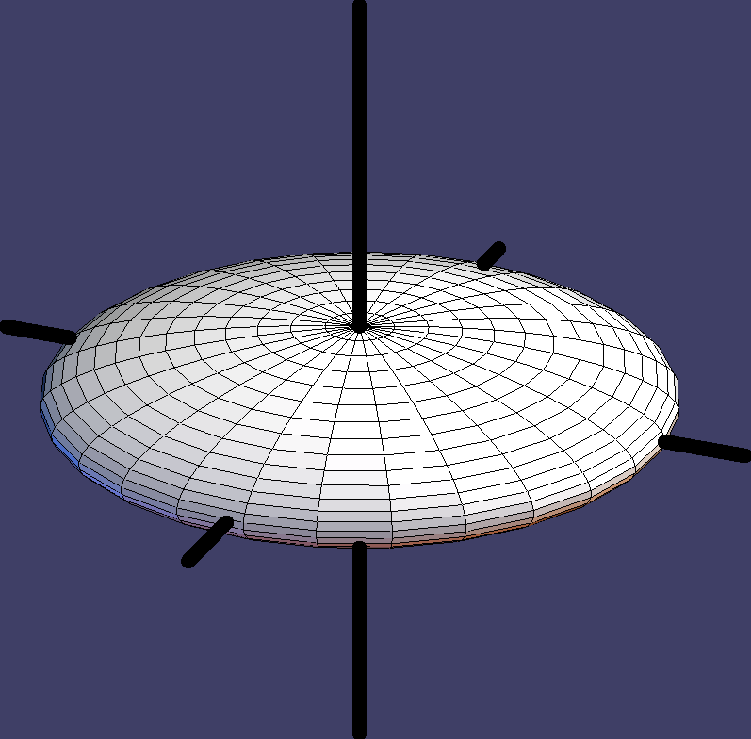
Symmetric Tensor Glyphs
A 2nd order symmetric 3D tensor is fully characterized by its 3 real eigenvalues (shape) and associated orthogonal eigenvectors (orientation)

Slide 11
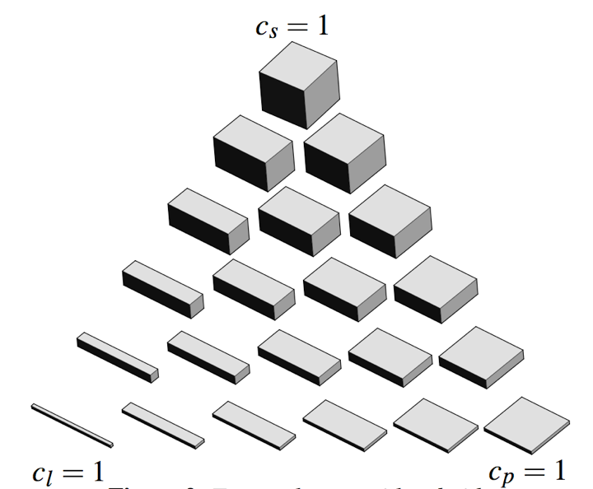
Symmetric Tensor Glyphs

Slide 12
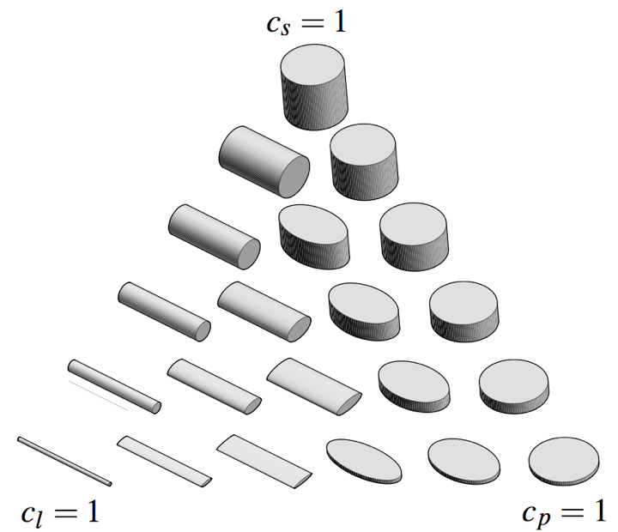
Symmetric Tensor Glyphs

Slide 13
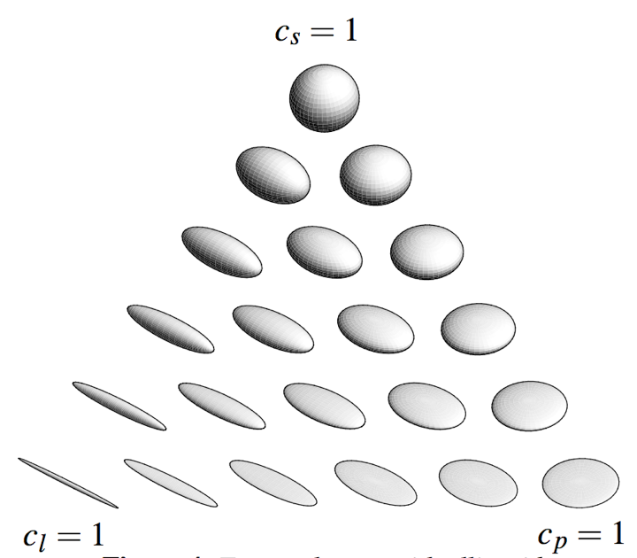
Symmetric Tensor Glyphs

Slide 14
Symmetric Tensor Glyphs
Shortcomings

Slide 15
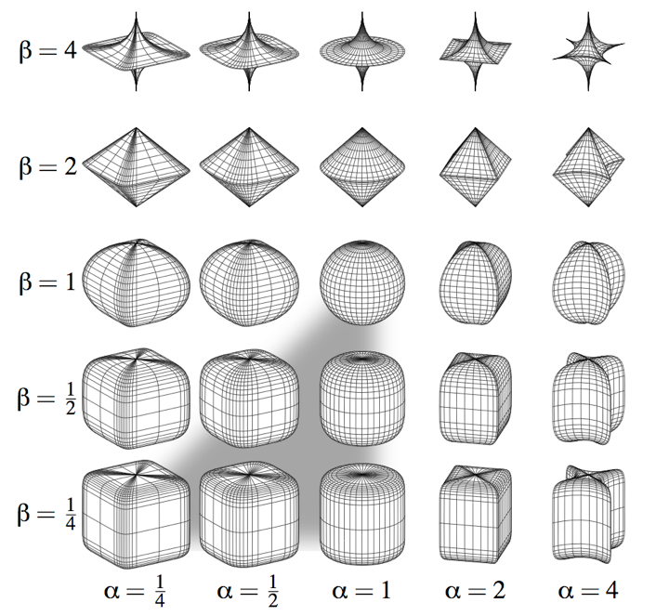
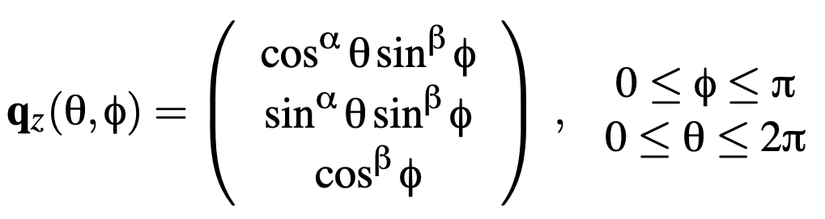
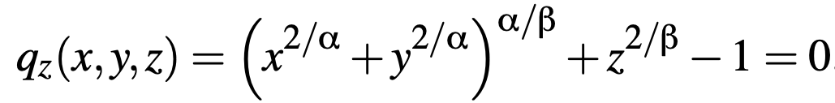
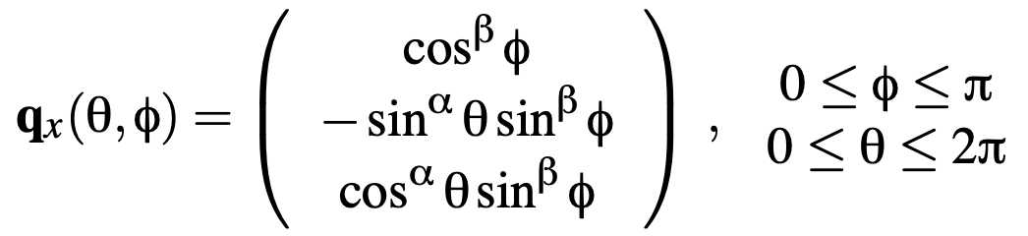
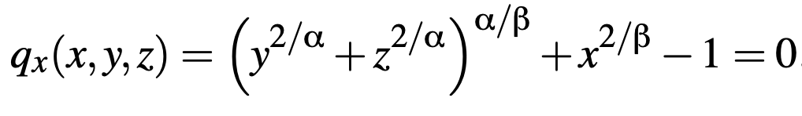
Superquadrics
A. Barr,
Superquadrics and angle-preserving transformations,
IEEE Computer Graphics and Applications 18(1), 1981

Slide 16
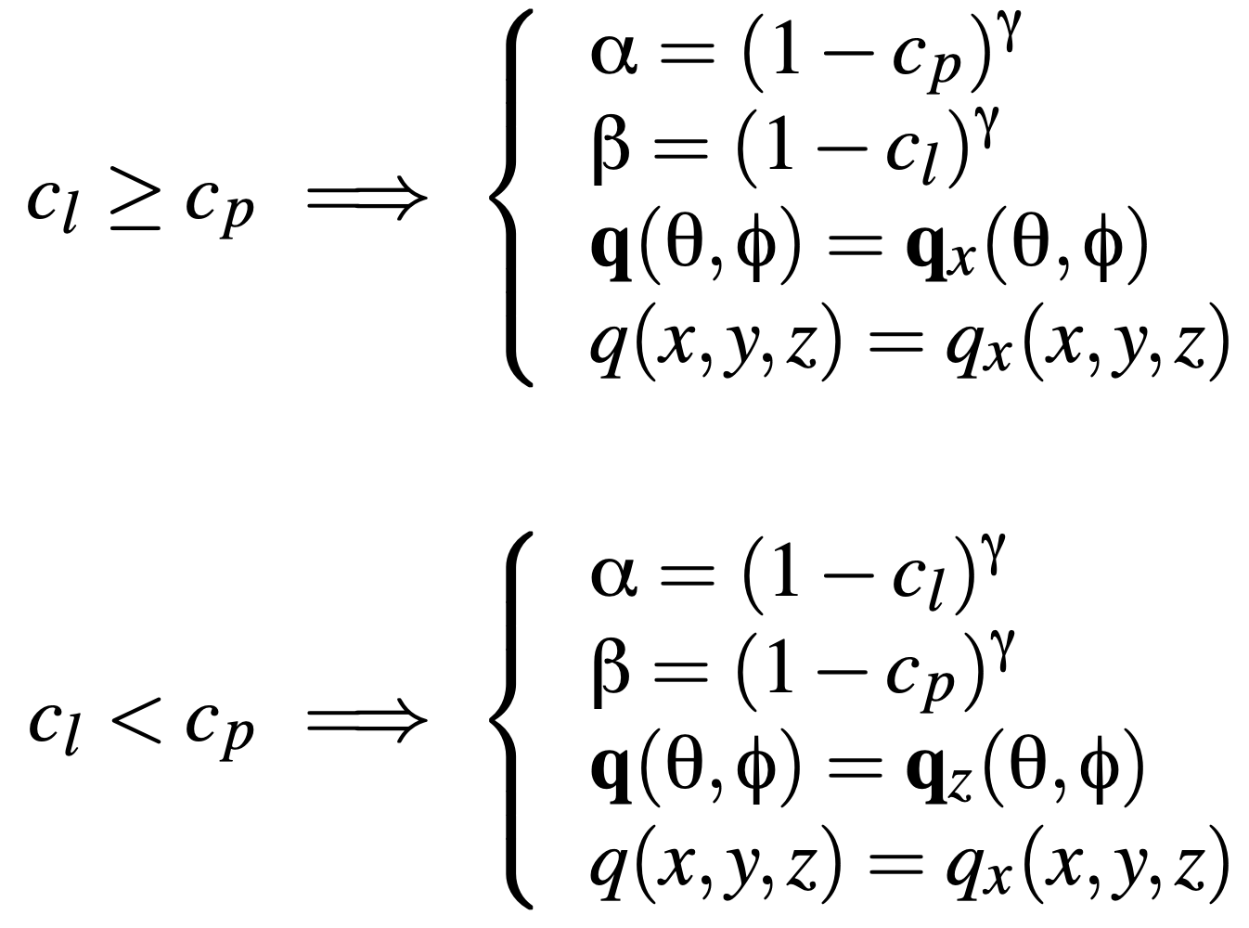
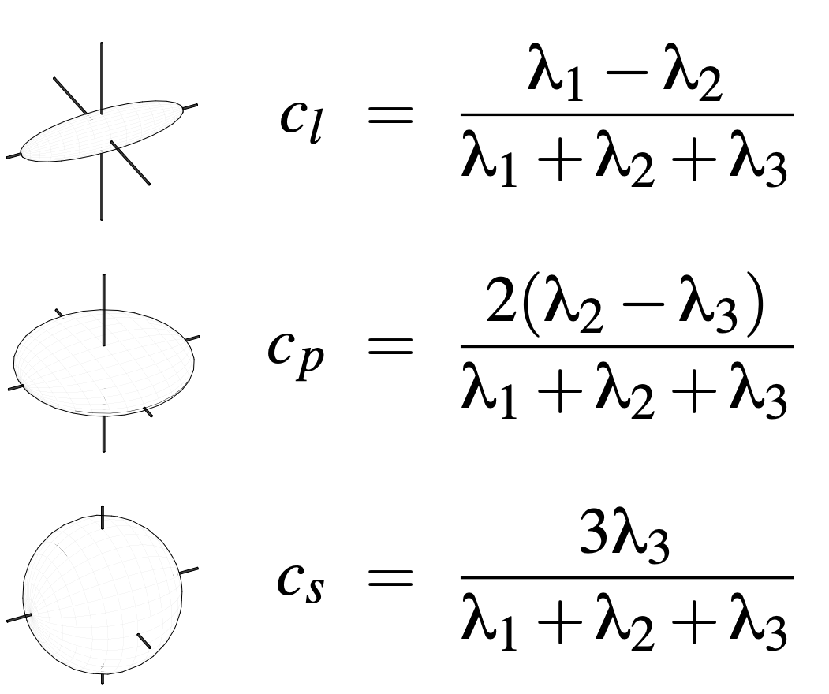
Superquadric Tensor Glyphs
Parameters 𝛼 and 𝛽 are a function of the tensor’s anisotropy measures:
with
G. Kindlmann, Superquadric Tensor Glyphs,
Joint Eurographics/IEEE VGTC Symposium on Visualization 2004

Slide 17
Superquadric Tensor Glyphs
Superquadric glyphs

Slide 18
Superquadric Tensor Glyphs
G. Kindlmann, Superquadric Tensor Glyphs,
Joint Eurographics/IEEE VGTC Symposium on Visualization 2004

Slide 19
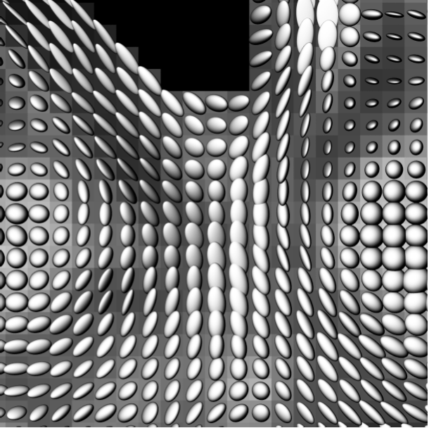
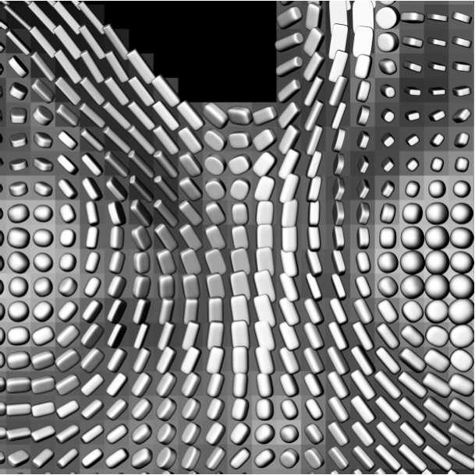
Comparison
G. Kindlmann, Superquadric Tensor Glyphs,
Joint Eurographics/IEEE VGTC Symposium on Visualization 2004

Slide 20
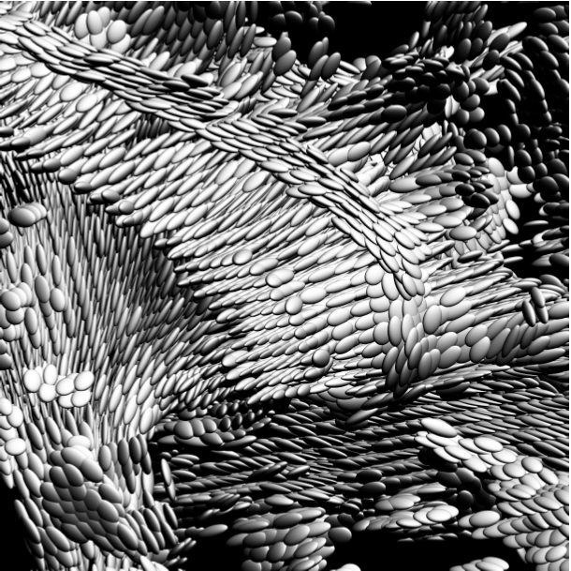
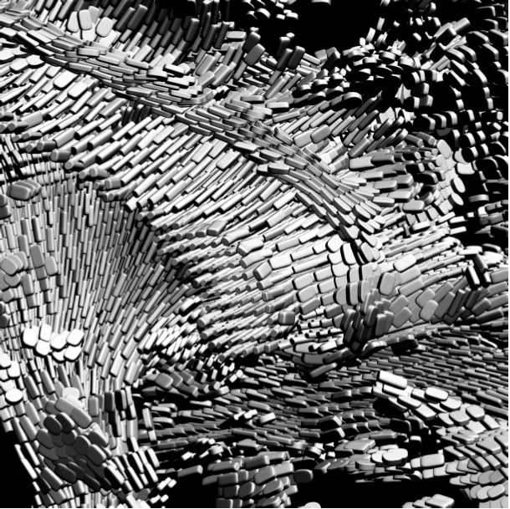
Comparison
G. Kindlmann, Superquadric Tensor Glyphs,
Joint Eurographics/IEEE VGTC Symposium on Visualization 2004

Slide 21
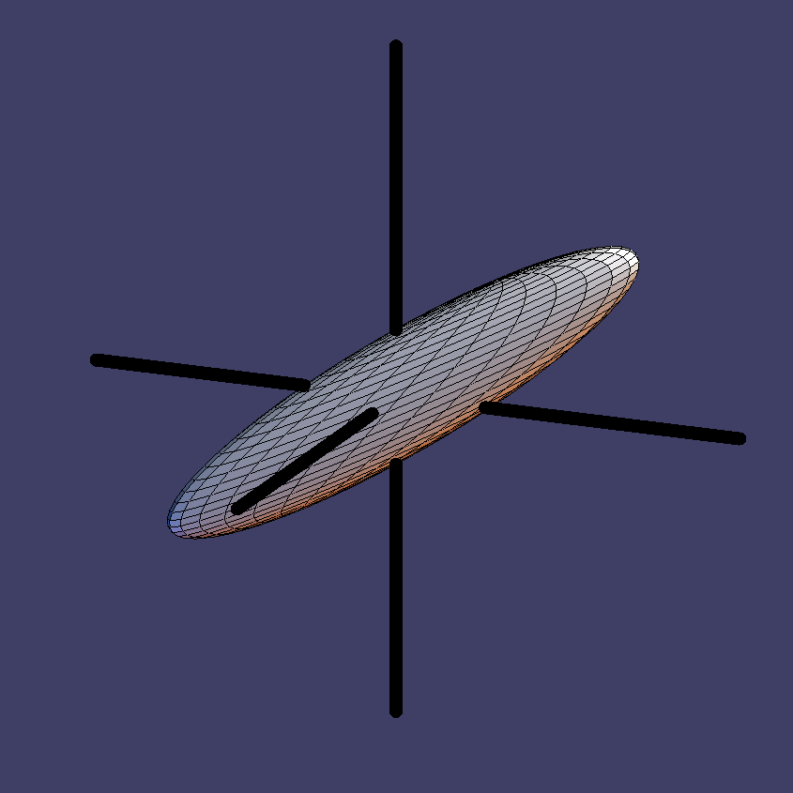
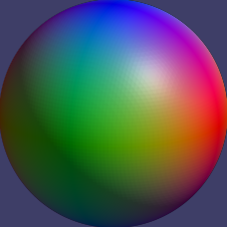
Symmetric Tensor Glyphs
Color-coding can be used to facilitate the interpretation of the orientation
  e.g., emax mapped to R=|x|, G=|y|, B=|z|

Slide 22
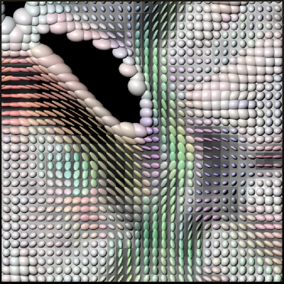
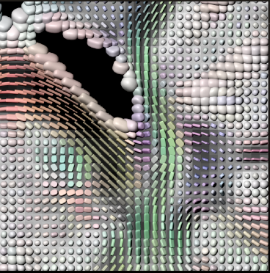
Comparison

Slide 23
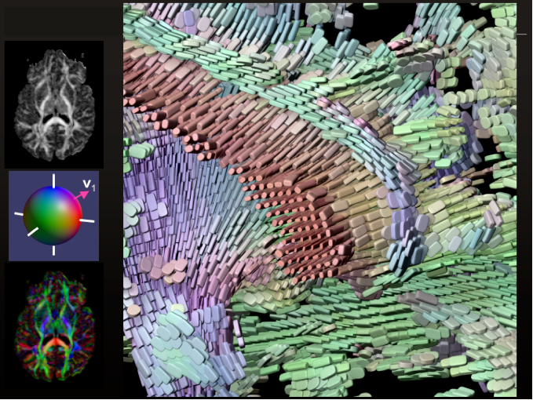
Symmetric Tensor Glyphs

Slide 24
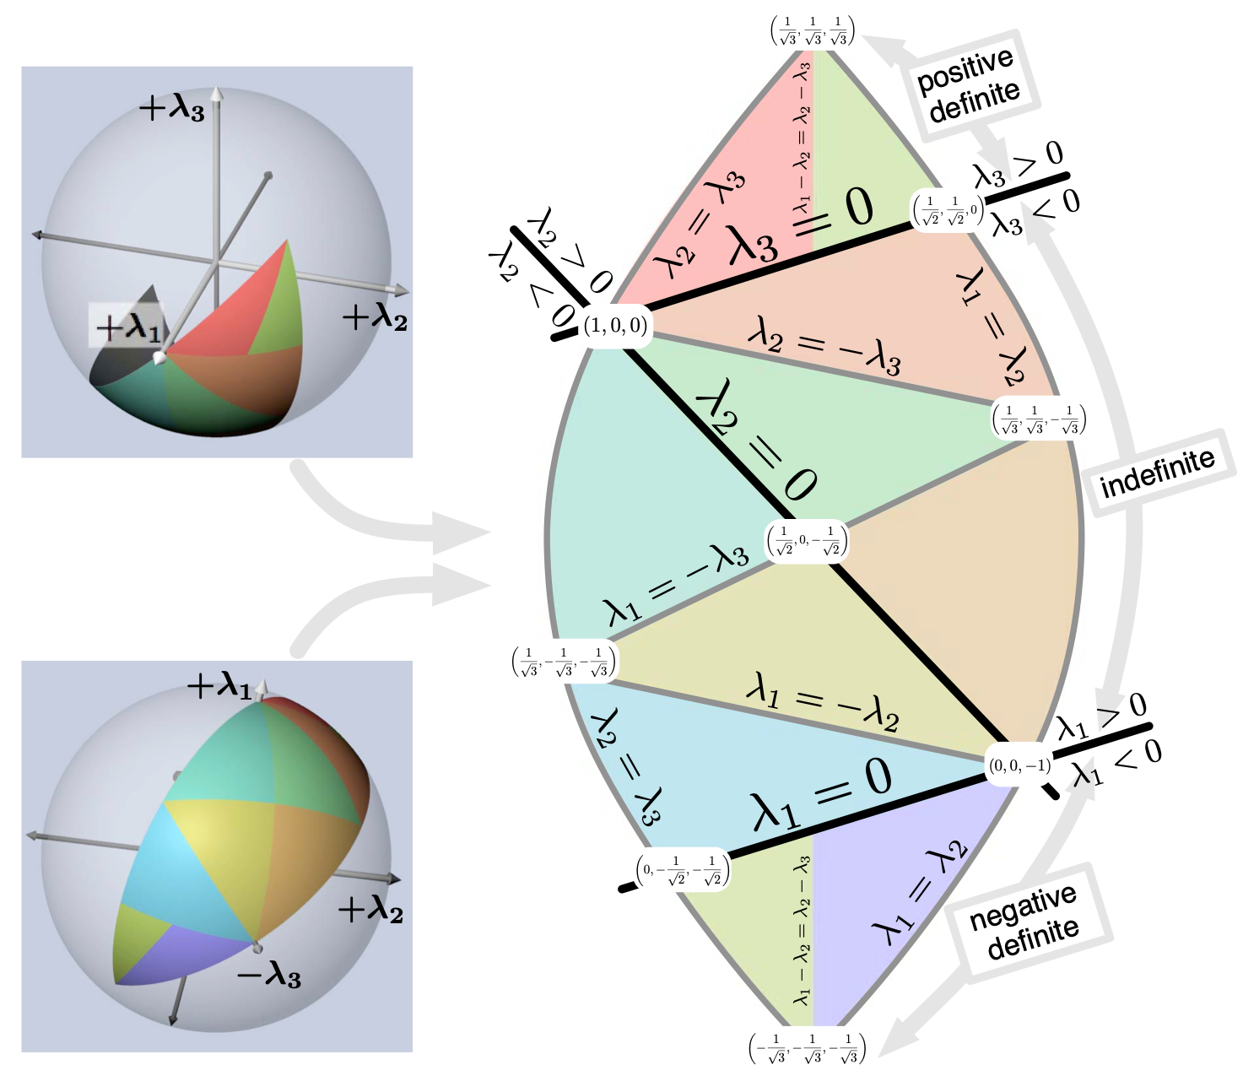
Symmetric Tensor Glyph
Glyphs for general symmetric tensors?
Eigenvalues can be positive or negative

Slide 25
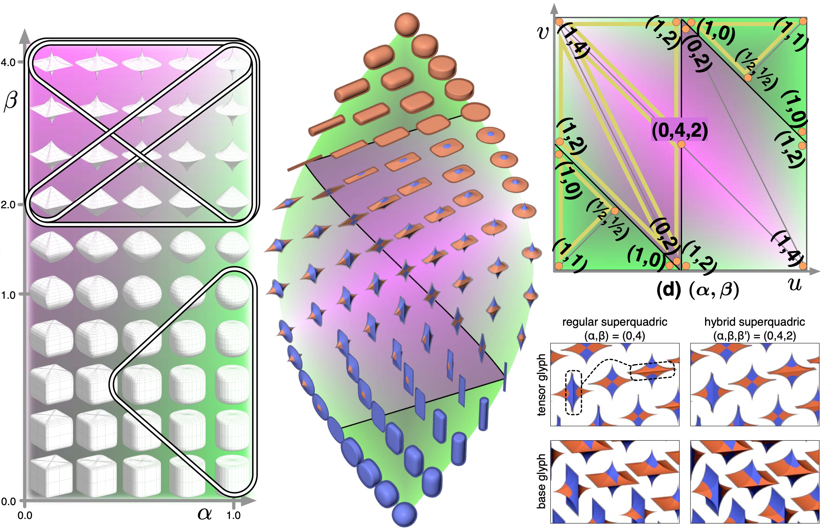
Symmetric Tensor Glyph
T. Schultz, G. Kindlmann, Superquadric Glyphs for Symmetric Second-Order Tensors,
IEEE TVCG 16 (6) (IEEE Visualization 2010)

Slide 26
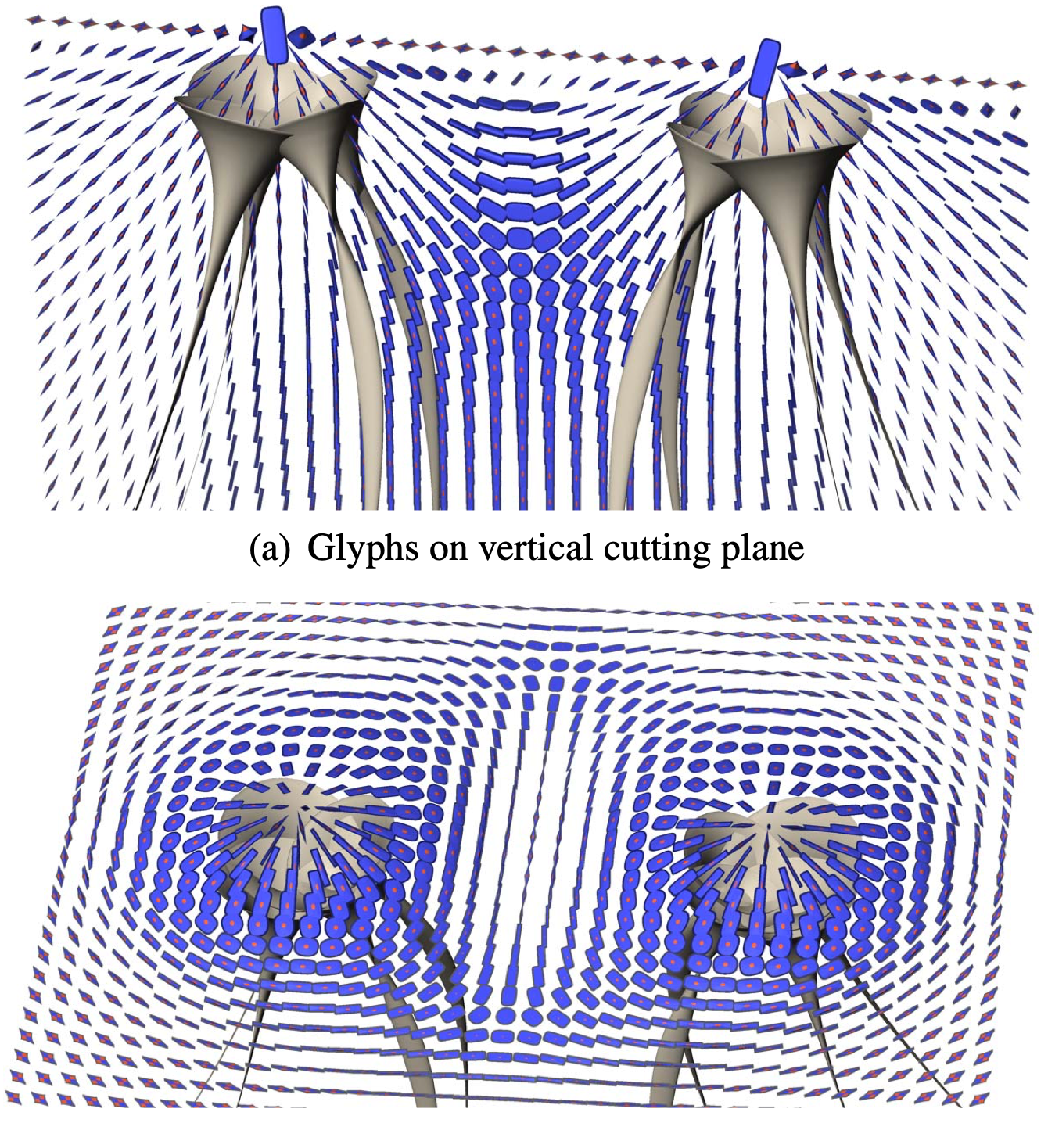
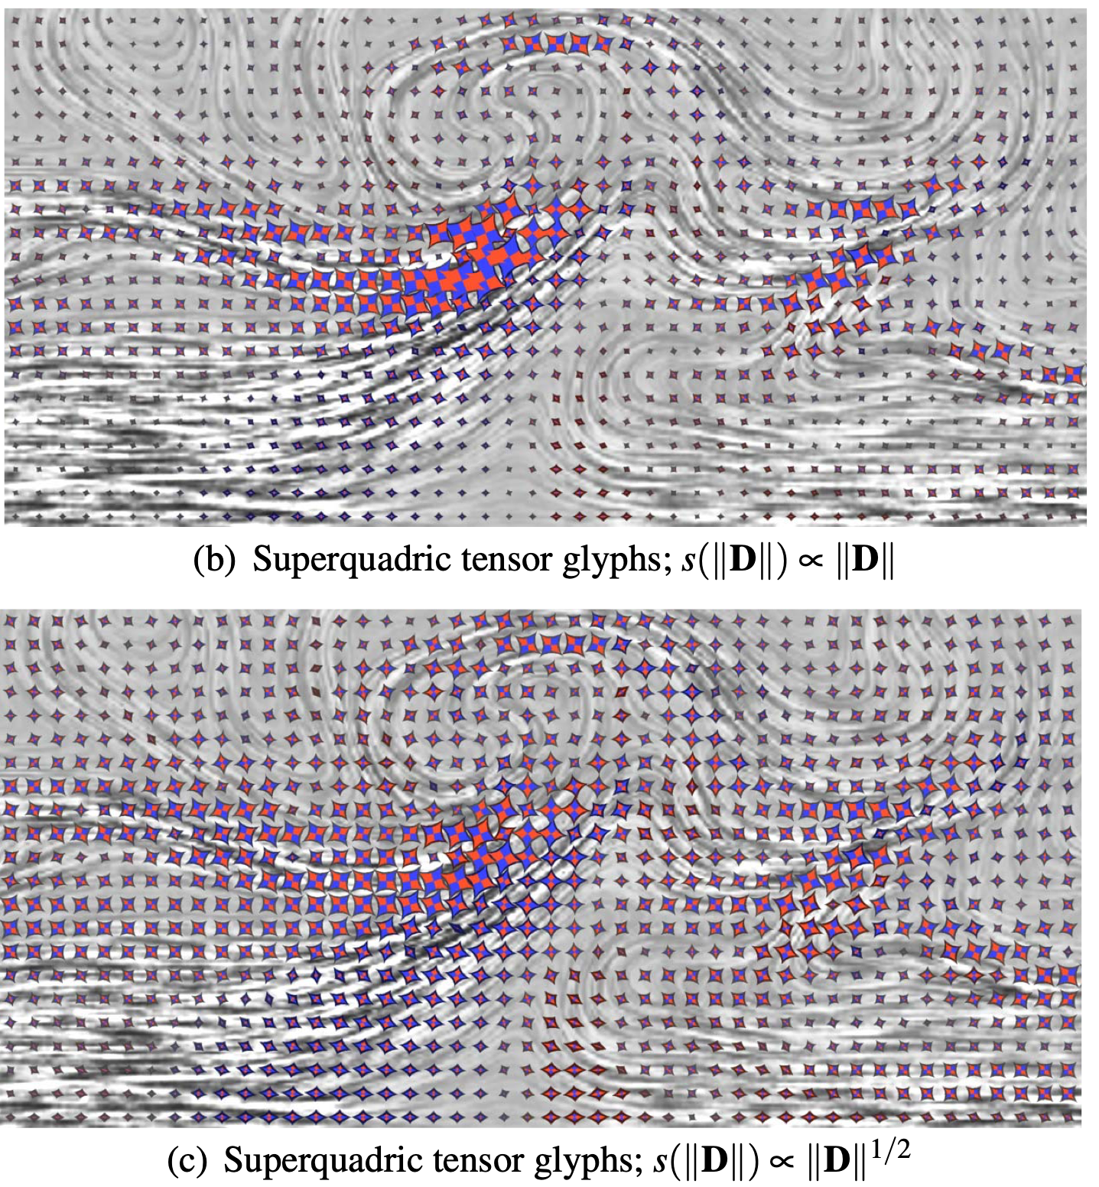
Results
T. Schultz, G. Kindlmann, Superquadric Glyphs for Symmetric Second-Order Tensors,
IEEE TVCG 16 (6) (IEEE Visualization 2010)

Slide 27
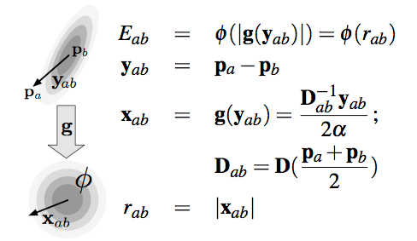
Glyph Packing
  Distribute (discrete) glyphs over continuous domain in data-driven way
  Reveal underlying continuous structures
  Remove artifacts caused by sampling bias
G. Kindlmann and C.-F. Westin, Diffusion Tensor Visualization with Glyph Packing, IEEE Visualization 2006

Slide 28
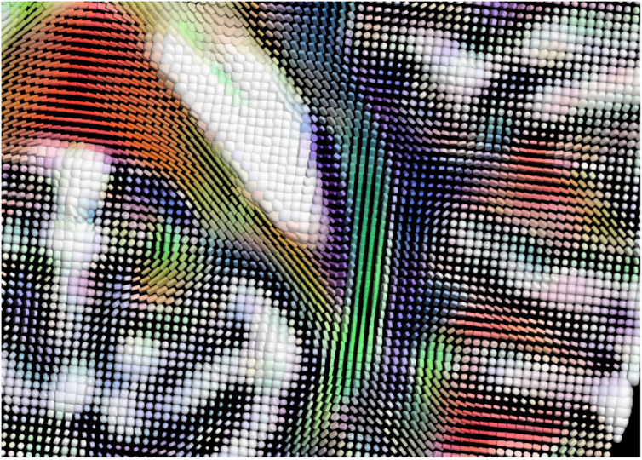
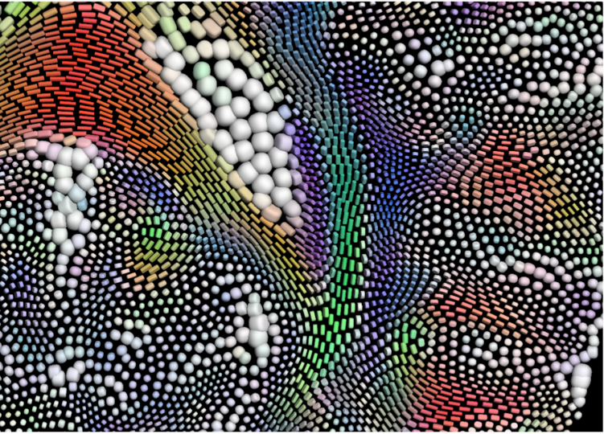
Glyph Packing
Regular grid
Glyph packing
G. Kindlmann and C.-F. Westin, Diffusion Tensor Visualization with Glyph Packing, IEEE Visualization 2006

Slide 29
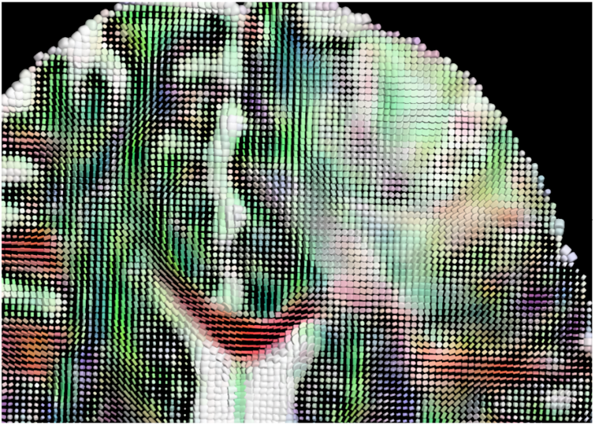
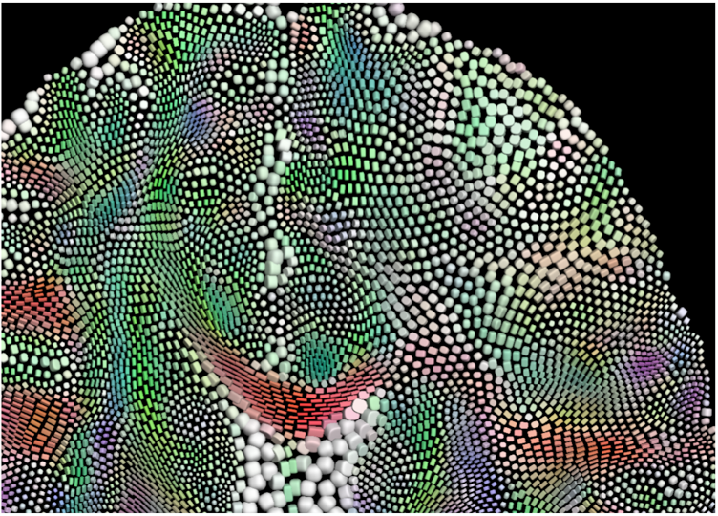
Glyph Packing
Regular grid
Glyph packing
G. Kindlmann and C.-F. Westin, Diffusion Tensor Visualization with Glyph Packing, IEEE Visualization 2006

Slide 30
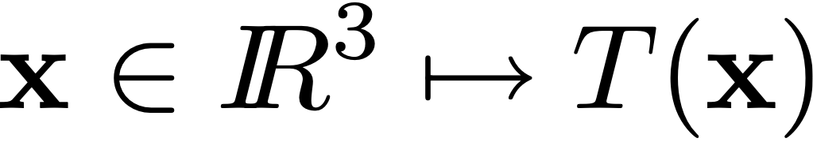
Hyperstreamlines
Method for symmetric 2nd order tensor fields in 3D
Identify eigenvector fields w.r.t. associated eigenvalues
and

Slide 31
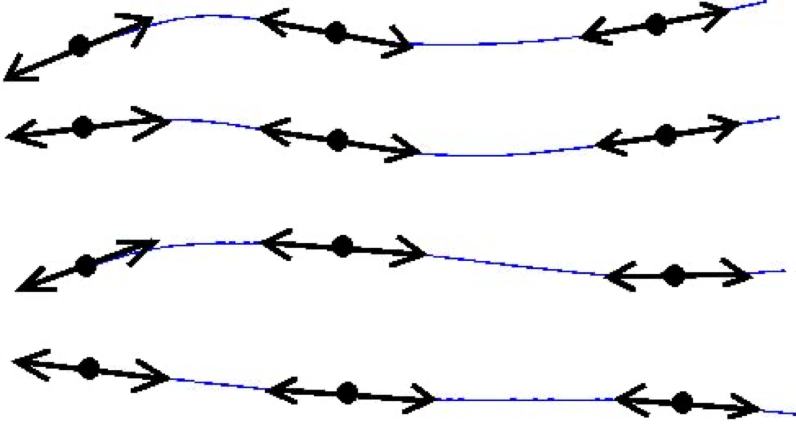
Hyperstreamlines
Tensor field lines (2D/3D): curve everywhere tangential to a given eigenvector field
R. R. Dickinson,
A Unified Approach to the Design of Visualization Software for the Analysis of Field Problems,
SPIE Proceedings, Vol. 1083, 1989

Slide 32
Hyperstreamlines
Remark: numerical integration using e.g. Runge-Kutta is faced with the problem of maintaining orientation consistency
R. R. Dickinson,
A Unified Approach to the Design of Visualization Software for the Analysis of Field Problems,
SPIE Proceedings, Vol. 1083, 1989

Slide 33
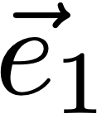
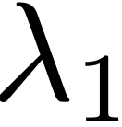
Hyperstreamlines
Method
Compute tensor field line along major eigenvector
Sweep geometric primitive representing two other eigenvalues and eigenvectors
  Ellipse stretched along eigenvectors by eigenvalues
  Cross depicting eigenvectors + eigenvalues
Color coding on geometric primitive determined by
T. Delmarcelle, L. Hesselink,
Visualization of Second Order Tensor Fields and Matrix Data,
IEEE Visualization 1992

Slide 34
Hyperstreamlines
Remarks
  Eigenvectors are orthogonal: cross section always orthogonal to tensor field line
  Eigenvalues mapped to length of edges in cross section: problems with negative eigenvalues
T. Delmarcelle, L. Hesselink,
Visualization of Second Order Tensor Fields and Matrix Data,
IEEE Visualization 1992

Slide 35
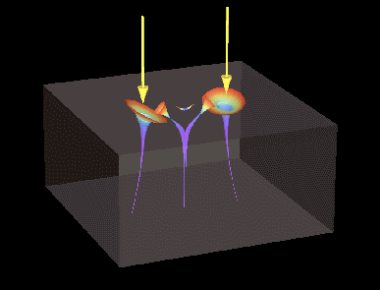
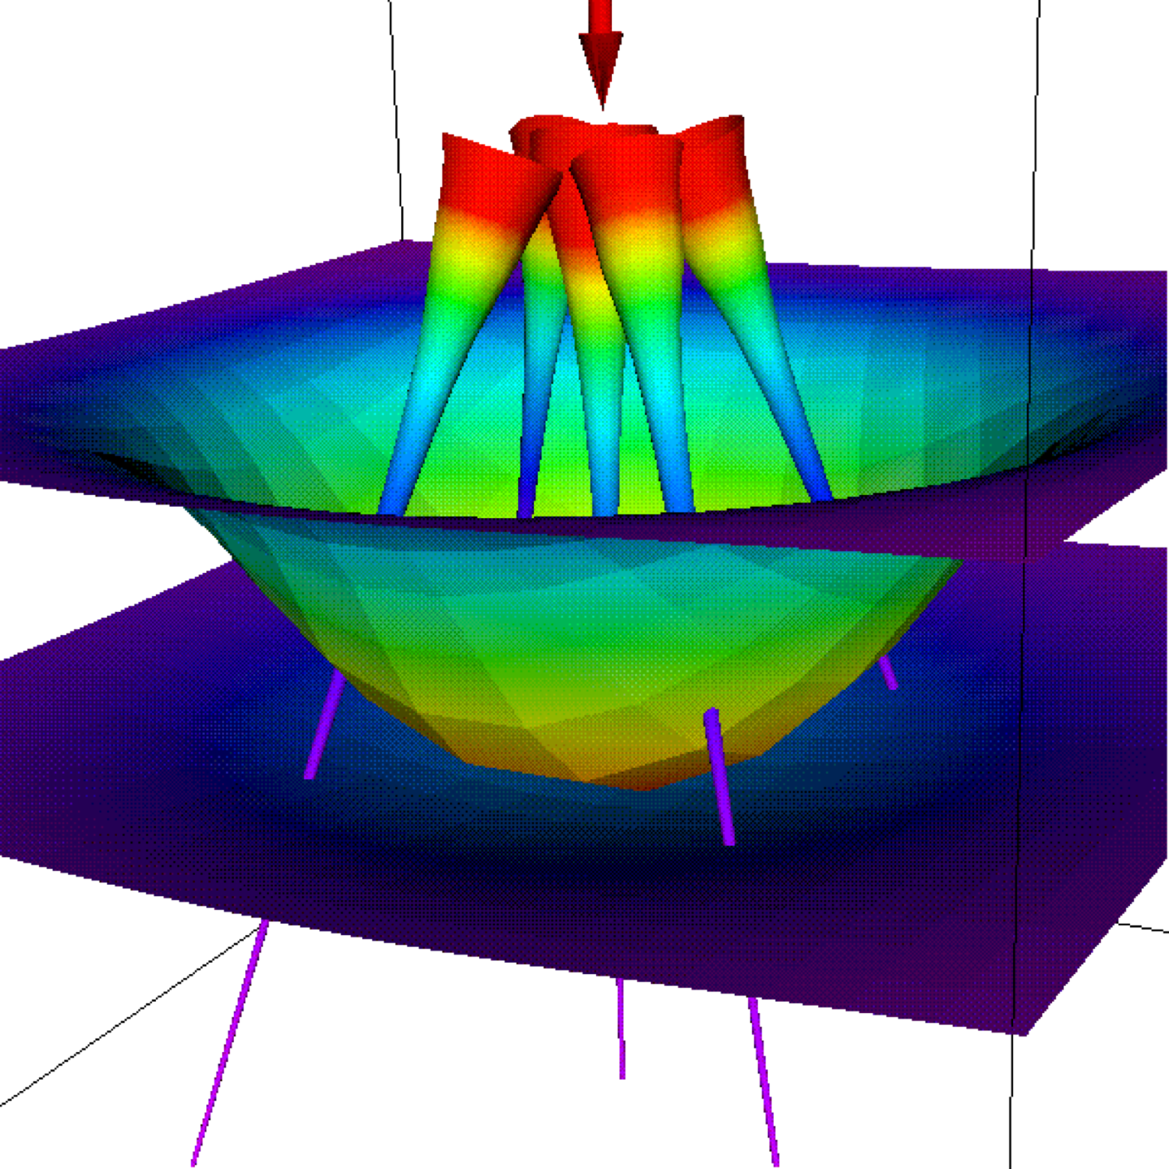
Hyperstreamlines
T. Delmarcelle, L. Hesselink,
Visualization of Second Order Tensor Fields and Matrix Data,
IEEE Visualization 1992

Slide 36
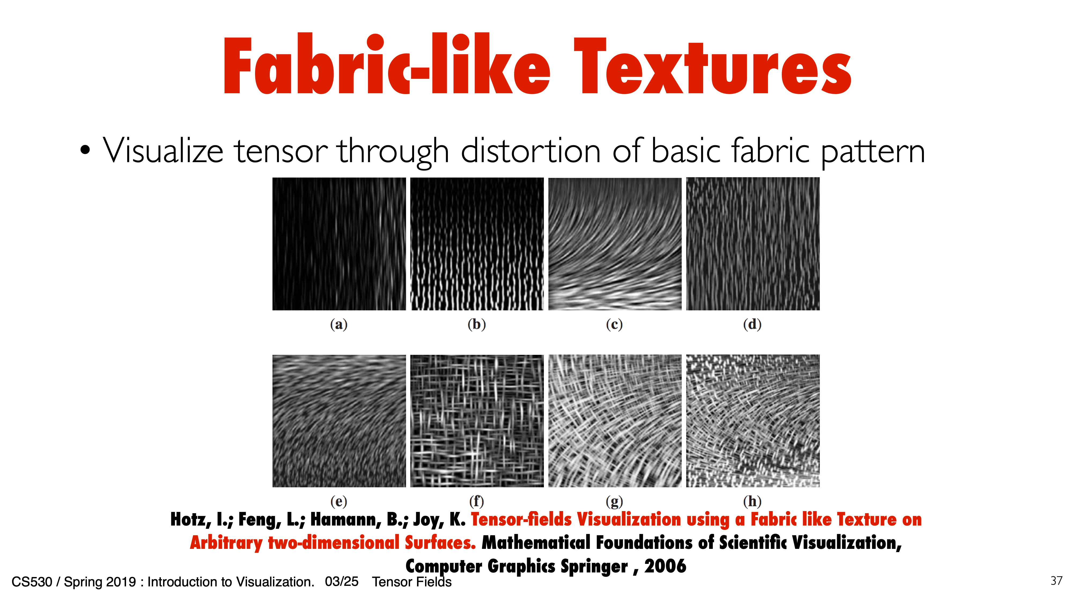
Fabric-like Texture
Visualize tensor through distortion of basic fabric pattern
March 5, 2020
11. Tensor Field Techniques

Slide 37
Fabric-like Texture
CS53000 / Spring 2020 : Introduction to Scientific Visualization .
March 5, 2020
11. Tensor Field Techniques

Slide 38
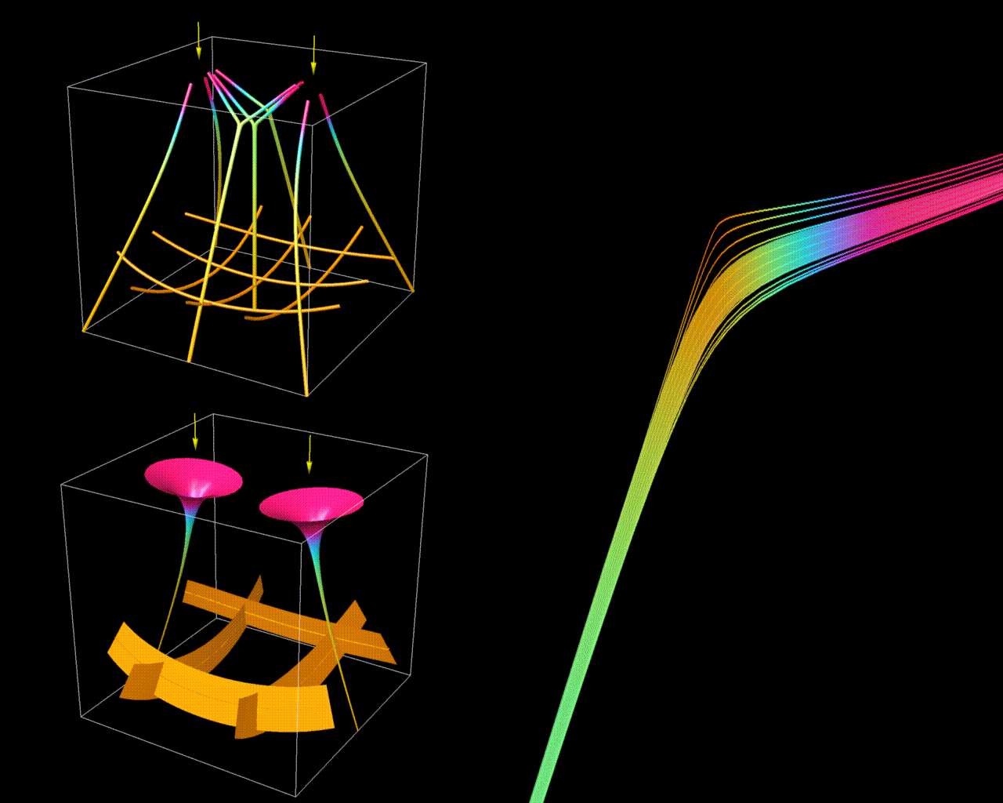
Hyperstreamlines

Slide 39

Hyperstreamlines

Slide 40

Hyperstreamlines
Extension of Hultquist’s
stream surfaces to
eigenvector fields
T. Delmarcelle, L. Hesselink,
Visualization of Second Order Tensor Fields and Matrix Data,
IEEE Visualization 1992

Slide 41

Topology
Idea: characterize global structure of tensor field lines (c.f. flow topology)
Singularities are loci where tensor is isotropic
Eigenvectors live in planes or volumes ≠ lines
  2D: 2 eigenvalues equal
  3D: 2 or 3 eigenvalues are equal
Specific tensor field line patterns around singularity based on its type

Slide 42

Topology
Singularities in 2D + separatrices
Patterns are impossible in vector fields!
Both eigenvector fields have singularities at same position
Trisector
Wedge I
Wedge II
T. Delmarcelle, L. Hesselink, The Topology of Symmetric,
Second order Tensor Fields, IEEE Visualization 1994

Slide 43


Topology
Singularities in 3D are typically lines
X. Zheng, A. Pang, Topological Lines in 3D Tensor Fields,
IEEE Visualization 2004

Slide 44


Topology
Singularities in 3D are typically lines
X. Zheng, A. Pang, Topological Lines in 3D Tensor Fields,
IEEE Visualization 2004

Slide 45


Topology
Singularities in 3D are typically lines
X. Zheng, A. Pang, Topological Lines in 3D Tensor Fields,
IEEE Visualization 2004

Slide 46


Topology
Separatrices

Slide 47


Topology
Separatrices

Slide 48
Diffusion Tensor Imaging
Diffusion Tensor (DT)-MRI measures anisotropic (directional) diffusion properties of biological tissue (e.g., brain)
Diffusion tensor is symmetric positive definite (positive eigenvalues)
Objective: use tensor information to reconstruct the path of tissue fibers
Problems: (very) noisy data + isotropy

Slide 49


Brain Structure - Fiber Tracks

Slide 50




DT MRI Visualization

Slide 51

White Matter Tracts
Park, Westin, and Kikinis, BWH, Harvard Medical School, 2003

Slide 52
Diffusion in Biological Tissue
Motion of water through tissue
Faster in some directions than others
Kleenex
Newspaper
Anisotropy: diffusion rate depends on direction
isotropic
anisotropic
Notes:
A basic characteristic of biological tissue is that water molecules move through and within it,
in a process called diffusion
Some materials have the interesting property that diffusion happens faster in some directions that others.
I’m demonstrating that here with some scans of inkblots I made on two kinds of materials, kleenex, and newspaper.
In kleenex- the ink spreads at same rate in all directions,
But newspaper has a preferred direction where the ink moveks faster.
The name for this phenemon is “anisottropy”.
The wider the variation in diffusion rate as a function of direction, the more “anisotropic” a material is,
This one-dimensional family of ellipses represents some of the different levels of anisotropy which can occur in 2D

Slide 53

Diffusion Tensor Visualization

Slide 54









Diffusion MRI of the Brain
Anisotropy high along white matter fiber tracts
2.1 -0.1 -0.2
-0.1 2.0 -0.0
-0.2 -0.0 2.1
3.7 0.3 -0.8
0.3 0.6 -0.1
-0.8 -0.1 0.8
1.7 0.1 -0.1
0.1 2.3 -0.3
-0.1 -0.3 0.3
Notes:
The exciting thing is that
Within the last five years or so, people have figured out how to use magnetic resonance imaging (MRI) to
Measure the diffusion tensor in living tissue, such as the brain.
The brain is interesting to study because it has a variety of anisotropies.
At the surface of the brain, around the outside, there’s the gray matter, which is basically isotropic,
More inside the brain, there’s the white matter, where the axons are organized into
white matter fiber tracts, which are anisotropic.
We can see those characteristics in actual, measured data, such as this.
This is a matrix of images, where each image shows one component of the diffusion tensor matrix across a 2D slice.
We can pick this spot in all the images, read off the tensor values, and look at the corresponding ellipsoid.
That was in the gray matter, so the ellipsoid is nearly spherical.
At a spot within the white matter, the corpus collosum, we can sample the values to get this matrix, and this ellipsoid.
And just to demonstrate that ALL types of anisotropy happen within measured data, we can pick this other point…

Slide 55

Fiber Tracing
Moving Least Squares:
  Apply Gauss filter mask whose support is determined by current path orientation and local anisotropy
  Trace fiber path along filtered eigenvector
L. Zhukov, A. Barr,
Oriented Tensor Reconstruction:
Tracing Neural Pathways from Diffusion Tensor MRI,
IEEE Visualization 2002

Slide 56

Fiber Tracing
White matter
L. Zhukov, A. Barr,
Oriented Tensor Reconstruction:
Tracing Neural Pathways from Diffusion Tensor MRI,
IEEE Visualization 2002

Slide 57

Fiber Tracing
White matter
L. Zhukov, A. Barr,
Oriented Tensor Reconstruction:
Tracing Neural Pathways from Diffusion Tensor MRI,
IEEE Visualization 2002

Slide 58

Fiber Tracing
Heart
L. Zhukov, A. Barr,
Heart Fiber Reconstruction from Diffusion Tensor MRI,
IEEE Visualization 2003

Slide 59

Visualizing Structures in DTI
Shortcomings of topology for DTI data
degenerate lines
(planar type)
degenerate lines
(linear type)
tractography
Schultz et al., IEEE Visualization 2007

Slide 60


Tensor Mode
mode = -1
mode = 0
mode = +1
Notes:
The invariants that we are interested in are, by definition, related to the shape of the tensor and they are therefore functions of the eigenvalues. Now, the eigenvalues of symmetric real tensor are obtained as the roots of a cubic polynomial. Without going into details, notice that the structure of the eigenvalue solution involves [click] this, plus [click] this times the cosine of [click] this, which has a natural geometric interpretation [click] as the position, radius, and angle of this eigenvalue wheel. In particular, [click] the angle of the wheel is determined by an invariant called *mode*, which comes out of the continuum mechanics literature. As mode varies from negative 1 to 1, the angle of this wheel changes, and the distribution of eigenvalues goes from planar anisotropy to linear anisotropy.

Slide 61
Invariants and Structure
Degenerate lines are extremal (ridge and valley) lines of mode
Mode / topology is not relevant in DTI
Extract ridge and valley manifolds in problem-relevant tensor invariant: FA

Slide 62
Crease Surfaces of FA

Slide 63

Slice Inspection: RGB(e1) (original data)

Slide 64

Slice Inspection: RGB(e1)

Slide 65

Slice Inspection: FA

Slide 66

Slice Inspection: | FA|
D

Slide 67

Slice Inspection: ridge strength: max(0, λ3)

Slide 68

Slice Inspection: g.e3 (modulated by strength)

Slide 69

Slice Inspection: sqrt((g.e3)2 + (g.e2)2)

Slide 70

3-D Results: coronal fibers

Slide 71

3-D Results: ridge surfaces

Slide 72

3-D Results: valley surfaces

Slide 73

3-D Results: valley surfaces with fibers

Slide 74

3-D Results: brainstem fibers

Slide 75

3-D Results: brainstem ridge surfaces

Slide 76

3-D Results: brainstem valley surfaces

Slide 77

3-D Results: combined results

Slide 78

Ridge Lines of FA in Brain
425 lines with
length > 15mm
Sort based on average ridge strength
1.5 x 1.5 x 1.5 mm

Slide 79

Ridge Lines of FA in Brain
Sort based on average ridge strength
FOR = Fornix,
CB = Cingulum Bundles
1.5 x 1.5 x 1.5 mm

Slide 80

Line Creases of White Matter Anisotropy
Notes:
CBR/L: left / right cingulum bundle
FOR: fornix
ILF: inferior longitudinal fasciculus
ICP: inferior cerebellar peduncles
CST: cortico-spinal tract

Slide 81


DTI
G. Kindlmann et al., Sampling and Visualizing Creases with Scale-space particles, IEEE Visualization 2009
CT

