Slide 1
Delaunay Mesh Generation
Tamal K. Dey
The Ohio State University

Slide 2
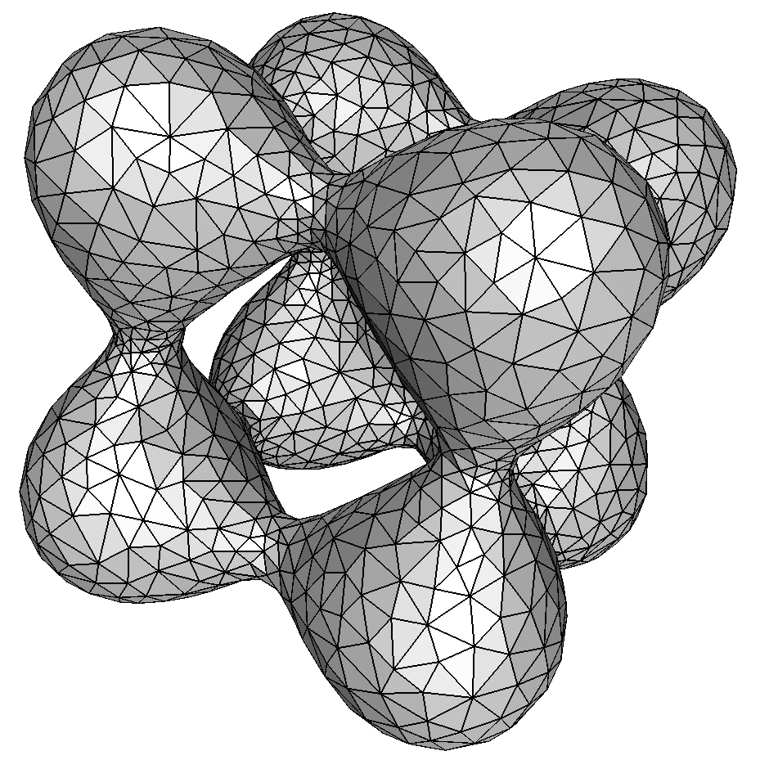
Delaunay Mesh Generation
Automatic mesh generation with good quality.
Delaunay refinements:
The Delaunay triangulation lends to a proof structure.
And it naturally optimizes certain geometric properties such as min angle.

Slide 3
Input/Output
Points P sampled from a surface Σ in 3D (don’t know Σ) ◊ Reconstruct Σ : A simplicial complex K,
(i) K has a geometric realization in 3D
(ii) |K| homeomorphic to Σ,
(iii) Hausdorff distance between |K| and Σ is small
A smooth surface Σ(or a compact set):
Generate a point sample P from Σ
Generate a simplicial complex K with vert K=P and satisfying (i), (ii), (iii).

Slide 4
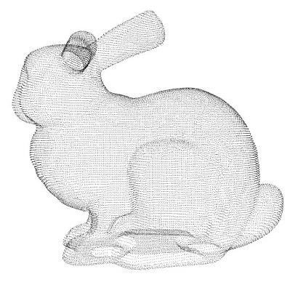
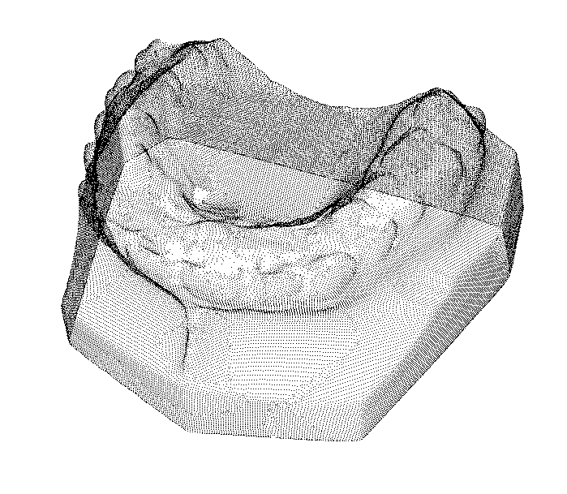
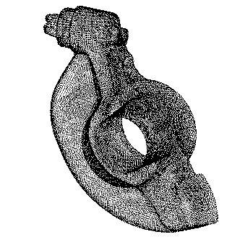
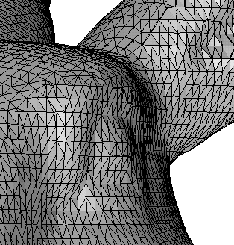
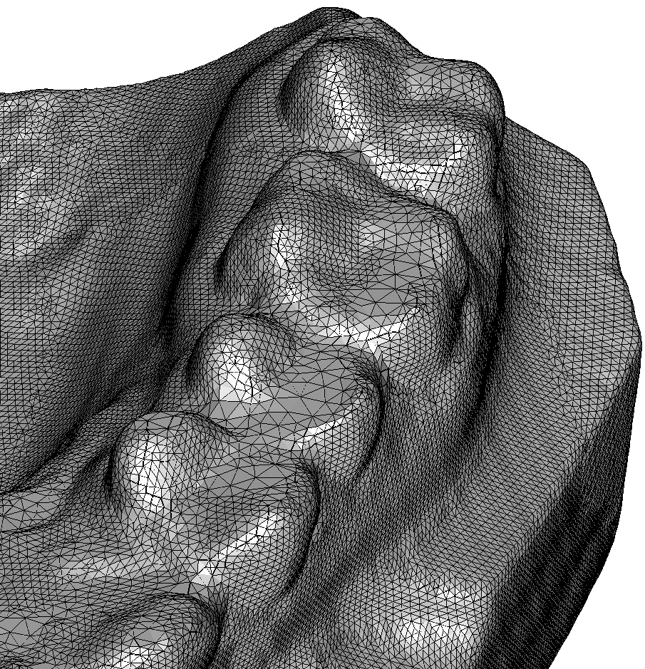
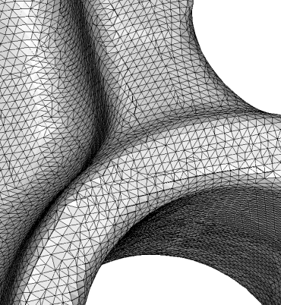
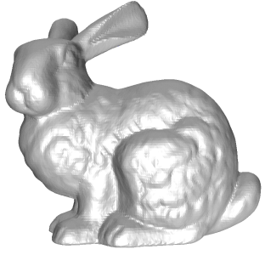
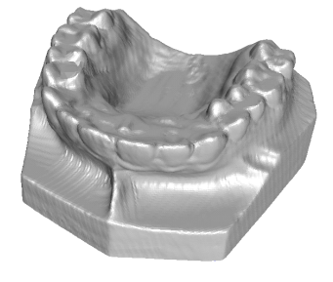
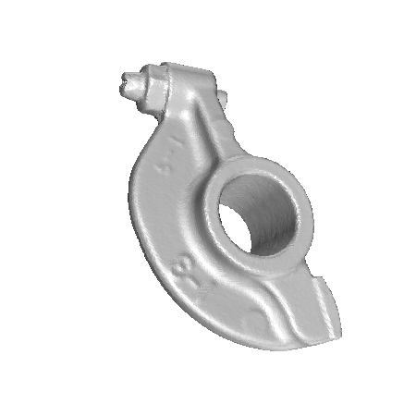
Surface Reconstruction
`
Point Cloud
Surface Reconstruction

Slide 5
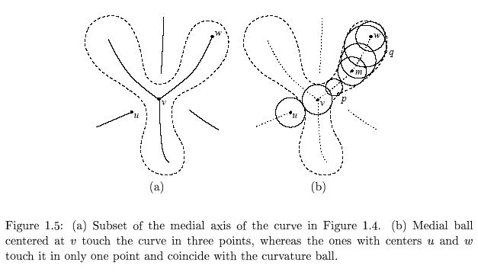
Medial Axis

Slide 6
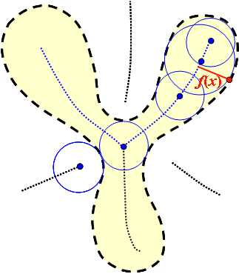
Local Feature Size (Smooth)
Local feature size is calculated using the medial axis of a smooth shape.
f(x) is the distance from a point to the medial axis

Slide 7
ε-Sample [ABE98]
x
Each x has a sample
within εf(x) distance

Slide 8
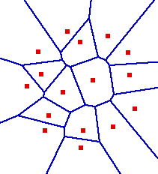
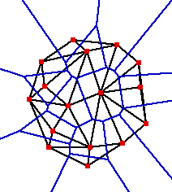
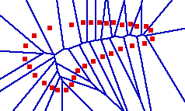
Voronoi/Delaunay

Slide 9
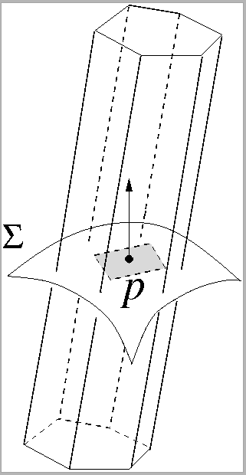
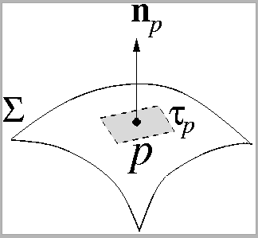
Normal and Voronoi Cells(3D) [Amenta-Bern SoCG98]

Slide 10
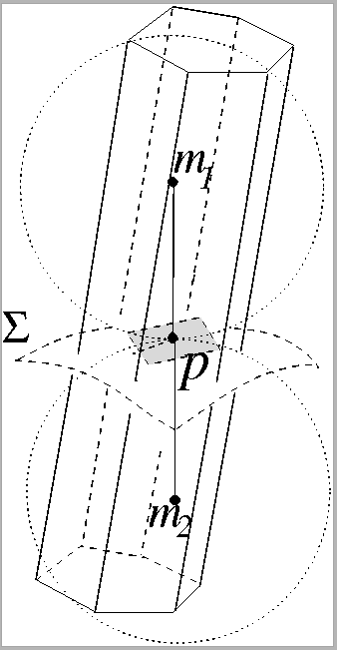
Poles
P⁺
P⁻

Slide 11
Normal Lemma
P⁺
The angle between the pole vector v_{p} and the normal n_{p} is O(ε).
v_{p}
n_{p}
P⁻

Slide 12
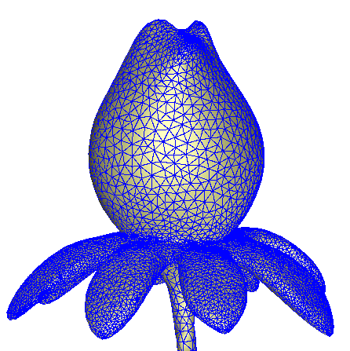
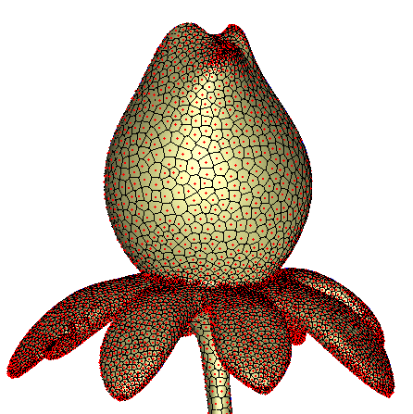
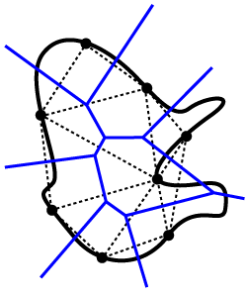
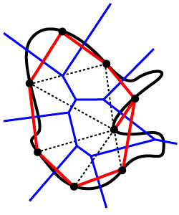
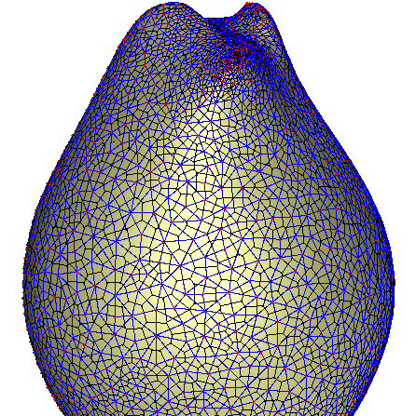
Restricted Delaunay
If the point set is sampled from a domain D.
We can define the restricted Delaunay triangulation, denoted Del P|_{D}.
Each simplex ξ ∈ Del P|_{D} is the dual of a Voronoi face V_{ξ} that has a nonempty intersection with the domain D.

Slide 13

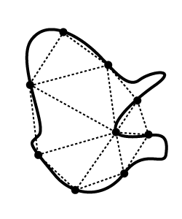
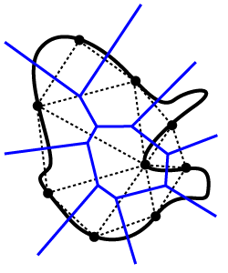
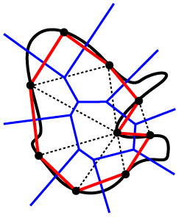
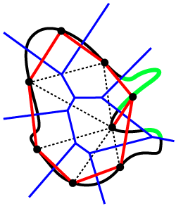
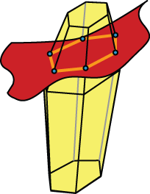
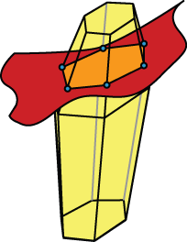
Topological Ball Property (TBP)
P has the TBP for a manifold Σ if each k-face in Vor P either does not intersect Σ or intersects in a topological (k-1)-ball.
Thm (Edelsbrunner-Shah97 ) If P has the TBP then Del P|_{Σ} is homeomorphic to Σ.

Slide 14
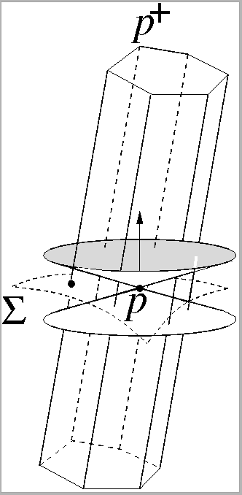
Cocone (Amenta-Choi-D.-Leekha)
v_{p}= p⁺ - p is the pole vector
Space spanned by vectors within the Voronoi cell making angle > 3π/8 with v_{p} or -v_{p}

Slide 15
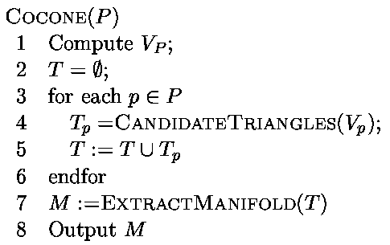
Cocone Algorithm

Slide 16
Cocone Guarantees
Theorem:
Any point x ∈ Σ is within O(ε)f(x) distance from a point in the output. Conversely, any point of output surface has a point x ∈ Σ within O(ε)f(x) distance. Triangle normals make O(ε) angle with true normals at vertices.
Theorem:
The output surface computed by Cocone from an ε-sample is homeomorphic to the sampled surface for sufficiently small ε (<0.06).

Slide 17
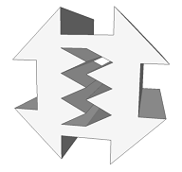
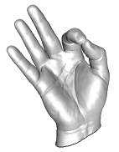
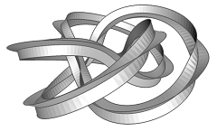
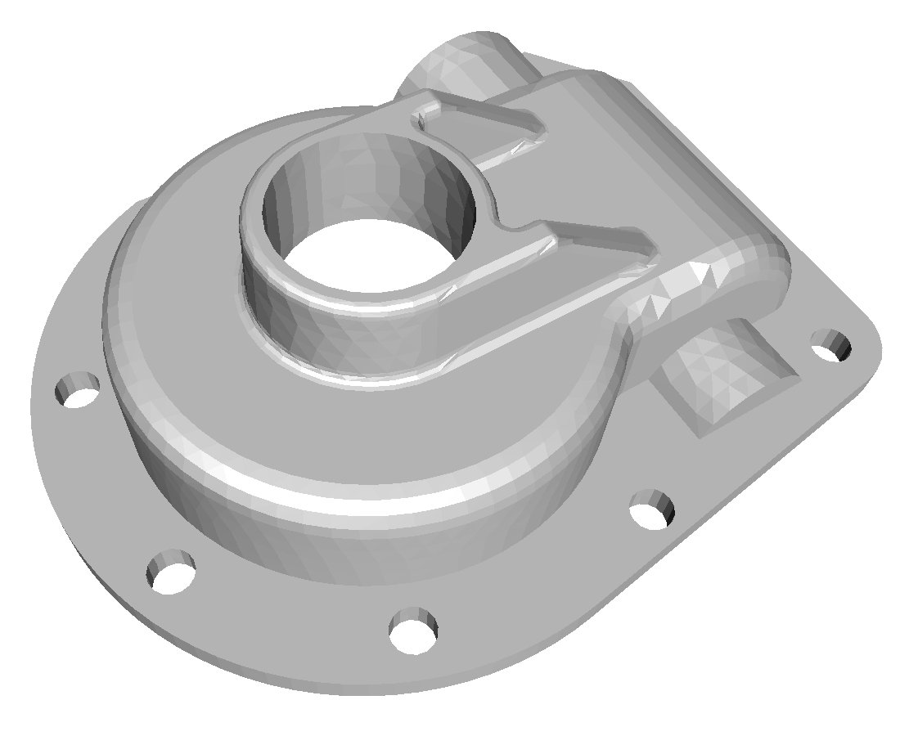
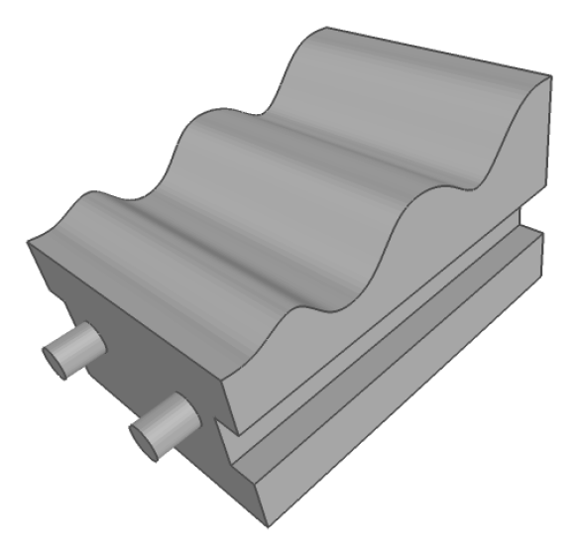
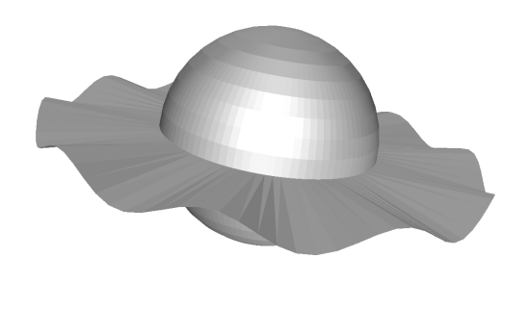
Meshing
Input
Polyhedra
Smooth Surfaces
Piecewise-smooth Surfaces
Non-manifolds
&

Slide 18
Basics of Delaunay Refinement
Pioneered by Chew89, Ruppert92, Shewchuck98
To mesh some domain D,
Initialize a set of points P ⊂ D, compute Del P.
If some condition is not satisfied, insert a point c from D into P and repeat step 2.
Return Del P|_{D}.
Burden is to show that the algorithm terminates (shown by a packing argument).

Slide 19
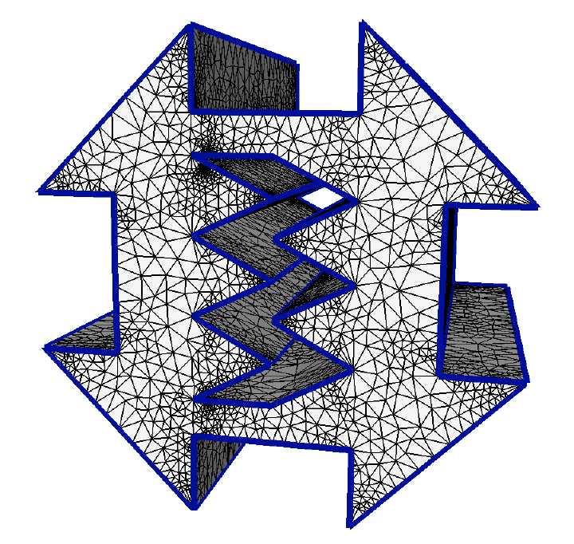
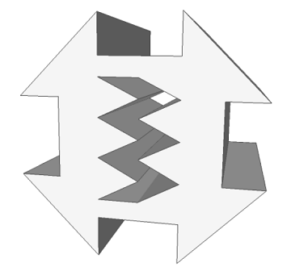
Polyhedral Meshing
Output mesh conforms to input:
All input edges meshed as a collection of Delaunay edges.
All input facets are meshed with a collection of Delaunay triangles.
Algorithms with angle restrictions:
Chew89, Ruppert92, Miller-Talmor-Teng-Walkington95, Shewchuk98.
Small angles allowed:
Shewchuk00, Cohen-Steiner-Verdiere-Yvinec02, Cheng-Poon03, Cheng-Dey-Ramos-Ray04, Pav-Walkington04.

Slide 20
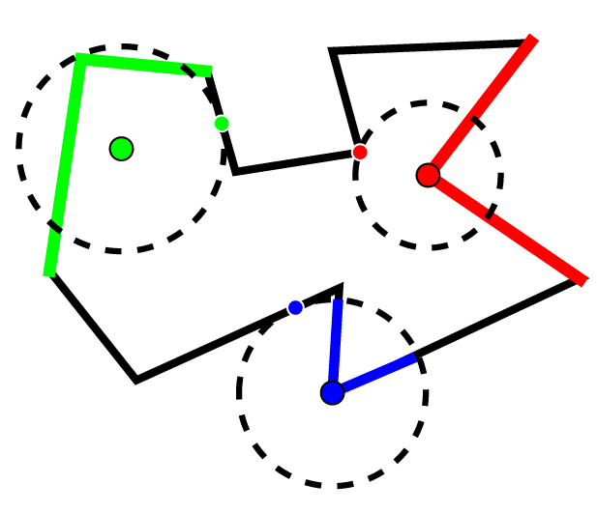
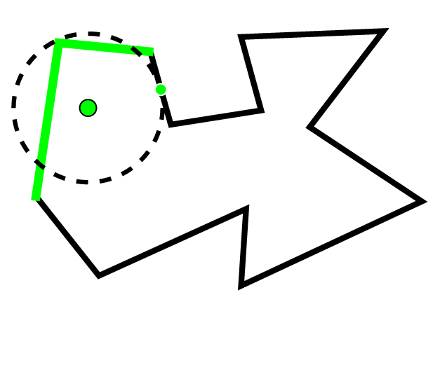
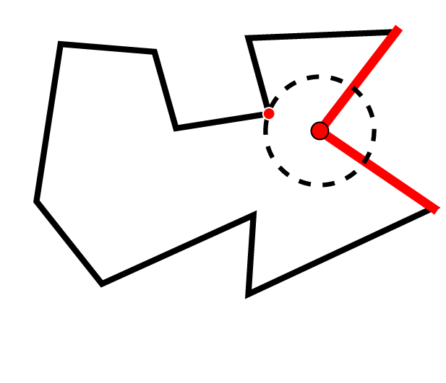
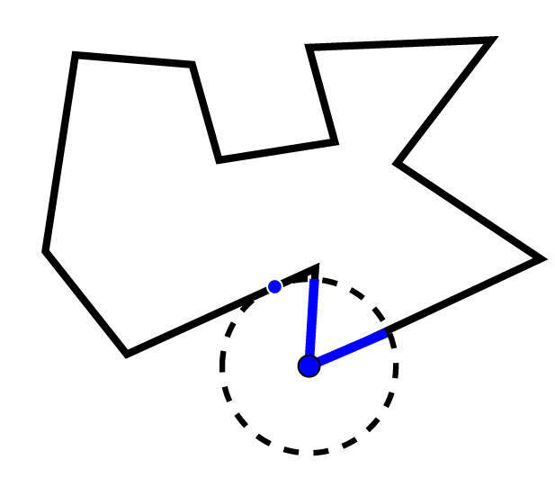
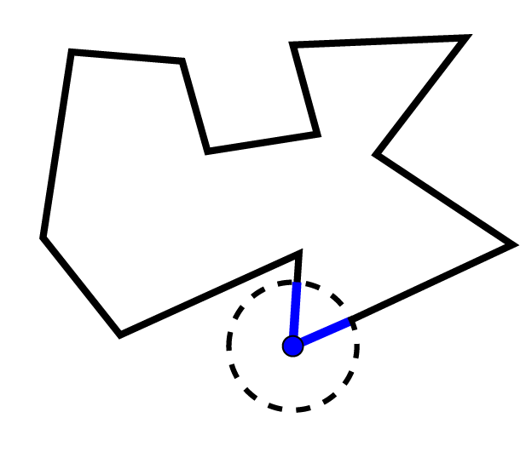
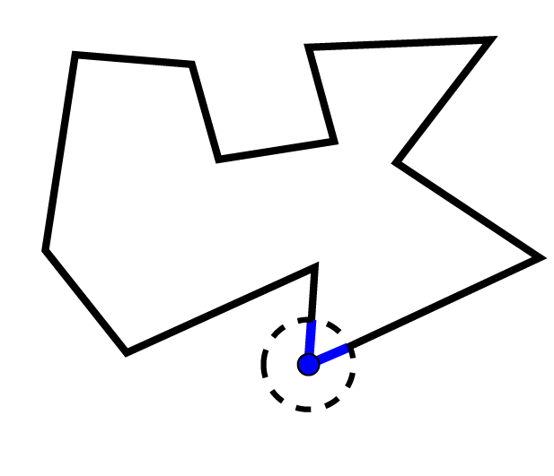
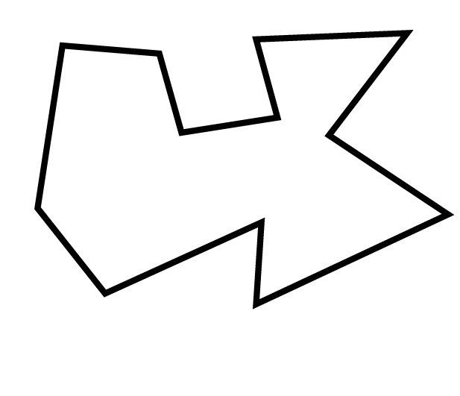
Local Feature Size (Polyhedral)
g(x) = the radius of the smallest ball placed at x which intersects the domain in two disjoint elements pieces.
g(x) is Lipschitz,
|g(x) - g(y)| <= |x - y|.
Termination for polyhedral meshing is shown by a packing argument using this local feature size.

Slide 21

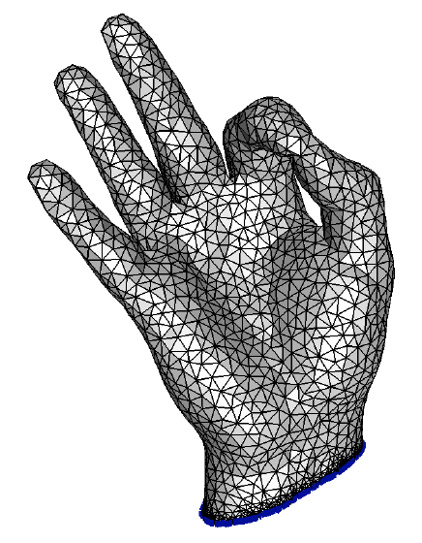
Smooth Surface Meshing
Input mesh is either an implicit surface or a polygonal mesh approximating a smooth surface
Output mesh approximates input geometry, conforms to input topology:
No guarantees:
Chew93.
Skin surfaces:
Cheng-Dey-Edelsbrunner-Sullivan01.
Provable surface algorithms:
Boissonnat-Oudot03 and Cheng-Dey-Ramos-Ray04.
Interior Volumes:
Oudot-Rineau-Yvinec06.

Slide 22
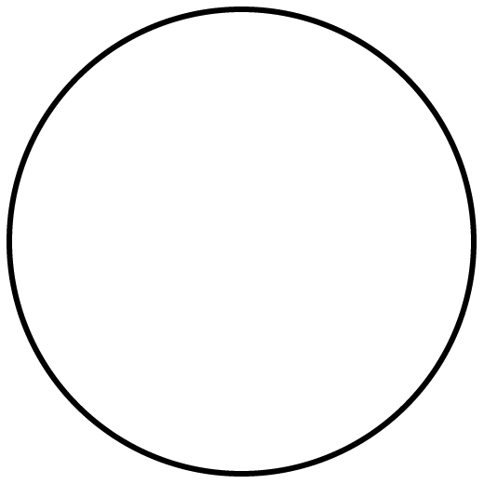
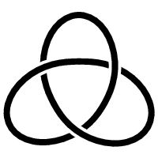
Homeomorphism and Isotopy
Homeomorphsim: A function f between two topological spaces:
f is a bijection
f and f⁻¹ are both continuous
Isotopy: A continuous deformation maintaining homeomorphism
=
≠

Slide 23
Sampling Theorem
Sampling Theorem Modified
Theorem:(Amenta-Bern 98, Cheng-Dey-Edelsbrunner-Sullivan 01)
If P∈ Σ is a discrete ε−sample of a smooth surface Σ, then for ε< 0.09 the restricted Delaunay triangulation Del P|_{Σ} has the following properties:
Theorem (Boissonat-Oudot 2005):
If P ∈ Σ is a discrete sample of a smooth surface Σ so that each x where a Voronoi edge intersects Σ lies within εf(x) distance from a sample, then for ε<0.09, the restricted Delaunay triangulation Del P|_{Σ} has the following properties:
It is homeomorphic to Σ (even isotopic embeddings).
Each triangle has normal aligning within O(ε) angle to the surface normals
Hausdorff distance between Σ and Del P|_{Σ} is O(ε²) of the local feature size.

Slide 24
Basic Delaunay Refinement
Surface Delaunay Refinement
Initialize a set of points P ⊂ Σ, compute Del P.
If some condition is not satisfied, insert a point c from Σ into P and repeat step 2.
Return Del P|_{Σ}.
If some Voronoi edge intersects Σ at x with
d(x,P)> εf(x) insert x in P.

Slide 25
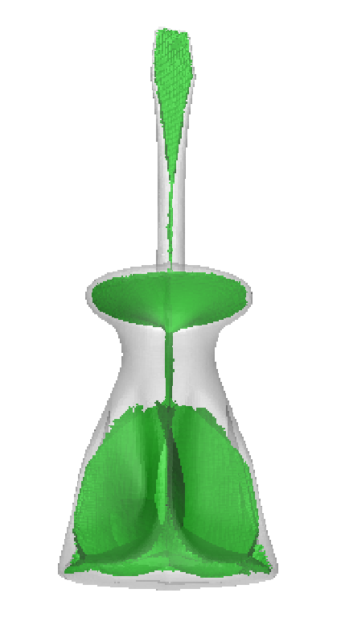
Difficulty
How to compute f(x)?
Special surfaces such as skin surfaces allow easy computation of f(x) [CDES01]
Can be approximated by computing approximate medial axis, needs a dense sample.

Slide 26

A Solution
Replace d(x,P)< εf(x) with d(x,P)<λ, an user parameter
But, this does not guarantee any topology
Require that triangles around vertices form topological disks
Guarantees that output is a manifold

Slide 27

A Solution
Initialize a set of points P ⊂ Σ, compute Del P.
If some Voronoi edge intersects Μ at x with d(x,P)>εf(x) insert x in P, and repeat step 2.
(b)If restricted triangles around a vertex p do not form a topological disk, insert furthest x where a dual Voronoi edge of a triangle around p intersects Σ.
Return Del P|_{Σ}
Algorithm DelSurf(Σ,λ)
(a) If some Voronoi edge intersects Σ at x with
d(x,P)> λ insert x in P, and repeat step 2(a).
X=center of largest Surface Delaunay ball
x

Slide 28
A MeshingTheorem
Theorem:
The algorithm DelSurf produces output mesh with the following guarantees:
The output mesh is always a 2-manifold
If λ is sufficiently small, the output mesh satisfies topological and geometric guarantees:
It is related to Σ with an isotopy.
Each triangle has normal aligning within O(λ) angle to the surface normals
Hausdorff distance between Σ and Del P|_{Σ} is O(λ²) of the local feature size.

Slide 29




Implicit surface

Slide 30




Remeshing

Slide 31
PSCs – A Large Input Class [Cheng-D.-Ramos 07]
Piecewise smooth complexes (PSCs) include:
Polyhedra
Smooth Surfaces
Piecewise-smooth Surfaces
Non-manifolds
&

Slide 32








Protecting Ridges
Balls must cover each element of D₁ completely.
Any 2 adjacent balls on a 1-face must overlap significantly without containing each others centers.
No 3 balls should have a common intersection.
(Tangent/Normal Variation) For any point p on a curve, if we look in a small enough region
The portion of the curve nearby p is a single piece.
The tangent along this piece varies a small amount.
The normal of each surface piece adjacent to p also varies little.

Slide 33
Protecting Ridges

Slide 34



A New Disk Condition
Cheng-Dey-Levine use a single topological disk condition:
For a point p on a 2-face σ,
Umb_{D}(p) is the set of triangles incident to p, restricted to D.
Umb_{σ}(p) is the set of triangles incident to p, restricted to σ.
DiskCondition(p) requires:
Umb_{D}(p) = ∪_{σ, p ∈ σ} Umb_{σ}(p)
For each σ containing p, Umb_{σ}(p) is a 2-disk where p is in the interior iff p ∈ int σ
DiskCondition() satisfied

Slide 35
A New Disk Condition
Cheng-Dey-Levine use a single topological disk condition:
For a point p on a 2-face σ,
Umb_{D}(p) is the set of triangles incident to p, restricted to D.
Umb_{σ}(p) is the set of triangles incident to p, restricted to σ.
DiskCondition(p) requires:
Umb_{D}(p) = ∪_{σ, p ∈ σ} Umb_{σ}(p)
For each σ containing p, Umb_{σ}(p) is a 2-disk where p is in the interior iff p ∈ int σ
DiskCondition() satisfied

Slide 36
DelPSC Algorithm [Cheng-D.-Ramos-Levine 07,08]
DelPSC(D, λ)
Protect ridges of D using protection balls.
Refine in the weighted Delaunay by turning the balls into weighted points.
Refine a triangle if it has orthoradius > l.
Refine a triangle or a ball if disk condition is violated
Refine a ball if it is too big.
Return ∪_{i} Del^{i} S|_{Di}

Slide 37


Guarantees for DelPSC
Manifold
For each σ ∈ D₂, triangles in Del S|_{σ} are a manifold with vertices only in σ. Further, their boundary is homeomorphic to bd σ with vertices only in σ.
Granularity
There exists some λ > 0 so that the output of DelPSC(D, λ) is homeomorphic to D.
This homeomorphism respects stratification, For 0 ≤ i ≤ 2, and σ ∈ D_{i}, Del S|_{σ} is homemorphic to σ too.

Slide 38






Reducing λ

Slide 39




Examples

Slide 40




Examples

Slide 41




Examples

Slide 42





Examples

Slide 43

Some Resources
Software available from
http://www.cse.ohio-state.edu/~tamaldey/cocone.html
http://www.cse.ohio-state.edu/~tamaldey/delpsc.html
http://www.cse.ohio-state.edu/~tamaldey/locdel.html
Open : Reconstruct piecewise smooth surfaces, non-manifolds
Open: Guarantee quality of all tetrahedra in volume meshing
A book Delaunay Mesh Generation: w/ S.-W. Cheng, J. Shewchuk (2012)

Slide 44
Thank You!

