Slide 1
New Results in Computing Zigzag and Multiparameter Persistence
Tamal K. Dey
Department of Computer Science
Purdue University
Part I (Zigzag): Joint with Tao Hou
Part II (MPP): Joint with Woojin Kim and Facundo Me′moli

Slide 2
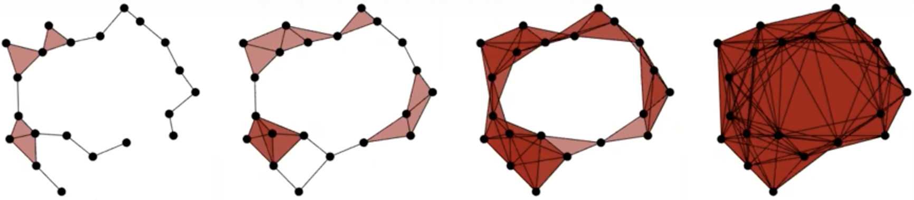
Topological data analysis (TDA) • Computational topology
Computation
Mathematics
Algorithm
Data Analysis
Topology
Geometry
…
Application
…
Algebra
Stat
ML
Rips Filtration
Persistent Homology
(fig. from AATRN)

Slide 3
Persistent homology
Expand each arrow into a sequence of additions of a single simplex
Filtration: a sequence of additions of a single simplex

Slide 4

Persistent homology
Input:
An interval $[b,d]$: starts and ends with indices in the filtration

Slide 5

Persistent homology
Input:
An interval $[b,d]$: starts and ends with indices in the filtration

Slide 6
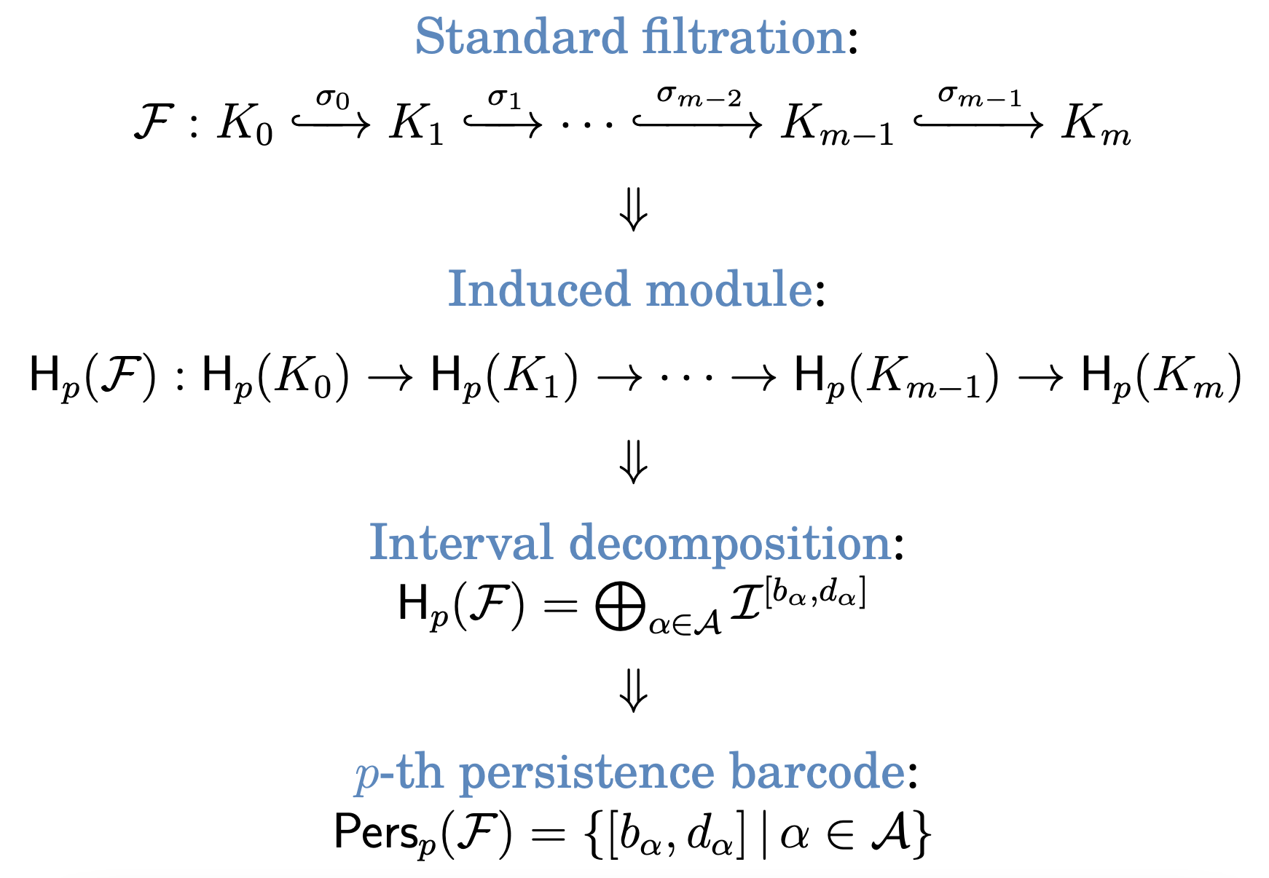
Standard persistence
[Gabriel 72]
Peter Gabriel. Unzerlegbare Darstellungen I. Manuscripta Mathematica, 6(1):71–103, 1972.

Slide 7
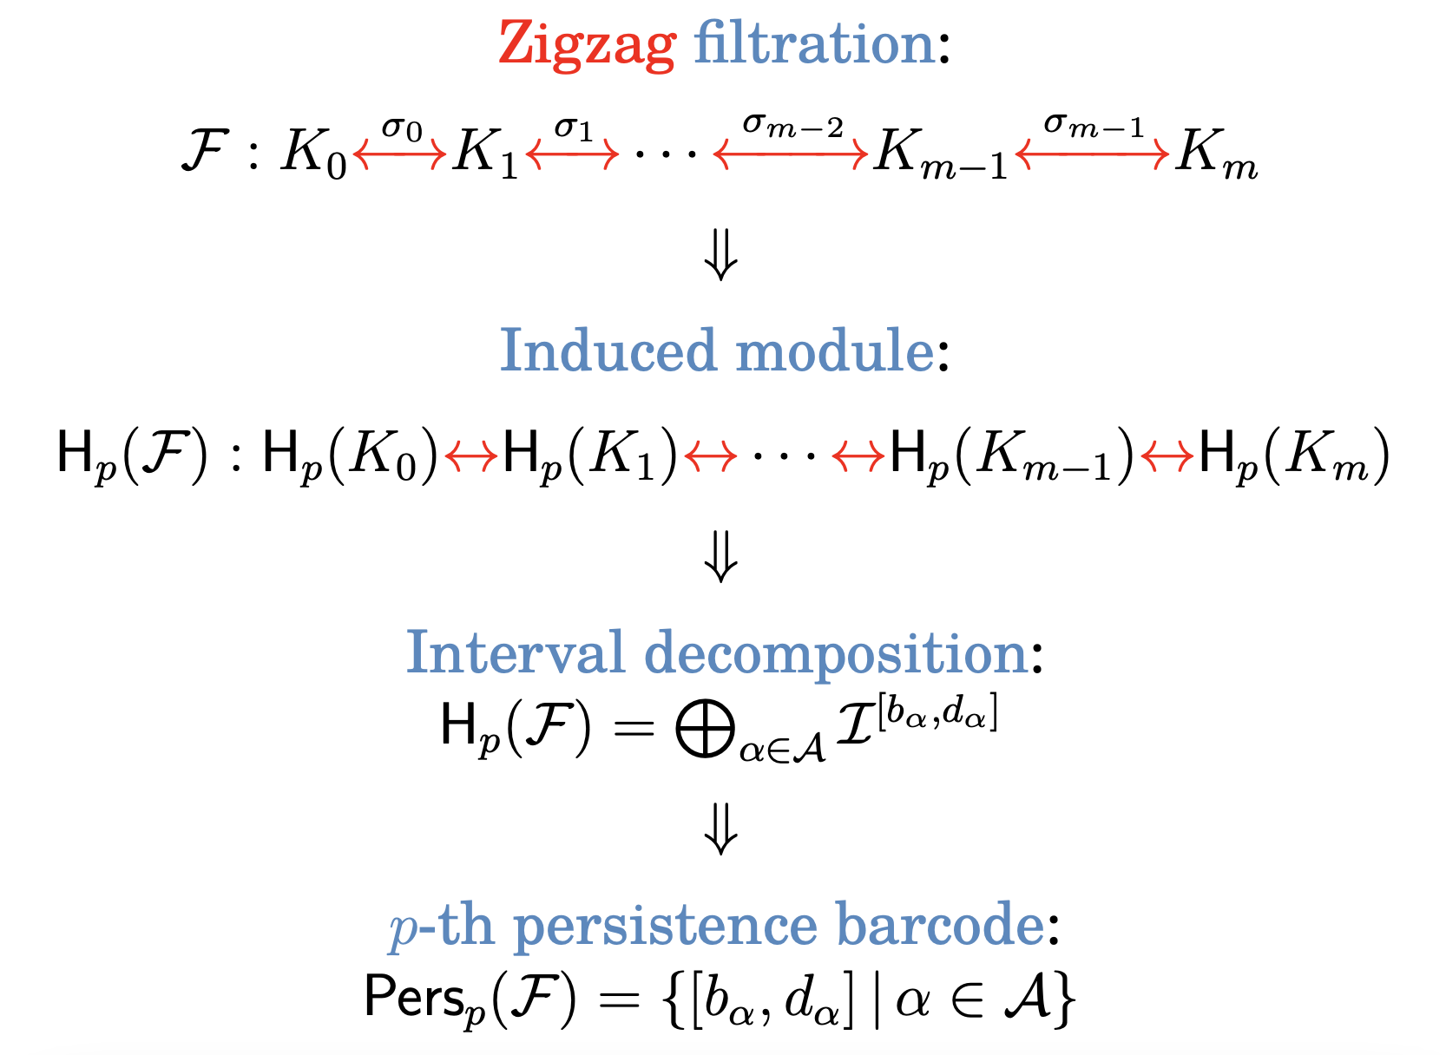
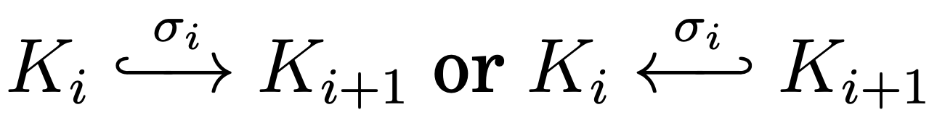
Zigzag persistence
Gunnar Carlsson and Vin de Silva. Zigzag persistence.
Foundations of Computational Mathematics, 10(4):367–405, 2010.

Slide 8
Zigzag persistence
[Gabriel 72]
Peter Gabriel. Unzerlegbare Darstellungen I. Manuscripta Mathematica, 6(1):71–103, 1972.

Slide 9
Application of Zigzag persistence
In time varying setting: functions, point cloud, vector field
  G. Carlsson, V. de Silva, and Dmitriy Morozov. Zigzag persistent homology and real-valued functions. 2009.
  W. Kim and F. Me’moli. Spaiotemporal persistent homology of dynamic metric spaces, Discrete & Comput. Geom. 2020, pages 1—45.
  T. Dey, M. Lipinsky, M. Mrozek, R. Slechta. Tracking dynamical features via continuation and persistence. 38th Annu. Symposium on Comput. Geometry, 2022.
In multiparameter persistence

Slide 10
non-Zigzag Vs. Zigzag persistence
1 type
[b……………………….d]
Bars in non-Zigzag: closed-open
4 types
Bars in Zigzag: closed-open
Bars in Zigzag: closed-closed
Bars in Zigzag: open-closed
Bars in Zigzag: open-open
Simplices( ) in Zigzag: insertion( ), deletion( ), repeated( )

Slide 11

Complexities of persistence computing
Herbert Edelsbrunner, David Letscher, and Afra Zomorodian. Topological persistence and simplification. 2000.
Gunnar Carlsson, Vin de Silva, and Dmitriy Morozov. Zigzag persistent homology and real-valued functions. 2009.
Note: the theoretical complexity of persistence computing is ${O(m}^{ω})$
Cle’ment Maria and Steve Oudot. Zigzag persistence via reflections and transpositions, SODA 2014.
Nikola Milosavljevi´c, Dmitriy Morozov, and Primoz Skraba. Zigzag persistent homology in matrix multiplication time. 2011.

Slide 12
Overview of FastZigzag
Input Zigzag Filtration: $\left(ℱ\right)$
Convert to a non-zigzag filtration of same length
  Linear time • Very Fast
Compute barcode for non-zigzag filtration $ℱ$
  Fast software [Gudhi, Phat etc.]
Convert barcode of $ℱ′$ to that of $ℱ$
  $O(1)$conversion per bar

Slide 13
Non-repetitive Zigzag
A simplex is added at most one time
Repetitive
1. Convert input zigzag to a non-repetitive zigzag filtration of same length
2. Convert a non-repetitive zigzag to an up-down filtration of same length
3. Convert up-down filtration to an extended filtration of same length
Conversions 1,2,3 are all done by a single simple linear scan of the input filtration
  Linear time • Very Fast

Slide 14

Non-repetitive to Up-down
1. input zigzag to a non-repetitive zigzag filtration of same length (Later)
$$m=2n$$
2. non-repetitive zigzag to up-down of same length

Slide 15

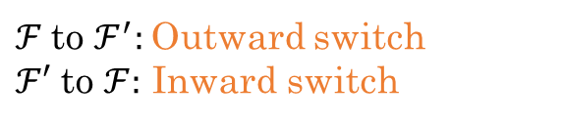
Up-down Filtration
Mayer-Vietoris Diamond[Carlsson-de Silva 10]
$$m=2n$$
$ℱ$to $ℱ^{′}:$Outward switch
$ℱ′$ to $ℱ:$ Inward switch
[D.-Hou, 2022]
T. K. Dey and T. Hou. Fast Computation of Zigzag Persistence.
European Symposium on Algorithms, ESA, 2022.

Slide 16
Barcode (finite) bijection between and
Degree may shift when also creator-destructor swap (closed-closed to open-open case)

Slide 17
Up-down to Extended
up-down to extended filtration: Use Mayer-Vietoris Pyramid [CdSM09]
Degree/creator-destructor shift
Gunnar Carlsson, Vin de Silva, and Dmitriy Morozov. Zigzag persistent homology and real-valued functions. 2009.

Slide 18
Extended to Non-zigzag
Use Coning [CEH06]
No change in barcode

Slide 19
Repetitive to Non-repetitive Zigzag
Treat each new occurrence of simplex as a new “cell”

Slide 20
Treat as cell-wise -complex Filtration
Two triangles sharing 0,1,2,3 edges

Slide 21
Overall Conversions

Slide 22
Software Fzz using Phat software for non-zigzag
Software Fzz Vs. Dionysus2, Gudhi
All run on Intel(R), Core™, i5-9500 CPU@3.00GHz, 16GB memory, Linux OS

Slide 23
P : A partially ordered set (poset), as a category. p ≤ q ⇔ p →∃! q.
vec : The category of finite dimensional vector spaces over a field F.
A functor M : P → vec is a (P-indexed) persistence module.
P is taken finite.
1-parameter
Zigzag
2-parameter
vertex ← a vector space
arrow ← a linear map
Every closed subdiagram commutes.

Slide 24
I ⊂ P is called an interval if I is connected and order-convex, i.e. [p, q ∈ I and p ≤ r ≤ q] ⇒ r ∈ I .
Examples.

Slide 25
I ⊂ P is called an interval if I is connected and order-convex, i.e. [p, q ∈ I and p ≤ r ≤ q] ⇒ r ∈ I .
An interval module I^{I} : P → vec is an indicator module over I .
1
1
1 1

Slide 26
I ⊂ P is called an interval if I is connected and order-convex, i.e. [p, q ∈ I and p ≤ r ≤ q] ⇒ r ∈ I .
An interval module I^{I} : P → vec is an indicator module over I .
1
1
1 1
Interval modules are indecomposable.
is called interval decomposable and {I_{i} } is called the barcode of M.

Slide 27

2-eter persistence and rank invariant
2-parameter persistence and rank invariant
M : R² → vec

Slide 28

2-parameter persistence and rank invariant
M : R² → vec
Rank invariant
[Carlsson, Zomordian]
(p ≤ q) → rk_{M} (p ≤ q), R → rk_{M} (R)

Slide 29

2-parameter persistence and rank invariant
M : R² → vec
Rank invariant
[Carlsson, Zomordian]
(p ≤ q) → rk_{M} (p ≤ q), R → rk_{M} (R)
Generalized Rank invariant
[Kim,Memoli] [Patel]
I → rk_{M} (I)
A complete stable invariant for interval decomposable modules

Slide 30


How to compute
How to compute the generalized rank invariant?
?

Slide 31

Generalized Rank to Zigzag
M : R² → vec
Rank invariant
R → rk_{M} (R)

Slide 32

Generalized Rank to Zigzag
M : R² → vec
Rank invariant (known)
R → rk_{M} (R)
= #(“Full” bars)

Slide 33

Generalized Rank to Zigzag
M : R² → vec
Rank invariant (known)
Theorem 1 [D., Kim, Me'moli]
R → rk_{M} (R)
= #(“Full” bars)
I → rk_{M} (I )

Slide 34
Generalized Rank to Zigzag
M : R² → vec
Rank invariant (known)
Theorem 1 [D., Kim, Me'moli]
R → rk_{M} (R)
= #(“Full” bars)
I → rk_{M} (I )
= #(“Full” bars)

Slide 35
Generalized Rank to Zigzag
M : R² → vec
Rank invariant (known)
Theorem 1 [D., Kim, Me'moli]
R → rk_{M} (R)
= #(“Full” bars)
I → rk_{M} (I )
= #(“Full” bars)

Slide 36
Generalized Rank to Zigzag on Boundary Cap
M : R² → vec
Rank invariant (known)
Theorem 1 [D., Kim, Me'moli]
R → rk_{M} (R)
= #(“Full” bars)
I → rk_{M} (I )
= #(“Full” bars) on bnd cap zigzag

Slide 37
Generalized Rank to Zigzag on Boundary Cap
M : R² → vec
Rank invariant (known)
Theorem 1 [D., Kim, Me'moli]
R → rk_{M} (R)
= #(“Full” bars)
I → rk_{M} (I )
= #(“Full” bars) on bnd cap zigzag
barc

Slide 38
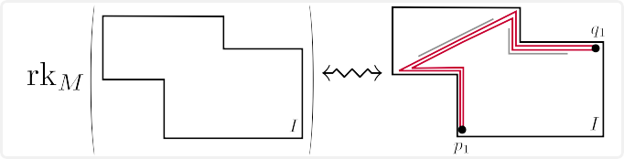
Applications

Slide 39
Input. A simplicial filtration F over a finite 2d-grid.

Slide 40
Input. A simplicial filtration F over a finite 2d-grid.
M := H(F)

Slide 41
Input. A simplicial filtration F over a finite 2d-grid.
M := H(F)
Algorithm 1. Given that M is interval decomposable, compute the barcode of M.

Slide 42
Input. A simplicial filtration F over a finite 2d-grid.
M := H(F)
Algorithm 1. Given that M is interval decomposable, compute the barcode of M.
Algorithm 2. Check whether M is interval decomposable or not.

Slide 43
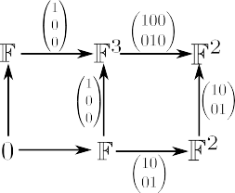
Algorithm 1. Compute the the barcode of M.

Slide 44
Algorithm 1. Compute the the barcode of M.

Slide 45
Algorithm 1. Compute the the barcode of M.

Slide 46
Algorithm 1. Compute the the barcode of M.
Step 1. (Extension process until rk_{M} = 0)

Slide 47
Algorithm 1. Compute the the barcode of M.
Step 1. (Extension process until rk_{M} = 0)

Slide 48
Algorithm 1. Compute the the barcode of M.
Step 1. (Extension process until rk_{M} = 0)

Slide 49
Algorithm 1. Compute the the barcode of M.
Step 1. (Extension process until rk_{M} = 0)

Slide 50
Algorithm 1. Compute the the barcode of M.
Step 1. (Extension process until rk_{M} = 0)

Slide 51
Algorithm 1. Compute the the barcode of M.
Step 1. (Extension process until rk_{M} = 0)

Slide 52
Algorithm 1. Compute the the barcode of M.
Step 1. (Extension process until rk_{M} = 0)

Slide 53
Algorithm 1. Compute the the barcode of M.
Step 1. (Extension process until rk_{M} = 0)
Remark. We can use Fast Zigzag algorithm in this process.

Slide 54
Algorithm 1. Compute the the barcode of M.
Step 1. (Extension process until rk_{M} = 0)
Remark. We can use Fast Zigzag algorithm in this process.

Slide 55
Algorithm 1. Compute the the barcode of M.
Step 1. (Extension process until rk_{M} = 0)
Step 2. (Subtraction)

Slide 56
Algorithm 1. Compute the the barcode of M.
Step 1. (Extension process until rk_{M} = 0)
Step 2. (Subtraction)
Repeat Steps 1 and 2 until the dimension vector becomes zero.

Slide 57
One possible scenario:

Slide 58
One possible scenario:

Slide 59
One possible scenario:

Slide 60
One possible scenario:

Slide 61
One possible scenario:

Slide 62
One possible scenario:

Slide 63
Theorem 2 (D., Kim, M´emoli)
If M is interval decomposable, then the output is barc(M); time
Corollary
If M does not admit the output as its barcode, then M is not interval decomposable.
Algorithm 2. Check whether M is interval decomposable; time
t= max(#simplices, grid size)

Slide 64
Theorem 2 (D., Kim, M´emoli)
If M is interval decomposable, then the output is barc(M); time
Corollary
If M does not admit the output as its barcode, then M is not interval decomposable. (use Asashiba et al.[AENY22])
Algorithm 2. Check whether M is interval decomposable; time
t= max(#simplices, grid size)

Slide 65
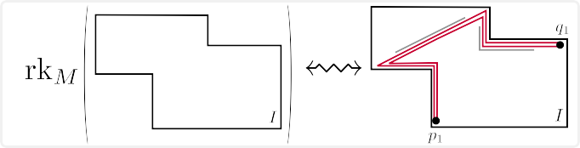
Future work
Use FastZigzag in other applications.
Beyond 2-parameter persistence.
Computing rk_{M} : Int(P) → Z_{≥0}.
Improving interval decomposability algorithm.

Slide 66
Thank you!

