Slide 1
Data privacy and coding for
Distributed machine learning:
The federated learning Paradigm
Jin Sima and Wojciech Szpankowki
Is there a promising way?
Postdoctoral Researcher
Center for Science of Information
Purdue University
Notes:
Hi everyone, thank you for coming to my interview talk, thank you professor for the introduction. ny name is I am current today my talk is going to be about my recent works on data privacy protection in machine learning, with connections to coding theory, an area that I worked on before

Slide 2
Privacy and distributed machine learning
Notes:
I will discuss data privacy in distributed learning. Let’s start

Slide 3







Motivation
Companies and institutions have powerful access to personal data
$$…$$
Notes:
The motivation for is that many tech giants, like google, meta and X, insitutions such as hospitals or banks have exlusive access to a lot of our data.

Slide 4
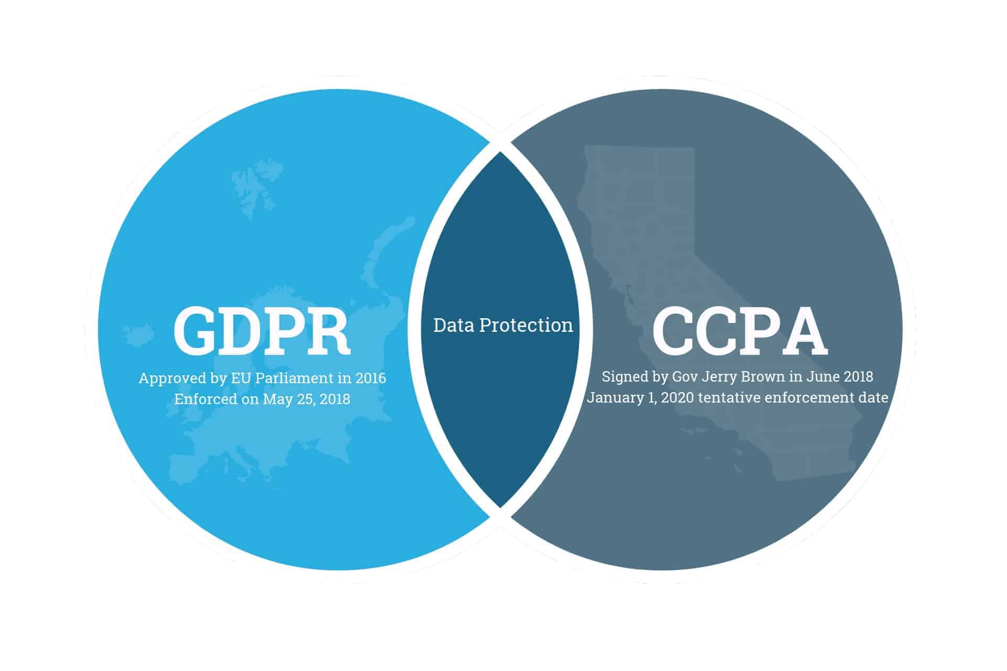
Motivation
Companies and institutions have powerful access to personal data
Data protection regulations
$$…$$
Notes:
Furthermore, the governments are trying to come up with data protection regulations to ensure users’ rights to limit data collection and usage in companies or other organizations. Examples include, gdpr and ccpa.

Slide 5
Motivation
Data are distributed across different repositories
$$…$$
Notes:
As you can see the personal data usually reside at different locations.

Slide 6
Motivation
Data are distributed across different repositories
Data are of different types (heterogeneity)
$$…$$
Notes:
And may be of different types, we want to find a learning paradigm that is suitable for learning with distributed and hetereogeneous data

Slide 7









The Federated learning paradigm
An adequate learning framework
Main ideas of federated learning paradigm:
Train locally – transmit privately – aggregate globally
Global model
Local model 1
Local model 2
Local model N
Notes:
One representative paradigm that characterizes this scenario is federated learning, which is a distributed learning setting, and the local devices train a model based on their own data and transmit the local models to the server and the server tries to learn a global model from local models.

Slide 8

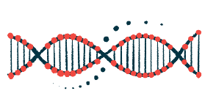
Fundamental Challenges of Federated Learning
The Federated learning paradigm
An adequate learning framework
Main ideas of federated learning paradigm:
Train locally – transmit privately – aggregate globally
Global model
Local model 1
Local model 2
Local model N
Resource constraints and heterogeneity
Notes:
The typical challenges for federated learning paradigm are the limitation of computation and communication resources of local devices. So we want the learning to be communication and computation efficient at local devices and also, we have the challenges posed by the heterogeneity of data at local devices

Slide 9
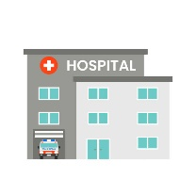


Fundamental Challenges of Federated Learning
The Federated learning paradigm
An adequate learning framework
Main ideas of federated learning paradigm:
Train locally – transmit privately – aggregate globally
Global model
Local model 1
Local model 2
Local model N
Resource constraints and heterogeneity
Distributed data repositories
Notes:
and distributed data repositories

Slide 10
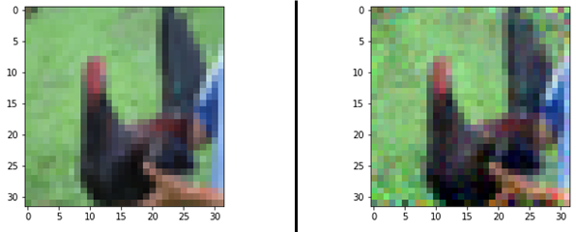
Fundamental Challenges of Federated Learning
The Federated learning paradigm
An adequate learning framework
Main ideas of federated learning paradigm:
Train locally – transmit privately – aggregate globally
Global model
Local model 1
Local model 2
Local model N
Distributed data repositories
Data leakage through communications
and privacy breaches through models
Resource constraints and heterogeneity
Original
Reconstructed
Notes:
And the privacy of the local data. It is required that the server cannot learn local data of the devices. Researchers found out that the training data can be inferred from the models. This is why we need to transmit the local models privately in communication

Slide 11
Fundamental Challenges of Federated Learning
The Federated learning paradigm
An adequate learning framework
Main ideas of federated learning paradigm:
Train locally – transmit privately – aggregate globally
Global model
Local model 1
Local model 2
Local model N
Distributed data repositories
Data leakage through communications
and privacy breaches through models
Resource constraints and heterogeneity
Original
Reconstructed
Notes:
One of our major focuses of this talk is to deal with data privacy in user server communication and model training

Slide 12





The Federated learning paradigm
FedAvg [McMahan et al., 17]: stochastic gradient descent
$$\sum_{i=1}^{N}{p_{i}w_{i}(t)}$$
$$w(t+1)$$
$$w_{1}\left(t\right)→w_{1}(t)−η∇f(w_{1}\left(t\right))$$
$$w_{2}\left(t\right)$$
$$w_{N}\left(t\right)$$
Notes:
Let me briefly introduce a few key concepts in federated learning. One of the widely considered scenario is to train dnn in federated. Where the users use sgd to train local models, privately transmit their gradient updates to the server. And the server only need to average these gradient updates.

Slide 13

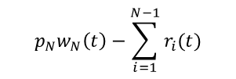


The Federated learning paradigm
FedAvg [McMahan et al., 17]: stochastic gradient descent
SecAgg [Bonawitz et al., 17]: Securely aggregate local models by adding random masks
$$\sum_{i=1}^{N}{p_{i}w_{i}(t)}$$
$$w(t+1)$$
$$w_{1}\left(t\right)→w_{1}(t)−η∇f(w_{1}\left(t\right))$$
$$w_{2}\left(t\right)$$
$$w_{N}\left(t\right)$$
$$p_{N}w_{N}\left(t\right)−\sum_{i=1}^{N−1}{r_{i}(t)}$$
$$p_{1}w_{1}\left(t\right)+r_{1}(t)$$
$$p_{2}w_{2}\left(t\right)+r_{2}(t)$$
$$p_{N−1}w_{N−1}\left(t\right)+r_{N−1}(t)$$
Notes:
The widely adopted approach to privately and securely average the local weights is to add random noises to obfuscate the gradient updates. And a critical idea is to make sure these noise sum up to 0

Slide 14



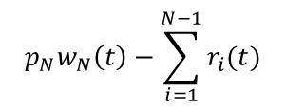






The Federated learning paradigm
FedAvg [McMahan et al., 17]: stochastic gradient descent
SecAgg [Bonawitz et al., 17]: Securely aggregate local models by adding random masks
$$\sum_{i=1}^{N}{p_{i}w_{i}(t)}$$
$$w(t+1)$$
$$w_{1}\left(t\right)→w_{1}(t)−η∇f(w_{1}\left(t\right))$$
$$w_{2}\left(t\right)$$
$$w_{N}\left(t\right)$$
$$p_{N}w_{N}\left(t\right)−\sum_{i=1}^{N−1}{r_{i}(t)}$$
$$=\sum_{i=1}^{N}{p_{i}w_{i}(t)}$$
$+$ $…$
$$p_{N−1}w_{N−1}\left(t\right)+r_{N−1}(t)$$
$$p_{1}w_{1}\left(t\right)+r_{1}(t)$$
$$+$$
$$p_{2}w_{2}\left(t\right)+r_{2}(t)$$
$$+$$
$$+$$
Data/model protection in communication
Notes:
So that the average of obfuscated gradient updates equals the average of weights. This approach protects the data and model privacy from the communication part

Slide 15
The Federated learning paradigm
FedAvg [McMahan et al., 17]: stochastic gradient descent
SecAgg [Bonawitz et al., 17]: Securely aggregate local models by adding random masks
$$\sum_{i=1}^{N}{p_{i}w_{i}(t)}$$
$$w(t+1)$$
$$w_{1}\left(t\right)→w_{1}(t)−η∇f(w_{1}\left(t\right))$$
$$w_{2}\left(t\right)$$
$$w_{N}\left(t\right)$$
Does SecAgg solve everything？
Notes:
But is this enough?

Slide 16
Federated unlearning of clusters
Federated classification in Hyperbolic spaces
Notes:
Asking this question leads us to investigate the problem of unlearing in the federated setting.

Slide 17
Machine unlearning
Data removal from training datasets
Data privacy regulations (e.g., GDPR, CCPA) ensure the Right to be Forgotten
Notes:
Consider a scenario where the users request to remove their personal data from the training dataset. This type request is protected by the regulations like gdpr and ccpa we mentioned before.

Slide 18
Machine unlearning
Data removal from training datasets
Data privacy regulations (e.g., GDPR, CCPA) ensure the Right to be Forgotten
Practical application: Removal requests received by the UK Biobank [Sudlow et al., 2015].
Notes:
And is actually happening in organizations such as UK biobank, that stores recors of genetic and medical data of nearly half a million people.

Slide 19
Machine unlearning
Data removal from training datasets
Data privacy regulations (e.g., GDPR, CCPA) ensure the Right to be Forgotten
Practical application: Removal requests received by the UK Biobank [Sudlow et al., 2015].
Physical data removal is straightforward, but deemed insufficient
Notes:
It is easy to erase personal data in the database.

Slide 20
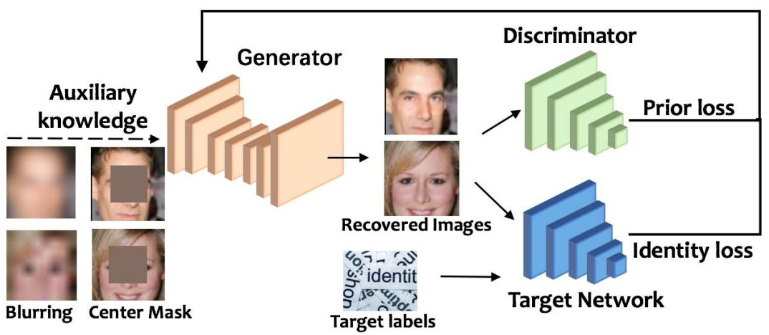
Machine unlearning
Data removal from training datasets
Data privacy regulations (e.g., GDPR, CCPA) ensure the Right to be Forgotten
Practical application: Removal requests received by the UK Biobank [Sudlow et al., 2015].
Physical data removal is straightforward, but deemed insufficient
Deep neural networks are known to memorize training samples [Feldman et al., 2020]
Model inversion attacks [Fredrikson et al., 2015]
Notes:
But the problem remains since the models trained on these data have already memorized them. And as we mentioned there are model inversion attacks that steal data from models.

Slide 21
Machine unlearning
Data removal from training datasets
Data privacy regulations (e.g., GDPR, CCPA) ensure the Right to be Forgotten
Practical application: Removal requests received by the UK Biobank [Sudlow et al., 2015].
Physical data removal is straightforward, but deemed insufficient
Deep neural networks are known to memorize training samples [Feldman et al., 2020]
Model inversion attacks [Fredrikson et al., 2015]
The influence of removed samples on relevant ML models needs to be eliminated as well
Notes:
So, to remove data, the influence of the data has to be removed as well.

Slide 22
Machine unlearning
Naive way is to always retrain from scratch
Pros: Complete privacy
Notes:
One naïve way to remove data influence is to retrain from scratch, which is perfect in protecting data privacy

Slide 23
Machine unlearning
Naive way is to always retrain from scratch
Pros: Complete privacy
Cons: Computationally expensive. Infeasible when there is a high frequency of data removal requests.
Notes:
But computationally expensive when we have to retrain every time upon data removal requests.

Slide 24
Machine unlearning
Naive way is to always retrain from scratch
Pros: Complete privacy
Cons: Computationally expensive. Infeasible when there is a high frequency of data removal requests.
How to “remove” a sample from ML models efficiently $→$ Machine unlearning [Cao et al., 2015].
Sharding: Divide the data into disjoint shards (small batches) and retrain from scratch for a single shard
Notes:
This motivates the problem of machine unlearning, finding efficient algorithms to remove the influence of data samples.
One way to do this is to divide the training data into small batches, and make sure that each of the small batches make small contributions to the global model. Then retrain a small batch from scratch upon each data removal request.

Slide 25
Machine unlearning
Naive way is to always retrain from scratch
Pros: Complete privacy
Cons: Computationally expensive. Infeasible when there is a high frequency of data removal requests.
How to “remove” a sample from ML models efficiently $→$ Machine unlearning [Cao et al., 2015].
Sharding: Divide the data into disjoint shards (small batches) and retrain from scratch for a single shard
Exact unlearning: Probabilistically equivalent to retraining from scratch [Cao et al., 2015], [Ginart et al., 2019].
Notes:
To mathematically define unlearning, we use the notion of exact unlearning. Basically, it asks that the behavior of an exact unlearning algorithm is the same as that of retraining from scratch. Sharding falls into the category of exact unlearning algorithms

Slide 26








Machine unlearning
is an exact unlearning algorithm if
: Dataset space
: Training set
: Training set after removal
: Model space
: Randomized learning algorithm
: Unlearning algorithm
Retraining from scratch
Notes:
This is a bit formal definition. Please ignore these complex notations.
The key observation is that we usually have randomness in the model training or retraining process. an exact unlearning just tries to mimic the randomness of retraining from scratch. This is mathematically reflected by the requirement that the output statistics of the unlearning algorithm should be the same as the output statistics of retraining from scratch.

Slide 27
Machine unlearning
is an exact unlearning algorithm if
: Dataset space
: Training set
: Training set after removal
: Model space
: Randomized learning algorithm
: Unlearning algorithm
Retraining from scratch
Exact Unlearning = Probabilistic model equivalence
Notes:
So exact unlearning asks for a probabilistic model equivalence

Slide 28
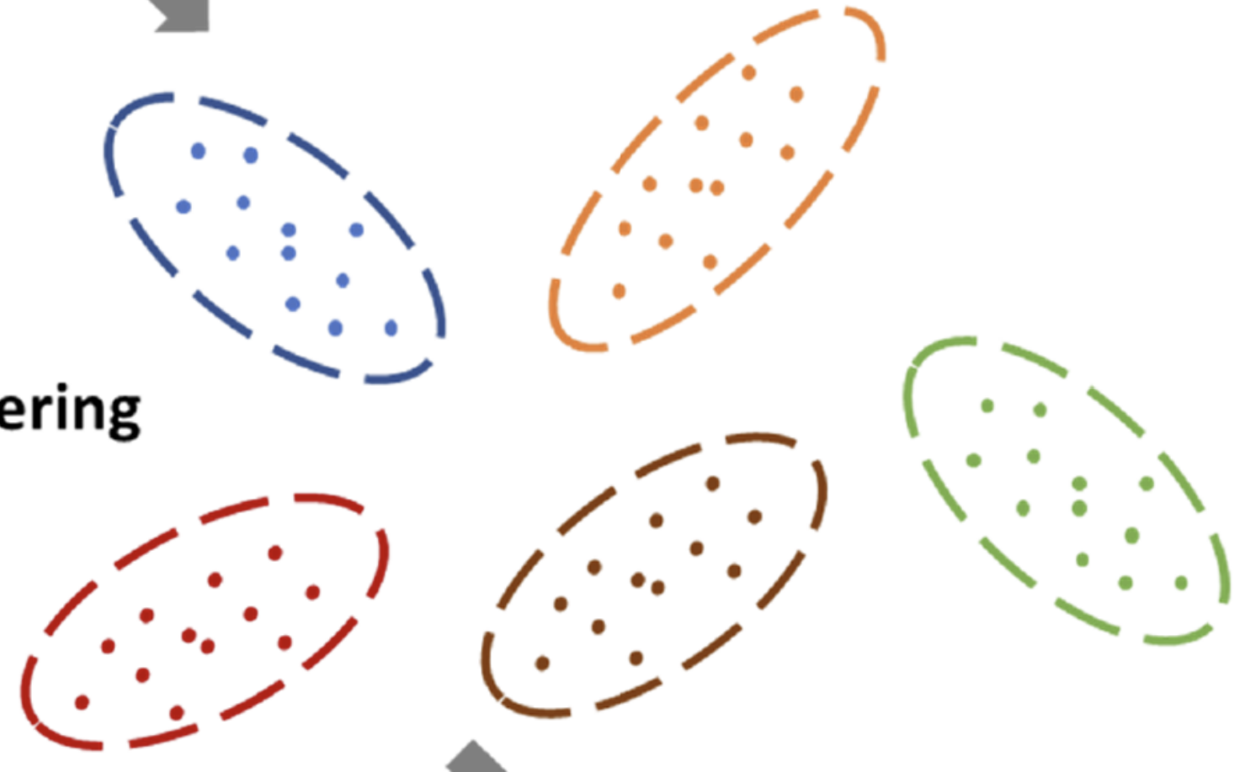
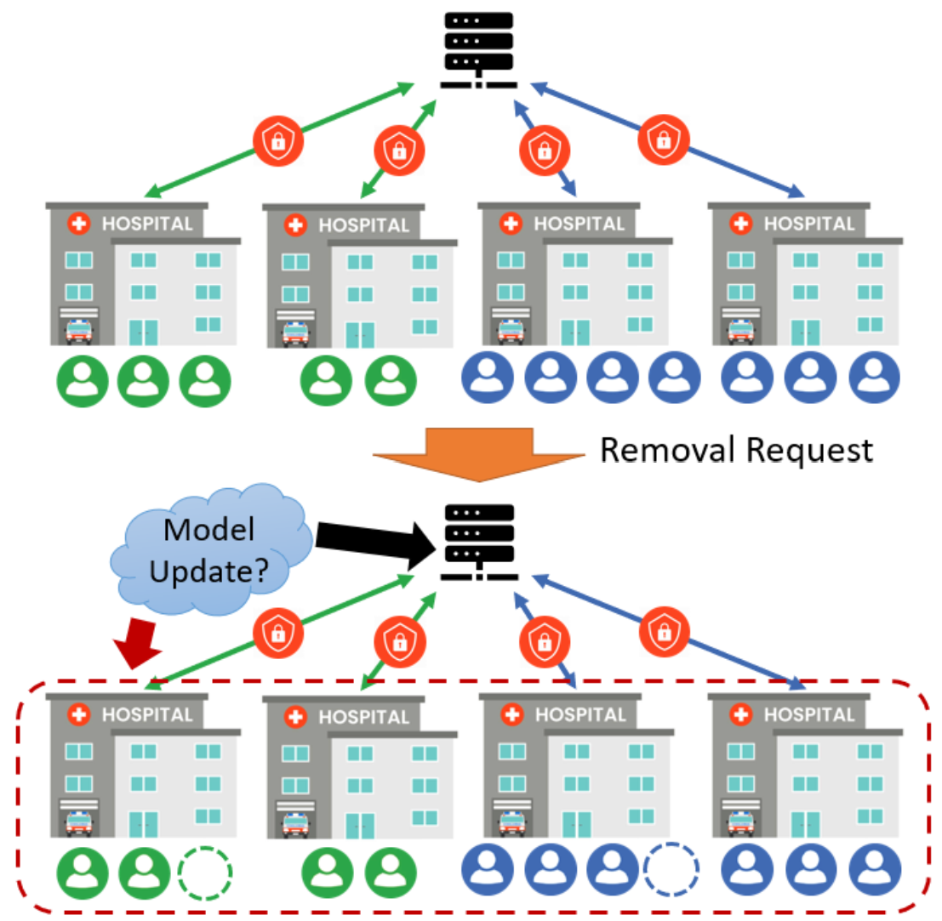
Federated unlearning of Clusters
Federated clustering + machine unlearning (completely new):
Patient Clustering
Identifying patient cluster structures
Notes:
Now we are ready to introduce our problem of federated unlearning of clusters.
It is basically doing machine unlearning in the federated setting.
And we focus on training clustering models. Specifically, we want to train clustering models that are easy to be updated when there are data removal requests.
Compared to many works on traiing deep neural networks in the federated setting, we choose this clustering models first because it is useful, for example in identifying patient data cluster structures.

Slide 29
Federated unlearning of Clusters
Federated clustering + machine unlearning (completely new):
Patient Clustering
Identifying client cluster structures
Efficient algorithms with theoretical performance guarantee.
Notes:
Also this cluster model gives us efficient algorithms with theoretical performance guarantee.

Slide 30
Federated unlearning of Clusters
Federated clustering + machine unlearning (completely new):
Patient Clustering
Identifying client cluster structures
Efficient algorithms with theoretical performance guarantee.
Only a handful of results known for federated clustering or unlearning.
Notes:
And it is a new scenario that is not fully investigated

Slide 31
Federated unlearning of Clusters
Federated clustering + machine unlearning (completely new):
Patient Clustering
Identifying client cluster structures
Efficient algorithms with theoretical performance guarantee.
Only a handful of results known for federated clustering or unlearning.
Goals:
Low communication overhead (one shot, small data volume)
Notes:
What is our goal? Our goal is to train a cluster model in the federated setting that supports efficient unlearning, We choose the kmeans clustering model since this is a standard clustering model.
We want low communication overhead, we consider one round communication from users to the server.

Slide 32
Federated unlearning of Clusters
Federated clustering + machine unlearning (completely new):
Patient Clustering
Identifying client cluster structures
Only a handful of results known for federated unlearning.
Only a handful of results known for federated clustering.
Goals:
Low communication overhead (one shot, small data volume)
Good clustering performance
Notes:
Of course to support unlearning, there is no free lunch. There is a sacrifice in the clustering performance. But we want to sacrifice only a little in the clustering performance.

Slide 33
Federated unlearning of Clusters
Federated clustering + machine unlearning (completely new):
Patient Clustering
Identifying client cluster structures
Only a handful of results known for federated unlearning.
Only a handful of results known for federated clustering.
Goals:
Low communication overhead (one shot, small data volume)
Good clustering performance
Meeting “privacy criteria” (exact unlearning and communication privacy)
Notes:
We want the algorithm to be private in communication and satisfy the exact unlearning property

Slide 34
Federated unlearning of Clusters
Federated clustering + machine unlearning (completely new):
Patient Clustering
Identifying client cluster structures
Only a handful of results known for federated unlearning.
Only a handful of results known for federated clustering.
Goals:
Low communication overhead (one shot, small data volume)
Good clustering performance
Meeting “privacy criteria” (exact unlearning and communication privacy)
Small unlearning complexity
Notes:
And we want the the computational complexity to be small.

Slide 35
Prior works on federated clustering
K-FED [Dennis et al., 2021] considers accuracy and communication efficiency
No privacy protection
Notes:
To give a brief introduction of the related works. K-FED, deals with learning clustering models in federeated setting. With no privacy protection

Slide 36
Prior works on federated clustering
K-FED [Dennis et al., 2021] considers accuracy and communication efficiency
No privacy protection
High computational complexity
Notes:
The computational complexity is also high

Slide 37
Prior works on federated clustering
K-FED [Dennis et al., 2021] considers accuracy and communication efficiency
No privacy protection
High computational complexity
SecFC [Li et al., 2022] considers accuracy and privacy
High communication and computational complexity overhead
Notes:
SecFC deals with the same setting of training cluster models in the federated setting. It consideres privacy but sacrifice communication and computational complexity.

Slide 38
Prior works on federated clustering
K-FED [Dennis et al., 2021] considers accuracy and communication efficiency
No privacy protection
High computational complexity
SecFC [Li et al., 2022] considers accuracy and privacy
High communication and computational complexity overhead
No support for efficient unlearning
Notes:
Also, these federated clustering methods do not have corresponding efficient unlearning algorithms.

Slide 39
Federated 𝐾-means Clustering Problem Formulation
Notes:
In the following, I will first first talk about how to train clustering models in the federated setting with good performance, low communication and computation cost, and then discuss how to do efficient unlearning based on our federated clustering algorithm. Let me start with the formulation of the problem.

Slide 40
Federated 𝐾-means Clustering Problem Formulation
Input:
Number of clusters $K$
Notes:
We consider federated training of k means clustering models

Slide 41
Federated 𝐾-means Clustering Problem Formulation
Input:
Number of clusters $K$
Number of clients $L$
Notes:
Where there are L clients

Slide 42


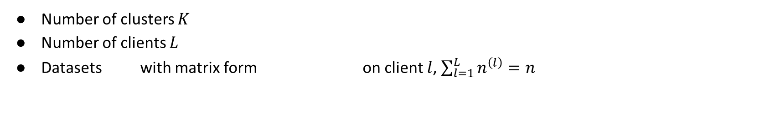
Federated 𝐾-means Clustering Problem Formulation
Input:
Number of clusters $K$
Number of clients $L$
Datasets with matrix form on client $l$, $\sum_{l=1}^{L}{n^{\left(l\right)}}=n$
Notes:
Each having its own dataset, that can be hetereogenous

Slide 43

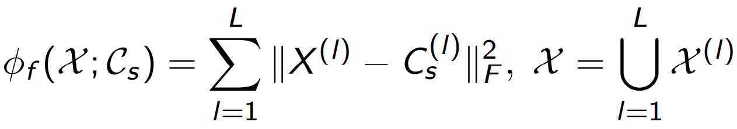
Federated 𝐾-means Clustering Problem Formulation
Input:
Number of clusters $K$
Number of clients $L$
Datasets with matrix form on client $l$, $\sum_{l=1}^{L}{n^{\left(l\right)}}=n$
Server finds $K$ global centroids that minimize the objective
Notes:
The clustering loss, which is the objective we want to minimize, is the sum of square of distances between the datapoints and the centroids globally trained at the server.

Slide 44
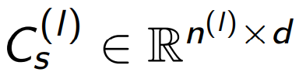
Federated 𝐾-means Clustering Problem Formulation
Input:
Number of clusters $K$
Number of clients $L$
Datasets with matrix form on client $l$, $\sum_{l=1}^{L}{n^{\left(l\right)}}=n$
Server finds $K$ global centroids that minimize the objective
corresponds to the $l$th client centroid assignment matrix (induced at the server)
Notes:
Here, we assume that local clients might not have data in all the K clusters because of hetereougeity. So we use Cls to denote the centroids of a subset of K clusters that the data of client l fall into.

Slide 45
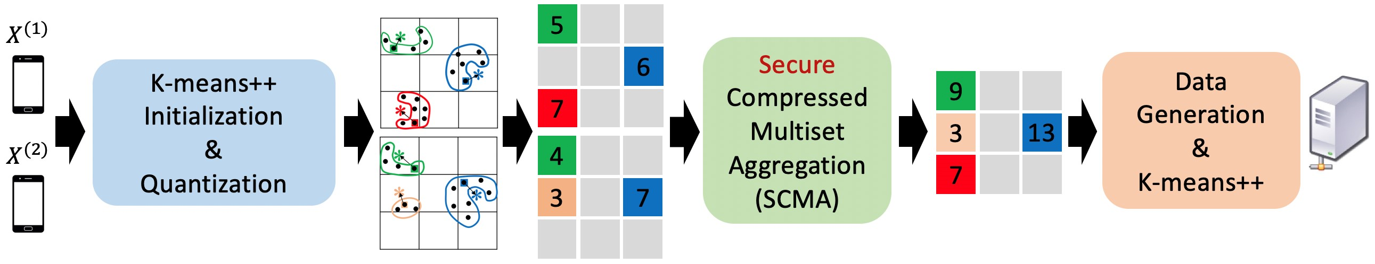
One-Shot Secure Federated Clustering
The framework
Client side clustering
K-means++ initialization for exact unlearning and good loss guarantee
Notes:
OK. We are now ready to go through the whole federated clustering framework. While more details will be provided later, let me first give an overview of the framework. The clients first use the k means++ initialization and obtain local k means models. The kmeans ++ is a randomized algorithm that we leverage for achieving exact unlearning. It also has a good theoretic guarantee on the loss.

Slide 46
One-Shot Secure Federated Clustering
The framework
Client side clustering
K-means++ initialization for exact unlearning and good loss guarantee
Quantization and cluster size encoding for privacy and low unlearn complexity
Notes:
After obtaining local models, the clients compute what information about local models they need to transmit to the server. Here we first quantize the k centraoids local models, this quantization step make the local models more resilient to small perturbations of the centroids and also hide the information about the centroids, this stability of local models is important so that we don’t need to retrain the local models every time upon data removal request and thus have low unlearn complexity. After quantization, we use the cluster size and quantized centroids to represent local models.

Slide 47
One-Shot Secure Federated Clustering
The framework
Client side clustering
K-means++ initialization for exact unlearning and good loss guarantee
Quantization and cluster size encoding for privacy and low unlearn complexity
Secure compressed multiset aggregation (SCMA) for privacy and low communication complexity
Notes:
Such representation is privately and efficiently transmitted to the server through a secure compressed multiset aggregation algorithm.

Slide 48
One-Shot Secure Federated Clustering
The framework
Client side clustering
K-means++ initialization for exact unlearning and good loss guarantee
Quantization and cluster size encoding for privacy and low unlearn complexity
Secure compressed multiset aggregation (SCMA) for privacy and low communication complexity
Server side clustering
Client cluster aggregation (centroid and cluster size)
Notes:
The server then use the information about local models to train a global k means model. It first obtain the summary statistics of the local clusters. For each centroid, sum up the cluster sizes with the same centroid.

Slide 49
One-Shot Secure Federated Clustering
The framework
Client side clustering
K-means++ initialization for exact unlearning and good loss guarantee
Quantization and cluster size encoding for privacy and low unlearn complexity
Secure compressed multiset aggregation (SCMA) for privacy and low communication complexity
Server side clustering
Client cluster aggregation (centroid and cluster size)
K-means++ on aggregated clusters
Notes:
The server then run k means ++ to learn the global model

Slide 50
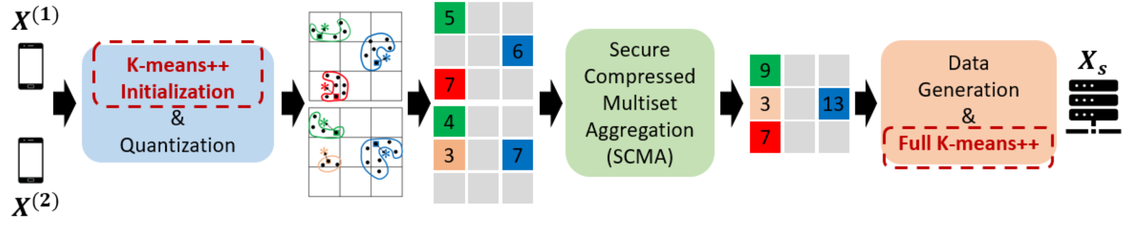
Client Side and Server Side Clustering
Client side and server side clustering
Notes:
Let me now give a brief introduction of more details about the whole framework. First is the k means++ initialization

Slide 51
K-means++ Clustering
K-means++ [Vassilvitskii et al., 2006]: A randomized initialization based (centralized clustering) algorithm for K-means clustering with $(\log{K})$-approximation for optimal loss
Notes:
It is a fast and randomized selection of k centroids with theoretical guarantee on the loss

Slide 52
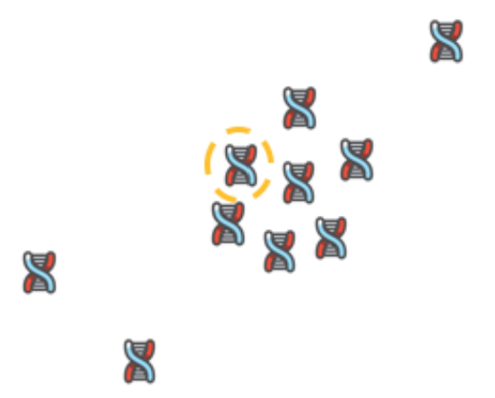
K-means++ Clustering
K-means++ [Vassilvitskii et al., 2006]: A randomized initialization based (centralized clustering) algorithm for K-means clustering with $(\log{K})$-approximation for optimal loss
Select first centroid randomly
Notes:
The way it works is to randomly and sequentially select centroids from the data set

Slide 53
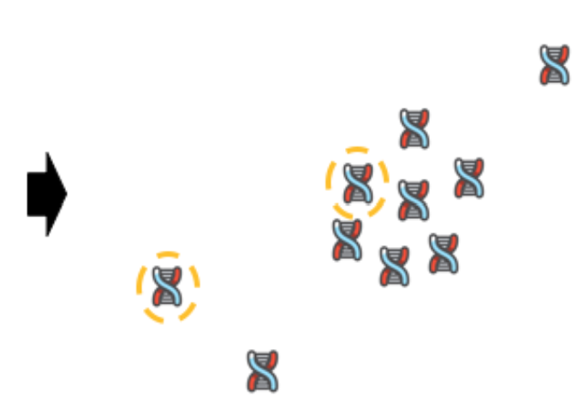
K-means++ Clustering
K-means++ [Vassilvitskii et al., 2006]: A randomized initialization based (centralized clustering) algorithm for K-means clustering with $(\log{K})$-approximation for optimal loss
Select first centroid randomly
Selection probability $∝{\left(D\left(⋅,C\right)\right)}^{2}$
Notes:
Where each data point is selected as a centroid with probaibilty proportional to its distance to existing slected centroids

Slide 54
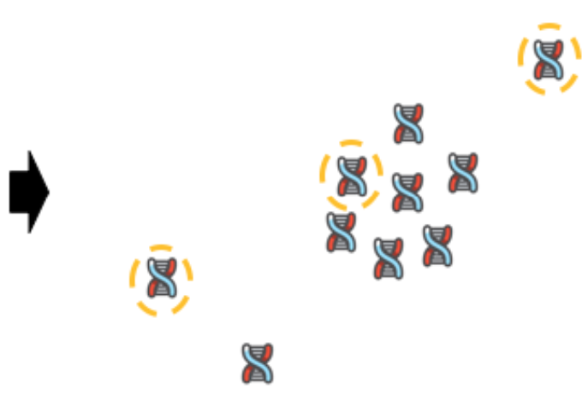
K-means++ Clustering
K-means++ [Vassilvitskii et al., 2006]: A randomized initialization based (centralized clustering) algorithm for K-means clustering with $(\log{K})$-approximation for optimal loss
Select first centroid randomly
Selection probability $∝{\left(D\left(⋅,C\right)\right)}^{2}$
Notes:
This means that datapoints that are further to the existing centroids are more likely to be seletecd

Slide 55
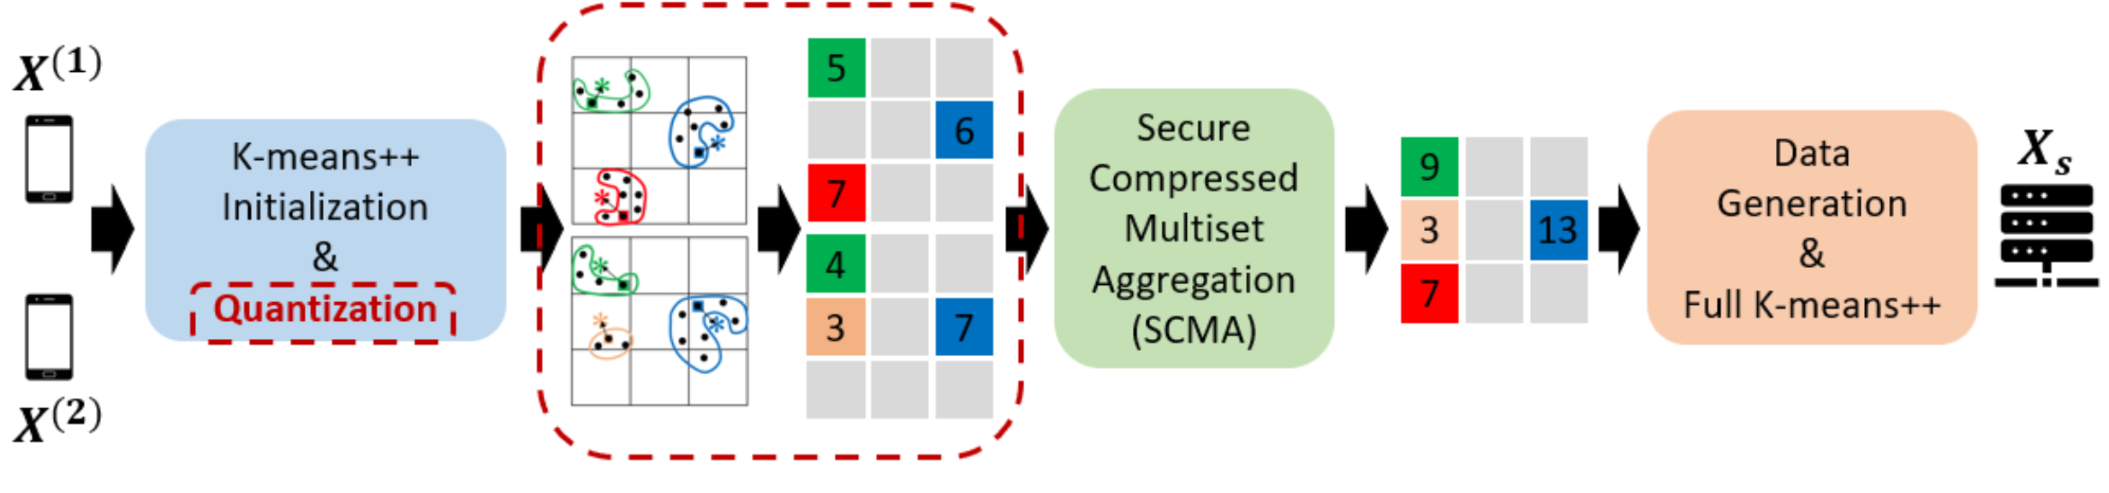
Local model encoding
Uniform quantization over a high dimensional grid
Notes:
The quantization step quantize the centroids in a uniformly spaced grid. Here d is the dimensioan of the grid B is the number of steps along each dimension

Slide 56
Client Local Information Processing
Uniform quantization over a high dimensional grid
Vector $q^{\left(l\right)}$ at client $l$ to represent the cluster sizes and centroids
Notes:
Then we use a vector ql to encode the size and the quantized centroid of each cluster into a vector

Slide 57
Client Local Information Processing
Uniform quantization over a high dimensional grid
Vector $q^{\left(l\right)}$ at client $l$ to represent the cluster sizes and centroids
$$q^{\left(1\right)}=(5,0,0,0,0,6,7,0,0)$$
$$q^{\left(2\right)}=(4,0,0,3,0,7,0,0,0)$$
Notes:
For example, in this case the first vector indicates that there are three clusters. there is a cluster with centroid in this region that has 5 points. A cluster of 6 points with centroid in this region.

Slide 58

Client Local Information Processing
Uniform quantization over a high dimensional grid
Vector $q^{\left(l\right)}$ at client $l$ to represent the cluster sizes and centroids
$$q^{\left(1\right)}=(5,0,0,0,0,6,7,0,0)$$
$$q^{\left(2\right)}=(4,0,0,3,0,7,0,0,0)$$
Aggregate $q^{\left(1\right)}+q^{\left(2\right)}=(9,0,0,3,0,13,7,0,0)$
Notes:
For example, in this case the first vector indicates that there are three clusters. there is a cluster with centroid in this region that has 5 points. A cluster of 6 points with centroid in this region.

Slide 59
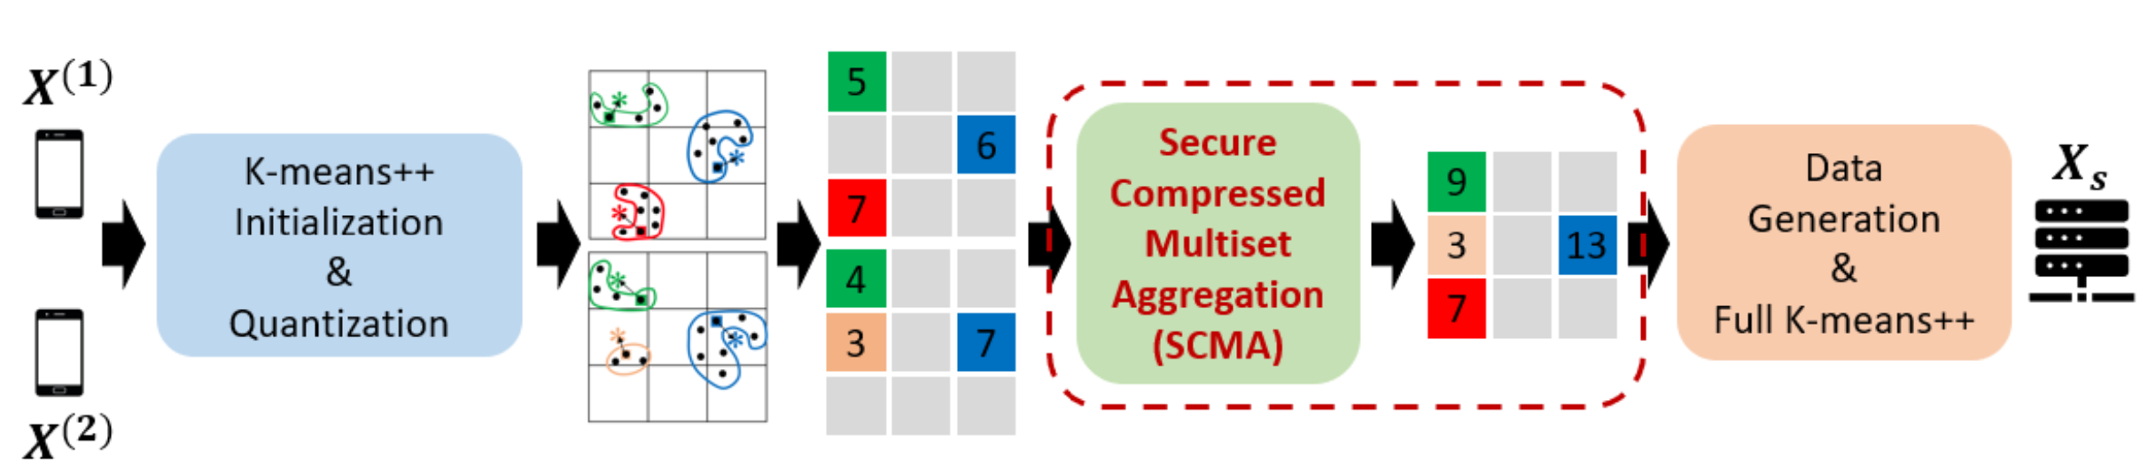
Secure compressed multiset aggregation
Leverage the sparsity of the encoded local model $q^{\left(l\right)}$
Sparse model aggregation [Beguier el al., 2020], [Ergun et al., 2021], [Chen el al., 2023]
Notes:
Now I want to highlight our algorithm securely transmit the local models to the server. It leverages the sparsity of the local model information which is encoded into the vector q. we know that there are at most k nonzero entries in q since there are k clusters. This is of independent interest to aggregate sparse models in federated learning. Existing works either requires high communication or computation cost. We addressed this issue using tools from coding theory. We were surprised to find coding theory to be powerful in federated learning tasks.

Slide 60
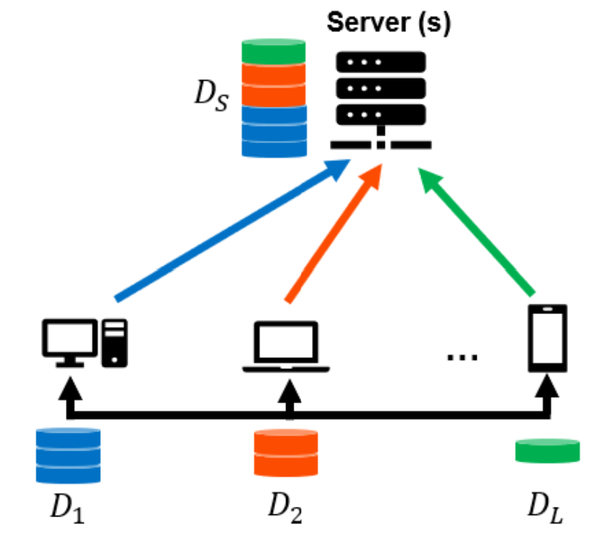
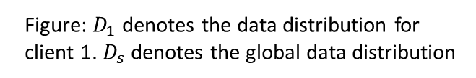
Secure Compressed Multiset Aggregation
Goal: Securely and efficiently recover $q=\sum_{l=1}^{L}{q^{\left(l\right)}}$ at the server, where $q^{\left(l\right)}$ stands for cluster size vector of client $l$.
Figure: $D_{1}$ denotes the data distribution for client 1. $D_{s}$ denotes the global data distribution
Notes:
To describe more details of the algorithm The goal of transmission is for the server to securely aggregate the local models, encoded as vectors ql

Slide 61
Secure Compressed Multiset Aggregation
Goal: Securely and efficiently recover $q=\sum_{l=1}^{L}{q^{\left(l\right)}}$ at the server, where $q^{\left(l\right)}$ stands for cluster size vector of client $l$.
Communication privacy: The server learns the nothing beyond $q$.
Figure: $D_{1}$ denotes the data distribution for client 1. $D_{s}$ denotes the global data distribution
Notes:
While satisfying the privacy requirement that the server cannot learn anything beyond the sum.

Slide 62
Secure Compressed Multiset Aggregation
Goal: Securely and efficiently recover $q=\sum_{l=1}^{L}{q^{\left(l\right)}}$ at the server, where $q^{\left(l\right)}$ stands for cluster size vector of client $l$.
Communication privacy: The server learns the nothing beyond $q$.
Applying secure aggregation entry-wise results in high communication cost
Figure: $D_{1}$ denotes the data distribution for client 1. $D_{s}$ denotes the global data distribution
Notes:
One approach is to use the secure aggregation algorithm for each dimension of q. Recall that secure aggregation is a method to privately average the local models. However, this results in high communication cost since q has large dimension.

Slide 63
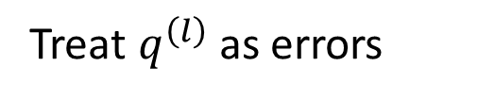
Secure Compressed Multiset Aggregation
Goal: Securely and efficiently recover $q=\sum_{l=1}^{L}{q^{\left(l\right)}}$ at the server, where $q^{\left(l\right)}$ stands for cluster size vector of client $l$.
Communication privacy: The server learns the nothing beyond $q$.
Idea: Encoding based on Reed-Solomon codes (error-correcting codes).
Treat $q^{\left(l\right)}$ as errors
Figure: $D_{1}$ denotes the data distribution for client 1. $D_{s}$ denotes the global data distribution
Notes:
Our idea is to use Reed-Solomon codes, which is a class of error-correcting codes that are able to identify sparse error patterns. What we do is that we treat the vectors ql as sparse error patterns and use Reed-Solomon code to recover these error patterns.

Slide 64
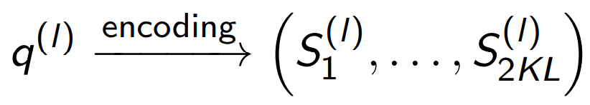
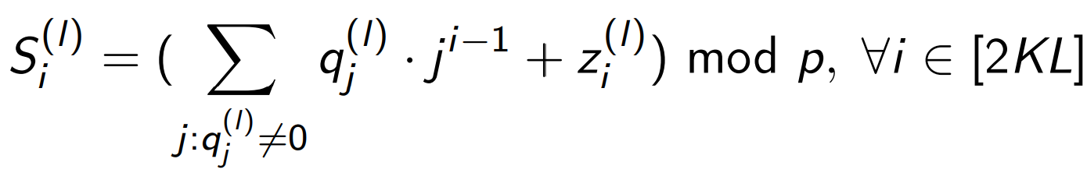
Secure Compressed Multiset Aggregation
Goal: Securely and efficiently recover $q=\sum_{l=1}^{L}{q^{\left(l\right)}}$ at the server, where $q^{\left(l\right)}$ stands for cluster size vector of client $l$.
Communication privacy: The server learns the nothing beyond $q$.
Idea: Encoding based on Reed-Solomon codes (error-correcting codes).
Treat $q^{\left(l\right)}$ as errors
Figure: $D_{1}$ denotes the data distribution for client 1. $D_{s}$ denotes the global data distribution
Notes:
The Reed-Somomon code is based on polynomial evaluations. We transmit these polynomial evaluations and add noise to the evaluations.

Slide 65

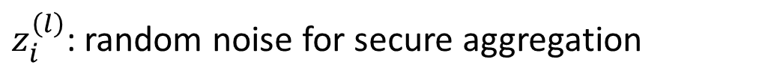
Secure Compressed Multiset Aggregation
Goal: Securely and efficiently recover $q=\sum_{l=1}^{L}{q^{\left(l\right)}}$ at the server, where $q^{\left(l\right)}$ stands for cluster size vector of client $l$.
Communication privacy: The server learns the nothing beyond $q$.
Idea: Encoding based on Reed-Solomon codes (error-correcting codes).
Treat $q^{\left(l\right)}$ as errors
$$\sum_{l=1}^{L}{z_{i}^{\left(l\right)}}=0$$
Figure: $D_{1}$ denotes the data distribution for client 1. $D_{s}$ denotes the global data distribution
$z_{i}^{\left(l\right)}$: random noise for secure aggregation
Notes:
As secure aggregation does, which is adding noises that sum up to 0.

Slide 66
Performance analysis
Optimal communication complexity at clients: $2KL⌈d log{B}⌉$ bits
Communication cost linear in $B^{d}$ in [Beguier el al., 2020], [Ergun et al., 2021]
Notes:
This is a theoretical guarantee of our secure sparse model aggregation algorithm. We achieve optimal communication cost that is logarithm in the number of quantized regions, while this is linear in existing works

Slide 67
Performance analysis
Optimal communication complexity at clients: $2KL⌈d log{B}⌉$ bits
Communication cost linear in $B^{d}$ in [Beguier el al., 2020], [Ergun et al., 2021]
Low computational complexity at server: $max \{O\left(K^{2}L^{2}d\log{B}\right), O\left({\left(KL\right)}^{1.5}{\left(d\log{B}\right)}^{2}+KL{\left(d\log{B}\right)}^{3}\right)\}$
Brute force search (exponential in $K$, $L$, and $log B$) [Chen el al., 2023]
Notes:
There is a recent work that achieves similarly optimal communication cost but requires intractable computation complexity. While our algorithm has low computational complexity

Slide 68
Performance analysis
Optimal communication complexity at clients: $2KL⌈d log{B}⌉$ bits
Linear in $B^{d}$ in [Beguier el al., 2020], [Ergun et al., 2021]
Low computational complexity at server: $max \{O\left(K^{2}L^{2}d\log{B}\right), O\left({\left(KL\right)}^{1.5}{\left(d\log{B}\right)}^{2}+KL{\left(d\log{B}\right)}^{3}\right)\}$
Brute force search (exponential in $K$, $L$, and $log B$) [Chen el al., 2023]
Low computational complexity at client: $O(K^{2}Ld\log{KL}\log{B})$
Notes:
We also have low computational complexity for cluster model training.

Slide 69
Performance analysis
Optimal communication complexity at clients: $2KL⌈d log{B}⌉$ bits
Linear in $B^{d}$ in [Beguier el al., 2020], [Ergun et al., 2021]
Low computational complexity at server: $max \{O\left(K^{2}L^{2}d\log{B}\right), O\left({\left(KL\right)}^{1.5}{\left(d\log{B}\right)}^{2}+KL{\left(d\log{B}\right)}^{3}\right)\}$
Brute force search (exponential in $K$, $L$, and $log B$) [Chen el al., 2023]
Low computational complexity at client: $O(K^{2}Ld\log{KL}\log{B})$
Low computational training (clustering) complexity at client: $O(n^{\left(l\right)}Kd)$
Notes:
We also have low computational complexity for cluster model training.

Slide 70
Performance analysis
Optimal communication complexity at clients: $2KL⌈d log{B}⌉$ bits
Linear in $B^{d}$ in [Beguier el al., 2020], [Ergun et al., 2021]
Low computational complexity at server: $max \{O\left(K^{2}L^{2}d\log{B}\right), O\left({\left(KL\right)}^{1.5}{\left(d\log{B}\right)}^{2}+KL{\left(d\log{B}\right)}^{3}\right)\}$
Brute force search (exponential in $K$, $L$, and $log B$) [Chen el al., 2023]
Low computational complexity at client: $O(K^{2}Ld\log{KL}\log{B})$
Low computational training (clustering) complexity at client: $O(n^{\left(l\right)}Kd)$
Low computational training (clustering) complexity at server: $O(K^{2}LdT)$
$T:$ The maximum number of Lloyed iterations
Notes:
We also have low computational complexity for cluster model training.

Slide 71
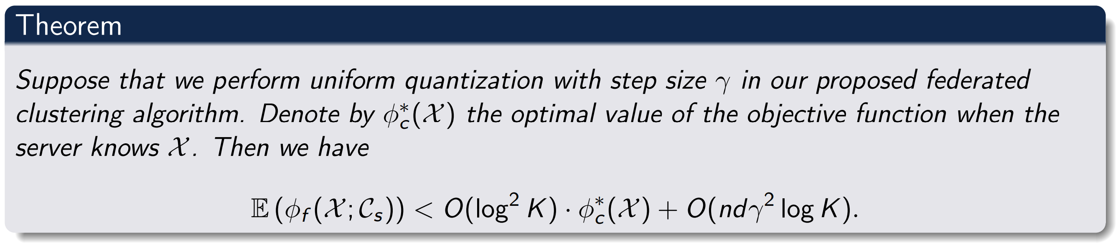
Performance analysis
our loss
optimal centralized loss
quantization term
$O(\log^{2}{K})$ is order-optimal scaling for federated clustering
Notes:
This is our theoretical guarantee on the sums of square of distance loss. It is greater than optimal by a scaling of at most an order of log k squre, which is orderwise optimal.

Slide 72
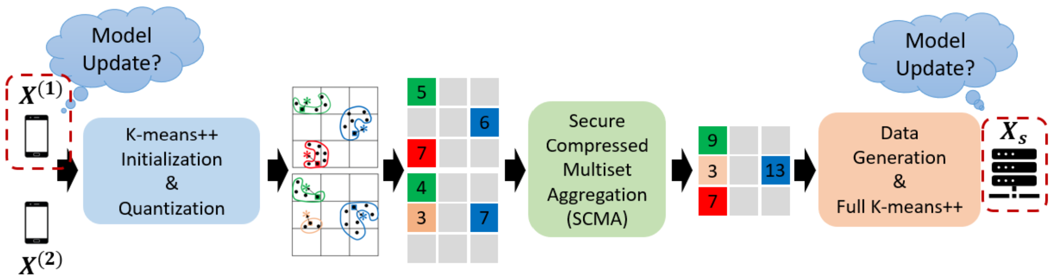
Unlearning Federated Clusters
The request is to remove data points from client $l$
Notes:
Now let me show how to do unlearning in the clustering model we trained. Suppose there is a request to remove data from client l.

Slide 73
Unlearning Federated Clusters
The request is to remove data points from client $l$
Unlearn only at client $l$ and the server.
Notes:
We only need to do unlearning at lient l and the server.

Slide 74
Unlearning Federated Clusters
The request is to remove data points from client $l$
Unlearn only at client $l$ and the server.
Client-side unlearning (lazy retraining to save computation cost)
If a centroid is to be removed, retraining (K means++)
Notes:
The key idea as we have previously mentioned is that because of the kmeans++ initialization and quantization, the locally learned model is stable and the need for retraining from scratch is low. So we only do retraining when the centroid is to be removed.

Slide 75
Unlearning Federated Clusters
The request is to remove data points from client $l$
Unlearn only at client $l$ and the server.
Client-side unlearning (lazy retraining to save computation cost)
If a centroid is to be removed, retraining (K means++)
Else, keep the current centroids
Notes:
We recall that in Kmeans initialization the centroiods are from data points

Slide 76
Unlearning Federated Clusters
The request is to remove data points from client $l$
Unlearn only at client $l$ and the server.
Client-side unlearning (lazy retraining to save computation cost)
If a centroid is to be removed, retraining (K means++)
Else, keep the current centroids
Server side unlearning: run full K means++
Notes:
The server runs the standard k means algorithm upon each data reoval request.

Slide 77
Unlearning Federated Clusters
The request is to remove data points from client $l$
Unlearn only at client $l$ and the server.
Client-side unlearning (lazy retraining to save computation cost)
If a centroid is to be removed, retraining (K means++)
Else, keep the current centroids
Server side unlearning: run full K means++
Exact unlearning guaranteed by K means++ random initialization
Notes:
The exact unlearning is theoretically guaranteed by the randomization of k means++ initialization

Slide 78
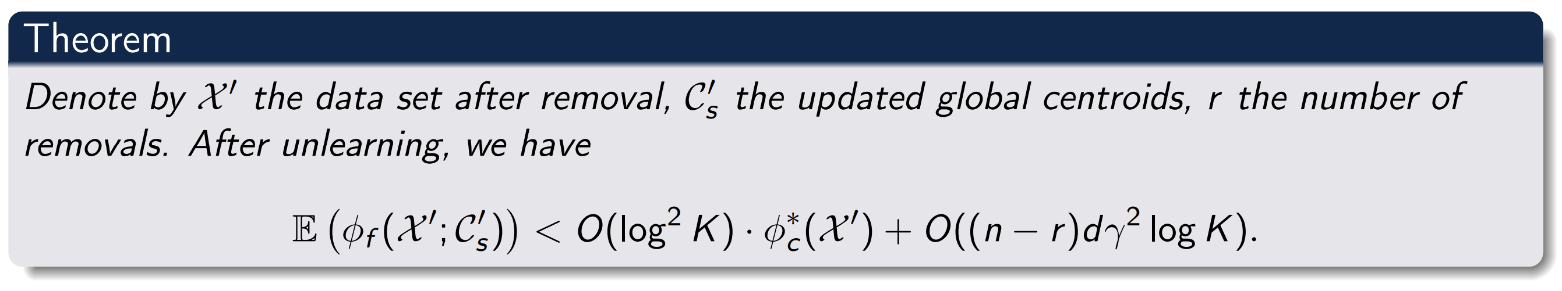
Unlearning Performance
Performance almost the same as retraining from scratch
Notes:
This shows that the expected loss after unlearning is amost the same as retraiing from scratch

Slide 79
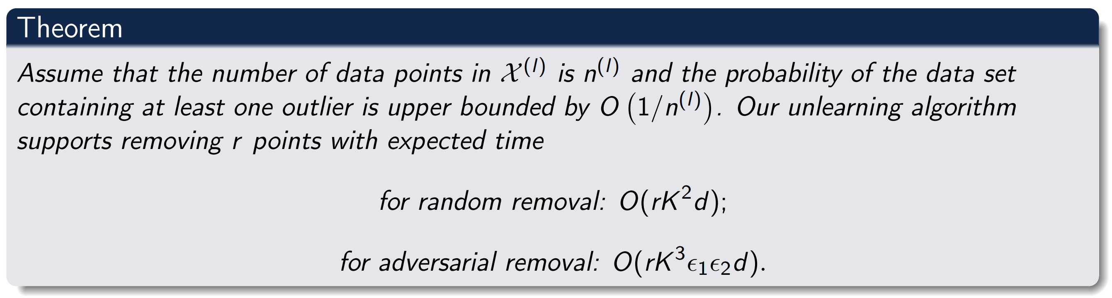
Unlearning Performance
$ε_{1}$: cluster size imbalance parameter
$ε_{2}$: outlier distance parameter
Notes:
Our computation complexity for unlearning is linear in the number of data points to be removed.

Slide 80
Unlearning Performance
$ε_{1}$: cluster size imbalance parameter
$ε_{2}$: outlier distance parameter
Scaling of the total number of data points if retrained from scratch
Notes:
However there is a complexity blowup if we retrain from scratch

Slide 81
Simulation Results
Our algorithm: MUFC (machine unlearning of federated clusters)
Notes:
Let me quickly go over the simulation results

Slide 82
Simulation Results
Our algorithm: MUFC (machine unlearning of federated clusters)
Baseline: Retraining, K-FED [Dennis et al., 2021] DC-KM [Ginart et al., 2019]
Notes:
We compare our algorithm with retraining and existing algorithm of K-FED

Slide 83
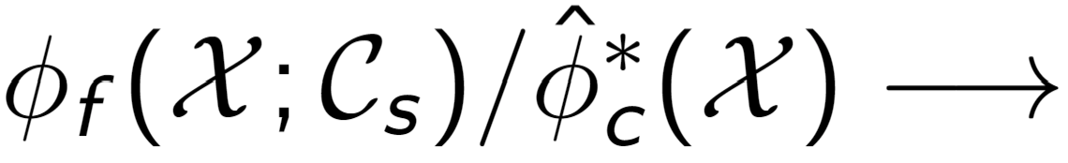
Simulation Results
Our algorithm: MUFC (machine unlearning of federated clusters)
Baseline: Retraining, K-FED [Dennis et al., 2021] DC-KM [Ginart et al., 2019]
Loss Ratio: Standard metric to quantify clustering performance
Notes:
We are interested in the loss ratio which is the ratio between the algorithm loss and the optimal loss, this is astandard metric to quantify clustering performance.

Slide 84
Simulation Results
Our algorithm: MUFC (machine unlearning of federated clusters)
Baseline: Retraining, K-FED [Dennis et al., 2021] DC-KM [Ginart et al., 2019]
Loss Ratio: Standard metric to quantify clustering performance
Accumulated removal time: client time + server time for data removals
Notes:
And the total time for data removal.

Slide 85
Simulation Results
K-FED consistently worse despite no unlearning mechanism
Notes:
It can be seen that our algorithm outperforms K-FED in all the data sets.

Slide 86
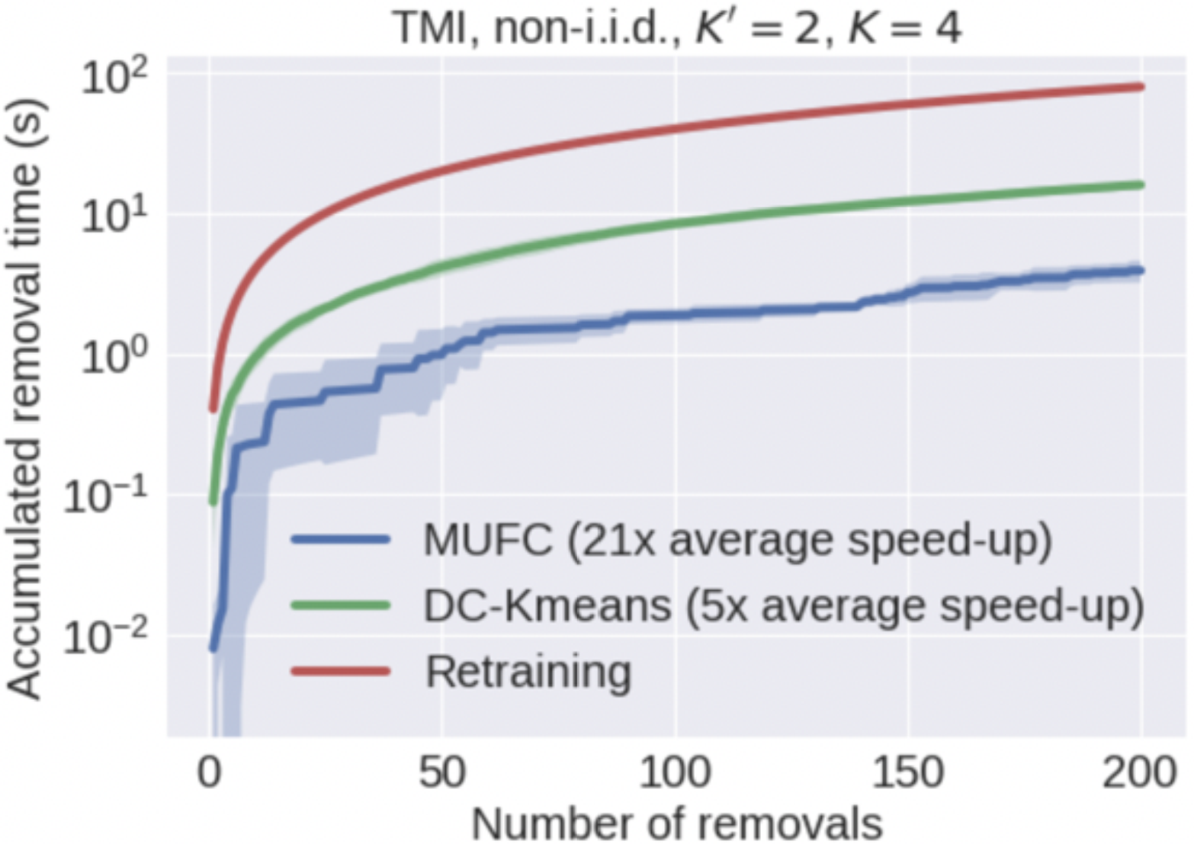
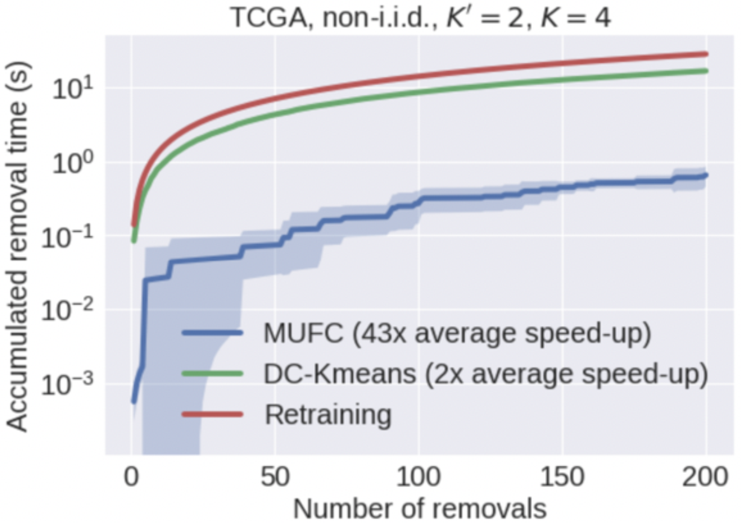
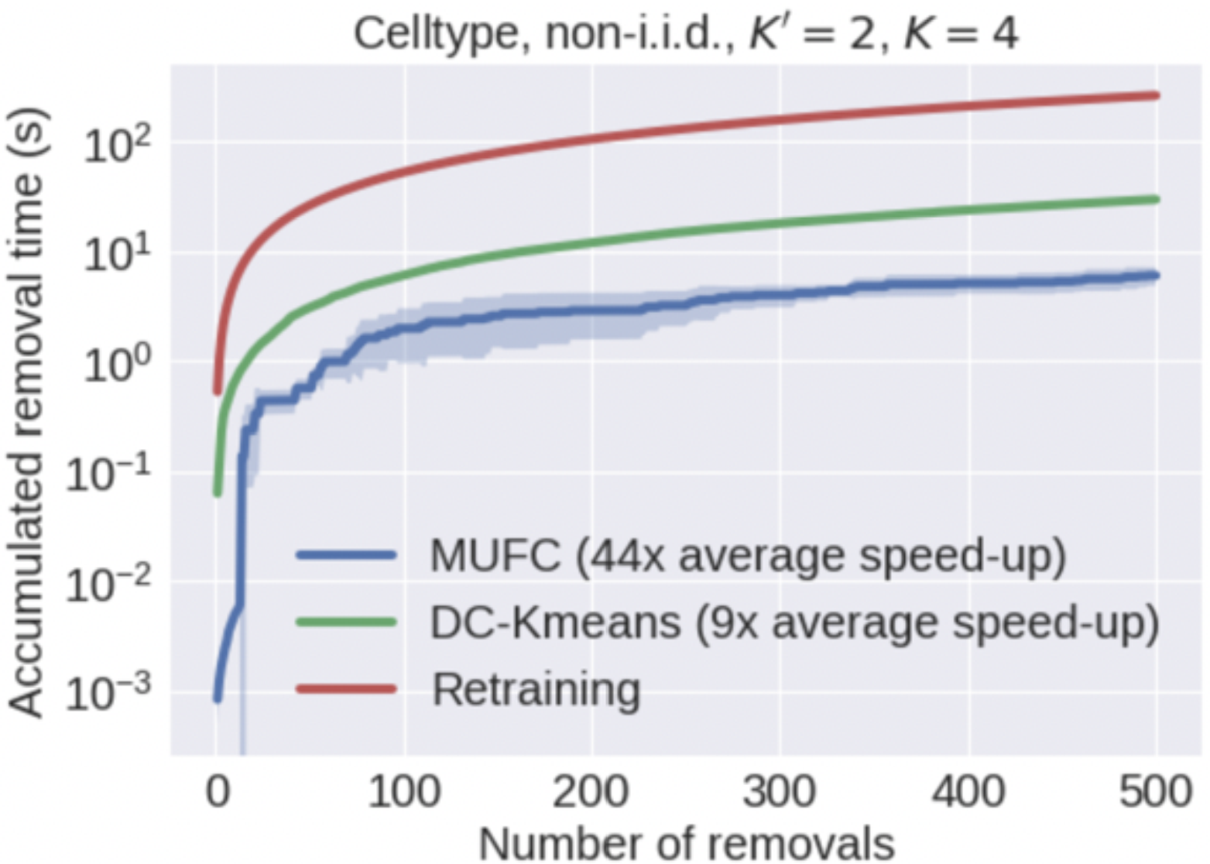
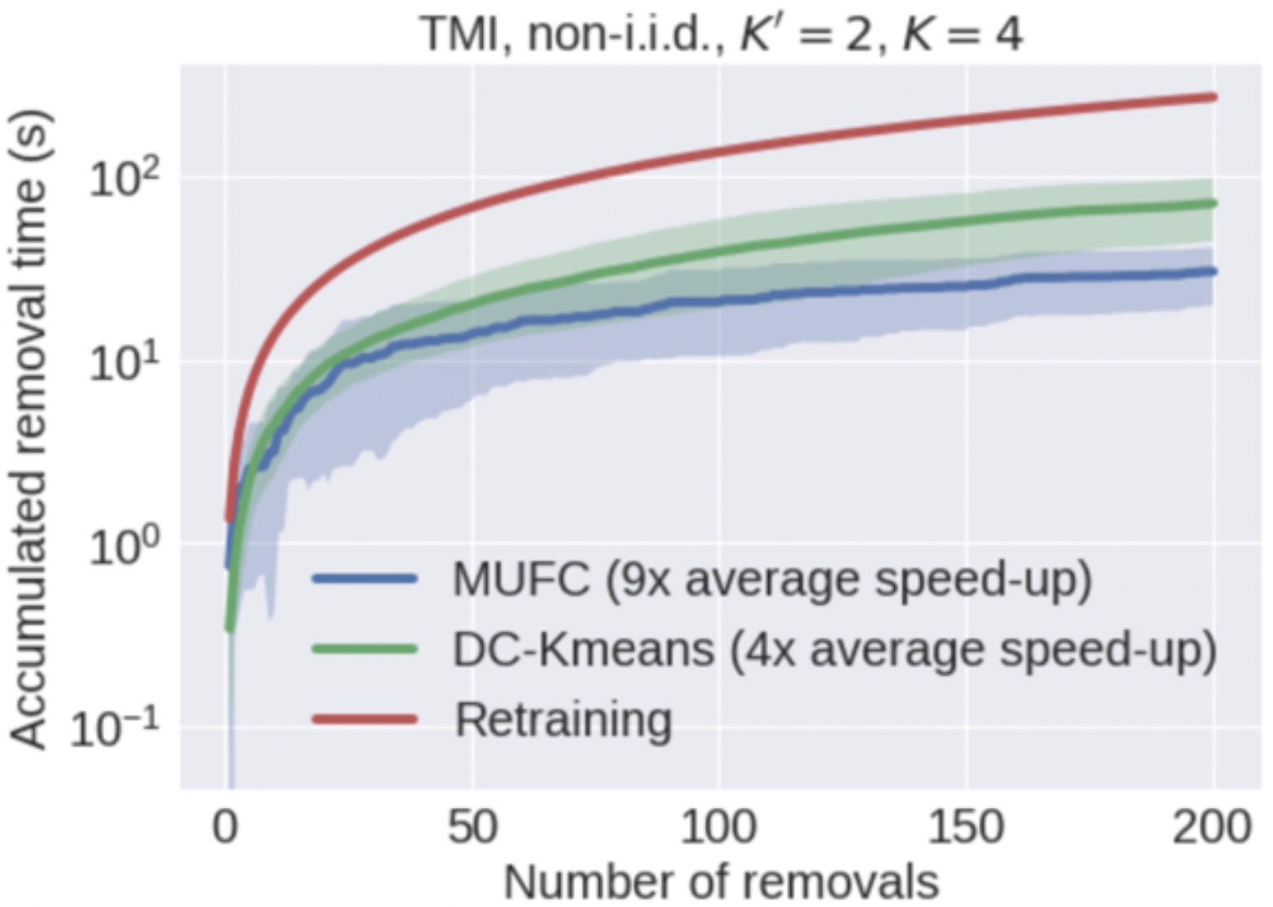
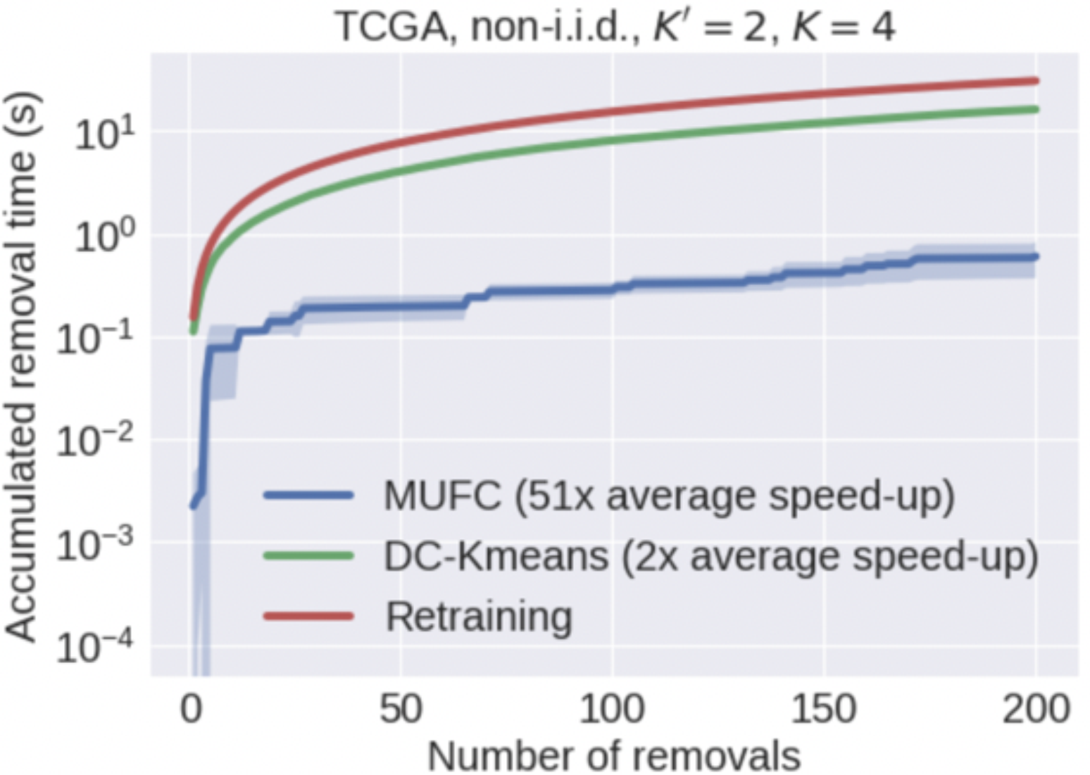
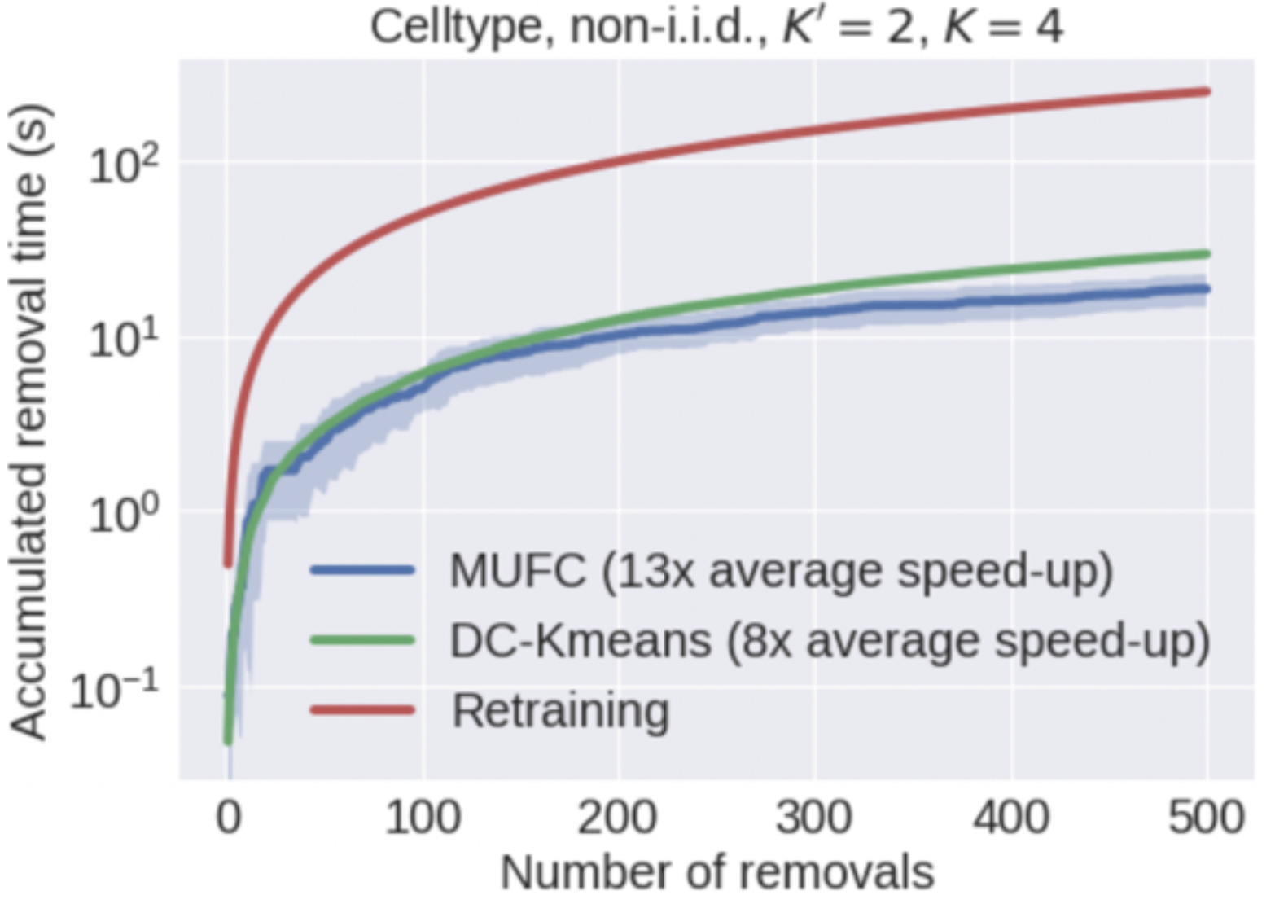
Simulation Results
Random data removal
Adversarial data removal
Notes:
Also, our unlearning time is less compared to existing methods

Slide 87
Federated unlearning of clusters
Federated classification in Hyperbolic spaces
Notes:
Now let me briefly talk about the federated classification in hyperbolic spaces.

Slide 88
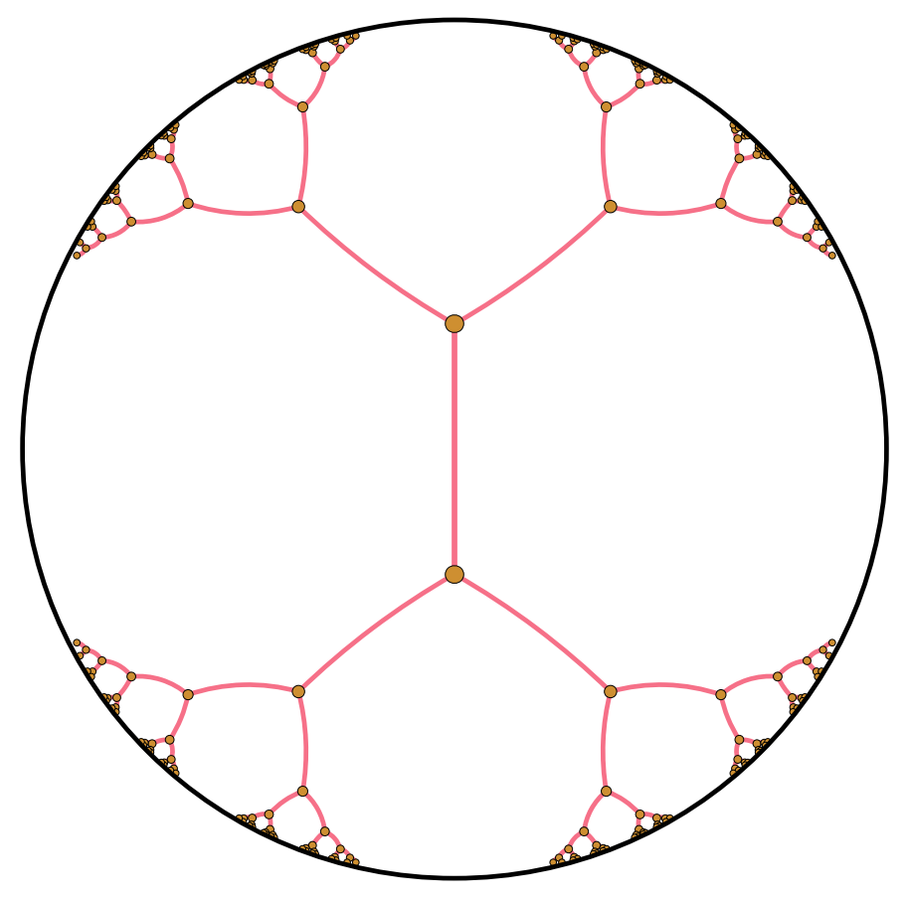
Federated classification in Hyperbolic spaces
Euclidean spaces Vs. Hyperbolic (Non-Euclidean) spaces
Notes:
Hyperbolic space is Non-Euclidean space.

Slide 89
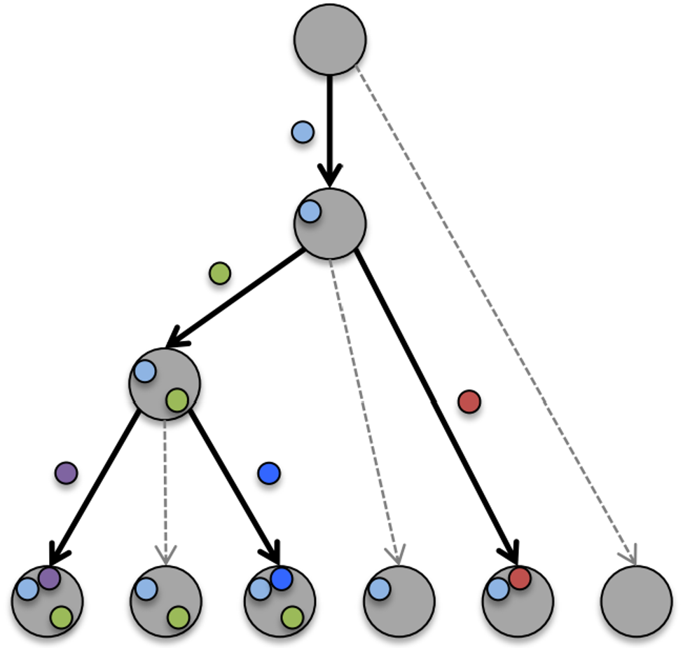
Federated classification in Hyperbolic spaces
Euclidean spaces Vs. Hyperbolic (Non-Euclidean) spaces
Hierarchical data or data with tree structures are better represented in Hyperbolic spaces
Notes:
Hyperbolic space is Non-Euclidean space.
It was shown that hiearachical data with tree structures are better represented in hyperbolic spaces.

Slide 90
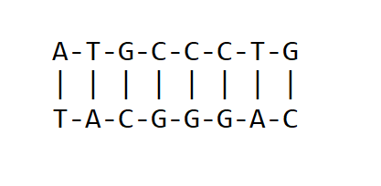
Federated classification in Hyperbolic spaces
Euclidean spaces Vs. Hyperbolic (Non-Euclidean) spaces
Hierarchical data or data with tree structures are better represented in Hyperbolic spaces
Genomic data sets and phylogeny trees
Notes:
Examples of these types of data include genomic data sets and phylogeny trees.

Slide 91
Federated classification in Hyperbolic spaces
Classification in Hyperbolic spaces
Support vector machine (SVM) in Hyperbolic spaces can perform better than SVM in Euclidean spaces [Pan et al. 2022]
Notes:
We are interested in classification in hyperbolic spaces. We focus on support vector machine is one of the efficient and useful algorithms to do classification.
It was shown that SVM in Hyperbolic spaces can have better performance over SVM in Euclidean spaces in some genomic datasets.

Slide 92
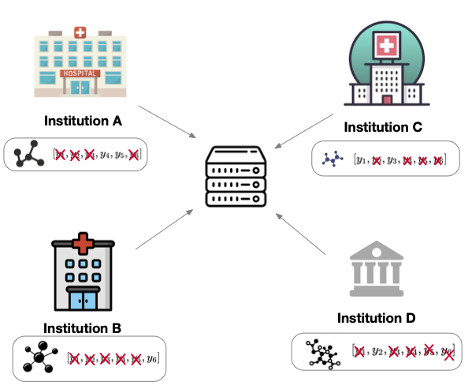
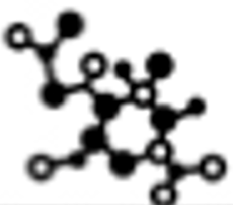

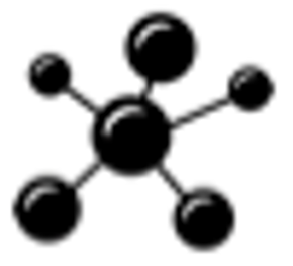

Federated classification in Hyperbolic spaces
Classification in Hyperbolic spaces
Support vector machine (SVM) in Hyperbolic spaces can perform better than SVM in Euclidean spaces [Pan et al. 2022]
How to train SVM in Hyperbolic spaces in federated settings?
Notes:
Motivated by this, we ask the question of how to do SVM in hyperbolic spaces in federated settings.

Slide 93
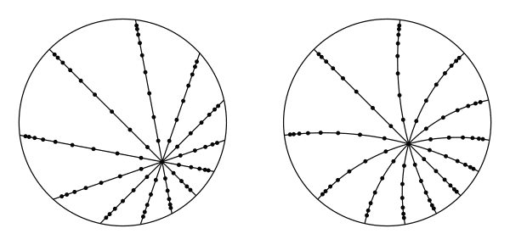
Federated classification in Hyperbolic spaces
Challenges (caused by data hetereogeneity)
Misaligned reference points (used to define the Hyperbolic spaces) across different clients
Reference point at client 1
Reference point at client 2
Notes:
One key step to do SVM in hyperbolic spaces is to find a reference point that defines the Hyperbolic space (which is like the origin in Euclidean spaces), these reference points are often defined based on the training data. This becomes challenging in federated learning settings since the data are hetereogeneous across different clients and thus, the reference points are different.

Slide 94
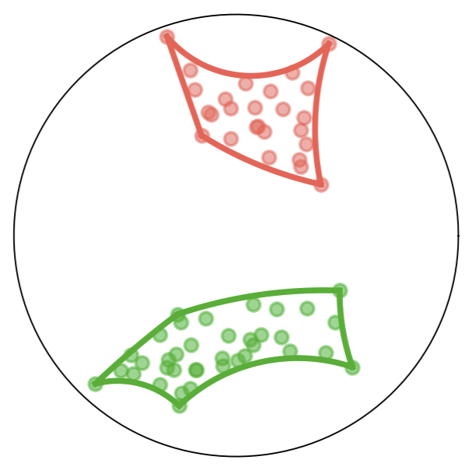
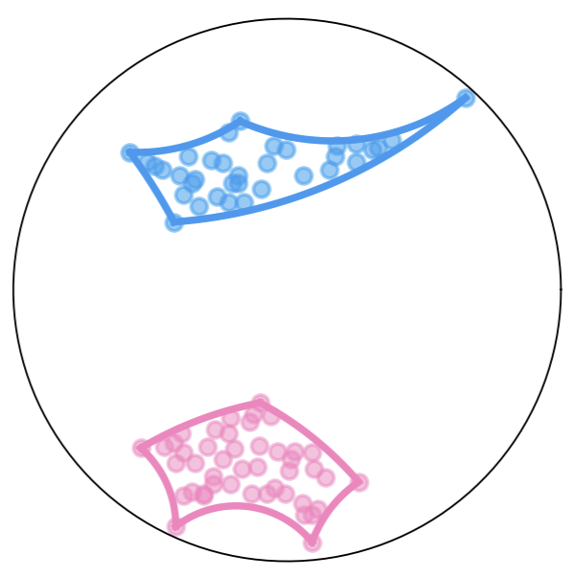
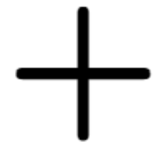

Federated classification in Hyperbolic spaces
Challenges (caused by data hetereogeneity)
Misaligned reference points (used to define the Hyperbolic spaces) across different clients
Label switching (do not arise in unlabeled learning such as clustering)
Reference point at client 1
Reference point at client 2
Client1
Client2
Notes:
Another issue that may arise is the problem of label switching, that is common in federated learning, where different clients may label the same class of data differently. This is different from clustering since there are no labels in cluster data.

Slide 95
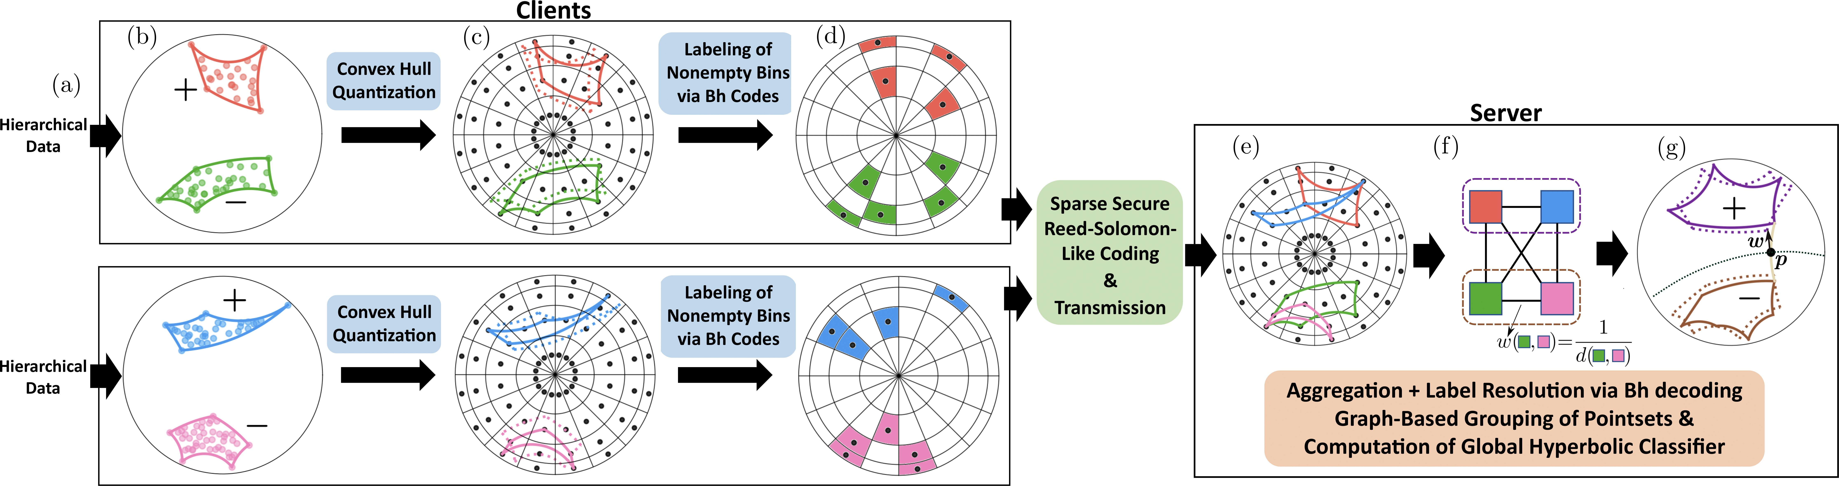
Federated classification in Hyperbolic spaces
Framework
Aggregate the quantized convex hull to find reference points
Notes:
Our contribution is a framework for doing SVM in hyperbolic spaces. For time reasons, let me quickly go over it. The key idea is to compute the convex hull in Hyperbolic spaces as local models. Then we use the Sparse model aggregation as we just described to do transmission.

Slide 96
Federated classification in Hyperbolic spaces
Framework
Aggregate the quantized convex hull to find reference points
Solving label switching through coding theory
Notes:
I would like to highlight our method for dealing with the label switching issue using coding theory.

Slide 97
Federated classification in Hyperbolic spaces
Framework
Aggregate the quantized convex hull to find reference points
Solving label switching through coding theory
Privacy leakage quantized by the number of points in the quantized convex hull
Notes:
Representative paradigm of aiml systems nowadays

Slide 98

Federated classification in Hyperbolic spaces
Encoding labels using $B_{h}$ ($h=L$) sequences
Notes:
The idea is to use B_h sequences, that

Slide 99
Federated classification in Hyperbolic spaces
Encoding labels using $B_{h}$ ($h=L$) sequences
$B_{h}$ ($h=L$): Uniquely determine constituent summands based on sums.
$B_{2}=\{1,3,7,12\}$. $1+1=2$, $1+3=4$, $3+3=6,$ $1+7=8$, etc.
Notes:
That are defined as a set of integers such that every sum of less than h integers in the set are different. And thus we can uniquely determine the constitutent summands based on the sums. Note that the server aggregates the sum of labels. We can therefore recover the individual labels of each cluster based on b_h sequences.

Slide 100

Simulations
Experiments with Biological datasets
Hyperbolic up to 11% better than Euclidean
Notes:
This is our semulation shouing that hyperbolic svm in hyperbolic spaces in the federated settings can be better than that in Euclidean spaces

Slide 101
Thank you
Comments and questions are welcomed
Notes:
That’s all thank you for your attention.

Slide 102
Machine unlearning
Naive way is to always retrain from scratch
Pros: Complete privacy
Cons: Computationally expensive. Infeasible when there is a high frequency of data removal requests.
How to “remove” a sample from ML models efficiently $→$ Machine unlearning [Cao et al., 2015].
Sharding: Divide the data into disjoint shards (small batches) and retrain from scratch for a single shard
Exact unlearning: Probabilistically equivalent to retraining from scratch [Cao et al., 2015], [Ginart et al., 2019].
Notes:
Representative paradigm of aiml systems nowadays

Slide 103
Machine unlearning
Naive way is to always retrain from scratch
Pros: Complete privacy
Cons: Computationally expensive. Infeasible when there is a high frequency of data removal requests.
How to “remove” a sample from ML models efficiently $→$ Machine unlearning [Cao et al., 2015].
Sharding: Divide the data into disjoint shards (small batches) and retrain from scratch for a single shard
Exact unlearning: Probabilistically equivalent to retraining from scratch [Cao et al., 2015], [Ginart et al., 2019].
How to mathematically define unlearning?
Notes:
Representative paradigm of aiml systems nowadays

Slide 104

Machine unlearning
is an $\left(ε,δ\right)−$approximate unlearning algorithm if
: Dataset space
: Training set
: Training set after removal
: Model space
: Randomized learning algorithm
: Unlearning algorithm
Retraining from scratch
Notes:
Put in the backup slides

Slide 105
Machine unlearning
is an $\left(ε,δ\right)−$approximate unlearning algorithm if
: Dataset space
: Training set
: Training set after removal
: Model space
: Randomized learning algorithm
: Unlearning algorithm
Related to but different from different privacy
Retraining from scratch
Notes:
Representative paradigm of aiml systems nowadays

Slide 106
One-Shot Secure Federated Clustering
The framework
K-means++ initialization at all clients
Centroid quantization and summary statistics computation at all clients (performed independently).
Notes:
Representative paradigm of aiml systems nowadays

Slide 107
One-Shot Secure Federated Clustering
The framework
K-means++ initialization at all clients
Centroid quantization and summary statistics computation at all clients (performed independently).
Secure compressed multiset aggregation (performed for pairs of clients through coding theory approaches)
Notes:
Representative paradigm of aiml systems nowadays

Slide 108
One-Shot Secure Federated Clustering
The framework
K-means++ initialization at all clients
Centroid quantization and summary statistics computation at all clients (performed independently).
Secure compressed multiset aggregation (performed for pairs of clients through coding theory approaches)
Server side secure aggregation, summary statistics computation
Notes:
Representative paradigm of aiml systems nowadays

Slide 109
One-Shot Secure Federated Clustering
The framework
K-means++ initialization at all clients
Centroid quantization and summary statistics computation at all clients (performed independently).
Secure compressed multiset aggregation (performed for pairs of clients through coding theory approaches)
Server side secure aggregation, summary statistics computation
Server side clustering
Notes:
Representative paradigm of aiml systems nowadays

Slide 110


Encoding
Notes:
Representative paradigm of aiml systems nowadays

Slide 111

Decoding
Server receives
Notes:
Representative paradigm of aiml systems nowadays

Slide 112

Decoding
Server receives
For decoding, use decoding algorithms of Reed-Solomon codes to recover $q$ at the server
Notes:
Representative paradigm of aiml systems nowadays

Slide 113

Decoding
Server receives
For decoding, use decoding algorithms of Reed-Solomon codes to recover $q$ at the server
Server cannot learn any information about individual $q^{\left(l\right)}$
Notes:
Representative paradigm of aiml systems nowadays

Slide 114
Performance analysis
Optimal communication complexity at clients: $2KL⌈d log{B}⌉$ bits
Linear in $B^{d}$ in [Beguier el al., 2020], [Ergun et al., 2021]
Low computational complexity at server: $max \{O\left(K^{2}L^{2}d\log{B}\right), O\left({\left(KL\right)}^{1.5}{\left(d\log{B}\right)}^{2}+KL{\left(d\log{B}\right)}^{3}\right)\}$
Notes:
Representative paradigm of aiml systems nowadays

Slide 115
Performance analysis
Optimal communication complexity at clients: $2KL⌈d log{B}⌉$ bits
Linear in $B^{d}$ in [Beguier el al., 2020], [Ergun et al., 2021]
Low computational complexity at server: $max \{O\left(K^{2}L^{2}d\log{B}\right), O\left({\left(KL\right)}^{1.5}{\left(d\log{B}\right)}^{2}+KL{\left(d\log{B}\right)}^{3}\right)\}$
Low computational training (clustering) complexity at client: $O(n^{\left(l\right)}Kd)$
Low computational training (clustering) complexity at server: $O(K^{2}LdT)$
$T:$ The maximum number of Lloyed iterations
Low computational complexity at client: $O(K^{2}Ld\log{KL}\log{B})$
Brute force search (exponential in $K$, $L$, and $B$) [Chen el al., 2023]
Notes:
Representative paradigm of aiml systems nowadays

Slide 116
Performance analysis
Optimal communication complexity at clients: $2KL⌈d log{B}⌉$ bits
Linear in $B^{d}$ in [Beguier el al., 2020], [Ergun et al., 2021]
Low computational complexity at server: $max \{O\left(K^{2}L^{2}d\log{B}\right), O\left({\left(KL\right)}^{1.5}{\left(d\log{B}\right)}^{2}+KL{\left(d\log{B}\right)}^{3}\right)\}$
Brute force search (exponential in $K$, $L$, and $B$) [Chen el al., 2023]
Low computational complexity at server: $max \{O\left(K^{2}L^{2}d\log{B}\right), O\left({\left(KL\right)}^{1.5}{\left(d\log{B}\right)}^{2}+KL{\left(d\log{B}\right)}^{3}\right)\}$
Notes:
Representative paradigm of aiml systems nowadays

Slide 117
Performance analysis
Optimal communication complexity at clients: $2KL⌈d log{B}⌉$ bits
Linear in $B^{d}$ in [Beguier el al., 2020], [Ergun et al., 2021]
Low computational complexity at client: $O(K^{2}Ld\log{KL}\log{B})$
Brute force search (exponential in $K$, $L$, and $B$) [Chen el al., 2023]
Low computational complexity at server: $max \{O\left(K^{2}L^{2}d\log{B}\right), O\left({\left(KL\right)}^{1.5}{\left(d\log{B}\right)}^{2}+KL{\left(d\log{B}\right)}^{3}\right)\}$
Low computational training (clustering) complexity at client: $O(n^{\left(l\right)}Kd)$
Notes:
Representative paradigm of aiml systems nowadays

Slide 118

Simulations
Experiments with Biological datasets
Hyperbolic up to 11% better than Euclidean
Size of quantized convex hull (privacy leakage)
Notes:
Representative paradigm of aiml systems nowadays

Slide 119
Weighted majority algorithm
Initialization: $w^{1}=(w_{1}^{1},…,w_{K}^{1})=(1,…,1)$

Slide 120

Weighted majority algorithm
Initialization: $w^{1}=(w_{1}^{1},…,w_{K}^{1})=(1,…,1)$
For time $t=1,…,T$
Select $\hat{f}\left(x_{1 },…,x_{t},y_{1},…,y_{t−1}\right)=f_{j}(x_{t})$ with probability $\frac{w_{j}^{t}}{\sum_{i=1}^{K}{w_{i}^{t}}}$

Slide 121

Weighted majority algorithm
Initialization: $w^{1}=(w_{1}^{1},…,w_{K}^{1})=(1,…,1)$
For time $t=1,…,T$
Select $\hat{f}\left(x_{1 },…,x_{t},y_{1},…,y_{t−1}\right)=f_{j}(x_{t})$ with probability $\frac{w_{j}^{t}}{\sum_{i=1}^{K}{w_{i}^{t}}}$
Receive $y_{t}$

Slide 122

Weighted majority algorithm
Initialization: $w^{1}=(w_{1}^{1},…,w_{K}^{1})=(1,…,1)$
For time $t=1,…,T$
Select $\hat{f}\left(x_{1 },…,x_{t},y_{1},…,y_{t−1}\right)=f_{j}(x_{t})$ with probability $\frac{w_{j}^{t}}{\sum_{i=1}^{K}{w_{i}^{t}}}$
Receive $y_{t}$
Update $w_{j}^{t+1}=w_{j}^{t}∗e^{−\sqrt{\frac{2log{K}}{T}}\log{f_{j}\left(x_{t}\right)\left[y_{t}\right]}}$, $j=1,…,K$
$f_{j}\left(x_{t}\right)\left[y_{t}\right]$ is the probability of $y_{t}$ under distribution $f_{j}(x_{t})$

Slide 123
Weighted majority algorithm
Initialization: $w^{1}=(w_{1}^{1},…,w_{K}^{1})=(1,…,1)$
For time $t=1,…,T$
Select $\hat{f}\left(x_{1 },…,x_{t},y_{1},…,y_{t−1}\right)=f_{j}(x_{t})$ with probability $\frac{w_{j}^{t}}{\sum_{i=1}^{K}{w_{i}^{t}}}$
Receive $y_{t}$
Update $w_{j}^{t+1}=w_{j}^{t}∗e^{−\sqrt{\frac{2log{K}}{T}}\log{f_{j}\left(x_{t}\right)\left[y_{t}\right]}}$, $j=1,…,K$
$f_{j}\left(x_{t}\right)\left[y_{t}\right]$ is the probability of $y_{t}$ under distribution $f_{j}(x_{t})$
The WMA achieves total Kullback-Leibler distance $O(\sqrt{2T\log{K}} )$
Optimal

Slide 124





Differentially Private online learning
Differentially private online learning
Nature reveals privatized version ${\tilde{y}}_{t}$ of $y_{t}$ to the learner
${\tilde{y}}_{t}$ is differentially privately generated
$$x_{t},y_{t}∼f\left(x_{t}\right)$$
$$x_{t}$$
$$\hat{f}(x_{1 },…,x_{t},y_{1},…,y_{t−1})$$
Nature
Learner
$${\tilde{y}}_{t}$$
Adding noise in WMA results in total KL distance $O(\sqrt{2T}K poly(\log{(KT)}))$
Suboptimal

Slide 125
Reference
This talk is based on the following works:
Privacy and distributed machine learning
C. Pan*, J. Sima*, S. Prakash*, V. Rana, and O. Milenkovic, ”Machine Unlearning of Federated Clusters,” International Conference on Learning Representations (ICLR), 2023 (* denotes equal contribution)
S. Prakash*, J. Sima*, C. Pan*, E. Chien, and O. Milenkovic, ”Federated Classification in Hyperbolic Spaces via Secure Aggregation of Convex Hulls,” accepted by Transactions on Machine Learning Research (TMLR). (* denotes equal contribution)
Privacy and online learning
J. Sima*, C. Wu*, O. Milenkovic, and W. Szpankowski, ”Online Distribution Learning with Local Private Constraints,” accepted by International Conference on Artificial Intelligence and Statistics (AISTATS), 2024 (* denotes equal contribution)
Notes:
This is a list of reference for this talk. I will discuss data privacy in distributed learning and then online learning

