Slide 1
Center for
Science of Information
Frontiers of Science of Information
Wojciech Szpankowski
Helsinki Distinguished Lecture Series
on Future Information Technology,
2014

Slide 2
Outline
Science of Information
Center Mission & Center Team
Research
  Fundamentals: Structural Information & Security
  Data Science: Quering & Twitter Models
  Life Sciences: DNA Resemble & Protein Folding

Slide 3
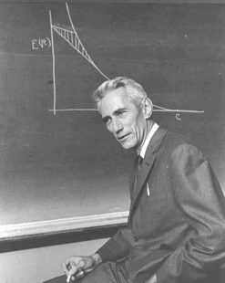
Shannon Legacy
The Information Revolution started in 1948, with the publication of:
A Mathematical Theory of Communication.
The digital age began.
Claude Shannon:
Shannon information quantifies the extent to which a recipient of data can reduce its statistical uncertainty.
“semantic aspects of communication are irrelevant . . .”
Objective: Reproducing reliably data:
Fundamental Limits for Storage and Communication.
Applications Enabler/Driver:
CD, iPod, DVD, video games, Internet, Facebook, WiFi, mobile, Google, . .
Design Driver:
universal data compression, voiceband modems, CDMA, multiantenna, discrete denoising, space-time codes, cryptography, distortion theory approach to Big Data.

Slide 4
What is Science of Information?
Claude Shannon laid the foundation of information theory, demonstrating that problems of data transmission and compression can be precisely modeled formulated, and analyzed.
Science of information builds on Shannon’s principles to address key challenges in understanding information that nowadays is not only communicated but also acquired, curated, organized, aggregated, managed, processed, suitably abstracted and represented, analyzed, inferred, valued, secured, and used in various scientific, engineering, and socio-economic processes.
.

Slide 5
Center’s Goals
Extend Information Theory to meet new challenges in
biology, economics, data sciences, knowledge extraction, …
Understand new aspects of information (embedded) in
structure, time, space, and semantics,
and
dynamic information, limited resources, complexity, representation-invariant information, and cooperation & dependency.
Extend Shannon findings to finite size objects (i.e., sequences, graphs, sets, data structures, social networks), that is, develop information theory of various objects beyond first-order asymptotics.

Slide 6
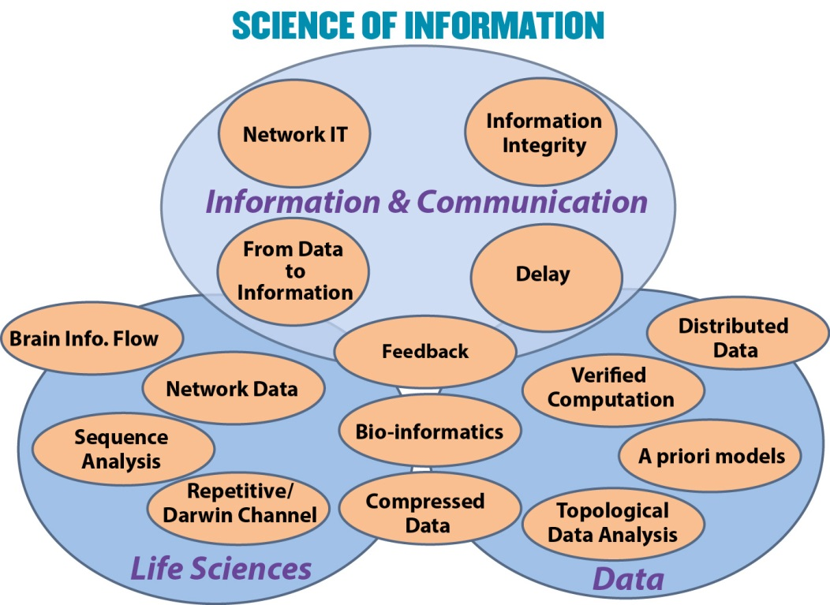

Slide 7
Center’s Main Theme
Data
Information
Knowledge
Framing the Foundation
Theory informs Practice (& vice versa)

Slide 8
Outline
Science of Information
Center Mission & Center Team
Research
  Fundamentals: Structural Information & Security
  Data Science: Quering & Twitter Models
  Life Sciences: DNA Resemble & Protein Folding

Slide 9

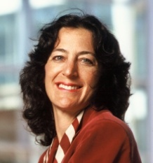
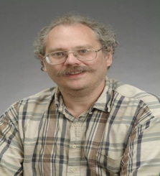
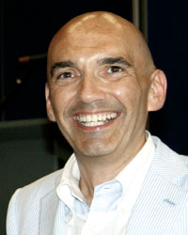

STC Team
Bryn Mawr College: D. Kumar
Howard University: C. Liu, L. Burge
MIT: P. Shor (co-PI), M. Sudan
Purdue University (lead): W. Szpankowski (PI)
Princeton University: S. Verdu (co-PI)
Stanford University: A. Goldsmith (co-PI)
Texas A&M: P.R. Kumar
University of California, Berkeley: Bin Yu (co-PI)
University of California, San Diego: S. Subramaniam
UIUC: O. Milenkovic.
Wojciech Szpankowski,
Purdue
Andrea Goldsmith,
Stanford
Peter Shor,
MIT
Sergio Verdú,
Princeton
R. Aguilar, M. Atallah, S. Datta, A. Grama, A. Mathur, J. Neville, D. Ramkrishna, L. Si, V. Rego, A. Qi, M. Ward, D. Xu, C. Liu, L. Burge, S. Aaronson, N. Lynch, R. Rivest, Y. Polyanskiy, W. Bialek, S. Kulkarni, C. Sims, G. Bejerano, T. Cover, A. Ozgur, T. Weissman, V. Anantharam, J. Gallant, T. Courtade, M. Mahoney, D. Tse,T.Coleman, Y. Baryshnikov, M. Raginsky, N. Santhanam.
Bin Yu,
U.C. Berkeley

Slide 10
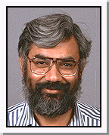
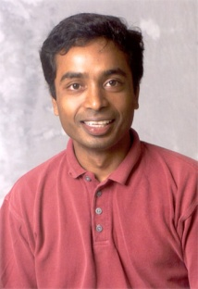
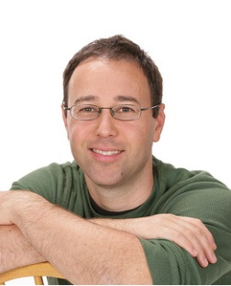
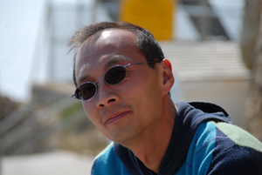
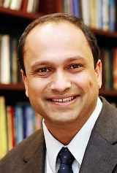

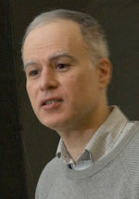
Mission and Integrated Research
CSoI MISSION :Advance science and technology through a new quantitative understanding of the representation, communication and processing of information in biological, physical, social and engineering systems.
RESEARCH MISSION : Create a shared intellectual space, integral to the Center’s activities, providing a collaborative research environment that crosses disciplinary and institutional boundaries.
S. Subramaniam A. Grama
Research Thrusts:
1. Information & Communication
2. Knowledge Extraction (Data Science)
3. Life Sciences
David Tse T. Weissman
S. Kulkarni J. Neville

Slide 11
Outline
Science of Information
Center Mission & Center Team
Research
  Fundamentals: Structural Information & Security
  Data Science: Quering & Twitter Models
  Life Sciences: DNA Resemble & Protein Folding
Based on: Choi and Szpankowski, ``Compression of Graphical Structures Fundamental Limits, Algorithms, and Experiments’’, IEEE Trans. Information Theory, 2012.

Slide 12
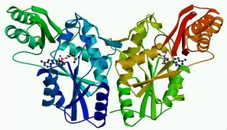
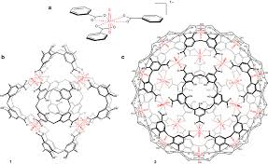
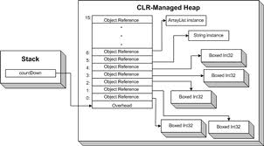
Challenge: Structural Information
Structure:
Measures are needed for quantifying information embodied in structures (e.g., information in material structures, nanostructures, biomolecules, gene regulatory networks, protein networks, social networks, financial transactions).
[F. Brooks, JACM, 2003]
Szpankowski, Choi, Manger : Information contained
in unlabeled graphs & universal graphical compression.
Grama & Subramaniam : quantifying role of noise and incomplete data, identifying conserved structures, finding orthologies in biological network reconstruction.
Neville: Outlining characteristics (e.g., weak dependence)
sufficient for network models to be well-defined in the limit.
Yu & Qi: Finding distributions of latent structures in social networks.
Szpankowski, Baryshnikov, & Duda: structure of Markov fields and
optimal compression.

Slide 13
Structure vs Labeled Structure
Paris
FRANCE
Lyon
FRANCE
Strasbourg
FRANCE
Gdansk
POLAND
Helsinki
FINLAND
Turku
FINLAND
Warsaw
POLAND
Tampere
FINLAND
How much information embedded in structure and (correlated) labels? Fundamental New Limits?

Slide 14
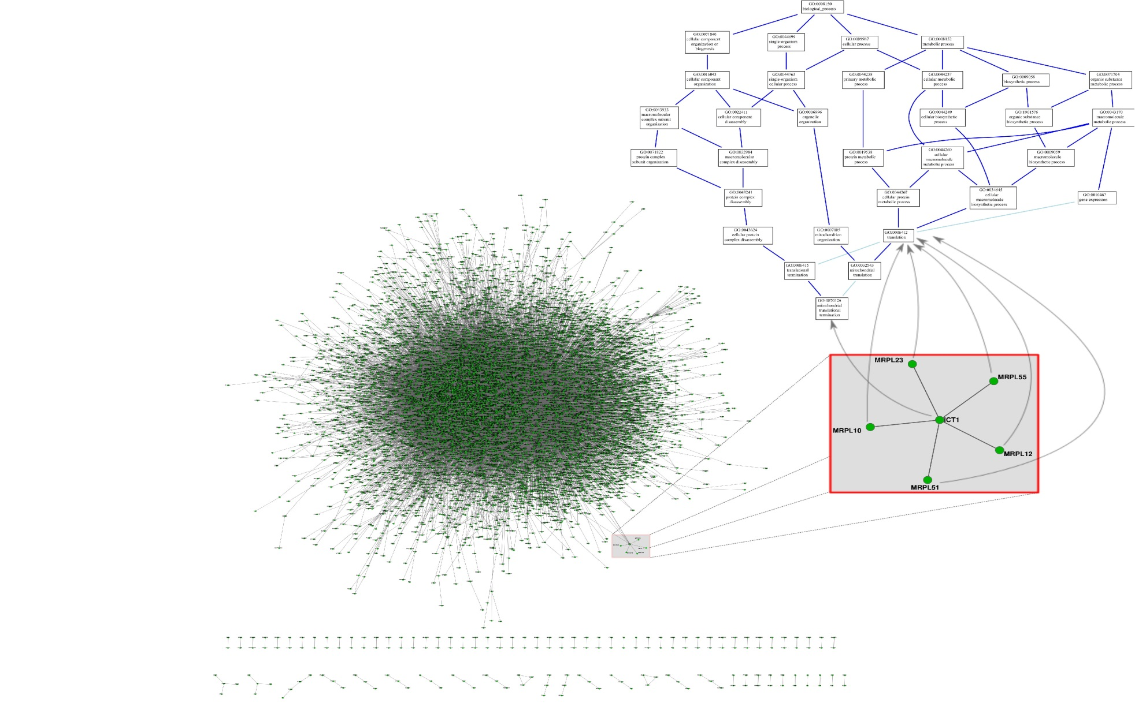
Real Stuff – Biological Networks

Slide 15
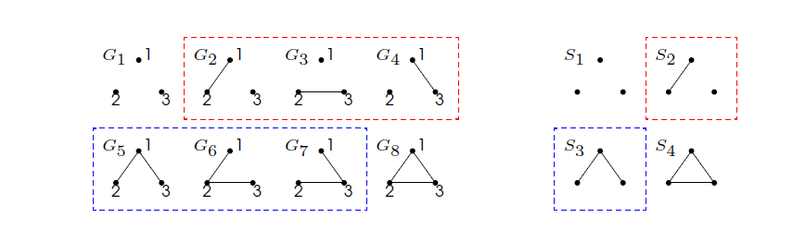
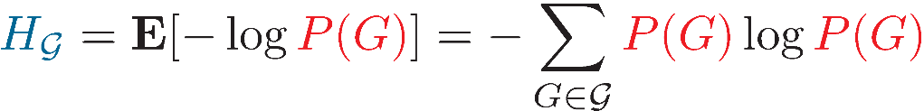
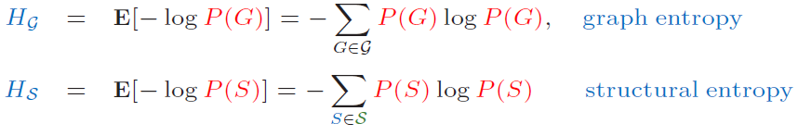
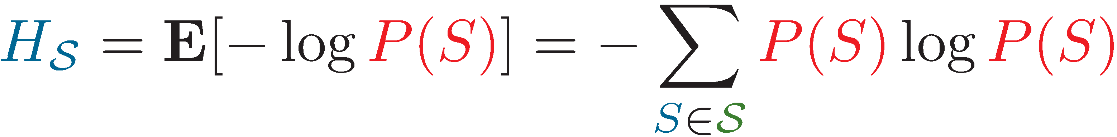
Structural Entropy on Graphs
Information Content of Unlabeled Graphs:
A structure model S of a graph G is defined for an unlabeled version.
Some labeled graphs have the same structure.
Graph Entropy vs Structural Entropy:
The probability of a structure S is: P(S) = N(S) · P(G)
where N(S) is the number of different labeled graphs having the same
structure.
15

Slide 16

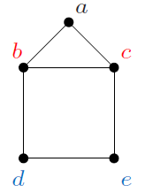
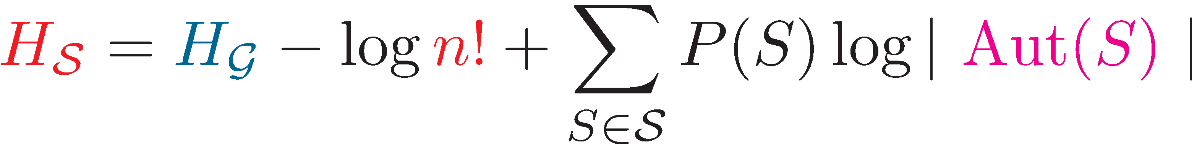



Graph Automorphism: For a graph G its automorphism is adjacency preserving permutation of vertices of G.
Lemma 1. If all isomorphic graphs have the same probability, then
where Aut(S) is the automorphism group of S.
Theorem. [Choi, WS, 2012] For Erdös-Rényi graphs G(n,p) and all p satisfying and (i.e., the graph is connected w.h.p.) we have
AEP:

Slide 17
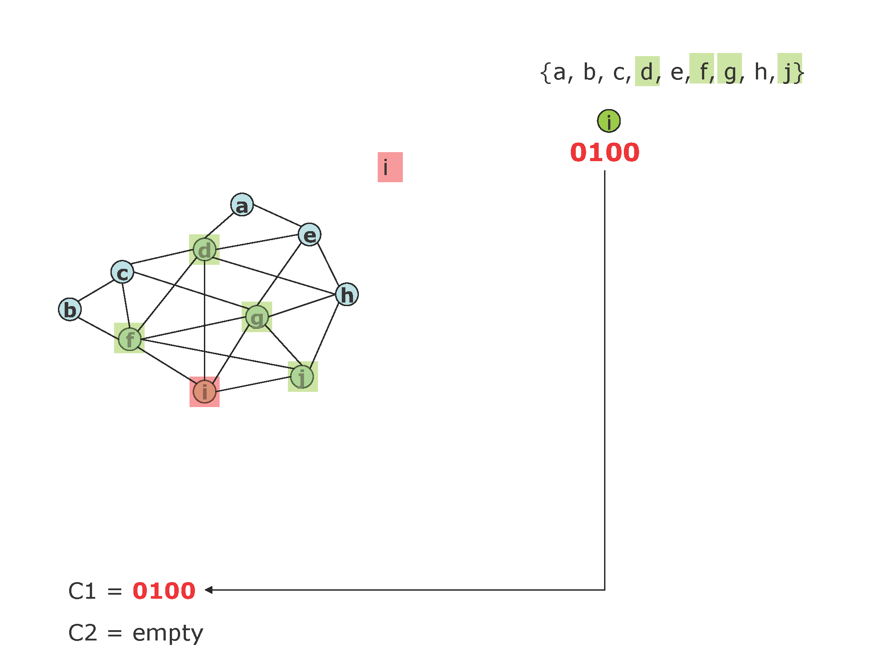
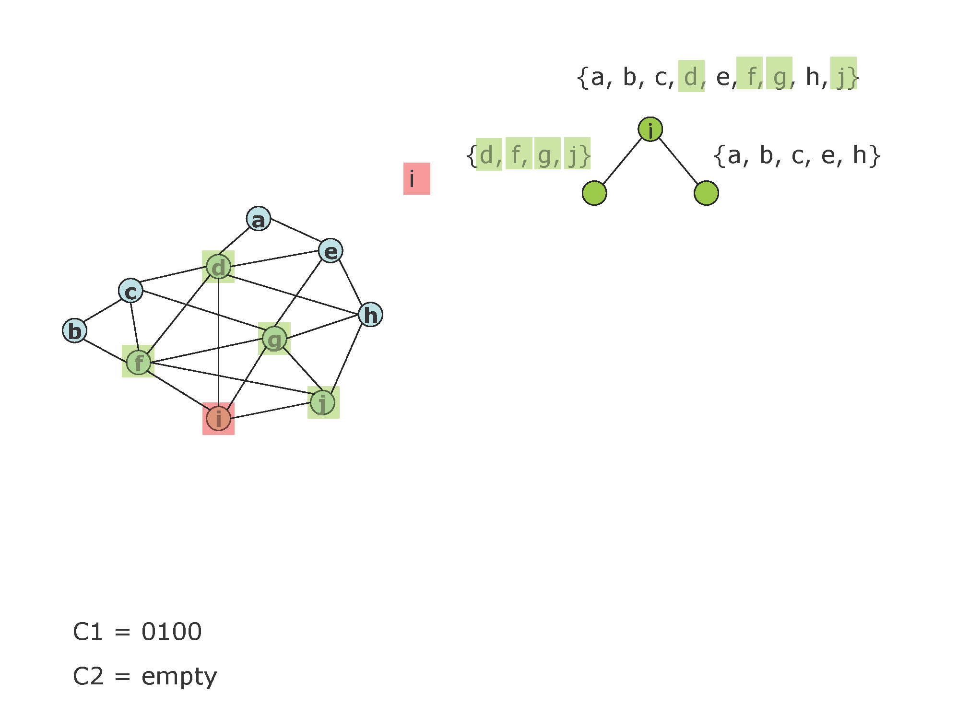
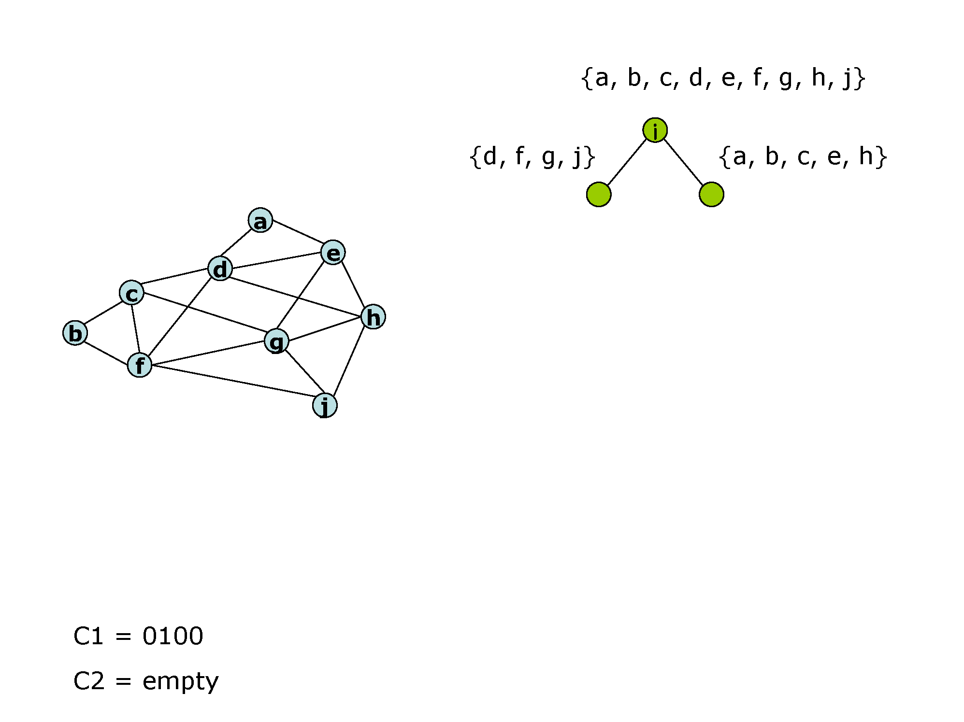
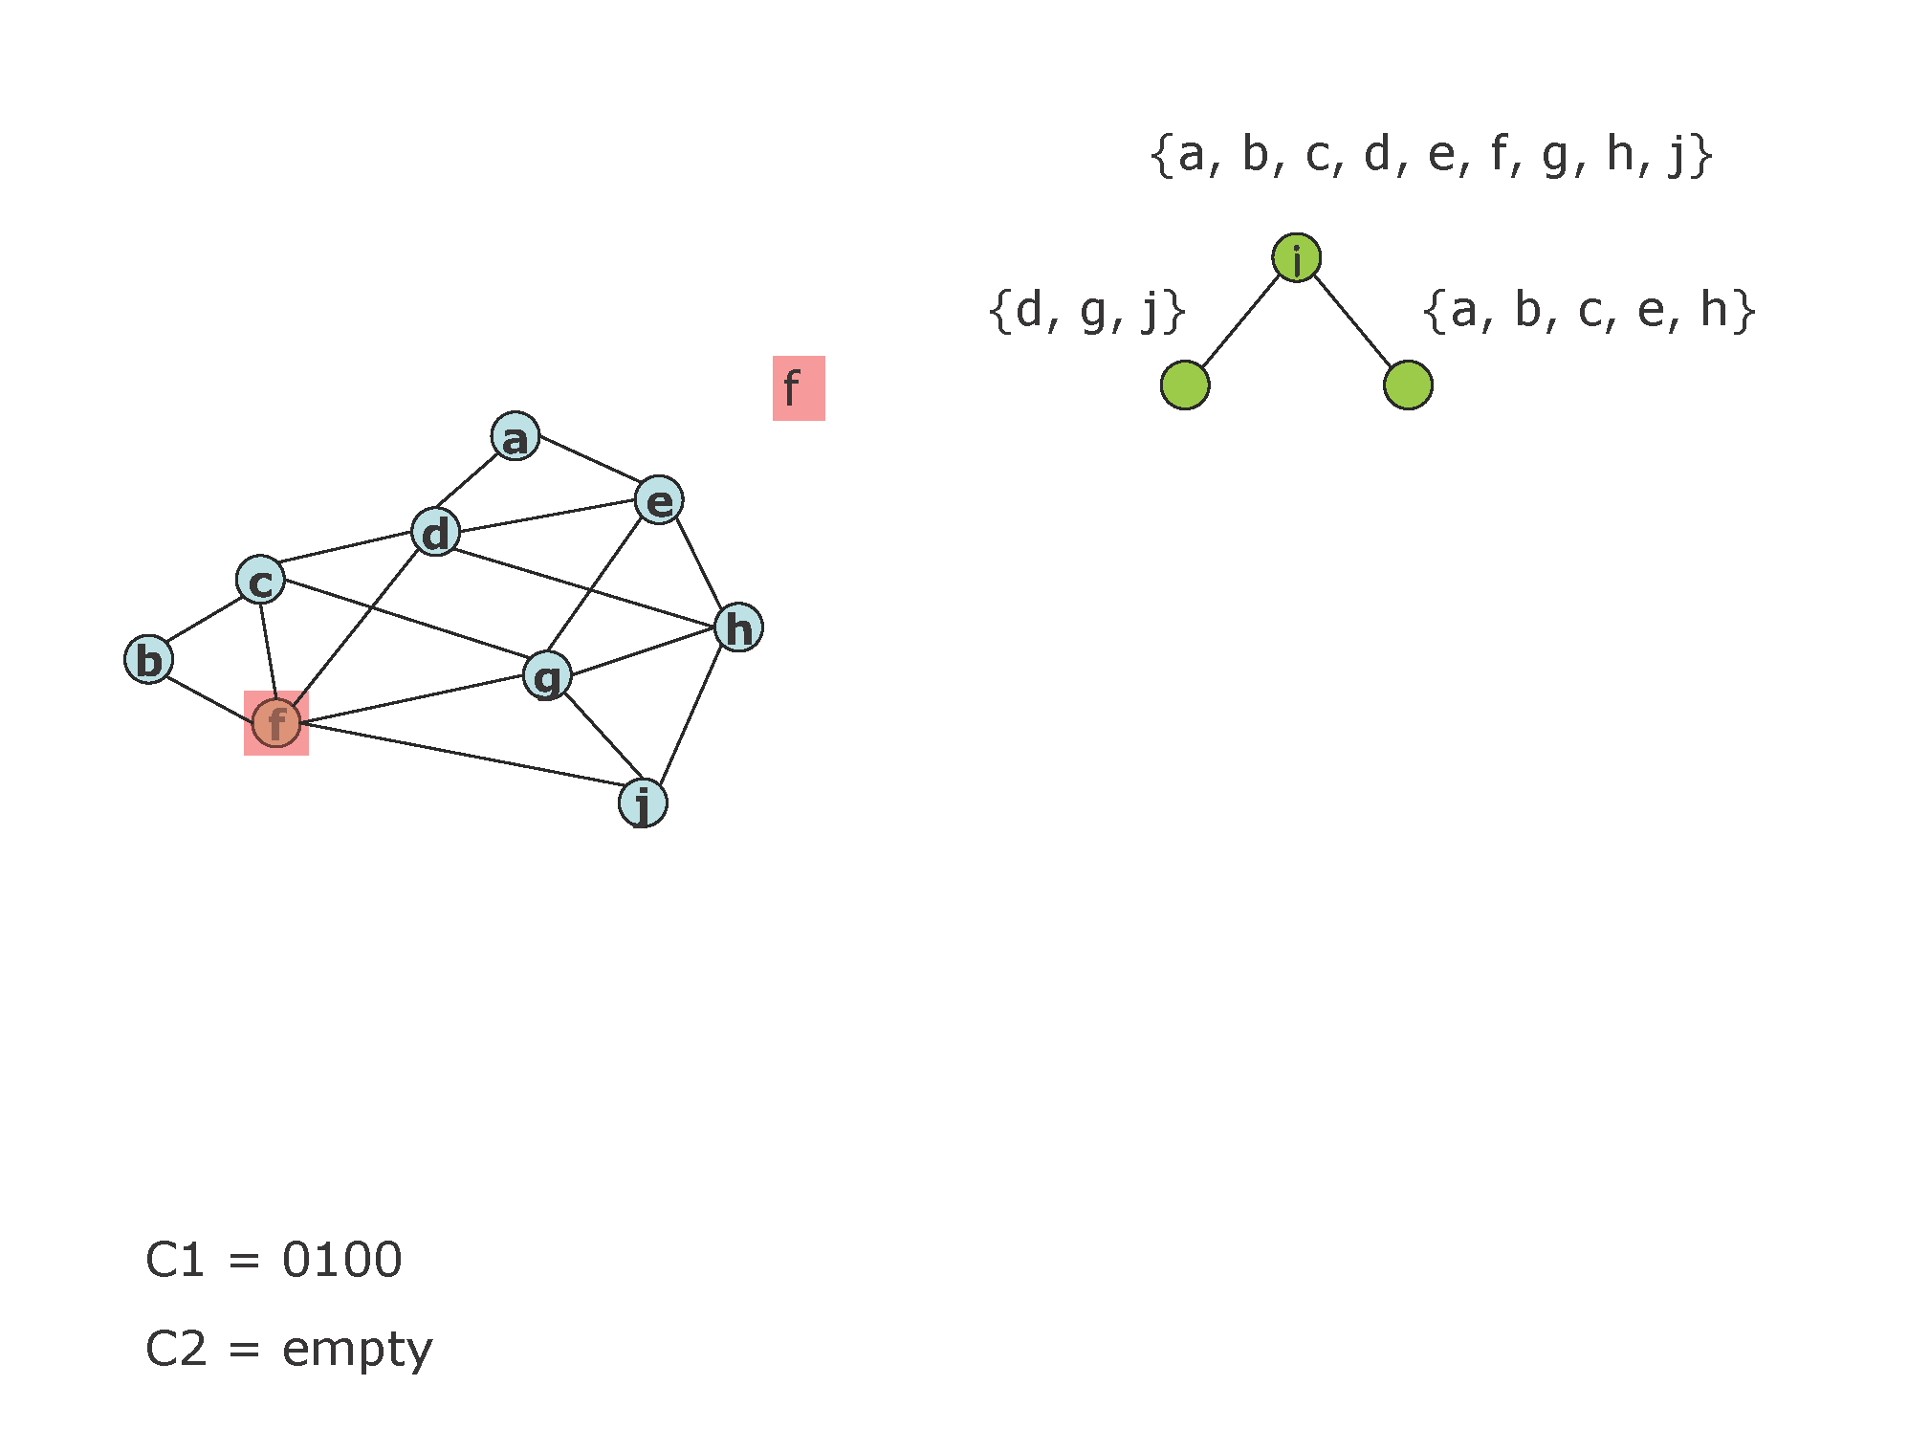
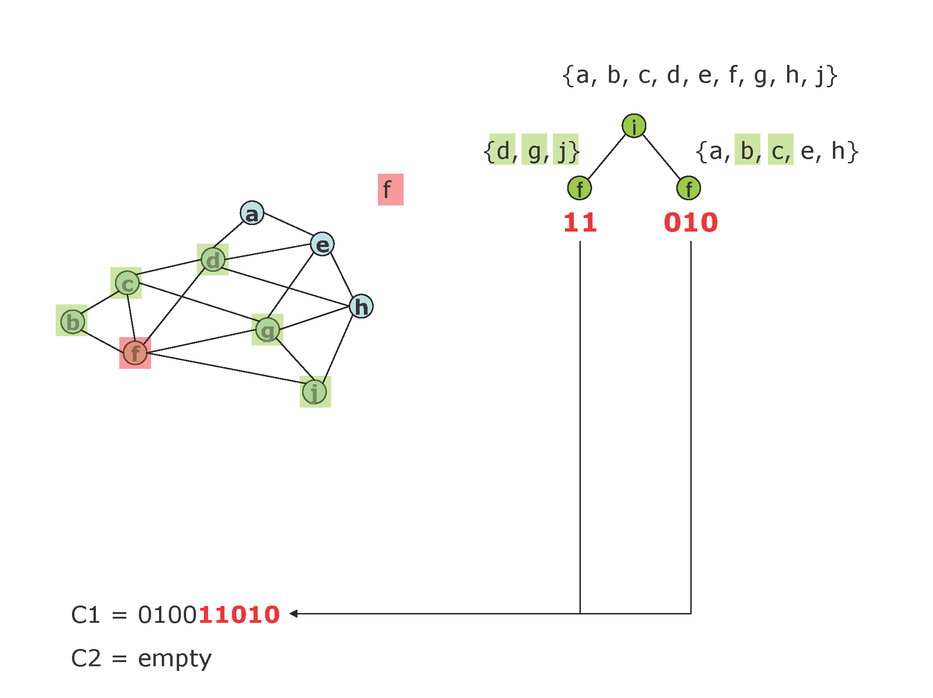
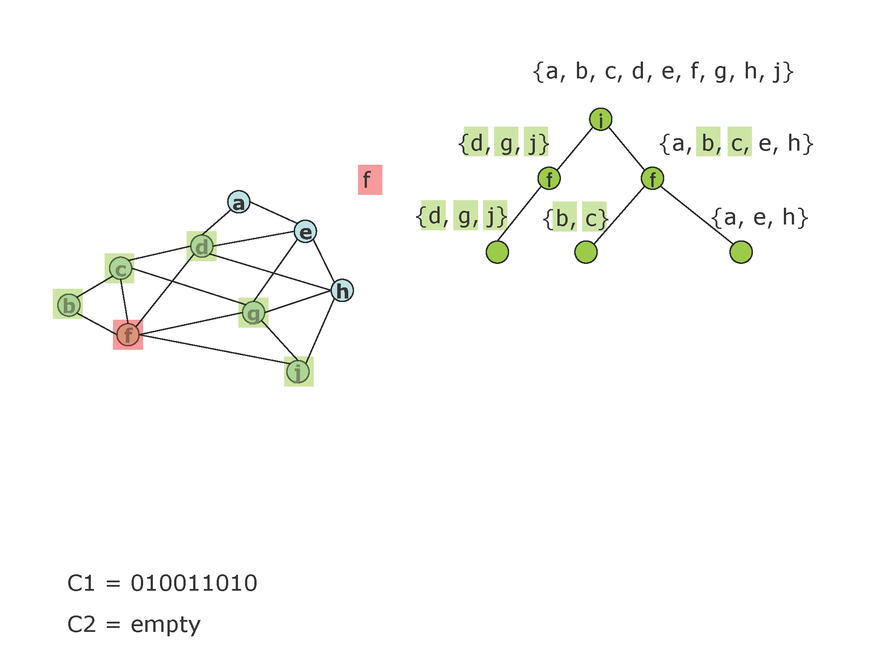
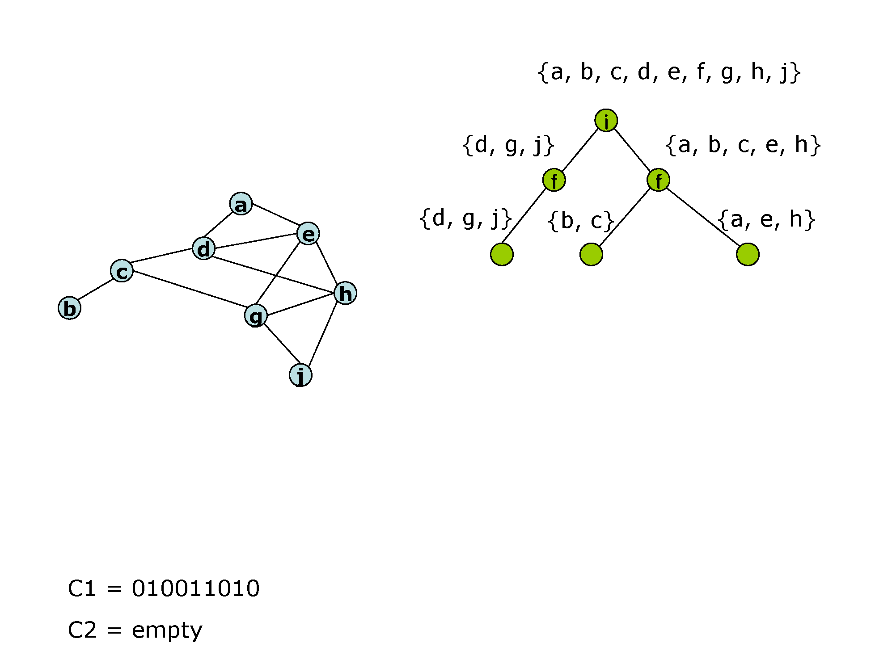
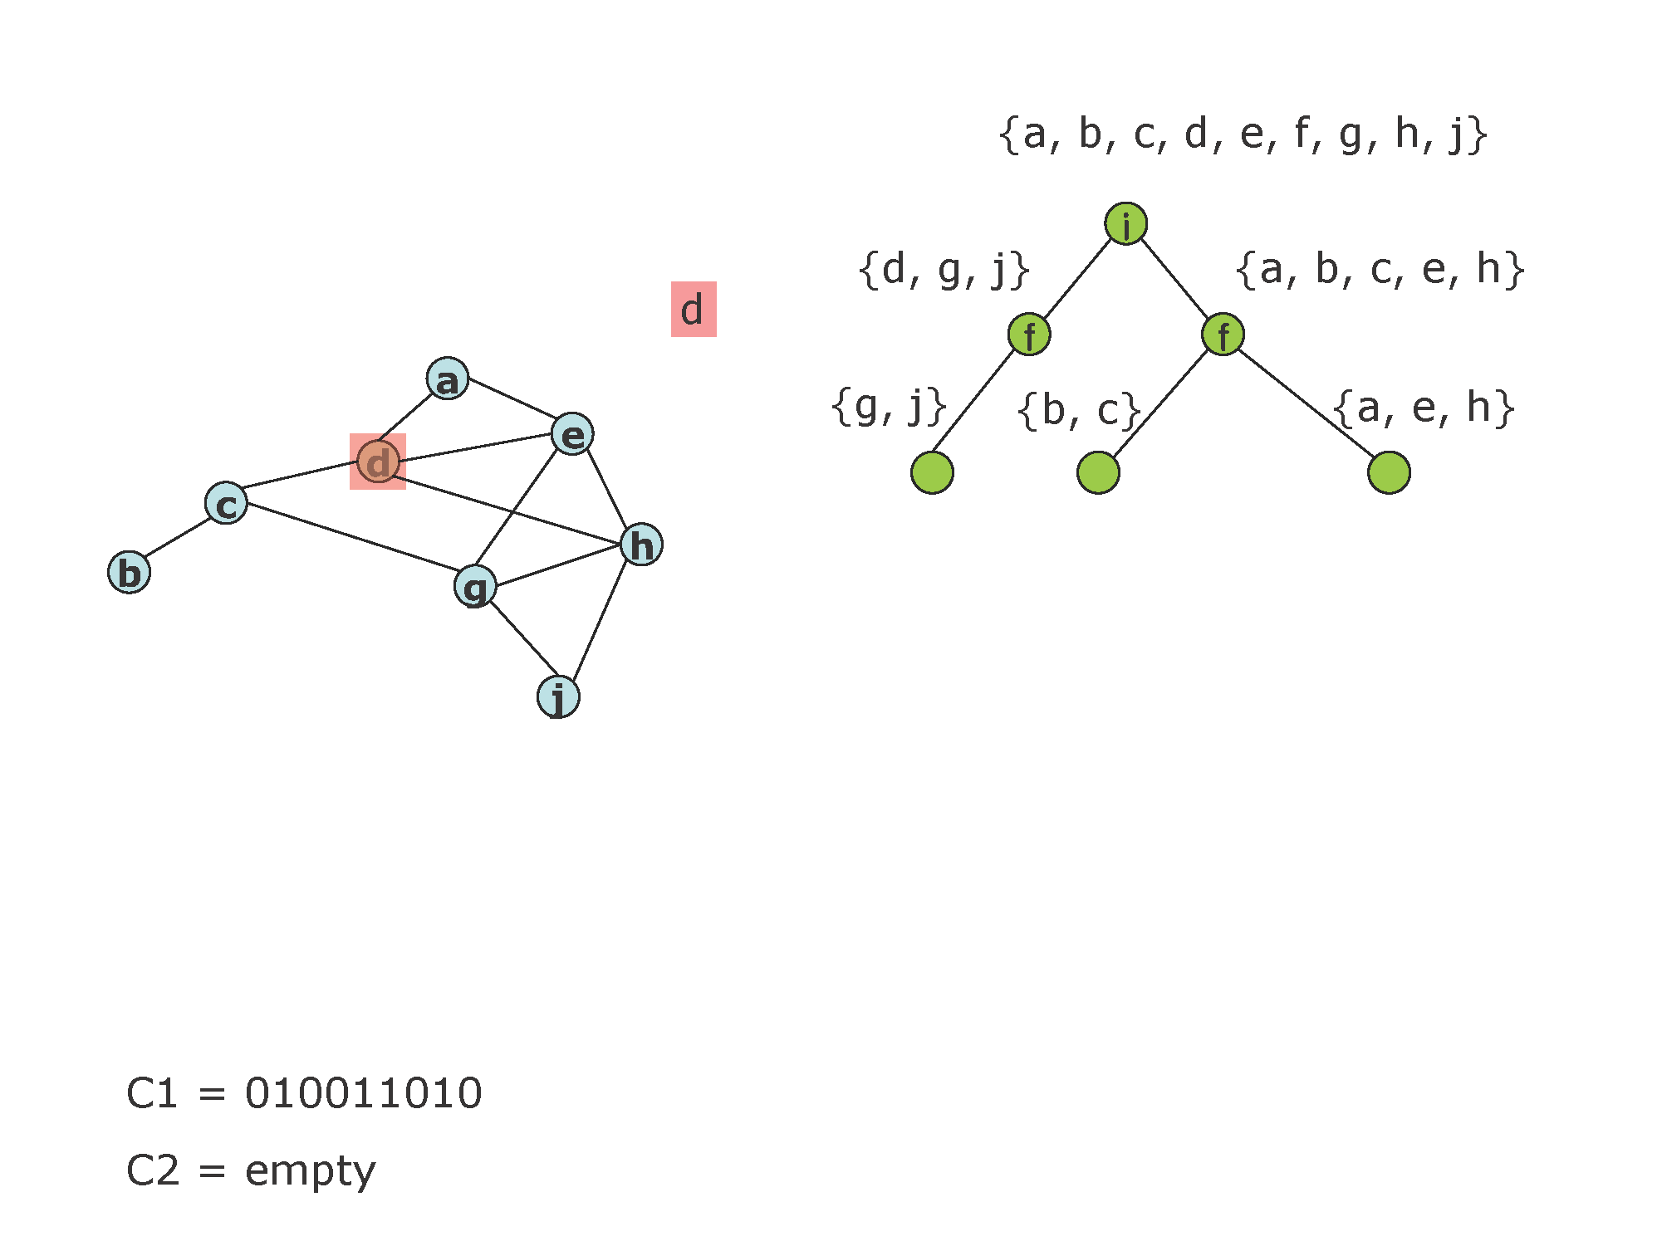
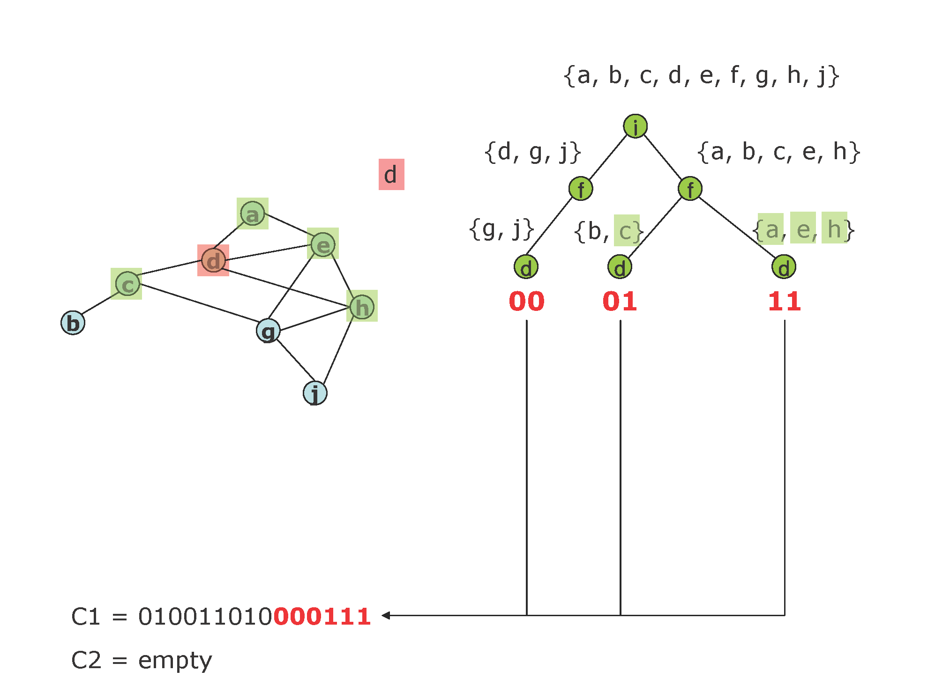
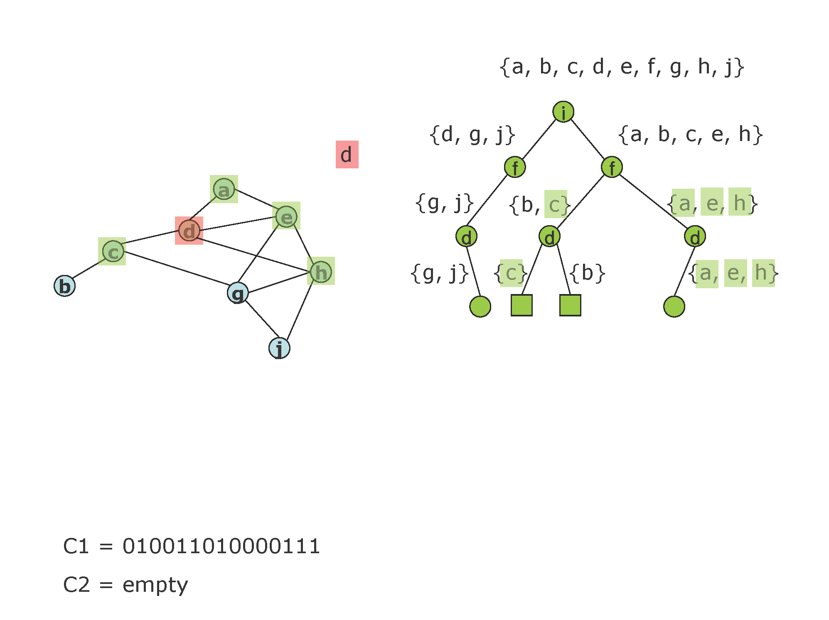
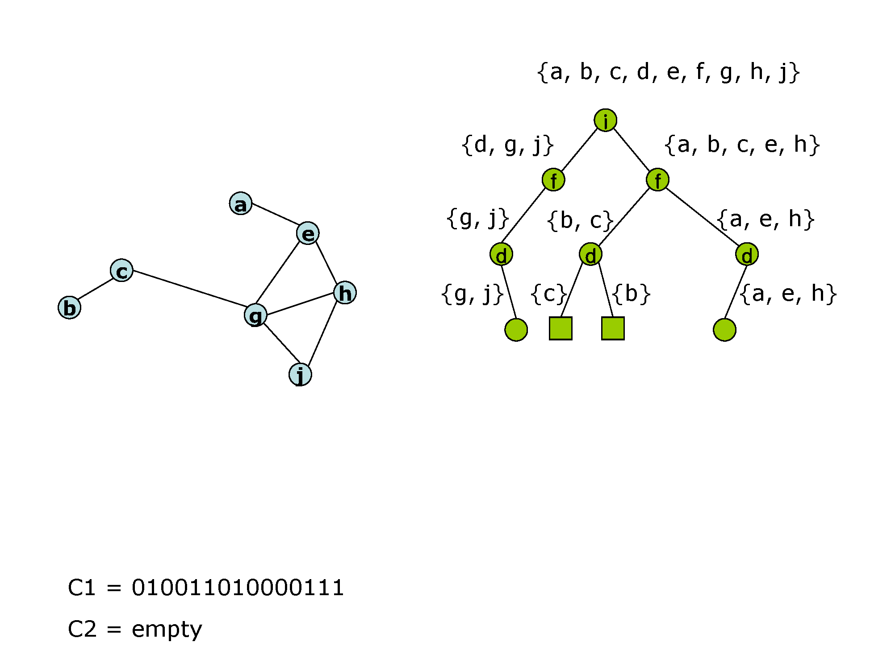
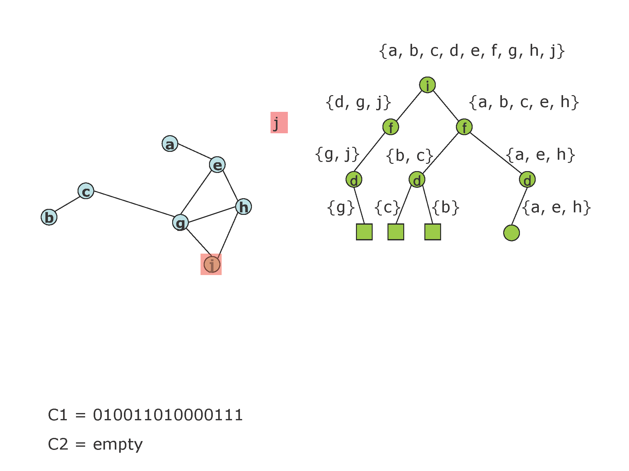
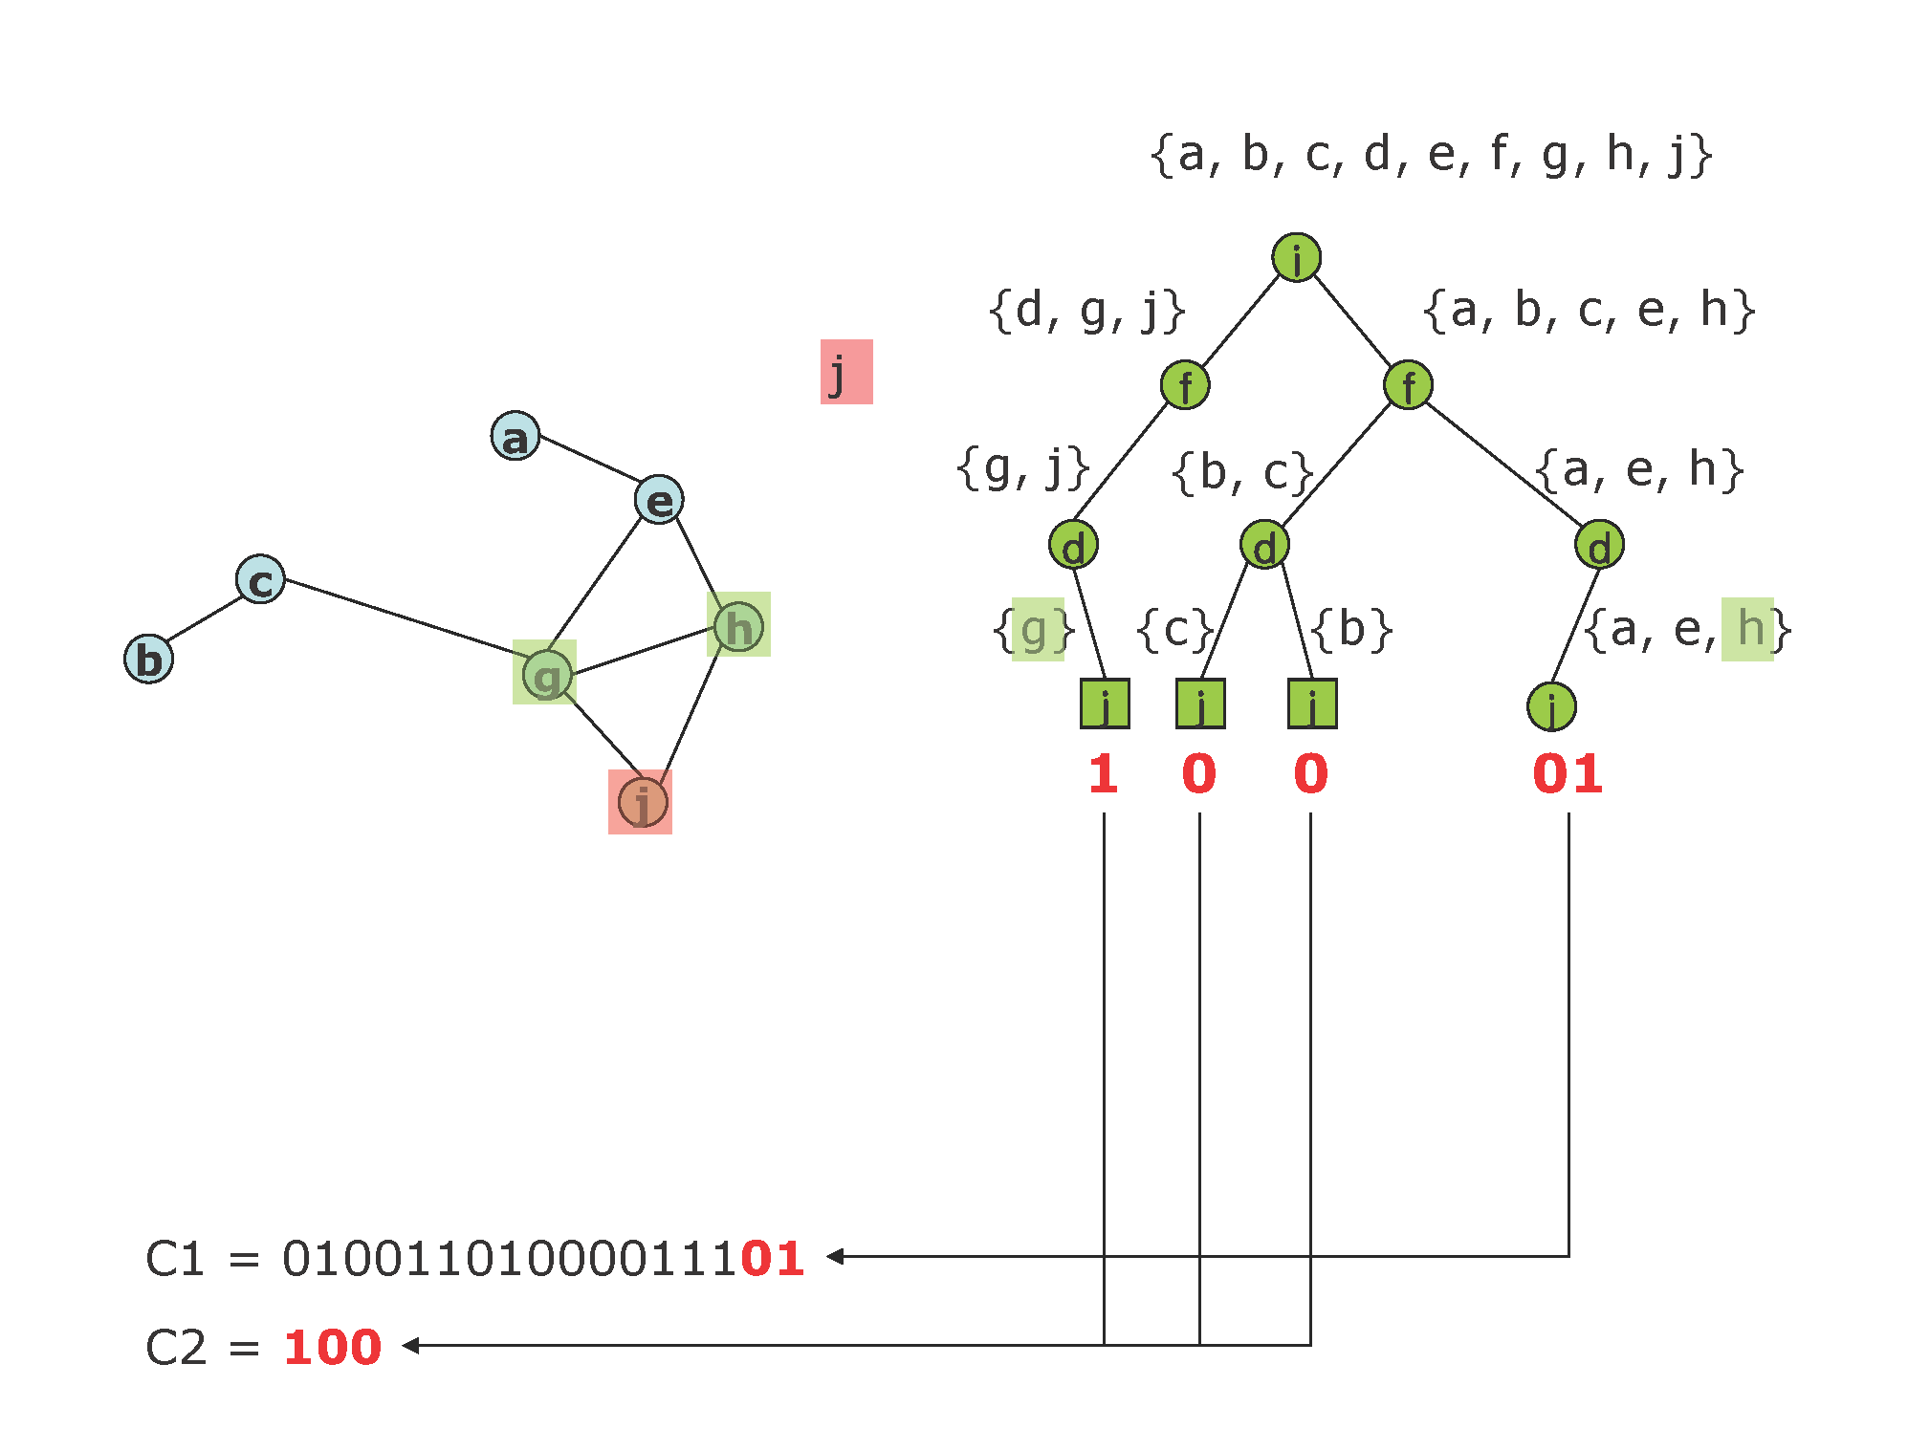
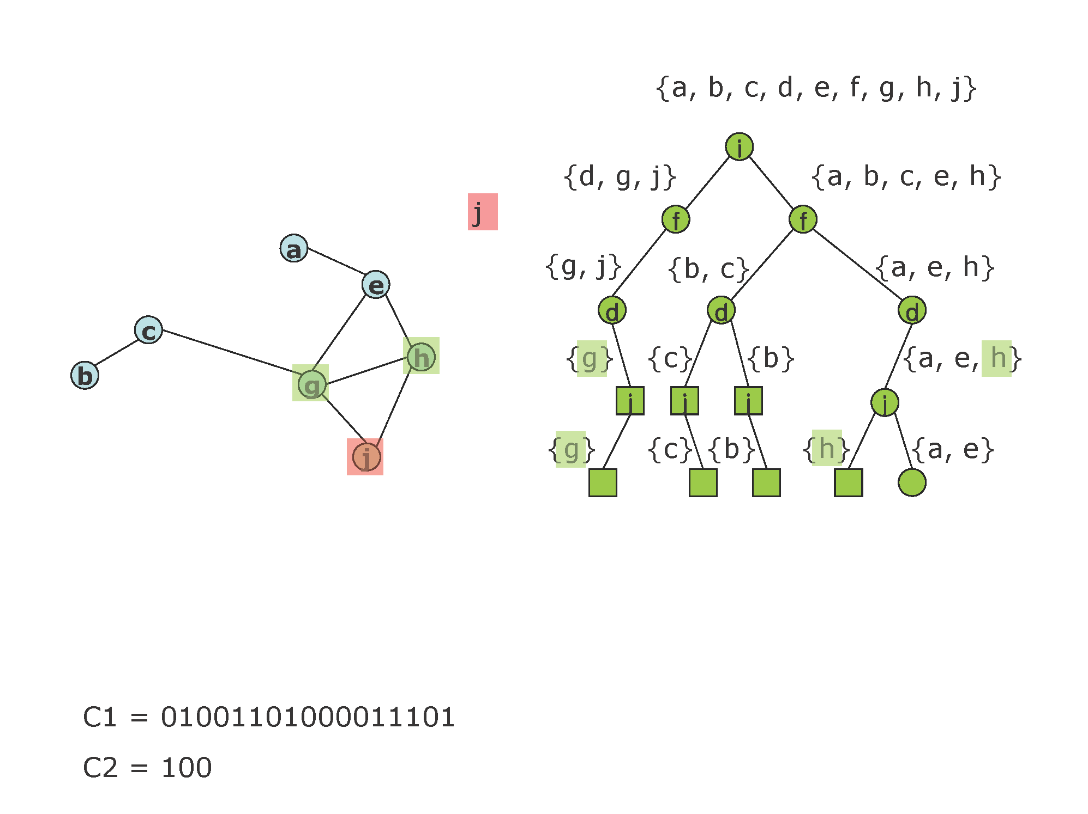
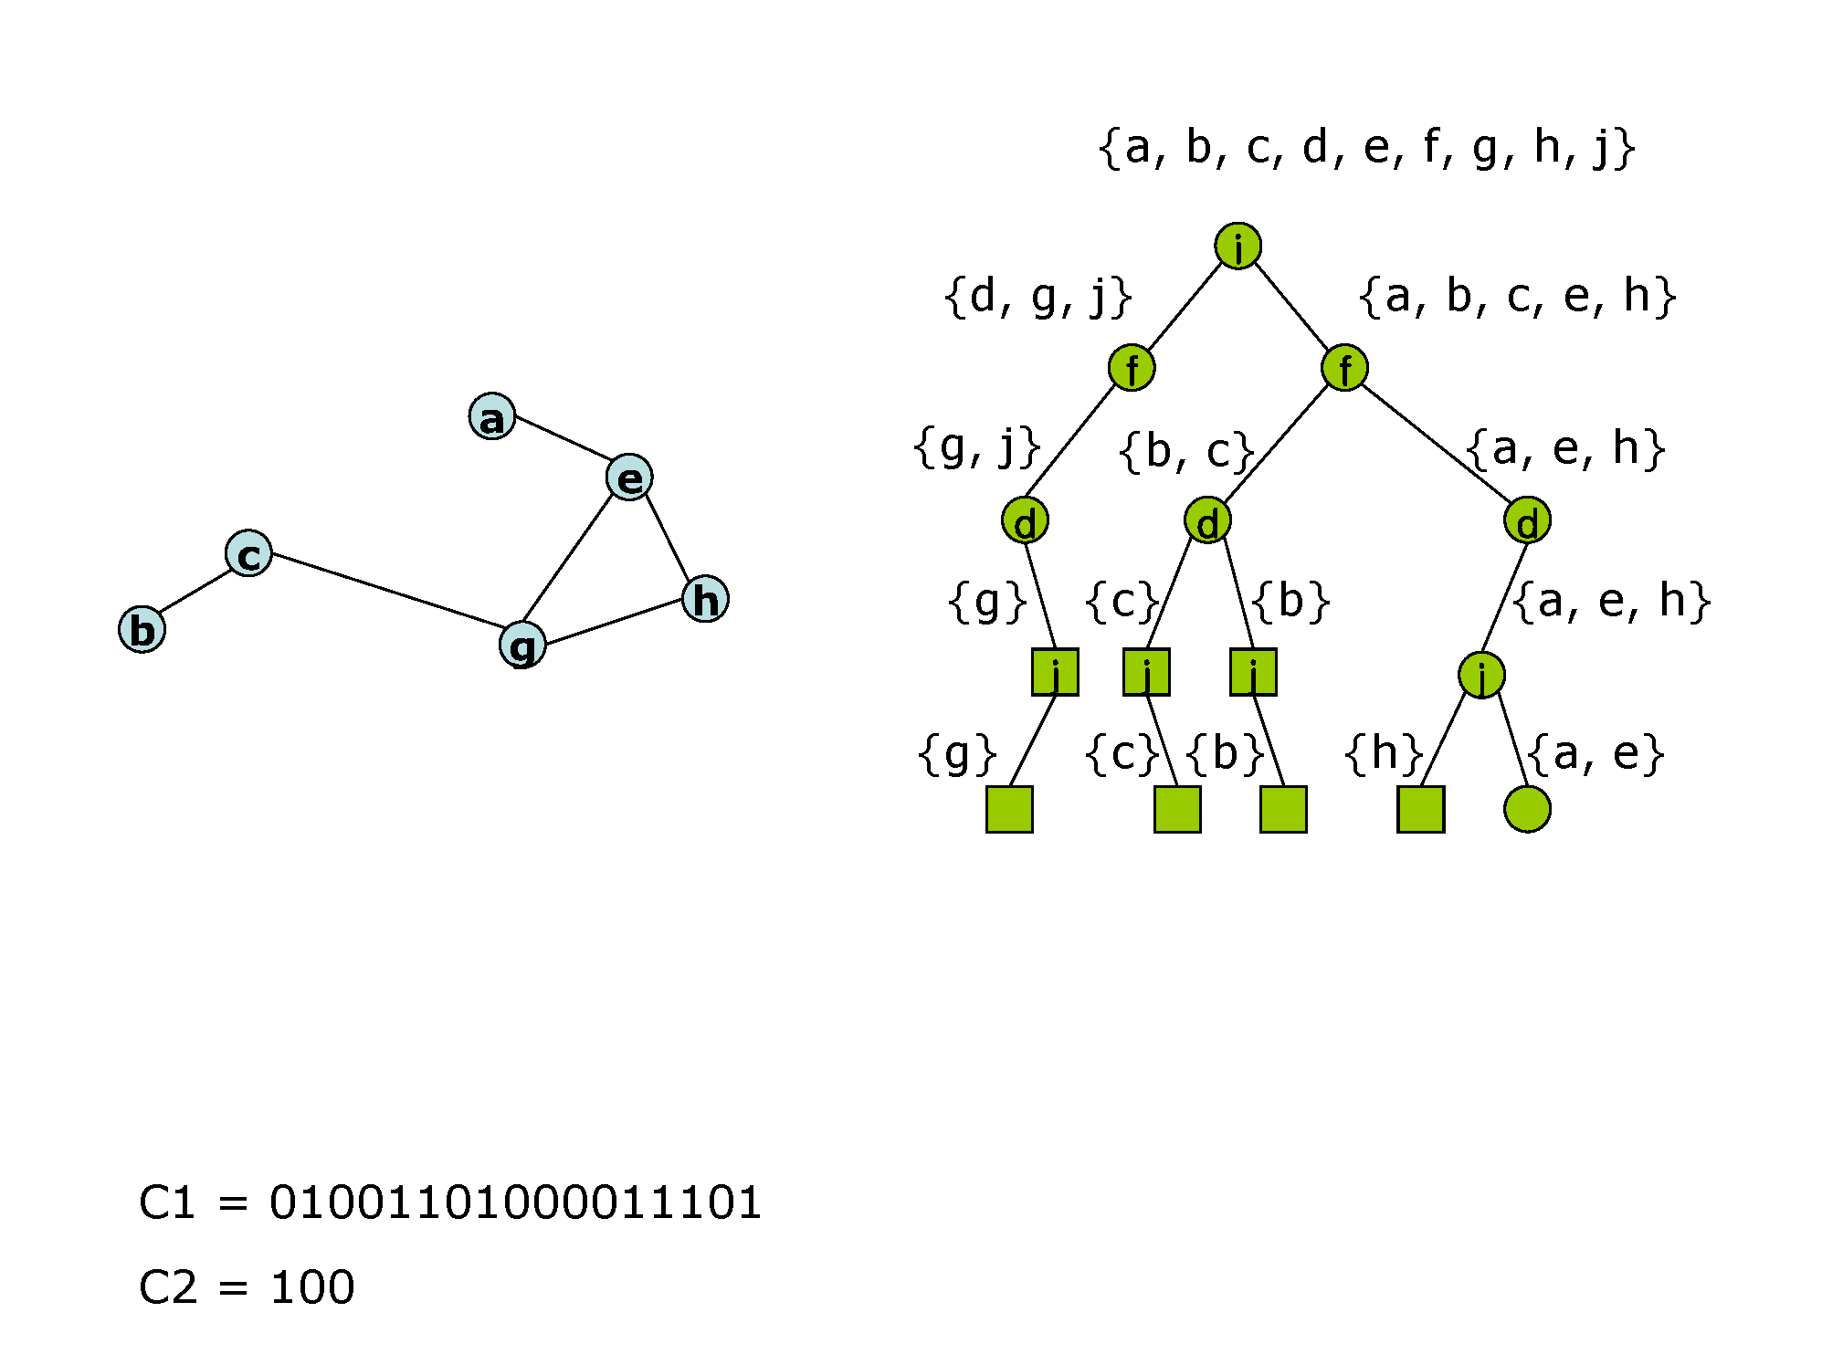
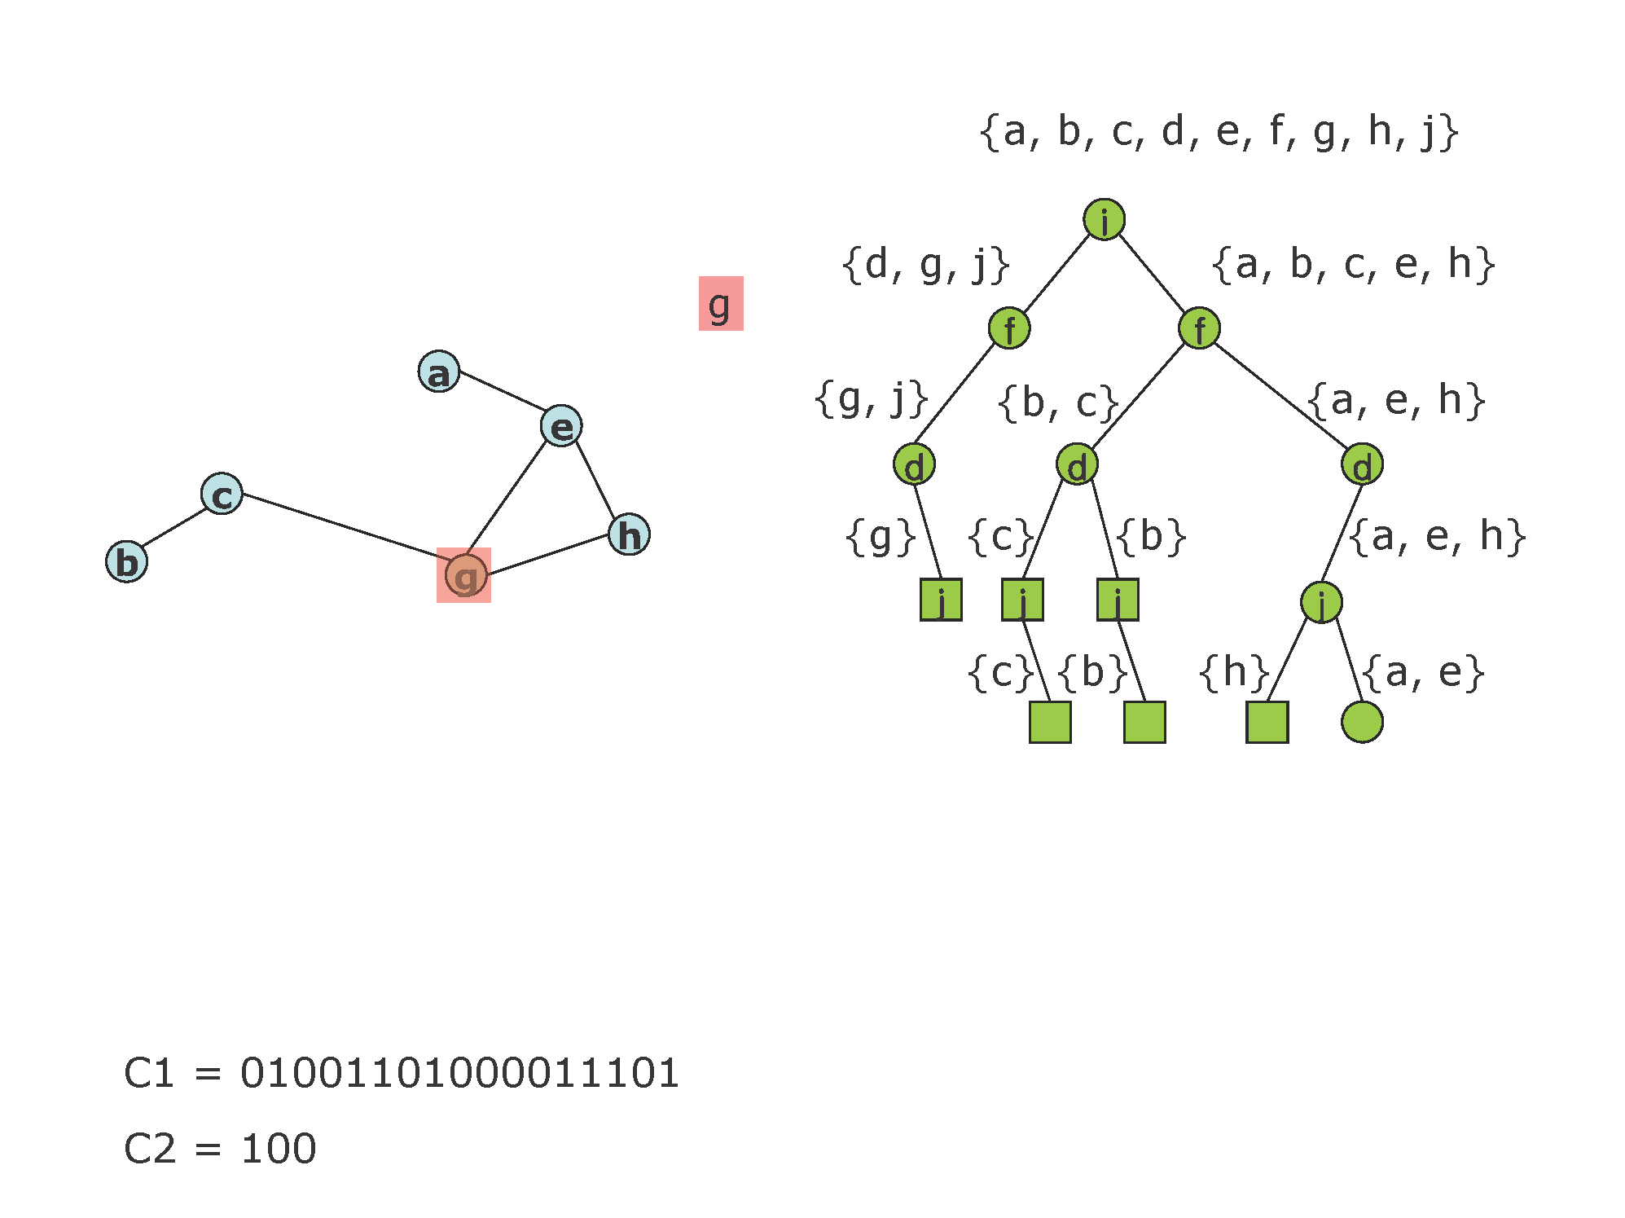
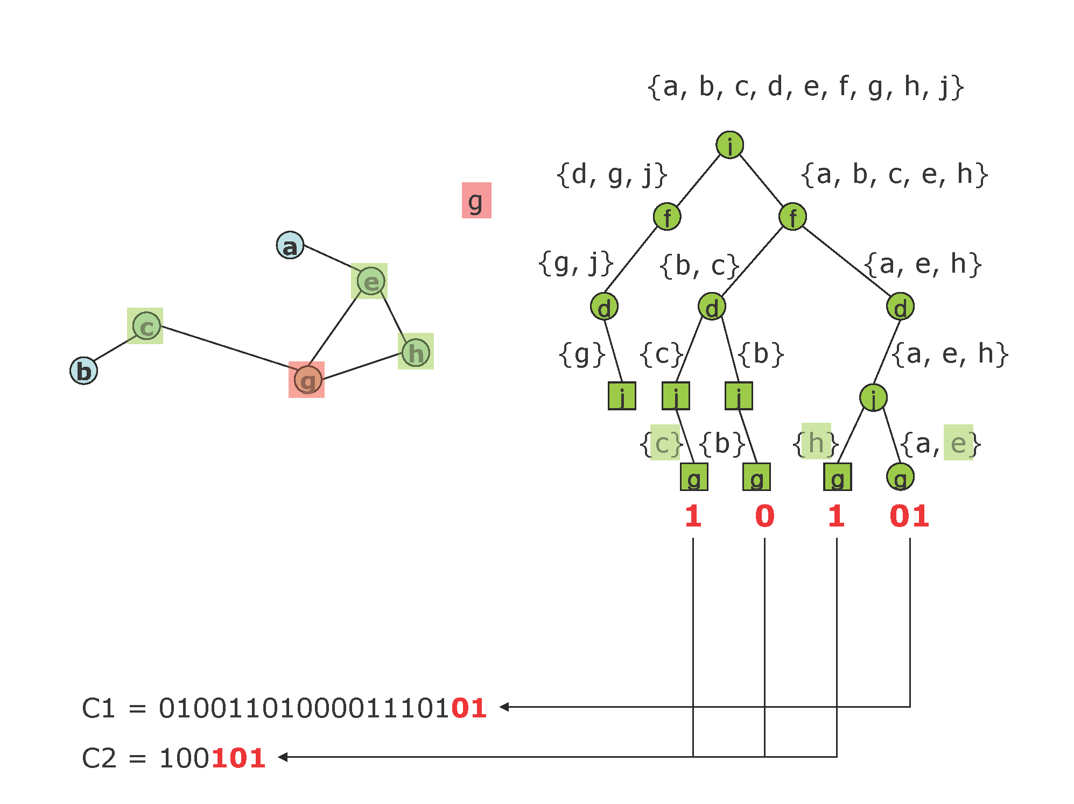
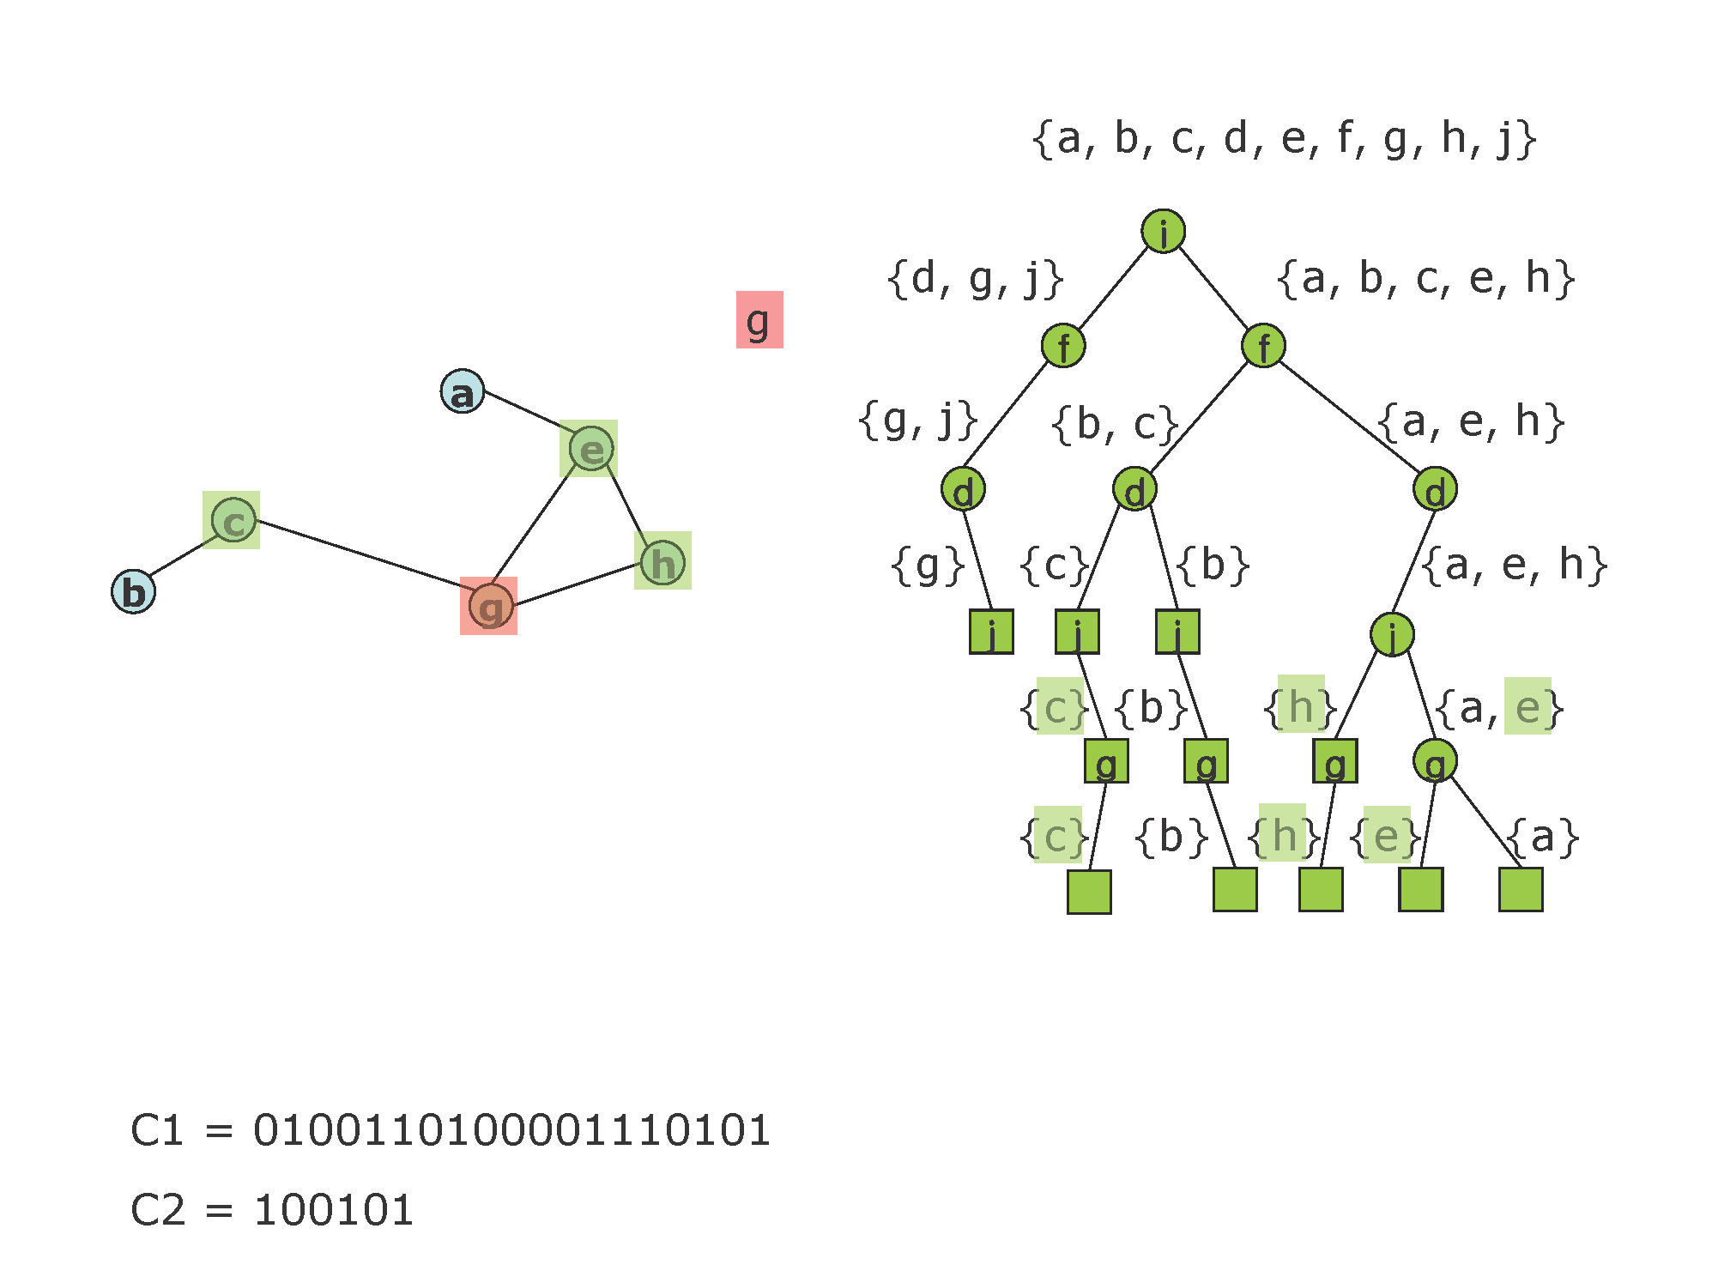
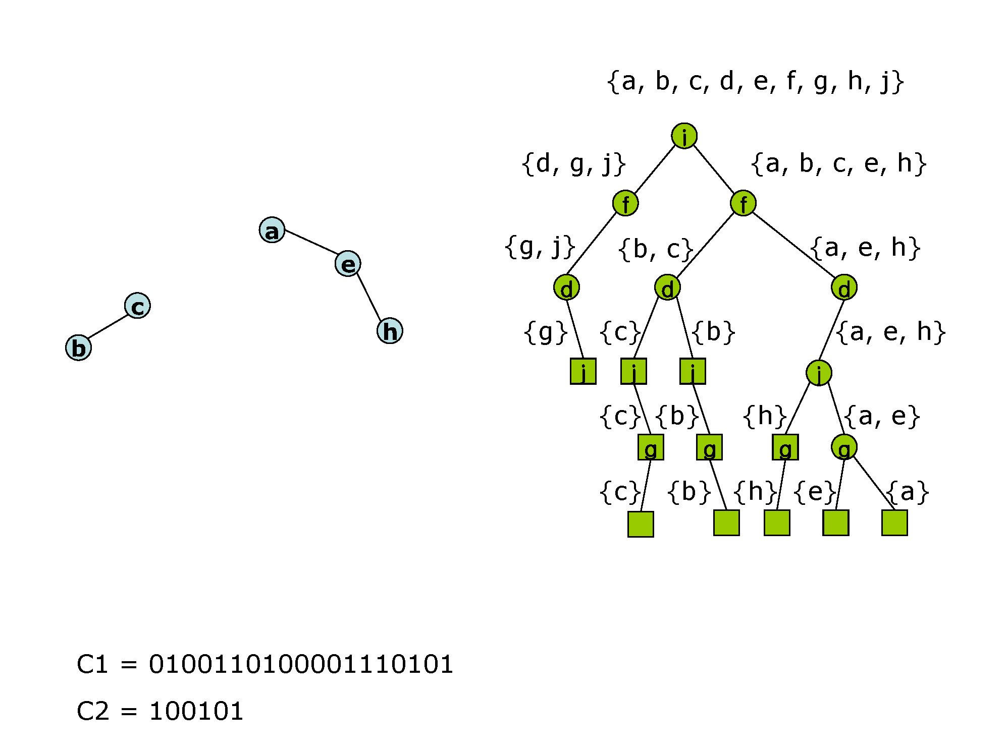
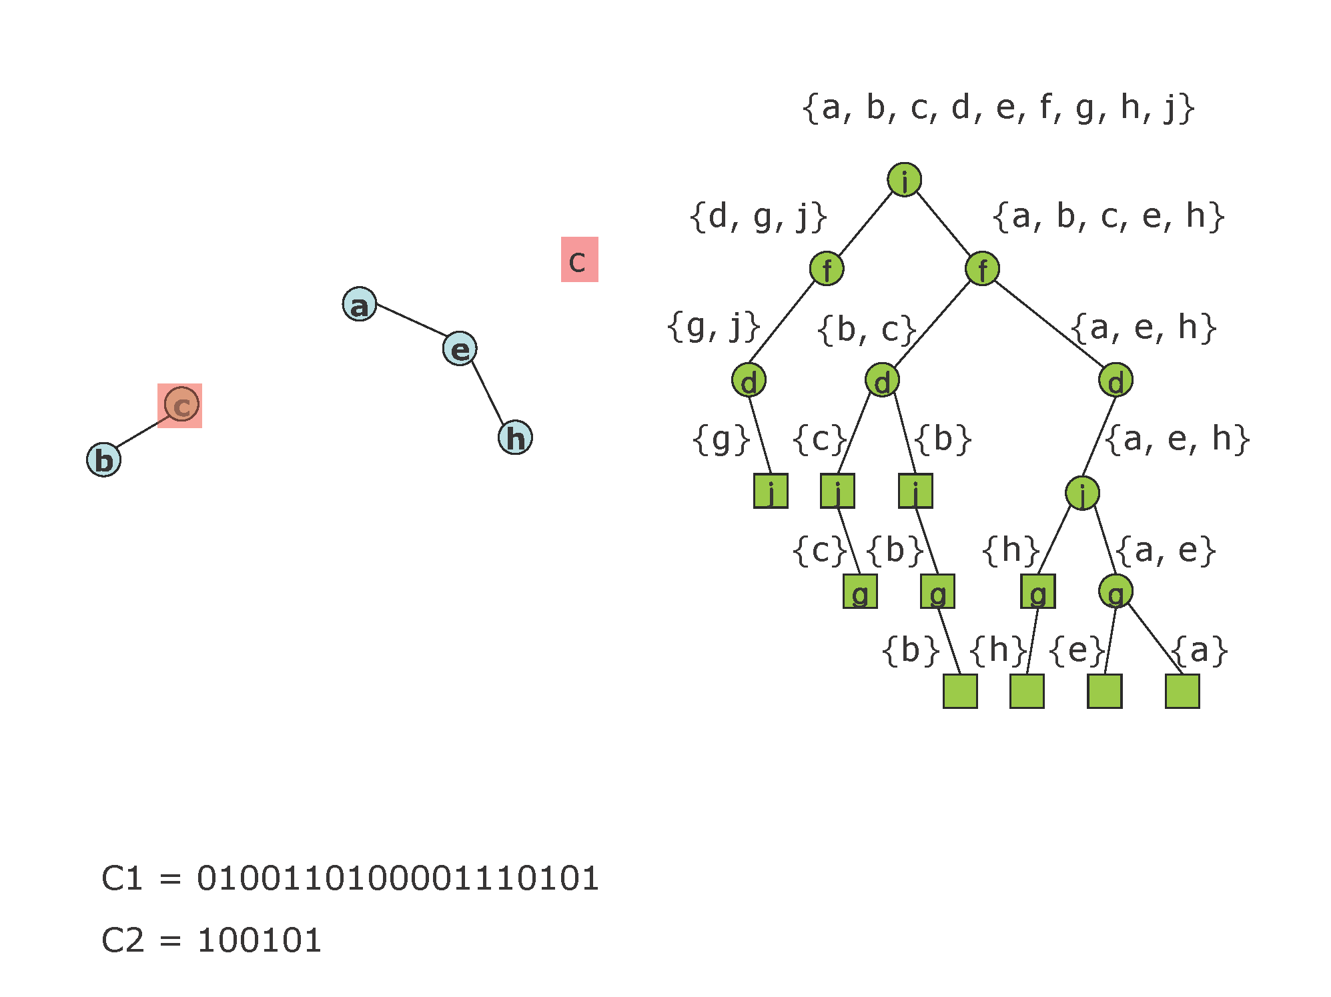
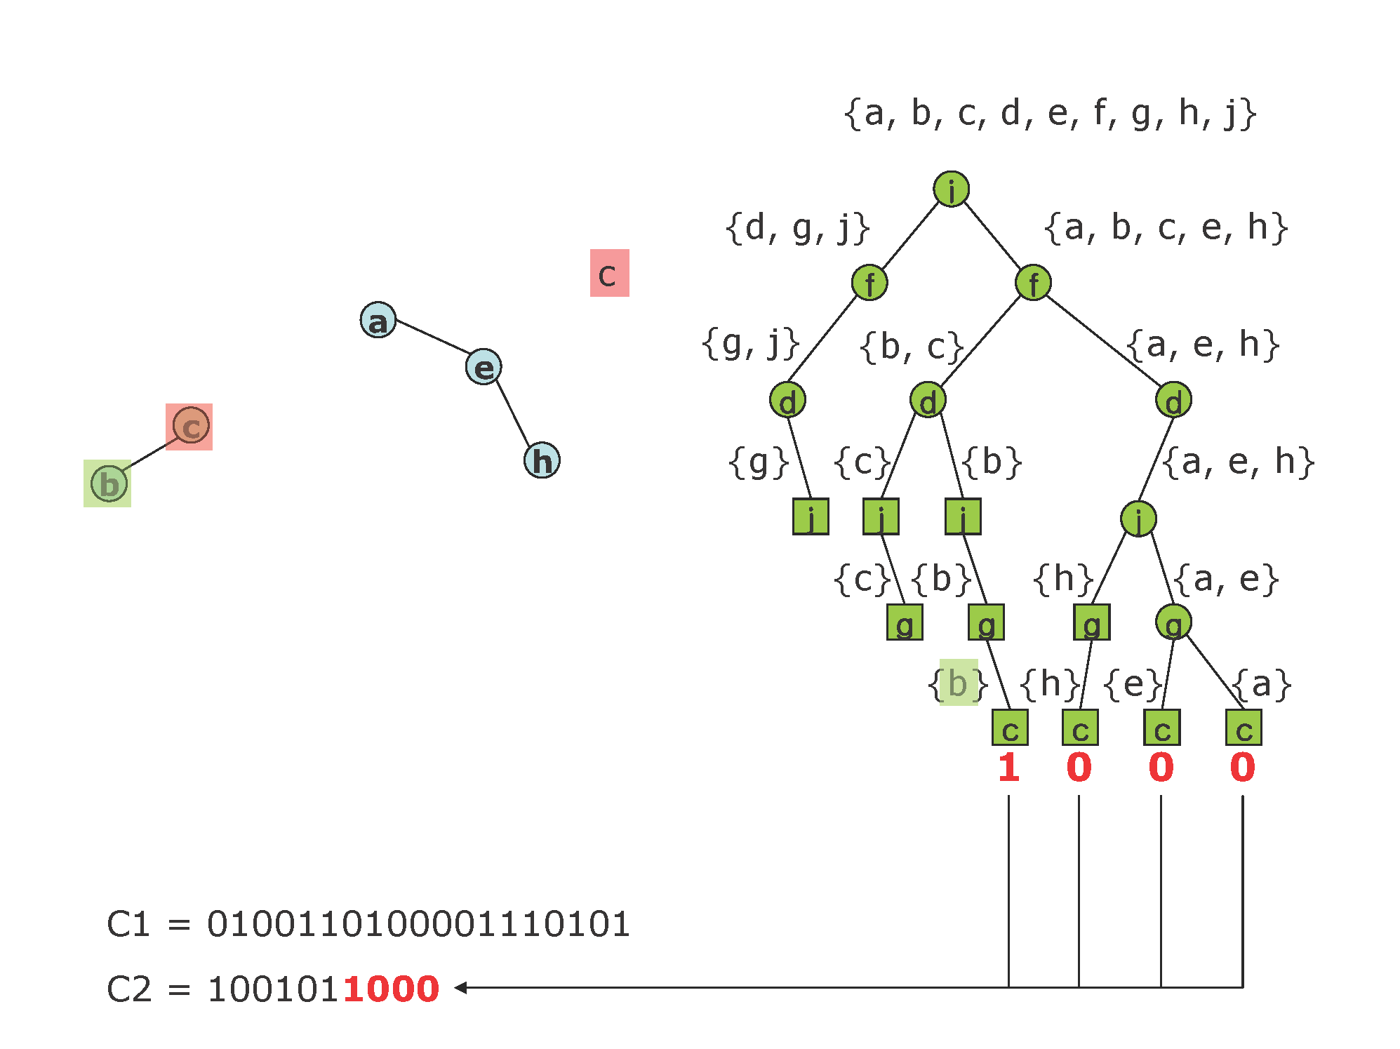
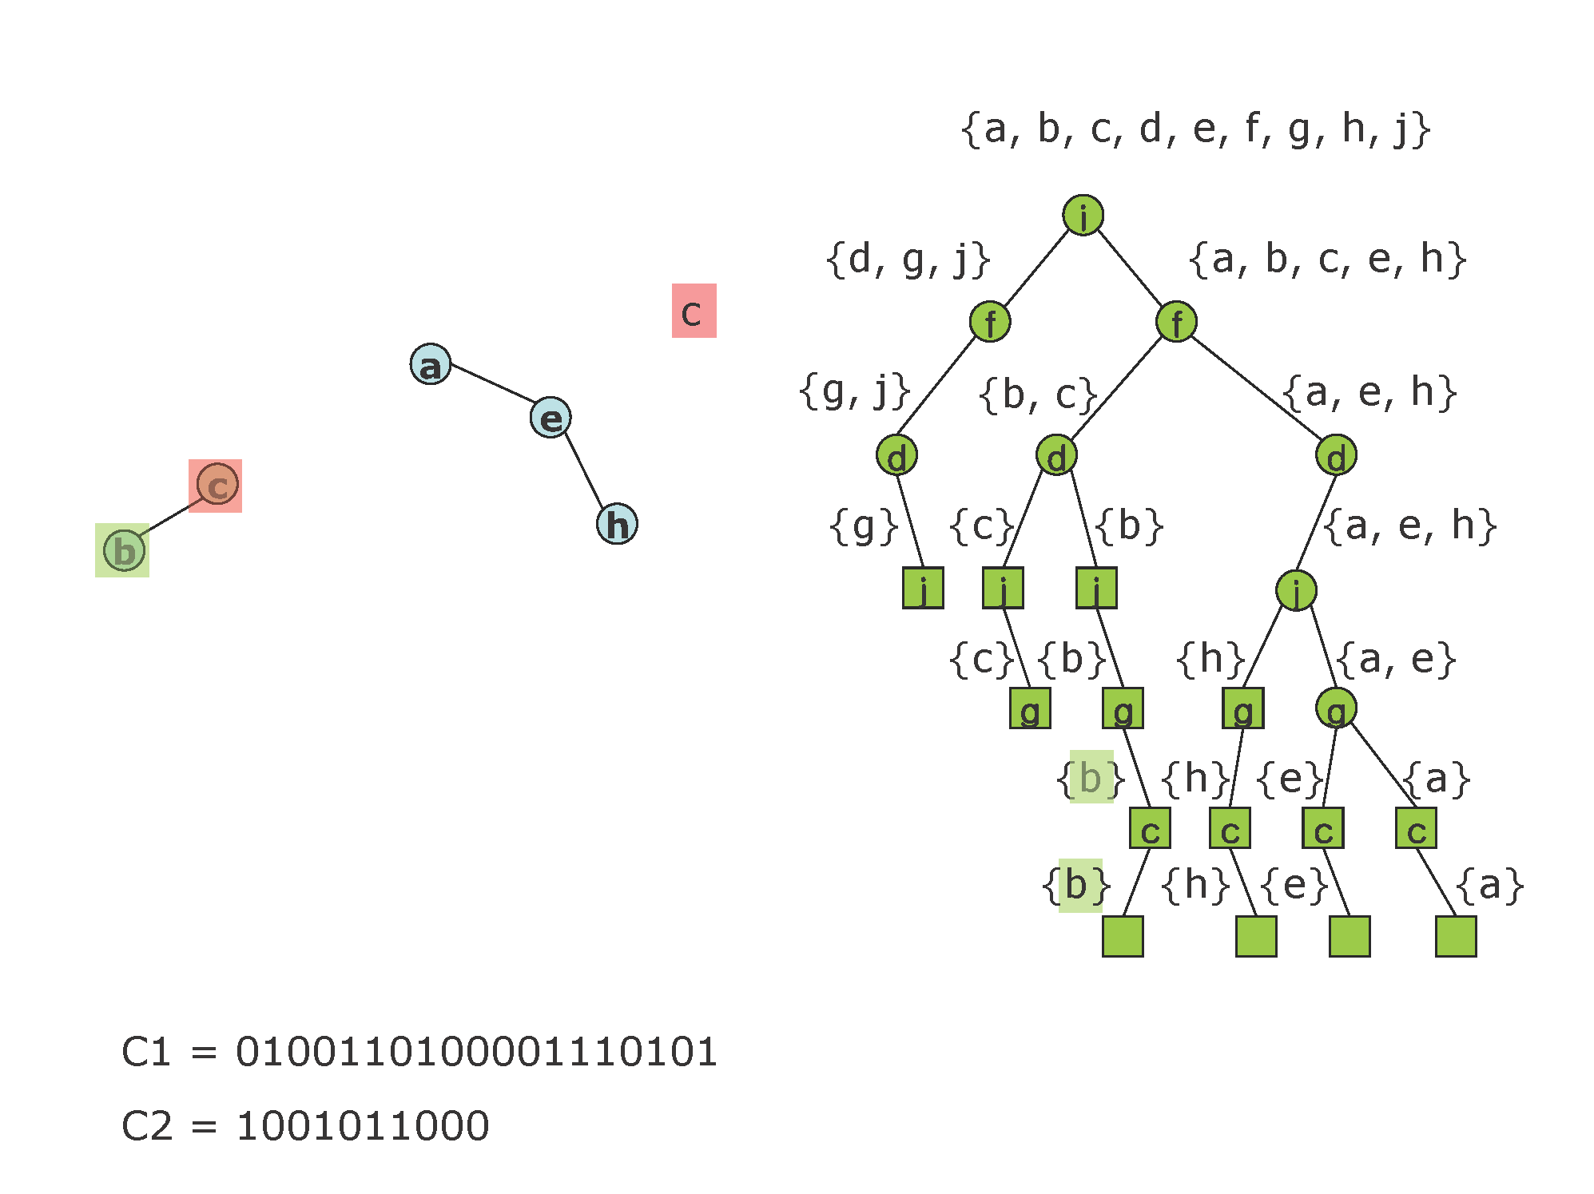
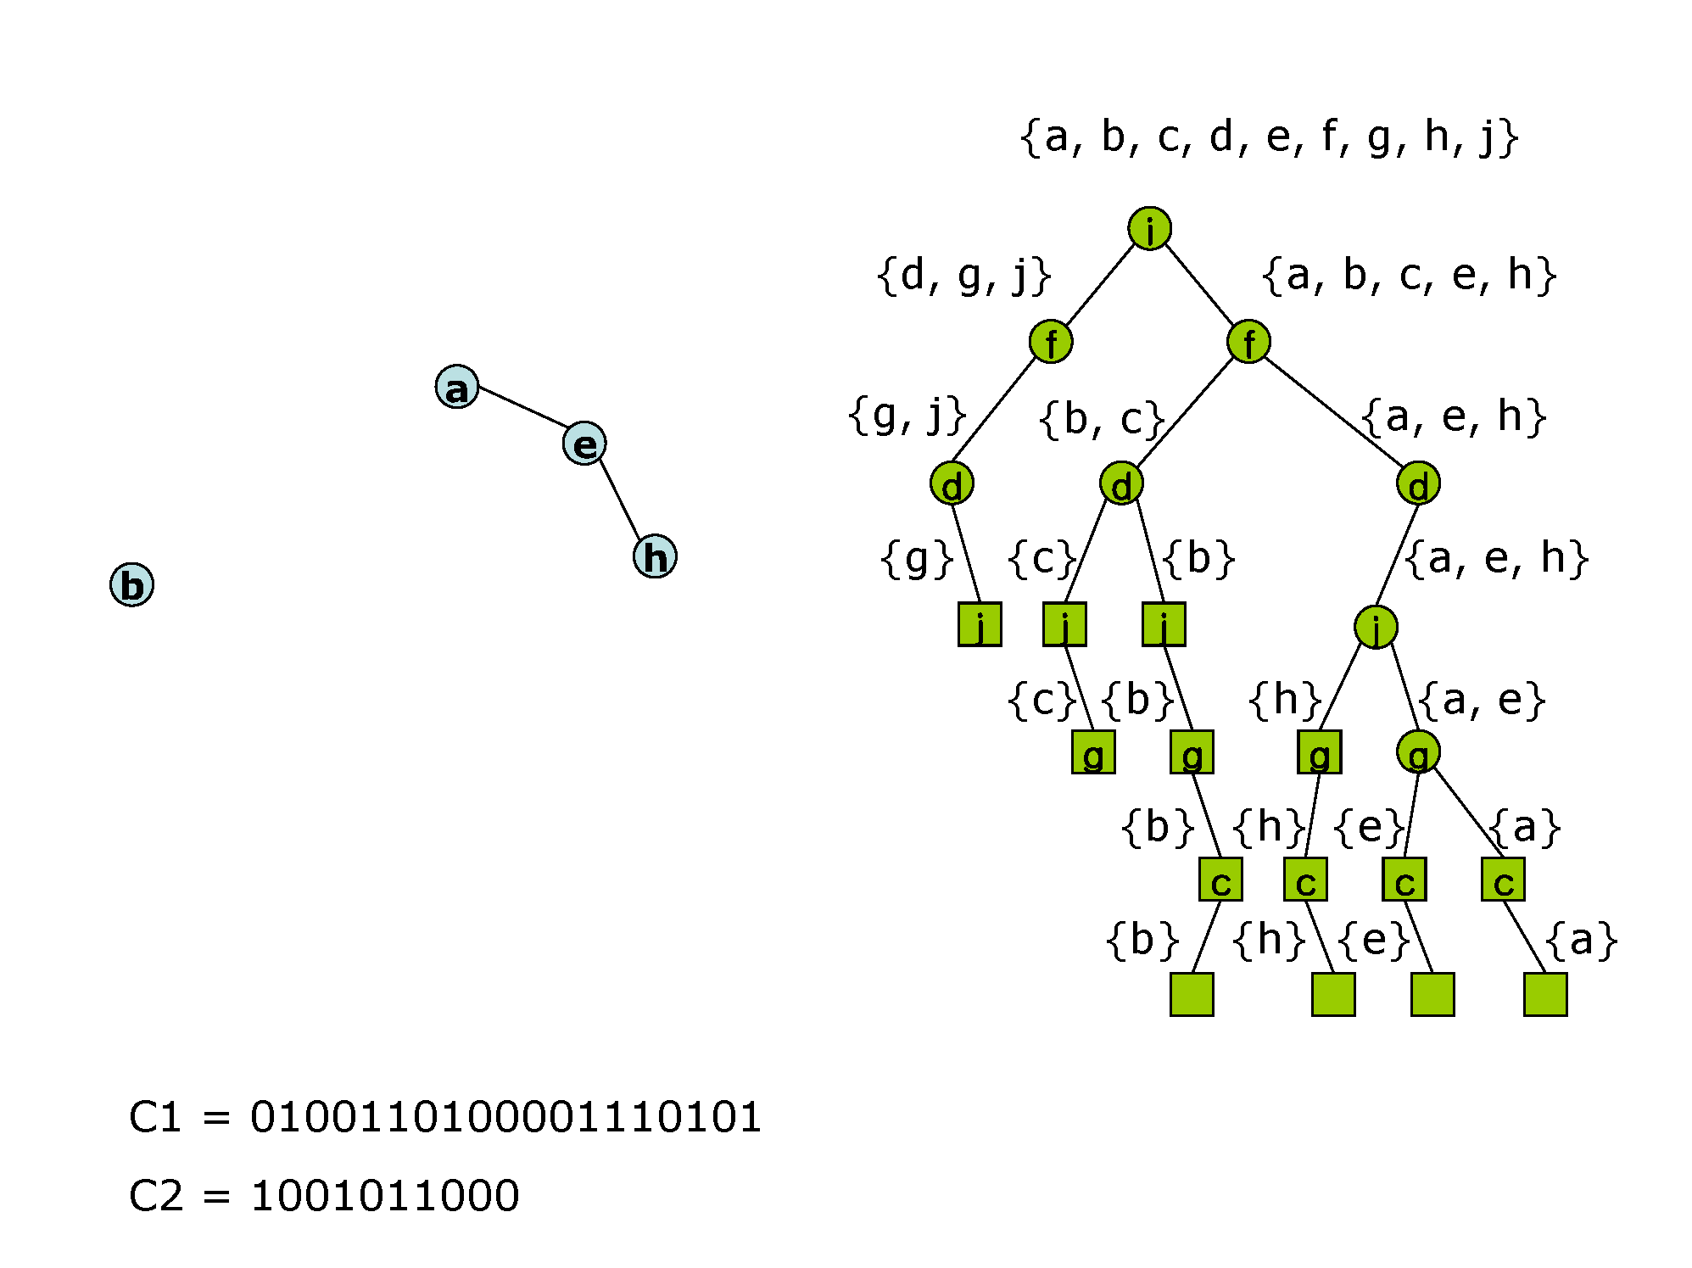
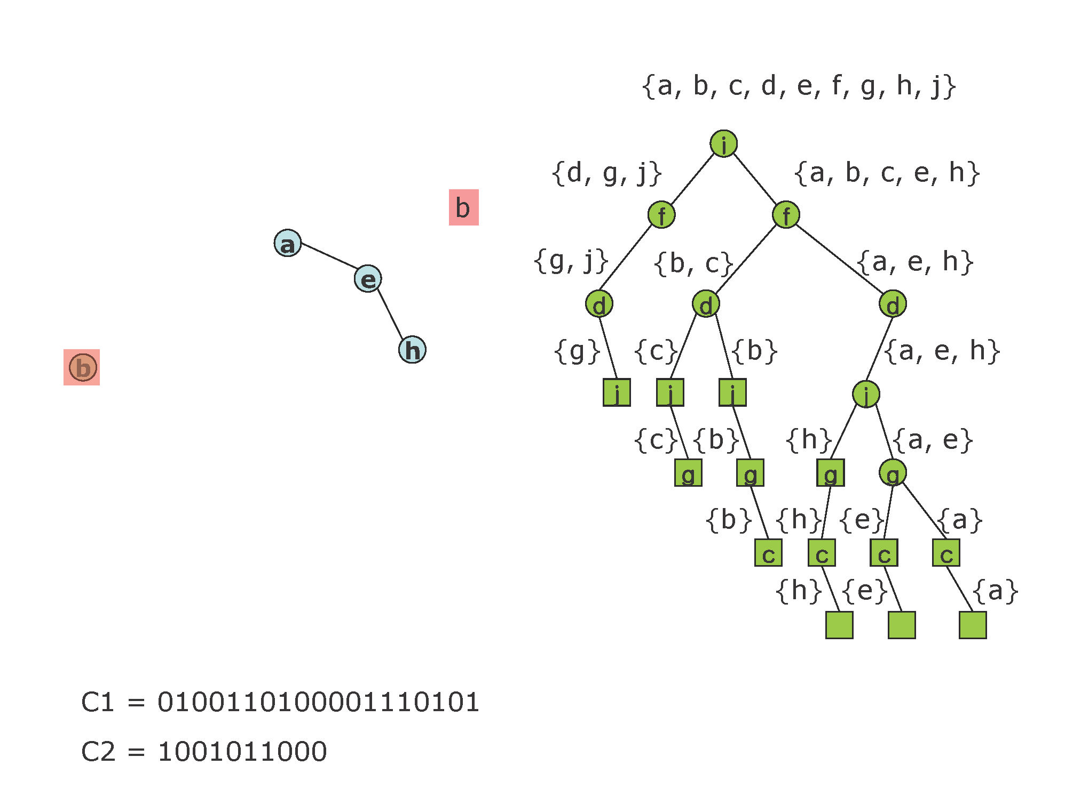
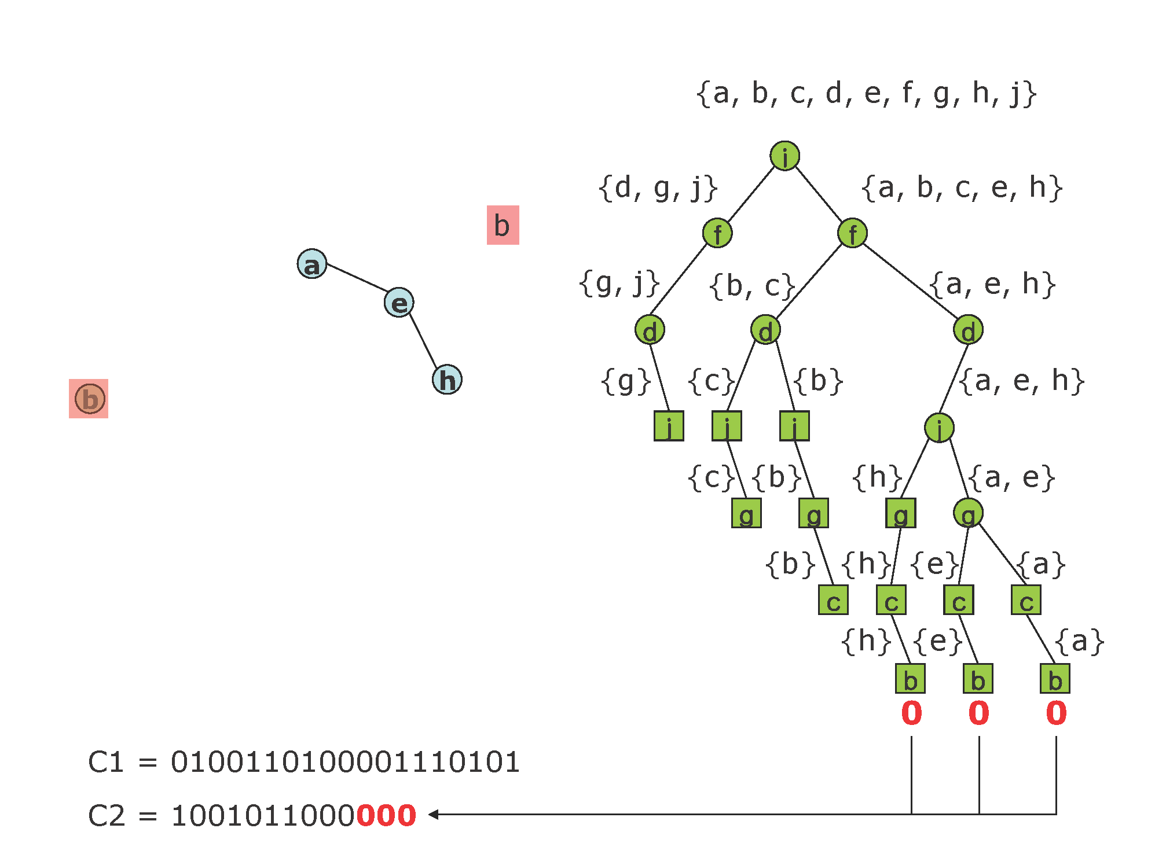
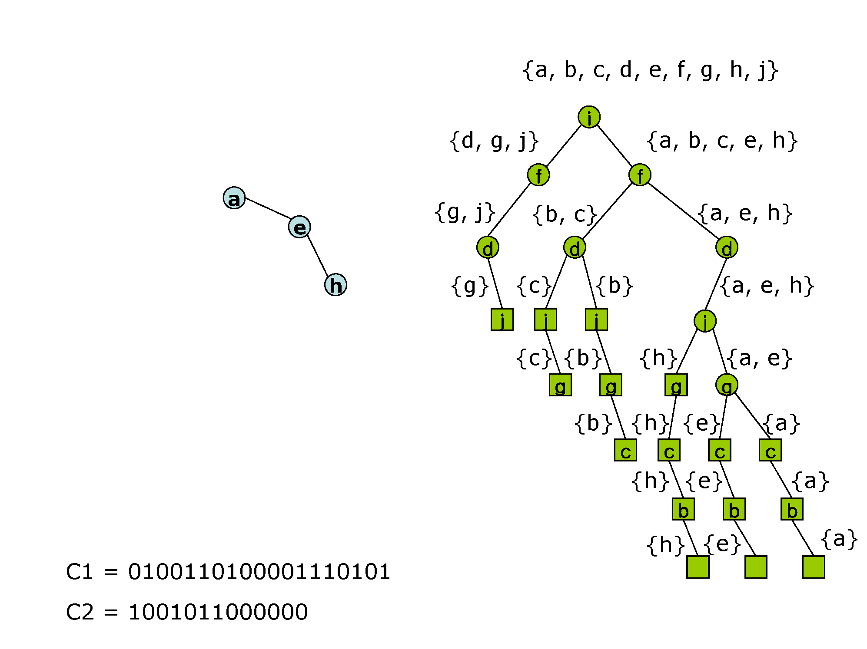
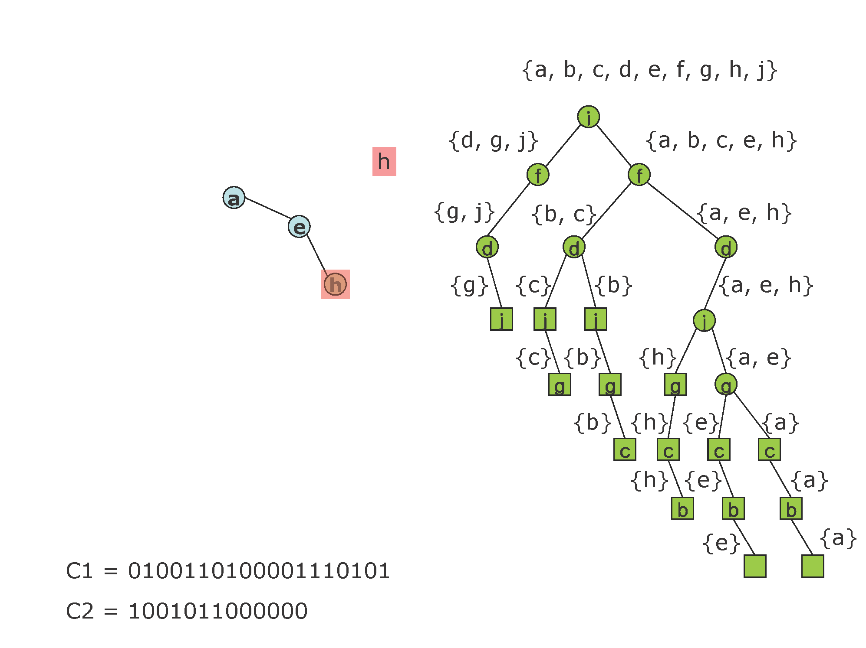
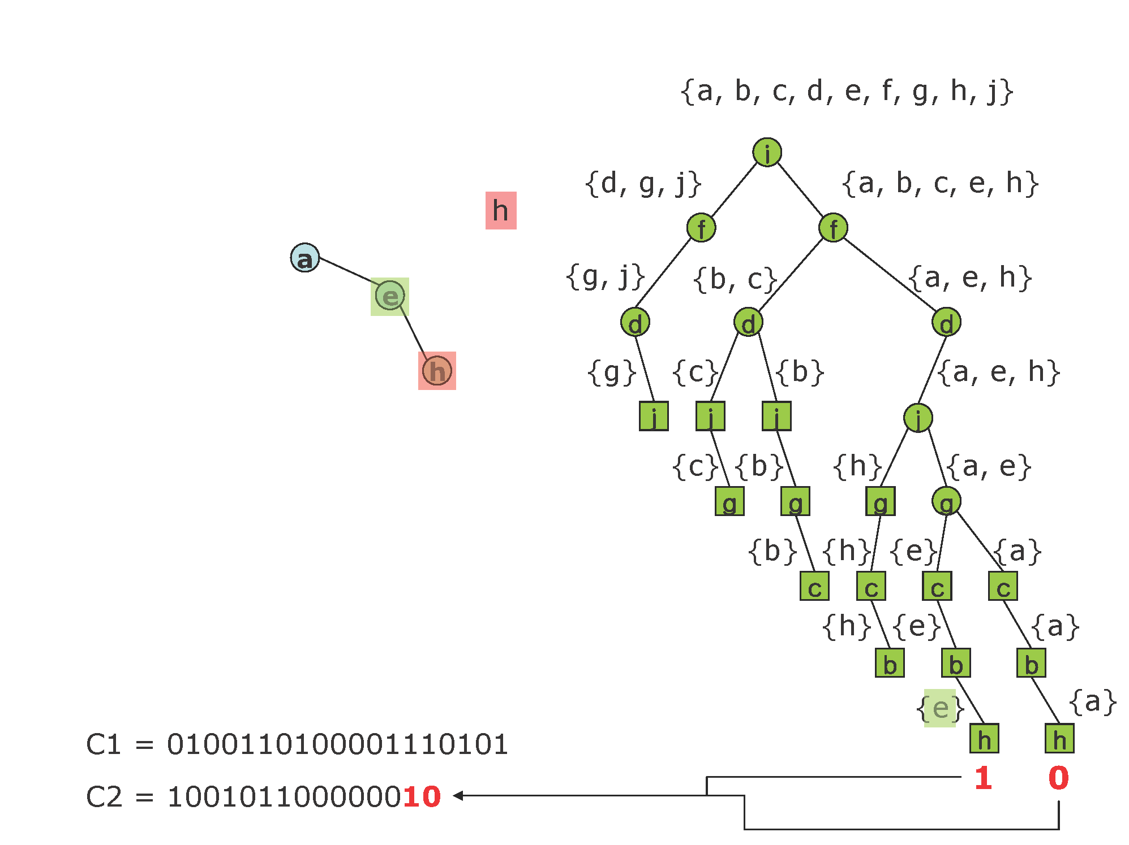
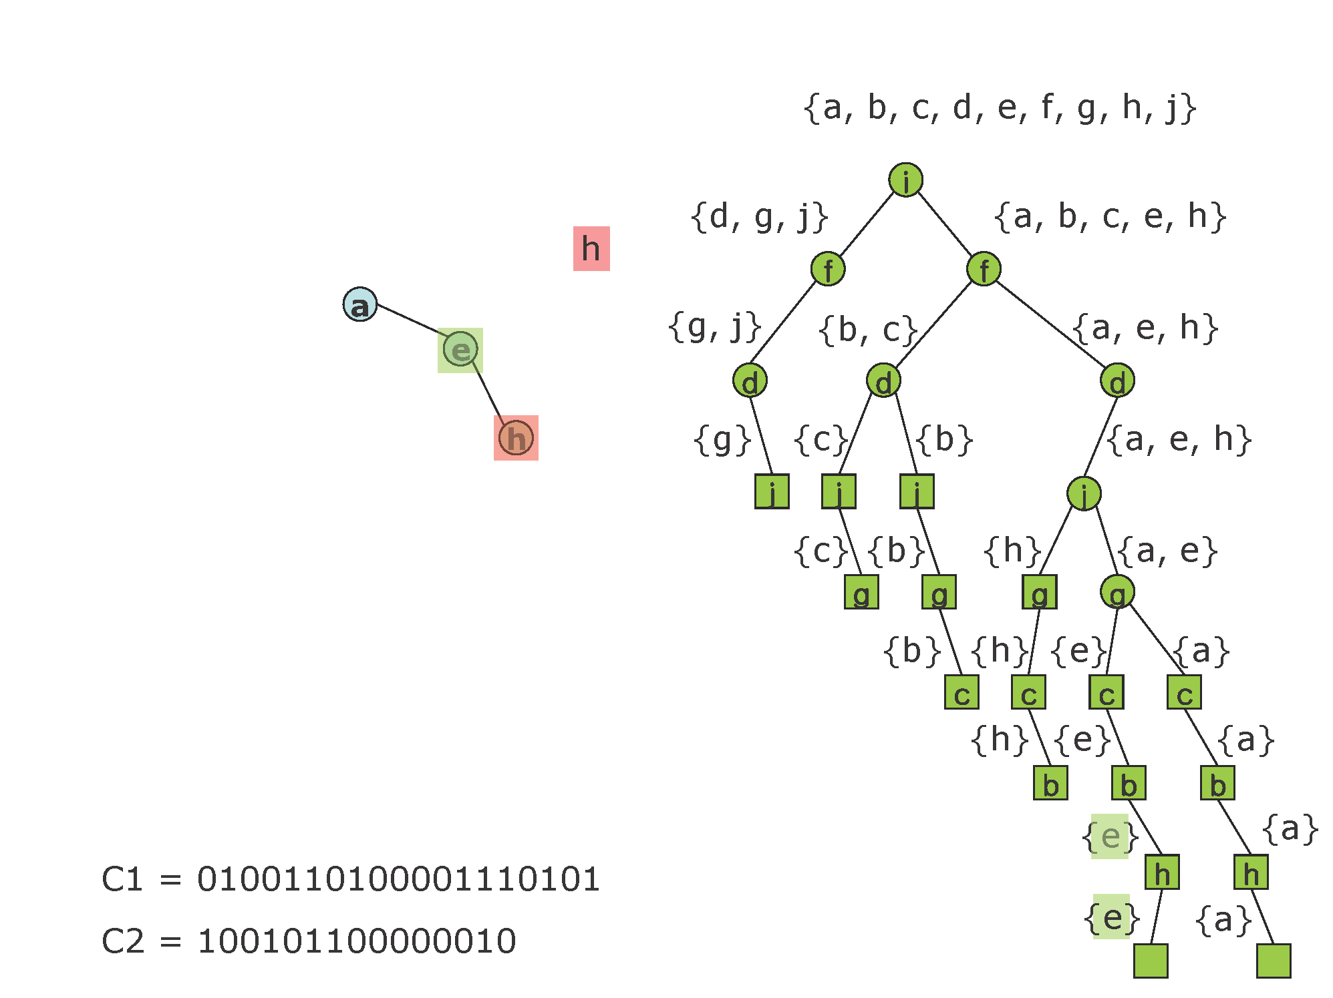







Slide 18

Structural Zip (SZIP) Algorithm

Slide 19



Asymptotic Optimality of SZIP
Theorem. [Choi, WS, 2012] Let be the code length.
Then for Erdös-Rényi graphs:
Lower Bound:
Upper Bound:
where c is an explicitly computable constant, and is a fluctuating function with
a small amplitude or zero.

Slide 20
Open Problems
Our algorithm seems to work well for non ER graphs. Can you extend our analysis to non ER graphs (prove asymmetry for preferential attachments graphs?)
How to extend our analysis and algorithm to graphs with correlated labels? Structural Lempel-Ziv algorithm?
Lossy SZIP? How to define distance/distortion that preserves structural properties?
Understand lower bound and design algorithms for multi-modal structural data.

Slide 21
Outline
Science of Information
Center Mission & Center Team
Research
  Fundamentals: Structural Information & Security
  Data Science: Quering & Twitting Models
  Life Sciences: DNA Resemble & Protein Folding
Based on: Kumar, Ponniah, ``Axiomatic Approach Clean Slate to Secure Wireless’’.

Slide 22
Motivation
Usual design approach, including in wireless networks, has been
  Build a system for good performance, often ignoring security concerns.
Then
  Some ATTACK is identified
  A DEFENSE is developed for that attack
  Then another ATTACK is identified
  Another DEFENSE for that attack
Result
  A sequence of patches
  An arms race
Difficulty
  We don’t know what other attacks are possible
  No guarantees of security
Wormhole attack
Sybil attack
Rushing attack
ARIADNE
TESLA

Slide 23
Goals
Can we develop a principled and holistic approach to security?
  Security addressed first, not an afterthought
  Performance addressed second; optimized while preserving security
  Reverse of the usual approach
Security objective
  A clean slate approach to secure wireless networking
  An axiomatic approach to security
  Provable security: Guaranteed if model assumptions satisfied
    Subsequently, model assumptions can be attacked/challenged
  Complete suite of algorithms/protocols
  An “existence theorem,” if you will, or as providing algorithms
Also a performance guarantee: Max-Min Optimal
  Max is over protocols
  Min is over all actions of malicious nodes

Slide 24
Security Performance: New Approach
Protocols yield network Max-Min optimal with respect to utility
Actually, we show a saddle-point: Min-Max optimality
Fundamental ingredients of our approach:
Standard cryptographic primitives are assumed
And, importantly: Clocks and synchronization
  Without a notion of time, we cannot even talk of throughput
  Without throughput we cannot talk of network Utility
  So time is an essential ingredient
  Without common time, nodes cannot cooperate temporally, share resources Cooperative scheduling, etc., will be impossible
  So synchronization will be a fundamental ingredient

Slide 25
Outline
Science of Information
Center Mission & Center Team
Research
  Fundamentals: Structural Information & Security
  Data Science: Quering & Twitter Models
  Life Sciences: DNA Resemble & Protein Folding
Based on: T. Courtade and T. Weissman ``Multiterminal Source Coding under Logarithmic Loss’’, IEEE Trans. Information Theory, 2013

Slide 26

Information Theory of Big Data?
Learnable Information (BigData):
Data driven science focuses on extracting information from data. How much information can actually be extracted from a given data repository?
Big data domain exhibits certain properties:
Large (peta and exa scale)
Noisy (high rate of false positives and negatives)
Multiscale (interaction at different levels of abstractions)
Dynamic (temporal and spatial changes)
Heterogeneous (high variability over space and time
Distributed (collected and stored at distributed locations)
Elastic (flexibility to data model and clustering capabilities)
Complex dependencies (structural, long term)
High dimensional
  Ad-hoc solutions do not work at scale!
``Big data has arrived but
big insights have not ..’’
Financial Times, J. Hartford.

Slide 27





Modern Data Processing
Data is often processed for purposes other than reproduction of the original data: (new goal: reliably answer queries rather than reproduce data!)
Recommendation systems make suggestions based on prior information:
Email on server
Distributed
Data
Processor
Prior search history
Recommendations are usually lists indexed by likelihood.
Databases may be compressed for the purpose of answering queries of the form:
“Is there an entry similar to y in the database?”.
Queries about
original database can
be answered reliably from
a compressed version of it.
Original (large) database is
compressed
Compressed version can be stored at several locations

Slide 28


Information-Theoretic Formulation and Results
Distributed (multiterminal) source coding under logarithmic loss
Quadratic similarity queries on compressed data
Fundamental Tradeoff: what is the minimum description (compression) rate required to generate a quantifiably good set of beliefs and/or reliable answers.
General Results: queries can be answered reliably if and only if the compression rate exceeds the identification rate.

Slide 29
Outline
Science of Information
Center Mission & Center Team
Research
  Fundamentals: Structural Information & Security
  Data Science: Quering & Twitter Models
  Life Sciences: DNA Resemble & Protein Folding
Based on: Jacquet, Milioris, Szpankowski, ``Classification of Markov Sources Through Joint String Complexity:Theory and Experiments’’,
AofA and ISIT, Montreal & Istanbul, 2012&2013.

Slide 30

String Comparison
Two DNA sequences?
Two Tweets?
  Apply: Joint String Complexity!
"allow users to download an entire movie in one second." I need
this http://t.co/3fbNfKEkah
Green energy boss accuses Govt of obstructing renewable energy
development http://t.co/v5Lq2Jx1GQ

Slide 31





Joint String Complexity
Given two strings X, Y, the joint string complexity J(X,Y) is the number of common subwords between X and Y.
    For example: X=banana, Y=ananas: J(X,Y)=10
    since J={ε, a, n, an, na, ana, nan, anan, nana, anana}.
Texts and are generated by stationary Markov sources 1 and 2 of length n and m: with transition matrix and stationary distribution .
Average joint string complexity

Slide 32







Results for Markov Sources
      where is the main eigenvalue of and Q(x)=0 in general, is periodic or double periodic of small amplitude.
Define
, then
For
we have

Slide 33

English vs. Non-English

Slide 34

Automated Classification Tweeters
politics
sport
technology
economics
lifestyle

Slide 35
Outline
Science of Information
Center Mission & Center Team
Research
  Fundamentals: Structural Information & Security
  Data Science: Quering & Twitter Models
  Life Sciences: DNA Resemble & Protein Folding
Based on: Tse, Motahari, Bresler ``Information Theory of DNA Sequencing’’,
Transaction on Information Theory, 2013.

Slide 36
Information Theory of Shotgun Sequencing
Reads are assembled to reconstruct the original genome.
State-of-the-art: many sequencing technologies and many assembly algorithms,
ad-hoc design tailored to specific technologies.
Our goal: a systematic unified design framework.
Central question: Given statistics of the genome, for what read length L and
# of reads N is reliable reconstruction possible?
An optimal algorithm is one that achieves the fundamental limit.

Slide 37
Simple Model: I.I.D. Genome
(Motahari, Bresler & Tse 12)
# of reads
N/N_{cov}
reconstructable
by the greedy algorithm
many repeats
of length L
no coverage of genome
(2 log G) /H_{renyi}
read length L

Slide 38
Real Genome Statistics
(Bresler, Bresler & Tse 12)
upper and lower bounds based on repeat
Statistics (99% reconstruction reliability)
Example: Stapholococcus Aureus
N_{min}/N_{cov}
greedy
K-mer
repeat
lower
bound
data
improved K-mer
i.i.d. fit
coverage
lower bound
optimized de Brujin
length
read length L
A data-driven approach to finding near-optimal assembly
algorithms.

Slide 39
Outline
Science of Information
Center Mission & Center Team
Research
  Fundamentals: Structural Information & Security
  Data Science: Quering & Twitter Models
  Life Sciences: DNA Resemble & Protein Folding
Based on: Manger, Kihara and Szpankowski "On the Origin of Protein Superfamilies and Superfolds“.

Slide 40
Why So Few Protein Folds?
Protein Folds in Nature
Probability of protein folds vs. sequence rank

Slide 41


Information-Theoretic Model
s
protein-fold
channel
f
HPHHPPHPHHPPHHPH
Optimal input distribution from Blahut-Arimoto algorithm:

Slide 42

Phase Transition - Experiments

Slide 43










Protein-Protein Channel
: set of self-avoiding walks of length
: Energy of a walk over sequence :
We can prove that:
is free energy, and
. Then
Phase transition of the free energy (hence the capacity):

Slide 44
Outline
Science of Information
Center Mission & Center Team
Research
  Fundamentals: Structural Information & Security
  Data Science: Quering & Twitter Models
  Life Sciences: DNA Resemble & Protein Folding
4. Other Challenges

Slide 45








Information Theory and Economy
Economic systems share many features with communication networks: acquiring, storing, sharing, and processing information.
Yet one crucial feature that distinguishes economic networks from reliable communication is value of information.
A major challenge in economics is to formalize the notion of information value for dynamic settings involving delay constrains.
Value of Information: For lattice and define value V(a) as:
V(a) 0; Flow of Information?
If a b then V(a) V(b)
V(a) is submodular:
If , then for all :

Slide 46

Cooperation & Dependency
How does cooperation impact information (nodes should cooperate in their own self-interest)?
Cover initiated a theory of cooperation and coordination in networks. Fundamental for coordination is the ability of distributed agents to create joint probability distribution. In recent work Anantharam brought hypercontractive inequalities (contractive maps) into the picture.
Study statistical causality in neural systems by Granger principles.
Dependency and rational expectation are also critical ingredients in Sims' work on dynamic economic theory leading to value of information.

Slide 47


Limited Resources and Representation
Limited Resources:
In many scenarios, information is limited by available computational resources (e.g., cell phone, living cell).
Bialek works on structure of molecular networks that optimize information flow, subject to constraints on the total number of molecules being used.
Verdu, Goldsmith, Grover investigate the minimum energy per bit as a function of data length in Gaussian channels.
Representation-invariance:
How to know whether two representations of the
same information are information equivalent?
(Universal language a la Kieffer’s weak compressibility:
(Anantharam, Santhanam, Szpankowski: weakly data-driven convergence;
Constructive types: Baryshnikov, Raginsky, Grama, Szpankowski).

