Slide 1



Beyond Models: Forecasting Complex Network Processes Directly from Data
Bruno Ribeiro (CMU)
Minh Hoang (UCSB)
Ambuj Singh (UCSB)
WWW’15
Florence, Italy
Notes:
(c) 2014, Bruno Ribeiro
© Bruno Ribeiro, 2015

Slide 2



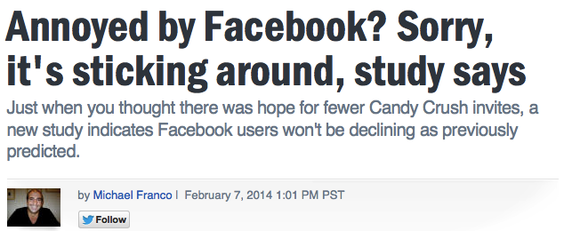
Twitter Cascade Statistics
External source
http://bit.ly/unique123
http://bit.ly/unique456
Alice
(seed)
Fabio
(seed)
no reshares
Bob
Dave
Carol
Cascade statistics after Δt time:
Avg. Cascade Size = <no. tweets> / <seeds>
% cascades of size 1 = <no. cascades size 1> / <seeds>
Notes:
© Bruno Ribeiro, 2015

Slide 3
Background: Cascade Predictions
Predict size of one cascade (one sample path)
Can cascades be predicted? (Cheng et al.’14)
Input: Cascade & user features
Output: Cascade doubles size? {Yes, No}
Predict aggregate of all cascades of all seeds
Time-series models
one seed
Cascade Statistics (average cascade size,
no. cascades with no retweets)
infection rate
time
[Leskovec et al. 2009]
[Matsubara et al. 2012]
…
Large cascades + Few seeds
= Small cascades + Many seeds
Notes:
© Bruno Ribeiro, 2015

Slide 4
Why Forecast Cascade Statistics?
Thought Experiment:
#A
Paid 20 seeds in Δt₁ time
Cascade sizes after Δt₁:
10 cascades with 0 retweets (1 tweet total)
10 cascades with 99 retweets (100 tweets total)
#B
Paid 2 seeds in Δt₁ time
Cascade sizes after Δt₁:
1 cascade with 0 retweets (1 tweet total)
1 cascade with 199 retweets (200 tweets total)
(1) Forecast how viral:
Average cascade size at Δt₂>Δt₁
↑ Average size = ↑ Viral = ↑ ROI paid seed
(2) Anomaly metrics: % seeds with no retweets at Δt₂
Notes:
© Bruno Ribeiro, 2015

Slide 5
Is Cascade Statistics Forecasting Hard?
Training data Δt₁
Future
Present
How well can we forecast at Δt₂ > Δt₁?
How far in the future can we forecast with reasonable accuracy?
Notes:
© Bruno Ribeiro, 2015

Slide 6
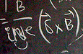
Cascade Statistics Evolve
Δt₁ = 2 weeks
Often Cascade_Statistics(Δt₂) ≠ Cascade_Statistics (Δt₁) Δt₂>Δt₁
Next: Simple model to understand forecasting hardness
Alice (seed) as example:
Constant infection rate λ_{Alice}
Time between infections ~ Exp(1/λ_{Alice})
Different seeds have different (random) infection rates: λ_{Alice}> λ_{Fabio}
Δt₂ = 8 weeks

Slide 7
Really Simple Infection Process
Infection rate λ_{Alice}
Total infections
X_{i} ~ Exp(1/λ_{Alice})
time
X₁
X₂
X₃
X₄
0
independent & identically distributed
time
All unrealistically easy = Forecast easy?
Notes:
(c) 2015, Bruno Ribeiro

Slide 8
Is Cascade Forecasting Easy in Large Networks?
Theorem → Depends if long-term or short-term
no. nodes ∝ n
no. seeds ∝ n
If tail cascade sizes at Δt₂ ~ heavier than exponential (cutoff )
MSE(Δt₁, Δt₂) = Mean Square Error of Unbiased estimate of average cascade size at Δt₂
With training data at Δt₁
Then,
*Through Cramér-Rao lower bound
Big Data Paradox
(more data can mean less long-term forecast accuracy)
Notes:
© Bruno Ribeiro, 2015

Slide 9

Why “Big Data Paradox”?
1) Noticeable only in large systems
2) Related to wait-time paradox
3) Based on little-known property
“Maximum Likelihood Estimate (MLE) asymptotically converges to true value with n→∞ i.i.d. samples”
MLE asymptotic convergence:
Not Central Limit Theorem (n → ∞)
Not Law of Large Numbers (n → ∞)
Yes, inverse total Fisher information in data (L. Le Cam’90)
Long-term forecasting gets harder as network grows
Larger network → more training cascades ∝ n
Larger cascades → Fisher information per cascade o(1/n)
Notes:
(c) 2015, Bruno Ribeiro

Slide 10
Big Data Paradox Implications
Sharp loss of forecasting power in large networks
In a simple cascade forecasting problem:
(Test data horizon) < (Training data horizon) → Forecast
(Test data horizon) > (Training data horizon) → Forecast
Paradox also suggests testing for sharp loss of forecasting power
Q: Other problems with sharp accuracy loss?
Training data Δt₁ Δt₂
Notes:
© Bruno Ribeiro, 2015

Slide 11
Forecasting Directly From Data
Notes:
© Bruno Ribeiro, 2015

Slide 12
Probabilistic Matching
But if training data truly large… just match examples of similar past cascades in training data
How to do the matching?
Time series: (Keogh et al. 2004)
General stochastic processes: ?
R. A. Fisher (UK) (1935)
Probability model described data
Maximum Likelihood Estimator learn model
Present:
Models with ever-increasing degrees of freedom
Large training datasets needed to train these models
A. Kolmogorov (RU) (1933)
Probability from axioms
Notes:
© Bruno Ribeiro, 2015

Slide 13
Our Method: S.E.D.
Notes:
© Bruno Ribeiro, 2015

Slide 14
S.E.D. Axioms
Unique State-Time Axiom At any point in time stochastic process has only one state
Equivalence Axiom
All stochastic processes are equivalent to one and only one other stochastic process
Notes:
© Bruno Ribeiro, 2015

Slide 15
S.E.D. Algorithm
Training data Δt₁
#ECOMONDAYS
#FOOD
#CNNFAIL
#YOUTUBE
#FORASARNEY
S.E.D. = Stochastic Equivalence Digraph
Notes:
© Bruno Ribeiro, 2015

Slide 16

Input
Empirical cascade size distributions (Twitter example)
#CNNFAIL
#ECOMONDAY
#FORASARNEY
(Present)
Empirical Distribution Cascade Sizes at Δt₁
(Future)
Empirical Distribution
Cascade Sizes at Δt₂
Forecast
?
Notes:
© Bruno Ribeiro, 2015

Slide 17
Input Parameters
k – no. seeds in future (or a range)
Used to produce confidence intervals of averages
m –another bootstrapping parameter
As large as computational resources allow
m = 1000 seems to work well
Stat() – function to compute statistics of interest
Notes:
© Bruno Ribeiro, 2015

Slide 18
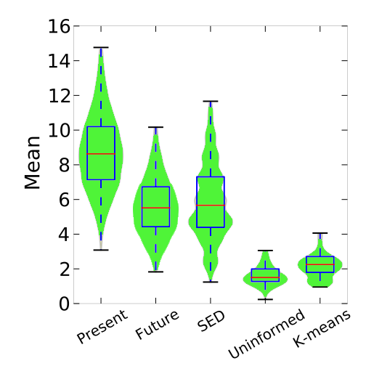

Output
Point estimates mean nothing (power laws have high variance)
Empirical average of size k cascades
Empirical median
violin plot
shows density
Stat()= Avg. Cascade Size
75% confidence (function of k)
Notes:
© Bruno Ribeiro, 2015

Slide 19
Forecasting using Equivalence Digraph
#ECOMONDAYS
1.
#FOOD
#CNNFAIL
P[#FORASARNEY = #CNNFAIL]
#YOUTUBE
#FORASARNEY
- Bootstrap #CNNFAIL cascades Δt₂ k times - Compute Stat() with bootstrap samples
2.
#CNNFAIL
(Future Δt₂)
3. goto 1; repeat m times
Notes:
© Bruno Ribeiro, 2015

Slide 20
Equivalence Graph Probabilities
Two sample test of empirical distributions Δt₁
#ECOMONDAYS
#FOOD
#CNNFAIL
1.
P_{Kuiper}(
,
)
#YOUTUBE
#FORASARNEY
2.
Run Sinkhorn probabilistic graph matching algorithm
(one iteration OK in our experiments)
Notes:
© Bruno Ribeiro, 2015

Slide 21
What happens if…
#C
Forecast #B but…
#B has too few seeds
Earlier example
#B has 2 seeds total
#D
#A
P_{Kuiper}(#B,#A)
#E
#B
P_{Kuiper}(#B,#E)
P_{Kuiper}(#B, * ) ≈ 1 (lack of evidence)
In practice:
#B has no strong matching preference ≈ Uniform prediction
Notes:
© Bruno Ribeiro, 2015

Slide 22
Improving Outlier Forecasts
Probability amplifier parameter α
Trivial to optimize α from data (details in paper)
#ECOMONDAYS
#FOOD
#CNNFAIL
∝ P[#FORASARNEY = #CNNFAIL]^{α}
#YOUTUBE
#FORASARNEY
α=0 (uninformed “average” forecast)
…
α→∞ (extreme outlier forecast)
Notes:
© Bruno Ribeiro, 2015

Slide 23
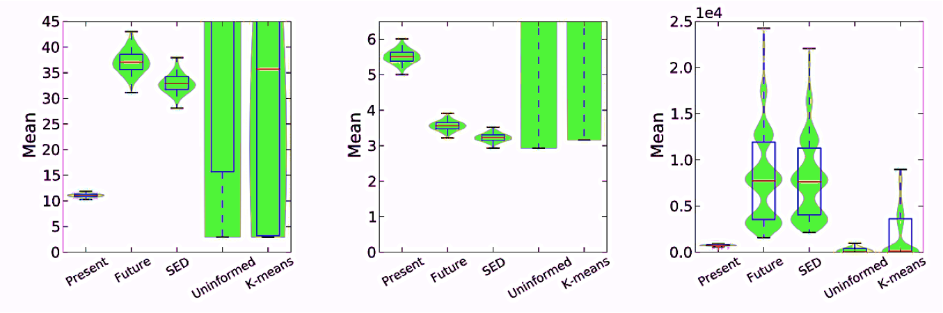
Results (Branching Process Simulation)
9 types of time-varying branching processes, 10 of each
Birth cascade seeds: PoissonProcess(ɣ_{i}(t))
no. children ~ i.i.d. log-Normal(μ_{i}(t),σ_{i}(t))
Small size increase
Small size decrease
Large size increase
Notes:
© Bruno Ribeiro, 2015

Slide 24
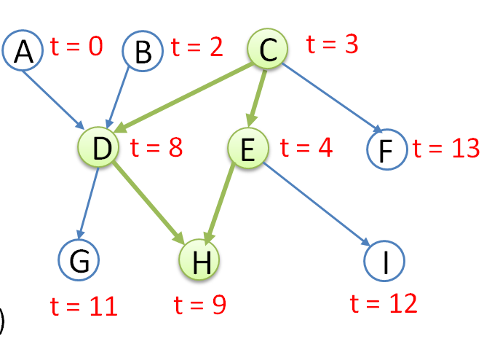
Twitter Data
From June 1 to December 31, 2009 (7 months) [Yang et al. 2011] & Twitter network [Kwak et al. 2010].
Disambiguation of #hashtag seed (see paper)
OK to mistakenly merge multiple independent cascades into one
Notes:
© Bruno Ribeiro, 2015

Slide 25
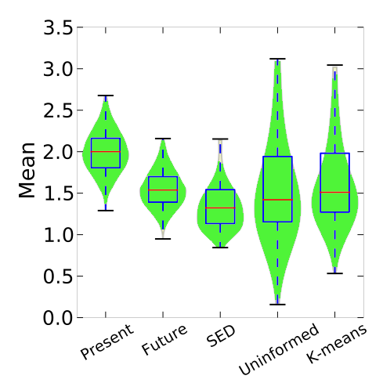
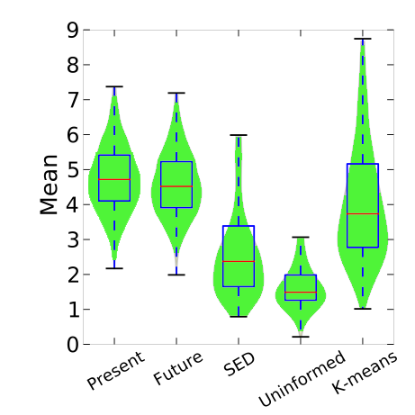

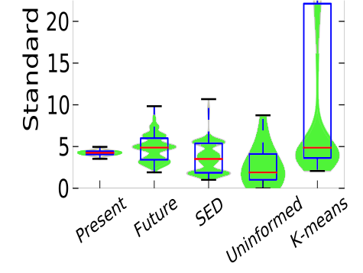
Twitter Data Results
#FORASARNEY
#ECOMONDAYS
#CNNFAIL
Avg. Cascade Size
3 weeks
8 weeks
#FB
Forecast Cascade Size Standard Deviation
Standard Dev.
Notes:
© Bruno Ribeiro, 2015

Slide 26
S.E.D. Properties
✔
Outputs prediction uncertainty
Can deal with complexities of social media cascades
Any stochastic process (model-free)
But seeds must be independent
Easy to compute & understand
Understand why decision was made
Shows which cascades in training data are similar
✔
✔
✔
Notes:
© Bruno Ribeiro, 2015

Slide 27
Summary
Big Data Paradox: Cascade size forecast problem show sharp loss of accuracy beyond training data time horizon
“NP-hard” – brute force does not scale “Big Data Paradox” – unbiased estimation does not scale
SED → Forecast directly from data
Matching algorithm for stochastic processes
Forecast takes into account amount of evidence in data
Adding rich cascade features possible through kernel two-sample test (Gretton et al. 2012)
#FORASARNEY
Thank you!
Notes:
© Bruno Ribeiro, 2015

