Slide 1
Modeling Website Popularity Competition in the Attention-Activity Marketplace
Bruno Ribeiro Christos Faloutsos
Carnegie Mellon University
WSDM 2015
February 5, 2015
Notes:
(c) 2015, Bruno Ribeiro

Slide 2

Motivation
MySpace’s demise
Bought for $580 million in 2005
Sold for $35 million in 2011
Sold
Summer 2008
Summer 2008
Hi5
Friendster
*source: TechCrunch
Notes:
(c) 2015, Bruno Ribeiro

Slide 3
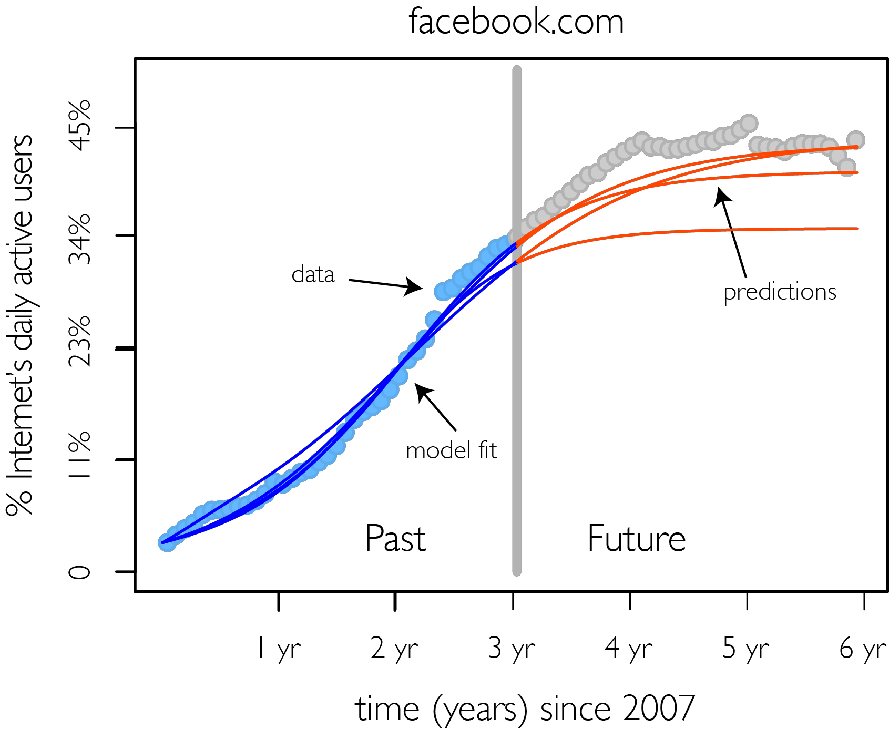
Predicting Network Popularity w/ Competition
?
?
Goal:
Fraction of Active Users (t)
?
Summer 2008
Why:
-$545 million dollars
Notes:
(c) 2015, Bruno Ribeiro

Slide 4

No Structural Telltale Signs of MySpace’s Demise
Total Adopters
MySpace.com until late 2008
new adopters/semester
And no abrupt topological changes in 2008
MySpace graph until recently:
35 million users
Matches known theoretical behavior
Mansfield’61, Rogers’03, Bass’69
★ http://www.myspace.com
Notes:
(c) 2015, Bruno Ribeiro

Slide 5
Background: Vast Adoption Literature
Economics:
  (Mansﬁeld ’63)
  (Katz&Shapiro’85)
  (Farrell&Saloner ’86)
  (Choi ’94)
  (Arthur ’94)
Marketing:
  (Bass ’69)
  (Fisher&Pry ’71)
Computer Science:
  (Kempe et al ’03)
  (Zhao et al., IMC’12)
  (Leskovec et al., SIGKDD’08)
  (Ugander et al., PNAS’12)
  (Aral&Walker, Science’12)
Sociology:
  (Ryan&Gross’49)
  (Everett ’62, ’03)
  (Rogers ’03)
  (Centola ’12)
We know how to model adoption
But how to model attention?
Summer 2008
Adopt ≠ Active
Fraction of Active Users (t)
Notes:
(c) 2015, Bruno Ribeiro

Slide 6
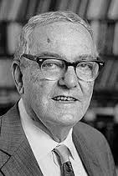
Attention & Information Overload
1969 - H. A. Simon on information overload:
Information consumes attention (time)
  Information-rich world ➔ Attention-poor world
Systems that “talk” more than “think” exacerbate
information overload
Notes:
(c) 2015, Bruno Ribeiro

Slide 7
How Facebook Talks (a lot)
Facebook
attention
& activity
Notes:
(c) 2015, Bruno Ribeiro

Slide 8
Positive & Negative Attention Loops
Positive Growth
Website
Survives
My Attention
My Content
Friends’ Attention
Friends’ Content
Negative Growth
Website
Dies
Notes:
(c) 2015, Bruno Ribeiro

Slide 9
Proposed Competition Model
Notes:
(c) 2015, Bruno Ribeiro

Slide 10
Proposed State Space
Never!
Unaware
Active
Inactive
states | ∅_{y} | U_{y} | A_{y} | I_{y}
∅_{x}
U_{x}
A_{x}
I_{x}
Website
Killers
User Subscribes to:
Both x & y
Only y for now
Only x for now
Neither for now
Not interested in x/y
Notes:
(c) 2015, Bruno Ribeiro

Slide 11
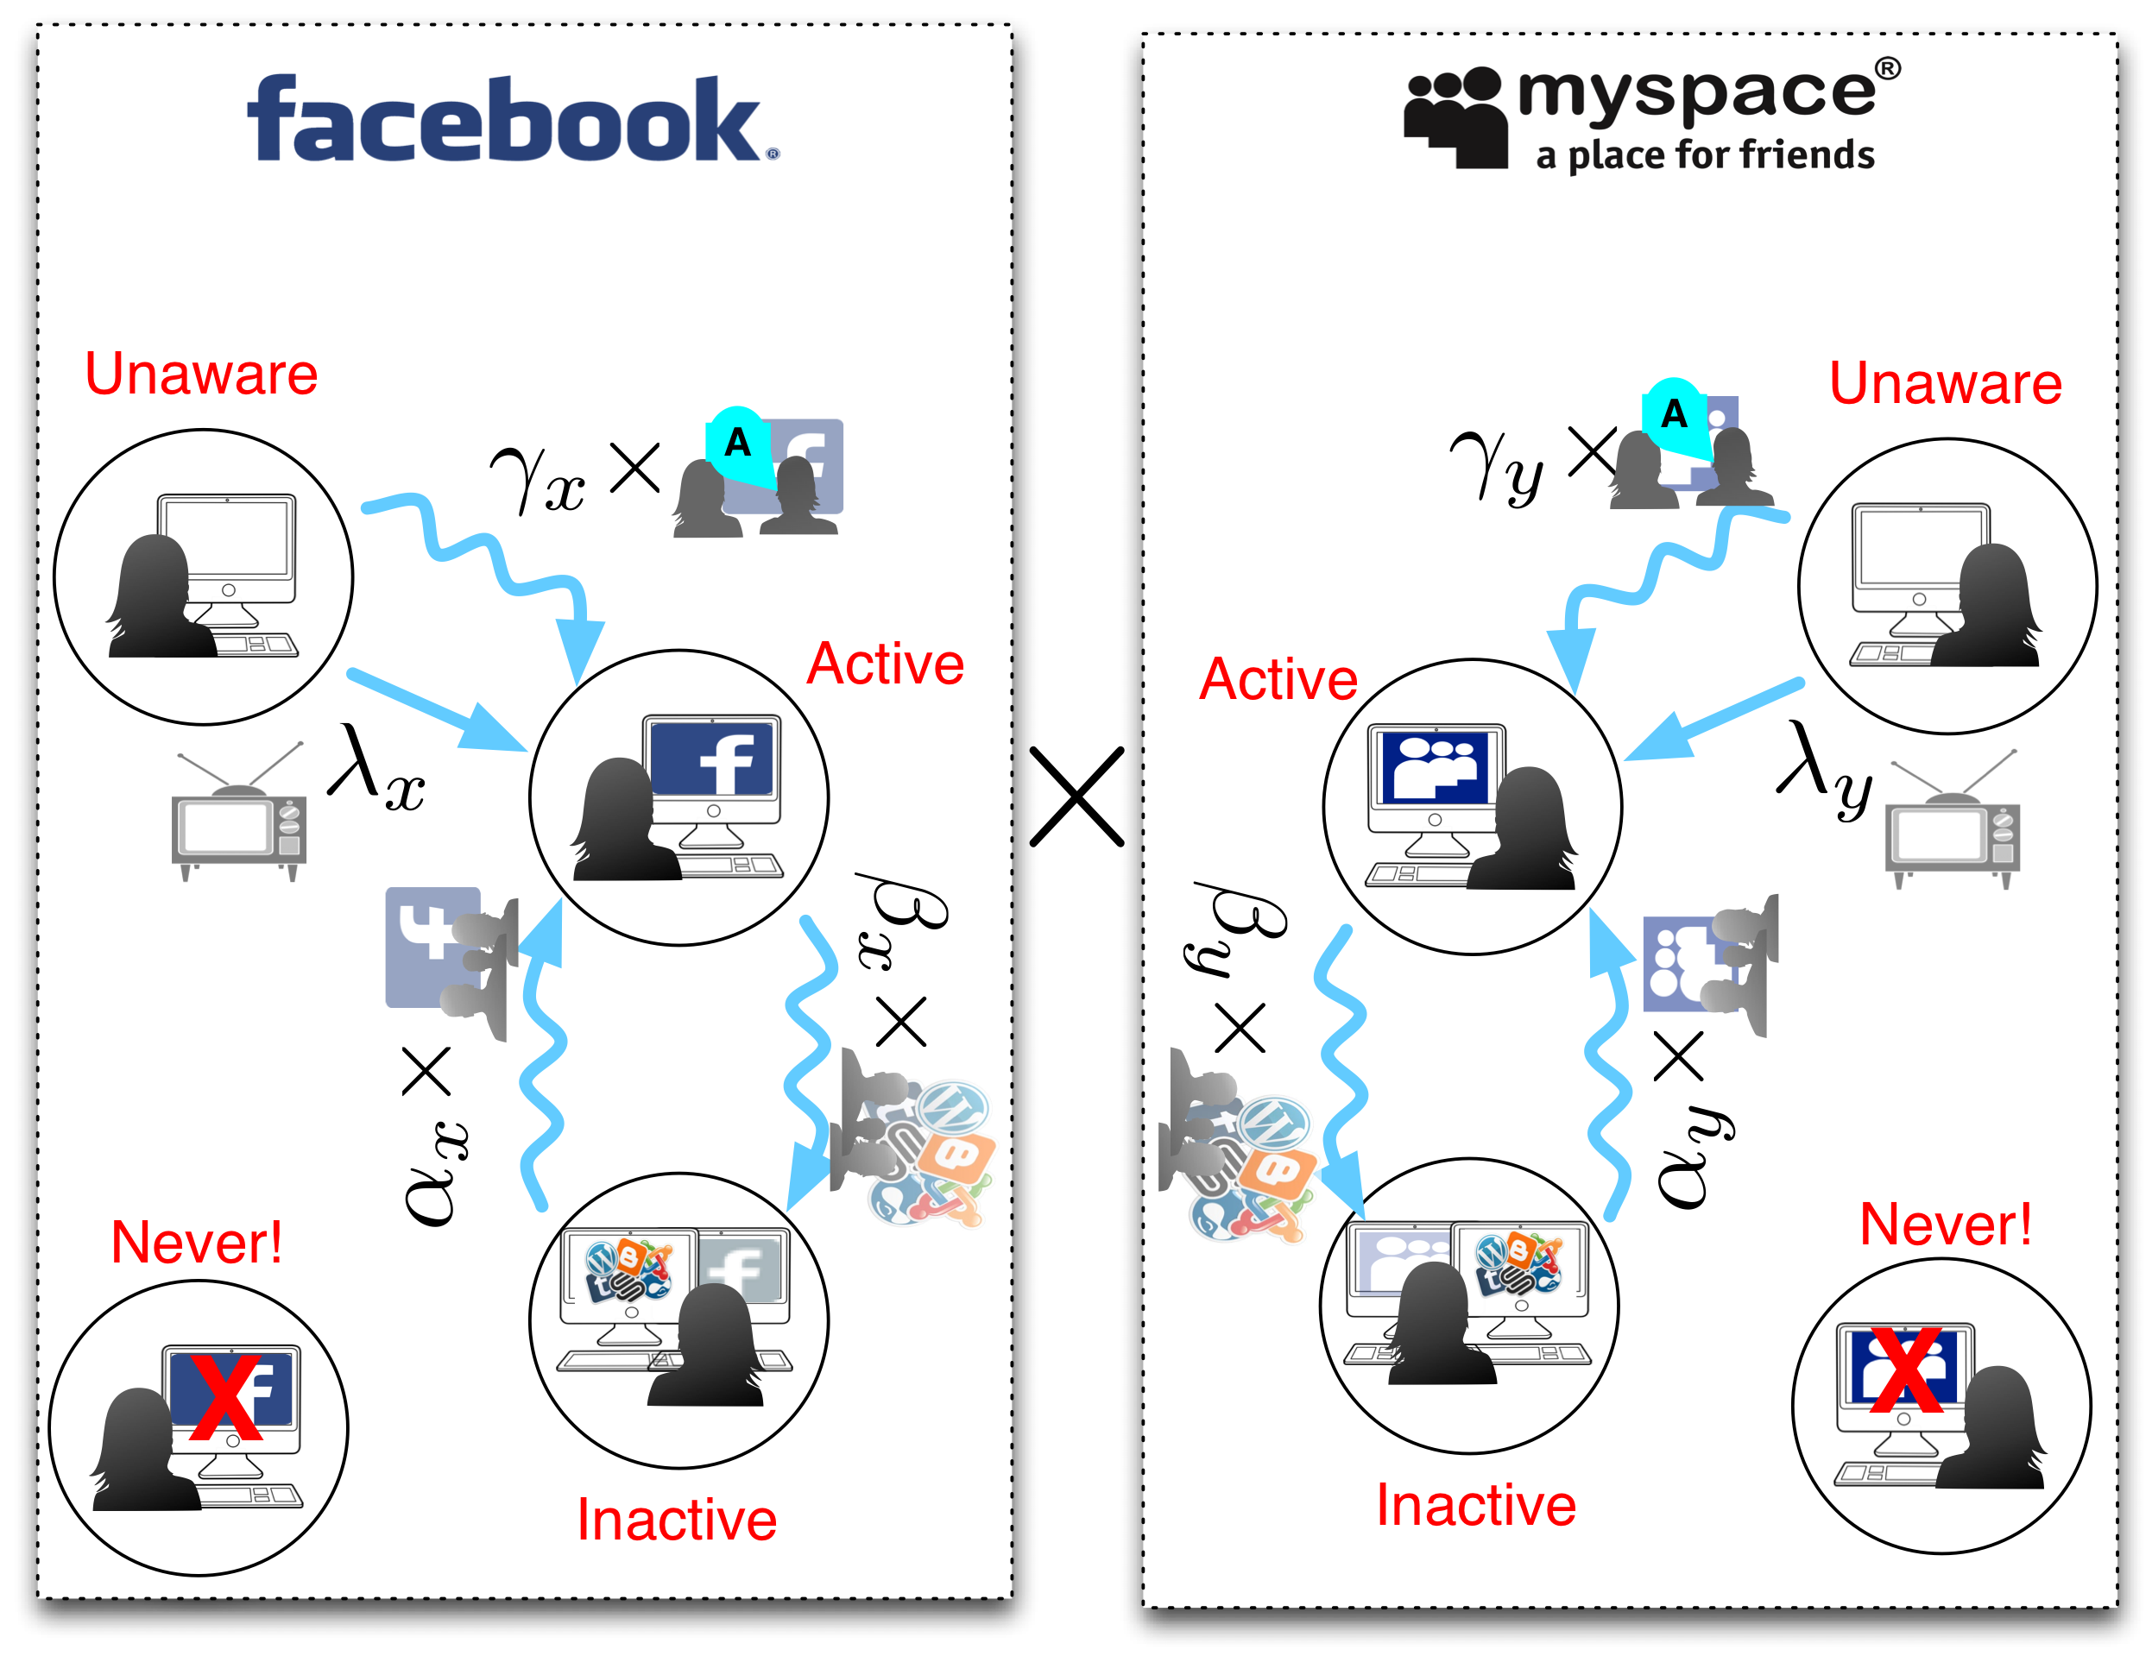
Model Transitions
User Competition
Notes:
(c) 2015, Bruno Ribeiro

Slide 12
Isolated Network Transitions
Details
states | ∅_{y} | U_{y} | A_{y} | I_{y} | SUM
∅_{x}
U_{x} | S_{(U,∅)}(t)
A_{x} | S_{(A,∅)}(t) |  |  |  | S_{(A,*)}(t)
I_{x} | S_{(I,∅)}(t)
Media/Marketing gets new subscribers
Word of mouth gets subscribers
Network x activity
attracts user back
Other activity
takes user away from x
Notes:
(c) 2015, Bruno Ribeiro

Slide 13
Model Predictions with Constant Distraction Factor
Outline
Predicting Online Social Network Popularity
  How websites do on their own
  Evolution with competition
Notes:
(c) 2015, Bruno Ribeiro

Slide 14
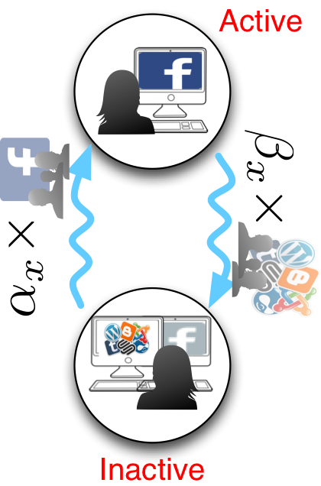
Signatures of Self-Sustainability
Long-term User Activity
[Ribeiro’14]
MySpace
≅1
Relative attractiveness of activity
Fraction of Active Users (t)
Fraction of Active Users (t)
t
t
Notes:
(c) 2015, Bruno Ribeiro

Slide 15
Signatures of Popularity Growth
Model prediction: Signatures of activity growth
[Ribeiro’14]
Media & Marketing
Word of mouth
Fraction of Active Users (t)
Fraction of Active Users (t)
t
t
Notes:
(c) 2015, Bruno Ribeiro

Slide 16
Predictions with Changing Distractions
Outline
Predicting Online Social Network Popularity
  How websites do on their own
  Evolution with competition
t
Notes:
(c) 2015, Bruno Ribeiro

Slide 17

Model Fitting
Details
Two observable states: S_{(A,*)}(t) and S_{(*,A)}(t)
Remaining states latent & treated as parameters
Data from Alexa.com
Fitted with Levenberg–Marquardt algorithm using squared error
friendster.com
S_{(I,*)}(t)?
S_{(U,*)}(t)?
S_{(A,I)}(t)?
S_{(A,A)}(t)?
S_{(A,U)}(t)?
S_{(A,∅)}(t)?
S_{(I,∅)}(t)?
S_{(U,∅)}(t)?
Fraction of Active Users (t)
S_{(A,*)}(t)
Notes:
(c) 2015, Bruno Ribeiro

Slide 18
Facebook Introduces Wall
MySpace
Multiply
Friendster
Hi5
Distraction of Concurrent Users
Increases as Facebook Introduces Wall
Notes:
(c) 2015, Bruno Ribeiro

Slide 19
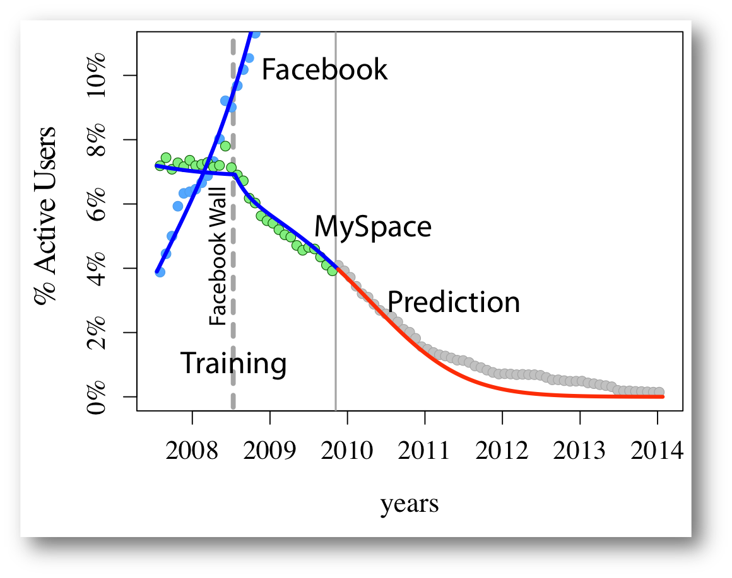
Results (Facebook x MySpace)
value
t
Notes:
(c) 2015, Bruno Ribeiro

Slide 20
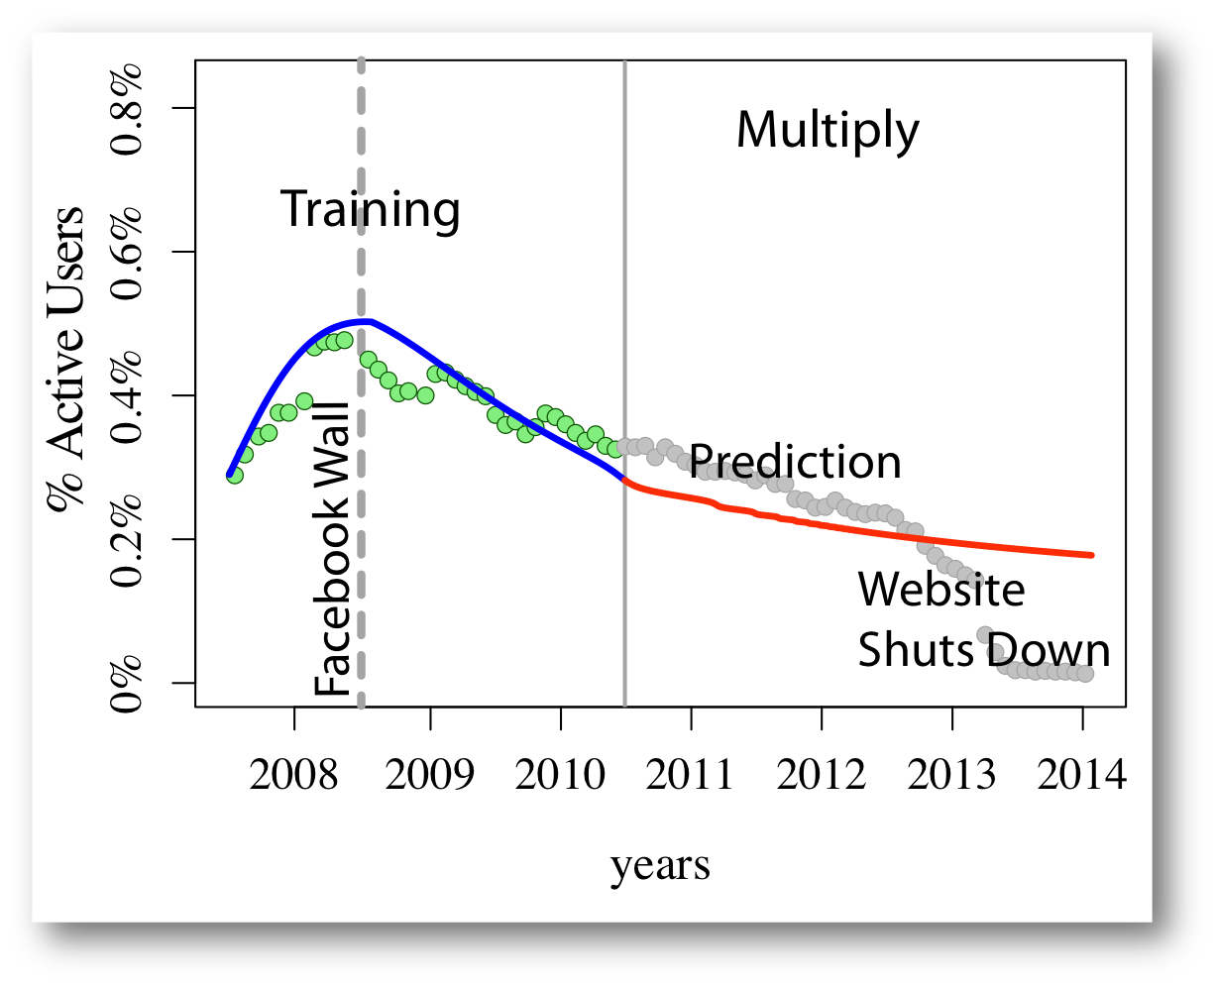
Results (Facebook x Multiply)
Multiply
value
t
Notes:
(c) 2015, Bruno Ribeiro

Slide 21
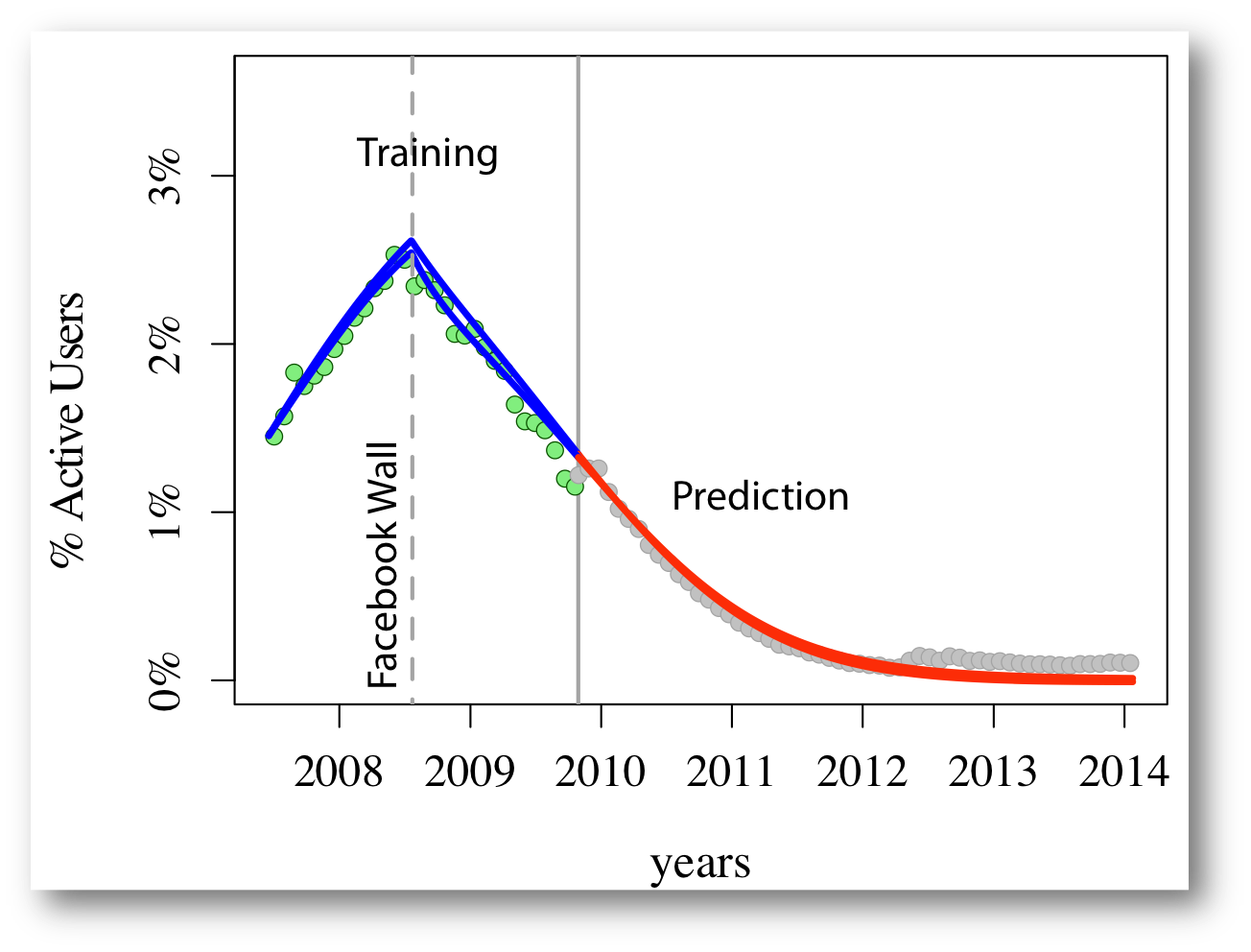
Results (Facebook x Hi5)
Hi5
value
t
Notes:
(c) 2015, Bruno Ribeiro

Slide 22
Results (Facebook x Hi5)
Model Captures Coexistence and Then
Death of Facebook Competitors
Too Many Concurrent Users = Fragility
Notes:
(c) 2015, Bruno Ribeiro

Slide 23
Conclusions
Attention feedback helps predict / understand network survival
No marketing can save from negative attention loop
Insights from model
  E.g.: Metrics of node centrality should take attention feedback into account
Notes:
(c) 2015, Bruno Ribeiro

Slide 24


Thank you!
Questions?
http://www.cs.cmu.edu/~ribeiro
@brunofmr
Notes:
(c) 2015, Bruno Ribeiro

Slide 25
Attention Competition Transitions
Details
states | ∅_{y} | U_{y} | A_{y} | I_{y} | SUM:
∅_{x}
U_{x} |  |  | S_{(U,A)}(t)
A_{x} |  | S_{(A,U)}(t) | S_{(A,A)}(t) | S_{(A,I)}(t) | S_{(A,*)}(t)
I_{x} |  |  | S_{(I,A)}(t)
SUM: |  |  | S_{(*,A)}(t)
User Subscribes to:
Both x & y
Only y for now
Only x for now
Neither for now
Not interested in x/y
“Geek factor”
Media/Marketing new subscribers
“Geek factor”
Word of mouth subscribers
Only parameter affected by attention competition
Notes:
(c) 2015, Bruno Ribeiro

