Slide 1





Pay Few, Influence Most:
Online Myopic Network Covering
Konstantin Avrachenkov (INRIA)
Prithwish Basu (BBN)
Giovanni Neglia (INRIA)
Bruno Ribeiro (CMU)
Don Towsley (UMass Amherst)
K. Avrachenkov, P. Basu, G. Neglia, B. Ribeiro*, and D. Towsley, Pay Few, Influence Most: Online Myopic Network Covering, IEEE NetSciCom Workshop 2014
* corresponding author
Notes:
(c) 2014, Bruno Ribeiro

Slide 2
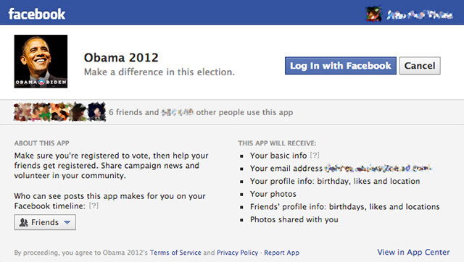
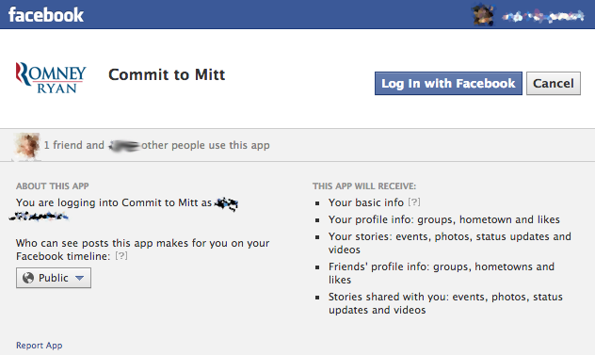
Motivation: Social Networks in Political Campaigns
Voter Boost on Facebook: Apps targeting supporters
  Ask campaign contributions (volunteer time, money, etc.)
  Remind users (recruited nodes) & friends to vote
  Access to friends list
Notes:
(c) 2014, Bruno Ribeiro

Slide 3

Myopic Recruitment Problem
Each recruitment has unit cost
recruited user
covered friend
Problem: Find largest cover given budget B
Notes:
(c) 2014, Bruno Ribeiro

Slide 4
If Topology Was Known
Common solutions:
Minimum Dominating Set (MDS)
  NO. Dominating Set must be connected
  Minimum Connected Dominating Set (MCDS)
  Dominating Set is connected
REAL-WORLD PROBLEM:
TOPOLOGY UNKNOWN
Notes:
(c) 2014, Bruno Ribeiro

Slide 5
Myopic app invitations
Prioritize invitations without friend degree information
Online algorithm
recruited user
covered friend
unknown node
Notes:
(c) 2014, Bruno Ribeiro

Slide 6
Outline
Existing approaches & shortcomings
MEED & MOD
Conclusions
Notes:
(c) 2014, Bruno Ribeiro

Slide 7
Outline
Existing approaches & shortcomings
MEED & MOD
Conclusions
Notes:
(c) 2014, Bruno Ribeiro

Slide 8
Breadth-first Search (BFS)
A
BFS explores nodes in order of discovery
FIFO queue priority
B
C
G
D
E
F
L
M
N
I
H
J
Q
K
O
P
Notes:
(c) 2014, Bruno Ribeiro

Slide 9
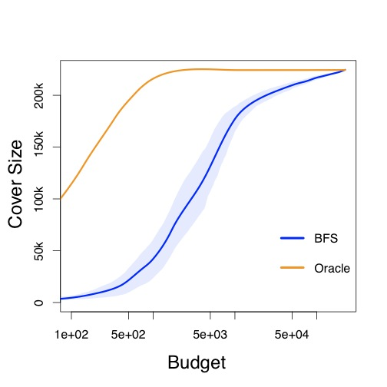
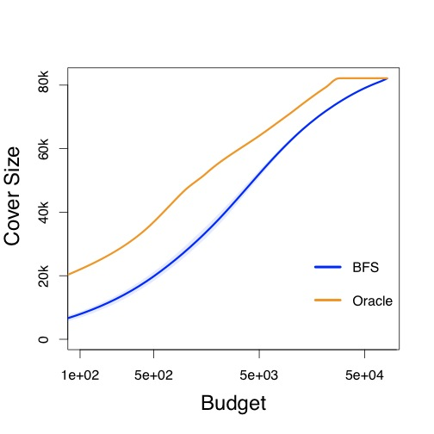
Cover Performance of BFS
Details in the paper
Oracle:
(Guha and Khuller’ 98) greedy cover w/known topology
BFS Problem: you and your friends have many friends in common (transitivity, cluster)
Wiki-talk
Slashdot
Notes:
(c) 2014, Bruno Ribeiro

Slide 10
Depth-first Search (DFS)
DFS chooses random unvisited neighbor
LIFO queue priority
Avoids “cluster” overexploration
A
B
C
D
E
G
F
J
H
I
K
P
L
M
N
O
Q
Notes:
(c) 2014, Bruno Ribeiro

Slide 11
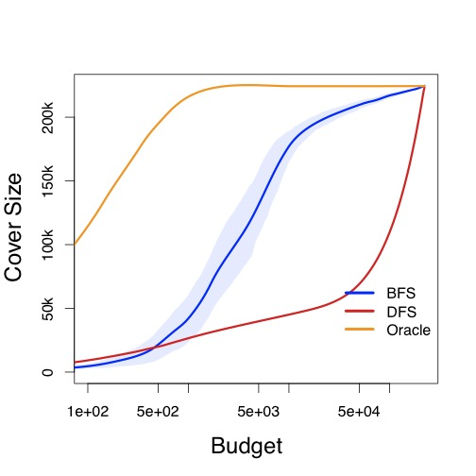
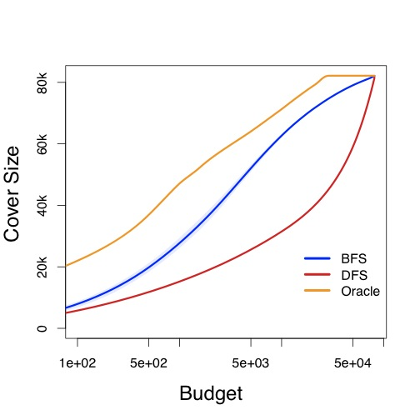
Cover Performance of DFS
Details in the paper
Oracle:
(Guha and Khuller’ 98) greedy cover w/known topology
DFS Problem:
  First observed nodes are hubs
  Hubs go to bottom of LIFO queue
Wiki-talk
Slashdot
Notes:
(c) 2014, Bruno Ribeiro

Slide 12
Stateless Search (RW)
Random Walk (RW) Search
A
RW chooses random neighbor
No cost of “revisiting” node
Random queue priority
B
C
D
E
G
F
J
H
I
K
P
L
M
N
O
Q
Notes:
(c) 2014, Bruno Ribeiro

Slide 13
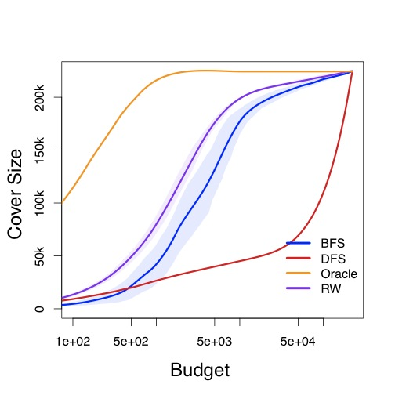
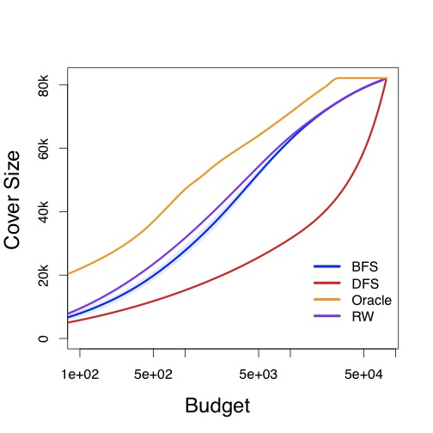
Cover Performance of RW
Details in the paper
Oracle:
(Guha and Khuller’ 98) greedy cover w/known topology
RW advantages:
  Less “cluster” problem than BFS
  Seeks hubs unlike DFS
RW Problem: random priority not targeting potential super-hubs
Wiki-talk
Slashdot
Notes:
(c) 2014, Bruno Ribeiro

Slide 14
Outline
Existing approaches & shortcomings
MEED & MOD
Conclusions
Notes:
(c) 2014, Bruno Ribeiro

Slide 15
Targeting “Super-hubs”
Details in Tech Report
Enron email network
Avg ex. degree unrecruited node
with 4 recruited friends
Avg ex. degree unrecruited node
with 2 recruited friends
Avg ex. degree unrecruited node
with 1 recruited friend
Avg ex. degree unrecruited
Mathematical analysis MUST consider finite graph effects
Budget spent so far
Notes:
(c) 2014, Bruno Ribeiro

Slide 16
MEED (Maximum Expected Excess Degree)
Details in the paper
(Guha and Kuller’98) myopic heuristic
    Start tree T = {v}
    Select neighbors of T with max excess degree
    Add node to T
    GOTO 2 until budget exhausted
MEED heuristic:
Replaces “with max excess degree” by
“with max EXPECTED excess degree”
Assumes known
topology
Excess degree
(uncovered degree)
Notes:
(c) 2014, Bruno Ribeiro

Slide 17
Maximum Observed Degree (MOD)
Details in the paper
Chooses node with max recruited neighbors
MOD heuristic
    Select unrecruited w/ max recruited neighbors
    Invite node
    GOTO 1 until budget is exhausted
In some topologies:
node max excess degree = node most recruited friends
  e.g., (finite!) random power law graphs with α∊{1,2}
  approx. true for Erdös-Rényi graphs
Notes:
(c) 2014, Bruno Ribeiro

Slide 18
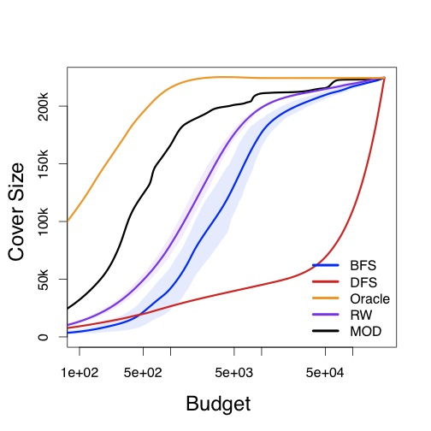
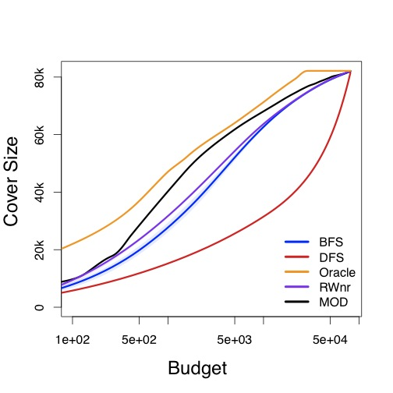
Cover Performance of MOD
Details in the paper
Oracle:
(Guha and Khuller’ 98) greedy cover w/known topology
MOD heuristic: closer to Oracle in all tested social networks
Wiki-talk
Slashdot
Notes:
(c) 2014, Bruno Ribeiro

Slide 19
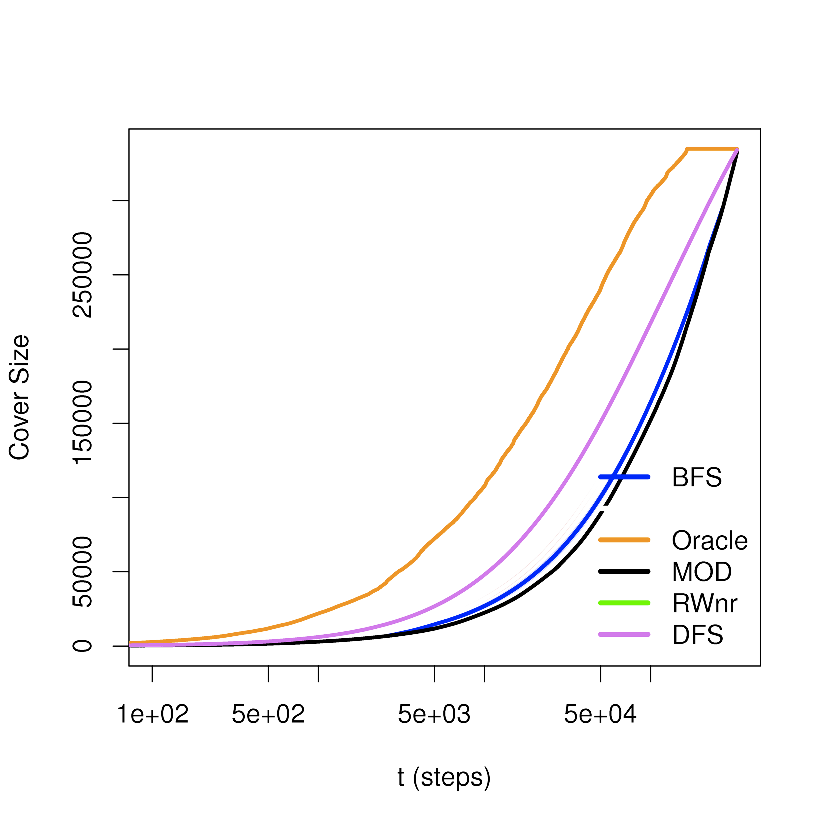
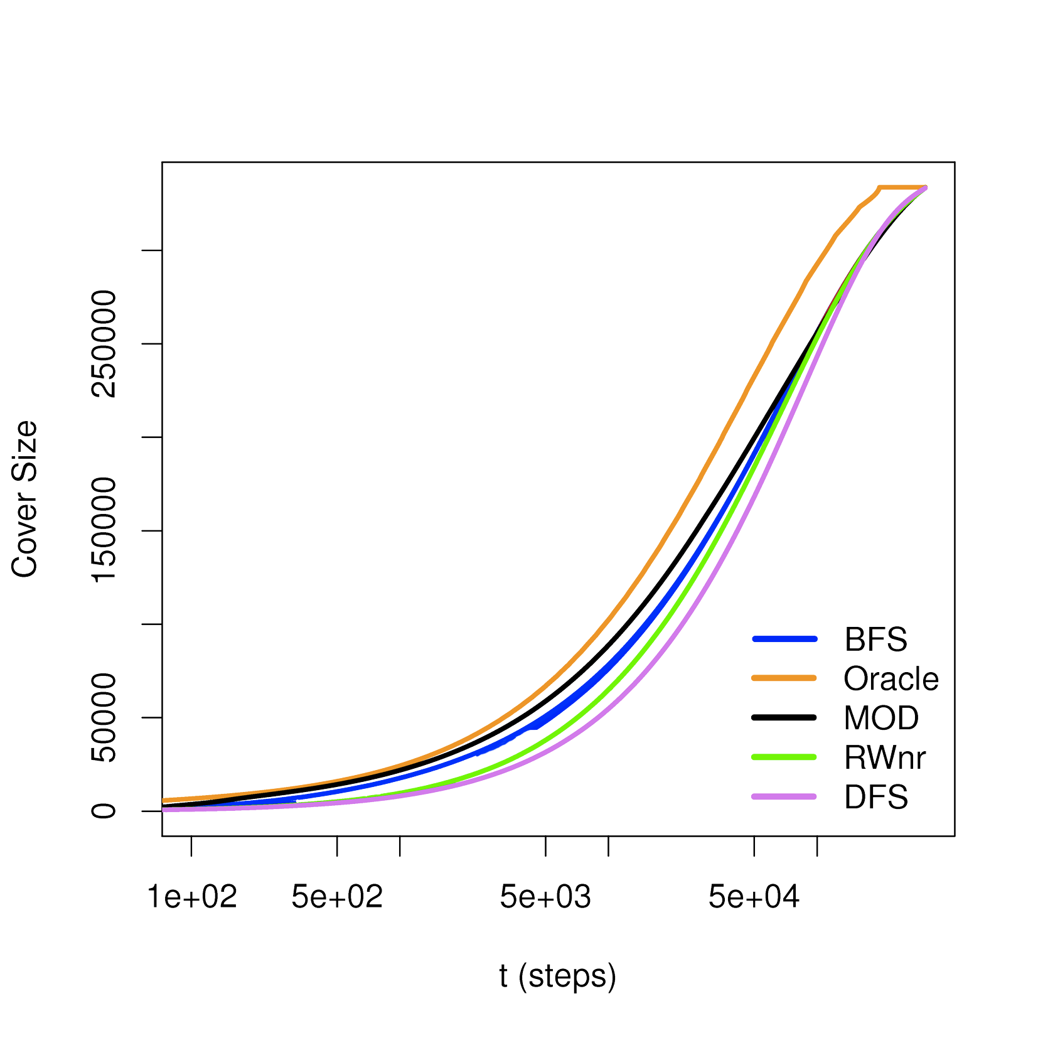
Anti-social counter-example
Details in the paper
Amazon product-product recommendation network
Same nodes, same degrees
+
randomized neighbors
Budget
^{(Maiya & Berger- Wolf,} ^{KDD’11)}
concluded DFS best heuristic for
^{most networks?!?}
Budget
Notes:
(c) 2014, Bruno Ribeiro

Slide 20
Outline
Existing approaches & shortcomings
MEED & MOD
Conclusions
Notes:
(c) 2014, Bruno Ribeiro

Slide 21
Conclusions
Myopic Pay-to-cover problems: many open problems with real-world applications
  Theory must consider finite networks!
Our work: Observations in social networks
  Theory: Analysis of finite networks
  Empirical + why:
    DFS consistently bad
    BFS suffers with clustering
    RW better than BFS
    MOD better overall
Thank you! Tech report @ http://www.cs.cmu.edu/~ribeiro
Notes:
(c) 2014, Bruno Ribeiro

