Slide 1

The Socio-monetary Incentives of Online Social Network Malware Campaigns
Ting-Kai Huang (Google)
Bruno Ribeiro (Carnegie Mellon University)
Harsha M. Madhyastha (University of Michigan)
Michalis Faloutsos (University of New Mexico)
Conference on Online Social Networks
Dublin, Ireland
October 2 2014
Notes:
(c) 2014, Bruno Ribeiro

Slide 2
Tech “Virus” x Bio Virus
In 1983 Cohen uses the term “virus” to describe a
self-replicating computer program
“Recently” added: Viral Marketing, Memes (1976), Viral Videos
 | Computer virus | Internet “viral” | Biological virus
self-replicating | ✓ | ✗ | ✓
mutates to fool defenses | ✓ | ✓✗ | ✓
copes with diverse “gene” pool | ✗ | ? | ✓
Notes:
(c) 2014, Bruno Ribeiro

Slide 3
OSN Malware
 | Computer virus | Internet “viral” | Biological virus
self-replicating | ✓ | ✗ | ✓
mutates to fool defenses | ✓ | ✗ | ✓
copes with diverse gene pool | ✗ | ? | ✓
 | OSN Malware | Biological virus
self-replicating | - | ✓
mutates to fool defenses | - | ✓
copes with diverse gene pool | - | ✓
Notes:
(c) 2014, Bruno Ribeiro

Slide 4


OSN Malware replication
Spreads through clickjacking
 | OSN Malware
self-replicating | ✗
mutates to fool defenses | ?
copes with diverse gene pool | ?
John Smith
Michael Smith
Play as Game to win a FREE iPad2!
Play NOW: http://fungame.info
Like Comment Share
Notes:
(c) 2014, Bruno Ribeiro

Slide 5

OSN Malware mutations
Text 0bfuscat1on to fool Facebook’s
spam detection engine
 | OSN Malware
self-replicating | ✗
mutates to fool defenses | ✓
copes with diverse gene pool | ?
Notes:
(c) 2014, Bruno Ribeiro

Slide 6
What makes people click on posted links?
What makes someone retweet?
What makes people forward videos?
Understanding what drives OSN malware cascades may help us create better models

Slide 7


What makes people do things?
Behavioral Economics has answers
BE studies what gets people to do something
Heyman & Ariely Labor Markets
  Social incentives
  Monetary incentives
John Smith
Michael Smith
Play a Game to win a FREE iPad2!
Play NOW: http://fungame.info
monetary incentive
Like Comment Share

Slide 8
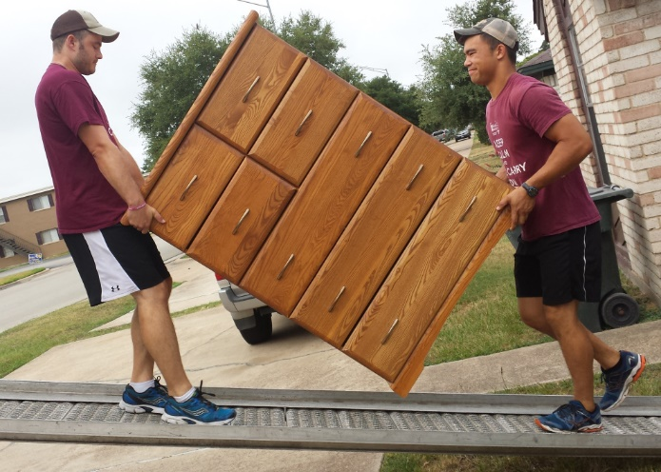
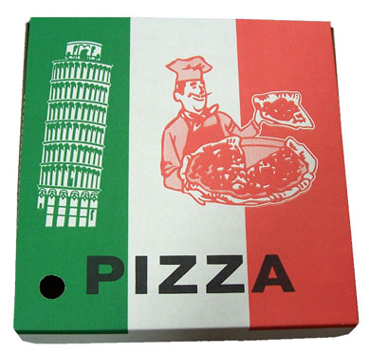
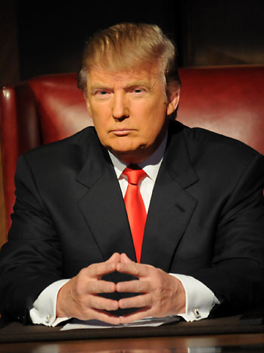

Heyman & Ariely Labor Markets
[Heyman & Ariely, 2004] experiments:
  Social incentive (“get friends to work for you”)
  Monetary incentive (“pay people to work for you`”)
  What about mixed socio-monetary incentives?
Money speaks louder than social capital
+
= ☺
= ☹
+
Socio-monetary incentive ≈ Monetary incentive

Slide 9
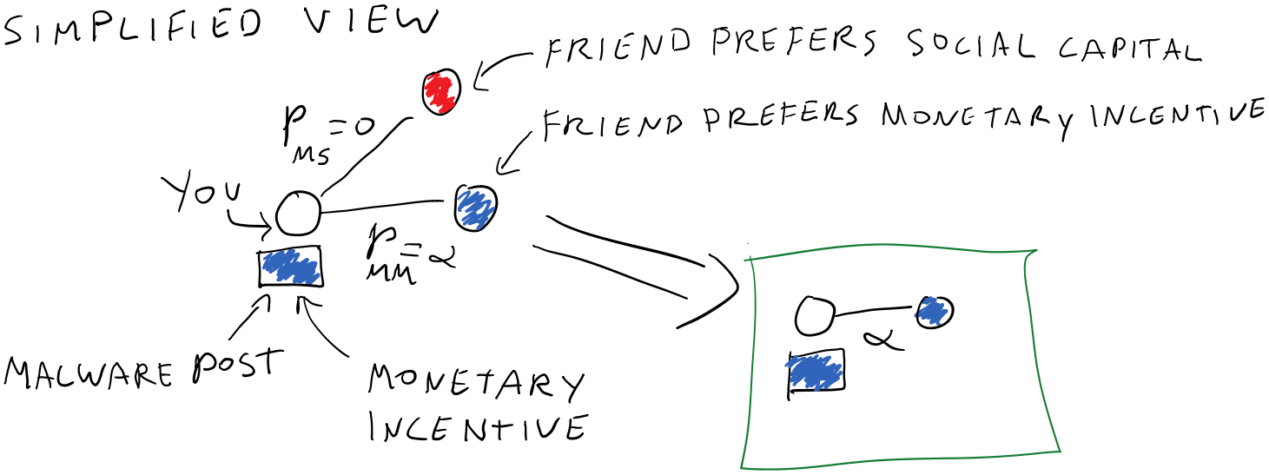
A Labor Market view of malware cascades
Notes:
(c) 2014, Bruno Ribeiro

Slide 10
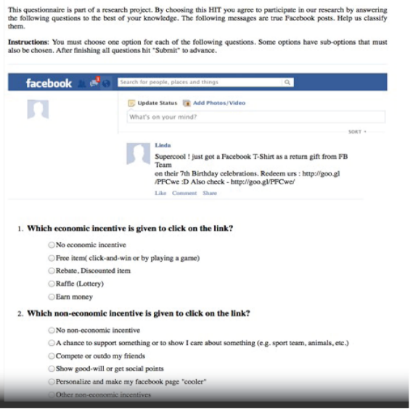
Classifying Facebook malware incentives
Our Facebook data:
  111 million posts
  164,000 malware posts
  3,100 distinct malware campaigns
  (campaign defined through URL of attack)
  From 07/2011 to 04/2012
Mechanical Turk to classify incentives
Notes:
(c) 2014, Bruno Ribeiro

Slide 11
Malware incentives
classifying the incentives in malware posts
“Some People will dominate all the games and some are doomed to remain losers their whole life (sic): ⟨link⟩”
  social incentive
“NEW GAME NOTICE! Come check out the awesome new contest that is available, you could win a Kindle Fire. Start playing⟨here⟩”
  monetary incentive
“CONTEST UPDATE: Currently in 10246th place in The Daily Addi’s Gem Swap II contest to win a 16GB iPad2. Think you can do better? You should give it a try ⟨here⟩”
  socio-monetary incentive
Notes:
(c) 2014, Bruno Ribeiro

Slide 12
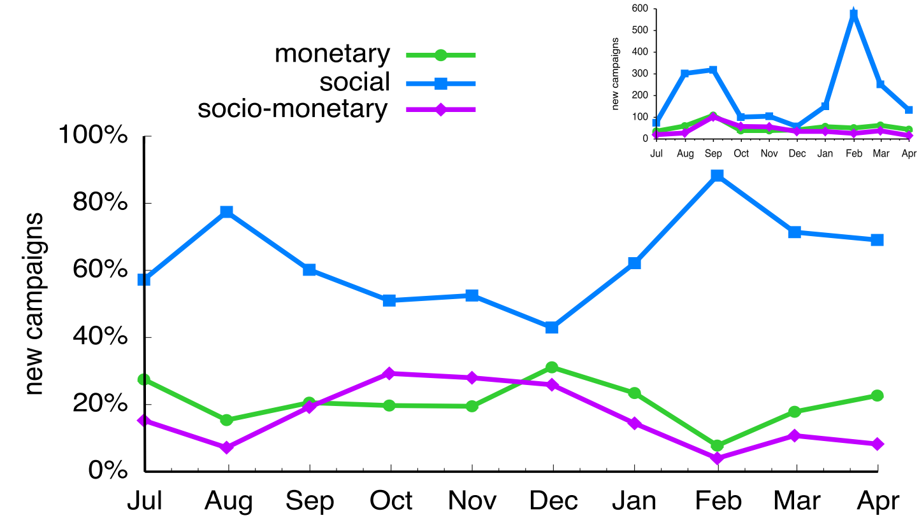
Results: “Social” is favorite incentive of developers
Notes:
(c) 2014, Bruno Ribeiro

Slide 13
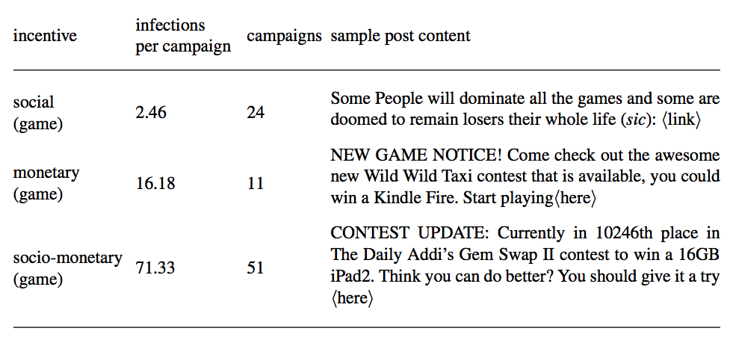
Facebook incentive popularity
Developers may know something?!
Illustrative
examples:
Which incentive most effective?
Notes:
(c) 2014, Bruno Ribeiro

Slide 14
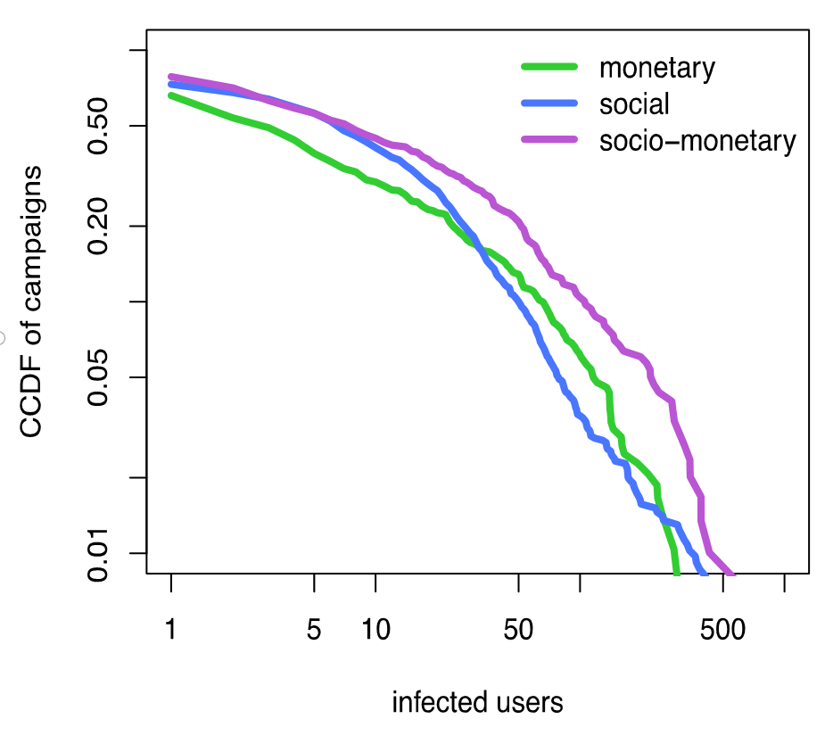
Results: Incentive efficiency
Results over all 3,100 campaigns
?
Duration
Reach
days
infected users
socio-monetary >_{st} monetary or social

Slide 15
Socio-monetary ~ monetary?
 | Computer virus | Internet “viral” | Biological virus
self-replicating | ✓ | ✗ | ✓
mutates to fool defenses | ✓ | ✗ | ✓
copes with diverse host population | ✗ | ? | ✓
 | OSN Malware | Biological virus
self-replicating | ✗ | ✓
mutates to fool defenses | ✓ | ✓
copes with diverse gene pool | ? | ✓
Elegant reconciliation of Heyman & Ariely

Slide 16
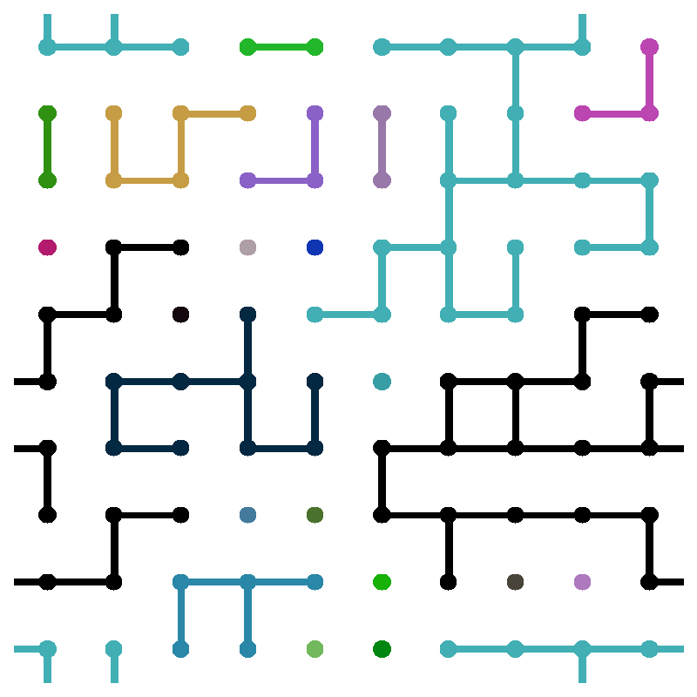
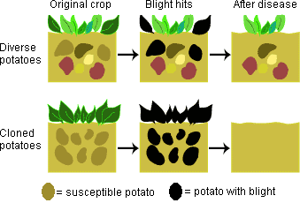
Mechanics of crop epidemics
Resilience of mixed crops
Fungi counteracts by becoming flexible
(but less virulent) [Chin & Wolfe, 84]
Also true for complex systems?
1D
2D

Slide 17
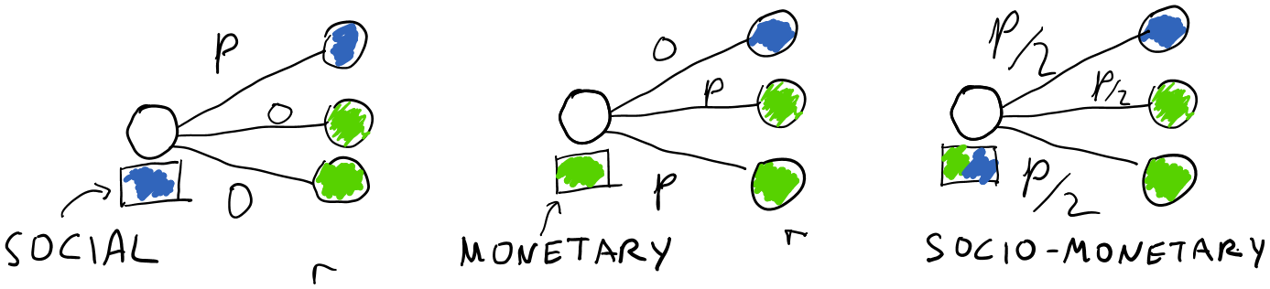
Epidemics with heterogeneous preferences
Enron email
network
36,692 nodes
Variant of
SIR model
infected users
p
Notes:
(c) 2014, Bruno Ribeiro

Slide 18
Malware must cope with diversity of incentives
Completing the picture
 | OSN Malware | Biological virus
self-replicating | ✗ | ✓
mutates to fool defenses | ✓ | ✓
copes with diverse “gene” pool | ✓ | ✓
Notes:
(c) 2014, Bruno Ribeiro

Slide 19
Conclusions
Labor market incentives help understand epidemics on online social networks
[Heyman & Ariely, 2004] conclusion
“socio-monetary ≈ monetary” may not be true in networks due to percolation effects
There can be other explanations
(but ours is elegant & fills gap bio ↔ techno viruses)
we didn't get university approval for our “malware epidemic” experiment
Notes:
(c) 2014, Bruno Ribeiro

Slide 20
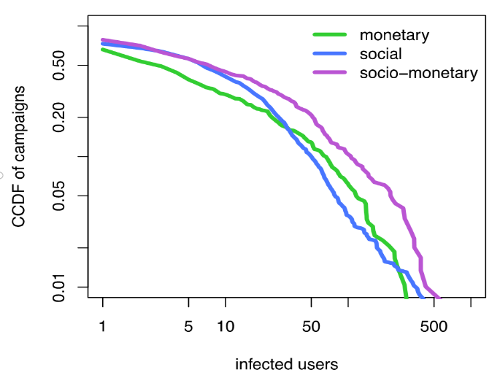
Thank you!
Incentive Percolation Effects
Notes:
(c) 2014, Bruno Ribeiro

