Slide 1
Modeling and Predicting the Growth and Death of Membership-based Websites
Bruno Ribeiro
Carnegie Mellon University
Bruno Ribeiro, “Modeling and Predicting the Growth and Death of
Membership-based Websites,” WWW 2014
Notes:
(c) 2014, Bruno Ribeiro

Slide 2
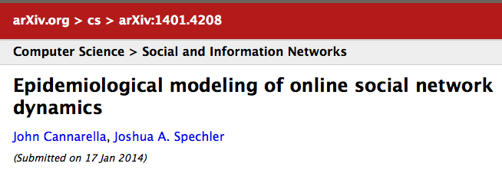
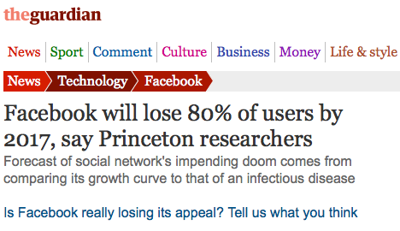
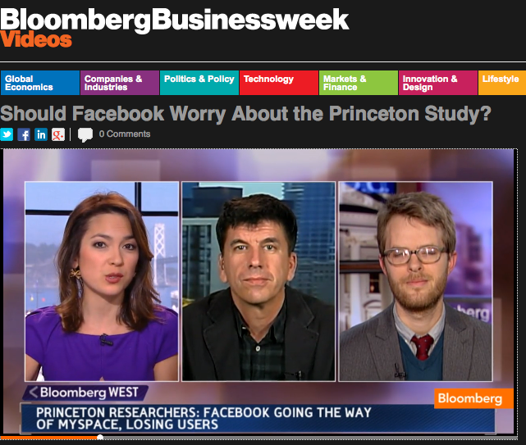

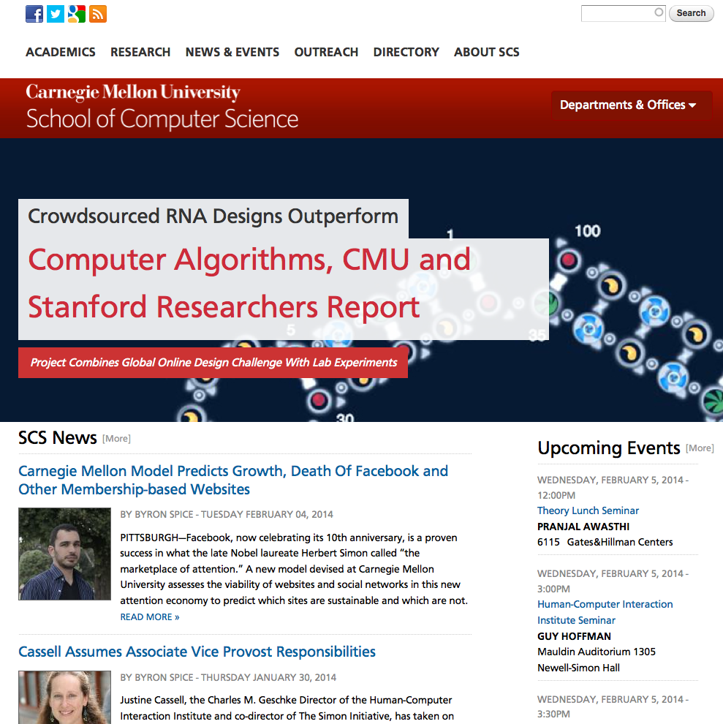

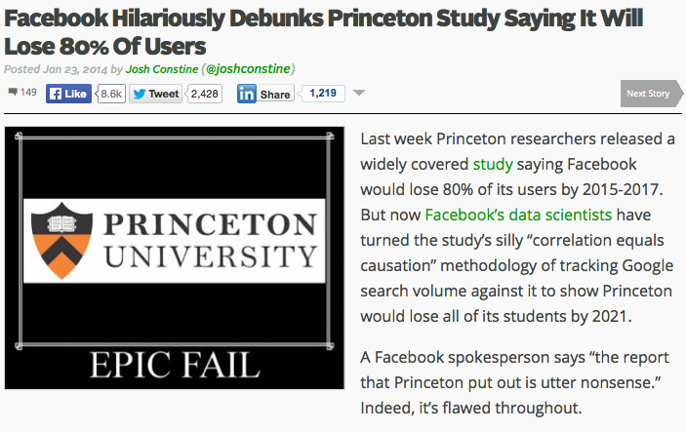
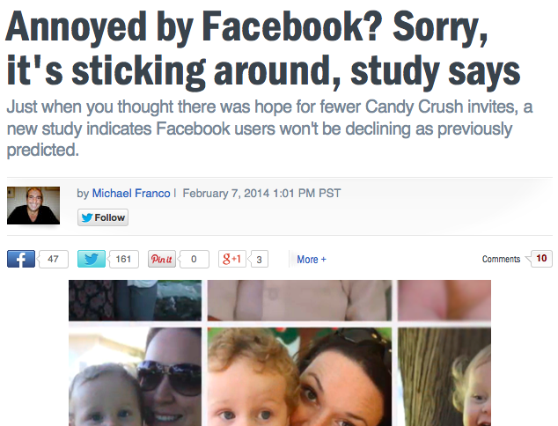
Unforeseen Preliminaries
`
Notes:
(c) 2014, Bruno Ribeiro

Slide 3
Research Starts Here
Notes:
(c) 2014, Bruno Ribeiro

Slide 4
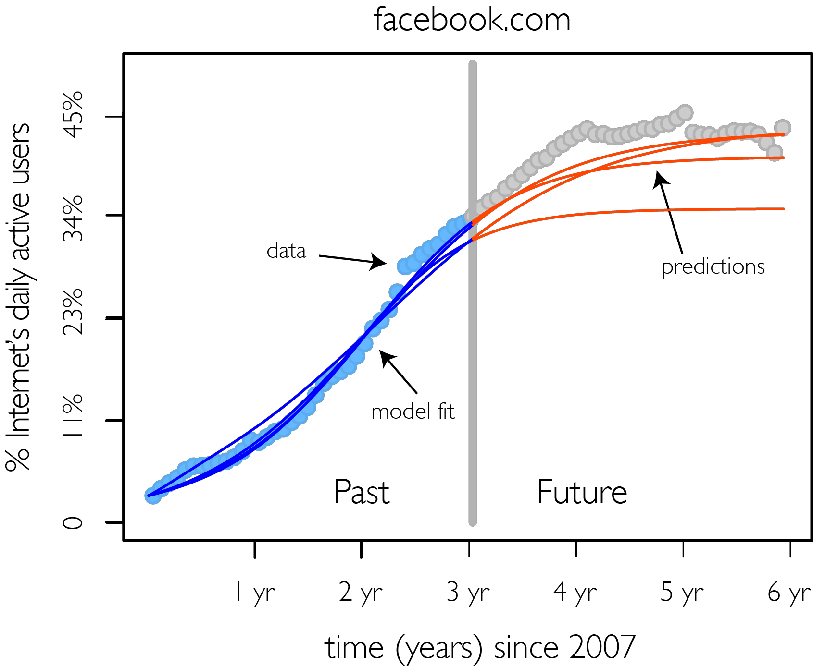
Problem: Website Popularity Forecast
?
?
?
?
?
Notes:
(c) 2014, Bruno Ribeiro

Slide 5
Outline
Website adoptions & existing models
Key to success lies in failures
Model
Model predictions
Discussion
Notes:
(c) 2014, Bruno Ribeiro

Slide 6
Outline
Website adoptions & existing models
Key to success lies in failures
Model
Model predictions
Discussion
Notes:
(c) 2014, Bruno Ribeiro

Slide 7

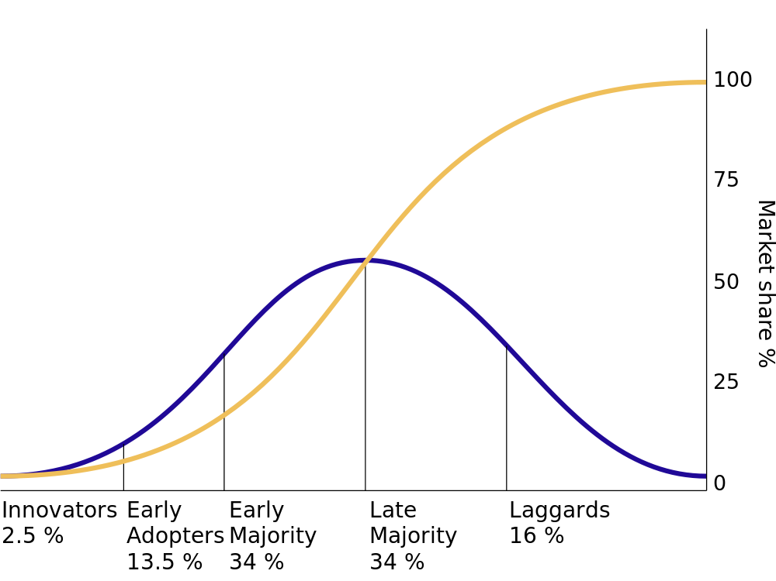


Background: Adoption of Innovations
How do people adopt new behavior or technology?
Mansfield’61, Rogers’03
E.g.: Bass model ’69
fraction of adopters (%)
C
rate of adoption
C/2
C - fraction of population
that adopts
some will
never adopt
0
C ≠ 100%
sources: wikipedia, arstechna, eideard.com
Notes:
(c) 2014, Bruno Ribeiro

Slide 8
Membership Growth in Successful Websites
new
subscribers/semester
MySpace.com
data collected in
Feb. 2009
bars – new members (adoptions)
line – active members
Notes:
(c) 2014, Bruno Ribeiro

Slide 9
Background: Vast Adoption Literature
Economics:
  (Mansﬁeld ’63)
  (Katz&Shapiro’85)
  (Farrell&Saloner ’86)
  (Choi ’94)
  (Arthur ’94)
Marketing:
  (Bass ’69)
  (Fisher&Pry ’71)
Computer Science:
  (Kempe et al ’03)
  (Zhao et al., IMC’12)
  (Leskovec et al., SIGKDD’08)
  (Ugander et al., PNAS’12)
  (Aral&Walker, Science’12)
Sociology:
  (Ryan&Gross’49)
  (Everett ’62, ’03)
  (Rogers ’03)
  (Centola ’12)
Notes:
(c) 2014, Bruno Ribeiro

Slide 10
Popularity of Success Seem to Follow
Adoption Models
Popularity of successful websites (Bass model, etc.)
huffingtonpost.com
facebook.com
Can adoption models
explain failed startups?
Notes:
(c) 2014, Bruno Ribeiro

Slide 11
Outline
Existing theory of adoptions
Key to success lies in failures
Model
Model predictions
Discussion
Notes:
(c) 2014, Bruno Ribeiro

Slide 12
Anatomy of a Startup Failure
Some startups are short-lived
Easy to dismiss failures:
“incompetence”
“no revenue”
12seconds.tv
≠ sigmoid
Notes:
(c) 2014, Bruno Ribeiro

Slide 13
Outline
Website adoptions & existing models
Key to success lies in failures
Model
Model predictions
Discussion
Notes:
(c) 2014, Bruno Ribeiro

Slide 14
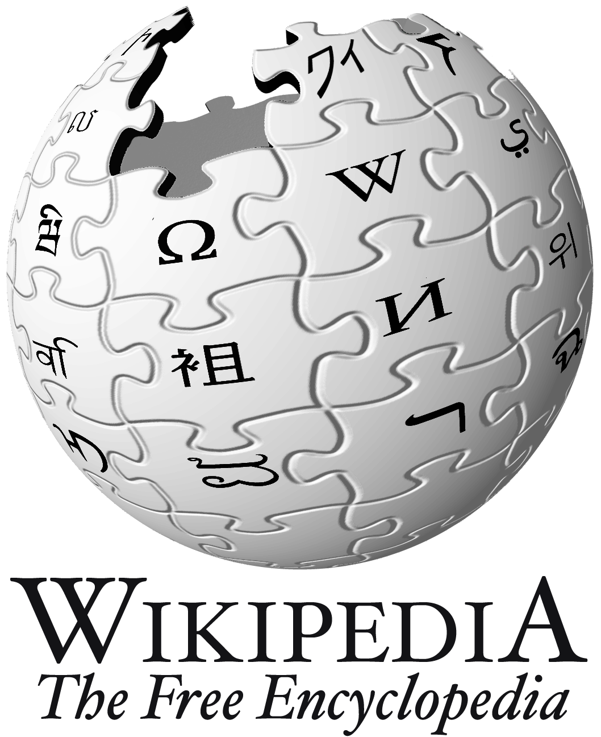



Today’s Information-Rich World
Web recently celebrated 25 years
Transformative nature of Web:
Anyone can create & access content
Increases wealth of information
Blogs
Facebook
Exacerbates information overload
Notes:
(c) 2014, Bruno Ribeiro

Slide 15
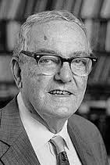
Herbert A. Simon on Information Overload
Herbert A. Simon
  Turing Award Winner, 1975
  Nobel Laureate in Economics, 1978
1969 - H. A. Simon on information overload:
Information consumes attention (time)
  Information-rich world ➔ Attention-depleted world
Systems that “talk” more than “think” exacerbate
information overload
Notes:
(c) 2014, Bruno Ribeiro

Slide 16
Facebook “talks”
Facebook
attention
& activity
Notes:
(c) 2014, Bruno Ribeiro

Slide 17
Positive & Negative Attention Loops
Positive Growth
Website
Survives
My Attention
My Content
Friends’ Attention
Friends’ Content
Negative Growth
Website
Dies
Notes:
(c) 2014, Bruno Ribeiro

Slide 18
Model
Details in the paper
Population-level model
Carrying capacity parameter
    C – fraction of active Internet population that will eventually become members
Notes:
(c) 2014, Bruno Ribeiro

Slide 19
Attention-Seeking Mechanics (activity - inactivity)
Details in the paper
Modeled as reaction-decay process
Reaction:
Decay:
mean field network externality effect
active user
inactive user
network
effect
Notes:
(c) 2014, Bruno Ribeiro

Slide 20
Adoptions Reaction-Diffusion Processes
Details in the paper
Modeled as reaction-diffusion process
Media & Marketing diffusion:
Word-of-mouth reaction:
mean field network externality effect
brings new user
brings new user
network
effect

Slide 21
Outline
Website adoptions & existing models
Key to success lies in failures
Model
Model predictions
Discussion
Notes:
(c) 2014, Bruno Ribeiro

Slide 22
Signatures of Self-Sustainability
Details in the paper
Model predictions – long-term DAU (t’ = t – t₀)
DAU = Daily Active Users
Notes:
(c) 2014, Bruno Ribeiro

Slide 23
Signatures of Popularity Growth
Details in the paper
Model prediction: DAU signatures of growth
Notes:
(c) 2014, Bruno Ribeiro

Slide 24
Datasets
22 websites
from Alexa.com
up to 6 years of DAU
(June 2007 – Sept 2013)
Notes:
(c) 2014, Bruno Ribeiro

Slide 25
Automatic parameter fit
Details in the paper
dataset
initialization
examples
train
test
model sel.
Levenberg-Marquardt
algorithm
L₂ error +
k-medoid clustering
model
predictions

Slide 26
Automatic parameter fit
Fitting parameters to dataset d (e.g., d=“facebook.com”)
split DAU into (train set, model selection set, test set)
for each dataset d’ ≠ d
  Use known fitted parameters of d’ to initialize
  Levenberg-Marquardt algorithm
    goal: minimize l₂ norm over train set of d
Collect set of fitted parameters M for all d’ datasets
for each m ∊ M : compute l₂ prediction error over
model selection set (ERR)
k-medoid clustering of model parameters & ERR
Choose k-medoid cluster with > 3 examples & smallest average ERR
Notes:
(c) 2014, Bruno Ribeiro

Slide 27
Fitted Parameters
Notes:
(c) 2014, Bruno Ribeiro

Slide 28
Growth Parameters (medoid of best cluster)
unsustainable
Word of Mouth
self-sustaining
Media & Marketing
γ
λ
Notes:
(c) 2014, Bruno Ribeiro

Slide 29
Self-Sustainability (medoid of best cluster)
Notes:
(c) 2014, Bruno Ribeiro

Slide 30
Predictions
Notes:
(c) 2014, Bruno Ribeiro

Slide 31
Predictions (self-sustaining)
Notes:
(c) 2014, Bruno Ribeiro

Slide 32
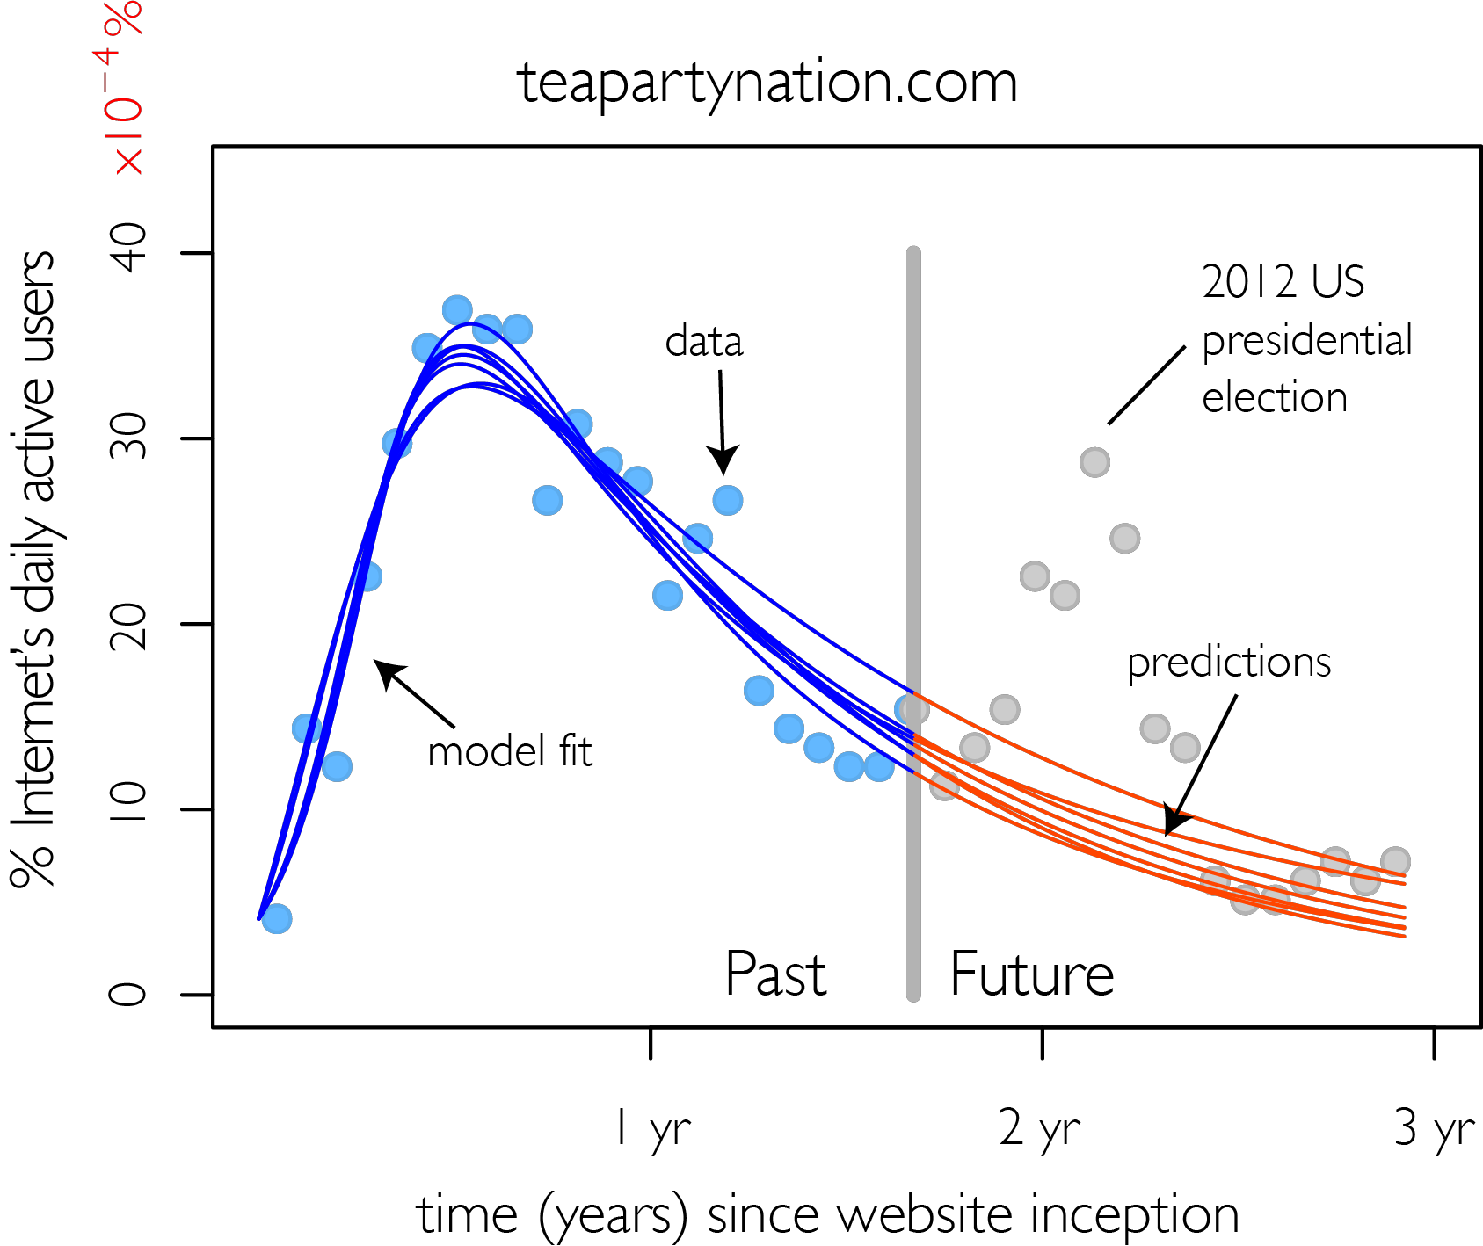
Predictions (unsustainable)
Notes:
(c) 2014, Bruno Ribeiro

Slide 33
Unobserved predicted behavior…
strong media & marketing
+
self-sustaining
Merrit & Clauset after paper was on arXiv
Halo Reach massive multiplayer online game network
Merrit & Clauset (2013)
Notes:
(c) 2014, Bruno Ribeiro

Slide 34
Attention Feedback Hypothesis
Without Attention Feedback websites never die
Model without
Attention Feedback
Model with
Attention Feedback
websites
can die
websites
never die
Notes:
(c) 2014, Bruno Ribeiro

Slide 35
Parting Thoughts
Notes:
(c) 2014, Bruno Ribeiro

Slide 36


Future work
(Ribeiro & Faloutsos arXiv:1403.0600)
Model competition for attention
MySpace
Multiply
Friendster
Hi5
Notes:
(c) 2014, Bruno Ribeiro

Slide 37
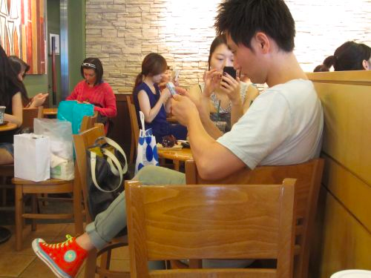


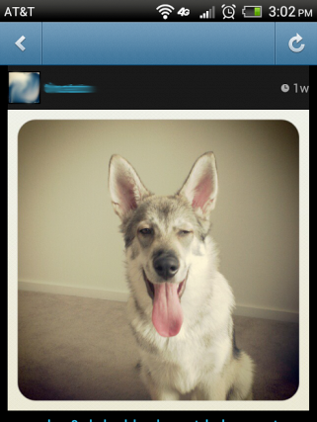
Parting Thoughts
Facebook, the Tea Party and Occupy Wall Street rely on users to compete for attention
Model insights
  Network structure likely 2nd order effect on adoptions
  Strong attention-activity feedback (“addiction”) good for business
  Model can help predict impact of new attention-grabbing tools
Attention-activity model to predict lasting DAU
impact of website changes
pictures:
micapie.com
huffingtonpost.com
Notes:
(c) 2014, Bruno Ribeiro

Slide 38

Thank you!
Questions?
12seconds.tv
marriedsecrets.com
netflix.com
Bruno Ribeiro, “Modeling and Predicting the Growth and Death of Membership-based Websites,” WWW 2014
http://www.cs.cmu.edu/~ribeiro/
@brunofmr
All data collection scripts and model-related code at
http://www.cs.cmu.edu/~ribeiro/Ribeiro_AIU.zip
Notes:
(c) 2014, Bruno Ribeiro

