Slide 1

Estimating and Sampling Graphs with Multidimensional Random Walks
Bruno Ribeiro Don Towsley
University of Massachusetts Amherst
IMC 2010
Melbourne, Australia

Slide 2
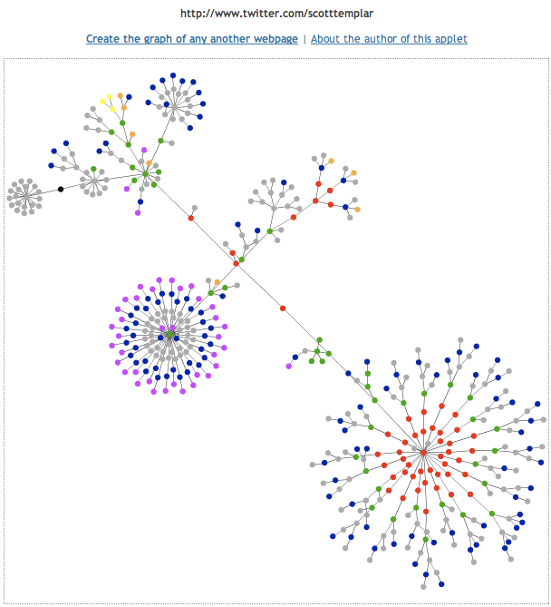

Motivation
sample of Twitter network
measure characteristics of social networks
in the wild

Slide 3
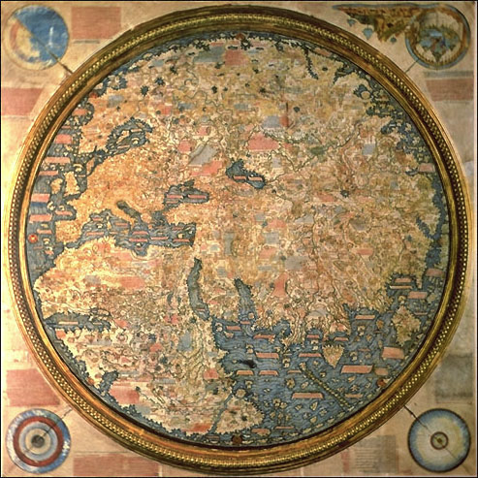
measurement distortions
“World Map” in 1459
  proved incomplete
  (Columbus et al. 1492)
  (Australia 17th century)
  wrong proportions (Africa & Asia)
The Fra Mauro world map (1459)
source: Wikipedia

Slide 4
outline
methods to sample graphs (online social networks)
uniform vertex sampling v.s. uniform edge sampling
random walks
our contribution (Frontier sampling random walk)
results

Slide 5
sampling graphs
random sampling
(uniform & independent)
crawling
vertex sampling
BFS sampling
edge sampling
random walk sampling
5

Slide 6
independent sampling
uniform vertex sampling
  θ_{i} - fraction of vertices with degree i
  vertex with degree i is sampled with probability θ_{i}
uniform edge sampling
  π_{i} - probability that a vertex with degree i is sampled
  π_{i} = θ_{i} x i / <average degree>
estimating θ_{i} from π_{i} (uniform edge) :
  trivial to remove bias
v
u

Slide 7
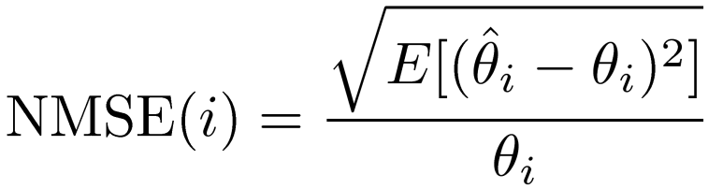

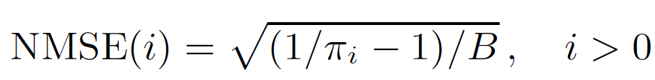

random sampling: accuracy of estimates
estimate: θ_{i} - fraction of vertices with degree i ;
budget: B samples
accuracy metric: Normalized root Mean Squared Error
uniform vertex
uniform edge
,

Slide 8
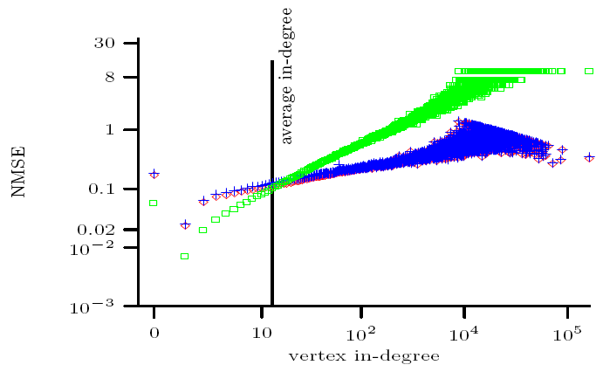
independent sampling: uniform vertex vs. uniform edge
Flickr graph (1.7 M vertices, 22M edges)
sampling budget: B = |V|/100 samples
θ head: GOOD
θ tail: BAD
BAD
uniform vertex
avg. degree
GOOD
uniform edge
θ head: BAD
θ tail: GOOD
vertex degree

Slide 9
pros & cons
uniform vertex
pros:
  independent sampling
  OSN needs numeric user IDs. E.g.: Livejournal, Flickr, MySpace, Facebook,...
cons:
  resource intensive (sparse user ID space)
  difficult to sample large degree vertices
uniform edge
pros:
  independent sampling
  easy to sample large degree vertices
cons:
  no public OSN interface to sample edges
  difficult to sample small degree vertices

Slide 10
random walk (RW) [crawling]
start at v
randomly selects a neighbor of v
...
until B samples
vertices can be sampled multiple times
often (resource-wise) cheaper than uniform vertex sampling
graph should be connected
multiple RWs: m independent walkers to capture ⎣B/m⎦ samples

Slide 11
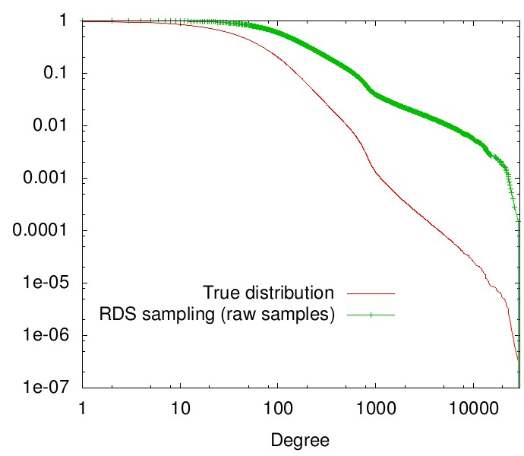
RW degree distribution estimation
θ_{i} – fraction of vertices with degree i
P[sampled degree = i] ≡ π_{i}
in steady state samples edges uniformly (only if graph connected)
RW = uniform edge sampling without independence
π_{i}
distribution observed by RW
θ_{i}
P[X > x]
CCDF
true distribution
RW sampling
(i)
x = degree (log-scale)

Slide 12
pros & cons
uniform vertex
pros:
  independent sampling
  supported by OSNs with numeric user IDs: Livejournal, Flickr, MySpace, Facebook,...
cons:
  resource intensive (sparse user ID space)
  difficult to sample large degree vertices
uniform edge RW
pros:
  independent sampling
  easy to sample high degree vertices
  resource-wise cheap
cons:
  graph must be connected
  large estimation errors when graph loosely connected
  should start in steady state (discard transient samples, but transient is unknown)

Slide 13
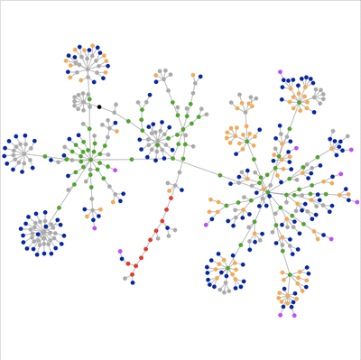
hybrid sampling?
A
B
uniform vertex samples both A and B subgraphs
  but is expensive
RW samples either A or B
  but is cheap
combine advantages of uniform vertex & RWs?

Slide 14
puzzle
design a RW that in steady state
  samples edges uniformly (importance sampling)
  &
  initialize steady state w/ uniform vertex sampling
in steady state we want
  to sample vertices proportional to degree
  to start with uniformly sampled vertices

Slide 15
need to think in multiple dimensions (multiple walkers)

Slide 16
multiple dependent walkers
Frontier Sampling (FS)
B – sampling budget
Let S = {v₁, v₂, … , v_{m}} be a set of m vertices
(1) select v_{r} ∈ S w.p. ∝ deg(v_{r})
(2) walk one step from v_{r}
(3) add walked edge to E’ and update v_{r}
(4) return to (1) (until m + | E’ | = B)

Slide 17
FS: an m-dimensional RW
G^{m} = m-th Cartesian power of G
j,j
j
j
j,u
u,j
u
×
u
=
j,k
u,u
k,j
k
k
u,k
k,u
k,k
×
=
G
G
G²
Frontier sampling
≡
random walk on G^{m}

Slide 18
a FS property
when in steady state (m → ∞)
  FS state at step k: S_{k}=(v₁, v₂, ... , v∞)
  FS state at step k+1: S_{k+1}=(v₁, u₂, ... , v∞)
  samples edges uniformly (like a RW)
  m → ∞ ⇒ number of walkers in v ∈ V is uniformly distributed (uniform vertex sampling)
uniform vertex
distribution
v₂ , u₂ chosen proportional
to their degrees

Slide 19

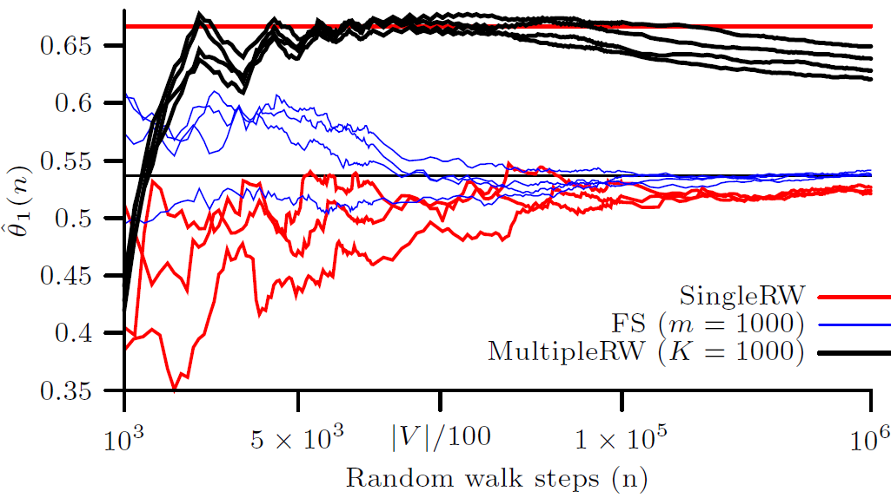
sample paths of θ₁ estimates (Flickr graph)
Flickr: 1.7M vertices, 22M edges
Plot evolution (n) , where n = number of steps
4 sample paths = 4 curves

Slide 20
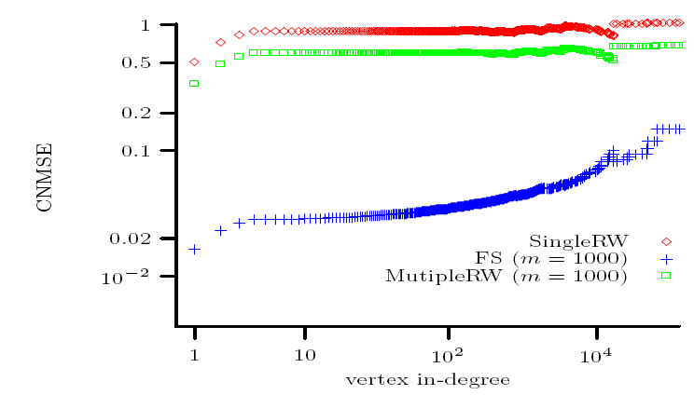
G_{AB} graph
2 Albert-Barabasi graphs (5x10⁵ vertices)
w/ avg. deg. 2 and 10 connected by 1 edge
AB
2
AB
10
1 edge

Slide 21
other metrics
assortativity => measure of degree correlation between neighboring vertices
global clustering coefficient
assortativity: FS consistently better
global clustering coefficient: all RWs do well

Slide 22
main contribution
RW cannot start close to steady state
FS steady state close to uniform vertex sampling
(m >> 1)

Slide 23
Thanks! ribeiro@cs.umass.edu http://www.cs.umass.edu/~ribeiro
Estimating and Sampling Graphs with Multidimensional Random Walks

Slide 24
RW + random jumps (uniform restarts)
A RW that can jump to a randomly chosen vertex
Improving Random Walk Estimation Accuracy with Uniform Restarts, (with Konstantin Avrachenkov (INRIA) and Don Towsley (UMASS) ), WAW 2010
Shorter mixing time
Smaller estimation error
trivial extension: Frontier sampling with random jumps

Slide 25
Distributed FS
centrally coordinated
but can be easily made distributed at no cost
Distributed FS:
independent multiple RWs
virtual budget B for each walker
at step i reduce budget by X ∼ exp(deg(v_{i}))
(v_{i} - RW vertex at step i)
no communication cost
virtual budget B ≠ # of samples

Slide 26


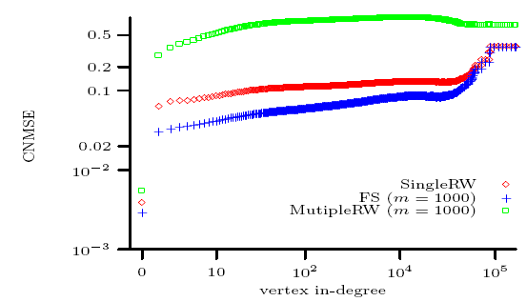
more degree distribution results
large connected component of Flickr graph
estimate complimentary cumulative distribution (CCDF)
metric of accuracy:
vertex degree

