Slide 1

RandNLA: Randomized Numerical Linear Algebra
Petros Drineas
Rensselaer Polytechnic Institute
Computer Science Department
To access my web page:
drineas

Slide 2
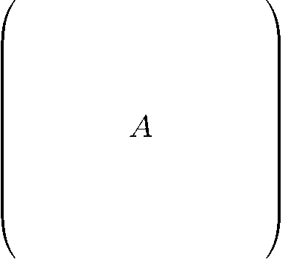
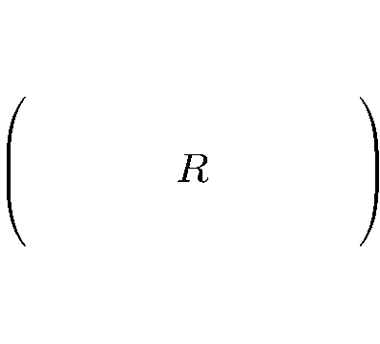

RandNLA: “sketch” a matrix by row/column sampling
Sampling algorithm (rows)
Input: m-by-n matrix A, sampling parameter r
Output: r-by-n matrix R, consisting of r rows of A
Let p_{i} for i=1…m be sampling probabilities summing up to 1;
In r i.i.d. trials (with replacement) pick r rows of A;
(In each trial the i-th row of A is picked with probability p_{i}.)
Let R be the matrix consisting of the rows;
(We rescale the rows of A prior to including them in R by 1/(rp_{i})^{1/2}.)

Slide 3
RandNLA: “sketch” a matrix by row/column sampling
Sampling algorithm (rows)
Input: m-by-n matrix A, sampling parameter r
Output: r-by-n matrix R, consisting of r rows of A
Let p_{i} for i=1…m be sampling probabilities summing up to 1;
In r i.i.d. trials (with replacement) pick r rows of A;
(In each trial the i-th row of A is picked with probability p_{i}.)
Let R be the matrix consisting of the rows;
(We rescale the rows of A prior to including them in R by 1/(rp_{i})^{1/2}.)
Column sampling is equivalent to row sampling, simply by working with A^{T} instead of A.

Slide 4

The p_{i}’s: length-squared sampling
Length-squared sampling: sample rows with probability proportional to the square of their Euclidean norms, i.e.,
Notation:
A_{(i)} : the i-th row of A
||A||_{F} : the Frobenius norm of A

Slide 5
The p_{i}’s: length-squared sampling
Length-squared sampling: sample rows with probability proportional to the square of their Euclidean norms, i.e.,
Notation:
A_{(i)} : the i-th row of A
||A||_{F} : the Frobenius norm of A
Leads to additive-error approximations for
low-rank matrix approximations and the Singular Value Decomposition (SVD),
the CUR and CX factorizations,
the Nystrom method, etc.
(Drineas, Kannan, Mahoney SICOMP 2006a, SICOMP 2006b, SICOMP 2006c, Drineas & Mahoney JMLR 2005, etc.)

Slide 6
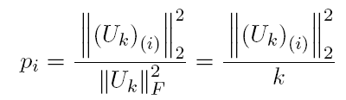
The p_{i}’s: leverage scores
Leverage score sampling: sample rows with probability proportional to the square of the Euclidean norms of the rows of the top k left singular vectors of A.
Notation:
U_{k}: the m-by-k matrix containing the top k left singular vectors of A
(U_{k})_{(i)} : the i-th row of U_{k}
k=||U_{k}||_{F}: the Frobenius norm of U_{k}

Slide 7
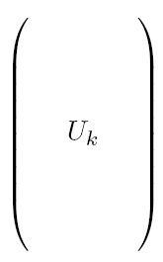

The p_{i}’s: leverage scores
Leverage score sampling: sample rows with probability proportional to the square of the Euclidean norms of the rows of the top k left singular vectors of A.
Notation:
U_{k}: the m-by-k matrix containing the top k left singular vectors of A
(U_{k})_{(i)} : the i-th row of U_{k}
k=||U_{k}||_{F}: the Frobenius norm of U_{k}
and

Slide 8
The p_{i}’s: leverage scores
Leverage score sampling: sample rows with probability proportional to the square of the Euclidean norms of the rows of the top k left singular vectors of A.
Notation:
U_{k}: the m-by-k matrix containing the top k left singular vectors of A
(U_{k})_{(i)} : the i-th row of U_{k}
k=||U_{k}||_{F}: the Frobenius norm of U_{k}
Leads to relative-error approximations for:
low-rank matrix approximations and the Singular Value Decomposition (SVD),
the CUR and CX factorizations,
Over- and under- constrained least-squares problems
Solving systems of linear equations with Laplacian input matrices

Slide 9
The p_{i}’s: leverage scores
Leverage score sampling: sample rows with probability proportional to the square of the Euclidean norms of the rows of the top k left singular vectors of A.
Notation:
U_{k}: the m-by-k matrix containing the top k left singular vectors of A
(U_{k})_{(i)} : the i-th row of U_{k}
k=||U_{k}||_{F}: the Frobenius norm of U_{k}
Column sampling is equivalent to row sampling by focusing on A^{T} and looking at its top k left singular vectors…
(Which, of course, are the top k right singular vectors of A, often denoted as V_{k} , an n-by-k matrix.)

Slide 10
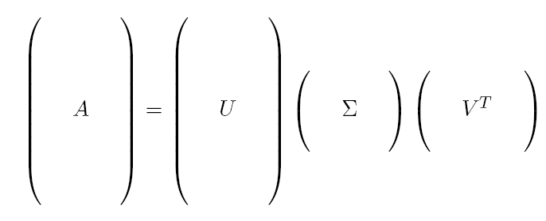



Leverage scores: tall & thin matrices
Let A be a (full rank) n-by-d matrix with n>>d whose SVD is:

Slide 11

Leverage scores: tall & thin matrices
Let A be a (full rank) n-by-d matrix with n>>d whose SVD is:
i-th row of U_{k}
(Row) Leverage scores: (set k to d)
The (row) leverage scores can now be used to sample rows from A to create a sketch.

Slide 12
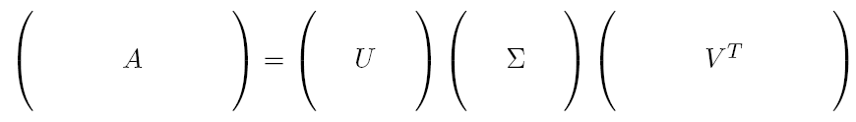
Leverage scores: short & fat matrices
Let A be a (full rank) d-by-n matrix with n>>d:

Slide 13
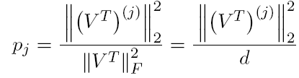
Leverage scores: short & fat matrices
Let A be a (full rank) d-by-n matrix with n>>d:
j-th column of V^{T} (or j-th row of V)
(Column) Leverage scores:
(set k to d)
The (column) leverage scores can now be used to sample rows from A to create a sketch.

Slide 14
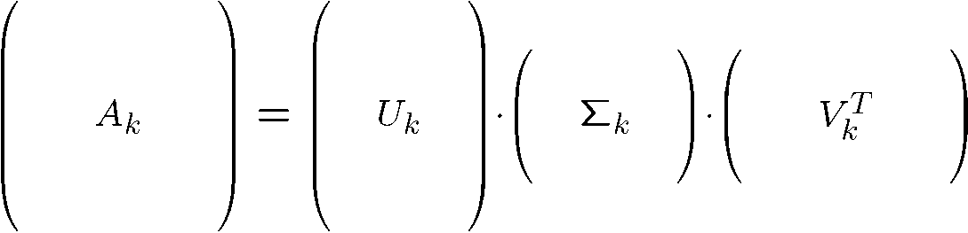




Leverage scores: general case
Let A be an m-by-n matrix A and let A_{k} be its best rank-k approximation (as computed by the SVD) :

Slide 15
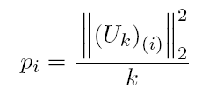
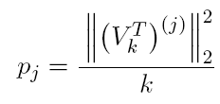
Leverage scores: general case
Let A be an m-by-n matrix A and let A_{k} be its best rank-k approximation (as computed by the SVD) :
i-th row of U_{k}
j-th column of V^{T}
(Row) Leverage scores:
(Column) Leverage scores:
The (row/column) leverage scores can now be used to sample rows/columns from A.

Slide 16
Other ways to create matrix sketches
Sampling based
  Volume sampling: see Amit Deshpande’s talk tomorrow.
Random projections
  Pre or post-multiply by Gaussian random matrices, random sign matrices, etc.
  (Faster) Pre or post-multiply by the sub-sampled Hadamard Transform.
  (Sparsity) Pre- or post-multiply by ultra-sparse matrices (Michael Mahoney’s talk).
Deterministic/streaming sketches
  Select columns/rows deterministically (some ideas in Nikhil Srivastava’s talk on graph sparsification).
  From item frequencies to matrix sketching (see Edo Liberty’s talk).
Element-wise sampling
    Sample elements with probabilities that depend on the absolute value (squared or not) of the matrix entries.
    Sample elements with respect to an element-wise notion of leverage scores!
Beyond matrices: tensors (Ravi Kannan’s talk)

Slide 17
Applications of leverage scores
Over (or under)-constrained Least Squares problems
Feature selection and the CX factorization
Solving systems of linear equations with Laplacian input matrices
Element-wise sampling

Slide 18
Applications of leverage scores
Over (or under)-constrained Least Squares problems
Feature selection and the CX factorization
Solving systems of linear equations with Laplacian input matrices
Element-wise sampling
BUT FIRST THINGS FIRST:
Why do they work?
How fast can we compute them?

Slide 19
Why do they work?
ALL proofs that use leverage score sampling use an argument of the following form:
U is an orthogonal matrix:
U^{T}U = I_{d}
Sample/rescale r rows of U w.r.t. the leverage scores (use the sampling algorithm of slide 2):

Slide 20
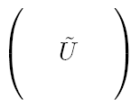

Why do they work?
ALL proofs that use leverage score sampling use an argument of the following form:
U is an orthogonal matrix:
U^{T}U = I_{d}
Sample/rescale r rows of U w.r.t. the leverage scores (use the sampling algorithm of slide 2):

Slide 21



Why do they work?
ALL proofs that use leverage score sampling use an argument of the following form:
Ũ is a full-rank matrix!
U is an orthogonal matrix:
U^{T}U = I_{d}
Then, with probability at least 1-δ:
It follows that, for all i:

Slide 22
Why do they work?
Recall: with probability at least 1-δ:
It follows that, for all i:
This implies that Ũ has full rank.
The result follows from randomized matrix multiplication algorithms and a matrix-Bernstein bound.
(see the tutorials by Drineas, Mahoney, and Tropp at the Simons Big Data Bootcamp, Sep 2-5, 2013)
These bounds allow us to manipulate the pseudo-inverse of Ũ and products of Ũ with other matrices.

Slide 23
Computing leverage scores
Trivial: via the Singular Value Decomposition
O(nd²) time for n-by-d matrices with n>d.
O(min{m²n,mn²}) time for general m-by-n matrices.
Non-trivial: relative error (1+ε) approximations for all leverage scores.
Tall & thin matrices (short & fat are similar):
Approximating leverage scores:
Pre-multiply A by – say – the subsampled Randomized Hadamard Transform matrix (an s-by-n matrix P).
Compute the QR decomposition PA = QR.
Estimate the lengths of the rows of AR⁻¹ (another random projection is used for speed)

Slide 24
Computing leverage scores
Trivial: via the Singular Value Decomposition
O(nd²) time for n-by-d matrices with n>d.
O(min{m²n,mn²}) time for general m-by-n matrices.
Non-trivial: relative error (1+ε) approximations for all leverage scores.
Tall & thin matrices (short & fat are similar):
Running time:
It suffices to set s = O(dε⁻¹ polylog(n/ε)).
Overall running time is O(ndε⁻¹ polylog(n/ε)).

Slide 25
Computing leverage scores
Trivial: via the Singular Value Decomposition
O(nd²) time for n-by-d matrices with n>d.
O(min{m²n,mn²}) time for general m-by-n matrices.
Non-trivial: relative error (1+ε) approximations for all leverage scores.
m-by-n matrices:
Caution:
A direct formulation of the problem is ill-posed.
(The k and (k+1)-st singular values could be very close estimating the corresponding singular vectors could result in a “swap”.)
A robust objective is to estimate the leverage scores of some rank k matrix X that is “close” to the best rank k approximation to A.
(see Drineas et al. (2012) ICML and JMLR for details)

Slide 26
Computing leverage scores
Trivial: via the Singular Value Decomposition
O(nd²) time for n-by-d matrices with n>d.
O(min{m²n,mn²}) time for general m-by-n matrices.
Non-trivial: relative error (1+ε) approximations for all leverage scores.
m-by-n matrices:
Algorithm:
Approximate the top k left (or right) singular vectors of A.
Use the approximations to estimate the leverage scores.
Overall running time is r = O(ndkε⁻¹ polylog(n/ε)).

Slide 27
Applications of leverage scores
Over (or under)-constrained Least Squares problems
Feature selection and the CX factorization
Solving systems of linear equations with Laplacian input matrices
Element-wise sampling

Slide 28
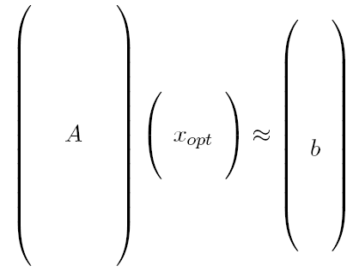

Least-squares problems
We are interested in over-constrained least-squares problems, n >> d.
(Under-constrained problems: see Tygert 2009 and Drineas et al. (2012) JMLR)
Typically, there is no x_{opt} such that Ax_{opt} = b.
Want to find the “best” x_{opt} such that Ax_{opt} ≈ b.

Slide 29


Exact solution to L₂ regression
Cholesky Decomposition:
If A is full rank and well-conditioned,
decompose A^{T}A = R^{T}R, where R is upper triangular, and
solve the normal equations: R^{T}Rx = A^{T}b.
QR Decomposition:
Slower but numerically stable, esp. if A is rank-deficient.
Write A = QR, and solve Rx = Q^{T}b.
Singular Value Decomposition:
Most expensive, but best if A is very ill-conditioned.
Write A = UΣV^{T}, in which case: x_{opt} = A⁺b = VΣ⁻¹U^{T}b.
Complexity is O(nd²) , but constant factors differ.
Projection of b on the subspace spanned by the columns of A
Pseudoinverse of A

Slide 30


Algorithm: Sampling for L₂ regression
(Drineas, Mahoney, Muthukrishnan SODA 2006,
Drineas, Mahoney, Muthukrishnan, & Sarlos NumMath2011)
Algorithm
Compute the row-leverage scores of A (p_{i}, i=1…n)
In r i.i.d. trials pick r rows of A and the corresponding elements of b with respect to the p_{i}.
(Rescale sampled rows of A and sampled elements of b by (1/(rp_{i})^{1/2}.)
Solve the induced problem.

Slide 31

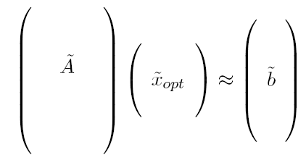

Algorithm: Sampling for least squares
Drineas, Mahoney, Muthukrishnan SODA 2006,
Drineas, Mahoney, Muthukrishnan, & Sarlos NumMath2011
Algorithm
Compute the row-leverage scores of A (p_{i}, i=1…n)
In r i.i.d. trials pick r rows of A and the corresponding elements of b with respect to the p_{i}.
(Rescale sampled rows of A and sampled elements of b by (1/(rp_{i})^{1/2}.)
Solve the induced problem.

Slide 32


Theorem
If the p_{i} are the row leverage scores of A, then, with probability at least 0.8,
The sampling complexity (the value of r) is
(Hiding a loglog factor for simplicity; see Drineas et al. (2011) NumMath for a precise statement.)

Slide 33
Applications of leverage scores
Over (or under)-constrained Least Squares problems
Feature selection and the CX factorization
Solving systems of linear equations with Laplacian input matrices
Element-wise sampling

Slide 34
SVD decomposes a matrix as…
The SVD has strong optimality properties.
Top k left singular vectors
It is easy to see that X = U_{k}^{T}A.
SVD has strong optimality properties.
The columns of U_{k} are linear combinations of up to all columns of A.

Slide 35

The CX decomposition
Mahoney & Drineas (2009) PNAS
Carefully chosen X
Goal: make (some norm) of A-CX small.
c columns of A, with c being as close to k as possible
Why?
If A is a data matrix with rows corresponding to objects and columns to features, then selecting representative columns is equivalent to selecting representative features to capture the same structure as the top eigenvectors.
We want c as close to k as possible!

Slide 36
CX decomposition
c columns of A, with c being as close to k as possible
Easy to prove that optimal X = C⁺A.
(with respect to unitarily invariant norms; C⁺ is the Moore-Penrose pseudoinverse of C)
Thus, the challenging part is to find good columns (features) of A to include in C.
Also known as: the Column Subset Selection Problem (CSSP).

Slide 37
The algorithm
Input: m-by-n matrix A, target rank k
0 < ε < .5, the desired accuracy
Output: C, the matrix consisting of the selected columns
Sampling algorithm
Let p_{j} be the column leverage scores of A, for j=1…n.
In c i.i.d. trials pick columns of A, where in each trial the j-th column of A is picked with probability p_{j}.
(c is a function of ε and k; see next slide)
Let C be the matrix consisting of the chosen columns.

Slide 38


Relative-error Frobenius norm bounds
Given an m-by-n matrix A, let C be formed as described in the previous algorithm. Then, with probability at least 0.9,
The sampling complexity (the value of c) is
The running time of the algorithm is dominated by the computation of the (column) leverage scores.

Slide 39
Leverage scores: human genetics data
Single Nucleotide Polymorphisms: the most common type of genetic variation in the genome across different individuals.
They are known locations at the human genome where two alternate nucleotide bases (alleles) are observed (out of A, C, G, T).
SNPs
… AG CT GT GG CT CC CC CC CC AG AG AG AG AG AA CT AA GG GG CC GG AG CG AC CC AA CC AA GG TT AG CT CG CG CG AT CT CT AG CT AG GG GT GA AG …
… GG TT TT GG TT CC CC CC CC GG AA AG AG AG AA CT AA GG GG CC GG AA GG AA CC AA CC AA GG TT AA TT GG GG GG TT TT CC GG TT GG GG TT GG AA …
… GG TT TT GG TT CC CC CC CC GG AA AG AG AA AG CT AA GG GG CC AG AG CG AC CC AA CC AA GG TT AG CT CG CG CG AT CT CT AG CT AG GG GT GA AG …
… GG TT TT GG TT CC CC CC CC GG AA AG AG AG AA CC GG AA CC CC AG GG CC AC CC AA CG AA GG TT AG CT CG CG CG AT CT CT AG CT AG GT GT GA AG …
… GG TT TT GG TT CC CC CC CC GG AA GG GG GG AA CT AA GG GG CT GG AA CC AC CG AA CC AA GG TT GG CC CG CG CG AT CT CT AG CT AG GG TT GG AA …
… GG TT TT GG TT CC CC CG CC AG AG AG AG AG AA CT AA GG GG CT GG AG CC CC CG AA CC AA GT TT AG CT CG CG CG AT CT CT AG CT AG GG TT GG AA …
… GG TT TT GG TT CC CC CC CC GG AA AG AG AG AA TT AA GG GG CC AG AG CG AA CC AA CG AA GG TT AA TT GG GG GG TT TT CC GG TT GG GT TT GG AA …
individuals
Matrices including thousands of individuals and hundreds of thousands if SNPs are available.

Slide 40

Worldwide data
South Altaians
-
-
Spanish
Japanese
Mende
Mbuti
Nahua
Mala
Burunge
Quechua
Africa
Europe
E Asia
America
274 individuals, 9 populations, ~10,000 SNPs
Shriver et al. (2005) Hum Genom

Slide 41
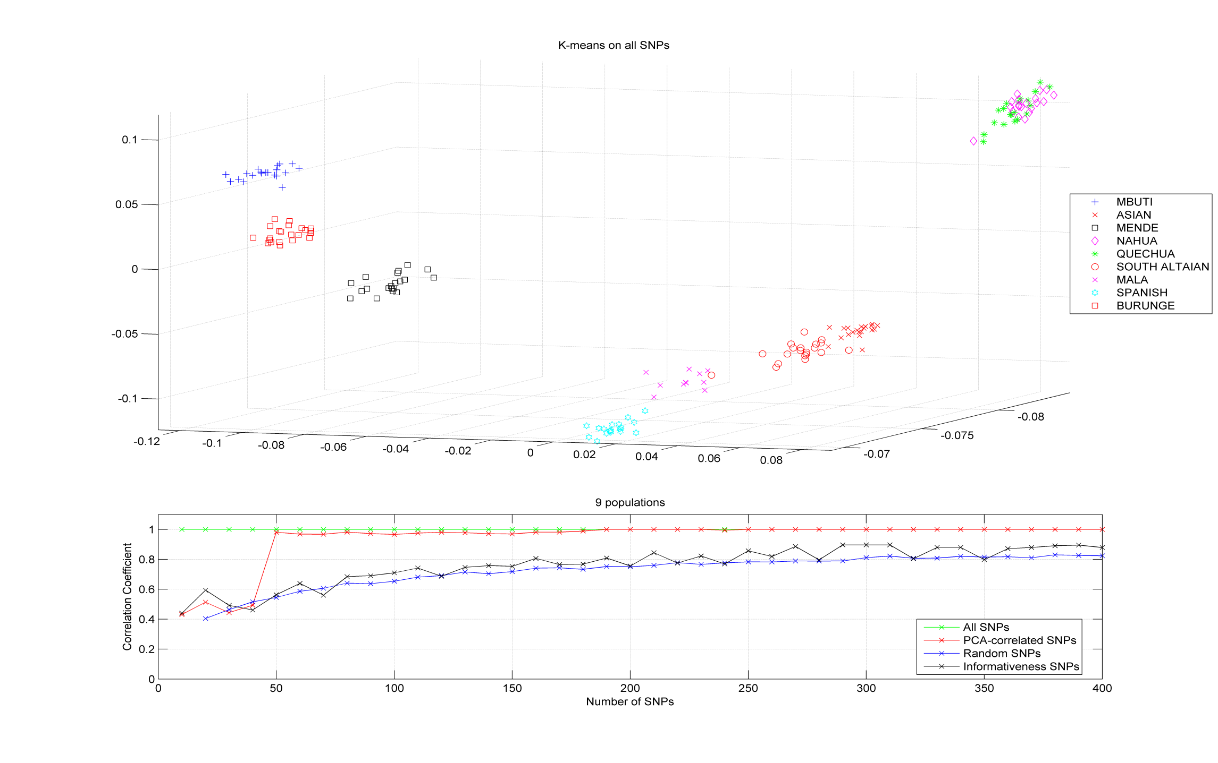
PCA projection on the top three left singular vectors.
Populations are clearly separated, BUT not altogether satisfactory:
The principal components are linear combinations of all SNPs.
Hard to interpret or genotype.
Can we find actual SNPs that capture the information in the left singular vectors?

Slide 42

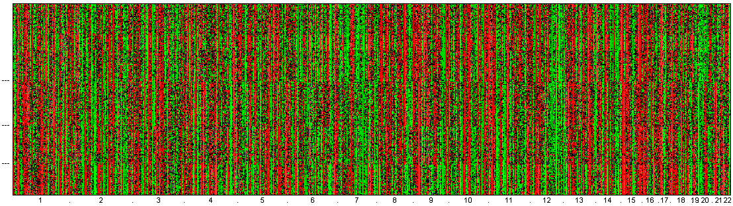
Leverage scores of the columns of the 274-by-10,000 SNP matrix
Africa
Europe
Asia
America
* top 30 PCA-correlated SNPs
PCA-scores
SNPs by chromosomal order
Paschou et al (2007; 2008) PLoS Genetics
Paschou et al (2010) J Med Genet
Drineas et al (2010) PLoS One

Slide 43
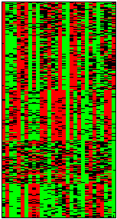
Selecting ancestry informative SNPs for individual assignment to four continents (Africa, Europe, Asia, America)
Afr
Eur
Asi
Africa
Ame
Europe
Asia
America
* top 30 PCA-correlated SNPs
PCA-scores
SNPs by chromosomal order
Paschou et al (2007; 2008) PLoS Genetics
Paschou et al (2010) J Med Genet
Drineas et al (2010) PLoS One

Slide 44
Applications of leverage scores
Over (or under)-constrained Least Squares problems
Feature selection and the CX factorization
Solving systems of linear equations with Laplacian input matrices
Element-wise sampling

Slide 45
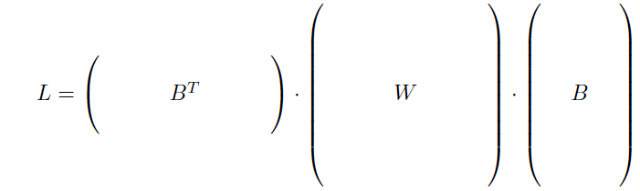


Leverage scores & Laplacians
Consider a weighted (positive weights only!) undirected graph G and let L be the Laplacian matrix of G.
Assuming n vertices and m > n edges, L is an n-by-n matrix, defined as follows:

Slide 46
Leverage scores & Laplacians
Consider a weighted (positive weights only!) undirected graph G and let L be the Laplacian matrix of G.
Assuming n vertices and m > n edges, L is an n-by-n matrix, defined as follows:
0
0
Edge-incidence matrix
(each row has two non-zero entries and corresponds to an edge; pick arbitrary orientation and use +1 and -1 to denote the “head” and “tail” node of the edge).
Diagonal matrix
of edge weights
Clearly, L = (B^{T}W^{1/2})(W^{1/2}B)= (B^{T}W^{1/2})(B^{T}W^{1/2})^{T}.

Slide 47
Leverage scores & effective resistances
(Spielman & Srivastava STOC 2008)
Effective resistances:
Let G denote an electrical network, in which each edge e corresponds to a resistor of resistance 1/w_{e} (the edge weight).
The effective resistance R_{e} between two vertices is equal to the potential difference induced between the two vertices when a unit of current is injected at one vertex and extracted at the other vertex.

Slide 48
Leverage scores & effective resistances
(Spielman & Srivastava STOC 2008)
Effective resistances:
Let G denote an electrical network, in which each edge e corresponds to a resistor of resistance 1/w_{e} (the edge weight).
The effective resistance R_{e} between two vertices is equal to the potential difference induced between the two vertices when a unit of current is injected at one vertex and extracted at the other vertex.
Formally, the effective resistances are the diagonal entries of the m-by-m matrix:
R = BL⁺B^{T}= B(B^{T}WB)⁺B^{T}

Slide 49
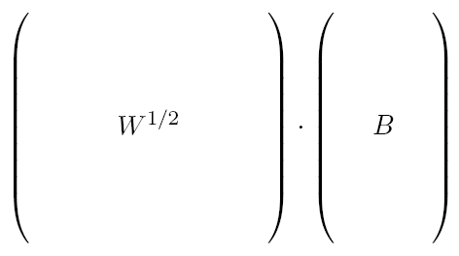
Leverage scores & effective resistances
(Drineas & Mahoney ArXiv 2010)
Lemma: The (row) leverage scores of the m-by-n matrix W^{1/2}B are equal to the effective resistances of the edges of G.
Edge-incidence matrix
Diagonal matrix
of edge weights

Slide 50
Leverage scores & effective resistances
(Drineas & Mahoney ArXiv 2010)
Lemma: The (row) leverage scores of the m-by-n matrix W^{1/2}B are equal to the effective resistances of the edges of G.
Edge-incidence matrix
Diagonal matrix
of edge weights
GRAPH SPARSIFICATION
Sample r edges to sparsify our graph G with respect to the row leverage scores of W^{1/2}B (equivalently, the effective resistances of the edges of G).
This process sparsifies the Laplacian L to construct a sparser Laplacian.

Slide 51
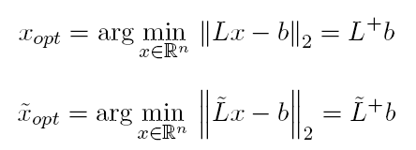


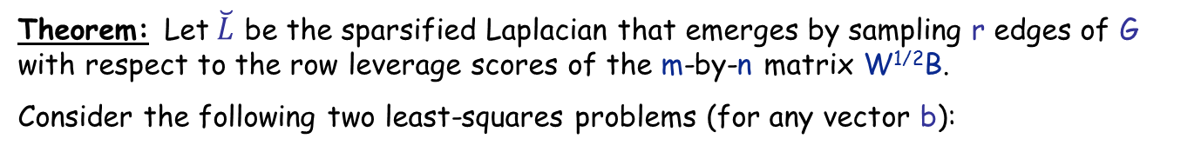
Leverage scores & effective resistances
(Drineas & Mahoney ArXiv 2010)
Theorem: Let$\breve{L}$ be the sparsified Laplacian that emerges by sampling r edges of G with respect to the row leverage scores of the m-by-n matrix W^{1/2}B.
Consider the following two least-squares problems (for any vector b):
Notation:
x^{T}Lx=||x||_{L}: energy norm
(as in the Spielman & Teng work)
Let
Then, with probability at least 2/3:

Slide 52
Leverage scores & effective resistances
(Drineas & Mahoney ArXiv 2010)
Theorem: Let$\breve{L}$ be the sparsified Laplacian that emerges by sampling r edges of G with respect to the row leverage scores of the m-by-n matrix W^{1/2}B.
Consider the following two least-squares problems (for any vector b):
Let
Then, with probability at least 2/3:
Computational savings depend on (i) efficiently computing leverage scores/effective resistances, and (ii) efficiently solving the “sparse” problem.

Slide 53
Running time issues
Approximating effective resistances (Spielman & Srivastava STOC 2008)
They can be approximated using the Laplacian solver of Spielman and Teng.
Breakthrough by Koutis, Miller, & Peng (FOCS 2010, FOCS 2011):
Low-stretch spanning trees provide a means to approximate effective resistances!
This observation (and a new, improved algorithm to approximate low-stretch spanning trees) led to almost optimal algorithms for solving Laplacian systems of linear equations.
Are leverage scores a viable alternative to approximate effective resistances?
Not yet! Our approximation algorithms are not good enough for W^{1/2}B, which is very sparse.
(2m non-zero entries).
We must take advantage of the sparsity and approximate the leverage scores/effective resistances in O(m polylog(m)) time.

Slide 54
Applications of leverage scores
Over (or under)-constrained Least Squares problems
Feature selection and the CX factorization
Solving systems of linear equations with Laplacian input matrices
Element-wise sampling

Slide 55


Element-wise sampling
(Drineas & Kundu 2013)
Element-wise sampling
  Introduced by Achlioptas and McSherry in STOC 2001.
  Current state-of-the-art: additive error bounds for arbitrary matrices and exact reconstruction under (very) restrictive assumptions using trace minimization.
  (important breakthroughs by Candes, Recht, Tao, Wainright, and others)
The setup: let A be an m-by-n matrix of rank ρ, whose SVD is A = UΣV^{T}.
Sample r elements of A in r i.i.d. trials, where in each trial the (i,j)-th element of A is sampled with probability p_{ij.}
Let Ω be the set of the r sampled indices and solve:

Slide 56

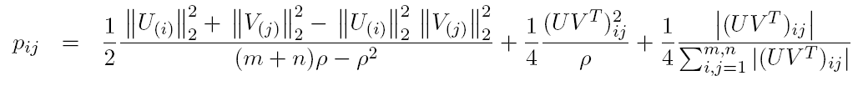
Element-wise sampling
(Drineas & Kundu 2013; similar result in Bhojanapalli et al. ArXiv 2013)
The setup: let A be an m-by-n matrix of rank ρ, whose SVD is A = UΣV^{T}.
Sample r elements of A in r i.i.d. trials, where in each trial the (i,j)-th element of A is sampled with probability p_{ij.}
Let Ω be the set of the r sampled indices and solve:
Let
Let
Then, with constant probability, A can be recovered exactly.

Slide 57
Element-wise sampling
(Drineas & Kundu 2013; similar result in Bhojanapalli et al. ArXiv 2013)
The setup: let A be an m-by-n matrix of rank ρ, whose SVD is A = UΣV^{T}.
Sample r elements of A in r i.i.d. trials, where in each trial the (i,j)-th element of A is sampled with probability p_{ij.}
Let Ω be the set of the r sampled indices and solve:
Let
Let
Row
leverage
Column
leverage
Additional term
Then, with constant probability, A can be recovered exactly.
The proof uses a novel result on approximating the product of two linear operators by element-wise sampling and builds upon Recht (JMLR) 2011, Drineas & Zouzias (2011) IPL, and uses the idea of L₁ sampling from Achlioptas, Karnin, & Liberty ArXiv 2013.

Slide 58
Conclusions
Leverage scores: a statistic on rows/columns of matrices that reveals the most influential rows/columns of a matrix.
Can also be used for element-wise sampling!
Leverage scores: equivalent to effective resistances.
Additional Fact: Leverage scores can be “uniformized” by preprocessing the matrix via random projection-type matrices.
(E.g., random sign matrices, Gaussian matrices, or Fast JL-type transforms.)

