Slide 1
Understanding the Sparse Vector Technique for Differential Privacy
Min Lyu, Dong Su, Ninghui Li

Slide 2





Learning from Private Data
Individuals
$$d_{1}$$
Attacker
$$d_{2}$$
Data Curator
$$⋮$$
Users
$$d_{n−1}$$
$$d_{n}$$
Notes:
Let’s abstract the above scenario into this generic model.
Where the left side is the database of n individuals and their data are sensitive and private.
The middle is the trusted data curator, who operate on this database and open some interface to the public.
The data analysts can then extract useful information from those sensitive data. And ofcourse, the malicious attacker are also among the users.
Classifications
Clustering
Regressions

Slide 3
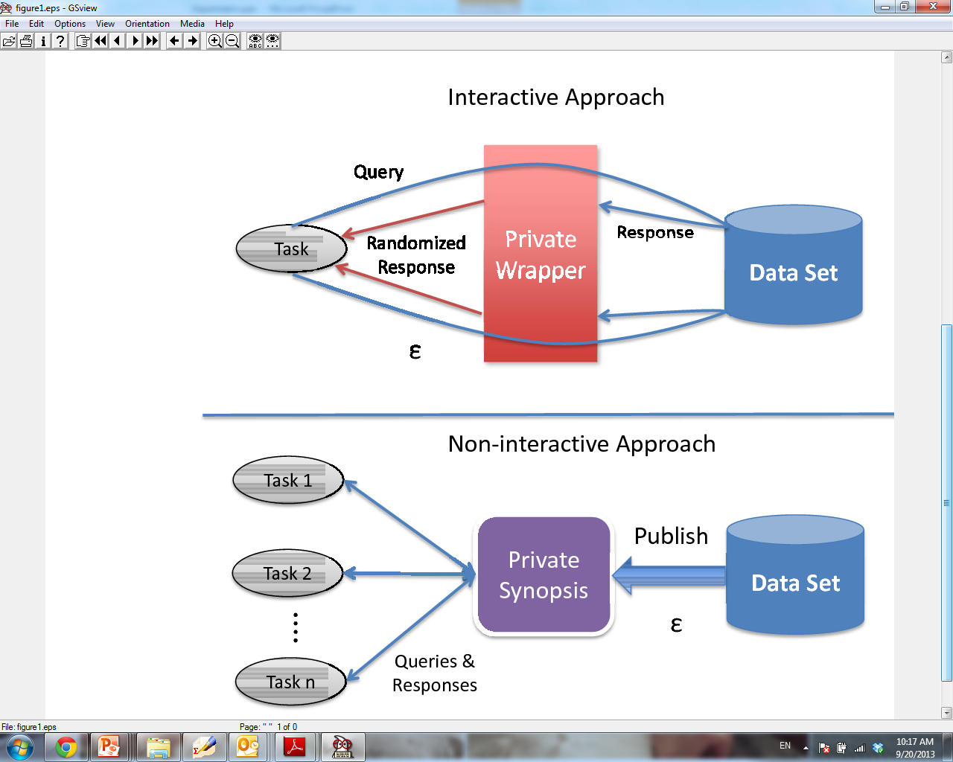
Interactive Setting versus. Non-interactive Setting
Interactive setting
  Answer queries as they come, not knowing what the rest of the queries are
Non-interactive setting
  The set of all queries that one wants to provide utility are known

Slide 4
Limitation of Interactive Setting
Answering each query consumes some privacy budget
After answering a pre-determined number of queries, one exhausts the privacy budget, and cannot answer any question anymore
Problem especially intractable when dealing with multiple users of data

Slide 5
Using the Sparse Vector Technique in Interactive Setting
For each new query,
  Use past queries/answers to generate an simulated answer
  Check whether the error of simulated answer is above some (noisy) threshold
  If error is below threshold, then return simulated answer
  If error is above threshold, then query the data to answer the query (consumes privacy budget), returns the answer and store the query/answer
If threshold is perturbed, then answering with simulated answer is “free” (i.e., not consuming privacy budget)

Slide 6
Example of SVT: Finding Frequent Items
Which items have support above threshold 4?
Ensure DP
7
6
5
Threshold = 4
4
Supports
3
3
2
2
1
0
1
2
3
4
5
…
N
Items
Notes:
We start with an example on finding frequent items in truncation datasets. Suppose the item space is {1,2,.., N}. The algorithm issues N queries to find which items are above the give threshold which is 4. And we also want to do this in a differentially private way.

Slide 7
Strawman Solution
Laplace Mechanism
~
Lap(N/ϵ)
7
6
5
4
3
3
2
2
1
0
1
2
3
4
5
…
N
Notes:
A strawman solution is to use the Laplace mechanism. That is to perturb each query to see whether the noisy answer can pass the threshold. The noises are sampled from the laplace distribution with parameter N/epsilon, adding or removing one transaction would change all of the N queries at most.

Slide 8
Strawman Solution
Laplace Mechanism
~
Lap(N/ϵ)
6
6
5
4
4
4
3
2
1
0
1
2
3
4
5
…
N
Notes:
This approach are very inaccurate, since the injected noise scale is too large.

Slide 9
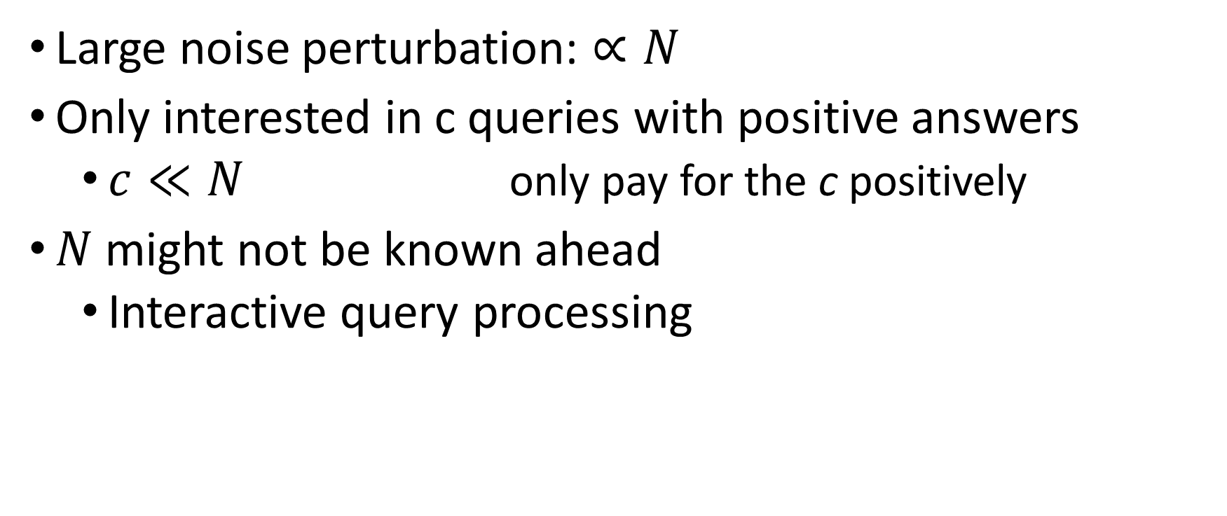
Strawman Solution
Large noise perturbation: $∝N$
Only interested in c queries with positive answers
  $c≪N$ only pay for the c positively
$N$ might not be known ahead
  Interactive query processing
Want to only pay for the positively answered queries
Notes:
What we learn from this solution is that. We actually only care about positive queries, whose number are always much much smaller than the total number of queries. We only want to pay budget for these queries. In addition, in the interactive query answering, N might not be known ahead.

Slide 10
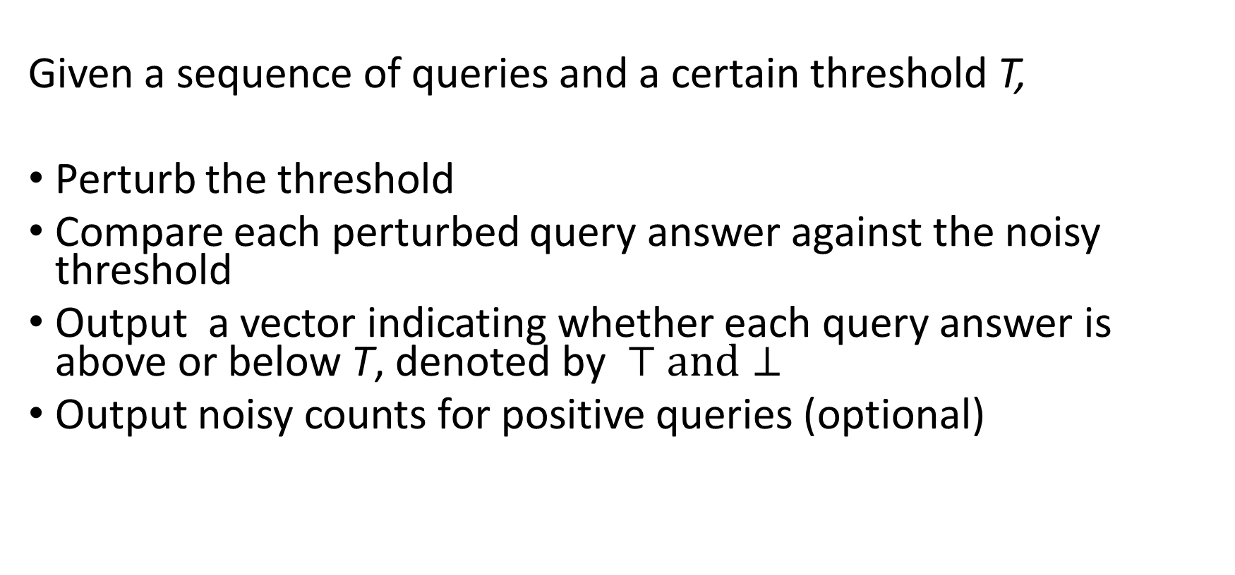
Sparse Vector Technique
Given a sequence of queries and a certain threshold T,
Perturb the threshold
Compare each perturbed query answer against the noisy threshold
Output a vector indicating whether each query answer is above or below T, denoted by $⊤ and⊥$
Output noisy counts for positive queries (optional)
Notes:
Applications: to select up c queries with highest answers privately from a large number of queries
Find c most frequent itemsets
Select attribute groups that are highly correlated
Select parameters to be shared when trying to learn neural-network models
……

Slide 11
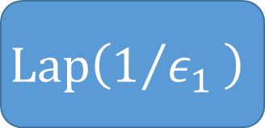
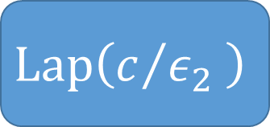
Sparse Vector Technique [DNR+09, HR10, RR10]
~
$$Lap\left(1/{ε_{1} }\right)$$
c = 3
7
~
$$Lap\left(c/{ε_{2} }\right)$$
6
5
4
3
3
2
2
1
0
1
2
3
4
5
…
N
Notes:
Sparse vector technique was first proposed by Dwork, and refined by Hardt and Rothblum and Roth and Roughgarden. The basic intuition is that one can output some query answers without apparently paying any privacy cost.
Perturb the threshold and then comparing each perturbed individual query answer against this noisy threshold. Only positive queries need budget and negative queries are free. The SVT algorithm stops when it reaches the pre-defined cutoff point.

Slide 12
Sparse Vector Technique
c = 3
PASS
PASS
PASS
~
$$Lap\left(1/{ε_{1} }\right)$$
Done!
~
$$Lap\left(c/{ε_{2} }\right)$$
6
6
5
5
5
FAIL
4
3
3
2
2
1
0
1
2
3
4
5
…
N

Slide 13
Sparse Vector Technique
Input: stream of queries and threshold
Output: vector of indicators
Key Points
  Perturbing threshold
  Expect predominant majority of queries are below threshold
  Only outputting “PASS” consumes privacy budget
  Keep answering queries until outputting c “PASS”es
[CM15], [ZXX15]
Lecture Notes [Roth11]
FIM [LC14]
HD data [CXZX15]
DNR+09 , HR10, RR10
DPBook [DR13]
Classification [SCM14]
Deep Learning [SS15]
Notes:
In SVT, one is given a sequences of queries and a certain threshold. Output a vector indicating whether each query answer is above or below the threshold. SVT works by first perturbing the threshold. Expects the predominant majority of queries are below the threshold, one can use SVT so that each positive output consumes some privacy budget, each negative output consumes none. One can keep answering queries as long as the number of positive answers does not exceed a predefined cutoff point.
The fact that many usage of SVT are not private, as pointed out in Chen and Ashwin and Zhang and Xiaokui xiaoin 2015. They pointed out that the SVT variants in

Slide 14
Sparse Vector Technique
Input: stream of queries and threshold
Output: vector of indicators
Key Points
  Perturbing threshold
  Expect predominant majority of queries are below threshold
  Only outputting “PASS” consumes privacy budget
  Keep answering queries until outputting c “PASS”es
[CM15], [ZXX15]
Lecture Notes [Roth11]
FIM [LC14]
Lecture Notes [Roth11]
HD data [CXZX15]
DNR+09 , HR10, RR10
DPBook [DR13]
Classification [SCM14]
Deep Learning [SS15]
Notes:
However, the proof of CM15 is also not correct.

Slide 15
Contribution
A new version of SVT that provides better utility
  Optimized privacy budget allocation
  Reduce sensitivity noise scale by half for monotonic queries
  Retraversal with higher threshold
Rigorous proof of SVT’s privacy
  Identify misunderstandings that likely caused the different non-private versions
  Pointed out the error in the proof of [CM15]
In non-interactive setting, SVT can be replaced by EM
Notes:
In this work, we make the following contributions.
Proposed a new SVT and a stack of utility optimization techniques. Advanced the state of the art
Provide a well-structured proof of SVT, identify the common misunderstandings that likely results in the non-private versions of SVT. Also pointed that CM15 the paper who said that other variants are wrong also has errors in their proof.
Experimentally showed that in the non-interactive setting, SVT can be replaced by EM.

Slide 16
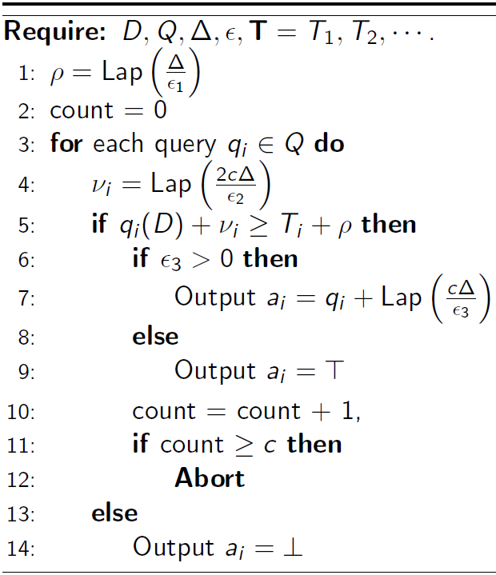
Our Proposed Standard SVT (SVT-S)
Perturb threshold once
Perturb each query with noise scaling with c
Pay extra budget for outputting numeric answers
Stop after getting c positive answers
Notes:
Some of exiting variants of SVT missed at least one of these four essential points and results in non-private results.

Slide 17
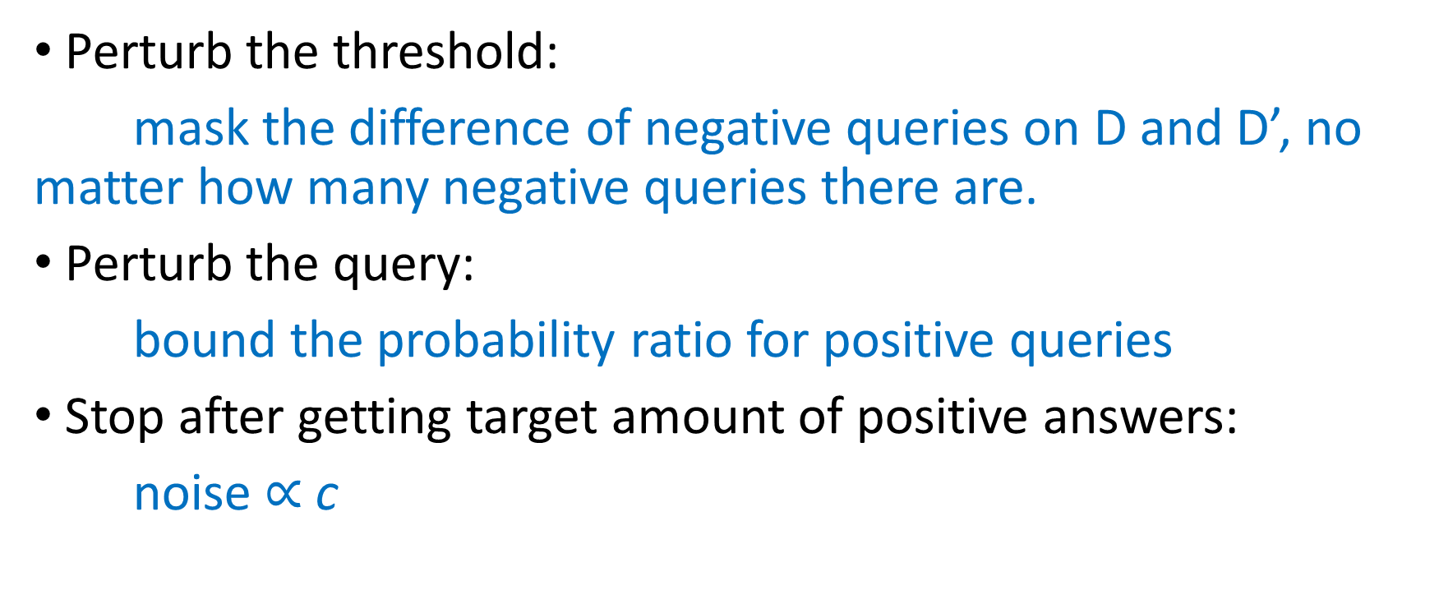
How to ensure DP?
Perturb the threshold:
mask the difference of negative queries on D and D’, no matter how many negative queries there are.
Perturb the query:
bound the probability ratio for positive queries
Stop after getting target amount of positive answers:
noise $∝$ c

Slide 18
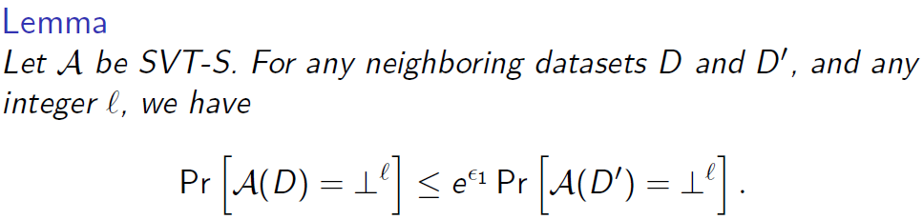


How to Prove Privacy?
First, analyze the situation that all outputs are negative.
D
D’
$$T+z+ Δ$$
$$T+z$$
1
2
3
4
…
N
1
2
3
4
…
N
Notes:
The proof is broken down in to two steps to make the proof easier to understand and to enable us to point out what confusions likely caused the different non-private variants.
In the first step, we analyze the situation where all outputs are negative. Suppose the
By using the same noisy threshold for all queries, we are able to bound the probability ratio when all outputs are negative for both the D and D’ cases. In the D dataset, all queries are compared with the noisy threshold T + z and in the D’ dataset, all queries are compared with the noisy threshold T+z+Delta, where Delta is the queries gloal sensitivity.

Slide 19
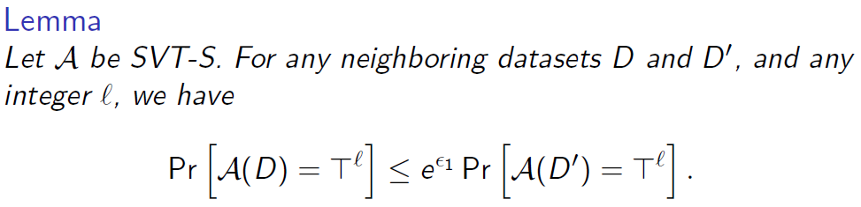

How to Prove Privacy?
Second, analyze the situation that all outputs are positive.
D
D’
$$T+z$$
$$T+z− Δ$$
1
2
3
4
…
N
1
2
3
4
…
N
Notes:
We can obtain similar results when outputs are all positive. In the D dataset, all queries are compared with the noisy threshold T + z and in the D’ dataset, all queries are compared with the noisy threshold T+z-Delta, where Delta is the queries gloal sensitivity.

Slide 20

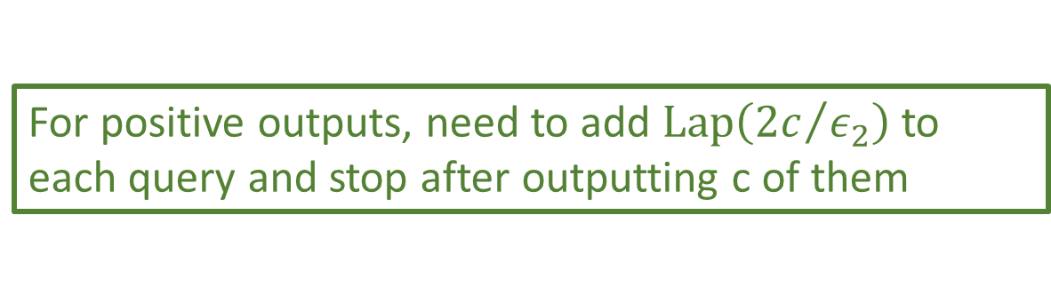

How to Prove Privacy?
Third, combine them together, but have to choose one direction
For negative outputs, budget on perturbing threshold is enough
For positive outputs, need to add $Lap\left({2c}/{ε_{2}}\right)$ to each query and stop after outputting c of them
D
D’
$$T+z$$
$$T+z+ Δ$$
1
2
3
4
…
N
1
2
3
4
…
N
Notes:
Finally, let’s If the positives and negatives are mixed. We have to choose one side, since we are using fixed noisy threshold. Suppose we choose For negative outputs, budget on perturbing threshold is enough.

Slide 21
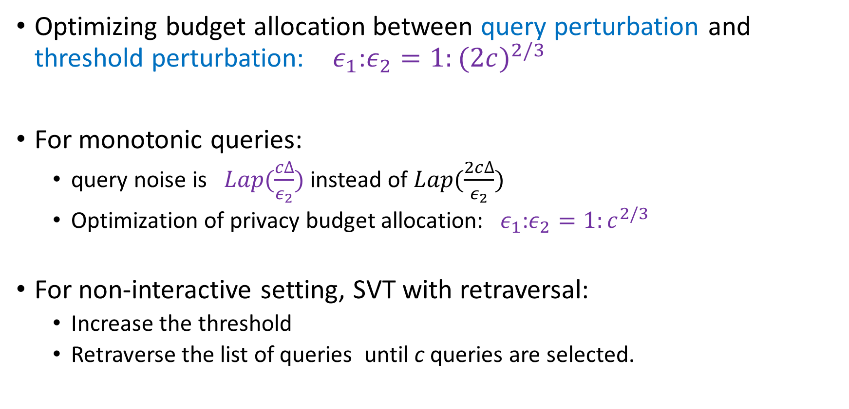
Improving Utility of SVT-S
Optimizing budget allocation between query perturbation and threshold perturbation: $ε_{1}$:$ε_{2}=1:{(2c)}^{2/3}$
For monotonic queries:
  query noise is $Lap(\frac{c∆}{ε_{2}})$ instead of $Lap(\frac{2c∆}{ε_{2}})$
  Optimization of privacy budget allocation: $ε_{1}$:$ε_{2}=1:c^{2/3}$
For non-interactive setting, SVT with retraversal:
  Increase the threshold
  Retraverse the list of queries until c queries are selected.

Slide 22
Experiment
Dataset | #Records | #Items
BMS-POS | 515,597 | 1,657
aol | 647,337 | 2,290,685
kosarak | 990,002 | 41,270
zipf | 10,00,000 | 10,000
Settings | Methods | Description
Interactive | SVT-DPBook | DPBook SVT
 | SVT-S | Standard SVT
Non-interactive | SVT-ReTr | Standard SVT with Retraversal
 | EM | Exponential Mechanism

Slide 23
Evaluation Metrics
F-Measure
  Harmonic mean of precision and recall of the computed item set and the ground truth item set
  Uniform penalization for all queries
    missing the top most item is penalized the same way as missing the N-th item.
1
2
3
4
5
…
N
Notes:
Missing the highest query will be penalized for the same as missing the border line
Selecting a very low query will be penalized for the same as strong candidates

Slide 24
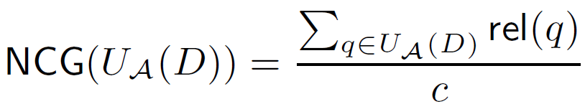

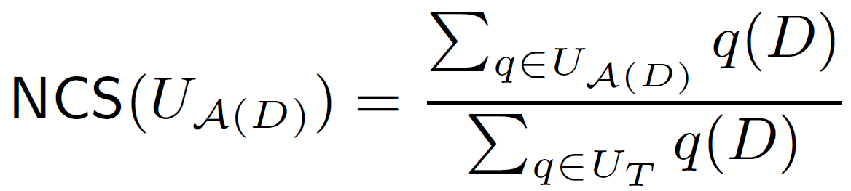
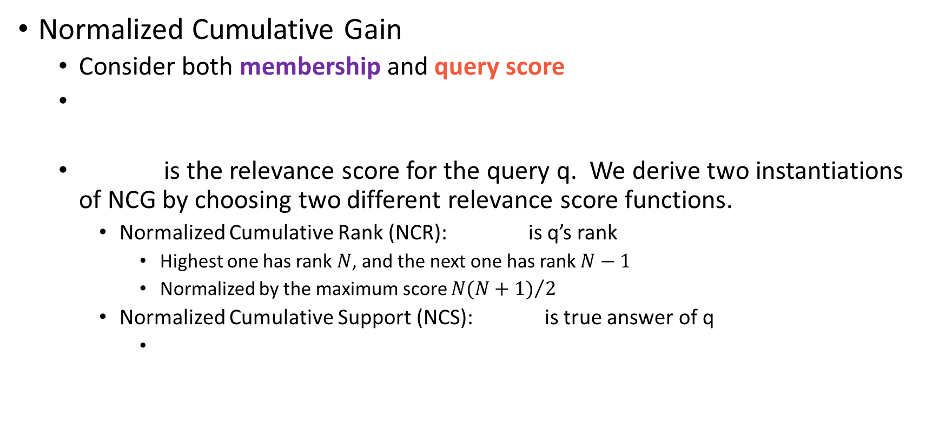
Evaluation Metrics
Normalized Cumulative Gain
  Consider both membership and query score
  is the relevance score for the query q. We derive two instantiations of NCG by choosing two different relevance score functions.
    Normalized Cumulative Rank (NCR): is q’s rank
      Highest one has rank $N$, and the next one has rank $N−1$
      Normalized by the maximum score ${N(N+1)}/2$
    Normalized Cumulative Support (NCS): is true answer of q

Slide 25
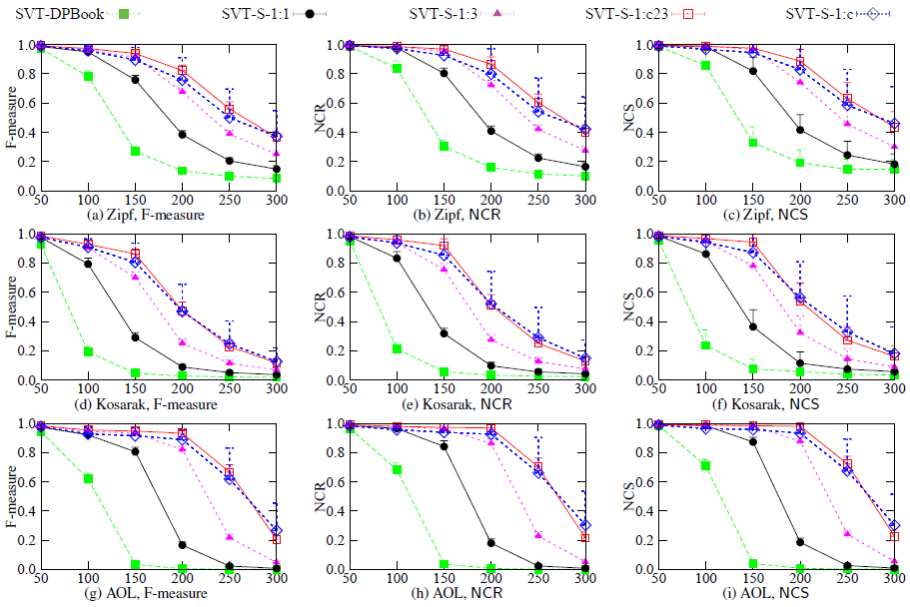
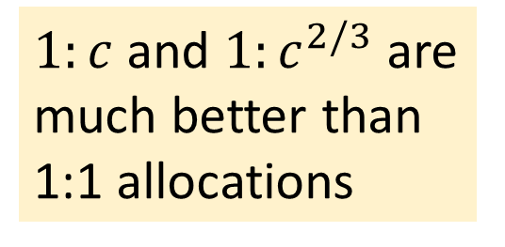
Comparison on Interactive Approaches
DPBook performs worst
$1:c$ and $1:c^{2/3}$ are much better than 1:1 allocations
Privacy budget 0.25

Slide 26
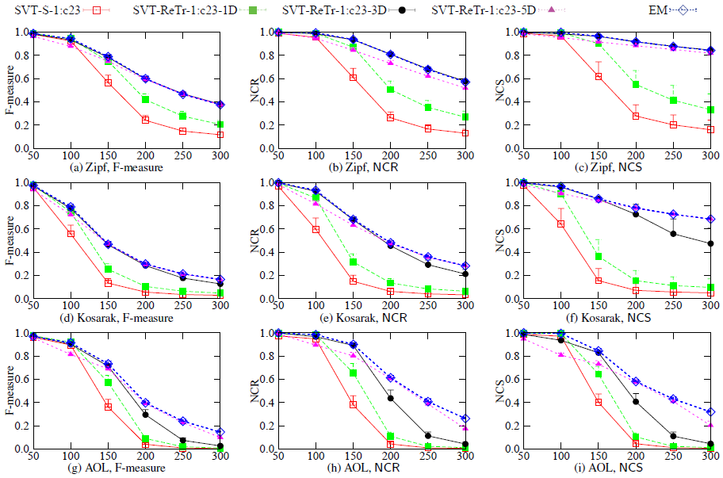
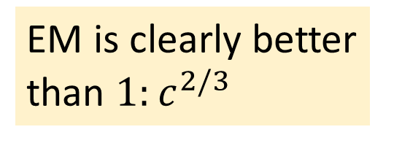
Comparison on Non-Interactive Approaches
Increasing threshold improve accuracy
EM is clearly better than $1:c^{2/3}$
Privacy budget 0.1

Slide 27
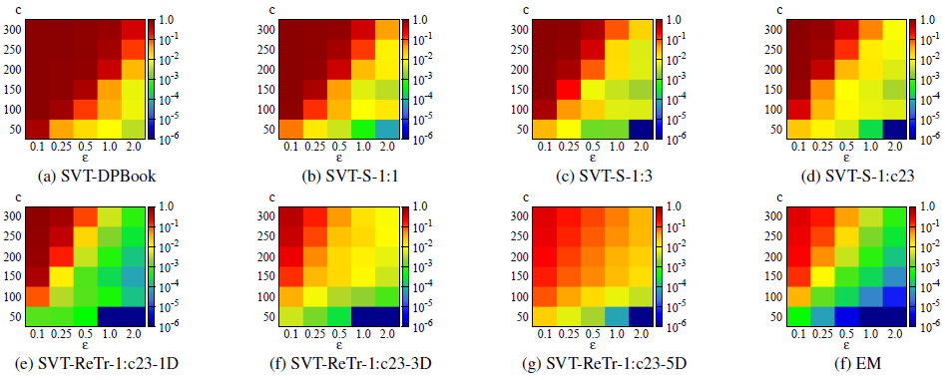
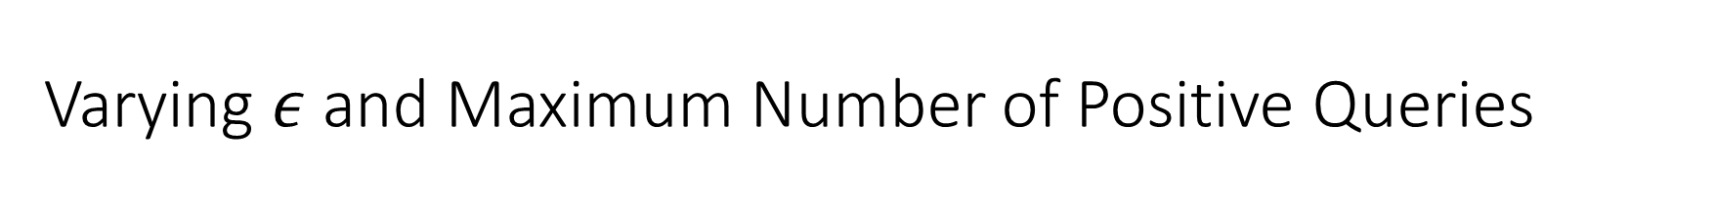
Varying $ε$ and Maximum Number of Positive Queries
Interactive
Non-interactive
Dataset: Kosarak
Metric: 1.0-NCS

Slide 28
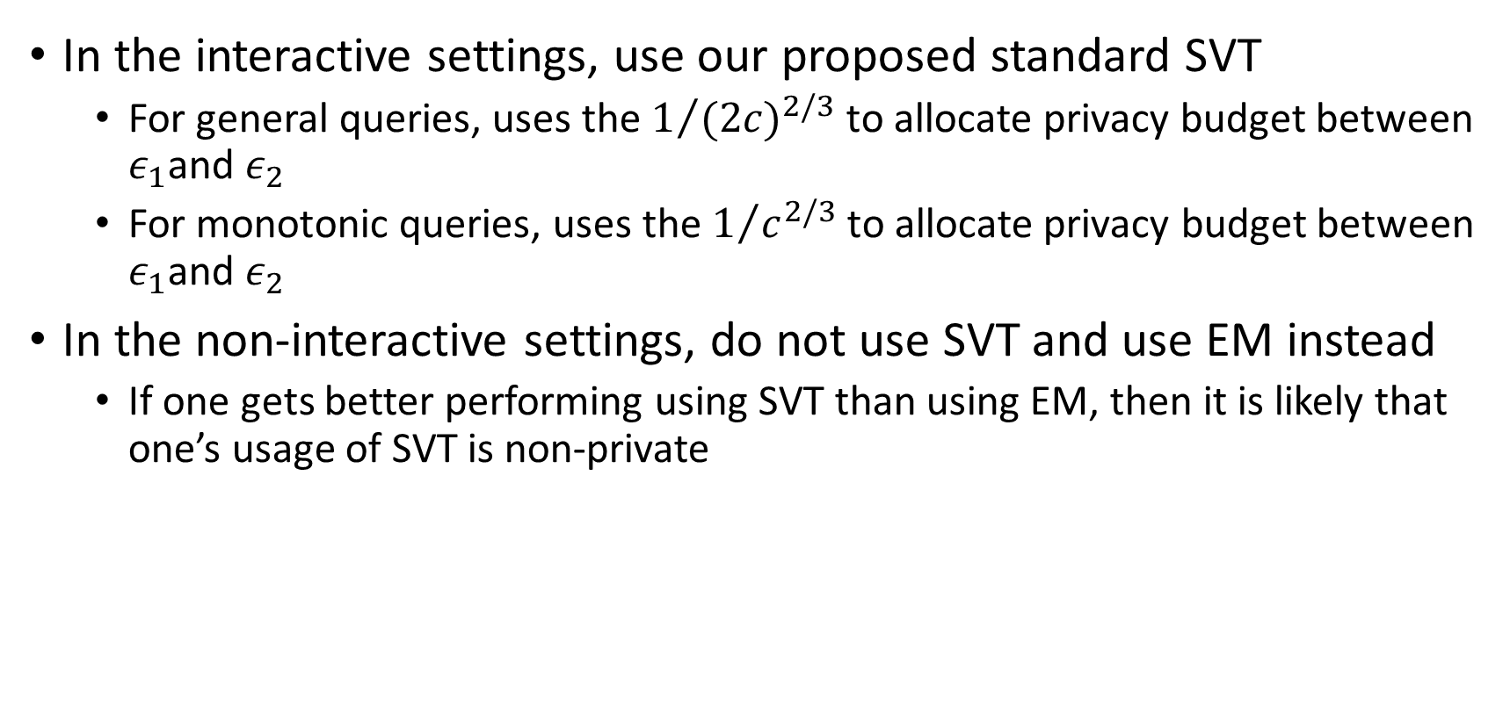
Recommendations
In the interactive settings, use our proposed standard SVT
  For general queries, uses the $1/{{(2c)}^{2/3}}$ to allocate privacy budget between $ε_{1}$and $ε_{2}$
  For monotonic queries, uses the $1/{c^{2/3}}$ to allocate privacy budget between $ε_{1}$and $ε_{2}$
In the non-interactive settings, do not use SVT and use EM instead
  If one gets better performing using SVT than using EM, then it is likely that one’s usage of SVT is non-private

Slide 29
Q & A?

