Slide 1
Differential Privacy: Publishing Histograms

Slide 2
Hierarchical Methods for Histograms
Reading
Wahbeh H. Qardaji, Weining Yang, Ninghui Li: Understanding Hierarchical Methods for Differentially Private Histograms. Proc. VLDB Endow. 6(14): 1954-1965 (2013)
M. Hay, V. Rastogi, G. Miklau, and D. Suciu. Boosting the accuracy of differentially private histograms through consistency. PVLDB, 3:1021–1032, September 2010.
T.-H. Hubert Chan, Elaine Shi, Dawn Song: Private and Continual Release of Statistics. ACM Trans. Inf. Syst. Secur. 14(3): 26:1-26:24 (2011)

Slide 3
Histogram
A histogram is a graphical representation of the distribution of numerical data: a partitioning of the data domain into multiple non-overlapping bins; the number of data points in each bin

Slide 4
Range Query
A range query represents a hyperrectangle in the d-dimensional domain specified by the dataset, and asks for the number of tuples that fall within the bins that are completely included in the area covered by the hyperrectangle
5 | 1 | 3 | 4
8 | 5 | 8 | 10
1 | 2 | 0 | 3
1 | 1 | 4 | 2
2 | 3 | 4 | 1 | 5 | 1 | 0 | 6

Slide 5
Histogram Settings
Has Suitable Partitioning
A pre-defined partitioning
The average number of data points in a bin is sufficiently high
Lacking Suitable Partitioning
No pre-defined partition
A pre-defined partitioning exists, but the average number of data points for each bin is low
Determine the partitioning

Slide 6
Utility Metrics (1)
Mean Absolute Error (MAE)
absolute difference between the noisy answer and the true answer
Mean Squared absolute Error (MSE)
often easier to compute
MSE is the variance of the random noise

Slide 7
Utility Metrics (2)
Mean Relative Error (MRE)
impact of the same absolute error is different when the true answers are different
the true answer may be very small, or even 0
chooses a threshold θ to be used as the denominator

Slide 8
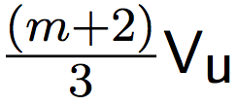
Dense Pre-defined Partitioning
The average bin count is at least ≥
Baseline: a simple histogram
Add noise sampled from Lap( ) to each bin
Variance:
Average length of queries:
Average-case MSE:
Unit Variance

Slide 9
A Digression
The hierarchy method uses a data structure called segment tree
Consider this problem
We will explain what is it and why by starting with prefix sum and difference arrays
Let us study these slides

Slide 10
Hierarchical Method
22
10
12
5
5
6
6
2 | 3 | 4 | 1 | 5 | 1 | 0 | 6
Notes:
In the hierarchical method Hb, one arranges intervals into a tree with branching factor b, where the unit-length intervals are the leaves, and each node in the tree corresponds to an interval that is the union of b intervals of its children.

Slide 11
Hierarchical Method
, the tree has h + 1 levels
Publish h different histograms of the data
Use the least number of nodes to answer a range query, no more than 2(b−1)h
If privacy budget is divided equally among the histogram, the noise added to each counting query has variance
Notes:
Balance the two effects

Slide 12
Branching Factor b
Increasing b
Reduce h, increase privacy budget to each node
More nodes to be used to answer a query on average
MSE:
Optimize b
Enumerate all possible b, or
b ≈ 16.8, when m is large
Notes:
Balance the two effects

Slide 13
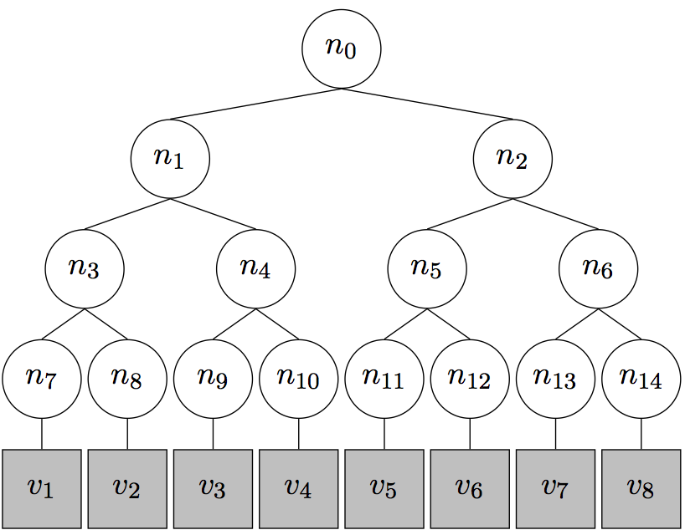
Constrained Inference
Goal: reduce variance and improve accuracy
n₁=n₃+n₄
Weighted Averaging
Mean Consistency
MSE is reduced by 3

Slide 14
Weighted Averaging
X₁ and X₂ that are both unbiased estimates of the same underlying quantity
X = αX₁ + (1 − α)X₂ is also an unbiased estimate of the quantity
To minimize variance of X,
Var(X) =

Slide 15
Weighted Averaging
At level i, new count
z_{i}[v] is that it is a weighted average of two estimates for the count at v

Slide 16
Weighted Averaging
Node | z
7 | n₇
8 | n₈
9 | n₉
10 | n₁₀
3 | (2n₃+n₇+n₈)/3
4 | (2n₄+n₉+n₁₀)/3
1 | (4n₁+2n₃+n₇+n₈+2n₄+n₉+n₁₀)/7

Slide 17
Mean Consistency
From the root down to the leaf level, update each node count so that the sum of each node’s children is the same as the node’s count
Parent of v

Slide 18
Mean Consistency (2)
Node | Value after weighted average | Value after mean consistency
7 | n₇ | (3n₁+5n₃-2n₄+13n₇-8n₈-n₉-n₁₀)/21
8 | n₈ | (3n₁+5n₃-2n₄-8n₇+13n₈-n₉-n₁₀)/21
9 | n₉ | (3n₁-2n₃+5n₄-n₇-n₈+13n₉-8n₁₀)/21
10 | n₁₀ | (3n₁-2n₃+5n₄-n₇-n₈-8n₉+13n₁₀)/21
3 | (2n₃+n₇+n₈)/3 | (6n₁+10n₃-4n₄+5n₇+5n₈-2n₉-2n₁₀)/21
4 | (2n₄+n₉+n₁₀)/3 | (6n₁-4n₃+10n₄+5n₇+5n₈-2n₉-2n₁₀)/21
1 | (4n₁+2n₃+n₇+n₈+2n₄+n₉+n₁₀)/7 | (4n₁+2n₃+n₇+n₈+2n₄+n₉+n₁₀)/7

Slide 19
Privacy Budget Allocation
Equally distributed
Geometrical allocation where each level has privacy budget that is of its parent level
With constrained inference
using the default equal privacy budget allocation performs as well as using the optimal budget allocation

Slide 20
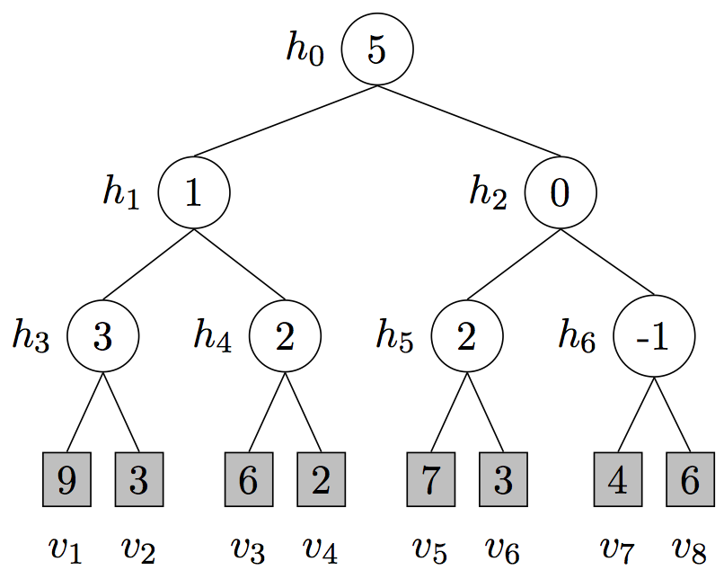
Wavelet Transformation
Perform a discrete Haar wavelet transform of the hierarchical histogram
h₀: average of all bins
h_{n} = (a_{l} − a_{r})/2, a_{l} and a_{r} are the average of left and right subtree of n
Add noise to the
Haar coefficients

Slide 21
The Matrix Mechanism
Optimize for a workload of counting queries
Each counting query can be represented as a binary vector, selecting the unit bins included in the query
A set of queries can be represented as a matrix
Given such a matrix, the method finds an alternative set of queries, called a query strategy
Find the best query strategy in order to answer the given workload queries with minimum error

Slide 22
Beyond One-Dimensional Datasets
d = 2, MSE:
MSE:
When hierarchical method is better?
1 dimensional: m > 45
2 dimensional: m > 4096
3 dimensional: m > 1.7E6
4 dimensional: m > 2.18E9
Total number of bins, n^{d}

Slide 23
Grid Methods
Reading:

Slide 24
Lacking Suitable Partitioning
There exists a pre-defined partitioning, but the average number of data points for each bin is low
Added noises likely overwhelm the true counts
The number of natural unit bins is so large that it is infeasible to enumerate through all of them
Real numbers

Slide 25
Example: Geospatial Data
xtom
xlisa
xeve
xalice
xbob
Notes:
However, directly release such data can have significant privacy concern.

Slide 26
Example: Geospatial Data
x
2
x
x
1
2
x
x
Notes:
anonymous

Slide 27
Uniform Grid
Partition domain into m x m cells of equal size
Add noise to counts of each cell to satisfy differential privacy
x(x,y)

Slide 28
Measuring Utility
Error from answering range queries
a query is a rectangle in the data domain
Notes:
Suprisingly, there are not much discussion on this simple method in the previous works on 2-d dataset. We think that is because there is a challenge that has not been fully thought of is how to choose M to minimize the error.

Slide 29
Sources of Error
Error from satisfying Differential Privacy (noise error)
Adding noise from the Laplace Distribution
Notes:
Increases linearly with size of query
Calls for coarser partitions

Slide 30
Sources of Error
Error from grid: Non-uniformity error
Assuming the data points within each cell are uniformly distributed
x
x
x
x
x
x
x
x
x
x
x
x
x
x
x
x
x
x
x
x
x
Notes:
Calls for finer-grained partitioning

Slide 31
Error Minimization
Noise error: calls for coarser partitioning
Non-uniformity error: calls for finer partitioning
Need to choose partition granularity to minimize the sum of the two errors

Slide 32
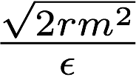
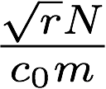
Determining Grid Size
m x m grid. Query selects a portion r of the domain.
Standard deviation of the noise error:
Standard deviation non-uniformity error:
Minimize sum of two errors

Slide 33
Limitation of Uniform Grid
Uniform Grid treats all regions equally
If a region is sparse, we might over-partitioning the region. This increases the noise error with little reduction in the non-uniformity error.
if a region is very dense, this method might result in under-partitioning of the region. As a result, the non-uniformity error would be quite large

Slide 34
Adaptive Grid
Adapt the level of partitioning based on the number of data points in each region
If a region is dense, use finer granularity to reduce non-uniformity error
If a region is sparse, use a more coarse grid

Slide 35
Adaptive Grid
x
x
x
x
x
x
x
x
x
x
x
x
x
x
x
x
x
x
x
x
x
x
x
x
x
x
x
x
x
x
x
x
x
x
x
x
x
x
x
x
x
x
x
x
x
x
x
x
x
x
x
x
x
x
x
x
x
x
x
x
x
x
x
x
x
x
x
x
x
x
x
x
x
x
x
x
x
x
x
x
x
x
x
x
x
x
x
x
x
x
x
x
x
x
x
x
x
x
x
x
x
x
x
x
x
x
x
x
x
x
x
x
x
x
x
x
x
x
x
x
x
x
x
x
x
x
x
x
x
x
x
x
x
x
x
x
x
x
x
x
x
x
x
x
x
x
x
x
x
x
x
x
x
x
x
x
x
x
x
x
x
x
x
x
x
x
x
x
x
x
x
x
x
x
x
x
x
x
x
x
x
x
x
x
x
x
x
x
x
x
x
x
x
x
x
x
x
x
x
x
x
x
x
x
x
x
x
x
x
x
x
x
x
x
x
x
x
x
x
x
x
x
x
x
x
x
x
x
x
x
x
x
x
x
x
x
x
x
x
x
x
x
x
x
x
x
x
x
x
x
x
x
x
x
x
x
x
x
x
x
x
x
x
x

Slide 36
Adaptive Grid
Two level partitioning:
Lay a coarse m1 x m1 grid over the data domain and obtain a noisy count for each cell
Partition each cell into an m2 x m2 grid, where m2 depends on the noisy count of the cell
Apply constrained inference

Slide 37
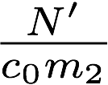
Adaptive Grids
Choosing Parameters (m2):
Average noise error:
Average non-uniformity error:
Notes:
C2 = c1 / 2 = 5

Slide 38
Adaptive Grids
Choosing Parameters (m1):
Parameter is less critical, since the second level adapts to the count of each cell
In general, we want it to be less than the choice for uniform grids.

Slide 39
Bottom-up Grouping
NoisyFirst
Compute the noisy histogram by Laplace mechanism
Merge bins on the noisy data to reduce the error.

Slide 40
Bottom-up Grouping
StructureFirst
Use half of privacy budget to get the structure that fits the data and noise well
Choose right boundary of histogram bins using exponential mechanism
The optimal number of groups k is computed by running all possible k values in NoisyFirst
Spend another half of privacy budget on releasing histogram with Laplace mechanism based on the chosen structure.

Slide 41
Recursive Partition
KD-Trees
Recursively partition along the median of each axis
15
8
7
x
x
x
x
x
x
x
x
x
x
x
x
4
4
4
3
x
x
x
G. Cormode, M. Procopiuc, E. Shen, D. Srivastava, and T. Yu, “Differentially private spatial decompositions,” in ICDE, 2012.

Slide 42
Recursive Partition
Quad-tree
Recursively partition each region into 4 quadrants
Tree of fixed depth
15
4
2
4
x
x
5
x
x
x
x
x
x
x
x
x
x
x
x
x
G. Cormode, M. Procopiuc, E. Shen, D. Srivastava, and T. Yu, “Differentially private spatial decompositions,” in ICDE, 2012.

Slide 43
Recursive Partition
KD-Hybrid
Quad-tree at first few levels and KD-tree for the other levels
Quad-opt
Optimize division of privacy budget
G. Cormode, M. Procopiuc, E. Shen, D. Srivastava, and T. Yu, “Differentially private spatial decompositions,” in ICDE, 2012.

