Slide 1
Local Differential Privacy (Part 1)
Definition
Frequency Oracle
  Tianhao Wang, Jeremiah Blocki, Ninghui Li, Somesh Jha: Locally Differentially Private Protocols for Frequency Estimation. USENIX Security Symposium 2017
Heavy Hitter Identification
  Tianhao Wang, Ninghui Li, Somesh Jha: Locally Differentially Private Heavy Hitter Identification. IEEE TDSC (2021)
Frequent Itemset Mining
  Tianhao Wang, Ninghui Li, Somesh Jha: Locally Differentially Private Frequent Itemset Mining. IEEE Symposium on Security and Privacy 2018

Slide 2
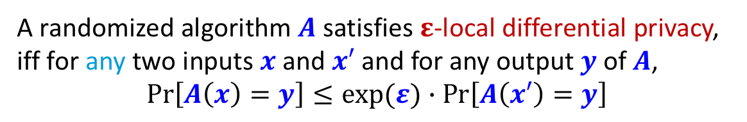
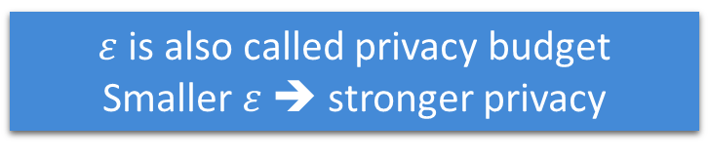
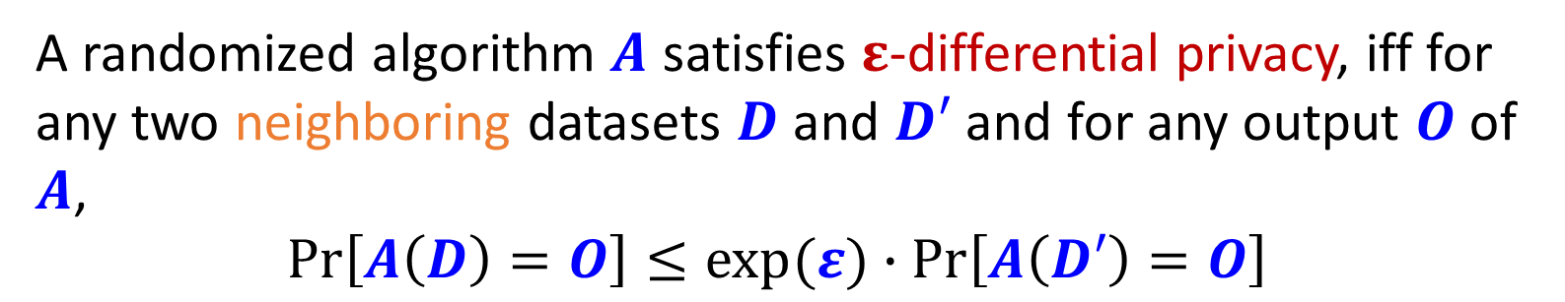
From DP to LDP: Formal Definition
Idea of DP: Any output should be about as likely regardless of whether or not I am in the dataset
A randomized algorithm $A$ satisfies $ε$-differential privacy, iff for any two neighboring datasets $D$ and $D′$ and for any output $O$of $A$,
$$\operatorname{Pr}\left[A\left(D\right)=O\right]≤exp⁡(ε)∙\operatorname{Pr}\left[A\left(D′\right)=O\right]$$
A randomized algorithm $A$ satisfies $ε$-local differential privacy, iff for any two inputs $x$ and $x′$ and for any output $y$of $A$,
$$\operatorname{Pr}\left[A\left(x\right)=y\right]≤exp⁡(ε)∙\operatorname{Pr}\left[A\left(x′\right)=y\right]$$
$ε$is also called privacy budget
Smaller $ε$➔ stronger privacy
Run by the server
Run by each single person
Idea of LDP: Any output should be about as likely regardless of my secret
Notes:
Feel free to interrupt

Slide 3
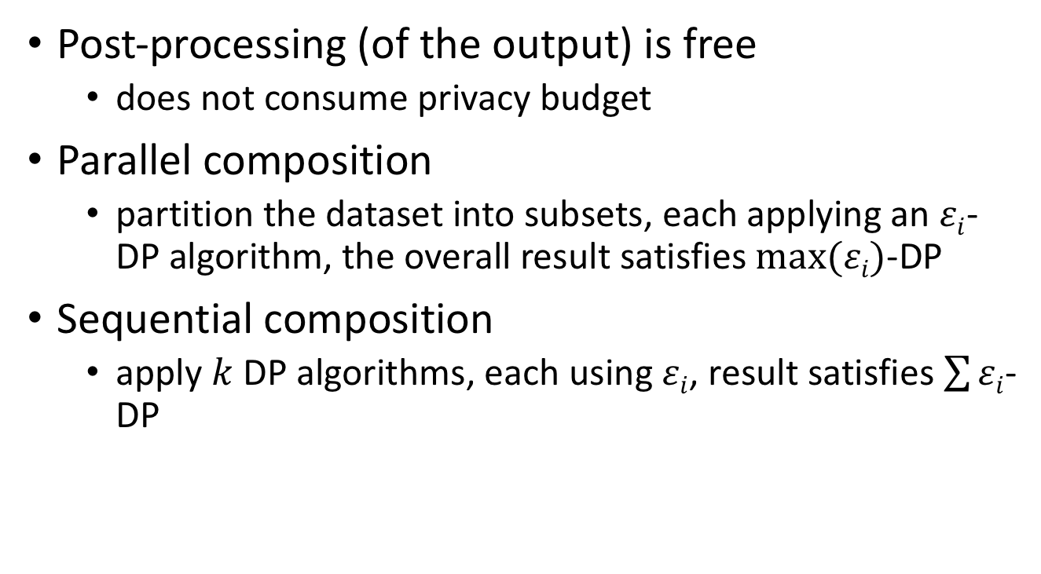
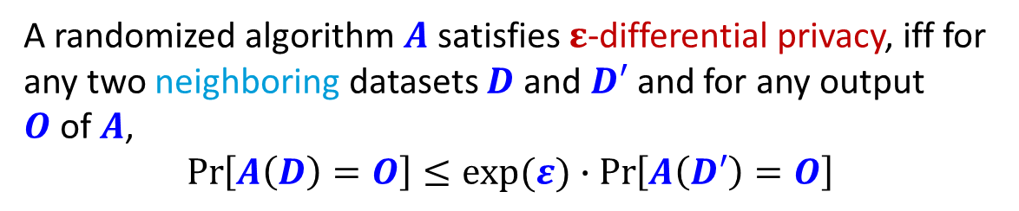
Properties of (Centralized) DP
A randomized algorithm $A$ satisfies $ε$-differential privacy, iff for any two neighboring datasets $D$ and $D′$ and for any output $O$of $A$,
$$\operatorname{Pr}\left[A\left(D\right)=O\right]≤exp⁡(ε)∙\operatorname{Pr}\left[A\left(D′\right)=O\right]$$
Post-processing (of the output) is free
  does not consume privacy budget
Parallel composition
  partition the dataset into subsets, each applying an $εi$-DP algorithm, the overall result satisfies $max⁡(εi)$-DP
Sequential composition
  apply $k$ DP algorithms, each using $εi$, result satisfies $\sum{εi}$-DP
What about LDP?

Slide 4
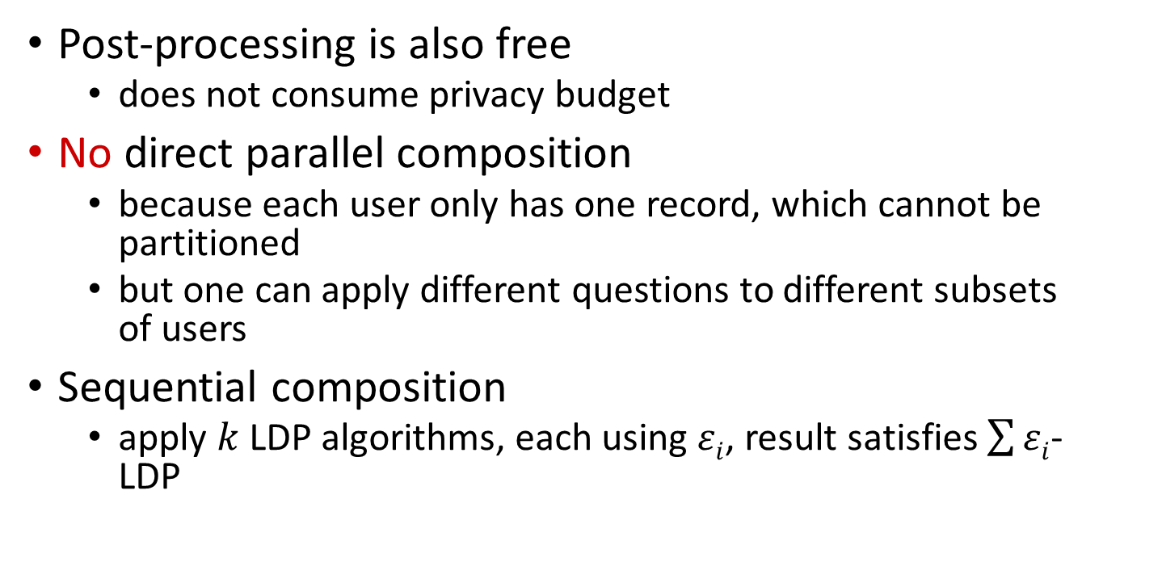
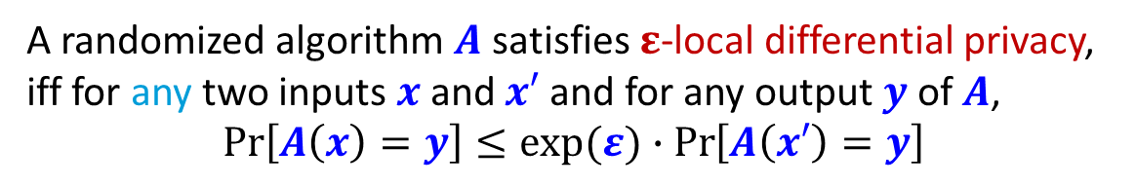
Properties of LDP
A randomized algorithm $A$ satisfies $ε$-local differential privacy, iff for any two inputs $x$ and $x′$ and for any output $y$of $A$,
$$\operatorname{Pr}\left[A\left(x\right)=y\right]≤exp⁡(ε)∙\operatorname{Pr}\left[A\left(x′\right)=y\right]$$
Post-processing is also free
  does not consume privacy budget
No direct parallel composition
  because each user only has one record, which cannot be partitioned
  but one can apply different questions to different subsets of users
Sequential composition
  apply $k$ LDP algorithms, each using $εi$, result satisfies $\sum{εi}$-LDP

Slide 5
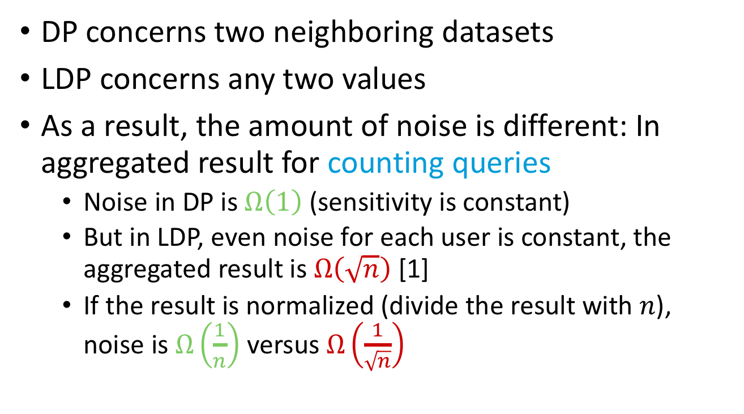
Key difference between DP and LDP
DP concerns two neighboring datasets
LDP concerns any two values
As a result, the amount of noise is different: In aggregated result for counting queries
  Noise in DP is $Ω\left(1\right)$ (sensitivity is constant)
  But in LDP, even noise for each user is constant, the aggregated result is $Ω\left(\sqrt{n}\right)$ [1]
  If the result is normalized (divide the result with $n$), noise is $Ω\left(\frac{1}{n}\right)$ versus $Ω\left(\frac{1}{\sqrt{n}}\right)$
[1] Optimal lower bound for differentially private multi-party aggregation by T.-H. H. Chan, E. Shi, and D. Song

Slide 6
Overview
Applications built from algorithms
Applications
Use tools to handle complicated settings
LDP Algorithms
Basic tools that satisfy LDP
Mechanisms

Slide 7

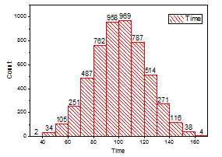






Frequency Estimation
Assumption: each user has a single value $x$ from a categorical domain $D$
Goal: Estimate the frequency of any value in $D$
Data+Noise
Data+Noise
Data+Noise
Trust boundary
Notes:
To effectively reduce the size of the set from Cartesian product

Slide 8

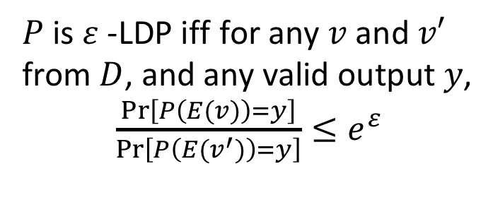
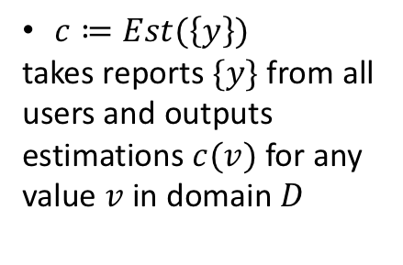

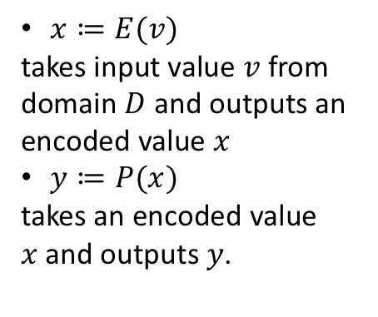
Frequency Oracle Framework
$x≔E(v)$
takes input value $v$ from domain $D$ and outputs an encoded value $x$
$y≔P(x)$
takes an encoded value $x$and outputs $y$.
$c≔Est(\left\{y\right\})$
takes reports $\{y\}$ from all users and outputs estimations $c(v)$ for any value $v$ in domain $D$
$$y$$
$P$ is $ε$-LDP iff$′$for any $v$ and $v′$ from $D$, and any valid output $y$,
$\frac{\operatorname{Pr}\left[P\left(E(v)\right)=y\right]}{\operatorname{Pr}\left[P\left(E(v^{′})\right)=y\right]}≤e^{ε}$
Notes:
Here encode is mainly used for presenting the paper

Slide 9

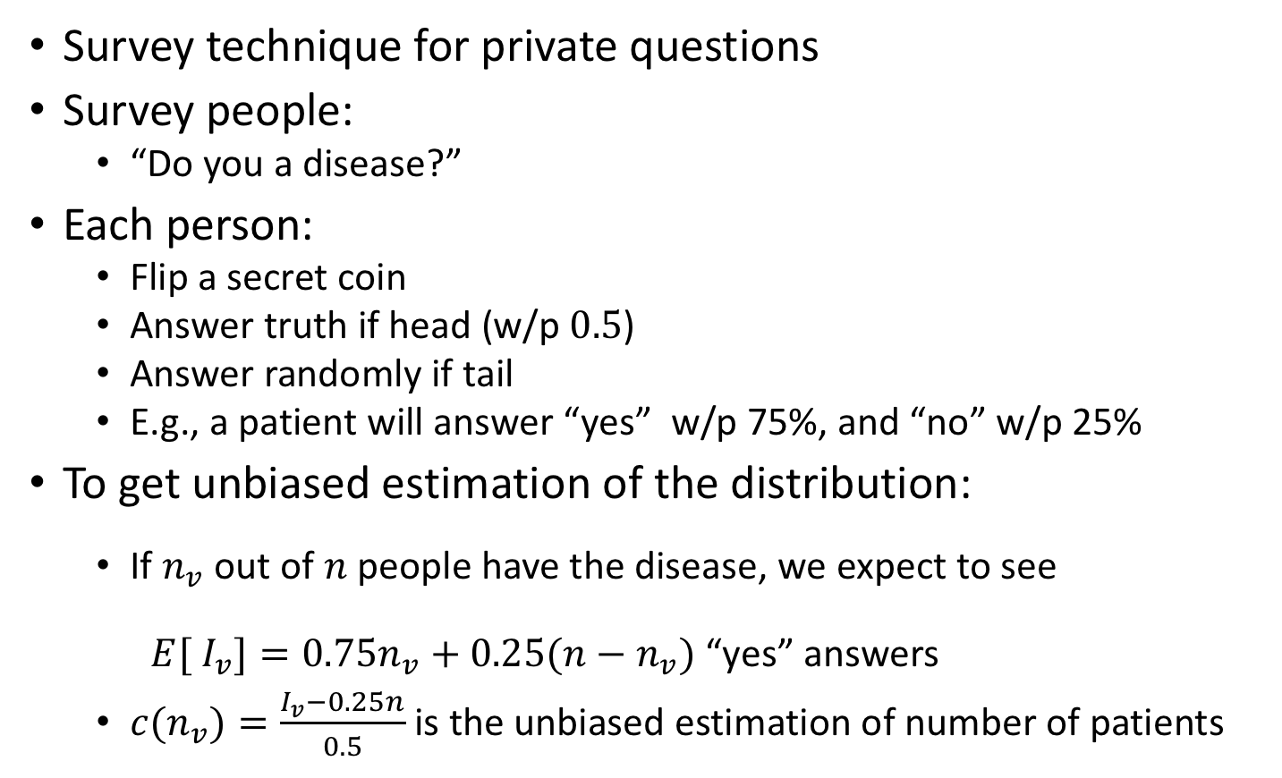
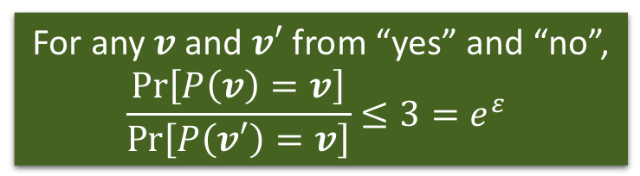
Random Response (Warner’65)
Survey technique for private questions
Survey people:
  “Do you a disease?”
Each person:
  Flip a secret coin
  Answer truth if head (w/p $0.5$)
  Answer randomly if tail
  E.g., a patient will answer “yes” w/p 75%, and “no” w/p 25%
To get unbiased estimation of the distribution:
  If $n_{v}$ out of $n$people have the disease, we expect to see
  $E[ {I_{v}]=0.75n}_{v}+0.25(n−n_{v})$ “yes” answers
  ${c(n}_{v})=\frac{I_{v}−0.25n}{0.5}$ is the unbiased estimation of number of patients
For any $v$ and $v′$ from “yes” and “no”,
$$\frac{\operatorname{Pr}\left[P\left(v\right)=v\right]}{\operatorname{Pr}\left[P\left(v′\right)=v\right]}≤3=e^{ε}$$
Provide deniability:
Seeing answer, not certain about the secret.
This only handles binary attribute.
We will handle the more general setting.
Notes:
The definition of LDP is not new.
Comes from …

Slide 10
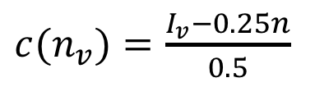
Concrete Example (Let’s do math)
  A patient will answer “yes” w/p 75%, and “no” w/p 25%
 | truth | ->yes | ->no
yes | 80 | 40+20 | 0+20
no | 20 | 0+5 | 10+5
observed
estimate
65 | 35
80 | 20
${c(n}_{v})=\frac{I_{v}−0.25n}{0.5}$

Slide 11
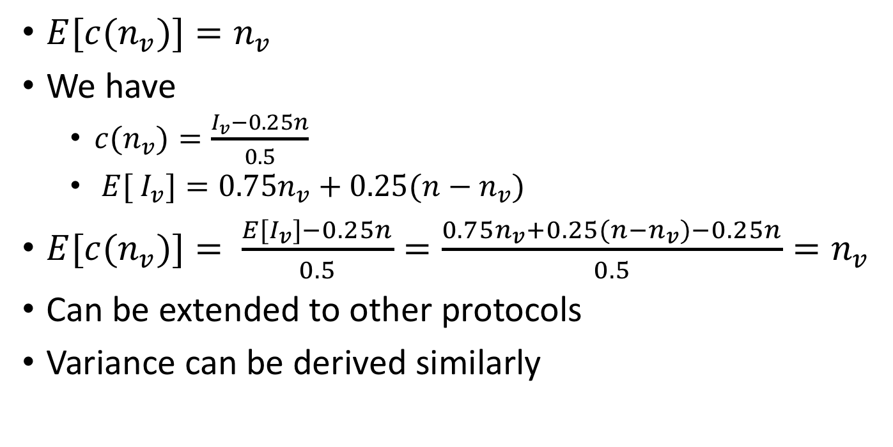
(Simple) Proofs
$E[{c(n}_{v})]=n_{v}$
We have
  ${c(n}_{v})=\frac{I_{v}−0.25n}{0.5}$
  $E[ {I_{v}]=0.75n}_{v}+0.25(n−n_{v})$
$E[{c(n}_{v})]= \frac{{E[I}_{v}]−0.25n}{0.5}=\frac{{0.75n}_{v}+0.25(n−n_{v})−0.25n}{0.5}=n_{v}$
Can be extended to other protocols
Variance can be derived similarly

Slide 12
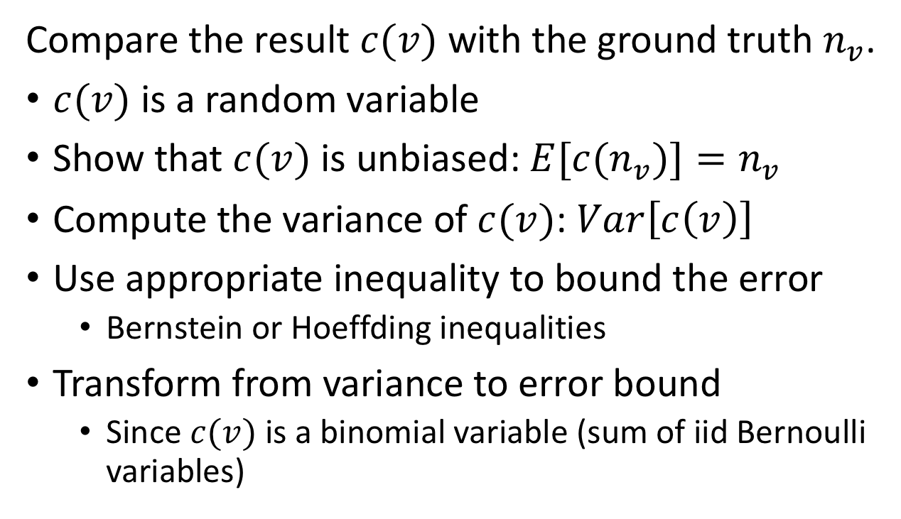
Probabilistic Analysis
Compare the result $c(v)$ with the ground truth $n_{v}$.
$c(v)$ is a random variable
Show that $c(v)$ is unbiased: $E[{c(n}_{v})]=n_{v}$
Compute the variance of $c(v)$: $Var\left[c\left(v\right)\right]$
Use appropriate inequality to bound the error
  Bernstein or Hoeffding inequalities
Transform from variance to error bound
  Since $c(v)$ is a binomial variable (sum of iid Bernoulli variables)
Notes:
We use variance, but one can also use others

Slide 13
From Two to Any Categories
Generalized Random Response
RAPPOR: Randomized Aggregatable Privacy-Preserving Ordinal Response. Ú. Erlingsson, V. Pihur, A. Korolova, CCS 2014
Random Response
Unary Encoding
Local, Private, Efficient Protocols for Succinct Histograms R. Bassily, A. Smith. STOC 2015.
Locally Differentially Private Protocols for Frequency Estimation T. Wang, J. Blocki, N. Li, S. Jha: USENIX Security 2017
Local Hash

Slide 14

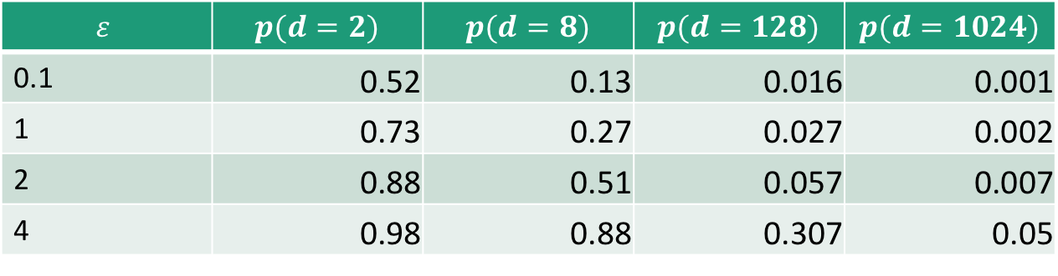
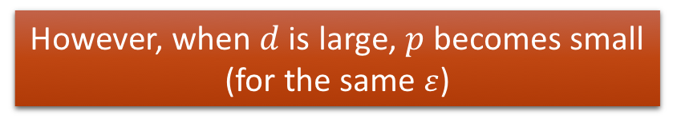
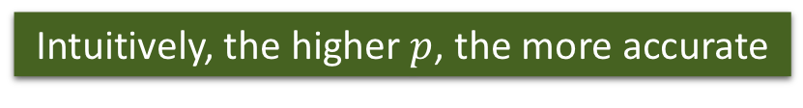
Generalized Random Response (Direct Encoding )
User:
  Encode $x=v$ (suppose $v$ from $D=\{1,2,…,d\}$)
  Toss a coin with bias $p$
  If it is head, report the true value $y=x$
  Otherwise, report any other value with probability $q=\frac{1−p}{d−1}$ (uniformly at random)
    $p=\frac{e^{ε}}{e^{ε}+d−1},q=\frac{1}{e^{ε}+d−1}⇒\frac{\operatorname{Pr}\left[P\left(v\right)=v\right]}{\operatorname{Pr}\left[P\left(v′\right)=v\right]}=\frac{p}{q}=e^{ε}$
Aggregator:
  Suppose $n_{v}$ users possess value $v, I_{v}$ is the number of reports on $v.$
  ${E[I}_{v}]=n_{v}⋅p+\left(n−n_{v}\right)⋅q$
  Unbiased Estimation: $c(v)=\frac{I_{v}−n⋅q}{p−q}$
Intuitively, the higher $p$, the more accurate
However, when $d$ is large, $p$ becomes small (for the same $ε$)
$$ε$$ | $$p(d=2)$$ | $$p(d=8)$$ | $$p(d=128)$$ | $$p(d=1024)$$
0.1 | 0.52 | 0.13 | 0.016 | 0.001
1 | 0.73 | 0.27 | 0.027 | 0.002
2 | 0.88 | 0.51 | 0.057 | 0.007
4 | 0.98 | 0.88 | 0.307 | 0.05
To get rid of dependency on domain size, we move to the unary encoding protocols.
Notes:
remind

Slide 15
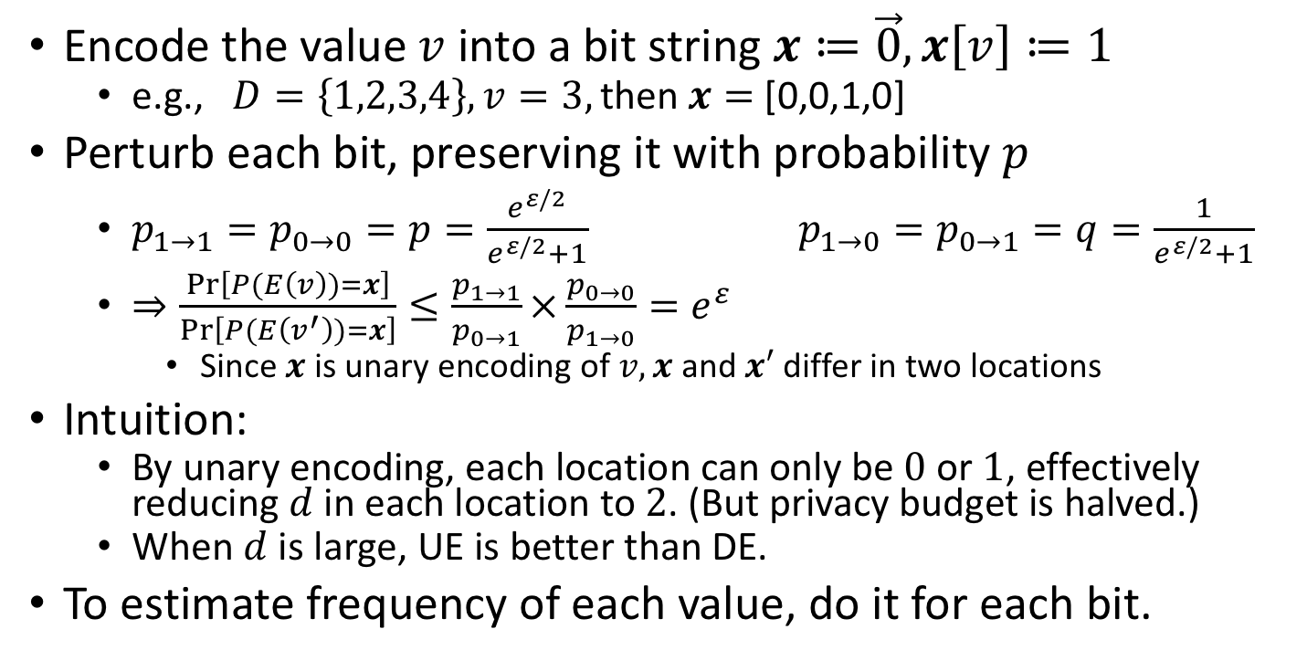
Unary Encoding (Basic RAPPOR)
Encode the value$v$ into a bit string $x≔\vec{0}, x\left[v\right]≔1$
  e.g., $D=\left\{1,2,3,4\right\}, v=3,\text{then} x=$ [0,0,1,0]
Perturb each bit, preserving it with probability $p$
  $p_{1→1}=p_{0→0}=p=\frac{e^{ε/2}}{e^{ε/2}+1} p_{1→0}=p_{0→1}=q=\frac{1}{e^{ε/2}+1}$
  $⇒\frac{\operatorname{Pr}\left[P(E\left(v\right))=x\right]}{\operatorname{Pr}\left[P(E\left(v^{′}\right))=x\right]}≤\frac{p_{1→1}}{p_{0→1}}×\frac{p_{0→0}}{p_{1→0}}=e^{ε}$
    Since $x$is unary encoding of $v,x$ and $x′$ differ in two locations
Intuition:
  By unary encoding, each location can only be $0$ or $1$, effectively reducing $d$ in each location to $2$. (But privacy budget is halved.)
  When $d$ is large, UE is better than DE.
To estimate frequency of each value, do it for each bit.
Notes:
Suppose there are $d=2$ values, $q=\frac{1−p}{d−1}=1−p$

Slide 16





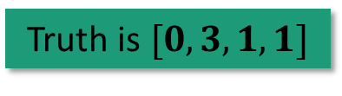






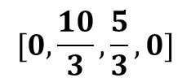


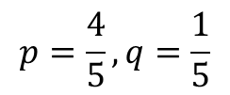





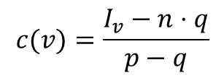





Truth is $[0,3,1,1]$
$$[0,\frac{10}{3},\frac{5}{3},0]$$
$$c$$
$$c(v)=\frac{I_{v}−n⋅q}{p−q}$$
$$Σy$$
$$[1,3,2,1]$$
Accuracy increase with number of users.
$$y$$
$$[0,1,0,0]$$
$$[0,0,0,0]$$
$$[0,1,1,0]$$
$$[0,1,1,0]$$
$$[1,0,0,1]$$
$$p=\frac{4}{5},q=\frac{1}{5}$$
$$x$$
$$[0,1,0,0]$$
$$[0,1,0,0]$$
$$[0,0,1,0]$$
$$[0,1,0,0]$$
$$[0,0,0,1]$$
$$d=4$$
$$v$$
$$2$$
$$2$$
$$3$$
$$2$$
$$4$$
Notes:
Accuracy is defined as relative error, or variance

Slide 17
Laplacian (Gaussian)
Instead of using randomize response for each bit, add Laplacian (Gaussian) noise to each bit.
  Sensitivity is 2, because two vectors differ in two bits.
It is equivalent to the centralized setting, but the number of record is only 1.
The server aggregates the results.
This is worse than UE.

Slide 18
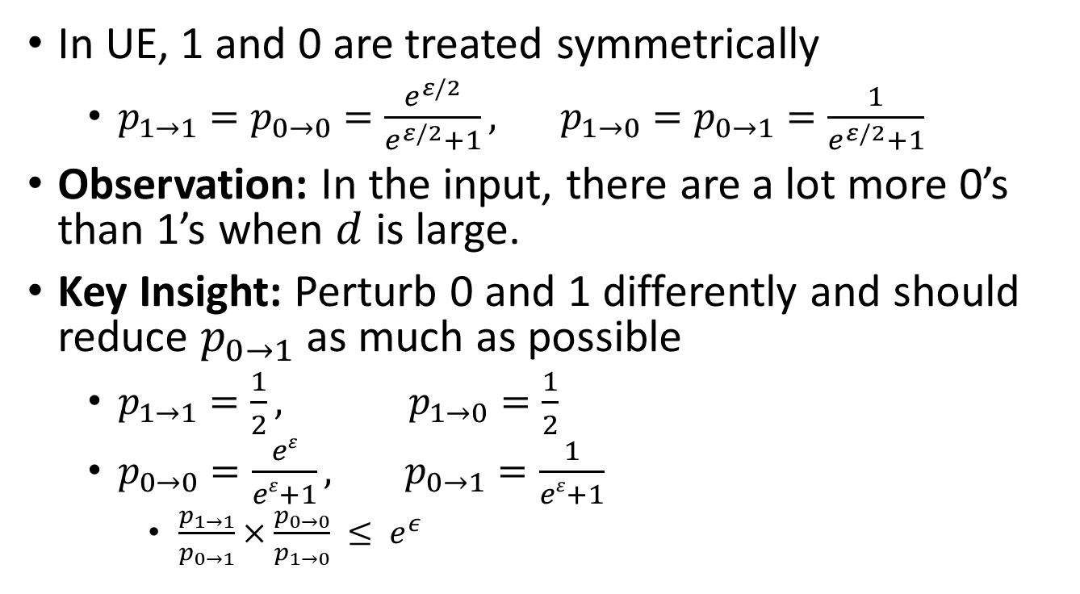
Optimized Unary Encoding (UE)
In UE, 1 and 0 are treated symmetrically
  $p_{1→1}=p_{0→0}=\frac{e^{ε/2}}{e^{ε/2}+1}, p_{1→0}=p_{0→1}=\frac{1}{e^{ε/2}+1}$
Observation: In the input, there are a lot more 0’s than 1’s when $d$ is large.
Key Insight: Perturb 0 and 1 differently and should reduce $p_{0→1}$ as much as possible
  $p_{1→1}=\frac{1}{2}, p_{1→0}=\frac{1}{2}$
  $p_{0→0}=\frac{eε}{eε+1}, p_{0→1}=\frac{1}{eε+1}$
    $\frac{p_{1→1}}{p_{0→1}}×\frac{p_{0→0}}{p_{1→0}} ≤ e^{ε}$

Slide 19
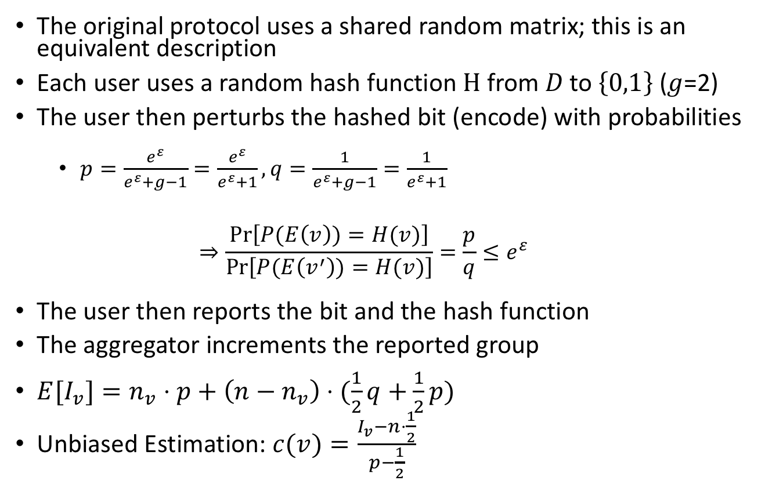
Binary Local Hash
Local, Private, Efficient Protocols for Succinct Histograms R. Bassily, A. Smith. STOC 2015.
The original protocol uses a shared random matrix; this is an equivalent description
Each user uses a random hash function$H$from$D \text{to} \left\{0,1\right\}$($g$=2)
The user then perturbs the hashed bit (encode) with probabilities
  $p=\frac{e^{ε}}{e^{ε}+g−1}=\frac{e^{ε}}{e^{ε}+1},q=\frac{1}{e^{ε}+g−1}=\frac{1}{e^{ε}+1}$
  $$⇒\frac{\operatorname{Pr}\left[P(E\left(v\right))=H(v)\right]}{\operatorname{Pr}\left[P(E\left(v^{′}\right))=H(v)\right]}=\frac{p}{q}≤e^{ε}$$
The user then reports the bit and the hash function
The aggregator increments the reported group
${E[I}_{v}]=n_{v}⋅p+\left(n−n_{v}\right)⋅(\frac{1}{2}q+\frac{1}{2}p)$
Unbiased Estimation: $c(v)=\frac{I_{v}−n⋅\frac{1}{2}}{p−\frac{1}{2}}$
Notes:
g is number of groups

Slide 20



Example
+ 1
+ 1
$$[0,0,0,0]$$
Group 1={2,4}
$$v=2$$
Group 1
$$D=\{1,2,3,4\}$$
Group 0

Slide 21










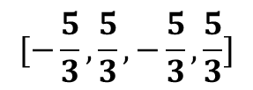

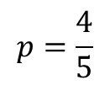






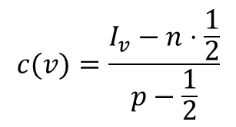




Because of $\frac{1}{2}$, results is worse than UE
$$c$$
$$[−\frac{5}{3},\frac{5}{3},−\frac{5}{3},\frac{5}{3}]$$
$$c(v)=\frac{I_{v}−n⋅\frac{1}{2}}{p−\frac{1}{2}}$$
$$Σ$$
$$[2,3,2,3]$$
Recover the vector
$$[0,1,0,1]$$
$$[0,1,0,1]$$
$$[1,0,1,0]$$
$$[0,1,0,1]$$
$$[1,0,1,0]$$
$$y$$
$$1$$
$$0$$
$$0$$
$$0$$
$$0$$
$$p=\frac{4}{5}$$
$$x=\left(v+j\right)\%2$$
$$1$$
$$0$$
$$0$$
$$0$$
$$1$$
$$d=4$$
$$v$$
$$2$$
$$2$$
$$3$$
$$2$$
$$4$$
Notes:
Suppose a simple hash function x=(v+i)%2, where i is the user index

Slide 22
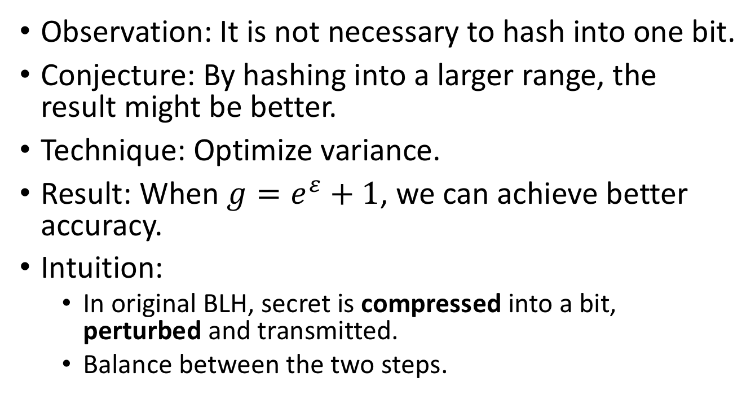
Optimized Local Hash (OLH)
Observation: It is not necessary to hash into one bit.
Conjecture: By hashing into a larger range, the result might be better.
Technique: Optimize variance.
Result: When $g=e^{ε}+1$, we can achieve better accuracy.
Intuition:
  In original BLH, secret is compressed into a bit, perturbed and transmitted.
  Balance between the two steps.

Slide 23
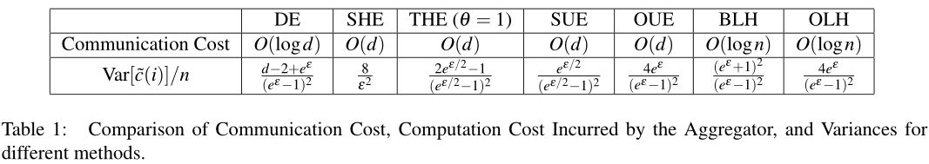
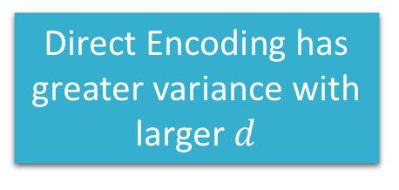
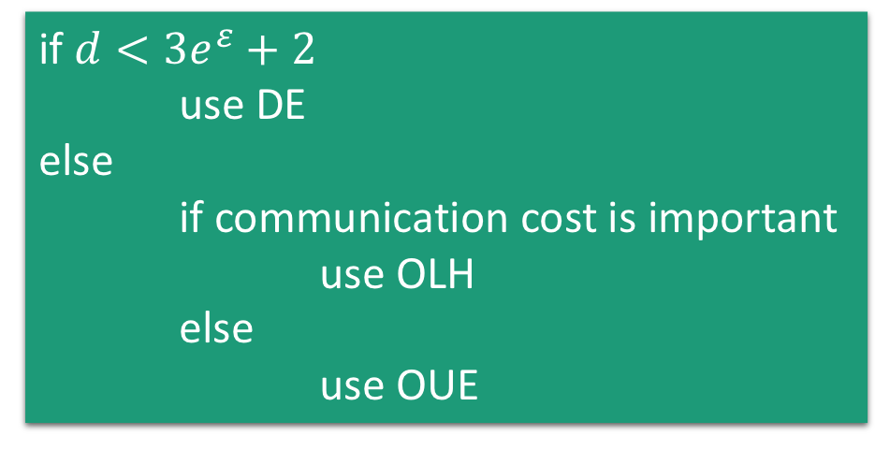
Comparison of Mechanisms
if $d<3e^{ε}+2$
use DE
else
if communication cost is important
use OLH
else
use OUE
Direct Encoding has greater variance with larger $d$
OUE and OLH have the same variance

Slide 24
Two other protocols
Subset Selection
  S. Wang, L. Huang, P. Wang, Y. Nie, H. Xu, W. Yang, X. Li, and C. Qiao. Mutual information optimally local private discrete distribution estimation. arXiv 2016.
  M. Ye and A. Barg. Optimal schemes for discrete distribution estimation under locally differential privacy. IEEE Transactions on Information Theory 2018.
Hadamard Response
  A. Jayadev, Z. Sun, and H. Zhang. Communication Efficient, Sample Optimal, Linear Time Locally Private Discrete Distribution Estimation. arXiv 2018.

Slide 25
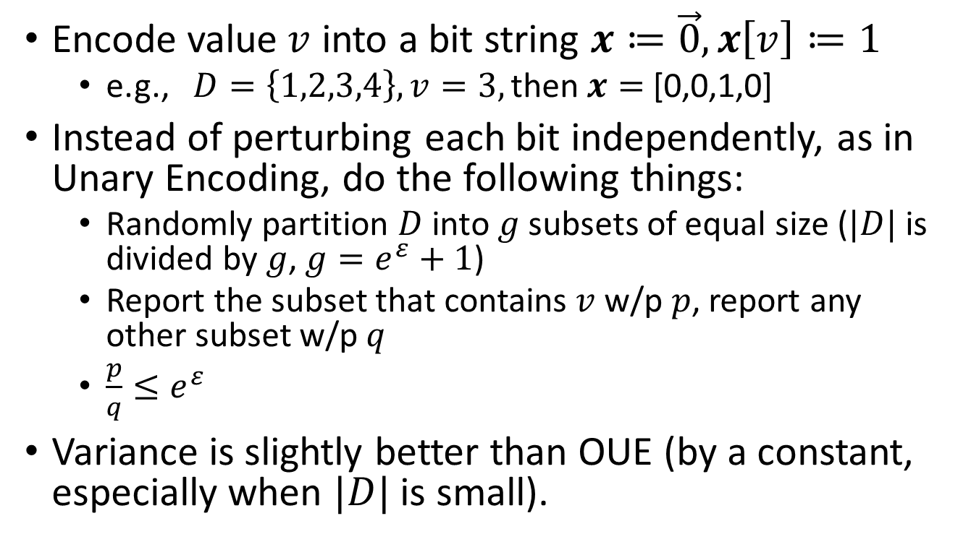
Subset Selection
Encode value$v$ into a bit string $x≔\vec{0}, x\left[v\right]≔1$
  e.g., $D=\left\{1,2,3,4\right\}, v=3,\text{then} x=$ [0,0,1,0]
Instead of perturbing each bit independently, as in Unary Encoding, do the following things:
  Randomly partition $D$ into $g$subsets of equal size ($|D|$ is divided by $g$, $g=e^{ε}+1$)
  Report the subset that contains $v$ w/p $p$, report any other subset w/p $q$
  $\frac{p}{q}≤e^{ε}$
Variance is slightly better than OUE (by a constant, especially when $|D|$ is small).

Slide 26
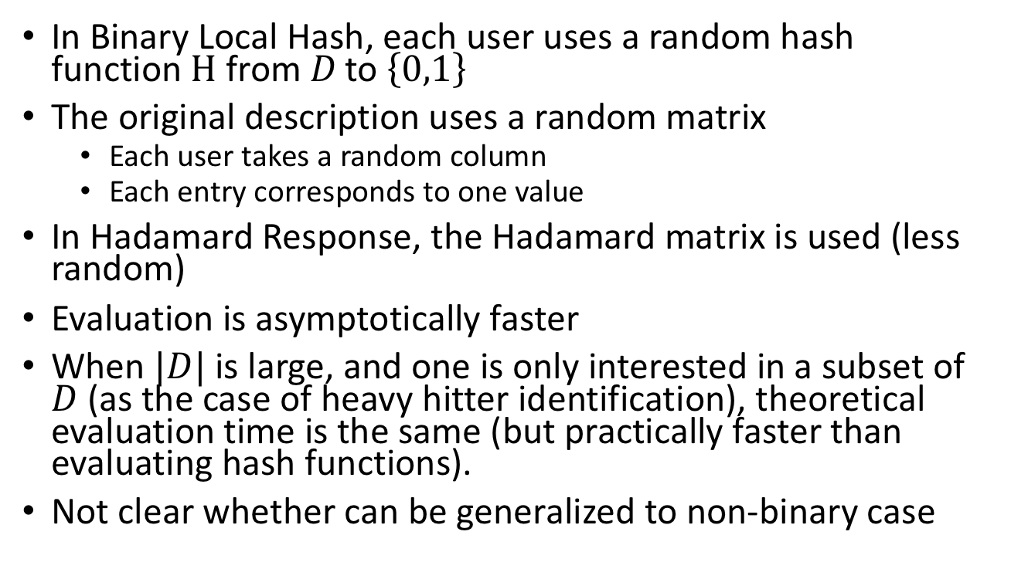
Hadamard Response
In Binary Local Hash, each user uses a random hash function$H$from$D \text{to} \left\{0,1\right\}$
The original description uses a random matrix
  Each user takes a random column
  Each entry corresponds to one value
In Hadamard Response, the Hadamard matrix is used (less random)
Evaluation is asymptotically faster
When $|D|$ is large, and one is only interested in a subset of $D$ (as the case of heavy hitter identification), theoretical evaluation time is the same (but practically faster than evaluating hash functions).
Not clear whether can be generalized to non-binary case

Slide 27
Summary of LDP Frequency Oracle Mechanisms
Generalized Random Response (generalization of random response)
Unary Encoding (Symmetric UE and Optimized UE)
  Can also be viewed as reporting random subsets
  A variant of this approach is to fix the size of reported subset
Local Hashing Approach (Binary LH and Optimized LH)
  One way to implement BLH is to use Hadamard Response

Slide 28
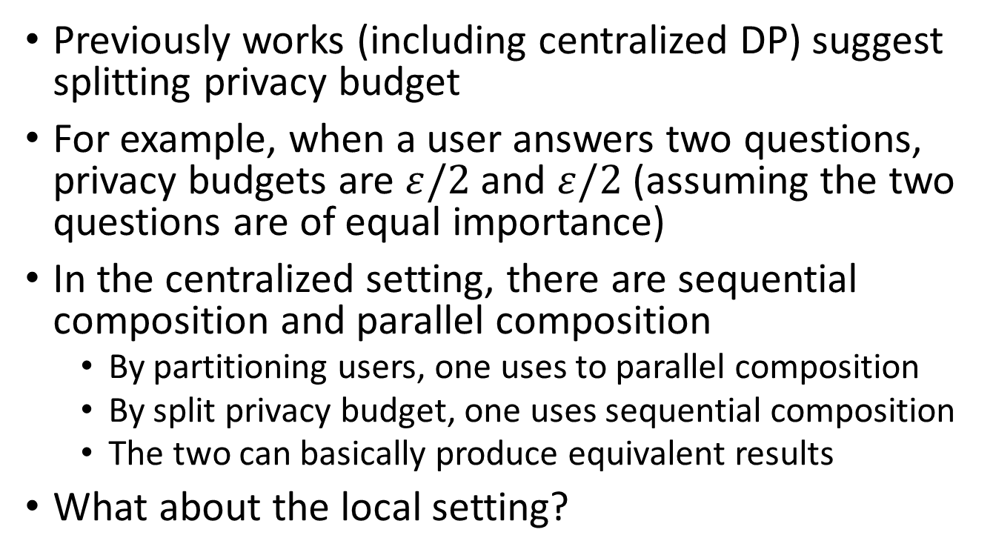
On answering multiple questions
Previously works (including centralized DP) suggest splitting privacy budget
For example, when a user answers two questions, privacy budgets are $ε/2$ and $ε/2$ (assuming the two questions are of equal importance)
In the centralized setting, there are sequential composition and parallel composition
  By partitioning users, one uses to parallel composition
  By split privacy budget, one uses sequential composition
  The two can basically produce equivalent results
What about the local setting?

Slide 29
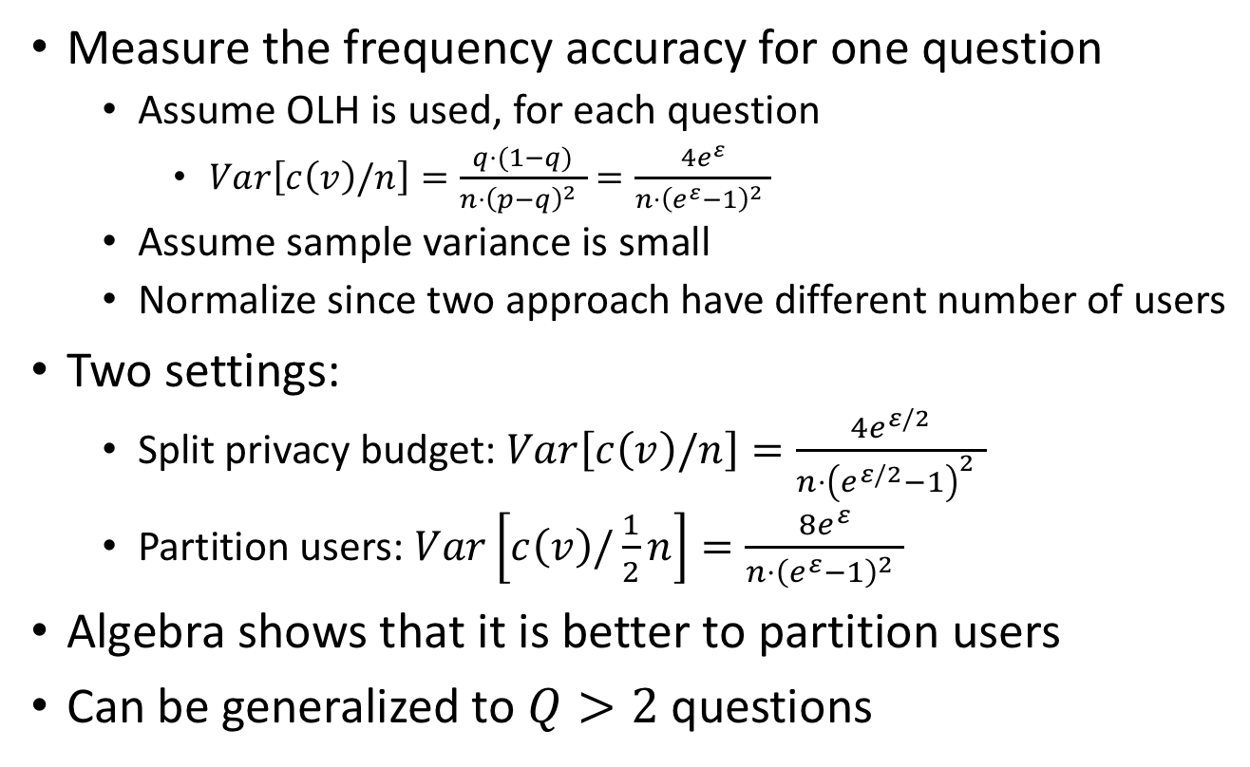
On answering multiple questions
Measure the frequency accuracy for one question
  Assume OLH is used, for each question
    $Var\left[c\left(v\right)/n\right]=\frac{q⋅(1−q)}{{n⋅\left(p−q\right)}^{2} }=\frac{4e^{ε}}{{n⋅\left(e^{ε}−1\right)}^{2} }$
  Assume sample variance is small
  Normalize since two approach have different number of users
Two settings:
  Split privacy budget: $Var\left[c\left(v\right)/n\right]=\frac{4e^{ε/2}}{{n⋅\left(e^{ε/2}−1\right)}^{2} }$
  Partition users: $Var\left[c\left(v\right)/\frac{1}{2}n\right]=\frac{8e^{ε}}{{n⋅\left(e^{ε}−1\right)}^{2} }$
Algebra shows that it is better to partition users
Can be generalized to $Q>2$ questions

Slide 30
LDP Applications
Applications built from LDP algorithms
Applications
Focus on
Heavy hitter identification
Frequent itemset mining
LDP Algorithms
Mechanisms

Slide 31
Heavy Hitter Estimation

Slide 32
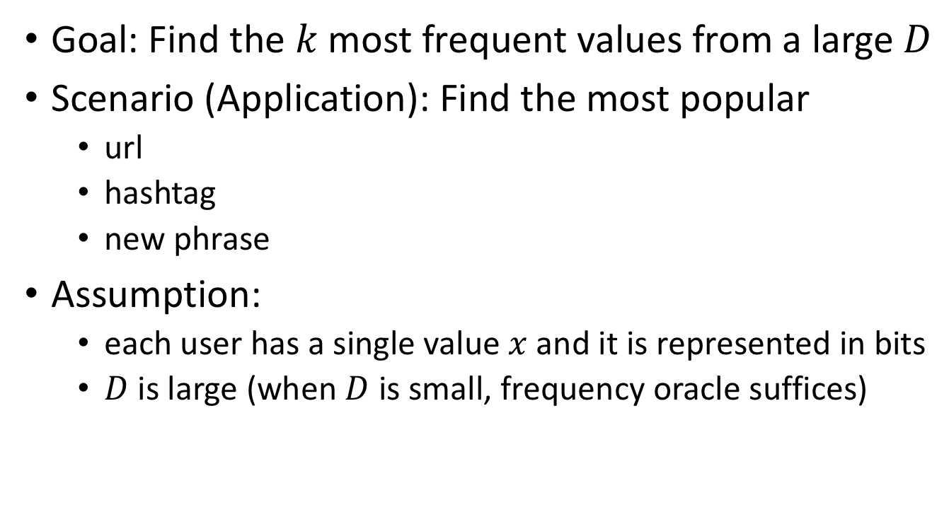
The heavy hitter problem
Goal: Find the $k$most frequent values from a large $D$
Scenario (Application): Find the most popular
  url
  hashtag
  new phrase
Assumption:
  each user has a single value $x$ and it is represented in bits
  $D$ is large (when $D$ is small, frequency oracle suffices)
Notes:
To effectively reduce the size of the set from Cartesian product

Slide 33
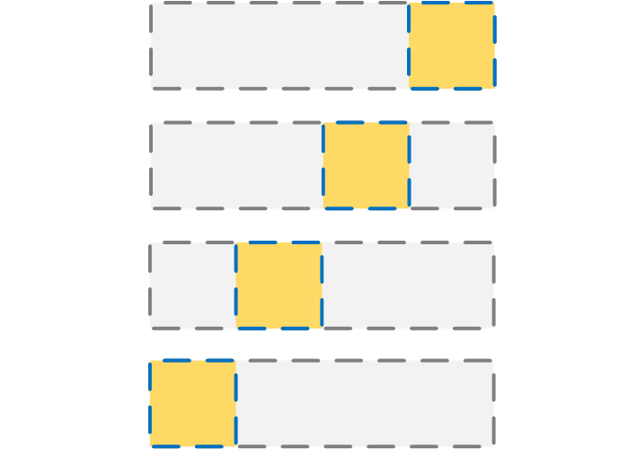

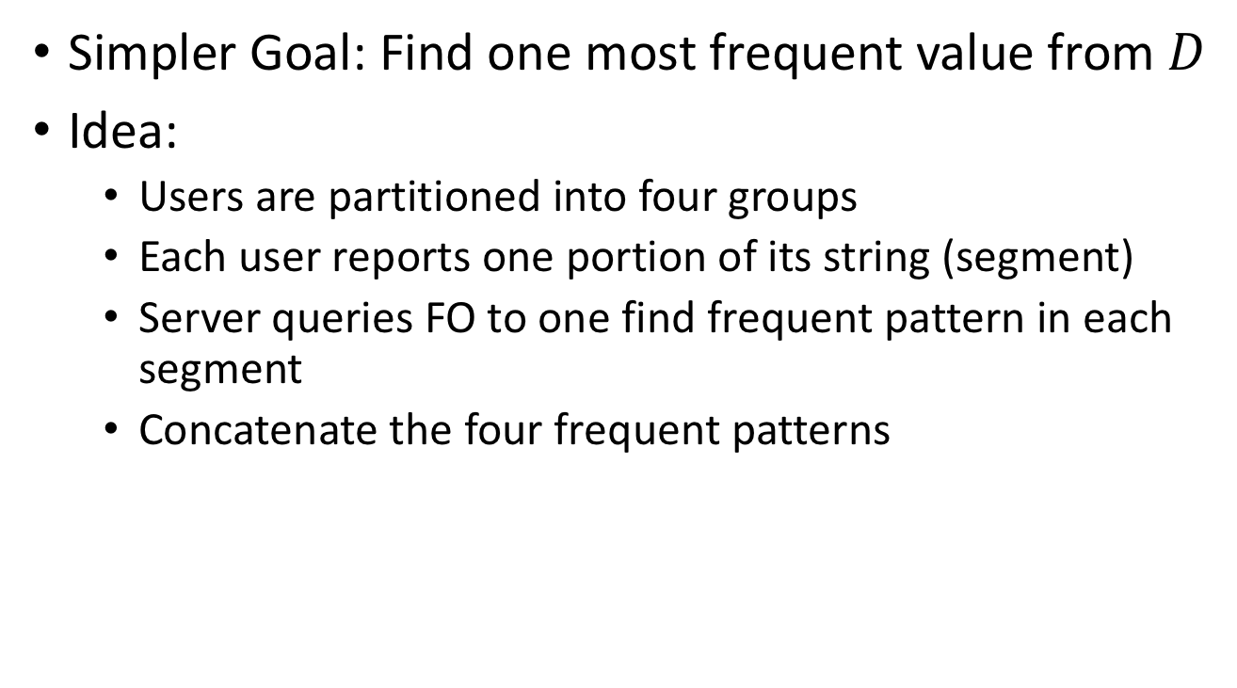
A First Solution
Simpler Goal: Find one most frequent value from $D$
Idea:
  Users are partitioned into four groups
  Each user reports one portion of its string (segment)
  Server queries FO to one find frequent pattern in each segment
  Concatenate the four frequent patterns
+
+
+
Notes:
To effectively reduce the size of the set from Cartesian product

Slide 34
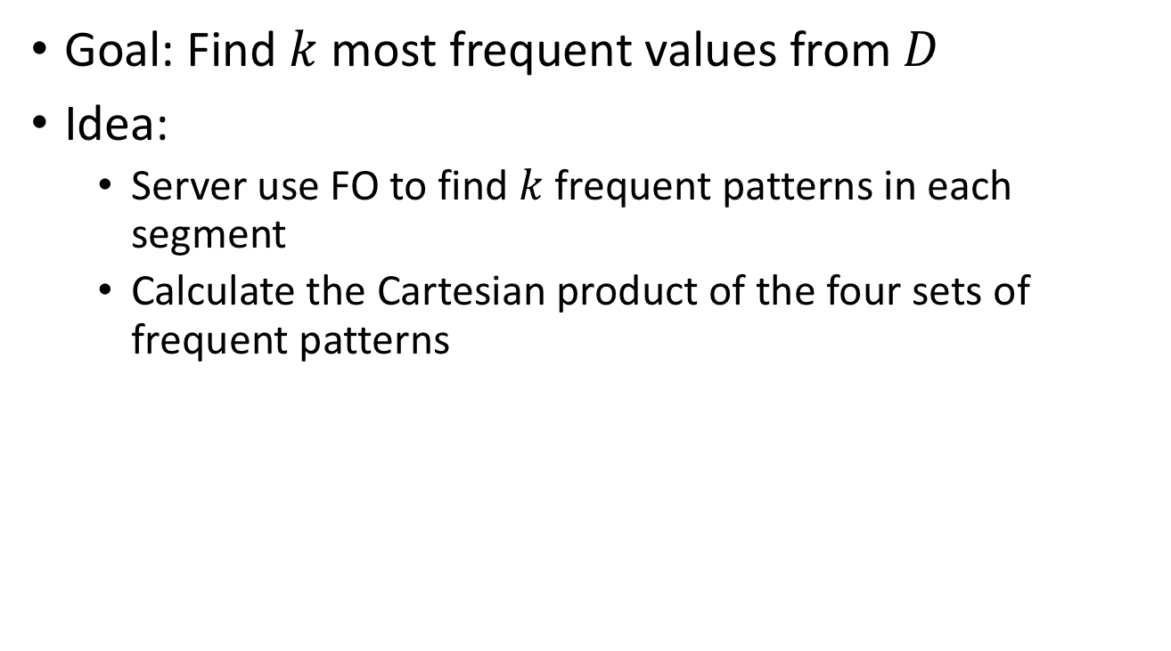
A First Solution
Goal: Find $k$ most frequent values from $D$
Idea:
  Server use FO to find $k$frequent patterns in each segment
  Calculate the Cartesian product of the four sets of frequent patterns
Drawback:
Composing the four segment candidate sets gives a very large set of results.
x
x
x
Notes:
To effectively reduce the size of the set from Cartesian product

Slide 35
Proposals
Building a rappor with the unknown: Privacy-preserving learning of associations and data dictionaries
  G. Fanti, V. Pihur, and U. Erlingsson, PoPETS 2016.
  Segment Pair Method
Local, Private, Efficient Protocols for Succinct Histograms
  R. Bassily, A. Smith. STOC 2015.
  Multiple Channel Method
Prefix Extending Methods (state-of-the-art)
Notes:
There are mainly three styles, but there are many papers in the third style

Slide 36
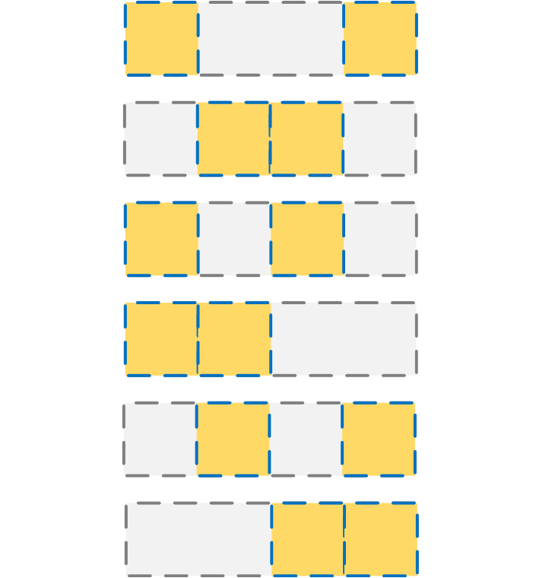
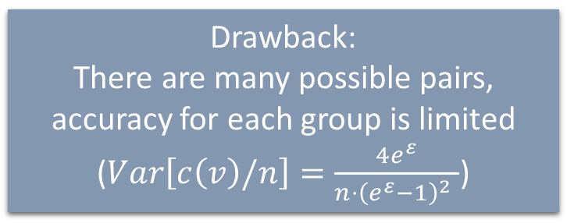
Segment Pair Method
Each user reports a pair of two randomly chosen segments.
A-priori principle:
  A pair of segments is frequent iff both segments are frequent
  A string is frequent iff any pair of segments is frequent
Step 1: For each location, test all possible segment
Step 2: For each pair, test all frequent segment pairs
Step 3: Build a k-partite graph where
  each node represents a frequent segment
  each edge represents a frequent segment pair
Step 4: Find cliques in the graph (heavy hitter candidates)
Step 5: Estimate frequencies of the heavy hitters
Drawback:
There are many possible pairs, accuracy for each group is limited ($Var\left[c\left(v\right)/n\right]=\frac{4e^{ε}}{{n⋅\left(e^{ε}−1\right)}^{2} }$)
G. Fanti, V. Pihur, and U. Erlingsson, “Building a rappor with the unknown: Privacy-preserving learning of associations and data dictionaries,” Proceedings on Privacy Enhancing Technologies (PoPETS), vol. issue 3, 2016, 2016.

Slide 37
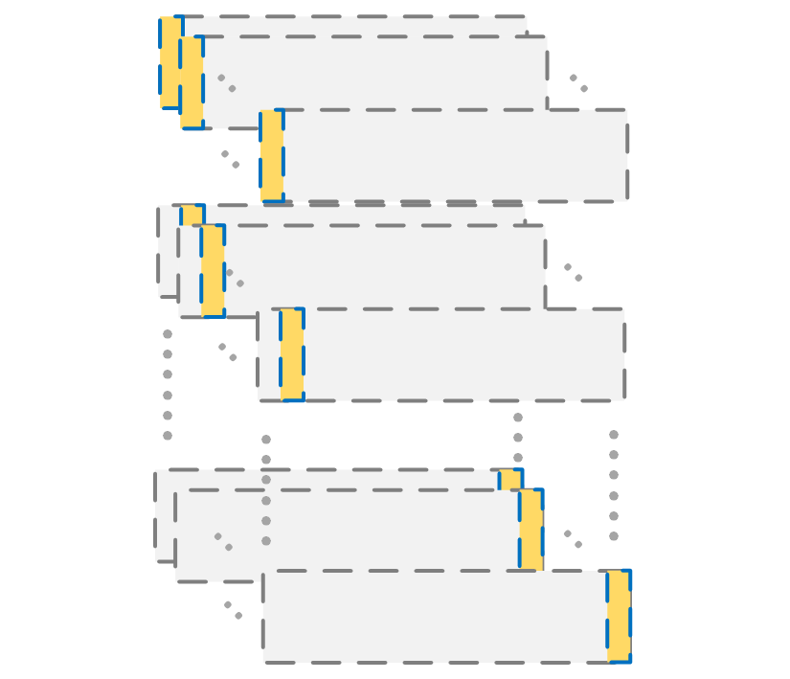
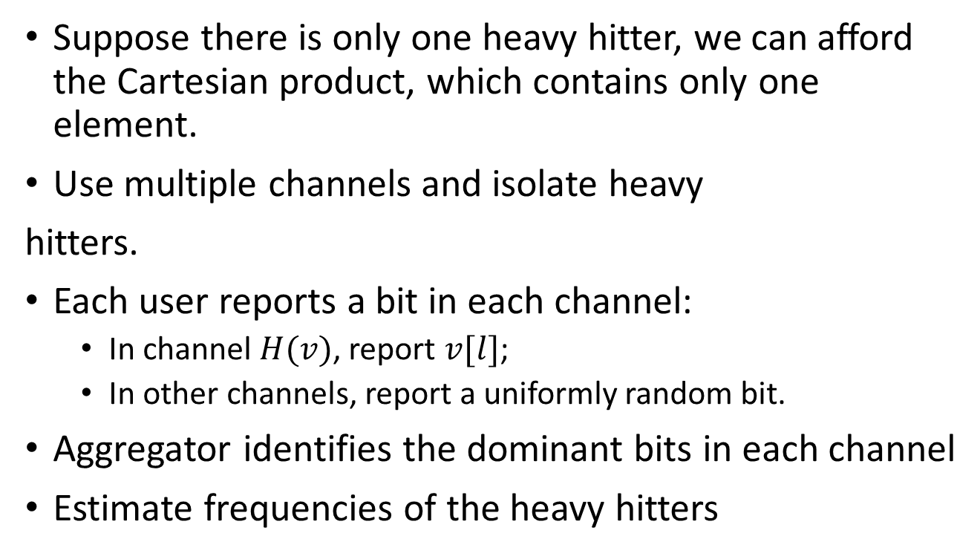
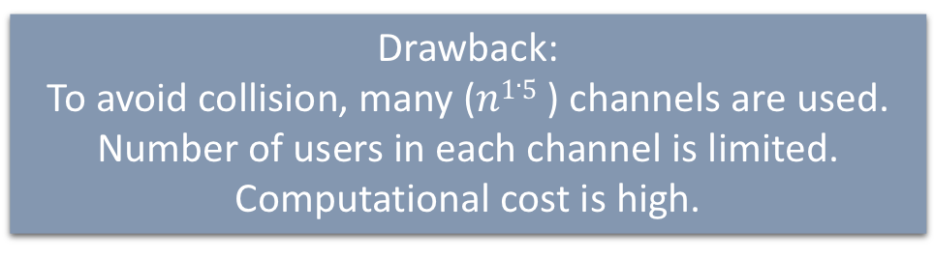
Multiple Channel Method
Suppose there is only one heavy hitter, we can afford the Cartesian product, which contains only one element.
Use multiple channels and isolate heavy
hitters.
Each user reports a bit in each channel:
  In channel $H(v)$, report $v[l]$;
  In other channels, report a uniformly random bit.
Aggregator identifies the dominant bits in each channel
Estimate frequencies of the heavy hitters
Drawback:
To avoid collision, many ($n1.5$) channels are used.
Number of users in each channel is limited.
Computational cost is high.
R. Bassily and A. Smith, “Local, private, efficient protocols for succinct histograms,” in Proceedings of the Forty-Seventh Annual ACM on Symposium on Theory of Computing. ACM, 2015, pp. 127–135.

Slide 38
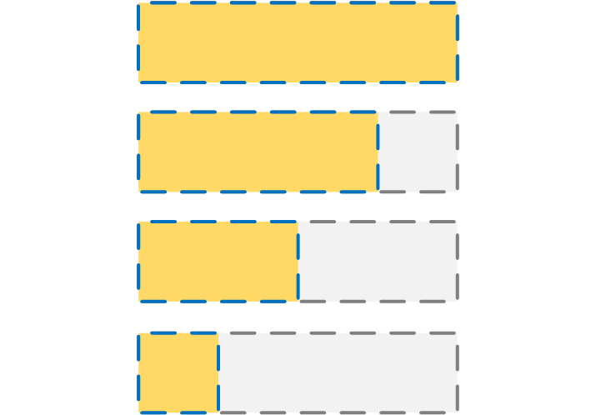









Prefix Extending Method
Start from a prefix, and gradually extend this prefix.
Identify the frequent patterns for a small prefix first, and then extend to a larger prefix.
Result for the last group can be used for frequency estimation
OLH.P($`deadbeef′$)
OLH.Q($`deadbe∗∗′$)->`deadbeef’
OLH.P($`deadbe′$)
OLH.Q($`dead∗∗′$)->`deadbe’
OLH.Q($`de∗∗′$)->`dead’
OLH.P($`dead′$)
OLH.Q($`∗∗′$)->`de’
OLH.P($`de′$)
$$v=`deadbeef′$$

Slide 39
Prefix Extending Style Proposals
Practical locally private heavy hitters
  R. Bassily, K. Nissim, U. Stemmer, and A. Thakurta, NIPS’17
  TreeHist
Locally Differentially Private Heavy Hitter Identification
  T. Wang, N. Li, S. Jha: arXiv 2017.
  PEM
Privtrie: Effective frequent term discovery under local differential privacy
  N. Wang, X. Xiao, Y. Yang, T. D. Hoang, H. Shin, J. Shin, and Y. Ge, ICDE’18
  PrivTrie (For a different setting)

Slide 40


Comparison
Assume the size of domain $D$ is $2m$; each value is encoded into $m$ bits
TreeHist
  Partition the users into $m$ groups, each reporting one additional bit
PEM
  Propose to let each group
  report as many bits as possible
PrivTrie (interactive)
  Propose to allocate less users
  on the top, more in the lower levels
  One bit at a time
Research Question:
How to determine number of additional bits each phase examines?
0
1
00
01
10
11
Notes:
Let’s visualize the process of prefix extending

Slide 41
More Bits or Fewer Bits?
Intuition:
  More bits -> Less groups -> More users in one -> More accurate and less rounds
  Less bits -> Less candidates -> Less likely an infrequent pattern becomes frequent
Analyze the expected utility score.
An optimization problem!

Slide 42

Optimize expected utility
Goal: Maximize expected number of heavy hitters that can be identified.
Input: $m, n,ε$
Output: How to group the users, and how many additional bits each group take.
Assumptions:
  A reasonable distribution (the more close the better)
  Probabilistic approximations
Findings:
Ideally (infeasible), all users report full string, and probe the FO for all possible string gives optimal result.
The constraint will be the computational power.
Each group should take as many bits as possible.

Slide 43
Frequent Itemset Mining

Slide 44

Frequent Itemset Mining
Strawman Method:
Encode the itemset as a value in a bigger domain (of size $2d$).
Disadvantage:
Cannot scale.
If an item is contained in many infrequent itemsets, it will not be captured
The goal is to find the frequent singletons and itemsets
Can be used for association rule mining etc
Report under LDP
Each user has a set of values
Top-3 singletons:
e(5), a(4), b(3)
Top-3 itemsets:
{e}(5), {a}(4), {a, e}(4)
Challenges:
1. Each user has multiple items
2. Each user’s itemset size is different
{a, c, e} {b, e} {a, b, e} {a, d, e} {a, b, c, d, e, f}

Slide 45
Proposals
Heavy hitter estimation over set-valued data with local differential privacy. In CCS, 2016.
  Z. Qin, Y. Yang, T. Yu, I. Khalil, X. Xiao, and K. Ren. CCS 2016.
  LDPMiner
Locally Differentially Private Frequent Itemset Mining
  T. Wang, N. Li, S. Jha: IEEE SP 2018.
  SVIM/SVSM

Slide 46





Pad and Sample Frequency Oracle
Each user’s itemset size is different
  Pad it to a fixed length $l$
Each user now has $l$ items (or more)
  Sample one at uniform random
  Report via LDP (e.g., using Random Response)
Idea: when many users have the item, it is sampled frequently; and the server can capture that.
a
c
e
a
c
e
*
*
c
c
b
e
b
e
*
*
*
*
aggregate
*
pad
$$l=5$$
sample
report
  multiply by $l$
a
b
e
a
b
e
*
*
e
e
$×$ $l$
a
d
e
a
d
e
*
*
d
*
a
b
c
d
e
f
a
b
c
d
e
f
a
a
Notes:
Use the full sentence?

Slide 47




LDPMiner
Phase 1 (identify candidates)
  Pad to $l$
    $l$is the 90 percentile of the size distribution
  Randomly select one
  Report
  Potential $2k$frequent items returned
Phase 2 (estimate frequency)
  Intersects $v$ with the $2k$ items
  Pad to $2k$
    Ensures no missed item
  Randomly select one
  Report
Observations
1. The value of $l$ affects error in two ways.
2. Sampling may have a privacy amplification effect.
Could find frequent items only.
Left finding frequent itemsets as an open problem.
Notes:
Their limitations, our key ideas

Slide 48





Sources of error
FO Variance:
To satisfy LDP, perturbation introduces noise
It increases with $l$, quadratically
Tradeoff between variance and under estimation.
a
c
e
a
c
e
*
*
c
c
b
e
b
e
*
*
*
*
aggregate
*
pad
$$l=5$$
sample
report
  multiply by $l$
a
b
e
a
b
e
*
*
e
e
$×$ $l$
a
d
e
a
d
e
*
*
d
*
a
b
c
d
e
f
a
b
c
d
e
f
a
a
Under Estimation:
Items are selected with 1/6 but multiplied with 5
It decreases when $l$ increases

Slide 49




Goal: Identification
$l$=1
Summary:
When the goal is identification, use small $l$;
When estimating frequencies,
use large $l$.
$l$=5
a
c
e
c
a
c
e
*
*
c
Observation: Even though under-estimation happens, the relative ranking of the frequent items is pretty stable.
b
e
*
*
*
*
b
e
e
Some users report dummy, making the signal weak.
a
b
e
*
*
e
$×$ $5$
a
b
e
e
Now let’s move on to the other key observation: privacy amplification
a
d
e
*
*
d
a
d
e
d
a
b
c
d
e
f
a
a
b
c
d
e
f
a
49
Notes:
When estimation, we are good

Slide 50



Privacy Amplification
LDP bounds the perturbation.
  E.g., in Random Response.
With sampling, things are different.
Adaptively choose better frequency oracle based on the variance.
report
sample
report
a
a
a
b
a
a
To satisfy $ε$–LDP, we can use $ε^{′}=ln⁡(l\left(e^{ε}−1\right)+1)$
b
a
b
c
b
a
$$\frac{\operatorname{Pr}\left[P\left(a\right)=a\right]}{\operatorname{Pr}\left[P\left(b\right)=a\right]}≤e^{ε}$$
Two randomization steps:
$$\operatorname{Pr}\left[Report\left(a,b\right)=a\right] =\operatorname{Pr}\left[Sample\left(a,b\right)=a\right]× Pr\left[P\left(a\right)=a\right]$$
$$+\operatorname{Pr}\left[Sample\left(a,b\right)=b\right]× Pr\left[P\left(b\right)=a\right]$$

Slide 51




SVIM: Set-Value Item Mining
Phase 1 (identify candidates)
  Randomly select one ($l=1$)
  Report
  Potential $2k$frequent items returned
Phase 2 (estimate length distribution)
  Intersects $v$ with the $2k$ identified ones
  Report the size
  The 90-percentile $l$ is returned
Phase 3 (estimate frequency)
  Pad to $l$
  Randomly select one
  Report via Adaptively chosen FO
SVIM (Set Value Item Mining)
With the new design, SVIM can identify $3×$ more frequent items, with $3$ magnitudes less errors.
Itemset Mining (more in paper)

Slide 52
Reporting Numerical Attributes

Slide 53




Numerical Mean Oracle
$x≔E(v)$
takes input value $v$ from domain $D$ and outputs an encoded value $x$
$y≔P(x)$
takes an encoded value $x$and outputs $y$.
$c≔Mean(\left\{y\right\})$
takes reports $\{y\}$ from all users and estimates mean $\frac{1}{n}\sum{v}$
$$y$$
Assume $D=[−1,+1]$
Mean estimation
Notes:
For now assume D=[-1,+1]. We will go to the more complex setting later.

Slide 54
Numerical Mean Oracle Proposals
Collecting and analyzing data from smart device users with local differential privacy
  T. T. Nguyen, X. Xiao, Y. Yang, S. C. Hui, H. Shin, and J. Shin. arXiv’16
Collecting telemetry data privately
  B. Ding, J. Kulkarni, and S. Yekhanin. NIPS’17
Notes:
Basically the same idea

Slide 55

Using Existing Methods
Apply Laplace/Gaussian noise
  Noise is too much
Use any Frequency Oracle
  With the domain range partitioned into many bins
  Transforms numerical problem to categorical problem
  Pro: Have a better understanding of the distribution
  Con: No optimal partition
    Example: all values are 0.01; when there are two bins: $\left[−1,0\right),[0,+1]$, estimation will be far from truth

Slide 56

The Method
Discretize the problem, but using an unbiased, non-deterministic way.
Encode the value$v$ into a bit$\left. x∈\{−1,+1\right\}$
  $\operatorname{Pr}\left[E\left(v\right)=+1\right]=$ $\frac{1}{2}+\frac{1}{2}v$, $\operatorname{Pr}\left[E\left(v\right)=−1\right]=$ $\frac{1}{2}−\frac{1}{2}v$
  This step ensures that encoding is unbiased.
Perturb the bit, with a frequency oracle
  Satisfy LDP
  Provides better results
Notes:
Suppose there are $d=2$ values, $q=\frac{1−p}{d−1}=1−p$

Slide 57

Complicated Numerical Settings
$D≠\left[−1,+1\right]$
  If $D=\left[a,b\right]$
    First convert to $\left[−1,+1\right]$; then convert the result back.
$D=\left[−1,+1\right]d$
  Numerical vector setting
  $d$ is number of dimensions
  Split privacy budget into each dimension
  Report only one dimension (partition users)

Slide 58
Summary so far
Random Response
Frequency Oracles
How to use FO
Mean Oracle
How to use MO
 | categorical | numerical
Scalar | FO | Prob. Assign+RR
Vector | Split Users | Split Users

Slide 59



Consistency of Distribution Estimate
Consistency: ${\sum_{v∈D}{\hat{x}}}_{v}=1$ and ${\hat{x}}_{v}≥0,∀v∈D$
Enforce consistency: project the estimate frequencies onto simplex (L1 unit ball)
Post-processing algorithms [7]
Enforce consistency
Result of OUE
Result of post-processing
(project onto simplex)
[7]T. Wang, Z. Li, N. Li, M. Lopuhaä-Zwakenberg, and B. Skoric. Locally differentially private frequency estimation with consistency. In NDSS, 2020.

Slide 60

Improvement on HH
How to enforce consistency on Hierarchy Histogram(HH)?
Previous work[6] only focus on ${\sum_{v∈D}{\hat{x}}}_{v}=1$ constraint, but no ${\hat{x}}_{v}≥0$
Our solution: HH-ADMM, idea from centralized DP[8].
Transform it to a constrained optimization problem
$$M\text{inimize} ½(\hat{x}−\tilde{x})$$
$$\text{subject} \text{to} \text{A}\hat{x}=0,\hat{x}≥0,{\hat{x}}_{0}=1$$
where $\hat{x} \text{and} \tilde{x}$are all nodes in hierarchy histogram, elements in A
$$a_{ij}\left\{\begin{aligned}1, \text{if} i=j \\ −1, \text{node} j \text{is} \text{a} \text{chil} \text{of} \text{node} i \\ 0, \text{othersize}\end{aligned}\right.$$
[6] T. Kulkarni, G. Cormode, and D. Srivastava. Answering range queries under local differential privacy. PVLDB, 2019
[8] J. Lee, Y. Wang, and D. Kifer. Maximum likelihood postprocessing for differential privacy under consistency constraints. SIGKDD 2015.

Slide 61



Ordered Nature of Numerical Domain
1. Values in numerical domain has distance between each other.
      Same L2 distance can results in very different distributions(A v.s. B and A v.s. C).
      Better metric to measure distribution distance: Wasserstein distance or KS distance.
2. Adjacent numerical values’ frequencies do not vary dramatically.

Slide 62


General Wave Mechanism (GW)
Intuition: in numerical domain, a report $\tilde{v}$that is different from but close to the true value $v$ also carries useful information about the distribution.
WLOG, assume that input domain $D=[0, 1]$and output domain $\tilde{D}=[−b, 1+b]$. Let $M_{v}\left(\tilde{v}\right)=Pr⁡[Ψ\left(v\right)=\tilde{v}]$ be the probability density function of input $v$.
Definition (General Wave Mechanism (GW) ).
There is a wave function $W:R→[q, e^{ε}q]$ with constant $q>0$ and $ε>0$, such that the output probability density function $M_{v}\left(\tilde{v}\right)=W(\tilde{v}−v)$:
$W\left(z\right)=q, \text{for} |z|>b$
$\int_{−b}^{b}{W\left(z\right)dz=1−q}$
Theorem 1: GW satisfies $ε$-LDP.
Input domain
Wave
-b
0
v
1
1+b
Output domain

Slide 63

Square Wave Mechanism (SW)
How to decide the shape of wave in GW?
A special case of GW mechanism is SW Mechanism.
Input domain
Definition (Square Wave Mechanism (SW) ).
$$M_{v}\left(\tilde{v}\right)=\left\{\begin{aligned}p=\frac{e^{ε}}{2be^{ε}+1}, \text{if} \left|v−\tilde{v}\right|≤b \\ q= \frac{1}{2be^{ε}+1}, \text{otherwise}\end{aligned}\right.$$
b
-b
0
v
1
1+b
Output domain

Slide 64




Square Wave Mechanism
Why square wave instead of other wave shape?
Intuition: Given different values $v≠ v′$, if $M_{v}$ and $M_{v′}$ are identical, then there is no way to distinguish those values; the further apart $M_{v}$ and $M_{v′}$ are, the easier to tell them apart.
Theorem 2. For any fixed b and $ε$, the SW is the GW that maximizes the Wasserstein distance between any two output distributions of two different inputs.
Lemma 1. Given $v_{1},v_{2} ∈𝒟$ as inputs to GW, where $v_{2} >v_{1}$and let $∆=v_{2}−v_{1}>0$, the Wasserstein distance between the output distributions of general wave mechanism is $∆(1−(2b+1)q).$
Lemma 2. For any fixed b and 𝜖, the minimum 𝑞 for GW is $q=\frac{1}{2be^{ε}+1}$, which is achieved if any only if the mechanism is SW.
-b
0
$$v_{1}$$
$$v_{2}$$
1
1+b

Slide 65

Square Wave Mechanism
How to choose parameter $b$ ?
Heuristic choice: $b=\frac{εe^{ε}−e^{ε}+1}{2e^{ε}(e^{ε}−1 −ε)}$, to maximize the upper bound of mutual information.
When $ε→0, b→\frac{1}{2}$; $ε→∞, b→0$.

Slide 66


Post-processing: EM
The reports $\tilde{v}$ are in $\tilde{D}=[−b, 1+b]$.
How to map them back to $D=[0, 1]$?
Generate histogram with $\tilde{d}$ bins on $\tilde{D}$ for the reported values.
Use EM algorithm to estimate the histogram with $d$ bins on $D$.

Slide 67



Post-processing: EM with smoothing (EMS)
How to use the prior knowledge that adjacent numerical values’ frequencies do not vary dramatically?
Smoothing after every M-step: $\hat{x_{i}}=\frac{1}{2}\hat{x_{i}}+\frac{1}{4}({\hat{x}}_{i−1}+{\hat{x}}_{i+1})$
Result of Norm sub
Result of SW+EM
Result of SW+EMS

Slide 68
Experiments
Four datasets:
Beta(5,2)
Taxi pickup time
Income
Retirement
Metrics:
Wasserstein distance and Kolmogorov-Smirnov (KS) distance
Range queries
mean/variance/quantiles

Slide 69

Experiments
Wasserstein distance (a.k.a earth mover distance) : Given a frequency vector $x$, the cumulative function $P\left(x,v\right)=\sum_{i=1}^{v}{x_{v}}$, one dimension Wasserstein distance :
$$W_{1}\left(x, \hat{x}\right)=\sum_{v∈D}{|P\left(x,v\right)−P\left(\hat{x},v\right)|}$$
Beta(5,2)
Taxi pickup time
Income
Retirement

