Slide 1
Data Security and Privacy
k-Anonymity, l-Diversity, t-Closeness, and Reconstruction Attacks

Slide 2
Readings for This Lecture
t-Closeness: Privacy Beyond k-Anonymity and l-Diversity. Ninghui Li, Tiancheng Li, and Suresh Venkatasubramanian. In ICDE, April 2007.

Slide 3
Outline
Privacy Incidences
K Anonymity
L Diversity
T Closeness
Reconstruction Attacks

Slide 4
All Kinds of Privacy Concerns
Deciding what data to collect and why, how to use the data, and with whom to share data
Communicate privacy policies to end users
Ensure that data are used in ways consistent with privacy policies
Protect collected data (security)
Anonymity in communications
Sharing data or using data for purposes in a way not allowed by privacy policies
  How?

Slide 5
Privacy Preserving Data Sharing
It is often necessary to share data
  For research purposes
    E.g., social, medical, technological, etc.
  Mandated by laws and regulations
    E.g., census
  For security/business decision making
    E.g., network flow data for Internet-scale alert correlation
  For system testing before deployment
  …
However, publishing data may result in privacy violations

Slide 6
GIC Incidence [Sweeny 2002]
Group Insurance Commissions (GIC, Massachusetts)
  Collected patient data for ~135,000 state employees.
  Gave to researchers and sold to industry.
  Medical record of the former state governor is identified.
Patient 1
Patient 2
……
Patient n
……
Name | DoB | Gender | Zip code | Disease
Bob | 1/3/45 | M | 47906 | Cancer
Carl | 4/7/64 | M | 47907 | Cancer
Daisy | 9/3/69 | F | 47902 | Flu
Emily | 6/2/71 | F | 46204 | Gastritis
Flora | 2/7/80 | F | 46208 | Hepatitis
Gabriel | 5/5/68 | F | 46203 | Bronchitis
GIC, MA
DB
Re-identification occurs!

Slide 7
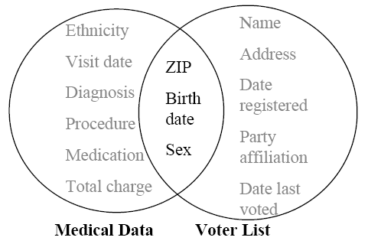
Real Threats of Linking Attacks
Fact: 87% of the US citizens can be uniquely linked using only three attributes <Zipcode, DOB, Sex>
Sweeney [Sweeney, 2002] managed to re-identify the medical record of the government of Massachusetts.
Census data (income), medical data, transaction data, tax data, etc.
Notes:
(1) The simple approach of removing identifiers, (2) the linking attack, (3) the example.

Slide 8
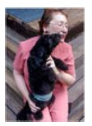
AOL Data Release [NYTimes 2006]
In August 2006, AOL Released search keywords of 650,000 users over a 3-month period.
  User IDs are replaced by random numbers.
  3 days later, pulled the data from public access.
AOL searcher # 4417749
  Thelman Arnold, a 62 year old widow who lives in Liburn GA, has three dogs, frequently searches her friends’ medical ailments.
  “landscapers in Lilburn, GA”
  queries on last name “Arnold”
  “homes sold in shadow lake subdivision Gwinnett County, GA”
  “num fingers”
  “60 single men”
  “dog that urinates on everything”
NYT
Re-identification occurs!

Slide 9
Netflix Movie Rating Data [Narayanan and Shmatikov 2009]
Netflix released anonymized movie rating data for its Netflix challenge
  With date and value of movie ratings
Knowing 6-8 approximate movie ratings and dates is able to uniquely identify a record with over 90% probability
  Correlating with a set of 50 users from imdb.com yields two records
Netflix cancels second phase of the challenge

Slide 10
Genome-Wide Association Study (GWAS) [Homer et al. 2008]
A typical study examines thousands of singe-nucleotide polymorphism locations (SNPs) in a given population of patients for statistical links to a disease.
From aggregated statistics, one individual’s genome, and knowledge of SNP frequency in background population, one can infer participation in the study.
  The frequency of every SNP gives a very noisy signal of participation; combining thousands of such signals give high-confidence prediction

Slide 11
GWAS Privacy Issue
Published Data
Adv. Info & Inference
 | Disease Group Avg | Control Group Avg
SNP1=A | 43% | …
SNP2=A | 11% | …
SNP3=A | 58% | …
SNP4=A | 23% | …
…
Population Avg | Target individual Info | Target in Disease Group
42% | yes | +
10% | no | -
59% | no | +
24% | yes | -
Membership disclosure occurs!

Slide 12
Main Challenges
How to define privacy for sharing data?
How to publish/anonymize data to satisfy privacy while providing utility?

Slide 13
Attempts at Defining Privacy
Preventing the following disclosures
  Identification disclosure
  Attribute disclosure
  Membership disclosure
Simulating an ideal world

Slide 14
k-Anonymity [Sweeney, Samarati ]
The Microdata
A 3-Anonymous Table
QID |  |  | SA
Zipcode | Age | Gen | Disease
47677 | 29 | F | Ovarian Cancer
47602 | 22 | F | Ovarian Cancer
47678 | 27 | M | Prostate Cancer
47905 | 43 | M | Flu
47909 | 52 | F | Heart Disease
47906 | 47 | M | Heart Disease
QID |  |  | SA
Zipcode | Age | Gen | Disease
476** 476** 476** | 2* 2* 2* | * * * | Ovarian Cancer Ovarian Cancer Prostate Cancer
4790* 4790* 4790* | [43,52] [43,52] [43,52] | * * * | Flu Heart Disease Heart Disease
k-Anonymity
  Attributes are separated into Quasi-identifiers (QIDs) and Sensitive Attributes (SAs)
  Each record is indistinguishable from ≥ k-1 other records when only “quasi-identifiers” are considered
  These k records form an equivalence class
Notes:
(1) the goal of data anonymization, (2) the generalization approach.

Slide 15
k-Anonymity & Generalization
k-Anonymity
  Each record is indistinguishable from at least k-1 other records
  These k records form an equivalent class
  k-Anonymity ensures that linking cannot be performed with confidence > 1/k.
Generalization
  Replace with less-specific but semantically-consistent values
476**
2*
*
47677
47602
47678
29
22
27
Male
Female
Zipcode
Age
Sex
Notes:
(1) the goal of data anonymization, (2) the generalization approach.

Slide 16
Data Publishing Methods
Generalization
  Make data less precise
Suppression
  Remove certain data
Segmentation
  Divide data up before publishing
Perturbation
  Add noise/errors
Data synthesis
  Synthesize similar data
???

Slide 17
Attacks on k-Anonymity
k-anonymity does not prevent attribute disclosure if:
  Sensitive values lack diversity
  The attacker has background knowledge
Homogeneity Attack
A 3-anonymous patient table
Bob
Zipcode | Age
47678 | 27
Zipcode | Age | Disease
476** 476** 476** | 2* 2* 2* | Heart Disease Heart Disease Heart Disease
4790* 4790* 4790* | ≥40 ≥40 ≥40 | Flu Heart Disease Cancer
476** 476** 476** | 3* 3* 3* | Heart Disease Cancer Cancer
Background Knowledge Attack
Carl does not have heart disease
Carl
Zipcode | Age
47673 | 36

Slide 18

l-Diversity [Machanavajjhala et al. 2006]
The l -diversity principle
  Each equivalent class contains at least l well-represented sensitive values
Instantiation
  Distinct l-diversity
    Each equi-class contains l distinct sensitive values
  Entropy l-diversity
    entropy(equi-class)≥log2(l)

Slide 19
Limitations of l-Diversity
l-diversity may be difficult and unnecessary to achieve.
  Consider a single sensitive attribute
  Two values: HIV positive (1%) and HIV negative (99%)
  Very different degrees of sensitivity
  One would not mind being known to be tested negative but one would not want to be known/considered to be tested positive.
l-diversity is unnecessary to achieve
  2-diversity is unnecessary for an equi-class that contains only negative records.
l-diversity is difficult to achieve
  Suppose there are 10000 records in total.
  To have distinct 2-diversity, there can be at most 10000*1%=100 equi-classes.

Slide 20
The Skewness Attack: An Example
Two values for the sensitive attribute
  HIV positive (1%) and HIV negative (99%)
Highest diversity still has serious privacy risk
  Consider an equi-class that contains an equal number of positive records and negative records.
Using diversity and entropy does not differentiate:
  Equi-class 1: 49 positive + 1 negative
  Equi-class 2: 1 positive + 49 negative
The overall distribution of sensitive values matters.

Slide 21
The Similarity Attack: An Example
A 3-diverse patient table
Zipcode | Age | Salary | Disease
476** 476** 476** | 2* 2* 2* | 20K 30K 40K | Gastric Ulcer Gastritis Stomach Cancer
4790* 4790* 4790* | ≥40 ≥40 ≥40 | 50K 100K 70K | Gastritis Flu Bronchitis
476** 476** 476** | 3* 3* 3* | 60K 80K 90K | Bronchitis Pneumonia Stomach Cancer
Bob
Zip | Age
47678 | 27
Conclusion
Bob’s salary is in [20k,40k], which is relative low.
Bob has some stomach-related disease.
The semantic meanings of attribute values matters.

Slide 22
How to Prevent These Attacks?
Goal is to quantify/limit amount of information leakage through data publication.
Looking only at the final output is inherently problematic because it cannot measure information gain.

Slide 23
Our Main Insight
Revealing the overall distribution of the sensitive attribute in the whole dataset should be considered to have no privacy leakage (is an ideal world for privacy)
  In other words, we assume that removing all quasi-identifier attributes preserves privacy
  Seems unavoidable unless willing to destroy utility
  Also seems desirable from utility perspective
Goal is to simulate this ideal world.

Slide 24
t-Closeness [Li et al. 2007]
Rationale

Belief | Knowledge
B₀ | External Knowledge

Slide 25
t-Closeness [Li et al. 2007]
Rationale
A completely generalized table

Age | Zipcode | …… | Gender | Disease
2* | 479** | …… | Male | Flu
2* | 479** | …… | Male | Heart Disease
2* | 479** | …… | Male | Cancer
. . . | . . . | …… …… …… | . . . | . . .
≥50 | 4766* | …… | * | Gastritis
Belief | Knowledge
B₀ | External Knowledge

Slide 26
t-Closeness [Li et al. 2007]
Rationale

Belief | Knowledge
B₀ | External Knowledge
B₁ | Overall distribution Q of sensitive values

Slide 27
t-Closeness [Li et al. 2007]
Rationale
A released table

Age | Zipcode | …… | Gender | Disease
* | * | …… | * | Flu
* | * | …… | * | Heart Disease
* | * | …… | * | Cancer
. . . | . . . | …… …… …… | . . . | . . .
* | * | …… | * | Gastritis
Belief | Knowledge
B₀ | External Knowledge
B₁ | Overall distribution Q of sensitive values

Slide 28
t-Closeness [Li et al. 2007]
Rationale

Belief | Knowledge
B₀ | External Knowledge
B₁ | Overall distribution Q of sensitive values
B₂ | Distribution P_{i} of sensitive values in each equi-class

Slide 29
t-Closeness [Li et al. 2007]
Rationale

Q should be public information
  The distribution Q is always available to the attacker as long as one wants to release the data at all.
We separate knowledge gain into two parts:
  About the whole population (from B₀ to B₁)
  About specific individuals (from B₁ to B₂)
We bound knowledge gain between B₁ and B₂ instead
Principle
  The distance between Q and P_{i} should be bounded by a threshold t.
Belief | Knowledge
B₀ | External Knowledge
B₁ | Overall distribution Q of sensitive values
B₂ | Distribution P_{i} of sensitive values in each equi-class

Slide 30
t-Closeness
Principle: Distribution of sensitive attribute value in each equi-class should be close to that of the overall dataset (distance ≤ t)
How to measure distance between two distributions so that semantic relationship among sensitive attribute values is captured.
  Assume distribution of income is (10K, 20K, 30K, …, 90K); intuitively (20K,50K,80K) is closer to it than (10K,20K,30K).

Slide 31
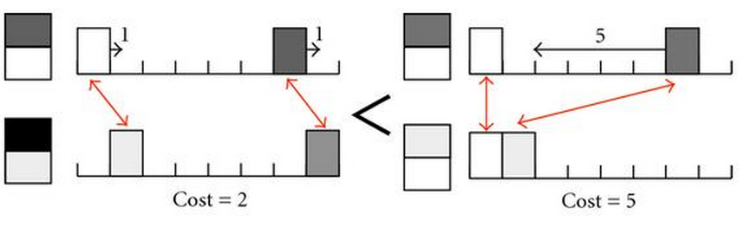

The Earth Mover Distance
We use Earth Mover Distance.
Distance between (10K, 20K, 30K, …, 90K) and (20K,50K,80K) is $0.1×\frac{1}{9}×6=\frac{2}{30}≈0.0067$
Distance between (10K, 20K, 30K, …, 90K) and (10K,20K,30K) is $\frac{1}{9}×(0.3+0.4+0.4+0.5+0.5+0.6)=0.3$

Slide 32
Limitations of t-Closeness
Utility may suffer too much, since interesting and significant deviation from global distribution cannot be learned.
(n,t)-closeness: Distribution of sensitive attribute value in each equi-class should be close to that of some natural super-group consisting at least n tuples
  Okay to learn information about a large group.

Slide 33
(n,t)-Closeness
One may argue that requiring t-closeness may destroy data utility
The notion of (n,t)-closeness requires distribution close to a large-enough natural group of size at least n
Intuition:
  It is okay to learn information about the a big group
  It is not okay to learn information about one individual

Slide 34
Other Limitations
Requires the distinction between Quasi-identifiers and sensitive attributes
The t-closeness notion is a property of input dataset and output dataset, not that of the algorithm; thus additional information leakage is possible when the algorithm is known

Slide 35
Limitation of These Privacy Notions
Limitation of previous privacy notions:
  Requires identifying which attributes are quasi-identifier or sensitive, not always possible
  Difficult to pin down adversary’s background knowledge
    There are many adversaries when publishing data
  Syntactic in nature (property of anonymized dataset)

Slide 36
Privacy Notions: Syntactic versus Algorithmic
Syntactic: Privacy is a property of only the final output
Algorithmic: Privacy is a property of the algorithm
Syntactic notions are typically justified by considering a particular inferencing strategy; however, adversaries may consider other sources of information
  E.g., Minimality Attack

Slide 37
Illustrating the Syntactic Nature of k-Anonymity
Method 1 for achieving k anonymity: Duplicating each record k times
Method 2: clusters records into groups of at least k, use one record from each group to replace all other records in the group
  Privacy of some individuals are violated
Method 3: cluster records into groups, then use generalized values to replace the specific values (e.g., consider a 2-D space)
  Record with extraordinary values are revealed/re-identified

Slide 38
Reconstruction Attacks
Readings
  Garfinkel, Abowd, Martindale, Understanding Database Reconstruction Attacks on Public Data, ACM Queue 2018.
  Section 8.1 of Dwork and Roth: The Algorithmic Foundations of Differential Privacy.
    Optional: Dinur and Nissim, Revealing Information while Preserving Privacy, Proceedings of ACM Symposium on Principles Of Database Systems 2003.
  Cohen and Nissim, Linear Program Reconstruction in Practice, Journal of Privacy and Confidentiality, 2020.

Slide 39
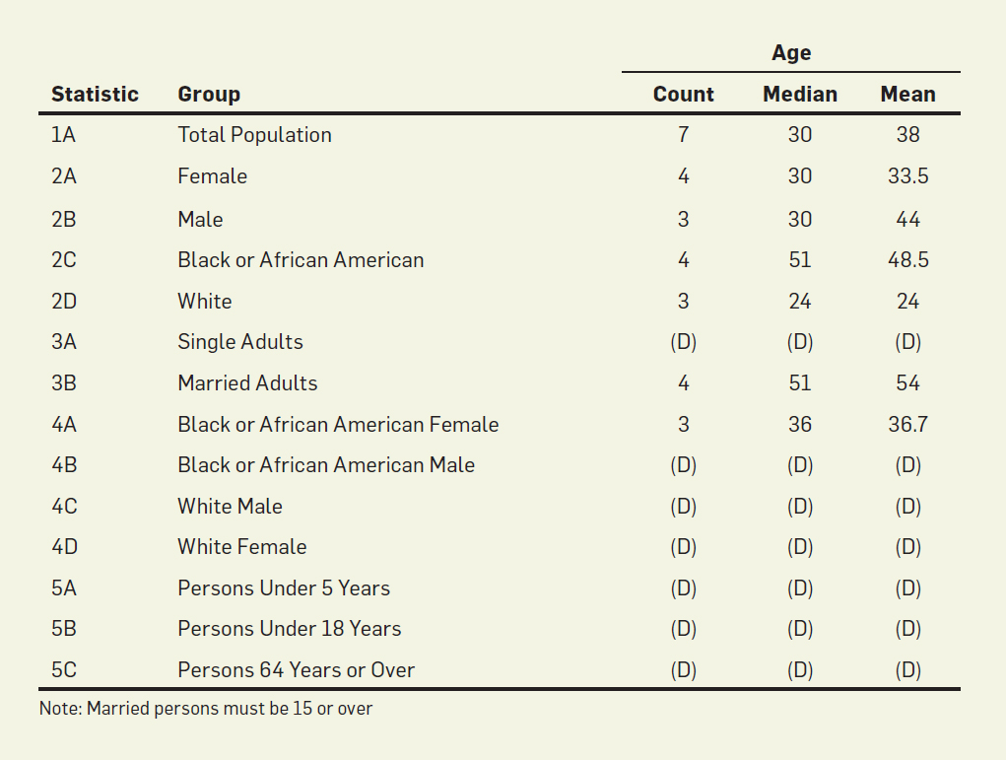
Fictional Statistical Queries with Answers for illustrating reconstruction attacks.
When count<3, results are suppressed.
What can be inferred?

Slide 40
Data Reconstruction Attacks using SAT Solver
Seven records, assign variables to possible values
The statistics provides constraints
Manual inference is possible
For automated attack, can be reconstructed using SAT solvers

Slide 41
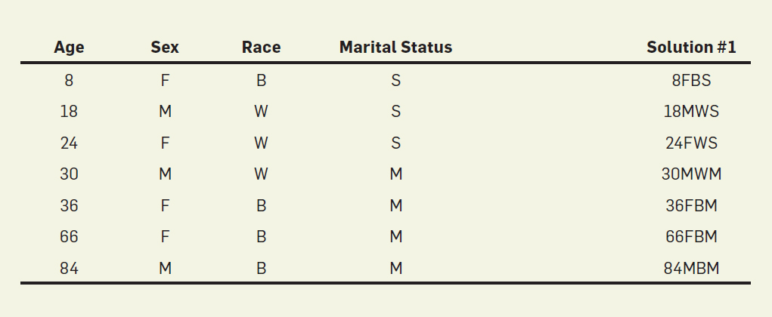

Slide 42
The Dinur – Nissim Paper
Study the privacy impact of answering statistical queries.
Setting:
  Each record has some attributes so that they can be selected in queries.
    For simplicity, assume that each record has a unique name/id.
  Each record has one sensitive bit.
  A query asks for the sum of sensitive bit in some subset.

Slide 43
Definition 8.1. A mechanism is blatantly non-private if an adversary can construct a candidate database c that agrees with the real database d in all but o(n) entries, i.e., ||c − d||₀ ∈ o(n).

Slide 44
Theorem 8.1. [Inefficient Reconstruction Attacks]: Let M be a mechanism with distortion of magnitude bounded by E. Then there exists an adversary that can reconstruct the database to within 4E positions.
  Query every subset, output a dataset that is consistent with all queries.
Efficient Linear Reconstruction Attacks.
  Issue random subset queries, then use linear programs to find a solution.

