Slide 1
Data Security and Privacy
Week 1 Introduction to the Course and Overview of Access Control
Prof. Ninghui Li (Purdue University)

Slide 2
Topics in the Course
Access control (AC)
  Operating system AC, mandatory AC, discretionary AC, role based AC, attribute-based AC, non-interference properties, integrity protection, AC in databases
Data privacy
  Privacy policies, data anonymization (k anonymity, t closeness, l diversity), differential privacy: concepts and algorithms, differential privacy in the local setting, membership privacy, differential privacy and machine learning
Using crypto for data protection
  secure multiparty computation, implementing crypto correctly, homomorphic encryption

Slide 3
Relationship to Other Courses
Require basic knowledge from
  526 Information Security
  555 Cryptography
Little overlap with
  527 Software Security
  528 Network Security
  523 Social Econ Legal Asp Of Sec
  529 Security Analytics

Slide 4
Time and location: TTh 10:30-11:45pm, LWSN B134
Instructor: Ninghui Li <ninghui@purdue.edu>,
  LWSN 2142K, office hours: after lecture and by appointment
We will use piazza
Teaching assistants: Zitao Li <li2490@purdue.edu>
  Office hours, Monday 1:30-2:30pm + Tuesday 4-5pm
  https://purdue-edu.zoom.us/j/99058485354?pwd=MDVYdDFDN1lwVnd3a2lDZUhodm9aZz09

Slide 5
Readings
No required text, readings will be announced/distributed on course webpage.

Slide 6
Grading
Homeworks (50% of grade)
  About 6 assignments, which will be either written assignments, or small projects that require programming
  Late policy: Three extension days to be used at your discretion
    Must be stated explicitly in header of work being turned in
    No fractional days
    May not be used to extend submission past last day of class.
Exams
  4 (in-class) quizs during the semester. (8% of grade)
  Mid-term exam. (18% of grade) Final exam. (24% of grade)

Slide 7
Policies for Homework Cheating
It is allowed/encouraged to discuss homework problems
However, if you looks at another student’s program code, or (written or typed) answers , or let another student look at your program code or answers, that is considered cheating.
If caught for the first time, receive 0 in the assignment. For the second time, receive a failing grade in class.

Slide 8
What is Information (Computer) Security?
Security = Sustain desirable properties under intelligent adversaries
Making the above statement precise requires clearly defining the following two
What are the desirable properties?
What the intelligent adversaries can do?
  Needs to understand/model adversaries
  Always think about adversaries.
Notes:
Differs from fault tolerance in that faults are random, and attacks are intelligently carried out.

Slide 9
Security Goals/Properties (C, I, A)
Confidentiality (secrecy, privacy)
  only those who are authorized to know can know
Integrity (also authenticity in communication)
  only modified by authorized parties and in permitted ways
  do things that are expected
Availability
  those authorized to access can get access

Slide 10
What is (Personal) Privacy?
Sometimes people use privacy to refer to confidentiality.
Personal privacy is complicated! It is primarily a social and legal concept.
Some concepts from the book “Understanding Privacy” by Daniel J. Solove:
  the right to be let alone
  limited access to the self
  secrecy—the concealment of certain matters from others;
  control over others' use of information about oneself
  personhood—the protection of one’s personality, individuality, and dignity;
  intimacy—control over, or limited access to, one’s intimate relationships or aspects of life.
Notes:
Whether it is to ensure compliance with privacy legislation, protect its reputation or increase consumer trust, organizations have an obligation to safeguard all personal information under their care and control.
Privacy is about individual information
Privacy is a social contract.
Privacy differs from confidentiality.

Slide 11
Security is Secondary
What protection/security mechanisms one has in the physical world?
Why the need for security mechanisms arises?
Security is secondary to the interactions that make security necessary.
Robert H. Morris: The three golden rules to ensure computer security are: (1) do not own a computer; (2) do not power it on; and (3) do not use it.
Notes:
What makes you feel secure in physical world?
Buildings. Cars. Law enforcement. Airport security. Border security. Etc.
Some of these do not exist in the past. Consider a village 6000 years ago. What make those people secure? Limited interaction.
Robert H. Morris: father of the creator of the Morris Worm. Was a researcher at Bell Labs from 1960 until 1986. Then working at the (NSA). Served as chief scientist of the NSA's National Computer Security Center, where he was involved in the production of the Rainbow Series of computer security standards, and retired from the NSA in 1994.

Slide 12
Information Security is Interesting
The most interesting/challenging threats to security are posed by human adversaries
  Security is harder than reliability
Information security is a self-sustaining field
  Can work both from attack perspective and from defense perspective
Security is about benefit/cost tradeoff
  Although often the tradeoff analysis is not explicit
Security is not all technological
  Humans are often the weakest link

Slide 13
Information Security is Challenging
Defense is almost always harder than attack.
In which ways information security is more difficult than physical security?
  adversaries can come from anywhere
  computers enable large-scale automation
  adversaries can be difficult to identify
  adversaries can be difficult to punish
  potential payoff can be much higher
In which ways information security is easier than physical security?
Notes:
Which ways information security is easier than physical security?
More well-defined entry points.
Lower cost of deploying high-quality security mechanisms.
E.g., cryptography

Slide 14
Access Control

Slide 15
What is Access Control?
Quote from Security Engineering by Ross Anderson
  “Its function is to control which principals (persons, processes, machines, …) have access to which resources in the system --- which files they can read, which programs they can execute, and how they share data with other principals, and so on.”
  Access control is the traditional center of gravity of computer security. It is where security engineering meets computer science.

Slide 16
Access Control is Pervasive
Application
  business applications
Middleware
  DBMS
Operating System
  controlling access to files, ports
Hardware
  memory protection, privilege levels

Slide 17
Access Control is Interesting
Has (relatively) well-developed theories
  40+ years history
  some (quite involved) theory (apparently) not useful for other fields
Many interesting and deep results
Many misconceptions and debates

Slide 18
A BRIEF History of Access Control Research

Slide 19
Earlier Years: Time-Sharing Operating Systems
Reference monitors (1972)
Access matrix (1971)
Discretionary access control
  trojan horse can leak information

Slide 20
Confidentiality
Bell-LaPadula Model
Noninterference (1982)
Nondeducibility (1986)
Covert channel
Proving information flow properties of systems and programs

Slide 21
Integrity
Biba model
Clark-Wilson
Chinese Wall

Slide 22
Database Access Control
System R approach: grant/revoke, view
Ingres approach (query rewriting)
Multilevel databases
Object/relational databases
Real systems
SQL grant/revoke, view, stored procedures, fine-grained access control

Slide 23
Role-Based Access Control
First in database context
Then a generic access control approach
Constraints
Administration
Extensions

Slide 24
Operating System Security

Slide 25
What Security Goals Does Operating System Provide (Past)?
Originally: time-sharing computers: enabling multiple users to securely share a computer
  Separation and sharing of processes, memory, files, devices, etc.
What is the threat model?
  Users may be malicious, users have terminal access to computers, software may be malicious/buggy, and so on
What security mechanisms are used?
  Memory protection
  Processor modes
  User authentication
  File access control
  Logging & Auditing
Notes:
Threat model: users may be malicious, users have terminal access to computers, software may be malicious/buggy.

Slide 26
What Security Goals Does Operating System Provide (Recent Past and Current)?
More recent past and present: Networked computers: ensure secure operation in networked environment
New threat?
  Attackers coming from the network. Network-facing programs on computers may be buggy. Users may be hurt via online communication.
Additional security mechanisms
  Secure Communication (using cryptography)
  Remote authentication
  Intrusion Prevention and Detection
  Recovery
Notes:
Threat model: adversaries control the network; can communicate with computers;
Security Goal: Confidentiality, Integrity, Availability

Slide 27
What Security Goals Does Operating System Provide (Current and Near Future)?
Present and near future: mobile computing devices and cloud platforms
New threat?
  Apps (programs) may be malicious or questionable.
  More tightly connected with personal life of the owner.
Security mechanisms for mobile devices?
  Isolation of each app.
  Security scanning of apps in appstores.
  Help users assess risks of apps.
  Risk communication.

Slide 28
Operating System Security Mechanism

Slide 29
Memory Protection: Access Control to Memory
Ensures that one user’s process cannot access other’s memory
  Implemented using paging in modern operating systems
Operating system and user processes need to have different privileges
  This is achieved using hardware support such as CPU modes
Notes:
Kernel needs to maintain separation among user processes.
OS kernel needs to access all memory, and user processes cannot
Kernel needs to have more power than user processes.
Earliest PC are not like this. In MS DOS, all processes have the same power.

Slide 30
CPU Modes (a.k.a. processor modes or privilege modes)
System mode (privileged mode, master mode, supervisor mode, kernel mode)
  Can execute any instruction
  Can access any memory locations, e.g., accessing hardware devices,
  Can enable and disable interrupts,
  Can change privileged processor state,
  Can access memory management units,
  Can modify registers for various descriptor tables .
Reading: http://en.wikipedia.org/wiki/CPU_modes
Notes:
The separation from different modes are like walls, protecting the kernel from the other processes.

Slide 31
User Mode
User mode
  Access to memory is limited,
  Cannot execute some instructions
  Cannot disable interrupts,
  Cannot change arbitrary processor state,
  Cannot access memory management units
Transition from user mode to system mode can only happen via well defined entry points, i.e., through system calls
Notes:
A wall separates the user mode with the system mode.
The wall need gates; and system call are the gates.

Slide 32
System Calls (Guarded Gates)
Guarded gates from user mode (space, land) into kernel mode (space, land)
  use a special CPU instruction (often an interruption), transfers control to predefined entry point in more privileged code; allows the more privileged code to specify where it will be entered as well as important processor state at the time of entry.
  the higher privileged code, by examining processor state set by the less privileged code and/or its stack, determines what is being requested and whether to allow it.

Slide 33
Kernel space vs User space
Part of the OS runs in the kernel model
  known as the OS kernel
Other parts of the OS run in the user mode, including service programs (daemon programs), user applications, etc.
  they run as processes
  they form the user space (or the user land)
When they need privileged access that only kernel can provide, they issue system calls.
Notes:
Analogy. Bank.

Slide 34
Privilege Levels
Security is often achieved by running control/protection code at a higher privilege level
Components running at the same level can be isolated by a higher-privilege component
If attack and defense are at the same level, then it is an arms’ race and there can be no guarantee

Slide 35
Basic Concepts in Access Control

Slide 36
Readings for This Lecture
Wikipedia
  Filesystem Permissions
Other readings
Unix file permissions
  http://www.unix.com/tips-tutorials/19060-unix-file-permissions.html

Slide 37
Access Control as a General Security Mechanism
Access Control is a Protection Wall with a Guarded Gate.
  Build a wall to prevent access.
  Then design a guarded gate to decide what access should be allowed.

Slide 38
Access Control
A reference monitor mediates all access to resources
Complete mediation principle: control all accesses to resources
Reference
monitor
?
Resource
Subjects
access request
Policy?
Notes:
System call gates actually performs access control.

Slide 39
Access Matrix Model for Policies
Objects (and Subjects)
 |  | P |  | G
U |  | r w own |  | r
V |  |  |  | r w own
Subjects
rights

Slide 40
ACCESS MATRIX MODEL
Basic Abstractions
  Subjects
    active entities that request accesses
  Objects
    entities on which accesses can be performed
  Rights
The rights in a cell specify the access of the subject (row) to the object (column)

Slide 41
Different Levels of Abstractions for Subjects
Human Users
  High-level policy objectives are usually regarding human users
Principals: User Accounts in Unix
  Policy grants access rights to principals
Subjects: Processes in Unix
  Processes run on behalf of principals
  Processes initiate access requests

Slide 42
USERS AND PRINCIPALS
USERS
PRINCIPALS
Unit of Access Control
and Authorization
Real World User
The system authenticates the human user to a particular principal

Slide 43
USERS AND PRINCIPALS
There should be a one-to-many mapping from users to principals
  a user may have many principals, but
  each principal is associated with an unique user
This help ensures accountability
  A system can identify which principals performed an action, and needs to uniquely identify the human for accountability
What does the above imply in practice?

Slide 44
Basic Concepts of UNIX Access Control: Users, Groups, Files, Processes
Each user account has a unique UID
  The UID 0 means the super user (system admin)
A user account belongs to multiple groups
  This is needed to make policy specification more succinct
Subjects are processes
  A sophisticated mechanism is used to determine which principal a subject/process is acting on behalf of
Most objects are modeled as files

Slide 45
Objects in UNIX

Slide 46
OBJECTS
An object is anything on which a subject can perform operations (mediated by rights)
Usually objects are passive, for example:
  File
  Directory (or Folder)
  Memory segment
But, subjects (i.e. processes) can also be objects, with operations performed on them
  kill, suspend, resume, send interprocess communication, etc.

Slide 47
Organization of Objects
In UNIX, almost all objects are modeled as files
  Files are arranged in a hierarchy
  Files exist in directories
  Directories are also one kind of files
Each object has
  owner
  group
  12 permission bits
    rwx for owner, rwx for group, and rwx for others
    suid, sgid, sticky

Slide 48
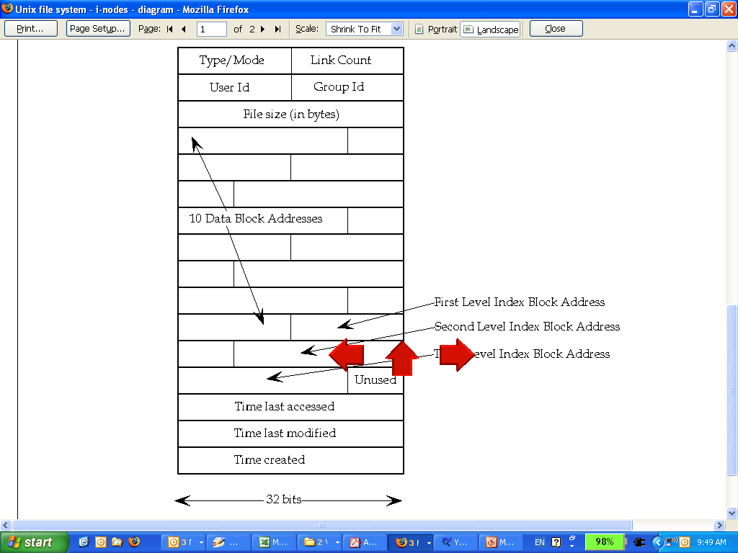
UNIX inodes
UNIX inodes:
Each file corresponds to an inode

Slide 49
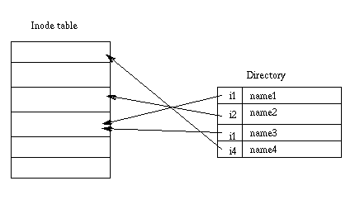
UNIX Directories
A directory stores a mapping from names to inode numbers.

Slide 50
Basic Permissions Bits on Files (Non-directories)
Read controls reading the content of a file
  i.e., the read system call
Write controls changing the content of a file
  i.e., the write system call
Execute controls loading the file in memory and execute
  i.e., the execve system call

Slide 51
Permission Bits on Directories
Read bit allows one to show all file names in a directory
The execution bit controls traversing a directory
  does a lookup, allows one to find inode # from file name
  chdir to a directory requires execution bit
Write + execution control creating/deleting files in the directory
  Deleting a file under a directory requires no permission on the file
Accessing a file identified by a path name requires execution to all directories along the path

Slide 52
Some Examples
What permissions are needed to access a file/directory?
  read a file: /d1/d2/f3
  write a file: /d1/d2/f3
  delete a file: /d1/d2/f3
  rename a file: from /d1/d2/f3 to /d1/d2/f4
  …
File/Directory Access Control is by System Calls
e.g., open(2), stat(2), read(2), write(2), chmod(2), opendir(2), readdir(2), readlink(2), chdir(2), …

Slide 53
The Three Sets of Permission Bits
Intuition:
  if the user is the owner of a file, then the r/w/x bits for owner apply
  otherwise, if the user belongs to the group the file belongs to, then the r/w/x bits for group apply
  otherwise, the r/w/x bits for others apply
What are the other 3 bits? What do they control?
Notes:
Can one implement negative authorization, i.e., only members of a particular group are not allowed to access a file?

Slide 54
The suid, sgid, sticky bits
 | suid | sgid | sticky bit
non-executable files | no effect | affect locking (unimportant for us) | not used anymore
executable files | change euid when executing the file | change egid when executing the file | not used anymore
Directories | no effect | new files inherit group of the directory | only the owner of a file can delete

Slide 55
Other Issues On Objects in UNIX
Accesses other than read/write/execute
  Who can change the permission bits?
    The owner can
  Who can change the owner?
    Only the superuser
Rights not related to a file
  Affecting another process
  Operations such as shutting down the system, mounting a new file system, listening on a low port
    traditionally reserved for the root user

Slide 56
from Subjects to Principals

Slide 57
Subjects vs. Principals
Access rights are specified for user accounts (principals).
Accesses are performed by processes (subjects)
The OS needs to know on which user accounts’ behalf a process is executing
How is this done in Unix?

Slide 58
UNIX Access Control Overview
Three concepts Our terminology
  Human Users Humans
  User Accounts Users/accounts/principals
  Process Processes/subjects
UNIX Access Control System has
  A discretionary policy specification
    determines which user accounts have access to which objects
  A policy enforcement component
    determines on which user’s behalf a subject (process) is acting upon

Slide 59
Process User ID Model in Modern UNIX Systems
Each process has three user IDs
  real user ID (ruid) owner of the process
  effective user ID (euid) used in most access control decisions
  saved user ID (suid)
and three group IDs
  real group ID
  effective group ID
  saved group ID

Slide 60
Process User ID Model in Modern UNIX Systems
When a process is created by fork
  it inherits all three users IDs from its parent process
When a process executes a file by exec
  it keeps its three user IDs unless the set-user-ID bit of the file is set, in which case the effective uid and saved uid are assigned the user ID of the owner of the file
In addition, a process may change the user ids via system calls

Slide 61
The Need for suid/sgid Bits
Some operations are not modeled as files and require user id = 0
  halting the system
  bind/listen on “privileged ports” (TCP/UDP ports below 1024)
  non-root users need these privileges
File level access control is not fine-grained enough
System integrity requires more than controlling who can write, but also how it is written

Slide 62
Security Problems of Programs with suid/sgid
These programs are typically setuid root
Violates the least privilege principle
  every program and every user should operate using the least privilege necessary to complete the job
Why violating least privilege is bad?
How would an attacker exploit this problem?
How to solve this problem?

Slide 63
Changing effective user IDs
  A process that executes a set-uid program can drop its privilege; it can
  drop privilege permanently
    removes the privileged user id from all three user IDs
  drop privilege temporarily
    removes the privileged user ID from its effective uid but stores it in its saved uid, later the process may restore privilege by restoring privileged user ID in its effective uid

Slide 64
What Happens during Logging in
login
pid | 2235
euid | 0
ruid | 0
suid | 0
login
Pid | 2235
euid | 500
ruid | 500
suid | 500
bash
pid | 2235
euid | 500
ruid | 500
suid | 500
setuid(500)
exec(“bash”)
fork()
After the login process verifies that the entered password is correct, it issues a setuid system call.
The login process then loads the shell, giving the user a login shell.
The user types in the passwd command to change his password.

Slide 65
What Happens during Logging in (2)
bash
pid | 2235
euid | 500
ruid | 500
suid | 500
password
pid | 2297
euid | 500
ruid | 500
suid | 500
Drop privilege permanently
bash
pid | 2297
euid | 500
ruid | 500
suid | 500
password
pid | 2297
euid | 0
ruid | 500
suid | 0
exec(“passwd”)
password
pid | 2297
euid | 500
ruid | 500
suid | 0
The fork call creates a new process, which loads “passwd”, which is owned by root user, and has setuid bit set.
Drop privilege temporarily

Slide 66
Issues to Consider in Designing an Access Control System
What are the objects? How are they organized?
What are the subjects? What are the principals?
How to relate subjects to principals?
Whether/how to map human users to principals?
What kinds of operations subjects can perform on objects?
Where to store the access control policy data?
How can access control policy data be updated? How to control the update operation?
How to intercept access to perform the check? Are all access path covered?
What are the limitations of the protection, i.e., what does it take to break the protection? How to deal with such residue threats?

Slide 67
Learning Outcomes
Describe the evolving threats for operating systems, and summarize the main security mechanisms
Explain the needs for protection modes and system calls for security
Explain the differences and relationships between users, security principals, and subjects in the context of Unix
Describe how file system access control work in Unix/Linux
Explain the mechanism in Unix/Linux to associate security principals with subjects
Explain potential security problems caused by setuid programs
Notes:
Earliest examples of digital data security

Slide 68
Coming Attractions …
How to deal with the threat of malicious and/or buggy software to enforcing access control policies?

