Slide 1
Differential Privacy in the Local Setting
Ninghui Li (Purdue University)
Joint work with Tianhao Wang, Somesh Jha, Jeremiah Blocki

Slide 2
Differential Privacy
Data mining
Statistical queries
Database
+Noise
Differential Privacy Interpretation:
The decision to include/exclude an individual’s record has limited ($ε$) influence on the outcome.
Smaller $ε$➔ Stronger Privacy
Classical/
centralized
setting
Data
Data
Data
Data
Data
Notes:
Reveal original data, either purposefully (e.g., to insider) or by outsider attacks
The epsilon value? Is the implementation correct?
This motivates us to go to the local setting.

Slide 3
Differential Privacy
Data mining
Statistical queries
Database
+Noise
Trusted
Trust boundary
Data
Data
Data
Data
Data
Notes:
Reveal original data, either purposefully (e.g., to insider) or by outsider attacks
The epsilon value? Is the implementation correct?
This motivates us to go to the local setting.

Slide 4
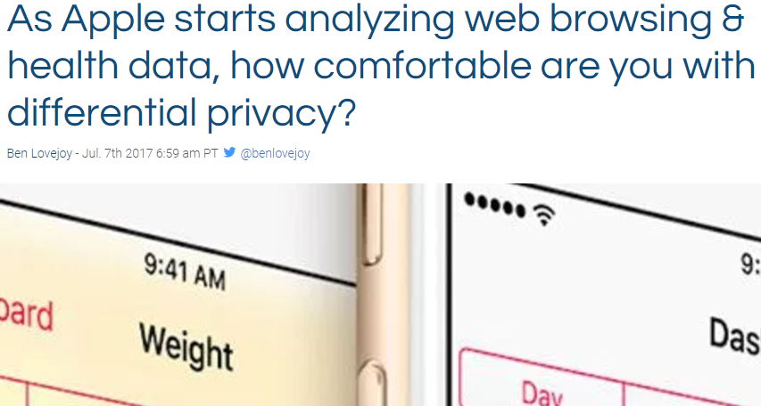
Local Differential Privacy
Data mining
Statistical queries
Database
No worry about untrusted server
Data+Noise
Data+Noise
Data+Noise
Trust boundary
Notes:
Hopefully with this, people are more willing to share their data

Slide 5
Outline
Motivation (just covered)
Histogram Estimation
Frequent Itemset Mining
Other problems

Slide 6
Outline
Motivation
Histogram Estimation
Frequent Itemset Mining
Other problems

Slide 7
Abstract LDP Protocol for Frequency Estimation
$x≔E(v)$
takes input value $v$ from domain $D$ and outputs an encoded value $x$
$y≔P(x)$
takes an encoded value $x$and outputs $y$.
$c≔Est(\left\{y\right\})$
takes reports $\{y\}$ from all users and outputs estimations $c(v)$ for any value $v$ in domain $D$
$$y$$
$P$satisfies $ε$-LDP
Frequency estimation
Notes:
Here encode is mainly used for presenting the paper

Slide 8
The Warner Model (1965)
Survey technique for private questions
Survey people:
“Are you communist party?”
Each person:
Flip a secret coin
Answer truth if head (w/p $0.5$)
Answer randomly if tail
E.g., a communist will answer “yes” w/p 75%, and “no” w/p 25%
To get unbiased estimation of the distribution:
If $n_{v}$ out of $n$people are communist, we expect to see
$E[ {I_{v}]=0.75n}_{v}+0.25(n−n_{v})$ “yes” answers
${c(n}_{v})=\frac{I_{v}−0.25n}{0.5}$ is the unbiased estimation of number of communists
Since $E[{c(n}_{v})]=\frac{{E[I}_{v}]−0.25n}{0.5}=n_{v}$
We say a protocol satisfies $ε$-LDP iff
for any $v$ and $v′$ from “yes” and “no”,
$$\frac{\operatorname{Pr}\left[P\left(v\right)=v\right]}{\operatorname{Pr}\left[P\left(v′\right)=v\right]}≤e^{ε}$$
Provide deniability:
Seeing answer, not certain about the secret.
This only handles binary attribute.
We want to handle the more general setting.
Notes:
The definition of LDP is not new.
Comes from …

Slide 9
Frequency Estimation Protocols
Randomised response: a survey technique for eliminating evasive answer bias
S.L. Warner, Journal of Ame. Stat. Ass. 1965
Direct Encoding (Generalized Random Response)
RAPPOR: Randomized Aggregatable Privacy-Preserving Ordinal Response.
Ú. Erlingsson, V. Pihur, A. Korolova, CCS 2014
Unary Encoding, Encode into a bit-vector
Local, Private, Efficient Protocols for Succinct Histograms
R. Bassily, A. Smith. STOC 2015.
Binary Local Hash: Encode by hashing and then perturb
Locally Differentially Private Protocols for Frequency Estimation
T. Wang, J. Blocki, N. Li, S. Jha: USENIX Security 2017
Notes:
Here we only analyze the simplest version of rappor
We compare general in empirical results
Frequency estimation -> output histogram

Slide 10
Direct Encoding (Random Response)
User:
Encode $x=v$ (suppose $v$ from $D=\{1,2,…,d\}$)
Toss a coin with bias $p$
If it is head, report the true value $y=x$
Otherwise, report any other value with probability $q=\frac{1−p}{d−1}$ (uniformly at random)
$p=\frac{e^{ε}}{e^{ε}+d−1},q=\frac{1}{e^{ε}+d−1}⇒\frac{\operatorname{Pr}\left[P\left(v\right)=v\right]}{\operatorname{Pr}\left[P\left(v′\right)=v\right]}=\frac{p}{q}=e^{ε}$
Aggregator:
Suppose $n_{v}$ users possess value $v, I_{v}$ is the number of reports on $v.$
${E[I}_{v}]=n_{v}⋅p+\left(n−n_{v}\right)⋅q$
Unbiased Estimation: $c(v)=\frac{I_{v}−n⋅q}{p−q}$
Intuitively, the higher $p$, the more accurate
However, when $d$ is large, $p$ becomes small
Notes:
remind

Slide 11
Unary Encoding (Basic RAPPOR)
Encode the value$v$ into a bit string $x≔\vec{0}, x\left[v\right]≔1$
e.g., $D=\left\{1,2,3,4\right\}, v=3,\text{then} x=$ [0,0,1,0]
Perturb each bit, preserving it with probability $p$
$p_{1→1}=p_{0→0}=p=\frac{e^{ε/2}}{e^{ε/2}+1} p_{1→0}=p_{0→1}=q=\frac{1}{e^{ε/2}+1}$
$⇒\frac{\operatorname{Pr}\left[P(E\left(v\right))=x\right]}{\operatorname{Pr}\left[P(E\left(v^{′}\right))=x\right]}≤\frac{p_{1→1}}{p_{0→1}}×\frac{p_{0→0}}{p_{1→0}}=e^{ε}$
Since $x$is unary encoding of $v,x$ and $x′$ differ in two locations
Intuition:
By unary encoding, each location can only be $0$ or $1$, effectively reducing $d$ in each location to $2$.
When $d$ is large, UE is better than DE.
To estimate frequency of each value, do it for each bit.
Notes:
Suppose there are $d=2$ values, $q=\frac{1−p}{d−1}=1−p$

Slide 12
Binary Local Hash
The protocol description in [Bassily-Smith ’15] is complicated
This is an equivalent description
Each user uses a random hash function from$D \text{to} \left\{0,1\right\}$
The user then perturbs the bit with probabilities
$p=\frac{e^{ε}}{e^{ε}+g−1}=\frac{e^{ε}}{e^{ε}+1},q=\frac{1}{e^{ε}+g−1}=\frac{1}{e^{ε}+1}$
$$⇒\frac{\operatorname{Pr}\left[P(E\left(v\right))=b\right]}{\operatorname{Pr}\left[P(E\left(v^{′}\right))=b\right]}=\frac{p}{q}=e^{ε}$$
The user then reports the bit and the hash function
The aggregator increments the reported group
${E[I}_{v}]=n_{v}⋅p+\left(n−n_{v}\right)⋅(\frac{1}{2}q+\frac{1}{2}p)$
Unbiased Estimation: $c(v)=\frac{I_{v}−n⋅\frac{1}{2}}{p−\frac{1}{2}}$
Notes:
g is number of groups

Slide 13
Our Work
We measure utility of a mechanism by its variance
E.g., in Random Response,
$Var\left[c\left(v\right)\right]=Var\left[\frac{I_{v}−n⋅q}{p−q}\right]=\frac{{Var[I}_{v}]}{{\left(p−q\right)}^{2} }≈\frac{n⋅q⋅(1−q)}{{\left(p−q\right)}^{2} }$
We propose a framework called ‘pure’ and cast existing mechanisms into the framework.
Each output $y$ “supports” a set of input $v$
E.g., In Unary Encoding, a bi vector supports each value with a corresponding 1
E.g., In BLH, Support$(y)$ = $\left\{v | H\left(v\right)=y\right\}$
A pure protocol is specified by $p′$ and $q′$
Each input is perturbed into a value “supporting it” with $p^{′},$ and into a value not supporting it with $q′$
$$minq′Var\left[c\left(v\right)\right]$$
or $minq′\frac{n⋅q′⋅(1−q′)}{{\left(p′−q\right)}^{′2} }$
where$p′, q′$satisfy $ε$-LDP
Notes:
Pure here is not the pure in centralized setting

Slide 14
Optimized Unary Encoding (UE)
In the original UE, 1 and 0 are treated symmetrically
$p_{1→1}=p_{0→0}=\frac{e^{ε/2}}{e^{ε/2}+1}, p_{1→0}=p_{0→1}=\frac{1}{e^{ε/2}+1}$
Observation: In the input, there are a lot more 0’s than 1’s when $d$ is large.
Key Insight: We can perturb 0 and 1 differently and should reduce $p_{0→1}$ as much as possible
$p_{1→1}=\frac{1}{2}, p_{1→0}=\frac{1}{2}$
$p_{0→0}=\frac{eε}{eε+1}, p_{0→1}=\frac{1}{eε+1}$
$\frac{p_{1→1}}{p_{0→1}}×\frac{p_{0→0}}{p_{1→0}} ≤ e^{ε}$

Slide 15
Optimized Local Hash (OLH)
In original BLH, secret is compressed into a bit, perturbed and transmitted.
Both steps cause information loss:
Compressing: loses much
Perturbation: information loss depends on $ε$
Key Insight: We want to make a balance between the two steps:
By compressing into more groups, the first step carries more information
Variance is optimized when $g=e^{ε}+1$
See our paper for details.

Slide 16
Comparison of Different Mechanisms
Direct Encoding has greater variance with larger $d$
OUE and OLH have the same variance
But OLH has smaller communication cost

Slide 17
Experiments Highlights
Dataset: Kosarak dataset
(also on Rockyou dataset and a Synthetic dataset)
Competitors: RAPPOR, BLH, OLH
Randomized Response is not compared because the domain is large
Key Results:
OLH performs better, with variance orders of magnitudes smaller, especially when $ε$is large
This also confirms our analytical conclusion

Slide 18
Accuracy on Frequent Values
RAPPOR1
$ε$= 4.39
RAPPOR2
$ε$= 7.78
More Accuracy
More Privacy
Notes:
Averaged squared error of the top 30 values in Kosarak dataset

Slide 19
Outline
Motivation (already covered)
Histogram Estimation (just covered)
Frequent Itemset Mining
Other problems

Slide 20
Outline
Motivation
Histogram Estimation
Frequent Itemset Mining
Other problems

Slide 21
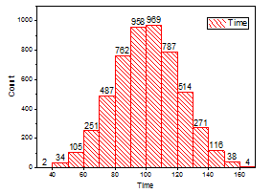
The Frequency Oracle
*For ease of presentation, let’s forget the encoding function and assume it is contained in the perturbation
$c≔Est(\left\{y\right\})$
takes reports $\{y\}$ from all users and outputs estimations $c(v)$ for any value $v$ in domain $D$
$y≔P(v)$
takes input value $v$ from domain $D$and outputs $y$.
$$y$$
FO is $ε$-LDP iff$′$for any $v$ and $v′$ from $D$, and any valid output $y$,
$\frac{\operatorname{Pr}\left[P\left(v\right)=y\right]}{\operatorname{Pr}\left[P\left(v′\right)=y\right]}≤e^{ε}$

Slide 22
Frequent Itemset Mining
Ideally,
Top-3 singletons:
a(5), e(5), b(3)
Top-3 itemsets:
{a}(5), {e}(5), {a, e}(4)
Each user has a set of values
The goal is to find the frequent singletons and itemsets
Challenges:
1. Each user has multiple items
2. Each user’s itemset size is different
Noisy Report
{a, c, e} {b, e} {a, b, e} {a, d, e} {a, b, c, d, e, f}
Notes:
For the problem studied in this paper, frequent itemset mining, the setting is different

Slide 23
Pad and Sample Frequency Oracle
Each user’s itemset size is different
Pad it to a fixed length $l$
Each user now has $l$ items (or more)
Sample one at uniform random
Report via a Frequency Oracle (e.g., Random Response)
a
c
e
a
c
e
*
*
c
c
b
e
b
e
*
*
*
*
*
aggregate
pad
$$l=5$$
sample
report
multiply by $l$
a
b
e
a
b
e
*
*
e
e
Results
a
d
e
a
d
e
*
*
d
*
a
b
c
d
e
f
a
b
c
d
e
f
a
a
Notes:
One solution is this pad-and-sample approach

Slide 24
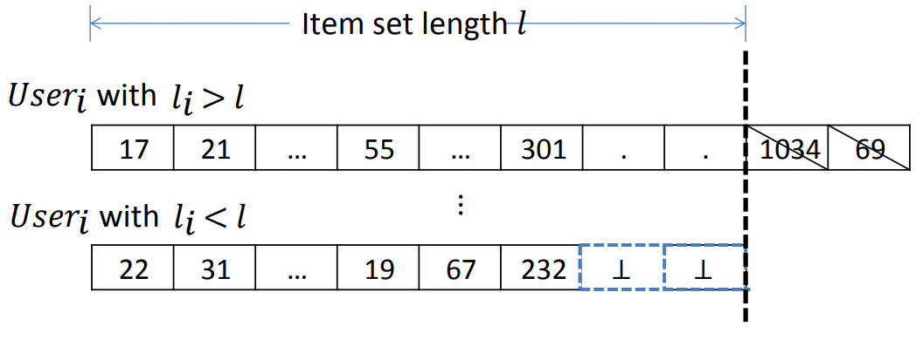
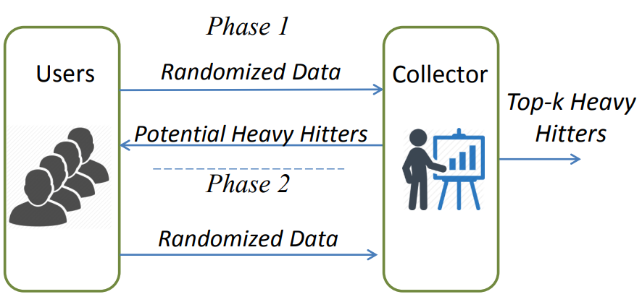
LDPMiner [“Heavy hitter estimation over set-valued data with local differential privacy”Qin et al’, CCS’16]
Observations
1. The value of $l$ affects error in two ways.
2. Sampling may have a privacy amplification effect.
Phase 1 (identify candidates)
Pad to $l$
$l$is the 90 percentile of the size distribution
Randomly select one
Report via Frequency Oracle
Phase 2 (estimate frequency)
Intersects $v$ with the $k$identified ones
Pad to $k$
Ensures no missed item
Randomly select one
Report via Frequency Oracle
Our contribution
PSFO framework
Find frequent items
Find frequent itemsets
Could find frequent items only.
Left finding frequent itemsets as an open problem.
Notes:
Z. Qin, Y. Yang, T. Yu, I. Khalil, X. Xiao, and K. Ren. Heavy hitter estimation over set-valued data with local differential privacy. In CCS, 2016.

Slide 25
Sources of error
FO Variance:
To satisfy LDP, permutation introduces noise
It increases with $l$, quadratically
Tradeoff between variance and under estimation:
depends on the goal
a
c
e
a
c
e
*
*
c
c
b
e
b
e
*
*
*
*
*
aggregate
pad
$$l=5$$
sample
report
multiply by $l$
a
b
e
a
b
e
*
*
e
e
Results
a
d
e
a
d
e
*
*
d
*
a
b
c
d
e
f
a
b
c
d
e
f
a
a
Under Estimation:
Items are selected with 1/6 but multiplied with 5
It decreases when $l$ increases

Slide 26
$l$=5
$l$=1
a
c
e
*
*
c
a
c
e
c
b
e
*
*
*
*
b
e
e
Under estimation
a
b
e
*
*
e
a
b
e
e
a
d
e
*
*
d
a
d
e
d
a
b
c
d
e
f
a
a
b
c
d
e
f
a
Goal 1: Estimation
26

Slide 27
$l$=5
$l$=1
c
c
Summary:
When the goal is identification, use small $l$;
When estimating frequencies,
use large $l$.
a
c
e
*
*
a
c
e
b
e
*
*
*
*
b
e
e
Many dummy items:
Even though this better reflects the frequencies, the signal is weak.
Under estimation: This does not reflect true frequencies; but each user reports non-dummy item.
a
b
e
*
*
e
a
b
e
e
a
d
e
*
*
d
a
d
e
d
a
b
c
d
e
f
a
a
b
c
d
e
f
a
Now let’s move on to the other key observation: privacy amplification
Goal 2: Identification
27

Slide 28
Privacy Amplification
LDP bounds the perturbation
With sampling, things are different
report
sample
report
a
a
a
b
a
a
b
a
b
c
b
a
$$\frac{\operatorname{Pr}\left[P\left(a\right)=a\right]}{\operatorname{Pr}\left[P\left(b\right)=a\right]}≤e^{ε}$$
To satisfy $ε$–LDP, we can use $ε^{′}=ln⁡(l\left(e^{ε}−1\right)+1)$ in FO protocol

Slide 29
Our Protocol
Phase 1 (identify candidates)
Randomly select one ($l=1$)
Report via Frequency Oracle
Phase 2 (estimate frequency)
Intersects $v$ with the $k$ identified ones
Pad to $l$
$l$is the 90 percentile
Randomly select one
Report via Frequency Oracle
With $ε^{′}=ln⁡(l\left(e^{ε}−1\right)+1)$
SVIM (Set Value Item Mining)
Itemset Mining (more in paper)

Slide 30
Experiments Highlights
Dataset: POS dataset
(also on Kosarak, Online, and Synthetic dataset)
Competitors: LDPMiner
Several improved variants of LDPMiner
Key Results:
Significantly outperforms existing methods
Reasonable results in practice

Slide 31
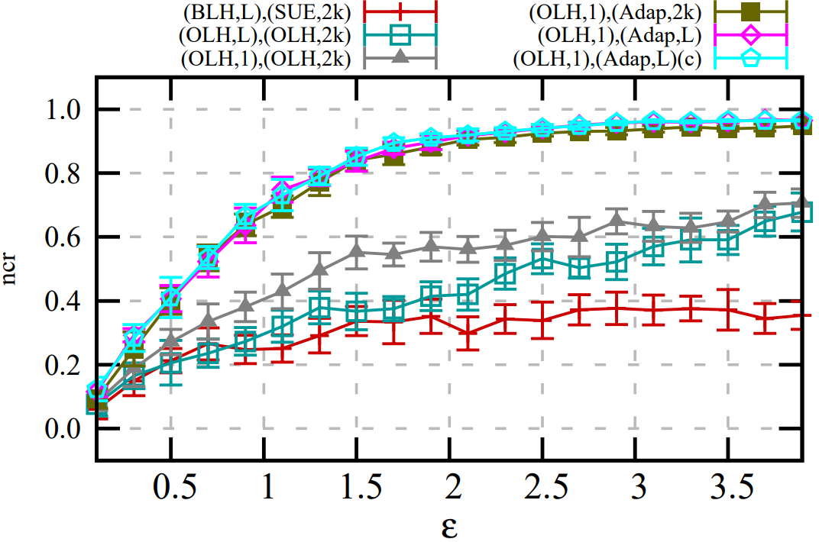
Identifying Frequent Singletons
LDPMiner
SVIM
When $ε$=2,
SVIM: 0.9, LDPMiner: 0.3
More Accuracy
When $ε$=1,
SVIM: 0.7, LDPMiner: 0.25
More Privacy

Slide 32
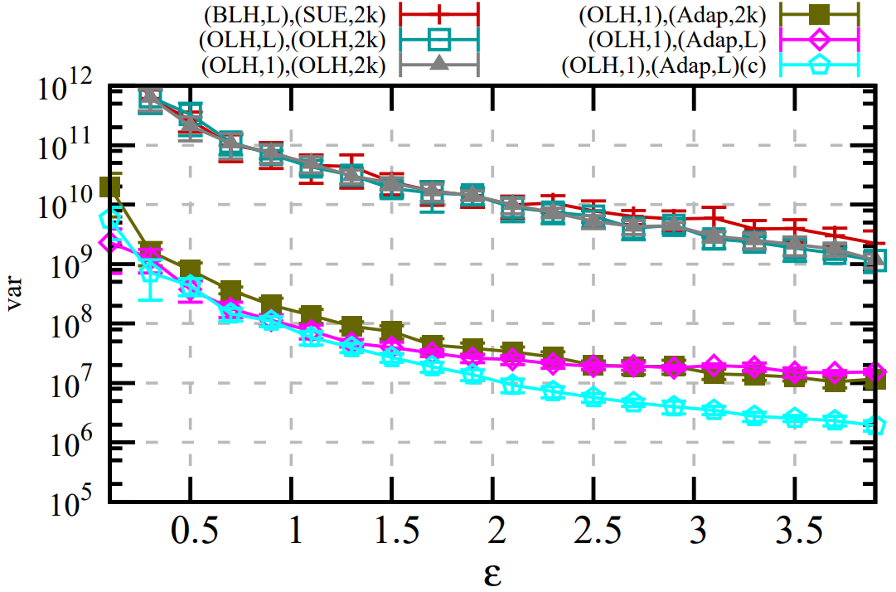
Estimating Frequent Singletons
LDPMiner
SVIM
More Accuracy
Error drops nearly 3 magnitudes for both $ε$=1 and $ε$=2
More Privacy

Slide 33
Outline
Motivation (covered)
Histogram Estimation (covered)
Frequent Itemset Mining (covered)
Other problems

Slide 34
Outline
Motivation
Histogram Estimation
Frequent Itemset Mining
Other problems

Slide 35
The heavy hitter problem
Goal: Find the most frequent $k$ values from $D$
Assumption: each user has a single value $x$ and it is represented in bits
Idea (under review):
Start from a prefix, and gradually extend this prefix.
Identify the frequent patterns for a small prefix first, and then extend to a larger prefix.
Result for the last group can be used for frequency estimation
Combine the result.
Notes:
To effectively reduce the size of the set from Cartesian product

Slide 36
Other interesting problems
Estimating mean:
Goal: Find the mean of continuous values
Assumption: Each user has a single value $x$ within the range of $[−1,+1]$
Intuition: Report +1 with higher probability if $x$ closer to +1
[https://arxiv.org/abs/1606.05053,https://arxiv.org/pdf/1712.01524]
Stochastic gradient descent
Goal: Find the optimal machine learning model
Assumption: Each user has a vector $x$
Intuition: Bolt-on sgd with noisy update
[https://arxiv.org/abs/1606.05053]
Bound the privacy leakage
Goal: Make multiple, periodic collection possible
Assumption: Each user has a value $x(t)$ that change with time
Intuition: Decide whether to participate based on the current result
[https://arxiv.org/abs/1802.07128]
Publish graph statistics [CCS’17], location data [TIFS’18], marginal [SIGMOD’18], etc
Notes:
To effectively reduce the size of the set from Cartesian product

Slide 37
Conclusion
Motivation
Users in LDP do not need to trust server.
By permute the secret in a principled way, users maintain deniability, while server can learn statistical information
Histogram Estimation
We surveyed and optimized existing mechanism
We proposed Optimized Local Hash
Frequent Itemset Mining
We can mine frequent singleton/itemset
Other problems
Heavy hitter problem
Mean estimation
Stochastic gradient descent

