Slide 1
Symbolic and Concolic Execution of Programs
Information Security, CS 526
Omar Chowdhury

Slide 2
Reading for this lecture
Symbolic execution and program testing - James King
KLEE: Unassisted and Automatic Generation of High-Coverage Tests for Complex Systems Programs - Cadar et. al.
Symbolic Execution for Software Testing: Three Decades Later - Cadar and Sen
A Few Billion Lines of Code Later Using Static Analysis to Find Bugs in the Real World - Engler et. al.
DART: Directed Automated Random Testing - Godefroid et. al.
CUTE: A Concolic Unit Testing Engine for C - Sen et. al.

Slide 3
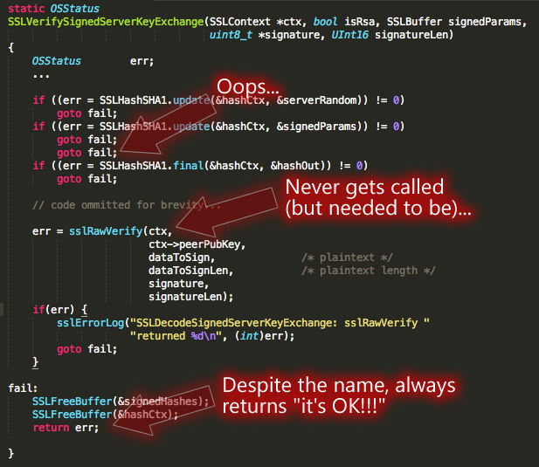
What is the goal?

Slide 4
Testing
Majority of the testing approaches are manual
Time consuming process
Error-prone
Incomplete
Depends on the quality of the test cases or inputs
Provides little in terms of coverage

Slide 5
Obvious Questions?
Yes, we can.
Can we do better in terms of test generation? Can we some how make it automatic?

Slide 6
Background: SAT
Given a propositional formula in CNF, find if there exists an assignment to Boolean variables that makes the formula true:
literals
ω₁ = (b c)
ω₂ = (¬ a ¬ d)
ω₃ = (¬ b d)
ϕ = ω₁ ω₂ ω₃
A = {a=0, b=1, c=0, d=1}
clauses
SATisfying assignment!

Slide 7
Background: SMT
SMT: Satisfiability Modulo Theories
Input: a first-order formula ϕ over background theory
Output: is ϕ satisfiable?
  does ϕ have a model?
  Is there a refutation of ϕ = proof of ¬ϕ?
For most SMT solvers: ϕ is a ground formula
  Background theories: Arithmetic, Arrays, Bit-vectors, Algebraic Datatypes
  Most SMT solvers support simple first-order sorts

Slide 8
Background: SMT
b + 2 = c and f(read(write(a,b,3), c-2)) ≠ f(c-b+1)
Arithmetic
Array Theory
Uninterpreted Function

Slide 9
Example SMT Solving
b + 2 = c and f(read(write(a,b,3), c-2)) ≠ f(c-b+1)
[Substituting c by b+2]
b + 2 = c and f(read(write(a,b,3), b+2-2)) ≠ f(b+2-b+1)
[Arithmetic simplification]
b + 2 = c and f(read(write(a,b,3), b)) ≠ f(3)
[Applying array theory axiom–
forall a,i,v:read(write(a,i,v), i) = v]
b+2 = c and f(3) ≠ f(3) [NOT SATISFIABLE]

Slide 10
Program Validation Approaches
Static Analysis
Verification
Concolic Execution
& White-box
Fuzzing
Extended Static Analysis
Confidence
Symbolic Execution
Ad-hoc testing
Cost (programmer effort, time, expertise)

Slide 11
Automatic Test Generation
Symbolic & Concolic Execution
How do we automatically generate test inputs that induce the program to go in different paths?
Intuition:
  Divide the whole possible input space of the program into equivalent classes of input.
  For each equivalence class, all inputs in that equivalence class will induce the same program path.
  Test one input from each equivalence class.

Slide 12
Symbolic Execution --- History
1976: A system to generate test data and symbolically execute programs (Lori Clarke)
1976: Symbolic execution and program testing (James King)
2005-present: practical symbolic execution
  Using SMT solvers
  Heuristics to control exponential explosion
  Heap modeling and reasoning about pointers
  Environment modeling
  Dealing with solver limitations

Slide 13
Symbolic Execution (contd.)
Void func(int x, int y){
int z = 2 * y;
if(z == x){
if (x > y + 10)
ERROR
}
}
int main(){
int x = sym_input();
int y = sym_input();
func(x, y);
return 0;
}
SMT solver
Path
constraint
Satisfying
Assignment
Symbolic
Execution
Engine
High coverage
test inputs
Symbolic Execution

Slide 14
Symbolic Execution --- Description
Execute the program with symbolic valued inputs (Goal: good path coverage)
Represents equivalence class of inputs with first order logic formulas (path constraints)
One path constraint abstractly represent all inputs that induces the program execution to go down a specific path
Solve the path constraint to obtain one representative input that exercises the program to go down that specific path

Slide 15
More details on Symbolic Execution
Instead of concrete state, the program maintains symbolic states, each of which maps variables to symbolic values
Path condition is a quantifier-free formula over the symbolic inputs that encodes all branch decisions taken so far
All paths in the program form its execution tree, in which some paths are feasible and some are infeasible

Slide 16
Symbolic Execution (contd.)
How does symbolic execution work?
Void func(int x, int y){
int z = 2 * y;
if(z == x){
if (x > y + 10)
ERROR
}
}
int main(){
int x = sym_input();
int y = sym_input();
func(x, y);
return 0;
}
func(x = a, y = b)
Path constraint
z = 2b
2b != a
2b == a
2b == a &&
a <= b + 10
2b == a &&
a > b + 10
x = a = 0
y = b = 1
ERROR
Generated
Test inputs
for this path
x = a = 2
y = b = 1
x = a = 30
y = b =15
Note: Require inputs to be marked as symbolic

Slide 17
Symbolic Execution (contd.)
How does symbolic execution work?
func(x = a, y = b)
x = a = 0
y = b = 1
x = a = 5
y = b = 4
x = a = 2
y = b = 3
………
z = 2b
2b != a
2b == a
x = a = 2
y = b = 1
x = a = 40
y = b = 20
………
x = a = 4
y = b = 2
………
2b == a &&
a <= b + 10
2b == a &&
a > b + 10
x = a = 30
y = b = 15
x = a = 0
y = b = 1
x = a = -6
y = b = -3
x = a = 48
y = b = 24
ERROR
Path constraints represent
equivalence classes of inputs
x = a = 2
y = b = 1
x = a = 30
y = b =15

Slide 18
SMT Queries
Counterexample queries (generate a test case)
Branch queries (whether a branch is valid)
Path Constraints = {C₁, C₂, …, C_{n}}; SAT
If K
Use queries to determine validity of a branch
else path is impossible: C₁ ∧ C₂ ∧ … ∧ C_{n} ∧ ¬K is UNSAT
then path is impossible: C₁ ∧ C₂ ∧ … ∧ C_{n} ∧ K is UNSAT
then
else

Slide 19
Optimizing SMT Queries
Expression rewriting
  Simple arithmetic simplifications (x * 0 = 0)
  Strength reduction (x * 2^{n} = x << n)
  Linear simplification (2 * x - x = x)
Constraint set simplification
  x < 10 && x = 5 --> x = 5
Implied Value Concretization
  x + 1 = 10 --> x = 9
Constraint Independence
  i<j && i < 20 && k > 0; new constraint i = 20

Slide 20
Optimizing SMT Queries (contd.)
Counter-example Cache
  i < 10 && i = 10 (no solution)
  i < 10 && j = 8 (satisfiable, with variable assignments i → 5, j → 8)
Superset of unsatisfiable constraints
  {i < 10, i = 10, j = 12} (unsatisfiable)
Subset of satisfiable constraints
  i → 5, j → 8, satisfies i < 10
Superset of satisfiable constraints
  Same variable assignments might works

Slide 21
How does Symbolic Execution Find bugs?
It is possible to extend symbolic execution to help us catch bugs
How: Dedicated checkers
  Divide by zero example --- y = x / z where x and z are symbolic variables and assume current PC is f
  Even though we only fork in branches we will now fork in the division operator
  One branch in which z = 0 and another where z !=0
  We will get two paths with the following constraints:
  z = 0 && f, z != 0 && f
  Solving the constraint z = 0 && f will give us concrete input values that will trigger the divide by zero error.
Write a dedicated checker for each kind of bug (e.g., buffer overflow, integer overflow, integer underflow)

Slide 22
Classic Symbolic Execution --- Practical Issues
Loops and recursions --- infinite execution tree
Path explosion --- exponentially many paths
Heap modeling --- symbolic data structures and pointers
SMT solver limitations --- dealing with complex path constraints
Environment modeling --- dealing with native / system/library calls/file operations/network events

Slide 23
Classic Symbolic Execution --- Practical Issues (possible solutions)
Path Constraints
Infinite execution tree
  Finitize paths by limiting the PC size (bounded verification)
  Use loop invariants (verification)
Path explosion
  Select next branch at random
  Select next branch based on coverage
  Interleave symbolic execution with random testing
Heap modeling
  Segmented address space via the theory of arrays (Klee)
  Lazy concretization (JPF)
  Concolic lazy concretization (CUTE)

Slide 24
Classic Symbolic Execution --- Practical Issues (possible solutions)
SMT solver limitations
  On-the-fly expression simplification
  Incremental solving
  Solution caching
  Counterexample caching
  Substituting concrete values for symbolic in complex PCs (CUTE)
Environment modeling
  Partial state concretization
  Manual models of the environment (Klee)

Slide 25
Symbolic Execution Coverage Problem
Symbolic execution may not reach deep into the execution tree. Specially when encountering loops.

Slide 26
Solution: Concolic Execution
Concolic = Concrete + Symbolic
Sometimes called dynamic symbolic execution
The intention is to visit deep into the program execution tree
Program is simultaneously executed with concrete and symbolic inputs
Start off the execution with a random input
Specially useful in cases of remote procedure call

Slide 27
Concolic Execution Steps
Generate a random seed input to start execution
Concretely execute the program with the random seed input and collect the path constraint
Example: a && b && c
In the next iteration, negate the last conjunct to obtain the constraint a && b && !c
Solve it to get input to the path which matches all the branch decisions except the last one
Why not from the first?

Slide 28
Concolic Execution
Random seed
x = 2, y = 1
Void func(int x, int y){
int z = 2 * y;
if(z == x){
if (x > y + 10)
ERROR
}
}
int main(){
int x = input();
int y = input();
func(x, y);
return 0;
}
func(x = a, y = b)
Path constraint
z = 2b
2b != a
2b == a
2b == a &&
a <= b + 10
2b == a &&
a > b + 10
ERROR
x = a = 30
y = b =15

Slide 29
Acknowledgement
Some of the content are derived from the slides of Endadul Haque, Emina Torlak, Nikolaj Bjørner, Bruno Dutertre, and Leonardo de Moura

