Slide 1
CS526: Computer Security
Fall 2015
Topic 8
Software Security

Slide 2
Secure Software
“A program is secure” – What does it mean?
To understand program security one has to understand if the program behaves as its designer intended and as the user expected
Software plays
  a major role in providing security
  as source of insecurity

Slide 3
Why Software Vulnerabilities Matter?
When a process reads input from attacker, the process may be exploited if it contains vulnerabilities.
When an attacker successfully exploits a vulnerability, he can
  Crash programs: Compromises availability
  Execute arbitrary code: Compromises integrity
  Obtain sensitive information: Compromises confidentiality
Software vulnerability enables the attacker to run with privileges of other users, violating desired access control policy

Slide 4
Attacks Exploiting Software Vulnerabilities
Drive-by download (drive-by installation)
  malicious web contents exploit vulnerabilities in browsers (or plugins) to download/install malware on victim system
Email attachments in PDF, Word, etc.
Network-facing daemon programs (such as http, ftp, mail servers, etc.) as entry points
Privilege escalation
  Attacker on a system exploits vulnerability in a root process and gains root privilege

Slide 5
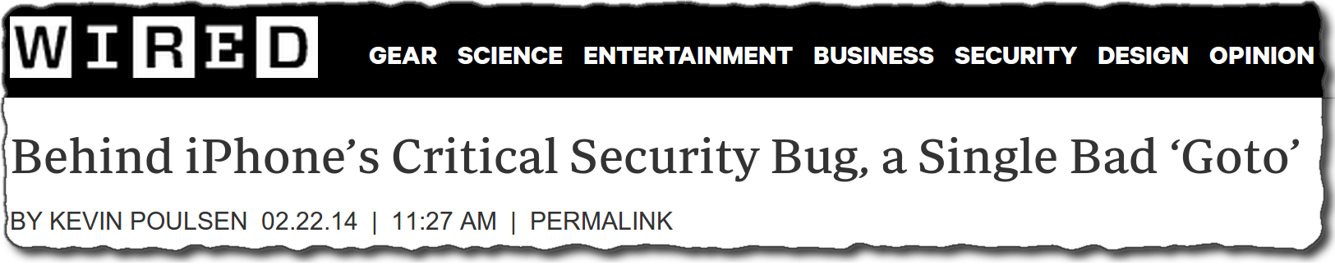
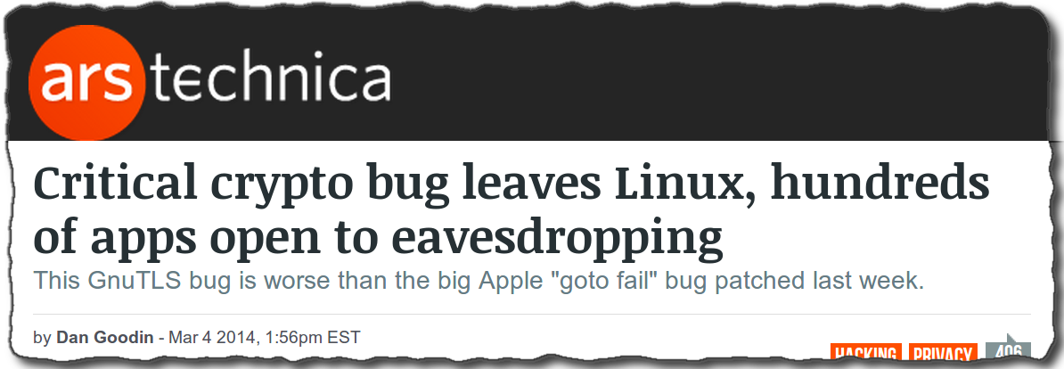
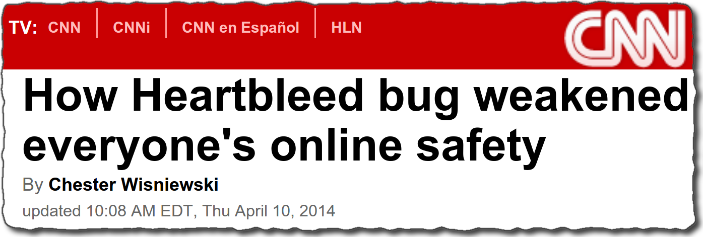
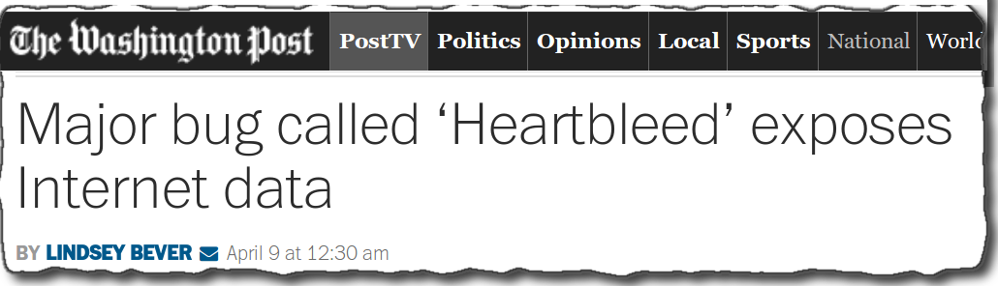
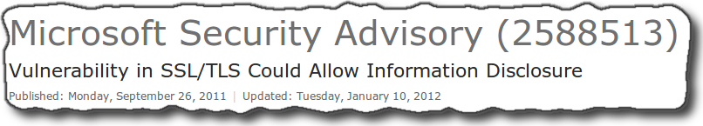
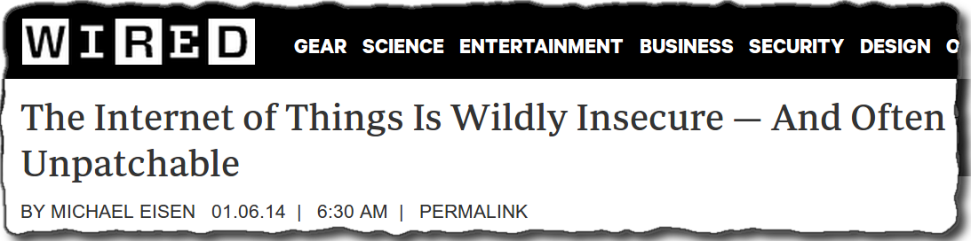
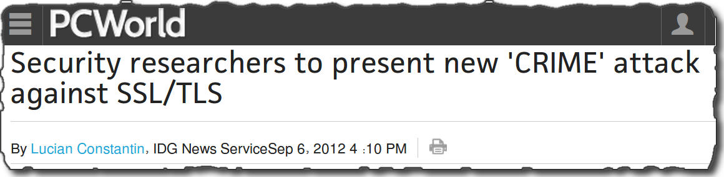
Secure Code – Where do we stand today?
Notes:
Let me first show you where do we stand today in terms of secure code
Recent discovery of vulnerabilities like “gotofail” in Apple’s custom SSL/TLS implementation demonstrate that even industry vetted code can contain such errant that can have serious security implications.
On the other hand, vulnerabilities like “heartbleed” in OpenSSL implementation demonstrates that even a well studied open source software may contain serious security vulnerabilities.
These are not isolated incidents. In fact, they are becoming increasing prominent.
[Recent discovery of vulnerabilities like “gotofail” in Apple’s custom SSL/TLS implementation allows a man-in-the-middle attackers to spoof SSL servers, which can lead to eavesdropping or user account hijacking. This demonstrates even industry vetted code can contain such errant that can have serious security implications.
On the other hand, vulnerabilities like “heartbleed” in OpenSSL implementation allows an attacker to read data contained in memory of the victim’s machine by sending a crafted heartbeat request, which can leak out sensitive information even including the private keys. This demonstrates even a well studied open source software may contain serious security vulnerabilities.
These are not isolated incidents. In fact, they are becoming increasing prominent.]

Slide 6
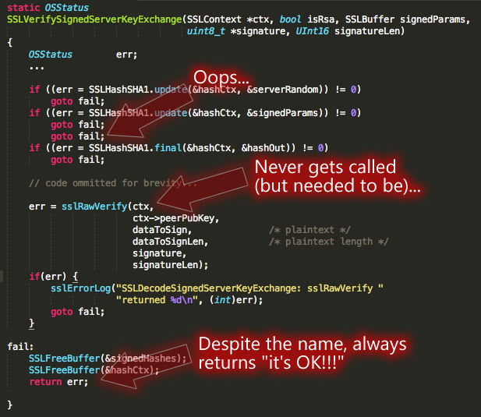
A Real Example of Vulnerability
** This picture is taken from http://zd.net/1mLOuXz

Slide 7
Common Software Vulnerabilities
Input validation
Race conditions
  Time-to-check-to-time-to-use (TOCTTOU)
Buffer overflows
Format string problems
Integer overflows
Failing to handle errors
Other exploitable logic errors
Notes:
Exploiting vulnerabilities is an important part of breaking in; this lecture discusses input validation and buffer overflows.

Slide 8
Input validation

Slide 9
Sources of Input that Need Validation
Sources of input for local applications
  Command line arguments
  Environment variables
  Configuration files, other files
  Inter-Process Communication call arguments
  Network packets
Sources of input for web applications
  Web form input
  Scripting languages with string input

Slide 10
Environment variables
Users can set the environment variables to anything
  Using execve
  Has some interesting consequences
Examples:
  PATH
  LD_LIBRARY_PATH
  IFS

Slide 11
Attack by Resetting PATH
A setuid program has a system call: system(ls);
The user sets his PATH to be . (current directory) and places a program ls in this directory
The user can then execute arbitrary code as the setuid program
Solution: Reset the PATH variable to be a standard form (i.e., “/bin:/usr/bin”)

Slide 12
Attack by Resetting IFS
Attacker can reset the IFS variable
  IFS is the characters that the system considers as white space
If not, the user may add “s” to the IFS
  system(ls) becomes system(l)
  Place a function l in the directory
Moral: things are intricately related and inputs can have unexpected consequences

Slide 13
Attack by Resetting LD_LIBRARY_PATH
Assume you have a setuid program that loads dynamic libraries
UNIX searches the environment variable LD_LIBRARY_PATH for libraries
A user can set LD_LIBRARY_PATH to /tmp/attack and places his own copy of the libraries here
Most modern C runtime libraries have fixed this by not using the LD_LIBRARY_PATH variable when the EUID is not the same as the RUID or the EGID is not the same as the RGID

Slide 14
Command Line as Source of Input
void main(int argc, char** argv) {
  char buf[1024];
  sprintf(buf, “cat %s”,argv[1]);
  system (“buf”);
}
Intention: get a file name from input and then cat the file
What can go wrong?
  Attacker can add to the command by using, e.g., “a; ls”
Notes:
User can set command line arguments to almost anything, e.g., by using execve system call to start a program, the invoker has complete control over all command line arguments

Slide 15
Input Validation in Web Applications
A remote example (PHP passthru)
  echo 'Your usage log:<br />';
  $username = $_GET['username'];
  passthru(“cat /logs/usage/$username”);
PHP passthru(string) executes command
What can go wrong?
  Attackers can put “;” to input to run desired commands, e.g.,
  “username=John;cat%20/etc/passwd”

Slide 16
Directory Traversal Vulnerabilities in Web Applications
A typical example of vulnerable application in php code is:
<?php
$template = 'red.php';
if ( isset( $_COOKIE['TEMPLATE'] ) ) $template = $_COOKIE['TEMPLATE']; include ( "/home/users/phpguru/templates/" . $template );
?>
Attacker sends
GET /vulnerable.php HTTP/1.0 Cookie: TEMPLATE=../../../../../../../../../etc/passwd

Slide 17
Checking input can be tricky: Unicode vulnerabilities
Some web servers check string input
  Disallow sequences such as ../ or \
  But may not check unicode %c0%af for '/'
IIS Example, used by Nimda worm
  passes <some command> to cmd command
  scripts directory of IIS has execute permissions
Input checking would prevent that, but not this
  IIS first checks input, then expands unicode
  http://victim.com/scripts/../../winnt/system32/cmd.exe?<some command>
  http://victim.com/scripts/..%c0%af..%c0%afwinnt/system32/...

Slide 18
Input Validation in Web Applications
SQL injection
  Caused by failure to validate/process inputs from web forms before using them to create SQL queries
Cross Site Scripting
  Caused by failure to validate/process inputs from web forms or URL before using them to create the web page

Slide 19

Takeaway: Input Validation
Malicious inputs can become code, or change the logic to do things that are not intended
Inputs interact with each other, sometimes in subtle ways
Use systematic approaches to deal with input validation
  Avoid checking for bad things (blacklisting)
  Instead check for things that allowed (whitelisting)

Slide 20
Time-of-check-to-time-of-use
TOCTTOU, pronounced "TOCK too“
A class of software bug caused by changes in a system between the checking of a condition (such as authorization) and use of the results of the check.
  When a process P requests to access resource X, the system checks whether P has right to access X; the usage of X happens later
  When the usage occurs, perhaps P should not have access to X anymore.
  The change may be because P changes or X changes.

Slide 21
An Example TOCTTOU
In Unix, the following C code, when used in a setuid program, is a TOCTTOU bug:
  if (access("file", W_OK) != 0)
  { exit(1); }
  fd = open("file", O_WRONLY);
  write(fd, buffer, sizeof(buffer));
Here, access is intended to check whether the real user who executed the setuid program would normally be allowed to write the file (i.e., access checks the real userid rather than effective userid).
Attacker tries to execute the following line in another process when this process reaches exactly this time:
Symlink(“/etc/passwd”, “file”)

Slide 22
TOCTTOU
Exploiting a TOCTTOU vulnerabilities requires precise timing of the victim process.
  Can run the attack multiple times, hoping to get lucky
Most general attack may require “single-stepping” the victim, i.e., can schedule the attacker process after each operation in the victim
  Techniques exist to “single-step” victim
Preventing TOCTTOU attacks is difficult

Slide 23
Buffer overflow

Slide 24
What is a Buffer Overflow?
Buffer overflow occurs when a program or process tries to store more data in a buffer than the buffer can hold
Very dangerous because the extra information may:
  Affect user’s data
  Affect user’s code
  Affect system’s data
  Affect system’s code

Slide 25
Why Does Buffer Overflow Happen?
No checks on bounds
  Programming languages give user too much control
  Programming languages have unsafe functions
  Users do not write safe code
C and C++, are more vulnerable because they provide no built-in protection against accessing or overwriting data in any part of memory
  Can’t know the lengths of buffers from a pointer
  No guarantees strings are null terminated
Notes:
You can't know the length of buffers just from a pointer
Partial solution: pass the length as a separate argument "C" string functions aren't safe
No guarantees that the new string will be null-terminated!
Doing all checks completely and properly is tedious and tricky

Slide 26
Why Buffer Overflow Matters
Overwrites
  other buffers
  variables
  program flow data
Results in
  erratic program behavior
  a memory access exception
  program termination
  incorrect results
  breach of system security
Notes:
May lead to total compromise of host or a crash
Adversary runs code on someone else’s server
Adversary escalates privilege in an unauthorized manner

Slide 27
History
Used in 1988’s Morris Internet Worm
Alphe One’s “Smashing The Stack For Fun And Profit” in Phrack Issue 49 in 1996 popularizes stack buffer overflows
Still extremely common today
*The Internet Worm Program: An Analysis --- by Eugene H. Spafford
(http://spaf.cerias.purdue.edu/tech-reps/823.pdf)

Slide 28
Types of Buffer Overflow Attacks
Stack overflow
  Shell code
  Return-to-libc
    Overflow sets ret-addr to address of libc function
  Off-by-one
  Overflow function pointers & longjmp buffers
Heap overflow

Slide 29
Process Memory
A 32-bit process sees memory as an array of bytes that goes from address 0 to 2³²-1 (0 to 4GB-1)
(4GB-1) 2³²-1
0

Slide 30
Memory Sections
The memory is organized into sections
called “memory mappings”
2³²-1
Stack
Shared Libs
Heap
Bss
Data
0
Text

Slide 31
Memory Sections
Each section has different permissions: read/write/execute or a combination of them.
Text- Instructions that the program runs
Data – Initialized global variables.
Bss – Uninitialized global variables. They are initialized to zeroes.
Heap – Memory returned when calling malloc/new. It grows upwards.
Stack – It stores local variables and return addresses. It grows downwards.

Slide 32
Background: C Program Execution
PC (program counter or instruction pointer) points to next machine instruction to be executed
Procedure call
  Prepare parameters
  Save state (SP (stack pointer) and PC) and allocate on stack local variables
  Jumps to the beginning of procedure being called
Procedure return
  Recover state (SP and PC (this is return address)) from stack and adjust stack
  Execution continues from return address

Slide 33
Background: Stack Frame
Parameters for the procedure
Save current PC onto stack (return address)
Save current SP value onto stack
Allocates stack space for local variables by decrementing SP by appropriate amount
Parameters
Return address
Stack Frame Pointer
Local variables
Stack
Growth
SP

Slide 34
Example of a Stack-based Buffer Overflow
Suppose a web server contains a function:
void my_func(char *str) {
char buf[128];
strcpy(buf, str);
do-something(buf);
}
When the function is invoked the stack looks like:
What if *str is 136 bytes long? After strcpy:
top
of
stack
buf
sfp
ret-addr
str
top
of
stack
ret
str
*str

Slide 35
Basic Stack Exploit
void my_func(char *str) {
char buf[128];
strcpy(buf, str);
do-something(buf);
}
Suppose *str is such that
after strcpy stack looks like:
When my_func() exits, the user will be given a shell
Note: attack code runs in stack.
To determine ret attacker guesses position when my_func() is called.
top
of
stack
*str ret Code for P
Program P: exec( “/bin/sh” )
For more info, see Smashing the Stack for Fun and Profit by Aleph One

Slide 36
Carrying out this Attack Requires
Determine the location of injected code position on stack when my_func() is called
  So as to change RET on stack to point to it
  Location of injected code is fixed relative to the location of the stack frame
Program P should not contain the ‘\0’ character.
  Easy to achieve
Overflow should not crash program before my_func() exits

Slide 37
Some Unsafe C lib Functions
strcpy (char *dest, const char *src)
strcat (char *dest, const char *src)
gets (char *s)
scanf ( const char *format, … )
printf (conts char *format, … )

Slide 38
Other Control Hijacking Opportunities
Stack smashing attack (the basic stack attack)
  Overwrite return address on the stack, by overflowing a local buffer variable.
Function pointers (used in attack on PHP 4.0.2)
  Overflowing buf will overwrite function pointer.
Heap
or
Stack
buf[128]
FuncPtr

Slide 39
return-to-libc attack
“Bypassing non-executable-stack during exploitation using return-to-libc” by c0ntex
*str ret Code for P
Shell code attack: Program P: exec( “/bin/sh” )
system() in libc
*str ret fake_ret
Return-to-libc attack: No code comes after ret (only the arg for the call)
“/bin/sh”
Notes:
Caller : push parameter(s), push ret addr, jmp to start addr of the callee
Callee: Push stack frame pointer, allocate space for locals, execute the instructions, restore stack frame pointer
Return: pop ret addr, jmp to addr

Slide 40
Return-to-libc Attacks
Instead of putting shellcode on stack, can put args there, overwrite return address with pointer to well known library function
  e.g.,
  system(“/bin/sh”);
Return-to-libc attack
system()
libc (text segment)
…
Increasing memory addresses
“/bin/sh”
local vars
request
0x80707336
saved fp
0x61a4ac14
return addr
0x63441827
0x80707308
args
17
38
main()’s
stack
frame
Slide from Brad Karp, UCL.

Slide 41
Heap-based Buffer Overflow Attacks
Remember that heap represents data sections other than the stack
  buffers that are dynamically allocated, e.g., by malloc
  statically initialized variables (data section)
  uninitialized buffers (bss section)
Heap overflow may overwrite other data allocated on heap
By exploiting the behavior of memory management routines, attacker may overwrite an arbitrary memory location with a small amount of data

Slide 42
Prevention mechanisms

Slide 43
Preventing Buffer Overflow Attacks
Use type safe languages (e.g., Java)
Use safe library functions (e.g., strncpy)
Static source code analysis
Non-executable stack
Run time checking (e.g., StackGaurd)
Address space layout randomization (ASLR)
Detecting deviation of program behavior

Slide 44
Static Source Code Analysis
Statically check source code to detect buffer overflows
Automate the code review process
Several tools exist
Expensive (exponential)
Typically done for short programs of critical importance
Find lots of bugs, but not all

Slide 45
Bugs to Detect in Source Code Analysis
Some examples
Crash Causing Defects
Null pointer dereference
Use after free
Double free
Array indexing errors
Mismatched array new/delete
Potential stack overrun
Potential heap overrun
Return pointers to local variables
Logically inconsistent code
Uninitialized variables
Invalid use of negative values
Passing large parameters by value
Underallocations of dynamic data
Memory leaks
File handle leaks
Network resource leaks
Unused values
Unhandled return codes
Use of invalid iterators

Slide 46
Non-Executable Stack
Basic stack exploit can be prevented by hardware support to mark stack segment as non-executable
  Support in Windows since XP SP2. Code patches exist for Linux, Solaris.
Problems:
  Does not defend against all attacks ( see “return-to-libc”)
  Does not block more general overflow exploits
    Overflow on heap; overflow func pointer

Slide 47
Run Time Checking: StackGuard
StackGuard checks for stack integrity at run time
  E.g., embed “canaries” in stack frames and verify their integrity prior to function return.
Frame 2
Frame 1
top
of
stack
local
canary
sfp
ret
str
local
canary
sfp
ret
str

Slide 48
Canary Types
Random canary
  Choose random string at program startup
  Insert canary string into every stack frame
  Verify canary before returning from function
  To corrupt random canary, attacker must learn current random string
Terminator canary
  Canary = 0, newline, linefeed, EOF
  String functions will not copy beyond terminator.
  Hence, attacker cannot use string functions to corrupt stack.
  Weakness: Adversary knows canary
Canaries do not offer full protection

Slide 49
Other Run Time Checking
Validate sufficient space (LibSafe)
  E.g., intercept calls to strcpy (dest, src) and check that:
  |frame-pointer – dest| > strlen(src)
  If so do strcpy, else terminate application.
Copying to a safe location (StackShield)
  E.g., at function prologue, copy return address to a safe location, and upon return check that return address still equals the saved copy

Slide 50
Randomization: Motivations
Buffer overflow and return-to-libc exploits need to know the (virtual) address to which pass control
  Address of attack code in the buffer
  Address of a standard kernel library routine
Same address is used on many machines
  Slammer infected 75,000 MS-SQL servers using same code on every machine
Idea: introduce artificial diversity
  Make stack addresses, addresses of library routines, etc. unpredictable and different from machine to machine

Slide 51
Address Space Layout Randomization
Arranging the positions of key data areas randomly in a process' address space.
  e.g., the base of the executable and position of libraries (libc), heap, and stack,
  Effects: for return to libc, needs to know address of the key functions.
  Attacks:
    Repetitively guess randomized address
    Use non-ASLR modules
Supported on Windows Vista, Linux (and other UNIX variants)

Slide 52
Takeaway
Software vulnerabilities may have severe implications
Mostly result from improper input validation and buffer overflow
Avoid using functions that don’t check boundaries

Slide 53
Acknowledgement
Slides from Ninghui Li, Endadul Haque, and Cristina Nita-Rotaru

Slide 54
Thank you

Slide 55
Background: Programs and Memory
The operating system creates a process by assigning memory and other resources
Code: the program instructions to be executed
Data: initialized variables including global and static variables, un-initialized variables
Heap: dynamic memory for variables that are created (e.g., with malloc) and disposed of with free
Stack: keeps track of the point to which each active subroutine should return control when it finishes executing; stores variables that are local to functions
Virtual Memory
Stack
Heap
Data
Code
Notes:
C compilers, on whatever platform, manage the memory associated to a program (the place where variables values are stored) in three main parts. First, there is a place where global and static vars are stored; these never cease to exist for all of the program's execution, and thus this memory is simply allocated and never disposed of. Second, there is the place where automatic variables (that is, variables that are local to functions) are stored; this is called a stack. The essence of a stack is that you always add new items on top and always remove items beginning from the top, so there is never a "hole" within the stack. When a function is called, its automatic variables are allocated on the top of the stack; when it ends, its variables are deallocated (and the stack becomes smaller). Whatever your program is like, the function that terminates at any given time is always the last that was called; so you have a stack (always remove from it the last thing you put in it). Third, there is a place for variables that are created with malloc and disposed of with free. As the order in which these are created/destroyed is totally under the control of the programmer, you can have no guarantee that the first var to be destroyed is the last that was created. Hence you can have holes. This makes this area more "confused" and it is thus called a "heap". Usually, heap and stack begin at the opposite ends of the program's memory so that either can grow independently, until they eventually collide (and you get a memory overflow error).

Slide 56
Code Fragment for Printing Stack Frame (from prstack.c)
int main(int argc, char*argv[]) {
int n;
int r;
if (argc == 2) {
n = atoi(argv[1]);
r = fac(n, 0);
} else if (argc == 3) {
n = atoi(argv[2]);
r = fac(n, 1);
}
return 0;
}
int fac(int a, int p) {
char f[8] = " ";
int b = 0;
// print stack frame
gets(f); // buffer may overflow
if (a == 1) { b = 1; }
else { b = a * fac(a-1,p); }
// print stack frame again }
return b;
}

Slide 57
Code Fragment for Printing Stack Frame (from prstack.c)
int fac(int a, int p) {
char f[8] = " "; int b = 0;
printf("Address %p: argument int p: 0x%.8x\n", &p, p);
printf("Address %p: argument int a: 0x%.8x\n", &a, a);
printf("Address %p: return address : 0x%.8x\n", &a-1, *(&a-1));
printf("Address %p: saved stack frame p: 0x%.8x\n", &a-2, *(&a-2));
printf("Address %p: local var f[4-7] : 0x%.8x\n", (char *)(&f)+4, *((int *)(&f[4])));
printf("Address %p: local var f[0-3] : 0x%.8x\n", &f, *((int *)f));
printf("Address %p: local var int b: 0x%.8x\n", &b, b);
printf("Address %p: gap : 0x%.8x\n", &b-1, *(&b-1));
…
}

Slide 58
Printed Stack Frame
Entering function call fac(a=2), code at 0x080484a5
Address 0xff98942c: argument int p: 0x00000001
Address 0xff989428: argument int a: 0x00000002
Address 0xff989424: return address : 0x0804860e
Address 0xff989420: saved stack frame p: 0xff989440
Address 0xff98941c: local var f[4-7] : 0x00202020
Address 0xff989418: local var f[0-3] : 0x20202020
Address 0xff989414: local var int b: 0x00000000
Address 0xff989410: gap : 0x00000000
Entering function call fac(a=1), code at 0x080484a5
Address 0xff98940c: argument int p: 0x00000001
Address 0xff989408: argument int a: 0x00000001
Address 0xff989404: return address : 0x0804860e
Address 0xff989400: saved stack frame p: 0xff989420
Address 0xff9893fc: local var f[4-7] : 0x00202020
Address 0xff9893f8: local var f[0-3] : 0x20202020
Address 0xff9893f4: local var int b: 0x00000000
Address 0xff9893f0: gap : 0x00000000

Slide 59
Stack Frame with Overflowed Buffer
Entering function call fac(a=1), code at 0x080484a5
Address 0xffd5724c: argument int p: 0x00000001
Address 0xffd57248: argument int a: 0x00000001
Address 0xffd57244: return address : 0x0804860e
Address 0xffd57240: saved stack frame p: 0xffd57260
Address 0xffd5723c: local var f[4-7] : 0x00202020
Address 0xffd57238: local var f[0-3] : 0x20202020
Address 0xffd57234: local var int b: 0x00000000
Address 0xffd57230: gap : 0x00000000
123456789012345
Leaving function call fac(a=1), code at 0x80484a5
Address 0xffd5724c: argument int p: 0x00000001
Address 0xffd57248: argument int a: 0x00000001
Address 0xffd57244: return address : 0x00353433
Address 0xffd57240: saved stack frame p: 0x32313039
Address 0xffd5723c: local var f[4-7] : 0x38373635
Address 0xffd57238: local var f[0-3] : 0x34333231
Address 0xffd57234: local var int b: 0x00000001
Address 0xffd57230: gap : 0x00000001
Segmentation fault (core dumped)
Input 15 bytes.
Overflowing f to overwrite saved sfp and return address.

Slide 60
What does a function do?
fac
0x080484a5 <+0>: push %ebp save stack frame pointer (fp)
0x080484a6 <+1>: mov %esp,%ebp set current stack fp
0x080484a8 <+3>: sub $0x18,%esp allocate space for local var
0x080484ab <+6>: movl $0x20202020,-0x8(%ebp) initialize f[0-3]
0x080484b2 <+13>: movl $0x202020,-0x4(%ebp) initialize f[4-7]
0x080484b9 <+20>: movl $0x0,-0xc(%ebp) initialize b
0x080484c0 <+27>: mov 0xc(%ebp),%eax load value of p to eax
0x080484c3 <+30>: test %eax,%eax check if eax is 0
0x080484c5 <+32>: je 0x80485e8 <fac+323> if so, skip printing frame
....
0x080485e8 <+323>: mov 0x8(%ebp),%eax load value of a to eax
0x080485eb <+326>: cmp $0x1,%eax check if a==1
0x080485ee <+329>: jne 0x80485f9 <fac+340> if not, call fac
0x080485f0 <+331>: movl $0x1,-0xc(%ebp) otherwise, assigns 1 to b
0x080485f7 <+338>: jmp 0x8048617 <fac+370>
….
0x08048609 <+356>: call 0x80484a5 <fac>
0x0804860e <+361>: mov 0x8(%ebp),%edx
0x08048611 <+364>: imul %edx,%eax

