Slide 1

Role and Attribute Based Access Control
Information Security
CS 526
Omar Chowdhury

Slide 2

Reading for This Lecture
RBAC96 Family
  R.S. Sandhu, E.J. Coyne,
  H.L. Feinstein, and C.E. Youman.
  “Role-Based Access Control Models”. IEEE Computer, 29(2):38--47, Feb 1996.

Slide 3
Access Control
Access control asserts who can access which resource with what capability under what condition
Examples
Discretionary Access Control (DAC)
Mandatory Access Control (DAC)

Slide 4


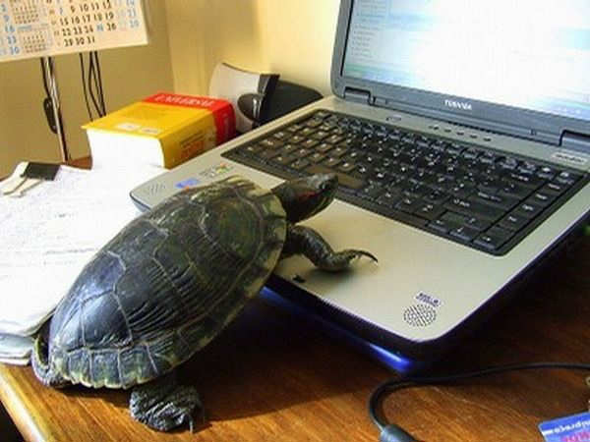





DAC Model
Users
Resources
Management of users and their permissions is a big problem.
Example: When a user gets fired or gets promoted.

Slide 5
Indirection
Butler Lampson or David Wheeler
All problems in Computer Science can be solved by another level of indirection
Roles

Slide 6



RBAC Model
Users
Resources
User-Role Assignment
Role-Permission Assignment
Roles

Slide 7
Why Role is the right level of indirection?
Potentially, fewer relationship to manage
  O(mn) to O(m+n), m = #users, n = #permissions
Organizations operate based on roles
Roles can give a semantic meaning to why someone needs a specific permission
A role may be more stable than
  The collection of users and the collection of permissions that are associated with them
Revocation, granting, or changing of permissions become much easier

Slide 8
RBAC96 Family of Models (Sandhu et. al.)
RBAC3
ROLE HIERARCHIES
CONSTRAINTS
RBAC1
ROLE HIERARCHIES
RBAC2
CONSTRAINTS
RBAC0
Core RBAC

Slide 9
RBAC0 – Core RBAC
User-Role Assignment
Role-Permission Assignment
USERS
ROLES
PERMISSIONS
SESSIONS

Slide 10
Permissions
Left intentionally abstract in the RBAC96 model
Permissions are only positive
No negative permissions or denials
  Closed policy
  All access are denied unless explicitly authorized by the policy
No obligations or future requirements
  Example: If a nurse accesses a patient’s psychotherapy notes, then she must notify patient within 30 days of access

Slide 11
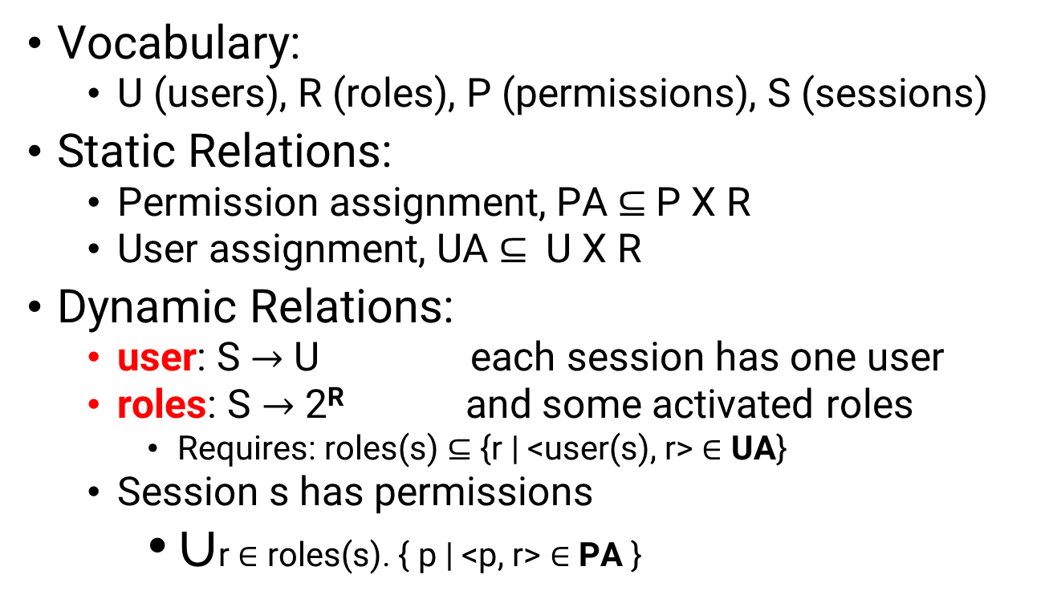
RBAC0- Formal Model
Vocabulary:
  U (users), R (roles), P (permissions), S (sessions)
Static Relations:
  Permission assignment, PA $⊆$P X R
  User assignment, UA $⊆$U X R
Dynamic Relations:
  user: S $→$ U each session has one user
  roles: S $→$ 2^{R} and some activated roles
    Requires: roles(s) $⊆$ {r | <user(s), r> $∈$ UA}
  Session s has permissions
    $∪$r $∈$ roles(s). { p | <p, r> $∈$ PA }

Slide 12
RBAC1– Role Hiearchies
User-Role Assignment
Role-Permission Assignment
USERS
ROLES
PERMISSIONS
Role Hierarchy
SESSIONS

Slide 13
Role Hierarchy Example (1)
Primary-Care Physician
Specialist Physician
ER Nurse
ICU Nurse
Nurse
Physician
More specialized (more permissions)
Health-Care Provider

Slide 14
Role Hierarchy Example (2)
Supervising
Engineer
Hardware Engineer
Software
Engineer
More specialized (more permissions)
Engineer

Slide 15
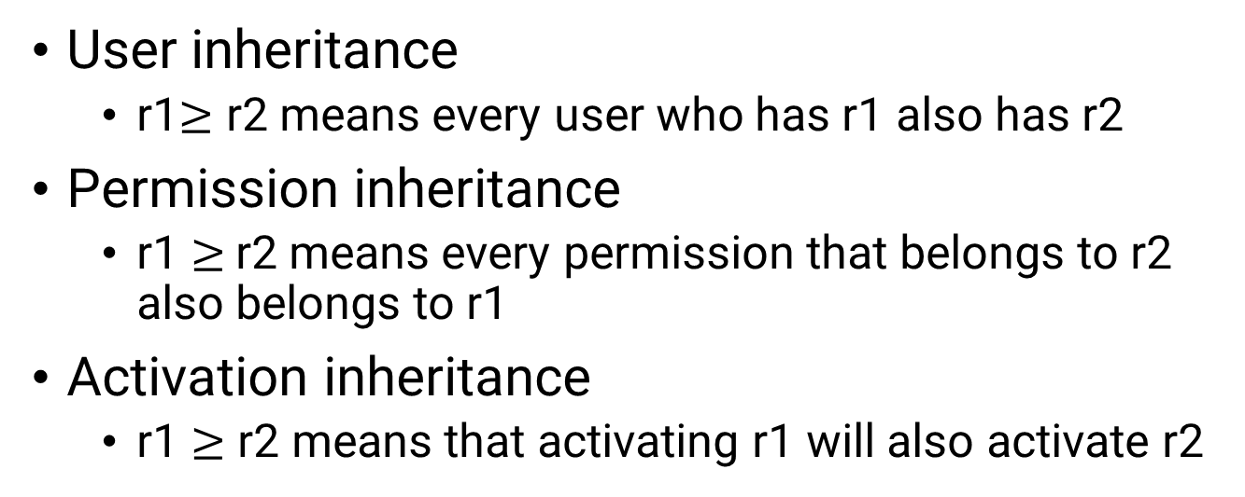
Semantics of Role Hiearchies
User inheritance
  r1$≥$ r2 means every user who has r1 also has r2
Permission inheritance
  r1 $≥$r2 means every permission that belongs to r2 also belongs to r1
Activation inheritance
  r1 $≥$ r2 means that activating r1 will also activate r2
Permission and Activation inheritance have different effect when there are constraints about activation.

Slide 16
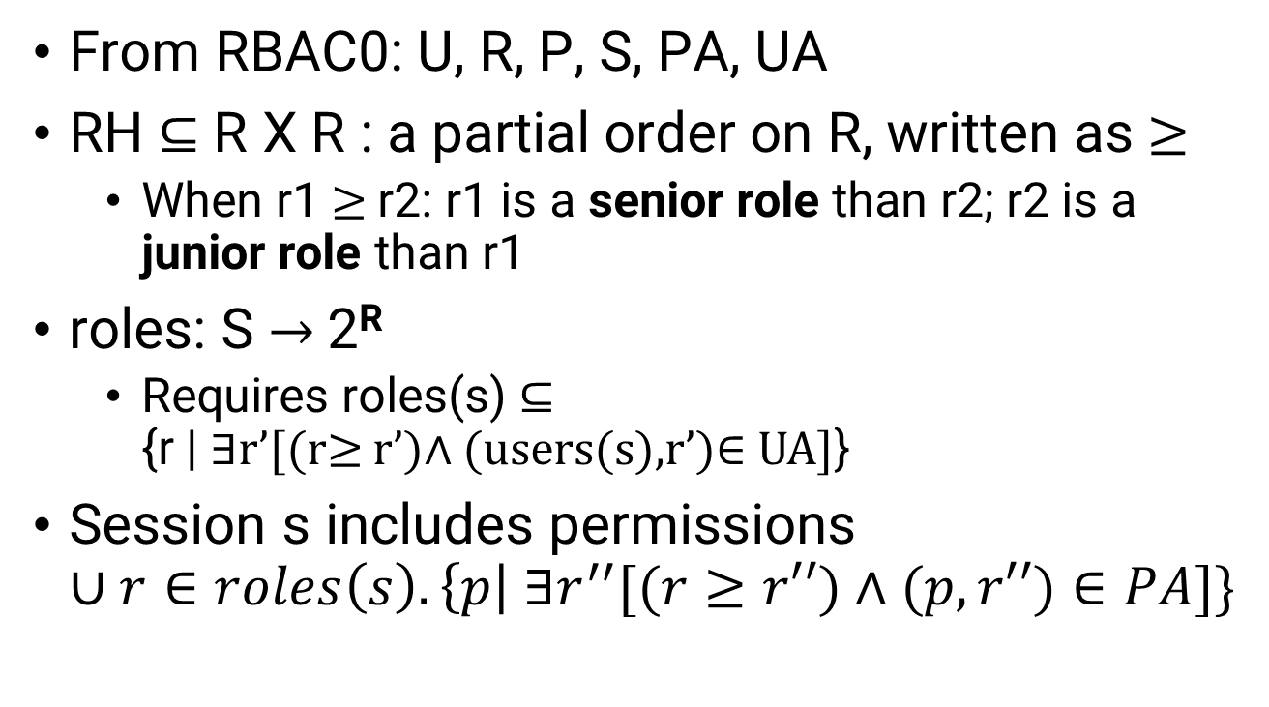
RBAC1 – Formal Model
From RBAC0: U, R, P, S, PA, UA
RH $⊆$ R X R : a partial order on R, written as $≥$
  When r1 $≥$r2: r1 is a senior role than r2; r2 is a junior role than r1
roles: S → 2^{R}
  Requires roles(s) $⊆$
  {r | ∃r’[(r≥ r’)∧ (users(s),r’)∈ UA]}
Session s includes permissions
$∪r∈roles\left(s\right).\left\{p\right| ∃r^{′′}[(r≥r′′)∧(p, r′′)∈PA]\}$

Slide 17
RBAC2 – RBAC0 + Constraints
No formal model specified
Example constraints
  Mutual exclusion
    Can be assigned (static) or can activate (dynamic) only one role from the set
    Enforces separation of duty
  Pre-condition
    Can be assigned a role if the user possesses some other pre-condition role
    Can be used to enforce least privilege principle
  Cardinality
    Maximum users that can be assigned a role
    Maximum roles any user can possess (possibly, in a session)
    Maximum roles having a certain permission

Slide 18
Mutual Exclusion Constraints
Mutually exclusion roles
  Static exclusion – No user can hold both roles
    Static separation of duty
    Preventing a user from having too much privilege
  Dynamic exclusion – No user can activate both roles in the same session
    Dynamic separation of duty
    Interact with role hierarchy interpretation

Slide 19
Cardinality Constraints
On User-Role Assignment
  At most K users can belong to the role
  At least K users must belong to the role
  Exactly K users must belong to the role
On role activation
  At most K users can activate a role
  ……

Slide 20
Why Constraints?
For laying out higher level organizational policy
  When the administrator is centralized it is a sanity checking tool
    Not essential for a vigilant administrator as he can check all organizational policies are met when making any changes to the RBAC policies
    Assertion checking in programming languages
A tool to enforce high-level policies when the administrator is decentralized

Slide 21
RBAC3
User-Role Assignment
Role-Permission Assignment
USERS
ROLES
PERMISSIONS
Role Hierarchy
Constraints
SESSIONS

Slide 22
Products Using RBAC
Database Management Systems (DBMS)
  Oracle, PostgreSQL
Enterprise Security Management
  IBM Tivoli Identity Manager (central administration and provisioning of account, resources)
Many operating systems claim to use roles
  Windows Server 2003, Solaris

Slide 23
NIST Standard for RBAC
Proposed NIST Standard for Role-Based Access Control. David F. Ferraiolo, Ravi S. Sandhu, Serban I. Gavrila, D. Richard Kuhn, and Ramaswamy Chandramouli. TISSEC, August 2001.
The model has number of flaws including typos, errors in mathematical definitions, and other high-level design choices.

Slide 24
Overview of the NIST Standard for RBAC
Core RBAC and with the following extensions
  Hierarchical RBAC
  Static separation of duties
  Dynamic separation of duties

Slide 25
Advantages of RBAC
Allows efficient security management
Principle of least privilege
Separation of duty to prevent fraud
Allows grouping of objects/ users
Policy-neutral – provides generality

Slide 26
Advantages of RBAC (contd.)
TASK | RBAC | NON-RBAC | DIFFERENCE
Assign existing privileges to new users | 6.14 | 11.39 | 5.25
Change existing users’ privileges | 9.29 | 10.24 | 0.95
Establish new privileges for existing users | 8.26 | 9.26 | 0.40
Termination of privileges | 0.81 | 1.32 | 0.51
Estimated time in minutes

Slide 27
Cost Benefit of RBAC
Saves about 7 minutes per employee, per year in administrative functions
  Average IT administrator salary -- $59.27 per hour
  The annual cost saving is
    $6,924 / 1,000;
    $692,471/100,000

Slide 28
Research Challenges in RBAC
Role engineering
  Design roles for an access control scenario
  Top down approach: start from analyzing business requirements
  Bottom up approach:
    Role mining – mine existing access control data for roles
Effective administration of RBAC systems
Effective usage of constraints

Slide 29
Administrative RBAC
Administrative roles assigned to administrators
Sub-models: URA (User-Role assignment), PRA (Permission-Role assignment), RRA (Role-Role assignment)
Can_assign(ar, Φ, G)
  Can_assign(Administrator, Physician, Specialist-Physician)
Can_revoke(ar, G)
  Can_revoke(Administrator, Physician)
PRA and RRA are out-of-scope of this class

Slide 30
Attribute-Based Access Control Model
An access control model where subjects’ requests to perform operations on objects are granted or denied based on –
  attributes of the subject,
    Job, role, clearance, division/unit, location
  attributes of the object,
    Sensitivity level, type
  contextual or environmental condition,
    Location, time, state of emergency
  And a set of policies defined based on the attributes and those conditions
    A list of rules, firewall rules

Slide 31
Questions to Ponder on
Can you use RBAC to express DAC?
Can you use RBAC to express MAC?
Can you use DAC to express RBAC?
Can you use MAC to express RBAC?
In which contexts, DAC makes more sense than RBAC?

Slide 32
Coming Attraction
Network Security:
DNS Cache Poisoning

Slide 33
Acknowledgement
Some of the slide materials are inspired by slides from Ninghui Li and James Joshi.

