Slide 1
Information Security
CS 526
Topic 6: User Authentication

Slide 2

Reading for this Lecture
Wikipedia
  Password
  Password strength
  Salt_(cryptography)
  Password cracking
  Trusted path
  One time password

Slide 3
Important Takeaway Message
Thinking about security is to consider and weigh in different trade-offs
Understanding and proper usages
of some basic terminologies are important

Slide 4
Three A’s of Information Security
Authentication
vs.
Access Control
vs.
Audit

Slide 5
Authentication, Authorization, and Audit
Authentication
  It is the process of determining whether somebody is who he/she is claiming to be
Access control
  It is the process of determining whether an action is allowed with respect to some well-defined rules or policies
Audit
  Record everything to identify attackers after the fact

Slide 6
Authentication and Access Control
(From Wikipedia)
Authentication is the act of establishing or confirming something (or someone) as authentic, that is, that claims made by or about the subject are true. This might involve confirming the identity of a person, tracing the origins of an artifact, ensuring that a product is what its packaging and labeling claims to be, or assuring that a computer program is a trusted one
Access control is a system which enables an authority to control access to areas and resources in a given physical facility or computer-based information system

Slide 7

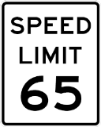
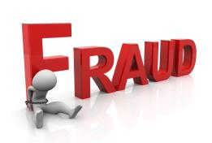
Why Audit?
Do not have enough information during decision making time to make a judgment whether an access request is valid
It is difficult to weigh in all possible conditions of a valid access request
Specially relevant when legitimacy of access request depends on contextual information

Slide 8
Our concentration today is user authentication

Slide 9
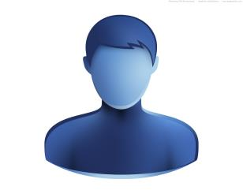


Scenarios Requiring User Authentication
Logging into a local computer
Logging into a remote computer
Logging into a network
Accessing websites
(A) I am John
(B) Yeah, Right.
(C) I am John, here is my token
(D) OKAY

Slide 10
Authentication Token
Based on something the user know
  Example: Passphrase, password
Based on something the user possesses
  Example: Smart card or token
Based on something the user is
  Example: Biometric

Slide 11
Proposals of Authentication Token
Cryptography-based
Others
  Passwords
  Biometrics
  Graphical passwords
  2-factor authentication
  Out of band authentication

Slide 12
Cryptography-based Designs
One-time passwords
  Each password is used only once
  Defend against adversary who can eavesdrop and later impersonate
Challenge-response
  Send a response related to the password and a challenge
Zero-knowledge proof of knowledge
  Prove knowledge of a value without revealing it (Out of scope)

Slide 13
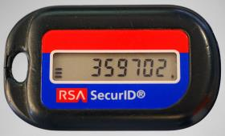
One-Time Passwords (OTP)
Two parties share a list of one-time passwords
Time synchronized OTP
  Example: MAC_{K}(t) where t is the current time
Using a hash chain
(Proposed by Lamport)
  H(s), H(H(s)), …, H¹⁰⁰⁰(s)
  Use these hash values in reverse order

Slide 14
Lamport’s One-Time Password
Setting: A wants to authenticate itself to B
Initialization:
  A selects an arbitrary value S, a hash function H(), and integer value t
  A computes w₀ = H^{t}(S) and sends w₀, and H() to B
  B stores w₀
Protocol: To authenticate to B at time i where 1 <= i <= t
  A sends to B: A, i, w_{i} = H^{t-i}(S)
  B checks: i = i_{A}, H(w_{i}) = w_{i-1}
  If both holds, i_{A} = i_{A} + 1

Slide 15
Challenge-Response Protocols
Goal: one entity authenticates to other entity proving the knowledge of a secret, ‘challenge’
How to design this using the crypto tool we have learned?
Approach: Use time-variant parameters to prevent replay, interleaving attacks, provide uniqueness and timeliness
  Example: nonce (used only once), timestamps

Slide 16
Challenge-Response Protocols
Unilateral authentication (timestamp-based)
  A to B: MAC_{K}(t_{A}, B)
Unilateral authentication (nonce-based)
  B to A: r_{B}
  A to B: MAC_{K}(r_{B}, B)
Mutual authentication (nonce-based)
  B to A: r_{B}
  A to B: r_{A}, MAC_{K}(r_{A}, r_{B}, B)
  B to A: MAC_{K}(r_{B}, r_{A})

Slide 17
Public-key Cryptography
Cleverly use Digital Signature to authenticate to a party.
(This will be covered later)

Slide 18
Passwords
Oldest and most common form of authentication token due to its ease of deployment
1961 Compatible Time-Sharing System at MIT was most likely the first deployment of passwords
Password was deployed in traditional computer systems like MULTICS and Unix in the 1970

Slide 19
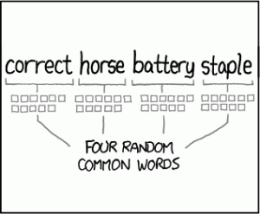
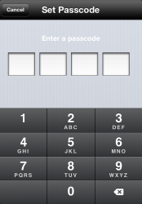
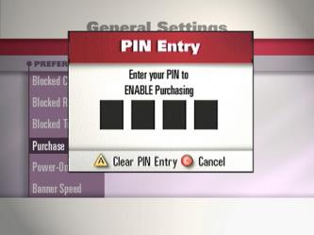
Variations of Passwords
Passphrase
  A sequence of words or other text used for similar purpose as password
Passcode
Personal Identification Number (PIN)

Slide 20
Attractive Properties of Password
Easily deployable
  No need for additional hardware
Customizable
  Choose your own password
Convenient to replace
Ease of use

Slide 21
Problems with Passwords
For security, it is desirable for passwords to be unpredictable
However, it is difficult to remember highly random things
Recent survey showed, an individual on average has 106 online accounts
It is desired for individuals to not have the same password for all accounts

Slide 22
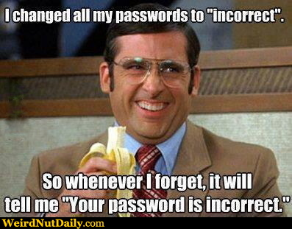
Problems with Passwords
There is an inherent tension between security and usability of passwords

Slide 23
Usability Metrics
Sentiment
  Creation difficulty, recall difficulty
Time
  Password creation and recall
Memorability
  Recall attempts, password writedown

Slide 24
Human Memory
Human Memory is semantic
Human memory is associative
Human memory is lossy

Slide 25
Human memory is Semantic
Memorize: nbccbsabc
Memorize: tkqizrlwp
3 Chunks vs. 9 Chunks!
Usability Goal: Minimize Number of Chunks
Source: The magical number seven, plus or minus two [Miller, 56]

Slide 26
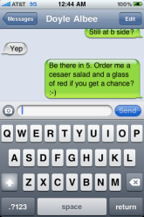
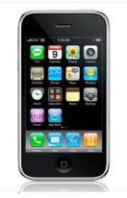
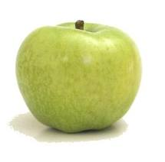

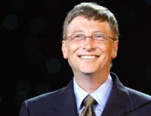

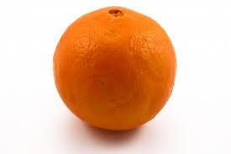
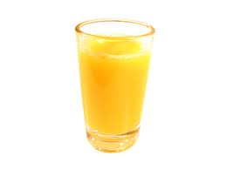
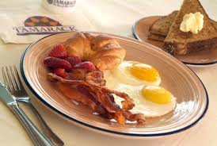
Human memory is Associative
?

Slide 27
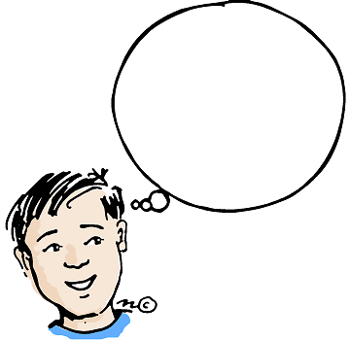
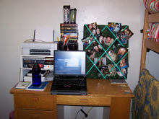


Cues
Cue: context when a memory is stored
Surrounding Environment
  Sounds
  Visual Surroundings
  Web Site
  ….
As time passes we forget some of
this context…

Slide 28

Human memory is Lossy
Rehearse or Forget!
  How much work?
Quantify Usability
  Rehearsal Assumption
p_{amazon}
????
p_{google}

Slide 29
Usability Question
Important Question: Are human inherently bad at remembering random information?
Answer: Not really, with proper training
Paper: Towards reliable storage of 56-bit secrets in human memory (USENIX-2014)

Slide 30
Example of Weak Passwords (Wikipedia)
Default passwords (as supplied by the system vendor and meant to be changed at installation time): password, default, admin, guest, etc.
Dictionary words: chameleon, RedSox, sandbags, bunnyhop!, IntenseCrabtree, etc.
Words with numbers appended: password1, deer2000, john1234, etc.,
Words with simple obfuscation: p@ssw0rd, l33th4x0r, g0ldf1sh, etc.
Doubled words: crabcrab, stopstop, treetree, passpass, etc., can be easily tested automatically.

Slide 31
Example of Weak Passwords (Wikipedia)
Common sequences from a keyboard row: qwerty, 12345, asdfgh, fred, etc.
Numeric sequences based on well known numbers such as 911, 314159, or 27182, etc.,
IDs: jsmith123, 1/1/1970, 555–1234, etc.,
Personal Info: license plate number, SSN, telephone number, student ID, address, birthday, relative's or pet's names, etc.,
  Can easily be tested automatically after a simple investigation of person's details.

Slide 32
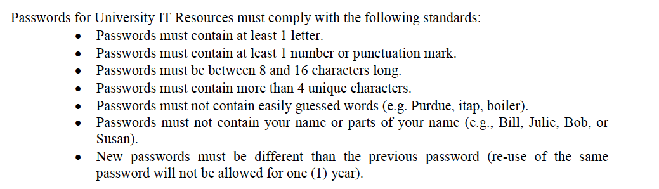
Password Composition Policy
Password Generated: P@ssw0rd1

Slide 33
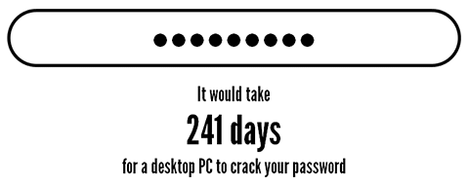
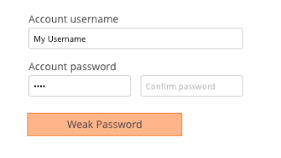

Password Strength
  One possible approach of deterring users from creating weak passwords is to notify them whenever they have created a weak password
  Just this information is sometimes good enough to make the user create a stronger password

Slide 34
Password Strength
The average number of guesses the attacker must make to find the correct password
  Determined by how unpredictable the password is, including how long the password is, what set of symbols it is drawn from, and how it is created.
The ease with which an attacker can check the validity of a guessed password
  Determined by how the password is stored, how the checking is done, and any limitation on trying passwords

Slide 35
Password Entropy
The entropy bits of a password (also known as guess entropy), i.e., the information entropy of a password, measured in bits, is
  The base-2 logarithm of the number of guesses needed to find the password with certainty
  A password with, say, 42 bits of strength calculated in this way would be as strong as a string of 42 bits chosen randomly
  Adding one bit of entropy to a password doubles the number of guesses required

Slide 36
Password Entropy Estimation
People are bad at achieving sufficient entropy to produce satisfactory passwords
NIST suggests the following scheme to estimate the entropy of human-generated passwords:
  The entropy of the 1st character is 4 bits;
  The entropy of the next 7 characters are 2 bits per character;
  The 9th through the 20th character has 1.5 bits of entropy per character;
  Characters 21 and above have 1 bit of entropy per character.
This would imply that an 8 character human-selected password has about 18 bits of entropy.

Slide 37
Towards a Better Estimation of Password Entropy
NIST suggestion fails to consider usage of different category of characters: Lower-case letters, digits, upper-case letters, special symbols
Orders also matter: “Password123!” should have different entropy from “ao3swPd!2s1r”
State of art: Variable-order markov chains to model probability of different strings as passwords: “A Study of Probabilistic Password Models” by Ma, Yang, Luo, Li in IEEE S&P 2014.
Fundamental challenge: there are different attack strategies out there, which try passwords with different ordering
.

Slide 38
Mechanisms to Avoid Weak Passwords
Allow long passphrases, forbid short passwords
Randomly generate passwords when appropriate
Give user suggestions/guidelines in choosing passwords
  Example: Think of a sentence and select letters from it, “It’s 12 noon and I am hungry” => “I’S12&IAH”
  Using both letter, numbers, and special characters
Check the quality of user-selected passwords
  Run dictionary attack tools and other sanity checks
  Evaluate strength of a password and explain the weaknesses
Active research area

Slide 39
Password Entropy and Usability
Forcing users to only use randomly generated password is bad
The “Weakest Link” security principle applies:
  Often times, guessing passwords is not the weakest link
  One can use various ways to reduce adversary’s abilities to test password guesses
  Forgotten password:
    The recovering method either has low security, or costs lots of money
    It creates a weaker link.
Notes:
Password expiration serves two purposes:
if the time to crack a password is estimated to be 100 days, password expiration times fewer than 100 days may help ensure insufficient time for an attacker.
if a password has been compromised, requiring it to be changed regularly should limit the access time for the attacker
Some argue that password expirations have become obsolete:
asking users to change passwords frequently encourages simple, weak passwords.
if one has a truly strong password, there is little point in changing it since the existing password is already strong.

Slide 40
Relevant Security Principle
Psychological acceptability:
  It is essential that the human interface be designed for ease of use, so that users routinely and automatically apply the protection mechanisms correctly. Also, to the extent that the user's mental image of his protection goals matches the mechanisms he must use, mistakes will be minimized. If he must translate his image of his protection needs into a radically different specification language, he will make errors.
  Taken from Saltzer & Schroeder: “The Protection of Information in Computer Systems”, which identifies 8 security principles, including the “open design” principle

Slide 41
Threats to Passwords
Eavesdropping (insecure channel between client and server)
Login spoofing (human errors), shoulder surfing, keyloggers
Offline dictionary attacks
Social engineering (human errors)
  Pretexting: creating and using an invented scenario (the pretext) to persuade a target to release information or perform an action and is usually done over the telephone
Online guessing (weak passwords)

Slide 42
Offline Dictionary Attacks
With the frequent data breaches offline dictionary attacks have become a real worry for system designers and security experts
Company | Victims
Adobe | 2.9 million
Evernote | 50 million
Twitter | 250,000
Living Social | 50 million

Slide 43
Password Storage (UNIX)
  The file /etc/passwd stores H(password) together with each user’s login name, user id, home directory, login shell, etc.
    H is essentially an one-way hash function
    Roger Needham and Mike Guy in the 1960s proposed storing password hashes
    The file /etc/passwd must be world readable
  Brute force attacks possible
    How to most effectively brute-force when trying to obtain password of any account on a system with many accounts?

Slide 44
Password Salts
More modern UNIX systems divide /etc/password into two files: /etc/password; and /etc/shadow (readable only by root)
Store [r, H(password,r)] rather than H(password) in /etc/shadow
  r is randomly chosen for each password
  r is public, similar to IV in CBC & CTR modes
Benefits
  Dictionary attacks much more difficult
    Single account attack cost remains the same
  Same password would have different hashes

Slide 45
Dictionary and Guessing Attacks
Protect stored passwords with cryptography and access control
  “Defense in Depth” principle is applicable:
    Use multiple independent methods of defense, so that even if one layer fails, security is still not compromised
    Example: Consider password dataset compromises
Disable accounts with multiple failed attempts
Require extra authentication mechanism
Notes:
Multiple safety nets

Slide 46
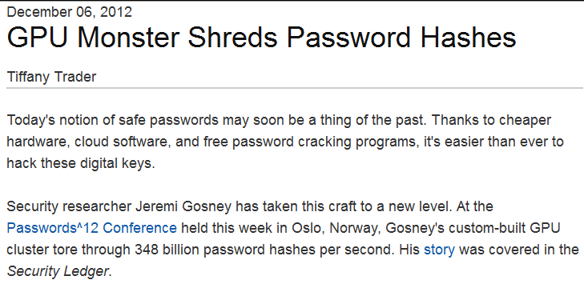
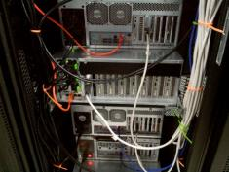
New Age of Offline Attacks

Slide 47
New Age of Offline Attacks
Attackers are building ASIC (Application Specific Integrated Circuits) for password cracking
They are very efficient in calculating hash values, e.g., 355 million SHA2 hashes/s
Relies on Graphical Processing Units (GPUs)
http://hashcat.net/oclhashcat/

Slide 48
Defenses against Offline Attacks
Intentionally make the hash functions slow, e.g., bcrypt, scrypt
Some on-going work on cost asymmetric hash function designs (CASH)
  Easy to verify a hash
  Difficult to carry out a dictionary/brute-force attack

Slide 49
Attack Strategy
Dumb Attacker | Smart Attacker
AAAAAA | password
AAAAAB | iloveyou
AAAAAC | monkey
AAAAAD | 12345678
AAAAAE | password1
…… | ……

Slide 50
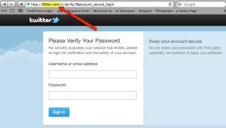
Login Spoofing
Login Spoofing Attacks:
  write a program showing a login window
  on screen and record the passwords
  put su in current directory
Defense: Trusted Path
  Mechanism that provides confidence that the user is communicating with the real intended server
    Attackers can't intercept or modify whatever information is being communicated.
    Defends attacks such as fake login programs
  Example: Ctrl+Alt+Del for log in on Windows
    Causes a non-maskable interrupt that can only be intercepted by the operating system, guaranteeing that the login window cannot be spoofed
Notes:
Principle of the Trusted Path (Yee, Ka-Ping): The most important input and output channels are those used to manipulate authorities; if these channels can be spoofed or corrupted, the system has a security vulnerability. Hence the principle of the trusted path: the user must have an unspoofable and incorruptible channel to any entity trusted to manipulate authorities on the user's behalf. The authority-manipulating entity could be a number of different things, depending on the domain. In an operating system, the authority-manipulating entities would be the operating system and user interface components for handling authorities.

Slide 51
Spoofing Attack on the Web
Phishing attacks
  Attempting to acquire sensitive information such as usernames and passwords details by masquerading as a trustworthy entity in electronic communication.
Website forgery
  Set up fake websites that look like e-commerce sites and trick users into visiting the sites and entering sensitive info
Defenses
  Browser filtering of known phishing sites
  Cryptographic authentication of servers
  User-configured authentication of servers
    To ensure that the site is the one the human user has in mind
    E.g., site key, pre-selected picture/phrases

Slide 52
KeyLogging
Threats from insecure client side
Keystroke logging is the action of logging the keys typed on a keyboard, typically in a covert manner so that the person using the keyboard is unaware that their actions are being monitored.
Software-based: key-stroke events, grab web forms, analyze HTTP packets
Hardware-based: Connectors, wireless sniffers, acoustic based
Defenses: Anti-spyware, network monitors, on-screen soft keyboard, automatic form filler, etc.
In general difficult to deal with once on the system

Slide 53
Recent Study by Us
How different people create the same passwords?
31.5%

Slide 54
Alternative Proposals

Slide 55





Honeywords: Making Password Cracking Detectable
P₁
P₂
…
P_{n-1}
P_{n}
_{Password/Honeyword Checker}
Honeywords
Real
Password
Alice

Slide 56
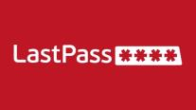

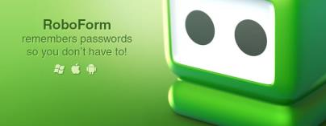
Password Managers
A software that generates random passwords for each website and stores them in a cryptographically secure manner.
Requires a master password.
Web-based or local
What is the problem with having a password manager manage your passwords?

Slide 57
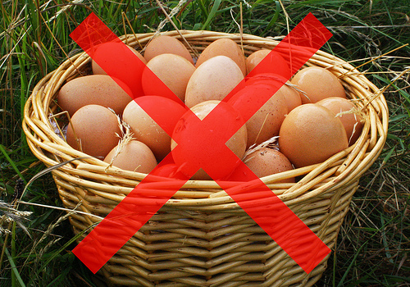
Password Managers
One single point of failure.
One master password protecting all your passwords.

Slide 58


GOTCHA
Shows random computer generated
inkblot images
Depends on human imagination
to give it an interpretation
Steroid Cow
Evil Clown

Slide 59
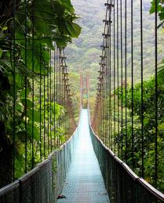
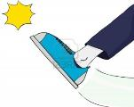
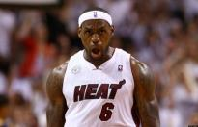

Naturally Rehearsing Password
Public Cue
Private
Object: bike
Action: kicking
Object: penguin

Slide 60
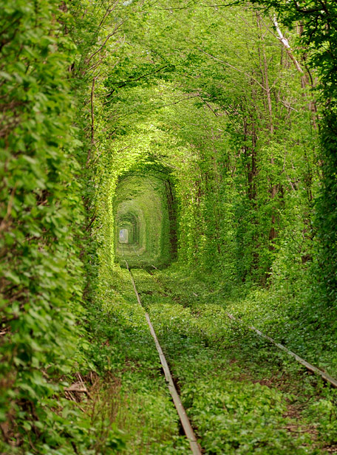
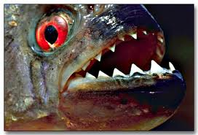
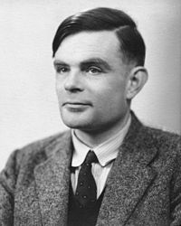

Naturally Rehearsing Password
Person | Alan Turing
Action | Kissing
Object | Piranha

Slide 61
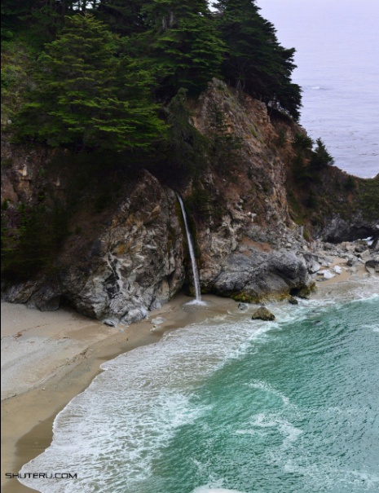

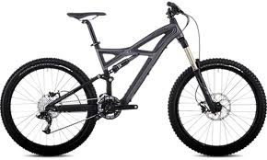
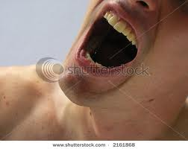
Naturally Rehearsing Password
Person | Bill Gates
Action | swallowing
Object | bike

Slide 62


Using the Password
…
Pwd
Kis+pir
Kic+Pen + ... +

Slide 63
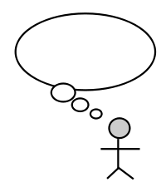



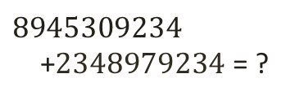
Human Computable Password
Restricted
  Simple operations (addition, lookup)
  Operations performed in memory (limited space)
$$8945309234$$
+2348979234 = ?
$$9+8=7 mod 10$$

Slide 64


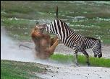
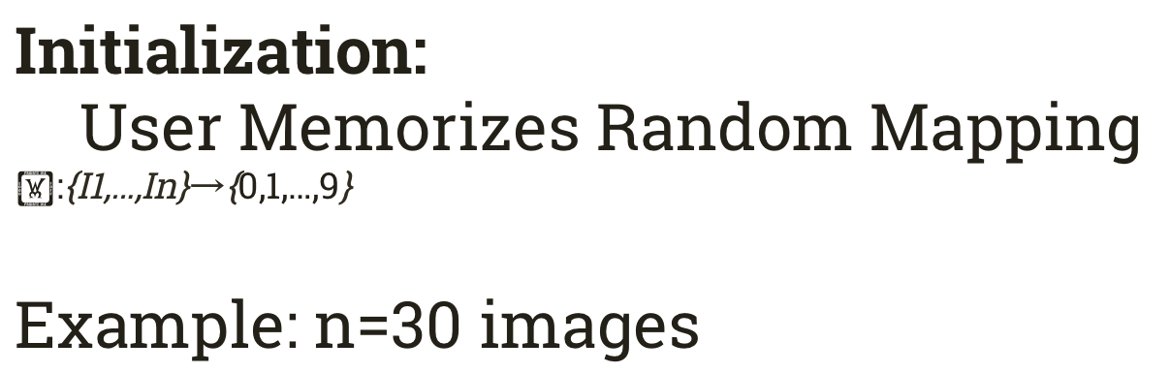
Image to Digit Mapping
Image I |  |  | …
(I) | 9 | 3 | … | 6
Initialization:
User Memorizes Random Mapping
Example: n=30 images

Slide 65

Mnemonics
⬧ = 4
Instruction: Remember that the eagle has a gold beak. There are four letters in “gold” and “beak”.

Slide 66
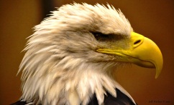
Mnemonics
⬧ = 7
Instruction: Trace the eagles body from the bottom of the eagle’s beak down to the bottom of the picture. It looks like the number 7.

Slide 67

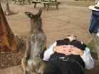











Challenge Response
0
1
2
3
4
5
6
7
8
9
Response:
⬧ +  mod 10
= 9+3 mod 10 = 2

Slide 68
Biometrics
Your fingerprint is your ID!
Your fingerprint is pretty unique
Your fingerprint is convenient to carry.

Slide 69
Biometrics
Your fingerprint is your ID!
  Your fingerprint is a lot more valuable to other people than it used to be
Your fingerprint is pretty unique
  You have limited number of biometrics, so if Google and Microsoft use the same biometric, they can authenticate as you to each other
Your fingerprint is convenient to carry
  Unfortunately, biometric readers are a lot less convenient to deploy. They generally require special hardware

Slide 70
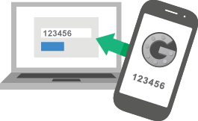
Two Factor Authentication
Somebody steals your password, you can steal be safe
Requiring two factor authentication all the time is not very usable

Slide 71
Additional Materials
TED talk by Bruce Schneier on trade-off: http://www.ted.com/talks/bruce_schneier#t-625467
TED talk by Lorrie Faith Cranor on passwords: http://www.ted.com/talks/lorrie_faith_cranor_what_s_wrong_with_your_pa_w0rd#t-764198
Famous XKCD comic on password strength: https://xkcd.com/936/
News article explaining password cracking strategy: http://arstechnica.com/security/2013/05/how-crackers-make-minced-meat-out-of-your-passwords/2/
Hashcat password cracking website: http://hashcat.net/oclhashcat/

Slide 72
Interesting Papers
Towards Reliable Storage of 56-bit Secrets in Human Memory: https://www.usenix.org/system/files/conference/usenixsecurity14/sec14-paper-bonneau.pdf
GOTCHA Password Hackers!: http://www.cs.cmu.edu/~jblocki/papers/aisec2013-fullversion.pdf
Naturally-Rehearsing Passwords: http://www.cs.cmu.edu/~jblocki/crypto2013.pdf
The Magical Number Seven, Plus or Minus Two: http://www.psych.utoronto.ca/users/peterson/psy430s2001/Miller%20GA%20Magical%20Seven%20Psych%20Review%201955.pdf
A Study of Probabilistic Password Models : http://www.ieee-security.org/TC/SP2014/papers/AStudyofProbabilisticPasswordModels.pdf
The Quest to Replace Passwords: A Framework for Comparative Evaluation of Web Authentication Schemes: http://www.cl.cam.ac.uk/~fms27/papers/2012-BonneauHerOorSta-password--oakland.pdf
Passwords and the Evolution of Imperfect Authentication: http://research.microsoft.com/pubs/250408/passwordsAndImperfectAuth.pdf

Slide 73
Acknowledgement
Most of the materials of this slide deck is taken from the slides of
Ninghui Li,
Lorrie Faith Cranor, and
Jeremiah Blocki

Slide 74
Next Topic
Continuation of Public Key Cryptography

