Slide 1

DNS Security
Information Security
CS 526
Omar Chowdhury

Slide 2

Reading for This Lecture
Optional:
  First attack by Schuba and Spafford - http://www.openbsd.org/advisories/sni_12_resolverid.txt
  An Illustrated Guide to the Kaminsky DNS Vulnerability
  Dan Kaminsky's Black Hat presentation (PowerPoint)

Slide 3
Purpose of Naming
Addresses are used to locate objects
Names are easier to remember than numbers
You would like to get to the address or other objects using a name
DNS provides a mapping from names to resources of several types

Slide 4
Domain Name System (DNS)
Forward DNS Resolution
  Given a domain name lookup the associated IP address
  Example: cs.purdue.edu ⇒ 128.10.19.20
Reverse DNS lookup
  Given an IP address lookup the domain name associated with the IP address
  Usage: Network troubleshooting, anti-spam techniques

Slide 5
DNS—Distributed Database
DNS records are kept in a distributed fashion
Highly dynamic
Decentralized authority

Slide 6
DNS–Hierarchical Namespace
Top-level domains (TLD)

Slide 7
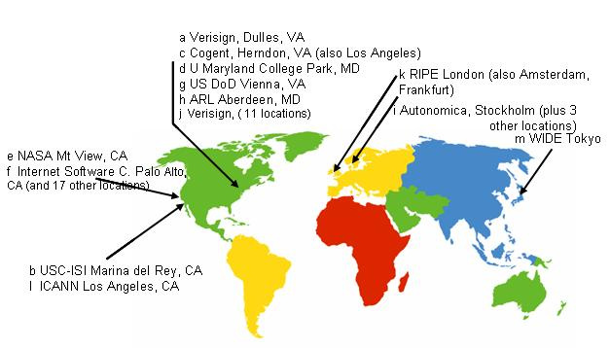
Root DNS Servers

Slide 8
Domain Name Servers
Top-level domain (TLD) servers
  Responsible for com, org, net, edu, etc.
  All top-level country domains, e.g. uk, fr, ca, jp, in.
  Network Solutions, LLC controls com servers
Authoritative DNS servers
  Organization’s DNS servers, providing authoritative hostname to IP mappings for organization’s servers.
  Can be maintained by organization or service provider
Local DNS servers
  Not strictly part of the domain hierarchy
  Each ISP (university, hospital, company) has one
cs.purdue.edu’s authoritative DNS servers are:
pendragon.cs.purdue.edu.
ns.purdue.edu.
harbor.ecn.purdue.edu.
ns2.purdue.edu.

Slide 9
DNS Resolving
When a host makes a DNS query, it is forwarded to a local upstream resolver
  The local upstream resolver acts as a proxy and forwards query into the domain name hierarchy
Two resolution schemes:
  Iterative
  Recursive

Slide 10
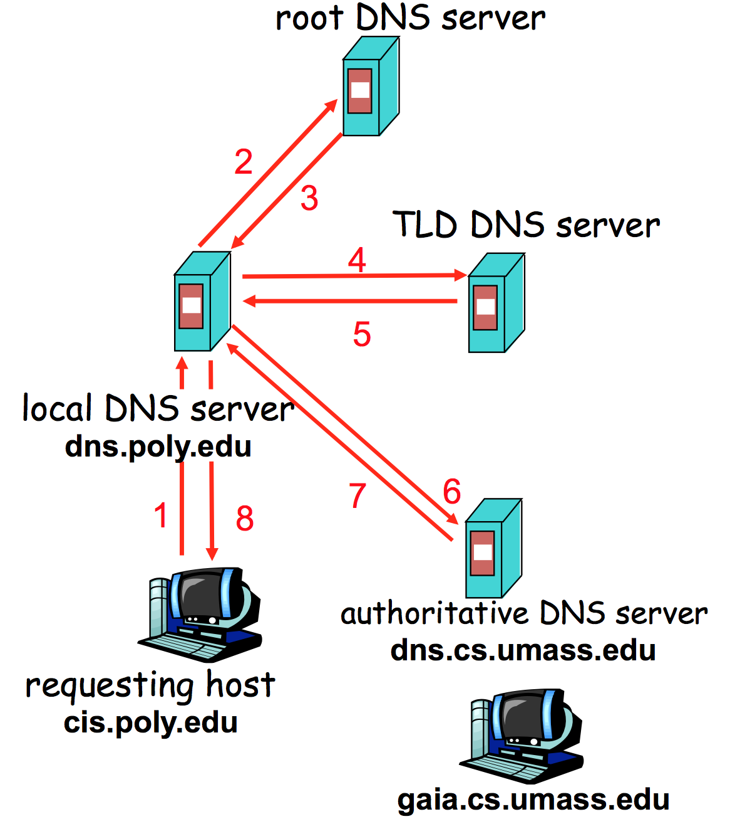
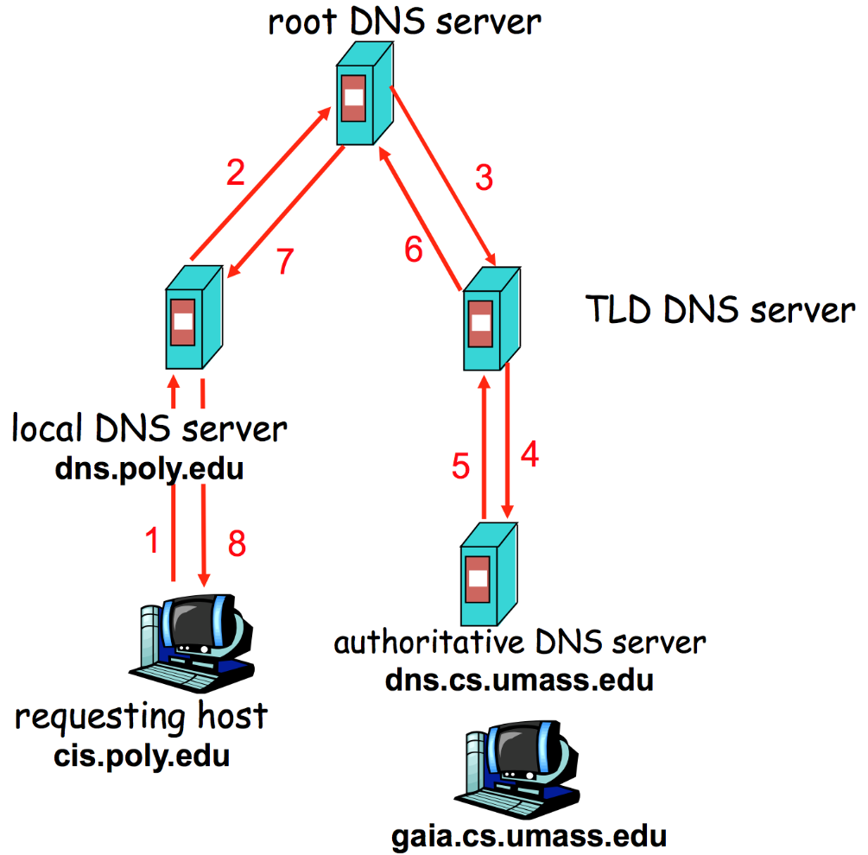
Iterative and Recursive Resolution
Iterative
Recursive

Slide 11
DNS Result Caching
DNS responses are cached
  Enables responding to the same query fast
Negative results are cached too
  Saves time for nonexistent sites, e.g., mistyping
Cached data has expiration
  Each DNS record (also known as, resource record or just RR) has an associated field called Time-To-Live (in short, TTL)

Slide 12
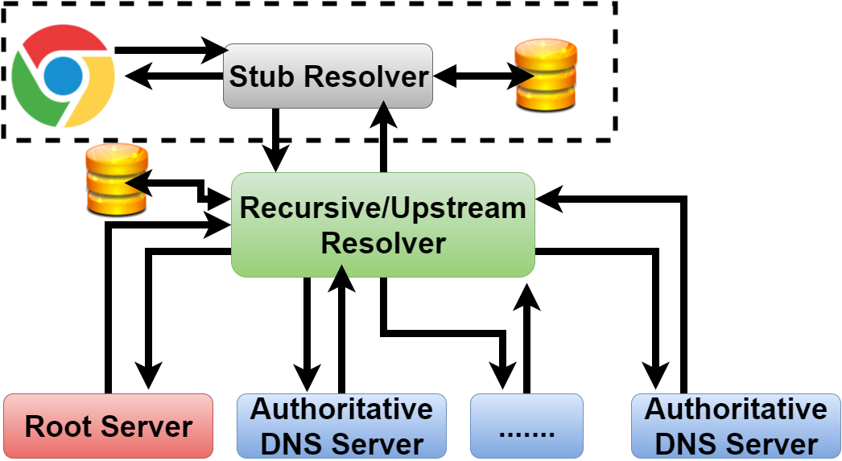
DNS Name Resolution

Slide 13
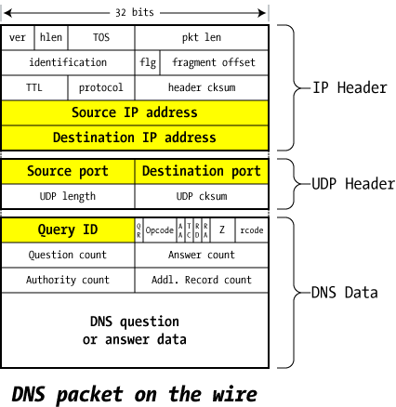
DNS Packet in the Wire
1-bit, 0-Query, 1-Ans
0-query
16-bit ID (TXID)
1 for Authoritative
Answer,
0-otherwise
Response code
from server
1 for truncated
answer
1 for recursion available
1 for recursion desired

Slide 14
Selective DNS Record Types
A record
  Domain name to IP mapping
NS record
  Information about (authoritative) DNS server
MX record
  Mail exchange record
SOA record
  Key information about the zone (e.g., contact address of the admin)
CNAME record
  Canonical or alias of a domain
TXT record
  Textual description of the domain

Slide 15
DNS Packet Payload
Question Section
  Contains the question asked
Answer Section
  Contains the records that answer the question
Authority Section
  Contains the records that point to domain authority
Additional Section
  Glue records
  IP address of the domain authorities
  Break circular dependency

Slide 16
DNS Name Resolution
www.unixwiz.net
A.ROOT-SERVERS.NET. IN A 198.41.0.4
B.ROOT-SERVERS.NET. IN A 192.228.79.201
C.ROOT-SERVERS.NET. IN A 192.33.4.12
...
M.ROOT-SERVERS.NET. IN A 202.12.27.33
/* Authority section */
NET. IN NS A.GTLD-SERVERS.NET.
IN NS B.GTLD-SERVERS.NET.
IN NS C.GTLD-SERVERS.NET.
...
IN NS M.GTLD-SERVERS.NET.
/* Additional section - "glue" records */
A.GTLD-SERVERS.net. IN A 192.5.6.30
B.GTLD-SERVERS.net. IN A 192.33.14.30
C.GTLD-SERVERS.net. IN A 192.26.92.30
...
M.GTLD-SERVERS.net. IN A 192.55.83.30
www.unixwiz.net
www.unixwiz.net
/* Authority section */
unixwiz.net. IN NS cs.unixwiz.net.
IN NS linux.unixwiz.net.
/* Additional section - "glue" records */
cs.unixwiz.net. IN A 8.7.25.94
linux.unixwiz.net. IN A 64.170.162.98

Slide 17
Inherent DNS Vulnerabilities
Users typically trust the host-address mapping provided by the DNS
  What can go wrong with bad DNS information?
DNS resolvers trust responses received after sending out queries
  How can one exploit this?
Root of all evil:
  No authentication for DNS responses

Slide 18
User side attack—Pharming
Exploit DNS poisoning attack
  Change IP addresses to redirect URLs to bad sites
  Potentially more dangerous than phishing attacks
DNS poisoning attacks are not uncommon:
  January 2005, the domain name for a large New York ISP, Panix, was hijacked to a site in Australia
  November 2004, Google and Amazon users were sent to Med Network Inc., an online pharmacy

Slide 19
DNS Cache Poisoning
Attacker wants his IP address returned for a DNS query
When the resolver asks ns1.google.com for www.google.com, the attacker could reply first,
with his own IP
What is supposed to prevent this?
Transaction or Query ID
  16-bit random number
  The real server knows the number, because it was contained in the query
  The attacker has to guess

Slide 20
DNS Cache Poisoning (contd.)
Responding before the real DNS server
  An attacker can guess when a DNS cache entry times out and a query has been sent, and provide a fake response.
  The fake response will be accepted only when its 16-bit transaction ID matches the query
  CERT reported in 1997 that BIND uses sequential transaction ID and is easily predicted
    fixed by using random transaction IDs

Slide 21
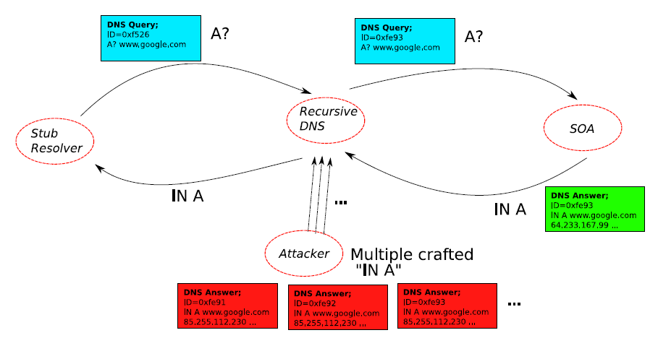
DNS Cache Poisoning: Racing to Respond First

Slide 22
DNS Cache Poisoning Attack 1 Schuba and Spafford in 1993
Intuition: Predictable Query ID (QID)
First, guess QID:
  Ask (dns.target.com) for www.evil.org
  Request is sent to dns.evil.org (get QID)
  Attacker controls dns.evil.org
Second, attack:
  Ask (dns.target.com) for www.yahoo.com
  Gives responses from dns.yahoo.com to the attackers chosen IP

Slide 23
Defense: the Bailiwicks Rules
The bailiwick system prevents foo.com from declaring anything about com, or some other new TLD, or www.google.com
Using the bailiwicks rules
  The root servers can return any record
  The com servers can return any record for com
  The google.com servers can return any record for google.com

Slide 24
DNS Cache Poisoning Attack 2 Birthday Attack – Vagner Sacramento 2002
Have many clients send the same DNS request to the resolver
Each such request generated a DNS query
Send hundreds of reply with random TXID at the same time
Due to birthday paradox, the success probability can be close to 1:
  With a few hundred client queries and several hundred fake responses
Defense– Rate limiting
For all the client queries asking for the same domain name, only send out one DNS query

Slide 25
DNS Cache Poisoning – so far
Early versions of DNS servers deterministically incremented the ID field
Vulnerabilities were discovered in the random ID generation
  Weak random number generator
  The attacker is able to predict the ID if knowing several IDs in previous transactions
Birthday attack
  16- bit (only 65,536 options).
  Force the resolver to send many identical queries, with different IDs, at the same time
  Increase the probability of making a correct guess

Slide 26
DNS Cache Poisoning Attack 3 Dan Kaminsky 2008
Kaminsky Attack
  Big security news in summer of 2008
  DNS servers were quickly patched to defend against this attack
  Sophisticated attack
In prior attacks, when the attacker loses the race, the record is cached with a TTL
  Before TTL expires, new instance of the attack cannot be carried out
  Poisoning address for google.com in a DNS server is not easy

Slide 27
Features of Kaminsky Attack
The attacker does not need to wait to launch an attack
The bad guy asks the resolver to look up www.google.com
  If the bad guy lost the race, the other race for www.google.com will be suppressed by the TTL
If the bad guy asks the resolver to look up 1.google.com, 2.google.com, 3.google.com, and so on
  Each new query starts a new race
Eventually, the bad guy will win
  he is able to spoof 183.google.com
  So what? No one wants to visit 183.google.com

Slide 28
Kaminsky-style Poisoning
A bad guy who wins the race for “183.google.com” can end up stealing “www.google.com” as well
Original malicious response:
  google.com NS www.google.com
  www.google.com A 6.6.6.6
Killer response:
  google.com NS ns1.google.com
  ns1.google.com A 12.34.56.78 [GLUE RECORD]

Slide 29
Kaminsky-style Poisoning
Why does it succeed?
  The attacker can start a new instance of attack anytime without waiting for the cache entry to expire
  No wait penalty for racing failure
  The attack is only bandwidth limited

Slide 30
Defenses based on increasing the entropy

Slide 31
Defense – 1
(Source Port Randomization)
Use a random source port for each out-going DNS query
Entropy: 16-bit (from TXID) + 11-bit (from source port) = 27-bit entropy
To win, the attacker has a much bigger space of possible IDs to forge a valid response
Limitation: When the resolver is behind a NAT device, the additional entropy provided by source port randomization is low (e.g., 2 bits)

Slide 32
Defense – 2
(0x20 Randomization)
Domain names are case-insensitive
www.google.com and WWW.GOOGLE.COM resolves to the same IP address
Randomly change some of the characters in the domain name to upper case letters
The expectation is that the resolver responding will copy the domain name in the response from the query
Limitations:
  Attacker can query: www.123.com
  Some of the resolvers always return domain name in all lower-case
  Some of the resolvers use a case-sensitive matching
  70% resolvers support 0x20 randomization

Slide 33
Defense – 3
(WSEC DNS)
While querying root or TLD DNS servers, preprend random prefix
Ddsj030gojfd.www.google.com and www.google.com returns the same RRs
(not IP)
Limitations:
  Domain names can be maximum 255-byte length
  Attackers can query 255-byte domains
  This is applicable to referrals not A queries
  Some resolvers exclude long domain names as they are uncommon

Slide 34
Defense – 4
(Randomize destination IP address)
Multiple IP addresses for a DNS server
Choose one randomly from that list to query
Limitations:
  The set of IP addresses are small
  They are many time predictable
  Attack it to make it more predictable
ns.purdue.edu. 86400 IN A 128.210.11.5
ns2.purdue.edu. 86400 IN A 128.210.11.57
harbor.ecn.purdue.edu. 86400 IN A 128.46.154.76
pendragon.cs.purdue.edu. 86400 IN A 128.10.2.5

Slide 35
Defense—5
(Randomizing Source IP)
This is called the NAT-antidote
This is applicable when the resolver is behind a NAT
When NAT receives a query from the resolver, it randomly changes the source IP address to a random IP in that network
Limitations:
  Extra entropy depends on the network size

Slide 36
Adaptive & Long-term Defenses

Slide 37
Attack Detection
Received a response for a query and the TXID of the response does not match with the query’s TXID
Can happen in benign cases as DNS runs on top of UDP

Slide 38
Defense—6
(Sandwich Antidote)
Detect attack and apply sandwich antidote
For querying www.google.com
  Query 1: dfjfdkjfhksdf.google.com
  Query 2: www.google.com [REAL QUERY]
  Query 3: jkjkjoiojohh.google.com
Observe whether the response arrive in-order
Limitation:
  Our experiment suggest that 50% of the queries arrive in order

Slide 39
Defense—7
(DNSSEC)
Proposed as a long-term solution
Uses digitally signed responses
Prevents cache poisoning attacks
Limitations:
  Adoption is very slow– 1% of all the .com and .net domains are secured by DNSSEC
  Opens door for DoS attack due to large response size

Slide 40
Defense – 8
(Use TCP)
Run DNS protocol on top of TCP instead of UDP
Limitations:
  High latency (almost 2X)
  Resolver throughput rate (1/10th)
  Not all resolvers support TCP
  In our experiment with Alexa’s top 15K domains, 10% of their authoritative nameservers do not support TCP – includes Facebook

Slide 41
Defense – 9
(Adaptively use TCP)
Run DNS protocol on top of TCP instead of UDP only when detected attack
Nominum implemented it in their product Vantio CacheServe
Limitations:
  Attack detection is not fine-grained – benign cases will be considered as attack
  Same as before
  Susceptible to the new attack we have proposed

Slide 42
Acknowledgement
Some of the slide materials are inspired by materials from Ninghui Li and http://unixwiz.net/.

