Slide 1

CS252: Systems Programming
Ninghui Li
Based on Slides by Prof. Gustavo Rodriguez-Rivera
Topic 15: Internet Overview

Slide 2
History of the Internet
1962 Galactic Network idea (J.C.R. Licklider of MIT)
Envisions a globally interconnected set of computers through which everyone could quickly access data and programs from any site
1961-1965 packet switching (Leonard Kleinrock at MIT
1967 Lawrence G. Roberts publishes plan for ARPANET
1968 Frank Heart led team at BBN to build packet switches called Interface Message Processors (IMP's)
Notes:
1/3 of the more than 6 billion people use it every day
Change from telephone network. Central switches, and physical wires are connected.
- Rumor (likely source from a RAND report): Scientists and military experts were especially concerned about what might happen in the event of a Soviet attack on the nation’s telephone system. Just one missile, they feared, could destroy the whole network of lines and wires that made efficient long-distance communication possible. In 1962, a scientist from M.I.T. and ARPA named J.C.R. Licklider proposed a solution to this problem: a “galactic network” of computers that could talk to one another. Such a network would enable government leaders to communicate even if the Soviets destroyed the telephone system.
In 1965, another M.I.T. scientist developed a way of sending information from one computer to another that he called “packet switching.” Packet switching breaks data down into blocks, or packets, before sending it to its destination. That way, each packet can take its own route from place to place. Without packet switching, the government’s computer network—now known as the ARPAnet—would have been just as vulnerable to enemy attacks as the phone system.

Slide 3
History of the Internet
1969 ARPANET started with 2 nodes, goes to 4 nodes
1972 email introduced
1973- Vinton G. Cerf and Robert E. Kahn developed TCP/IP to support connecting different networks: 4 ground rules
Each distinct network stands on its own
Communications on best effort basis
Blackboxes (gateways/routers) connect networks
Simply forward packets based on local decision. End hosts deal with errors.
No global control at operation level
Notes:
Each distinct network would have to stand on its own and no internal changes could be required to any such network to connect it to the Internet.
Communications would be on a best effort basis. If a packet didn't make it to the final destination, it would shortly be retransmitted from the source.
Black boxes would be used to connect the networks; these would later be called gateways and routers. There would be no information retained by the gateways about the individual flows of packets passing through them, thereby keeping them simple and avoiding complicated adaptation and recovery from various failure modes.
There would be no global control at the operations level.

Slide 4
History of the Internet
First computer virus: creeper (which year?)
World Wide Web (Tim Berners-Lee) (Which year?)
Some people attribute the increase in productivity in the last 15 years to the existence of the Internet. People produce more in less time.
Notes:
Creeper: 1971. Copy itself to each system.
WWW: 1980. Tim Berners-Lee build tool to play with hypertext.
1990. HTTP protocol 0.9. HTML. First web browser.

Slide 5
Internet Architecture
The Internet is a collection of
Networks
Routers interconnecting networks
Hosts connected to networks.
H
H
H
H
R
Network
R
Network
Network
H
H
H
Network
H
H
H
H

Slide 6
Internet Architecture
The networks may be implemented using different kinds of hardware: Ethernet, 802.11, FDDI, etc.
The goal of the Internet is to hide all this heterogeneity to the user and user programs.
The internet is a virtual network with its own addressing and name scheme.

Slide 7
Open Systems Interconnection (OSI) model of Networking
International Standards Organization (ISO) standard
Physical layer
Data link layer
Network layer
Transport layer
Session layer
Presentation layer
Application layer

Slide 8
Internet Layering
It reflects the layering used by the TCP/IP protocols
Closer to reality than ISO/OSI- Layering
Application
- Individual Application Programs (HTTP)
Transport
- Program to Program (TCP and UDP)
Internet
- Packet Forwarding. Machine to Machine. (IP)
Network Interface
- Local Area Network (Ethernet, RS232, etc)
Physical
- Basic Network Hardware

Slide 9
Network Protocols Stack
Application protocol
Application
Application
Transport
TCP protocol
Transport
Network
IP protocol
IP
IP protocol
Network
Link
Data Link
Network Access
Data Link
Link

Slide 10
Types of Addresses in Internet
Domain names + protocol names for the application/human layer
E.g., http://www.purdue.edu
IP addresses + ports for the transport layer
E.g., 128.3.23.3:80
IP addresses for the network layer
32 bits for IPv4, and 128 bits for IPv6
E.g., 128.3.23.3
Media Access Control (MAC) addresses in the network access layer
Associated w/ network interface card (NIC)
48 bits or 64 bits

Slide 11
Routing and Translation of Addresses
Translation between IP addresses and MAC addresses
Address Resolution Protocol (ARP) for IPv4
Neighbor Discovery Protocol (NDP) for IPv6
Routing with IP addresses
TCP, UDP, IP for routing packets, connections
Border Gateway Protocol for routing table updates
Translation between IP addresses and domain names
Domain Name System (DNS)

Slide 12
IP Addressing
The 32 bits are divided into two parts:
The prefix identifies a network (variable length)
The suffix identifies the host in that network.
Network Number
Host Number
N1
H5
N2
H3
H
N1
H1
H
N2
H2
R
N2
N1
N1
H2
H
H
N2
H1
N1
H3
H
H
N1
H4

Slide 13
IP Addressing
A global authority assigns a unique prefix for the network.
A local administrator assigns a unique prefix to the hosts.
The number of bits assigned to the prefix and suffix is variable depending on the size of the number of hosts in each network.

Slide 14
DNS: Domain Name Server
Humans prefer to use computer names instead of IP addresses.
Example: www.cs.purdue.edu instead of 128.10.19.20
Before DNS the mappings name to IP address where stored in a file /etc/hosts
The Net administrators used to exchange updates in the /etc/hosts file.
This solution was not scalable..

Slide 15
DNS: Domain Name Server
DNS is a distributed database that translates host names to IP addresses.
Information is stored in a distributed way
Highly dynamic
Decentralized authority

Slide 16
Domain Name System
Hierarchical Name Space
root
org
net
edu
com
uk
ca
wisc
illinois
purdue
indiana
umich
cs
ece
www

Slide 17
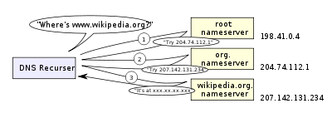
DNS Resolver: Recursive Resolver
Recursive resolver
Normally thought of as a “DNS server”
Accept queries from users, understand the zone hierarchy, interact with the authority servers
Cache answers
From wikipedia
Notes:
When you configure your machine the address of a DNS server. The server runs a DNS resolver.

Slide 18
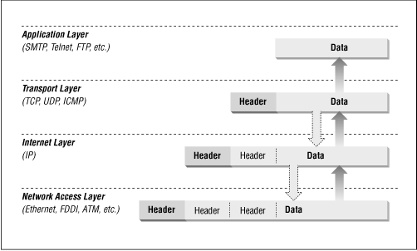
Network Layered Encapsulation
http://bio3d.colorado.edu/tor/sadocs/tcpip/tcpip-1.html

Slide 19
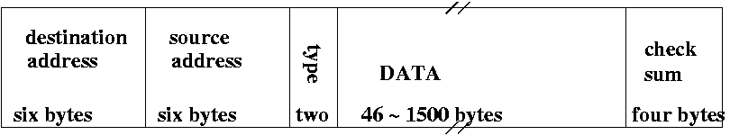
Ethernet Packet

Slide 20
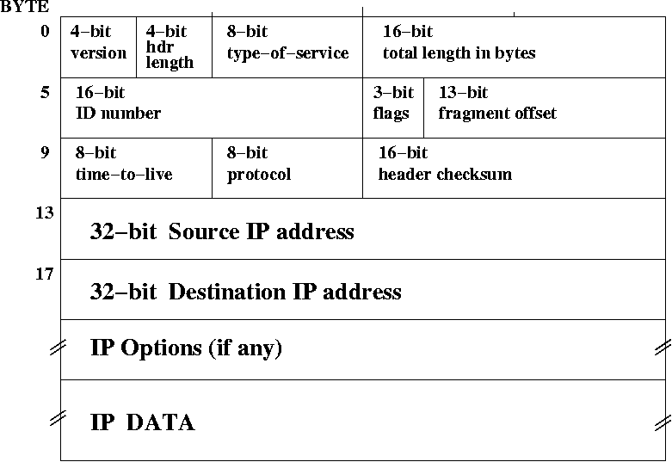
IP Packet
http://bio3d.colorado.edu/tor/sadocs/tcpip/tcpip-1.html

Slide 21
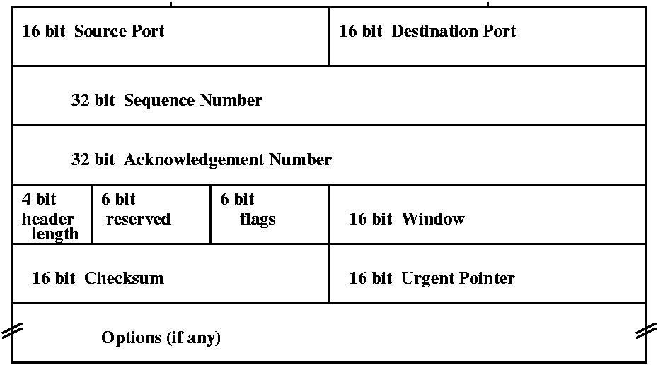
TCP Packet Header
http://bio3d.colorado.edu/tor/sadocs/tcpip/tcpip-2.html

Slide 22
Routing
The routing table tells which is the next router for delivering to any destination network.
The source of the table information can be:
Manual:
Suitable for small networks where routes never change
Automatic
Software creates/updates the routing table using information from neighboring routers.
It is needed for lager nets
It changes routes if failure.

Slide 23
IP packet from A to M
A: Routing Table
Target Net Net/Subnet Mask Next Hop
40.0.0.0 255.0.0.0 Directly
128.10.3.0 255.255.255.0 40.0.0.11(R1)
128.10.5.0 255.255.255.0 40.0.0.11(R1)
128.10.4.0 255.255.255.0 40.0.0.11(R1)
216.109.112.0 255.255.255.0 40.0.0.11(R1)
Default: 255.255.255.255 40.0.0.1(R3)
216.109.112.45
216.109.112.48
E
F
128.10.3.9
I
128.10.5.9
40.0.0.7
216.109.112.0
216.109.112.1
H
K
A
IP
IP
128.10.3.1
128.10.5.2
40.0.0.0
R1
128.10.3.0
R2
128.10.5.0
B
L
40.0.0.11
128.10.3.2
C
128.10.4.2
D
128.10.4.0
40.0.0.5
J
R3
G
M
40.0.0.1
128.10.4.7
Internet
128.10.3.5
128.10.4.10
Packet addresses: E_{src}=E_{A}, E_{dst}=E_{R1}, IP_{src}=A, IP_{dst}=M
Notes:
Layered envelopes

Slide 24
IP packet from A to M
R1: Routing Table
Target Net Net/Subnet Mask Next Hop
40.0.0.0 255.0.0 Directly
128.10.3.0 255.255.255.0 Directly
128.10.5.0 255.255.255.0 128.10.3.2(R2)
128.10.4.0 255.255.255.0 128.10.3.2(R2)
216.109.112.0 255.255.255.0 Directly
Default: 255.255.255.255 40.0.0.1(R3)
216.109.112.45
216.109.112.48
E
F
128.10.3.9
I
128.10.5.9
40.0.0.7
216.109.112.0
216.109.112.1
H
K
A
128.10.3.1
128.10.5.2
IP
40.0.0.0
R1
128.10.3.0
R2
128.10.5.0
B
L
40.0.0.11
128.10.3.2
C
128.10.4.2
D
128.10.4.0
40.0.0.5
J
R3
G
M
40.0.0.1
128.10.4.7
Internet
128.10.3.5
128.10.4.10
IP: E_{src}=E_{R1}, E_{dst}=E_{R2}, IP_{src}=A, IP_{dst}=M

Slide 25
IP packet from A to M
R2: Routing Table
Target Net Net/Subnet Mask Next Hop
40.0.0.0 255.0.0 128.10.3.1(R1)
128.10.3.0 255.255.255.0 Directly
128.10.5.0 255.255.255.0 Directly
128.10.4.0 255.255.255.0 Directly
216.109.112.0 255.255.255.0 128.10.3.1(R1)
Default: 255.255.255.255 128.10.3.1(R1)
216.109.112.45
216.109.112.48
E
F
128.10.3.9
I
128.10.5.9
40.0.0.7
216.109.112.0
216.109.112.1
H
K
A
128.10.3.1
128.10.5.2
40.0.0.0
R1
128.10.3.0
R2
128.10.5.0
B
L
40.0.0.11
128.10.3.2
IP
C
128.10.4.2
D
128.10.4.0
40.0.0.5
J
R3
G
M
40.0.0.1
128.10.4.7
Internet
128.10.3.5
128.10.4.10
IP: E_{src}=E_{R2}, E_{dst}=E_{M}, IP_{src}=A, IP_{dst}=M

Slide 26
Addresses in IP packet
The IP source and destination addresses of the packet remain the same during the transit of the packet.
The hardware source and destination address will be different every time the packet is forwarded.
The source host or some of the routers may need to send ARP requests if the hardware destination address is not in the ARP cache.

Slide 27
IP Addressing
While normally, one think of an IP Address corresponds to a specific computer, this is technically not true.
Each IP address identifies a connection between a computer and a network.
An IP address identifies a network interface.
A computer with multiple network connections (like a router) must have multiple IP addresses, one for each connection.
Anycast routing may have multiple machines share the same IP address

Slide 28
Address Resolution Protocol (ARP)
Primarily used to translate IP addresses to Ethernet MAC addresses
The device driver for Ethernet NIC needs to do this to send a packet
Also used for IP over other LAN technologies, e.g. IEEE 802.11
Each host maintains a table of IP to MAC addresses
Message types:
ARP request, ARP reply, ARP announcement
Notes:
An internet packet contains an IP address. After it reaches the local network, one needs to know which host should receive it.
When a host needs to know the APR address for a given IP, one uses ARP request.
When a host that owns an IP address receives a APR request, the host sends a ARP response.
When a host joins a network, it sends ARP announcement.

Slide 29
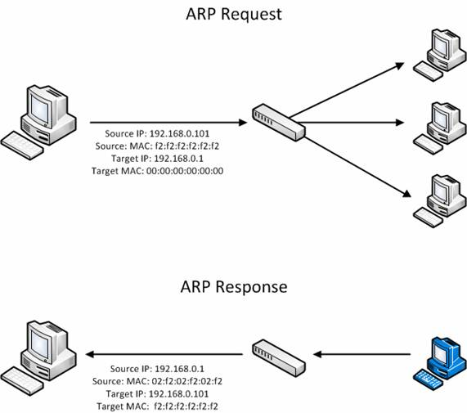
http://www.windowsecurity.com
Notes:
The request is broadcasted (FF:FF:..FF) means broadcasting. This means that the source address 192.168.0.1 wants to know the MAC address of 192.168.0.3.
The reply says “I am 192.168.0.3”, and my MAC address is …

Slide 30
DHCP – Dynamic Host Configuration Protocol
Allows connecting computers to the Internet without the need of an administration.
Before DHCP, an administrator had to manually configure the following parameters to add a computer to the Internet:
The local IP address – Current address
The subnet mask – Determines which hosts are in same LAN
The default router – Deliver packets to hosts outside the LAN
The default DNS server – convert names to IP addresses.
In UNIX the command used to set these parameters is ifconfig. In Windows is ipconfig or the Control Panel.

Slide 31
Transport Protocols
Two transport protocols available in the TCP/IP family
UDP – User Datagram Protocol
TCP – Transmission Control Protocol

Slide 32
UDP- User Datagram Protocol
Unreliable Transfer.
Packets may be dropped, received more than once, delivered out of order
Applications will need to implement their own reliability if necessary.
Minimal overhead in both computation and communication.
It is best for LAN applications. Why?
Connectionless – No initial connection necessary. No state in both ends
Useful for video conferencing, online gaming, etc.

Slide 33
UDP- User Datagram Protocol
Message Oriented
Each message is encapsulated in an IP datagram.
UDP messages should not be too large
If the resulting IP packet is larger than MTU (maximum transmission unit) of underlying network, the packet will be fragmented.
Many applications limit UDP data in one message to 512 bytes
The UDP header has ports that identify
Source application (Source Port)
Destination application (Destination Port)

Slide 34
TCP – Transmission Control Protocol
It is the major transport protocol used in the Internet
It is:
Reliable – It uses acknowledgement and retransmission to accomplish reliability
Connection-Oriented - An initial connection is required. Both end points keep state about the connection.
Full-Duplex – Communication can happen in both ways simultaneously.
Stream Interface – Transfer of bytes look like writing/reading to a file.

Slide 35
TCP Reliability
How does TCP achieve reliability?
It uses Acknowledgments and Retransmissions
Acknowledgement-
The receiver sends an acknowledgement when the data arrives.
Retransmission
The sender starts a timer whenever the message is transmitted
If the timer expires before the acknowledgement arrives, the sender retransmits the message.

Slide 36
TCP Reliability
Normal Exchange
Host 1
Host 2
1.Send packet
2.Timer Starts
3.Receive pkt 1
4.Send ack 1
5.Receive ack1
6.Timer Cancel
7.Send pkt 2
9.Receive pkt 2
8.Timer Starts
10.Send ack 2
11.Receive ack2
12.Timer Cancel
13.Send pkt 3

Slide 37
TCP Reliability
Packet Lost
Host 1
Host 2
3.Packet Lost
1.Send pkt 1
2.Timer Starts
4.Timer Expires
5.Send pkt1
6.Timer Starts
7.Receive pkt 1
8.Send ack 1
9.Receive ack1
10. Timer Cancel
11.Send pkt 2
12.Timer Starts
13.Receive pkt 2

Slide 38
TCP Reliability
Ack Lost
Host 1
Host 2
1.Send pkt 1
2.Timer Starts
3.Receive pkt 1
4.Send ack 1
5.Ack Lost
6.Timer Expires
7.Send pkt1
8.Timer Starts
9.Receive pkt 1
10.Send ack1
11.Receive ack1
12. Timer Cancel
13.Send pkt 2
14.Timer Starts
15.Receive pkt 2

Slide 39
TCP Summary of Features
1. Adaptive Retransmission
The retransmission timer is set to RTT+4*RTTVAR where RTT is estimated. This allows TCP work in slow and fast networks.
2. Cumulative Acknowledgments
An acknowledgment is for all the bytes received so far without holes and not for every packet received.
3. Fast Retransmission
It is a heuristic where a duplicated acknowledgment for the same sequence is signal of a packet lost. The data is retransmitted before the timer expires.

Slide 40
TCP Summary of Features
4. Flow Control
It slows down the sender if the receiver is running out of buffer space. The window (receiver’s buffer size) is sent in every acknowledgment.
5. Congestion Control
For TCP a lost packet is signal of congestion.
Instead of aggressively retransmit, it will slow down the retransmission. It will use first “Slow Start” and then a “Congestion Avoidance” where the window of retransmitted data is reduced in size.

Slide 41
TCP Summary of Features
6. Reliable Connection and Shutdown
TCP uses a Three way Handshake to initiate or to close connections.

Slide 42
When to Use UDP or TCP
If you need reliable communication in your application use TCP.
Only use UDP in the following cases:
Broadcasting: that is the computer needs to reach all or part of the computers in the local network.
Example: Find out of the existence of a server (Example DHCP, or finding a printer).
Multicasting data to several machines simultaneously.
Real Time Data: Applications where packets arriving on time with minimum delay is more important than reliability where retransmission can add to the delay.
Example: Voice over IP, teleconferencing.

Slide 43
Clicker Question 1 (Network Architecture)
The HTTP protocol belongs to which layer in the network architecture?
Application
Transport
Network / Internet
Data Link / Network Interface / Network Address
Physical

Slide 44
Clicker Question 2 (Network Architecture)
The Ethernet protocol belongs to which layer in the network architecture?
Application
Transport
Network / Internet
Data Link / Network Interface / Network Address
Physical

Slide 45
Clicker Question 3 (Packet Transmitting)
When a host receives a TCP packet sent by a sender (assuming that Ethernet is used), which headers have changed since it was sent out?
Only the Ethernet header
Only the IP header
Only the Ethernet header and the IP header
The Ethernet header, the IP header, and the TCP header
None of the above

Slide 46
Clicker Question 4 (TCP)
When we say TCP provides reliable transmission, we mean:
When an application uses TCP to send some data, the data is guaranteed to arrive at the sender.
When an application receives data from TCP, these data are in the order they are sent.
When an application uses TCP to send some data, the application learns the status of the transmission.
B and C
A, B, and C

