Slide 1
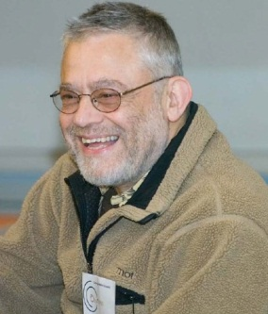
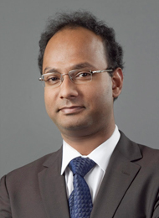
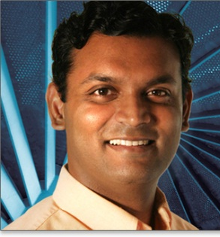
Towards Human Computable Passwords
Jeremiah Blocki
Manuel Blum
Anupam Datta
Santosh Vempala
ITCS 2017

Slide 2
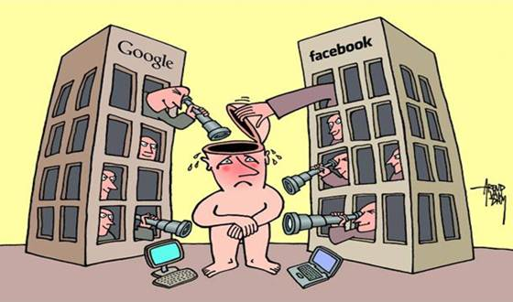
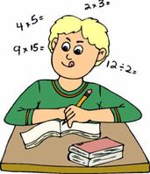
Philosophical Questions for Lunch
Is privacy dead?
What types of functions can a human compute in his head without assistance? Quickly?

Slide 3
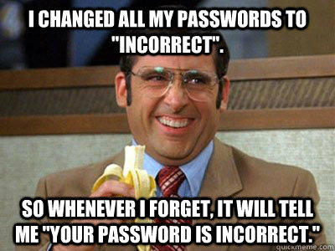
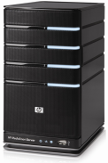






Password Management
p₁
p₂
p₃
p₄
p₅
p₅
…
PayPaul.com
Competing Goals:
Security
Usability

Slide 4
Security
Attacks |  |  |  | …
Reuse | No | No | No | No
Independent | Yes | Yes | Yes | Yes
Usable + Insecure
Unusable + Secure
Notes:
First Column and Third Column:  = 10⁻⁶
Second Column:  = 10⁻²

Slide 5

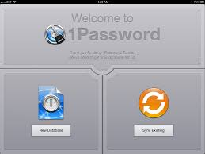
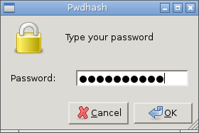
Password Managers
Notes:
LastPass
KeePass
1Password

Slide 6
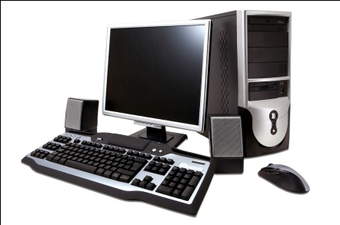
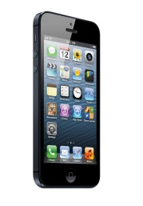
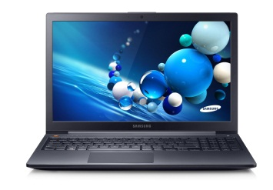

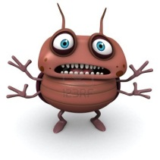
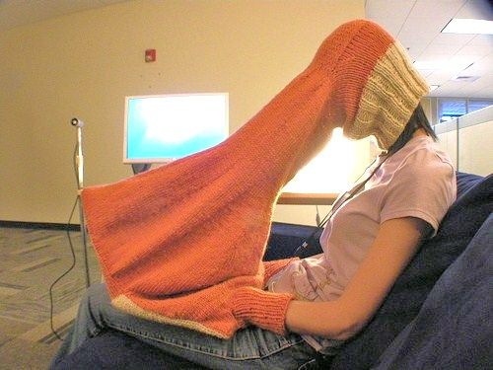
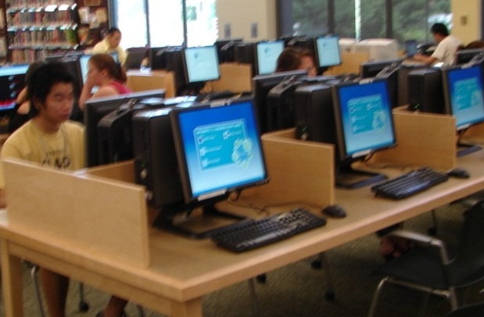
Trusted Computer Assumption?

Slide 7
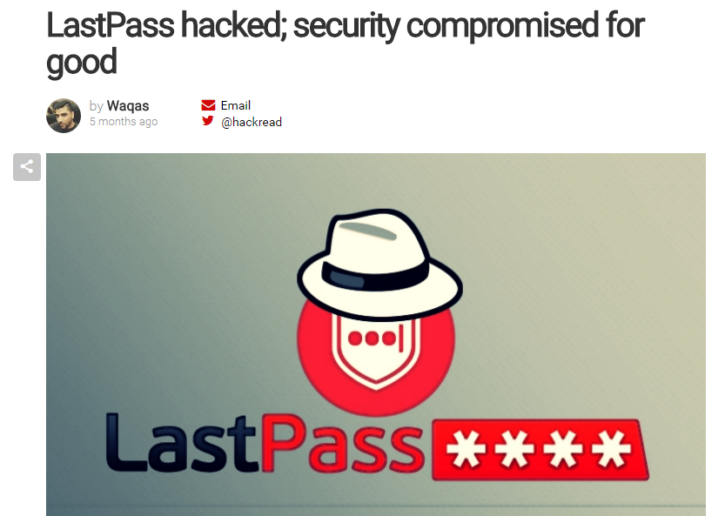
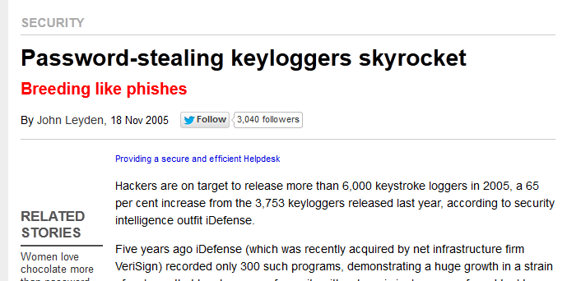
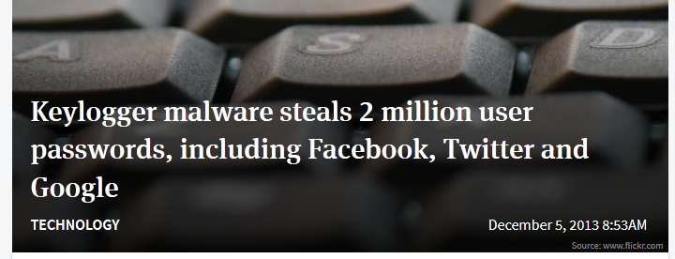
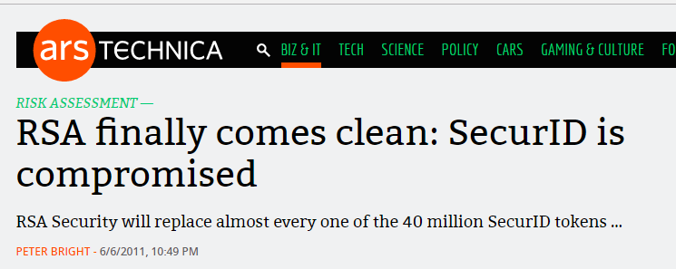
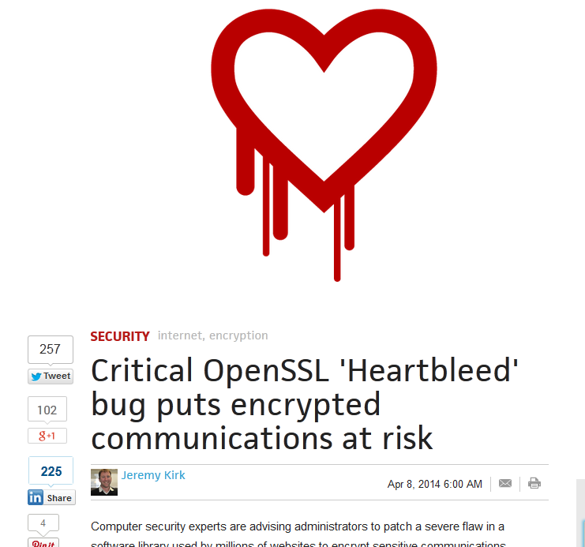
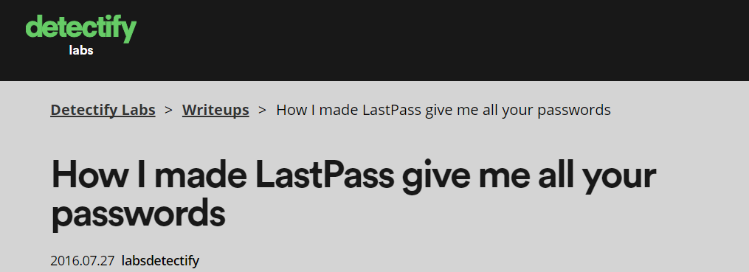
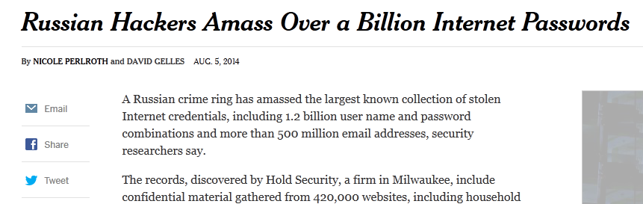
Stronger Security?
Notes:
Password management scheme is any strategy used to create and remember multiple passwords for multiple accounts.
Increased challenge security/usability analysis should look at the problem wholelistically
Position: This is not the user’s fault!
We want a management scheme which is
1. Easy for the user to manage
2. Secure (hard for adversary to compromise accounts)

Slide 8
Our Scheme: Human Computable Passwords
Passwords computed by responding to public challenges
  Computation done in user’s head
Remains secure many breaches (e.g., 100)
Simple Operations
  Addition modulo 10
  Memorize a random mapping
Notes:
This is where our work comes in. We present a scheme that remains secure even after many breaches (e.g., 100). In light of the recent SSL bug this is a highly desirable security property. In our scheme the user memorizes a short secret which is used to compute all of his different passwords. We stress that all of the computation is done inside the user’s head. Because computations are done in the user’s head we only consider a very restricted set of operations: addition modulo 10 and memorizing the secret random mapping.

Slide 9



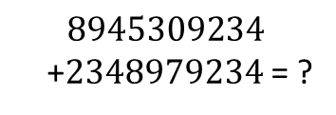

Human Computation
Restricted
  Simple operations (addition, lookup)
  Operations performed in memory (limited space)
$$8945309234$$
+2348979234 = ?
$$9+8=7 mod 10$$
Notes:
In our scheme the user to perform complicated cryptographic operations. In fact, we will not even ask the user to add large numbers. Our scheme is very simple. In fact, in the next minute I can show you exactly how the user computes his passwords.

Slide 10
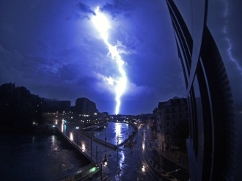
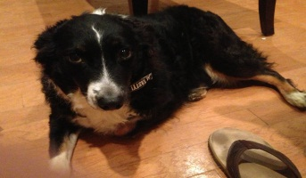
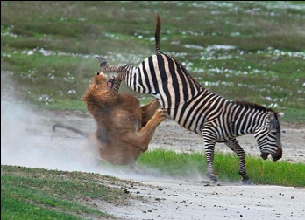
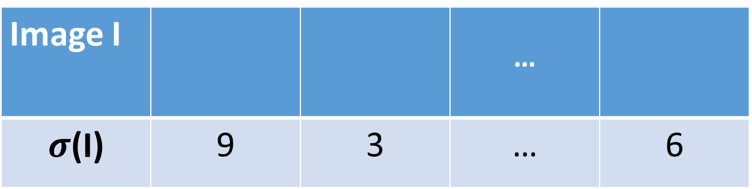
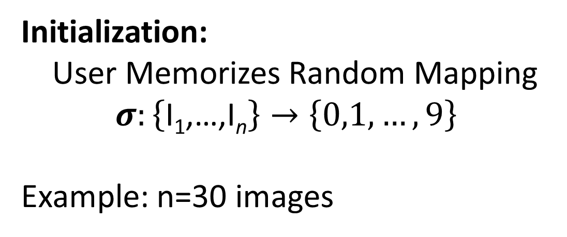
Random Mapping
Image I |  |  | …
$σ$(I) | 9 | 3 | … | 6
Initialization:
User Memorizes Random Mapping
$$σ:\left\{\text{I}\text{1}\text{,…,}\text{I}\text{n}\right\}→\left\{0,1,…,9\right\}$$
Example: n=30 images
Notes:
To begin using our scheme the user first memorizes a secret mapping from pictures to digits. For example, the user must remember that picture of the lightening bolt maps to 9 and the picture of the dog maps to 3. Once the user has memorized this mapping he can compute hundreds of secure passwords by responding to single digit challenges.

Slide 11
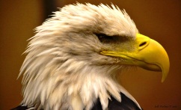
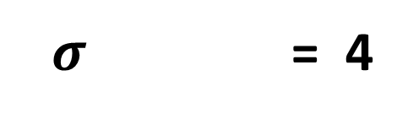
Mnemonics
$σ$ = 4
Instruction: Remember that the eagle has a gold beak. There are four letters in “gold” and “beak”.

Slide 12
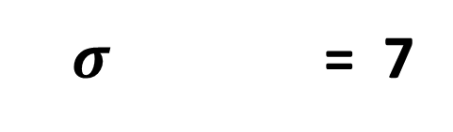
Mnemonics
$σ$ = 7
Instruction: Trace the eagles body from the bottom of the eagle’s beak down to the bottom of the picture. It looks like the number 7.

Slide 13
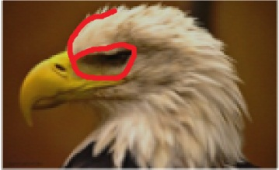
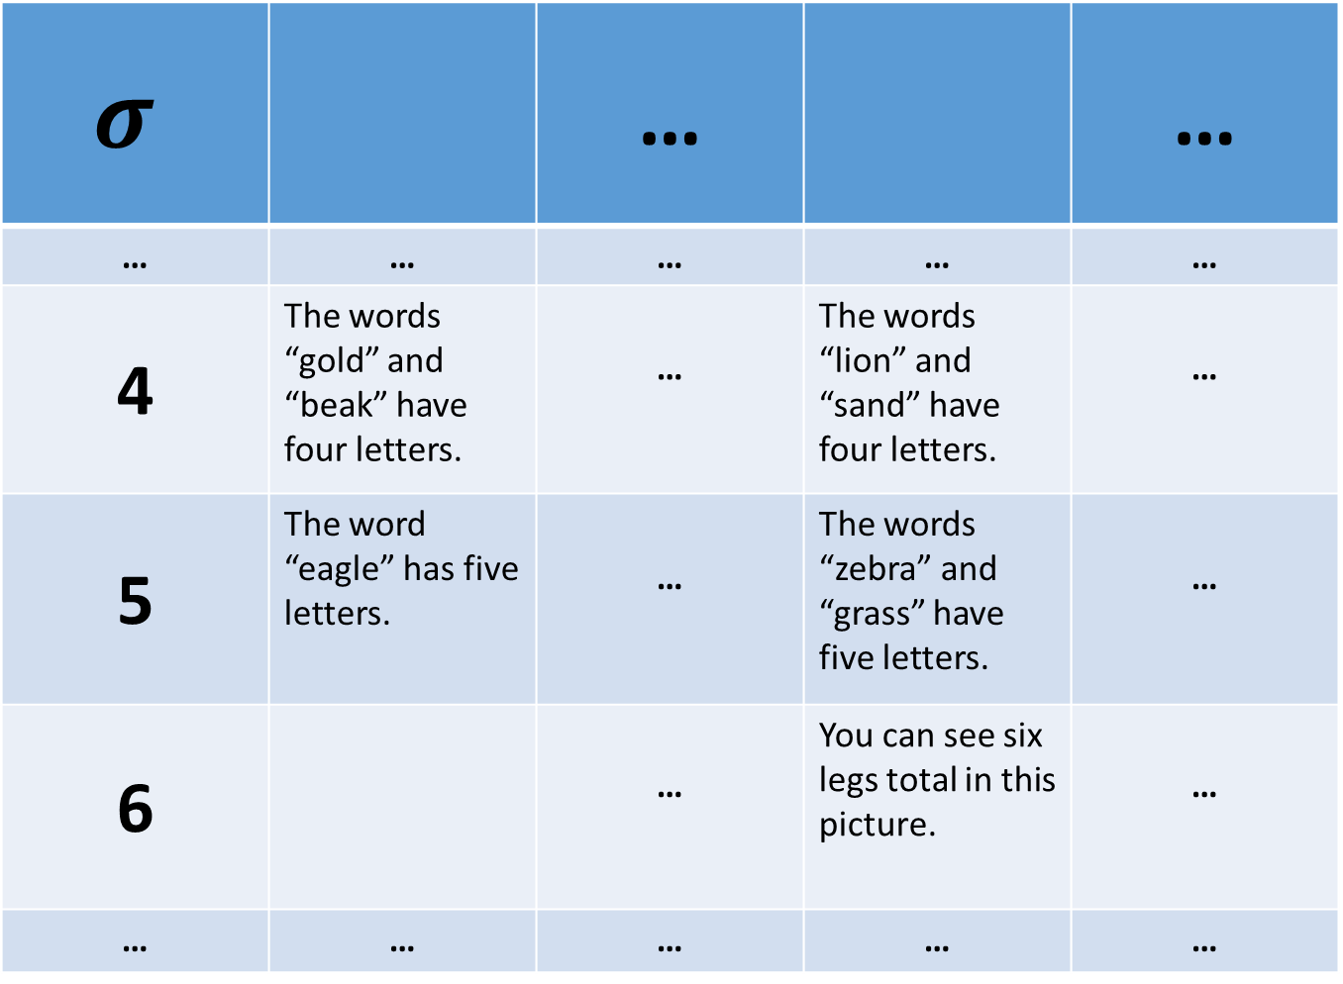
$$σ$$ |  | … |  | …
… | … | … | … | …
4 | The words “gold” and “beak” have four letters. | … | The words “lion” and “sand” have four letters. | …
5 | The word “eagle” has five letters. | … | The words “zebra” and “grass” have five letters. | …
6 |  | … | You can see six legs total in this picture. | …
… | … | … | … | …

Slide 14
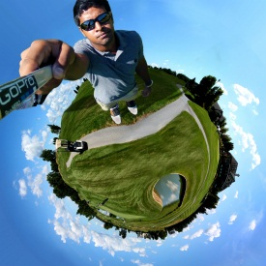
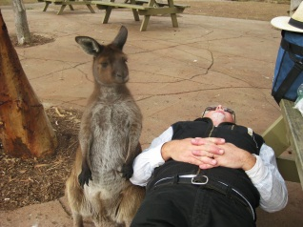
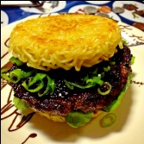

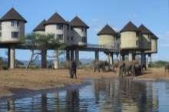


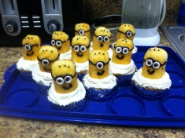
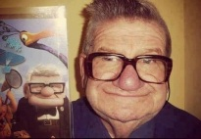
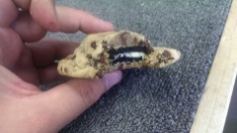
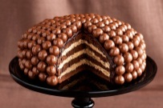
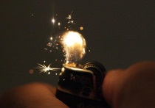
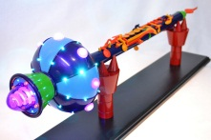
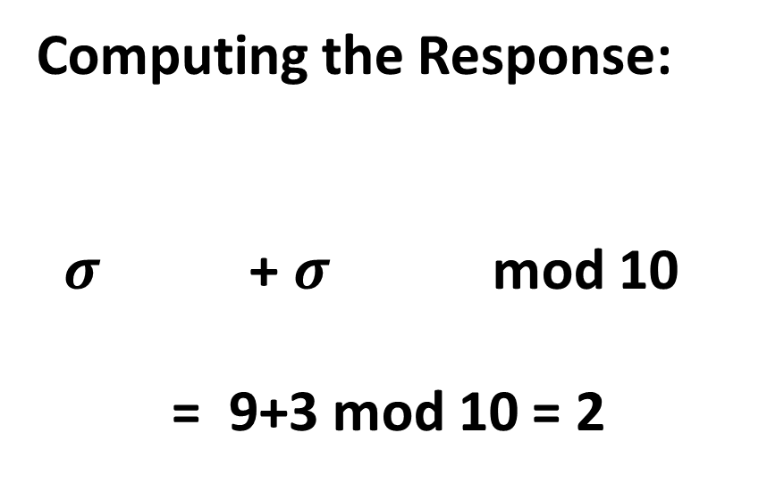
Single-Digit Challenge
0
1
2
3
4
5
6
7
8
9
Computing the Response:
$σ$ + $σ$ mod 10
= 9+3 mod 10 = 2
Notes:
A single-digit challenge is a list of 14 pictures displayed as follows. The pictures are divided into two groups. The four larger pictures on top and the lookup table with 10 images on the bottom. To compute the response to a single digit challenge the user takes the first two pictures, adds them together to compute an index. In this example, 9+3 is 2 mod 10. (next slide)

Slide 15
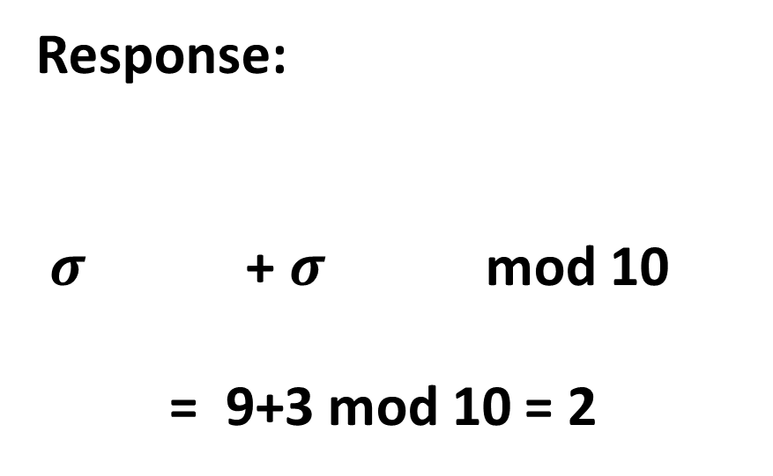
Single-Digit Challenge
0
1
2
3
4
5
6
7
8
9
Response:
$σ$ + $σ$ mod 10
= 9+3 mod 10 = 2
Notes:
The user now looks up the second picture in the table

Slide 16
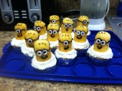
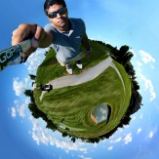
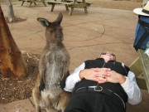
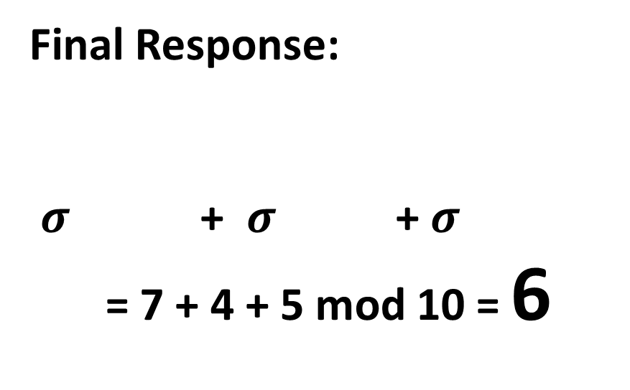
Single-Digit Challenge
0
1
2
3
4
5
6
7
8
9
Final Response:
$σ$ + $σ$ + $σ$
= 7 + 4 + 5 mod 10 = 6
Notes:
And adds this picture to the remaining to pictures to get the final answer 6.

Slide 17
Passwords
0
1
2
3
4
5
6
7
8
9
Username:
jblocki
Password:
Notes:
Each password is computed by responding to several single-digit challenges. When the user types in the response to the first challenge then the second challenge is displayed.

Slide 18

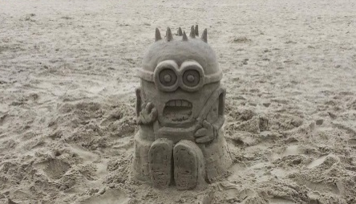





Passwords
0
1
2
3
4
5
6
7
8
9
Username:
jblocki
Password:
*

Slide 19












Passwords
0
1
2
3
4
5
6
7
8
9
Username:
jblocki
Password:
**

Slide 20
Usability
My Authentication Time:
7.5 seconds/digit
30 seconds for a 4-digit password
1.25 minutes for a 10-digit password
Memorizing the Secret Mapping:
Memorized 100 image/digit pairs in 2.5 hours
One Time Cost
  Spaced Rehearsal Model Prediction

Slide 21

Usability (Memorization)
 | Human Computable Passwords |  |  | Shared Cues
 | N = 100 | N = 50 | N=30 | SC-1 | SC-0
Active | 0.40 | $≈$0 | $≈$0 | 3.93 | $≈$0
Typical | 2.14 | $≈$0.04 | $≈$0 | 10.89 | $≈$0
Occasional | 2.50 | $≈$0.05 | $≈$0 | 22.07 | $≈$0
Infrequent | 70.7 | $≈$22.3 | $≈$6.1 | 119.77 | 2.44
E[X₃₆₅]: Extra Rehearsals to maintain all passwords over the first year.

Slide 22

Security
Thm (Informal): Any statistical algorithm needs to see at least $m=\tilde{O}\left(n^{1.5}\right)$ passwords before it can even approximately guess the secret mapping $σ.$
Example: n=30 images
Notes:
We prove that our scheme is secure against the class of statistical adversaries who can see fewer than n^1.5 examples. Our results are significant because most known algorithmic techniques fit within this framework. Guassian elimination is a notable exception, but we also rule out attacks based on Gaussian elimination. While our scheme is simple the analysis is complex. We use generalized hypercontractivity bounds with the fourier decomposition of our function to lower bound the statistical dimension of our induced distribution over challenge response pairs.

Slide 23







Statistical Algorithm
$$q$$
…
$$q1$$
$q$₂
$q$_{L}
…
…
$$q11$$
$q1$₂
$$q1L$$
…
Notes:
We can think of a statistical algorithm as a tree. Each node of the tree contains a query.

Slide 24



Statistical Algorithm
$$q$$
Response: 6
1
$L=n$^{1.5}
…
2
Notes:
Each query is simply a function that takes as input a randomly chosen challenge response pair and tells us which edge to take.

Slide 25






Statistical Algorithm
$$q$$
Response: 6
1
L
2
…
$$q2$$
…
$$qL$$
$$q1$$
Response: 3

Slide 26







Statistical Algorithm
$$q$$
…
$q$_{L}
$$q1$$
$q$₂
…
…
$$q11$$
$q1$₂
$$q1L$$
…
Guess $σ$
Notes:
We want to prove that this tree must either be deep or the guess is not even close to the real mapping with high probability.

Slide 27
Security
Thm (Informal): Any statistical algorithm needs to see at least $m=\tilde{O}\left(n^{1.5}\right)$ passwords before it can even approximately guess the secret mapping $σ.$
Almost all known algorithmic techniques
Spectral Methods
Local Search
Expectation Maximization
First and Second Order Methods for Convex Optimization
Gaussian Elimination
Example: n=30 images
Notes:
We prove that our scheme is secure against the class of statistical adversaries who can see fewer than n^1.5 examples. Our results are significant because most known algorithmic techniques fit within this framework. Guassian elimination is a notable exception, but we also rule out attacks based on Gaussian elimination. While our scheme is simple the analysis is complex. We use generalized hypercontractivity bounds with the fourier decomposition of our function to lower bound the statistical dimension of our induced distribution over challenge response pairs.

Slide 28


Security
Thm (Informal): Any statistical algorithm needs to see at least $m=\tilde{O}\left(n^{1.5}\right)$ passwords before it can even approximately guess the secret mapping $σ.$
Thm (Informal): Any polynomial time adversary needs to see $m=\tilde{O}\left(n^{3}\right)$ passwords before he can use Gaussian Elimination to approximately guess the secret mapping $σ.$
Thm (Informal): Any polynomial time adversary who can guess the user’s passwords with accuracy much better than random guessing can also approximately recover the secret mapping $σ.$
Notes:
We prove that our scheme is secure against the class of statistical adversaries who can see fewer than n^1.5 examples. Our results are significant because most known algorithmic techniques fit within this framework. Guassian elimination is a notable exception, but we also rule out attacks based on Gaussian elimination. While our scheme is simple the analysis is complex. We use generalized hypercontractivity bounds with the fourier decomposition of our function to lower bound the statistical dimension of our induced distribution over challenge response pairs.

Slide 29

Technical Tools
Discrimination Norm
  On average how much different would the answers to a query q be if we picked a random challenge and a random response?
  Small discrimination norm => Statistical Algorithm must use deep tree. [FPV13]
Fourier Analysis
  Express discrimination norm as a low degree function
Generalized Hypercontractivity Theorem
  Bounds the expected value of low degree functions

Slide 30

Challenge: Break Our Scheme
Goal: Guess one of the user’s secret ten-digit passwords
Given: One-hundred of the user’s other ten-digit passwords.
http://www.cs.cmu.edu/~jblocki/HumanComputablePasswordsChallenge/challenge.htm
Paper: http://arxiv.org/abs/1404.0024
Notes:
The challenges can be found on my webpage along with the paper itself. In first challenge we first give you the responses to 1000 single-digit challenges or 100 ten-digit passwords. Your goal is to guess one of the user’s other passwords. I presented this challenge at two conferences: ASIACRYPT and Oakland. So far nobody has broken any of the passwords.

Slide 31

Thanks for Listening

