Slide 1
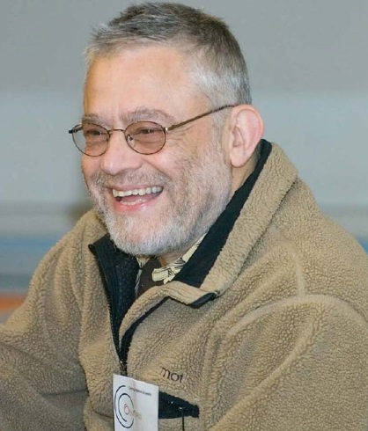
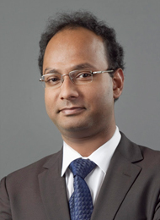
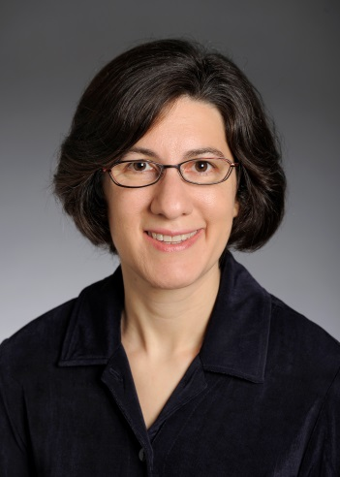
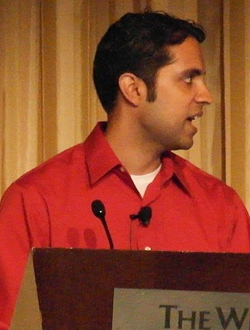
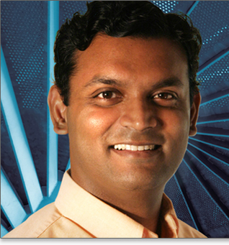
Usable and Secure Human Authentication
Jeremiah Blocki
Collaborators

Slide 2

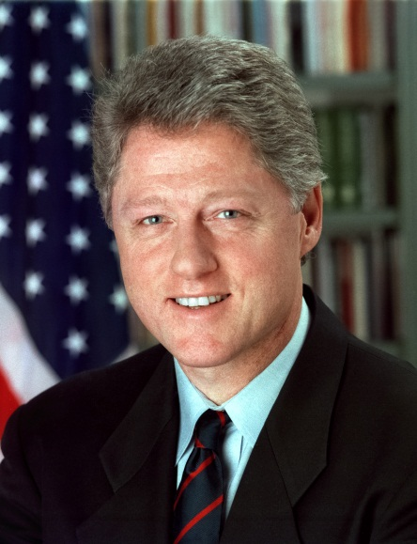
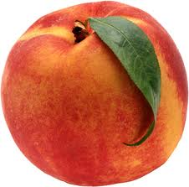
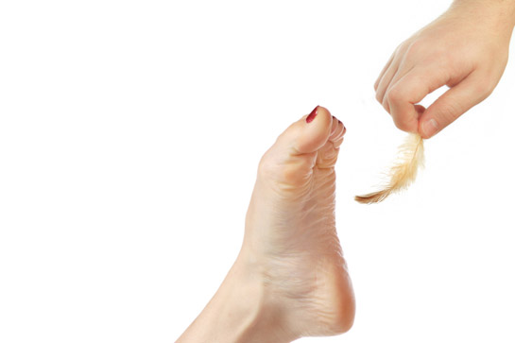
Memory Experiment 1
Person | Bill Clinton
Action | Tickling
Object | Peach

Slide 3
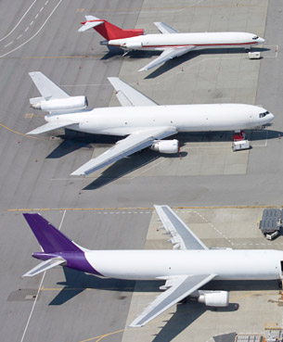
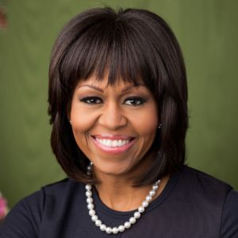
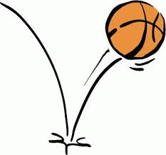
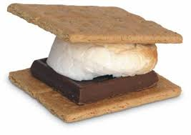
Memory Experiment 2
Person | Michelle Obama
Action | Bouncing
Object | Smore

Slide 4
Outline
Introduction
  Motivation
  Common Attacks
  Our Approach
Naturally Rehearsing Passwords
User Studies
Human Computable Passwords
Conclusion

Slide 5





Password Management
…
Competing Goals:
Security
Usability
Notes:
Password management scheme is any strategy used to create and remember multiple passwords for multiple accounts.
Increased challenge security/usability analysis should look at the problem wholelistically
Position: This is not the user’s fault!
We want a management scheme which is
1. Easy for the user to manage
2. Secure (hard for adversary to compromise accounts)

Slide 6
Security (what could go wrong?)
Three Types of Attacks
Online
Offline
Plaintext Recovery
Danger
Notes:
Three types of attacks, Online, Offline and Phishing. I will illustrate each attack in more detail in the following slides.

Slide 7
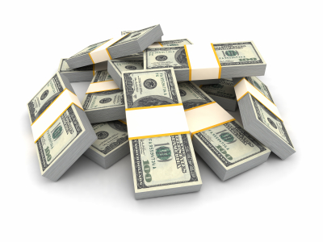

Online Attack
123456
password
123456
Guess Limit: k-strikes policy
Notes:
A k-strikes policy is used to mitigate this threat. However, users who select popular passwords like 123456 might still be vulnerable.

Slide 8


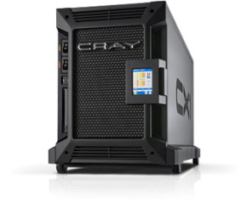

Offline Dictionary Attack
jblocki, 123456
Username
jblocki
Salt
89d978034a3f6
Hash
85e23cfe0021f584e3db87aa72630a9a2345c062
SHA1(12345689d978034a3f6)=85e23cfe0021f584e3db87aa72630a9a2345c062
+
Notes:
To understand the next type of attack it is necessary to understand how organizations store passwords. When I create an account online the server typically will
select a random value (called the salt).
Compute and store the cryptographic hash of my password with the salt appended.
Later to authenticate the server will re-compute this hash value, and make sure that it matches the stored version.
Sometimes these password files are stolen by adversaries, who can then execute an offline dictionary attack. Offline attacks are more dangerous than online attacks because there is no k-strikes limit. There are many popular password cracking tools that the adversary could use (e.g, John the Ripper). Unfortunately, these attacks are commonplace. Even large companies like (Sony, Zappos, and LinkedIn) have been breached.

Slide 9









A Common Problem
Password breaches at major companies have affected millions of users.
Notes:
Unfortunately, offline dictionary attacks are quite common. Password breaches at major companies have affected millions of users.

Slide 10


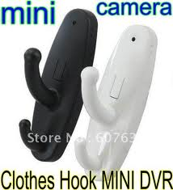
Plaintext Recovery Attack
pwd
PayPaul.com
pwd
Notes:
Instead of trying to crack the user’s password. Why not just get him to tell me the password. Adversary tricks user into creating an account on a malicious site (PayPaul.com).
Examples of plaintext recovery attacks include phishing attacks, malware and hidden cameras.
Once the adversary has this password the PayPal account is compromised. If the user reuses the same password for other accounts then the adversary can also access these sites.

Slide 11
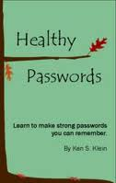
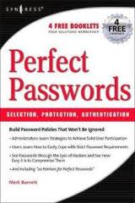
A Challenging Problem
Traditional Security Advice
Use numbers and letters
Use special symbols
Don’t Reuse Passwords
Don’t use words/names
Not too short
Don’t Write it Down
Use mix of lower/upper case letters
Change your passwords every 90 days
Notes:
We have been using passwords for decades. Many books and articles have been written about password creation. Traditionally the advice a user gets is something like the following…
Is it time to re-evaluate the traditional security advice?

Slide 12
Password Management
…
Competing Goals:
Security
Usability
Notes:
Password management scheme is any strategy used to create and remember multiple passwords for multiple accounts.
Increased challenge security/usability analysis should look at the problem wholelistically
Position: This is not the user’s fault!
We want a management scheme which is
1. Easy for the user to manage
2. Secure (hard for adversary to compromise accounts)

Slide 13
Questions
How can we evaluate password management strategies?
  Quantify Usability
  Quantify Security
Can we design password management schemes which balance security and usability considerations?

Slide 14
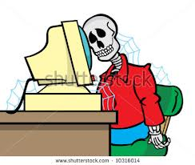
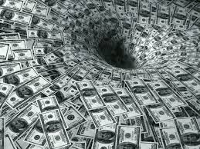
Naïve Approach
Propose New Password
Management Scheme
User Study: Evaluate New
Password Management Scheme
Notes:
The challenges are that the user studies would necessarily be slow and expensive. We would need to track each users success at remembering multiple passwords over an extended period of time. If we make any modifications to our password management scheme we would need to

Slide 15
Our Argument
User models and security models can guide the development of human authentication schemes with analyzable usability and security properties.

Slide 16
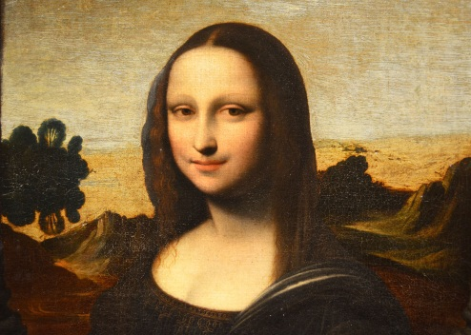

Our Approach
User Model
Capabilities + Behavior
Example 1: Users can remember a person-action-object story if they follow a particular rehearsal schedule.
Example 2: How often a user visits each website on average.

Slide 17
Our Approach
User Model
Capabilities + Behavior
Fast: Evaluation does not require expensive user studies
Robust: Can be used to analyze broad class of password management schemes
Prior Cognitive Science Studies
User Studies
Develop + Analyze
User Model
Empirical Validation

Slide 18
Results
Result | User Model | Security
Naturally Rehearsing Passwords | Spaced Rehearsal of Passwords Visitation Schedule | Online + Offline + Phishing + Attacks
Human Computable Passwords | + Addition modulo 10. (e.g., 9+7 = 6 mod 10). | Online, Offline, Multiple Phishing Attacks
Naturally Rehearsing Passwords: http://arxiv.org/abs/1302.5122
Human Computable Passwords: http://arxiv.org/abs/1404.0024
Spaced Repetition and Mnemonics Enable Recall of
Multiple Strong Passwords

Slide 19
Outline
Introduction
Naturally Rehearsing Passwords
  Example Password Management Schemes
  Usability Model
  Security Model
  Shared Cues
User Studies
Human Computable Passwords
Conclusion

Slide 20
Password Management
…
Competing Goals:
Security
Usability
Notes:
Password management scheme is any strategy used to create and remember multiple passwords for multiple accounts.
Increased challenge security/usability analysis should look at the problem wholelistically
Position: This is not the user’s fault!
We want a management scheme which is
1. Easy for the user to manage
2. Secure (hard for adversary to compromise accounts)

Slide 21
Scheme 1: Reuse Strong Password
Pick four random words w₁,w₂,w₃,w₄
Account | Amazon | Ebay
Password | w₁w₂w₃w₄ | w₁w₂w₃w₄

Slide 22
Scheme 2: Strong Random Independent
Four Independent Random Words per Account
Account | Amazon | Ebay
Password | w₁w₂w₃w₄ | x₁x₂x₃x₄

Slide 23
Outline
Introduction
Naturally Rehearsing Passwords
  Example Password Management Schemes
  Usability Model
  Security Model
  Shared Cues
Human Computable Passwords
User Studies
Conclusion

Slide 24
Human Memory is Semantic
Memorize: nbccbsabc
Memorize: tkqizrlwp
3 Chunks vs. 9 Chunks!
Usability Goal: Minimize Number of Chunks
Source: The magical number seven, plus or minus two [Miller, 56]
Notes:
If all we care about is usability one good goal is minimizing number of chunks in the password

Slide 25
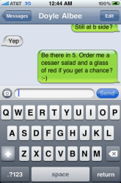
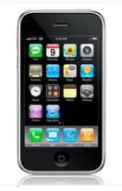
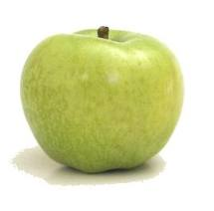



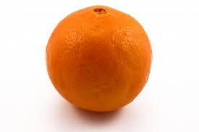
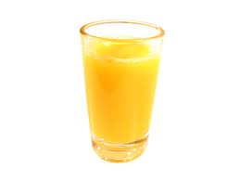
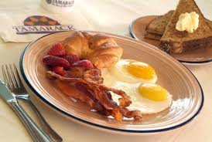
Human Memory is Associative
?
Source: Human Memory: Theory and Practice [Baddeley, 90]

Slide 26
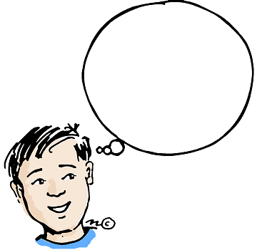
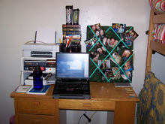

Cues
Cue: context when a memory is stored
Surrounding Environment
  Sounds
  Visual Surroundings
  Web Site
  ….
As time passes we forget some of this context…
Source: Human Memory: Theory and Practice [Baddeley, 90]
Notes:
Insert Picture Here!
Environment: Memory Champions Wear Blinders

Slide 27

Human Memory is Lossy
Rehearse or Forget!
  How much work?
Quantify Usability
  Rehearsal Assumption
p_{amazon}
????
p_{google}
Notes:
Our brain doesn’t store everything that we ever see. That would be overwhelming. Instead our brain decides what information is important to store. We don’t know exactly how the brain does this but the brain tends to keep information that we have seen recently, information we have seen frequently and information we find particularly interesting.

Slide 28
Quantifying Usability
Human Memory is Lossy
  Rehearse or Forget!
  How much work does this take?
Rehearsal Assumptions
Visitation Schedule
  Natural Rehearsal for frequently visited accounts

Slide 29
Rehearsal Requirement
Day: 1 2 4 5 8
Expanding Rehearsal Assumption: user maintains cue-association pair by rehearsing during each interval [s^{i}, s^{i+1}].
Visit Amazon: Natural Rehearsal
Google
X_{t}: extra rehearsals to maintain all passwords for t days.
Source: Optimization of Repetition Spacing in the Practice of Learning [WG, 94]
Notes:
Observe that if the user reuses his password then all cues are rehearsal requirements are satisfied naturally. If the passwords are completely independent then X_{8.}
_{Sources:}
Wozniak, P., and Gorzelanczyk, E. J. Optimization of repetition spacing in
the practice of learning. Acta neurobiologiae experimentalis 54 (1994), 59–59.
Algorithm behind SuperMemo
Anderson, J. R., and Schooler, L. J. Reflections of the environment in memory.
Psychological science 2, 6 (1991), 396–408.

Slide 30
Rehearsal Requirement
Day: 1 2 4 5 8
X_{t}: extra rehearsals to maintain all passwords for t days.
 | Reuse Password | Independent Passwords
X₈ | 0 | 2
Usability Measure: X_{t}
Usability Goal: Minimize X_{t}
Notes:
Observe that if the user reuses his password then all cues are rehearsal requirements are satisfied naturally. If the passwords are completely independent then X₈

Slide 31


Visitation Schedule
Poisson Process with parameter 𝞴
Cue shared by Amazon and Google
$\text{λ}\text{=}\text{λ}$+ 𝞴
t₁
t₂
t₂
$$\text{E}\left[t2−t1\right]=1/{\text{λ} }$$

Slide 32
Visitation Schedule
User | =1 (daily) | =1/3 (biweekly) | =1/7 (weekly) | =1/31 (monthly) | =1/365 (annual)
Active | 10 | 10 | 10 | 10 | 35
Typical | 5 | 10 | 10 | 10 | 40
Occasional | 2 | 10 | 20 | 20 | 23
Infrequent | 0 | 2 | 5 | 10 | 58
Number of accounts visited with frequency 

Slide 33
Usability Results
 | Reuse Strong | Strong Random Independent
Active | 0.023 | 420
Typical | 0.084 | 456.6
Occasional | 0.12 | 502.7
Infrequent | 1.2 | 564
E[X₃₆₅]: Extra Rehearsals to maintain all passwords over the first year.
Usable
Unusable

Slide 34
Outline
Introduction
Naturally Rehearsing Passwords
  Example Password Management Schemes
  Usability Model
  Security Model
  Shared Cues
Human Computable Passwords
User Studies
Conclusion

Slide 35
Our Security Approach
Dangerous World Assumption
  Not enough to defend against existing adversaries
  Adversary can adapt after learning the user’s new password management strategy
Provide guarantees even when things go wrong
  Offline attacks should fail with high probability
  Limit damage of a successful phishing attack
Notes:
Philosophy: We can propose a password management scheme, but adversary will adapt his attack.
Lets introduce a formal framework for analyzing security

Slide 36

Security as a Game
p₁
p₂
p₃
p₄
p₅
BCRYPT(p₄)
p₅
PayPaul.com
q_{$1,000,000} guesses
+

Slide 37
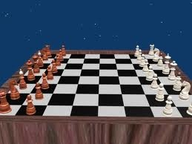
The Adversary’s Game
Adversary can compromise at most r sites (plaintext recovery attack).
Adversary can execute offline attacks against at most h additional sites
  Resource Constraints => at most q guesses
Adversary wins if he can compromise any new sites.
pwd
BCRYPT(pwd)
Notes:
We model the adversary using a game. The adversaries goal is simple. Compromise the user’s accounts.
Specifically, we assume the adversary can compromise at most k sites. This means that the adversary learns up to k of the user’s passwords. We assume that the adversary execute offline attacks against at most t additional sites, and has time and resources to try at most M guesses in each offline attack. For example, the adversary might be willing to dedicate 1 year of time on a cray supercomputer to crack the user’s password.
We introduce our definition of security using a game. In the game the adversary gets to compromise a few sites and wins if he can compromise new sites. The user wins if the adversary fails to compromise new accounts.

Slide 38
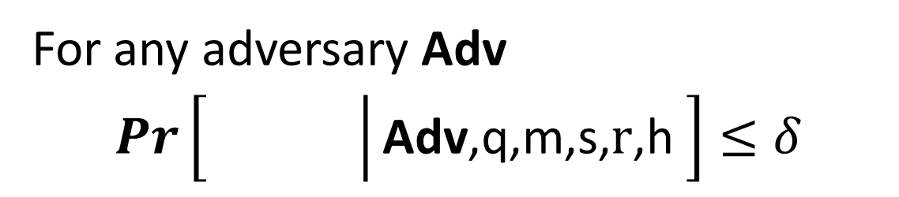
(q,,m,s,r,h)-Security
For any adversary Adv
$Pr\left[\left.\begin{matrix} & \\ & \end{matrix}\right|\text{Adv}\text{,}\text{q}\text{,}\text{m}\text{,}\text{s}\text{,} \text{r}\text{,}\text{h} \right]≤δ$
q = # offline guesses
s = # online guesses
r = #
h = #
m = # of accounts
Plaintext Recovery Accounts
Offline Attack Accounts

Slide 39
Example: (q,,m,3,1,1)-Security
h=1
+
PayPaul.com
q guesses
r=1
Notes:
User is safe as long as the adversary can’t execute more than one phishing/offline attack

Slide 40
Security Results
Attacks | r= 1 | r= 1 h=1 | r=2
Reuse | No | No | No | No
Strong Random Independent | Yes | Yes | Yes | Yes
Usable + Insecure
Unusable + Secure
(q_{$1,000,000},,m,3,r,h,)-security
Notes:
First Column and Third Column:  = 10⁻⁶
Second Column:  = 10⁻²

Slide 41
Outline
Introduction
Naturally Rehearsing Passwords
  Example Password Management Schemes
  Usability Model
  Security Model
  Shared Cues
User Studies
Human Computable Passwords
Conclusion

Slide 42
Usability Desiderata
Minimize #chunks per password
Cued Recall to Exploit Associative Memory
Maximize Natural Rehearsal

Slide 43
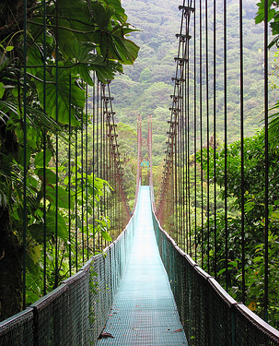

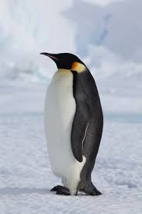
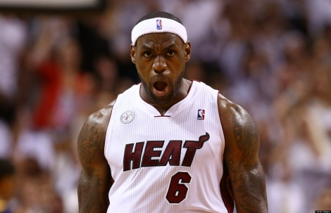
Our Approach
Public Cue
Private
Object: bike
Action: kicking
Object: penguin

Slide 44
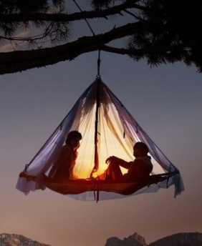
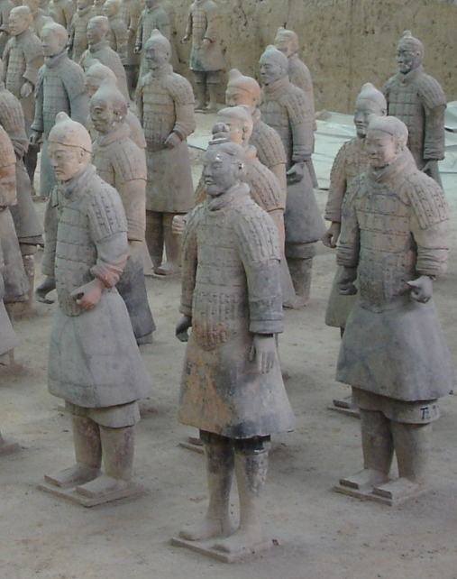

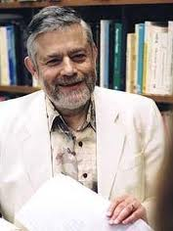

Login
…
Pwd
Kic+Pen + Tor + Lio + ...

Slide 45
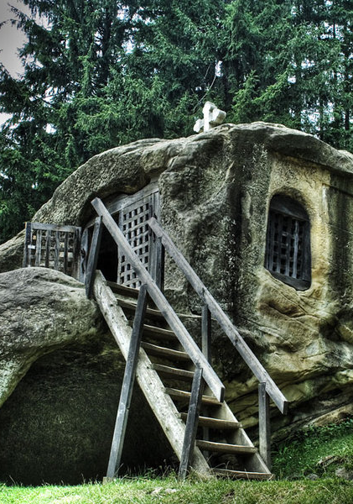
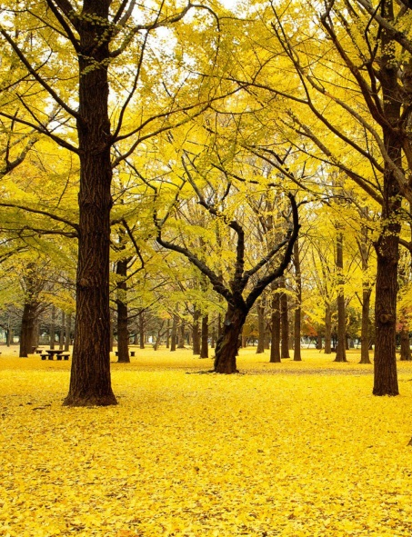
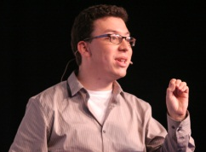
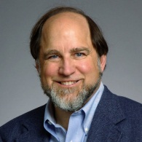
Login
…
Pwd
Kic+Pen + ….

Slide 46
Sharing Cues
Day: 1 2 4 5 8
Usability Advantages
  Fewer stories to remember!
  More Natural Rehearsals!
Security?

Slide 47
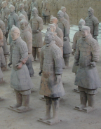



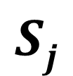



(n,l,)-Sharing Set Family
Definition: A (n,l,)-Sharing Set Family of size m is a family of sets {S₁,…,S_{m}} with the following properties
$∀i≠j, \left|Si\bigcap{Sj}\right|≤γ$
$∀i \left|Si\right|=l$
$\left|\bigcup_{i=1}^{m}{Si}\right|=n$
n
n
$$Sj$$
$$Si$$
$$l$$
$$γ$$
$$l$$

Slide 48

(n,l,)-Sharing Set Family
m – number of passwords {S₁,…,S_{m}}.
n – total #PAO stories
l – #PAO stories for
each site
$γ$– max intersection
$Si$ – PAO stories for
account i.
n
n
$$Sj$$
$$Si$$
$$l$$
$$γ$$
$$l$$

Slide 49
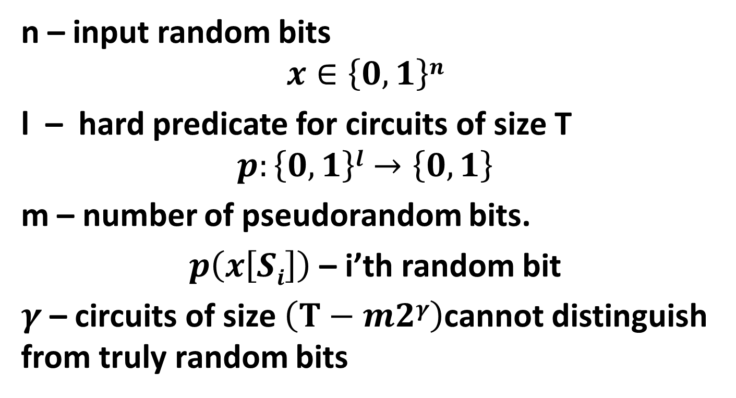
Pseudorandom Number Generators
n – input random bits
$$x∈\left\{0,1\right\}n$$
l – hard predicate for circuits of size T
$$p:\left\{0,1\right\}l→\left\{0,1\right\}$$
m – number of pseudorandom bits.
$p\left(x\left[Si\right]\right)$ – i’th random bit
$γ$– circuits of size $\left(T−m2γ\right)$cannot distinguish from truly random bits

Slide 50
Security Results
Attacks | r= 1 | r= 1 h=1 | r=2
(n,4,4)-Sharing [Reuse] | No | No | No | No
(n,4,0)-Sharing [Independent] | Yes | Yes | Yes | Yes
(n,4,1)-Sharing [SC-1] | Yes | Yes | Yes | No
(n,4,3)-Sharing [SC-0] | Yes | No | No | No
(q_{$1,000,000},,m,3,r,h)-security
Notes:
First Column and Third Column:  = 10⁻⁶
Second Column:  = 10⁻²

Slide 51
Sharing Cues
Thm: There is a (43,4,1)-Sharing Set Family of size m=90, and a (9,4,3)-Sharing Set Family of size 126
Proof?
  Chinese Remainder Theorem!
  Notice that 43 = 9+10+11+13 where 9, 10, 11, 13 are pair wise coprime.
  A_{i} uses cues: {i mod 9, i mod 10, i mod 11, i mod 13}
Notes:
Divide cues into four sets: red, blue, green and purple.

Slide 52
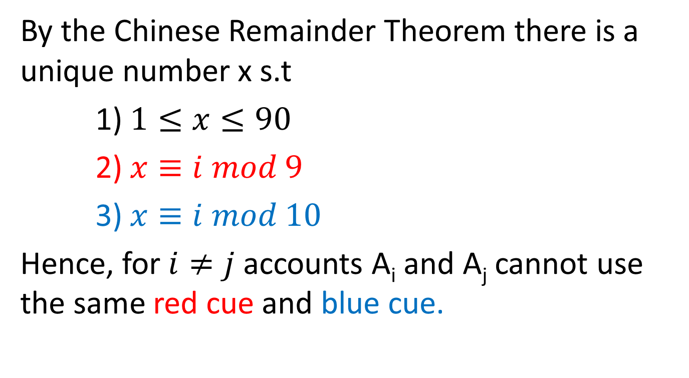
Chinese Remainder Theorem
By the Chinese Remainder Theorem there is a unique number x s.t
1) $1≤x≤90$
2) $x≡i mod 9$
3) $x≡i mod 10$
Hence, for $i≠j$ accounts A_{i} and A_{j} cannot use the same red cue and blue cue.
Notes:
Similar reasoning holds for green and purple cues.

Slide 53
Example (Account #80)
Red Set (9 Cues) | Blue Set (10 Cues) | Green Set (11 Cues) | Purple Set (13 Cues)
Cue 0 | Cue 0 | Cue 0 | Cue 0
Cue 1 | Cue 1 | Cue 1 | Cue 1
Cue 2 | Cue 2 | Cue 2 | Cue 2
Cue 3 | Cue 3 | Cue 3 | Cue 3
Cue 4 | Cue 4 | Cue 4 | Cue 4
Cue 5 | Cue 5 | Cue 5 | Cue 5
Cue 6 | Cue 6 | Cue 6 | Cue 6
Cue 7 | Cue 7 | Cue 7 | Cue 7
Cue 8 | Cue 8 | Cue 8 | Cue 8
 | Cue 9 | Cue 9 | Cue 9
 |  | Cue 10 | Cue 10
 |  |  | Cue 11
 |  |  | Cue 12

Slide 54
Example (Account #80)
Public Cue for Account 80
 | Cue 8 | Cue 0 | Cue 3 | Cue 2
Password 80 | Secret 8 | Secret 0 | Secret 3 | Secret 2

Slide 55
Usability Results
 | Reuse | Strong Random Independent | SC-1 | SC-0
Active | 0 | 420 | 3.93 | 0
Typical | 0 | 456.6 | 10.89 | 0
Occasional | 0 | 502.7 | 22.07 | 0
Infrequent | 1.2 | 564 | 119.77 | 2.44
E[X₃₆₅]: Extra Rehearsals to maintain all passwords over the first year.

Slide 56
Security Results
Attacks | r= 1 | r= 1 h=1 | r=2
(n,4,4)-Sharing [Reuse] | No | No | No | No
(n,4,0)-Sharing [Independent] | Yes | Yes | Yes | Yes
(n,4,1)-Sharing [SC-1] | Yes | Yes | Yes | No
(n,4,3)-Sharing [SC-0] | Yes | No | No | No
Usable + Insecure
Unusable + Secure
Usable + Secure
Usable + Secure
(q_{$1,000,000},,m,3,r,h)-security
Notes:
First Column and Third Column:  = 10⁻⁶
Second Column:  = 10⁻²

Slide 57
Outline
Introduction
Naturally Rehearsing Passwords
User Studies
Human Computable Passwords
Conclusion

Slide 58
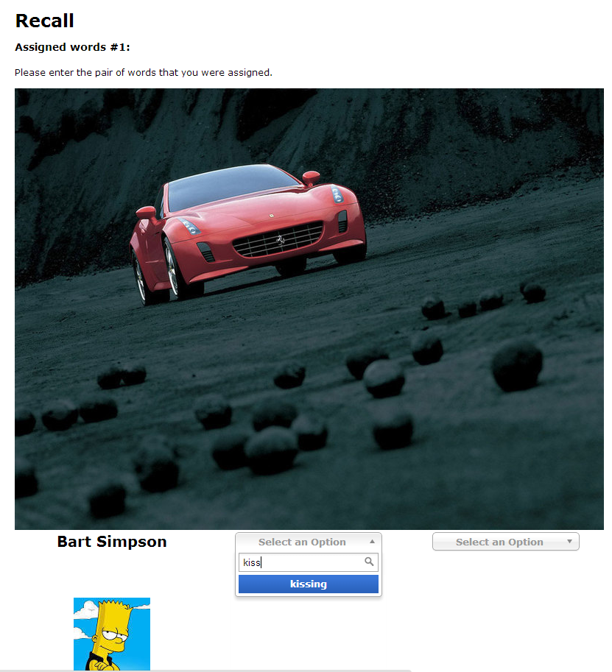
Experimental Validation of User Model
Validity of Expanding Rehearsal Assumption
Mnemonic Devices and Rehearsal Schedules
Collaborate with CyLab Usable Privacy and Security group (CUPS)

Slide 59

User Study Protocol
Memorization Phase (5 minutes):
  Participants asked to memorize four randomly selected person-action object stories.
  $0.50
Rehearsal Phase (90 days):
  Participants periodically asked to return and rehearse their stories (following rehearsal schedule)
  $0.75 per rehearsal
Notes:
Mnemonic Group/Non Mnemonic Group
We will test several different rehearsal schedules
Long term memory study

Slide 60
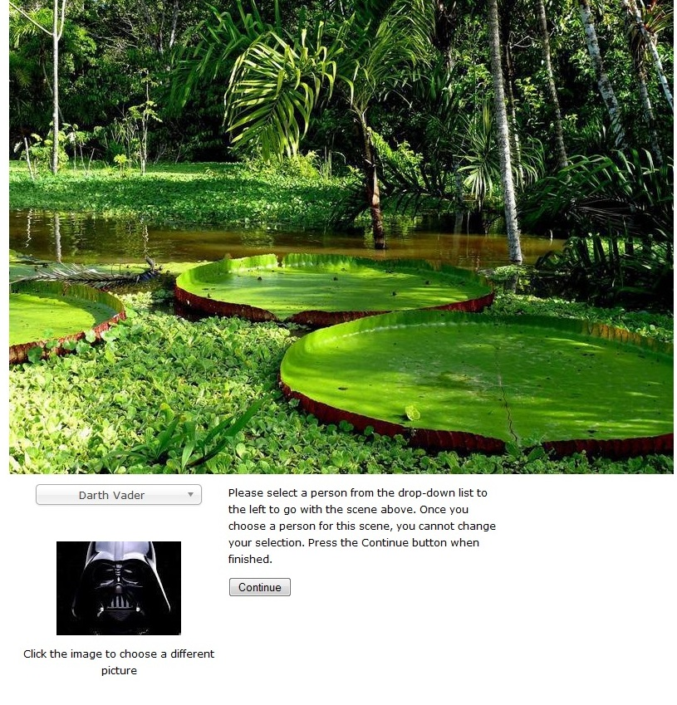
Memorization

Slide 61

Memorization

Slide 62

Memorization

Slide 63

Rehearsal

Slide 64
Rehearsal Schedules
Rehearsal#/ Schedule | 1 | 2 | 3 | 4 | 5 | 6 | 7 | 8 | 9 | 10 | 11 | 12
12hrx1.5 | .5 day | 1.75 | 4.2 | 8.2 | 14.7 | 24.7 | 40.7 | 64.7 | 101.7 | 157.7 | N/A | N/A
24hrX2 | 1 day | 3 | 7 | 15 | 31 | 63 | 127 | N/A | N/A | N/A | N/A | N/A
24hrX2+2Start | .1 day | .6 | 1.6 | 3.6 | 7.6 | 15.6 | 31.6 | 63.6 | 127.6 | N/A | N/A | N/A
30minX2 | .5 hr | 1.5hr | 3.5hr | 7.5hr | 15.5 hr | 1.7 day | 3.7 | 7.7 | 15.7 | 31.7 | 63.7 | 127.7

Slide 65

Results
Succeeded(i)/Returned(i)
Notes:
Top two groups asked to memorize one or two stories. The rest of the groups were asked to memorize four stories. The text group did not use the memory palace mnemonic technique.

Slide 66

Backup Results

Slide 67
Discussion
Mnemonic Techniques Benefit Recall
Benefit of memorizing one or two stories at a time
Most forgetting takes place during early rounds

Slide 68
Outline
Introduction
Naturally Rehearsing Passwords
User Studies
Human Computable Passwords
Conclusion

Slide 69
Our Scheme: Human Computable Passwords
Remains secure many breaches (e.g., 100)
  Heartbleed
Passwords computed by responding to public challenges
  Computation done in user’s head
Required Operations
  Addition modulo 10
  Memorize a random mapping
Notes:
This is where our work comes in. We present a scheme that remains secure even after many breaches (e.g., 100). In light of the recent SSL bug this is a highly desirable security property. In our scheme the user memorizes a short secret which is used to compute all of his different passwords. We stress that all of the computation is done inside the user’s head. Because computations are done in the user’s head we only consider a very restricted set of operations: addition modulo 10 and memorizing the secret random mapping.

Slide 70





Human Computation
Restricted
  Simple operations (addition, lookup)
  Operations performed in memory (limited space)
$$8945309234$$
+2348979234 = ?
$$9+8=7 mod 10$$
Notes:
In our scheme the user to perform complicated cryptographic operations. In fact, we will not even ask the user to add large numbers. Our scheme is very simple. In fact, in the next minute I can show you exactly how the user computes his passwords.

Slide 71




Random Mapping
Image I |  |  | …
(I) | 9 | 3 | … | 6
Initialization:
User Memorizes Random Mapping
$$:\left\{\text{I}\text{1}\text{,…,}\text{I}\text{n}\right\}→\left\{0,1,…,9\right\}$$
Example: n=30 images
Notes:
To begin using our scheme the user first memorizes a secret mapping from pictures to digits. For example, the user must remember that picture of the lightening bolt maps to 9 and the picture of the dog maps to 3. Once the user has memorized this mapping he can compute hundreds of secure passwords by responding to single digit challenges.

Slide 72

Mnemonics
⬧ = 4
Instruction: Remember that the eagle has a gold beak. There are four letters in “gold” and “beak”.

Slide 73
Mnemonics
⬧ = 7
Instruction: Trace the eagles body from the bottom of the eagle’s beak down to the bottom of the picture. It looks like the number 7.

Slide 74


$$σ$$ |  | … |  | …
… | … | … | … | …
4 | The words “gold” and “beak” have four letters. | … | The words “lion” and “sand” have four letters. | …
5 | The word “eagle” has five letters. | … | The words “zebra” and “grass” have five letters. | …
6 |  | … | You can see six legs total in this picture. | …
… | … | … | … | …

Slide 75













Single-Digit Challenge
0
1
2
3
4
5
6
7
8
9
Computing the Response:
⬧ +  mod 10
= 9+3 mod 10 = 2
Notes:
A single-digit challenge is a list of 14 pictures displayed as follows. The pictures are divided into two groups. The four larger pictures on top and the lookup table with 10 images on the bottom. To compute the response to a single digit challenge the user takes the first two pictures, adds them together to compute an index. In this example, 9+3 is 2 mod 10. (next slide)

Slide 76
Single-Digit Challenge
0
1
2
3
4
5
6
7
8
9
Response:
⬧ +  mod 10
= 9+3 mod 10 = 2
Notes:
The user now looks up the second picture in the table

Slide 77



Single-Digit Challenge
0
1
2
3
4
5
6
7
8
9
Final Response:
⬧ +  + 
= 7 + 4 + 5 mod 10 = 6
Notes:
And adds this picture to the remaining to pictures to get the final answer 6.

Slide 78
Passwords
0
1
2
3
4
5
6
7
8
9
Username:
jblocki
Password:
Notes:
Each password is computed by responding to several single-digit challenges. When the user types in the response to the first challenge then the second challenge is displayed.

Slide 79













Passwords
0
1
2
3
4
5
6
7
8
9
Username:
jblocki
Password:
*

Slide 80






Passwords
0
1
2
3
4
5
6
7
8
9
Username:
jblocki
Password:
**

Slide 81
Usability
My Authentication Time:
7.5 seconds/digit
30 seconds for a 4-digit password
1.25 minutes for a 10-digit password
Memorizing the Secret Mapping:
Essentially a one time cost
Lots of natural rehearsals for secret mapping

Slide 82
Usability (Memorization)
 | Human Computable Passwords |  |  | Shared Cues
 | N = 100 | N = 50 | N=30 | SC-1 | SC-0
Active | 0.40 | 0 | 0 | 3.93 | 0
Typical | 2.14 | 0.04 | 0 | 10.89 | 0
Occasional | 2.50 | 0.05 | 0 | 22.07 | 0
Infrequent | 70.7 | 22.3 | 6.1 | 119.77 | 2.44
E[X₃₆₅]: Extra Rehearsals to maintain all passwords over the first year.

Slide 83

Security
Thm (Informal): Any statistical algorithm needs to see at least $m=\tilde{O}\left(n^{1.5}\right)$ passwords before it can even approximately guess the secret mapping $σ.$
Example: n=30 images
Notes:
We prove that our scheme is secure against the class of statistical adversaries who can see fewer than n^1.5 examples. Our results are significant because most known algorithmic techniques fit within this framework. Guassian elimination is a notable exception, but we also rule out attacks based on Gaussian elimination. While our scheme is simple the analysis is complex. We use generalized hypercontractivity bounds with the fourier decomposition of our function to lower bound the statistical dimension of our induced distribution over challenge response pairs.

Slide 84







Statistical Algorithm
$$q$$
…
$$q1$$
$q$₂
$q$_{L}
…
…
$$q11$$
$q1$₂
$$q1L$$
…
Notes:
We can think of a statistical algorithm as a tree. Each node of the tree contains a query.

Slide 85



Statistical Algorithm
$$q$$
Response: 6
1
$L=n$^{1.5}
…
2
Notes:
Each query is simply a function that takes as input a randomly chosen challenge response pair and tells us which edge to take.

Slide 86






Statistical Algorithm
$$q$$
Response: 6
1
L
2
…
$$q2$$
…
$$qL$$
$$q1$$
Response: 3

Slide 87







Statistical Algorithm
$$q$$
…
$q$_{L}
$$q1$$
$q$₂
…
…
$$q11$$
$q1$₂
$$q1L$$
…
Guess $σ$
Notes:
We want to prove that this tree must either be deep or the guess is not even close to the real mapping with high probability.

Slide 88
Security
Thm (Informal): Any statistical algorithm needs to see at least $m=\tilde{O}\left(n^{1.5}\right)$ passwords before it can even approximately guess the secret mapping $σ.$
Almost all known algorithmic techniques
Local Search
Expectation Maximization
First and Second Order Methods for Convex Optimization
Gaussian Elimination
Example: n=30 images
Notes:
We prove that our scheme is secure against the class of statistical adversaries who can see fewer than n^1.5 examples. Our results are significant because most known algorithmic techniques fit within this framework. Guassian elimination is a notable exception, but we also rule out attacks based on Gaussian elimination. While our scheme is simple the analysis is complex. We use generalized hypercontractivity bounds with the fourier decomposition of our function to lower bound the statistical dimension of our induced distribution over challenge response pairs.

Slide 89


Security
Thm (Informal): Any statistical algorithm needs to see at least $m=\tilde{O}\left(n^{1.5}\right)$ passwords before it can even approximately guess the secret mapping $σ.$
Thm (Informal): Any polynomial time adversary needs to see $m=\tilde{O}\left(n^{3}\right)$ passwords before he can use Gaussian Elimination to approximately guess the secret mapping $σ.$
Thm (Informal): Any polynomial time adversary who can guess the user’s passwords with accuracy much better than random guessing can also approximately recover the secret mapping $σ.$
Notes:
We prove that our scheme is secure against the class of statistical adversaries who can see fewer than n^1.5 examples. Our results are significant because most known algorithmic techniques fit within this framework. Guassian elimination is a notable exception, but we also rule out attacks based on Gaussian elimination. While our scheme is simple the analysis is complex. We use generalized hypercontractivity bounds with the fourier decomposition of our function to lower bound the statistical dimension of our induced distribution over challenge response pairs.

Slide 90

Technical Tools
Discrimination Norm
  On average how much different would the answers to a query q be if we picked a random challenge and a random response?
  Small discrimination norm => Statistical Algorithm must use deep tree. [FPV13]
Fourier Analysis
  Express discrimination norm as a low degree function
Generalized Hypercontractivity Theorem
  Bounds the expected value of low degree functions

Slide 91

Statistical Algorithms
Given a secret mapping σ use ${Q_{σ}^{}}_{}^{f}$ to denote the induced distribution over challenge-response pairs.
We use D$σ$ to denote the set of σ’ that are ε-Correlated with σ.
The goal of a statistical algorithm is to find a secret mapping in D$σ$ given samples from ${Q_{σ}^{}}_{}^{f}$.
Statistical algorithm can pick a query q and is given q(${Q_{σ}^{}}_{}^{f}$), q applied to a random sample from ${Q_{σ}^{}}_{}^{f}$.

Slide 92

Statistical Dimension
Def: The largest integer $SDN\left(κ,η\right)$ such that
For all σ the set D_{σ} has size $≥{\left(1−η\right)10}^{n}$
For all subsets $D′$ D_{σ} where $\left|D′\right|≥\frac{\left|\text{D}\text{σ}\right|}{SDN\left(κ,η\right)}$ we have $2\left(D^{′},U\right)≤$ $$.
Can be used to lower bound the number of queries required by a statistical algorithm.

Slide 93

Discrimination Norm
$$2\left(D^{′},U\right)≝\max_{h,\left\|h\right\|U=1}\left\{\underset{σ\sim D′}{E}\left[∆\left(σ,h\right)\right]\right\}$$
D’ is a set of mappings
Expected Value Taken Over All Secret Mappings in D’
Maximum over queries h with norm 1.
$$∆\left(σ,h\right)≝\underset{i\sim \left[9\right],C\sim Xk}{E}\left[h\left(C,f\left(σ\left(C\right)\right)\right)−h(C,i)\right]$$
Expected value of h applied to random challenge response pair with correct answer.
Expected value of h applied to random challenge response pair with random answer.

Slide 94



Analysis Discrimination Norm
Degree $l$ function
Theorem:
$∆\left(σ,h\right)=\sum_{l=r(f)}^{k}{\frac{bl\left(σ\right)}{θ\left(nl\right)}}$,
where
f – human computable function. k=14. r(f)=3.
Expected value of h applied to random challenge response pair with correct answer.
Expected value of h applied to random challenge response pair with random answer.

Slide 95

Notation
${Q_{σ}^{}}_{}^{f}$- distribution over challenge response pairs induced by σ and human computable function f.
$F$ – set of secret mappings
D – set of distributions

Slide 96

ε-Correlated
Definition: We say that two mapping σ₁ and σ₂ are ε-Correlated if
$$\frac{H\left(σ1,σ2\right)}{n}≤\frac{9}{10}−ε$$
and we use
Hamming Distance
Expected Hamming Distance for Random Mappings

Slide 97

Statistical Dimension
The largest integer $SDN\left(κ,η\right)$ such that
For all σ the set D_{σ} has size $≥{\left(1−η\right)10}^{n}$
For all subsets $D′$ D_{σ} where $\left|D′\right|≥\frac{\left|\text{D}\text{σ}\right|}{SDN\left(κ,η\right)}$ we have $2\left(D^{′},D\right)≤$ $$.

Slide 98

Challenge: Break Our Scheme
Goal: Guess one of the user’s secret ten-digit passwords
Given: One-hundred of the user’s other ten-digit passwords.
http://www.cs.cmu.edu/~jblocki/HumanComputablePasswordsChallenge/challenge.htm
Paper: http://arxiv.org/abs/1404.0024
Notes:
The challenges can be found on my webpage along with the paper itself. In first challenge we first give you the responses to 1000 single-digit challenges or 100 ten-digit passwords. Your goal is to guess one of the user’s other passwords. I presented this challenge at two conferences: ASIACRYPT and Oakland. So far nobody has broken any of the passwords.

Slide 99
CSP Solver Attack
 | 50 | 100 | 300 | 500 | 1000 | 10000
N=26 | 23.5 hr | 40 min | 4.5 hr | 29 min | 10 min | 2 min
N=30 | HARD | UNSLV | 2.33 hr | 36 min | 10 min | 20 s
N=50 | HARD | HARD | HARD | HARD | UNSLV | 7 hr
N=100 | HARD | HARD | HARD | HARD | HARD | UNSLV
UNSLV – Solver did not find secret mapping in 2.5 days
HARD – Instance is harder than unsolved instance

Slide 100
Outline
Introduction
Naturally Rehearsing Passwords
Human Computable Passwords
User Studies
Conclusion

Slide 101
Results
Result | User Model | Security
Naturally Rehearsing Passwords | Spaced Rehearsal of Passwords Visitation Schedule | Online + Offline + Phishing + Attacks
Human Computable Passwords | + Addition modulo 10. (e.g., 9+7 = 6 mod 10). | Online, Offline, Multiple Phishing Attacks

Slide 102
Memory Experiment 1

Slide 103
Memory Experiment 2

Slide 104

Thanks for Listening!

Slide 105
Backup Slides

Slide 106



Password Managers?
Notes:
LastPass
KeePass
1Password

Slide 107



Limited Protection

Slide 108






Limited Protection

Slide 109
Biometrics
Advantages:
Nothing to remember
Disadvantages:
Hardware Requirement
Unchangeable
Low Entropy
Source: The Quest to Replace Passwords [BHOS, 12]

Slide 110
Biometrics Entropy
Method | Entropy (Bits)
Fingerprint | 13.3
Iris | 19.9
Voice | 11.7
Source: Comparing passwords, tokens, and biometrics for user authentication [Gorman, 03]

