Slide 1
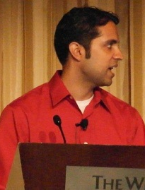
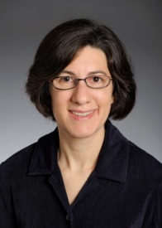
Spaced Repetition and Mnemonics Enable Recall of Multiple Strong Passwords
Jeremiah Blocki
Saranga Komanduri
Lorrie Cranor
Anupam Datta
NDSS 2015
Notes:
I should start out by thanking everyone for waking up early in the morning on the last day of the conference to attend this talk. This is joint work with …

Slide 2
Motivation
…
Notes:
As motivation lets consider a problem that we are all familiar with. A typical internet user is given the complex task of creating and remembering passwords for many accounts.

Slide 3
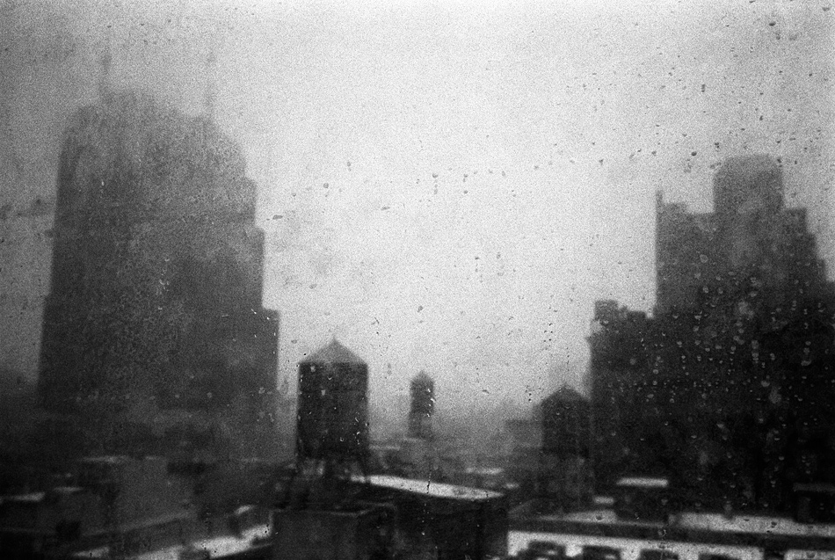
Notes:
It is easy to take a pessimistic outlook on the situation. Is this a battle that the adversary will win?

Slide 4
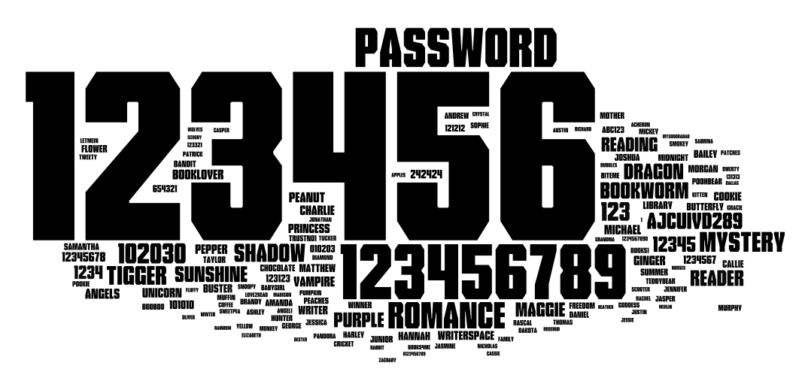
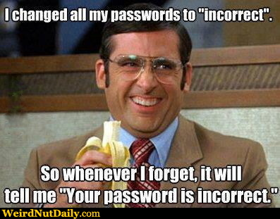
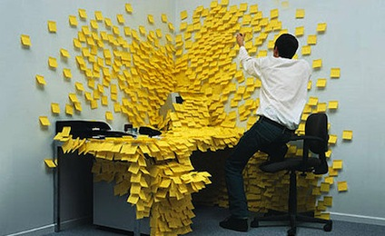
Usability Problem
Notes:
On the other side we also have a usability problem. User’s struggle to remember so many different passwords and often cope by selecting weak passwords, reusing passwords and writing down passwords.

Slide 5
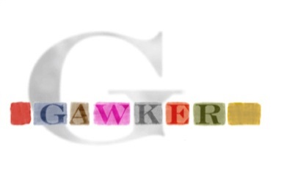
Security Problem
Password breaches at major companies have affected millions of users.
Notes:
On the other side in the last few years we have seen password breaches at major organizations which affect millions of users. The damages of these breaches are often compounded by password reuse.

Slide 6
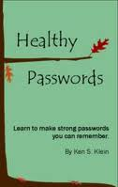
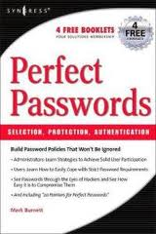
Traditional Security Advice
Use numbers and letters
Use special symbols
Don’t Reuse Passwords
Don’t use words/names
Not too short
Don’t Write it Down
Use mix of lower/upper case letters
Change your passwords every 90 days
Notes:
In response to breaches like these users get many reminders about ways to make their passwords secure. Traditionally, the advice a user gets is something like the following…
Is it time to re-evaluate the traditional security advice?

Slide 7
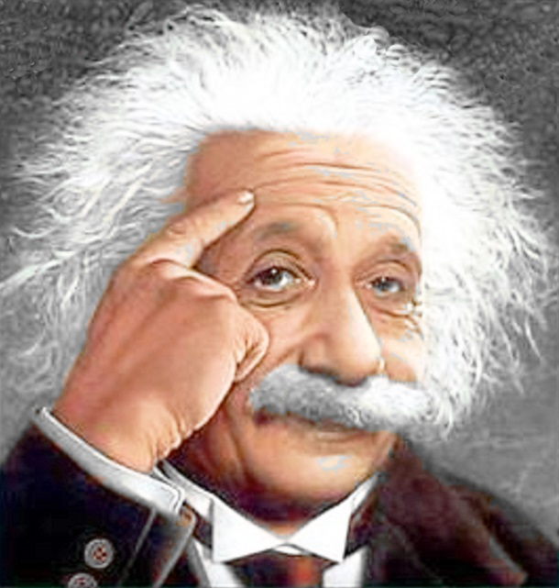
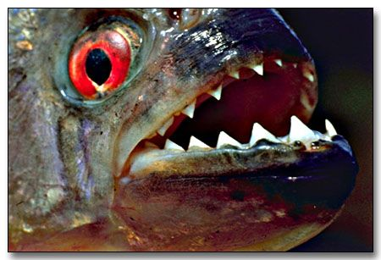
Notes:
In this talk I hope to convince you that there is reason for optimism. We conducted a user study in which we asked participants to memorize several randomly generated person-action object stories. For example, Albert Einstein kissing a piranha on the beach. Our results indicate that people are able to remember their stories over a time period of 120+ days by following certain spaced repetition schedules.
In particular I will report on a user study that provides evidence that people are capable of remembering several randomly generated person-action-object stories like Furthermore,

Slide 8
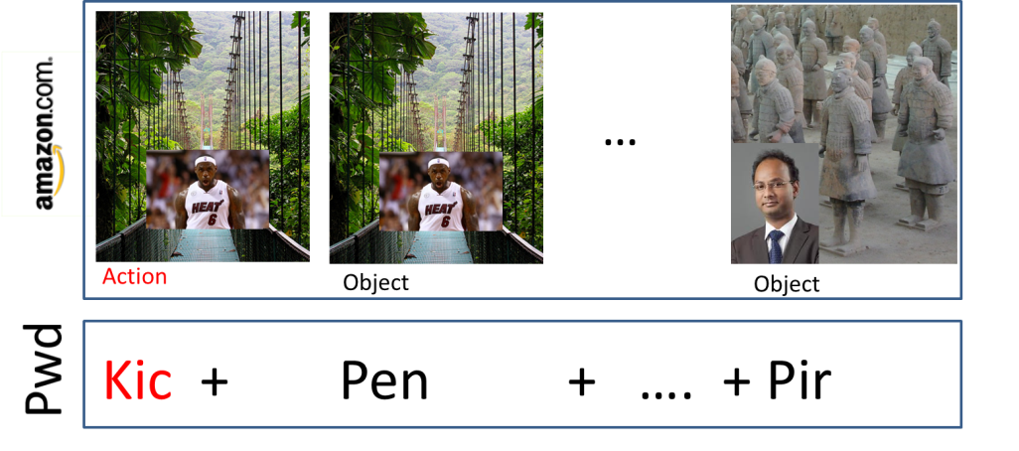
Previous Work: Shared Cues
Combinatorial Design: Each pairs of accounts has at most 𝛄 secret stories in common.
Source: Naturally Rehearsing Passwords [BBD13]
Notes:
Previous work demonstrates that a user could use a few person-action-object stories to create multiple strong passwords. For example, in the Shared Cues scheme the user memorizes several randomly generated PAO stories. These stories are divided into two parts a public cue and a private secret. When the user authenticates to an account like amazon he is prompted with a public challenge, and the user forms his password by using the corresponding actions or objects that he has memorized. Similarly, when the user authenticates to Paypal the user is prompted with a different public challenge. Notice that part of the challenge is the same. The advantages of sharing cues are two fold: First, we reduce the number of stories that the user needs to memorize. More importantly we increase the rate at which the user rehearses each of his secret stories.

Slide 9
Previous Work: Sharing Cues
Day: 1 2 4 5 8
Usability Advantages
Fewer stories to remember!
More Natural Rehearsals!
Security?
Visit Amazon: Natural Rehearsal
Google
Source: Naturally Rehearsing Passwords [BBD13]

Slide 10
Previous Work: Shared Cues
PAO Stories | #Passwords | Security
4 | 14
7 | 75+
Adversary with one password is unlikely to crack any other password
15 | 75+
43 | 75+
Notes:
In the shared cues scheme there are tradeoffs between the number of stories that the user needs memorize, the number of passwords that we can form and the security of the scheme.
If the user is willing to memorize four stories then we can generate 14 unique passwords with the following moderately strong security guarantee. If the user is willing to memorize three more stories then we can generate over 75 unique passwords with the same security guarantee. If the user wants a stronger security guarantee that an adversary who has seen two passwords can’t guess any other password then he will need to memorize 15 passwords and if the user wants security after six password breaches then he needs to memorize 43 stories.

Slide 11
User Study Goals
Spaced Repetition
Can users recall multiple PAO stories by following spaced repetition schedules?
Which schedules work best?
Mnemonic Advantage
Does the PAO mnemonic technique improve recall?
Interference Effect

Slide 12
Outline
Motivation
Study Protocol
Recruitment and Incentives
Memorization Phase
Rehearsal Phase
Conditions
Results
Discussion
Future Directions

Slide 13
Recruitment
578 participants completed initial memorization phase
Notes:
We recruited participants in our study on mechanical turk. We advertised our study as a memory study in which participants would be asked to memorize and rehearse random words. We advertised our study as a memory study in which participants would be asked to memorize and rehearse random words.

Slide 14
Recruitment
“Participate in a Carnegie Mellon University research study on memory. …”
“…you will be asked to memorize and rehearse random words.”
578 participants completed initial memorization phase
Notes:
And we advertised our study as a memory study.

Slide 15
User Study Protocol
Memorization Phase (5 minutes):
Participants asked to memorize four randomly selected person-action object stories.
Rehearsal Phase (120+ days):
Participants periodically asked to return and rehearse their stories (following rehearsal schedule)
Notes:
Mnemonic Group/Non Mnemonic Group
We will test several different rehearsal schedules
Long term memory study

Slide 16
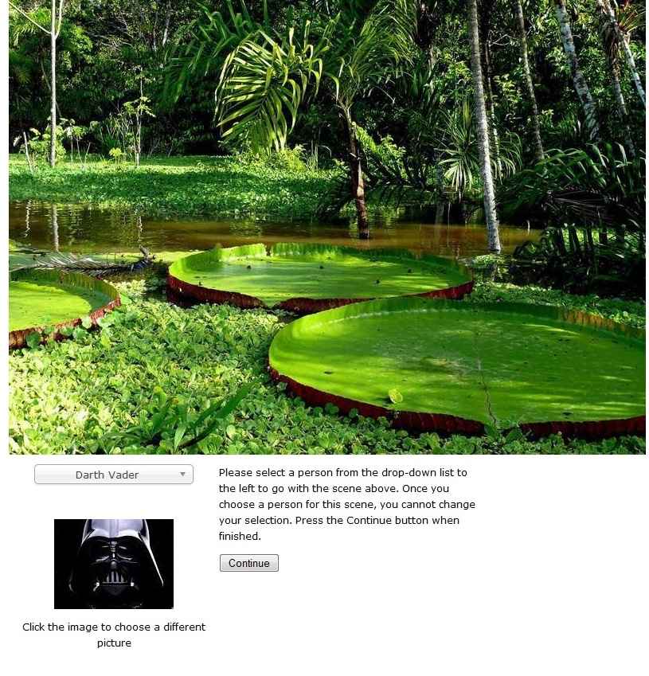
Memorization Phase
Notes:
We allowed the user to select any celebrity that they wanted. Then we generated a random action-object pair for the user from a set of almost 100 actions and a set of almost 100 objects

Slide 17
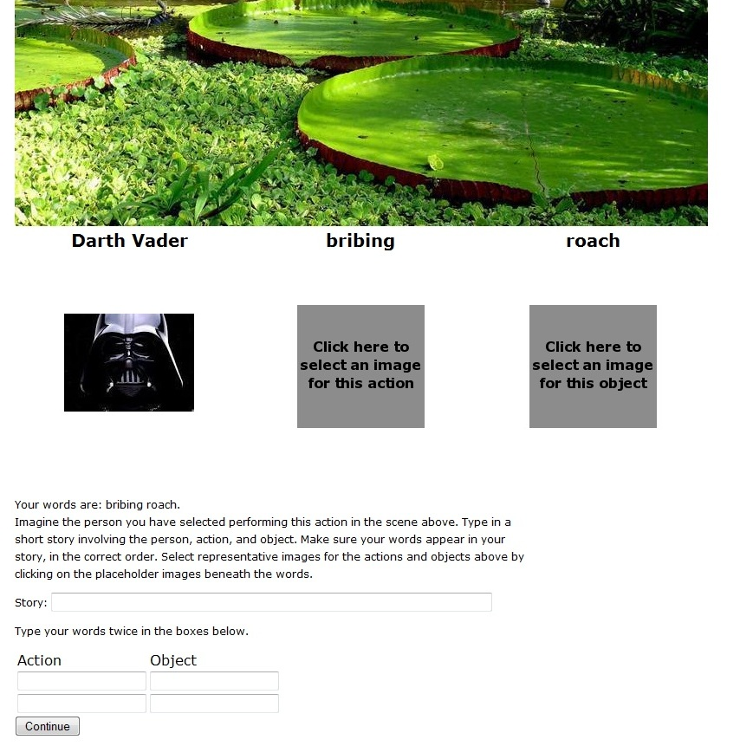
Memorization Phase
Notes:
We then asked the user to 1. make up a story involving his person, action and object. 2. Select images of his action and object and 3. type in his action-object pair two times. Most users repeated this process four times to memorize a total of four PAO stories.

Slide 18
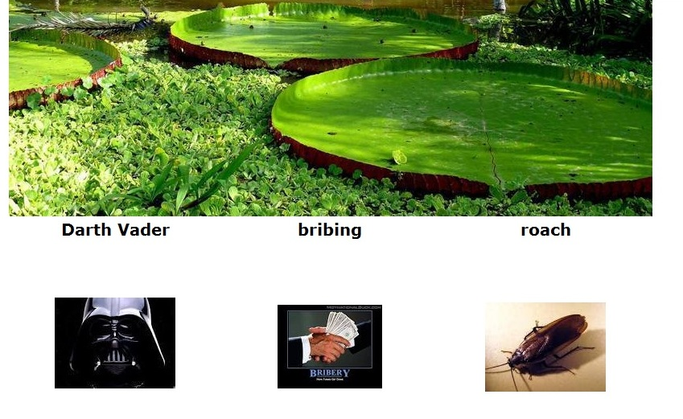
Memorization Phase
Notes:
Here is a snapshot of the screen after the user has selected images for his words bribing and roach.

Slide 19
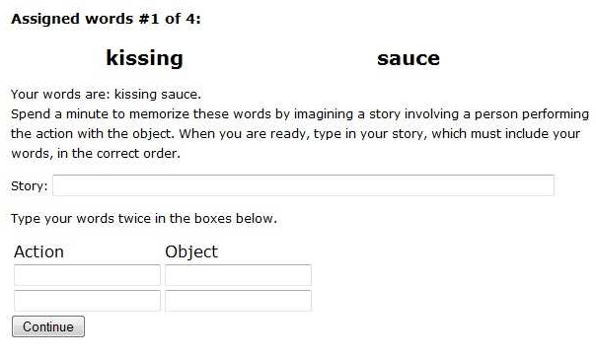
Memorization Phase (Text)

Slide 20
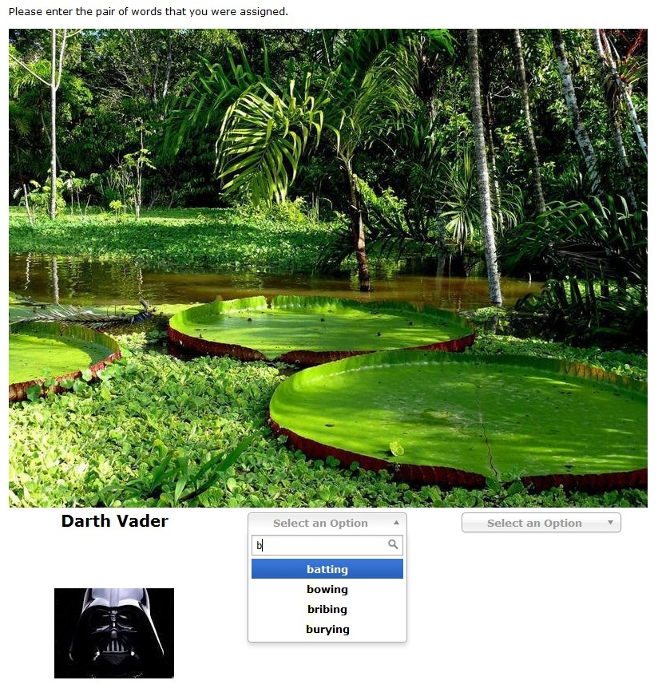
Rehearsal
Notes:
During each rehearsal we prompted users with their scene and their person and asked them to remember their action-object pair. Participants were given three attempts for each PAO story that they memorized. After three wrong guesses we reminded participants of their PAO stories and asked them to recomplete the memorization phase.

Slide 21
Rehearsal Schedules
Example 1: 12hrX1.5
First Rehearsal (t₁): 12 hours
$$t_{i+1}−t_{i}=12hr×{\left(1.5\right)}^{i}$$
Final Rehearsal (t₁₀): 157 days
2
4
6
7
10
0
1
3
5
8
9
Day:0 16 32 48 64 80 96 112 128 144 160
Notes:
In this schedule the first rehearsal comes twelve hours after memorization and the gap between the I’th and the i+1’th rehearsal was 12 hours times 1.5 to the power i. Thus the time gaps increase over time. The 10th and final rehearsal in this schedule took place on day 156

Slide 22
Rehearsal Schedules
Example 2: 24hrX2
First Rehearsal (t₁): 24 hours
$$t_{i+1}−t_{i}=24hr×{\left(2\right)}^{i}$$
Final Rehearsal (t₇): 127 days
2
4
6
7
0
1
3
5
Day:0 16 32 48 64 80 96 112 128 144 160

Slide 23
Rehearsal Schedules
Rehearsal#/ Schedule | 1 | 2 | 3 | 4 | 5 | 6 | 7 | 8 | 9 | 10 | 11 | 12
12hrx1.5 | .5 day | 1.75 | 4.2 | 8.2 | 14.7 | 24.7 | 40.7 | 64.7 | 101.7 | 157.7 | N/A | N/A
24hrX2 | 1 day | 3 | 7 | 15 | 31 | 63 | 127 | N/A | N/A | N/A | N/A | N/A
24hrX2+2Start | .1 day | .6 | 1.6 | 3.6 | 7.6 | 15.6 | 31.6 | 63.6 | 127.6 | N/A | N/A | N/A
30minX2 | .5 hr | 1.5hr | 3.5hr | 7.5hr | 15.5 hr | 1.7 day | 3.7 | 7.7 | 15.7 | 31.7 | 63.7 | 127.7
Notes:
Overall we considered four different rehearsal schedules. Each schedule lasted

Slide 24
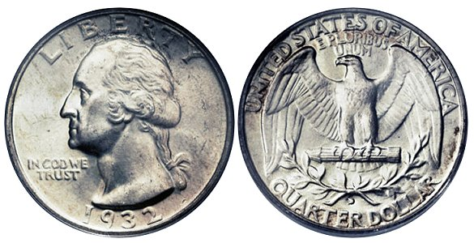
Incentives
Memorization Phase ($0.5)
Rehearsal Phase ($0.75 each)
Encourage participants to return
Discourage Cheating
Notes:
We paid participants 50 cents for completing the initial memorization phase, and we paid participants 75 cents for each rehearsal.

Slide 25
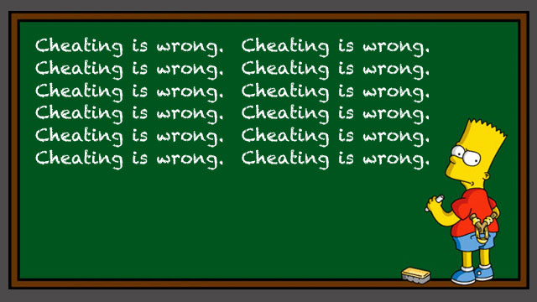
Do Not Write Down Your Words
“…we ask that you do not write down the words that we ask you to memorize.”
“You will be paid for each completed rehearsal phase --- even if you forgot the words.”
“Important: …do not write down the words”
“You will be paid for each completed rehearsal phase --- even if you forgot the words.”
Notes:
In a remote study we cannot absolutely guarantee that participants didn’t write down their words. However, we repeatedly instructed participants not to write down their words and we reminded user’s that they would get paid even when they forget their words.

Slide 26
Study Conditions
Mnemonic/text
Rehearsal Schedule
# PAO Stories
One, Two or Four
m_12hrX1.5_4
Notes:
Each participant was assigned to one of seven different study conditions, where each condition specified a memorization technique (mnemonic or text), a rehearsal schedule and the number of PAO stories that the user memorized.

Slide 27
Study Conditions
Condition | Comment
m_24hrX2+2Start_1 | 1 PAO Story
m_24hrX2+2Start_2 | 2 PAO Stories
m_24hrX2+2Start_4 | 4 PAO Stories
Interference
Condition | Comment
t_24hrX2+2Start_4 | Text condition/No Cues
m_24hrX2+2Start_4 | Mnemonic Condition
Mnemonic vs Text

Slide 28
Study Conditions
Condition | Comment
m_24hrX2_4 | 24 hour base
m_24hrX2+2Start_4 | Two Extra Rehearsals on Day 1
m_30minX2_4 | 30 min base
m_12hrX1.5_4 | Growth Rate: 1.5x
Compare Rehearsal Schedules

Slide 29
Challenge: Dropped Participants
Result of Last Rehearsal | Invited to Return for Next Rehearsal?
Remembered All Words | Yes
Forgot Some Words | Yes*
Failed to Return/Late | No
* Participant was reminded of his words & asked to rehearse again

Slide 30
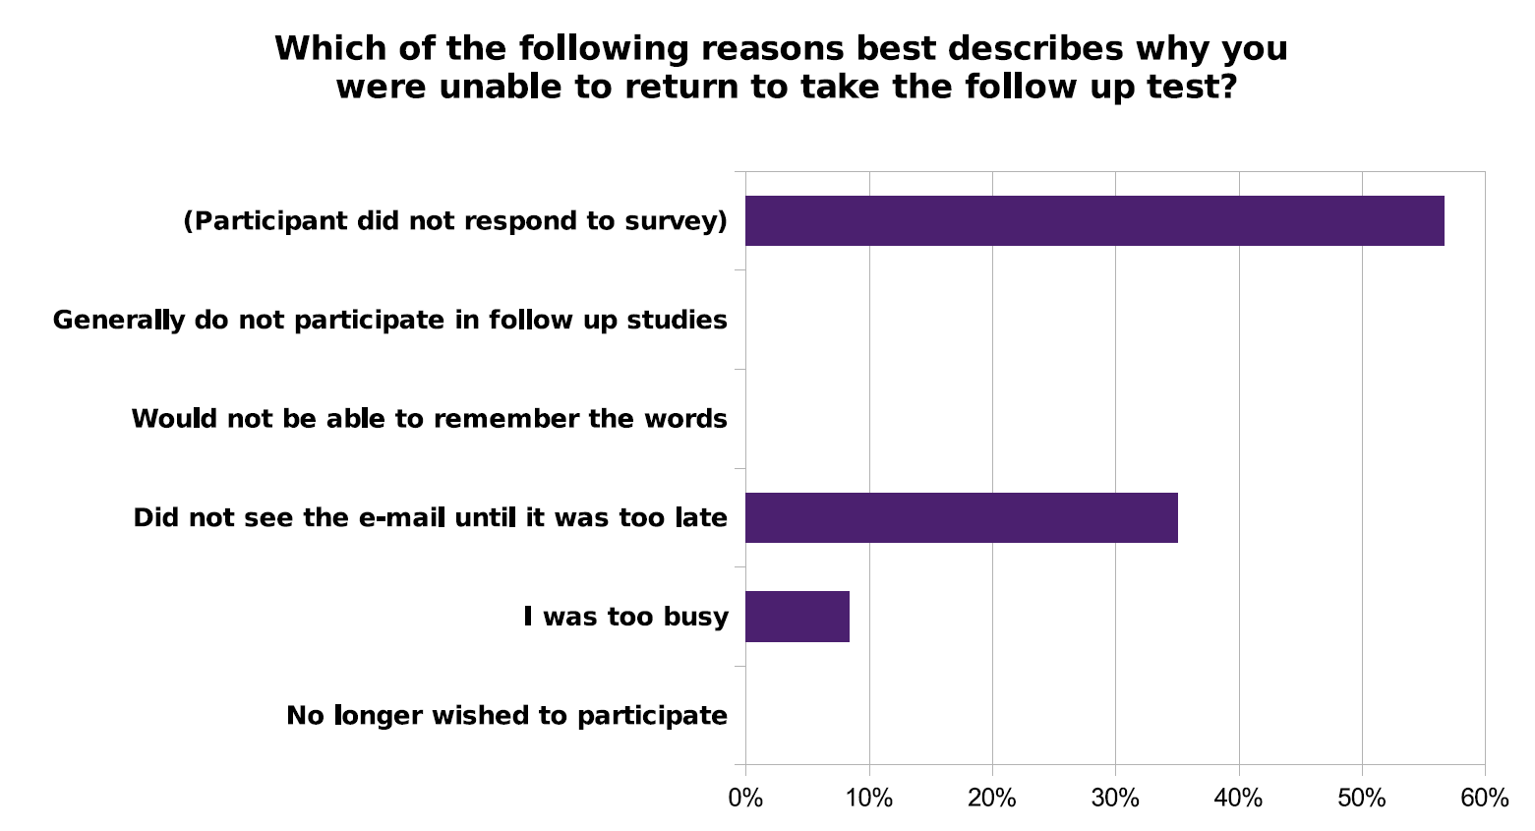
Survey: Dropped Participants
No participant self-reported that they didn’t return because the stories were too difficult to memorize.

Slide 31
Outline
Motivation
Study Protocol
Results
Discussion
Future Directions

Slide 32
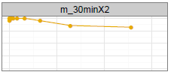
Rehearsal Schedules
Days
Days
Survived(i)/Returned(i)

Slide 33
Rehearsal Schedules
Days
Days
Survived(i)/Returned(i)
$$\operatorname{Exp}\left(β\right)=0.42∗$$
Participants twice as likely to
fail at any given point in time
* Statistically Significant (p=0.05)

Slide 34
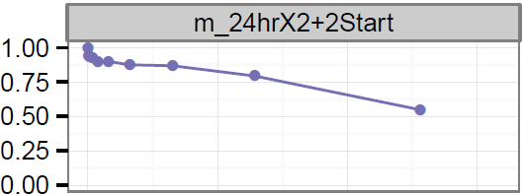
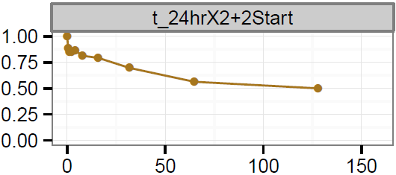
Text vs Mnemonic
Advantage is statistically significant
Advantage is not statistically significant
Survived(i)/Returned(i)

Slide 35
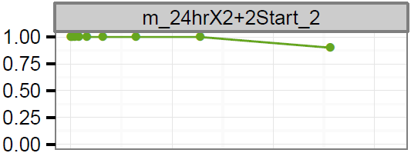
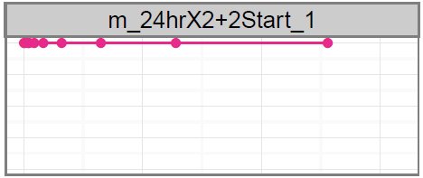
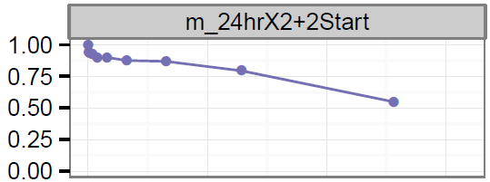
Interference
Days
Days
Survived(i)/Returned(i)
Interference Effect was Statistically Significant

Slide 36
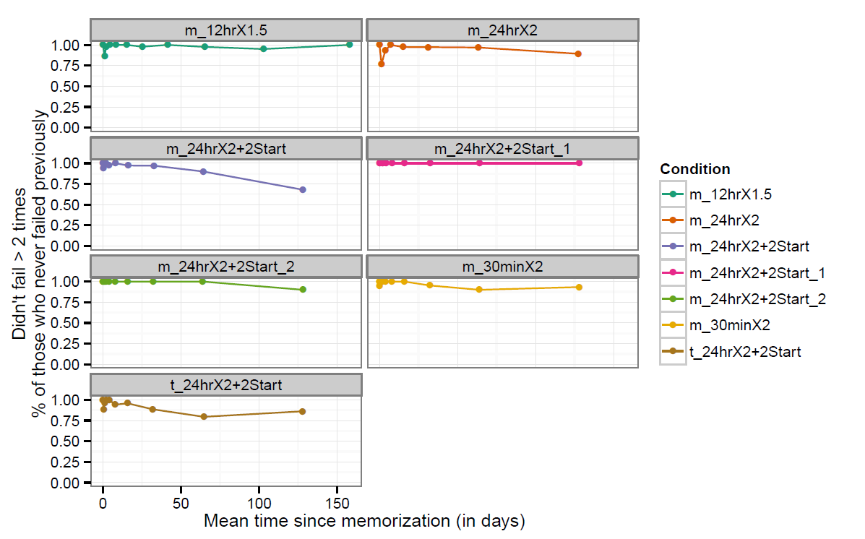
Results
Succeeded(i)/Returned(i)
Notes:
Top two groups asked to memorize one or two stories. The rest of the groups were asked to memorize four stories. The text group did not use the memory palace mnemonic technique.

Slide 37
Backup Results

Slide 38
Findings
Spaced Repetition
Yes, participants did remember multiple PAO stories!
Winning Schedule: 12hrX1.5
Mnemonics
Short Term: Benefit is statistically significant
Long Term: Rehearsal schedule was only significant factor
Interference
Benefit: Memorize one story at a time
Future Work: Causes of interference

Slide 39
Outline
Motivation
Study Protocol
Results
Discussion & Future Directions
Password Expiration Policies
Password Strengthening
Mitigating Interference

Slide 40
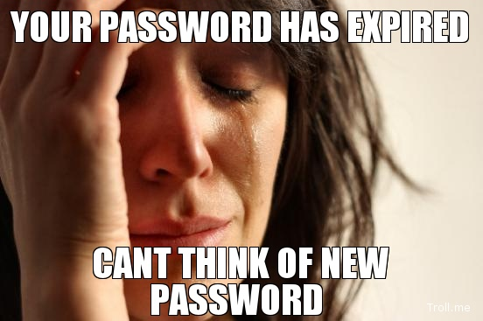
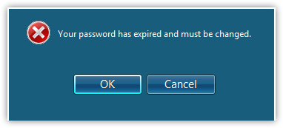
Password Expiration Policy
Notes:
http://cs.unc.edu/~fabian/papers/PasswordExpire.pdf
“…our study calls into question the continued use of expiration [policies]…”

Slide 41
Our Take: Password Expiration Policies
High Effort Region
Low Effort Region
2
4
5
6
7
10
1
3
8
9
Day:0 16 32 48 64 80 96 112 128 144 160
We believe our study calls into question the merit of continuing the practice of password expiration.
Notes:
We need to reconsider password expiration policies. These policies are well known to frustrate users, and our study provides insight into why these policies are so frustrating.

Slide 42
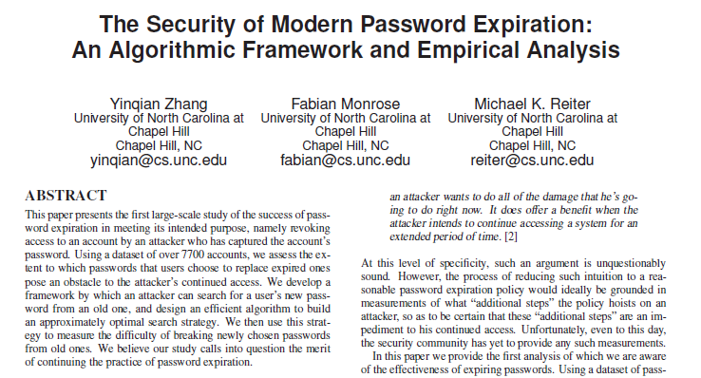
We believe our study calls into question the merit of continuing the practice of password expiration.
Notes:
Previous studies cast serious doubts on any security benefits of password expiration policies.

Slide 43
Password Strengthening
Towards reliable storage of 56-bit secrets in human memory [BS14]
7
90
0
Day:0 16
Notes:
Our study is similar to a recent user study conducted by Bonneau and Schechter. They nudged participants to gradually memorize stronger passwords over a time period of 15 days. There are a few key differences between their study and our study. For example, we used mnemonic techniques in our study and we required user’s memorize all four of their PAO stories up front. The primary difference between our studies is the time frame.

Slide 44
Related Work
2
7
90
0
Day:0 16
2
4
6
7
10
0
1
3
5
8
9
Day:0 16 32 48 64 80 96 112 128 144 160
Notes:
By contrast, our time frame was approximately 10 times longer and we reduced the number of rehearsals by a factor of 9. Furthermore, participants who only memorized one PAO story in our study never made a mistake

Slide 45
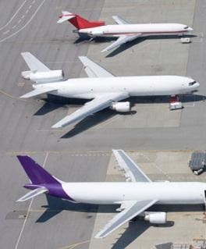
Password Strengthening Mechanism
jblocki, Abcd1234
Bouncing, Smore

Slide 46
Password Strengthening Mechanism
jblocki
Abcd1234 + ?
Bouncing, Smore
Notes:
A k-strikes policy is used to mitigate this threat. However, users who select popular passwords like 123456 might still be vulnerable.

Slide 47
Password Strengthening Mechanism
jblocki
Abcd1234 + EatingSmore
Bouncing, Smore
Notes:
A k-strikes policy is used to mitigate this threat. However, users who select popular passwords like 123456 might still be vulnerable.

Slide 48
Password Strengthening Mechanism
jblocki
Abcd1234 + BouncingSmore
Once we can be confident that the user will remember the story we add it to the password.
Notes:
A k-strikes policy is used to mitigate this threat. However, users who select popular passwords like 123456 might still be vulnerable.

Slide 49
Future Directions
Understand the Cause(s) of Interference
User Fatigue?
Mixing up stories?
Mitigating Interference
Staggered Memorization Schedule?
Gracefully Expanding Combinatorial Designs

Slide 50
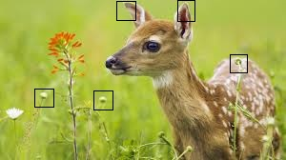
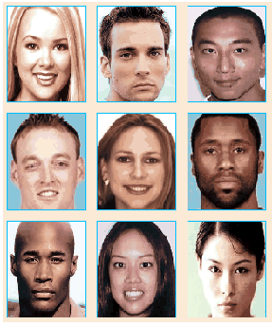
Future Directions
Spaced Repetition with other mnemonics
Graphical Secrets

Slide 51
Thanks for Listening

Slide 52
Conclusion
Spaced Repetition and Mnemonics Enable Recall of Multiple Strong Passwords
…
…

Slide 53
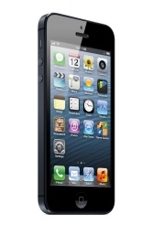
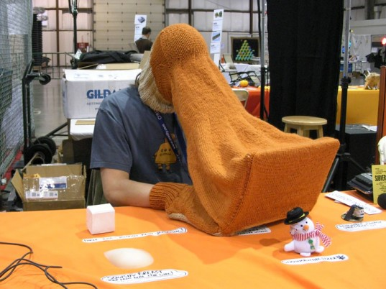
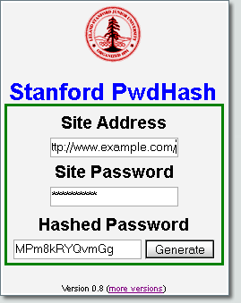
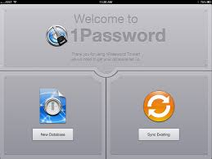
Related Work
Goal: Minimize Trust Assumptions about User’s
Computational Devices
Password Management Software
Notes:
LastPass
KeePass
1Password
A Usability Study and Critique of Two Password Managers ∗
by S Chiasson, PC van Oorschot, R Biddle
PwdHash
Blake Ross, Collin Jackson, Nicholas Miyake, Dan Boneh and John C. Mitchell

Slide 54
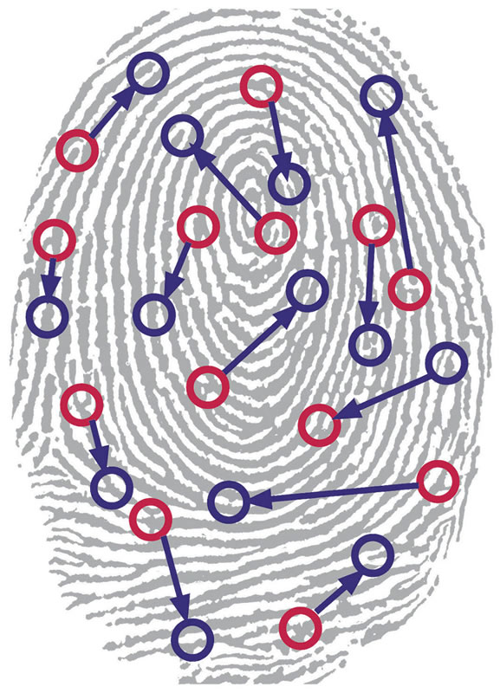
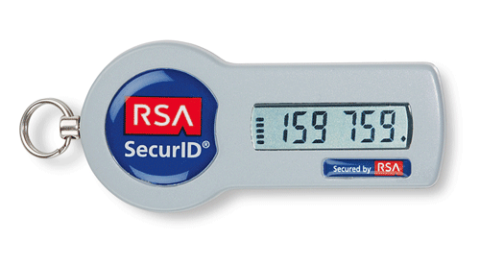
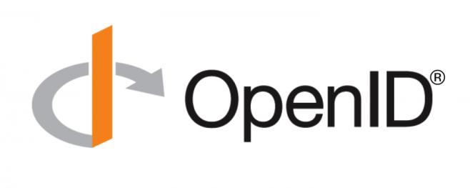
Related Work
Quest to Replace Passwords [BHOS2012]
Alternatives to Passwords
Notes:
Another line of research has sought to eliminate text passwords. One might ask whether or not password research will be relevant in the future. Bonneau, et al. considered each of these alternatives to text passwords in 2012 and concluded that there was no silver bullet to replace text passwords. While every proposed replacement has desirable properties, every replacement scheme they evaluated also had its disadvantages. For example, biometrics signals like fingerprints cannot be changed if they are compromised.
Quest to Replace Passwords
Bonneau, J. ; Univ. of Cambridge, Cambridge, UK ; Herley, C. ; van Oorschot, P.C. ; Stajano, F.

