Slide 1
Towards a Theory of Data-Independent Memory Hard Functions
Jeremiah Blocki (Purdue)
Joel Alwen (IST Austria)
Krzysztof Pietrzak (IST Austria)

Slide 2


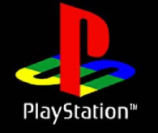


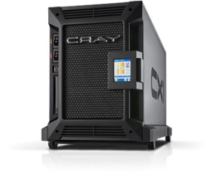

Motivation: Offline Dictionary Attack
jblocki, 123456
Username
jblocki
Salt
89d978034a3f6
Hash
85e23cfe0021f584e3db87aa72630a9a2345c062
SHA1(12345689d978034a3f6)=85e23cfe0021f584e3db87aa72630a9a2345c062
+
Notes:
GOTCHAs are intended to address a specific type of attack against passwords called an offline dictionary attack. When a user creates an account the server stores a password file with a cryptographic hash of the user’s password. If an adversary is able to breach the server and recover this password file then he check a password guess by evaluating the hash function --- without getting locked out after several incorrect guesses.

Slide 3






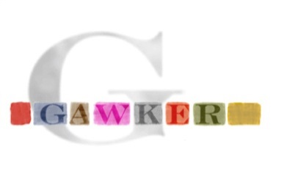

Offline Attacks: A Common Problem
Password breaches at major companies have affected millions of users.
Notes:
Unfortunately, offline dictionary attacks are quite common. Password breaches at major companies have affected millions of users.

Slide 4



Offline Attacks: A Common Problem
Password breaches at major companies have affected millions of users.
Notes:
Unfortunately, offline dictionary attacks are quite common. Password breaches at major companies have affected millions of users.

Slide 5
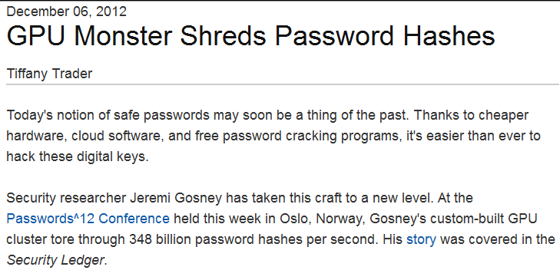
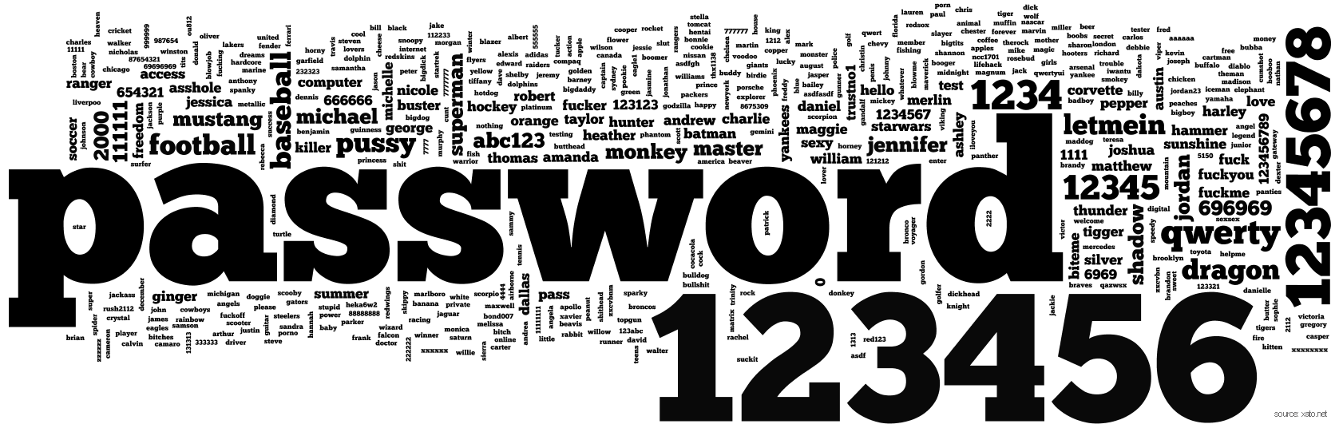
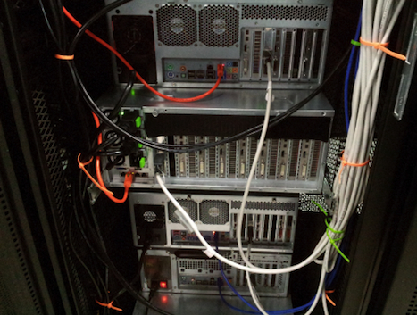
Notes:
Offline dictionary attacks are also very powerful. Some password hash functions can be evaluated at 348 billion hashes per second! How can we defend against these attacks?

Slide 6
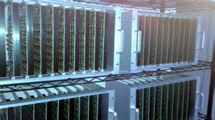




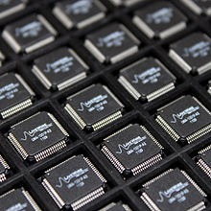
Goal: Moderately Expensive Hash Function
Equitable Costs?
Notes:
One proposed defense is to intentionally make the cryptographic hash function more expensive to evaluate by using a cryptographic hash function like BRCRYPT or sCrypt. The tradeoff is that making the hash function more expensive to evaluate increases costs for the adversary and a legitimate server.
Note: This slide could be skipped if the presentation is too long.

Slide 7
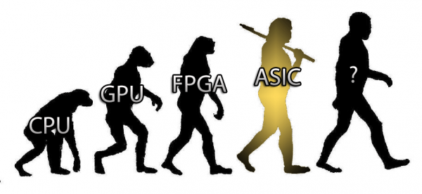
Bitcoin Mining (SHA256) is not Equitable!
Cost(SHA256) varies by a factor of 10⁶

Slide 8
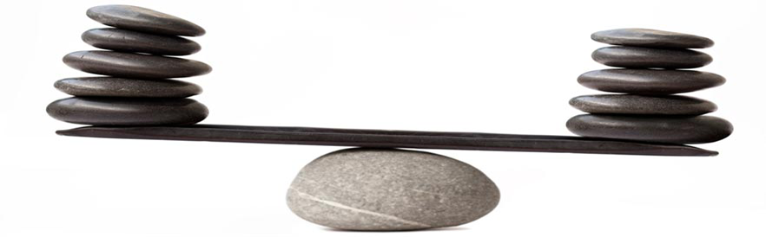
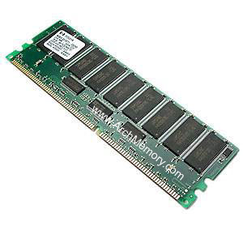
Memory Costs: Equitable Across Architectures

Slide 9

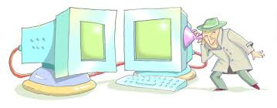
Memory Hard Function (MHF)
Computation costs dominated by memory costs
Data Independent Memory Hard Function (iMHF)
  Memory access pattern should not depend on secret input

Slide 10
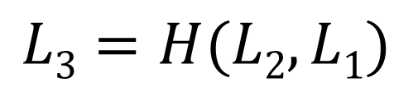

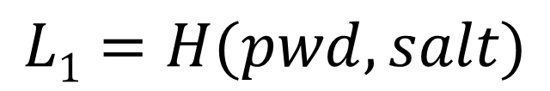
iMHF (f_{G,H})
Given by a hash function H and DAG G
H:$\left\{0,1\right\}2k→\left\{0,1\right\}k$ (Random Oracle)
G encodes data-dependencies
Input:
2
4
Output: L₄
1
1
pwd, salt
3
$$L1=H(pwd,salt)$$
$$L3=H(L2,L1)$$

Slide 11

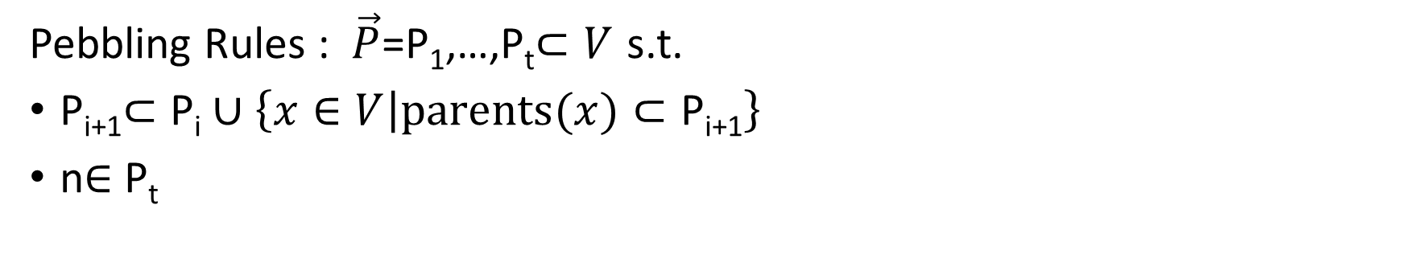

Evaluating an iMHF (pebbling)
2
4
Output: L₄
Input:
1
1
pwd, salt
3
$$L1=H(pwd,salt)$$
$$L3=H(L2,L1)$$
Pebbling Rules : $\vec{P}$=P₁,…,P_{t}$⊂V$ s.t.
P_{i+1}$⊂\text{P}\text{i}∪\left\{x∈V | parents(x)⊂\text{P}\text{i}\text{+1}\right\}$
n$∈$ P_{t}

Slide 12
Pebbling Example
4
5
3
4
5
1
2
3
1
2

Slide 13
Pebbling Example
1
2
3
4
5
P₁ = {1}

Slide 14
Pebbling Example
1
2
3
4
5
P₁ = {1}
P₂ = {1,2}

Slide 15
Pebbling Example
1
2
3
4
5
P₁ = {1}
P₂ = {1,2}
P₃ = {3}

Slide 16
Pebbling Example
1
2
3
4
5
P₁ = {1}
P₂ = {1,2}
P₃ = {3}
P₄ = {3,4}

Slide 17
Pebbling Example
1
2
3
4
5
P₁ = {1}
P₂ = {1,2}
P₃ = {3}
P₄ = {3,4}
P₅ = {5}

Slide 18
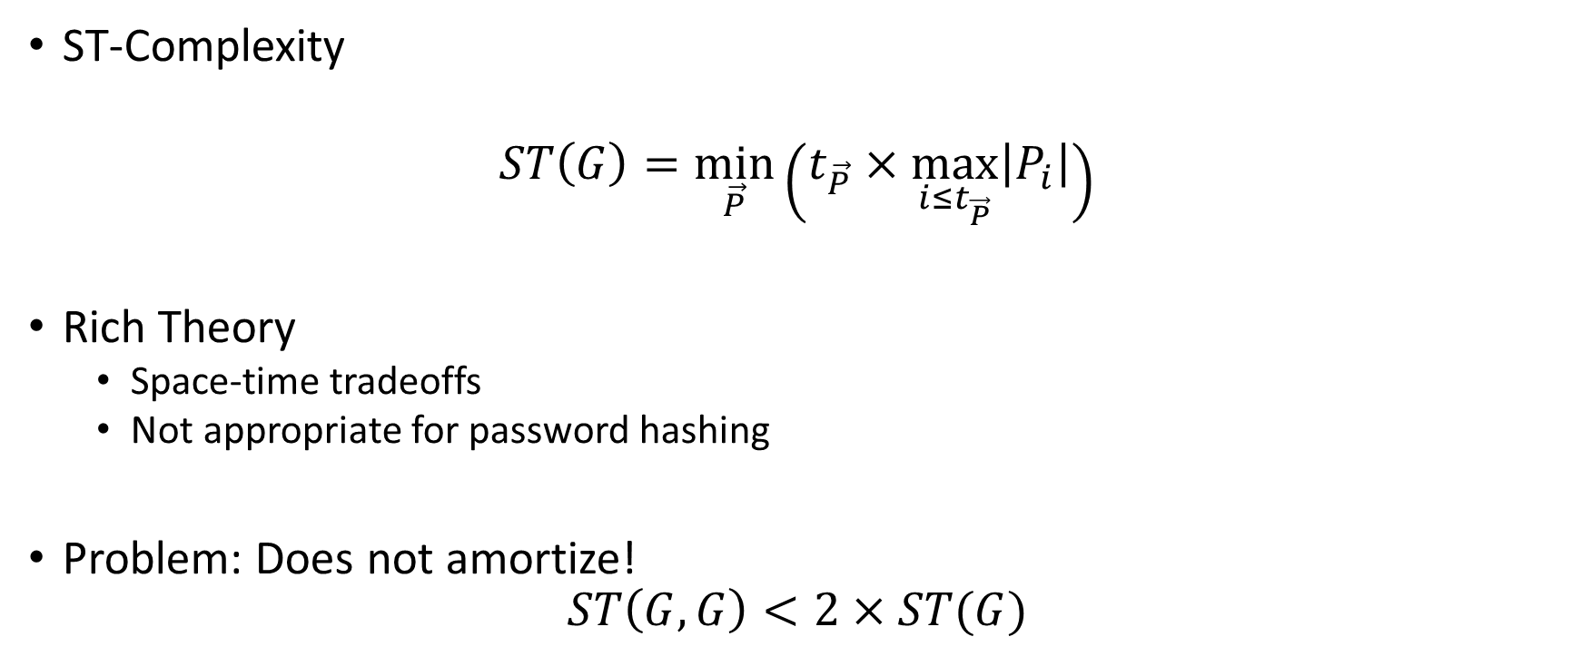
Measuring Cost: Attempt 1
ST-Complexity
$$ST\left(G\right)=\min_{\vec{P}}\left(t_{\vec{P}}×\max_{i≤t_{\vec{P}}}\left|P_{i}\right|\right)$$
Rich Theory
  Space-time tradeoffs
  Not appropriate for password hashing
Problem: Does not amortize!
$$ST\left(G,G\right)<2×ST(G)$$

Slide 19

Measuring Cost: Improved [AS15]
Cumulative Complexity (CC)
$$CC\left(G\right)=\min_{\vec{P}}{\sum_{i=1}^{t_{\vec{P}}}{\left|P_{i}\right|}}$$
Amortization
$$CC\left(G,G\right)=2×CC(G)$$

Slide 20
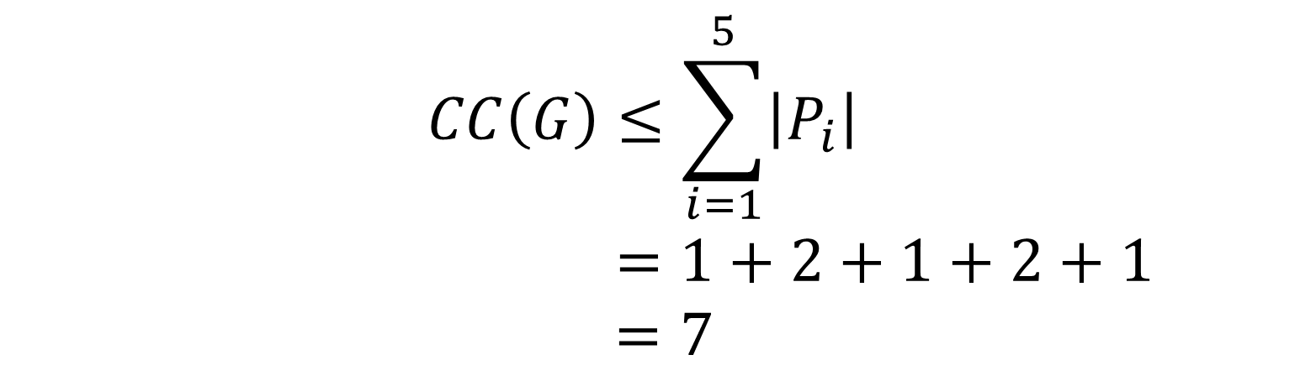
Pebbling Example
1
2
3
4
5
P₁ = {1}
$$CC\left(G\right)≤\sum_{i=1}^{5}{\left|P_{i}\right|}$$
$$=1+2+1+2+1$$
$=7$
P₂ = {1,2}
P₃ = {3}
P₄ = {3,4}
P₅ = {5}

Slide 21
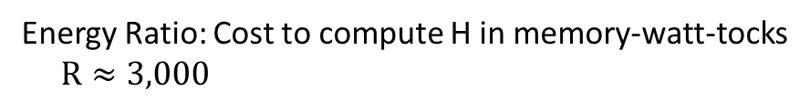

Energy Complexity [AB16]
$$ER\left(G\right)=\min_{\vec{P}}{\sum_{i=1}^{t_{\vec{P}}}{\left(\left|P_{i}\right|+R\left|P_{i}\backslash P_{i−1}\right|\right)}}$$
Memory costs in
memory-watt-tocks
Energy Ratio: Cost to compute H in memory-watt-tocks
$R≈3,000$

Slide 22

Energy Complexity [AB16]
$$ER\left(G\right)=\min_{\vec{P}}{\sum_{i=1}^{t_{\vec{P}}}{\left(\left|P_{i}\right|+R\left|P_{i}\backslash P_{i−1}\right|\right)}}$$
$$ER\left(G\right)=θ\left(CC(G)\right)$$
Memory costs (equitable)
Cost of querying H (inequitable)

Slide 23

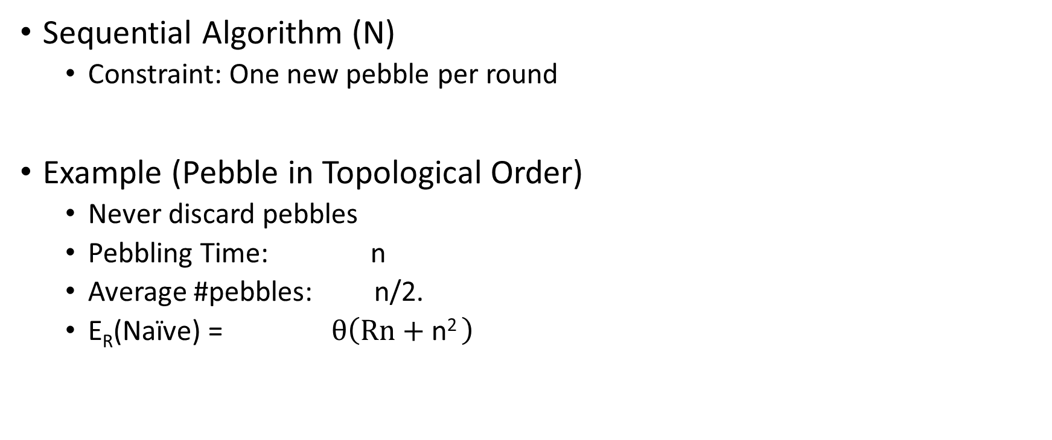
Naïve Pebbling Algorithm
Sequential Algorithm (N)
  Constraint: One new pebble per round
Example (Pebble in Topological Order)
  Never discard pebbles
  Pebbling Time: n
  Average #pebbles: n/2.
  E_{R}(Naïve) = $θ\left(Rn+\text{n}\text{2 }\right)$

Slide 24

Amortized Attack Quality
$$QualityR\left(A\right)=\frac{\text{E}\text{R}\text{(}\text{Na}\text{ï}\text{ve}\text{)}}{ER\left(A\right)}×\#inst(A)$$

Slide 25
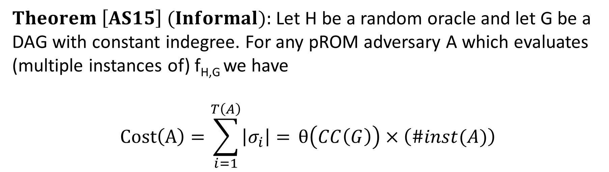
Pebbling Equivalence
$Theorem \left[AS15\right] (Informal):$Let H be a random oracle and let G be a DAG with constant indegree. For any pROM adversary A which evaluates (multiple instances of) f_{H,G} we have
$$Cost\left(A\right)=\sum_{i=1}^{T\left(A\right)}{\left|σ_{i}\right|= }θ\left(CC\left(G\right)\right)×\left(\#inst(A)\right)$$

Slide 26

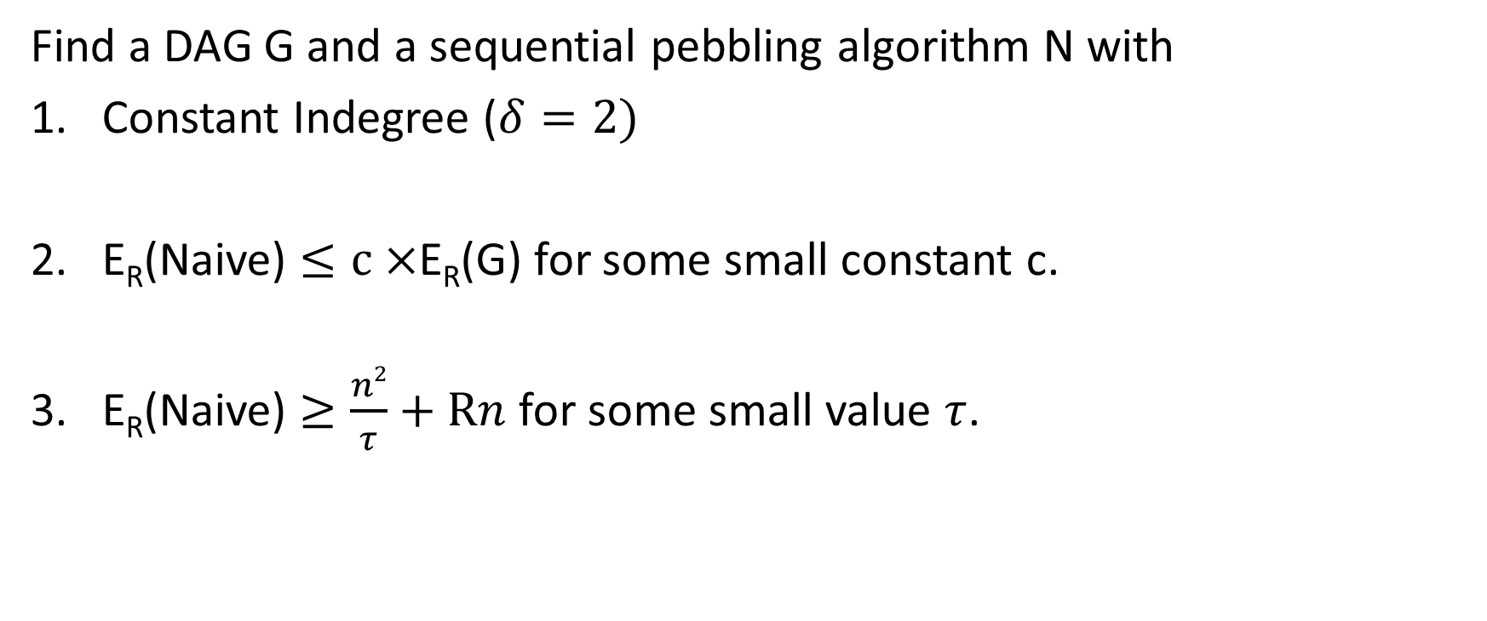
Desiderata
Find a DAG G and a sequential pebbling algorithm N with
Constant Indegree ($δ=2)$
E_{R}(Naive) $≤c×$E_{R}(G) for some small constant c.
E_{R}(Naive) $≥\frac{n2}{τ}+Rn$ for some small value $τ$.

Slide 27
Desiderata
Find a DAG G and a sequential pebbling algorithm N with
Constant Indegree ($δ=2)$
E_{R}(Naive) $≤c×$E_{R}(G) for some small constant c.
E_{R}(Naive) $≥\frac{n2}{τ}+Rn$ for some small value $τ$.
…
1
2
3
n

Slide 28
Desiderata
Find a DAG G and a sequential pebbling algorithm N with
Constant Indegree ($δ=2)$
E_{R}(Naive) $≤c×$E_{R}(G) for some small constant c.
E_{R}(Naive) $≥\frac{n2}{τ}+Rn$ for some small value $τ$.
…
1
2
3
n

Slide 29
Desiderata
Find a DAG G and a sequential pebbling algorithm N with
Constant Indegree ($δ=2)$
E_{R}(Naive) $≤c×$E_{R}(G) for some small constant c.
E_{R}(Naive) $≥\frac{n2}{τ}+Rn$ for some small value $τ$.
…
1
2
3
n

Slide 30
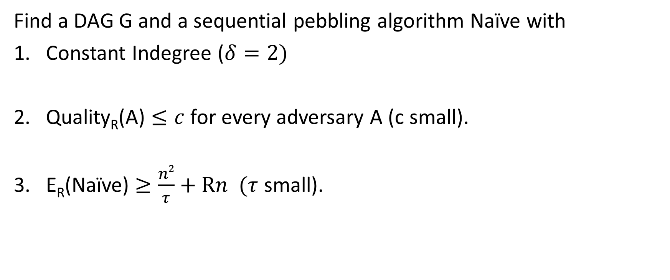
Desiderata
Find a DAG G and a sequential pebbling algorithm Naïve with
Constant Indegree ($δ=2)$
Quality_{R}(A) $≤c$ for every adversary A (c small).
E_{R}(Naïve) $≥\frac{n2}{τ}+Rn$ $(τ$ small).
…
1
2
3
n

Slide 31
Desiderata
E_{R}(Naive)=E_{R}(G)=n+Rn
Cost dominated by queries to H
(inequitable)
Find a DAG G and a sequential pebbling algorithm N with
Constant Indegree ($δ=2)$
E_{R}(Naive) $≤c×$E_{R}(G) for some small constant c.
E_{R}(Naive) $≥\frac{n2}{τ}+Rn$ for some small value $τ$.
…
1
2
3
n

Slide 32
Desiderata
Find a DAG G and a sequential pebbling algorithm N with
Constant Indegree ($δ=2)$
E_{R}(Naive) $≤c×$E_{R}(G) for some small constant c.
E_{R}(Naive) $≥\frac{n2}{τ}+Rn$ for some small value $τ$.
Memory costs should dominate

Slide 33
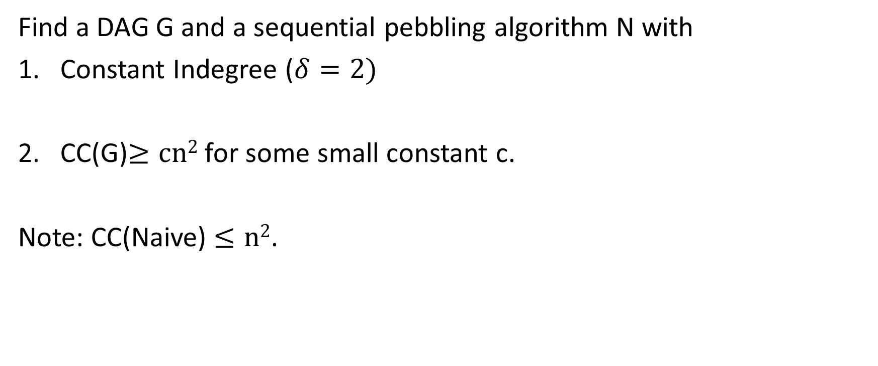
c-Ideal iMHF
Find a DAG G and a sequential pebbling algorithm N with
Constant Indegree ($δ=2)$
CC(G)$≥cn2$ for some small constant c.
Note: CC(Naive) $≤n2$.

Slide 34

Depth-Robustness is the Key to Success

Slide 35
Outline
Motivation
Data Independent Memory Hard Functions (iMHFs)
Attacks
  General Attack on Non Depth Robust DAGs
  Existing iMHFs are not Depth Robust
  No c-Ideal iMHF exists
Constructing iMHFs (New!)
Open Questions

Slide 36

Depth Robustness
Definition: A DAG G=(V,E) is (e,d)-depth reducible if there exists $S⊆V$
s.t. $\left|S\right|≤e$ and depth(G-S) $≤ d.$
Otherwise, we say that G is (e,d)-depth robust.
Example: (1,2)-reducible
1
2
3
4
5

Slide 37

Depth Robustness
Definition: A DAG G=(V,E) is (e,d)-depth reducible if there exists $S⊆V$
s.t. $\left|S\right|≤e$ and depth(G-S) $≤d.$
Otherwise, we say that G is (e,d)-depth robust.
Example: (1,2)-reducible
1
2
3
4
5

Slide 38

Depth-Robustness is Necessary [AB16]
Theorem (Depth-Robustness is a necessary condition): If G is not (e,d)-node robust then is an (efficient) attack A such that
$\operatorname{ER}\left(A\right)≤\min_{g≥d}\left(en+gn+\frac{n}{g}nd+nR+ \frac{n}{g}n\text{R}\right)$.
In particular, setting $g=\sqrt{nd}$ we get
$$\operatorname{ER}\left(A\right)=O\left(en+n\sqrt{nd}\right)$$

Slide 39
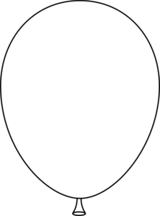
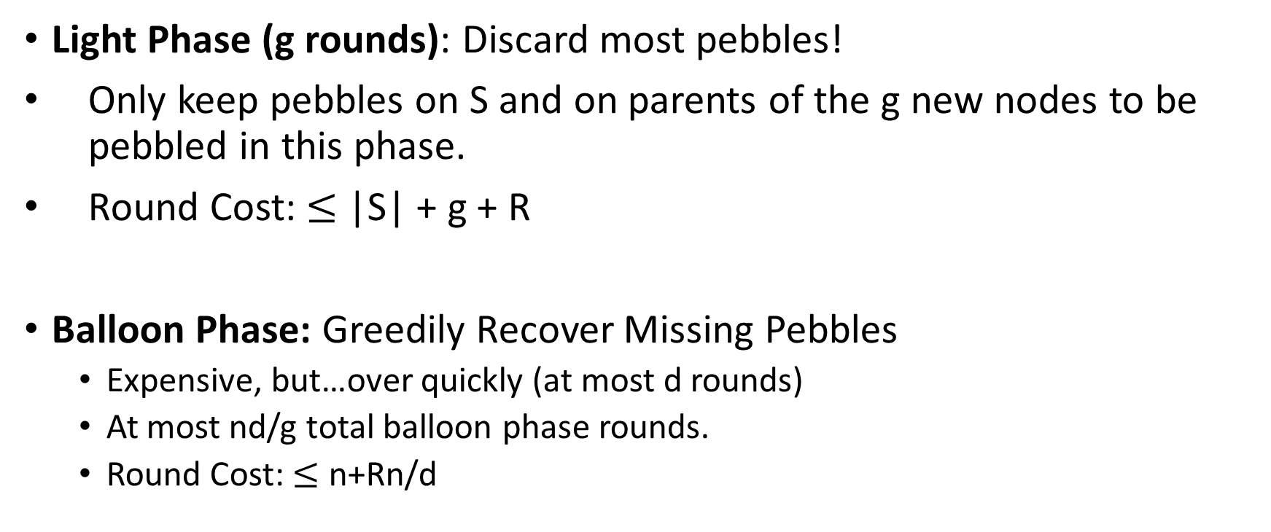
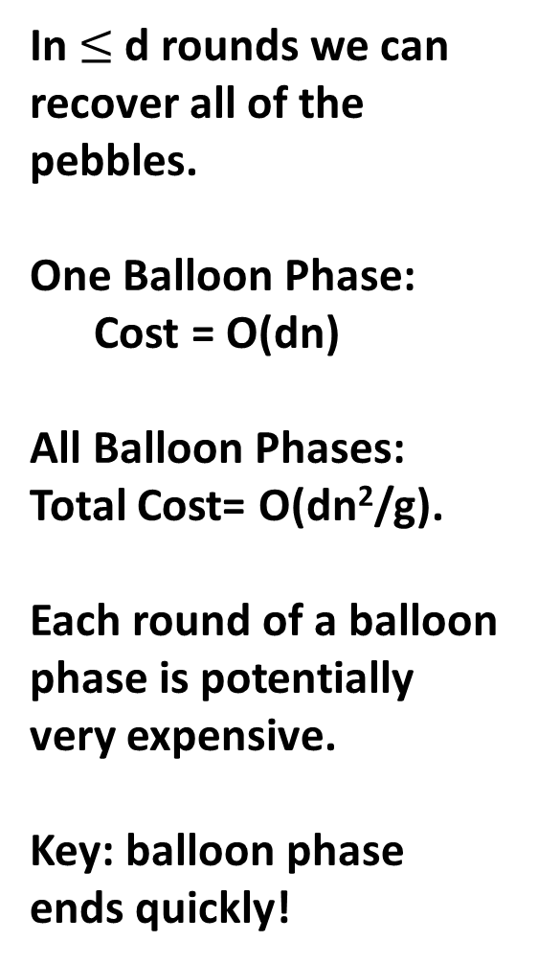
Attacking (e,d)-reducible DAGs
Light Phase (g rounds): Discard most pebbles!
Only keep pebbles on S and on parents of the g new nodes to be pebbled in this phase.
Round Cost: $≤$ |S| + g + R
Balloon Phase: Greedily Recover Missing Pebbles
  Expensive, but…over quickly (at most d rounds)
  At most nd/g total balloon phase rounds.
  Round Cost: $≤$ n+Rn/d
In $≤$d rounds we can recover all of the pebbles.
One Balloon Phase:
Cost = O(dn)
All Balloon Phases:
Total Cost= O(dn²/g).
Each round of a balloon phase is potentially very expensive.
Key: balloon phase ends quickly!
Light Phase: Discard most pebbles!
Only keep pebbles on parents of next g nodes.
One Light Phase: Cost = O(g|S|)
All Light Phases: Total Cost = O(g|S|(n/g))= O(n|S|)

Slide 40
Attacking (e,d)-reducible DAGs
In $≤$d rounds we can recover all of the pebbles.
One Balloon Phase:
Cost = O(dn)
All Balloon Phases:
Total Cost= O(dn²/g).
Each round of a balloon phase is potentially very expensive.
Key: balloon phase ends quickly!

Slide 41

Main Theorem
Theorem (Depth-Robustness is a necessary condition): If G is not (e,d)-node robust then is an (efficient) attack A such that
$\operatorname{ER}\left(A\right)≤en+gn+\frac{n}{g}nd+nR+ \frac{n}{g}n$R.

Slide 42

Depth-Robustness is Necessary [AB16]
Theorem (Depth-Robustness is a necessary condition): If G is not (e,d)-node robust then is an (efficient) attack A such that
$\operatorname{ER}\left(A\right)≤en+gn+\frac{n}{g}nd+nR+ \frac{n}{g}n$R.
Never delete pebbles
from nodes $x∈S$, where
$$\left|S\right|=e$$
depth(G-S) $≤d$
#pebbling rounds

Slide 43
Depth-Robustness is Necessary [AB16]
Theorem (Depth-Robustness is a necessary condition): If G is not (e,d)-node robust then is an (efficient) attack A such that
$\operatorname{ER}\left(A\right)≤en+gn+\frac{n}{g}nd+nR+ \frac{n}{g}n$R.
Maintain pebbles on parents of next g nodes to be pebbled.
#pebbling rounds

Slide 44
Depth-Robustness is Necessary [AB16]
Theorem (Depth-Robustness is a necessary condition): If G is not (e,d)-node robust then is an (efficient) attack A such that
$\operatorname{ER}\left(A\right)≤en+gn+\frac{n}{g}nd+nR+ \frac{n}{g}n$R.
Maintain pebbles on parents of next g nodes to be pebbled.
#pebbling rounds

Slide 45
Depth-Robustness is Necessary [AB16]
Theorem (Depth-Robustness is a necessary condition): If G is not (e,d)-node robust then is an (efficient) attack A such that
$\operatorname{ER}\left(A\right)≤en+gn+\frac{n}{g}nd+nR+ \frac{n}{g}n$R.
Length of a balloon phase
#balloon phases
Max #pebbles on G
In each round of balloon phase

Slide 46
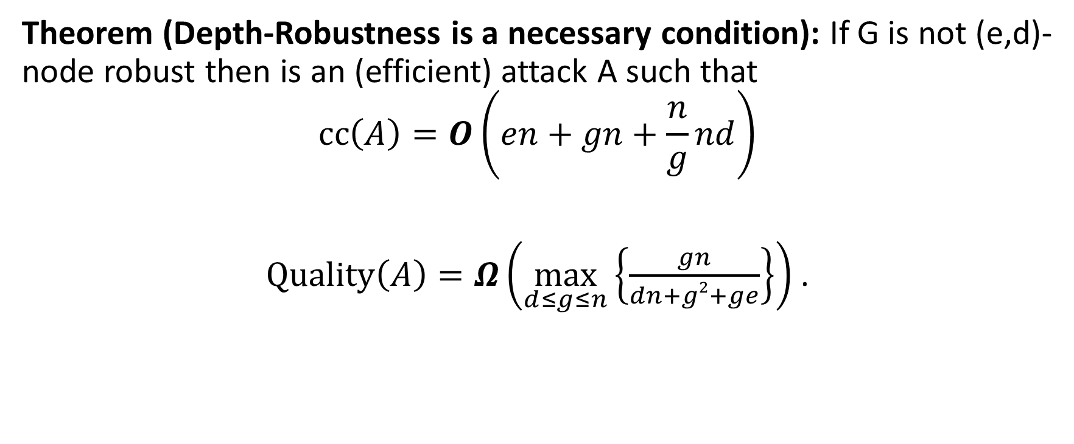
Main Theorem
Theorem (Depth-Robustness is a necessary condition): If G is not (e,d)-node robust then is an (efficient) attack A such that
$$\operatorname{cc}\left(A\right)=O\left(en+gn+\frac{n}{g}nd\right)$$
$\operatorname{Quality}\left(A\right)=Ω\left(\max_{d≤g≤n}\left\{\frac{gn}{dn+g2+ge}\right\}\right)$ .

Slide 47
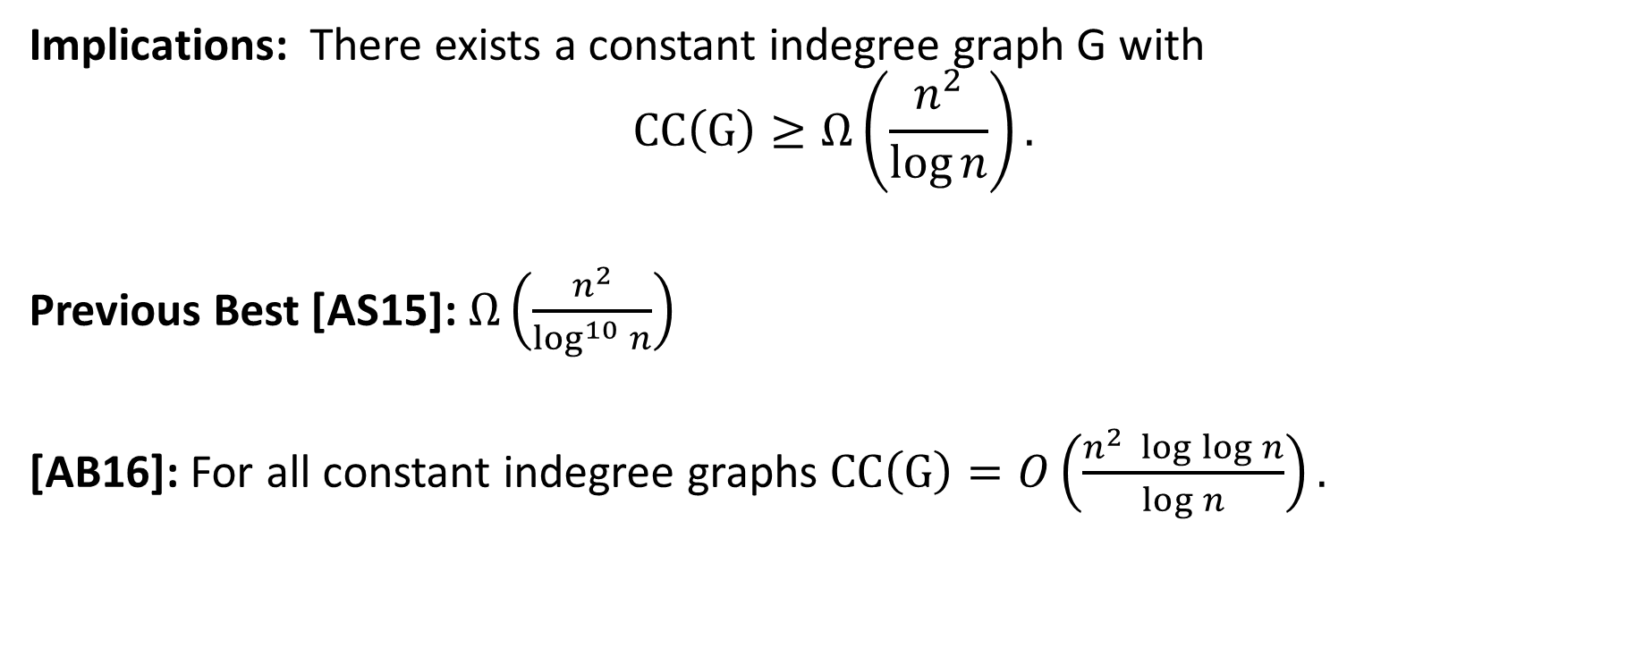
Depth-Robustness is Sufficient! [ABP16]
$Key Theorem:$Let G=(V,E) be (e,d)-depth robust then CC(G)$≥ed$.
Implications: There exists a constant indegree graph G with
$$CC\left(G\right)≥Ω\left(\frac{n^{2}}{\log{n}}\right).$$
Previous Best [AS15]: $Ω\left(\frac{n^{2}}{\log^{10}{n}}\right)$
[AB16]: For all constant indegree graphs $CC\left(G\right)=O\left(\frac{n^{2} \log{\log{n}}}{\log{n}}\right).$

Slide 48
Reviewer Feedback
$Key Theorem:$Let G=(V,E) be (e,d)-depth robust then CC(G)$≥ed$.
“The proof of this result is really an incredibly simple and beautiful two-line argument….I generally view simplicity as a positive, and this is the right proof. But there is such as thing as too simple...”

Slide 49
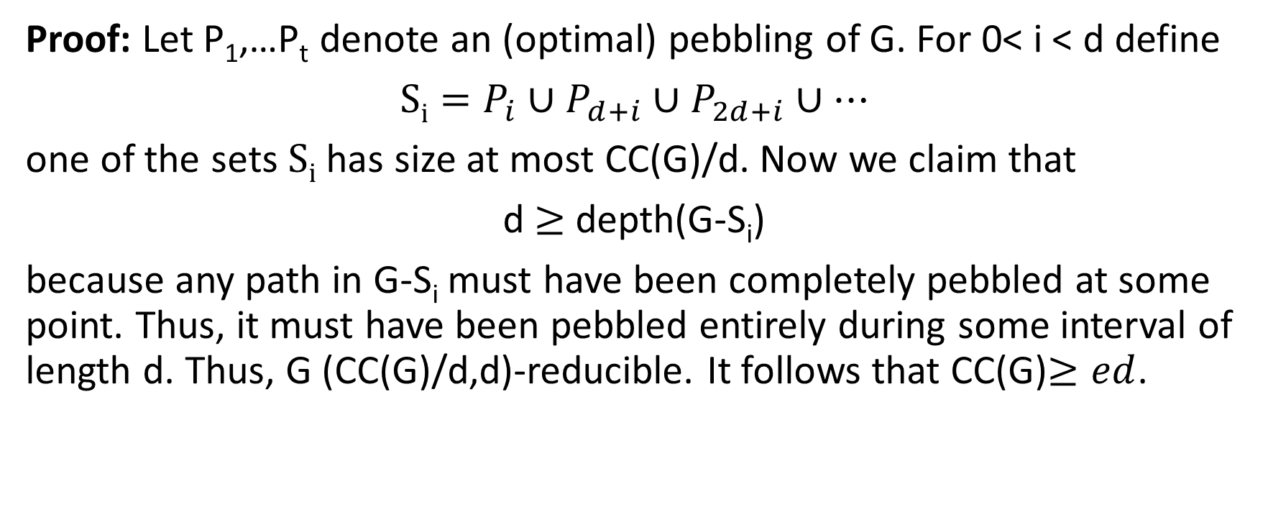
Depth-Robustness is Sufficient! [ABP16]
Proof: Let P₁,…P_{t} denote an (optimal) pebbling of G. For 0< i < d define
$Si=P_{i}∪P_{d+i}∪P_{2d+i}$ $∪…$
one of the sets $Si$ has size at most CC(G)/d. Now we claim that
d $≥$depth(G-S_{i})
because any path in G-S_{i} must have been completely pebbled at some point. Thus, it must have been pebbled entirely during some interval of length d. Thus, G (CC(G)/d,d)-reducible. It follows that CC(G)$≥ed$.

Slide 50

Question
Are existing iMHF candidates based on depth-robust DAGs?

Slide 51

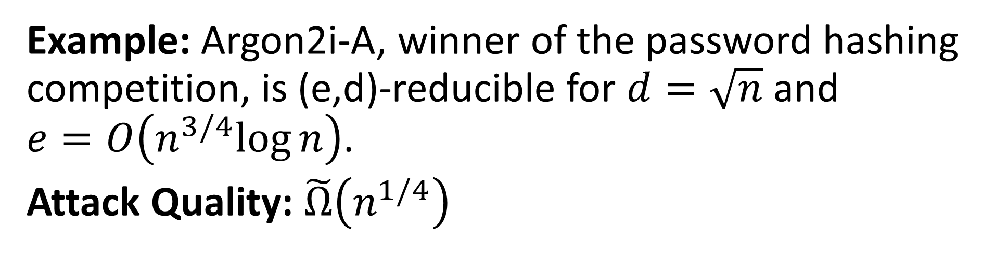
Answer
NO!
Example: Argon2i-A, winner of the password hashing competition, is (e,d)-reducible for $d=\sqrt{n}$ and $e=O\left(n^{3/4}log{n}\right)$.
Attack Quality: $\tilde{Ω}\left(n^{1/4}\right)$

Slide 52
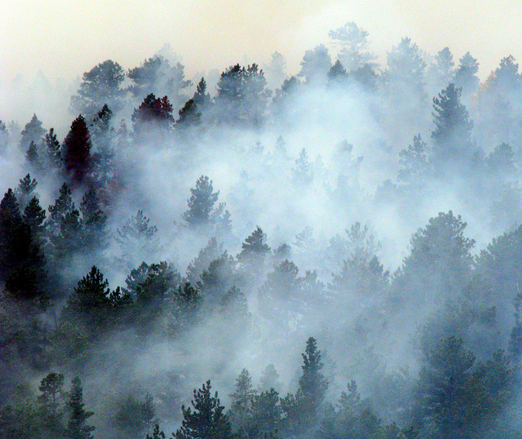
Drama: Are the attacks `Practical’
Argon2i team: No, at least for realistic parameter ranges.
Recent: Argon2i-B to IRTF (Internet Research Task Force) for standardization.
New Result [AB16b]:
  New heuristics to reduce overhead by constant factor
  Simulate the attack on real instances

Slide 53
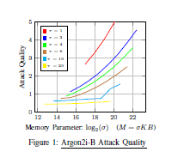
Empirical Results
Parameter setting could easily be chosen when following Argon2i-B guidelines
…
Pessimistic Argon 2i-B parameter
Attack on Argon 2i-B is practical even for pessimistic parameter ranges (brown line).

Slide 54
Lots of Future Work
Practical iMHF with provable security?
Better constructions of depth-robust graphs?
Other tools to lower-bound memory hardness?
Improved attacks on Argon2i?

Slide 55
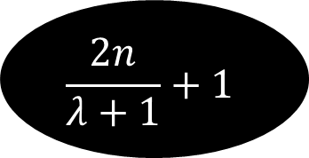
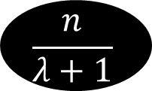

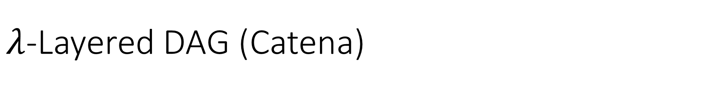
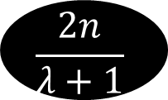
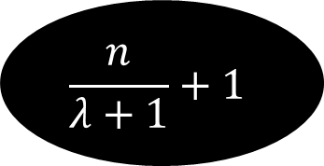
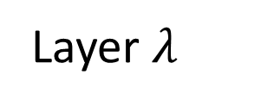
$λ$-Layered DAG (Catena)
…
$$\frac{2n}{λ+1}+1$$
2
3
4
5
$$\frac{n}{λ+1}$$
Layer $λ$
…
…
…
$$\frac{n}{λ+1}+1$$
+2
+3
4
5
$$\frac{2n}{λ+1}$$
Layer 1
…
1
2
3
4
5
$$\frac{n}{λ+1}$$
Layer 0

Slide 56
$λ$-Layered DAG (Catena)
…
$$\frac{2n}{λ+1}+1$$
2
3
4
5
$$\frac{n}{λ+1}$$
Layer $λ$
…
…
…
$$\frac{n}{λ+1}+1$$
+2
+3
4
5
$$\frac{2n}{λ+1}$$
Layer 1
…
1
2
3
4
5
$$\frac{n}{λ+1}$$
Layer 0

Slide 57
$λ$-Layered DAG (Catena)
…
$$\frac{2n}{λ+1}+1$$
2
3
4
5
$$\frac{n}{λ+1}$$
Layer $λ$
…
…
…
$$\frac{n}{λ+1}+1$$
+2
+3
4
5
$$\frac{2n}{λ+1}$$
Layer 1
…
1
2
3
4
5
$$\frac{n}{λ+1}$$
Layer 0
Disallowed! All edges must go to a higher layer (except for (i,i+1))

Slide 58
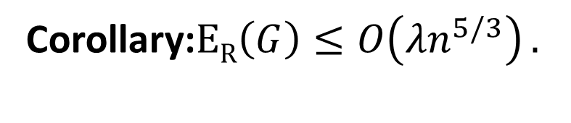


Layered Graphs are Reducible
Theorem (Layered Graphs Not Depth Robust): Let G be a $λ$-Layered DAG then G is $\left(n^{2/3},n^{1/3}\left(λ+1\right)\right)$-reducible.
Corollary:$\operatorname{ER}\left(G\right)≤O\left({λn}^{5/3}\right).$
Attack Quality:$\operatorname{QualityR}\left(A\right)=Ω\left(\frac{n^{q/3}}{λ}\right).$

Slide 59






Layered Graphs are Reducible
Theorem (Layered Graphs Not Depth Robust): Let G be a $λ$-Layered DAG then G is $\left(n^{2/3},n^{1/3}\left(λ+1\right)\right)$-reducible.
Proof: Let$S=\left\{{i×n}^{1/3} | {i≤n}^{2/3}\right\}$ any path p can spend at most $n^{1/3}$
steps on layer i.
…
…
…
…
…
…
2
$$\frac{n}{λ+1}$$
Layer 0
1
$$n^{1/3}$$
$${2n}^{1/3}$$
$$n^{1/3}$$
$$n^{1/3}$$

Slide 60
Layered Graphs are Reducible
Theorem (Layered Graphs Not Depth Robust): Let G be a $λ$-Layered DAG then G is $\left(n^{2/3},n^{1/3}\left(λ+1\right)\right)$-reducible.
Proof: Let$S=\left\{{i×n}^{1/3} | {i≤n}^{2/3}\right\}$ any path p can spend at most $n^{1/3}$
steps on layer i.
…
…
…
…
…
…
2
$$\frac{n}{λ+1}$$
Layer 0
1
$$n^{1/3}$$
$${2n}^{1/3}$$
$$n^{1/3}$$
$$n^{1/3}$$

Slide 61


Catena
Catena Bit Reversal DAG (${\text{BRG}}_{λ}^{n}$)
  $λ$-layered (by d$esign λ≤5$)
  Edges between layers correspond to the bit-reversal operation
  Theorem[LT82]: ST(${\text{BRG}}_{1}^{n}$)$=Ω\left(n^{2}\right)$
Catena Butterfly (${\text{DB}\text{G}}_{λ}^{n}$)
  $λ=O(\log{n)}$-layered (by d$esign λ≤5$)
  Edges between layers correspond to FFT
  ${\text{DB}\text{G}}_{λ}^{n}$ is a “super-concentrator.”
  Theorem[LT82] => ST(${\text{BRG}}_{1}^{n}$)$=Ω\left(\frac{n^{2}}{log⁡(n)}\right)$
Notes:
Thomas Lengauer and Robert Endre Tarjan. Asymptotically Tight Bounds on Time-Space Trade-oﬀs in a Pebble Game. J. ACM, 29(4):1087–1130, 1982

Slide 62

ST complexity vs CC complexity
$${ \text{CC}\text{(}\text{BRG}}_{1}^{n})≪{ \text{ST}\text{(}\text{BRG}}_{1}^{n})=Ω\left(n^{2}\right)$$
Previous attacks on Catena (${\text{BRG}}_{λ}^{n}$)
  [AS15] ${ \text{CC}\text{(}\text{BRG}}_{1}^{n})≤O\left(n^{1.5}\right)$
  [BK15] ${ \text{ST}\text{(}\text{BRG}}_{λ}^{n})≤O\left(n^{1.8}\right)$ for $λ$ > 1.
  Our result ${\text{CC}\text{(}\text{BRG}}_{λ}^{n})$ $≤O\left(n^{1.5}\right)$
    Applies to all Catena variants.
Notes:
Alwen/Serbinenko
Alex Biryukov and Dmitry Khovratovich

Slide 63

Argon2i [BDK]
Argon2: Winner of the password hashing competition[2015]
Authors recommend Argon2i variant (data-independent) for password hashing.
Notes:
Alex Biryukov, Daniel Dinu, and Dmitry Khovratovich from University of Luxembourg.

Slide 64
Argon2i
…
1
2
3
4
i
n

Slide 65

Argon2i
random predecessor r(i) < i
…
1
2
3
4
i
n
Indegree: $δ=2$

Slide 66






Argon2i is a layered DAG (almost)
…
…
n
Layer $\sqrt[4]{n}$
…
…
$n^{3/4}$+1
+2
+3
+$\sqrt[4]{n}$
$${2n}^{3/4}$$
Layer 1
…
…
1
2
3
$$\sqrt[4]{n}$$
$$n^{3/4}$$
Layer 0

Slide 67


Argon2i is a layered DAG (almost)
Definition: $S2=\left\{vi | v_{r(i)}and vi in same layer\right\}$
…
…
n
Layer $\sqrt[4]{n}$
…
…
$n^{3/4}$+1
+2
+3
+$\sqrt[4]{n}$
$${2n}^{3/4}$$
Layer 1
…
…
1
2
3
$$\sqrt[4]{n}$$
$$n^{3/4}$$
Layer 0
zzzzzzzzzzzzzzzzzzzzzzzzzzzzzzzz
$$Claim: E\left[S2\right]=O\left(n^{3/4}\log{n}\right)$$

Slide 68






Argon2i is a layered DAG (almost)
Definition: $S2=\left\{vi | v_{r(i)}and vi in same layer\right\}$
…
…
Layer $\sqrt[4]{n}$
…
…
$n^{3/4}$+1
+2
+3
+$\sqrt[4]{n}$
$${2n}^{3/4}$$
Layer 1
…
…
1
2
3
$$\sqrt[4]{n}$$
$$n^{3/4}$$
Layer 0
$$\text{Pr}\left[v∈S2\left|v in Layer i\right.\right]≤\frac{1}{i}$$
$$E\left[Layer i∩S2\right]≤\frac{n^{3/4}}{i}$$

Slide 69
Argon2i is a layered DAG (almost)
Definition: $S2=\left\{vi | v_{r(i)}and vi in same layer\right\}$
…
…
n
Layer $\sqrt[4]{n}$
…
…
$n^{3/4}$+1
+2
+3
+$\sqrt[4]{n}$
$${2n}^{3/4}$$
Layer 1
…
…
1
2
3
$$\sqrt[4]{n}$$
$$n^{3/4}$$
Layer 0
$$Claim: E\left[S2\right]=O\left(n^{3/4}\log{n}\right)$$

Slide 70

Argon2i is a layered DAG (almost)
Let S = S₁+S₂
…
…
n
Layer $\sqrt[4]{n}$
…
…
$n^{3/4}$+1
+2
+3
+$\sqrt[4]{n}$
$${2n}^{3/4}$$
Layer 1
…
…
1
2
3
$$\sqrt[4]{n}$$
$$n^{3/4}$$
Layer 0
$Fact: E\left[S\right]=O\left(n^{3/4}\log{n}\right)$ and depth(G-S)$≤\sqrt{n}.$

Slide 71
Argon2i is a layered DAG (almost)
Let S = S₁+S₂
…
…
n
Layer $\sqrt[4]{n}$
…
…
$n^{3/4}$+1
+2
+3
+$\sqrt[4]{n}$
$${2n}^{3/4}$$
Layer 1
…
…
1
2
3
$$\sqrt[4]{n}$$
$$n^{3/4}$$
Layer 0
$Theorem:$G is (2$n^{3/4}\log{n}$, $\sqrt{n}$)-reducible with high probability.

Slide 72


Argon2i is a layered DAG (almost)
Let S = S₁+S₂
…
…
n
Layer $\sqrt[4]{n}$
…
…
$n^{3/4}$+1
+2
+3
+$\sqrt[4]{n}$
$${2n}^{3/4}$$
Layer 1
…
…
1
2
3
$$\sqrt[4]{n}$$
$$n^{3/4}$$
Layer 0
Corollary:$\operatorname{ER}\left(G\right)≤O\left(n^{7/4}\log{n}\right).$
$\operatorname{QualityR}\left(A\right)≤Ω\left(\frac{n^{1/4}}{\log{n}}\right).$

Slide 73



Do c-Ideal iMHFs exist?
$Thm[AS15]:$There is a DAG G with $CC\left(G\right)=Ω\left(\frac{n^{2}}{\log^{10+ε}{n} }\right)$and $δ$=2.
$Lemma[Valiant77]:$Let G=(V,E) be a DAG with depth $d≤n$ then there is a set S$⊂V$ of at most $\left(\frac{nδ}{\log{d}}\right)$ nodes such that depth(G-S)$≤d/2$.
$Theorem:$Let G=(V,E) be a DAG with n nodes then there is a set S$⊂V$ of $\left(\frac{nδlog log{n}}{\log{n}}\right)$ edges such that depth(G-S)$≤n/{\log{n}}$.
$Corollary:$Let G=(V,E) be a DAG with n nodes then for any constant $ε>0$
$$ER\left(G\right)=o\left(\frac{n^{2}}{\log^{1−ε}{n}}\right)$$

Slide 74

Do c-Ideal iMHFs exist?
$Corollary:$Let G=(V,E) be a DAG with n nodes then for any constant $ε>0$
$$ER\left(G\right)=o\left(\frac{n^{2}}{\log^{1−ε}{n}}\right)$$
NO!

Slide 75


















Light Phase Units
Light Phase Units
Balloon Phase Unit
Instance n^{1/4}/2+1
Instance 1
$$H$$
$$H$$
Instance 2
Instance n^{1/4}/2+2
$$H$$
$$H$$
…
$H$₁
…
$$H_{\sqrt{n}}$$
Instance i
Instance n^{1/4}-1
$H$₂
$$H$$
$$H$$
$H$₃
…
…
Instance n^{1/4}/2
Instance n^{1/4}
$$H$$
$$H$$

Slide 76
Practical Consequences (R = 3,000)

Slide 77
Outline
Motivation
Data Independent Memory Hard Functions (iMHFs)
Attacks
Constructing iMHFs (New!)
Open Questions
Notes:
Joint work with Joel Alwen and Krzysztof Pietrzak

Slide 78



New (Positive) Results
$Key Theorem:$Let G=(V,E) be (e,d)-depth robust then CC(G)$≥ed$.
$Theorem[EGS75]:$There is an $\left(Ω\left(n\right),Ω\left(n\right)\right)$-depth robust DAG G with indegree $δ=O\left(\log{n}\right)$.
$Corollary:$There is a DAG G with indegree $δ=O\left(\log{n}\right)$ and
$\text{CC}\text{(}\text{G}\text{)}≥Ω\left(n^{2}\right)$.
$Theorem (Indegree Reduction):$Let G’ be a DAG with n’ = n/(2$δ′$) nodes and indegree $δ$’. If G’ is (e’,d’)-depth robust then we can construct a DAG G on n nodes such that G is (e’,d = $δ$’d’)-depth robust and has maximum indegree $δ$=2.

Slide 79



New (Positive) Results
$Theorem (Indegree Reduction):$Let G’ be a DAG with n’ = n/(2$δ′$) nodes and indegree $δ$’. If G’ is (e’,d’)-depth robust then we can construct a DAG G on n nodes such that G is (e’,d = $δ$’d’)-depth robust and has maximum indegree $δ$=2.
$Corollary:$There is a DAG G with maximum indegree $δ=2$ and
$\text{CC}\text{(}\text{G}\text{)}=Ω\left(\frac{n^{2}}{\log{n}}\right)$.
$Theorem:$There is a DAG G with maximum indegree $δ=2$ and
$\text{CC}\text{(}\text{G}\text{)}=Ω\left(\frac{n^{2}}{\log{n}}\right)$. Furthermore, there is a sequential pebbling algorithm N with cost $\text{CC}\text{(}\text{N}\text{)}$ $=O\left(\frac{n^{2}}{\log{n}}\right)$.

Slide 80

Proof of Key Theorem
$Key Theorem:$Let G=(V,E) be (e,d)-depth robust then CC(G)$≥ed$.
Proof: Let P₁,…P_{t} denote an (optimal) pebbling of G. For 0< i < d define
$Si=P_{i}∪P_{d+i}∪P_{2d+i}$ $∪…$
one of the sets $Si$ has size at most CC(G)/d. Now we claim that
d $≥$depth(G-S_{i})
because any path in G-S_{i} must have been completely pebbled at some point. Thus, it must have been pebbled entirely during the some interval of length d. Thus, G (CC(G)/d,d)-reducible. It follows that CC(G)$≥ed$.

Slide 81
Pebbling Equivalence
$Theorem \left[AS15\right] (Informal):$Let H be a random oracle and let G be a DAG with constant indegree. For any pROM adversary A which evaluates (multiple instances of) f_{H,G} we have
$$Cost\left(A\right)=\sum_{i=1}^{T\left(A\right)}{\left|σ_{i}\right|= }θ\left(CC\left(G\right)\right)×\left(\#inst(A)\right)$$

Slide 82

Miscellaneous Results
New Lower Bounds:
  CC(Argon2i) $≥\tilde{Ω}\left(n^{1.5}\right)$
  CC(Catena) $≥\tilde{Ω}\left(n^{1.5}\right)$
New Upper Bounds:
  CC(Argon2i) $=\tilde{O}\left(n^{1.71}\right)$
  CC(Catena) $=\tilde{O}\left(n^{1.618}\right)$

Slide 83
Open Questions
Computational Complexity of CC(G)
  Efficient Algorithm to Approximate CC(G)?
  Hardness of Approximation?
Improved Constructions of Depth-Robust Graphs
  Constants matter!
What is CC(Argon2i)?
  Upper Bound: n^{1.71}
  Lower Bound: n^{1.5}

