Slide 1


Towards a Theory of Data-Independent Memory Hard Functions
Jeremiah Blocki (Purdue)
Joël Alwen (IST Austria)
Krzysztof Pietrzak (IST Austria)
Real World Crypto 2017

Slide 2


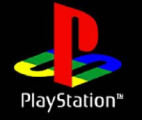


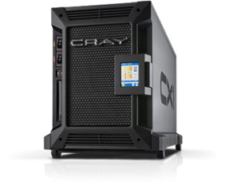

Motivation: Password Storage
jblocki, 123456
Username
jblocki
Salt
89d978034a3f6
Hash
85e23cfe0021f584e3db87aa72630a9a2345c062
SHA1(12345689d978034a3f6)=85e23cfe0021f584e3db87aa72630a9a2345c062
+
Notes:
As a motivating example consider an adversary who breaks into an authentication server and steals a users crptographic hash value. The adversary can execute an offline attack against the password by comparing the hash value with the hashes of likely password guesses. The adversary is limited only by the resources that he is willing to invest cracking the passwords.

Slide 3






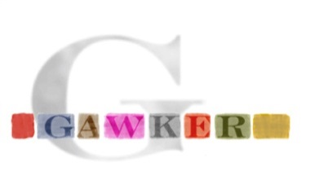

Offline Attacks: A Common Problem
Password breaches at major companies have affected millions of users.
Notes:
Unfortunately, offline dictionary attacks are quite common. Password breaches at major companies have affected millions of users. In the past few years I have had to update the slide several times.

Slide 4






Offline Attacks: A Common Problem
Password breaches at major companies have affected millions of users.
Notes:
Unfortunately, offline dictionary attacks are quite common. Password breaches at major companies have affected millions of users.

Slide 5
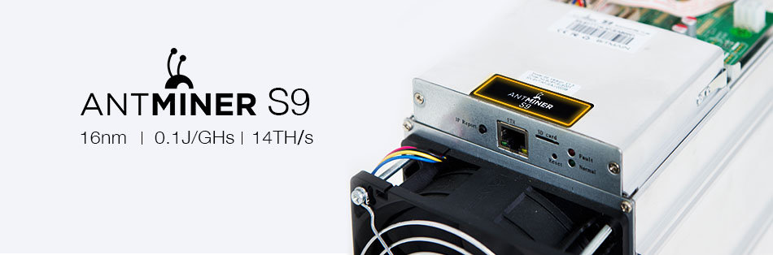
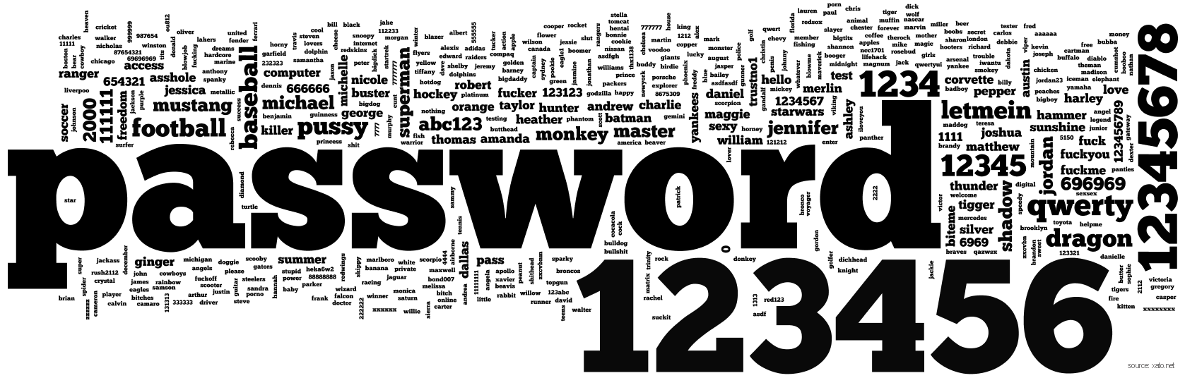
A Dangerous Problem
$2,400 on Amazon

Slide 6
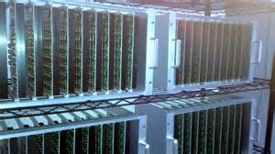



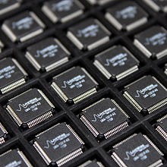
Goal: Moderately Expensive Hash Function
Fast on PC and
Expensive on ASIC?
Notes:
This motivates the need for moderately hard functions. The basic idea is to build a password hash function that is moderately expensive to compute to limit the number of guesses that an adversary would be willing to try. An honest server only needs to compute the function once during a typical authentication session. However, the adversary potentially has an advantage in this game. While the honest server must typically evaluate the function on standard hardware, the adversary could use potentially reduce the cost per password guess by developing customized hardware (GPUs, FPGAs, ASICs) to evaluate the password hash function. Thus, we want to ensure that the cost to evaluate this function is equitable across platforms.

Slide 7
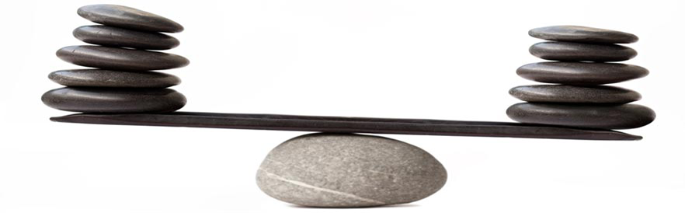
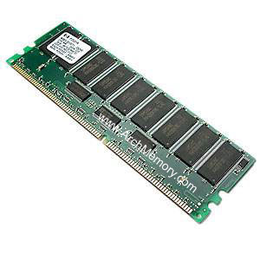
Memory Costs: Equitable Across Architectures
Notes:
By contrast, memory costs tends to be much more equitable across different architectures

Slide 8
Outline
Motivation
Data Independent Memory Hard Functions (iMHFs)
  Graph Pebbling
  Measuring Pebbling Costs
  Desiderata
Attacks on iMHF Constructions
Constructing iMHFs
Open Questions

Slide 9



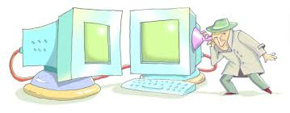
Memory Hard Function (MHF)
Intuition: computation costs dominated by memory costs
vs.
Data Independent Memory Hard Function (iMHF)
  Memory access pattern should not depend on input
Notes:
In this work we study a special type of memory hard function called data-independent memory hard functions. As the name suggests the memory access pattern will not depend on the input making the functions resistant to side-channel attacks.

Slide 10


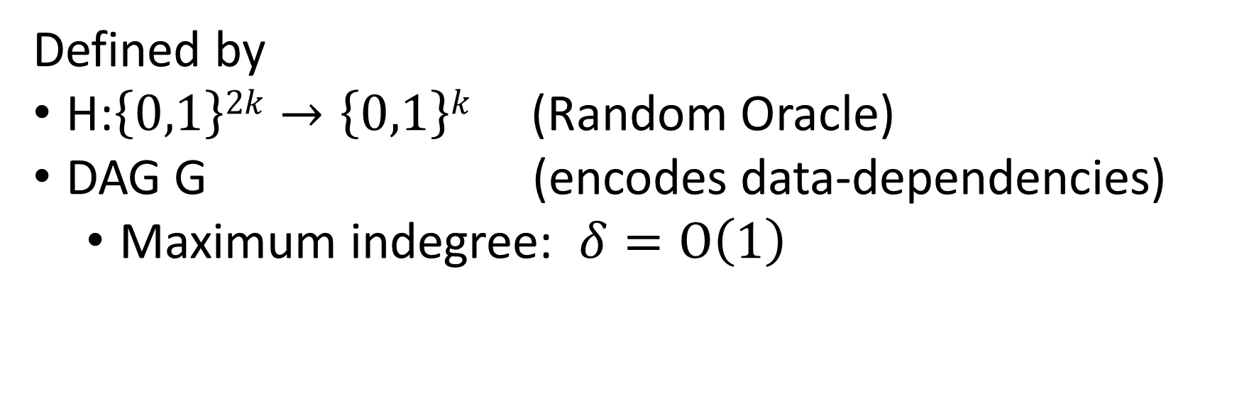
iMHF (f_{G,H})
Defined by
H:$\left\{0,1\right\}2k→\left\{0,1\right\}k$ (Random Oracle)
DAG G (encodes data-dependencies)
  Maximum indegree: $δ=O\left(1\right)$
Input: pwd, salt
2
4
1
Output: f_{G,H} (pwd,salt)= L₄
1
3
$$L1=H(pwd,salt)$$
$$L3=H(L2,L1)$$

Slide 11
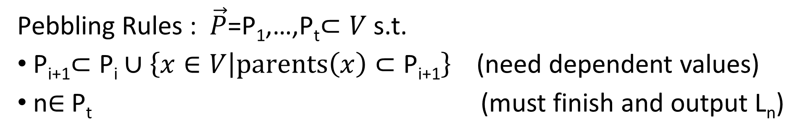


Evaluating an iMHF (pebbling)
2
4
Output: L₄
Input:
1
1
pwd, salt
3
$$L1=H(pwd,salt)$$
$$L3=H(L2,L1)$$
Pebbling Rules : $\vec{P}$=P₁,…,P_{t}$⊂V$ s.t.
P_{i+1}$⊂\text{P}\text{i}∪\left\{x∈V | parents\left(x\right)⊂\text{P}\text{i}\text{+1}\right\}$(need dependent values)
n$∈$P_{t} (must finish and output L_{n})
Notes:
We will describe our algorithms for evaluating an iMHF using the language of graph pebbling. Placing a pebble on a node corresponds to computing the corresponding label, and keeping a pebble on the graph corresponds to storing that label in memory. Of course we can only compute a label if we have all of the dependent labels. Thus, in a legal pebbling we cannot place a pebble on a node until we have pebbles on the parents of that node. If the adversary is parallel then we are allowed to place multiple pebbles on the graph in each round. We can remove pebbles from the graph at any point in time.

Slide 12
Pebbling Example
4
5
3
4
5
1
3
1
2

Slide 13
Pebbling Example
1
2
3
4
5
P₁ = {1}

Slide 14
Pebbling Example
1
2
3
4
5
P₁ = {1}
P₂ = {1,2}

Slide 15
Pebbling Example
1
2
3
4
5
P₁ = {1}
P₂ = {1,2}
P₃ = {3}

Slide 16
Pebbling Example
1
2
3
4
5
P₁ = {1}
P₂ = {1,2}
P₃ = {3}
P₄ = {3,4}

Slide 17
Pebbling Example
1
2
3
4
5
P₁ = {1}
P₂ = {1,2}
P₃ = {3}
P₄ = {3,4}
P₅ = {5}

Slide 18
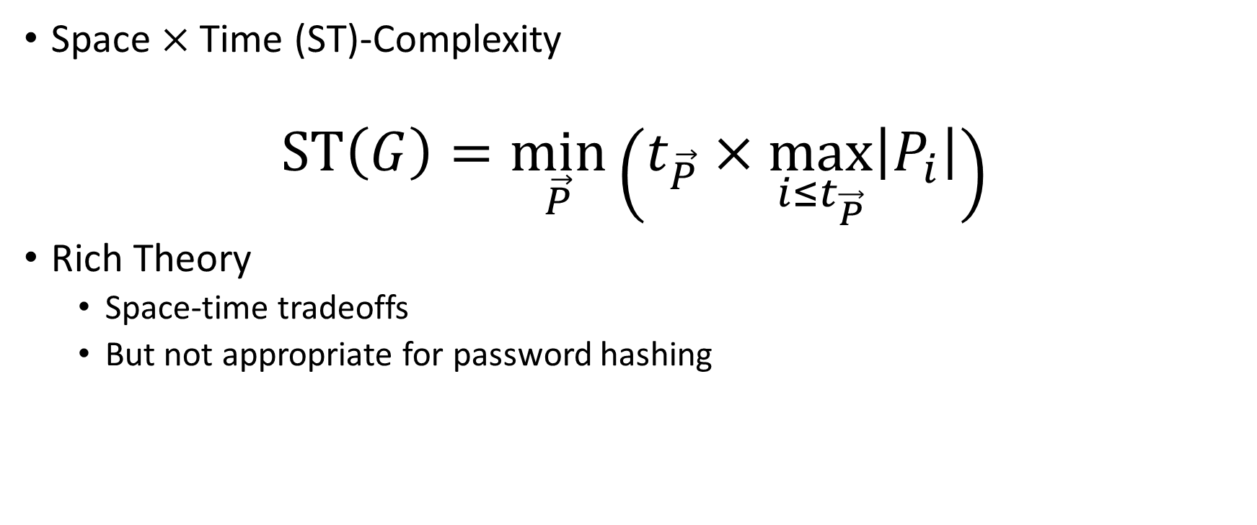
Measuring Cost: Attempt 1
Space $×$Time (ST)-Complexity
$$ST\left(G\right)=\min_{\vec{P}}\left(t_{\vec{P}}×\max_{i≤t_{\vec{P}}}\left|P_{i}\right|\right)$$
Rich Theory
  Space-time tradeoffs
  But not appropriate for password hashing
Notes:
Recall that we want to force the attacker to lock up a lot of memory for a long period of time. How do we formalize this constraint.

Slide 19

Amortization and Parallelism
Problem: for parallel computation ST-complexity can scale badly in the number of evaluations of a function.
[AS15] $∃$function f_{n} (consisting of n RO calls) such that: $ST\left(f^{×\sqrt{n}}\right)=O(ST\left(f\right))$
S₃
S₁
space
ST₁ = S₁ × T₁ ≈ S₃ × T₃ = ST₃
cost of computing
f once
cost of computing
f three times
time
T₁
T₃

Slide 20
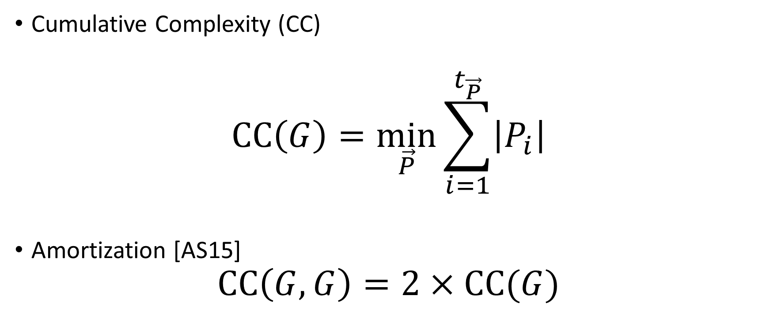
Measuring Cost: Attempt 2
Cumulative Complexity (CC)
$$CC\left(G\right)=\min_{\vec{P}}{\sum_{i=1}^{t_{\vec{P}}}{\left|P_{i}\right|}}$$
Amortization [AS15]
$$CC\left(G,G\right)=2×CC(G)$$

Slide 21
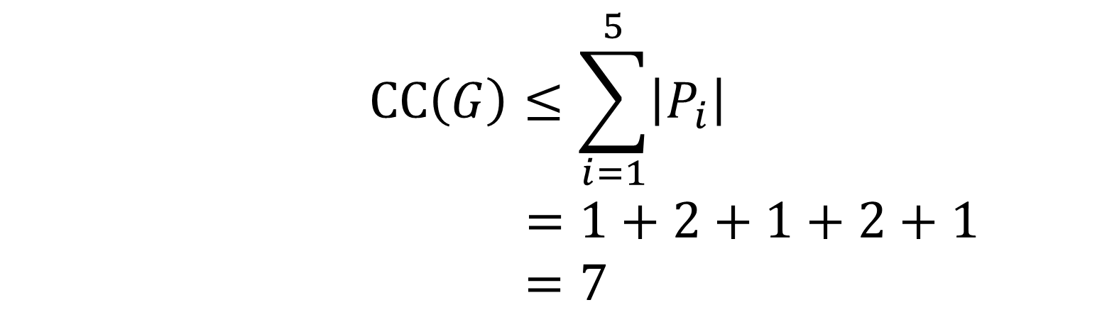
Pebbling Example (CC)
1
2
3
4
5
P₁ = {1}
$$CC\left(G\right)≤\sum_{i=1}^{5}{\left|P_{i}\right|}$$
$$=1+2+1+2+1$$
$=7$
P₂ = {1,2}
P₃ = {3}
P₄ = {3,4}
P₅ = {5}

Slide 22
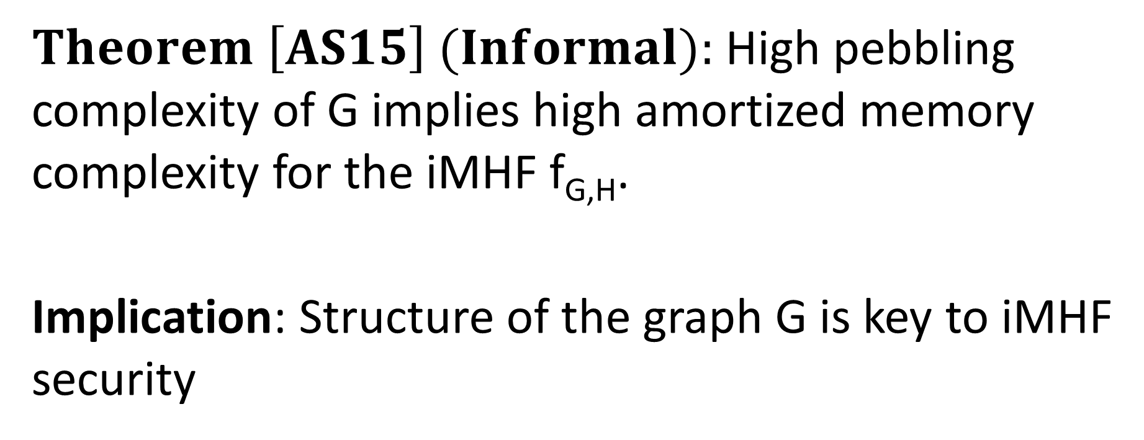
Pebbling Equivalence
$Theorem \left[AS15\right] (Informal):$High pebbling complexity of G implies high amortized memory complexity for the iMHF f_{G,H}.
Implication: Structure of the graph G is key to iMHF security

Slide 23

Energy Complexity/Amortized AT complexity
$$ER\left(G\right)=\min_{\vec{P}}{\sum_{i=1}^{t_{\vec{P}}}{\left(\left|P_{i}\right|+R\left|P_{i}\backslash P_{i−1}\right|\right)}}$$
$$ER\left(G\right)=θ\left(CC(G)\right)$$
Memory costs (equitable)
Cost of querying H (inequitable)

Slide 24

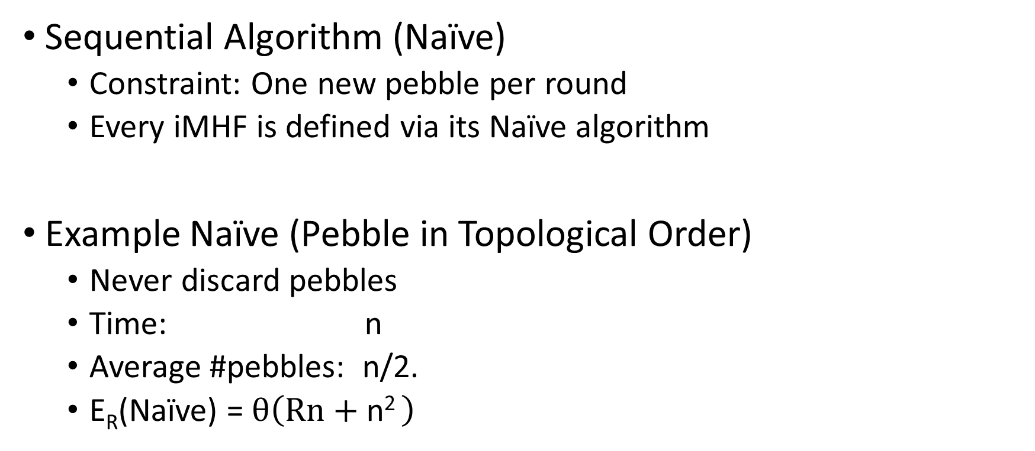
Naïve Pebbling Algorithms
Sequential Algorithm (Naïve)
  Constraint: One new pebble per round
  Every iMHF is defined via its Naïve algorithm
Example Naïve (Pebble in Topological Order)
  Never discard pebbles
  Time: n
  Average #pebbles: n/2.
  E_{R}(Naïve) = $θ\left(Rn+\text{n}\text{2 }\right)$

Slide 25
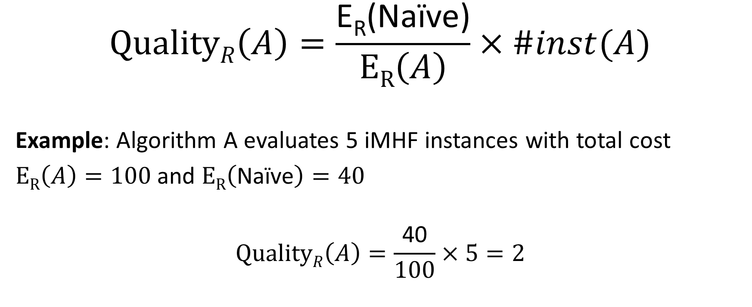
Amortized Attack Quality
$$QualityR\left(A\right)=\frac{\text{E}\text{R}\text{(}\text{Na}\text{ï}\text{ve}\text{)}}{ER\left(A\right)}×\#inst(A)$$
Example: Algorithm A evaluates 5 iMHF instances with total cost
$ER\left(A\right)=100$and $ER\left(\text{Na}\text{ï}\text{ve}\right)=40$
$$QualityR\left(A\right)=\frac{\text{40}}{100}×5=2$$
Notes:
Use Example

Slide 26

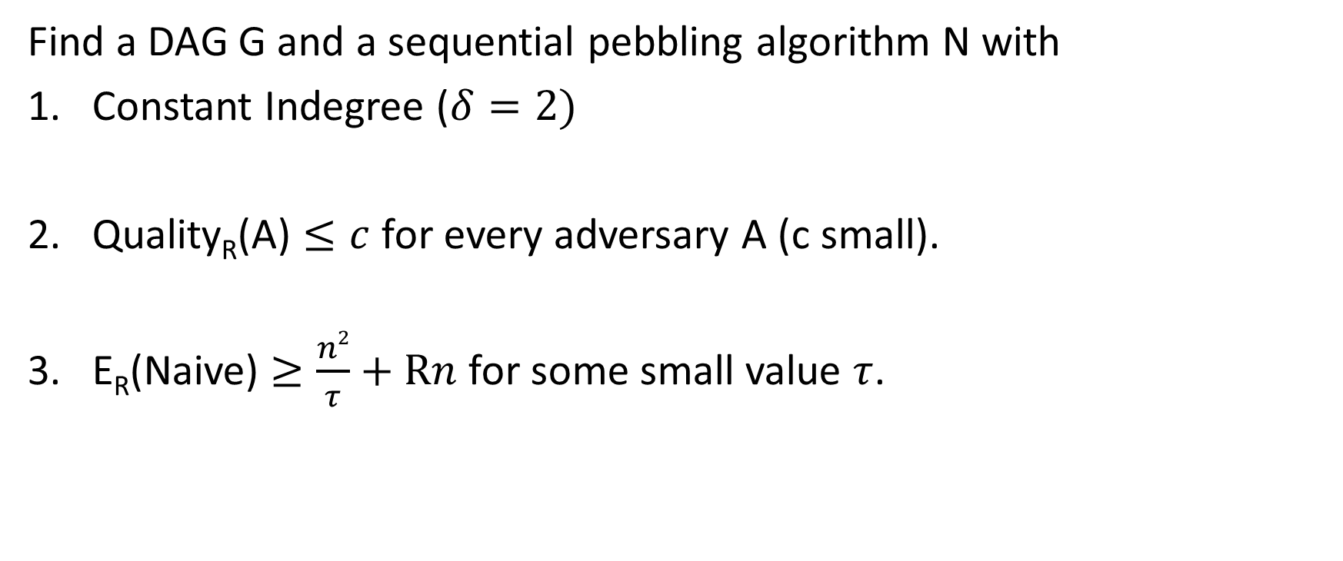
Desiderata
Find a DAG G and a sequential pebbling algorithm N with
Constant Indegree ($δ=2)$
Quality_{R}(A) $≤c$ for every adversary A (c small).
E_{R}(Naive) $≥\frac{n2}{τ}+Rn$ for some small value $τ$.
Memory costs should dominate

Slide 27
Desiderata
Find a DAG G and a sequential pebbling algorithm N with
Constant Indegree ($δ=2)$
Quality_{R}(A) $≤c$ for every adversary A (c small).
E_{R}(Naive) $≥\frac{n2}{τ}+Rn$ for some small value $τ$.
Maximize costs for fixed n
(Users are impatient)

Slide 28
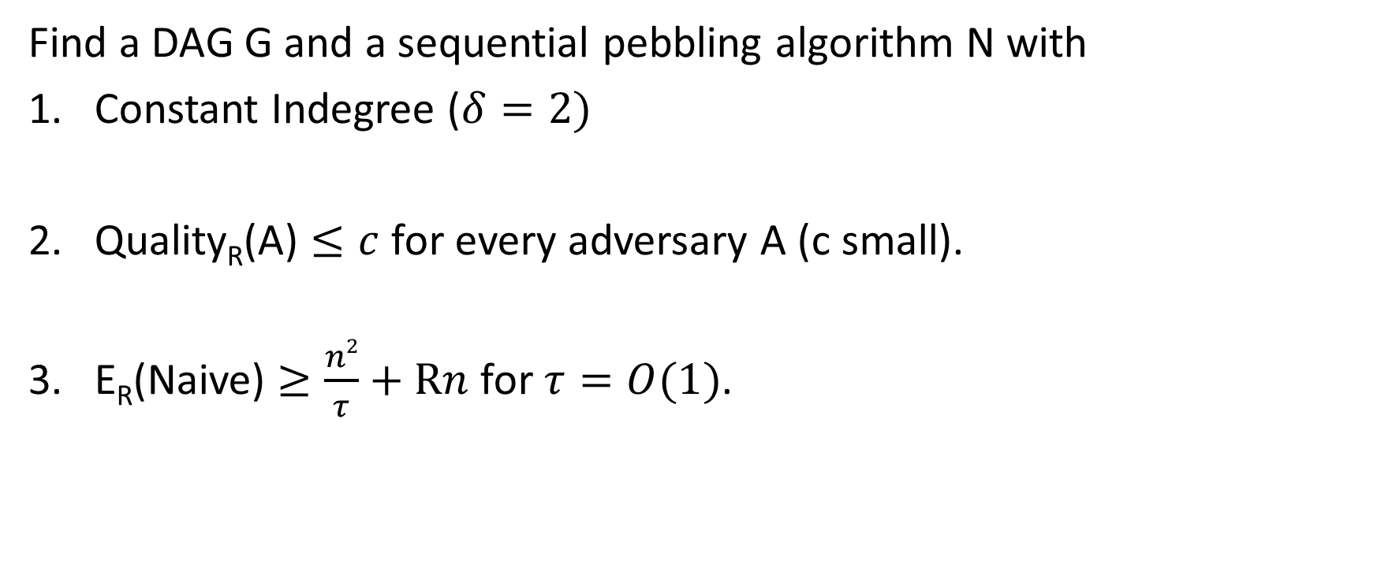
c-Ideal iMHF
Find a DAG G and a sequential pebbling algorithm N with
Constant Indegree ($δ=2)$
Quality_{R}(A) $≤c$ for every adversary A (c small).
E_{R}(Naive) $≥\frac{n2}{τ}+Rn$ for $τ=O(1)$.

Slide 29
Outline
Motivation
Data Independent Memory Hard Functions (iMHFs)
Our Attacks
  General Attack on Non Depth Robust DAGs
  Existing iMHFs are not Depth Robust
  Ideal iMHFs don’t exist
Subsequent Results (Depth-Robustness is Sufficient)
Open Questions

Slide 30

Depth-Robustness: The Key Property
Necessary [AB16] and sufficient [ABP16] for secure iMHFs

Slide 31

Depth Robustness
Definition: A DAG G=(V,E) is (e,d)-reducible if there exists $S⊆V$
s.t. $\left|S\right|≤e$ and depth(G-S) $≤d.$
Otherwise, we say that G is (e,d)-depth robust.
Example: (1,2)-reducible
1
2
3
4
5

Slide 32

Depth Robustness
Definition: A DAG G=(V,E) is (e,d)-reducible if there exists $S⊆V$
s.t. $\left|S\right|≤e$ and depth(G-S) $≤d.$
Otherwise, we say that G is (e,d)-depth robust.
Example: (1,2)-reducible
1
2
3
4
5

Slide 33
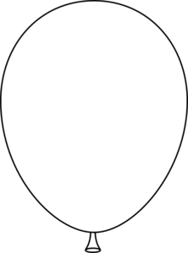
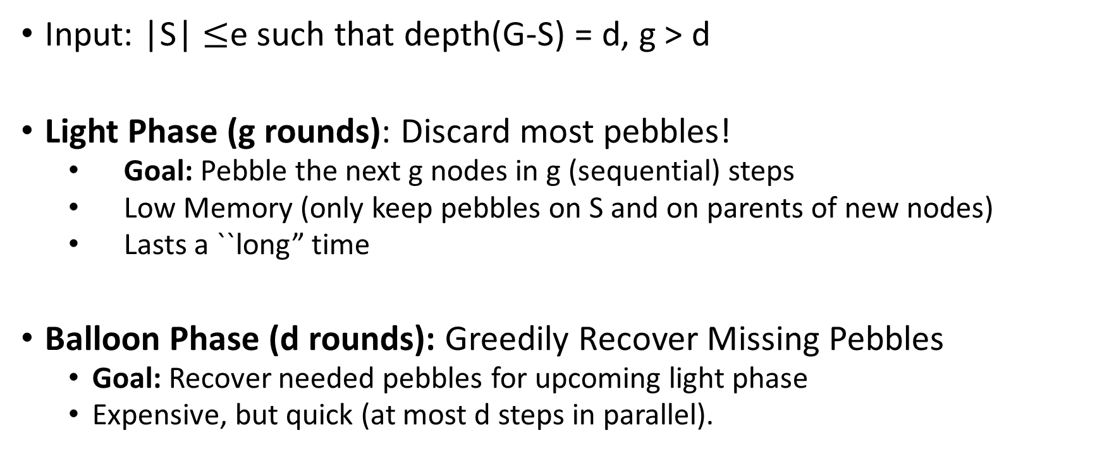
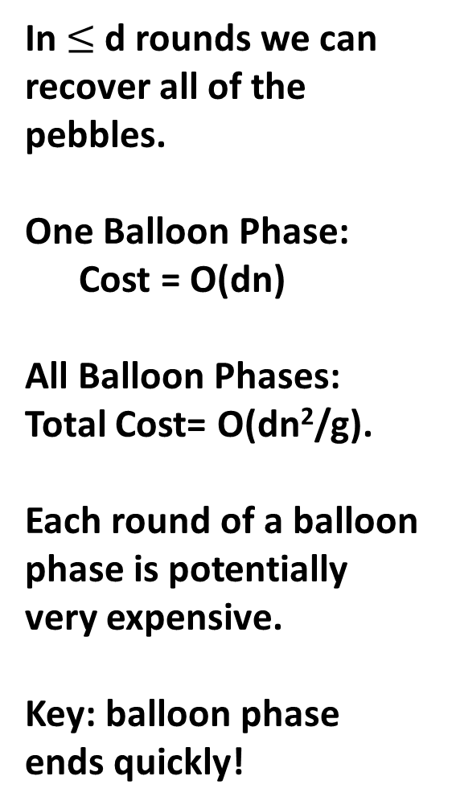
Attacking (e,d)-reducible DAGs
Input: |S| $≤$e such that depth(G-S) = d, g > d
Light Phase (g rounds): Discard most pebbles!
  Goal: Pebble the next g nodes in g (sequential) steps
  Low Memory (only keep pebbles on S and on parents of new nodes)
  Lasts a ``long” time
Balloon Phase (d rounds): Greedily Recover Missing Pebbles
  Goal: Recover needed pebbles for upcoming light phase
  Expensive, but quick (at most d steps in parallel).
In $≤$d rounds we can recover all of the pebbles.
One Balloon Phase:
Cost = O(dn)
All Balloon Phases:
Total Cost= O(dn²/g).
Each round of a balloon phase is potentially very expensive.
Key: balloon phase ends quickly!
Light Phase: Discard most pebbles!
Only keep pebbles on parents of next g nodes.
One Light Phase: Cost = O(g|S|)
All Light Phases: Total Cost = O(g|S|(n/g))= O(n|S|)

Slide 34
Attacking (e,d)-reducible DAGs
In $≤$d rounds we can recover all of the pebbles.
One Balloon Phase:
Cost = O(dn)
All Balloon Phases:
Total Cost= O(dn²/g).
Each round of a balloon phase is potentially very expensive.
Key: balloon phase ends quickly!

Slide 35

Depth Robustness is Necessary
Theorem (Depth-Robustness is a necessary condition): If G is (e,d)-reducible then is an (efficient) attack A such that
$\operatorname{ER}\left(A\right)≤en+δgn+\frac{n}{g}nd+nR+ \frac{n}{g}n$R.

Slide 36
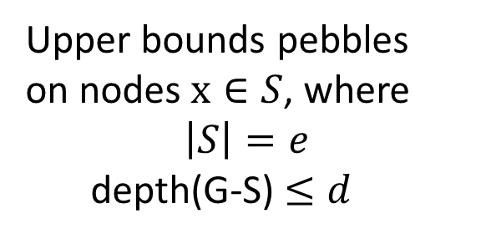
Main Theorem
Theorem (Depth-Robustness is a necessary condition): If G is (e,d)-reducible then is an (efficient) attack A such that
$\operatorname{ER}\left(A\right)≤en+δgn+\frac{n}{g}nd+nR+ \frac{n}{g}n$R.
Upper bounds pebbles
on nodes $x∈S$, where
$$\left|S\right|=e$$
depth(G-S) $≤d$
#pebbling rounds

Slide 37
Main Theorem
Theorem (Depth-Robustness is a necessary condition): If G is (e,d)-reducible then is an (efficient) attack A such that
$\operatorname{ER}\left(A\right)≤en+δgn+\frac{n}{g}nd+nR+ \frac{n}{g}n$R.
Maintain pebbles on parents of next g nodes to be pebbled.
#pebbling rounds

Slide 38

Main Theorem
Theorem (Depth-Robustness is a necessary condition): If G is not (e,d)-node robust then is an (efficient) attack A such that
$\operatorname{ER}\left(A\right)≤en+δgn+\frac{n}{g}nd+nR+ \frac{n}{g}n$R.
Length of a balloon phase
#balloon phases
Max #pebbles on G
In each round of balloon phase

Slide 39
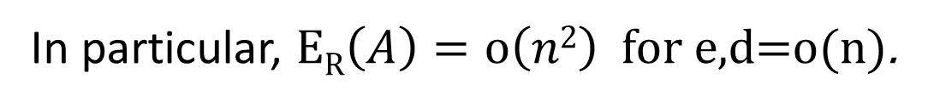

Depth Robustness is Necessary
Theorem (Depth-Robustness is a necessary condition): If G is not (e,d)-node robust then is an (efficient) attack A such that
$\operatorname{ER}\left(A\right)≤en+δgn+\frac{n}{g}nd+nR+ \frac{n}{g}n$R.
Set $g=\sqrt{nd}$
$\operatorname{ER}\left(A\right)=O\left(en+\sqrt{n3d}\right)$ .
In particular, $\operatorname{ER}\left(A\right)=o\left(n2\right)$ for e,d=o(n).

Slide 40

Question
Are existing iMHF candidates based on depth-robust DAGs?

Slide 41

iMHF Candidates
Catena [FLW15]
  Special Recognition at Password Hashing Competition
  Two Variants: Dragonfly and Double-Butterfly
Argon2 [BDK15]
  Winner of the Password Hashing Competition
  Argon2i (data-independent mode) is recommended for Password Hashing
Balloon Hashing [BCS16]
  Newer proposal (three variants in original proposal)
Notes:
In terms of depth-robustness two of these variants were similar to Catena and one variant was similar to Argon.

Slide 42
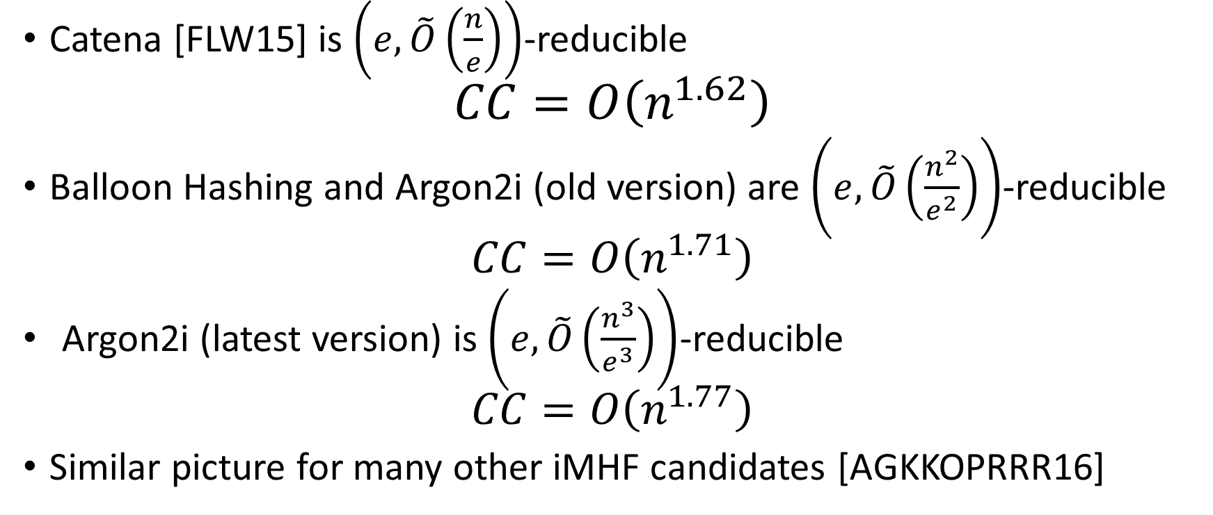
Answer: No
Catena [FLW15] is $\left(e,\tilde{O}\left(\frac{n}{e}\right)\right)$-reducible
$$CC=O\left(n^{1.62}\right)$$
Balloon Hashing and Argon2i (old version) are $\left(e,\tilde{O}\left(\frac{n^{2}}{e^{2}}\right)\right)$-reducible
  $$CC=O\left(n^{1.71}\right)$$
  Argon2i (latest version) is $\left(e,\tilde{O}\left(\frac{n^{3}}{e^{3}}\right)\right)$-reducible
  $$CC=O\left(n^{1.77}\right)$$
Similar picture for many other iMHF candidates [AGKKOPRRR16]

Slide 43

Argon2i [BDK]
Argon2: Winner of the password hashing competition[2015]
Authors recommend Argon2i variant (data-independent) for password hashing.
Notes:
Alex Biryukov, Daniel Dinu, and Dmitry Khovratovich from University of Luxembourg.

Slide 44
Argon2i
…
1
2
3
4
i
n

Slide 45
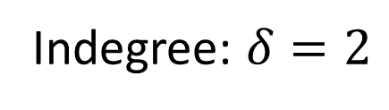
Argon2i
random predecessor r(i) < i
…
1
2
3
4
i
n
Indegree: $δ=2$

Slide 46


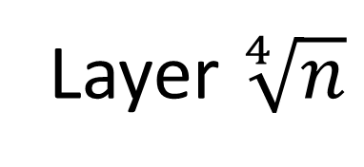


Argon2i: Reducing depth to $\sqrt{n}$
…
…
n
Layer $\sqrt[4]{n}$
…
…
…
$${2n}^{3/4}$$
Layer 1
…
…
1
2
3
$$\sqrt[4]{n}$$
$$n^{3/4}$$
Layer 0

Slide 47

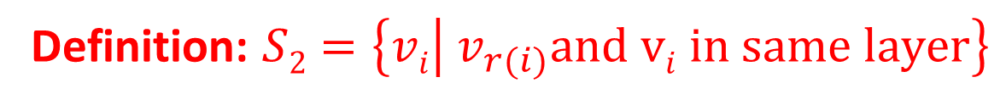
Argon2i: Reducing depth to $\sqrt{n}$
Definition: $S2=\left\{vi | v_{r(i)}and vi in same layer\right\}$
…
…
n
Layer $\sqrt[4]{n}$
…
…
…
$${2n}^{3/4}$$
Layer 1
…
…
1
2
3
$$\sqrt[4]{n}$$
$$n^{3/4}$$
Layer 0
$$Claim:S2is small$$

Slide 48



Argon2i is a layered DAG (almost)
Let S = S₁+S₂
…
…
n
Layer $\sqrt[4]{n}$
…
…
…
+2
+3
$${2n}^{3/4}$$
Layer 1
…
…
1
2
3
$$\sqrt[4]{n}$$
$$n^{3/4}$$
Layer 0
$$Fact:Easy to reduce the depth of a path$$

Slide 49
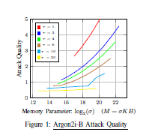
Attack Simulation [AB16b]
Parameter setting could easily be chosen when following Argon2i-B guidelines
…
Pessimistic Argon 2i-B parameter
Attack on Argon 2i-B is practical even for pessimistic parameter ranges
(brown line).

Slide 50

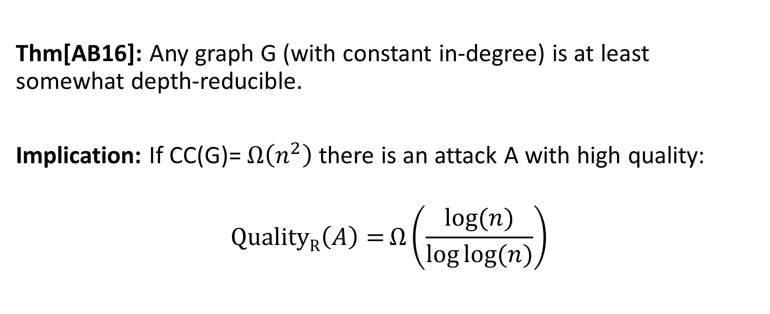
Ideal iMHFs Don’t Exist
Thm[AB16]: Any graph G (with constant in-degree) is at least somewhat depth-reducible.
Implication: If CC(G)= $Ω\left(n^{2}\right)$there is an attack A with high quality:
$$\operatorname{QualityR}\left(A\right)=Ω\left(\frac{log⁡(n)}{\log{log⁡(n)}}\right)$$

Slide 51
But, we cannot rule them out in practice

Slide 52
Outline
Motivation
Data Independent Memory Hard Functions (iMHFs)
Attacks
Constructing iMHFs (New!)
  Depth-Robustness is sufficient
Conclusions and Open Questions
Notes:
Joint work with Joel Alwen and Krzysztof Pietrzak

Slide 53
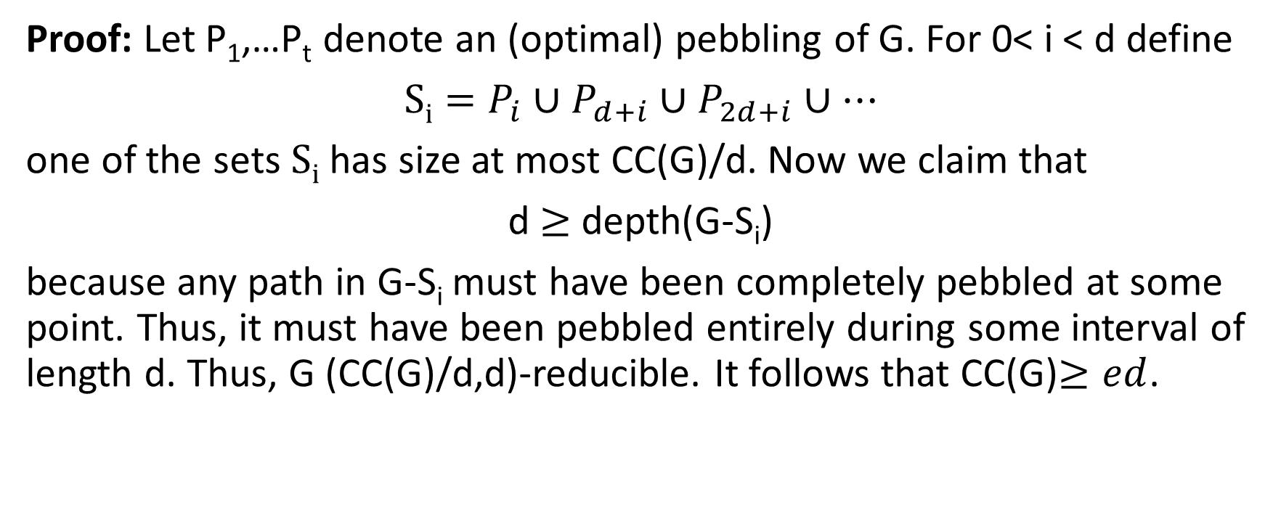
Depth-Robustness is Sufficient! [ABP16]
$Key Theorem:$Let G=(V,E) be (e,d)-depth robust then CC(G)$≥ed$.
Proof: Let P₁,…P_{t} denote an (optimal) pebbling of G. For 0< i < d define
$Si=P_{i}∪P_{d+i}∪P_{2d+i}$ $∪…$
one of the sets $Si$ has size at most CC(G)/d. Now we claim that
d $≥$depth(G-S_{i})
because any path in G-S_{i} must have been completely pebbled at some point. Thus, it must have been pebbled entirely during some interval of length d. Thus, G (CC(G)/d,d)-reducible. It follows that CC(G)$≥ed$.

Slide 54
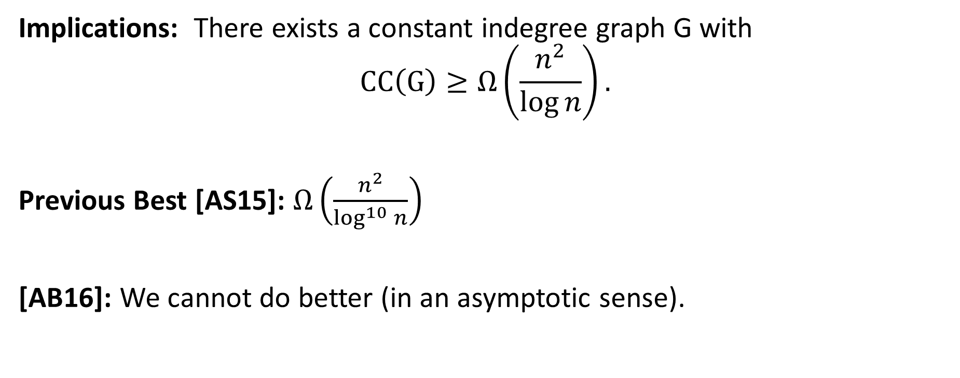
Depth-Robustness is Sufficient! [ABP16]
$Key Theorem:$Let G=(V,E) be (e,d)-depth robust then CC(G)$≥ed$.
Implications: There exists a constant indegree graph G with
$$CC\left(G\right)≥Ω\left(\frac{n^{2}}{\log{n}}\right).$$
Previous Best [AS15]: $Ω\left(\frac{n^{2}}{\log^{10}{n}}\right)$
[AB16]: We cannot do better (in an asymptotic sense).

Slide 55
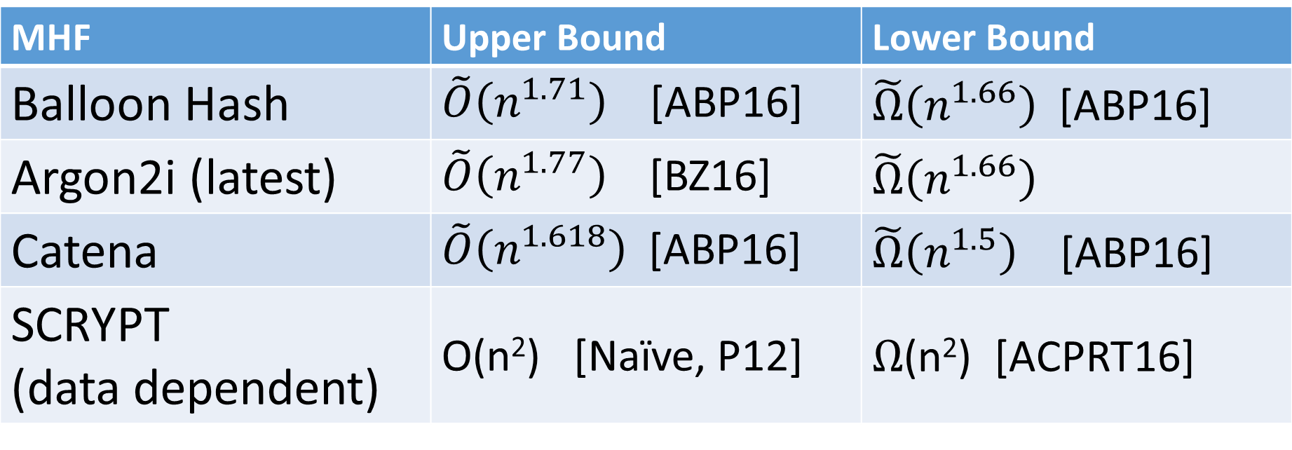
More New Results
MHF | Upper Bound | Lower Bound
Balloon Hash | $\tilde{O}\left(n^{1.71}\right)$ [ABP16] | $\tilde{Ω}\left(n^{1.66}\right)$ [ABP16]
Argon2i (latest) | $\tilde{O}\left(n^{1.77}\right)$ [BZ16] | $\tilde{Ω}\left(n^{1.66}\right)$
Catena | $\tilde{O}\left(n^{1.618}\right)$ [ABP16] | $\tilde{Ω}\left(n^{1.5}\right)$ [ABP16]
SCRYPT (data dependent) | O(n²) [Naïve, P12] | $Ω$(n²) [ACPRT16]

Slide 56
Conclusions
Depth-robustness is a necessary and sufficient for secure iMHFs
  [AB16] [ABP16]
Big Challenge: Improved Constructions of Depth-Robust Graphs
  We already have constructions in theory [EGS77, PR80, …]
  But constants matter!

Slide 57
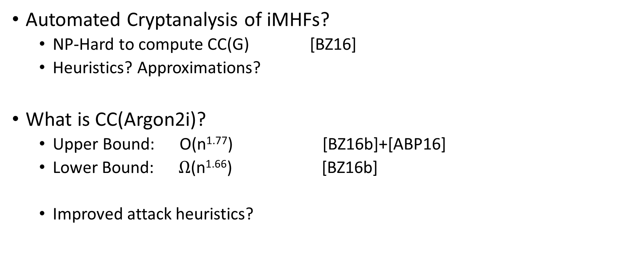
More Open Questions
Automated Cryptanalysis of iMHFs?
  NP-Hard to compute CC(G) [BZ16]
  Heuristics? Approximations?
What is CC(Argon2i)?
  Upper Bound: O(n^{1.77}) [BZ16b]+[ABP16]
  Lower Bound: $Ω$(n^{1.66}) [BZ16b]
  Improved attack heuristics?
Large Gap Remains

Slide 58

Thanks for Listening

