Slide 1


Password Strength Signaling:
A Counter-Intuitive Defense Against Password Cracking
Jeremiah Blocki, Wenjie Bai and Ben Harsha
Department of Computer Science
Purdue University
GameSec 2021
CERIAS Security Seminar (Fall 2021)

Slide 2








Motivation: Traditional Password Storage
($\text{alice}\text{,}\text{123456}$)
Username
alice
Salt
89d978034a3f6
Hash
85e23cfe0021f584e3db87aa72630a9a2345c062
SHA1(12345689d978034a3f6)=85e23cfe0021f584e3db87aa72630a9a2345c062
+
Notes:
Suppose that I register for an account at playstation.com

Slide 3

















Offline Attacks: A Common Problem
Password breaches at major companies have affected millions billions of user accounts.
Notes:
Unfortunately, such breaches are increasingly commonplace and have affected billions of user accounts. Shown below is an incomplete list of major breaches and I apologize if I forgot to include your competitor.

Slide 4
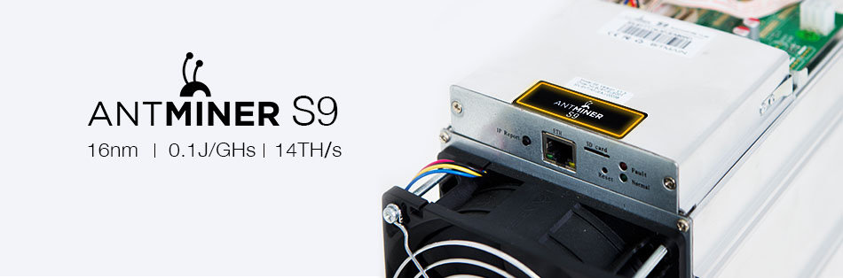
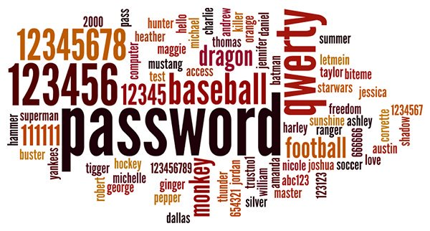
A Dangerous Problem
Can we deter the password attacker?
$1,200

Slide 5
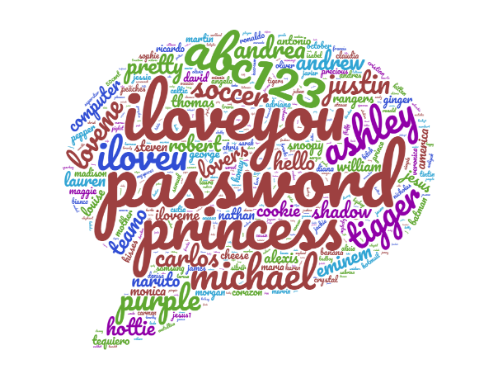



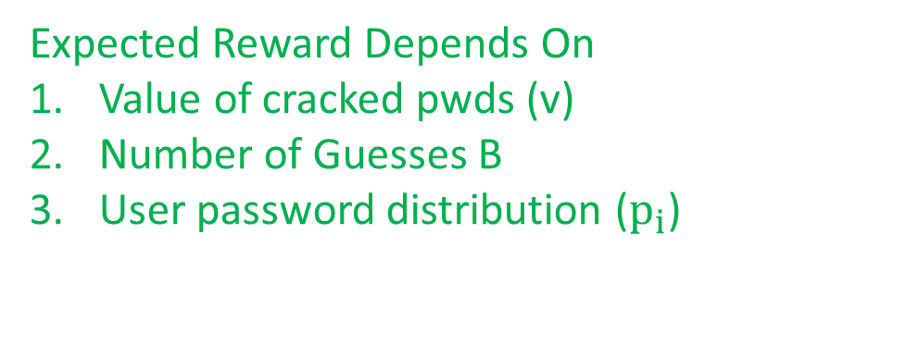
Decision Theoretic Model [BD16,BHZ18]
Untargeted Rational Password Attacker
  Attacker knows the distribution of user chosen passwords, but not which particular password the user picked
  Strategy: Guess top B passwords and then give up
  Goal: Pick B to maximize (expected) profit
  $P\left(B,v,k\right)=E\left[Reward−Guessing Cost\right]$
$$v\sum_{i=1}^{B}{p_{i}}$$
Expected Reward Depends On
Value of cracked pwds (v)
Number of Guesses B
User password distribution ($p_{i}$)
Probability attacker cracks pwd
Adversary value (v) for cracked password

Slide 6

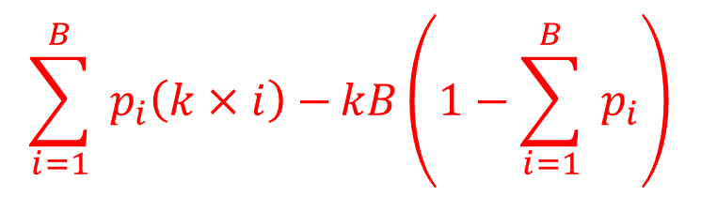
Decision Theoretic Model [BD16,BHZ18]
Untargeted Rational Password Attacker
  Attacker knows the distribution of user chosen passwords, but not which particular password the user picked
  Strategy: Guess top B passwords and then give up
  Goal: Pick B to maximize (expected)profit
  $$P\left(B,v,k\right)=E\left[Reward−Guessing Cost\right]$$
Expected Guessing Cost Depends On:
User Password Distribution
Cost (k) per password guess
  Key Stretching deliberately increases
  password hashing costs
  Limited by server workload
$$\sum_{i=1}^{B}{{ p}_{i}\left(k×i\right)−}kB\left(1−\sum_{i=1}^{B}{{ p}_{i}}\right)$$
Cost if i’th guess is correct
Cost on Fail
Probability fail to crack

Slide 7




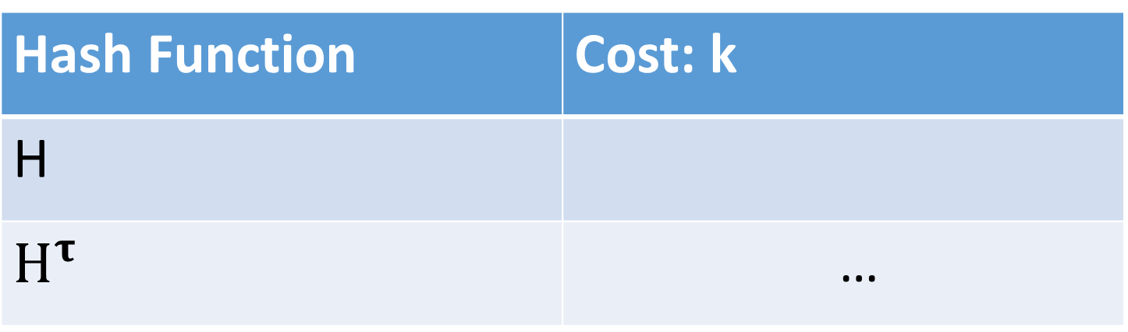
Key Stretching: Deterring a Rational Attacker
Hash Function | Cost: k
H
$H^{τ}$ | …
Hash Iteration
Limitations! The honest party must evaluate the password hash function too!
Memory Hard Functions
PBKDF2

Slide 8

A Crazy Idea: Password Strength Signaling
Username
alice
Salt
89d978034a3f6
Hash
85e23cfe0021f584e3db87aa72630a9a2345c062
Strength Signal
Weak
Noisy Signal:
Sometimes the signaled strength is accurate
Sometimes the signaled strength is a lie
Question: Can we reduce the number of cracked
Passwords by tuning the noisy signal?

Slide 9
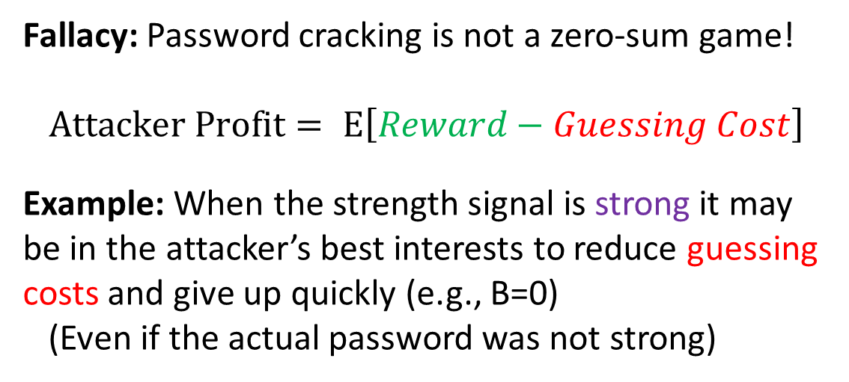
A Crazy Idea: Password Strength Signaling
Question: Can we reduce the number of cracked passwords by tuning the noisy signal?
Intuitive Answer: No way! A rational attacker will only use the signal if it benefits him. In the best case the attacker will simply ignore the signal.
Username
alice
Salt
89d978034a3f6
Hash
85e23cfe0021f584e3db87aa72630a9a2345c062
Strength Signal
Strong
Fallacy: Password cracking is not a zero-sum game!
$$Attacker Profit= E\left[Reward−Guessing Cost\right]$$
Example: When the strength signal is strong it may be in the attacker’s best interests to reduce guessing costs and give up quickly (e.g., B=0)
(Even if the actual password was not strong)
Motivation: Bayesian Persuasion

Slide 10

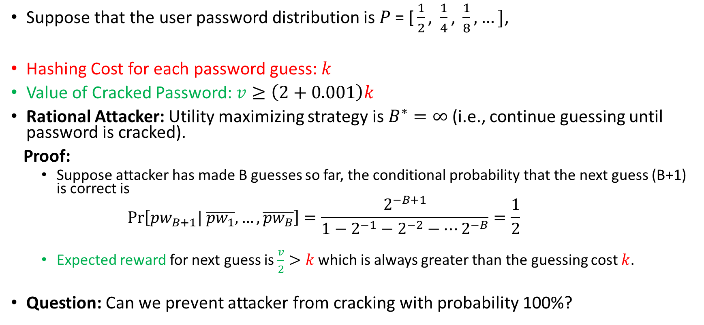

Motivating Example
Most popular password ${pw}_{1}$
Suppose that the user password distribution is $P\text{ = [}\frac{1}{2}\text{, }\frac{1}{4}\text{, }\frac{1}{8},…]$,
Hashing Cost for each password guess: $k$
Value of Cracked Password: $v≥\left(2+0.001\right)k$
Rational Attacker: Utility maximizing strategy is $B^{∗}=∞$ (i.e., continue guessing until password is cracked).
Proof:
  Suppose attacker has made B guesses so far, the conditional probability that the next guess (B+1) is correct is
    $$\operatorname{Pr}\left[{pw}_{B+1}| \overline{{pw}_{1}},…,\overline{{pw}_{B}}\right]=\frac{2^{−B+1}}{1−2^{−1}−2^{−2}−…2^{−B}}=\frac{1}{2}$$
  Expected reward for next guess is $\frac{v}{2}>k$which is always greater than the guessing cost $k$.
Question: Can we prevent attacker from cracking with probability 100%?
$$\operatorname{Pr}\left[{pw}_{i}\right]=2^{−i}$$

Slide 11

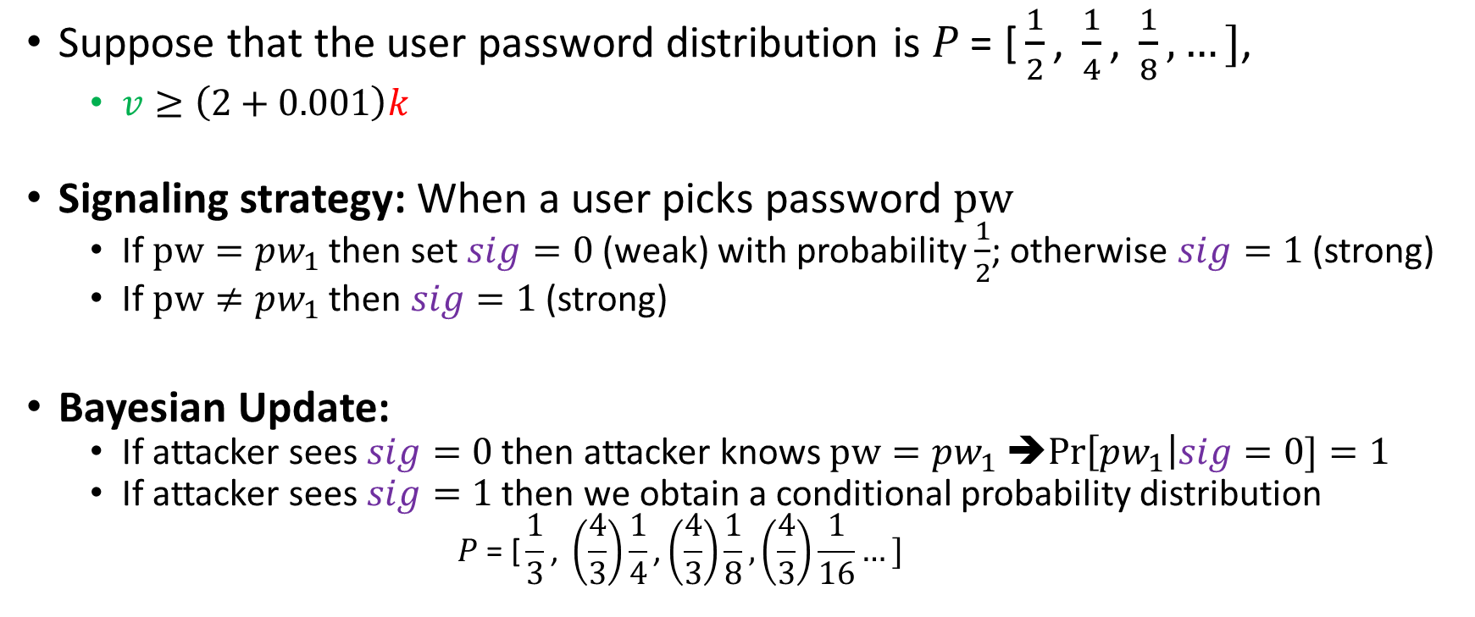
Motivating Example: Signaling
Suppose that the user password distribution is $P\text{ = [}\frac{1}{2}\text{, }\frac{1}{4}\text{, }\frac{1}{8},…]$,
  $v≥\left(2+0.001\right)k$
Signaling strategy: When a user picks password $pw$
  If $pw={pw}_{1}$ then set $sig=0$ (weak) with probability $\frac{1}{2}$; otherwise $sig=1$ (strong)
  If $pw≠{pw}_{1}$ then $sig=1$ (strong)
Bayesian Update:
  If attacker sees $sig=0$ then attacker knows $pw={pw}_{1}$ ➔$Pr\left[{pw}_{1}\right|sig=0]=1$
  If attacker sees $sig=1$ then we obtain a conditional probability distribution
    $$P\text{ = [}\frac{1}{3}\text{, }\left(\frac{4}{3}\right)\frac{1}{4}\text{,}\left(\frac{4}{3}\right)\frac{1}{8},\left(\frac{4}{3}\right)\frac{1}{16}…]$$
$$Pr\left[{pw}_{i}\right|sig=1]$$

Slide 12

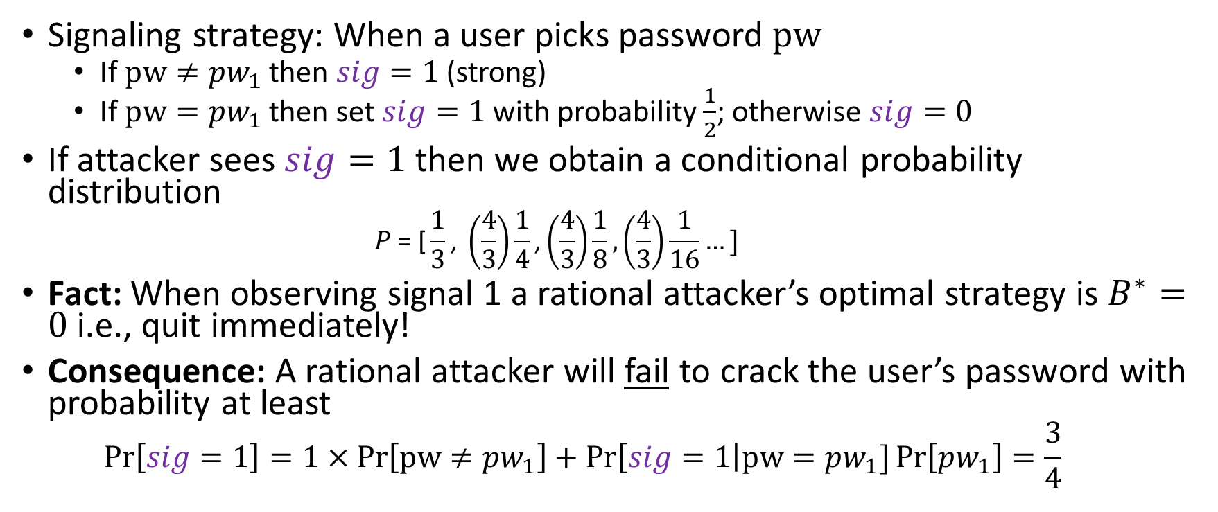
Motivating Example: Signaling
Signaling strategy: When a user picks password $pw$
  If $pw≠{pw}_{1}$ then $sig=1$ (strong)
  If $pw={pw}_{1}$ then set $sig=1$ with probability $\frac{1}{2}$; otherwise $sig=0$
If attacker sees $sig=1$ then we obtain a conditional probability distribution
    $$P\text{ = [}\frac{1}{3}\text{, }\left(\frac{4}{3}\right)\frac{1}{4}\text{,}\left(\frac{4}{3}\right)\frac{1}{8},\left(\frac{4}{3}\right)\frac{1}{16}…]$$
Fact: When observing signal 1 a rational attacker’s optimal strategy is $B^{∗}=0$ i.e., quit immediately!
Consequence: A rational attacker will fail to crack the user’s password with probability at least
  $$Pr\left[sig=1\right]=1×Pr\left[pw≠{pw}_{1}\right]+Pr\left[sig=1\right|pw={pw}_{1}]\operatorname{Pr}\left[{pw}_{1}\right]=\frac{3}{4}$$
$$Pr\left[{pw}_{i}\right|sig=1]$$

Slide 13
Our Contributions
Introduce Password Strength Signaling as a Counter-Intuitive defense against rational password cracking attackers
Stackelberg Game Model for Password Strength Signaling
  Defender (leader) commits to signaling strategy
    Goal: Minimize % of passwords cracked by rational adversary
  Rational attacker (follower) plays to maximize utility/profit
Empirical Analysis on Real-World Password Datasets

Slide 14


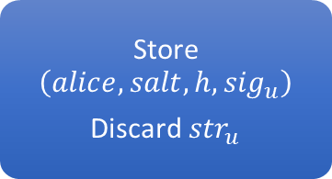
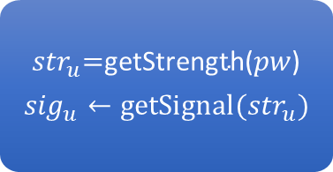

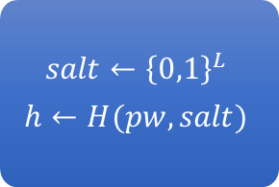
Strength Signaling: account creation
($\text{alice}\text{, }\text{pw}\text{=123456}$)
$$\$$$
Store $\left(alice, salt, h, {sig}_{u}\right)$
Discard ${str}_{u}$
$${str}_{u}\text{=}\text{getStrength}\text{(}pw\text{)}$$
$${sig}_{u}←{\text{getSignal}(str}_{u})$$
$$salt←{\left\{0,1\right\}}^{L}$$
$$h←H(pw,salt)$$
$$\$$$
$$\$$$

Slide 15

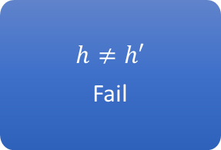
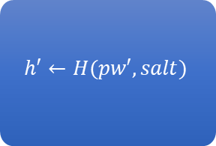
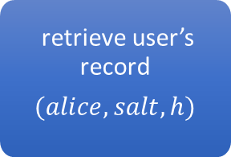
Authentication
($\text{alice}\text{, }\text{pw}\text{′=654321}$)
$$h≠h′$$
Fail
$$h′←H(pw′,salt)$$
retrieve user’s record
$$(alice, salt, h)$$

Slide 16
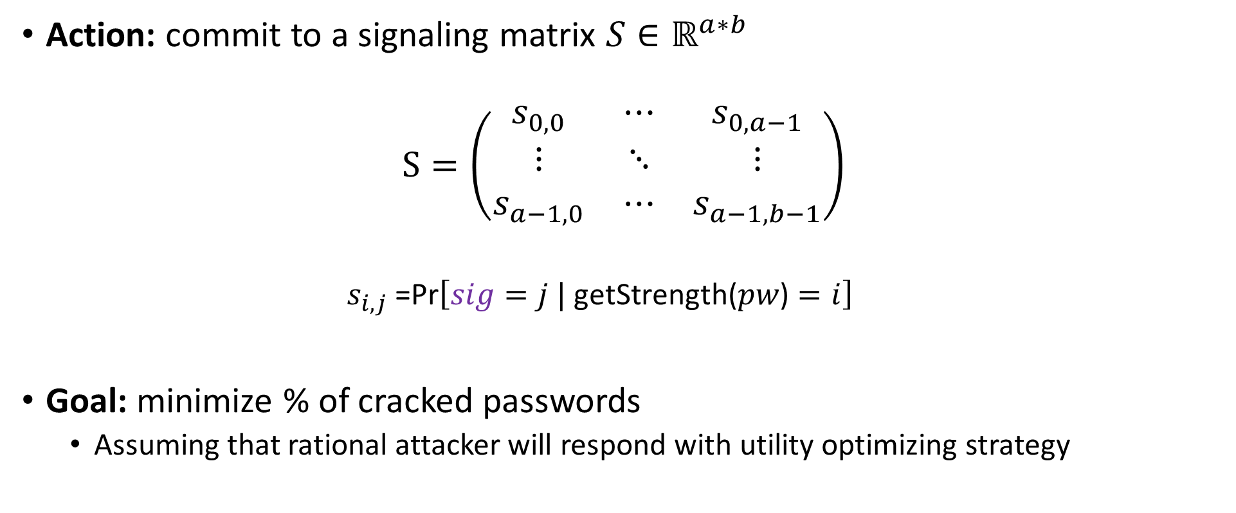
Stackelberg Model: Defender (Server)
Action: commit to a signaling matrix $S∈ℝ^{a∗b}$
$$S=\left(\begin{matrix}s_{0,0} & ⋯ & s_{0,a−1} \\ ⋮ & ⋱ & ⋮ \\ s_{a−1,0} & ⋯ & s_{a−1,b−1}\end{matrix}\right)$$
  $$s_{i,j}\text{ =}\text{Pr}\left[sig=j | \text{getStrength}\text{(}pw\text{)}=i\right]$$
Goal: minimize % of cracked passwords
  Assuming that rational attacker will respond with utility optimizing strategy
Signaled Password Strength
Actual strength of user’s password

Slide 17
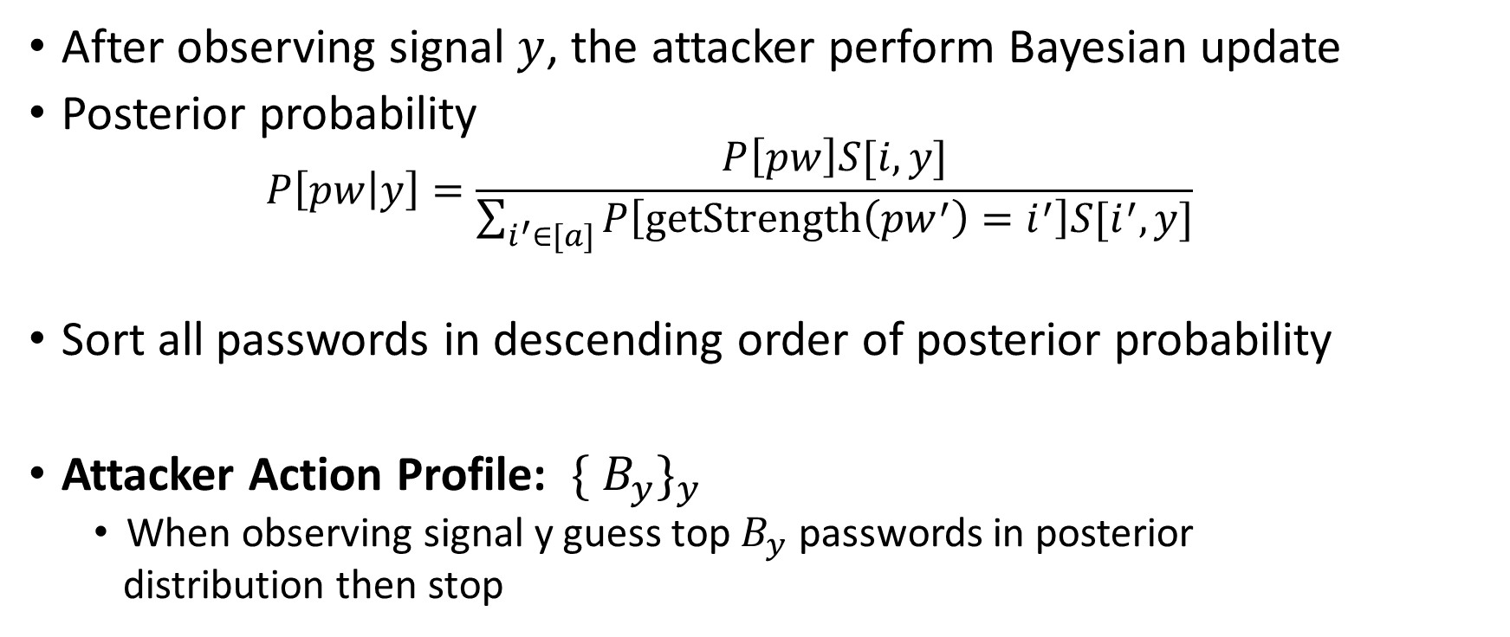
Stackelberg Model: Rational Attacker
After observing signal $y$, the attacker perform Bayesian update
Posterior probability
  $$P\left[pw | y\right]=\frac{P\left[pw\right]S[i,y]}{\sum_{i^{′}∈[a]}{P\left[getStrength\left({pw}^{′}\right)=i^{′}\right]S[i^{′},y]}}$$
Sort all passwords in descending order of posterior probability
Attacker Action Profile: ${\{ B_{y}\}}_{y}$
  When observing signal y guess top $B_{y}$ passwords in posterior
  distribution then stop
  Let $λ\left(B;y\right)$ be probability of top B passwords (posterior)

Slide 18
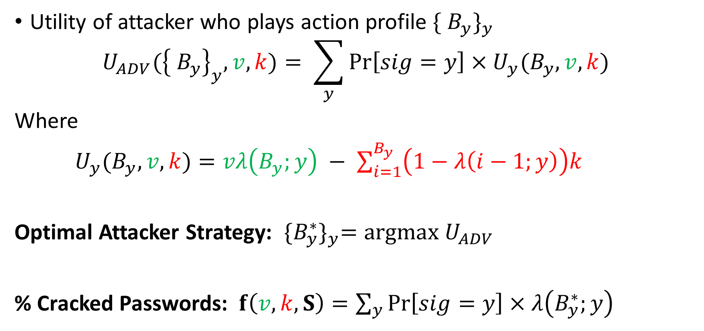
Attacker’s Utility: with signaling
Utility of attacker who plays action profile ${\{ B_{y}\}}_{y}$
$$U_{ADV}({\left\{ B_{y}\right\}}_{y},v,k)= \sum_{y}{Pr\left[sig=y\right]}×U_{y}(B_{y},v,k)$$
Where
$U_{y}(B_{y},v,k)=vλ\left(B_{y};y\right) − \sum_{i=1}^{B_{y}}{\left(1−λ\left(i−1;y\right)\right)k}$
Optimal Attacker Strategy: ${\{B_{y}^{∗}\}}_{y}=argmax U_{ADV}$
% Cracked Passwords: $f\left(v,k,S\right)=\sum_{y}{Pr\left[sig=y\right]}×λ\left(B_{y}^{∗};y\right)$

Slide 19
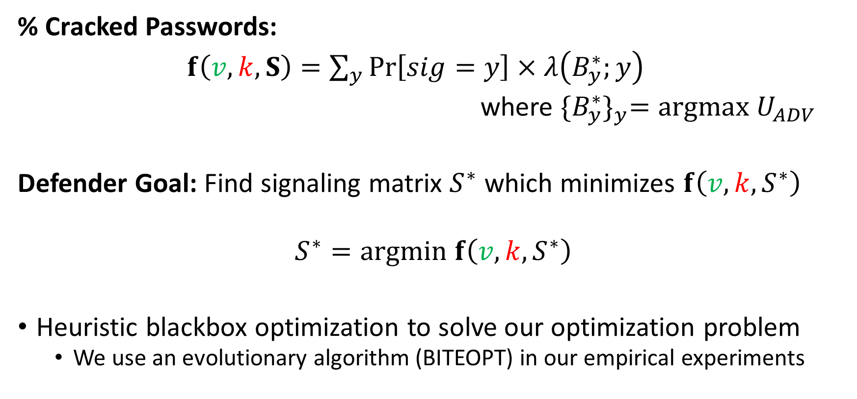
Defender Strategy
% Cracked Passwords:
$f\left(v,k,S\right)=\sum_{y}{Pr\left[sig=y\right]}×λ\left(B_{y}^{∗};y\right)$
where ${\{B_{y}^{∗}\}}_{y}=argmax U_{ADV}$
Defender Goal: Find signaling matrix $S^{∗}$ which minimizes $f\left(v,k,S^{∗}\right)$
$$S^{∗}=argmin f\left(v,k,S^{∗}\right)$$
Heuristic blackbox optimization to solve our optimization problem
  We use an evolutionary algorithm (BITEOPT) in our empirical experiments

Slide 20
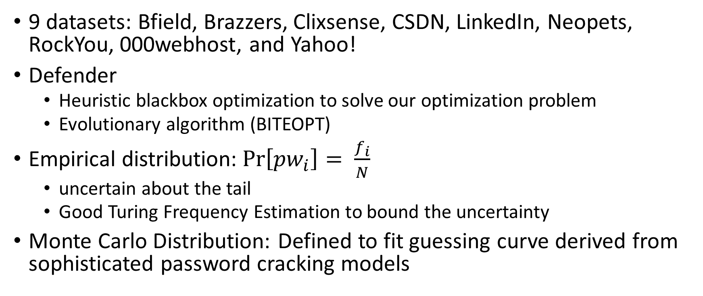
Experiments
9 datasets: Bfield, Brazzers, Clixsense, CSDN, LinkedIn, Neopets, RockYou, 000webhost, and Yahoo!
Defender
  Heuristic blackbox optimization to solve our optimization problem
  Evolutionary algorithm (BITEOPT)
Empirical distribution:$\operatorname{Pr}\left[{pw}_{i}\right]= \frac{f_{i}}{N}$
  uncertain about the tail
  Good Turing Frequency Estimation to bound the uncertainty
Monte Carlo Distribution: Defined to fit guessing curve derived from sophisticated password cracking models

Slide 21
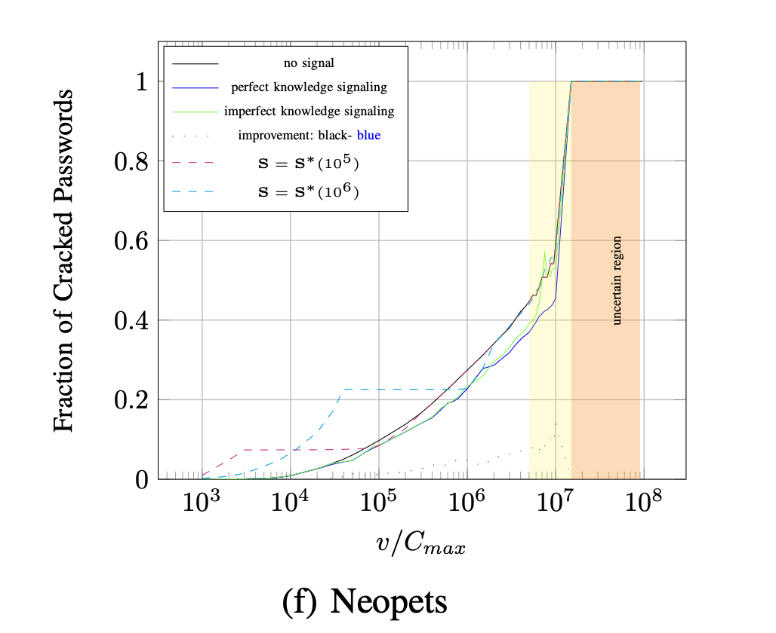
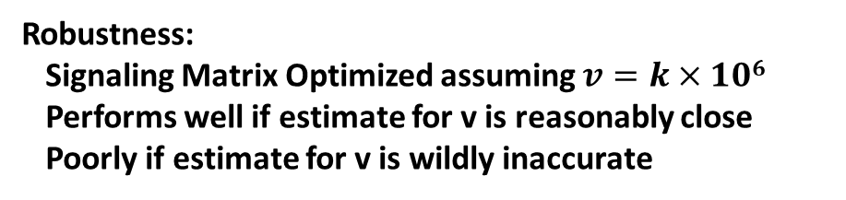

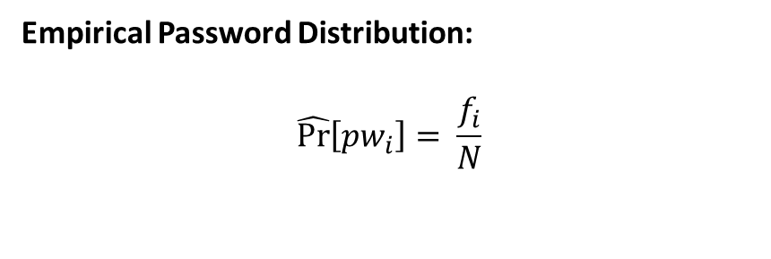
Empirical Evaluation: Offline Attack
Empirical Password Distribution:
$$\hat{Pr}\left[{pw}_{i}\right]= \frac{f_{i}}{N}$$
# occurrences of ${pw}_{i}$
8% improvement
# User passwords in leaked
Password dataset (Neopets)
Uncertain Region: Empirical password distribution may diverge from real distribution
v/k
Robustness:
Signaling Matrix Optimized assuming $v=k×106$
Performs well if estimate for v is reasonably close
Poorly if estimate for v is wildly inaccurate
Notes:
, explain x-axis and y-axis and Highlight specific points on plot
Omit sup(E) >= 0.1

Slide 22
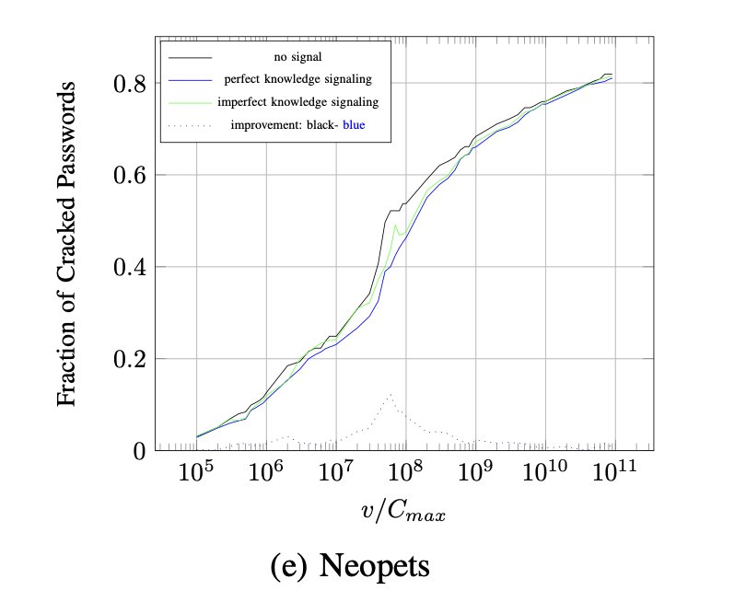
Empirical Evaluation: Monte Carlo distribution
Monte Carlo distribution: Password distribution derived from guessing curves derived by running password cracking models on leaked password dataset
10% improvement
v/k

Slide 23
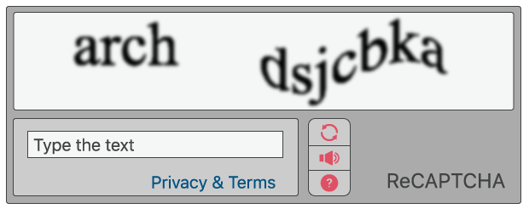
Empirical Evaluation: Online attack
Example: Many companies use CAPTCHAs to throttle online attackers
➔ Guessing cost is cost to solve CAPTCHA
(cost k is much larger than evaluating password hash)
(v/k is much smaller than in an offline attack)
3.4% improvement
v/k
Notes:
, explain x-axis and y-axis and Highlight specific points on plot
Omit sup(E) >= 0.1

Slide 24
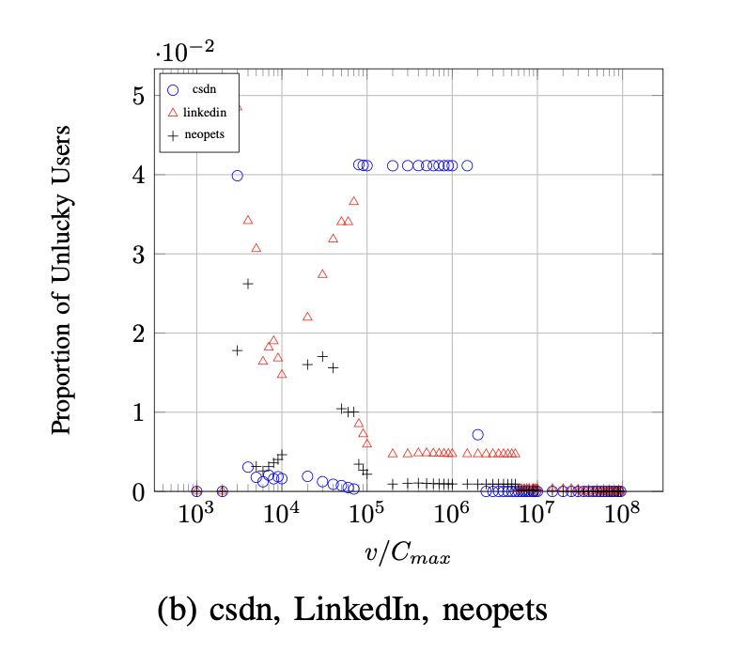
An Important Ethical Question
Definition: Call a user unlucky (resp. lucky) if the password is (resp. is not) cracked after signaling, but without signaling the user’s password would have (resp. would not have) been safe with no signaling
Observation 1: More lucky users than unlucky
Observation 2: the optimal signaling strategy sometimes has unlucky users as well
Ethical Concern?
  Modify optimization function to penalize solutions with unlucky users?
  Voluntary adoption?
v/k

Slide 25
Conclusion
Password strength signaling
  Bayesian Persuasion to convince rational attacker to crack less passwords
  Reduces the fraction of passwords that would have been cracked in an untargeted offline (resp. online) attack.
  Easy to integrate with current authentication procedures
Important Ethical/Societal Questions still need to be addressed before adoption
  We view our work as a proof-of-concept

Slide 26

Thanks for Listening

Slide 27

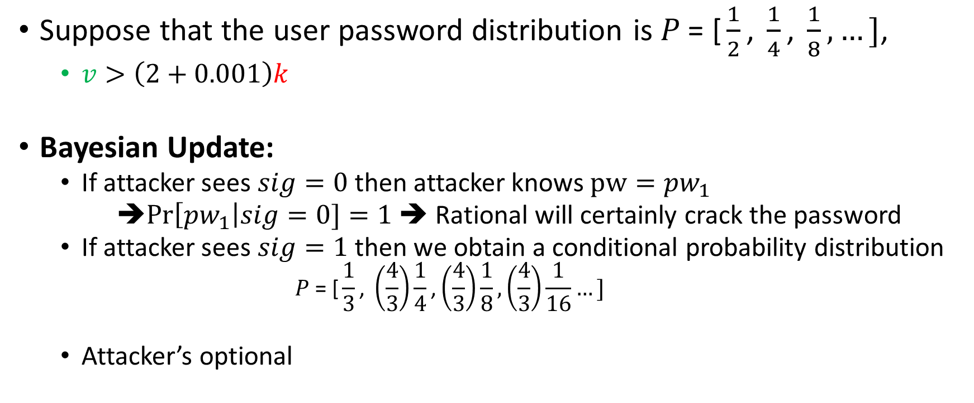
Motivating Example: Signaling
Suppose that the user password distribution is $P\text{ = [}\frac{1}{2}\text{, }\frac{1}{4}\text{, }\frac{1}{8},…]$,
  $v>\left(2+0.001\right)k$
Bayesian Update:
  If attacker sees $sig=0$ then attacker knows $pw={pw}_{1}$
  ➔$Pr\left[{pw}_{1}\right|sig=0]=1$ ➔ Rational will certainly crack the password
  If attacker sees $sig=1$ then we obtain a conditional probability distribution
    $$P\text{ = [}\frac{1}{3}\text{, }\left(\frac{4}{3}\right)\frac{1}{4}\text{,}\left(\frac{4}{3}\right)\frac{1}{8},\left(\frac{4}{3}\right)\frac{1}{16}…]$$
  Attacker’s optional
$$Pr\left[{pw}_{i}\right|sig=1]$$

Slide 28
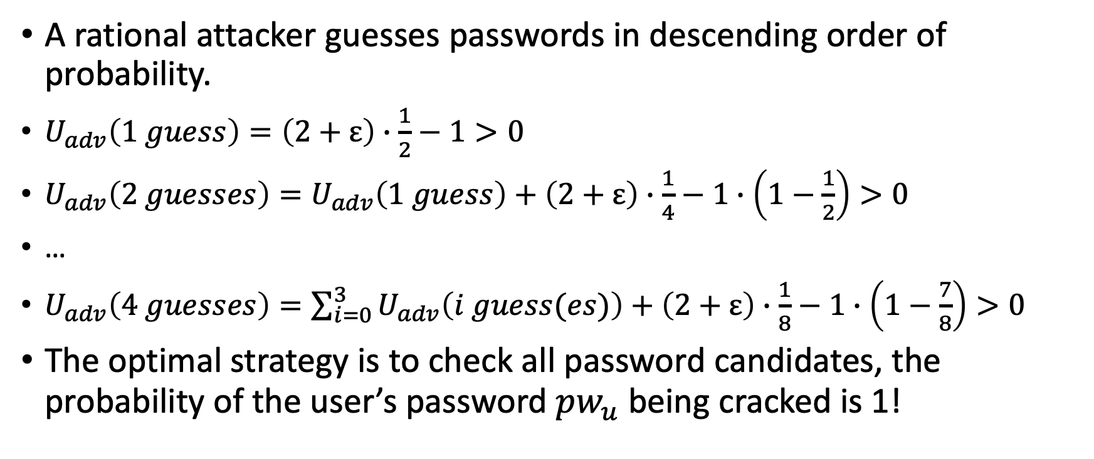

w.o signaling
A rational attacker guesses passwords in descending order of probability.
$U_{adv}\left(1 guess\right)=\left(2+ε\right)∙\frac{1}{2}−1>0$
$U_{adv}\left(2 guesses\right)=U_{adv}\left(1 guess\right)+\left(2+ε\right)∙\frac{1}{4}−1∙\left(1−\frac{1}{2}\right)>0$
…
$U_{adv}\left(4 guesses\right)=\sum_{i=0}^{3}{U_{adv}\left(i guess(es)\right)+}$ $\left(2+ε\right)∙\frac{1}{8}−1∙\left(1−\frac{7}{8}\right)>0$
The optimal strategy is to check all password candidates, the probability of the user’s password ${pw}_{u}$being cracked is 1!
Password value
Probability of making 2st guess
$$Pr[{pw}_{u}={pw}_{2}]$$
Hash cost

Slide 29
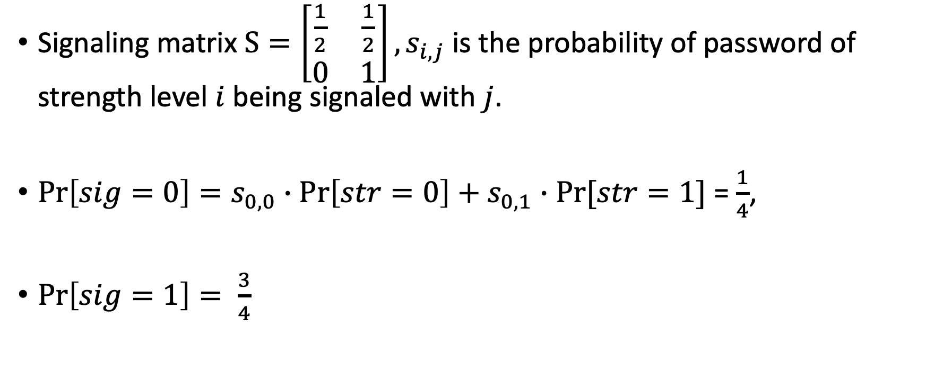
With signaling
Signaling matrix $S=\left[\begin{matrix}\frac{1}{2} & \frac{1}{2} \\ 0 & 1\end{matrix}\right],s_{i,j}$ is the probability of password of strength level $i$ being signaled with $j$.
$\operatorname{Pr}\left[sig=0\right]=s_{0,0}∙\operatorname{Pr}\left[str=0\right]+s_{0,1}∙Pr⁡[str=1]$ = $\frac{1}{4}$,
$\operatorname{Pr}\left[sig=1\right]= \frac{3}{4}$

Slide 30
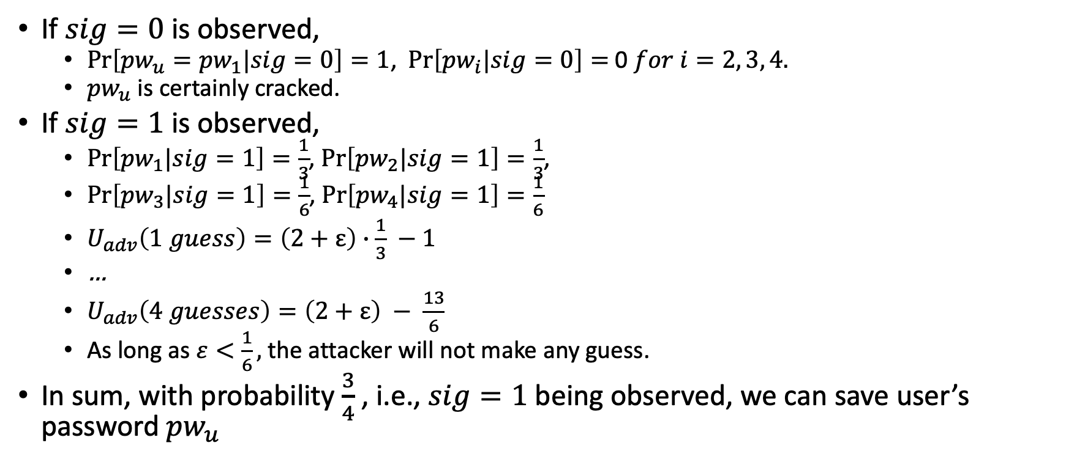
With signaling
If $sig=0$ is observed,
  $\operatorname{Pr}\left[{{pw}_{u}=pw}_{1}|sig=0\right]=1$, $\operatorname{Pr}\left[{pw}_{i}|sig=0\right]=$ 0 $for i=2, 3, 4.$
  ${pw}_{u}$ is certainly cracked.
If $sig=1$ is observed,
  $\operatorname{Pr}\left[{pw}_{1}|sig=1\right]=\frac{1}{3}$, $\operatorname{Pr}\left[{pw}_{2}|sig=1\right]=\frac{1}{3}$,
  $\operatorname{Pr}\left[{pw}_{3}|sig=1\right]=\frac{1}{6}$, $\operatorname{Pr}\left[{pw}_{4}|sig=1\right]=\frac{1}{6}$
  $U_{adv}\left(1 guess\right)=\left(2+ε\right)∙\frac{1}{3} −1$
  …
  $U_{adv}\left(4 guesses\right)=\left(2+ε\right) − \frac{13}{6}$
  As long as $ε<\frac{1}{6},$ the attacker will not make any guess.
In sum, with probability $\frac{3}{4}$ , i.e., $sig=1$ being observed, we can save user’s password ${pw}_{u}$

Slide 31
Strength Signaling: account creation
($\text{alice}\text{, }\text{pw}\text{=123456}$)
$$\$$$
Store $\left(alice, salt, h, {sig}_{u}\right)$
Discard ${str}_{u}$
$${str}_{u}\text{=}\text{getStrength}\text{(}pw\text{)}$$
$${sig}_{u}←{\text{getSignal}(str}_{u})$$
$$salt←{\left\{0,1\right\}}^{L}$$
$$h←H(pw,salt)$$
$$\$$$
$$\$$$

Slide 32
Authentication
($\text{alice}\text{, }\text{pw}\text{′=654321}$)
$$h≠h′$$
Fail
$$h′←H(pw′,salt)$$
retrieve user’s record
$$(alice, salt, h)$$

Slide 33
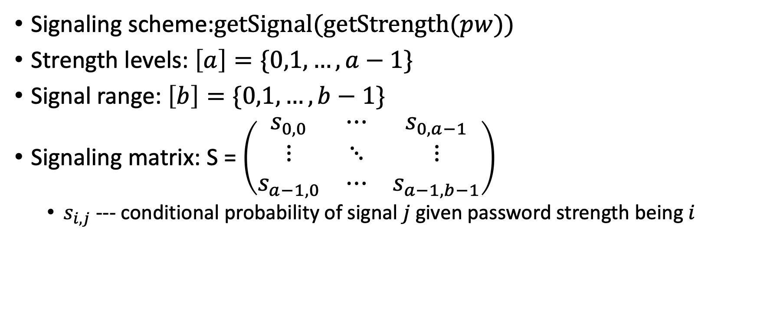
Strength Signaling
Signaling scheme:$\text{getSignal}(\text{getStrength}(pw))$
Strength levels: $\left[a\right]=\{0,1, …,a−1\}$
Signal range: $\left[b\right]=\{0,1,…,b−1\}$
Signaling matrix: S = $\left(\begin{matrix}s_{0,0} & ⋯ & s_{0,a−1} \\ ⋮ & ⋱ & ⋮ \\ s_{a−1,0} & ⋯ & s_{a−1,b−1}\end{matrix}\right)$
  $s_{i,j}$ --- conditional probability of signal $j$ given password strength being $i$

Slide 34

Defender’s Model (Server)
Action--- commit to a signaling matrix $S∈ℝ^{a∗b}$
Objective---minimize the percentage of cracked passwords in case of an offline attack

Slide 35
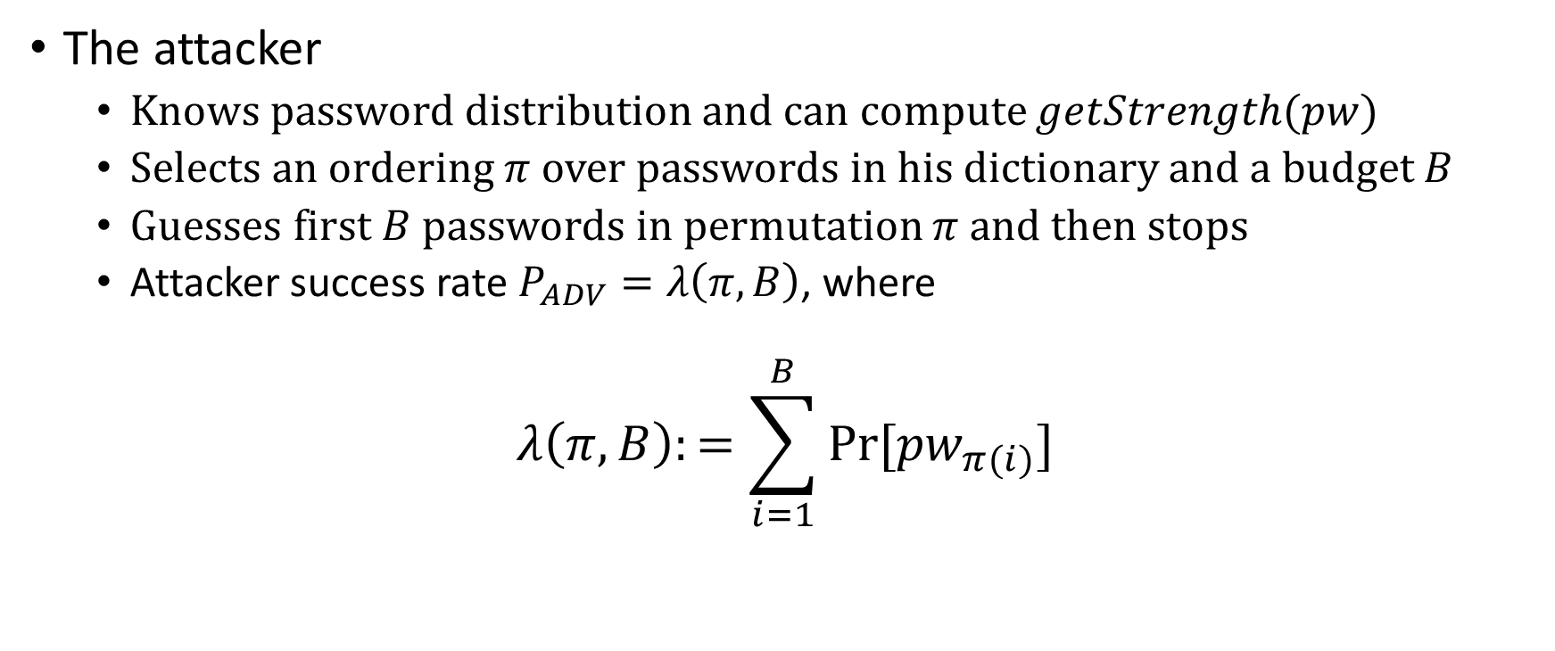
Attacker’s Model: without signaling
The attacker
  Knows password distribution and can compute $getStrength(pw)$
  Selects an ordering $π$ over passwords in his dictionary and a budget $B$
  Guesses first $B$ passwords in permutation $π$ and then stops
  Attacker success rate $P_{ADV}=λ\left(π,B\right)$, where
$$λ\left(π,B\right):=\sum_{i=1}^{B}{Pr⁡[{pw}_{π(i)}]}$$

Slide 36
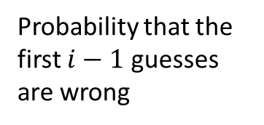
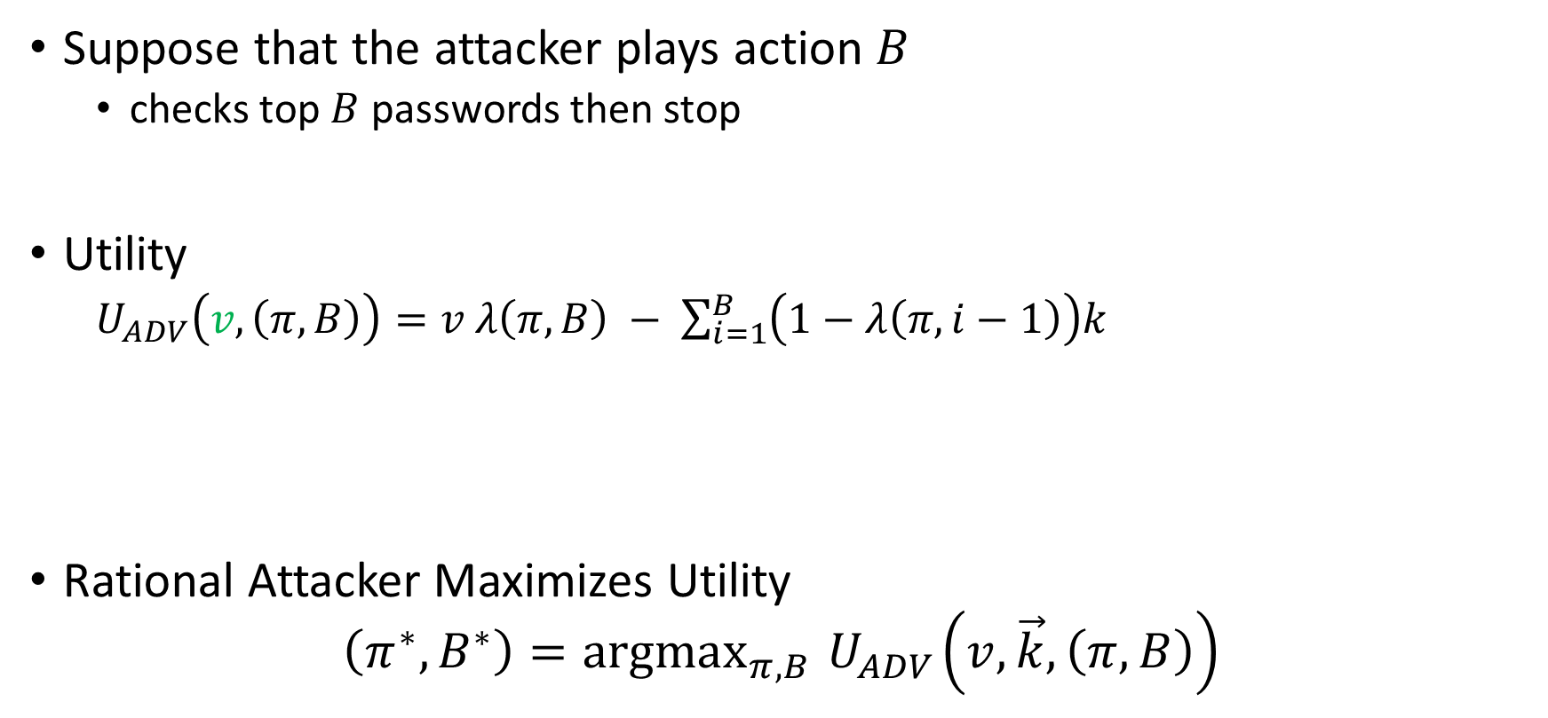
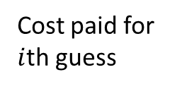
Attacker’s Utility: without signaling
Suppose that the attacker plays action $B$
  checks top $B$ passwords then stop
Utility
  $U_{ADV}\left(v, \left(π,B\right)\right)=v$ $λ\left(π,B\right) − \sum_{i=1}^{B}{\left(1−λ\left(π,i−1\right)\right)k}$
Rational Attacker Maximizes Utility
$$\left(π^{∗},B^{∗}\right)={argmax}_{π,B}{ U}_{ADV}\left(v,\vec{k},\left(π,B\right)\right)$$
Expected cost
Cost paid for $i$th guess
Expected gain
Probability that the first $i−1$ guesses are wrong

Slide 37
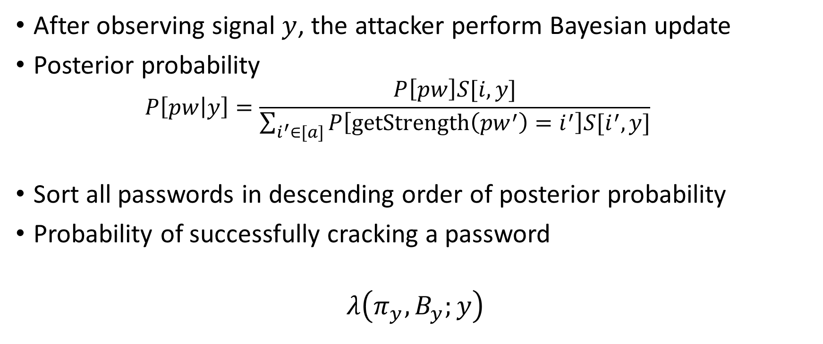
Attacker’s Model: with signaling
After observing signal $y$, the attacker perform Bayesian update
Posterior probability
  $$P\left[pw | y\right]=\frac{P\left[pw\right]S[i,y]}{\sum_{i^{′}∈[a]}{P\left[getStrength\left({pw}^{′}\right)=i^{′}\right]S[i^{′},y]}}$$
Sort all passwords in descending order of posterior probability
Probability of successfully cracking a password
$$λ\left(π_{y},B_{y};y\right)$$

Slide 38
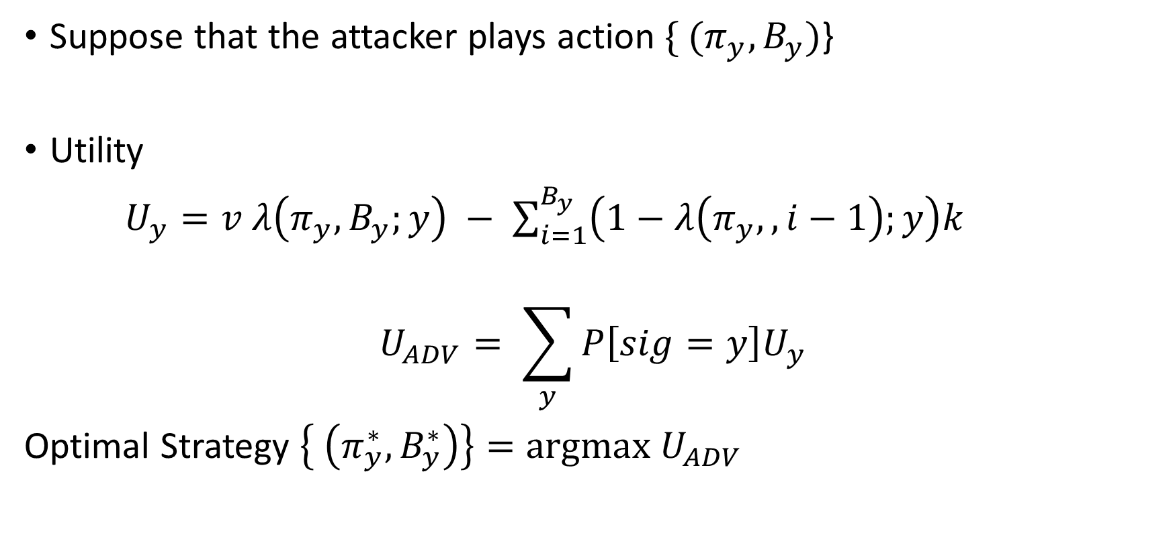
Attacker’s Utility: with signaling
Suppose that the attacker plays action $\{ (π_{y},B_{y})$}
Utility
$U_{y}=v$ $λ\left(π_{y},B_{y};y\right) − \sum_{i=1}^{B_{y}}{\left(1−λ\left(π_{y},,i−1\right);y\right)k}$
$$U_{ADV}= \sum_{y}{P\left[sig=y\right]U_{y}}$$
Optimal Strategy $\left\{ \left(π_{y}^{∗},B_{y}^{∗}\right)\right\}=argmax U_{ADV}$

Slide 39
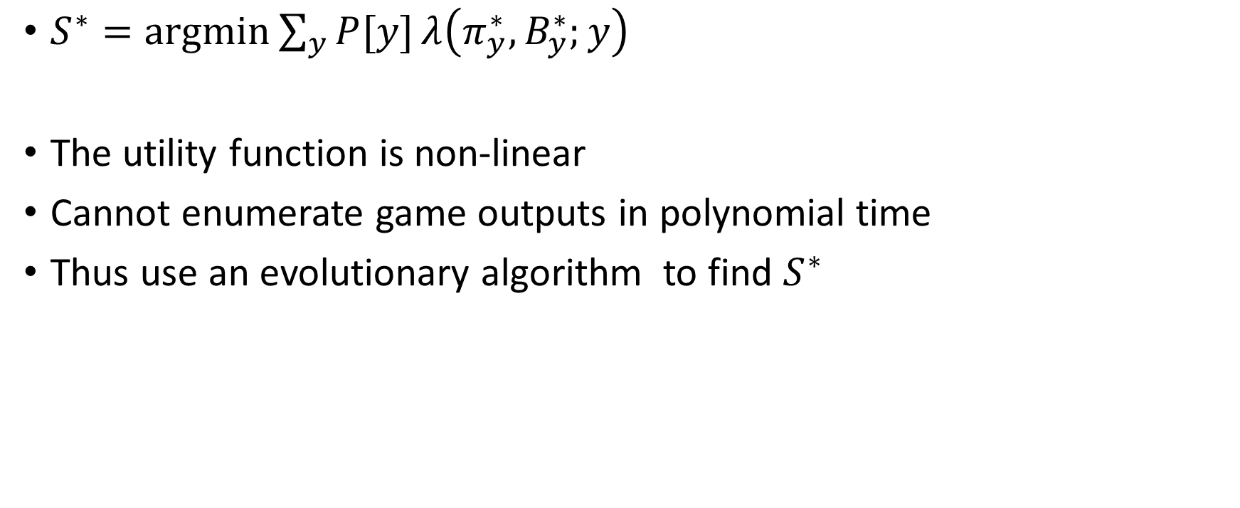
Optimal signaling scheme
$S^{∗}=argmin\sum_{y}{P[y]}λ\left(π_{y}^{∗},B_{y}^{∗};y\right)$
The utility function is non-linear
Cannot enumerate game outputs in polynomial time
Thus use an evolutionary algorithm to find $S^{∗}$

