Slide 1
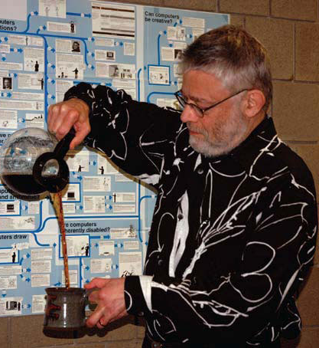
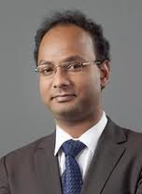
Naturally Rehearsing Passwords
Jeremiah Blocki
NSF TRUST
October 2013
Manuel Blum
Anupam Datta
Notes:
This is ongoing work that I have been doing with Manuel Blum and Anupam Datta.

Slide 2
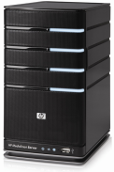




Password Management
…
Competing Goals:
Security
Usability
Notes:
Password management scheme is any strategy used to create and remember multiple passwords for multiple accounts.
Increased challenge security/usability analysis should look at the problem wholelistically
Position: This is not the user’s fault!
We want a management scheme which is
1. Easy for the user to manage
2. Secure (hard for adversary to compromise accounts)

Slide 3
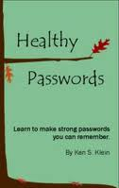
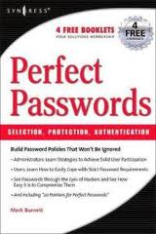
A Challenging Problem
Traditional Security Advice
Use numbers and letters
Use special symbols
Don’t Reuse Passwords
Don’t use words/names
Not too short
Don’t Write it Down
Use mix of lower/upper case letters
Change your passwords every 90 days
Notes:
We have been using passwords for decades. Many books and articles have been written about password creation. Traditionally the advice a user gets is something like the following…
Is it time to re-evaluate the traditional security advice?

Slide 4
Experiment #0
Memorize the following string
L~;z&K5De
Notes:
Pause 30 Seconds

Slide 5
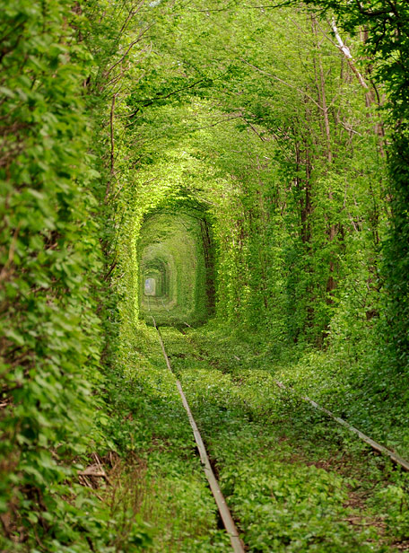
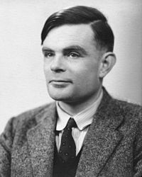
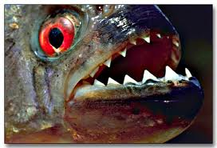

Memory Experiment 1
Person | Alan Turing
Action | Kissing
Object | Piranha

Slide 6
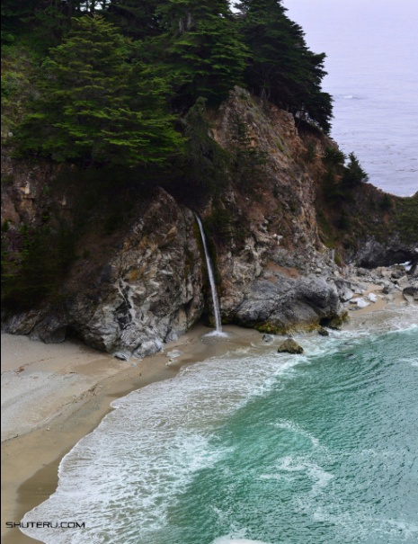
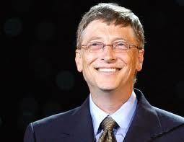
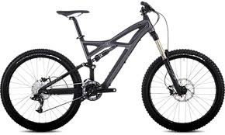
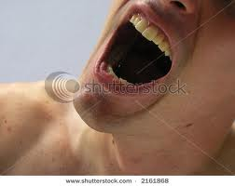
Memory Experiment 2
Person | Bill Gates
Action | swallowing
Object | bike

Slide 7
Outline
Introduction and Experiments
Example Password Management Schemes
Quantifying Usability
Quantifying Security
Our Password Management Scheme
Notes:
Need to model the adversary to quantify security. Our approach: We also need to attempt to quantify usability! Much more difficult!

Slide 8
Password Management
…
Competing Goals:
Security
Usability
Notes:
Password management scheme is any strategy used to create and remember multiple passwords for multiple accounts.
Increased challenge security/usability analysis should look at the problem wholelistically
Position: This is not the user’s fault!
We want a management scheme which is
1. Easy for the user to manage
2. Secure (hard for adversary to compromise accounts)

Slide 9
Scheme 0: Reuse Weak Password
Pick four random words w (e.g., airplane)
Account | Amazon | Ebay
Password | w | w

Slide 10
Scheme 1: Reuse Strong Password
Pick four random words w₁,w₂,w₃,w₄
Account | Amazon | Ebay
Password | w₁w₂w₃w₄ | w₁w₂w₃w₄

Slide 11
Scheme 2: Lifehacker
Base Pwd + Derivation Rule
  Derivation Rule: First two letters + last letter
  Three random words
Account | Amazon | Ebay
Derived | amn | eby
Password | w₁w₂w₃amn | w₁w₂w₃eby
Source: http://lifehacker.com/184773/geek-to-live--choose-and-remember-great-passwords

Slide 12
Scheme 2: Strong Random Independent
Four Independent Random Words per Account
Account | Amazon | Ebay
Password | w₁w₂w₃w₄ | x₁x₂x₃x₄

Slide 13
Questions
How can we evaluate password management strategies?
  Quantify Usability
  Quantify Security
Can we design password management schemes which balance security and usability considerations?

Slide 14
Outline
Introduction and Experiments
Example Password Management Schemes
Quantifying Usability
  Human Memory
  Rehearsal Requirement
  Visitation Schedule
Quantifying Security
Our Password Management Scheme

Slide 15
Human Memory is Semantic
Memorize: nbccbsabc
Memorize: tkqizrlwp
3 Chunks vs. 9 Chunks!
Usability Goal: Minimize Number of Chunks
Source: The magical number seven, plus or minus two [Miller, 56]
Notes:
If all we care about is usability one good goal is minimizing number of chunks in the password

Slide 16
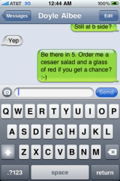
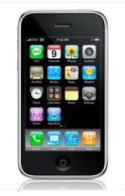
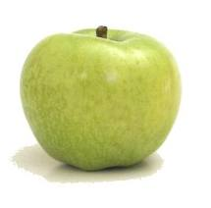



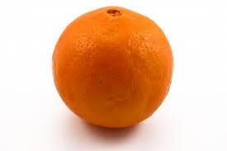
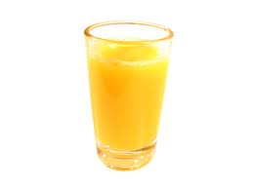
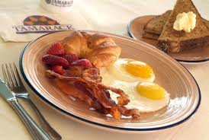
Human Memory is Associative
?

Slide 17
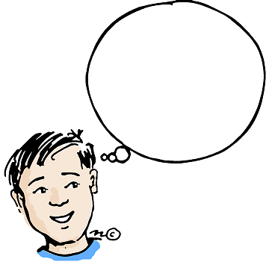
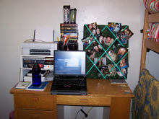

Cues
Cue: context when a memory is stored
Surrounding Environment
  Sounds
  Visual Surroundings
  Web Site
  ….
As time passes we forget some of this context…
Notes:
Insert Picture Here!
Environment: Memory Champions Wear Blinders

Slide 18

Human Memory is Lossy
Rehearse or Forget!
  How much work?
Quantify Usability
  Rehearsal Assumption
p_{amazon}
????
p_{google}

Slide 19
Quantifying Usability
Human Memory is Lossy
  Rehearse or Forget!
  How much work does this take?
Rehearsal Assumptions
Visitation Schedule
  Natural Rehearsal for frequently visited accounts

Slide 20
Rehearsal Requirement
Day: 1 2 4 5 8
Expanding Rehearsal Assumption: user maintains cue-association pair by rehearsing during each interval [s^{i}, s^{i+1}].
Visit Amazon: Natural Rehearsal
Google
X_{t}: extra rehearsals to maintain all passwords for t days.
Notes:
Observe that if the user reuses his password then all cues are rehearsal requirements are satisfied naturally. If the passwords are completely independent then X₈

Slide 21
Rehearsal Requirement
Day: 1 2 4 5 8
X_{t}: extra rehearsals to maintain all passwords for t days.
 | Reuse Password | Independent Passwords
X₈ | 0 | 2
Notes:
Observe that if the user reuses his password then all cues are rehearsal requirements are satisfied naturally. If the passwords are completely independent then X₈

Slide 22


Visitation Schedule
Poisson Process with parameter 𝞴
Cue shared by Amazon and Google
$\text{λ}\text{=}\text{λ}$+ 𝞴
t₁
t₂
t₂
$$\text{E}\left[t2−t1\right]=1/{\text{λ} }$$

Slide 23
Visitation Schedule
Poisson Process with parameter 
Amazon
Google
User | =1 (daily) | =1/3 (biweekly) | =1/7 (weekly) | =1/31 (monthly) | =1/365 (annual)
Active | 10 | 10 | 10 | 10 | 35
Typical | 5 | 10 | 10 | 10 | 40
Occasional | 2 | 10 | 20 | 20 | 23
Infrequent | 0 | 2 | 5 | 10 | 58
Day: 2 4 5 8
Number of accounts visited with frequency 

Slide 24
Usability Results
 | Reuse Strong + Lifehacker | Strong Random Independent
Active | 0.023 | 420
Typical | 0.084 | 456.6
Occasional | 0.12 | 502.7
Infrequent | 1.2 | 564
E[X₃₆₅]: Extra Rehearsals to maintain all passwords over the first year.
Usable
Unusable

Slide 25


Valuable Resources Protected by Passwords
Notes:
No need to kidnap a princess to break the password. Many accounts are vulnerable to an adversary who has absolutely no background knowledge about the user.

Slide 26
Outline
Introduction and Experiments
Example Password Management Schemes
Quantifying Usability
Quantifying Security
  Background
  Failed Ideas
  Our Approach: Security as a Game
Our Password Management Scheme

Slide 27
Security (what could go wrong?)
Three Types of Attacks
Online
Offline
Phishing
Danger
Notes:
Three types of attacks, Online, Offline and Phishing. I will illustrate each attack in more detail in the following slides.

Slide 28
Online Attack
123456
password
123456
Guess Limit: k-strikes policy
Notes:
A k-strikes policy is used to mitigate this threat. However, users who select popular passwords like 123456 might still be vulnerable.

Slide 29


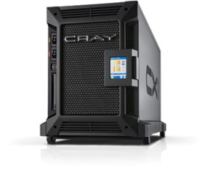

Offline Dictionary Attack
jblocki, 123456
Username
jblocki
Salt
89d978034a3f6
Hash
85e23cfe0021f584e3db87aa72630a9a2345c062
SHA1(12345689d978034a3f6)=85e23cfe0021f584e3db87aa72630a9a2345c062
+
Notes:
To understand the next type of attack it is necessary to understand how organizations store passwords. When I create an account online the server typically will
select a random value (called the salt).
Compute and store the cryptographic hash of my password with the salt appended.
Later to authenticate the server will re-compute this hash value, and make sure that it matches the stored version.
Sometimes these password files are stolen by adversaries, who can then execute an offline dictionary attack. Offline attacks are more dangerous than online attacks because there is no k-strikes limit. There are many popular password cracking tools that the adversary could use (e.g, John the Ripper). Unfortunately, these attacks are commonplace. Even large companies like (Sony, Zappos, and LinkedIn) have been breached.

Slide 30


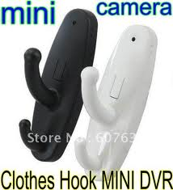
Plaintext Recovery Attack
pwd
PayPaul.com
pwd
Notes:
Instead of trying to crack the user’s password. Why not just get him to tell me the password. Adversary tricks user into creating an account on a malicious site (PayPaul.com).
Examples of plaintext recovery attacks include phishing attacks, malware and hidden cameras.
Once the adversary has this password the PayPal account is compromised. If the user reuses the same password for other accounts then the adversary can also access these sites.

Slide 31
Snowball Effect
pwd
pwd
+
PayPaul.com
Source: CERT Incident Note IN-98.03: Password Cracking Activity
Notes:
Instead of trying to crack the user’s password. Why not just get him to tell me the password.
Adversary tricks user into creating an account on a malicious site (PayPaul.com).
Once the adversary has this background information the brute force attack on PlayStation may be more likely to succeed
Finally, the background information from PayPaul (and possibly PlayStation) can be used to help improve the Online attack

Slide 32
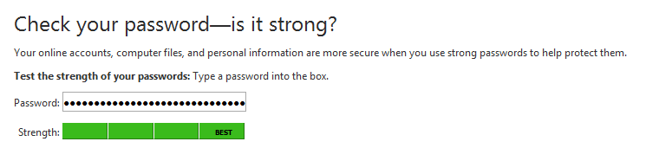
Password Strength Meters
mmmmmmmmmmmmmmmmmmmmmmmmmmmmmmmmmmmmmmm
Source: https://www.microsoft.com/security/pc-security/password-checker.aspx
Notes:
The typical notion of strength: estimate how long it would take for a password cracker to guess the password
Challenge: There may be many ‘obvious’ passwords that a particular password cracker doesn’t try immediately.
If people begin using these `obvious’ passwords then the adversary can simply adapt his brute force attack in response. If this seems too simple remember that 66% of real passwords were very simple.

Slide 33
Entropy (Weaknesses)
mmmm
mmmm
mmmm
G₁ has high entropy, but is insecure!

Slide 34
Min-Entropy (Weaknesses)
x
x
PayPaul.com
x
Notes:
G1 would be great if the only attacks an adversary could mount were offline/online attacks. However, there are other attacks (e.g. phishing) where the adversary might learn one of the users passwords (phishing, virus, etc…)
G1 is weak because it does not control the damage after the original password is leaked.
Weakness: Min-Entropy does not consider the correlation between passwords
One security breach could easily propagate through the rest of the system.

Slide 35
Our Security Approach
Dangerous World Assumption
  Not enough to defend against existing adversaries
  Adversary can adapt after learning the user’s new password management strategy
Provide guarantees even when things go wrong
  Offline attacks should fail with high probability
  Limit damage of a successful phishing attack
Notes:
Philosophy: We can propose a password management scheme, but adversary will adapt his attack.
Lets introduce a formal framework for analyzing security

Slide 36
Security as a Game
p₁
p₂
p₃
p₄
p₅
Sha1(p₄)
p₅
PayPaul.com
q_{$1,000,000} guesses
+

Slide 37
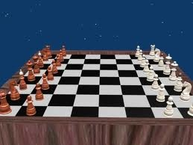
The Adversary’s Game
Adversary can compromise at most r sites (phishing).
Adversary can execute offline attacks against at most h additional sites
  Resource Constraints => at most q guesses
Adversary wins if he can compromise any new sites.
pwd
Sha1(pwd)
Notes:
We model the adversary using a game. The adversaries goal is simple. Compromise the user’s accounts.
Specifically, we assume the adversary can compromise at most k sites. This means that the adversary learns up to k of the user’s passwords. We assume that the adversary execute offline attacks against at most t additional sites, and has time and resources to try at most M guesses in each offline attack. For example, the adversary might be willing to dedicate 1 year of time on a cray supercomputer to crack the user’s password.
We introduce our definition of security using a game. In the game the adversary gets to compromise a few sites and wins if he can compromise new sites. The user wins if the adversary fails to compromise new accounts.

Slide 38
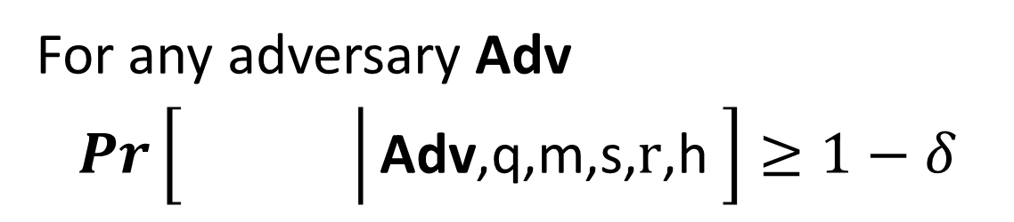
(q,,m,s,r,h)-Security
For any adversary Adv
$Pr\left[\left.\begin{matrix} & \\ & \end{matrix}\right|\text{Adv}\text{,}\text{q}\text{,}\text{m}\text{,}\text{s}\text{,} \text{r}\text{,}\text{h} \right]≥1−δ$
q = # offline guesses
s = # online guesses
r = #
h = #
m = # of accounts
Phishing Attack Accounts
Offline Attack Accounts

Slide 39
Example: (q,,m,3,1,1)-Security
h=1
+
PayPaul.com
q guesses
r=1
Notes:
User is safe as long as the adversary can’t execute more than one phishing/offline attack

Slide 40
Security Results
Attacks | r= 1 | r= 1 h=1 | r=2
Reuse | No | No | No | No
Strong Random Independent | Yes | Yes | Yes | Yes
Usable + Insecure
Unusable + Secure
(q_{$1,000,000},,m,3,r,h)-security
Notes:
First Column and Third Column:  = 10⁻⁶
Second Column:  = 10⁻²

Slide 41
Outline
Introduction and Experiments
Example Password Management Schemes
Quantifying Usability
Quantifying Security
Our Password Management Scheme

Slide 42
Usability Desiderata
Minimize #chunks per password
Cues to keep context consistent
Minimize Interference
Maximize Natural Rehearsal
What mnemonic techniques do the memory experts use?

Slide 43
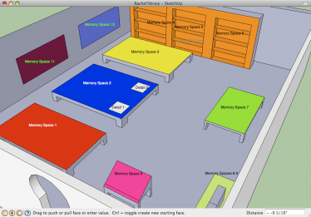
Memory Palace
Memory champions like Dominic O'Brien regularly use memory palaces
Notes:
Idea: A large fraction of the original cue should always be available. Just walk through the room!

Slide 44
Memory Palace
Idea: Humans have excellent visual/spatial memory
Memorize a list of words
  Memorize: Mentally walk through your house and “store” one word in each location
  Recall: Mentally walk past each location to recover each word
Key Point: By associating each word with a familiar location we can always recover part of the original cue
Source: Rhetorica ad Herennium [Cicero?]
Notes:
What mnemonic techniques do the memory champions use?

Slide 45
Memory Palace Interference?
Don’t reuse the same memory palace very often!
Memory Champions have hundreds of memory palaces!
  Spend time mentally “clearing” each palace before a competition
Usability: A typical user doesn’t have time to prepare hundreds of memory palaces!
Source: Moonwalking with Einstein [Foer, 2010]
Notes:
Memory champions also wear blinders when memorizing/retrieving to minimize interference!

Slide 46
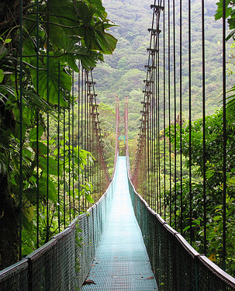

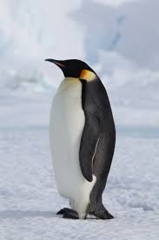
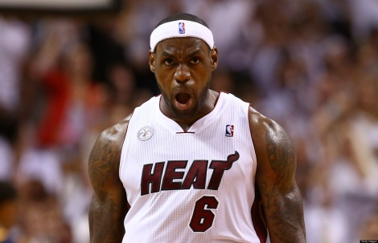
Our Approach
Public Cue
Private
Object: bike
Action: kicking
Object: penguin

Slide 47
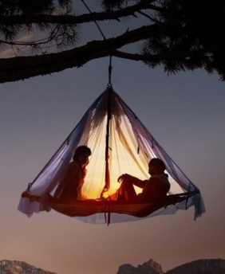
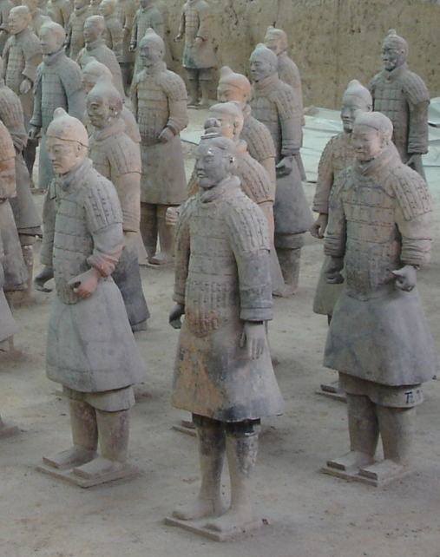

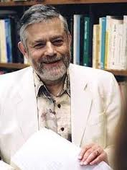
Login
…
Pwd
Kic+Pen + Tor + Lio + ...

Slide 48
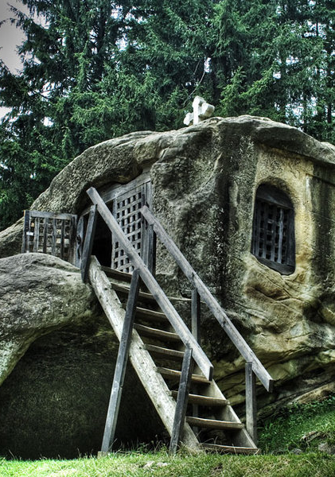
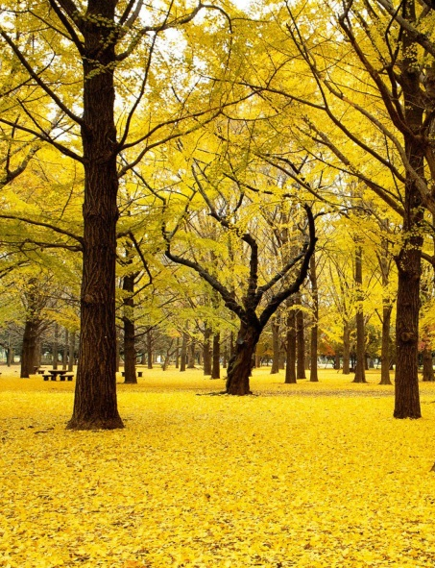
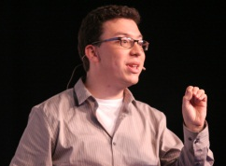
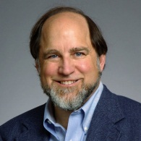
Login
…
Pwd
Kic+Pen + ….

Slide 49
Sharing Cues
Day: 1 2 4 5 8
Usability Advantages
  Fewer stories to remember!
  More Natural Rehearsals!
Security?

Slide 50
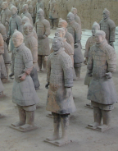



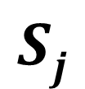



(n,l,)-Sharing Set Family
Definition: A (n,l,)-Sharing Set Family of size m is a family of sets {S₁,…,S_{m}} with the following properties
$∀i≠j, \left|Si\bigcap{Sj}\right|≤γ$
$∀i \left|Si\right|=l$
$\left|\bigcup_{i=1}^{m}{Si}\right|=n$
n
n
$$Sj$$
$$Si$$
$$l$$
$$γ$$
$$l$$

Slide 51

(n,l,)-Sharing Set Family
m – number of passwords {S₁,…,S_{m}}.
n – total #PAO stories
l – #PAO stories for
each site
$γ$– max intersection
$Si$ – PAO stories for
account i.
n
n
$$Sj$$
$$Si$$
$$l$$
$$γ$$
$$l$$

Slide 52
Security Results
Attacks | r= 1 | r= 1 h=1 | r=2
(n,4,4)-Sharing [Reuse] | No | No | No | No
(n,4,0)-Sharing [Independent] | Yes | Yes | Yes | Yes
(n,4,1)-Sharing [SC-1] | Yes | Yes | Yes | No
(n,4,3)-Sharing [SC-0] | Yes | No | Yes | No
(q_{$1,000,000},,m,3,r,h)-security
Notes:
First Column and Third Column:  = 10⁻⁶
Second Column:  = 10⁻²

Slide 53
Sharing Cues
Thm: There is a (43,4,1)-Sharing Set Family of size m=90, and a (9,4,3)-Sharing Set Family of size 126
Proof?
  Chinese Remainder Theorem!
  Notice that 43 = 9+10+11+13 where 9, 10, 11, 13 are pair wise coprime.
  A_{i} uses cues: {i mod 9, i mod 10, i mod 11, i mod 13}
Notes:
Divide cues into four sets: red, blue, green and purple.

Slide 54
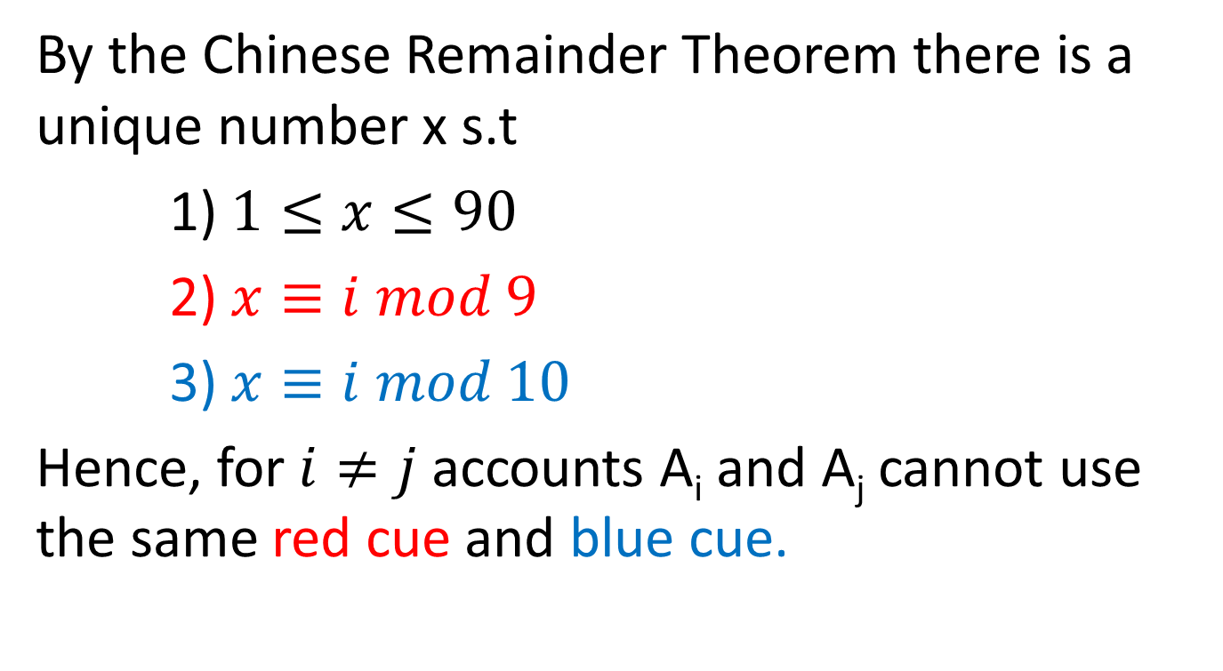
Chinese Remainder Theorem
By the Chinese Remainder Theorem there is a unique number x s.t
1) $1≤x≤90$
2) $x≡i mod 9$
3) $x≡i mod 10$
Hence, for $i≠j$ accounts A_{i} and A_{j} cannot use the same red cue and blue cue.
Notes:
Similar reasoning holds for green and purple cues.

Slide 55
Example (Account #80)
Red Set (9 Cues) | Blue Set (10 Cues) | Green Set (11 Cues) | Purple Set (13 Cues)
Cue 0 | Cue 0 | Cue 0 | Cue 0
Cue 1 | Cue 1 | Cue 1 | Cue 1
Cue 2 | Cue 2 | Cue 2 | Cue 2
Cue 3 | Cue 3 | Cue 3 | Cue 3
Cue 4 | Cue 4 | Cue 4 | Cue 4
Cue 5 | Cue 5 | Cue 5 | Cue 5
Cue 6 | Cue 6 | Cue 6 | Cue 6
Cue 7 | Cue 7 | Cue 7 | Cue 7
Cue 8 | Cue 8 | Cue 8 | Cue 8
 | Cue 9 | Cue 9 | Cue 9
 |  | Cue 10 | Cue 10
 |  |  | Cue 11
 |  |  | Cue 12

Slide 56
Example (Account #80)
Public Cue for Account 80
 | Cue 8 | Cue 0 | Cue 3 | Cue 2
Password 80 | Secret 8 | Secret 0 | Secret 3 | Secret 2

Slide 57
Usability Results
 | Reuse | Strong Random Independent | SC-1 | SC-0
Active | 0 | 420 | 3.93 | 0
Typical | 0 | 456.6 | 10.89 | 0
Occasional | 0 | 502.7 | 22.07 | 0
Infrequent | 1.2 | 564 | 119.77 | 2.44
E[X₃₆₅]: Extra Rehearsals to maintain all passwords over the first year.

Slide 58
Security Results
Attacks | r= 1 | r= 1 h=1 | r=2
(n,4,4)-Sharing [Reuse] | No | No | No | No
(n,4,0)-Sharing [Independent] | Yes | Yes | Yes | Yes
(n,4,1)-Sharing [SC-1] | Yes | Yes | Yes | No
(n,4,3)-Sharing [SC-0] | Yes | No | Yes | No
Usable + Insecure
Unusable + Secure
Usable + Secure
Usable + Secure
(q_{$1,000,000},,m,3,r,h)-security
Notes:
First Column and Third Column:  = 10⁻⁶
Second Column:  = 10⁻²

Slide 59
Experiment #0
Can anybody remember the 10 character password?
L~;z&K5De
Notes:
Pause 30 Seconds

Slide 60
Memory Experiment 1

Slide 61
Memory Experiment 2

Slide 62

Thanks for Listening!

Slide 63
Backup Slides

Slide 64
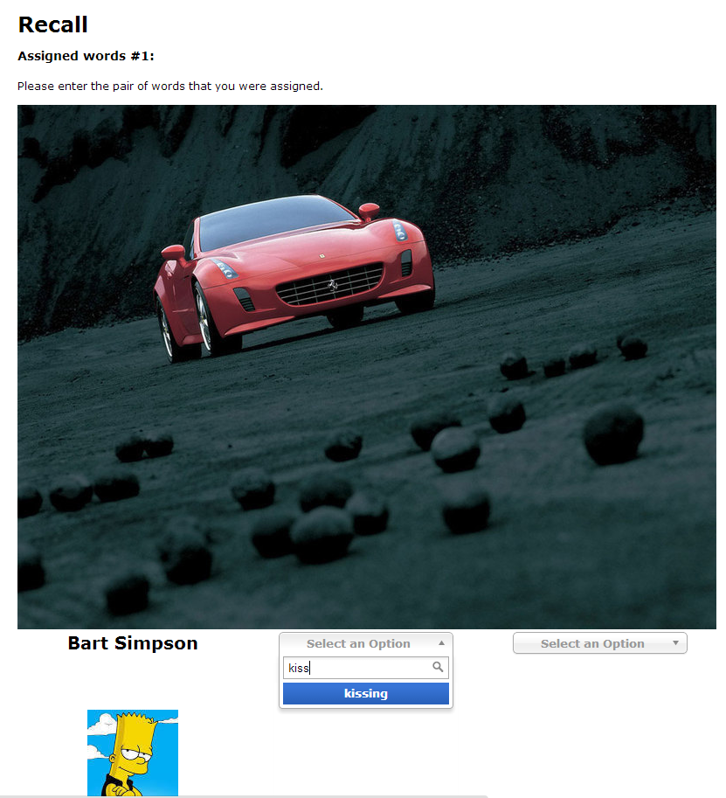
User Study
Validity of Expanding Rehearsal Assumption
Mnemonic Devices and Rehearsal Schedules
Collaborate with CyLab Usable Privacy and Security group (CUPS)

Slide 65

User Study Protocol
Memorization Phase (5 minutes):
  Participants asked to memorize four randomly selected person-action object stories.
Rehearsal Phase (90 days):
  Participants periodically asked to return and rehearse their stories (following rehearsal schedule)
Notes:
Mnemonic Group/Non Mnemonic Group
We will test several different rehearsal schedules
Long term memory study

Slide 66
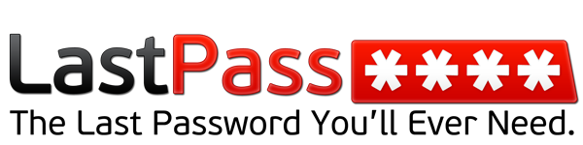
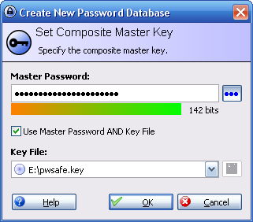
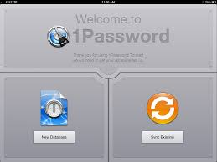
Password Managers?
Notes:
LastPass
KeePass
1Password

Slide 67
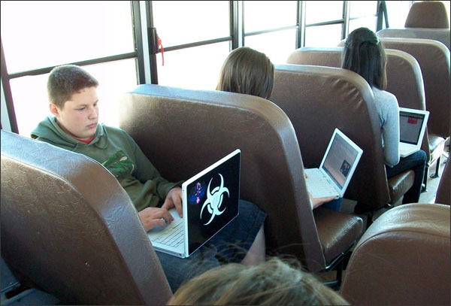
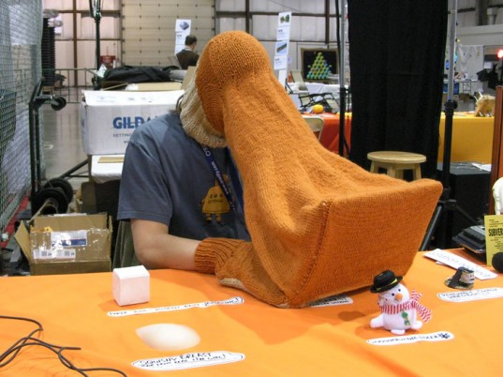
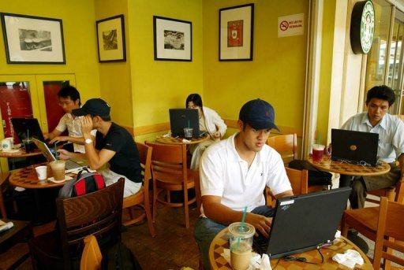
Limited Protection

Slide 68
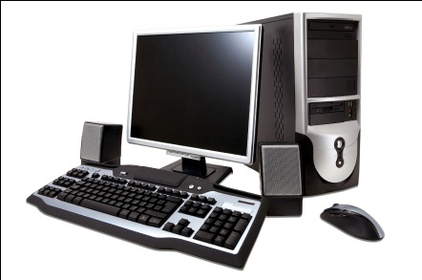





Limited Protection

