Slide 1
Towards Usable Human Authentication
Jeremiah Blocki
MSR
Heidelberg Laureate Forum 2015

Slide 2

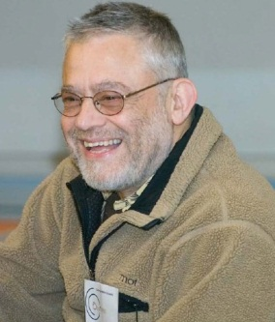
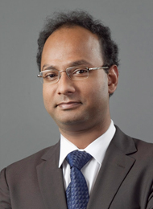

About Me
Past: Carnegie Mellon University
Fall 2015: MSR New England
Fall 2016: Purdue

Slide 3







Password Management
p₁
p₂
p₃
p₄
p₅
…
p₅
PayPaul.com
Competing Goals:
Security
Usability

Slide 4
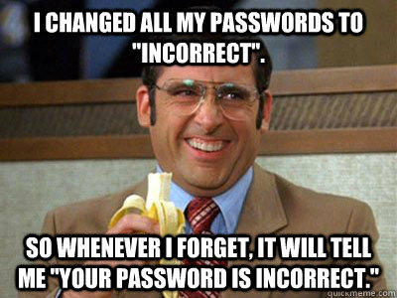
Security
Attacks |  |  |  | …
Reuse | No | No | No | No
Independent | Yes | Yes | Yes | Yes
Usable + Insecure
Unusable + Secure
Notes:
First Column and Third Column:  = 10⁻⁶
Second Column:  = 10⁻²

Slide 5
Related Results
Security
Human Computable Passwords
Shared Cues
Independent Strong Passwords
Reuse Passwords
User Effort
Notes:
Before we continue let me give you a brief preview of what is coming. I will present quantitative models for evaluating the security and usability of password management schemes, and use these models to develop schemes that balance security and usability. The first scheme we describe is Shared Cues. This scheme offers reasonably strong security guarantees and requires minimal user effort. The second scheme we describe requires more effort on the part of the user, but the security guarantees are very strong. A user who memorizes independent high entropy passwords for each of his accounts will also achieve very strong security guarantees, but as we will see this strategy requires an unrealistic amount of memorization effort.

Slide 6

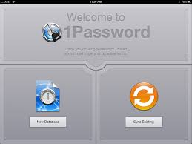
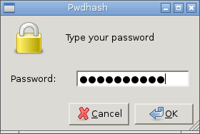
Password Managers
Notes:
LastPass
KeePass
1Password

Slide 7
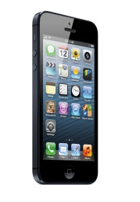
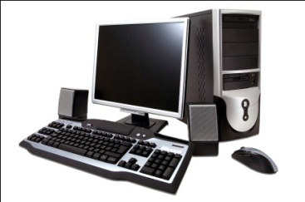
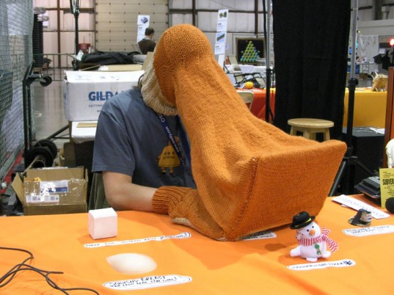
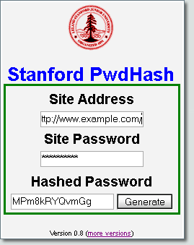



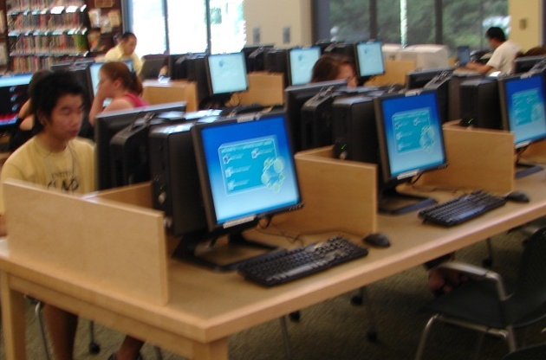
Password Managers
Goal: Minimize Trust Assumptions about User’s
Computational Devices
Password Management Software
Notes:
LastPass
KeePass
1Password
A Usability Study and Critique of Two Password Managers ∗
by S Chiasson, PC van Oorschot, R Biddle
PwdHash
Blake Ross, Collin Jackson, Nicholas Miyake, Dan Boneh and John C. Mitchell

Slide 8



Trusted Computer Assumption?

Slide 9
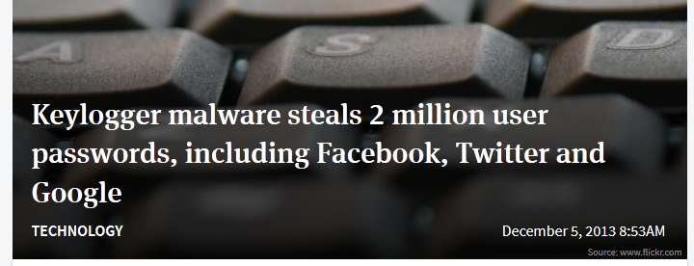
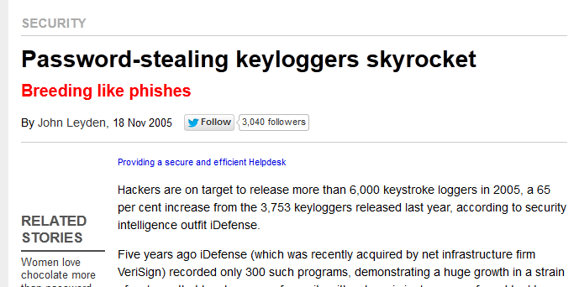
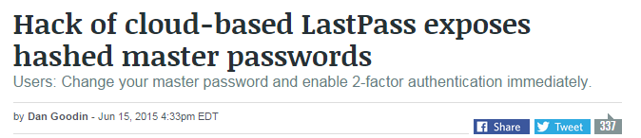
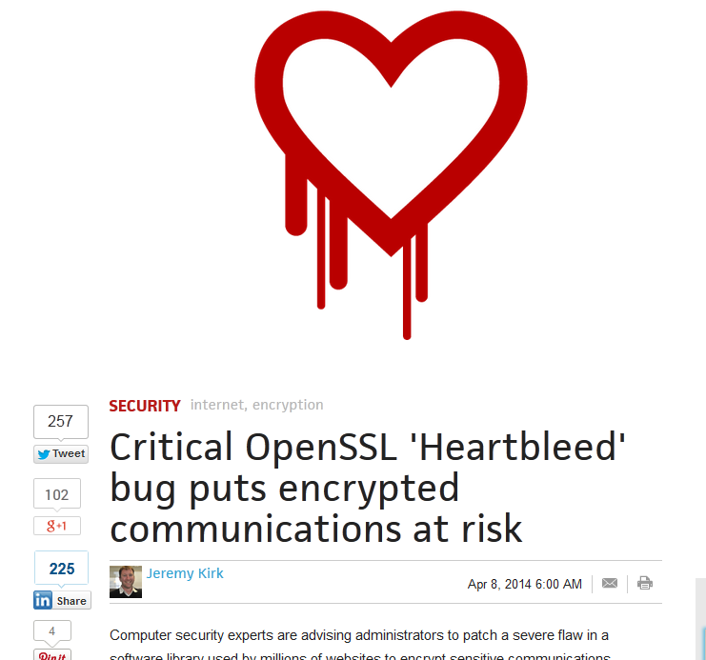
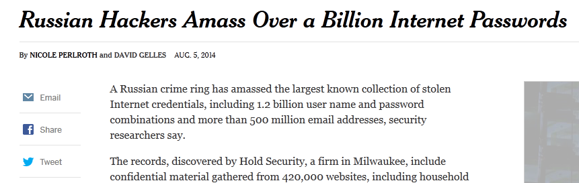
Valid Trust Assumption?
Notes:
Password management scheme is any strategy used to create and remember multiple passwords for multiple accounts.
Increased challenge security/usability analysis should look at the problem wholelistically
Position: This is not the user’s fault!
We want a management scheme which is
1. Easy for the user to manage
2. Secure (hard for adversary to compromise accounts)

Slide 10
Our Scheme: Human Computable Passwords
Passwords computed by responding to public challenges
  Computation done in user’s head
Remains secure many breaches (e.g., 100)
Simple Operations
  Addition modulo 10
  Memorize a random mapping
Notes:
This is where our work comes in. We present a scheme that remains secure even after many breaches (e.g., 100). In light of the recent SSL bug this is a highly desirable security property. In our scheme the user memorizes a short secret which is used to compute all of his different passwords. We stress that all of the computation is done inside the user’s head. Because computations are done in the user’s head we only consider a very restricted set of operations: addition modulo 10 and memorizing the secret random mapping.

Slide 11



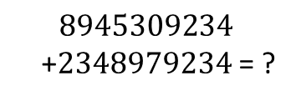

Human Computation
Restricted
  Simple operations (addition, lookup)
  Operations performed in memory (limited space)
$$8945309234$$
+2348979234 = ?
$$9+8=7 mod 10$$
Notes:
In our scheme the user to perform complicated cryptographic operations. In fact, we will not even ask the user to add large numbers. Our scheme is very simple. In fact, in the next minute I can show you exactly how the user computes his passwords.

Slide 12
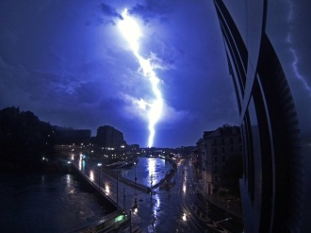
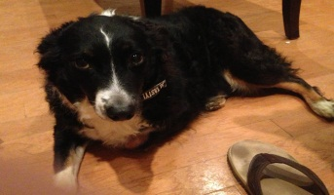
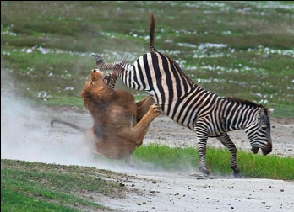
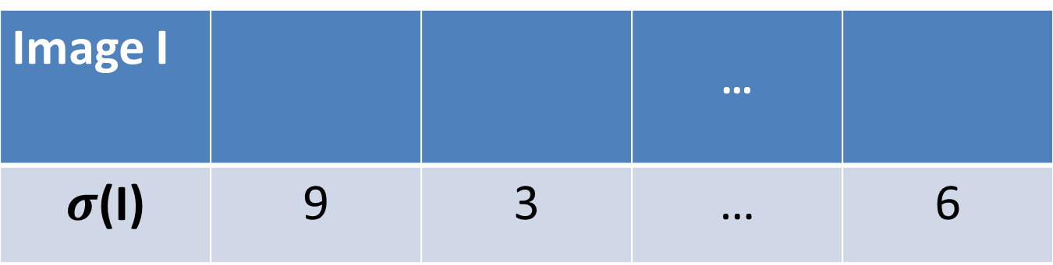
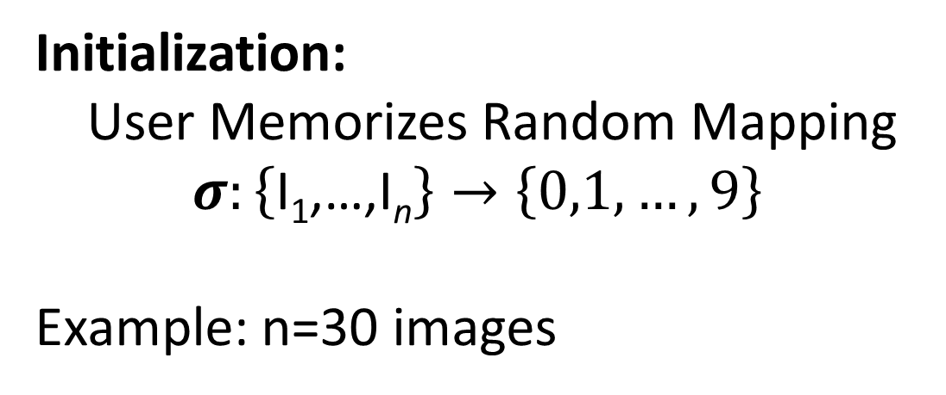
Random Mapping
Image I |  |  | …
$σ$(I) | 9 | 3 | … | 6
Initialization:
User Memorizes Random Mapping
$$σ:\left\{\text{I}\text{1}\text{,…,}\text{I}\text{n}\right\}→\left\{0,1,…,9\right\}$$
Example: n=30 images
Notes:
To begin using our scheme the user first memorizes a secret mapping from pictures to digits. For example, the user must remember that picture of the lightening bolt maps to 9 and the picture of the dog maps to 3. Once the user has memorized this mapping he can compute hundreds of secure passwords by responding to single digit challenges.

Slide 13
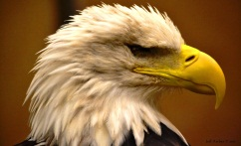
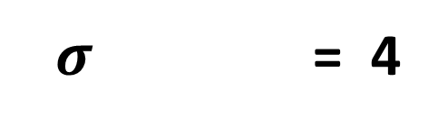
Mnemonics
$σ$ = 4
Instruction: Remember that the eagle has a gold beak. There are four letters in “gold” and “beak”.

Slide 14
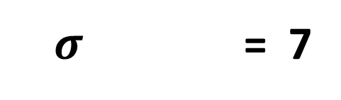
Mnemonics
$σ$ = 7
Instruction: Trace the eagles body from the bottom of the eagle’s beak down to the bottom of the picture. It looks like the number 7.

Slide 15
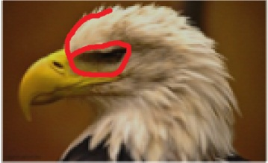
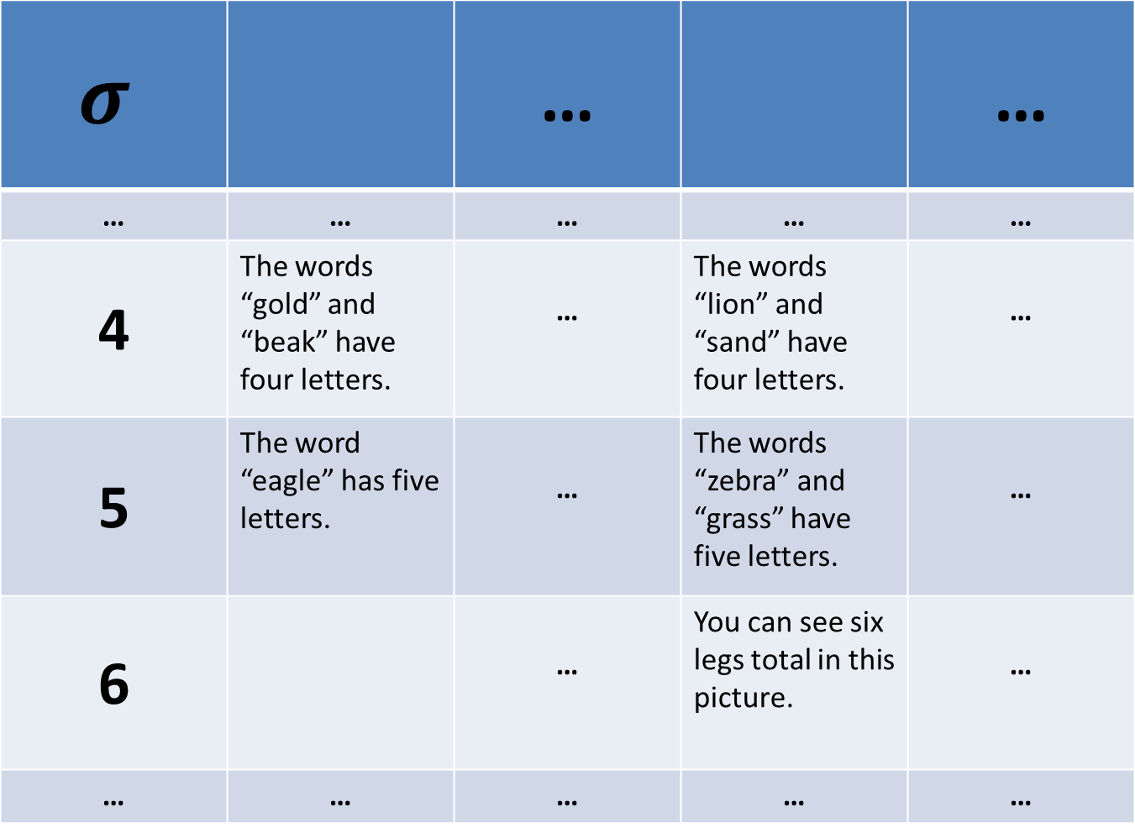
$$σ$$ |  | … |  | …
… | … | … | … | …
4 | The words “gold” and “beak” have four letters. | … | The words “lion” and “sand” have four letters. | …
5 | The word “eagle” has five letters. | … | The words “zebra” and “grass” have five letters. | …
6 |  | … | You can see six legs total in this picture. | …
… | … | … | … | …

Slide 16
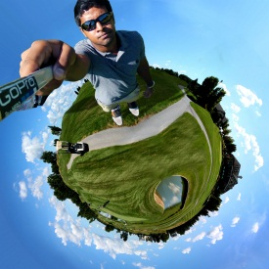
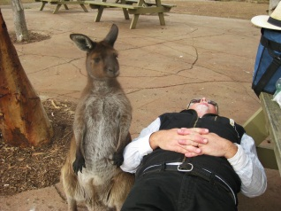
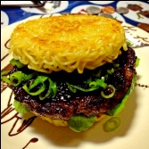

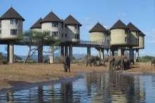


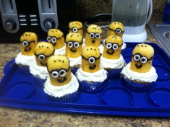
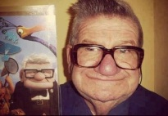
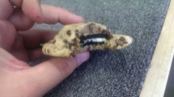
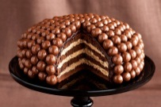


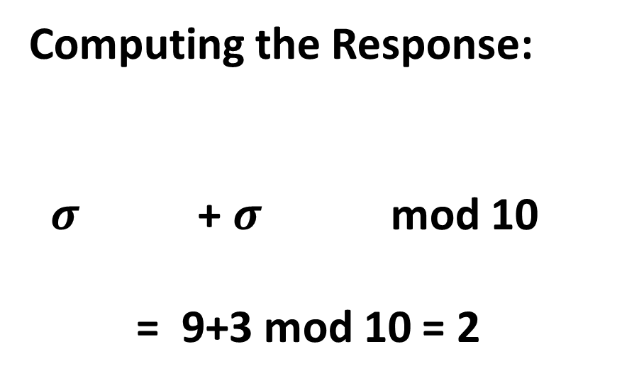
Single-Digit Challenge
0
1
2
3
4
5
6
7
8
9
Computing the Response:
$σ$ + $σ$ mod 10
= 9+3 mod 10 = 2
Notes:
A single-digit challenge is a list of 14 pictures displayed as follows. The pictures are divided into two groups. The four larger pictures on top and the lookup table with 10 images on the bottom. To compute the response to a single digit challenge the user takes the first two pictures, adds them together to compute an index. In this example, 9+3 is 2 mod 10. (next slide)

Slide 17
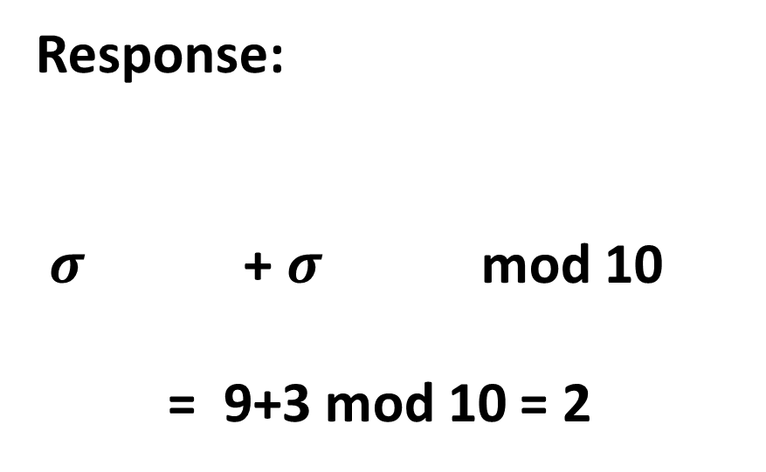
Single-Digit Challenge
0
1
2
3
4
5
6
7
8
9
Response:
$σ$ + $σ$ mod 10
= 9+3 mod 10 = 2
Notes:
The user now looks up the second picture in the table

Slide 18
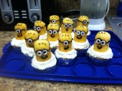
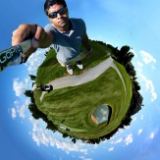
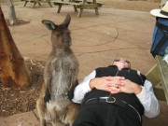
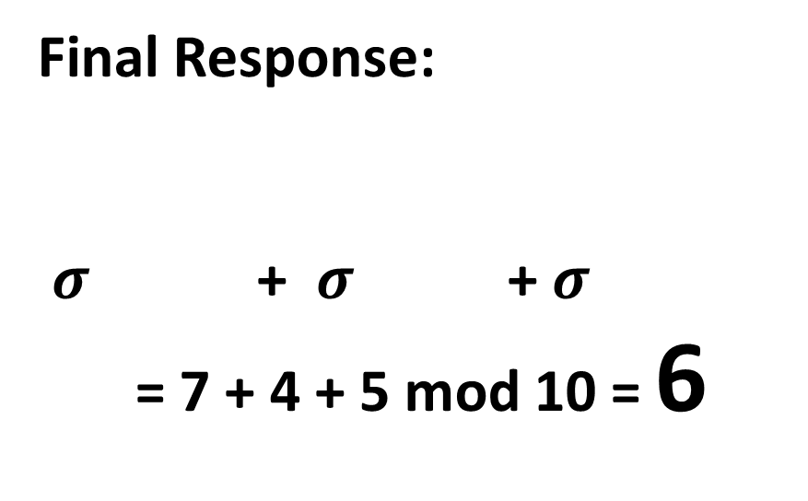
Single-Digit Challenge
0
1
2
3
4
5
6
7
8
9
Final Response:
$σ$ + $σ$ + $σ$
= 7 + 4 + 5 mod 10 = 6
Notes:
And adds this picture to the remaining to pictures to get the final answer 6.

Slide 19
Passwords
0
1
2
3
4
5
6
7
8
9
Username:
jblocki
Password:
Notes:
Each password is computed by responding to several single-digit challenges. When the user types in the response to the first challenge then the second challenge is displayed.

Slide 20
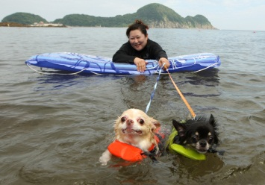
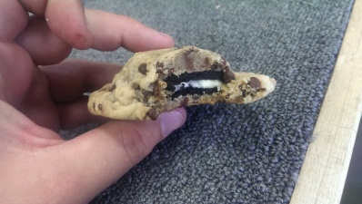
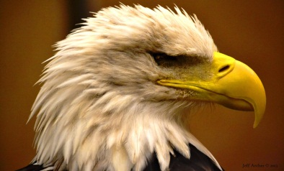
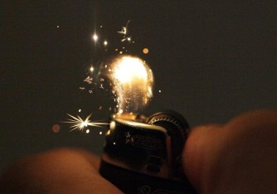
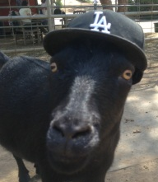
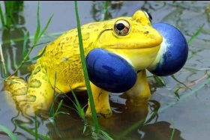






Passwords
0
1
2
3
4
5
6
7
8
9
Username:
jblocki
Password:
*

Slide 21

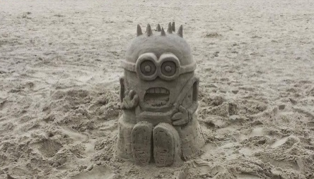




Passwords
0
1
2
3
4
5
6
7
8
9
Username:
jblocki
Password:
**

Slide 22
Usability
My Authentication Time:
7.5 seconds/digit
30 seconds for a 4-digit password
1.25 minutes for a 10-digit password
Memorizing the Secret Mapping:
Memorized 100 image/digit pairs in 2.5 hours
One Time Cost
  Spaced Rehearsal Model Prediction

Slide 23
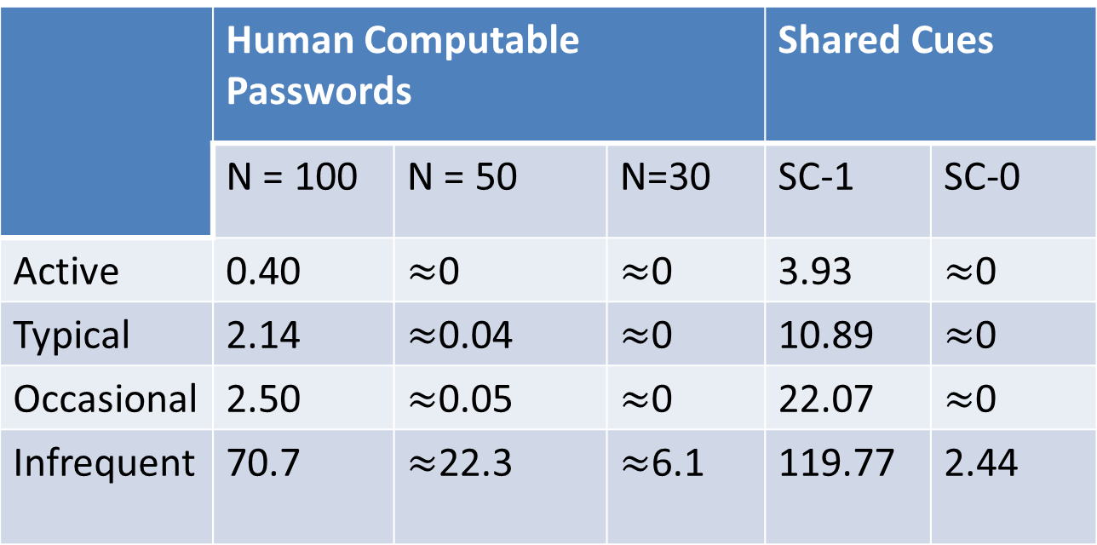
Usability (Memorization)
 | Human Computable Passwords |  |  | Shared Cues
 | N = 100 | N = 50 | N=30 | SC-1 | SC-0
Active | 0.40 | $≈$0 | $≈$0 | 3.93 | $≈$0
Typical | 2.14 | $≈$0.04 | $≈$0 | 10.89 | $≈$0
Occasional | 2.50 | $≈$0.05 | $≈$0 | 22.07 | $≈$0
Infrequent | 70.7 | $≈$22.3 | $≈$6.1 | 119.77 | 2.44
E[X₃₆₅]: Extra Rehearsals to maintain all passwords over the first year.

Slide 24
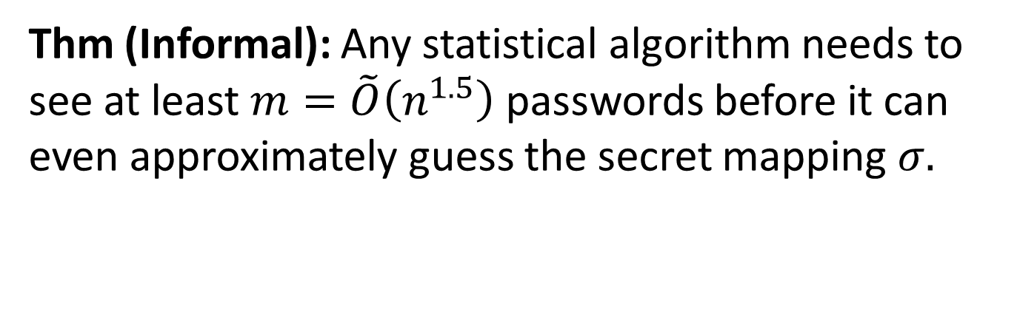
Security
Thm (Informal): Any statistical algorithm needs to see at least $m=\tilde{O}\left(n^{1.5}\right)$ passwords before it can even approximately guess the secret mapping $σ.$
Example: n=30 images
Notes:
We prove that our scheme is secure against the class of statistical adversaries who can see fewer than n^1.5 examples. Our results are significant because most known algorithmic techniques fit within this framework. Guassian elimination is a notable exception, but we also rule out attacks based on Gaussian elimination. While our scheme is simple the analysis is complex. We use generalized hypercontractivity bounds with the fourier decomposition of our function to lower bound the statistical dimension of our induced distribution over challenge response pairs.

Slide 25
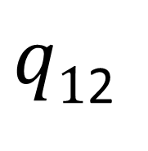






Statistical Algorithm
$$q$$
…
$$q1$$
$q$₂
$q$_{L}
…
…
$$q11$$
$q1$₂
$$q1L$$
…
Notes:
We can think of a statistical algorithm as a tree. Each node of the tree contains a query.

Slide 26



Statistical Algorithm
$$q$$
Response: 6
1
$L=n$^{1.5}
…
2
Notes:
Each query is simply a function that takes as input a randomly chosen challenge response pair and tells us which edge to take.

Slide 27






Statistical Algorithm
$$q$$
Response: 6
1
L
2
…
$$q2$$
…
$$qL$$
$$q1$$
Response: 3

Slide 28







Statistical Algorithm
$$q$$
…
$q$_{L}
$$q1$$
$q$₂
…
…
$$q11$$
$q1$₂
$$q1L$$
…
Guess $σ$
Notes:
We want to prove that this tree must either be deep or the guess is not even close to the real mapping with high probability.

Slide 29
Security
Thm (Informal): Any statistical algorithm needs to see at least $m=\tilde{O}\left(n^{1.5}\right)$ passwords before it can even approximately guess the secret mapping $σ.$
Almost all known algorithmic techniques
Spectral Methods
Local Search
Expectation Maximization
First and Second Order Methods for Convex Optimization
Gaussian Elimination
Example: n=30 images
Notes:
We prove that our scheme is secure against the class of statistical adversaries who can see fewer than n^1.5 examples. Our results are significant because most known algorithmic techniques fit within this framework. Guassian elimination is a notable exception, but we also rule out attacks based on Gaussian elimination. While our scheme is simple the analysis is complex. We use generalized hypercontractivity bounds with the fourier decomposition of our function to lower bound the statistical dimension of our induced distribution over challenge response pairs.

Slide 30


Security
Thm (Informal): Any statistical algorithm needs to see at least $m=\tilde{O}\left(n^{1.5}\right)$ passwords before it can even approximately guess the secret mapping $σ.$
Thm (Informal): Any polynomial time adversary needs to see $m=\tilde{O}\left(n^{3}\right)$ passwords before he can use Gaussian Elimination to approximately guess the secret mapping $σ.$
Thm (Informal): Any polynomial time adversary who can guess the user’s passwords with accuracy much better than random guessing can also approximately recover the secret mapping $σ.$
Notes:
We prove that our scheme is secure against the class of statistical adversaries who can see fewer than n^1.5 examples. Our results are significant because most known algorithmic techniques fit within this framework. Guassian elimination is a notable exception, but we also rule out attacks based on Gaussian elimination. While our scheme is simple the analysis is complex. We use generalized hypercontractivity bounds with the fourier decomposition of our function to lower bound the statistical dimension of our induced distribution over challenge response pairs.

Slide 31

Technical Tools
Discrimination Norm
  On average how much different would the answers to a query q be if we picked a random challenge and a random response?
  Small discrimination norm => Statistical Algorithm must use deep tree. [FPV13]
Fourier Analysis
  Express discrimination norm as a low degree function
Generalized Hypercontractivity Theorem
  Bounds the expected value of low degree functions

Slide 32

Challenge: Break Our Scheme
Goal: Guess one of the user’s secret ten-digit passwords
Given: One-hundred of the user’s other ten-digit passwords.
http://www.cs.cmu.edu/~jblocki/HumanComputablePasswordsChallenge/challenge.htm
Paper: http://arxiv.org/abs/1404.0024
Notes:
The challenges can be found on my webpage along with the paper itself. In first challenge we first give you the responses to 1000 single-digit challenges or 100 ten-digit passwords. Your goal is to guess one of the user’s other passwords. I presented this challenge at two conferences: ASIACRYPT and Oakland. So far nobody has broken any of the passwords.

Slide 33

Visual Cryptography

Slide 34




Memory Experiment 1
Person | Bill Clinton
Action | Tickling
Object | Peach
Notes:
One of the authentication schemes I will present involves having users memorize randomly generated person-action-object stories. To start off I am going to ask you to memorize a few random person-action-object. For the first story I want you to imagine Bill Clinton standing on the beach tickling a peach. I want you to really imagine it. Okay, so that is Bill Clinton tickling a peach.

Slide 35




Memory Experiment 2
Person | Michelle Obama
Action | Bouncing
Object | Smore
Notes:
Next I want you to imagine Michelle Obama bounding a smore on top of the jet.
Person: Michelle Obama
Action: Bouncing
Object: Smore

Slide 36


Password Management
p₁
p₂
p₃
p₄
p₅
Security
Usability
Notes:
Let’s start of by defining the problem we will be looking at in this talk: password management. A typical user has to create and remember passwords for many different accounts. A password management scheme is any user strategy to create and remember passwords for multiple accounts. We will focus on user strategies because we want to make minimal trust assumptions about the authentication servers as well as any of the user’s computational devices. Our goal is to find a password management scheme that is usable and secure. Informally, usability means that the user doesn’t rip his hair out trying to remember all of his passwords and security means that the user doesn’t want the adversary to break into his accounts.

Slide 37









Security Problem
Password breaches at major companies have affected millions of users.
Notes:
Password security is not merely a theoretical issue. In the past few years we have seem password breaches at major organizations. Shown here is an incomplete wall of shame. These password breaches have affected millions of users.
Unfortunately, offline dictionary attacks are quite common. Here is an incomplete wall of shame. There have been major password breaches at all of these companies. Looking through the list we can see that these are major companies that have been breached. These breaches have affected millions of users.

Slide 38


Traditional Security Advice
Use numbers and letters
Use special symbols
Don’t Reuse Passwords
Don’t use words/names
Not too short
Don’t Write it Down
Use mix of lower/upper case letters
Change your passwords every 90 days
Notes:
In response to breaches like these users get many suggestions about ways to make their passwords secure. Traditionally, the advice a user gets is something like the following…
Is it time to re-evaluate the traditional security advice?

Slide 39


Usability Problem
Notes:
This brings me to my second point. We have a problem with usabilty. Users struggle to remember their passwords. The popularity of memes like these indicate that this is a common user experience.

Slide 40
Fundamental Question
How can we evaluate password management strategies?
  Quantify Usability
  Quantify Security
Notes:
Before we can design good password management schemes we need to address two fundamental questions. How can we quantify usability? How can we quantify security? Quantifying usability is the more challenging task because our understanding of human cognition is still incomplete. Ultimately, the goal is to develop quantitative models that can guide the development of good password management schemes.

Slide 41
Outline
Introduction
  Motivation
  My Approach
Usability and Security Models
Shared Cues
Conclusion and Future Vision
Notes:
Let me start off by giving you a brief overview of the talk. I will start by motivating the problem of password management, describing some common attacks on passwords and talking about my approach to addressing this problem. Next, I will present two of our solutions. I will conclude by discussing related work and my future research vision.

Slide 42


Insufficient Approach
Propose New Password
Management Scheme
User Study: Evaluate New
Password Management Scheme
Notes:
The traditional approach in usable security is to propose a new scheme and then conduct a large scale user study to evaluate usability. While I do believe that user studies are tremendously helpful I would also argue that user studies alone are insufficient. To properly evaluate a password management scheme a user study would have to track multiple users success at remember multiple passwords over an extended period of time. This process would be expensive and slow.
Before I describe my approach to quantifying usability. Let me first describe an approach that I believe is naïve. Propose a password management scheme, conduct a large user study to evaluate the password management scheme, modify the password management scheme based on these results and repeat.
The challenges are that the user studies would necessarily be slow and expensive. We would need to track each users success at remembering multiple passwords over an extended period of time.

Slide 43
Our Thesis
User models and security models can guide the development of human authentication schemes with analyzable usability and security properties.
Develop + Analyze
User Model
Security Model

Slide 44


My Approach: User Models
User Model
Capabilities + Behavior
Example Capability: Users can remember a random secret with enough rehearsal.
Example Behavior: How often a user visits each website on average.
Notes:
In a nutshell, my philosophy is that it is critical to develop good user models. A user model describes the users capabilities and behaviors. For example, a capability might say that a user can remember a PAO story if they get sufficient rehearsal. An a behavior might describe how often a user rehearses each of his passwords by logging into different websites.

Slide 45
My Approach: User Models
User Model
Capabilities + Behavior
Fast: Evaluation does not require expensive user studies
Robust: Can be used to analyze broad class of password management schemes
Prior Cognitive Science Studies
User Studies
Develop + Analyze
User Model
Empirical Validation
Notes:
We want to develop user model’s that are robust enough to analyze a wide class of password management schemes. Once we have such a model the development process becomes much faster. We can analyze a new password management scheme without conducting a large user study. Of course it is important to develop password management schemes that are well grounded.

Slide 46
Outline
Introduction
Usability and Security Models
  Example Password Management Schemes
  Usability Model
  Security Model
Shared Cues
Human Computable Passwords
Conclusion and Future Vision
Notes:
Before I present our usability and security models I will briefly present two simple password management schemes that we will use as illustrative examples in our analysis.

Slide 47
Scheme 1: Reuse Strong Password
Pick four random words w₁,w₂,w₃,w₄
Account | Amazon | Ebay
Password | w₁w₂w₃w₄ | w₁w₂w₃w₄
Notes:
In our first example scheme the user selects for words at random from a dictionary and appends them together to form a password. This is the users password at Amazon, Ebay and every other account that the user will ever create.

Slide 48
Scheme 2: Strong Random Independent
Four Independent Random Words per Account
Account | Amazon | Ebay
Password | w₁w₂w₃w₄ | x₁x₂x₃x₄
Notes:
In our second example scheme the user selects a different set of four words for each account. Thus, the user’s eBay password is completely independent from the user’s Amazon password.
Intuitively, this scheme seems like it would be difficult to follow, while the last scheme seems insecure. Can we formalize these intuitions?

Slide 49
Outline
Introduction
Usability and Security Models
  Example Password Management Schemes
  Usability Model
  Security Model
Shared Cues
Conclusion and Future Vision
Notes:
Let me start off by giving you a brief overview of the talk. I will start by motivating the problem of password management, describing some common attacks on passwords and talking about my approach to addressing this problem. Next, I will present two of our solutions. I will conclude by discussing related work and my future research vision.

Slide 50
First Attempt: Chunking
Memorize: nbccbsabc
Memorize: tkqizrlwp
3 Chunks vs. 9 Chunks!
Usability Goal: Minimize Number of Chunks in Passwords
Incomplete
Source: The magical number seven, plus or minus two [Miller, 56]
Notes:
If all we care about is usability one good goal is minimizing number of chunks in the password

Slide 51


Human Memory: Vast, but Lossy
Rehearse or Forget!
  How much work?
Quantify Usability
  Rehearsal Assumption
p_{amazon}
????
p_{google}
Notes:
While our memory is vast, but we tend to forget things. This is what makes the password management problem challenging. Our basic premise is that we our capable of remembering secrets if we get sufficient rehearsal. We seek to quantify usability by estimating how much extra work this takes.

Slide 52
Memory Capability
Day: 1 2 4 5 8
Expanding Rehearsal Assumption: user maintains cue-association pair by rehearsing during each interval [s^{i}, s^{i+1}].
Source: Optimization of Repetition Spacing in the Practice of Learning [WG, 94]
Notes:
Our user model is based on a memory capability. This capability states that a user can remember a secret if he rehearses the secret once during each of the following intervals. We call this rehearsal assumption the expanding rehearsal assumption because the intervals grow over time. Intuitively, it is easier to remember a secret if you have rehearsed several times in the past. The parameter s can account for factors like the strength of the mnemonic techniques used to memorize the secret.
This assumption was based on previous empirical results on spaced repetition, which indicate that participants were successfully able to remember vocabulary words when they followed similar rehearsal schedules. In our own user study we found that users were able to remember PAO stories by following this schedule over 157 days. Users were most successful with s = 1.5.
A user might naturally satisfy some of these rehearsal requirements if he has to remember a secret to authenticate. Suppose that we remind a user to rehearse a secret whenever he doesn’t get natural practice during an interval.
Observe that if the user reuses his password then all cues are rehearsal requirements are satisfied naturally. If the passwords are completely independent then X_{8.}
_{Sources:}
Wozniak, P., and Gorzelanczyk, E. J. Optimization of repetition spacing in
the practice of learning. Acta neurobiologiae experimentalis 54 (1994), 59–59.
Algorithm behind SuperMemo
Anderson, J. R., and Schooler, L. J. Reflections of the environment in memory.
Psychological science 2, 6 (1991), 396–408.

Slide 53

Memory Capability
Day
0
50
100
150
Succeeded(i)/Returned(i)
Source: Spaced Repetition and Mnemonics Enable Recall of Multiple Strong Passwords [BKCD15]
Notes:
Our user model is based on a memory capability. This capability states that a user can remember a secret if he rehearses the secret once during each of the following intervals. We call this rehearsal assumption the expanding rehearsal assumption because the intervals grow over time. Intuitively, it is easier to remember a secret if you have rehearsed several times in the past. The parameter s can account for factors like the strength of the mnemonic techniques used to memorize the secret.
This assumption was based on previous empirical results on spaced repetition, which indicate that participants were successfully able to remember vocabulary words when they followed similar rehearsal schedules. In our own user study we found that users were able to remember four PAO stories by following this schedule over 157 days. Users were most successful with s = 1.5.
A user might naturally satisfy some of these rehearsal requirements if he has to remember a secret to authenticate. Suppose that we remind a user to rehearse a secret whenever he doesn’t get natural practice during an interval.
Observe that if the user reuses his password then all cues are rehearsal requirements are satisfied naturally. If the passwords are completely independent then X_{8.}
_{Sources:}
Wozniak, P., and Gorzelanczyk, E. J. Optimization of repetition spacing in
the practice of learning. Acta neurobiologiae experimentalis 54 (1994), 59–59.
Algorithm behind SuperMemo
Anderson, J. R., and Schooler, L. J. Reflections of the environment in memory.
Psychological science 2, 6 (1991), 396–408.

Slide 54
Natural Rehearsal
Day: 1 2 4 5 8
Expanding Rehearsal Assumption: user maintains cue-association pair by rehearsing during each interval [s^{i}, s^{i+1}].
Visit Amazon: Natural Rehearsal
Google
X_{t}: extra rehearsals to maintain all passwords for t days.
Source: Optimization of Repetition Spacing in the Practice of Learning [WG, 94]
Notes:
Our user model is based on a memory capability. This capability states that a user can remember a secret if he rehearses the secret once during each of the following intervals. We call this rehearsal assumption the expanding rehearsal assumption because the intervals grow over time. Intuiively, it is easier to remember a secret if you have rehearsed several times in the past. The parameter s can account for factors like the strength of the mnemonic techniques used to memorize the secret.
This assumption was based on previous empirical results on spaced repetition, which indicate that participants were successfully able to remember vocabulary words when they followed similar rehearsal schedules. In our own user study we found that users were able to remember PAO stories by following this schedule over 157 days. Users were most successful with s = 1.5.
A user might naturally satisfy some of these rehearsal requirements if he has to remember a secret to authenticate. Suppose that we remind a user to rehearse a secret whenever he doesn’t get natural practice during an interval.
Observe that if the user reuses his password then all cues are rehearsal requirements are satisfied naturally. If the passwords are completely independent then X_{8.}
_{Sources:}
Wozniak, P., and Gorzelanczyk, E. J. Optimization of repetition spacing in
the practice of learning. Acta neurobiologiae experimentalis 54 (1994), 59–59.
Algorithm behind SuperMemo
Anderson, J. R., and Schooler, L. J. Reflections of the environment in memory.
Psychological science 2, 6 (1991), 396–408.

Slide 55
Extra Rehearsals
Day: 1 2 4 5 8
X_{t}: extra rehearsals to maintain all passwords for t days.
 | Reuse Password | Independent Passwords
X₈ | 0 | 2
Usability Measure: X_{t}
Usability Goal: Minimize X_{t}
Notes:
Observe that if the user reuses his password then all cues are rehearsal requirements are satisfied naturally. If the passwords are completely independent then X₈
Our usability goal is to minimize the total amount of extra work that the user needs to do.

Slide 56


Visitation Schedule
Poisson Arrival Process with parameter 𝞴
Cue shared by Amazon and Google
$\text{λ}\text{=}\text{λ}$+ 𝞴
t₁
t₂
t₂
$$\text{E}\left[t2−t1\right]=1/{\text{λ} }$$

Slide 57
Visitation Profiles
User | 𝞴=1 (daily) | 𝞴=1/3 (biweekly) | 𝞴=1/7 (weekly) | 𝞴=1/31 (monthly) | 𝞴=1/365 (annual)
Active | 10 | 10 | 10 | 10 | 35
Typical | 5 | 10 | 10 | 10 | 40
Occasional | 2 | 10 | 20 | 20 | 23
Infrequent | 0 | 2 | 5 | 10 | 58
Number of accounts visited with frequency 𝞴

Slide 58
Usability Results
 | Reuse Strong | Strong Random Independent
Active | 0.002 | 2,938
Typical | 0.023 | 2,974
Occasional | 0.109 | 3,135
Infrequent | 3.239 | 4,024
E[X$∞$]: Extra Rehearsals to maintain all passwords over lifetime.
m = 75 accounts, s=1.5
Usable
Unusable
Notes:
Our usability model explains why it is so hard to memorize independent passwords.
We developed several different types of user profiles. Each user has 75 accounts. The active user visits many of his accounts regularly, while the infrequent user rarely visits his accounts. If we reuse passwords then essentially we never need rehearsal reminders. If we pick independent passwords then we need thousands of rehearsal reminders. To make matters worse thousands of these rehearsal reminders come in the first week!

Slide 59
Outline
Introduction
Usability and Security Models
  Example Password Management Schemes
  Usability Model
  Security Model
Shared Cues
Future Directions
Notes:
Let me start off by giving you a brief overview of the talk. I will start by motivating the problem of password management, describing some common attacks on passwords and talking about my approach to addressing this problem. Next, I will present two of our solutions. I will conclude by discussing related work and my future research vision.

Slide 60




Security as a Game
p₁
p₂
p₃
p₄
p₅
BCRYPT(p₄)
p₅
PayPaul.com
q guesses
+

Slide 61


(q,$δ$,m,s,r,h)-Security
For any adversary Adv
$Pr\left[\left.\begin{matrix} & \\ & \end{matrix}\right|\text{Adv}\text{,}\text{q}\text{,}\text{m}\text{,}\text{s}\text{,} \text{r}\text{,}\text{h} \right]≤δ$
q = # offline guesses
s = # online guesses
r = #
h = #
m = # of accounts
Plaintext Recovery Accounts
Offline Attack Accounts
Notes:
We are interested in understanding how many offline/phishing attacks our scheme can withstand

Slide 62

Security Results
Attacks | r= 1 | r= 1 h=1 | r=2
Reuse | No | No | No | No
Strong Random Independent | Yes | Yes | Yes | Yes
Usable + Insecure
Unusable + Secure
(10¹⁰,$δ$,m,3,r,h)-security
Notes:
First Column and Third Column:  = 10⁻⁶
Second Column:  = 10⁻²

Slide 63
Outline
Introduction
Usability and Security Models
Shared Cues
Future Directions
Notes:
Let me start off by giving you a brief overview of the talk. I will start by motivating the problem of password management, describing some common attacks on passwords and talking about my approach to addressing this problem. Next, I will present two of our solutions. I will conclude by discussing related work and my future research vision.

Slide 64




Our Approach
Public Cue
Private
Object: bike
Action: kicking
Object: penguin
Notes:
A couple of remarks: The action-object pairs are randomly generated and have no correlation with the public cue. This means that we don’t have to hide the cue from the adversary. Our security guarantees are information theoretic.

Slide 65



Login
…
Action
Object
Object
Pwd
Kic + Pen + …. + Pir
Notes:
The login process is similar for other accounts. Notice that the first public cue (Lebron James on the bridge) is the same in both Amazon and Paypal.

Slide 66


Login
…
Action
Object
Action
Pwd
Kic + Lio + ... + Kis

Slide 67
Sharing Cues
Day: 1 2 4 5 8
Usability Advantages
  Fewer stories to remember!
  More Natural Rehearsals!
Security?
Notes:
Note Combinatorial design problem

Slide 68








(n,𝓵,γ)-Sharing Set Family
Definition: A (n,𝓵,γ)-Sharing Set Family of size m is a family of sets {S₁,…,S_{m}} with the following properties
$∀i≠j, \left|Si\bigcap{Sj}\right|≤γ$
$∀i \left|Si\right|=\text{𝓵}$
$\left|\bigcup_{i=1}^{m}{Si}\right|=n$
n
n
$$Sj$$
$$Si$$
$$\text{𝓵}$$
$$γ$$
$$\text{𝓵}$$
Object
Action
Notes:
Shared Cues depends on a particular type of combinatorial design called an (n,l,gamma) sharing set family. These families were used by Nisan and Wigderson to construct PRGs.

Slide 69



(n,𝓵,γ)-Sharing Set Family
m – number of passwords {S₁,…,S_{m}}.
n/2 – total #PAO stories
𝓵 – #words in each pwd
$γ$– max intersection
$Si$ – PAO stories for
account i.
n
n
$$Sj$$
$$Si$$
$$l$$
$$γ$$
$$l$$
Object
Action

Slide 70
Previous Work: Shared Cues
PAO Stories | #Passwords | Security
4 | 14
7 | 75+
15 | 75+
43 | 75+
Notes:
m(8,4,2) = 14
m(14,4,2) >= 77
m(30,6,2) >= 75
m(46,8,1) >= 78
M(22,6,2) >= 36
M(28,6,2)>=80

Slide 71



(8,4,2)-sharing family
$$S_{1}$$
1 | 2 | 3 | 4
1 | 2 | 5 | 6
3 | 4 | 5 | 6
1 | 4 | 6 | 7
2 | 3 | 6 | 7
2 | 4 | 5 | 7
1 | 2 | 7 | 8
1 | 3 | 6 | 8
1 | 4 | 5 | 8
2 | 3 | 5 | 8
2 | 4 | 6 | 8
3 | 4 | 7 | 8
5 | 6 | 7 | 8
14 Sets
$$…$$
$$S_{14}$$
Notes:
Set 1={1,2,3,4}
Set 2={1,2,5,6}
Set 3={3,4,5,6}
Set 4={1,3,5,7}
Set 5={1,4,6,7}
Set 6={2,3,6,7}
Set 7={2,4,5,7}
Set 8={1,2,7,8}
Set 9={1,3,6,8}
Set 10={1,4,5,8}
Set 11={2,3,5,8}
Set 12={2,4,6,8}
Set 13={3,4,7,8}
Set 14={5,6,7,8}

Slide 72
Security Results
Attacks | r=1 | r=1 h=1 | r=2
(n,𝓵,𝓵)-Sharing [Reuse] | No | No | No | No
(n,𝓵,0)-Sharing [Independent] | Yes | Yes | Yes | Yes
(n,8,3)-Sharing [SC-1] | Yes | Yes | Yes | No
(n,5,3)-Sharing [SC-0] | Yes | No | No | No
(10¹⁰,δ,m,3,r,h)-security
Notes:
First Column and Third Column:  = 10⁻⁶
Second Column:  = 10⁻²

Slide 73

Usability Results
 | Reuse | Strong Random Independent | [SC-1] 15 PAO Stories | [SC-0] 7 PAO Stories
Active | $$≈0$$ | 2,938 | 9.8 | 4.0
Typical | $$≈0$$ | 2,974 | 11.8 | 4.5
Occasional | $$≈0$$ | 3,135 | 15.2 | 5.5
Infrequent | 3.2 | 4,024 | 93.2 | 25.7
E[X$∞$]: Extra Rehearsals to maintain all passwords over lifetime.
Notes:
In the Shared Cues scheme the user only needs a couple of rehearsal reminders in the first week to make sure that he remembers his passwords. These schemes require a bit more effort than reusing the same password, but the security guarantees are much stronger. After the first week the reminder mechanism would not be needed.

Slide 74
Summary: Shared Cues
Attacks | r= 1 | r= 1 h=1 | r=2
(n,𝓵,𝓵)-Sharing [Reuse] | No | No | No | No
(n,𝓵,0)-Sharing [Independent] | Yes | Yes | Yes | Yes
(n,8,3)-Sharing [SC-1] | Yes | Yes | Yes | No
(n,5,3)-Sharing [SC-0] | Yes | No | No | No
Usable + Insecure
Unusable + Secure
Usable + Secure
Usable + Secure
(10¹⁰,δ,m,3,r,h)-security

Slide 75
Outline
Introduction
Usability and Security Models
Shared Cues
Future Directions
Notes:
Let me start off by giving you a brief overview of the talk. I will start by motivating the problem of password management, describing some common attacks on passwords and talking about my approach to addressing this problem. Next, I will present two of our solutions. I will conclude by discussing related work and my future research vision.

Slide 76

Shared Cues App
https://smoothpass.github.io/ (under development)

Slide 77

Tolerating Mistakes

Slide 78



Password Memorization as a Game

Slide 79



Incremental Password Memorization
jblocki, Abcd1234
Bouncing, Smore

Slide 80

Incremental Password Memorization
jblocki
Abcd1234 + ?
Bouncing, Smore
Notes:
A k-strikes policy is used to mitigate this threat. However, users who select popular passwords like 123456 might still be vulnerable.

Slide 81
Incremental Password Memorization
jblocki
Abcd1234 + EatingSmore
Bouncing, Smore
Notes:
A k-strikes policy is used to mitigate this threat. However, users who select popular passwords like 123456 might still be vulnerable.

Slide 82

Incremental Password Memorization
jblocki
Abcd1234 + BouncingSmore
Once we can be confident that the user will remember the story we add it to the password.
Notes:
A k-strikes policy is used to mitigate this threat. However, users who select popular passwords like 123456 might still be vulnerable.

Slide 83
Memory Experiment 1

Slide 84
Memory Experiment 2

Slide 85

Thanks for Listening!

Slide 86
Outline
Introduction
Usability and Security Models
Shared Cues
Future Directions
  Related Work
Notes:
Before I introduce our usability and security models lets first consider some related work

Slide 87


Related Work
Challenge: Multiple Passwords
Graphical Passwords
  Passfaces, Cued Click Points, Windows 8
…
Notes:
Graphical passwords have been an active area of research over the past 2 decades. Graphical password schemes aim to make passwords easier to remember by taking advantage of the natural human capacity for visual memory and cued recall. We will seek to exploit visual and associative memory with Person-Action-Object stories. The key difference is that we are focused on strategies for creating and remembering multiple passwords.
Graphical password authentication using cued click points
S Chiasson, PC van Oorschot, R Biddle - Computer Security–ESORICS

Slide 88

Related Work
Goal: Quantify Security for Multiple Passwords
Password Strength Metrics
  Telepathwords
  Markov Models
  Password Grammar
  Guessing Numbers
…
Notes:
Another line of research has focused on developing metrics to quantify password strength. Once again the key difference is that we want to quantify security for multiple passwords.
Adaptive Password-Strength Meters from Markov Models.
C Castelluccia, M Dürmuth, D Perito - NDSS, 2012 - planete.inrialpes.fr
Telepathwords: Preventing weak passwords by reading users' minds
S Komanduri, R Shay, LF Cranor, C Herley and Stuart Schechter- 23rd USENIX Security …, 2014 - usenix.org

Slide 89
Related Work
Goal: Minimize Trust Assumptions about User’s
Computational Devices
Password Management Software
Notes:
LastPass
KeePass
1Password
A Usability Study and Critique of Two Password Managers ∗
by S Chiasson, PC van Oorschot, R Biddle
PwdHash
Blake Ross, Collin Jackson, Nicholas Miyake, Dan Boneh and John C. Mitchell

Slide 90





Related Work
Quest to Replace Passwords [BHOS2012]
Alternatives to Passwords
Notes:
Another line of research has sought to eliminate text passwords. One might ask whether or not password research will be relevant in the future. Bonneau, et al. considered each of these alternatives to text passwords in 2012 and concluded that there was no silver bullet to replace text passwords. While every proposed replacement has desirable properties, every replacement scheme they evaluated also had its disadvantages. For example, biometrics signals like fingerprints cannot be changed if they are compromised.
Quest to Replace Passwords
Bonneau, J. ; Univ. of Cambridge, Cambridge, UK ; Herley, C. ; van Oorschot, P.C. ; Stajano, F.

Slide 91






Research Goal
Human Computable Cryptography
Notes:
Even more broadly I would like to develop a general theory of human computable cryptography.
Limited Trust Assumptions?
Authentication? Verification? Signatures? Bit Commitment? Coin-Flipping?
with minimal computer assistance?
with no computer assistance?
Applications
Security in Orwellian World
Lightweight Cryptography
Potential Building Blocks
k-junta problem
Statistical Dimension + Fourier Analysis

Slide 92



Applying Obfuscation
Please sign x
Challenges
….
6, 2, ….
Sign(sk,x)

