Slide 1

Releasing a Differentially Private Password Frequency Corpus from 70 Million Yahoo! Passwords
Jeremiah Blocki
Purdue University
DIMACS/Northeast Big Data Hub Workshop on Overcoming Barriers to Data Sharing including Privacy and Fairness
Notes:
Thanks for sticking around for the last session. Today I am going to tell you about differential private password frequency lists. Or…

Slide 2




What is a Password Frequency List?
12345
password
abc123
abc123
Password Dataset:
(N users)
Histogram
2
Frequency
1
1
abc123
12345
password
Notes:
Suppose we have a dataset with N users. Alice picked 12345, Bob the builder selected password etc…Removing usernames we can represent this dataset as a histogram… I stress that this is not a password frequency list.

Slide 3
What is a Password Frequency List?
12345
password
abc123
abc123
Password Dataset:
(N users)
Histogram
Frequency List
2
2
Frequency
1
1
Frequency
1
1
abc123
12345
password
Most
Frequent
2nd Most
Frequent
3rd Most
Frequent
Notes:
To obtain the password frequqncy list we also replace the specific passwords that users selected with generiv plabes (most popular, second most popular etc…)

Slide 4
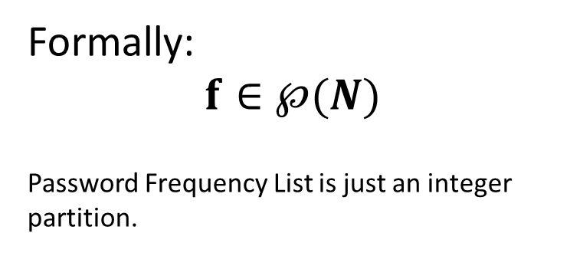
What is a Password Frequency List?
12345
password
abc123
abc123
Password Dataset:
(N users)
Histogram
Frequency List
Formally:
$$f∈℘(N)$$
Password Frequency List is just an integer partition.
2
2
Frequency
1
1
Frequency
1
1
abc123
12345
password
Most
Frequent
2nd Most
Frequent
3rd Most
Frequent
Notes:
More formally the password frequency list is a non-decreasing list of numbers f1, f2 etc… such that fi is the number of users who picked the ith most popular password.

Slide 5



Password Frequency List (Example Use)
Estimate #accounts compromised by attacker with $β$guesses per user
  Online Attacker ($β$ small)
  Offline Attacker ($β$ large)
Password Frequency Lists allow us to estimate
Marginal Guessing Cost (MGC)
Marginal Benefit (MB)
Rational Adversary: MGC = MB
$$λβ=\sum_{i=1}^{β}{f_{i}}$$
Notes:
Why are password frequency lists useful? One immediate application is that it allows us to immediately estimate how many accounts could be broken by an adversary with a fixed budget beta per use.

Slide 6
Available Password Frequency Lists (2015)
Site | #User Accounts (N) | How Released
RockYou | 32.6 Million | Data Breach*
LinkedIn | 6 | Data Breach*
…. | … | …
Yahoo! [B12] | 70 Million | With Permission**
* entire frequency list available due to improper password storage
** frequency list perturbed slightly to preserve differential privacy.
Yahoo! Frequency data is now available online at:
https://figshare.com/articles/Yahoo_Password_Frequency_Corpus/2057937
Notes:
Ok, hopefully I have convinced you that password frequency lists are useful. Where can we obtain them? The unfortunate reality is that in the past we have had to wait for data from security breaches at hapless organizations like RockYou

Slide 7
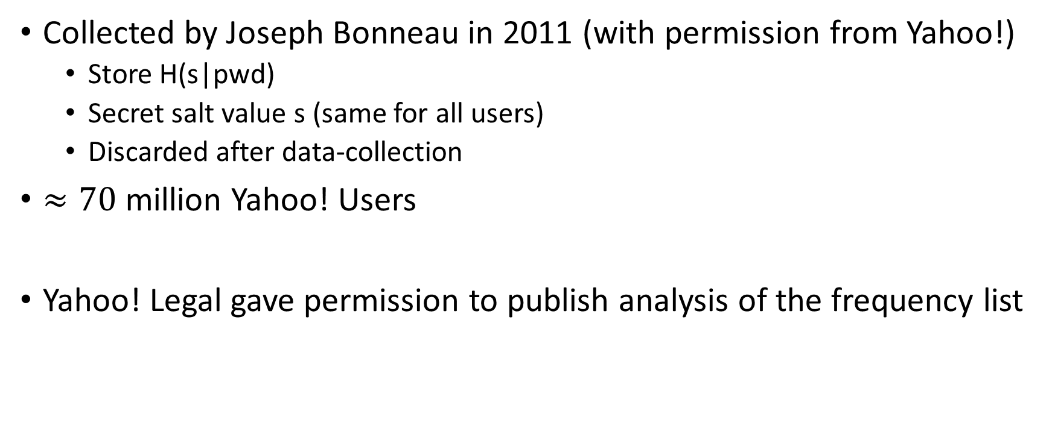
Yahoo! Password Frequency List
Collected by Joseph Bonneau in 2011 (with permission from Yahoo!)
  Store H(s|pwd)
  Secret salt value s (same for all users)
  Discarded after data-collection
$≈70$ million Yahoo! Users
Yahoo! Legal gave permission to publish analysis of the frequency list

Slide 8


Project Origin
Would it be possible to access the Yahoo! data? I am working on a cool new research project and the password frequency data would be very useful.

Slide 9

Project Origin
I would love to make the data public, but Yahoo! Legal has concerns about security and privacy. They won’t let me release it.

Slide 10
Project Origin
I would love to make the data public, but Yahoo! Legal has concerns about security and privacy. They won’t let me release it.

Slide 11
Available Password Frequency Lists
Site | #User Accounts (N) | How Released
RockYou | 32.6 Million | Data Breach*
LinkedIn | 6 | Data Breach*
…. | … | …
Yahoo! [B12] | 70 Million | With Permission**
* entire frequency list available due to improper password storage
** frequency list perturbed slightly to preserve differential privacy.
Yahoo! Frequency data is now available online at:
https://figshare.com/articles/Yahoo_Password_Frequency_Corpus/2057937
Notes:
I am excited to announce that we have released password frequency lists from 70 million Yahoo! Users. This frequency data was originally collect by Bonneau with Yahoo!s permission using tools from cryptography to protect users during the data collection phase.

Slide 12
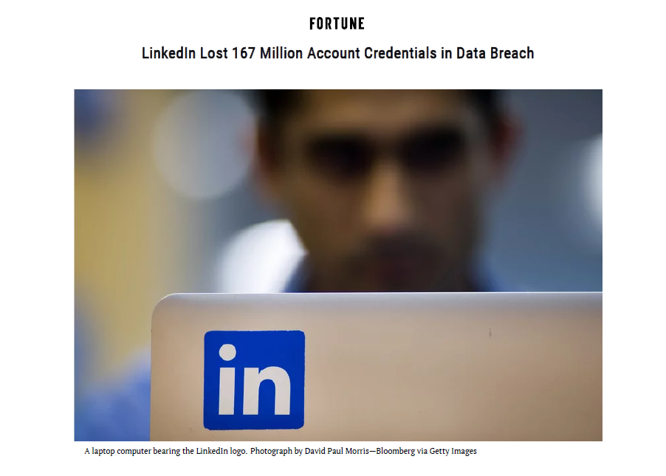

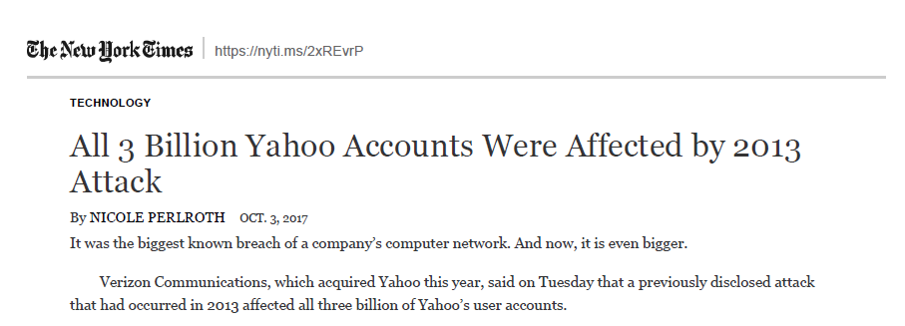

Yahoo! Frequency Corpus
Largest publicly available frequency corpus
(that was not result of a data-breach)
Source $≠$Dark Web

Slide 13
Why not just publish the original frequency lists?
Heuristic Approaches to Data Privacy often break down when the adversary has background knowledge
  Netflix Prize Dataset[NS08]
    Background Knowledge: IMDB
  Massachusetts Group Insurance Medical Encounter Database [SS98]
    Background Knowledge: Voter Registration Record
  Many other attacks [BDK07,…]
In the absence of provable privacy guarantees Yahoo! was understandably reluctant to release these password frequency lists.

Slide 14

Security Risks (Example)
???
12345
abc123
abc123
Adversary Background Knowledge

Slide 15
Security Risks (Example)
???
12345
abc123
abc123
3
abc123
12345
other
2
2
2
2
1
1
1

Slide 16


Differential Privacy (Dwork et al)
Definition: An (randomized) algorithm A preserves $\left(ε,δ\right)$-differential privacy if for any subset S$⊆Range(A)$ of possible outcomes and any we have
Pr$\left[A(f)∈S\right]≤e^{ε}Pr\left[A(f′)∈S\right]+δ$
for any pair of adjacent password frequency lists f and f’,
${\left\|f−f′\right\|}_{1}=1$.
$${\left\|f−f′\right\|}_{1}≝\sum_{i}{\left|f_{i}−f_{i}′\right|}$$

Slide 17

Differential Privacy (Dwork et al)
Definition: An (randomized) algorithm A preserves $\left(ε,δ\right)$-differential privacy if for any subset S$⊆Range(A)$ of possible outcomes and any we have
Pr$\left[A(f)∈S\right]≤e^{ε}Pr\left[A(f′)∈S\right]+δ$
for any pair of adjacent password frequency lists f and f’,
${\left\|f−f′\right\|}_{1}=1$.
f – original password frequency list
f’ – remove Alice’s password from dataset

Slide 18
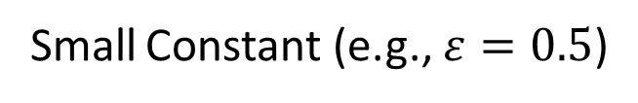
Differential Privacy (Dwork et al)
Definition: An (randomized) algorithm A preserves $\left(ε,δ\right)$-differential privacy if for any subset S$⊆Range(A)$ of possible outcomes and any we have
Pr$\left[A(f)∈S\right]≤e^{ε}Pr\left[A(f′)∈S\right]+δ$
for any pair of adjacent password frequency lists f and f’,
${\left\|f−f′\right\|}_{1}=1$.
Small Constant (e.g., $ε=0.5$)
f – original password frequency list
f’ – remove Alice’s password from dataset

Slide 19
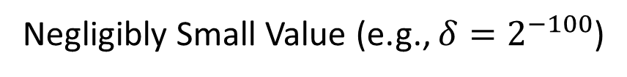
Differential Privacy (Dwork et al)
Definition: An (randomized) algorithm A preserves $\left(ε,δ\right)$-differential privacy if for any subset S$⊆Range(A)$ of possible outcomes and any we have
Pr$\left[A(f)∈S\right]≤e^{ε}Pr\left[A(f′)∈S\right]+δ$
for any pair of adjacent password frequency lists f and f’,
${\left\|f−f′\right\|}_{1}=1$.
Small Constant (e.g., $ε=0.5$)
Negligibly Small Value (e.g., ${δ=2}^{−100}$)
f – original password frequency list
f’ – remove Alice’s password from dataset

Slide 20

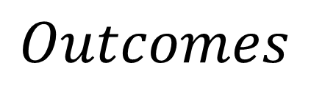
Differential Privacy (Example)
2
2
2
2
2
=
Subset S of all potentially
harmful outcomes to Alice
minus
1
f
f’
$$Outcomes$$
Notes:
Popup:Differential Privacy wrt Vertex Adjacency is a stronger privacy guarantee

Slide 21

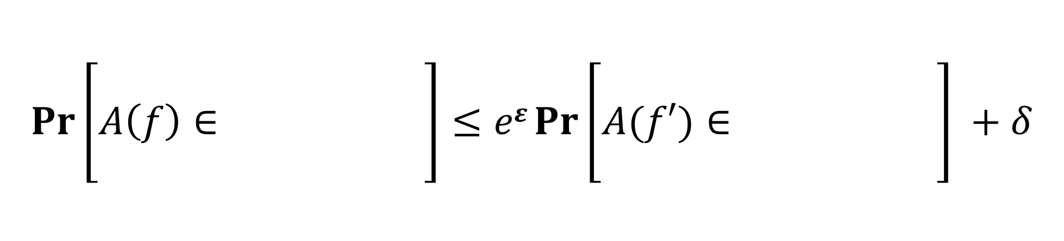
Differential Privacy (Example)
2
2
2
2
2
=
Subset S of all potentially
harmful outcomes to Alice
minus
1
f
f’
$$Pr\left[A\left(f\right)∈\begin{matrix} & & \\ & & \\ & & \end{matrix}\right]≤eε Pr⁡\left[A(f′)∈\begin{matrix} & & \\ & & \\ & & \end{matrix}\right] +δ$$
Notes:
Popup:Differential Privacy wrt Vertex Adjacency is a stronger privacy guarantee

Slide 22

Differential Privacy (Example)
Intuition: Alice won’t be harmed because her password
was included in the dataset.
$$Pr\left[A\left(f\right)∈\begin{matrix} & & \\ & & \\ & & \end{matrix}\right]≤eε Pr⁡\left[A(f′)∈\begin{matrix} & & \\ & & \\ & & \end{matrix}\right] +δ$$
Notes:
Popup:Differential Privacy wrt Vertex Adjacency is a stronger privacy guarantee

Slide 23


Main Technical Result
Theorem: There is a computationally efficient algorithm
$A:℘×℘→℘$ such that A preserves $\left(ε,δ\right)$-differential privacy and, except with probability $δ$, A(f) outputs $\tilde{f}$ s.t.
$$\frac{{\left\|f−\tilde{f}\right\|}_{1}}{N}≤O\left(\frac{1}{ε\sqrt{N}}+\frac{\ln\left(1/δ\right)}{εN}\right).$$
$$Time\left(A\right)=O\left(\frac{N\sqrt{N}+N\ln\left(1/δ\right)}{ε}\right)=Space(A)$$
$$℘=\bigcup_{n=1}^{∞}{℘\left(n\right)}$$

Slide 24

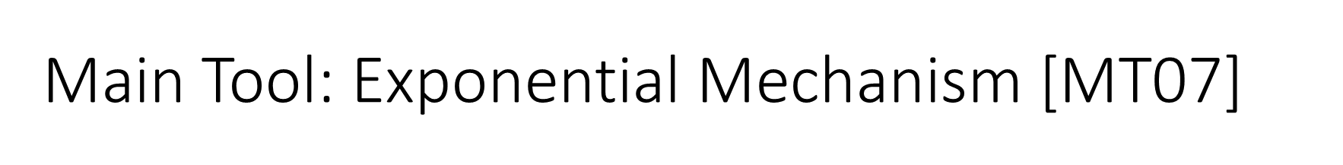
Main Tool: Exponential Mechanism [MT07]
Input: f
Output: $Pr\left[ℇ^{ε}\left(f\right)=\tilde{f}\right]∝e^{−\frac{{\left\|f−\tilde{f}\right\|}_{1}}{2ε}}$
Assigns very small probability to
inaccurate outcomes.

Slide 25
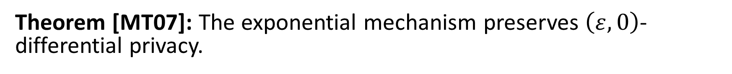
Main Tool: Exponential Mechanism [MT07]
Input: f
Output: $Pr\left[ℇ^{ε}\left(f\right)=\tilde{f}\right]∝e^{−\frac{{\left\|f−\tilde{f}\right\|}_{1}}{2ε}}$
Theorem [MT07]: The exponential mechanism preserves $\left(ε,0\right)$-differential privacy.

Slide 26
Analysis: Exponential Mechanism
Input: f
Output: $Pr\left[ℇ^{ε}\left(f\right)=\tilde{f}\right]∝e^{−\frac{{\left\|f−\tilde{f}\right\|}_{1}}{2ε}}$
Assigns very small probability to
inaccurate outcomes.
Theorem [HR18]: There are $e^{O\left(\sqrt{N}\right)}$ partitions of the integer N.

Slide 27
Analysis: Exponential Mechanism
Input: f
Output: $Pr\left[ℇ^{ε}\left(f\right)=\tilde{f}\right]∝e^{−\frac{{\left\|f−\tilde{f}\right\|}_{1}}{2ε}}$
Assigns very small probability to
inaccurate outcomes.
Theorem [HR18]: There are $e^{O\left(\sqrt{N}\right)}$ partitions of the integer N.
Union Bound → ${\left\|f−\tilde{f}\right\|}_{1}≤O\left(\frac{\sqrt{N}}{ε}\right)$ with high probability when $\frac{1}{ε}=O\left(\sqrt{N}\right)$.

Slide 28
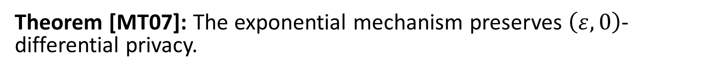
Analysis: Exponential Mechanism
Input: f
Output: $Pr\left[ℇ^{ε}\left(f\right)=\tilde{f}\right]∝e^{−\frac{{\left\|f−\tilde{f}\right\|}_{1}}{2ε}}$
Assigns very small probability to
inaccurate outcomes.
Theorem: $\frac{{\left\|f−\tilde{f}\right\|}_{1}}{N}≤O\left(\frac{1}{ε\sqrt{N}}\right)$ with high probability.
Theorem [MT07]: The exponential mechanism preserves $\left(ε,0\right)$-differential privacy.

Slide 29
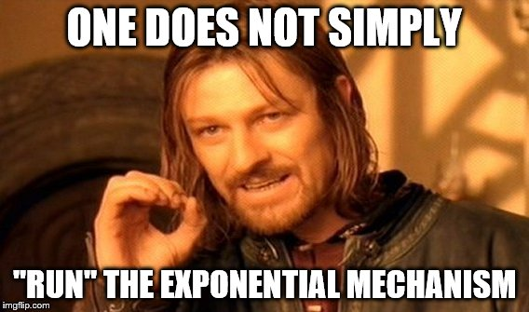
(e.g., [U13])

Slide 30
The Challenge --- Efficiency
Naïve Implementation: Exponential time (distribution assigns weights to infinitely many integer partitions)
Strong Evidence: Sampling from the exponential mechanism is computationally intractable in general (e.g., [U13]).

Slide 31
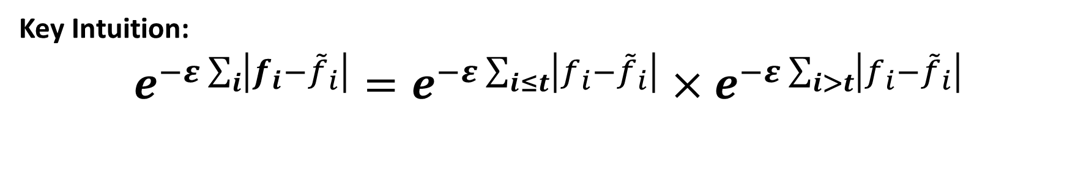

But, we did run the exponential mechanism
Theorem: There is an efficient algorithm A to sample from a distribution that is $δ$–close to the exponential mechanism $ℇ$ over integer partitions. The algorithm uses time and space
$$O\left(\frac{N\sqrt{N}+N ln\left(\frac{1}{δ}\right)}{ε}\right)$$
Key Intuition:
$$e^{−ε\sum_{i}{\left|f_{i}−{\tilde{f}}_{i}\right|}}=e^{−ε\sum_{i≤t}{\left|f_{i}−{\tilde{f}}_{i}\right|}}×e^{−ε\sum_{i>t}{\left|f_{i}−{\tilde{f}}_{i}\right|}}$$
Suggests Potential Recurrence Relationships

Slide 32
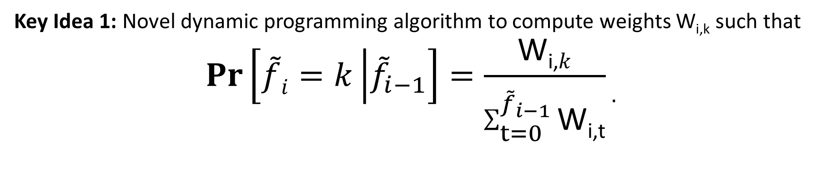
But, we did run the exponential mechanism
Theorem: There is an efficient algorithm A to sample from a distribution that is $δ$–close to the exponential mechanism $ℇ$ over integer partitions. The algorithm uses time and space
$$O\left(\frac{N\sqrt{N}+N ln\left(\frac{1}{δ}\right)}{ε}\right)$$
Key Idea 1: Novel dynamic programming algorithm to compute weights W_{i,k} such that
$$Pr\left[\tilde{f}i=k\left|{\tilde{f}}_{i−1}\right.\right]=\frac{\text{W}\text{i}\text{,}k}{\sum_{t=0}^{{\tilde{f}}_{i−1}}{\text{W}\text{i}\text{,}\text{t}}}.$$

Slide 33
But, we did run the exponential mechanism
Theorem: There is an efficient algorithm A to sample from a distribution that is $δ$–close to the exponential mechanism $ℇ$ over integer partitions. The algorithm uses time and space
$$O\left(\frac{N\sqrt{N}+N ln\left(\frac{1}{δ}\right)}{ε}\right)$$
Key Idea 1: Novel dynamic programming algorithm to compute weights W_{i,t}
Key Idea 2: Allow A to ignore a partition $\tilde{f}$ if ${\left\|f−\tilde{f}\right\|}_{1}$ very large.

Slide 34

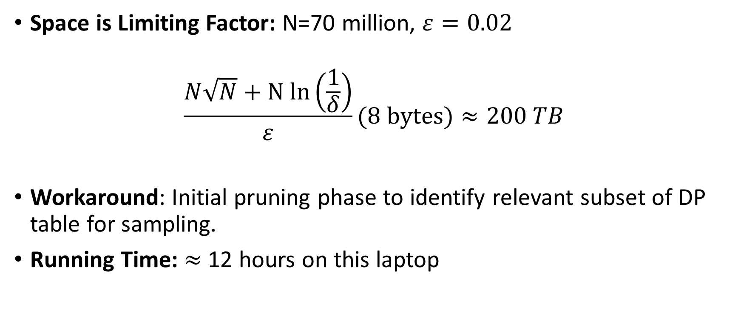
Practical Challenge #1
Space is Limiting Factor: N=70 million, $ε=0.02$
$$\frac{N\sqrt{N}+N ln\left(\frac{1}{δ}\right)}{ε}(8 bytes)≈200 TB$$
Workaround: Initial pruning phase to identify relevant subset of DP table for sampling.
Running Time: $≈$12 hours on this laptop

Slide 35
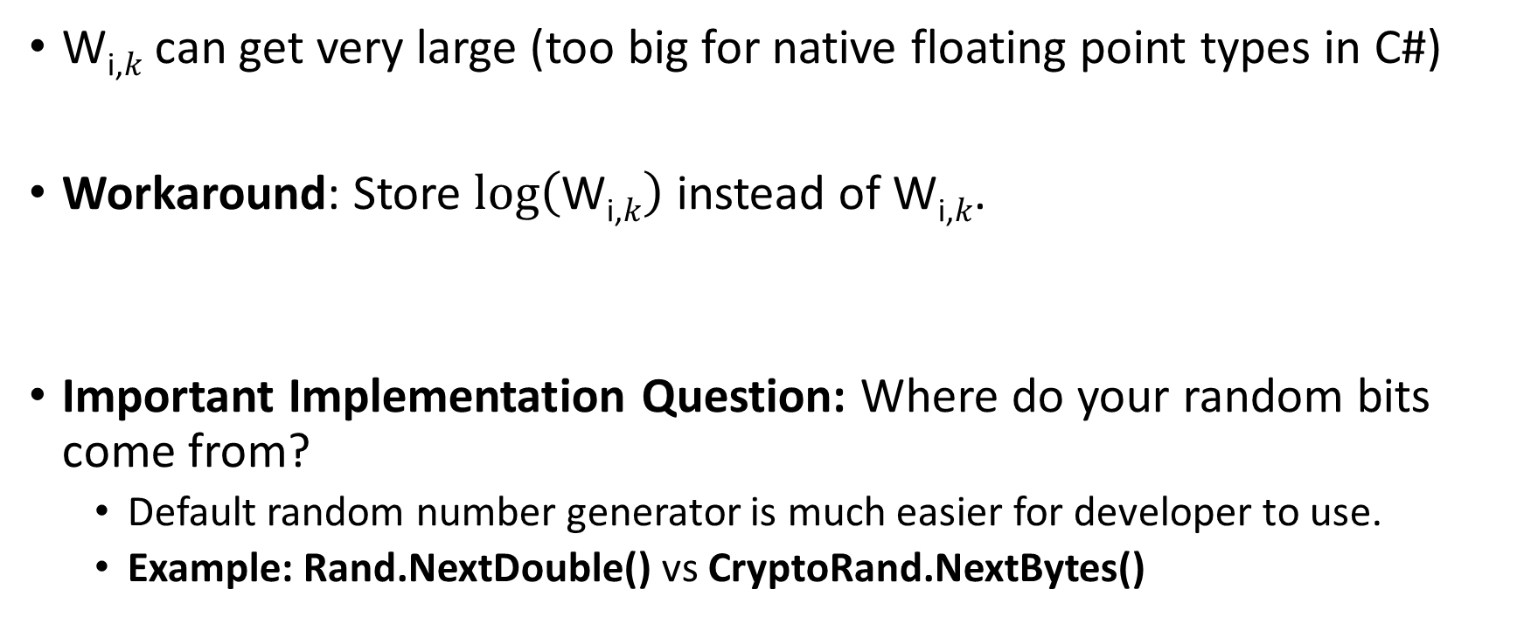
Practical Challenge #2
$\text{W}\text{i}\text{,}k$ can get very large (too big for native floating point types in C#)
Workaround: Store $\log\left(\text{W}\text{i}\text{,}k\right)$ instead of $\text{W}\text{i}\text{,}k$.
Important Implementation Question: Where do your random bits come from?
  Default random number generator is much easier for developer to use.
  Example: Rand.NextDouble() vs CryptoRand.NextBytes()

Slide 36
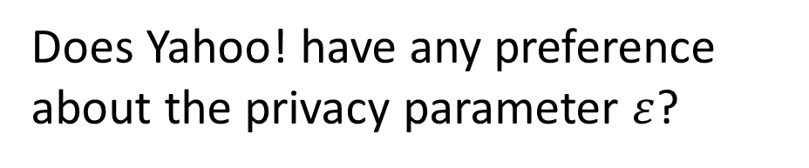
Practical Challenge #3
Does Yahoo! have any preference about the privacy parameter $ε$?

Slide 37
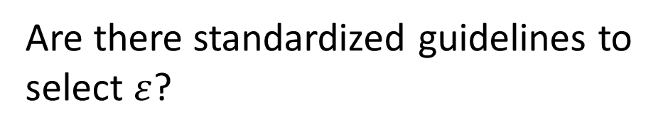
Practical Challenge #3
Are there standardized guidelines to select $ε$?

Slide 38
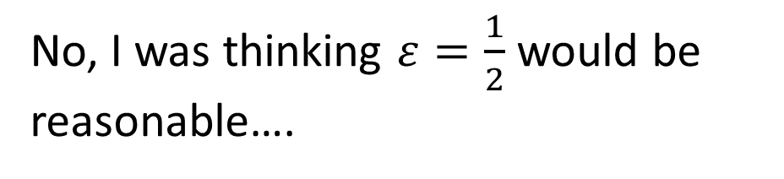
Practical Challenge #3
No, I was thinking $ε=\frac{1}{2}$ would be reasonable….

Slide 39
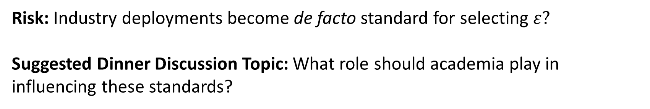

Practical Challenge #3
Yahoo! is fine with $ε=\frac{1}{2}$
Risk: Industry deployments become de facto standard for selecting $ε?$
Suggested Dinner Discussion Topic: What role should academia play in influencing these standards?

Slide 40
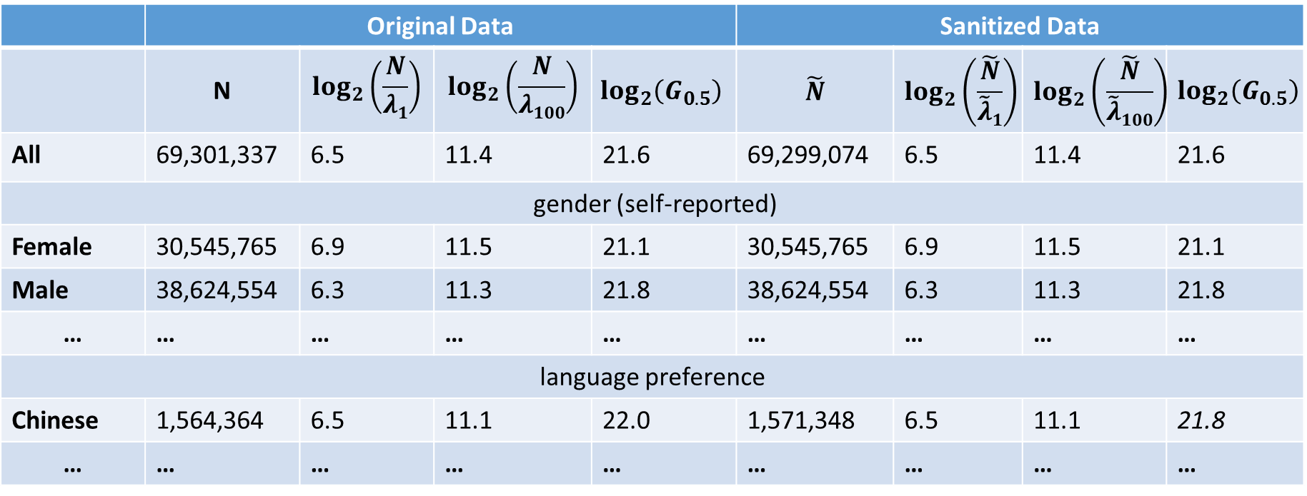
Yahoo! Results
 | Original Data |  |  |  | Sanitized Data
 | N | $$\log_{2}\left(\frac{N}{λ1}\right)$$ | $$\log_{2}\left(\frac{N}{λ100}\right)$$ | $$\log_{2}\left(G_{0.5}\right)$$ | $$\tilde{N}$$ | $$\log_{2}\left(\frac{\tilde{N}}{\tilde{λ}1}\right)$$ | $$\log_{2}\left(\frac{\tilde{N}}{\tilde{λ}100}\right)$$ | $$\log_{2}\left(G_{0.5}\right)$$
All | 69,301,337 | 6.5 | 11.4 | 21.6 | 69,299,074 | 6.5 | 11.4 | 21.6
gender (self-reported)
Female | 30,545,765 | 6.9 | 11.5 | 21.1 | 30,545,765 | 6.9 | 11.5 | 21.1
Male | 38,624,554 | 6.3 | 11.3 | 21.8 | 38,624,554 | 6.3 | 11.3 | 21.8
… | … | … | … | … | … | … | … | …
language preference
Chinese | 1,564,364 | 6.5 | 11.1 | 22.0 | 1,571,348 | 6.5 | 11.1 | 21.8
… | … | … | … | … | … | … | … | …
Yahoo! Frequency data is now available online at:
https://figshare.com/articles/Yahoo_Password_Frequency_Corpus/2057937

Slide 41
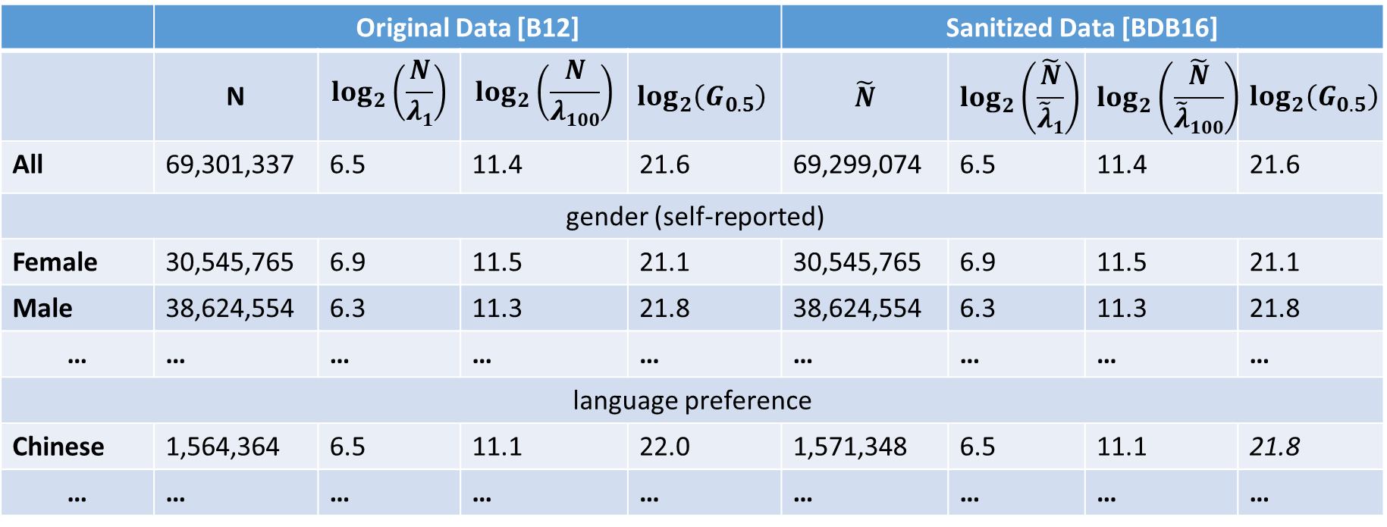
Yahoo! Results
 | Original Data [B12] |  |  |  | Sanitized Data [BDB16]
 | N | $$\log_{2}\left(\frac{N}{λ1}\right)$$ | $$\log_{2}\left(\frac{N}{λ100}\right)$$ | $$\log_{2}\left(G_{0.5}\right)$$ | $$\tilde{N}$$ | $$\log_{2}\left(\frac{\tilde{N}}{\tilde{λ}1}\right)$$ | $$\log_{2}\left(\frac{\tilde{N}}{\tilde{λ}100}\right)$$ | $$\log_{2}\left(G_{0.5}\right)$$
All | 69,301,337 | 6.5 | 11.4 | 21.6 | 69,299,074 | 6.5 | 11.4 | 21.6
gender (self-reported)
Female | 30,545,765 | 6.9 | 11.5 | 21.1 | 30,545,765 | 6.9 | 11.5 | 21.1
Male | 38,624,554 | 6.3 | 11.3 | 21.8 | 38,624,554 | 6.3 | 11.3 | 21.8
… | … | … | … | … | … | … | … | …
language preference
Chinese | 1,564,364 | 6.5 | 11.1 | 22.0 | 1,571,348 | 6.5 | 11.1 | 21.8
… | … | … | … | … | … | … | … | …
Yahoo! Frequency data is now available online at:
https://figshare.com/articles/Yahoo_Password_Frequency_Corpus/2057937

Slide 42

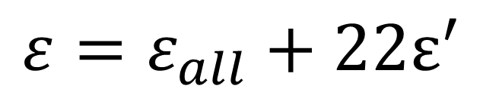
Yahoo! Results (Selecting Epsilon)
 | Original Data [B12] |  |  |  | Sanitized Data [BDB16]
 | N | $$\log_{2}\left(\frac{N}{λ1}\right)$$ | $$\log_{2}\left(\frac{N}{λ100}\right)$$ | $$\log_{2}\left(G_{0.5}\right)$$ | $$\tilde{N}$$ | $$\log_{2}\left(\frac{\tilde{N}}{\tilde{λ}1}\right)$$ | $$\log_{2}\left(\frac{\tilde{N}}{\tilde{λ}100}\right)$$ | $$\log_{2}\left(G_{0.5}\right)$$
All | 69,301,337 | 6.5 | 11.4 | 21.6 | 69,299,074 | 6.5 | 11.4 | 21.6
gender (self-reported)
Female | 30,545,765 | 6.9 | 11.5 | 21.1 | 30,545,765 | 6.9 | 11.5 | 21.1
Male | 38,624,554 | 6.3 | 11.3 | 21.8 | 38,624,554 | 6.3 | 11.3 | 21.8
… | … | … | … | … | … | … | … | …
language preference
Chinese | 1,564,364 | 6.5 | 11.1 | 22.0 | 1,571,348 | 6.5 | 11.1 | 21.8
… | … | … | … | … | … | … | … | …
Any individual participates in at most 23 groups (including All)
$$ε=ε_{all}+22ε^{′}$$

Slide 43

Yahoo! Results (Selecting Epsilon)
 | Original Data [B12] |  |  |  | Sanitized Data [BDB16]
 | N | $$\log_{2}\left(\frac{N}{λ1}\right)$$ | $$\log_{2}\left(\frac{N}{λ100}\right)$$ | $$\log_{2}\left(G_{0.5}\right)$$ | $$\tilde{N}$$ | $$\log_{2}\left(\frac{\tilde{N}}{\tilde{λ}1}\right)$$ | $$\log_{2}\left(\frac{\tilde{N}}{\tilde{λ}100}\right)$$ | $$\log_{2}\left(G_{0.5}\right)$$
All | 69,301,337 | 6.5 | 11.4 | 21.6 | 69,299,074 | 6.5 | 11.4 | 21.6
gender (self-reported)
Female | 30,545,765 | 6.9 | 11.5 | 21.1 | 30,545,765 | 6.9 | 11.5 | 21.1
Male | 38,624,554 | 6.3 | 11.3 | 21.8 | 38,624,554 | 6.3 | 11.3 | 21.8
… | … | … | … | … | … | … | … | …
language preference
Chinese | 1,564,364 | 6.5 | 11.1 | 22.0 | 1,571,348 | 6.5 | 11.1 | 21.8
… | … | … | … | … | … | … | … | …
$$ε_{all}=0.25$$
$$ε^{′}=\frac{ε_{all}}{22}$$
$$ε=ε_{all}+22ε^{′}$$

Slide 44
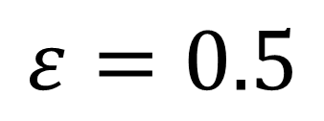
Yahoo! Results (Selecting Epsilon)
 | Original Data [B12] |  |  |  | Sanitized Data [BDB16]
 | N | $$\log_{2}\left(\frac{N}{λ1}\right)$$ | $$\log_{2}\left(\frac{N}{λ100}\right)$$ | $$\log_{2}\left(G_{0.5}\right)$$ | $$\tilde{N}$$ | $$\log_{2}\left(\frac{\tilde{N}}{\tilde{λ}1}\right)$$ | $$\log_{2}\left(\frac{\tilde{N}}{\tilde{λ}100}\right)$$ | $$\log_{2}\left(G_{0.5}\right)$$
All | 69,301,337 | 6.5 | 11.4 | 21.6 | 69,299,074 | 6.5 | 11.4 | 21.6
gender (self-reported)
Female | 30,545,765 | 6.9 | 11.5 | 21.1 | 30,545,765 | 6.9 | 11.5 | 21.1
Male | 38,624,554 | 6.3 | 11.3 | 21.8 | 38,624,554 | 6.3 | 11.3 | 21.8
… | … | … | … | … | … | … | … | …
language preference
Chinese | 1,564,364 | 6.5 | 11.1 | 22.0 | 1,571,348 | 6.5 | 11.1 | 21.8
… | … | … | … | … | … | … | … | …
$$ε=0.5$$

Slide 45
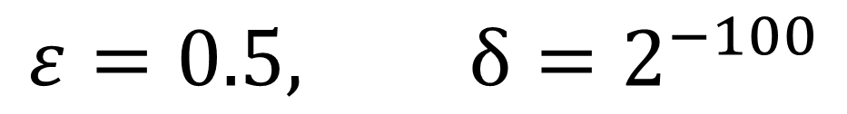
Yahoo! Results (Selecting Epsilon)
 | Original Data [B12] |  |  |  | Sanitized Data [BDB16]
 | N | $$\log_{2}\left(\frac{N}{λ1}\right)$$ | $$\log_{2}\left(\frac{N}{λ100}\right)$$ | $$\log_{2}\left(G_{0.5}\right)$$ | $$\tilde{N}$$ | $$\log_{2}\left(\frac{\tilde{N}}{\tilde{λ}1}\right)$$ | $$\log_{2}\left(\frac{\tilde{N}}{\tilde{λ}100}\right)$$ | $$\log_{2}\left(G_{0.5}\right)$$
All | 69,301,337 | 6.5 | 11.4 | 21.6 | 69,299,074 | 6.5 | 11.4 | 21.6
gender (self-reported)
Female | 30,545,765 | 6.9 | 11.5 | 21.1 | 30,545,765 | 6.9 | 11.5 | 21.1
Male | 38,624,554 | 6.3 | 11.3 | 21.8 | 38,624,554 | 6.3 | 11.3 | 21.8
… | … | … | … | … | … | … | … | …
language preference
Chinese | 1,564,364 | 6.5 | 11.1 | 22.0 | 1,571,348 | 6.5 | 11.1 | 21.8
… | … | … | … | … | … | … | … | …
$$ε=0.5, δ=2^{−100}$$

Slide 46

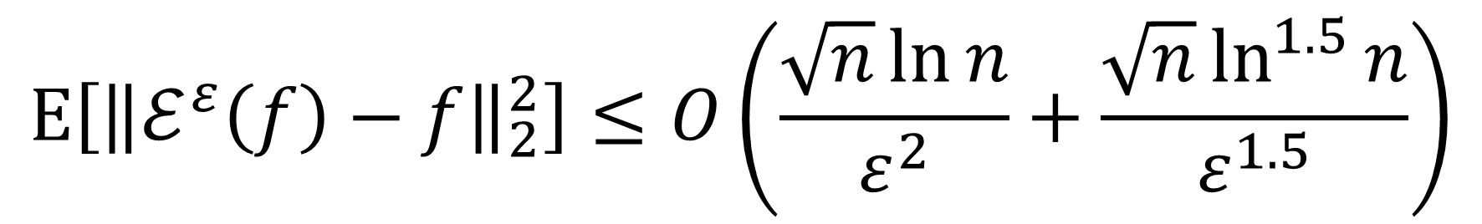

New Result #1 (Mean Squared Error)
Exponential Mechanism achieves good MSE:
$$E\left[{\left\|ℰ^{ε}\left(f\right)−f\right\|}_{2}^{2}\right]≤O\left(\frac{\sqrt{n}\ln{n}}{ε^{2}}+\frac{\sqrt{n}\ln^{1.5}{n}}{ε^{1.5}}\right)$$
Improves on [HMJ09] by $\left(\ln{n}\right)2$ factor if $\frac{1}{ε}≥\ln{n}$.
Improves on [HMJ09] by $\frac{{\left(\ln{n}\right)}^{1.5}}{\sqrt{ε}}$ factor.

Slide 47
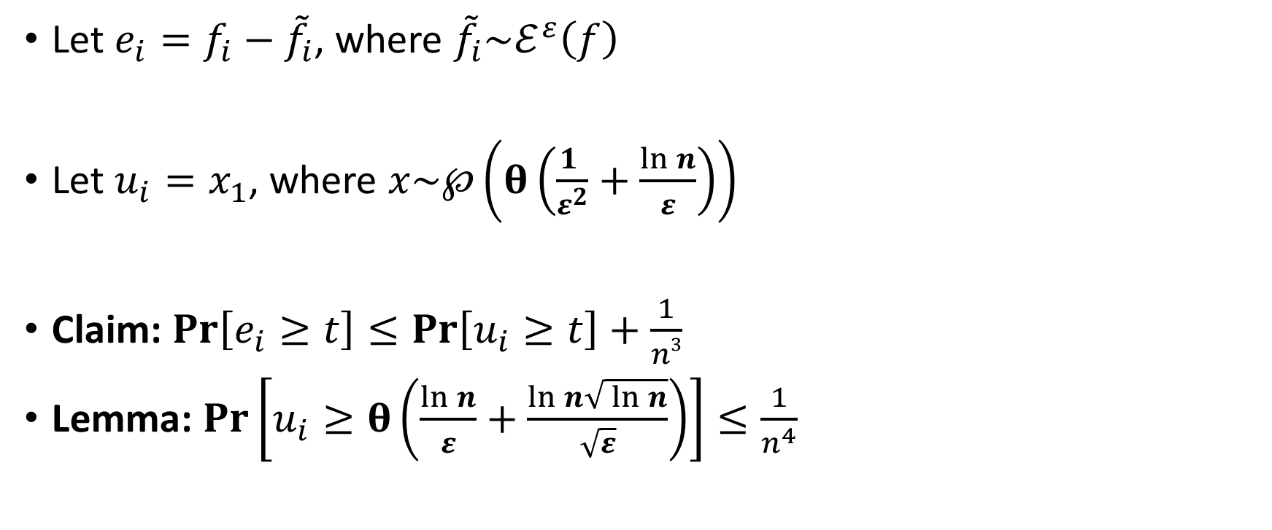
Proof Sketch
Let $e_{i}=f_{i}−{\tilde{f}}_{i}$, where ${\tilde{f}}_{i}\sim ℰ^{ε}\left(f\right)$
Let $u_{i}=x_{1}$, where $x\sim ℘\left(θ\left(\frac{1 }{ε^{2}}+\frac{\ln{n}}{ε}\right)\right)$
Claim: $Pr\left[e_{i}≥t\right]≤Pr\left[u_{i}≥t\right]+\frac{1}{n3}$
Lemma: $Pr\left[u_{i}≥θ\left(\frac{\ln{n}}{ε}+\frac{\ln{n}\sqrt{ \ln{n}}}{\sqrt{ε}}\right)\right]≤\frac{1}{n^{4}}$

Slide 48

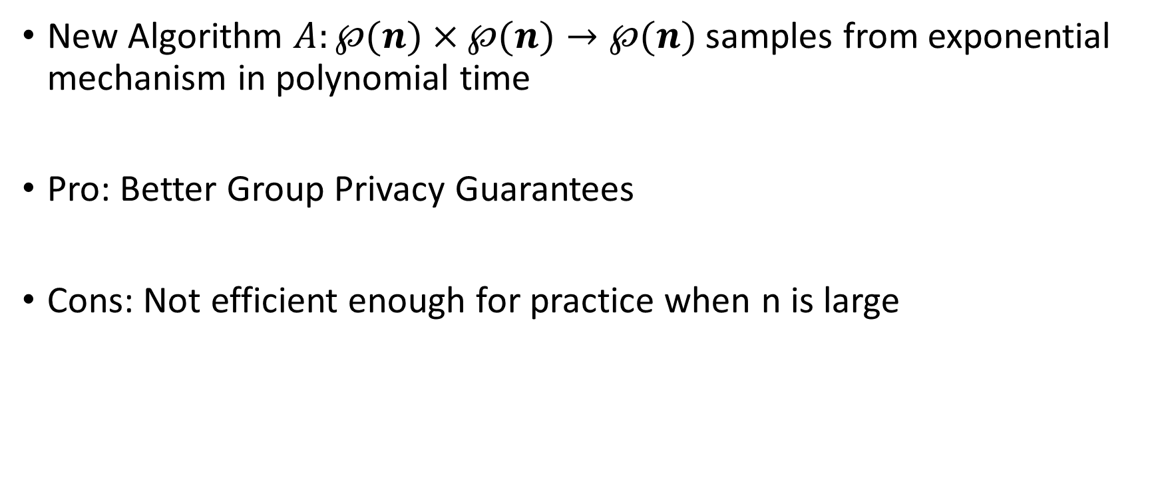
New Result #2 (pure-differential privacy)
New Algorithm $A:℘(n)×℘(n)→℘(n)$ samples from exponential mechanism in polynomial time
Pro: Better Group Privacy Guarantees
Cons: Not efficient enough for practice when n is large
$$Time\left(A\right)=O\left(n^{4}\right)=Space(A)$$

Slide 49


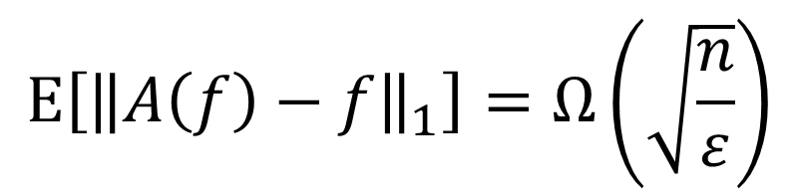






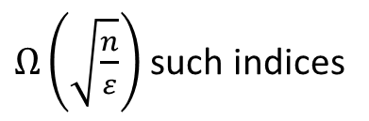



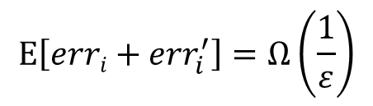
New Result #3 (Lower Bound L1 Error)
Theorem: For any differentially private $A:℘×℘→℘$ there exists a partition $f∈℘$s.t
$$E\left[{\left\|A\left(f\right)−f\right\|}_{1}\right]=Ω\left(\sqrt{\frac{n}{ε}}\right)$$
$$E\left[erri+{err}_{i}^{′}\right]=Ω\left(\frac{1}{ε}\right)$$
$$\frac{10}{ε}$$
…
$$\frac{6}{ε}$$
$$\frac{10}{ε}$$
…
…
$$\frac{4}{ε}$$
$Ω\left(\sqrt{\frac{n}{ε}}\right)$ such indices
…
…
…
…
…
$$f_{i−1}$$
$$f_{i}$$
$$f_{i+1}$$
$$f_{i−1}^{′}$$
$$f_{i}^{′}$$
$$f_{i+1}^{′}$$

Slide 50




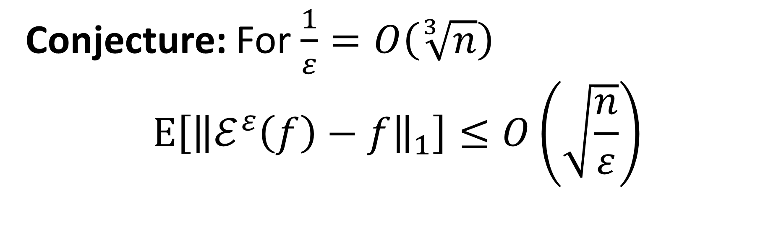
An Open Problem
Th
Conjecture: For $\frac{1}{ε}=O\left(\sqrt[3]{n}\right)$
$$E\left[{\left\|ℰ^{ε}\left(f\right)−f\right\|}_{1}\right]≤O\left(\sqrt{\frac{n}{ε}}\right)$$
Application to Social Networks: Degree Distribution with Node Privacy

Slide 51
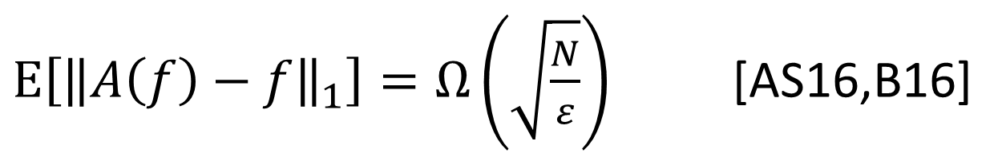
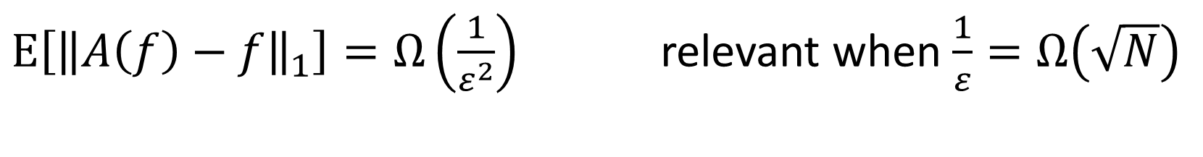
Lower Bounds on L1 Error
$E\left[{\left\|A\left(f\right)−f\right\|}_{1}\right]=Ω\left(\sqrt{\frac{N}{ε}}\right)$ [AS16,B16]
$E\left[{\left\|A\left(f\right)−f\right\|}_{1}\right]=Ω\left(\frac{1}{ε^{2}}\right)$ relevant when $\frac{1}{ε}=Ω\left(\sqrt{N}\right)$
Notes:
A lower bound on the release of differentially private integer partitions
Author links open overlay panelFrancescoAldàHans UlrichSimon

Slide 52


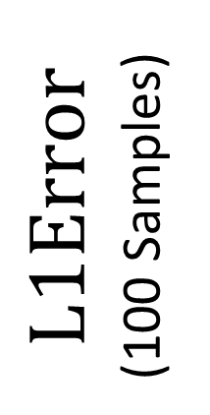
Empirical Evidence
$$L1Error$$
(100 Samples)
n=32.6 million users
$${\left(\sqrt{ε}\right)}^{−1}$$

Slide 53

More Empirical Evidence
$$ε≈\frac{1}{\sqrt[3]{N}}$$

Slide 54


More Empirical Evidence
$$ε≈\frac{1}{\sqrt{N}}$$
$$ε≈\frac{1}{\sqrt[3]{N}}$$

Slide 55
Comparison with Prior Techniques

Slide 56



Conclusions
Differential Privacy Enables Analysis of Sensitive Data
The exponential mechanism is not always intractable
  integer partitions
  Other practical settings?
Applications to Social Networks?

Slide 57


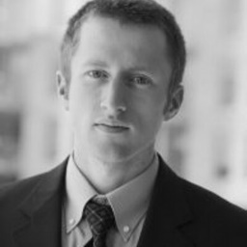
Thanks for Listening
Anupam Datta
CMU
Joseph Bonneau
NYU

Slide 58

Dinner Discussion Topics
Risk: Industry deployments become de facto standard for selecting $ε$?.

Slide 60
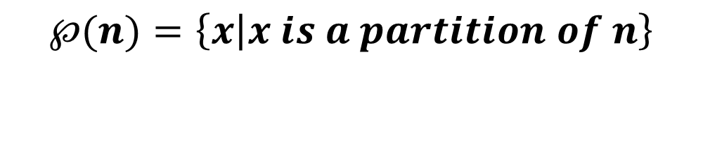



Integer Partition
Definition: A partition of an integer n > 0 is a non-increasing sequence of numbers $x_{1}≥x_{2}$ $≥⋯≥$0 such that:
$$x_{1}+x_{2}+⋯ =n.$$
$$℘(n)=\left\{x | x is a partition of n\right\}$$
Example:
$$℘\left(3\right)= \left\{\left(3\right),\left(2,1\right),(1,1,1)\right\}$$
$$\left|℘\left(n\right)\right|\sim \frac{1}{4n\sqrt{3}}e^{π\sqrt{{2n}/3}}$$
Fact[HR18]

Slide 61


Integer Partition: Basic Facts
Fact[Fristedt93]: Let $x\sim ℘\left(n\right)$ then
$$Pr\left[x1≥\frac{\sqrt{6n}}{π}\left(t+\ln\left(\frac{\sqrt{6n}}{π}\right)\right)\right]≈e^{−t}$$

Slide 62
Outline
Password Frequency List
Potential Security Concerns
Differential Privacy
A DP Algorithm with Minimal Distortion
Released Yahoo! Frequency List
Notes:
Brief outline of the talk. First I am going to tell you what a password frequency list is and why they are useful. Then we will discuss potential security involved in releasing this data, and how these concerns can be addresses using the notion of differential privacy. Finally, I will briefly describe our novel differentially private algorithm for releasing password frequency lists. The algorithm introdues minimal distortion. Finally, I will tell you how we used the algorithm to release password frequency lists for 70 million Yahoo! Passwords.

Slide 63

Password Frequency List (Application 2)
Quantify Benefits from Key-Stretching
Halting Condition (Rational Offline Adversary):
Marginal Guessing Cost $≥$ Marginal Benefit
Password Frequency Lists allow us to estimate
Marginal Guessing Cost (MGC)
Marginal Benefit (MB)
Rational Adversary: MGC = MB
Can estimate when the offline adversary will give up.
Notes:
A more advanced application: password freuqncy lists can help us understand the incentives of a password attacker. In particular, we can use a password frequency list to estimate the marginal cost and marginal benefit of one more password guess for the attacker. This allows us to predict when the adversary will give up, and how many accounts the adversary will break. This can help the organization to make more informed decisions about any defense that he might deploy.

Slide 64



Why not just publish the original frequency lists?
Heuristic Approaches to Data Privacy often break down when the adversary has background knowledge
  Massachusetts Group Insurance Medical Encounter Database [SS98]
    Background Knowledge: Voter Registration Record

Slide 65



Why not just publish the original frequency lists?
Heuristic Approaches to Data Privacy often break down when the adversary has background knowledge
  Massachusetts Group Insurance Medical Encounter Database [SS98]
    Background Knowledge: Voter Registration Record
  Netflix Prize Dataset[NS08]
    Background Knowledge: IMDB

