Slide 1


Memory Hard Functions and Human Authentication
Jeremiah Blocki
jblocki@purdue.edu
https://www.cs.purdue.edu/homes/jblocki/
CERIAS Security Seminar (Fall 2017)

Slide 2
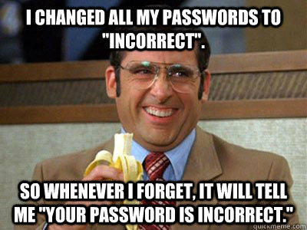





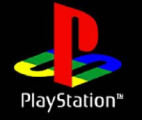

Password Management
p₁
p₂
p₃
p₄
p₅
p₅
…
PayPaul.com
Competing Goals:
Security
Usability

Slide 3

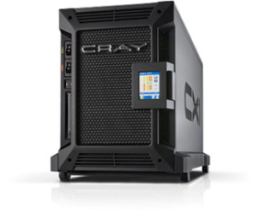

Motivation: Password Storage
jblocki, 123456
Username
jblocki
Salt
89d978034a3f6
Hash
85e23cfe0021f584e3db87aa72630a9a2345c062
SHA1(12345689d978034a3f6)=85e23cfe0021f584e3db87aa72630a9a2345c062
+
Notes:
As a motivating example consider an adversary who breaks into an authentication server and steals a users crptographic hash value. The adversary can execute an offline attack against the password by comparing the hash value with the hashes of likely password guesses. The adversary is limited only by the resources that he is willing to invest cracking the passwords.

Slide 4






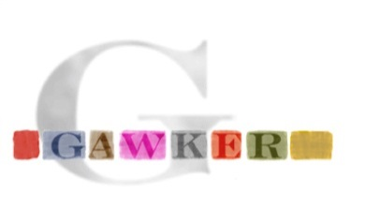

Offline Attacks: A Common Problem
Password breaches at major companies have affected millions of users.
Notes:
Unfortunately, offline dictionary attacks are quite common. Password breaches at major companies have affected millions of users. In the past few years I have had to update the slide several times.

Slide 5
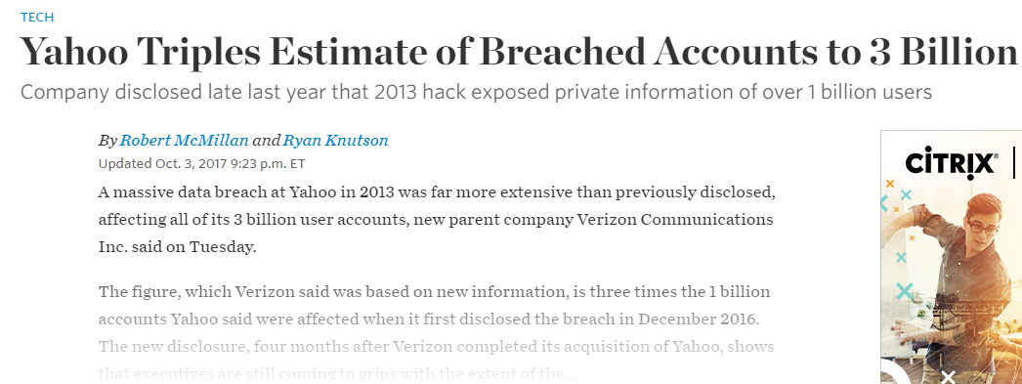






Offline Attacks: A Common Problem
Password breaches at major companies have affected millions of users.
Notes:
Unfortunately, offline dictionary attacks are quite common. Password breaches at major companies have affected millions of users.

Slide 6
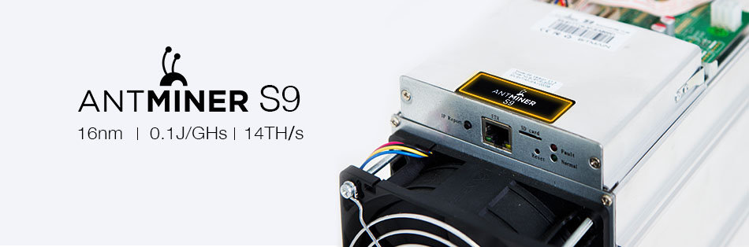

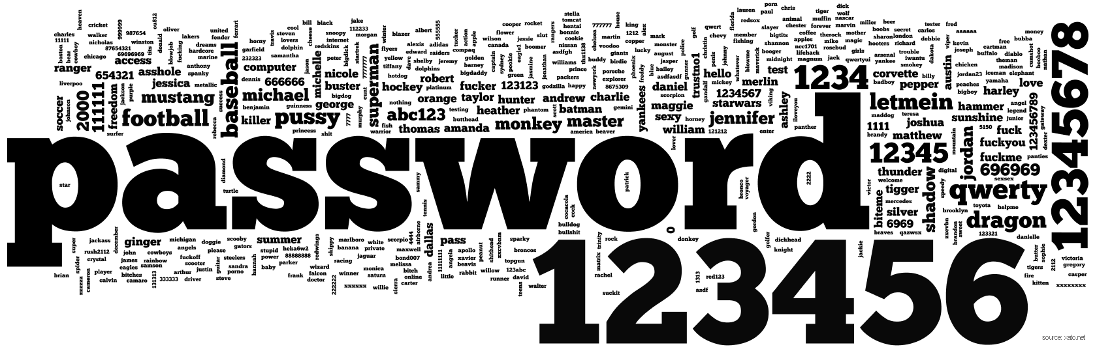

A Dangerous Problem
Can we increase guessing costs for the attacker?
$2,400 on Amazon

Slide 7
Attempt 1: Hash Iteration
BCRYPT
PBKDF2
100,000 SHA256 computations
(iterative)
Estimated Cost on ASIC: $1 per billion password guesses [BS14]

Slide 8

The Challenge
Cost SHA256
USD $
Standard Patience Units
User Patience
Time
Disclaimer: This slide is entirely for humorous effect.

Slide 9
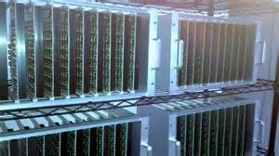
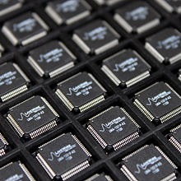
Goal: Moderately Expensive Hash Function
Fast on PC and
Expensive on ASIC?
Notes:
This motivates the need for moderately hard functions. The basic idea is to build a password hash function that is moderately expensive to compute to limit the number of guesses that an adversary would be willing to try. An honest server only needs to compute the function once during a typical authentication session. However, the adversary potentially has an advantage in this game. While the honest server must typically evaluate the function on standard hardware, the adversary could use potentially reduce the cost per password guess by developing customized hardware (GPUs, FPGAs, ASICs) to evaluate the password hash function. Thus, we want to ensure that the cost to evaluate this function is equitable across platforms.

Slide 10
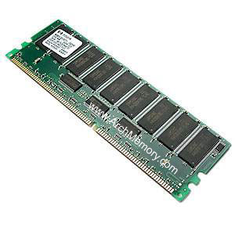


Memory Hard Function (MHF)
Intuition: computation costs dominated by memory costs
vs.
Goal: force attacker to lock up large amounts of memory for duration of computation
  →Expensive even on customized hardware
Notes:
In this work we study a special type of memory hard function called data-independent memory hard functions. As the name suggests the memory access pattern will not depend on the input making the functions resistant to side-channel attacks.

Slide 11

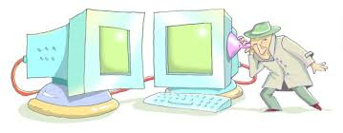
Memory Hard Function (MHF)
Intuition: computation costs dominated by memory costs
vs.
Data Independent Memory Hard Function (iMHF)
  Memory access pattern should not depend on input
Notes:
In this work we study a special type of memory hard function called data-independent memory hard functions. As the name suggests the memory access pattern will not depend on the input making the functions resistant to side-channel attacks.

Slide 12
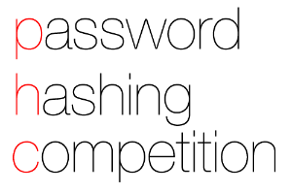

iMHF Candidates
Catena [FLW15]
  Special Recognition at Password Hashing Competition
  Two Variants: Dragonfly and Double-Butterfly
Argon2 [BDK15]
  Winner of the Password Hashing Competition
  Argon2i (data-independent mode) is recommended for Password Hashing
Balloon Hashing [BCS16]
  Newer proposal (three variants in original proposal)
Notes:
In terms of depth-robustness two of these variants were similar to Catena and one variant was similar to Argon.

Slide 13


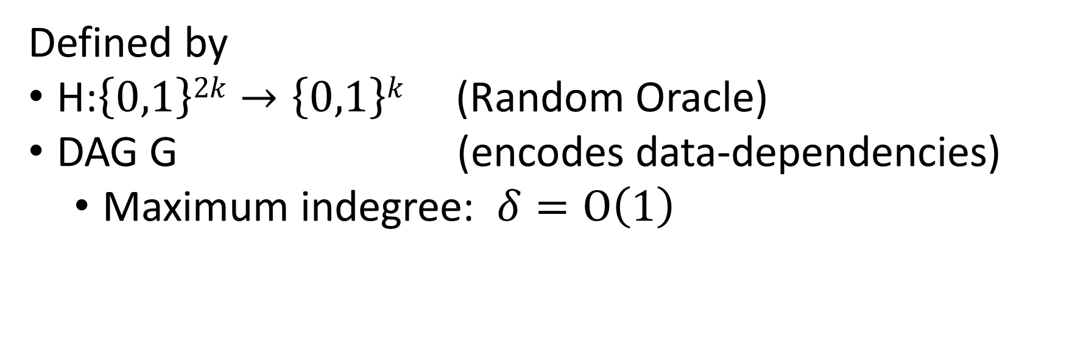
iMHF (f_{G,H})
Defined by
H:$\left\{0,1\right\}2k→\left\{0,1\right\}k$ (Random Oracle)
DAG G (encodes data-dependencies)
  Maximum indegree: $δ=O\left(1\right)$
Input: pwd, salt
2
4
1
Output: f_{G,H} (pwd,salt)= L₄
1
3
$$L1=H(pwd,salt)$$
$$L3=H(L2,L1)$$

Slide 14
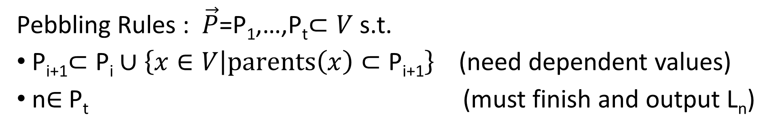


Evaluating an iMHF (pebbling)
2
4
Output: L₄
Input:
1
1
pwd, salt
3
$$L1=H(pwd,salt)$$
$$L3=H(L2,L1)$$
Pebbling Rules : $\vec{P}$=P₁,…,P_{t}$⊂V$ s.t.
P_{i+1}$⊂\text{P}\text{i}∪\left\{x∈V | parents\left(x\right)⊂\text{P}\text{i}\text{+1}\right\}$(need dependent values)
n$∈$P_{t} (must finish and output L_{n})
Notes:
We will describe our algorithms for evaluating an iMHF using the language of graph pebbling. Placing a pebble on a node corresponds to computing the corresponding label, and keeping a pebble on the graph corresponds to storing that label in memory. Of course we can only compute a label if we have all of the dependent labels. Thus, in a legal pebbling we cannot place a pebble on a node until we have pebbles on the parents of that node. If the adversary is parallel then we are allowed to place multiple pebbles on the graph in each round. We can remove pebbles from the graph at any point in time.

Slide 15
Evaluating an iMHF (pebbling)
4
5
3
4
5
1
3
1
2

Slide 16
Evaluating an iMHF (pebbling)
1
2
3
4
5
P₁ = {1} (data value L₁ stored in memory)

Slide 17
Pebbling Example
1
2
3
4
5
P₁ = {1}
P₂ = {1,2} (data values L₁ and L₂ stored in memory)

Slide 18
Pebbling Example
1
2
3
4
5
P₁ = {1}
P₂ = {1,2}
P₃ = {3}

Slide 19
Pebbling Example
1
2
3
4
5
P₁ = {1}
P₂ = {1,2}
P₃ = {3}
P₄ = {3,4}

Slide 20
Pebbling Example
1
2
3
4
5
P₁ = {1}
P₂ = {1,2}
P₃ = {3}
P₄ = {3,4}
P₅ = {5}

Slide 21
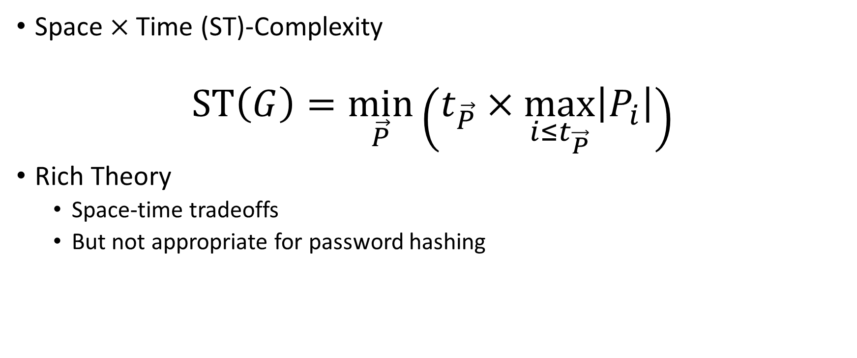
Measuring Cost: Attempt 1
Space $×$Time (ST)-Complexity
$$ST\left(G\right)=\min_{\vec{P}}\left(t_{\vec{P}}×\max_{i≤t_{\vec{P}}}\left|P_{i}\right|\right)$$
Rich Theory
  Space-time tradeoffs
  But not appropriate for password hashing

Slide 22

Amortization and Parallelism
Problem: for parallel computation ST-complexity can scale badly in the number of evaluations of a function.
[AS15] $∃$function f_{n} (consisting of n RO calls) such that: $ST\left(f^{×\sqrt{n}}\right)=O(ST\left(f\right))$
S₃
ST₁ = S₁ × T₁ ≈ S₃ × T₃ = ST₃
S₁
space
cost of computing
f once
cost of computing
f three times
time
T₁
T₃

Slide 23
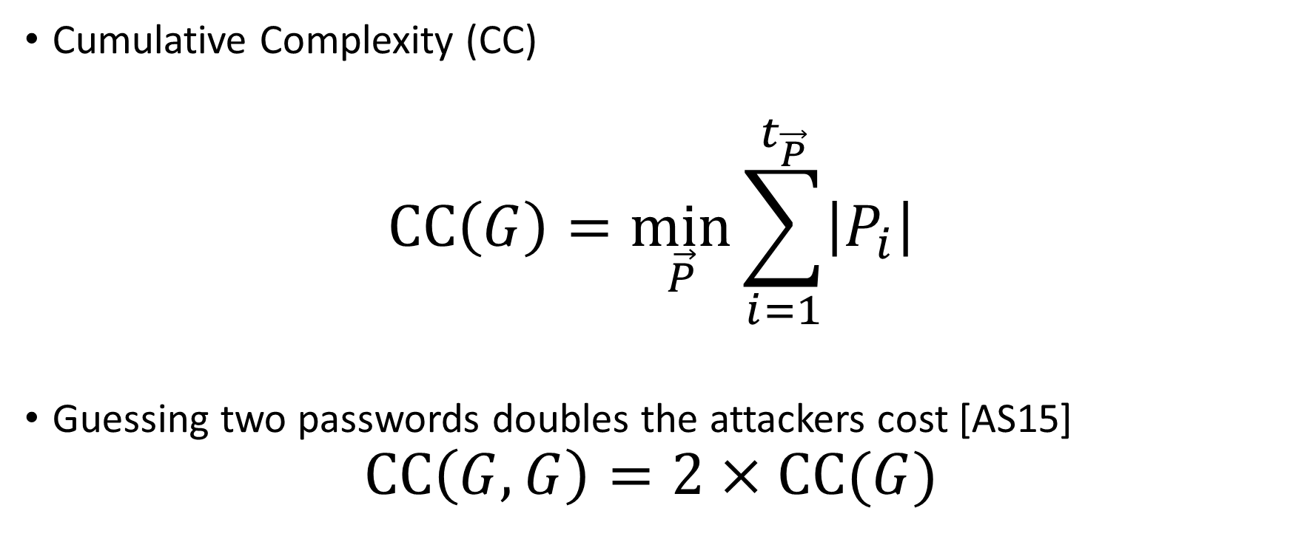
Measuring Cost
Cumulative Complexity (CC)
$$CC\left(G\right)=\min_{\vec{P}}{\sum_{i=1}^{t_{\vec{P}}}{\left|P_{i}\right|}}$$
Guessing two passwords doubles the attackers cost [AS15]
$$CC\left(G,G\right)=2×CC(G)$$

Slide 24
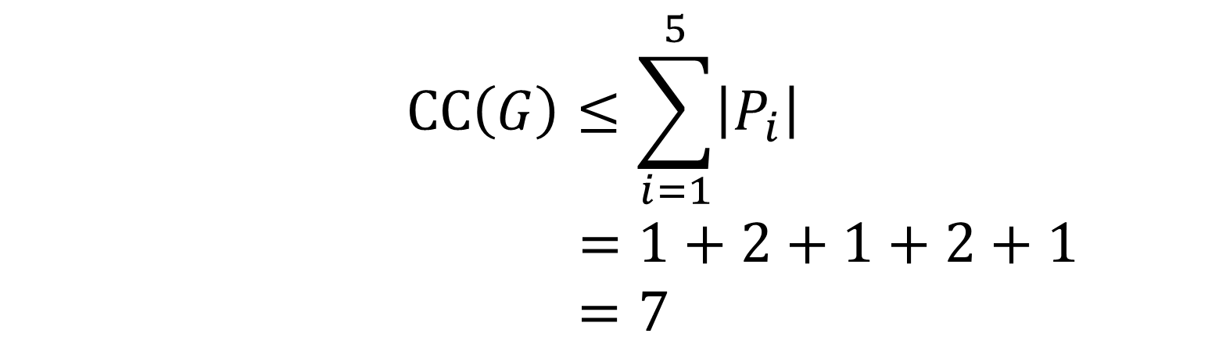
Pebbling Example (CC)
1
2
3
4
5
P₁ = {1}
$$CC\left(G\right)≤\sum_{i=1}^{5}{\left|P_{i}\right|}$$
$$=1+2+1+2+1$$
$=7$
P₂ = {1,2}
P₃ = {3}
P₄ = {3,4}
P₅ = {5}

Slide 25


Desiderata
Find a DAG G on n nodes such that
Constant Indegree ($δ=2)$
  Running Time: $n\left(δ−1\right)=n$
CC(G) $≥\frac{n2}{τ}$ for some small value $τ$.
Maximize costs for fixed running time n
(Users are impatient)

Slide 26
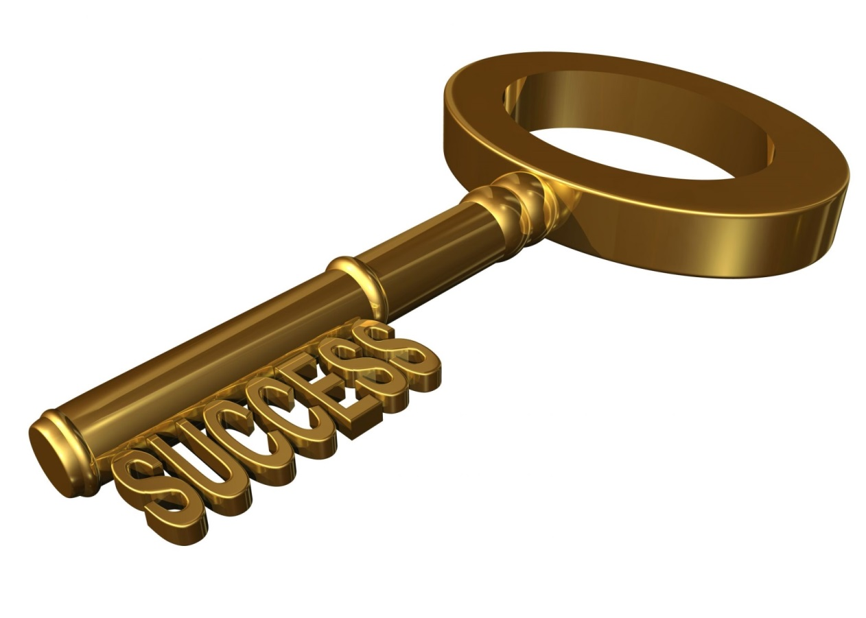
Depth-Robustness: The Key Property
Necessary [AB16] and sufficient [ABP16] for secure iMHFs

Slide 27

Depth Robustness
Definition: A DAG G=(V,E) is (e,d)-reducible if there exists $S⊆V$
s.t. $\left|S\right|≤e$ and depth(G-S) $≤d.$
Otherwise, we say that G is (e,d)-depth robust.
Example: (1,2)-reducible
1
2
3
4
5

Slide 28

Depth Robustness
Definition: A DAG G=(V,E) is (e,d)-reducible if there exists $S⊆V$
s.t. $\left|S\right|≤e$ and depth(G-S) $≤d.$
Otherwise, we say that G is (e,d)-depth robust.
Example: (1,2)-reducible
1
2
3
4
5

Slide 29


Depth Robustness is Necessary
Theorem (Depth-Robustness is a necessary condition): If G is not (e,d)-node robust then $\operatorname{CC}\left(G\right)=O\left(en+\sqrt{n3d}\right)$ .
In particular, $\operatorname{CC}\left(G\right)=o\left(n2\right)$ for e,d=o(n).
Are existing iMHF candidates based on depth-robust DAGs?

Slide 30

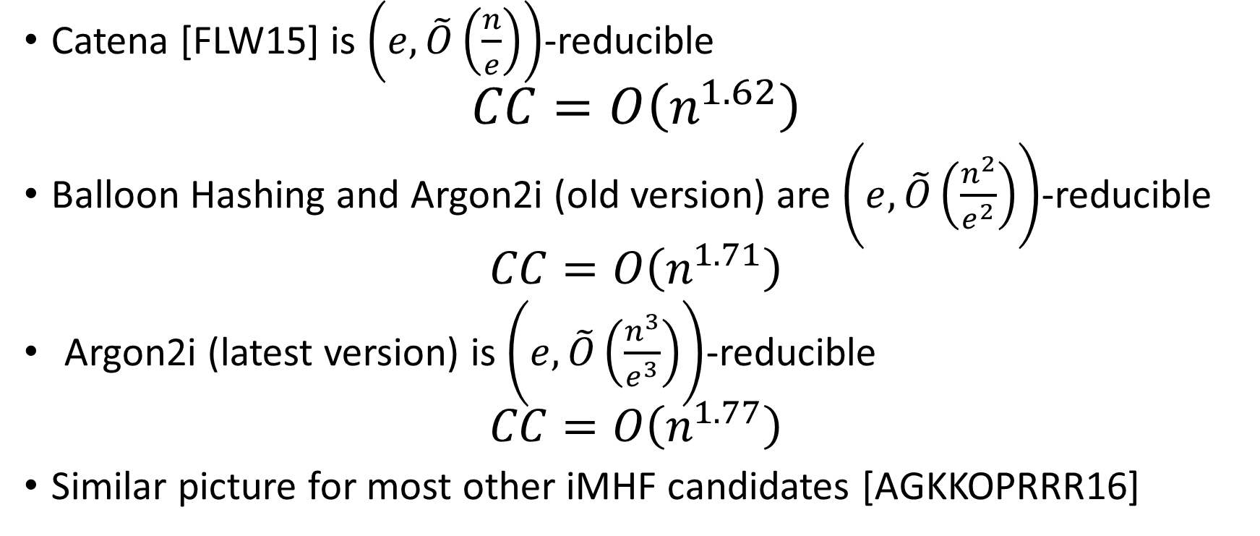
Answer: No
Catena [FLW15] is $\left(e,\tilde{O}\left(\frac{n}{e}\right)\right)$-reducible
$$CC=O\left(n^{1.62}\right)$$
Balloon Hashing and Argon2i (old version) are $\left(e,\tilde{O}\left(\frac{n^{2}}{e^{2}}\right)\right)$-reducible
  $$CC=O\left(n^{1.71}\right)$$
  Argon2i (latest version) is $\left(e,\tilde{O}\left(\frac{n^{3}}{e^{3}}\right)\right)$-reducible
  $$CC=O\left(n^{1.77}\right)$$
Similar picture for most other iMHF candidates [AGKKOPRRR16]

Slide 31

Argon2i [BDK]
Argon2: Winner of the password hashing competition[2015]
Authors originally recommended Argon2i variant (data-independent) for password hashing.
Notes:
Alex Biryukov, Daniel Dinu, and Dmitry Khovratovich from University of Luxembourg.

Slide 32
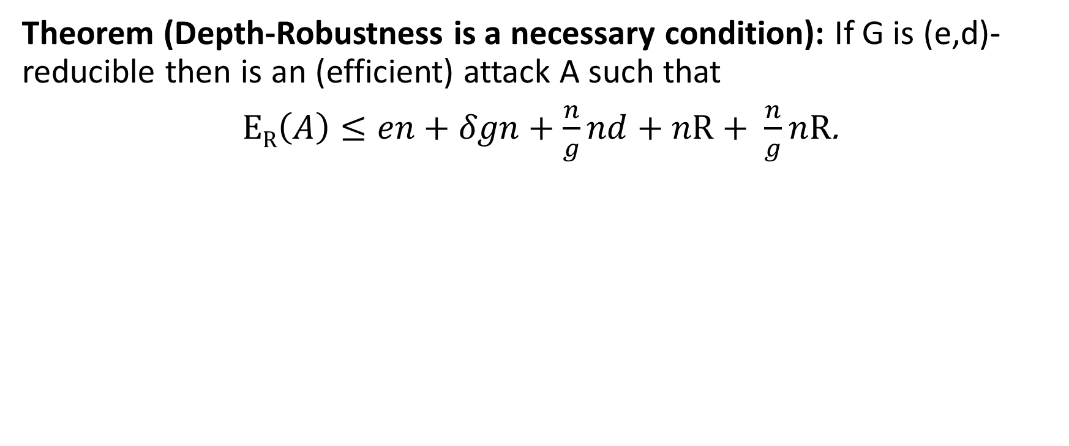
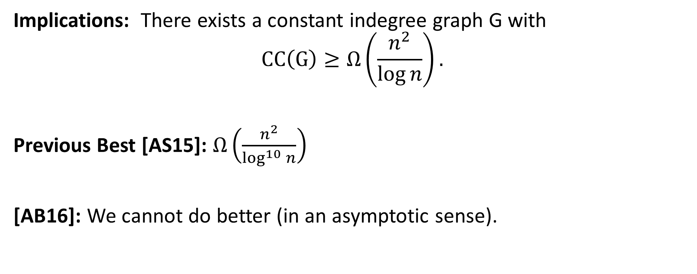
Depth-Robustness is Sufficient! [ABP17]
$Key Theorem:$Let G=(V,E) be (e,d)-depth robust then CC(G)$≥ed$.
Implications: There exists a constant indegree graph G with
$$CC\left(G\right)≥Ω\left(\frac{n^{2}}{\log{n}}\right).$$
Previous Best [AS15]: $Ω\left(\frac{n^{2}}{\log^{10}{n}}\right)$
[AB16]: We cannot do better (in an asymptotic sense).

Slide 33
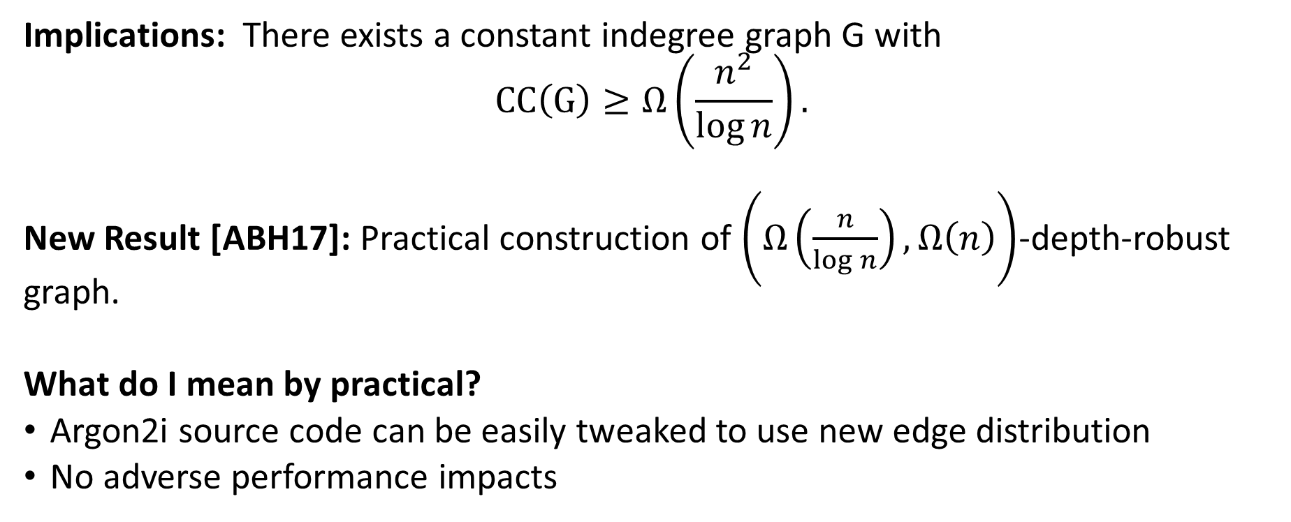
Practical Construction of Depth-Robust Graph
$Theorem [ABP17]:$Let G=(V,E) be (e,d)-depth robust then CC(G)$≥ed$.
Implications: There exists a constant indegree graph G with
$$CC\left(G\right)≥Ω\left(\frac{n^{2}}{\log{n}}\right).$$
New Result [ABH17]: Practical construction of $\left(Ω\left(\frac{n}{\log{n}}\right),Ω\left(n\right)\right)$-depth-robust graph.
What do I mean by practical?
Argon2i source code can be easily tweaked to use new edge distribution
No adverse performance impacts

Slide 34
Empirical Security Analysis
More Secure

Slide 35
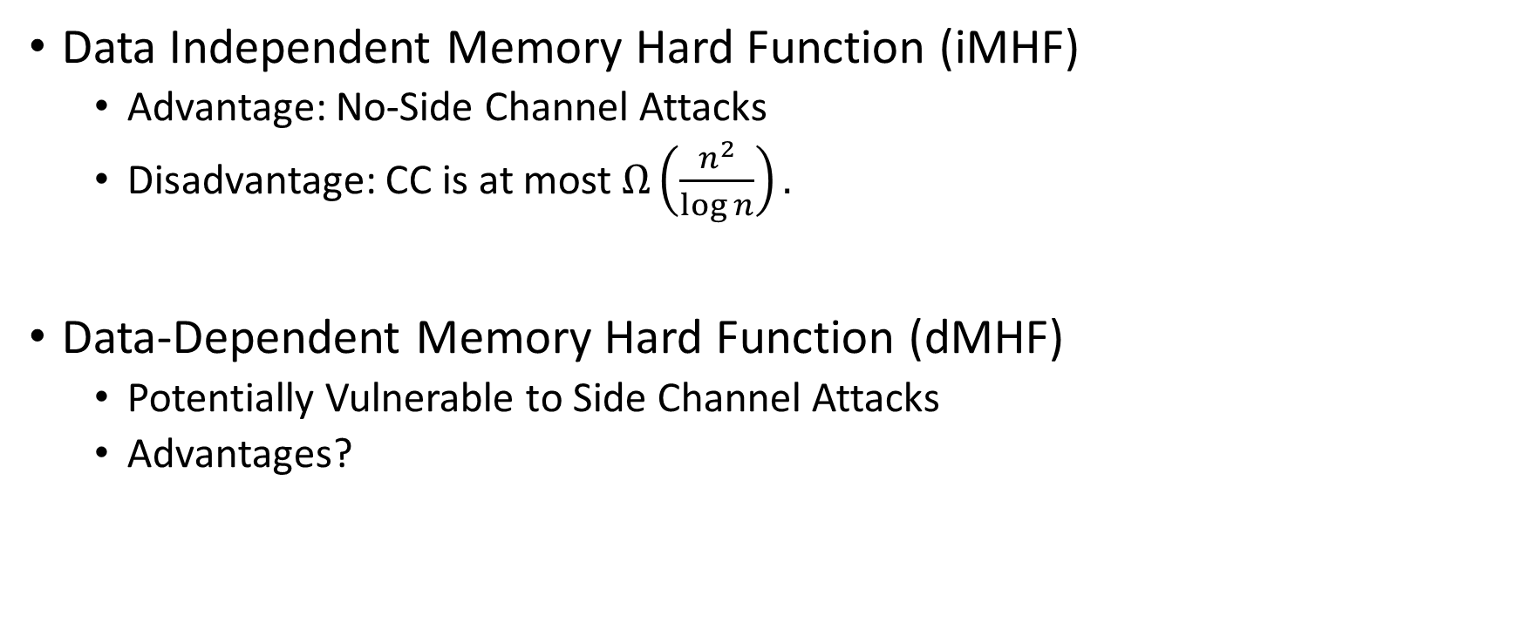
Data-Independent vs. Data-Dependent MHF
Data Independent Memory Hard Function (iMHF)
  Advantage: No-Side Channel Attacks
  Disadvantage: CC is at most $Ω\left(\frac{n^{2}}{\log{n}}\right).$
Data-Dependent Memory Hard Function (dMHF)
  Potentially Vulnerable to Side Channel Attacks
  Advantages?
Notes:
In this work we study a special type of memory hard function called data-independent memory hard functions. As the name suggests the memory access pattern will not depend on the input making the functions resistant to side-channel attacks.

Slide 36
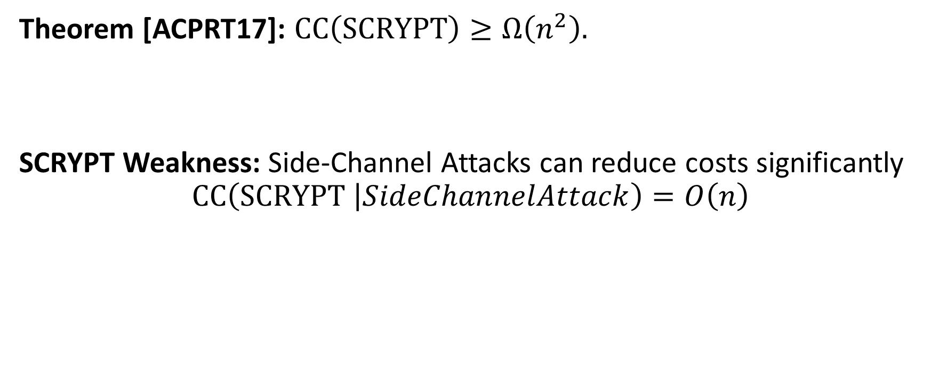
On the Security of SCRYPT
Theorem [ACPRT17]: $CC\left(SCRYPT\right)≥Ω\left(n^{2}\right).$
SCRYPT Weakness: Side-Channel Attacks can reduce costs significantly
$$CC\left(SCRYPT \left|SideChannelAttack\right.\right)=O\left(n\right)$$

Slide 37
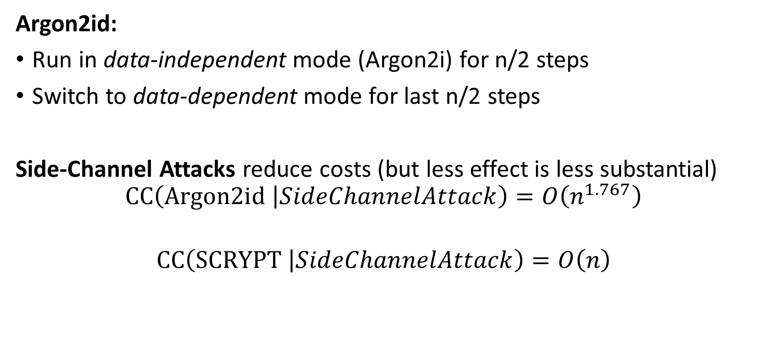
Hybrid Modes
Argon2id:
Run in data-independent mode (Argon2i) for n/2 steps
Switch to data-dependent mode for last n/2 steps
Side-Channel Attacks reduce costs (but less effect is less substantial)
$$CC\left(Argon2id \left|SideChannelAttack\right.\right)=O\left(n^{1.767}\right)$$
$$CC\left(SCRYPT \left|SideChannelAttack\right.\right)=O\left(n\right)$$

Slide 38
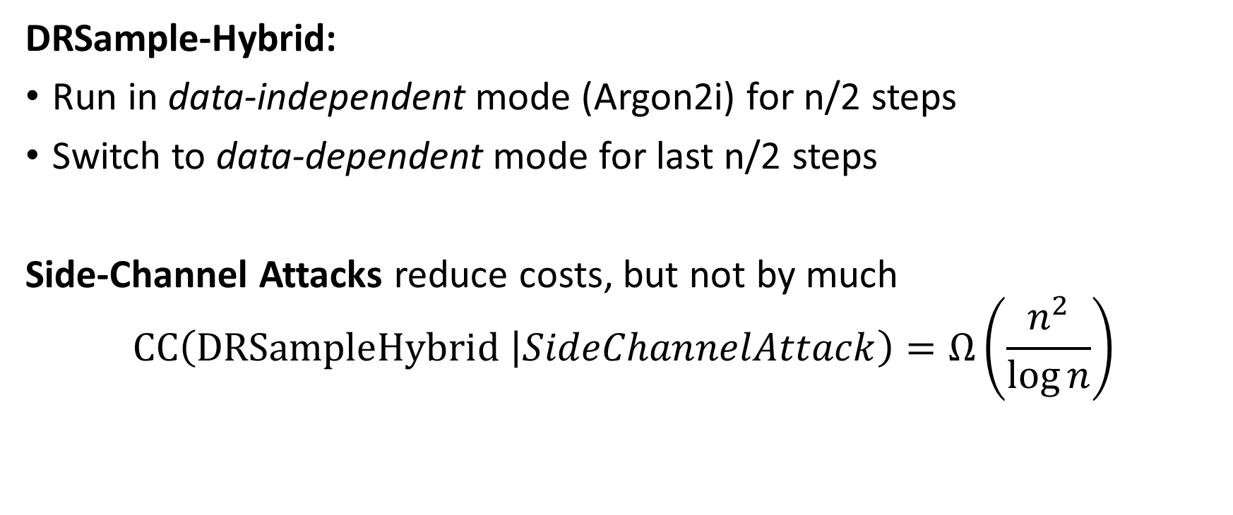
ABH17 Hybrid
DRSample-Hybrid:
Run in data-independent mode (Argon2i) for n/2 steps
Switch to data-dependent mode for last n/2 steps
Side-Channel Attacks reduce costs, but not by much
$$CC\left(DRSampleHybrid \left|SideChannelAttack\right.\right)=Ω\left(\frac{n^{2}}{\log{n}}\right)$$

Slide 39

Summary
BCRYPT and PBKDF2 are no longer sufficient for password hashing
Argon2i is an improvement over BCRYPT and PBKDF2
  But still has its flaws [AB16,AB17]
Argon2id
  No side channel attacks? Resists known attacks
  Side channel attacks reduce security to Argon2i
New Practical Construction from Depth-Robust Graphs
MHFs: Active Research Area

Slide 40

Thanks for Listening

Slide 41
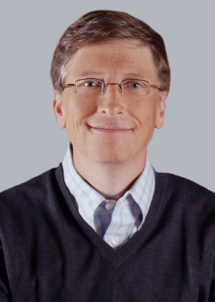
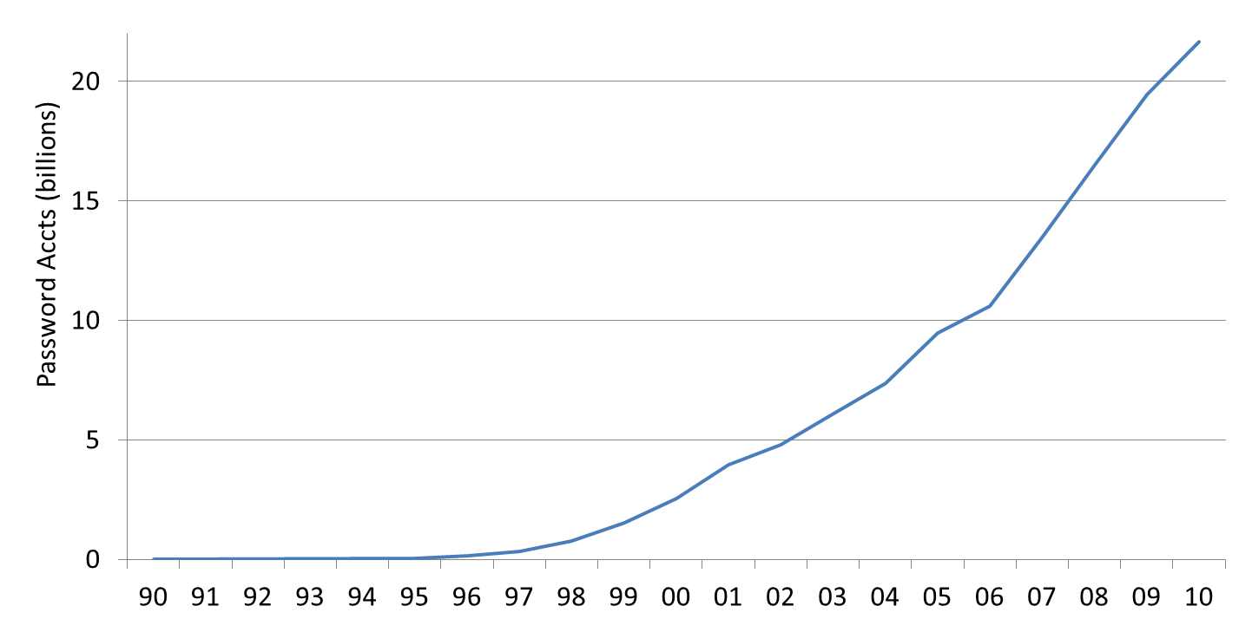
Passwords vs time: Look how far we’ve come
Source: Cormac’s estimate
“The password is dead”
Netscape IPO
Dotcom crash

Slide 42
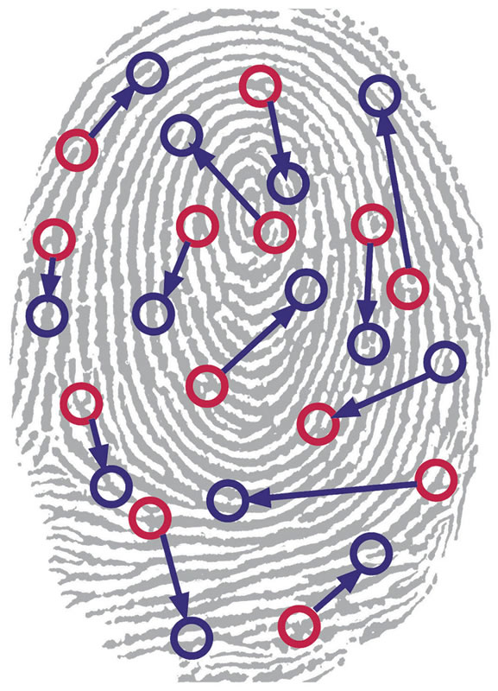
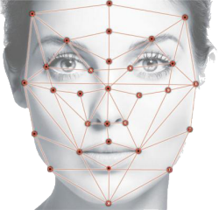
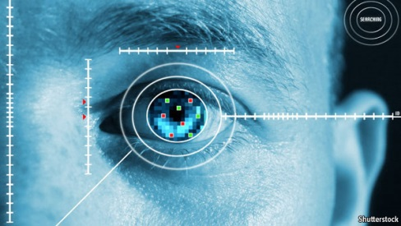

Biometrics
Notes:
Another line of research has sought to eliminate text passwords. One might ask whether or not password research will be relevant in the future. Bonneau, et al. considered each of these alternatives to text passwords in 2012 and concluded that there was no silver bullet to replace text passwords. While every proposed replacement has desirable properties, every replacement scheme they evaluated also had its disadvantages. For example, biometrics signals like fingerprints cannot be changed if they are compromised.
Quest to Replace Passwords
Bonneau, J. ; Univ. of Cambridge, Cambridge, UK ; Herley, C. ; van Oorschot, P.C. ; Stajano, F.

Slide 43
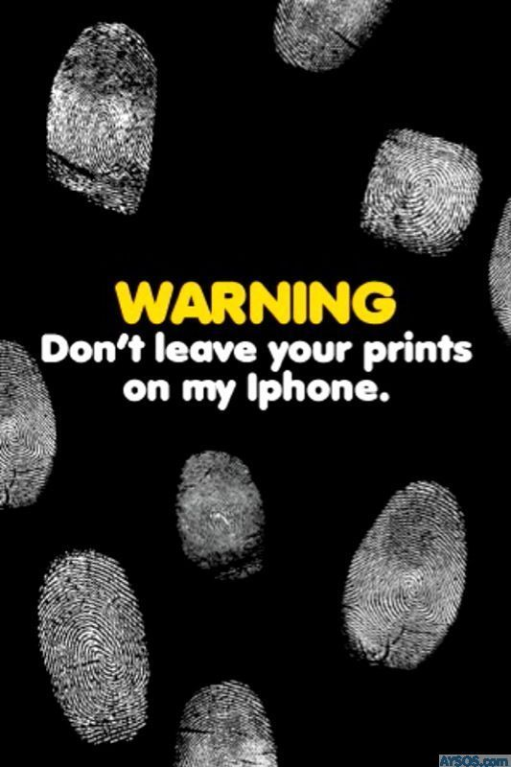
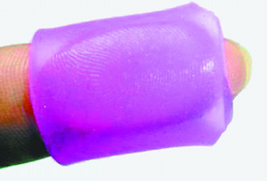
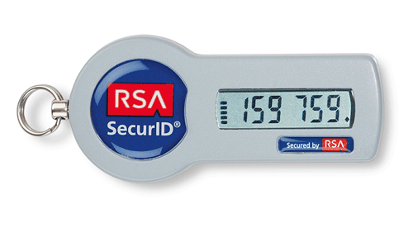


Biometrics
Challenges: Revoke? Secrecy?
Alternatives to Passwords
Notes:
Another line of research has sought to eliminate text passwords. One might ask whether or not password research will be relevant in the future. Bonneau, et al. considered each of these alternatives to text passwords in 2012 and concluded that there was no silver bullet to replace text passwords. While every proposed replacement has desirable properties, every replacement scheme they evaluated also had its disadvantages. For example, biometrics signals like fingerprints cannot be changed if they are compromised.
Quest to Replace Passwords
Bonneau, J. ; Univ. of Cambridge, Cambridge, UK ; Herley, C. ; van Oorschot, P.C. ; Stajano, F.

Slide 44
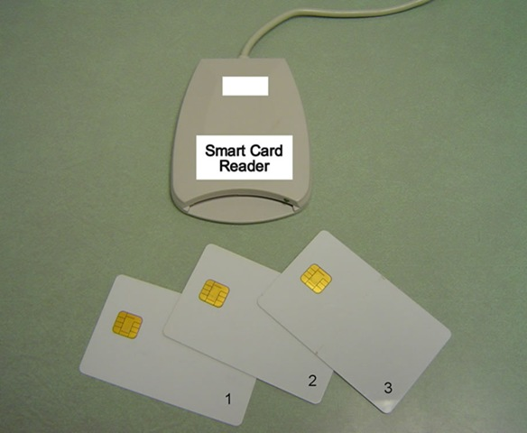
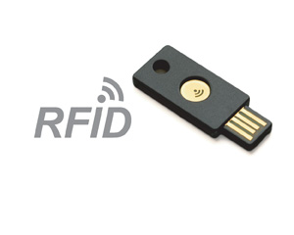
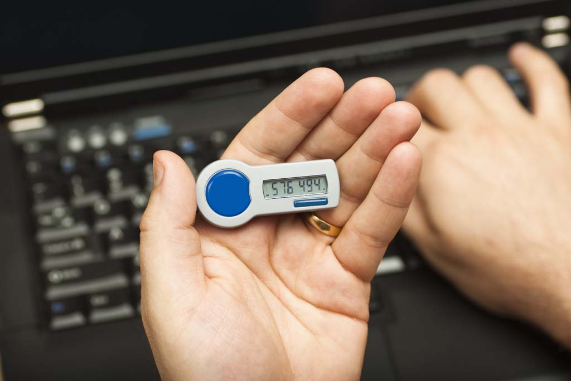
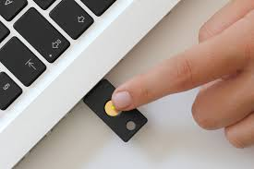
Hardware Tokens
Notes:
Another line of research has sought to eliminate text passwords. One might ask whether or not password research will be relevant in the future. Bonneau, et al. considered each of these alternatives to text passwords in 2012 and concluded that there was no silver bullet to replace text passwords. While every proposed replacement has desirable properties, every replacement scheme they evaluated also had its disadvantages. For example, biometrics signals like fingerprints cannot be changed if they are compromised.
Quest to Replace Passwords
Bonneau, J. ; Univ. of Cambridge, Cambridge, UK ; Herley, C. ; van Oorschot, P.C. ; Stajano, F.

Slide 45
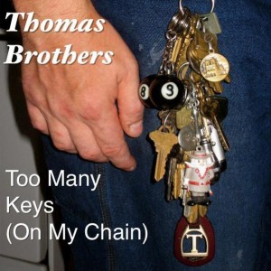
Hardware Tokens
Challenge: $$$ + more stuff to carry around
Alternatives to Passwords
Notes:
Another line of research has sought to eliminate text passwords. One might ask whether or not password research will be relevant in the future. Bonneau, et al. considered each of these alternatives to text passwords in 2012 and concluded that there was no silver bullet to replace text passwords. While every proposed replacement has desirable properties, every replacement scheme they evaluated also had its disadvantages. For example, biometrics signals like fingerprints cannot be changed if they are compromised.
Quest to Replace Passwords
Bonneau, J. ; Univ. of Cambridge, Cambridge, UK ; Herley, C. ; van Oorschot, P.C. ; Stajano, F.

Slide 46
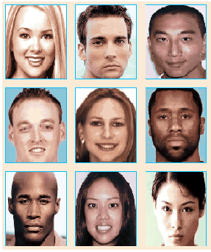
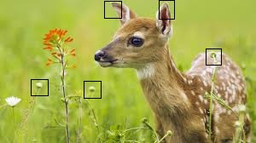
Graphical Passwords
Examples:
  Passfaces, Cued Click Points, Windows 8
…
Notes:
Graphical passwords have been an active area of research over the past 2 decades. Graphical password schemes aim to make passwords easier to remember by taking advantage of the natural human capacity for visual memory and cued recall. We will seek to exploit visual and associative memory with Person-Action-Object stories. The key difference is that we are focused on strategies for creating and remembering multiple passwords.
Graphical password authentication using cued click points
S Chiasson, PC van Oorschot, R Biddle - Computer Security–ESORICS

Slide 47
Graphical Passwords
Challenge: Multiple Passwords
Graphical Passwords
  Passfaces, Cued Click Points, Windows 8
…
Notes:
Graphical passwords have been an active area of research over the past 2 decades. Graphical password schemes aim to make passwords easier to remember by taking advantage of the natural human capacity for visual memory and cued recall. We will seek to exploit visual and associative memory with Person-Action-Object stories. The key difference is that we are focused on strategies for creating and remembering multiple passwords.
Graphical password authentication using cued click points
S Chiasson, PC van Oorschot, R Biddle - Computer Security–ESORICS

Slide 48
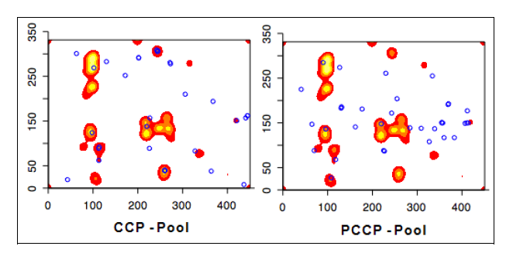
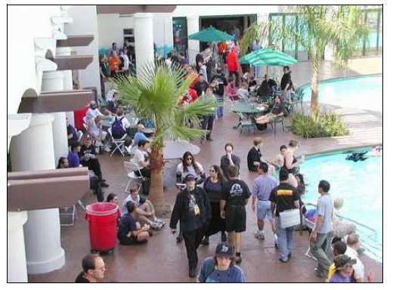
Graphical Passwords: Hotspots

Slide 49
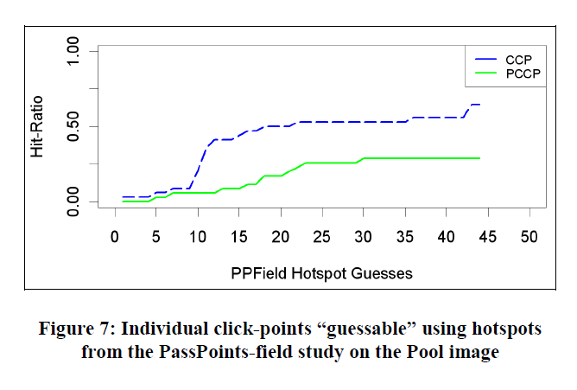
Graphical Passwords: Hotspots

Slide 50

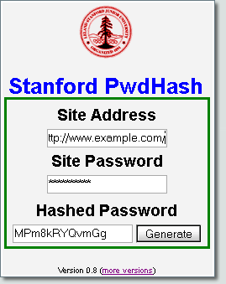

Password Managers
Password Management Software
Notes:
LastPass
KeePass
1Password
A Usability Study and Critique of Two Password Managers ∗
by S Chiasson, PC van Oorschot, R Biddle
PwdHash
Blake Ross, Collin Jackson, Nicholas Miyake, Dan Boneh and John C. Mitchell

Slide 51







Related Work
Challenge: Single point of failure
Password Management Software
Notes:
LastPass
KeePass
1Password
A Usability Study and Critique of Two Password Managers ∗
by S Chiasson, PC van Oorschot, R Biddle
PwdHash
Blake Ross, Collin Jackson, Nicholas Miyake, Dan Boneh and John C. Mitchell

Slide 52
References
Depth-Robust Graphs and Their Cumulative Memory Complexity. with Joel Alwen and Krzysztof Pietrzak. EUROCRYPT 2017 (to appear). [ePrint]
On the Computational Complexity of Minimal Cumulative Cost Graph Pebbling. with Samson Zhou. (Working Paper). [arXiv]
Towards Practical Attacks on Argon2i and Balloon Hashing. with Joel Alwen. EuroS&P 2017 (to appear). [ePrint]
Efficiently Computing Data Independent Memory Hard Functions. with Joel Alwen. CRYPTO 2016. [Full Version]

