Slide 1

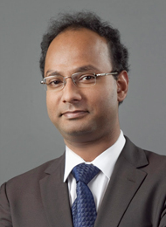
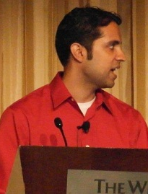
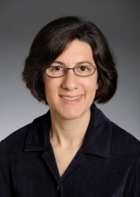
Usable and Secure Human Authentication
Professor Jeremiah Blocki
Computer Science Department
CERIAS Security Seminar
10/19/2016

Slide 2

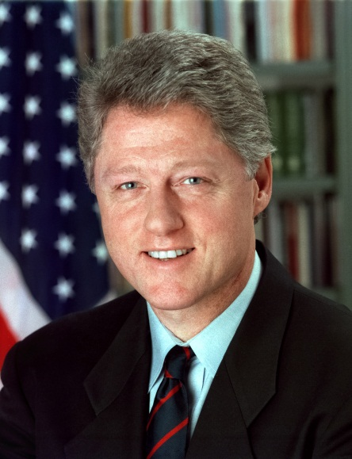
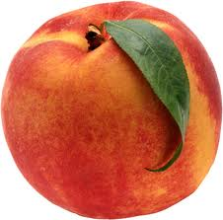
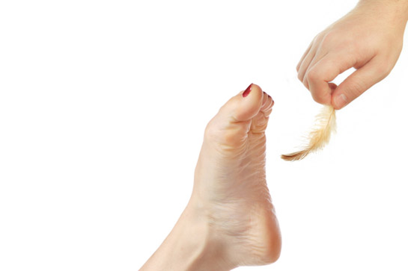
Memory Experiment 1
Person | Bill Clinton
Action | Tickling
Object | Peach

Slide 3

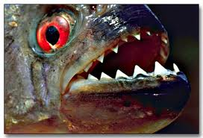
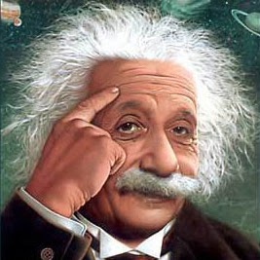

Memory Experiment 3
Person | Albert Einstein
Action | Kissing
Object | Piranha

Slide 4





Password Management
…
Competing Goals:
Security
Usability
Notes:
Password management scheme is any strategy used to create and remember multiple passwords for multiple accounts.
Increased challenge security/usability analysis should look at the problem wholelistically
Position: This is not the user’s fault!
We want a management scheme which is
1. Easy for the user to manage
2. Secure (hard for adversary to compromise accounts)

Slide 5
Security (what could go wrong?)
Three Types of Attacks
Online
Offline
Plaintext Recovery
Danger
Notes:
Three types of attacks, Online, Offline and Phishing. I will illustrate each attack in more detail in the following slides.

Slide 6


Online Attack
123456
password
123456
Guess Limit: k-strikes policy
Notes:
A k-strikes policy is used to mitigate this threat. However, users who select popular passwords like 123456 might still be vulnerable.

Slide 7


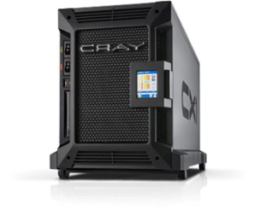
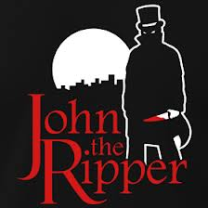
Offline Dictionary Attack
jblocki, Unbr3akabl3
Username
jblocki
Salt
89d978034a3f6
Hash
75fe9ccf4a568f31e66b8597b8eb97c2e915e6b1
SHA1(Unbr3akabl389d978034a3f6)=75fe9ccf4a568f31e66b8597b8eb97c2e915e6b1
+
Notes:
To understand the next type of attack it is necessary to understand how organizations store passwords. When I create an account online the server typically will
select a random value (called the salt).
Compute and store the cryptographic hash of my password with the salt appended.
Later to authenticate the server will re-compute this hash value, and make sure that it matches the stored version.
Sometimes these password files are stolen by adversaries, who can then execute an offline dictionary attack. Offline attacks are more dangerous than online attacks because there is no k-strikes limit. There are many popular password cracking tools that the adversary could use (e.g, John the Ripper). Unfortunately, these attacks are commonplace. Even large companies like (Sony, Zappos, and LinkedIn) have been breached.

Slide 8







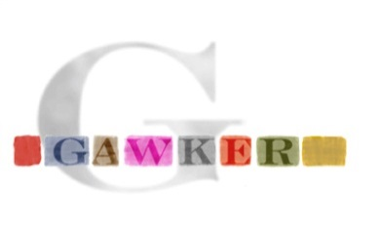

A Common Problem
Password breaches at major companies have affected millions of users.
Notes:
Unfortunately, offline dictionary attacks are quite common. Password breaches at major companies have affected millions of users.

Slide 9





Security Problem
Password breaches at major companies have affected millions of users.
Notes:
Unfortunately, offline dictionary attacks are quite common. Password breaches at major companies have affected millions of users.

Slide 10
Security Problem
Password breaches at major companies have affected millions of users.
Notes:
Unfortunately, offline dictionary attacks are quite common. Password breaches at major companies have affected millions of users.

Slide 11
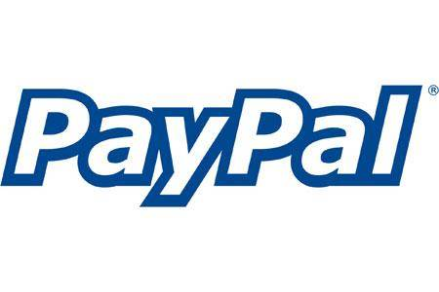


Plaintext Recovery Attack
pwd
PayPaul.com
pwd
Notes:
Instead of trying to crack the user’s password. Why not just get him to tell me the password. Adversary tricks user into creating an account on a malicious site (PayPaul.com).
Examples of plaintext recovery attacks include phishing attacks, malware and hidden cameras.
Once the adversary has this password the PayPal account is compromised. If the user reuses the same password for other accounts then the adversary can also access these sites.

Slide 12


Plaintext Recovery
pwd
pwd
PayPaul.com
Source: CERT Incident Note IN-98.03: Password Cracking Activity
Notes:
Instead of trying to crack the user’s password. Why not just get him to tell me the password.
Adversary tricks user into creating an account on a malicious site (PayPaul.com).
Once the adversary has this background information the brute force attack on PlayStation may be more likely to succeed
Finally, the background information from PayPaul (and possibly PlayStation) can be used to help improve the Online attack

Slide 13
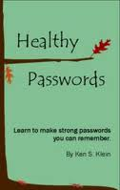
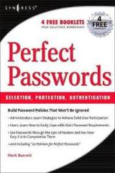
A Challenging Problem
Traditional Security Advice
Use numbers and letters
Use special symbols
Don’t Reuse Passwords
Don’t use words/names
Not too short
Don’t Write it Down
Use mix of lower/upper case letters
Change your passwords every 90 days
Notes:
We have been using passwords for decades. Many books and articles have been written about password creation. Traditionally the advice a user gets is something like the following…
Is it time to re-evaluate the traditional security advice?

Slide 14
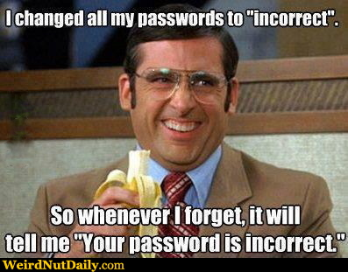
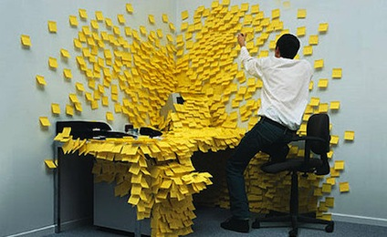
User Frustration
Notes:
This brings me to my second point. We have a problem with usabilty. Users struggle to remember their passwords. The popularity of memes like these indicate that this is a common user experience.

Slide 15
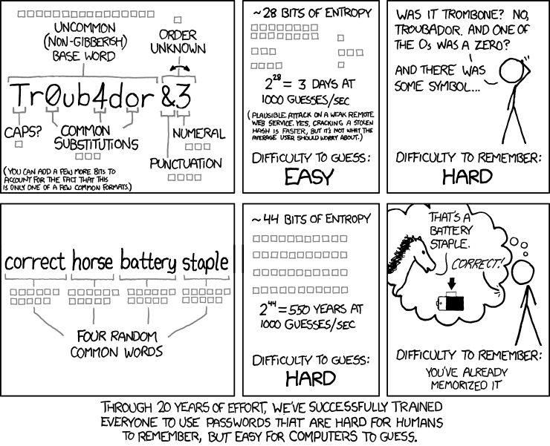
Reevaluate Traditional Advice?
XKCD
Source: http://www.xkcd.com/936/ [Munroe]
Notes:
In a recent web comic Randal Munroe suggested it would be easier (and more secure) for users to pick 4 random words from a 2000 word dictionary than to follow traditional advice.
Question: Is it time to reevaluate the password management advice that is given to users?
Lets run a couple of tests…
In each experiment I am going to ask you to associate a four randomly selected words with a picture. At the end of the talk I will show you the picture and check to see how many of the words you can remember. This is a memory experiment so please don’t write down any of the words.
Takes advantage of chunking!
Note: Comic uses entropy metric, but if the words are selected uniformly at random from a Dictionary of 2000 words then the min-entropy is also 44 bits

Slide 16
Scheme 1: Reuse Strong Password
Pick four random words w₁,w₂,w₃,w₄
Account | Amazon | Ebay
Password | w₁w₂w₃w₄ | w₁w₂w₃w₄

Slide 17
Scheme 2: Strong Random Independent
Four Independent Random Words per Account
Account | Amazon | Ebay
Password | w₁w₂w₃w₄ | x₁x₂x₃x₄

Slide 18
Password Management
…
Competing Goals:
Security
Usability
Notes:
Password management scheme is any strategy used to create and remember multiple passwords for multiple accounts.
Increased challenge security/usability analysis should look at the problem wholelistically
Position: This is not the user’s fault!
We want a management scheme which is
1. Easy for the user to manage
2. Secure (hard for adversary to compromise accounts)

Slide 19
Can We Do Better?
My Answer: Yes, we can.
Mnemonics
Spaced Repetition
Combinatorial Designs
Better Solutions

Slide 20

Human memory is not a hard disk
Read/Write Head
Platters
Slide Credit [BS14]
Notes:
The standard computer science approach would be to look at the problem this way
*

Slide 21
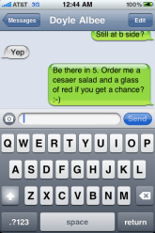
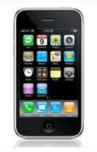
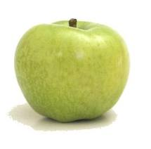





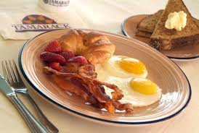
Human Memory is Associative
?
Source: Human Memory: Theory and Practice [Baddeley, 90]

Slide 22
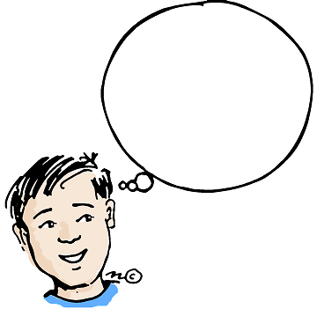
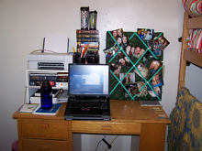

Cues
Cue: context when a memory is stored
Surrounding Environment
  Sounds
  Visual Surroundings
  Web Site
  ….
As time passes we forget some of this context…
Source: Human Memory: Theory and Practice [Baddeley, 90]
Notes:
Insert Picture Here!
Environment: Memory Champions Wear Blinders

Slide 23
First Attempt: Chunking
Memorize: nbccbsabc
Memorize: tkqizrlwp
3 Chunks vs. 9 Chunks!
Usability Goal: Minimize Number of Chunks in Passwords
Incomplete
Source: The magical number seven, plus or minus two [Miller, 56]
Notes:
If all we care about is usability one good goal is minimizing number of chunks in the password

Slide 24

Human Memory: Vast, but Lossy
Rehearse or Forget!
  How much work?
Quantify Usability
  Rehearsal Assumption
p_{amazon}
????
p_{google}
Notes:
While our memory is vast, but we tend to forget things. This is what makes the password management problem challenging. Our basic premise is that we our capable of remembering secrets if we get sufficient rehearsal. We seek to quantify usability by estimating how much extra work this takes.

Slide 25
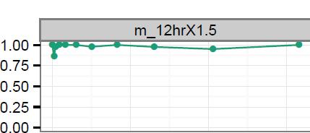
Memory Capability
Day
0
50
100
150
Succeeded(i)/Returned(i)
Source: Spaced Repetition and Mnemonics Enable Recall of Multiple Strong Passwords [BKCD15]
Notes:
Our user model is based on a memory capability. This capability states that a user can remember a secret if he rehearses the secret once during each of the following intervals. We call this rehearsal assumption the expanding rehearsal assumption because the intervals grow over time. Intuitively, it is easier to remember a secret if you have rehearsed several times in the past. The parameter s can account for factors like the strength of the mnemonic techniques used to memorize the secret.
This assumption was based on previous empirical results on spaced repetition, which indicate that participants were successfully able to remember vocabulary words when they followed similar rehearsal schedules. In our own user study we found that users were able to remember four PAO stories by following this schedule over 157 days. Users were most successful with s = 1.5.
A user might naturally satisfy some of these rehearsal requirements if he has to remember a secret to authenticate. Suppose that we remind a user to rehearse a secret whenever he doesn’t get natural practice during an interval.
Observe that if the user reuses his password then all cues are rehearsal requirements are satisfied naturally. If the passwords are completely independent then X_{8.}
_{Sources:}
Wozniak, P., and Gorzelanczyk, E. J. Optimization of repetition spacing in
the practice of learning. Acta neurobiologiae experimentalis 54 (1994), 59–59.
Algorithm behind SuperMemo
Anderson, J. R., and Schooler, L. J. Reflections of the environment in memory.
Psychological science 2, 6 (1991), 396–408.

Slide 26
Rehearsal Requirement
Day: 1 2 4 5 8
Expanding Rehearsal Assumption: user maintains cue-association pair by rehearsing during each interval [s^{i}, s^{i+1}].
Visit Amazon: Natural Rehearsal
Google
Source: Optimization of Repetition Spacing in the Practice of Learning [WG, 94]
Notes:
Observe that if the user reuses his password then all cues are rehearsal requirements are satisfied naturally. If the passwords are completely independent then X_{8.}
_{Sources:}
Wozniak, P., and Gorzelanczyk, E. J. Optimization of repetition spacing in
the practice of learning. Acta neurobiologiae experimentalis 54 (1994), 59–59.
Algorithm behind SuperMemo
Anderson, J. R., and Schooler, L. J. Reflections of the environment in memory.
Psychological science 2, 6 (1991), 396–408.

Slide 27
Extra Rehearsals
Day: 1 2 4 5 8
X_{t}: extra rehearsals to maintain all passwords for t days.
 | Reuse Password | Independent Passwords
X₈ | 0 | 2
Usability Measure: X_{t}
Usability Goal: Minimize X_{t}
Notes:
Observe that if the user reuses his password then all cues are rehearsal requirements are satisfied naturally. If the passwords are completely independent then X₈
Our usability goal is to minimize the total amount of extra work that the user needs to do.

Slide 28
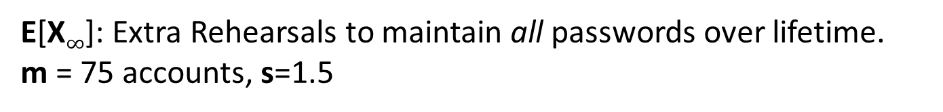
Usability Results
 | Reuse Password | Strong Random Independent
Active | 0.002 | 2,938
Typical | 0.023 | 2,974
Occasional | 0.109 | 3,135
Infrequent | 3.239 | 4,024
E[X$∞$]: Extra Rehearsals to maintain all passwords over lifetime.
m = 75 accounts, s=1.5
Usable
Unusable
Notes:
Our usability model explains why it is so hard to memorize independent passwords.
We developed several different types of user profiles. Each user has 75 accounts. The active user visits many of his accounts regularly, while the infrequent user rarely visits his accounts. If we reuse passwords then essentially we never need rehearsal reminders. If we pick independent passwords then we need thousands of rehearsal reminders. To make matters worse thousands of these rehearsal reminders come in the first week!

Slide 29
Our Security Approach
Dangerous World Assumption
  Not enough to defend against existing adversaries
  Adversary can adapt after learning the user’s new password management strategy
Provide guarantees even when things go wrong
  Offline attacks should fail with high probability
  Limit damage of a successful phishing attack
Notes:
Philosophy: We can propose a password management scheme, but adversary will adapt his attack.
Lets introduce a formal framework for analyzing security

Slide 30

Security as a Game
p₁
p₂
p₃
p₄
p₅
BCRYPT(p₄)
p₅
PayPaul.com
q_{$1,000,000} guesses
+

Slide 31
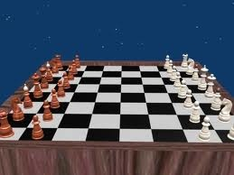
The Adversary’s Game
Adversary can compromise at most r sites (plaintext recovery attack).
Adversary can execute offline attacks against at most h additional sites
  Resource Constraints => at most q guesses
Adversary wins if he can compromise any new sites.
pwd
BCRYPT(pwd)
Notes:
We model the adversary using a game. The adversaries goal is simple. Compromise the user’s accounts.
Specifically, we assume the adversary can compromise at most k sites. This means that the adversary learns up to k of the user’s passwords. We assume that the adversary execute offline attacks against at most t additional sites, and has time and resources to try at most M guesses in each offline attack. For example, the adversary might be willing to dedicate 1 year of time on a cray supercomputer to crack the user’s password.
We introduce our definition of security using a game. In the game the adversary gets to compromise a few sites and wins if he can compromise new sites. The user wins if the adversary fails to compromise new accounts.

Slide 32
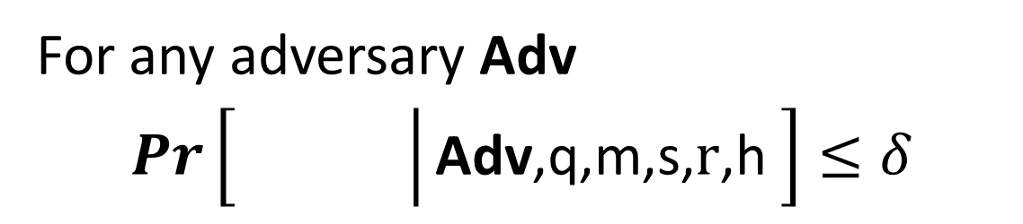

(q,$δ$,m,s,r,h)-Security
For any adversary Adv
$Pr\left[\left.\begin{matrix} & \\ & \end{matrix}\right|\text{Adv}\text{,}\text{q}\text{,}\text{m}\text{,}\text{s}\text{,} \text{r}\text{,}\text{h} \right]≤δ$
q = # offline guesses
s = # online guesses
r = #
h = #
m = # of accounts
Plaintext Recovery Accounts
Offline Attack Accounts

Slide 33
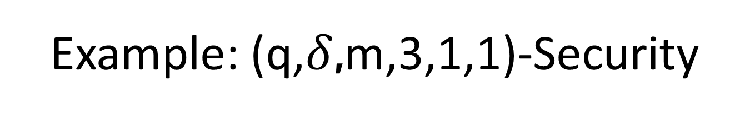
Example: (q,$δ$,m,3,1,1)-Security
h=1
+
PayPaul.com
q guesses
r=1
Notes:
User is safe as long as the adversary can’t execute more than one phishing/offline attack

Slide 34
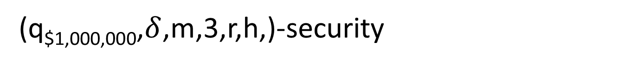
Security Results
Attacks | r= 1 | r= 1 h=1 | r=2
Reuse | No | No | No | No
Strong Random Independent | Yes | Yes | Yes | Yes
Usable + Insecure
Unusable + Secure
(q_{$1,000,000},$δ$,m,3,r,h,)-security
Notes:
First Column and Third Column:  = 10⁻⁶
Second Column:  = 10⁻²

Slide 35


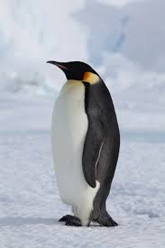
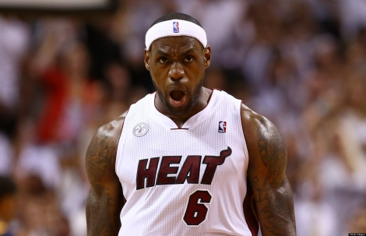
Our Approach
Public Cue
Private
Object: bike
Action: kicking
Object: penguin

Slide 36
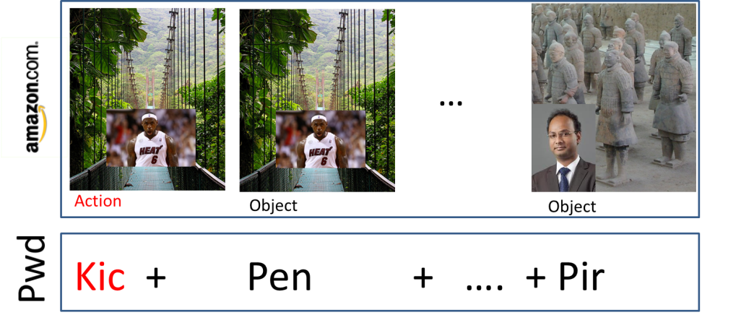
Login

Slide 37
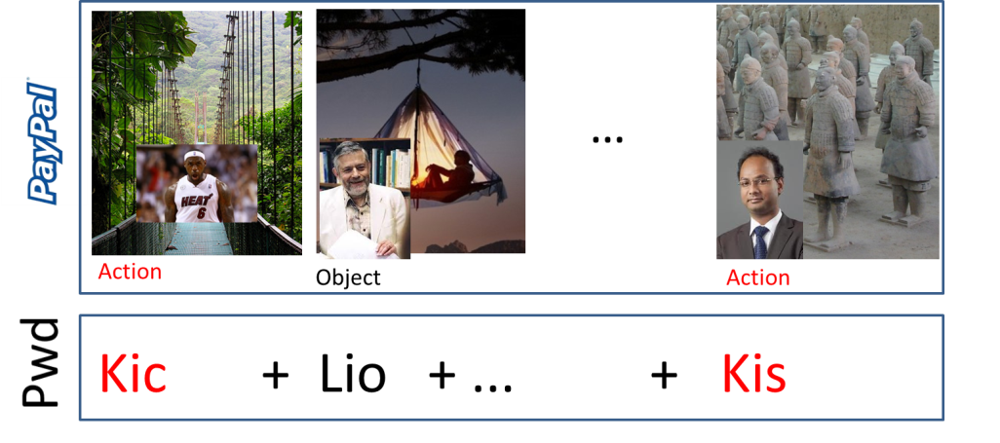
Login

Slide 38
Sharing Cues
Day: 1 2 4 5 8
Usability Advantages
  Fewer stories to remember!
  More Natural Rehearsals!
Security?

Slide 39
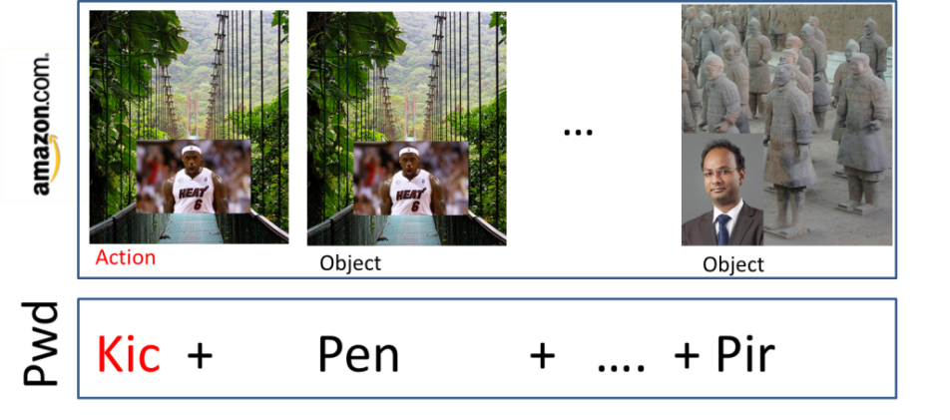

Sharing Cues
Combinatorial Design: Each pairs of accounts has at most 𝛄 secret stories in common.
Source: Naturally Rehearsing Passwords [BBD13]
Notes:
Previous work demonstrates that a user could use a few person-action-object stories to create multiple strong passwords. For example, in the Shared Cues scheme the user memorizes several randomly generated PAO stories. These stories are divided into two parts a public cue and a private secret. When the user authenticates to an account like amazon he is prompted with a public challenge, and the user forms his password by using the corresponding actions or objects that he has memorized. Similarly, when the user authenticates to Paypal the user is prompted with a different public challenge. Notice that part of the challenge is the same. The advantages of sharing cues are two fold: First, we reduce the number of stories that the user needs to memorize. More importantly we increase the rate at which the user rehearses each of his secret stories.

Slide 40
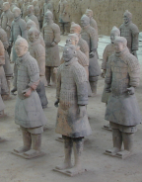
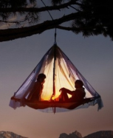

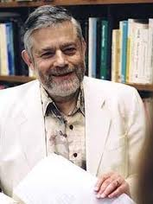

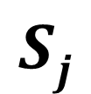




(n,$l$,$γ$)-Sharing Set Family
m – number of passwords {S₁,…,S_{m}}.
n – total #secrets the user memorizes
l – #secrets per password
$γ$– max intersection
$Si$ – secrets for
account i.
n
n
$$Sj$$
$$Si$$
$$l$$
$$γ$$
$$l$$

Slide 41
How Many Passwords?
PAO Stories | #Passwords | Security
4 | 14
Notes:
In the shared cues scheme there are tradeoffs between the number of stories that the user needs memorize, the number of passwords that we can form and the security of the scheme.
If the user is willing to memorize four stories then we can generate 14 unique passwords with the following moderately strong security guarantee. If the user is willing to memorize three more stories then we can generate over 75 unique passwords with the same security guarantee. If the user wants a stronger security guarantee that an adversary who has seen two passwords can’t guess any other password then he will need to memorize 15 passwords and if the user wants security after six password breaches then he needs to memorize 43 stories.

Slide 42
How Many Passwords?
PAO Stories | #Passwords | Security
4 | 14
Adversary with one password is unlikely to guess any other password
Notes:
In the shared cues scheme there are tradeoffs between the number of stories that the user needs memorize, the number of passwords that we can form and the security of the scheme.
If the user is willing to memorize four stories then we can generate 14 unique passwords with the following moderately strong security guarantee. If the user is willing to memorize three more stories then we can generate over 75 unique passwords with the same security guarantee. If the user wants a stronger security guarantee that an adversary who has seen two passwords can’t guess any other password then he will need to memorize 15 passwords and if the user wants security after six password breaches then he needs to memorize 43 stories.

Slide 43
How Many Passwords?
PAO Stories | #Passwords | Security
4 | 14
7 | 75+
15 | 75+
43 | 75+
Notes:
In the shared cues scheme there are tradeoffs between the number of stories that the user needs memorize, the number of passwords that we can form and the security of the scheme.
If the user is willing to memorize four stories then we can generate 14 unique passwords with the following moderately strong security guarantee. If the user is willing to memorize three more stories then we can generate over 75 unique passwords with the same security guarantee. If the user wants a stronger security guarantee that an adversary who has seen two passwords can’t guess any other password then he will need to memorize 15 passwords and if the user wants security after six password breaches then he needs to memorize 43 stories.

Slide 44

Security Results
Attacks | r=1 | r=1 h=1 | r=2
(n,𝓵,𝓵)-Sharing [Reuse] | No | No | No | No
(n,𝓵,0)-Sharing [Independent] | Yes | Yes | Yes | Yes
(30,6,2)-Sharing [SC-1] | Yes | Yes | Yes | No
(n,5,3)-Sharing [SC-0] | Yes | No | No | No
(10¹⁰, $δ$,m,3,r,h)-security
Notes:
First Column and Third Column:  = 10⁻⁶
Second Column:  = 10⁻²

Slide 45
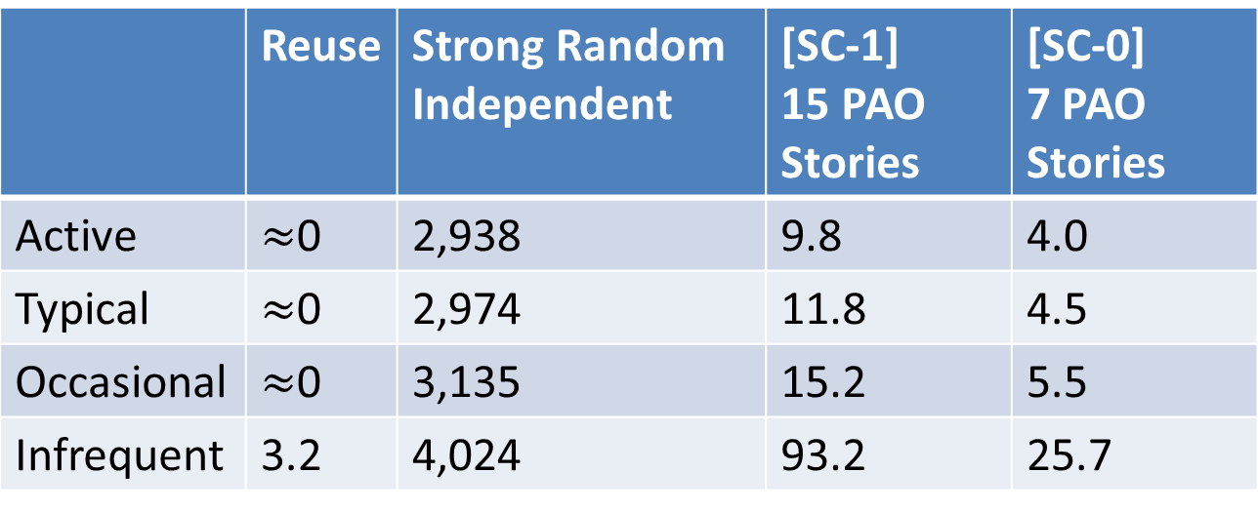
Usability Results
 | Reuse | Strong Random Independent | [SC-1] 15 PAO Stories | [SC-0] 7 PAO Stories
Active | $≈$0 | 2,938 | 9.8 | 4.0
Typical | $≈$0 | 2,974 | 11.8 | 4.5
Occasional | $≈$0 | 3,135 | 15.2 | 5.5
Infrequent | 3.2 | 4,024 | 93.2 | 25.7
E[X$∞$]: Extra Rehearsals to maintain all passwords over lifetime.
Notes:
In the Shared Cues scheme the user only needs a couple of rehearsal reminders in the first week to make sure that he remembers his passwords. These schemes require a bit more effort than reusing the same password, but the security guarantees are much stronger. After the first week the reminder mechanism would not be needed.

Slide 46
Future Directions
Shared Cues as Browser Extension
Gradual Password Strengthening
Recovering Forgotten Secrets
Intrusion Detection

Slide 47

Other Research Interests
Making Hashed Passwords as hard as possible to crack
  Memory Hard Functions
  Security Games
Human Computable Challenge-Response Style Authentication

Slide 48

Thanks for Listening!

Slide 49

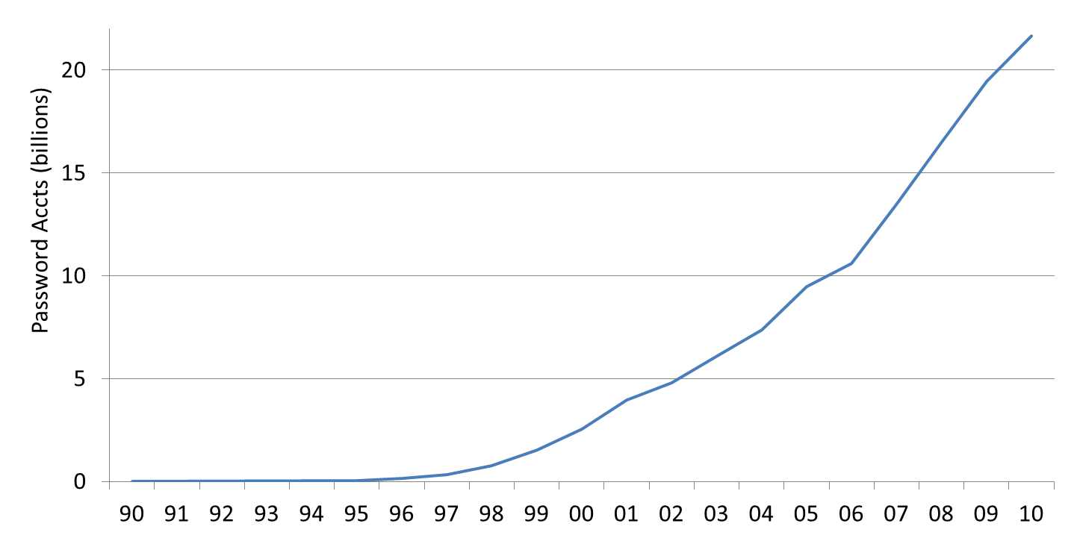
Passwords vs time: Look how far we’ve come
“The password is dead”
Netscape IPO
Dotcom crash
Source: Cormac Hereley’s estimate

Slide 50
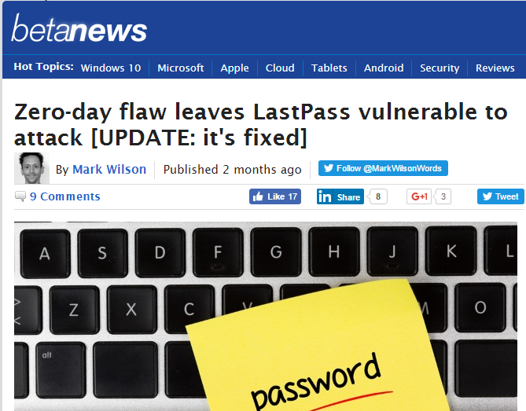
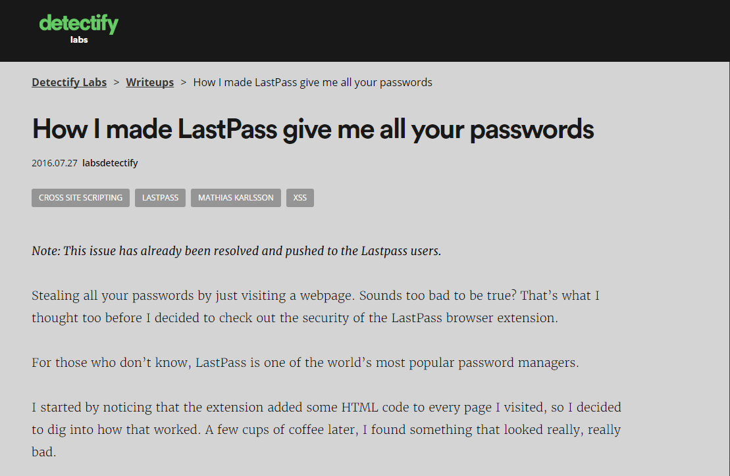
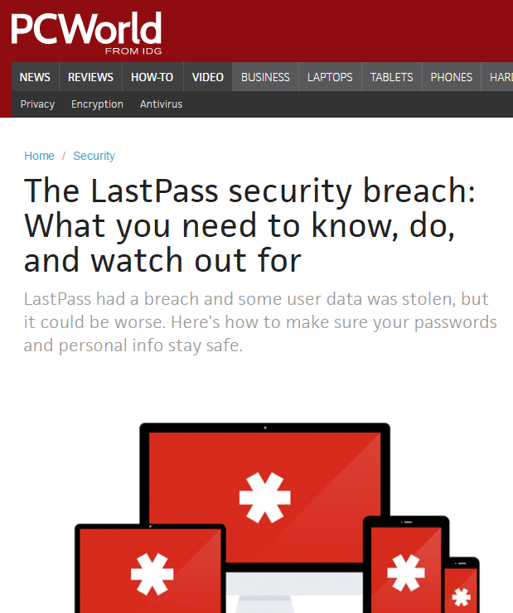
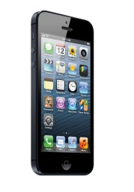


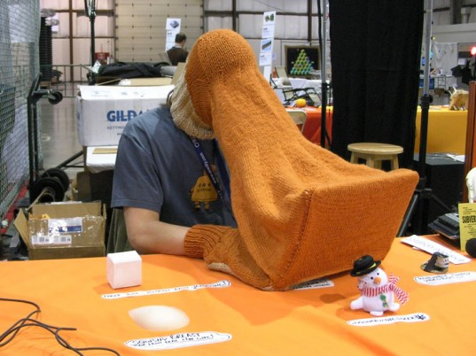
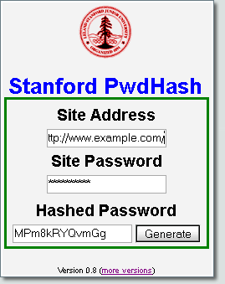



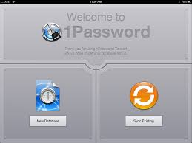
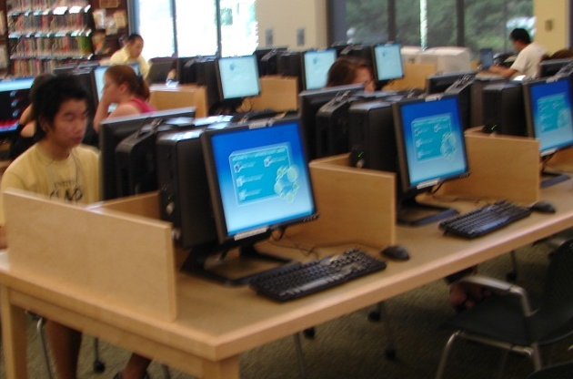
Password Manager
Goal: Minimize Trust Assumptions about User’s
Computational Devices
Password Management Software
Notes:
LastPass
KeePass
1Password
A Usability Study and Critique of Two Password Managers ∗
by S Chiasson, PC van Oorschot, R Biddle
PwdHash
Blake Ross, Collin Jackson, Nicholas Miyake, Dan Boneh and John C. Mitchell

Slide 51

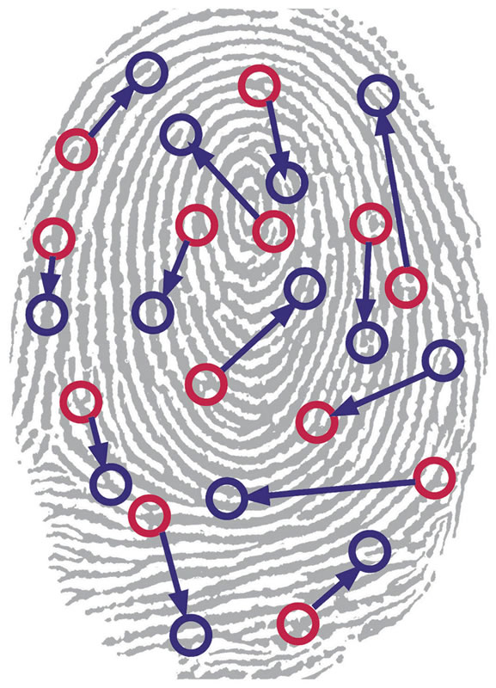



Related Work
Quest to Replace Passwords [BHOS2012]
Alternatives to Passwords
Notes:
Another line of research has sought to eliminate text passwords. One might ask whether or not password research will be relevant in the future. Bonneau, et al. considered each of these alternatives to text passwords in 2012 and concluded that there was no silver bullet to replace text passwords. While every proposed replacement has desirable properties, every replacement scheme they evaluated also had its disadvantages. For example, biometrics signals like fingerprints cannot be changed if they are compromised.
Quest to Replace Passwords
Bonneau, J. ; Univ. of Cambridge, Cambridge, UK ; Herley, C. ; van Oorschot, P.C. ; Stajano, F.

