Slide 1
Practical Graphs for Optimal Side-Channel Resistant Memory-Hard Functions
Joël Alwen (IST Austria/Wickr Inc.)
Jeremiah Blocki (Purdue University)
Ben Harsha (Purdue University)
CCS 2017

Slide 2

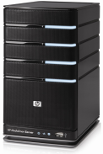
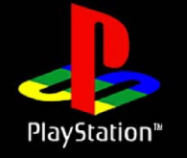
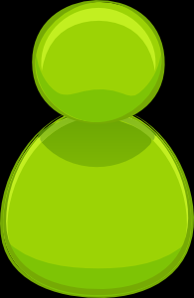

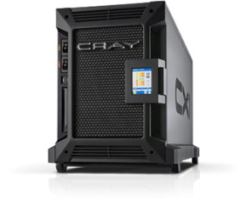

Motivation: Password Storage
jblocki, 123456
Username
jblocki
Salt
89d978034a3f6
Hash
85e23cfe0021f584e3db87aa72630a9a2345c062
SHA1(12345689d978034a3f6)=85e23cfe0021f584e3db87aa72630a9a2345c062
+
Notes:
As a motivating example consider an adversary who breaks into an authentication server and steals a users crptographic hash value. The adversary can execute an offline attack against the password by comparing the hash value with the hashes of likely password guesses. The adversary is limited only by the resources that he is willing to invest cracking the passwords.

Slide 3

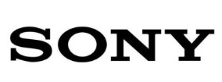




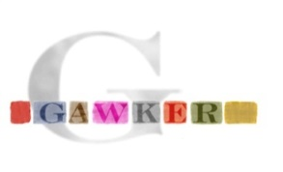

Offline Attacks: A Common Problem
Password breaches at major companies have affected millions of users.
Notes:
Unfortunately, offline dictionary attacks are quite common. Password breaches at major companies have affected millions of users. In the past few years I have had to update the slide several times.

Slide 4
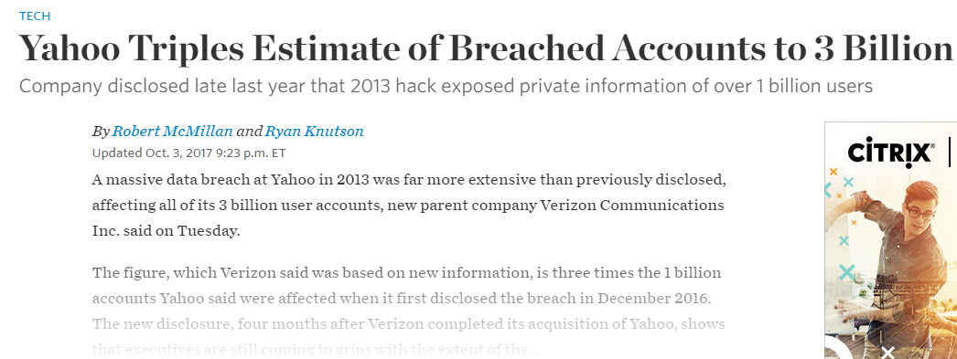











Offline Attacks: A Common Problem
Password breaches at major companies have affected millions billions of user accounts.
Notes:
Unfortunately, offline dictionary attacks are quite common. Password breaches at major companies have affected millions of users.

Slide 5
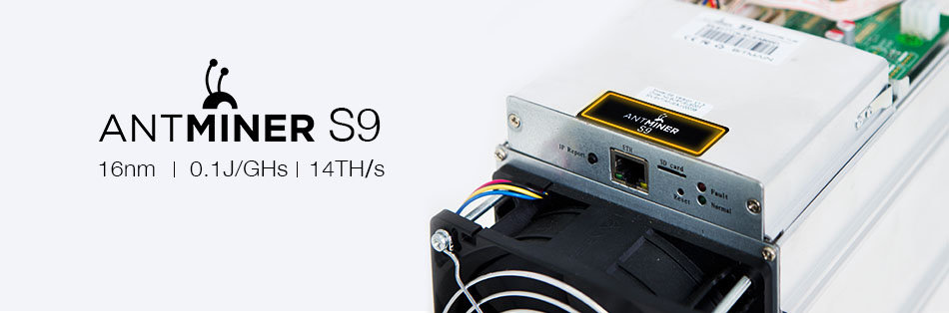

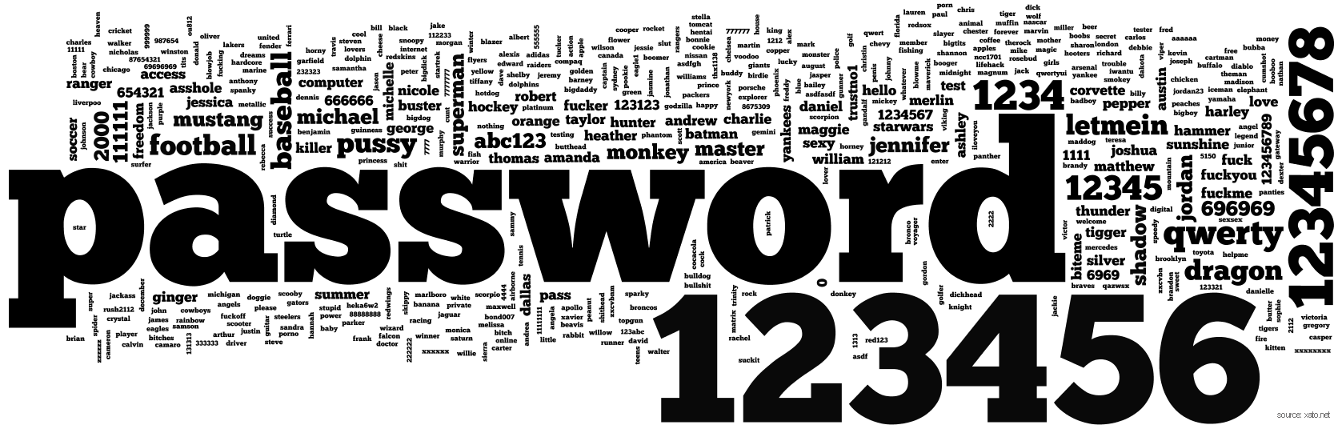

A Dangerous Problem
Can we increase guessing costs for the attacker?
$2,400 on Amazon

Slide 6
Attempt 1: Hash Iteration
BCRYPT
PBKDF2
100,000 SHA256 computations
(iterative)
Estimated Cost on ASIC: $1 per billion password guesses [BS14]

Slide 7

The Challenge
Cost SHA256
USD $
Standard Patience Units
User Patience
Time
Disclaimer: This slide is entirely for humorous effect.

Slide 8
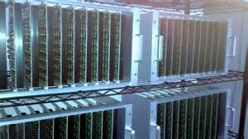
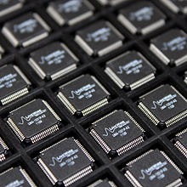
Goal: Moderately Expensive Hash Function
Fast on PC and
Expensive on ASIC?
Notes:
This motivates the need for moderately hard functions. The basic idea is to build a password hash function that is moderately expensive to compute to limit the number of guesses that an adversary would be willing to try. An honest server only needs to compute the function once during a typical authentication session. However, the adversary potentially has an advantage in this game. While the honest server must typically evaluate the function on standard hardware, the adversary could use potentially reduce the cost per password guess by developing customized hardware (GPUs, FPGAs, ASICs) to evaluate the password hash function. Thus, we want to ensure that the cost to evaluate this function is equitable across platforms.

Slide 9
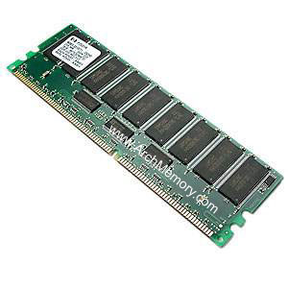

Memory Hard Function (MHF)
Intuition: computation costs dominated by memory costs
vs.
Goal: force attacker to lock up large amounts of memory for duration of computation
  →Expensive even on customized hardware
Notes:
In this work we study a special type of memory hard function called data-independent memory hard functions. As the name suggests the memory access pattern will not depend on the input making the functions resistant to side-channel attacks.

Slide 10
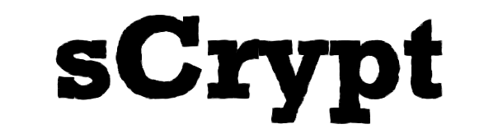
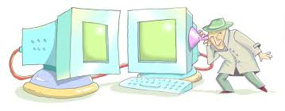
Memory Hard Function (MHF)
Intuition: computation costs dominated by memory costs
vs.
Data Independent Memory Hard Function (iMHF)
  Memory access pattern should not depend on input
Notes:
In this work we study a special type of memory hard function called data-independent memory hard functions. As the name suggests the memory access pattern will not depend on the input making the functions resistant to side-channel attacks.

Slide 11


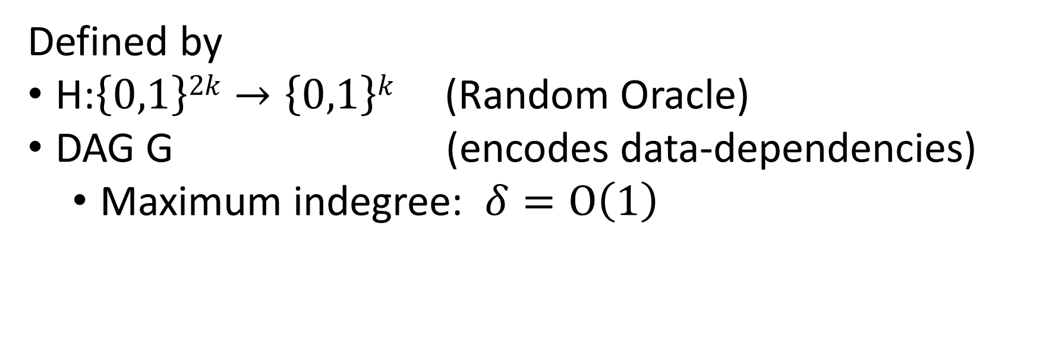
iMHF (f_{G,H})
Defined by
H:$\left\{0,1\right\}2k→\left\{0,1\right\}k$ (Random Oracle)
DAG G (encodes data-dependencies)
  Maximum indegree: $δ=O\left(1\right)$
Input: pwd, salt
2
4
1
Output: f_{G,H} (pwd,salt)= L₄
1
3
$$L1=H(pwd,salt)$$
$$L3=H(L2,L1)$$

Slide 12
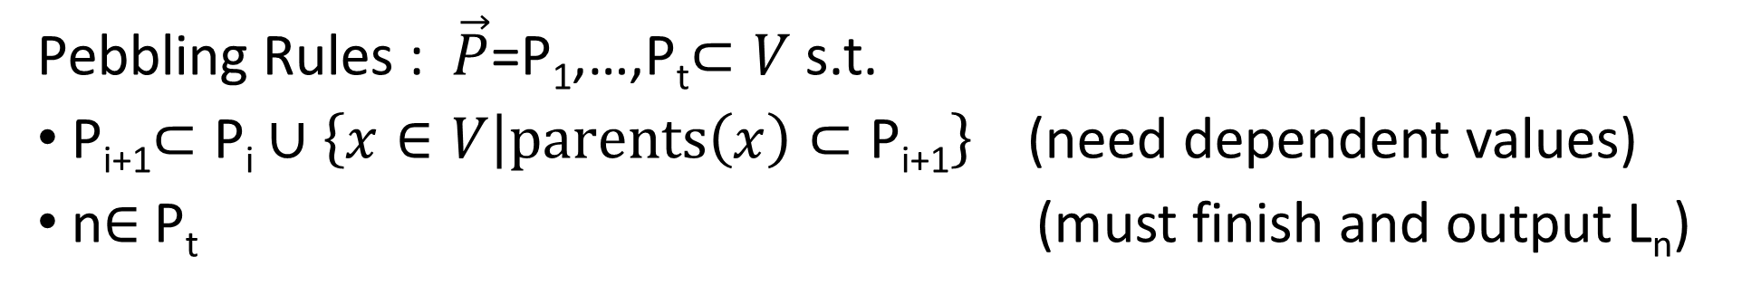


Evaluating an iMHF (pebbling)
2
4
Output: L₄
Input:
1
1
pwd, salt
3
$$L1=H(pwd,salt)$$
$$L3=H(L2,L1)$$
Pebbling Rules : $\vec{P}$=P₁,…,P_{t}$⊂V$ s.t.
P_{i+1}$⊂\text{P}\text{i}∪\left\{x∈V | parents\left(x\right)⊂\text{P}\text{i}\text{+1}\right\}$(need dependent values)
n$∈$P_{t} (must finish and output L_{n})
Notes:
We will describe our algorithms for evaluating an iMHF using the language of graph pebbling. Placing a pebble on a node corresponds to computing the corresponding label, and keeping a pebble on the graph corresponds to storing that label in memory. Of course we can only compute a label if we have all of the dependent labels. Thus, in a legal pebbling we cannot place a pebble on a node until we have pebbles on the parents of that node. If the adversary is parallel then we are allowed to place multiple pebbles on the graph in each round. We can remove pebbles from the graph at any point in time.

Slide 13
Evaluating an iMHF (pebbling)
4
5
3
4
5
1
3
1
2

Slide 14
Evaluating an iMHF (pebbling)
1
2
3
4
5
P₁ = {1} (data value L₁ stored in memory)

Slide 15
Pebbling Example
1
2
3
4
5
P₁ = {1}
P₂ = {1,2} (data values L₁ and L₂ stored in memory)

Slide 16
Pebbling Example
1
2
3
4
5
P₁ = {1}
P₂ = {1,2}
P₃ = {3}

Slide 17
Pebbling Example
1
2
3
4
5
P₁ = {1}
P₂ = {1,2}
P₃ = {3}
P₄ = {3,4}

Slide 18
Pebbling Example
1
2
3
4
5
P₁ = {1}
P₂ = {1,2}
P₃ = {3}
P₄ = {3,4}
P₅ = {5}

Slide 19
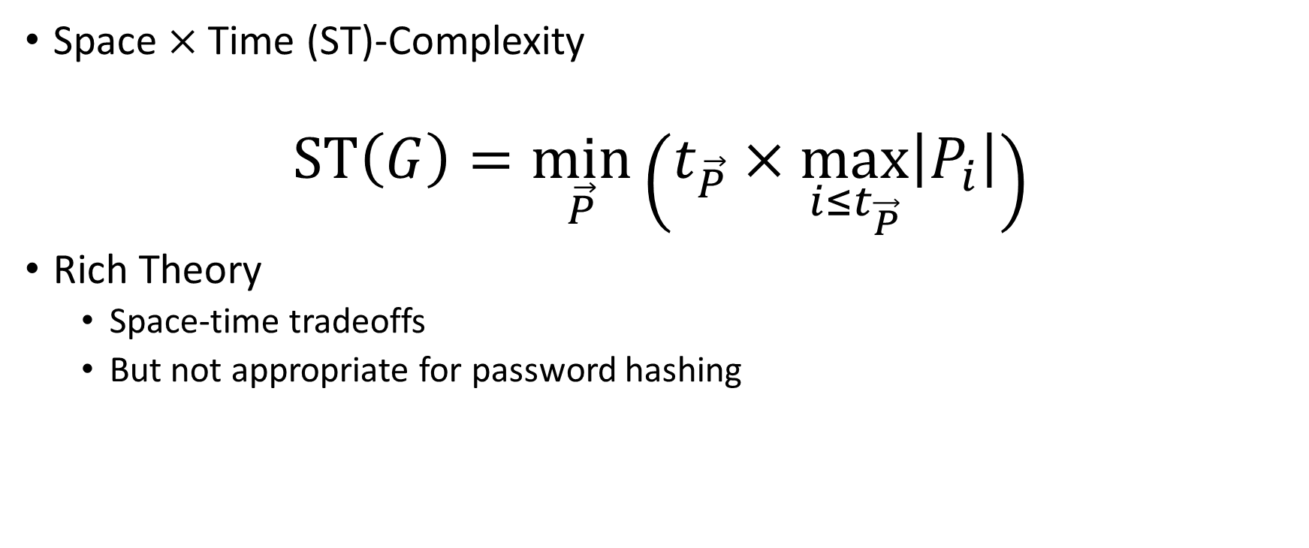
Measuring Cost: Attempt 1
Space $×$Time (ST)-Complexity
$$ST\left(G\right)=\min_{\vec{P}}\left(t_{\vec{P}}×\max_{i≤t_{\vec{P}}}\left|P_{i}\right|\right)$$
Rich Theory
  Space-time tradeoffs
  But not appropriate for password hashing

Slide 20

Amortization and Parallelism
Problem: for parallel computation ST-complexity can scale badly in the number of evaluations of a function.
[AS15] $∃$function f_{n} (consisting of n RO calls) such that: $ST\left(f^{×\sqrt{n}}\right)=O(ST\left(f\right))$
S₃
ST₁ = S₁ × T₁ ≈ S₃ × T₃ = ST₃
S₁
space
cost of computing
f once
cost of computing
f three times
time
T₁
T₃

Slide 21
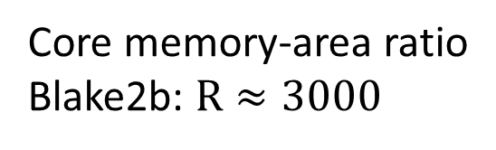


Amortized Area-Time Complexity
$$aATR\left(G\right)=\min_{\vec{P}}{\sum_{i=1}^{t_{\vec{P}}}{\left(\left|P_{i}\right|+R\left|P_{i}\backslash P_{i−1}\right|\right)}}$$
$\text{aAT} \text{costs}$scale linearly with #password guesses
$$m×aAT\left(G,…,G\right)=m×aAT(G)$$
Memory costs
(area under curve)
Core memory-area ratio
Blake2b: $R≈3000$
$m$ times

Slide 22
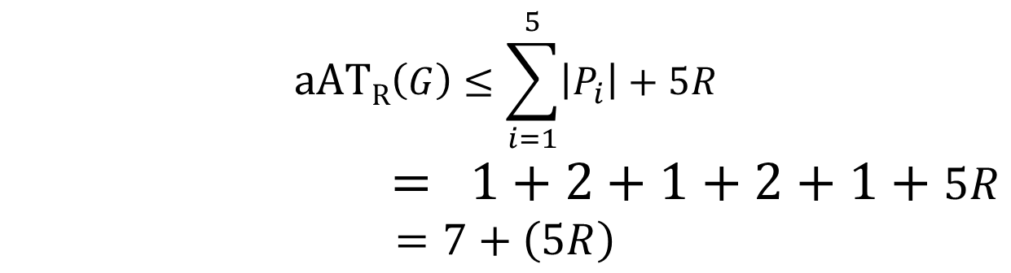
Pebbling Example: (amortized) Area Time
1
2
3
4
5
P₁ = {1}
$$aATR\left(G\right)≤\sum_{i=1}^{5}{\left|P_{i}\right|}+5R$$
$$= 1+2+1+2+1+5R$$
$$=7+\left(5R\right)$$
P₂ = {1,2}
P₃ = {3}
P₄ = {3,4}
P₅ = {5}

Slide 23

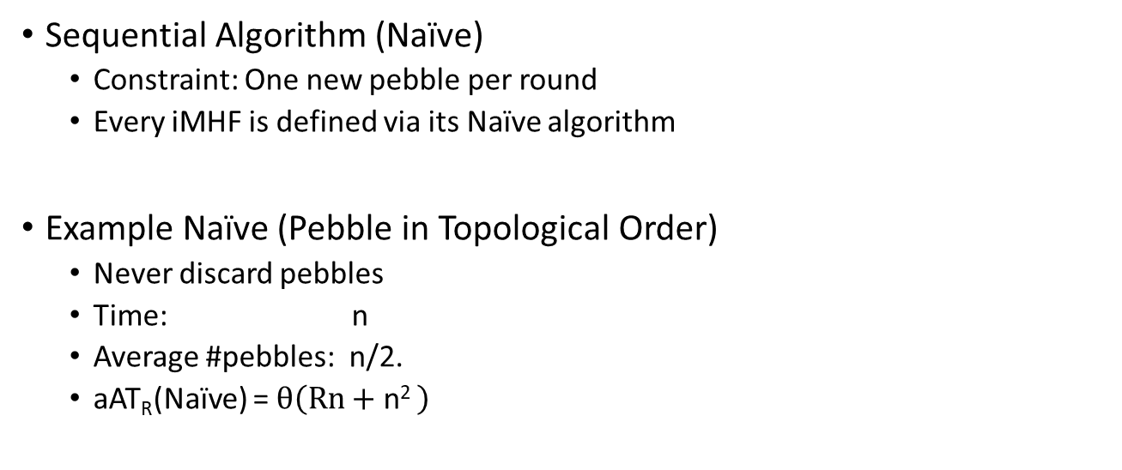
Naïve Pebbling Algorithms
Sequential Algorithm (Naïve)
  Constraint: One new pebble per round
  Every iMHF is defined via its Naïve algorithm
Example Naïve (Pebble in Topological Order)
  Never discard pebbles
  Time: n
  Average #pebbles: n/2.
  aAT_{R}(Naïve) = $θ\left(Rn+\text{n}\text{2 }\right)$

Slide 24
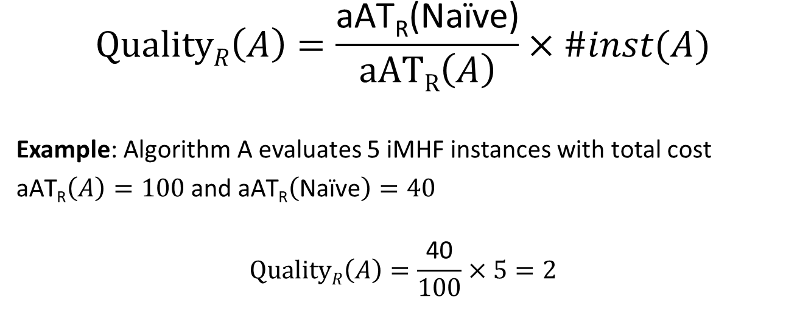
Amortized Attack Quality
$$QualityR\left(A\right)=\frac{\text{aAT}\text{R}\text{(}\text{Na}\text{ï}\text{ve}\text{)}}{aATR\left(A\right)}×\#inst(A)$$
Example: Algorithm A evaluates 5 iMHF instances with total cost
$\text{aAT}\text{R}\left(A\right)=100$and $\text{aAT}\text{R}\left(\text{Na}\text{ï}\text{ve}\right)=40$
$$QualityR\left(A\right)=\frac{\text{40}}{100}×5=2$$

Slide 25


Desiderata
Find a DAG G on n nodes such that
Constant Indegree ($δ=2)$
  Running Time: $n\left(δ−1\right)=n$
aAT(G) $≥\frac{n2}{τ}$ for some small value $τ$.
Maximize costs for fixed running time n
(Users are impatient)

Slide 26
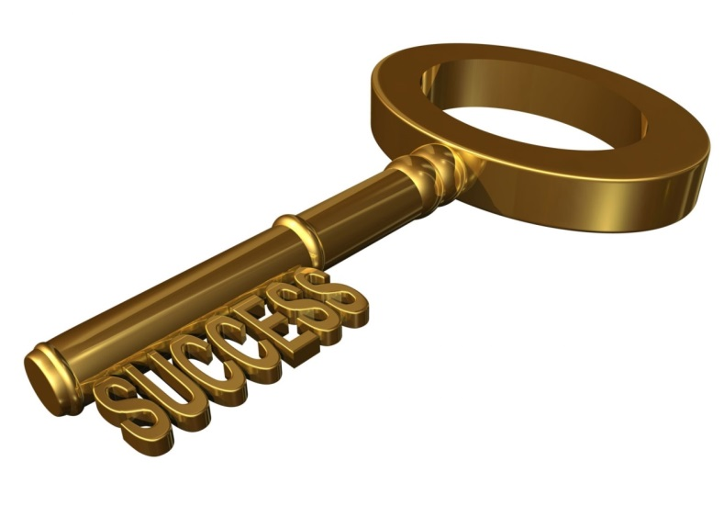
Depth-Robustness: The Key Property
Necessary [AB16] and sufficient [ABP16] for secure iMHFs
Bonus: Other applications in cryptography e.g., Proof of Sequential Work [MMV13]

Slide 27

Depth Robustness
Definition: A DAG G=(V,E) is (e,d)-reducible if there exists $S⊆V$
s.t. $\left|S\right|≤e$ and depth(G-S) $≤d.$
Otherwise, we say that G is (e,d)-depth robust.
Example: (1,2)-reducible
1
2
3
4
5

Slide 28

Depth Robustness
Definition: A DAG G=(V,E) is (e,d)-reducible if there exists $S⊆V$
s.t. $\left|S\right|≤e$ and depth(G-S) $≤d.$
Otherwise, we say that G is (e,d)-depth robust.
Example: (1,2)-reducible
1
2
3
4
5

Slide 29



Depth Robustness is Necessary
Theorem (Depth-Robustness is a necessary condition): If G is not (e,d)-node robust then $\operatorname{aAT}\left(G\right)=O\left(en+\sqrt{n3d}\right)$ .
In particular, $\operatorname{aAT}\left(G\right)=o\left(n2\right)$ for e,d=o(n).
Corollary (Depth-Robustness is a necessary condition): For any DAG G with constant indegree we have $\operatorname{aAT}\left(G\right)=O\left(\frac{n^{2}\log{\log{n}}}{\log{n}}\right)$
Much stronger attacks against all practical iMHF candidates including Argon2i, winner of password hashing competition [AB16,AB17,AGKKOPRRR16].

Slide 30

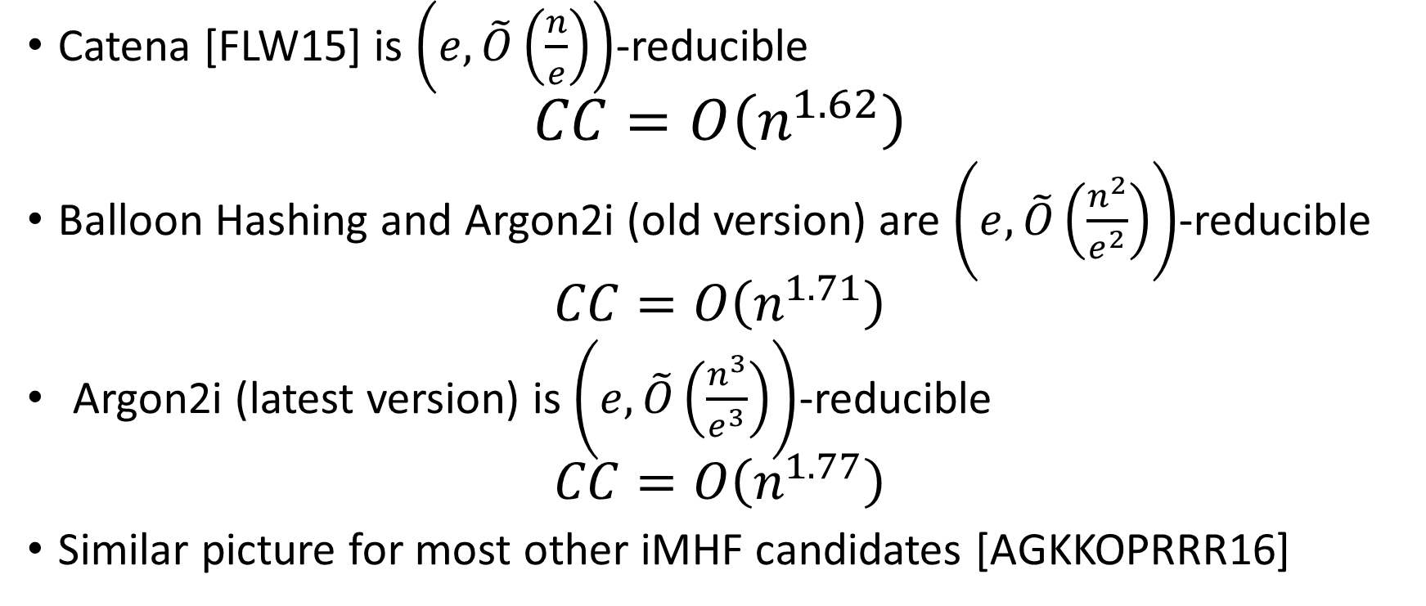
Answer: No
Catena [FLW15] is $\left(e,\tilde{O}\left(\frac{n}{e}\right)\right)$-reducible
$$CC=O\left(n^{1.62}\right)$$
Balloon Hashing and Argon2i (old version) are $\left(e,\tilde{O}\left(\frac{n^{2}}{e^{2}}\right)\right)$-reducible
  $$CC=O\left(n^{1.71}\right)$$
  Argon2i (latest version) is $\left(e,\tilde{O}\left(\frac{n^{3}}{e^{3}}\right)\right)$-reducible
  $$CC=O\left(n^{1.77}\right)$$
Similar picture for most other iMHF candidates [AGKKOPRRR16]

Slide 31

Argon2i [BDK]
Argon2: Winner of the password hashing competition[2015]
Authors originally recommended Argon2i variant (data-independent) for password hashing.
Notes:
Alex Biryukov, Daniel Dinu, and Dmitry Khovratovich from University of Luxembourg.

Slide 32
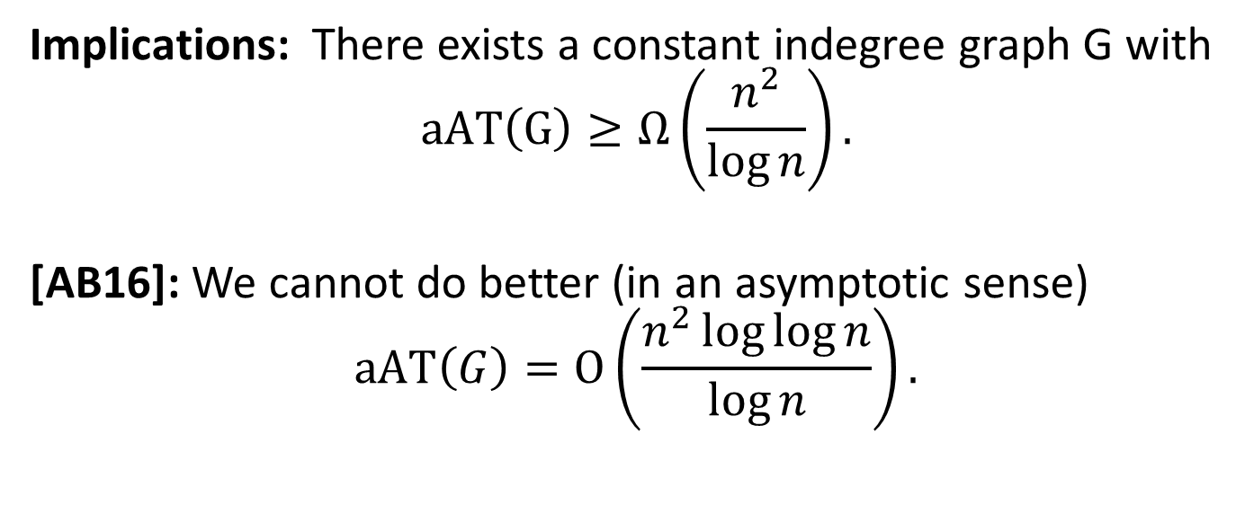
Depth-Robustness is Sufficient! [ABP17]
$Key Theorem:$Let G=(V,E) be (e,d)-depth robust then $aAT$(G)$≥ed$.
Implications: There exists a constant indegree graph G with
$$aAT\left(G\right)≥Ω\left(\frac{n^{2}}{\log{n}}\right).$$
[AB16]: We cannot do better (in an asymptotic sense)
$$\operatorname{aAT}\left(G\right)=O\left(\frac{n^{2}\log{\log{n}}}{\log{n}}\right).$$

Slide 33
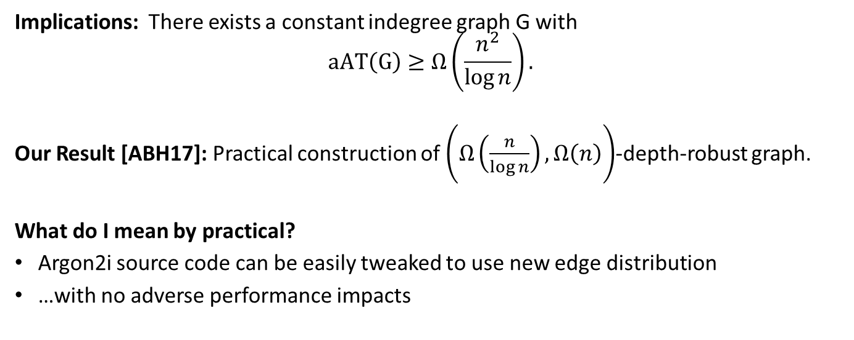
Practical Construction of Depth-Robust Graph
$Theorem [ABP17]:$Let G=(V,E) be (e,d)-depth robust then $aAT$(G)$≥ed$.
Implications: There exists a constant indegree graph G with
$$aAT\left(G\right)≥Ω\left(\frac{n^{2}}{\log{n}}\right).$$
Our Result [ABH17]: Practical construction of $\left(Ω\left(\frac{n}{\log{n}}\right),Ω\left(n\right)\right)$-depth-robust graph.
What do I mean by practical?
Argon2i source code can be easily tweaked to use new edge distribution
…with no adverse performance impacts

Slide 34
DRSample
…
1
2
3
4
i
n

Slide 35
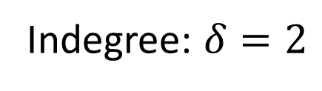
DRSample
random predecessor r(i) < i
…
1
2
3
4
i
n
Indegree: $δ=2$
Key Modification to Argon2i: New distribution for r(i)

Slide 36
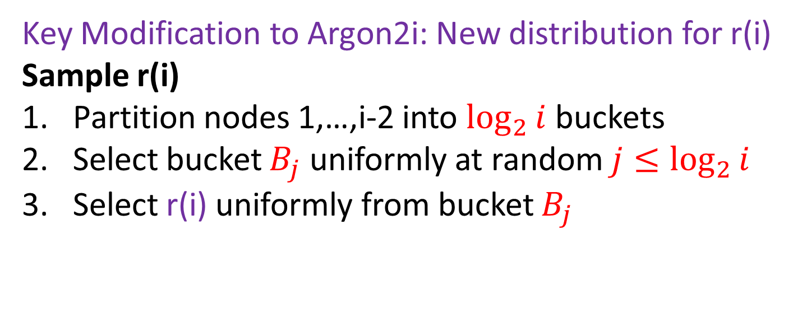



DRSample
$$B_{3}$$
$$B_{2}$$
$$B_{1}$$
…
…
…
1
2
i-8
i-4
i-4
i-3
i-2
i-1
i
n
Indegree: $δ=2$
r(i)
Key Modification to Argon2i: New distribution for r(i)
Sample r(i)
Partition nodes 1,…,i-2 into $\log_{2}{i}$ buckets
Select bucket $B_{j}$ uniformly at random $j≤\log_{2}{i}$
Select r(i) uniformly from bucket $B_{j}$

Slide 37
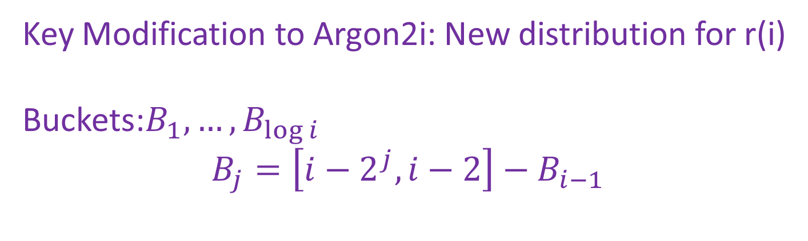



DRSample
$$B_{3}$$
$$B_{2}$$
$$B_{1}$$
…
…
…
1
2
i-8
i-4
i-4
i-3
i-2
i-1
i
n
Indegree: $δ=2$
Key Modification to Argon2i: New distribution for r(i)
Buckets:$B_{1}, …,B_{\log{i}}$
$$B_{j}=\left[i−2^{j},i−2\right]−B_{i−1}$$

Slide 38

DRSample Analysis
Theorem: With high probability a random DRSample DAG G is $\left(Ω\left(\frac{n}{\log{n}}\right),Ω\left(n\right)\right)$-depth-robust.
Corollary: With high probability a random DRSample DAG G has aAT-complexity
$$aAT\left(G\right)=Ω\left(\frac{n^{2}}{\log{n}}\right)$$

Slide 39
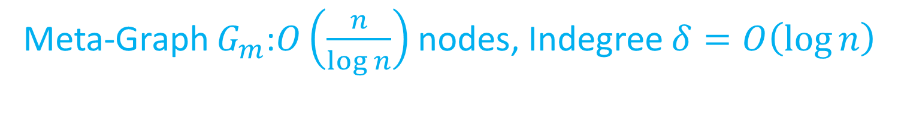




DRSample Meta-Graph
$$m=O\left(\log{n}\right)$$
…
…
…
$$G$$
1
2
n
$$m$$
2m
$$G_{m}$$
Meta-Graph $G_{m}$:$O\left(\frac{n}{\log{n}}\right)$ nodes, Indegree $δ=O\left(\log{n}\right)$

Slide 40
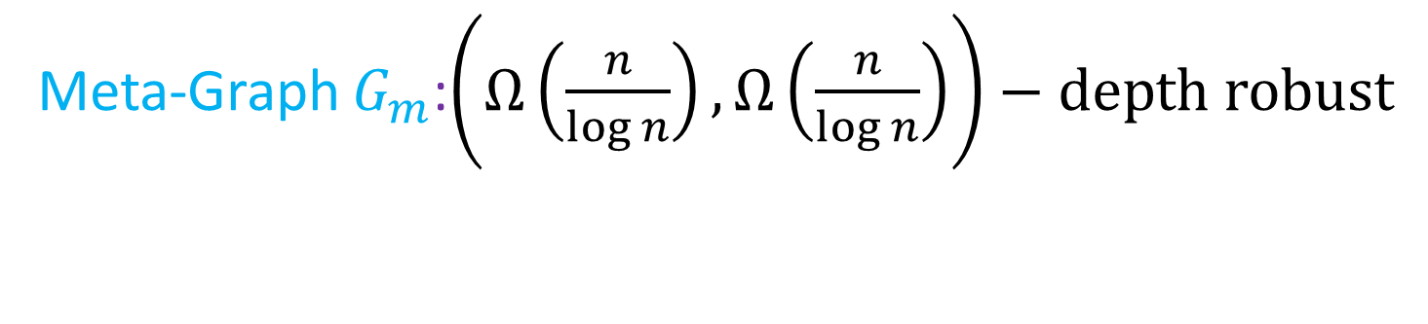

DRSample Meta-Graph
$$m=O\left(\log{n}\right)$$
…
…
…
$$G$$
1
2
n
$$m$$
2m
$$G_{m}$$
Meta-Graph $G_{m}$:$\left(Ω\left(\frac{n}{\log{n}}\right),Ω\left(\frac{n}{\log{n}}\right)\right)−depth robust$

Slide 41
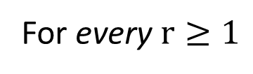

Local Expander Node: v
For every $r≥1$
…
…
…
…
1
2
v-2r
v-r-1
v-r
v
n
$$Contains Bipartite Expander Graph$$
…
…
…
…
1
2
v
v+r-1
v+r
v+2r-1
n

Slide 42

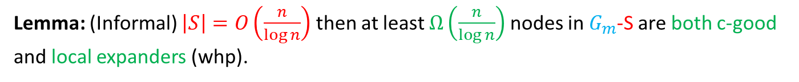

c-good Node: v for deleted set S
For every $r≥1$
…
…
…
1
2
v-r
v
2
v+r-1
v+r
n
$≤c×r$ nodes in S
$≤c×r$ nodes in S
Lemma: (Informal) $\left|S\right|=O\left(\frac{n}{\log{n}}\right)$ then at least $Ω\left(\frac{n}{\log{n}}\right)$ nodes in $G_{m}$-S are both c-good and local expanders (whp).
Lemma: (Informal) If nodes v and w are both c-good with respect to a set S and v and w are both local expander nodes then there is a directed path from node v to node w in $G_{m}$-S .

Slide 43
Analysis of DR-Sample
$$m=O\left(\log{n}\right)$$
…
…
…
$$G$$
1
2
n
$$m$$
2m
$$G_{m}$$
Corollary: $G_{m} is \left(Ω\left(\frac{n}{\log{n}}\right),Ω\left(\frac{n}{\log{n}}\right)\right)−depth robust$ (whp)
Corollary: G is $\left(Ω\left(\frac{n}{\log{n}}\right),Ω\left(n\right)\right)−depth robust$ .

Slide 44
Analysis of DR-Sample
$$m=O\left(\log{n}\right)$$
…
…
…
$$G$$
1
2
n
$$m$$
2m
Corollary: G is $\left(Ω\left(\frac{n}{\log{n}}\right),Ω\left(n\right)\right)−depth robust$ .
Corollary: $aAT\left(G\right)=Ω\left(\frac{n^{2}}{\log{n}}\right)$ with high probability.
Disclaimer: Constants in provable lower bound are small.

Slide 45
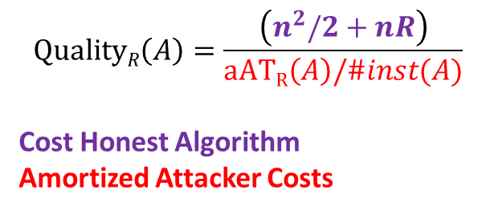
Empirical Security Analysis
$$QualityR\left(A\right)=\frac{\left(n^{2}/2+nR\right)}{aATR\left(A\right)/\#inst(A)}$$
Cost Honest Algorithm
Amortized Attacker Costs
More Secure

Slide 46
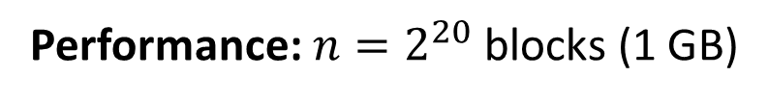
Implementation of DRSample
Modified Argon2 Source Code to use depth-robust edge distribution
Summary: No adverse performance impacts from modifications
Argon2i | DRSample
0.969 seconds | 0.966 seconds
Performance: $n=2^{20}$ blocks (1 GB)
https://github.com/Practical-Graphs/Argon2-Practical-Graph

Slide 47
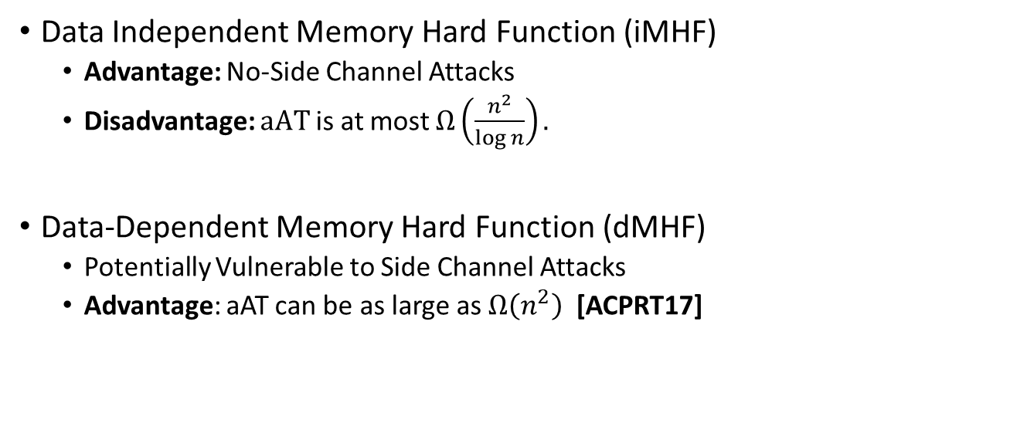
Data-Independent vs. Data-Dependent MHF
Data Independent Memory Hard Function (iMHF)
  Advantage: No-Side Channel Attacks
  Disadvantage: $aAT$is at most $Ω\left(\frac{n^{2}}{\log{n}}\right).$
Data-Dependent Memory Hard Function (dMHF)
  Potentially Vulnerable to Side Channel Attacks
  Advantage: aAT can be as large as $Ω\left(n^{2}\right) \text{[}\text{ACPRT}\text{17]}$
Notes:
In this work we study a special type of memory hard function called data-independent memory hard functions. As the name suggests the memory access pattern will not depend on the input making the functions resistant to side-channel attacks.

Slide 48
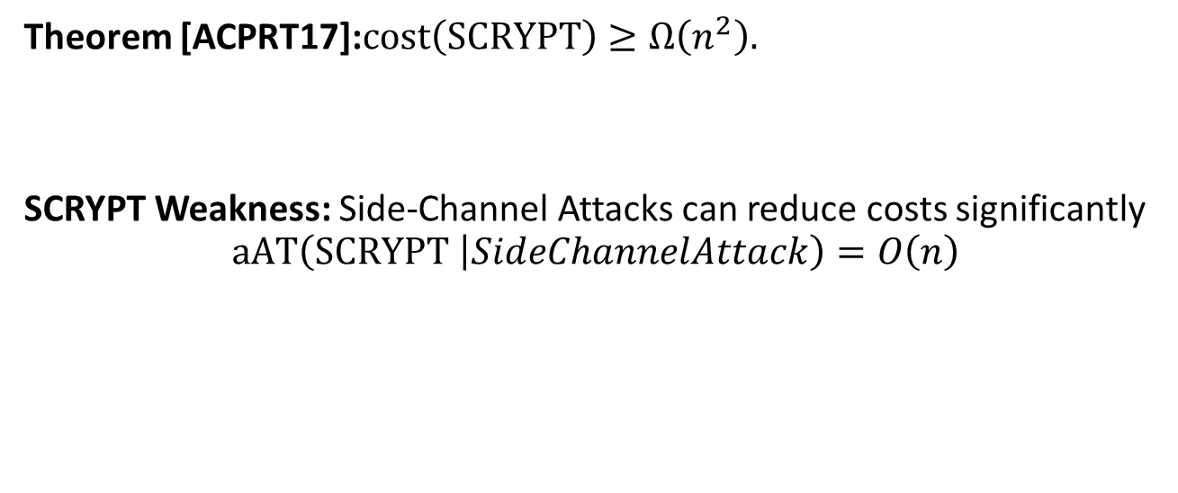
On the Security of SCRYPT
Theorem [ACPRT17]:$cost\left(SCRYPT\right)≥Ω\left(n^{2}\right).$
SCRYPT Weakness: Side-Channel Attacks can reduce costs significantly
$$aAT\left(SCRYPT \left|SideChannelAttack\right.\right)=O\left(n\right)$$

Slide 49
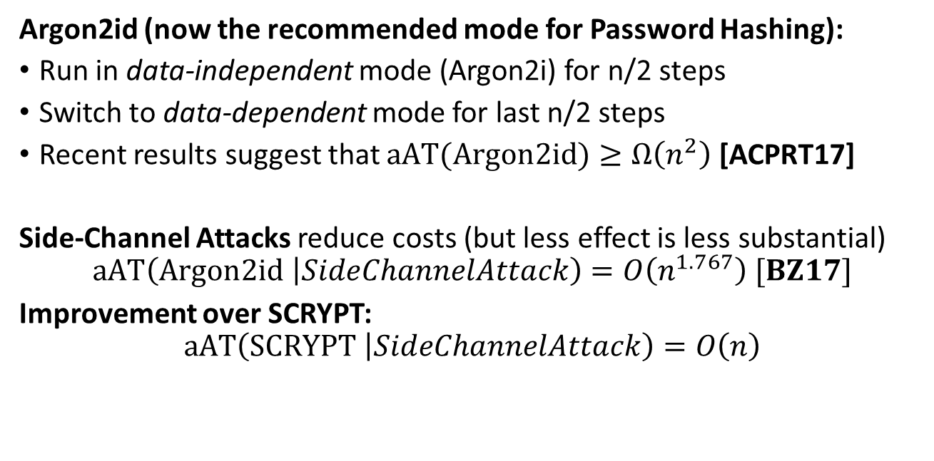
Hybrid Modes
Argon2id (now the recommended mode for Password Hashing):
Run in data-independent mode (Argon2i) for n/2 steps
Switch to data-dependent mode for last n/2 steps
Recent results suggest that $aAT(Argon2id)≥Ω\left(n^{2}\right)$ [ACPRT17]
Side-Channel Attacks reduce costs (but less effect is less substantial)
$$aAT\left(Argon2id \left|SideChannelAttack\right.\right)=O\left(n^{1.767}\right) [BZ17]$$
Improvement over SCRYPT:
$$aAT\left(SCRYPT \left|SideChannelAttack\right.\right)=O\left(n\right)$$

Slide 50
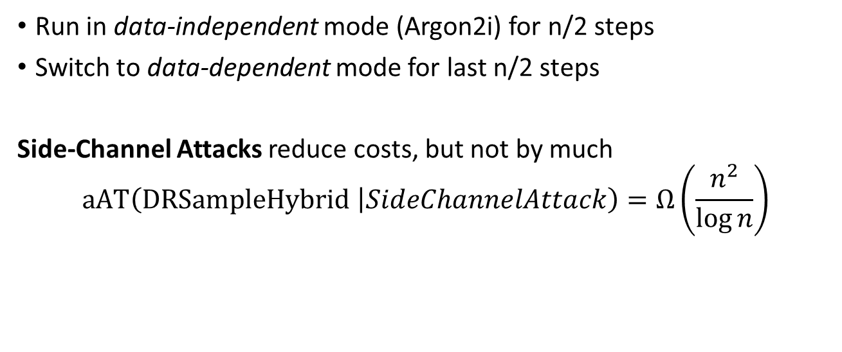
DRSample-Hybrid:
Run in data-independent mode (Argon2i) for n/2 steps
Switch to data-dependent mode for last n/2 steps
Side-Channel Attacks reduce costs, but not by much
$$aAT\left(DRSampleHybrid \left|SideChannelAttack\right.\right)=Ω\left(\frac{n^{2}}{\log{n}}\right)$$

Slide 51
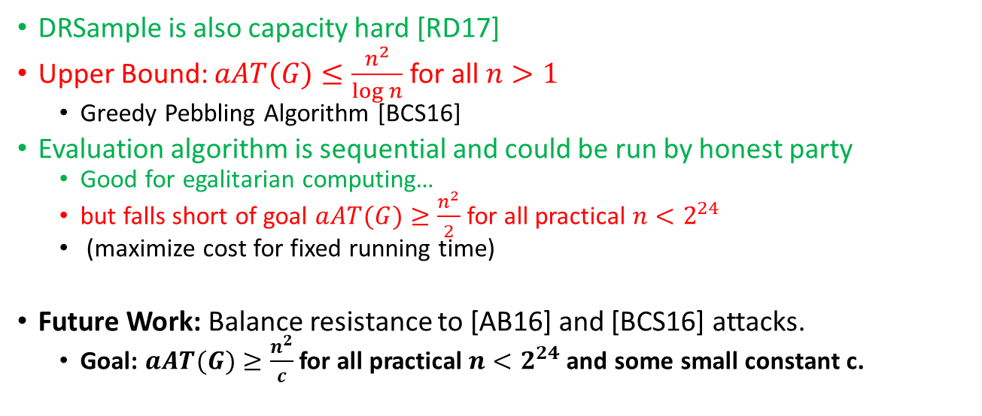
New Results
DRSample is also capacity hard [RD17]
Upper Bound: $aAT(G)≤\frac{n^{2}}{\log{n}}$ for all $n>1$
  Greedy Pebbling Algorithm [BCS16]
Evaluation algorithm is sequential and could be run by honest party
  Good for egalitarian computing…
  but falls short of goal $aAT(G)≥\frac{n^{2}}{2}$ for all practical $n<2^{24}$
  (maximize cost for fixed running time)
Future Work: Balance resistance to [AB16] and [BCS16] attacks.
  Goal: $aAT(G)≥\frac{n^{2}}{c}$ for all practical $n<2^{24}$ and some small constant c.

Slide 52

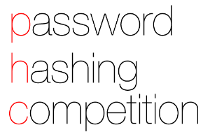
Summary
First practical construction of highly depth-robust graphs
Simple modifications to Argon2 yields
  iMHF with optimal asymptotic guarantees
  Hybrid mode with optimal side-channel resistance
  Conjecture: Stronger resistance to space-time tradeoffs
More research is needed to understand constant factors in security bounds

Slide 53

Thanks for Listening

Slide 54

A Puzzle
First person to find the unsavory solution wins a $20 Amazon Gift card
E-mail: jblocki@purdue.edu

