Slide 1
On the Depth-Robustness and Cumulative Pebbling Cost of Argon2i
Jeremiah Blocki (Purdue University)
Samson Zhou (Purdue University)
TCC 2017

Slide 2

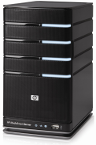
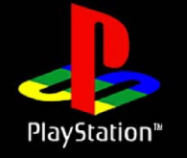


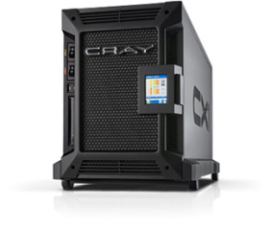

Motivation: Password Storage
jblocki, 123456
Username
jblocki
Salt
89d978034a3f6
Hash
85e23cfe0021f584e3db87aa72630a9a2345c062
SHA1(12345689d978034a3f6)=85e23cfe0021f584e3db87aa72630a9a2345c062
+
Notes:
As a motivating example consider an adversary who breaks into an authentication server and steals a users crptographic hash value. The adversary can execute an offline attack against the password by comparing the hash value with the hashes of likely password guesses. The adversary is limited only by the resources that he is willing to invest cracking the passwords.

Slide 3

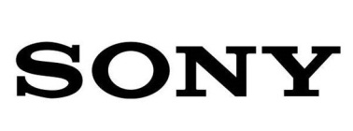








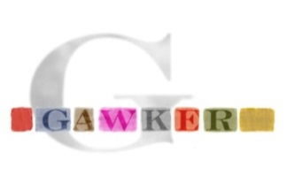


Offline Attacks: A Common Problem
Password breaches at major companies have affected millions billions of user accounts.
Notes:
Unfortunately, offline dictionary attacks are quite common. Password breaches at major companies have affected millions of users.

Slide 4
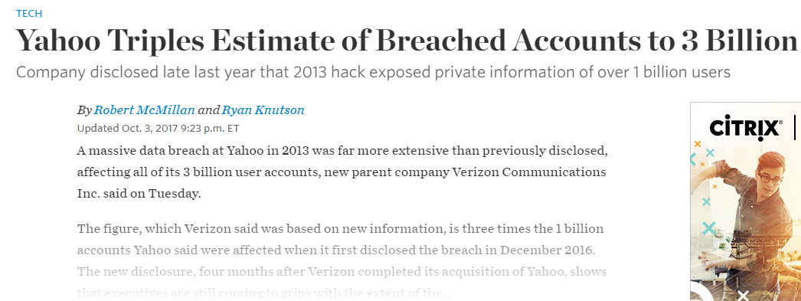
Offline Attacks: A Common Problem
Password breaches at major companies have affected millions billions of user accounts.
Notes:
Unfortunately, offline dictionary attacks are quite common. Password breaches at major companies have affected millions of users.

Slide 5
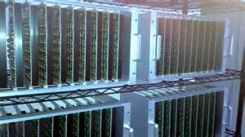



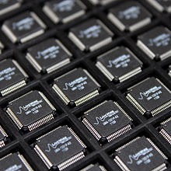
Goal: Moderately Expensive Hash Function
Fast on PC and
Expensive on ASIC?
Notes:
This motivates the need for moderately hard functions. The basic idea is to build a password hash function that is moderately expensive to compute to limit the number of guesses that an adversary would be willing to try. An honest server only needs to compute the function once during a typical authentication session. However, the adversary potentially has an advantage in this game. While the honest server must typically evaluate the function on standard hardware, the adversary could use potentially reduce the cost per password guess by developing customized hardware (GPUs, FPGAs, ASICs) to evaluate the password hash function. Thus, we want to ensure that the cost to evaluate this function is equitable across platforms.

Slide 6

(2013-2015)
https://password-hashing.net/

Slide 7

We recommend that you use Argon2…
(2013-2015)
https://password-hashing.net/

Slide 8
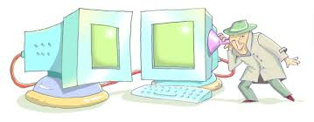
We recommend that you use Argon2…
There are two main versions of Argon2, Argon2i and Argon2d. Argon2i is the safest against side-channel attacks
(2013-2015)
https://password-hashing.net/

Slide 9
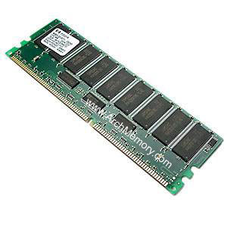

Memory Hard Function (MHF)
Intuition: computation costs dominated by memory costs
vs.
Goal: force attacker to lock up large amounts of memory for duration of computation
  →Expensive even on customized hardware
Notes:
In this work we study a special type of memory hard function called data-independent memory hard functions. As the name suggests the memory access pattern will not depend on the input making the functions resistant to side-channel attacks.

Slide 10

Memory Hard Function (MHF)
Intuition: computation costs dominated by memory costs
vs.
Notes:
In this work we study a special type of memory hard function called data-independent memory hard functions. As the name suggests the memory access pattern will not depend on the input making the functions resistant to side-channel attacks.

Slide 11
Memory Hard Function (MHF)
Intuition: computation costs dominated by memory costs
vs.
Notes:
In this work we study a special type of memory hard function called data-independent memory hard functions. As the name suggests the memory access pattern will not depend on the input making the functions resistant to side-channel attacks.

Slide 12
Memory Hard Function (MHF)
Intuition: computation costs dominated by memory costs
vs.
Data Independent Memory Hard Function (iMHF)
  Memory access pattern should not depend on input
Notes:
In this work we study a special type of memory hard function called data-independent memory hard functions. As the name suggests the memory access pattern will not depend on the input making the functions resistant to side-channel attacks.

Slide 13
Memory Hard Function (MHF)
Intuition: computation costs dominated by memory costs
vs.
Data Independent Memory Hard Function (iMHF)
  Memory access pattern should not depend on input
Notes:
In this work we study a special type of memory hard function called data-independent memory hard functions. As the name suggests the memory access pattern will not depend on the input making the functions resistant to side-channel attacks.

Slide 14


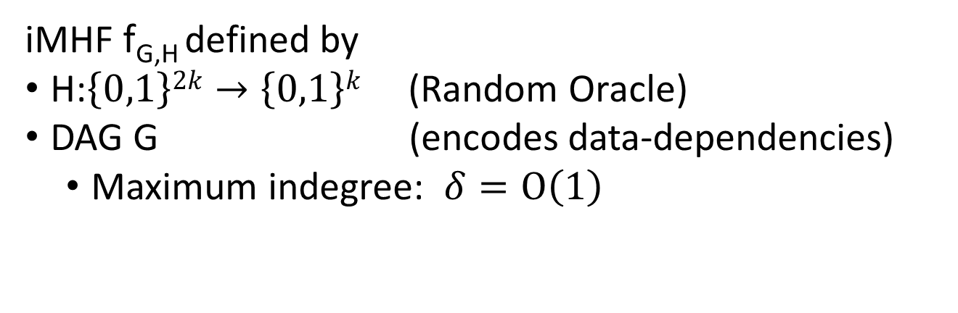
Data-Independent Memory Hard Function (iMHF)
iMHF f_{G,H} defined by
H:$\left\{0,1\right\}2k→\left\{0,1\right\}k$ (Random Oracle)
DAG G (encodes data-dependencies)
  Maximum indegree: $δ=O\left(1\right)$
Input: pwd, salt
2
4
1
Output: f_{G,H} (pwd,salt)= L₄
1
3
$$L1=H(pwd,salt)$$
$$L3=H(L2,L1)$$

Slide 15
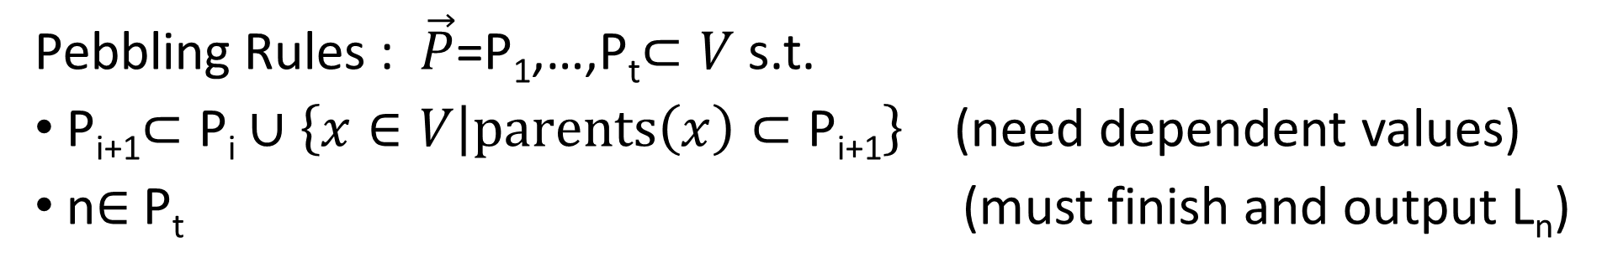


Evaluating an iMHF (pebbling)
2
4
Output: L₄
Input:
1
1
pwd, salt
3
$$L1=H(pwd,salt)$$
$$L3=H(L2,L1)$$
Pebbling Rules : $\vec{P}$=P₁,…,P_{t}$⊂V$ s.t.
P_{i+1}$⊂\text{P}\text{i}∪\left\{x∈V | parents\left(x\right)⊂\text{P}\text{i}\text{+1}\right\}$(need dependent values)
n$∈$P_{t} (must finish and output L_{n})
Notes:
We will describe our algorithms for evaluating an iMHF using the language of graph pebbling. Placing a pebble on a node corresponds to computing the corresponding label, and keeping a pebble on the graph corresponds to storing that label in memory. Of course we can only compute a label if we have all of the dependent labels. Thus, in a legal pebbling we cannot place a pebble on a node until we have pebbles on the parents of that node. If the adversary is parallel then we are allowed to place multiple pebbles on the graph in each round. We can remove pebbles from the graph at any point in time.

Slide 16
Evaluating an iMHF (pebbling)
4
5
3
4
5
1
3
1
2

Slide 17
Evaluating an iMHF (pebbling)
1
2
3
4
5
P₁ = {1} (data value L₁ stored in memory)

Slide 18
Pebbling Example
1
2
3
4
5
P₁ = {1}
P₂ = {1,2} (data values L₁ and L₂ stored in memory)

Slide 19
Pebbling Example
1
2
3
4
5
P₁ = {1}
P₂ = {1,2}
P₃ = {3}

Slide 20
Pebbling Example
1
2
3
4
5
P₁ = {1}
P₂ = {1,2}
P₃ = {3}
P₄ = {3,4}

Slide 21
Pebbling Example
1
2
3
4
5
P₁ = {1}
P₂ = {1,2}
P₃ = {3}
P₄ = {3,4}
P₅ = {5}

Slide 22
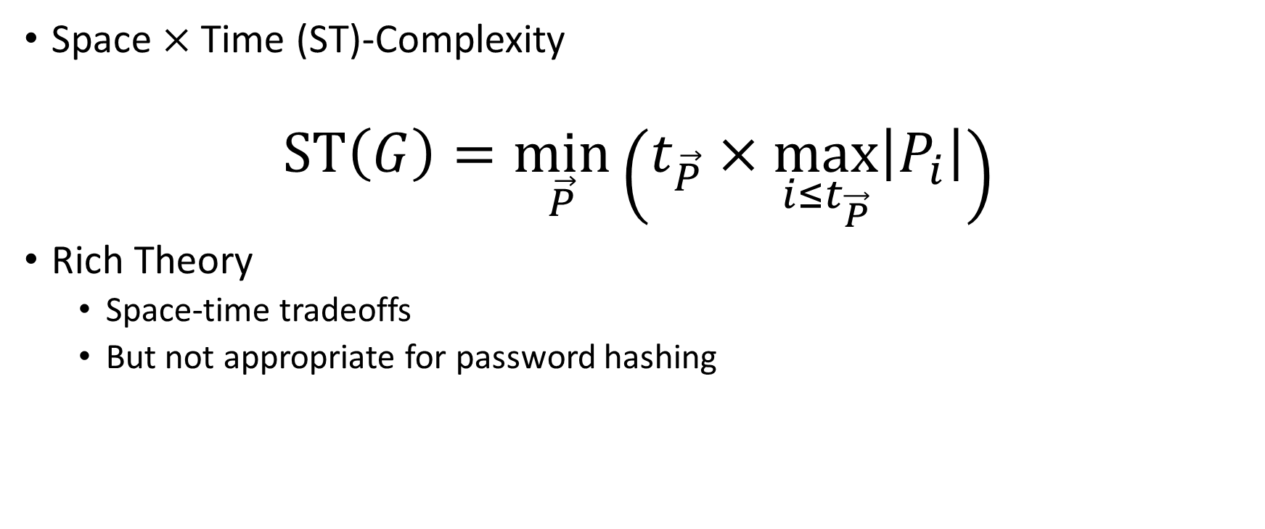
Measuring Cost: Attempt 1
Space $×$Time (ST)-Complexity
$$ST\left(G\right)=\min_{\vec{P}}\left(t_{\vec{P}}×\max_{i≤t_{\vec{P}}}\left|P_{i}\right|\right)$$
Rich Theory
  Space-time tradeoffs
  But not appropriate for password hashing

Slide 23

Amortization and Parallelism
Problem: for parallel computation ST-complexity can scale badly in the number of evaluations of a function.
[AS15] $∃$function f_{n} (consisting of n RO calls) such that: $ST\left(f^{×\sqrt{n}}\right)=O(ST\left(f\right))$
S₃
ST₁ = S₁ × T₁ ≈ S₃ × T₃ = ST₃
S₁
space
cost of computing
f once
cost of computing
f three times
time
T₁
T₃

Slide 24

Measuring Pebbling Costs [AS15]
$$CC\left(G\right)=\min_{\vec{P}}{\sum_{i=1}^{t_{\vec{P}}}{\left|P_{i}\right|}}$$
Approximates Amortized Area x Time Complexity of iMHF
Memory Used at Step i

Slide 25


Measuring Pebbling Costs [AS15]
$$CC\left(G\right)=\min_{\vec{P}}{\sum_{i=1}^{t_{\vec{P}}}{\left|P_{i}\right|}}$$
[AS15] $\text{C}\text{osts}$scale linearly with #password guesses
$$m×CC\left(G,…,G\right)=m×CC(G)$$
Memory Used at Step i
$m$ times

Slide 26
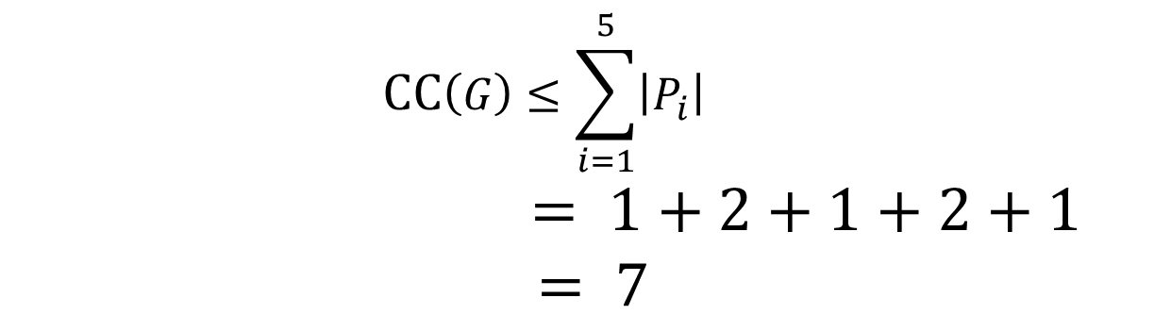
Pebbling Example: Cumulative Cost
1
2
3
4
5
P₁ = {1}
$$CC\left(G\right)≤\sum_{i=1}^{5}{\left|P_{i}\right|}$$
$$= 1+2+1+2+1$$
$= 7$
P₂ = {1,2}
P₃ = {3}
P₄ = {3,4}
P₅ = {5}

Slide 27


Desiderata
Find a DAG G on n nodes such that
Constant Indegree ($δ=2)$
  Running Time: $n\left(δ−1\right)=n$
CC(G) $≥\frac{n2}{τ}$ for some small value $τ$.

Slide 28
Desiderata
Find a DAG G on n nodes such that
Constant Indegree ($δ=2)$
  Running Time: $n\left(δ−1\right)=n$
CC(G) $≥\frac{n2}{τ}$ for some small value $τ$.
Maximize costs for fixed running time n
(Users are impatient)

Slide 29
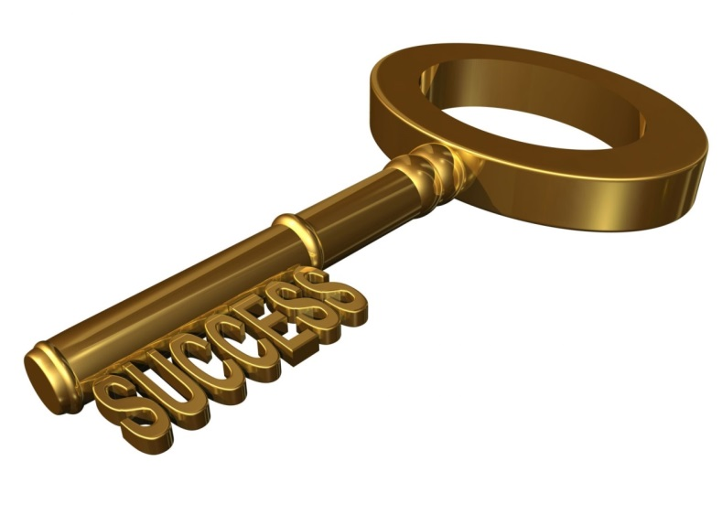
Depth-Robustness: The Key Property
Necessary [AB16] and sufficient [ABP17] for secure iMHFs

Slide 30

Block Depth Robustness [ABP17]
Definition: A DAG G=(V,E) is (e,d,b)-block depth-robust for all $S⊆V$
s.t. $\left|S\right|≤e$ we have $depth\left(G−\bigcup_{v∈S}{[v,v+b)}\right)>d.$
Otherwise, we say that G is (e,d,b)-reducible.
Example: (e=1,d=2,b=2)-block reducible
1
2
3
4
5
6

Slide 31
Block Depth Robustness [ABP17]
Definition: A DAG G=(V,E) is (e,d,b)-block depth-robust for all $S⊆V$
s.t. $\left|S\right|≤e$ we have $depth\left(G−\bigcup_{v∈S}{[v,v+b)}\right)>d.$
Otherwise, we say that G is (e,d,b)-reducible.
Example: (e=1,d=2,b=2)-block reducible
1
2
3
4
5
6

Slide 32
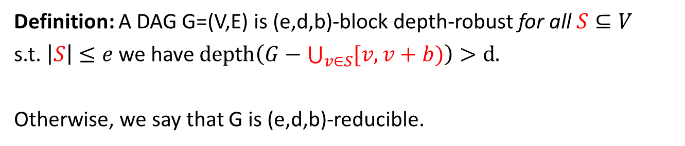
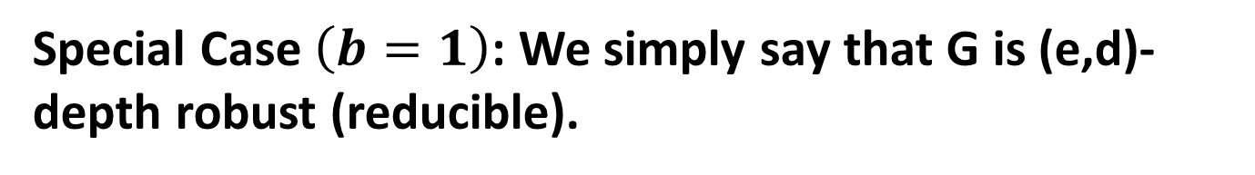
Block Depth Robustness [ABP17]
Definition: A DAG G=(V,E) is (e,d,b)-block depth-robust for all $S⊆V$
s.t. $\left|S\right|≤e$ we have $depth\left(G−\bigcup_{v∈S}{[v,v+b)}\right)>d.$
Otherwise, we say that G is (e,d,b)-reducible.
Special Case $\left(b=1\right)$: We simply say that G is (e,d)-depth robust (reducible).

Slide 33

Depth Robustness is Necessary [AB16]
Theorem (Depth-Robustness is a necessary condition): If G is not (e,d)-depth robust then $\operatorname{CC}\left(G\right)=O\left(en+\sqrt{n3d}\right)$ .
In particular, $\operatorname{CC}\left(G\right)=o\left(n2\right)$ for e,d=o(n).

Slide 34
How Depth-Reducible is Argon2i?
Theorem [AB17]: A random Argon2i DAG G is $\left(n^{0.8},O\left(n^{0.6}\right)\right)$–reducible (whp).
Corollary [AB16,AB17]: For a random Argon2i DAG G we have $CC\left(G\right)=O\left(n^{1.8}\right)$ (whp).

Slide 35

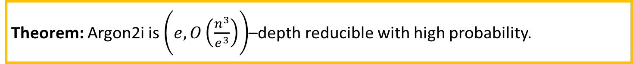
How Depth-Reducible is Argon2i?
Theorem [AB17]: A random Argon2i DAG G is $\left(n^{0.8},O\left(n^{0.6}\right)\right)$–reducible (whp).
Corollary [AB16,AB17]: For a random Argon2i DAG G we have $CC\left(G\right)=O\left(n^{1.8}\right)$ (whp).
Theorem: Argon2i is $\left(e,O\left(\frac{n^{3}}{e^{3}}\right)\right)$–depth reducible with high probability.

Slide 36


How Depth-Reducible is Argon2i?
Theorem [AB17]: A random Argon2i DAG G is $\left(n^{0.8},O\left(n^{0.6}\right)\right)$–reducible (whp).
Corollary [AB16,AB17]: For a random Argon2i DAG G we have $CC\left(G\right)=O\left(n^{1.8}\right)$ (whp).
Theorem: Argon2i is $\left(e,O\left(\frac{n^{3}}{e^{3}}\right)\right)$–depth reducible with high probability.
Corollary: For a random Argon2i DAG G we have $CC\left(G\right)=O\left(n^{1.768}\right)$ (whp).
Proof Sketch: Recursive Attack [ABP17] against DAG G is (e,d)-reducible at multiple points a curve e.g., $d\left(e\right)=O\left(\frac{n^{3}}{e^{3}}\right)$.

Slide 37
Depth-Robustness is Sufficient! [ABP17]
$Key Theorem:$Let G=(V,E) be (e,d)-depth robust then $CC$(G)$≥ed$.

Slide 38
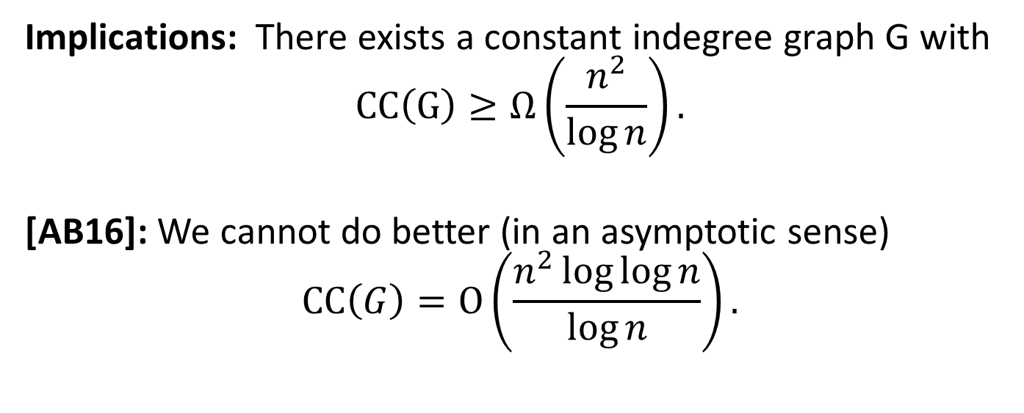
Depth-Robustness is Sufficient! [ABP17]
$Key Theorem:$Let G=(V,E) be (e,d)-depth robust then $CC$(G)$≥ed$.
Implications: There exists a constant indegree graph G with
$$CC\left(G\right)≥Ω\left(\frac{n^{2}}{\log{n}}\right).$$
[AB16]: We cannot do better (in an asymptotic sense)
$$\operatorname{CC}\left(G\right)=O\left(\frac{n^{2}\log{\log{n}}}{\log{n}}\right).$$

Slide 39
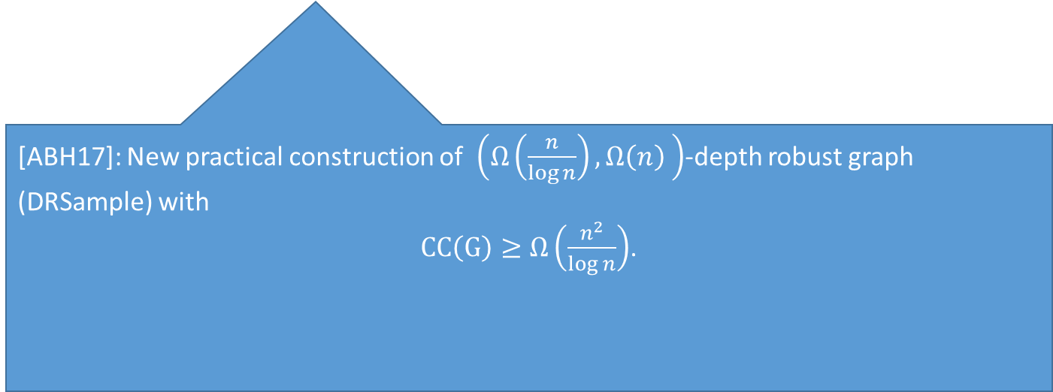
Depth-Robustness is Sufficient! [ABP17]
$Key Theorem:$Let G=(V,E) be (e,d)-depth robust then $CC$(G)$≥ed$.
Implications: There exists a constant indegree graph G with
$$CC\left(G\right)≥Ω\left(\frac{n^{2}}{\log{n}}\right).$$
[AB16]: We cannot do better (in an asymptotic sense)
$$\operatorname{CC}\left(G\right)=O\left(\frac{n^{2}\log{\log{n}}}{\log{n}}\right).$$
[ABH17]: New practical construction of $\left(Ω\left(\frac{n}{\log{n}}\right),Ω\left(n\right) \right)$-depth robust graph (DRSample) with
$CC\left(G\right)≥Ω\left(\frac{n^{2}}{\log{n}}\right)$.

Slide 40
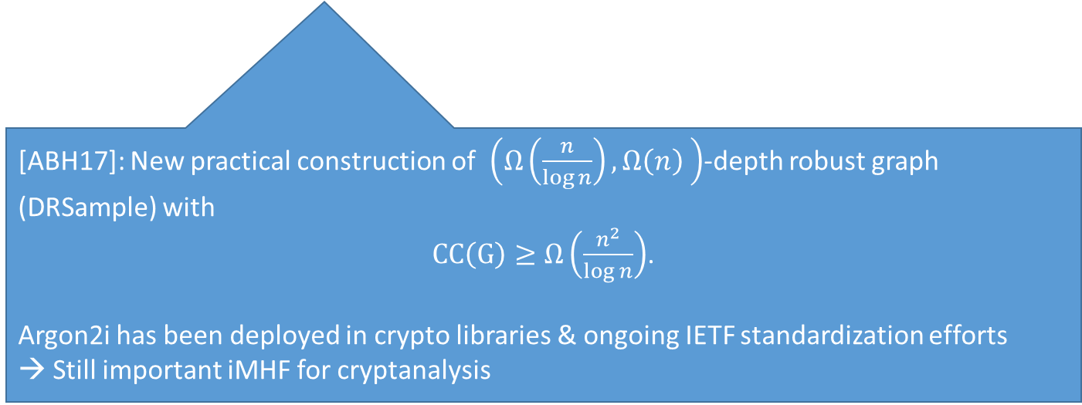
Depth-Robustness is Sufficient! [ABP17]
$Key Theorem:$Let G=(V,E) be (e,d)-depth robust then $CC$(G)$≥ed$.
Implications: There exists a constant indegree graph G with
$$CC\left(G\right)≥Ω\left(\frac{n^{2}}{\log{n}}\right).$$
[AB16]: We cannot do better (in an asymptotic sense)
$$\operatorname{CC}\left(G\right)=O\left(\frac{n^{2}\log{\log{n}}}{\log{n}}\right).$$
[ABH17]: New practical construction of $\left(Ω\left(\frac{n}{\log{n}}\right),Ω\left(n\right) \right)$-depth robust graph (DRSample) with
$CC\left(G\right)≥Ω\left(\frac{n^{2}}{\log{n}}\right)$.
Argon2i has been deployed in crypto libraries & ongoing IETF standardization efforts
→ Still important iMHF for cryptanalysis

Slide 41
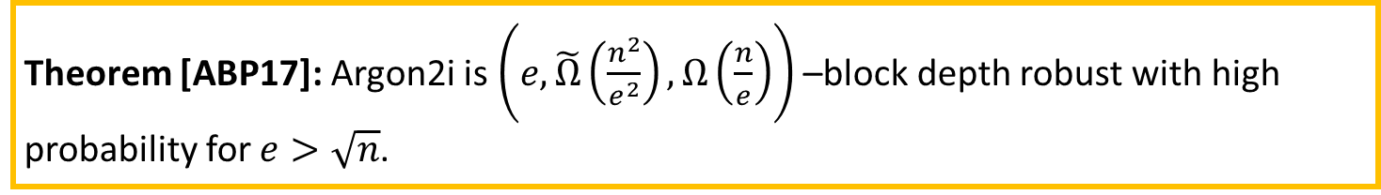
How Depth-Robust is Argon2i?
Theorem [ABP17]: Argon2i is $\left(e,\tilde{Ω}\left(\frac{n^{2}}{e^{2}}\right),Ω\left(\frac{n}{e}\right)\right)$ –block depth robust with high probability for $e>\sqrt{n}$.

Slide 42

How Depth-Robust is Argon2i?
Theorem [ABP17]: Argon2i is $\left(e,\tilde{Ω}\left(\frac{n^{2}}{e^{2}}\right),Ω\left(\frac{n}{e}\right)\right)$ –block depth robust with high probability for $e>\sqrt{n}$.
Big Gap Between Upper/Lower Bound on depth
$$\frac{n^{3}}{e^{3}}≫\frac{n^{2}}{e^{2}}$$

Slide 43

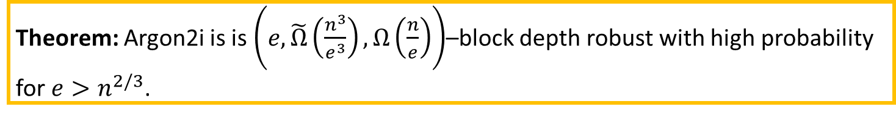
How Depth-Robust is Argon2i?
Theorem [ABP17]: Argon2i is $\left(e,\tilde{Ω}\left(\frac{n^{2}}{e^{2}}\right),Ω\left(\frac{n}{e}\right)\right)$ –block depth robust with high probability for $e>\sqrt{n}$.
Big Gap Between Upper/Lower Bound on depth
$$\frac{n^{3}}{e^{3}}≫\frac{n^{2}}{e^{2}}$$
Theorem: Argon2i is is $\left(e,\tilde{Ω}\left(\frac{n^{3}}{e^{3}}\right),Ω\left(\frac{n}{e}\right)\right)$–block depth robust with high probability for $e>n^{2/3}$.

Slide 44

Complexity of Argon2i DAG G
Theorem: Argon2i is is $\left(e,\tilde{Ω}\left(\frac{n^{3}}{e^{3}}\right),Ω\left(\frac{n}{e}\right)\right)$–block depth robust with high probability for $e>n^{2/3}$.

Slide 45
Complexity of Argon2i DAG G
Theorem: Argon2i is is $\left(e,\tilde{Ω}\left(\frac{n^{3}}{e^{3}}\right),Ω\left(\frac{n}{e}\right)\right)$–block depth robust with high probability for $e>n^{2/3}$.
Theorem [ABP17]: If DAG G is $\left(e,d\right)$–depth robust then
$$CC\left(G\right)=Ω\left(ed\right)$$

Slide 46
Complexity of Argon2i DAG G
Theorem: Argon2i is is $\left(e,\tilde{Ω}\left(\frac{n^{3}}{e^{3}}\right),Ω\left(\frac{n}{e}\right)\right)$–block depth robust with high probability for $e>n^{2/3}$.
Theorem [ABP17]: If DAG G is $\left(e,d\right)$–depth robust then
$$CC\left(G\right)=Ω\left(ed\right)$$
Corollary: $CC\left(Argon2i\right)=\max_{e>n^{2/3}}{\tilde{Ω}\left(e\frac{n^{3}}{e^{3}}\right)}=\tilde{Ω}\left(n^{5/3}\right)$

Slide 47
Complexity of Argon2i DAG G
Theorem: Argon2i is is $\left(e,\tilde{Ω}\left(\frac{n^{3}}{e^{3}}\right),Ω\left(\frac{n}{e}\right)\right)$–block depth robust with high probability for $e>n^{2/3}$.
Theorem [ABP17]: If DAG G is $\left(e,d\right)$–depth robust then
$$CC\left(G\right)=Ω\left(ed\right)$$
Corollary: $CC\left(Argon2i\right)=\max_{e>n^{2/3}}{\tilde{Ω}\left(e\frac{n^{3}}{e^{3}}\right)}=\tilde{Ω}\left(n^{5/3}\right)$
Our Stronger Theorem: $CC\left(G\right)=\tilde{Ω}\left(n^{7/4}\right)≫\tilde{Ω}\left(n^{5/3}\right)$

Slide 48
Complexity of Argon2i DAG G
Theorem: Argon2i is is $\left(e,\tilde{Ω}\left(\frac{n^{3}}{e^{3}}\right),Ω\left(\frac{n}{e}\right)\right)$–block depth robust with high probability for $e>n^{2/3}$.
Proves Argon2i was stronger than competing iMHF candidates like Catena and Balloon Hashing [AB16,AB17,AGKKOPRRR16].
Theorem [ABP17]: If DAG G is $\left(e,d\right)$–depth robust then
$$CC\left(G\right)=Ω\left(ed\right)$$
Corollary: $CC\left(Argon2i\right)=\max_{e>n^{2/3}}{\tilde{Ω}\left(e\frac{n^{3}}{e^{3}}\right)}=\tilde{Ω}\left(n^{5/3}\right)$
Our Stronger Theorem: $CC\left(G\right)=\tilde{Ω}\left(n^{7/4}\right)≫\tilde{Ω}\left(n^{5/3}\right)$

Slide 49
Argon2i
…
1
2
3
4
i
n

Slide 50

Argon2i
random predecessor r(i) < i
…
1
2
3
4
i
n
Indegree: $δ=2$
Argon2iA (v1.1): Uniform Distribution
Argon2iB (v1.2+): Non-Uniform

Slide 51
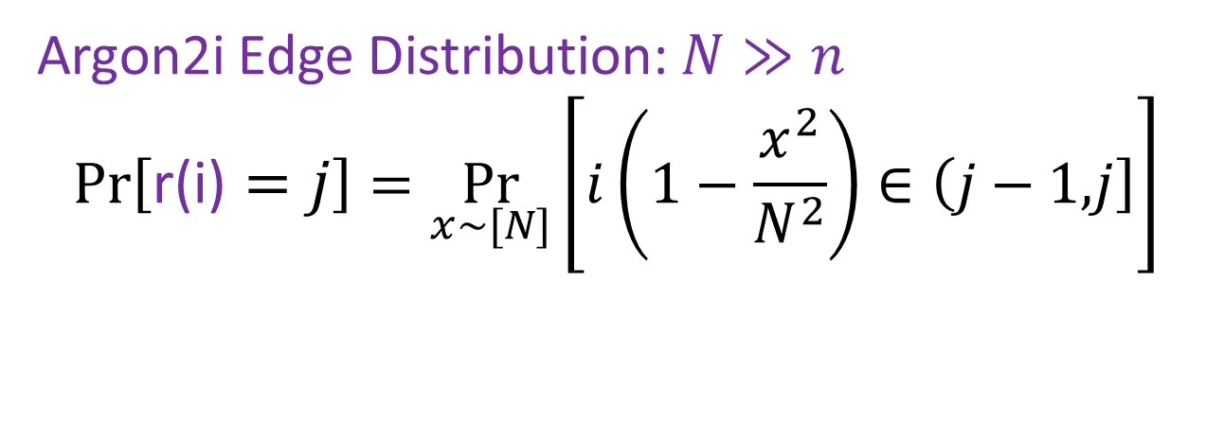

Argon2i
…
…
…
1
2
i-8
i-4
i-4
i-3
i-2
i-1
i
n
Indegree: $δ=2$
r(i)
Argon2i Edge Distribution: $N≫n$
$$Pr\left[\text{r}\text{(}\text{i}\text{)}=j\right]=\underset{x\sim [N]}{Pr}\left[i\left(1−\frac{x^{2}}{N^{2}}\right)∈\left(j−1,\right.\left.j\right]\right]$$

Slide 52

Argon2i
$$Closer Nodes receive more weight$$
…
…
…
1
2
i-8
i-4
i-4
i-3
i-2
i-1
i
n
Indegree: $δ=2$
r(i)
Argon2i Edge Distribution: $N≫n$
$$Pr\left[\text{r}\text{(}\text{i}\text{)}=j\right]=\underset{x\sim [N]}{Pr}\left[i\left(1−\frac{x^{2}}{N^{2}}\right)∈\left(j−1,\right.\left.j\right]\right]$$

Slide 53
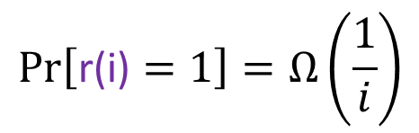
Argon2i
$$Pr\left[\text{r}\text{(}\text{i}\text{)}=1\right]=Ω\left(\frac{1}{i}\right)$$
$$Closer Nodes receive more weight$$
…
…
…
1
2
i-8
i-4
i-4
i-3
i-2
i-1
i
n
Indegree: $δ=2$
r(i)
Argon2i Edge Distribution: $N≫n$
$$Pr\left[\text{r}\text{(}\text{i}\text{)}=j\right]=\underset{x\sim [N]}{Pr}\left[i\left(1−\frac{x^{2}}{N^{2}}\right)∈\left(j−1,\right.\left.j\right]\right]$$

Slide 54


Argon2i Meta-Graph
…
…
…
$$G$$
1
2
n
$$m$$
2m

Slide 55
Argon2i Meta-Graph
…
…
…
$$G$$
1
2
n
$$m$$
2m

Slide 56

Argon2i Meta-Graph
…
…
…
$$G$$
1
2
n
$$m$$
2m
$$G_{m}$$

Slide 57
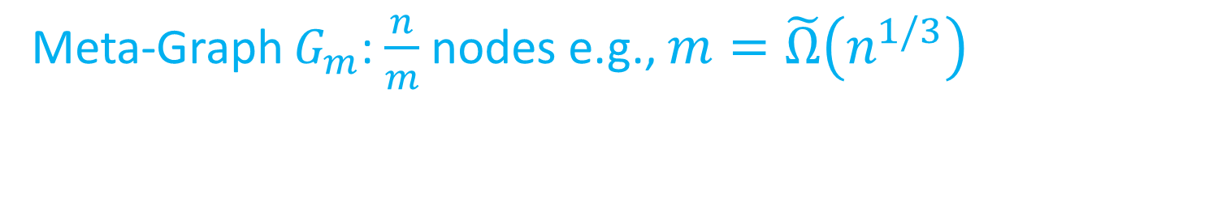
Argon2i Meta-Graph
…
…
…
$$G$$
1
2
n
$$m$$
2m
$$G_{m}$$
Meta-Graph $G_{m}$: $\frac{n}{m}$ nodes e.g., $m=\tilde{Ω}\left(n^{1/3}\right)$

Slide 58
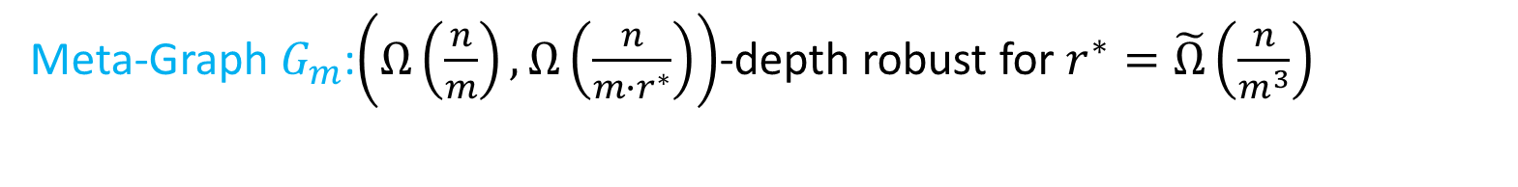
Argon2i Meta-Graph
…
…
…
$$G$$
1
2
n
$$m$$
2m
$$G_{m}$$
Meta-Graph $G_{m}$:$\left(Ω\left(\frac{n}{m}\right),Ω\left(\frac{n}{m∙r^{∗}}\right)\right)$-depth robust for $r^{∗}=\tilde{Ω}\left(\frac{n}{m^{3}}\right)$

Slide 59
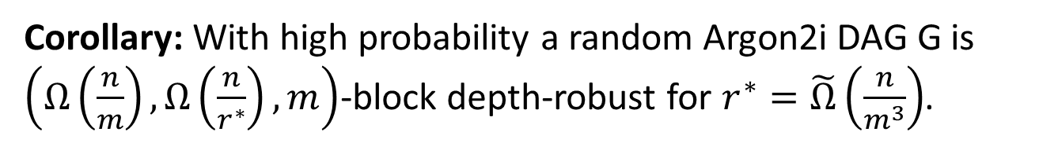
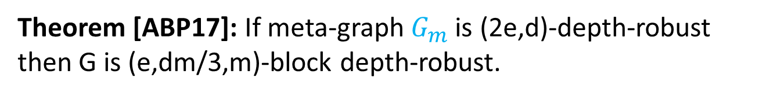

Argon2i Analysis
Theorem [ABP17]: If meta-graph $G_{m}$ is (2e,d)-depth-robust then G is (e,dm/3,m)-block depth-robust.
Meta-Graph $G_{m}$:$\left(Ω\left(\frac{n}{m}\right),Ω\left(\frac{n}{m∙r^{∗}}\right)\right)$-depth robust for $r^{∗}=\tilde{Ω}\left(\frac{n}{m^{3}}\right)$
Corollary: With high probability a random Argon2i DAG G is $\left(Ω\left(\frac{n}{m}\right),Ω\left(\frac{n}{r^{∗}}\right),m\right)$-block depth-robust for $r^{∗}=\tilde{Ω}\left(\frac{n}{m^{3}}\right)$.

Slide 60

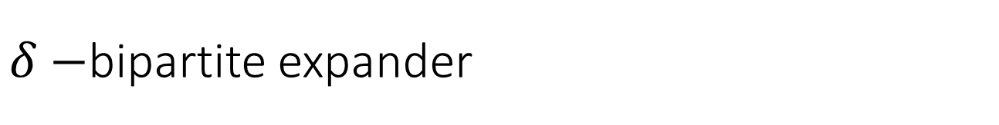
$δ−$bipartite expander
$$\left|A\right|=\left|B\right|=n$$
B
A

Slide 61


$δ−$bipartite expander
$$\left|A\right|=\left|B\right|=n$$
B
$$≥δn$$
A
$$\text{X}⊆A$$

Slide 62



$δ−$bipartite expander
$$\text{Y}⊆B$$
$$<δn$$
$$\left|A\right|=\left|B\right|=n$$
$$\text{Y}⊆B$$
(unreachable from $\text{X}$)
B
$$≥δn$$
A
$$\text{X}⊆A$$

Slide 63

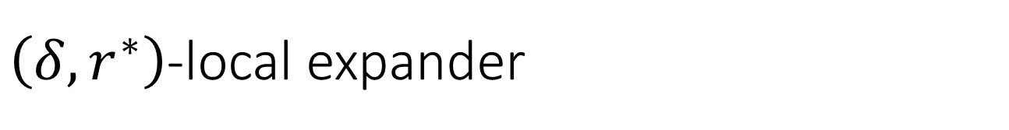
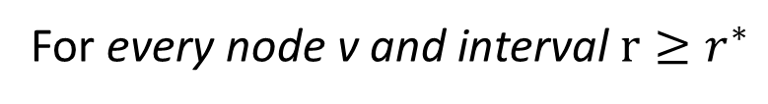
$\left(δ,r^{∗}\right)$-local expander
For every node v and interval $r≥r^{∗}$
…
…
…
…
1
2
v-2r
v-r-1
v-r
v
n
$$Contains Bipartite Expander Graph$$
…
…
…
…
1
2
v
v+r-1
v+r
v+2r-1
n

Slide 64

Argon2i Analysis
Lemma 1: Let $G_{m}$ be the meta-graph of a random Argon2i DAG G and suppose$r^{∗}=\tilde{Ω}\left(\frac{n}{m^{3}}\right)$. Then with high probability $G_{m}$ is a $\left(δ,r^{∗}\right)$-local expander.
Remark 1: Increased weight placed on closer edges improves this bound in comparison to previous iMHF constructions.
Remark 2: Recent work [AB17] modifies distribution to obtain maximally depth-robust graphs.

Slide 65

Argon2i Analysis
Lemma 1: Let $G_{m}$ be the meta-graph of a random Argon2i DAG G and suppose$r^{∗}=\tilde{Ω}\left(\frac{n}{m^{3}}\right)$. Then with high probability $G_{m}$ is a $\left(δ,r^{∗}\right)$-local expander.
It remains to show that Local Expansion → Depth-Robustness

Slide 66


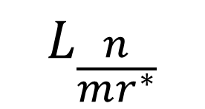



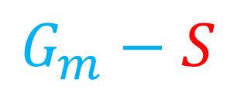


Layers of Argon2i Meta-Graph
…
…
…
$$G_{m}$$
$$\frac{n}{m}$$
1
2
$$r^{∗}$$
$$2r^{∗}$$
$$L_{2}$$
$$L_{\frac{n}{mr^{∗}}}$$
$$L_{1}$$
$$…$$
$$G_{m}−S$$

Slide 67



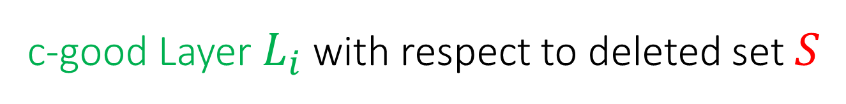





c-good Layer $L_{i}$ with respect to deleted set $S$
…
…
…
$$G_{m}$$
$$\frac{n}{m}$$
1
2
$$r^{∗}$$
$$2r^{∗}$$
$$L_{i}$$
$$…$$
$$L_{i+k}$$
For every $k≥1$
$$\left|S∩\left(\bigcup_{j=0}^{i+k}{L_{k+j}}\right)\right|≤c\left(k+1\right)r^{∗}$$
Fraction of deleted nodes must be small

Slide 68

Proof Outline
Claim 4: If $\left|S\right|≤\frac{n}{10000 m}$ then at least half $k=\left(\frac{n}{2mr^{∗}}\right)$ of the layers are c-good.
Notation: Let $H_{1,S},H_{2,S},…,H_{k,S}$denote the c-good layers and let $R_{i,S}⊂H_{i,S}$ denote the set of nodes reachable from previous layer ($R_{i−1,S}$) in $G_{m}−S$.

Slide 69

Proof Outline
Claim 4: If $\left|S\right|≤\frac{n}{10000 m}$ then at least half $k=\left(\frac{n}{2mr^{∗}}\right)$ of the layers are c-good.
Notation: Let $H_{1,S},H_{2,S},…,H_{k,S}$denote the c-good layers and let $R_{i,S}⊂H_{i,S}$ denote the set of nodes reachable from previous layer ($R_{i−1,S}$) in $G_{m}−S$.
Note 1: ${R_{1,S}:=H}_{1,S}$
Note 2: If $R_{k,S}≠∅$ then $G_{m}$ contains a path of length $k=\left(\frac{n}{2mr^{∗}}\right)$

Slide 70

Proof Outline
Claim 4: If $\left|S\right|≤\frac{n}{10000 m}$ then at least half $k=\left(\frac{n}{2mr^{∗}}\right)$ of the layers are c-good.
Notation: Let $H_{1,S},H_{2,S},…,H_{k,S}$denote the c-good layers and let $R_{i,S}⊂H_{i,S}$ denote the set of nodes reachable from previous layer ($R_{i−1,S}$) in $G_{m}−S$.
Note 1: ${R_{1,S}:=H}_{1,S}$
Note 2: If $R_{k,S}≠∅$ then $G_{m}$ contains a path of length $k=\left(\frac{n}{2mr^{∗}}\right)$
Lemma 3: Let $G_{m}$ be a $\left(δ=\frac{1}{16},r^{∗}\right)$-local expander and let $S⊂V\left(G_{m}\right)$ be given such that $\left|S\right|≤\frac{n}{10000 m}$ then $\left|R_{i,S}\right|≥\frac{7r^{∗}}{8}$

Slide 71
Intuitive Proof of Lemma 3
Reachable Nodes: must Be large by expansion (inductive argument).
Deleted Nodes: Must Be Small since layer $H_{i,S}$ is c-good w.r.t S.
Deleted Nodes: Must Be Small since layer $H_{i+1,S}$ is c-good w.r.t S.

Slide 72
Intuitive Proof of Lemma 3
Deleted Nodes: Must Be Small since layer $H_{i,S}$ is c-good w.r.t S.

Slide 73
Intuitive Proof of Lemma 3
Deleted Nodes: Must Be Small since layer $H_{i,S}$ is c-good w.r.t S.
Deleted Nodes: Must Be Small since layer $H_{i+1,S}$ is c-good w.r.t S.

Slide 74
Intuitive Proof of Lemma 3
Reachable Nodes: must Be large by expansion (inductive argument).
Deleted Nodes: Must Be Small since layer $H_{i,S}$ is c-good w.r.t S.
Deleted Nodes: Must Be Small since layer $H_{i+1,S}$ is c-good w.r.t S.

Slide 75

Complexity of Argon2i DAG G
Theorem: Argon2i is is $\left(e,\tilde{Ω}\left(\frac{n^{3}}{e^{3}}\right),Ω\left(\frac{n}{e}\right)\right)$–block depth robust with high probability for $e>n^{2/3}$.
Theorem [ABP17]: If G is $\left(e,d\right)$–depth robust then $CC\left(G\right)=Ω\left(ed\right)$.

Slide 76
Complexity of Argon2i DAG G
Theorem: Argon2i is is $\left(e,\tilde{Ω}\left(\frac{n^{3}}{e^{3}}\right),Ω\left(\frac{n}{e}\right)\right)$–block depth robust with high probability for $e>n^{2/3}$.
Theorem [ABP17]: If G is $\left(e,d\right)$–depth robust then $CC\left(G\right)=Ω\left(ed\right)$.
Corollary: $CC\left(G\right)=\max_{e>n^{2/3}}{\tilde{Ω}\left(e\frac{n^{3}}{e^{3}}\right)}=\tilde{Ω}\left(n^{5/3}\right)$

Slide 77
Complexity of Argon2i DAG G
Theorem: Argon2i is is $\left(e,\tilde{Ω}\left(\frac{n^{3}}{e^{3}}\right),Ω\left(\frac{n}{e}\right)\right)$–block depth robust with high probability for $e>n^{2/3}$.
Theorem [ABP17]: If G is $\left(e,d\right)$–depth robust then $CC\left(G\right)=Ω\left(ed\right)$.
Corollary: $CC\left(G\right)=\max_{e>n^{2/3}}{\tilde{Ω}\left(e\frac{n^{3}}{e^{3}}\right)}=\tilde{Ω}\left(n^{5/3}\right)$
Our Stronger Theorem: $CC\left(G\right)=\tilde{Ω}\left(n^{7/4}\right)≫\tilde{Ω}\left(n^{5/3}\right)$

Slide 78





Tighter Analysis via Block Depth-Robustness
…
$$G_{U}$$
$$\frac{n}{2}+1$$
…
…
n
…
…
…
$$G_{L}$$
$$\frac{n}{2}$$
1
2
$$m$$
2m

Slide 79

Tighter Analysis via Block Depth-Robustness
…
$$G_{U}$$
$$\frac{n}{2}+1$$
…
…
n
…
…
…
$$G_{L}$$
$$\frac{n}{2}$$
1
2
$$m$$
2m
Lower graph $G_{L}$ is $\left(e,\tilde{Ω}\left(\frac{n^{3}}{e^{3}}\right),Ω\left(\frac{n}{e}\right)\right)$-block depth-robust

Slide 80
Tighter Analysis via Block Depth-Robustness
…
$$G_{U}$$
$$\frac{n}{2}+1$$
…
…
n
…
…
…
$$G_{L}$$
$$\frac{n}{2}$$
1
2
$$m$$
2m
In particular, $G_{L}$ is $\left(n^{3/4},\tilde{Ω}\left(n^{3/4}\right),Ω\left(n^{1/4}\right)\right)$-block depth-robust

Slide 81

Tighter Analysis via Block Depth-Robustness
…
$$G_{U}$$
$$\frac{n}{2}+1$$
…
…
n
…
…
…
$$G_{L}$$
$$\frac{n}{2}$$
1
2
$$m$$
2m
[ABP17] → $Cost to repebble \left(most of\right){ G}_{L}$ from starting configuration with at
most $e=\tilde{O}\left(n^{3/4}\right)$ pebbles is at least $Ω\left(ed\right)= \tilde{Ω}\left(n^{3/2}\right)$

Slide 82

Pebbling $\tilde{O}\left(n^{3/4}\right)$ consecutive nodes in $G_{U}$ + $≤\tilde{O}\left(n^{3/4}\right)$ pebbles on${ G}_{L}$
→must re-pebble (almost all) of ${ G}_{L}$
…
$$G_{U}$$
$$\frac{n}{2}+1$$
…
…
n
…
…
…
$$G_{L}$$
$$\frac{n}{2}$$
1
2
$$m$$
2m
[ABP17] → $Cost to repebble \left(most of\right){ G}_{L}$ from starting configuration with at
most $e=\tilde{O}\left(n^{3/4}\right)$ pebbles is at least $Ω\left(ed\right)= \tilde{Ω}\left(n^{3/2}\right)$

Slide 83

Case Analysis
Case 1: Keep $e=\tilde{Ω}\left(n^{3/4}\right)$ pebbles on $G_{L}$ for $Ω\left(n\right)$ steps.
  CC is at least $\tilde{Ω}\left(n^{7/4}\right)$
Case 2: (Mostly) repebble $G_{L}$ at least $\tilde{Ω}\left(n^{1/4}\right)$ times.
  CC is at least $\tilde{Ω}\left(n^{3/2}\right)×\tilde{Ω}\left(n^{1/4}\right)=\tilde{Ω}\left(n^{7/4}\right)$

Slide 84

Summary of Results
Theorem: Argon2i is $\left(e,O\left(\frac{n^{3}}{e^{3}}\right)\right)$–depth reducible with high probability.
Corollary: For a random Argon2i DAG G we have $CC\left(G\right)=O\left(n^{1.768}\right)$ (whp).

Slide 85

Summary of Results
Theorem: Argon2i is $\left(e,O\left(\frac{n^{3}}{e^{3}}\right)\right)$–depth reducible with high probability.
Corollary: For a random Argon2i DAG G we have $CC\left(G\right)=O\left(n^{1.768}\right)$ (whp).
Theorem: Argon2i is is $\left(e,\tilde{Ω}\left(\frac{n^{3}}{e^{3}}\right),Ω\left(\frac{n}{e}\right)\right)$–block depth robust with high probability for $e>n^{2/3}$.
Theorem:For a random Argon2i DAG G we have$CC\left(G\right)=\tilde{Ω}\left(n^{7/4}\right)$ (whp).

Slide 86

Data-Independent vs. Data-Dependent MHF
Data Independent Memory Hard Function (iMHF)
  Advantage: No-Side Channel Attacks
  Disadvantage: $CC$is at most $Ω\left(\frac{n^{2}}{\log{n}}\right).$
Data-Dependent Memory Hard Function (dMHF)
  Potentially Vulnerable to Side Channel Attacks
  Advantage: CC can be as large as $Ω\left(n^{2}\right) \text{[}\text{ACPRT}\text{17]}$
Notes:
In this work we study a special type of memory hard function called data-independent memory hard functions. As the name suggests the memory access pattern will not depend on the input making the functions resistant to side-channel attacks.

Slide 87

Hybrid Modes of Operation (Argon2id)
Argon2id (now the recommended mode for Password Hashing):
Run in data-independent mode (Argon2i) for n/2 steps
Switch to data-dependent mode for last n/2 steps
Recent results suggest that $CC(Argon2id)≥Ω\left(n^{2}\right)$ [ACPRT17]
Side-Channel Attacks reduce costs (but less effect is less substantial)
$$CC\left(Argon2id \left|SideChannelAttack\right.\right)=O\left(n^{1.767}\right) [BZ17]$$
Improvement over SCRYPT:
$$CC\left(SCRYPT \left|SideChannelAttack\right.\right)=O\left(n\right)$$

Slide 88

New Results
DRSample: practical construction of maximally depth-robust graph [ABH17]
  Easy to implement (small modification to Argon2 source code)
  Optimal asymptotic guarantees for DRSample $CC(G)=Ω\left(\frac{n^{2}}{\log{n}}\right)$
  Hybrid mode with optimal side-channel resistance
Argon2i + DRSample are both bandwidth hard [RD17]
  See next talk for definition of bandwidth hardness [RD17]
Future Work: Sustained Space Complexity of Argon2id? Constant factors?

Slide 89

Thanks for Listening

Slide 90

A Puzzle
First person to find the unsavory solution wins a $20 Amazon Gift card
E-mail: jblocki@purdue.edu

