Slide 1
Designing Proofs of Human Work for Cryptocurrency and Beyond
Jeremiah Blocki (Purdue)
Hong-Sheng Zhou (VCU)
TCC 2016 B

Slide 2
Designing Proofs of Human Work for Cryptocurrency and Beyond

Slide 3
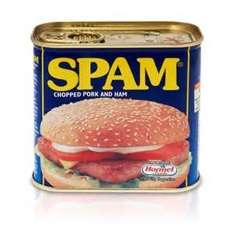


Proofs of Work (PoW) [DN92]
Fight Spam
Mitigate Sybil Attacks
Distributed Consensus
Cryptocurrency
  Honest Parties control 51% of work-capacity

Slide 4

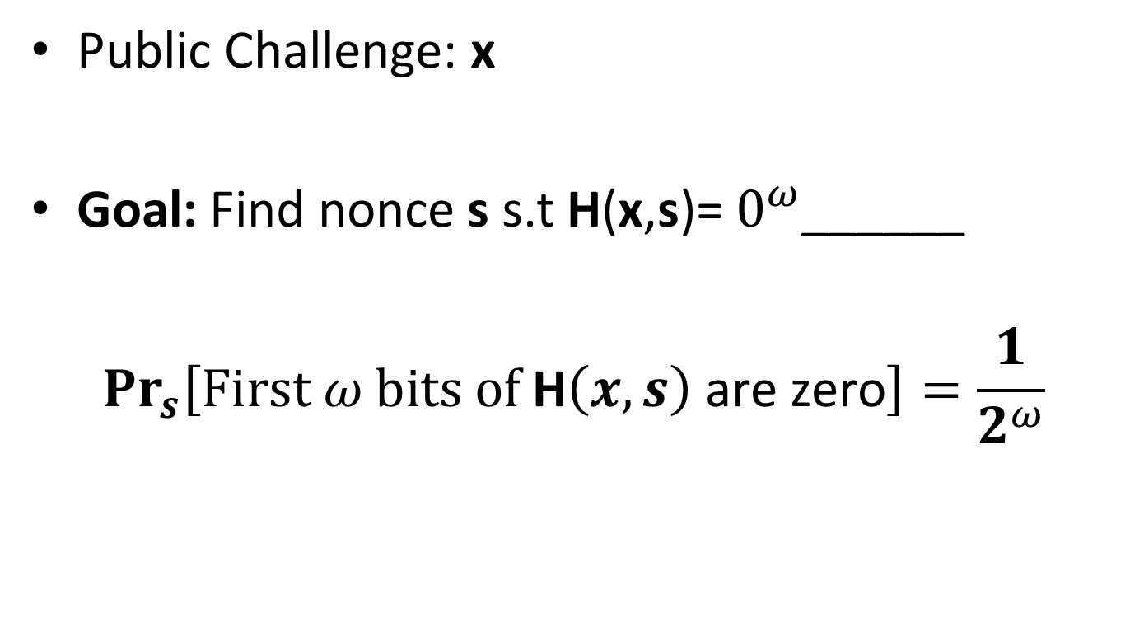
Hashcash Proof of Work
Public Challenge: x
Goal: Find nonce s s.t H(x,s)= $0^{ω}$______
$${Pr}_{s}\left[\text{First} ω \text{bits} \text{of} \text{H}\left(x,s\right) \text{are} \text{zero}\right]=\frac{1}{2^{ω}}$$
SHA256

Slide 5


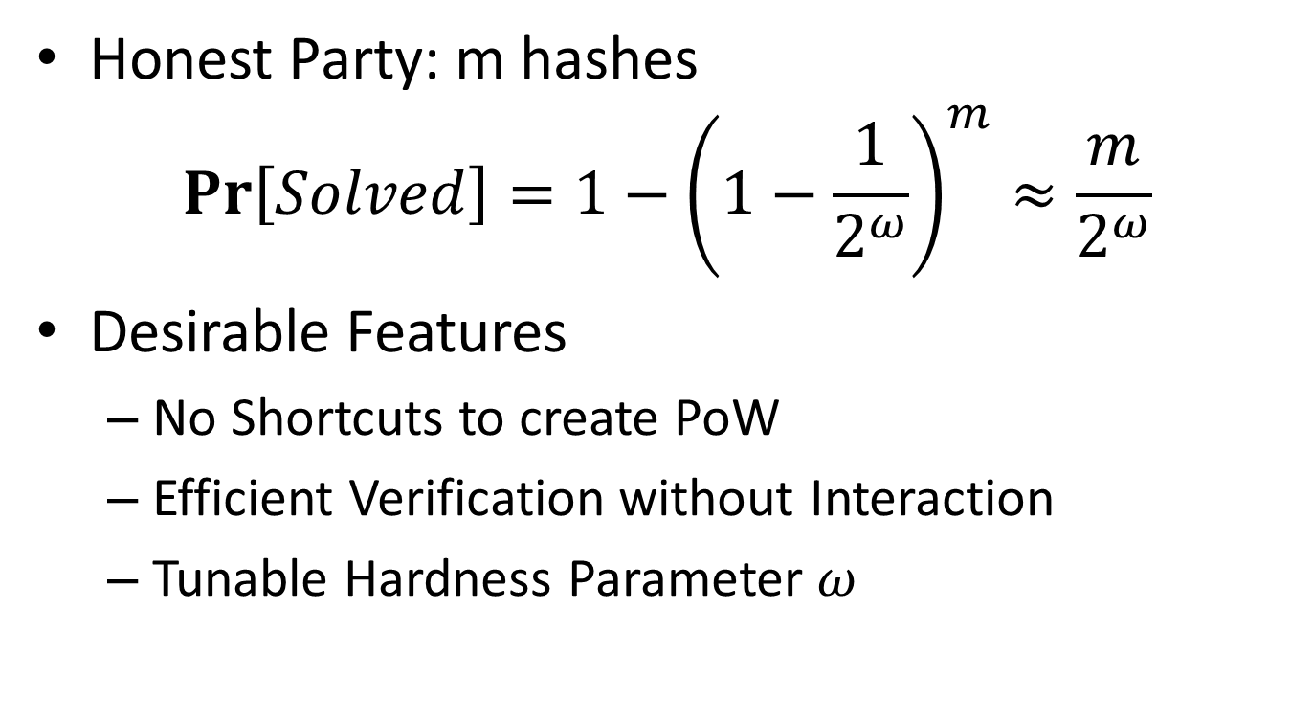
Hashcash Proof of Work
Honest Party: m hashes
$$Pr\left[Solved\right]={1−\left(1−\frac{1}{2^{ω}}\right)}^{m}≈\frac{m}{2^{ω}}$$
Desirable Features
  No Shortcuts to create PoW
  Efficient Verification without Interaction
  Tunable Hardness Parameter $ω$

Slide 6
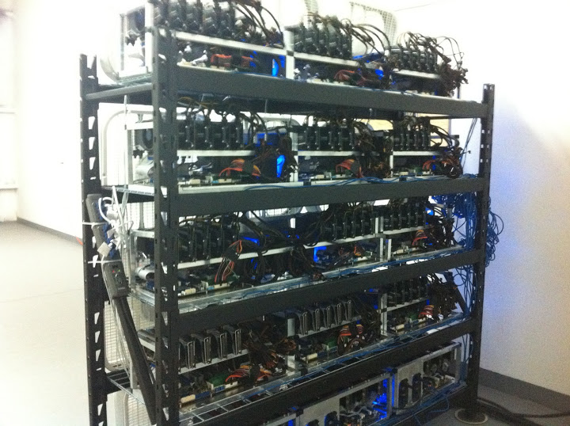
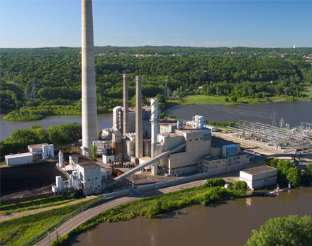
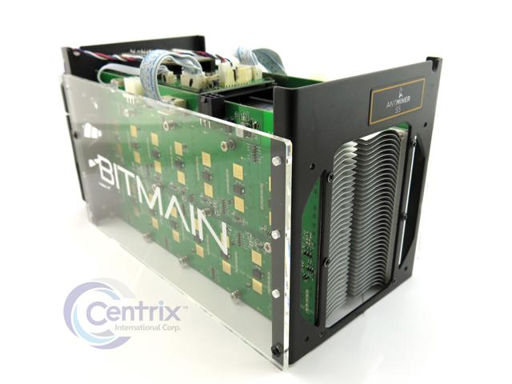
Undesirable Features: Environment
Energy Intensive

Slide 7
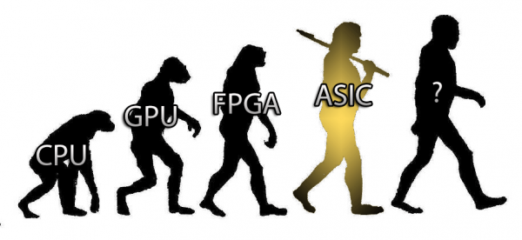


Undesirable Features: Inequitable
Cost(SHA256) varies by a factor of 10⁶

Slide 8
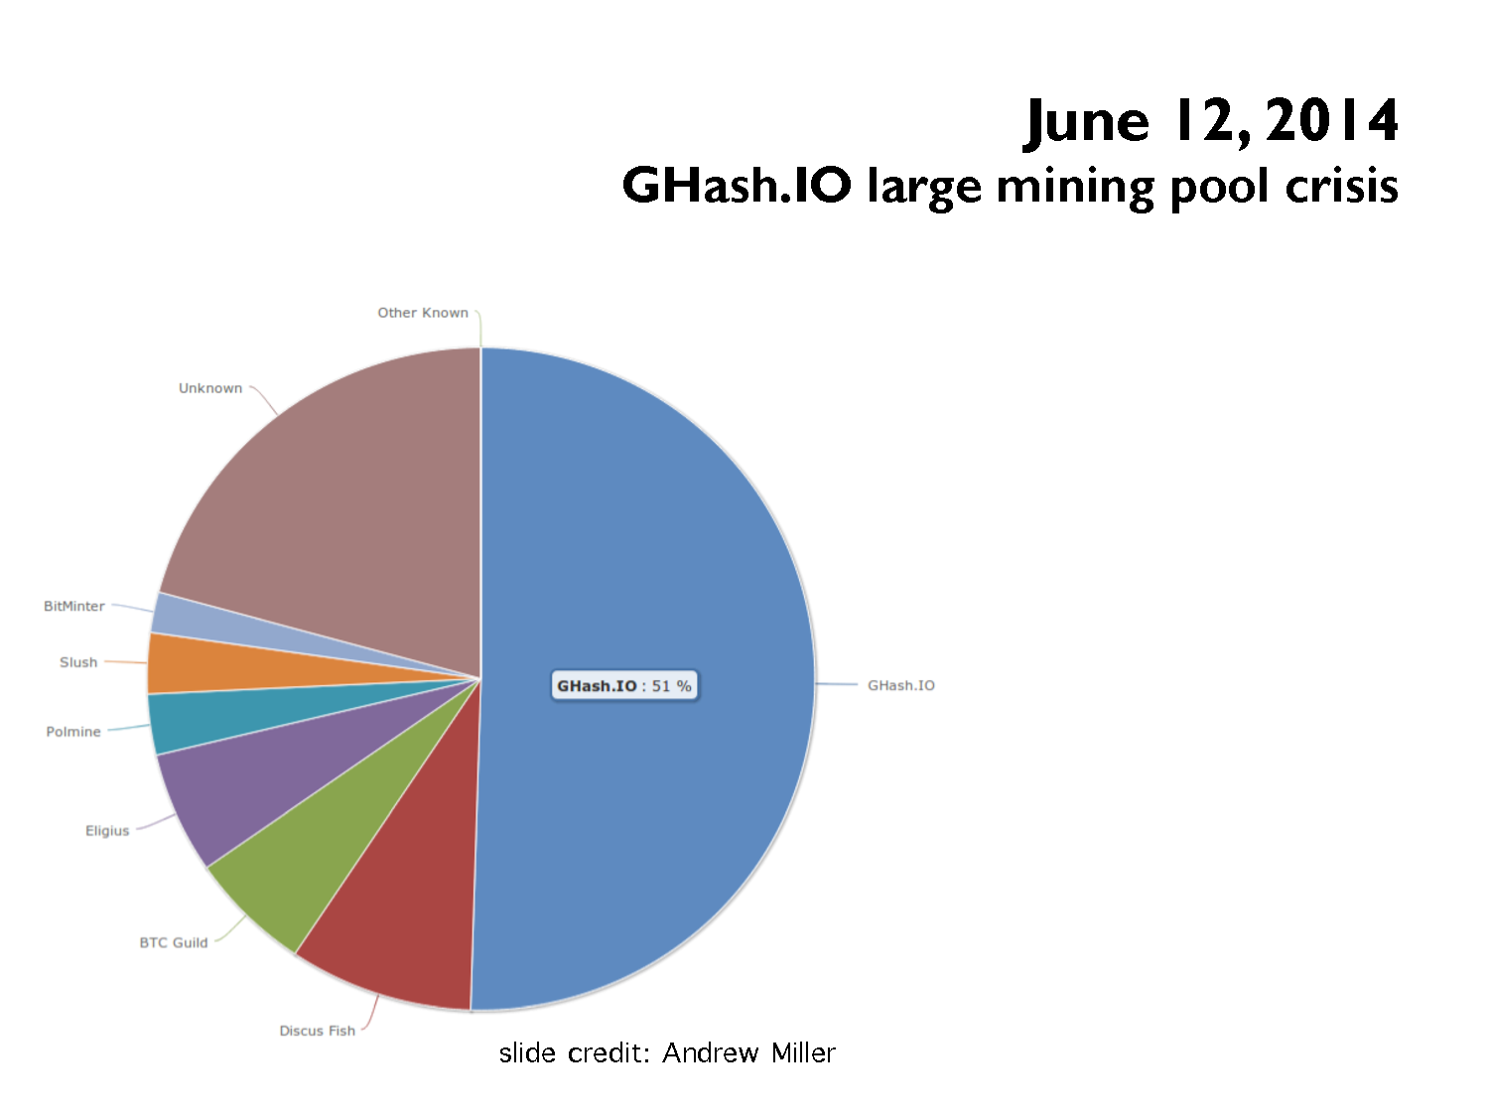
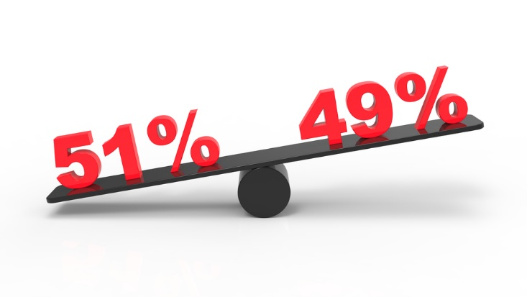
Bitcoin currency could have been destroyed by '51%' attack ...
www.theguardian.com › Technology › Bitcoin
Bitcoin currency could have been destroyed by '51% ... mining pool Ghash.io controlled 51% of all the processing power being used to perform the calculations that ...

Slide 9
Designing Proofs of Human Work for Cryptocurrency and Beyond

Slide 10

Proof of Human Work
Convincing non-interactive proof that a human invested effort to validate some string x
  “Create Account: _____”
  “Authenticate: ____”
  “Validate Transaction: _____”
Verifiable by computer without human effort
Sounds a bit like a CAPTCHA…

Slide 11


CAPTCHAs
Convincing non-interactive proof that a human invested effort to validate some string x
Create Account: username
Answer: KWTER
Random bits
Answer: KWTER
CAPTCHA

Slide 12
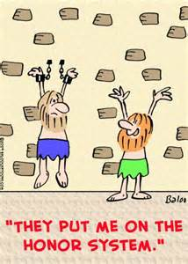

CAPTCHAs
Convincing non-interactive proof that a human invested effort to validate some string x
Create Account: username
Random bits
Answer: KWTER
CAPTCHA
Answer: KWTER

Slide 13
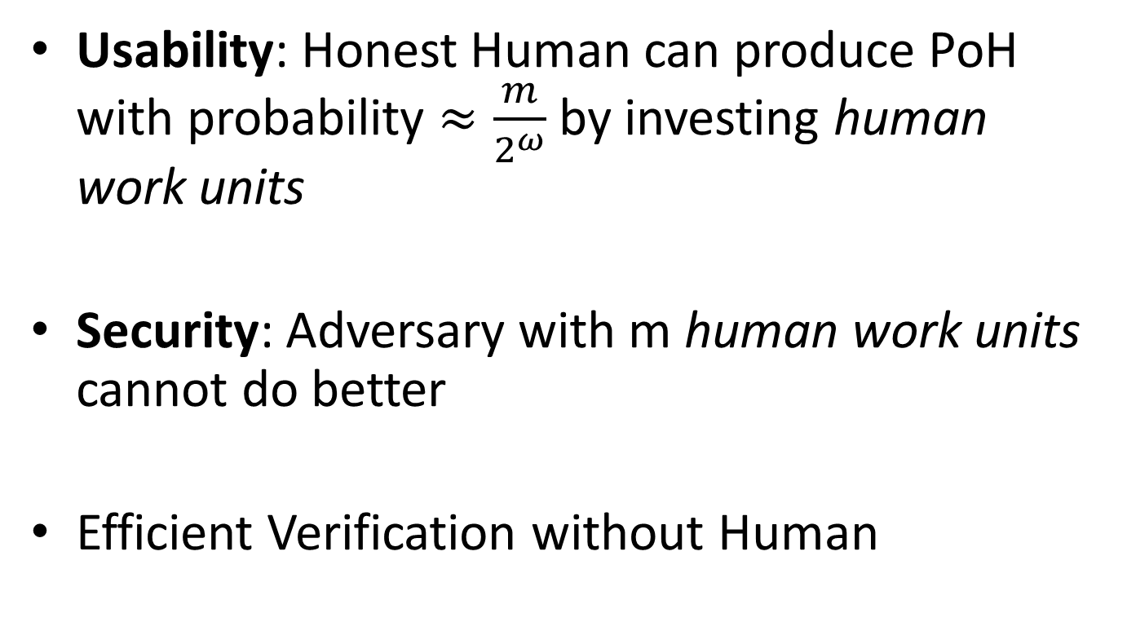
Proof of Human Work (PoH)
Usability: Honest Human can produce PoH with probability $≈\frac{m}{2^{ω}}$ by investing human work units
Security: Adversary with m human work units cannot do better
Efficient Verification without Human
Notes:
Breeding humans with super-CAPTCHA solving powers is a bit more difficult

Slide 14



PoH Advantages
Equitable:
Eco-Friendly
A
M
N
Notes:
We conjecture, but do not prove, that it is difficult to breed humans with superhuman CAPTCHA solving ability…
Unlike Bitcoin solving a PoH does not require massive electircity consumption

Slide 15
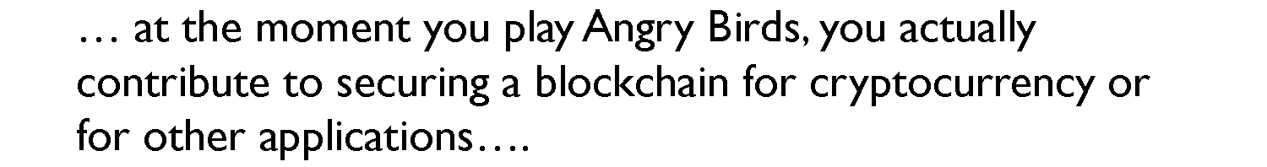

Waste of Human Effort?
Fun CAPTCHAs/Educational CAPTCHAs
NEW (July 19, 2016): Humans won the 2016 Man vs Machine Challenge. Now that Go is solved, Angry Birds is the next big AI Challenge! (Source: www.aibirds.org)
Notes:
Maybe we are wasting human effort instead of electricity?

Slide 16

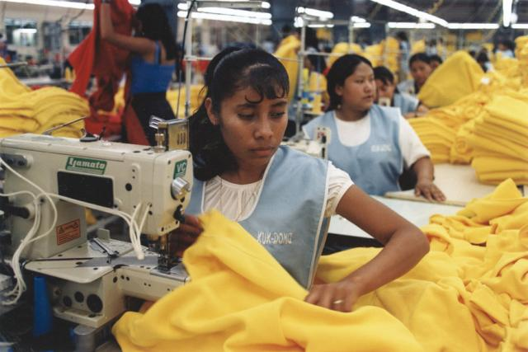
PoH in Practice
?????
?????
Construction requires iO

Slide 17
Our PoH Construction: Assumptions
Crypto: iO, OWF, Random Oracles
  iO+OWF → Universal Samplers in the Random Oracle Model [Hofheinz et al. ASIACRYPT 2016]
AI: Any (known) adversary with m human work units and n random CAPTCHAs z₁,…,z_{n} (n > m) can solve at most m CAPTCHAs with high probability
  Even if puzzle z_{i} includes hash of solution a_{i}
+ SHA1(CAPTCHA) = 2d91cbf686b351676576ac028972d6cfd03500fe

Slide 18
Will we ever have secure/practical iO construction?
Is the AI assumption valid?

Slide 19
Hardness-amplification theorem
Weakly-verifiable puzzle system, Z=(G,V)
Let ε, n be functions of security parameter
  n polynomially bounded
[Thm] If Z is ε-hard then Z^{n} is ε^{n}-hard
  i.e., is no efficient S solves Z better than ε+negl, then no efficient S solves Z^{n} better than ε^{n}+negl
100 character CAPTCHA could be acceptable for HumanCoin since solution to each puzzle is just a lottery ticket
Slide Credit: Hardness Amplification of Weakly-Verifiable Puzzles[CHS]

Slide 20
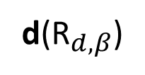
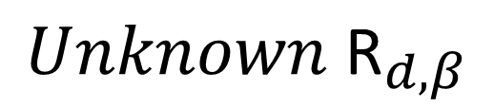
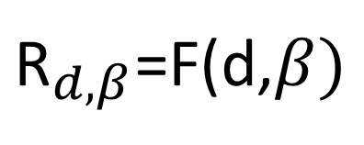
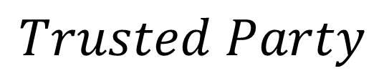

Key Tool: Universal Sampler
[Hofheinz et al. 2016]
d(${\text{R}}_{d,β}$)
${\text{R}}_{d,β}$=F(d,$β)$
Circuit: d
$$β$$
$$Unknown {\text{R}}_{d,β}$$
$$Trusted Party$$
Univ.Sample
$$Ideal World:F is truly random$$

Slide 21
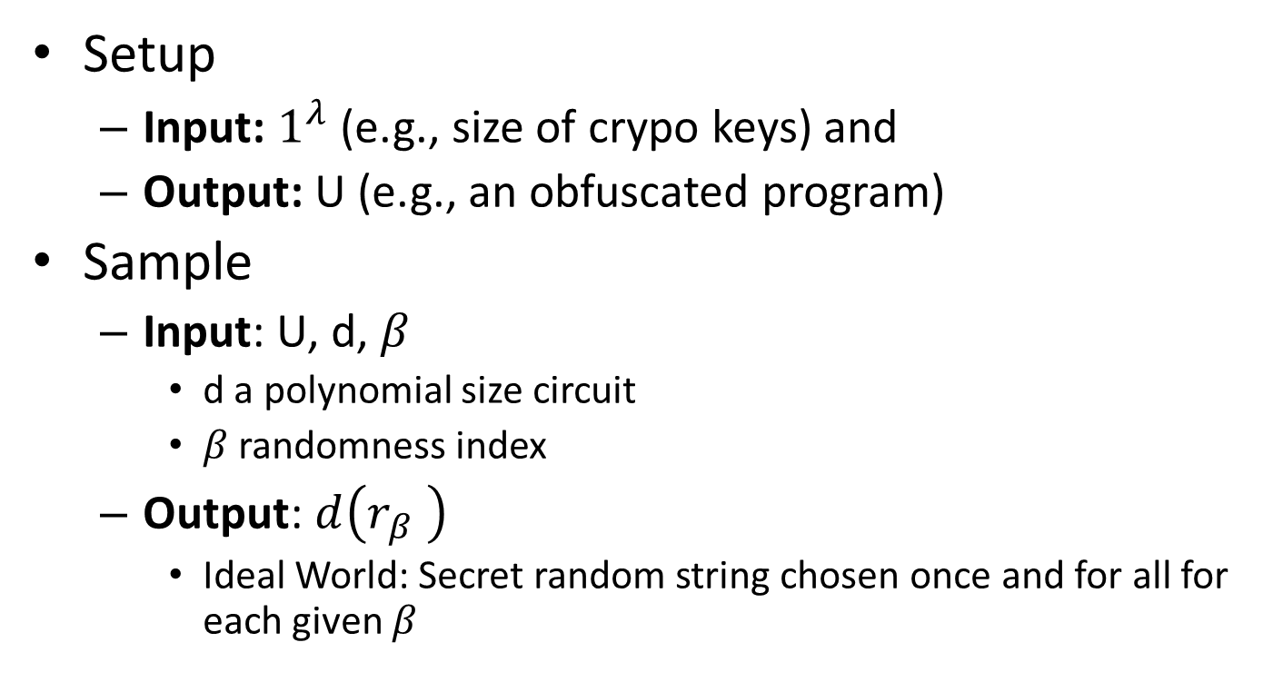
Key Tool: Universal Sampler
Setup
  Input: $1^{λ}$ (e.g., size of crypo keys) and
  Output: U (e.g., an obfuscated program)
Sample
  Input: U, d, $β$
    d a polynomial size circuit
    $β$ randomness index
  Output: $d\left(r_{β }\right)$
    Ideal World: Secret random string chosen once and for all for each given $β$

Slide 22
Universal Sampler
[Hofheinz et al. 2016]
Construction in Random Oracle Model
Crypto Assumptions: iO + OWF
  Random Oracle not queried inside iO
Adaptive Security
  “delayed backdoor programming” via Random Oracle

Slide 23
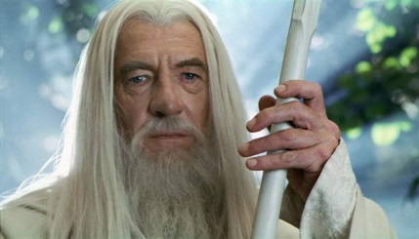
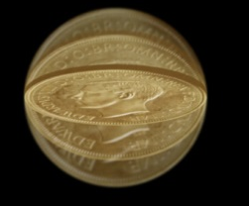
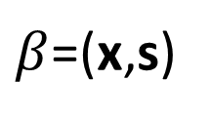

PoH Construction
Instance: x
Nonce: s
OWF(KWTER)
Answer: KWTER
d
$β$=(x,s)
r
Sample
CAPTCHA
r
U
Random Oracle
Circuit d
d(${\text{R}}_{d,β}$)

Slide 24
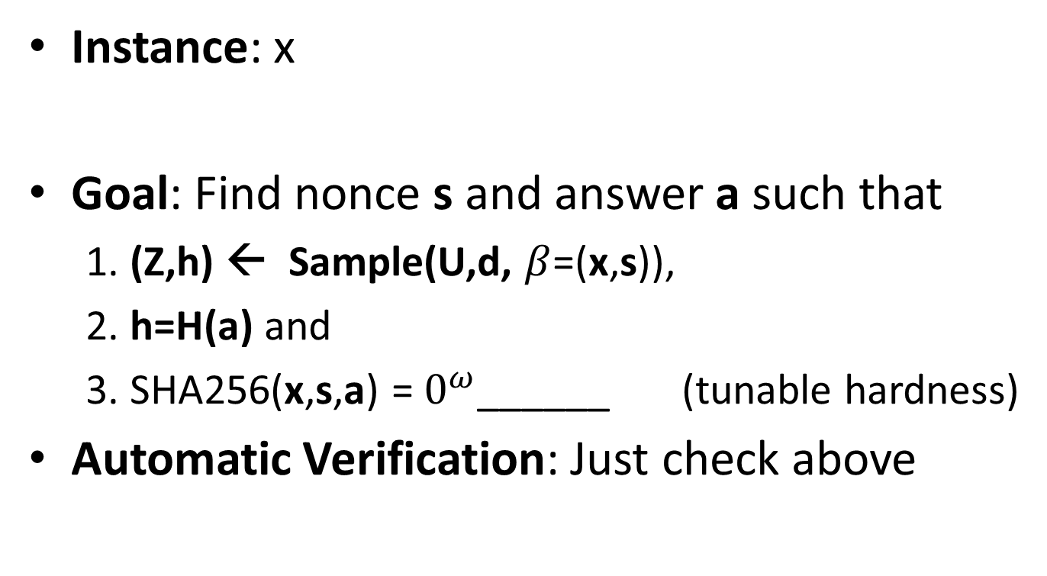
PoH Construction
Instance: x
Goal: Find nonce s and answer a such that
  1. (Z,h) ← Sample(U,d, $β$=(x,s)),
  2. h=H(a) and
  3. SHA256(x,s,a) = $0^{ω}$______ (tunable hardness)
Automatic Verification: Just check above

Slide 25
Security Reduction
Main Theorem: Blackbox reduction transforms any ppt algorithm breaking PoH security into a ppt algorithm breaking CAPTCHA security.
(Assuming security of Universal Sampler)
Statement about human ignorance

Slide 26

PoH for Password Storage
X=“Authenticate: jblocki, 123456”
Answer: KWTER
Username
jblocki
Salt
89d978034a3f6
Hash
1f88ecdcb0c25e8ae1ed1c9ce6f2e2e6dcfb0e21
x
+H(KWTER)
SHA1(123456KWTER89d978034a3f6)=1f88ecdcb0c25e8ae1ed1c9ce6f2e2e6dcfb0e21
Universal Sampler
CAPTCHA

Slide 27
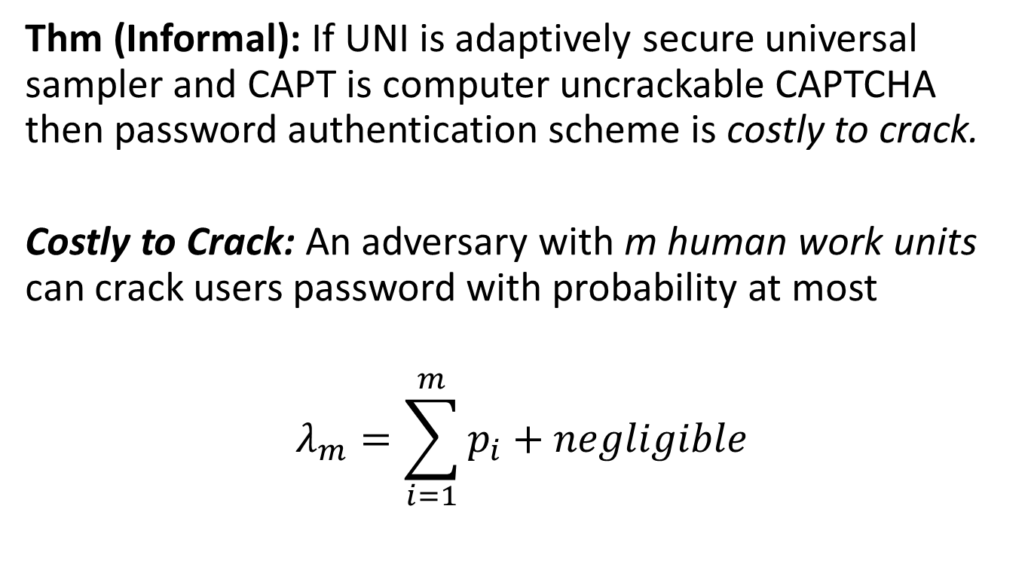
Security Analysis
Thm (Informal): If UNI is adaptively secure universal sampler and CAPT is computer uncrackable CAPTCHA then password authentication scheme is costly to crack.
Costly to Crack: An adversary with m human work units can crack users password with probability at most
$$λ_{m}=\sum_{i=1}^{m}{p_{i}}+negligible$$

Slide 28

Security Analysis
Standard CAPTCHA assumption: Adversary not given hashes answers to puzzles.
Thm (Informal): If UNI is adaptively secure universal sampler and CAPT is computer uncrackable CAPTCHA then password authentication scheme is costly to crack.
Costly to Crack: An adversary with m `human work units’ can crack users password with probability at most
$$λ_{m}=\sum_{i=1}^{m}{p_{i}}+negligible$$

Slide 29
Security Analysis
Standard CAPTCHA assumption: Adversary not given hashes answers to puzzles.
Thm (Informal): If UNI is adaptively secure universal sampler and CAPT is computer uncrackable CAPTCHA then password authentication scheme is costly to crack.
Costly to Crack: An adversary with m `human work units’ can crack users password with probability at most
$$λ_{m}=\sum_{i=1}^{m}{p_{i}}+negligible$$
** Actually show blackbox reduction from ppt adversary breaking security of password scheme to ppt adversary breaking CAPTCHA security

Slide 30
PoH for E-mails
Answer: KWTER
E-mail: x
x
+H(KWTER)
Universal Sampler
x
+H(KWTER)
CAPTCHA
Universal Sampler
CAPTCHA

Slide 31
Future Challenges
Make iO efficient again
  For targeted applications?
What other applications are possible?
How could efficient obfuscation shape human-computer interaction?

Slide 32

Thanks for Listening

