Slide 1


Memory Hard Functions, Random Oracles, Graph Pebbling and Extractor Arguments
Jeremiah Blocki
CSoI Seminar 2019

Slide 2





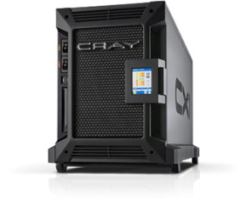

Motivation: Password Storage
jblocki, 123456
Username
jblocki
Salt
89d978034a3f6
Hash
85e23cfe0021f584e3db87aa72630a9a2345c062
SHA1(12345689d978034a3f6)=85e23cfe0021f584e3db87aa72630a9a2345c062
+
Notes:
As a motivating example consider an adversary who breaks into an authentication server and steals a users crptographic hash value. The adversary can execute an offline attack against the password by comparing the hash value with the hashes of likely password guesses. The adversary is limited only by the resources that he is willing to invest cracking the passwords.

Slide 3













Offline Attacks: A Common Problem
Password breaches at major companies have affected millions billions of user accounts.
Notes:
Unfortunately, offline dictionary attacks are quite common. Password breaches at major companies have affected millions of users.

Slide 4
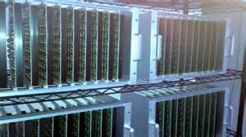



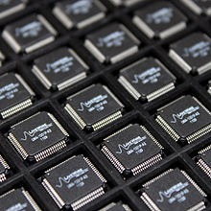
Goal: Moderately Expensive Hash Function
Fast on PC and
Expensive on ASIC?
Notes:
This motivates the need for moderately hard functions. The basic idea is to build a password hash function that is moderately expensive to compute to limit the number of guesses that an adversary would be willing to try. An honest server only needs to compute the function once during a typical authentication session. However, the adversary potentially has an advantage in this game. While the honest server must typically evaluate the function on standard hardware, the adversary could use potentially reduce the cost per password guess by developing customized hardware (GPUs, FPGAs, ASICs) to evaluate the password hash function. Thus, we want to ensure that the cost to evaluate this function is equitable across platforms.

Slide 5
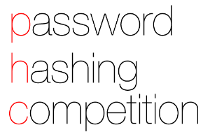
(2013-2015)
https://password-hashing.net/

Slide 6

We recommend that you use Argon2…
(2013-2015)
https://password-hashing.net/

Slide 7
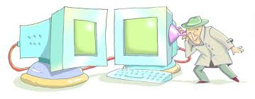
We recommend that you use Argon2…
There are two main versions of Argon2, Argon2i and Argon2d. Argon2i is the safest against side-channel attacks
(2013-2015)
https://password-hashing.net/

Slide 8
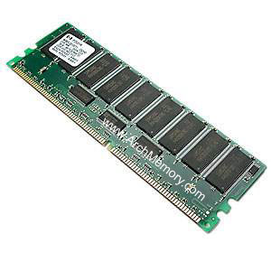

Memory Hard Function (MHF)
Intuition: computation costs dominated by memory costs
vs.
Goal: force attacker to lock up large amounts of memory for duration of computation
  →Expensive even on customized hardware
Notes:
In this work we study a special type of memory hard function called data-independent memory hard functions. As the name suggests the memory access pattern will not depend on the input making the functions resistant to side-channel attacks.

Slide 9

Memory Hard Function (MHF)
Intuition: computation costs dominated by memory costs
vs.
Notes:
In this work we study a special type of memory hard function called data-independent memory hard functions. As the name suggests the memory access pattern will not depend on the input making the functions resistant to side-channel attacks.

Slide 10
Memory Hard Function (MHF)
Intuition: computation costs dominated by memory costs
vs.
Notes:
In this work we study a special type of memory hard function called data-independent memory hard functions. As the name suggests the memory access pattern will not depend on the input making the functions resistant to side-channel attacks.

Slide 11
Memory Hard Function (MHF)
Intuition: computation costs dominated by memory costs
vs.
Data Independent Memory Hard Function (iMHF)
  Memory access pattern should not depend on input
Notes:
In this work we study a special type of memory hard function called data-independent memory hard functions. As the name suggests the memory access pattern will not depend on the input making the functions resistant to side-channel attacks.

Slide 12
Memory Hard Function (MHF)
Intuition: computation costs dominated by memory costs
vs.
Data Independent Memory Hard Function (iMHF)
  Memory access pattern should not depend on input
Notes:
In this work we study a special type of memory hard function called data-independent memory hard functions. As the name suggests the memory access pattern will not depend on the input making the functions resistant to side-channel attacks.

Slide 13
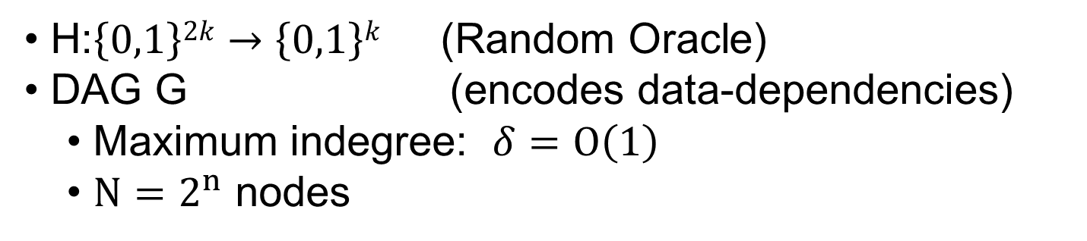
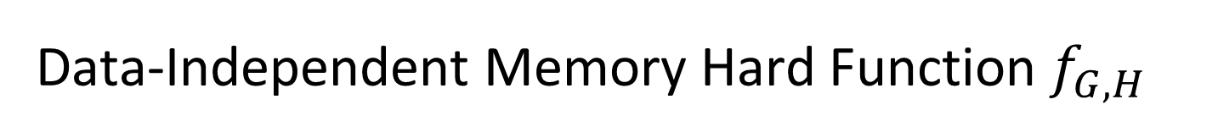


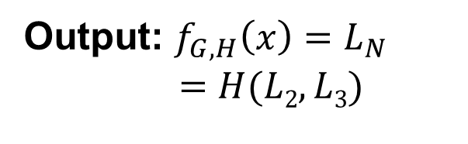
Data-Independent Memory Hard Function $f_{G,H}$
Input: x
2
4
Output: $f_{G,H}\left(x\right)=L_{N}$
$$=H(L2,L3)$$
1
1
3
$$L1=H(x)$$
$$L3=H(L1,L2)$$
H:$\left\{0,1\right\}2k→\left\{0,1\right\}k$ (Random Oracle)
DAG G (encodes data-dependencies)
  Maximum indegree: $δ=O\left(1\right)$
  $N=2^{n}$ nodes

Slide 14
Evaluating an iMHF (pebbling)
4
5
3
4
5
1
3
1
2

Slide 15
Evaluating an iMHF (pebbling)
1
2
3
4
5
P₁ = {1} (data value L₁ stored in memory)

Slide 16
Evaluating an iMHF (pebbling)
1
2
3
4
5
P₁ = {1}
P₂ = {1,2} (data values L₁ and L₂ stored in memory)

Slide 17
Evaluating an iMHF (pebbling)
1
2
3
4
5
P₁ = {1}
P₂ = {1,2}
P₃ = {3}

Slide 18
Evaluating an iMHF (pebbling)
1
2
3
4
5
P₁ = {1}
P₂ = {1,2}
P₃ = {3}
P₄ = {3,4}

Slide 19
Evaluating an iMHF (pebbling)
1
2
3
4
5
P₁ = {1}
P₂ = {1,2}
P₃ = {3}
P₄ = {3,4}
P₅ = {5}

Slide 20
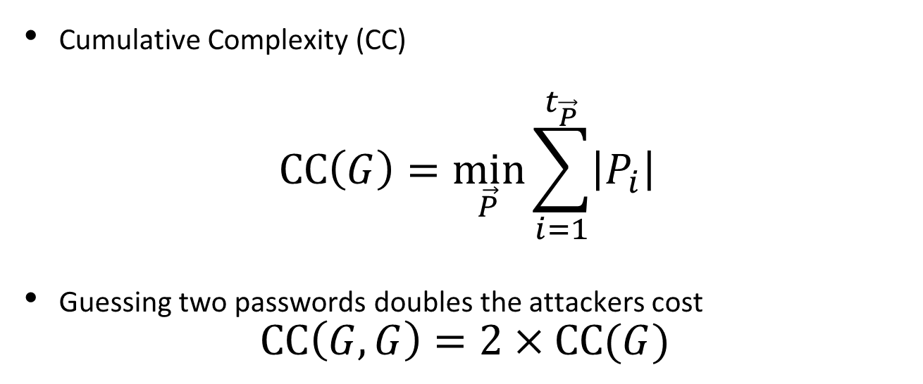
Measuring Pebbling Costs [AS15]
Cumulative Complexity (CC)
$$CC\left(G\right)=\min_{\vec{P}}{\sum_{i=1}^{t_{\vec{P}}}{\left|P_{i}\right|}}$$
Guessing two passwords doubles the attackers cost
$$CC\left(G,G\right)=2×CC(G)$$
Memory Used at Step i
Approximates Amortized Area x Time Complexity of iMHF

Slide 21

Measuring Pebbling Costs [AS15]
$$CC\left(G\right)=\min_{\vec{P}}{\sum_{i=1}^{t_{\vec{P}}}{\left|P_{i}\right|}}$$
Approximates Amortized Area x Time Complexity of iMHF
Memory Used at Step i
Cumulative Memory Cost
space
iterations

Slide 22
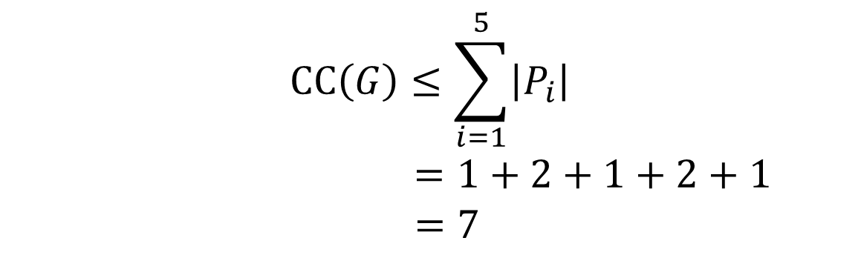
Pebbling Example (CC)
1
2
3
4
5
P₁ = {1}
$$CC\left(G\right)≤\sum_{i=1}^{5}{\left|P_{i}\right|}$$
$$=1+2+1+2+1$$
$=7$
P₂ = {1,2}
P₃ = {3}
P₄ = {3,4}
P₅ = {5}

Slide 23


Desiderata
Find a DAG G on n nodes such that
Constant Indegree ($δ=2)$
  Running Time: $n\left(δ−1\right)=n$
CC(G) $≥\frac{n2}{τ}$ for some small value $τ$.
Maximize costs for fixed running time n
(Users are impatient)

Slide 24
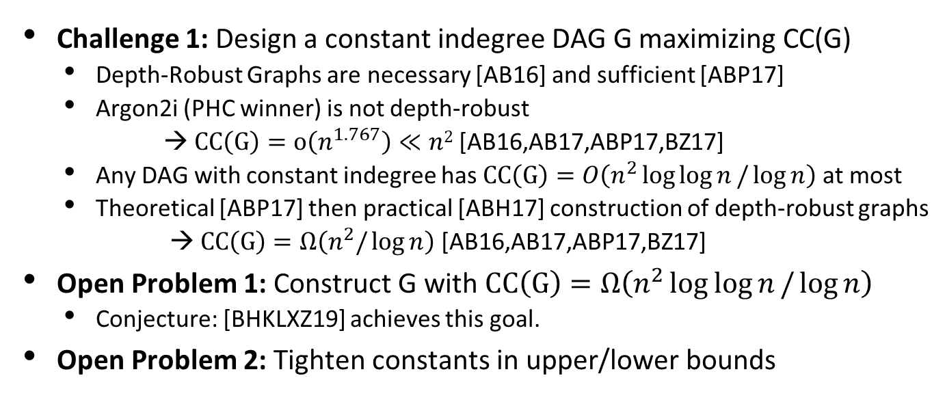
DAGs with Maximal CC(G)
Challenge 1: Design a constant indegree DAG G maximizing CC(G)
  Depth-Robust Graphs are necessary [AB16] and sufficient [ABP17]
  Argon2i (PHC winner) is not depth-robust
  → $CC\left(G\right)=o\left(n^{1.767}\right)≪n2$ [AB16,AB17,ABP17,BZ17]
  Any DAG with constant indegree has $CC\left(G\right)=O\left(n^{2}\log{\log{n}}/\log{n}\right)$ at most
  Theoretical [ABP17] then practical [ABH17] construction of depth-robust graphs
  → $CC\left(G\right)=Ω\left(n^{2}/\log{n}\right)$[AB16,AB17,ABP17,BZ17]
Open Problem 1: Construct G with $CC\left(G\right)=Ω\left(n^{2}\log{\log{n}}/\log{n}\right)$
  Conjecture: [BHKLXZ19] achieves this goal.
Open Problem 2: Tighten constants in upper/lower bounds

Slide 25
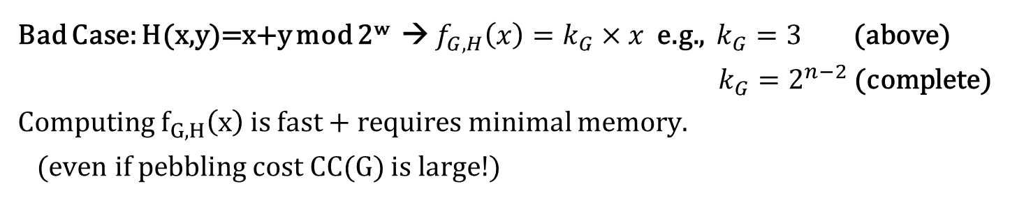

Question: CC(G) → cumulative memory cost?
Input: x
2
4
Output: $f_{G,H}\left(x\right)=L_{N}$
$$=H(L2,L3)$$
1
1
3
$$L1=H(x,0)$$
$$L3=H(L1,L2)$$
Bad Case: H(x,y)=x+y mod 2^{w} → $f_{G,H}\left(x\right)=k_{G}×x$ e.g., $k_{G}=3$ (above)
$k_{G}=2^{n−2}$(complete)
Computing $f_{G,H}\left(x\right)$ is fast + requires minimal memory.
(even if pebbling cost CC(G) is large!)
Independent of input!

Slide 26
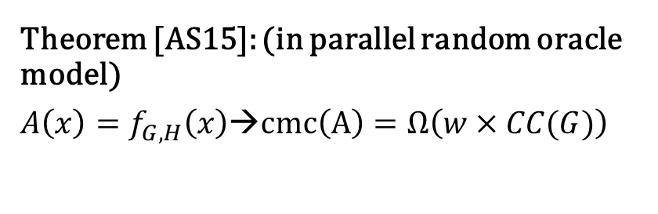
Question: CC(G) → cumulative memory cost?
Input: x
2
4
Output: $f_{G,H}\left(x\right)=L_{N}$
$$=H(L2,L3)$$
1
1
3
$$L1=H(x)$$
$$L3=H(L1,L2)$$
Theorem [AS15]: (in parallel random oracle model)
$A\left(x\right)=f_{G,H}\left(x\right)$→$cmc\left(A\right)=Ω\left(w×CC(G)\right)$
2
4
1
1
3

Slide 27
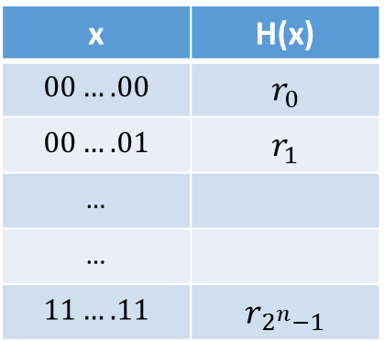
Random Oracle Model (PROM)
Model hash function H as a random function
Algorithms can only interact with H as an oracle
  Query: x
  Response: H(x)
If we submit the same query you see the same response
If x has not been queried, then the value of H(x) is uniform
x | H(x)
$$00….00$$ | $$r_{0}$$
$$00….01$$ | $$r_{1}$$
…
…
$$11….11$$ | $$r_{2^{n}−1}$$
Real World: H instantiated as cryptographic hash function (e.g., SHA3) of fixed length (no Merkle-Damgård)

Slide 28
Random Oracle Model: Justification
“A proof of security in the random-oracle model is significantly better than no proof at all.” [Katz-Lindell]
Evidence of sound design (any weakness involves the hash function used to instantiate the random oracle)
Empirical Evidence for Security
“there have been no successful real-world attacks on
schemes proven secure in the random oracle model”

Slide 29
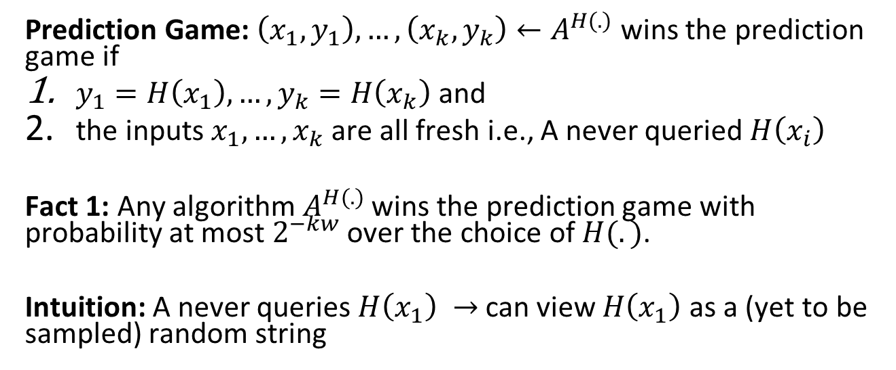
Random Oracle Model: Prediction Game
Prediction Game: $\left(x_{1},y_{1}\right),…,\left(x_{k},y_{k}\right)←A^{H(.)}$ wins the prediction game if
$y_{1}=H\left(x_{1}\right),…,y_{k}=H\left(x_{k}\right)$ and
the inputs $x_{1},…,x_{k}$ are all fresh i.e., A never queried $H\left(x_{i}\right)$
Fact 1: Any algorithm${ A}^{H(.)}$ wins the prediction game with probability at most $2^{−kw}$ over the choice of $H(.)$.
Intuition: A never queries $H\left(x_{1}\right) →$can view $H\left(x_{1}\right)$ as a (yet to be sampled) random string

Slide 30
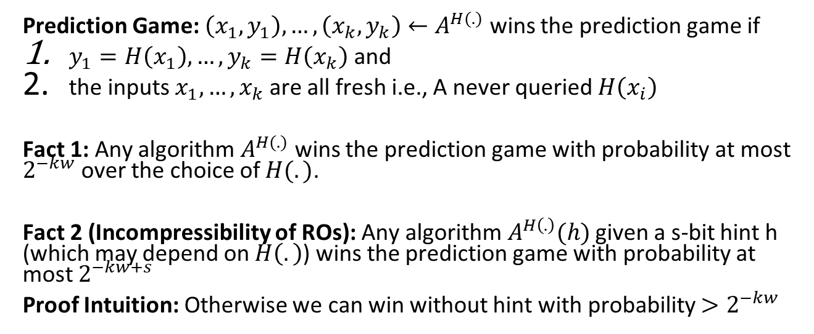
Random Oracle Model: Prediction Game
Prediction Game: $\left(x_{1},y_{1}\right),…,\left(x_{k},y_{k}\right)←A^{H(.)}$ wins the prediction game if
$y_{1}=H\left(x_{1}\right),…,y_{k}=H\left(x_{k}\right)$ and
the inputs $x_{1},…,x_{k}$ are all fresh i.e., A never queried $H\left(x_{i}\right)$
Fact 1: Any algorithm${ A}^{H(.)}$ wins the prediction game with probability at most $2^{−kw}$ over the choice of $H(.)$.
Fact 2 (Incompressibility of ROs): Any algorithm${ A}^{H\left(.\right)}(h)$ given a s-bit hint h (which may depend on $H\left(.\right)$) wins the prediction game with probability at most $2^{−kw+s}$
Proof Intuition: Otherwise we can win without hint with probability $>2^{−kw}$
Reduction: Guess correct hint h with probability $2^{−s}$ and run ${ A}^{H\left(.\right)}(h)$

Slide 31

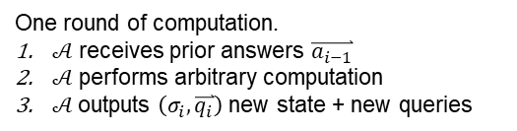
Parallel Random Oracle Model (PROM)
PROM Algorithm $𝒜$(x)
  Initial Input/State: $σ_{0}=x$
  $\left(σ_{1},\overset{⃑}{q_{1}}=\left(x_{1}^{1},…,x_{r_{1}}^{1}\right)\right)←𝒜\left(σ_{0}\right)$
    New State + Batch of Random Oracle Queries
  $\overset{⃑}{a_{1}}=(H(x_{1}^{1}),…,H(x_{r_{1}}^{1}))$
    Answers to Random Oracle Queries
  $\left(σ_{2},\overset{⃑}{q_{2}}=\left(x_{1}^{2},…x_{r_{2}}^{2}\right)\right)←𝒜\left(σ_{1},\overset{⃑}{a_{1}}\right)$
  ….
  $\left(σ_{i},\overset{⃑}{q_{i}}=\left(x_{1}^{i},…x_{r_{i}}^{i}\right)\right)←𝒜\left(σ_{i−1},\overset{⃑}{a_{i−1}}\right)$
  ….
  $y←𝒜\left(σ_{t},\overset{⃑}{a_{t}}\right)$
x | H(x)
$$00….00$$ | $$r_{0}$$
$$00….01$$ | $$r_{1}$$
…
…
$$11….11$$ | $$r_{2^{n}−1}$$
One round of computation.
$𝒜$ receives prior answers $\overset{⃑}{a_{i−1}}$
$𝒜$ performs arbitrary computation
$𝒜$outputs $\left(σ_{i},\overset{⃑}{q_{i}}\right)$ new state + new queries

Slide 32


Parallel Random Oracle Model (PROM)
PROM Algorithm $𝒜$(x)
  Fixing $𝒜$, x and H we get an execution trace
  $${Trace}_{𝒜,H}\left(x\right)= {\left\{σ_{i},\overset{⃑}{q_{i}},\overset{⃑}{a_{i}}\right\}}_{i=1}^{t}$$
  Cumulative Memory Cost of Execution Trace
  $$cmc\left({Trace}_{𝒜,H}\left(x\right)\right)=\sum_{i=1}^{t}{\left(\left|σ_{i}\right|+|\overset{⃑}{a_{i}}|\right)}$$
  Cumulative Memory Cost of a Function
  $$cmc\left(f_{G,H}\right)=\min_{𝒜,x}{𝔼_{H}\left[cmc\left({Trace}_{𝒜,H}\left(x\right)\right)\right]}$$
x | H(x)
$$00….00$$ | $$r_{0}$$
$$00….01$$ | $$r_{1}$$
…
…
$$11….11$$ | $$r_{2^{n}−1}$$
Min over inputs x and PROM algorithms $𝒜$evaluating${ f}_{G,H}$
Expectation over selection of random oracle

Slide 33
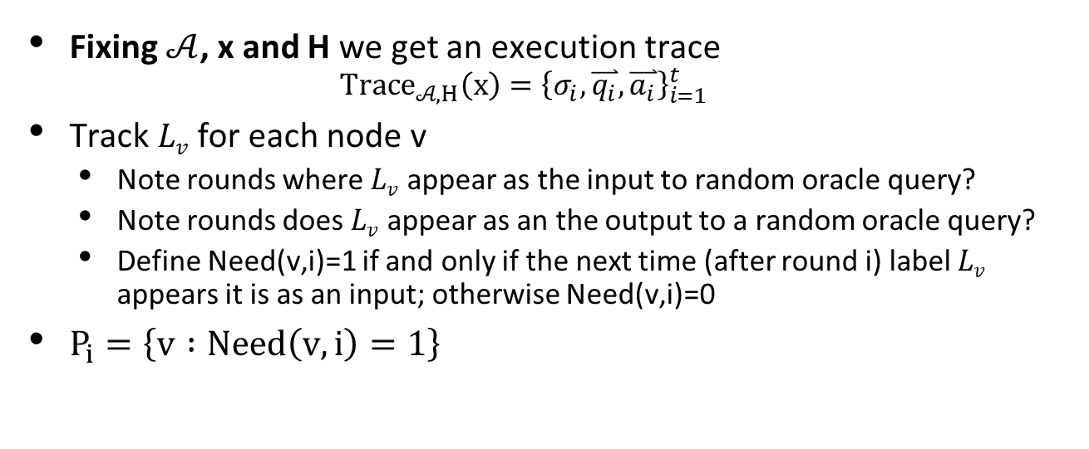
Ex Post Facto Pebbling
Fixing $𝒜$, x and H we get an execution trace
  $${Trace}_{𝒜,H}\left(x\right)={\left\{σ_{i},\overset{⃑}{q_{i}},\overset{⃑}{a_{i}}\right\}}_{i=1}^{t}$$
Track $Lv$ for each node v
  Note rounds where $Lv$ appear as the input to random oracle query?
  Note rounds does $Lv$ appear as an the output to a random oracle query?
  Define Need(v,i)=1 if and only if the next time (after round i) label $Lv$ appears it is as an input; otherwise Need(v,i)=0
$P_{i}=\left\{v :Need\left(v,i\right)=1\right\}$
Need(v,i)=0
Need(v,i)=1
0
I
0
I
0
0
I
0
Rounds where v occurs as output 0 or input I
t

Slide 34

Ex Post Facto Pebbling
$P_{i}=\left\{v :Need\left(v,i\right)=1\right\}$ → does this give us a legal pebbling?
Order(v) be the bad event $Lv$ is used as an RO input before it has appeared as an output
Unexpected order
I
0
I
0
0
I
0
Rounds where v occurs as output 0 or input I
t
Expected order
0
I
0
I
0
0
I
0
Rounds where v occurs as output 0 or input I
t

Slide 35
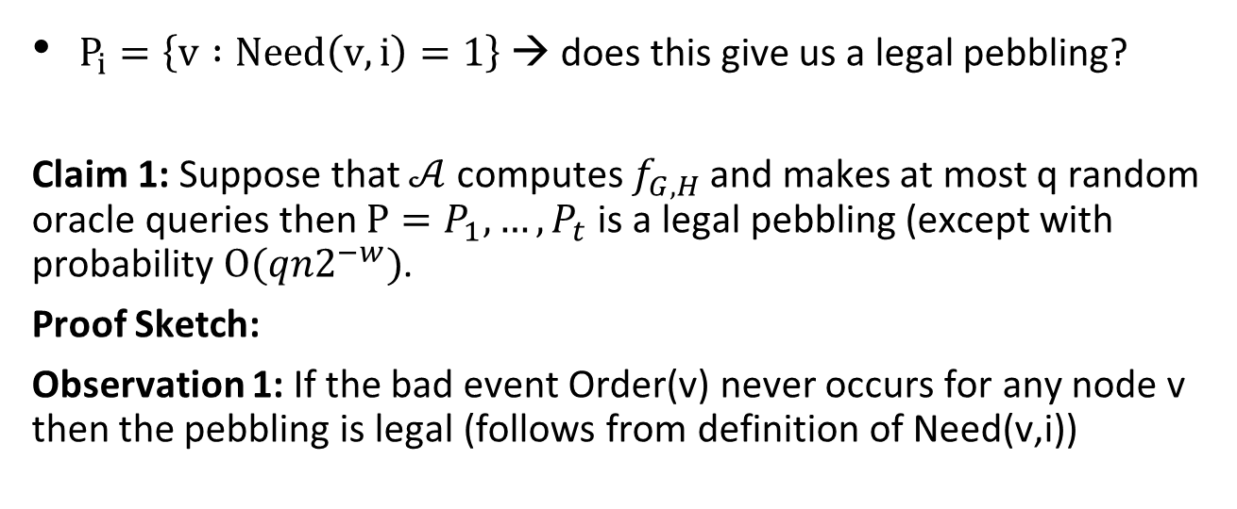
Ex Post Facto Pebbling
$P_{i}=\left\{v :Need\left(v,i\right)=1\right\}$ → does this give us a legal pebbling?
Claim 1: Suppose that $𝒜$ computes $f_{G,H}$ and makes at most q random oracle queries then $P=P_{1},…,P_{t}$ is a legal pebbling (except with probability $O(qn2^{−w})$.
Proof Sketch:
Observation 1: If the bad event Order(v) never occurs for any node v then the pebbling is legal (follows from definition of Need(v,i))

Slide 36
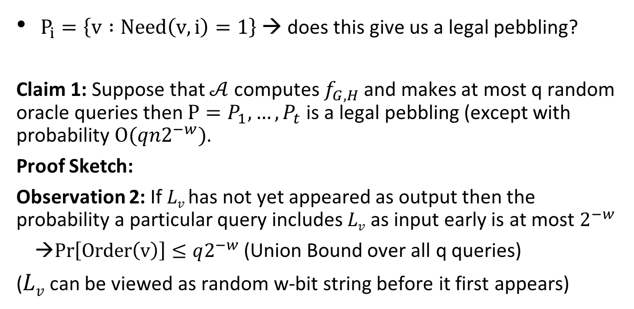
Ex Post Facto Pebbling
$P_{i}=\left\{v :Need\left(v,i\right)=1\right\}$ → does this give us a legal pebbling?
Claim 1: Suppose that $𝒜$ computes $f_{G,H}$ and makes at most q random oracle queries then $P=P_{1},…,P_{t}$ is a legal pebbling (except with probability $O(qn2^{−w})$.
Proof Sketch:
Observation 2: If $Lv$has not yet appeared as output then the probability a particular query includes $Lv$ as input early is at most $2^{−w}$
→$Pr\left[Order\left(v\right)\right]≤q2^{−w}$(Union Bound over all q queries)
($Lv$ can be viewed as random w-bit string before it first appears)

Slide 37
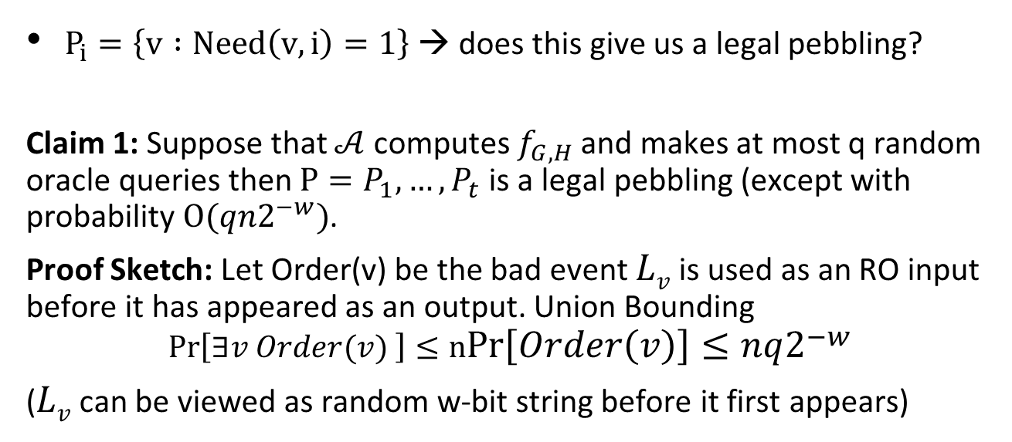
Ex Post Facto Pebbling
$P_{i}=\left\{v :Need\left(v,i\right)=1\right\}$ → does this give us a legal pebbling?
Claim 1: Suppose that $𝒜$ computes $f_{G,H}$ and makes at most q random oracle queries then $P=P_{1},…,P_{t}$ is a legal pebbling (except with probability $O(qn2^{−w})$.
Proof Sketch: Let Order(v) be the bad event $Lv$ is used as an RO input before it has appeared as an output. Union Bounding
$$Pr\left[∃v Order(v) \right]≤nPr\left[Order\left(v\right)\right]≤nq2^{−w}$$
($Lv$ can be viewed as random w-bit string before it first appears)

Slide 38
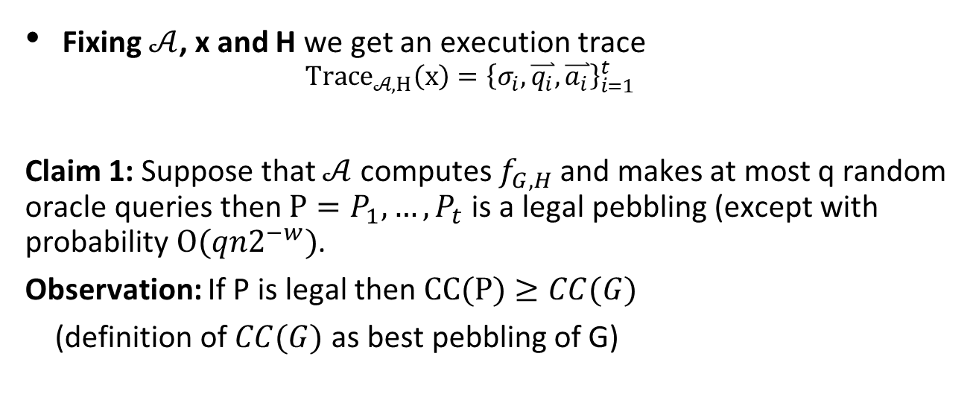
Ex Post Facto Pebbling
Fixing $𝒜$, x and H we get an execution trace
  $${Trace}_{𝒜,H}\left(x\right)={\left\{σ_{i},\overset{⃑}{q_{i}},\overset{⃑}{a_{i}}\right\}}_{i=1}^{t}$$
Claim 1: Suppose that $𝒜$ computes $f_{G,H}$ and makes at most q random oracle queries then $P=P_{1},…,P_{t}$ is a legal pebbling (except with probability $O(qn2^{−w})$.
Observation: If P is legal then $CC(P)≥CC(G)$
(definition of $CC(G)$ as best pebbling of G)

Slide 39
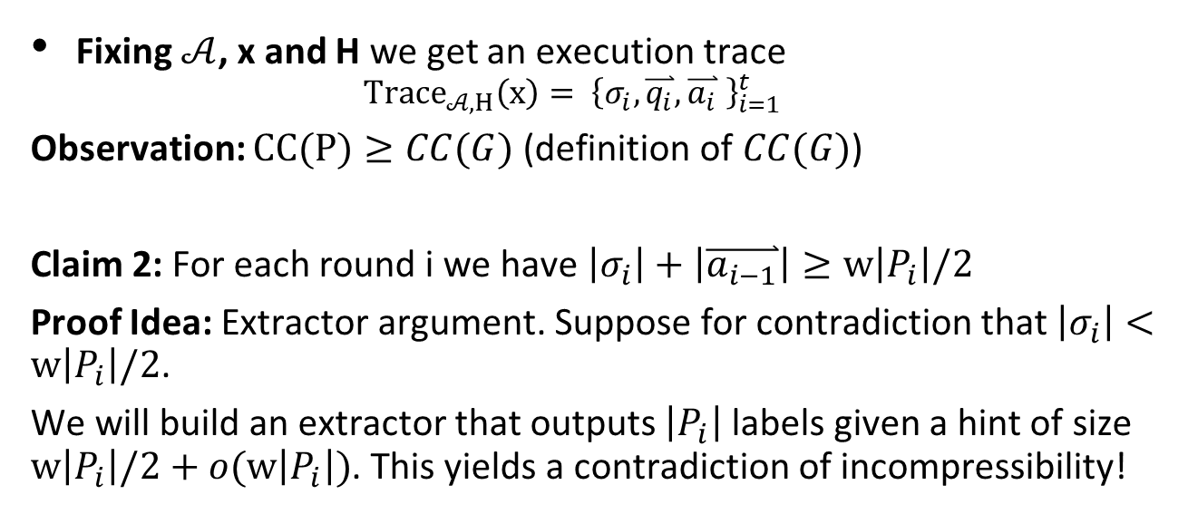
Extractor Argument
Fixing $𝒜$, x and H we get an execution trace
  $${Trace}_{𝒜,H}\left(x\right)= {\left\{σ_{i},\overset{⃑}{q_{i}},\overset{⃑}{a_{i}} \right\}}_{i=1}^{t}$$
Observation: $CC(P)≥CC(G)$ (definition of $CC(G)$)
Claim 2: For each round i we have $\left|σ_{i}\right|+\left|\overset{⃑}{a_{i−1}}\right|≥w\left|P_{i}\right|/2$
Proof Idea: Extractor argument. Suppose for contradiction that $\left|σ_{i}\right|<w\left|P_{i}\right|/2$.
We will build an extractor that outputs $\left|P_{i}\right|$ labels given a hint of size $w\left|P_{i}\right|/2+o(w\left|P_{i}\right|)$. This yields a contradiction of incompressibility!

Slide 40
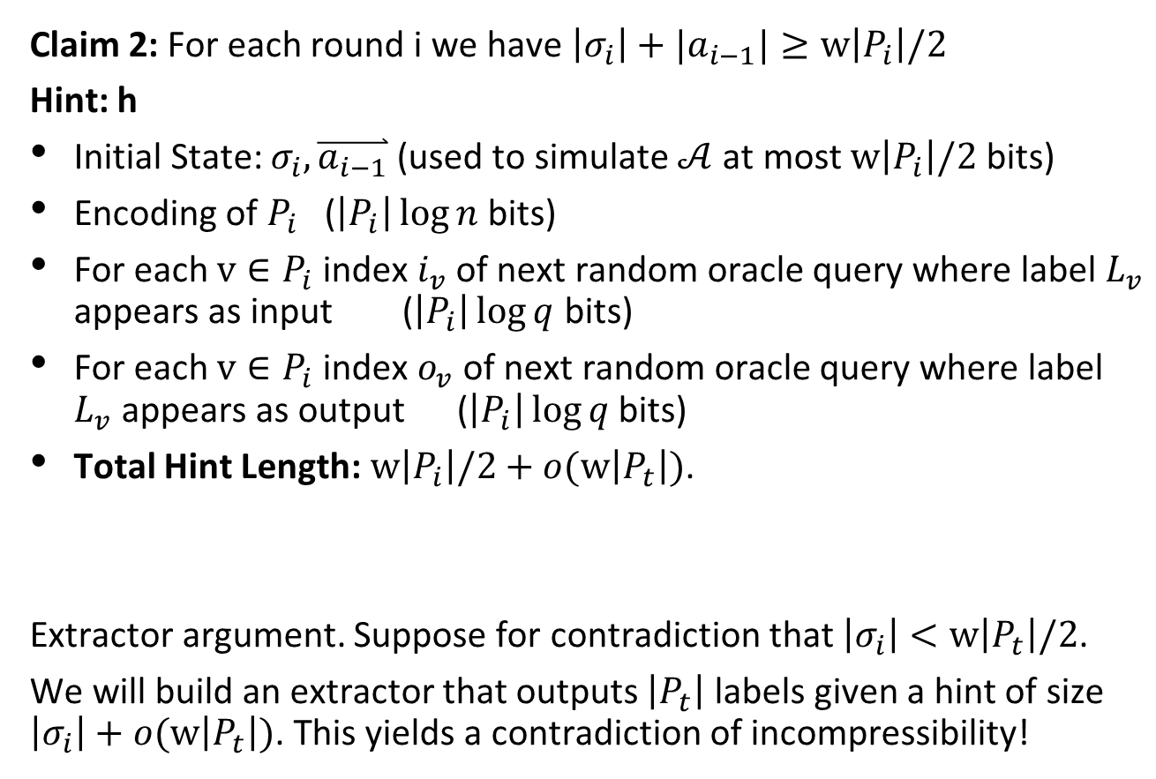
Extractor Hint
Claim 2: For each round i we have $\left|σ_{i}\right|+|a_{i−1}|≥w\left|P_{i}\right|/2$
Hint: h
Initial State: $σ_{i},\overset{⃑}{a_{i−1}}$ (used to simulate $𝒜$ at most $w\left|P_{i}\right|/2$ bits)
Encoding of $P_{i}$ ($\left|P_{i}\right|\log{n}$ bits)
For each $v∈P_{i}$ index $i_{v}$ of next random oracle query where label $L_{v}$ appears as input ($\left|P_{i}\right|\log{q}$ bits)
For each $v∈P_{i}$ index $o_{v}$ of next random oracle query where label $L_{v}$ appears as output ($\left|P_{i}\right|\log{q}$ bits)
Total Hint Length:$w\left|P_{i}\right|/2+o(w\left|P_{t}\right|)$.
Extractor argument. Suppose for contradiction that $\left|σ_{i}\right|<w\left|P_{t}\right|/2$.
We will build an extractor that outputs $\left|P_{t}\right|$ labels given a hint of size $\left|σ_{i}\right|+o(w\left|P_{t}\right|)$. This yields a contradiction of incompressibility!

Slide 41




Extractor: Simulating Attacker
Extractor E
Hint: h = ($σ_{i}$, $\overset{⃑}{a_{i−1}}$ $P_{i},…$)
Random Oracle
$$H:{\left\{0,1\right\}}^{∗}→{\left\{0,1\right\}}^{w}$$
P_{i} | Label | Input Query | Output Query
v₁ | ??? | (i+2,4) | (i+3,5)
v₂ | ??? | (i,5) | (i+1,2)
… | …
$σ_{i+1},$ $\overset{⃑}{q_{i}},$
Simulate
$$𝒜(σ_{i},\overset{⃑}{a_{i−1}})$$

Slide 42




Extractor: Simulating Attacker
$$\overset{⃑}{q_{i}},$$
Extractor E
Hint: h = ($σ_{i}$, $\overset{⃑}{a_{i−1}}$ $P_{i},…$)
Random Oracle
$$H:{\left\{0,1\right\}}^{∗}→{\left\{0,1\right\}}^{w}$$
$$\overset{⃑}{a_{i}},$$
P_{i} | Label | Input Query | Output Query
v₁ | ??? | (i+2,4) | (i+3,5)
v₂ | $$L_{v_{2}}$$ | (i,5) | (i+1,2)
… | …
$σ_{i+1},$ $\overset{⃑}{q_{i}},$
Simulate
$$𝒜(σ_{i},\overset{⃑}{a_{i−1}})$$
Extract!
$\overset{⃑}{q_{i}}$[5] contains $L_{v_{2}}$

Slide 43


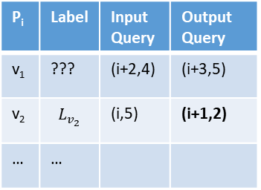
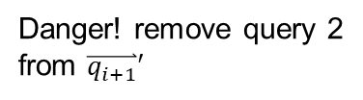



Extractor: Simulating Attacker
$$\overset{⃑}{q_{i+1}}′,$$
Extractor E
Hint: h = ($σ_{i}$, $\overset{⃑}{a_{i−1}}$ $P_{i},…$)
Random Oracle
$$H:{\left\{0,1\right\}}^{∗}→{\left\{0,1\right\}}^{w}$$
$$\overset{⃑}{a_{i+1}}′,$$
P_{i} | Label | Input Query | Output Query
v₁ | ??? | (i+2,4) | (i+3,5)
v₂ | $$L_{v_{2}}$$ | (i,5) | (i+1,2)
… | …
$σ_{i+2},$ $\overset{⃑}{q_{i+1}}$
Simulate
$$𝒜(σ_{i+1},\overset{⃑}{a_{i}})$$
$σ_{i+1},$ $\overset{⃑}{q_{i}},$
Danger! remove query 2
from $\overset{⃑}{q_{i+1}}′$
$\overset{⃑}{a_{i+1}}$ → add${ L}_{v_{2}}$ to $\overset{⃑}{a_{i+1}}′$

Slide 44
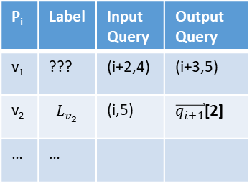


Extractor: Simulating Attacker
$$\overset{⃑}{q_{i+1}}′,$$
Extractor E
Hint: h = ($σ_{i}$, $\overset{⃑}{a_{i−1}}$ $P_{i},…$)
Random Oracle
$$H:{\left\{0,1\right\}}^{∗}→{\left\{0,1\right\}}^{w}$$
$$\overset{⃑}{a_{i+1}}′,$$
P_{i} | Label | Input Query | Output Query
v₁ | ??? | (i+2,4) | (i+3,5)
v₂ | $$L_{v_{2}}$$ | (i,5) | $\overset{⃑}{q_{i+1}}$[2]
… | …
$σ_{i+2},$ $\overset{⃑}{q_{i+1}}$
Simulate
$$𝒜(σ_{i+2},\overset{⃑}{a_{i+1}})$$
$σ_{i+3},$ $\overset{⃑}{q_{i+2}}$
Danger! remove query 2
from $\overset{⃑}{q_{i+1}}′$
$\overset{⃑}{a_{i+1}}$ → add${ L}_{v_{2}}$ to $\overset{⃑}{a_{i+1}}′$

Slide 45
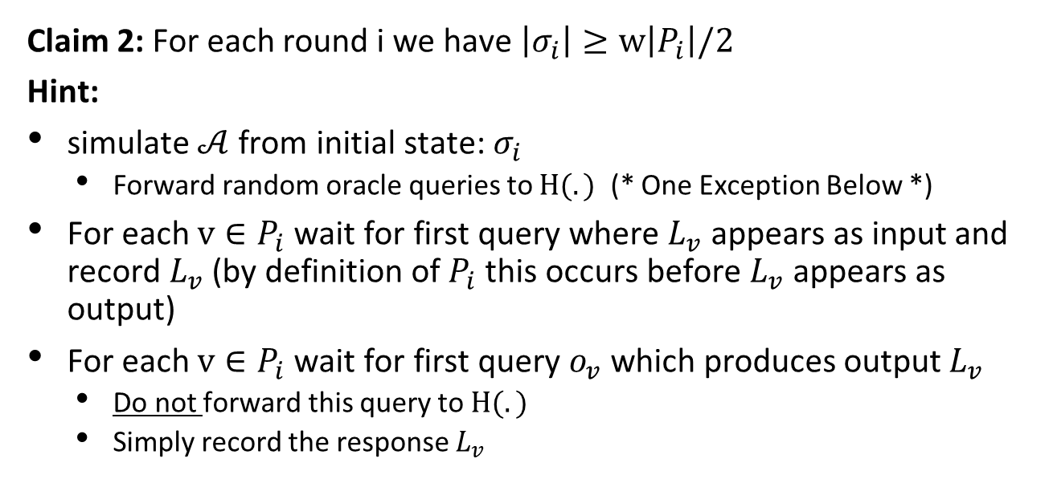
Extractor: Simulating Attacker
Claim 2: For each round i we have $\left|σ_{i}\right|≥w\left|P_{i}\right|/2$
Hint:
simulate $𝒜$ from initial state: $σ_{i}$
  Forward random oracle queries to $H(.)$ (* One Exception Below *)
For each $v∈P_{i}$ wait for first query where $L_{v}$ appears as input and record $L_{v}$(by definition of $P_{i}$ this occurs before $L_{v}$ appears as output)
For each $v∈P_{i}$ wait for first query $o_{v}$ which produces output $L_{v}$
  Do not forward this query to $H(.)$
  Simply record the response $L_{v}$

Slide 46
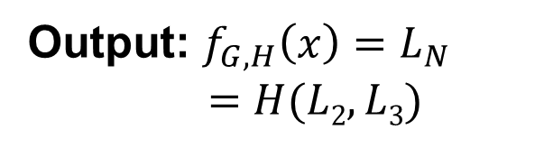
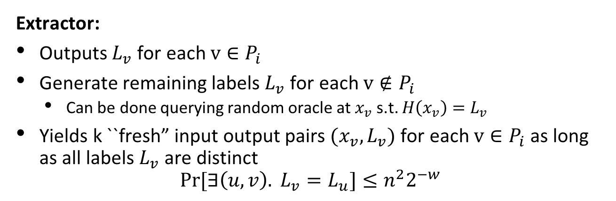


Input: x
2
4
Output: $f_{G,H}\left(x\right)=L_{N}$
$$=H(L2,L3)$$
1
1
3
$$L1=H(x)$$
$$L3=H(L1,L2)$$
Extractor:
Outputs $L_{v}$ for each $v∈P_{i}$
Generate remaining labels $L_{v}$ for each $v∉P_{i}$
  Can be done querying random oracle at $x_{v}$ s.t. $H\left(x_{v}\right)=L_{v}$
Yields k ``fresh” input output pairs $(x_{v},L_{v})$ for each $v∈P_{i}$ as long as all labels $L_{v}$ are distinct
$$Pr[∃\left(u,v\right). L_{v}=L_{u}]≤n^{2}2^{−w}$$

Slide 47
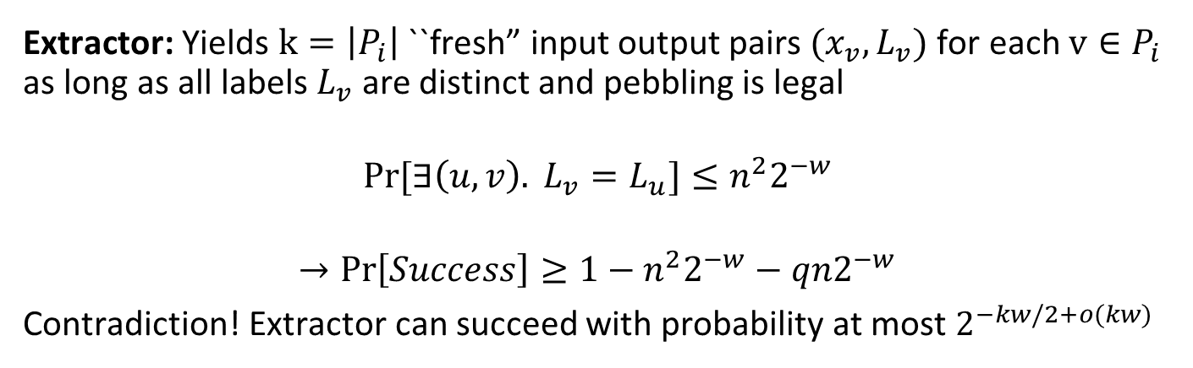
Input: x
2
4
Output: $f_{G,H}\left(x\right)=L_{N}$
$$=H(L2,L3)$$
1
1
3
$$L1=H(x)$$
$$L3=H(L1,L2)$$
Extractor: Yields $k=\left|P_{i}\right|$ ``fresh” input output pairs $(x_{v},L_{v})$ for each $v∈P_{i}$ as long as all labels $L_{v}$ are distinct and pebbling is legal
$$Pr[∃\left(u,v\right). L_{v}=L_{u}]≤n^{2}2^{−w}$$
$$→Pr\left[Success\right]≥1−n^{2}2^{−w}−qn2^{−w}$$
Contradiction! Extractor can succeed with probability at most $2^{−kw/2+o(kw)}$

Slide 48
Reflection: Extractor Argument
What properties of the random oracle did we use?
Simulatability/Delayed Sampling:
  Can view H(x) as uniformly random string that is yet to be sampled
    (until x is actually queried)
    used to analyze the probability that a label L_{v} appears out of order (also collisions)
Extractability of Queries:
  When attacker submits random oracle query the extractor gets to see the query (and the response)

Slide 49
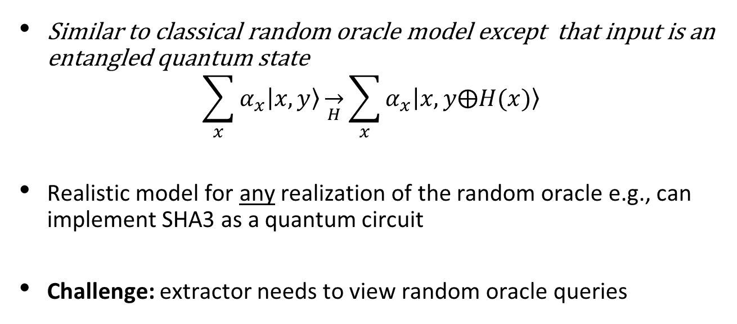
Quantum Random Oracle Model
Similar to classical random oracle model except that input is an entangled quantum state
$$\sum_{x}{α_{x}\left|\left.x,y\right\rangle \right.}\overset{→}{H}\sum_{x}{α_{x}\left|\left.x,y⨁H(x)\right\rangle \right.}$$
Realistic model for any realization of the random oracle e.g., can implement SHA3 as a quantum circuit
Challenge: extractor needs to view random oracle queries

Slide 50


Slide 51
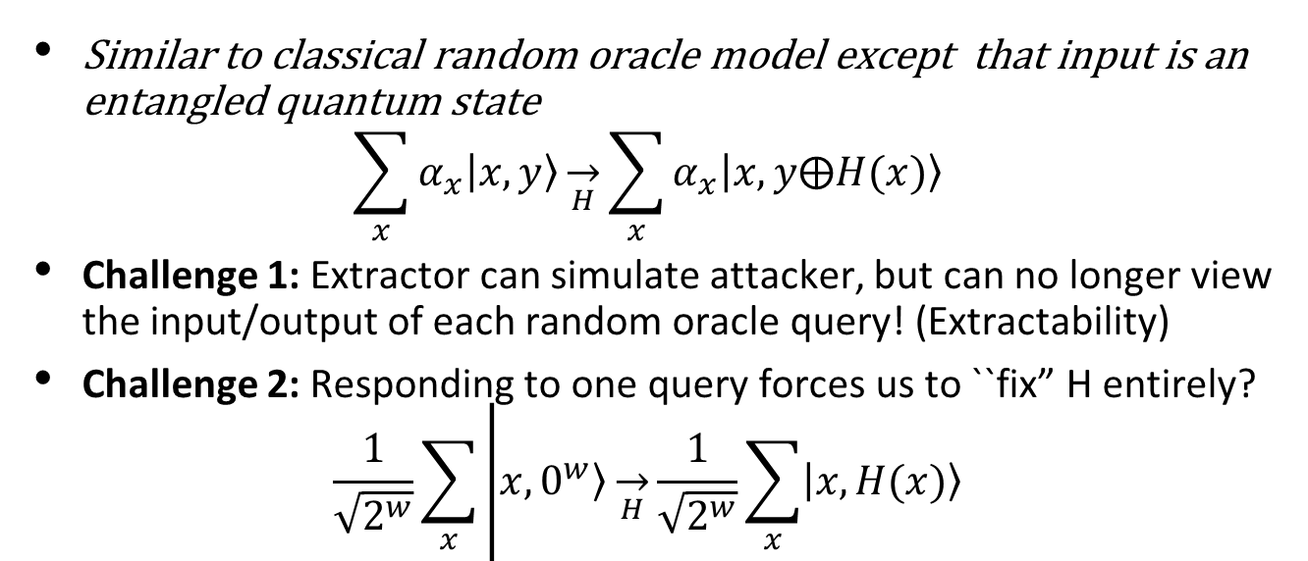
Quantum Random Oracle Model
Similar to classical random oracle model except that input is an entangled quantum state
$$\sum_{x}{α_{x}\left|\left.x,y\right\rangle \right.}\overset{→}{H}\sum_{x}{α_{x}\left|\left.x,y⨁H(x)\right\rangle \right.}$$
Challenge 1: Extractor can simulate attacker, but can no longer view the input/output of each random oracle query! (Extractability)
Challenge 2: Responding to one query forces us to ``fix” H entirely?
$$\frac{1}{\sqrt{2^{w}}}\sum_{x}{\left|\left.x,0^{w}\right\rangle \overset{→}{H}\frac{1}{\sqrt{2^{w}}}\sum_{x}{\left|\left.x,H(x)\right\rangle \right.}\right.}$$

Slide 52
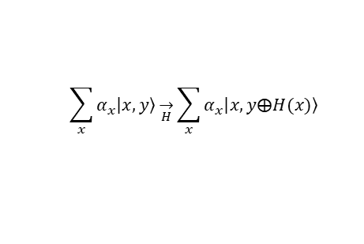

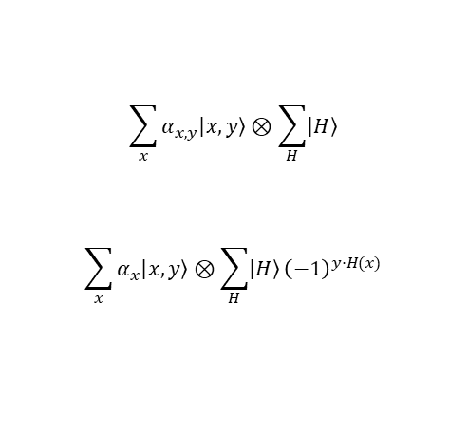
A Promising Approach?
CRYPTO 2019
Key Idea: Change of View
$$\sum_{x}{α_{x}\left|\left.x,y\right\rangle \right.}\overset{→}{H}\sum_{x}{α_{x}\left|\left.x,y⨁H(x)\right\rangle \right.}$$
$$\sum_{x}{α_{x,y}\left|\left.x,y\right\rangle \right.}⊗\sum_{H}{\left|\left.H\right\rangle \right.}$$
$$\sum_{x}{α_{x}\left|\left.x,y\right\rangle \right.}⊗\sum_{H}{\left|\left.H\right\rangle \right.}{\left(−1\right)}^{y⋅H(x)}$$
$$\overset{→}{RO Query}$$

Slide 53

Thanks for Listening

Slide 54
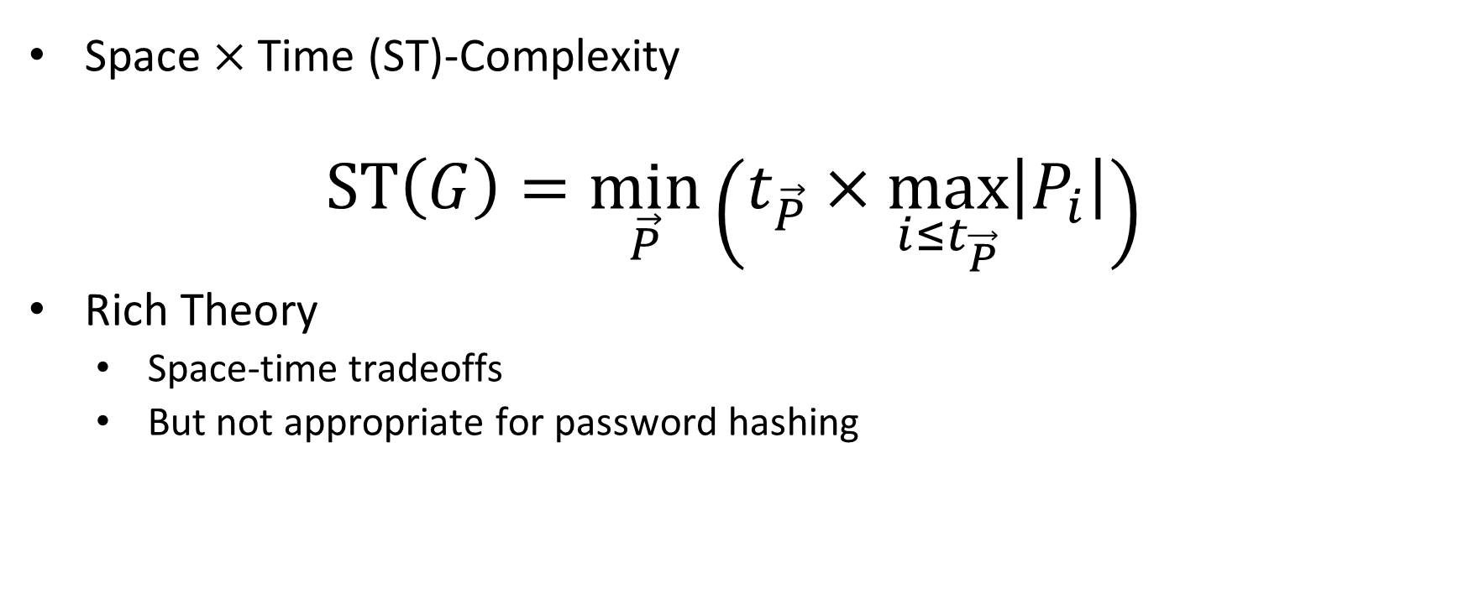
Measuring Pebbling Cost: Attempt 1
Space $×$Time (ST)-Complexity
$$ST\left(G\right)=\min_{\vec{P}}\left(t_{\vec{P}}×\max_{i≤t_{\vec{P}}}\left|P_{i}\right|\right)$$
Rich Theory
  Space-time tradeoffs
  But not appropriate for password hashing
ST Cost
m
space
time
t

Slide 55

Amortization and Parallelism
Problem: for parallel computation ST-complexity can scale badly in the number of evaluations of a function.
[AS15] $∃$function f_{n} (consisting of n RO calls) such that: $ST\left(f^{×\sqrt{n}}\right)=O(ST\left(f\right))$
S₃
ST₁ = S₁ × T₁ ≈ S₃ × T₃ = ST₃
S₁
space
cost of computing
f once
cost of computing
f three times
time
T₁
T₃

Slide 56
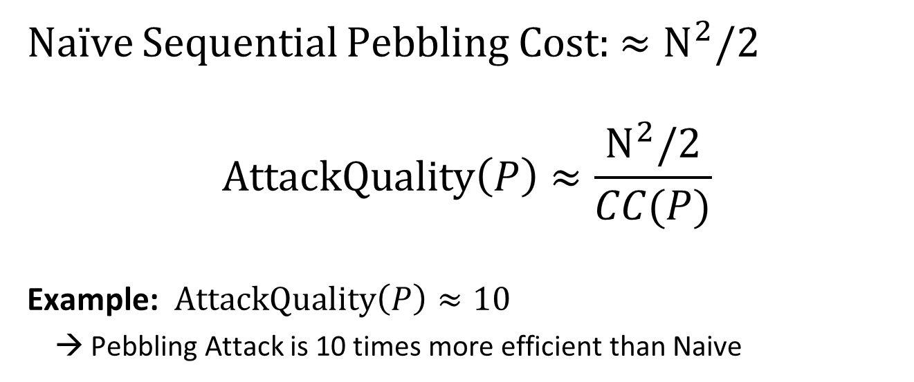
Amortized Attack Quality
Naïve Sequential Pebbling Cost: $≈N^{2}/2$
$$AttackQuality\left(P\right)≈\frac{N^{2}/2}{CC(P)}$$
Example: $AttackQuality\left(P\right)≈10$
→ Pebbling Attack is 10 times more efficient than Naive

Slide 57

Sustained Space Complexity [ABP18]
Using memory is more costly than doing computation (at least for ASICs).
Idea: Only charge for computational step where a lot of memory is being used.
Definition: s-Sustained Space
“Time spent above memory threshold s”
  FACT:
  $$CC>st$$
s-Sustained Space
  Intuition: trade-offs are free.
space
s
time

Slide 58

Sustained Space Complexity [ABP18]
Using memory is more costly than doing computation (at least for ASICs).
Idea: Only charge for computational step where a lot of memory is being used.
Definition: s-Sustained Space
“Time spent above memory threshold s”
Difficult Goal!
No known practical constructions with strong sustained space guarantees.
Theoretical DAG with $s=Ω\left(N\right)/\log{N}$ -sustained space complexity$t=Ω\left(N\right)$ [ABP18]
  FACT:
  $$CC>st$$
s-Sustained Space
  Intuition: trade-offs are free.
space
s
time

Slide 59

Depth-Robust Graphs
Necessary [AB16] and sufficient [ABP17] for secure iMHFs

Slide 60

Depth Robustness
Definition: A DAG G=(V,E) is (e,d)-depth-robust for all $S⊆V$ s.t. $\left|S\right|≤e$ we have $depth\left(G−S\right)>d.$
Otherwise, we say that G is (e,d)-reducible.
Example: (e=2,d=2)-reducible
1
2
3
4
5
6

Slide 61
Depth Robustness
Definition: A DAG G=(V,E) is (e,d)-depth-robust for all $S⊆V$ s.t. $\left|S\right|≤e$ we have $depth\left(G−S\right)>d.$
Otherwise, we say that G is (e,d)-reducible.
Example: (e=2,d=2)-reducible
1
2
3
4
5
6

Slide 62

Building iMHFs with Depth-Robust Graphs
Argon2i
  Password Hashing Competition Winner
  Not maximally depth-robust [AB16,AB17,ABP17,BZ18]
  Parallel Pebbling Attack: $CC\left(G\right)=O\left(N^{1.767}\right)$
  Parallel Pebbling Attack:

Slide 63

Building iMHFs with Depth-Robust Graphs
Argon2i
  Password Hashing Competition Winner
  Not maximally depth-robust [AB16,AB17,ABP17,BZ18]
  Parallel Pebbling Attack: $CC\left(G\right)=O\left(N^{1.767}\right)$
DRSample [ABH17]
  Efficient construction of maximally depth-robust (asymptotic)
  (e,d)-depth-robust for $e=Ω\left(N/\log{N}\right)$ and $d=Ω\left(N\right)$
  $CC\left(G\right)≥ed=Ω\left(N^{2}/\log{N}\right)$
  The concrete constants are still poorly understood

Slide 64
Building iMHFs with Depth-Robust Graphs
Argon2i
  Password Hashing Competition Winner
  Not maximally depth-robust [AB16,AB17,ABP17,BZ18]
  Implication: Efficient Pebbling Attacks
DRSample [ABH17]
  Efficient construction of maximally depth-robust (asymptotic)
  The concrete constants are poorly understood
DRSample+BRG [New]
  Improves on Argon2i and DRSample
  Optimal resistance to all known pebbling attacks

Slide 65


Prior Attacks (Necessity of Depth-Robustness)
Theorem [AB16]: If G is (e,d)-reducible then
$$\operatorname{CC}\left(G\right)=O\left(eN+\sqrt{N3d}\right)$$
In particular, $\operatorname{CC}\left(G\right)=o\left(N2\right)$ for e,d=o(N).
Corollary[AB16]: $CC\left(G\right)=O\left(N^{2}\log{\log{N}}/\log{N}\right)$ for any constant indegree DAG G
Argon2i [AB17,BZ17]: $CC\left(G\right)=O\left(N^{1.768}\right)$

Slide 66

Prior Constructions
$Theorem[ABP17]:$ $CC(G)≥ed$for any (e,d)-depth robust DAG G
DRSample [ABH17]: Practical construction of (e,d)-depth robust DAG G
  (e,d)-depth-robust for $e=Ω\left(N/\log{N}\right)$ and $d=Ω\left(N\right)$
  $CC\left(G\right)≥ed=Ω\left(N^{2}/\log{N}\right)$
DRSample vs Argon2i:
Asymptotically DRSample is superior
Constant factors?

Slide 67

Prior Empirical Analysis [ABH17]
High Quality Attacks against Argon2i
DRSample: Only found low quality attacks

Slide 68
Main Theorem
For any n∊ℕ we give a function f_{n} and prove that in the parallel Random Oracle Model (PROM):
Bonus: f_{n} is an iMHF.
  E runs in constant time and has data-independent memory access pattern
Honest
Sequential Algorithm E
Time(E(f_{n})) = n
ST(E(f_{n})) = n²
Adversarial
∀ parallel algs. A
s-SS(A(f_{n})) = Ω(n) per eval.
for s = Ω(n/log(n))

Slide 69

The Parallel Black Pebbling Game
Parallel Black Pebbling Game: Same as Black Pebbling, except can touch many pebbles per iteration.
s-SS analogue: Count number of steps when at least s pebbles on graph.
Goal: Place a pebble on the sink.
Rule 1: A node can be pebbled only if all parents contain a pebble.
Rule 2: A pebble can always be removed.
Want G with…
Size(G) = n
In-degree(G) = 2
$\frac{n}{log⁡(n)}$ -SS(G) = Ω(n)
G
s-SS Complexity
1-SS = 3
2-SS = 1

Slide 70


Lessons from SCRYPT
  SCRYPT [Per09]
  CON: Data-Dependent→ Side-Channel Concerns
  PRO: Proven to have high CC [ACPRT17]
  CC(SCRYPT) = $Ω\left(n^{2}\right)$
  Contrast: any iMHF has CC at most $O\left(\frac{n^{2}\log{\log{n}}}{\log{n}}\right)$
Maximally Memory Hard → Egalitarian?

Slide 71

What Happened?
CC(SCRYPT) = $Ω\left(n^{2}\right)$ the function can be computed with low memory
Each strategy below is easily feasible
  Evaluate with $O\left(n\right)$ memory in $O\left(n\right)$ time
  Evaluate with $O\left(\sqrt{n}\right)$memory in $O\left(n\sqrt{n}\right)$ time
  Evaluate with $O\left(1\right)$memory in $O\left(n^{2}\right)$ time
SCRYPT ASIC miners opt for low memory + high computation options
Goal: Ensure that low memory options are infeasible

Slide 72
Other Applications of Depth-Robust Graphs
Proofs of Space [DFKP13]
  Environmentally friendly alternative to PoW
Proofs of Replication [P19]
Proofs of Sequential Work [MMV13]
  Relaxed Notion of ``Weighted Depth-Robustness” [CP18]
Relaxed Locally Correctable Codes [BGVZ19]
Blockchain Verification? Other applications?
  Shorter Signatures? Shorter Public Keys?
Improved Constructions of Depth-Robust Graphs?
  Computer Assisted Analysis?

