Slide 1

Data-Independent Memory Hard Functions: New Attacks and Stronger Constructions
Jeremiah Blocki
Ben Harsha
Siteng Kang
Seunghoon Lee
Lu Xing
Samson Zhou
CRYPTO 2019

Slide 2

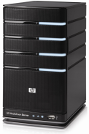
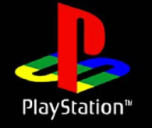


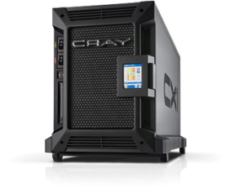

Motivation: Password Storage
jblocki, 123456
Username
jblocki
Salt
89d978034a3f6
Hash
85e23cfe0021f584e3db87aa72630a9a2345c062
SHA1(12345689d978034a3f6)=85e23cfe0021f584e3db87aa72630a9a2345c062
+
Notes:
As a motivating example consider an adversary who breaks into an authentication server and steals a users crptographic hash value. The adversary can execute an offline attack against the password by comparing the hash value with the hashes of likely password guesses. The adversary is limited only by the resources that he is willing to invest cracking the passwords.

Slide 3

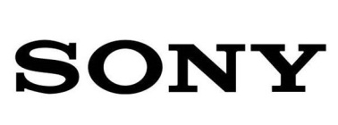








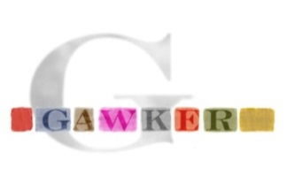


Offline Attacks: A Common Problem
Password breaches at major companies have affected millions billions of user accounts.
Notes:
Unfortunately, offline dictionary attacks are quite common. Password breaches at major companies have affected millions of users.

Slide 4
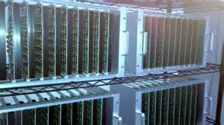



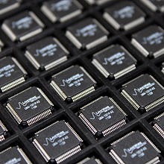
Goal: Moderately Expensive Hash Function
Fast on PC and
Expensive on ASIC?
Notes:
This motivates the need for moderately hard functions. The basic idea is to build a password hash function that is moderately expensive to compute to limit the number of guesses that an adversary would be willing to try. An honest server only needs to compute the function once during a typical authentication session. However, the adversary potentially has an advantage in this game. While the honest server must typically evaluate the function on standard hardware, the adversary could use potentially reduce the cost per password guess by developing customized hardware (GPUs, FPGAs, ASICs) to evaluate the password hash function. Thus, we want to ensure that the cost to evaluate this function is equitable across platforms.

Slide 5
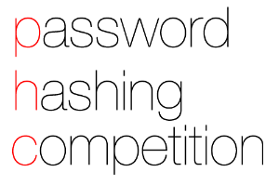
(2013-2015)
https://password-hashing.net/

Slide 6

We recommend that you use Argon2…
(2013-2015)
https://password-hashing.net/

Slide 7
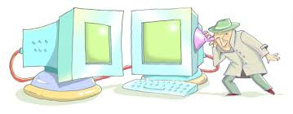
We recommend that you use Argon2…
There are two main versions of Argon2, Argon2i and Argon2d. Argon2i is the safest against side-channel attacks
(2013-2015)
https://password-hashing.net/

Slide 8
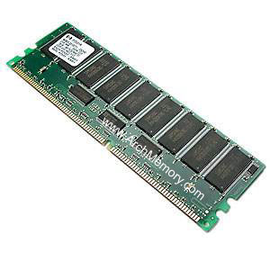

Memory Hard Function (MHF)
Intuition: computation costs dominated by memory costs
vs.
Goal: force attacker to lock up large amounts of memory for duration of computation
  →Expensive even on customized hardware
Notes:
In this work we study a special type of memory hard function called data-independent memory hard functions. As the name suggests the memory access pattern will not depend on the input making the functions resistant to side-channel attacks.

Slide 9

Memory Hard Function (MHF)
Intuition: computation costs dominated by memory costs
vs.
Notes:
In this work we study a special type of memory hard function called data-independent memory hard functions. As the name suggests the memory access pattern will not depend on the input making the functions resistant to side-channel attacks.

Slide 10
Memory Hard Function (MHF)
Intuition: computation costs dominated by memory costs
vs.
Notes:
In this work we study a special type of memory hard function called data-independent memory hard functions. As the name suggests the memory access pattern will not depend on the input making the functions resistant to side-channel attacks.

Slide 11
Memory Hard Function (MHF)
Intuition: computation costs dominated by memory costs
vs.
Data Independent Memory Hard Function (iMHF)
  Memory access pattern should not depend on input
Notes:
In this work we study a special type of memory hard function called data-independent memory hard functions. As the name suggests the memory access pattern will not depend on the input making the functions resistant to side-channel attacks.

Slide 12
Memory Hard Function (MHF)
Intuition: computation costs dominated by memory costs
vs.
Data Independent Memory Hard Function (iMHF)
  Memory access pattern should not depend on input
Notes:
In this work we study a special type of memory hard function called data-independent memory hard functions. As the name suggests the memory access pattern will not depend on the input making the functions resistant to side-channel attacks.

Slide 13
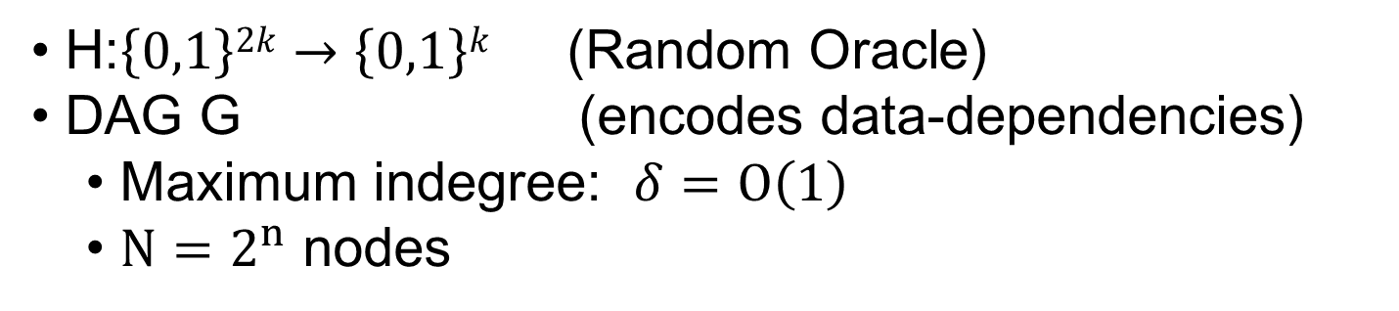
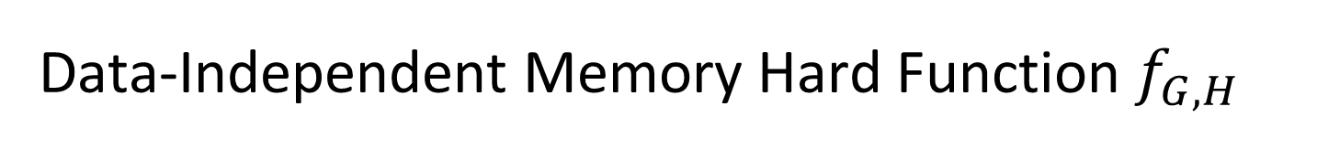


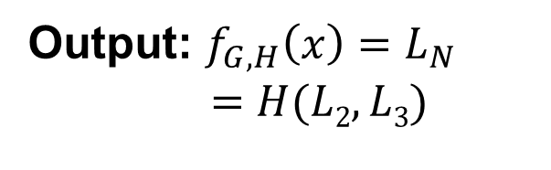
Data-Independent Memory Hard Function $f_{G,H}$
Input: x
2
4
Output: $f_{G,H}\left(x\right)=L_{N}$
$$=H(L2,L3)$$
1
1
3
$$L1=H(x)$$
$$L3=H(L1,L2)$$
H:$\left\{0,1\right\}2k→\left\{0,1\right\}k$ (Random Oracle)
DAG G (encodes data-dependencies)
  Maximum indegree: $δ=O\left(1\right)$
  $N=2^{n}$ nodes

Slide 14
Evaluating an iMHF (pebbling)
4
5
3
4
5
1
3
1
2

Slide 15
Evaluating an iMHF (pebbling)
1
2
3
4
5
P₁ = {1} (data value L₁ stored in memory)

Slide 16
Evaluating an iMHF (pebbling)
1
2
3
4
5
P₁ = {1}
P₂ = {1,2} (data values L₁ and L₂ stored in memory)

Slide 17
Evaluating an iMHF (pebbling)
1
2
3
4
5
P₁ = {1}
P₂ = {1,2}
P₃ = {3}

Slide 18
Evaluating an iMHF (pebbling)
1
2
3
4
5
P₁ = {1}
P₂ = {1,2}
P₃ = {3}
P₄ = {3,4}

Slide 19
Evaluating an iMHF (pebbling)
1
2
3
4
5
P₁ = {1}
P₂ = {1,2}
P₃ = {3}
P₄ = {3,4}
P₅ = {5}

Slide 20
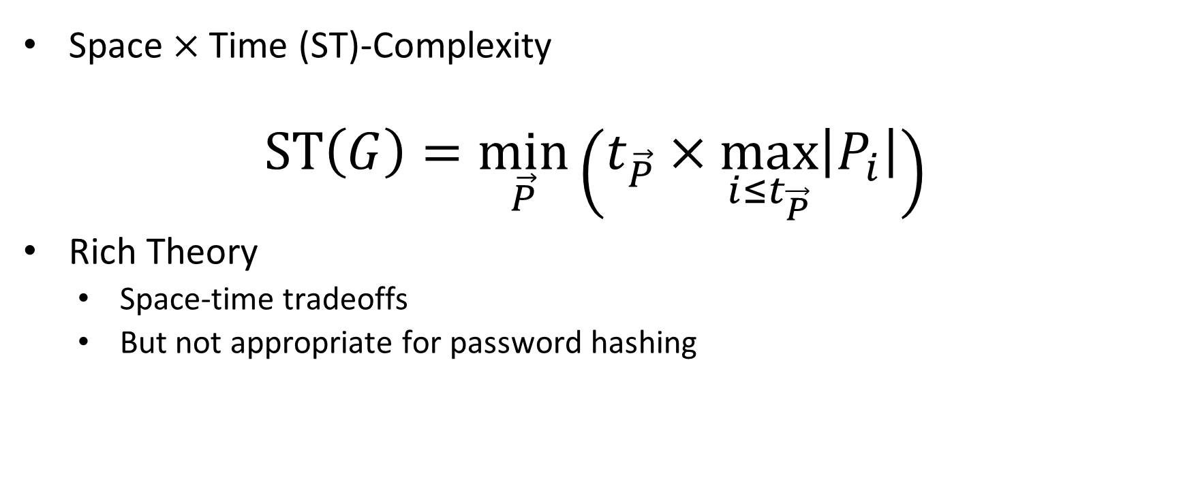
Measuring Pebbling Cost: Attempt 1
Space $×$Time (ST)-Complexity
$$ST\left(G\right)=\min_{\vec{P}}\left(t_{\vec{P}}×\max_{i≤t_{\vec{P}}}\left|P_{i}\right|\right)$$
Rich Theory
  Space-time tradeoffs
  But not appropriate for password hashing
ST Cost
m
space
time
t

Slide 21

Amortization and Parallelism
Problem: for parallel computation ST-complexity can scale badly in the number of evaluations of a function.
[AS15] $∃$function f_{n} (consisting of n RO calls) such that: $ST\left(f^{×\sqrt{n}}\right)=O(ST\left(f\right))$
S₃
ST₁ = S₁ × T₁ ≈ S₃ × T₃ = ST₃
S₁
space
cost of computing
f once
cost of computing
f three times
time
T₁
T₃

Slide 22

Measuring Pebbling Costs [AS15]
$$CC\left(G\right)=\min_{\vec{P}}{\sum_{i=1}^{t_{\vec{P}}}{\left|P_{i}\right|}}$$
Approximates Amortized Area x Time Complexity of iMHF
Memory Used at Step i
Cumulative Memory Cost
space
iterations

Slide 23
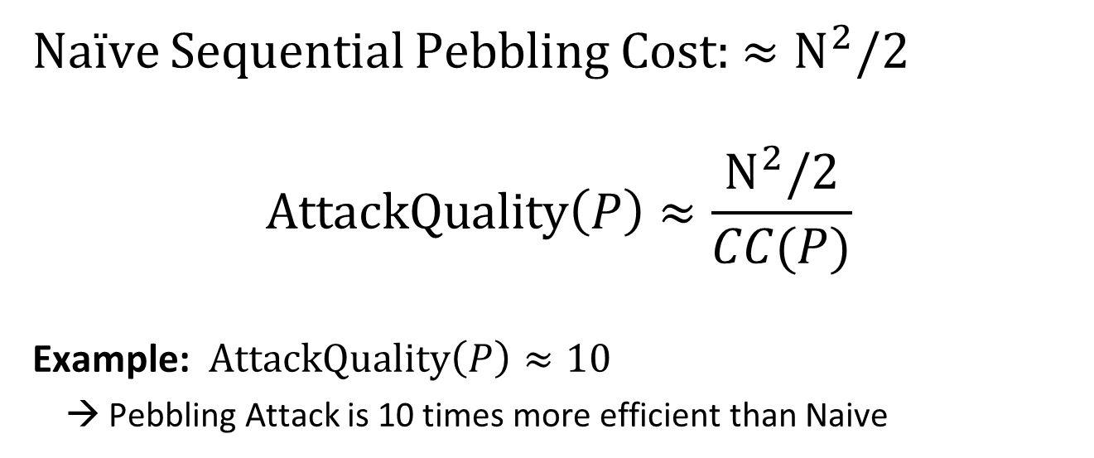
Amortized Attack Quality
Naïve Sequential Pebbling Cost: $≈N^{2}/2$
$$AttackQuality\left(P\right)≈\frac{N^{2}/2}{CC(P)}$$
Example: $AttackQuality\left(P\right)≈10$
→ Pebbling Attack is 10 times more efficient than Naive

Slide 24

Sustained Space Complexity [ABP18]
Using memory is more costly than doing computation (at least for ASICs).
Idea: Only charge for computational step where a lot of memory is being used.
Definition: s-Sustained Space
“Time spent above memory threshold s”
  FACT:
  $$CC>st$$
s-Sustained Space
  Intuition: trade-offs are free.
space
s
time

Slide 25

Sustained Space Complexity [ABP18]
Using memory is more costly than doing computation (at least for ASICs).
Idea: Only charge for computational step where a lot of memory is being used.
Definition: s-Sustained Space
“Time spent above memory threshold s”
Difficult Goal!
No known practical constructions with strong sustained space guarantees.
Theoretical DAG with $s=Ω\left(N\right)/\log{N}$ -sustained space complexity$t=Ω\left(N\right)$ [ABP18]
  FACT:
  $$CC>st$$
s-Sustained Space
  Intuition: trade-offs are free.
space
s
time

Slide 26
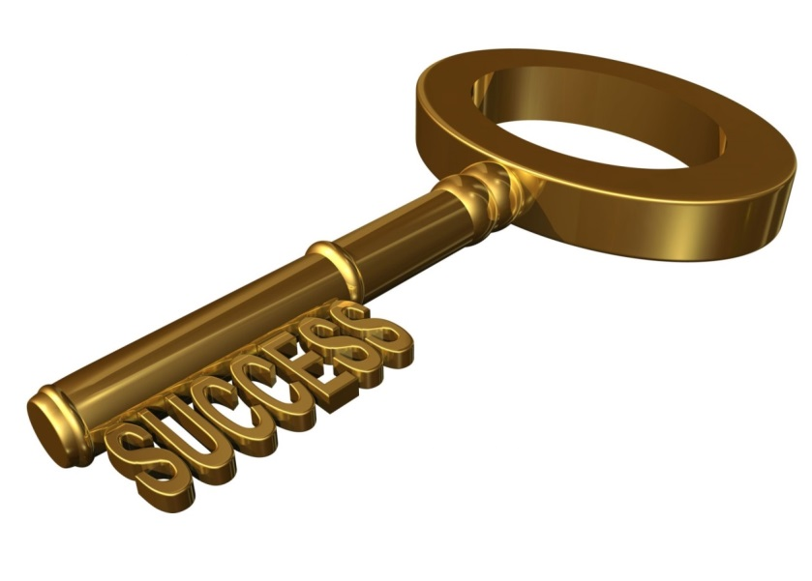
Depth-Robust Graphs
Necessary [AB16] and sufficient [ABP17] for secure iMHFs

Slide 27
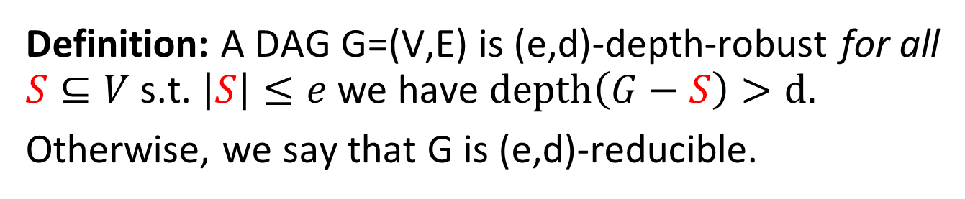
Depth Robustness
Definition: A DAG G=(V,E) is (e,d)-depth-robust for all $S⊆V$ s.t. $\left|S\right|≤e$ we have $depth\left(G−S\right)>d.$
Otherwise, we say that G is (e,d)-reducible.
Example: (e=2,d=2)-reducible
1
2
3
4
5
6

Slide 28
Depth Robustness
Definition: A DAG G=(V,E) is (e,d)-depth-robust for all $S⊆V$ s.t. $\left|S\right|≤e$ we have $depth\left(G−S\right)>d.$
Otherwise, we say that G is (e,d)-reducible.
Example: (e=2,d=2)-reducible
1
2
3
4
5
6

Slide 29
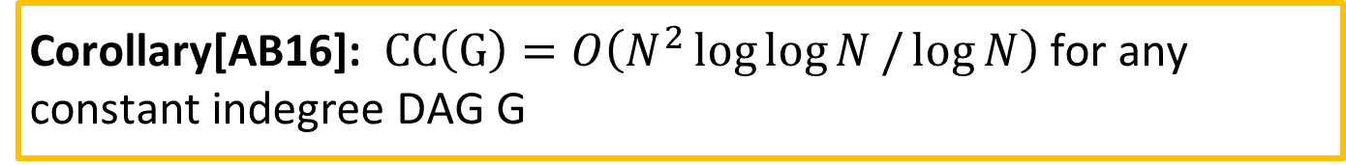
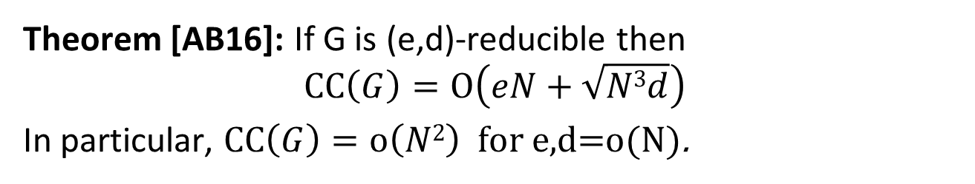
Prior Attacks (Necessity of Depth-Robustness)
Theorem [AB16]: If G is (e,d)-reducible then
$$\operatorname{CC}\left(G\right)=O\left(eN+\sqrt{N3d}\right)$$
In particular, $\operatorname{CC}\left(G\right)=o\left(N2\right)$ for e,d=o(N).
Corollary[AB16]: $CC\left(G\right)=O\left(N^{2}\log{\log{N}}/\log{N}\right)$ for any constant indegree DAG G
Argon2i [AB17,BZ17]: $CC\left(G\right)=O\left(N^{1.768}\right)$

Slide 30
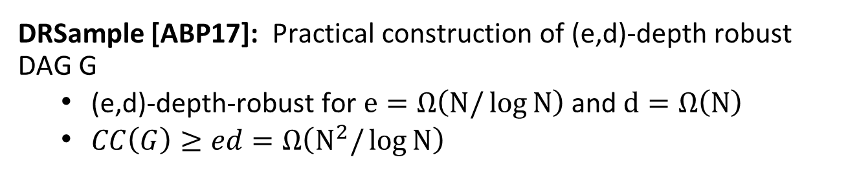
Prior Constructions
$Theorem[ABP17]:$ $CC(G)≥ed$for any (e,d)-depth robust DAG G
DRSample [ABP17]: Practical construction of (e,d)-depth robust DAG G
  (e,d)-depth-robust for $e=Ω\left(N/\log{N}\right)$ and $d=Ω\left(N\right)$
  $CC\left(G\right)≥ed=Ω\left(N^{2}/\log{N}\right)$
DRSample vs Argon2i:
Asymptotically DRSample is superior
Constant factors?

Slide 31
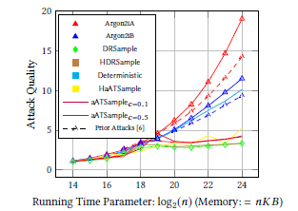
Prior Empirical Analysis [ABH17]
High Quality Attacks against Argon2i
DRSample: Only found low quality attacks

Slide 32
Our Contributions (Attacks)
New analysis of Greedy Pebbling Attack [BGS16]
  Surprisingly effective against DRSample
  Reverses prior conclusions
New heuristic algorithm for constructing small depth-reducing sets
  Empirical Analysis: Improves upon prior algorithms
  Implications for many cryptographic objects : iMHFs, Proofs of Replication [F18], Proofs of Space
  See paper
Trivial Parallelization of Argon2i Round Function
  Reduces Area x Time Costs by nearly 1 order of magnitude

Slide 33
Our Contributions (Constructions)
New iMHF construction: DRSample + BRG
  Optimal resistance to all known pebbling attacks
  First practical construction with strong sustained space complexity guarantee
New Pebbling Reduction for XOR Labeling Rule
  Used by deployed iMHFs like Argon2i
Inherently Sequential Round Function
  Increases Area x Time cost for attacker by nearly 1 order of magnitude

Slide 34
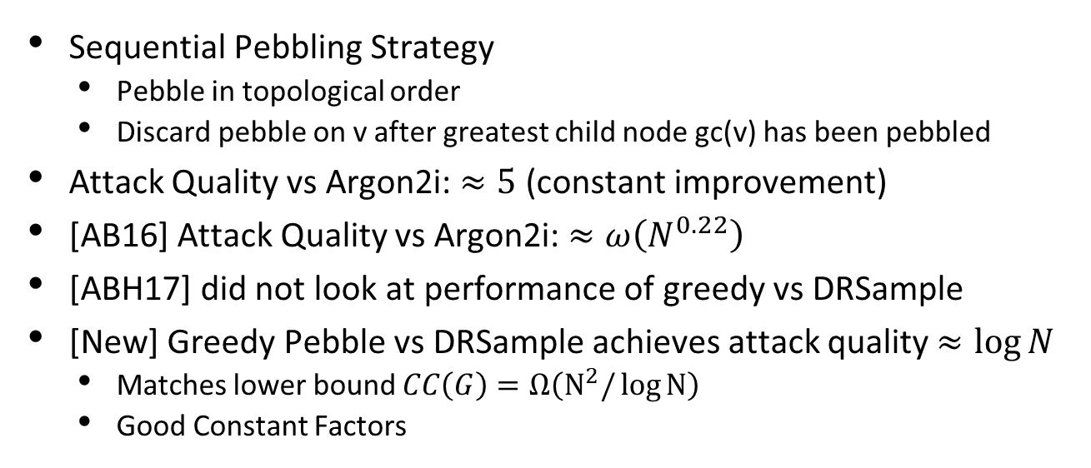
Greedy Pebble Attack [BCS16]
Sequential Pebbling Strategy
  Pebble in topological order
  Discard pebble on v after greatest child node gc(v) has been pebbled
Attack Quality vs Argon2i: $≈5$ (constant improvement)
[AB16] Attack Quality vs Argon2i: $≈ω\left(N^{0.22}\right)$
[ABH17] did not look at performance of greedy vs DRSample
[New] Greedy Pebble vs DRSample achieves attack quality $≈\log{N}$
  Matches lower bound $CC\left(G\right)=Ω\left(N^{2}/\log{N}\right)$
  Good Constant Factors

Slide 35
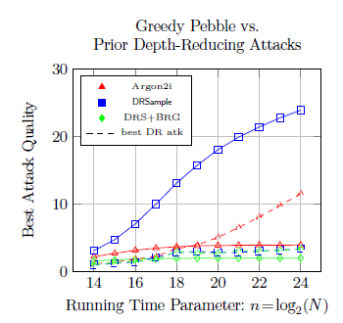
DRSample
(Greedy Pebble)
Argon2i
New Construction

Slide 36
Seeking: DAG that resists both attacks
Parallel Depth-Reducing Attacks [AB16]
  Effective against Argon2i and many other iMHF candidates
  DRSample designed to resist these attacks
Greedy Pebbling Attack
  Effective against DRSample

Slide 37
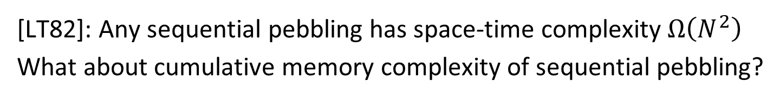
Bit Reversal Graph (n=3)
000
001
010
011
100
101
110
111
000
001
010
011
100
101
110
111
[LT82]: Any sequential pebbling has space-time complexity $Ω\left(N^{2}\right)$
What about cumulative memory complexity of sequential pebbling?

Slide 38
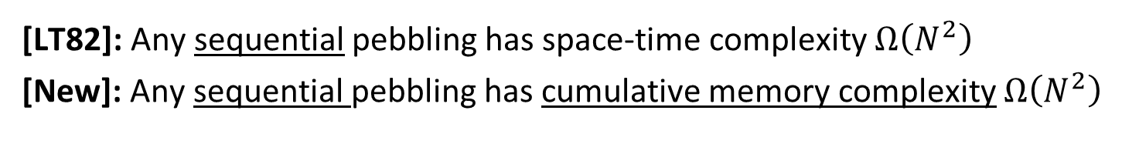
Bit Reversal Graph (n=3)
000
001
010
011
100
101
110
111
000
001
010
011
100
101
110
111
[LT82]: Any sequential pebbling has space-time complexity $Ω\left(N^{2}\right)$
[New]: Any sequential pebbling has cumulative memory complexity $Ω\left(N^{2}\right)$

Slide 39
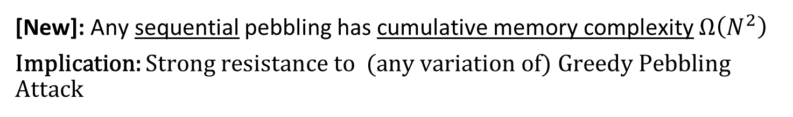
Bit Reversal Graph (n=3)
000
001
010
011
100
101
110
111
000
001
010
011
100
101
110
111
[New]: Any sequential pebbling has cumulative memory complexity $Ω\left(N^{2}\right)$
Implication: Strong resistance to (any variation of) Greedy Pebbling Attack

Slide 40
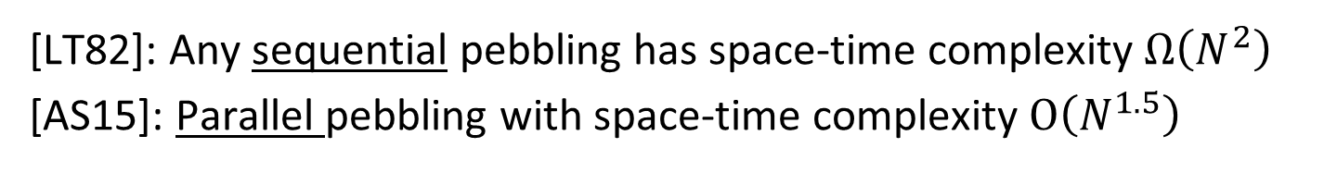
Bit Reversal Graph (n=3)
000
001
010
011
100
101
110
111
000
001
010
011
100
101
110
111
[LT82]: Any sequential pebbling has space-time complexity $Ω\left(N^{2}\right)$
[AS15]: Parallel pebbling with space-time complexity $O\left(N^{1.5}\right)$

Slide 41
Bit Reversal Overlay
000
001
010
011
100
101
110
111
000
001
010
011
100
101
110
111
000
001
010
011
100
101
110
111

Slide 42
Bit Reversal Overlay
000
001
010
011
100
101
110
111
000
001
010
011
100
101
110
111
000
001
010
011
100
101
110
111
Our Construction: DRSample + BRG
(First layer of BRG replaced with depth-robust DAG)

Slide 43
DRSample + BRG
Empirical Analysis: Resistant to all known pebbling attacks
Inherits resistance to depth-reducing attacks (DRSample)
Inherits resistance to all (nearly) sequential pebblings (BRG)
(includes Greedy Pebbling Attack)
Combined Graph Yields New Properties
First graph with strong sustained-space complexity guarantee
Theoretical construction of [ABP18] is not practical

Slide 44
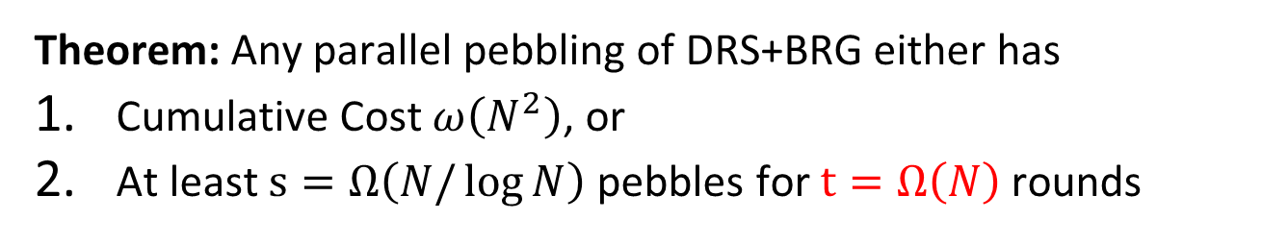
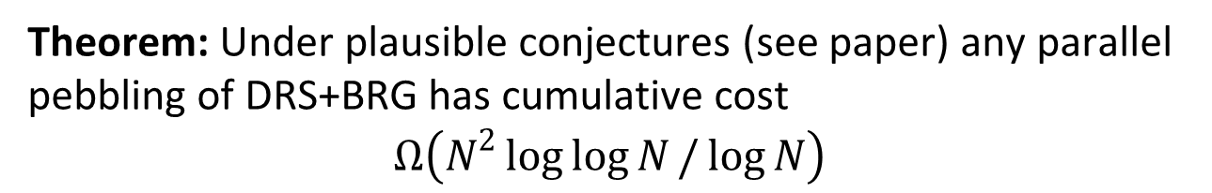
DRSample + BRG
Theorem: Any parallel pebbling of DRS+BRG either has
Cumulative Cost $ω\left(N^{2}\right)$, or
At least $s=Ω\left(N/\log{N}\right)$ pebbles for $t=Ω\left(N\right)$ rounds
Theorem: Under plausible conjectures (see paper) any parallel pebbling of DRS+BRG has cumulative cost
$$Ω\left(N^{2}\log{\log{N}}/\log{N}\right)$$
Recall:$CC\left(G\right)=O\left(N^{2}\log{\log{N}}/\log{N}\right)$ for any G with const indegree

Slide 45
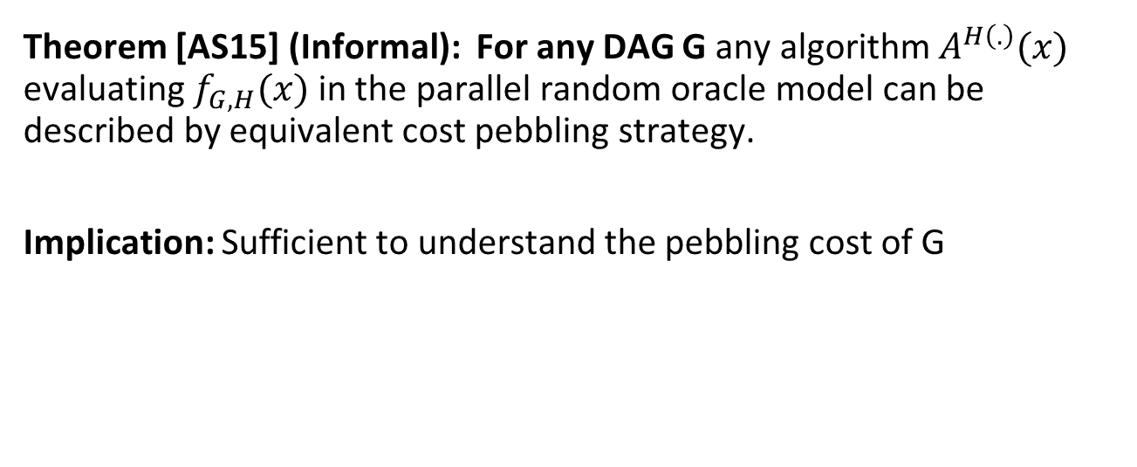
Pebbling Reduction
Theorem [AS15] (Informal): For any DAG G any algorithm $A^{H\left(.\right)}(x)$ evaluating $f_{G,H}(x)$ in the parallel random oracle model can be described by equivalent cost pebbling strategy.
Implication: Sufficient to understand the pebbling cost of G

Slide 46
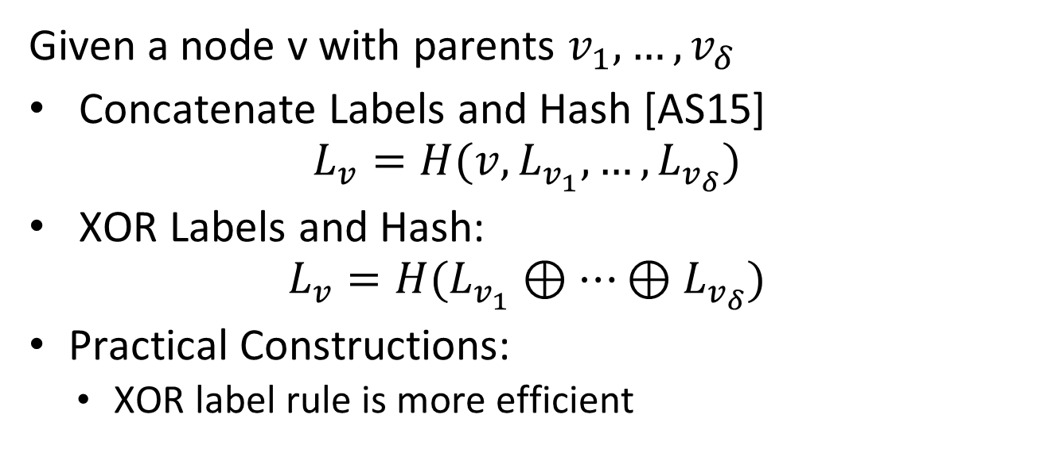
What Labeling Function?
Given a node v with parents $v_{1},…,v_{δ}$
Concatenate Labels and Hash [AS15]
$$L_{v}=H(v,L_{v_{1}},…,L_{v_{δ}})$$
XOR Labels and Hash:
$$L_{v}=H(L_{v_{1}}⊕…⊕L_{v_{δ}})$$
Practical Constructions:
  XOR label rule is more efficient

Slide 47
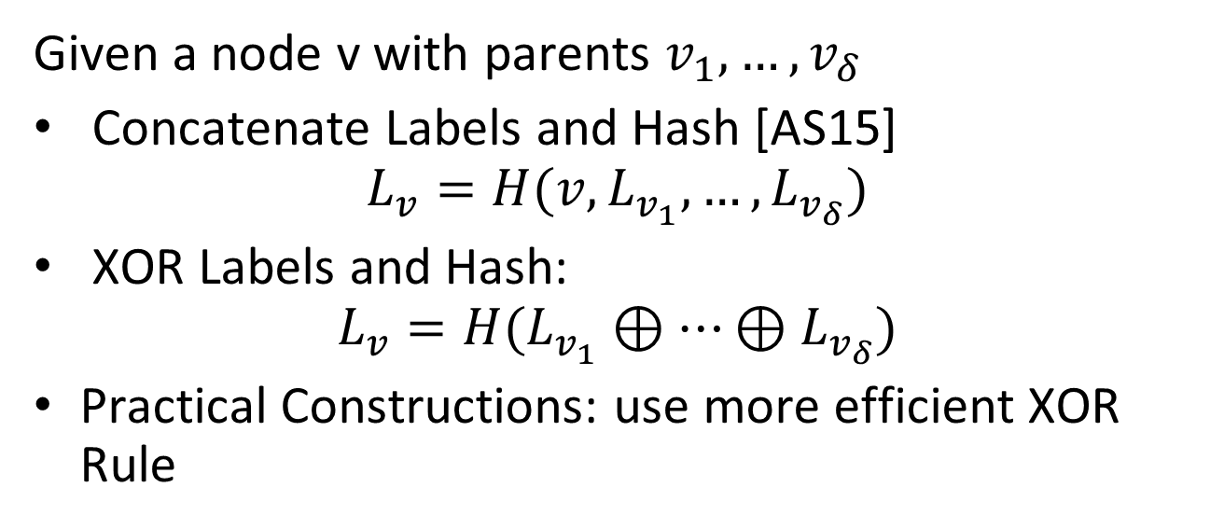
What Labeling Function?
Prior Intuition: Focus on pebbling cost.
Question: Does this still hold for iMHFs using XOR rule?
Given a node v with parents $v_{1},…,v_{δ}$
Concatenate Labels and Hash [AS15]
$$L_{v}=H(v,L_{v_{1}},…,L_{v_{δ}})$$
XOR Labels and Hash:
$$L_{v}=H(L_{v_{1}}⊕…⊕L_{v_{δ}})$$
Practical Constructions: use more efficient XOR Rule

Slide 48
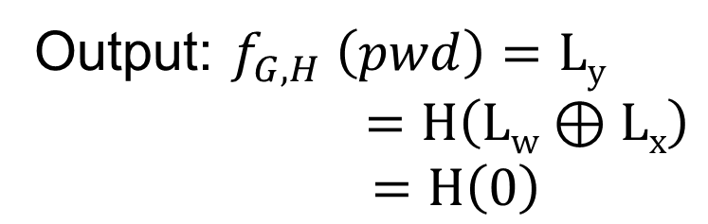

A Problematic Case….
u
w
Output: $f_{G,H} \left(pwd\right)=Ly$
$=H\left(Lw⊕Lx\right)$
$$=H\left(0\right)$$
Input:
…
1
y
v
x
$$Lw=H\left(Lu⊕Lv\right)=Lx$$

Slide 49
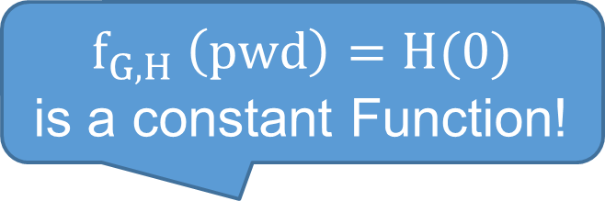
A Problematic Case….
$f_{G,H} \left(pwd\right)=H(0)$
is a constant Function!
u
w
Output: $f_{G,H} \left(pwd\right)=Ly$
$=H\left(Lw⊕Lx\right)$
$$=H\left(0\right)$$
Input:
…
1
y
v
x
$$Lw=H\left(Lu⊕Lv\right)=Lx$$

Slide 50
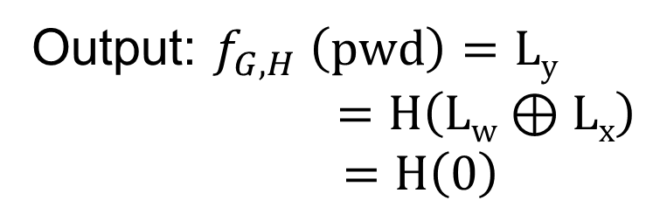
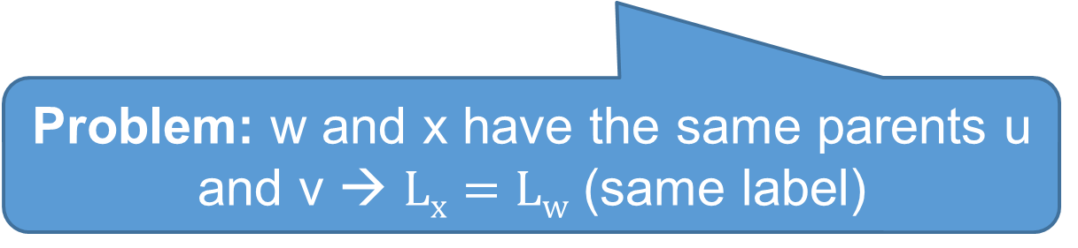
A Problematic Case….
u
w
Output: $f_{G,H} \left(pwd\right)=Ly$
$=H\left(Lw⊕Lx\right)$
$$=H\left(0\right)$$
Input:
…
1
y
v
x
Problem: w and x have the same parents u and v → $Lx=Lw$ (same label)

Slide 51
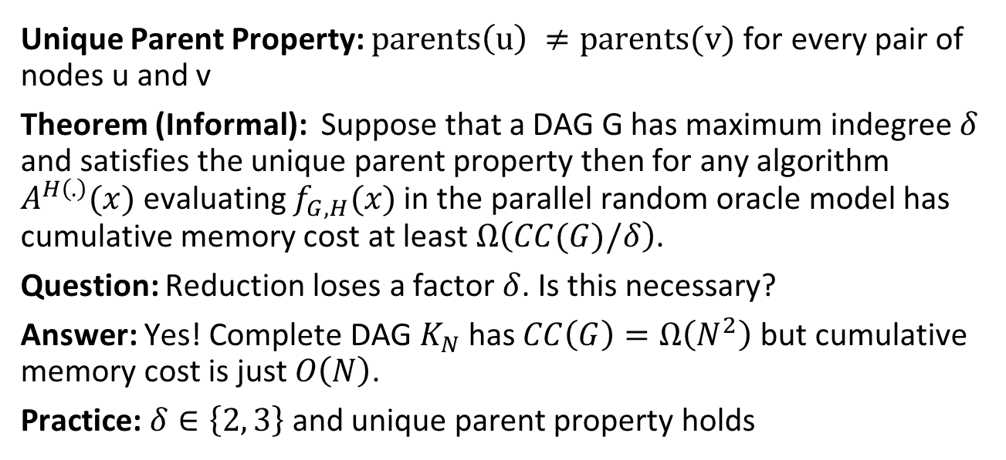
New Pebbling Reduction
Unique Parent Property: $parents\left(u\right) ≠parents(v)$ for every pair of nodes u and v
Theorem (Informal): Suppose that a DAG G has maximum indegree $δ$ and satisfies the unique parent property then for any algorithm $A^{H\left(.\right)}(x)$ evaluating $f_{G,H}(x)$ in the parallel random oracle model has cumulative memory cost at least $Ω\left(CC(G)/δ\right)$.
Question: Reduction loses a factor $δ$. Is this necessary?
Answer: Yes! Complete DAG $K_{N}$has $CC\left(G\right)=Ω\left(N^{2}\right)$ but cumulative memory cost is just $O\left(N\right)$.
Practice: $δ∈\left\{2, 3\right\}$ and unique parent property holds

Slide 52
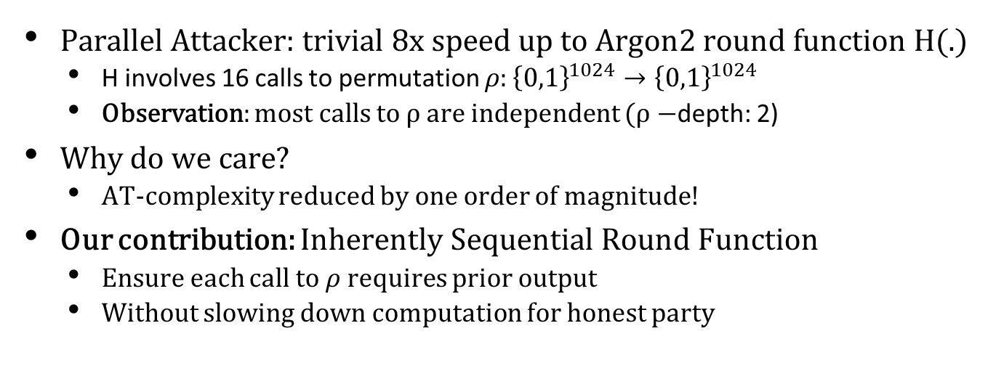
Improving the Round Function
Parallel Attacker: trivial 8x speed up to Argon2 round function H(.)
  H involves 16 calls to permutation $ρ:{\left\{0,1\right\}}^{1024}→{\left\{0,1\right\}}^{1024}$
  Observation: most calls to $ρ$ are independent ($ρ−$depth: 2)
Why do we care?
  AT-complexity reduced by one order of magnitude!
Our contribution: Inherently Sequential Round Function
  Ensure each call to $ρ$ requires prior output
  Without slowing down computation for honest party

Slide 53
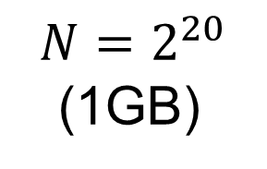
Implementation and Evaluation
Modifications to Argon2 source code
Updated edge distributions (DRS+BRG)
Inherently Sequential Round Function
 | Old Round Function | Inherently Sequential
Argon2i | 1.4 seconds | 1.4 seconds
DRS+BRG | 1.4 seconds | 1.4 seconds
$$N=2^{20}$$
(1GB)
https://github.com/antiparallel-drsbrg-argon/Antiparallel-DRS-BRG

Slide 54
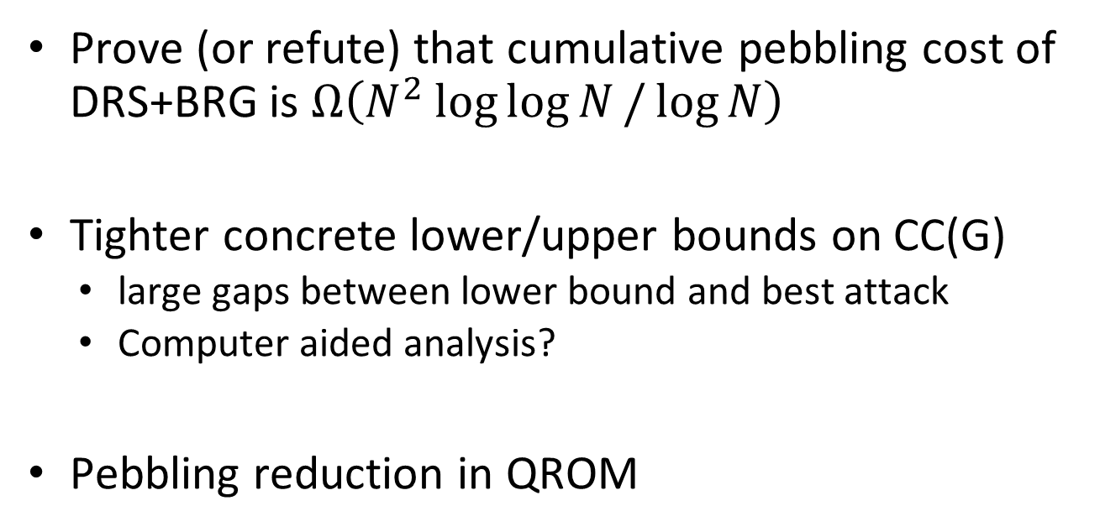
Future Challenges
Prove (or refute) that cumulative pebbling cost of DRS+BRG is $Ω\left(N^{2}\log{\log{N}}/\log{N}\right)$
Tighter concrete lower/upper bounds on CC(G)
  large gaps between lower bound and best attack
  Computer aided analysis?
Pebbling reduction in QROM

Slide 55

Thanks for Listening

Slide 56
Main Theorem
For any n∊ℕ we give a function f_{n} and prove that in the parallel Random Oracle Model (PROM):
Bonus: f_{n} is an iMHF.
  E runs in constant time and has data-independent memory access pattern
Honest
Sequential Algorithm E
Time(E(f_{n})) = n
ST(E(f_{n})) = n²
Adversarial
∀ parallel algs. A
s-SS(A(f_{n})) = Ω(n) per eval.
for s = Ω(n/log(n))

Slide 57
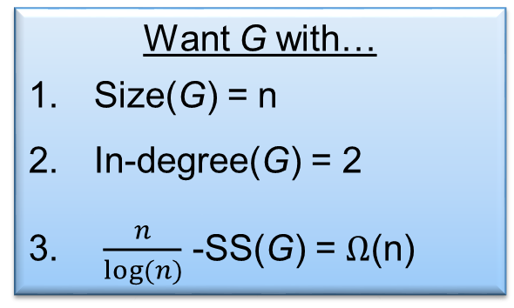
The Parallel Black Pebbling Game
Parallel Black Pebbling Game: Same as Black Pebbling, except can touch many pebbles per iteration.
s-SS analogue: Count number of steps when at least s pebbles on graph.
Goal: Place a pebble on the sink.
Rule 1: A node can be pebbled only if all parents contain a pebble.
Rule 2: A pebble can always be removed.
Want G with…
Size(G) = n
In-degree(G) = 2
$\frac{n}{log⁡(n)}$ -SS(G) = Ω(n)
G
s-SS Complexity
1-SS = 3
2-SS = 1

Slide 58
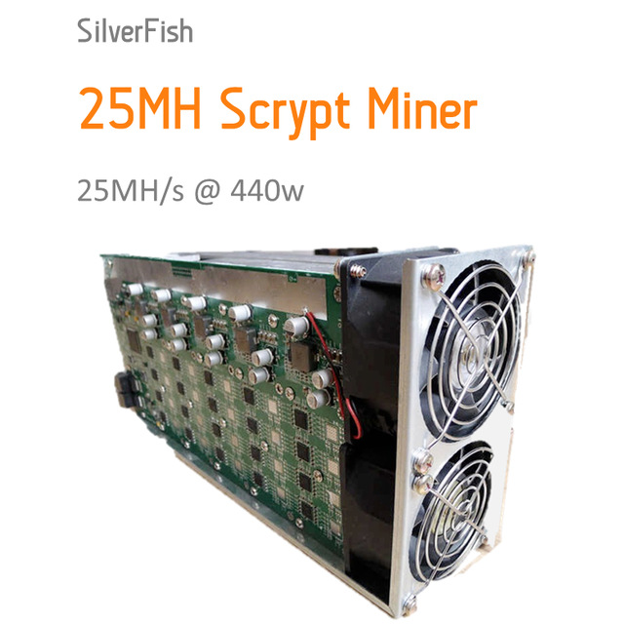
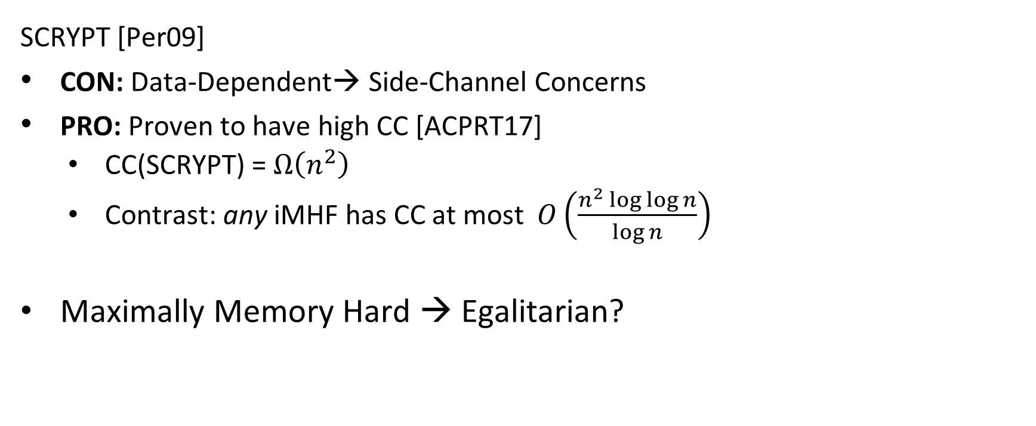
Lessons from SCRYPT
  SCRYPT [Per09]
  CON: Data-Dependent→ Side-Channel Concerns
  PRO: Proven to have high CC [ACPRT17]
  CC(SCRYPT) = $Ω\left(n^{2}\right)$
  Contrast: any iMHF has CC at most $O\left(\frac{n^{2}\log{\log{n}}}{\log{n}}\right)$
Maximally Memory Hard → Egalitarian?

Slide 59
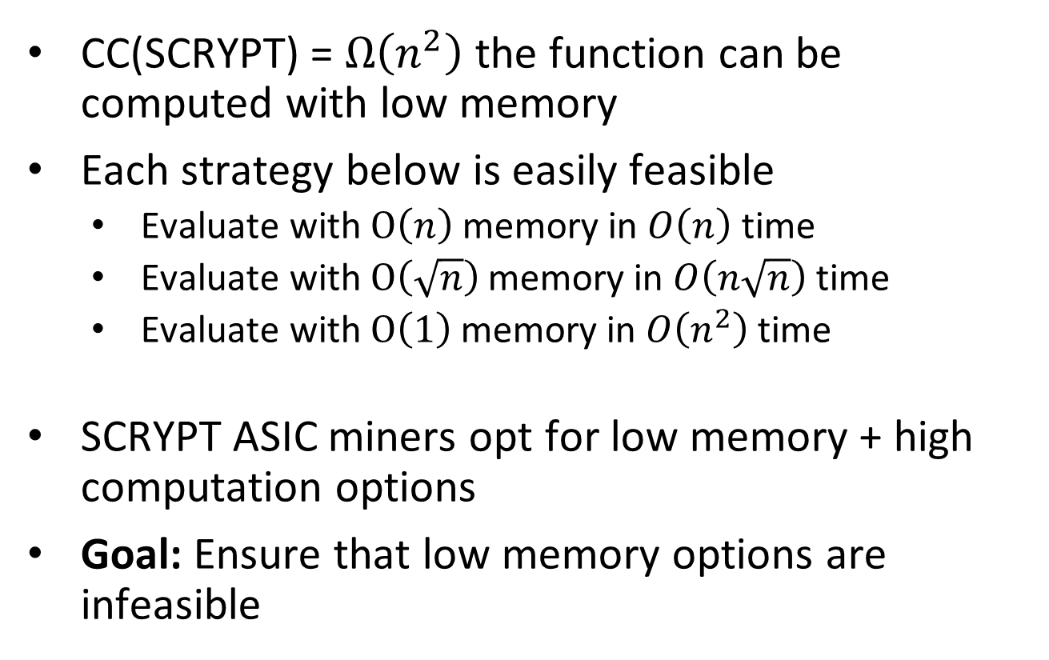
What Happened?
CC(SCRYPT) = $Ω\left(n^{2}\right)$ the function can be computed with low memory
Each strategy below is easily feasible
  Evaluate with $O\left(n\right)$ memory in $O\left(n\right)$ time
  Evaluate with $O\left(\sqrt{n}\right)$memory in $O\left(n\sqrt{n}\right)$ time
  Evaluate with $O\left(1\right)$memory in $O\left(n^{2}\right)$ time
SCRYPT ASIC miners opt for low memory + high computation options
Goal: Ensure that low memory options are infeasible

Slide 60
Other Applications of Depth-Robust Graphs
Proofs of Space [DFKP13]
  Environmentally friendly alternative to PoW
Proofs of Replication [P19]
Proofs of Sequential Work [MMV13]
  Relaxed Notion of ``Weighted Depth-Robustness” [CP18]
Relaxed Locally Correctable Codes [BGVZ19]
Blockchain Verification? Other applications?
  Shorter Signatures? Shorter Public Keys?
Improved Constructions of Depth-Robust Graphs?
  Computer Assisted Analysis?

Slide 61
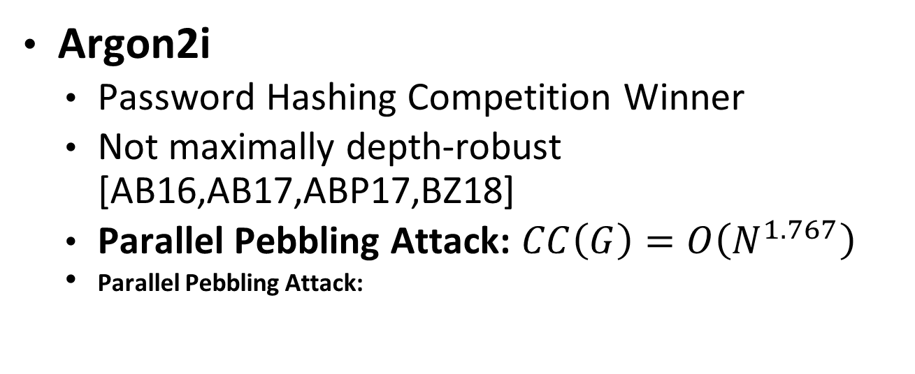
Building iMHFs with Depth-Robust Graphs
Argon2i
  Password Hashing Competition Winner
  Not maximally depth-robust [AB16,AB17,ABP17,BZ18]
  Parallel Pebbling Attack: $CC\left(G\right)=O\left(N^{1.767}\right)$
  Parallel Pebbling Attack:

Slide 62
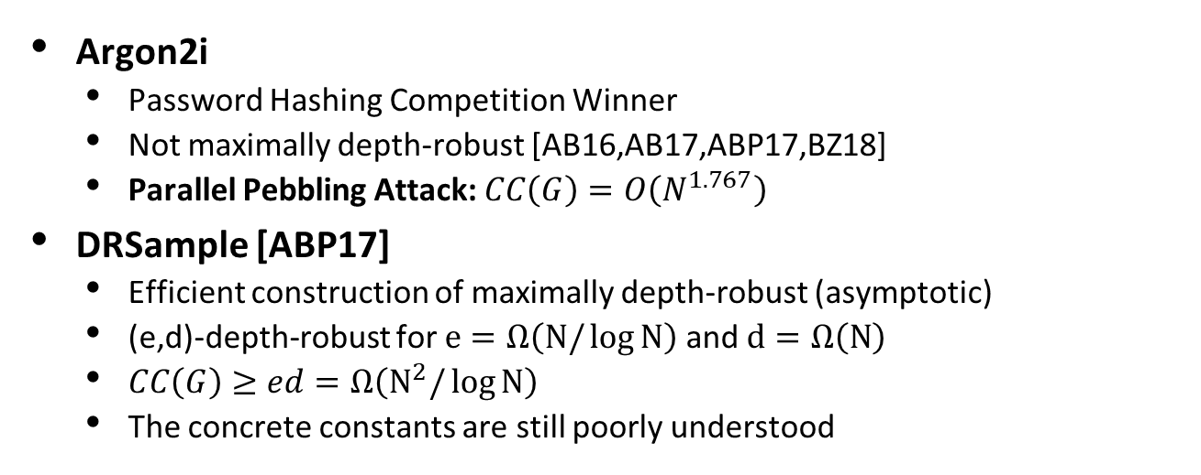
Building iMHFs with Depth-Robust Graphs
Argon2i
  Password Hashing Competition Winner
  Not maximally depth-robust [AB16,AB17,ABP17,BZ18]
  Parallel Pebbling Attack: $CC\left(G\right)=O\left(N^{1.767}\right)$
DRSample [ABP17]
  Efficient construction of maximally depth-robust (asymptotic)
  (e,d)-depth-robust for $e=Ω\left(N/\log{N}\right)$ and $d=Ω\left(N\right)$
  $CC\left(G\right)≥ed=Ω\left(N^{2}/\log{N}\right)$
  The concrete constants are still poorly understood

Slide 63
Building iMHFs with Depth-Robust Graphs
Argon2i
  Password Hashing Competition Winner
  Not maximally depth-robust [AB16,AB17,ABP17,BZ18]
  Implication: Efficient Pebbling Attacks
DRSample [ABP17]
  Efficient construction of maximally depth-robust (asymptotic)
  The concrete constants are poorly understood
DRSample+BRG [New]
  Improves on Argon2i and DRSample
  Optimal resistance to all known pebbling attacks

Slide 64


