Slide 1
Techniques for Achieving Vertex Level Differential Privacy
Jeremiah Blocki

Slide 2
Vertex Level Differential Privacy
Differentially Private Data Analysis of Social Networks via Restricted Sensitivity [BBDS13]
Analyzing Graphs with Node Differential Privacy [KNRS13]
Private Graphon Estimation for Sparse Graphs [BCS15]
Notes:
Shiva Kasiviswanathan, Nissim, Raskhodnikova, Smith

Slide 3

Goal
useful statistics
Preserve Privacy and Release Useful Statistics

Slide 4
Outline
Background
  Social Networks
  Differential Privacy
The Challenge
Achieving Vertex Level Differential Privacy
Notes:
General Inefficient Construction
Bounded Degree Assumption
Edge Adjacency Construction
Vertex Adjacency Construction

Slide 5
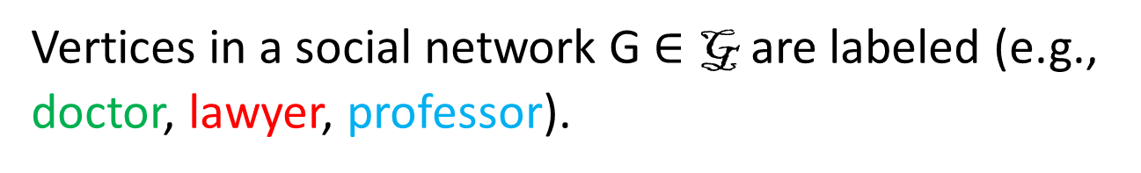
Social Network
Vertices in a social network G $∈$ G are labeled (e.g., doctor, lawyer, professor).

Slide 6

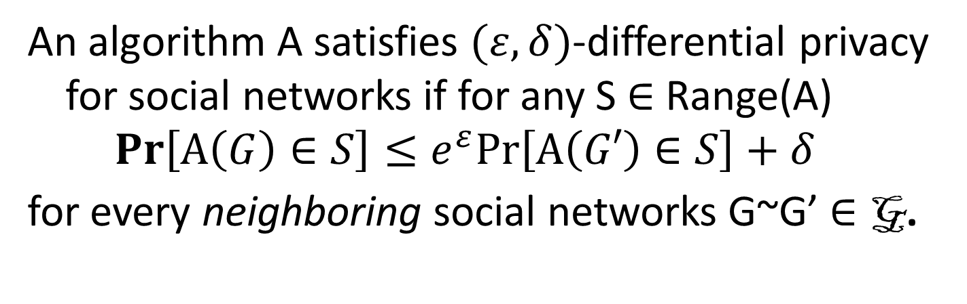
Differential Privacy (Dwork et al)
An algorithm A satisfies $(ε,δ)$-differential privacy for social networks if for any S $∈$ Range(A)
$$Pr\left[A\left(G\right)∈S\right]≤e^{ε}Pr\left[A\left(G′\right)∈S\right]+δ$$
for every neighboring social networks G~G’ $∈$ G.
Who is my neighbor?
Notes:
Intuition before mathematical definition?

Slide 7
Edge Adjacency
Notes:
The first network is a neighbor because we change the label of one node.
The second network is a neighbor because we removed one edge.
The third network is not a neighbor because we removed two edges.

Slide 8





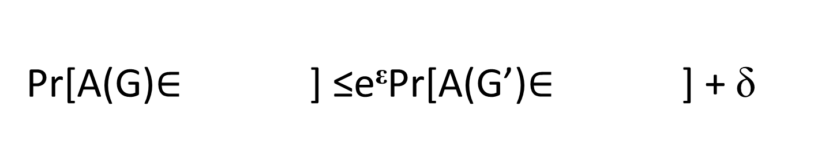
Graphs: Edge Adjacency
G
G’
~
Pr[A(G)$∈$ ] ≤e^{ε}Pr[A(G’)$∈$ ] + δ
Notes:
If a mechanism A satisfies differential privacy then the mechanism must produce similar distributions over both graphs.
Intuition: Johnny’s mom may be able tell if he watched an R-rated movie.

Slide 9
Graphs: Edge Adjacency
G
G’
~
Johnny’s mom does not learn if he watched Saw from the output A(G).
Notes:
If a mechanism A satisfies differential privacy then the mechanism must produce similar distributions over both graphs.
Intuition: Johnny’s mom may be able tell if he watched an R-rated movie.

Slide 10

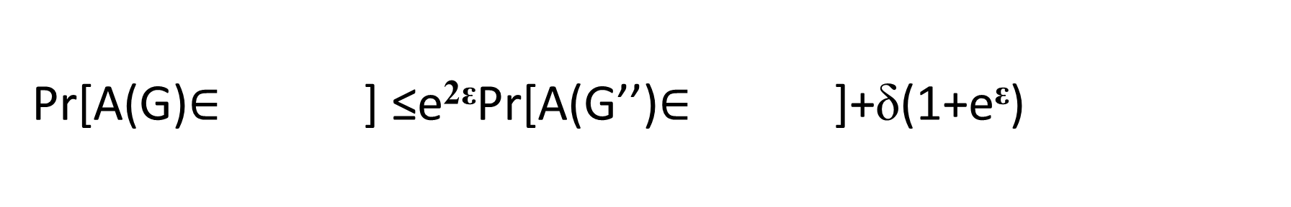
Privacy for Two Edges?
G
G’’
~
Pr[A(G)$∈$ ] ≤e^{2ε}Pr[A(G’’)$∈$ ]+δ(1+e^{ε})
10

Slide 11
Limitations
G
G^{t}
~
…
…
Johnny’s mom may now be able tell if he watches R-rated movies from A(G).
Notes:
Now the graphs are not neighbors

Slide 12
Vertex Adjacency
Notes:
The first two graphs (right) are still neighbors.
The bottom graph now is a neighbor because we only removed edges incident to blue.
In fact the bottom right graph is also a neighbor for the same reason.
However, if we remove another edge then the graph is no longer a neighbor.

Slide 13
Vertex Adjacency
G₁
G₂
~
…
…
Pr[A(G)$∈$ ] ≤e^{ε}Pr[A(G’)$∈$ ] + δ
Notes:
Popup:Differential Privacy wrt Vertex Adjacency is a stronger privacy guarantee

Slide 14
Vertex Adjacency
G₁
G₂
~
…
…
Johnny’s mom cannot tell if he watches R-rated movies.
Notes:
Popup:Differential Privacy wrt Vertex Adjacency is a stronger privacy guarantee

Slide 15
Outline
Background
The Challenge
  High Sensitivity of Queries
  Local/Smooth Sensitivity
  An Impossibility Result
Achieving Vertex Level Differential Privacy
Notes:
General Inefficient Construction
Bounded Degree Assumption
Edge Adjacency Construction
Vertex Adjacency Construction

Slide 16
Subgraph Counting Queries
How many copies of K₃ does Facebook contain where one node is a doctor, one node is a professor and one node is a lawyer?
Notes:
Clustering coefficient/triadic closure

Slide 17
Local Profile Query
How many people know 2 lawyers who know each other and 2 doctors who know each other, but the lawyers aren’t friends with the doctors?
Notes:
The local profile of blue depends only on the graph induced by blue and any adjacent vertices
Examples: Clustering Coefficient, Bridges etc…

Slide 18
Global Sensitivity
f(G) = “how many people in G know two pianists?”
G₁
G₂
GS_{f} = n
~
f(G₁) = 0
f(G₂) = n

Slide 19
Global Sensitivity
Global Sensitivity of f:
Local Profile Queries (f):
GS_{f} = n
Notes:
Define Global Sensitivity from Scratch then motivate local sensitivity then smooth sensitivity

Slide 20
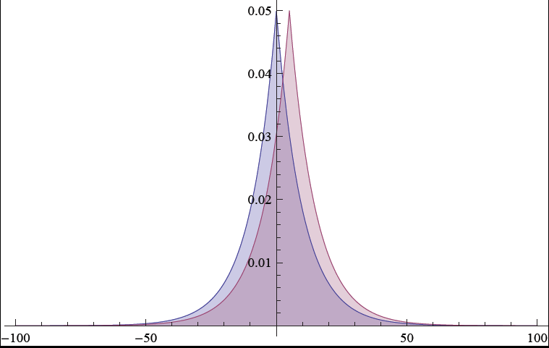
Laplacian Mechanism
The mechanism
A(G) = f(G) + Lap(GS_{f}/ε),
satisfies (ε,0)-differential privacy.

Slide 21



Privacy vs. Accuracy
A(G) = f(G) + Lap(n/ε)
Private, ….
but not accurate!

Slide 22
Local Sensitivity
f(G) = “how many people in G know two pianists?”
G₁
G₂
LS_{f}(G₁) = 1
~
f(G₁) = 0
f(G₂) = 1

Slide 23

Local Sensitivity
Local Sensitivity of f at G:
LS_{f}(G) = max_{G~G’} |f(G)-f(G’) |
Fact: The mechanism
A(G) = f(G) + Lap(LS_{f}(G)/ε)
does not satisfy differential privacy.

Slide 24
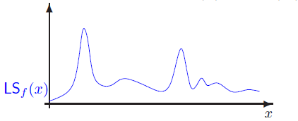
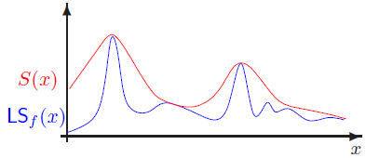
Smooth Sensitivity (Nissim et al)
Problem: LS_{f}(G) itself could be highly sensitive!

Slide 25

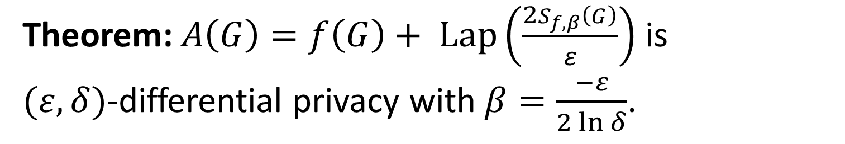
Smooth Sensitivity (Nissim et al)
Def: A $β$-smooth upper bound on the local sensitivity $S_{f,β}$ satisfies
$S_{f,β}\left(G\right)≥{LS}_{f}\left(G\right)$ for all G $∈$ G.
$S_{f,β}\left(G\right)≥e^{β}\left(S_{f,β}\left(G′\right)\right)$ for all G’~G.
Theorem: $A\left(G\right)=f\left(G\right)+ \operatorname{Lap}\left(\frac{2S_{f,β}\left(G\right)}{ε}\right)$ is
$(ε,δ)$-differential privacy with $β=\frac{−ε}{2\ln{δ}}$.
Notes:
Motivate Smooth Sensitivity with a Picture from Adam Smith’s Talk
Upper bound on Local Sensitivity
Smoothness

Slide 26


Smooth Sensitivity
A $β$-smooth upper bound on the local sensitivity $S_{f,β}$ satisfies
$S_{f,β}\left(G\right)≥{LS}_{f}\left(G\right)$ for all G $∈$ G.
$S_{f,β}\left(G\right)≥e^{β}\left(S_{f,β}\left(G′\right)\right)$ for all G’~G.
When is $S_{f,β}\left(G\right)$ small?
LS_{f}(G) must be small.
For any nearby graph G’, LS_{f}(G’) must also be small.
Notes:
So does smooth sensitivity solve our problem? Not quite. In our example, neither condition (1) or (2) is satisfied.

Slide 27
Smooth Sensitivity is High!
f(G) = “how many people in G know a pianist?”
G₁
G₂
f(G₁)=0
f(G₂)=n
~
Accuracy
Privacy
No private mechanism A can be accurate for both G₁ and G₂!

Slide 28
Hopeless?
f(G) = “how many people know two pianists who are friends with each other.”
G₁
G₂
f(G₁)=n-2
f(G₂)=0
Accuracy
Privacy
No private mechanism A can be accurate for both G₁ and G₂!
Notes:
Even Smooth Sensitivity cannot help, because the local sensitivity is already too high!
Notice that every graph G is close to a graph G’ with f(G’) = n. Either f(G) = n or we are close to an instance with high local sensitivity!

Slide 29
Previous Work
Edge Adjacency Model
  Degree Distribution [HLM’09]
  Cut Queries [BBDS’12]
  Subgraph Counting [KRSY’11]
  ….
Limited Work on Vertex Adjacency
Notes:
[14] M. Hay, C. Li, G. Miklau, and D. Jensen. Accurate estimation of the degree distribution of
private networks. In ICDM, pages 169–178, 2009.
[5] J. Blocki, A. Blum, A. Datta, and O. Sheffet. The johnson-lindenstrauss transform itself preserves
differential privacy. In Proceedings of the 53rd annual IEEE Symposium on Foundations
of Computer Science. IEEE, 2012.
[16] V. Karwa, S. Raskhodnikova, A. Smith, and G. Yaroslavtsev. Private analysis of graph structure.
PVLDB, 4(11):1146–1157, 2011.

Slide 30
Vertex Level Differential Privacy
Differentially Private Data Analysis of Social Networks via Restricted Sensitivity [BBDS13]
Analyzing Graphs with Node Differential Privacy [KNRS13]
Private Graphon Estimation for Sparse Graphs [BCS15]
Notes:
Shiva Kasiviswanathan, Nissim, Raskhodnikova, Smith

Slide 31
Outline
Background
The Challenge
Achieving Vertex Level Differential Privacy
  Relaxed Goal
  Restricted Sensitivity
  Results
Notes:
A new sensitivity definition
Demonstrate that it has lower sensitivity
Challenge to leverage this idea
Relaxed Accuracy Goals

Slide 32
Traditional Goal
Query f
x₁
…
x_{n}
A(D) = f(D)+noise
Analyst
Database D
Usual goal:
Accurate for all D
Differential Privacy
Notes:
In the traditional differential privacy setting a data analyst wants to ask some query (e.g., “how many computer scientists have cancer?”) about a dataset D. Because the data may be sensitive the institution will add noise to the true answer to preserve the privacy of individuals in the database. There are two goals: 1) give accurate answers to the data analyst and 2) satisfy differential privacy – a rigorous notion of privacy that I will define later. However, in our social network setting it is impossible to satisfy both goals so we need to look for a new approach: Restricted Sensitivity.

Slide 33
Relaxed Goal
Query f, Hypothesis H
x₁
…
x_{n}
f_{H}(D)+lower noise
Analyst
Database D
Accurate for D in H
Differential Privacy
Notes:
In our setting the analyst submits a query and a hypothesis about the database D. We relax our accuracy goal to only require that the answer is accurate when the hypothesis is true. The guarantee of differential privacy must hold even when the hypothesis H is false. Can we gain anything by taking this approach?

Slide 34

[BBDS] Bounded Degree Hypothesis
Bounded Degree Hypothesis:
$$H_{k}=\left\{G | \max_{v∈V(G)}{deg⁡(v)≤k}\right\}$$
Typical:
G
H₂
Notes:
Think of k = Sqrt(n). There are 900 million facebook users, but very few have degree > 5,000. Sqrt(900 million) = 30,000

Slide 35



[KNRS] $α−$Decay
Def: A graph G satisfies $α−$Decay if for all t > 1
$$P\left(t×\overline{d}\right)≤t^{−α}$$
$\overline{d}$is the average degree of nodes in G
P(d) is the fraction of nodes with degree $≥d$
As a Hypothesis:
$$H_{α}=\left\{G | G satisfies α−\text{Decay}\right\}$$
Notes:
Every graph satisfies 1-decay. Many natural graphs satisfy alpha > 1 decay.

Slide 36
Outline
Background
The Challenge
Achieving Vertex Level Differential Privacy
  Relaxed Goal
  Restricted Sensitivity
  Lipschitz Extenstions: A General Template
  Results
Notes:
A new sensitivity definition
Demonstrate that it has lower sensitivity
Challenge to leverage this idea
Relaxed Accuracy Goals

Slide 37

[BBDS] Restricted Sensitivity
Hypothesis: H $⊂$ G
Notes:
Highlight, contained in H. Split slides

Slide 38
Restricted Sensitivity RS_{f}(H_{k})
Fact: For local profile queries f, RS_{f}(H_{k}) ≤ 2k+1
k= 2
k=2
G₁
G₂
|f(G₁) –f(G₂)|≤ 5=RS_{f}(H₂)
Notes:
Proof by example. (Point at red node).
The local profile of the red not can change
The local profile of the old neighbors can change
The local profile of new neighbors can change
All other local profiles are identical.

Slide 39
Sensitivity over H_{k}
 | Local Profile Query |  | Subgraph Counting Query (P)
Adjacency | Smooth | Restricted | Smooth | Restricted
Edge | k+1 | k+1 | O(|P| k^{|P|-1}) | O(|P| k^{|P|-1})
Vertex | n | 2k+1 | O(n^{|P|-1}) | O(|P| k^{|P|-1})
[BBDS13]
[BBDS13]
[KNRS13]
[KNRS13]: Private degree distribution
Notes:
Circle n and 2k+1

Slide 40
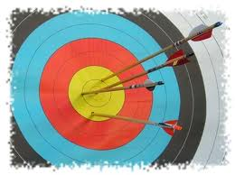
Restricted Sensitivity
For k << n the mechanism
A(G) = f(G) + Lap(RS_{f}(H_{k})/ε)
is accurate!
Fact: The mechanism
A(G) = f(G) + Lap(RS_{f}(H)/ε)
does not preserve differential privacy for all G.
Notes:
Key Problem: How do we answer for G not in H?

Slide 41
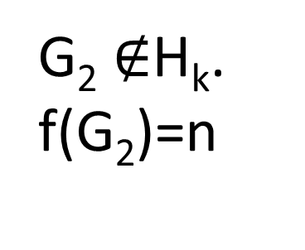
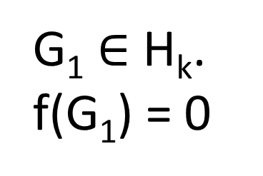

An Example
f(G) = “how many people in G know a pianist?”
G₂ $∉$H_{k}.
f(G₂)=n
G₁
G₁ $∈$ H_{k}.
f(G₁) = 0
G₂
Pr[A(G₁) $≈$0] ≤ e^{ε} Pr[A(G₂) $≈$ 0] + $δ$

Slide 42
Privacy for All, Accuracy for Some
H
useful data, released to the public
Privacy for all G
Accurate statistics for G  H

Slide 43
Outline
Background
The Challenge
Achieving Vertex Level Differential Privacy
  Relaxed Goal
  Restricted Sensitivity
  Lipschitz Extenstions: A General Template
  Results
Notes:
A new sensitivity definition
Demonstrate that it has lower sensitivity
Challenge to leverage this idea
Relaxed Accuracy Goals

Slide 44
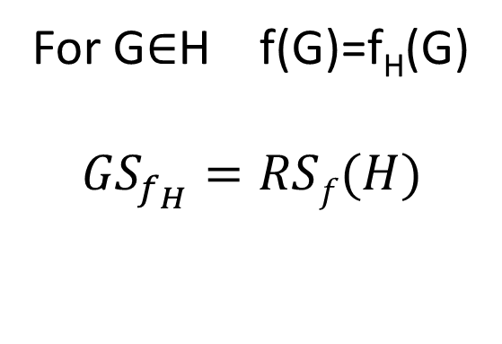
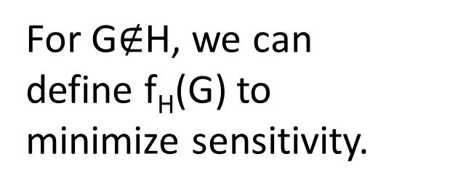
Lipschitz Extension
f
f_{H}
Hypothesis (H)
G₁
H
For G$∉$H, we can
define f_{H}(G) to
minimize sensitivity.
For G$∈$H f(G)=f_{H}(G)
$${GS}_{f_{H}}=RSf(H)$$
Notes:
If we achieve this goal then…

Slide 45
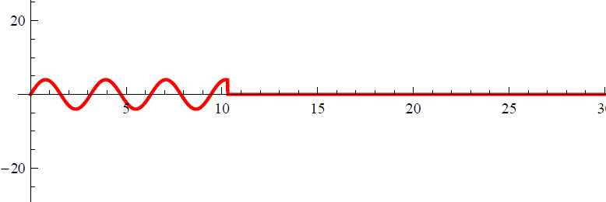
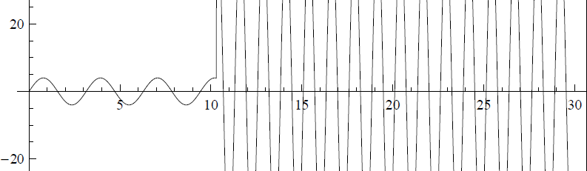
Accuracy for Some
f
f_{H}
Hypothesis (H)
f_{H}
f
H
Notes:
If we achieve this goal then…

Slide 46
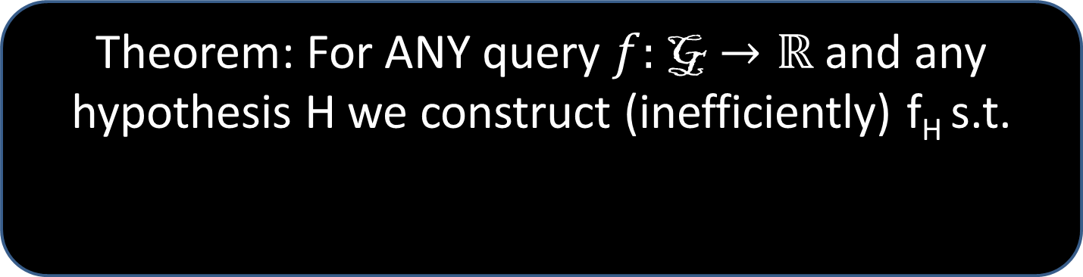
Accuracy for G in H
f
f_{H}
Hypothesis (H)
Theorem: For ANY query $f:\text{G}→ℝ$ and any hypothesis H we construct (inefficiently) f_{H} s.t.
Notes:
If we achieve this goal then…

Slide 47
Privacy For All
f
f_{H}
Hypothesis (H)
Answer f_{H} in a differentially private manner.
Ideally, we would like to compute f_{H} efficiently.
Notes:
If we achieve this goal then…

Slide 48

General Construction of f_{H}
Theorem: For any $f:\text{G}→ℝ$, $∃f_{H}$ such that
  f_{H}(G) = f(G) for all G $∈$ H
  ${GS}_{f_{H}}=RSf(H)$
Disclaimer: The general construction of f_{H} is not efficient.
Notes:
Works for any query, and any hypothesis H

Slide 49
Outline
Background
The Challenge
Achieving Vertex Level Differential Privacy
  Relaxed Goal
  Restricted Sensitivity
  Lipschitz Extenstions: A General Template
  Results
Notes:
A new sensitivity definition
Demonstrate that it has lower sensitivity
Challenge to leverage this idea
Relaxed Accuracy Goals

Slide 50

[KNRS] Subgraph Counting Queries
Lemma: Can efficiently compute Lipschitz extension $f_{H_{k}}$ when f is a subgraph counting query for a constant size subgraph (e.g., triangles)*.
Proof: Convex Programming
Theorem: Assume that G satisfies $α$-decay for $α>1$ then there is an efficient DP mechanism to (1+o(1))-approximate subgraph counting queries*.
* Some technical details omitted
Notes:
A couple of remarks:
KNRS did not consider labeled subgraphs, but there techniques appear to generalize.
BBDS proved a similar Theorem (described later), but did not try to prove utility for graphs with alpha-Decay.

Slide 51
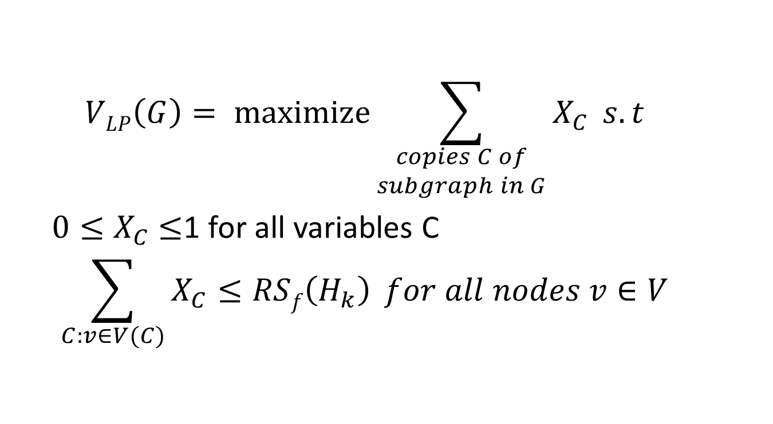
[KNRS] Subgraph Counting Queries
  $$VLP\left(G\right)= maximize{\sum_{\begin{aligned}copies C of \\ subgraph in G\end{aligned}}{X_{C}}} s.t$$
  $0≤X_{C}$ $≤$1 for all variables C
  $$\sum_{C:v∈V(C)}{X_{C}≤RSf\left(H_{k}\right)} for all nodes v∈V$$

Slide 52
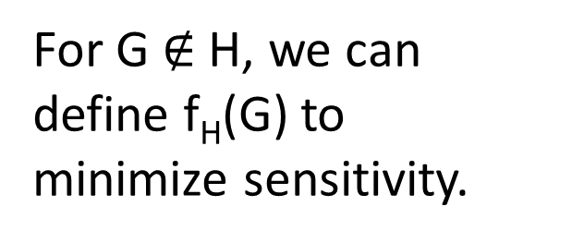
Relaxed Lipschitz Extension
f
f_{H}
Hypothesis (H)
G₁
H
For G $∉$H, we can
define f_{H}(G) to
minimize sensitivity.
For G$∈$H f(G)=f_{H}(G)
$${GS}_{f_{H}}=RSf(H)$$
Notes:
If we achieve this goal then…

Slide 53

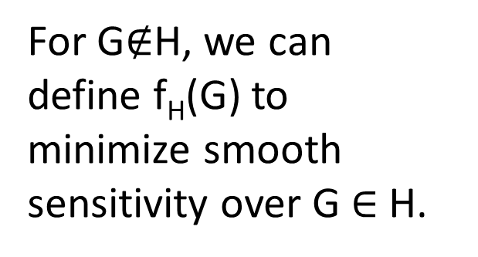
Relaxed Lipschitz Extension
f
f_{H}
Hypothesis (H)
G₁
H
For G$∈$H f(G)=f_{H}(G)
For G$∈$H $S_{f_{H},β}\left(G\right)=\tilde{O}\left(RSf(H)\right)$
For G$∉$H, we can
define f_{H}(G) to
minimize smooth sensitivity over G $∈$H.
Notes:
If we achieve this goal then…

Slide 54

[BBDS] Relaxed Lipschitz Extension
Theorem: For any efficiently computable $f:\text{G}→ℝ$, we can efficiently compute $f_{H_{k}}$such that
$$f_{H_{k}}\left(G\right)=f\left(G\right) ∀G∈H﷮k$$
and
$$S_{f_{H_{k}},β}\left(G\right)=\tilde{O}\left({RS}_{f}\left(Hk\right)\right) ∀G∈H﷮k$$

Slide 55
General Construction of f_{H}
Consider a canonical ordering G₁,G₂,… over all social networks(G).
  For G_{i}  H set f_{H}(G_{i}) = f(G_{i})
  Find
f_{H}(G_{j})
  I_{j}
d(G_{i},G_{j})RS_{f}(H)
d(G_{i},G_{j})RS_{f}(H)
Notes:
Backup slide (picture)

Slide 56
f(G_{i})
f(G_{j})
d(G_{i},G_{j})RS_{f}(H)
d(G_{i},G_{j})RS_{f}(H)

Slide 57
Suppose for contradiction that no value exists….
Can find two nonintersecting intervals I_{j} and I_{k} (j,k < i).
f(G_{j})
f(G_{k})
d(G_{i},G_{j})RS_{f}(H)
d(G_{i},G_{k})RS_{f}(H)

Slide 58
Can Find Non Intersecting Intervals

Slide 59
Suppose for contradiction that no value exists….
Triangle Inequality
Contradiction of Inductive Hypothesis!
G_{i}
G_{k}
G_{j}

Slide 60
Suppose for contradiction that no value exists….
Then there must exist two intervals which don’t intersect (j,k < i).

Slide 61
Suppose for contradiction that no value exists….
Triangle Inequality
Contradiction of Inductive Hypothesis!

Slide 62
Outline
Differential Privacy in Social Networks
The Problem
Restricted Sensitivity
Algorithms
  General Template
  Possibility: A General Inefficient Algorithm
  Efficient Algorithms for H_{k} via Projections
    Edge Adjacency Model
    Vertex Adjacency
Notes:
General Inefficient Construction
Bounded Degree Assumption
Edge Adjacency Construction
Vertex Adjacency Construction

Slide 63
Projection onto H
: G H
G₁
H
(G₁)
G₂ = (G₂)

Slide 64
c-smooth Projection
: G H
d
G₁
G₂
❍
H
❍
(G₁)
(G₂)
c d

Slide 65
c-smooth Projection Lemma
Let : G H be a c-smooth projection then f_{H}(G) = f((G)) satisfies:
For G  H, f_{H}(G) = f(G), and
GS_{fH}≤ c RS_{f}(H).
Notes:
The first claim is trivial.

Slide 66
Proof of (1)
(1) For G  H, f_{H}(G) = f(G),
H
G₂ = (G₂)
f_{H}(G₂) = f((G₂))
= f(G₂)

Slide 67
Proof of (2)
: G H
d
G₁
G₂
❍
H
❍
(G₁)
(G₂)
c d
| f_{H}(G₁) -f_{H}(G₂)| = |f((G₁)) - f((G₂))|
≤ d((G₁), (G₂)) RS_{f}(H)/d
≤ c RS_{f}(H)
Notes:
The second claim immediately follows from the definition of c-smooth projection and restricted sensitivity.

Slide 68
Outline
Differential Privacy in Social Networks
The Problem
Restricted Sensitivity
Algorithms
  General Template
  Possibility: A General Inefficient Algorithm
  Efficient Algorithms for H_{k} via Projections
    Edge Adjacency Model
    Vertex Adjacency
Notes:
General Inefficient Construction
Bounded Degree Assumption
Edge Adjacency Construction
Vertex Adjacency Construction

Slide 69
Edge Adjacency (: G H_{k})
For each vertex v with deg(v) > k:
  Let (v,u₁),…,(v, u_{deg(v)}) denote the edges incident to v in canonical order
  Mark the edge (v,u_{i}) for each i > k.
Delete all marked edges.
Call the resulting graph (G).

Slide 70
Edge Adjacency (: G H_{k})
Claim: The efficiently computable mapping (G) is a 3-smooth projection.
Proof:
(1) If G  H_{k} then no edges are deleted so (G)=G.
(2) WTS: For any G~G’, d((G), (G’)) ≤ 3.

Slide 71
Edge Adjacency (: G H_{k})
(2) For any G~G’, d((G), (G’)) ≤ 3.
Proof:
If E(G’) = E(G)+(u,v) then
  (G’) might still contain (u,v).
  At most one edge (u,w₁)  E((G))\ E(G’).
  At most one edge (v,w₂)  E((G))\ E(G’).
  So d((G), (G’)) ≤ 3.
  (QED)

Slide 72
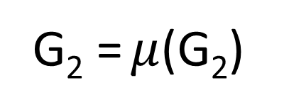
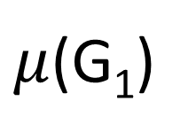
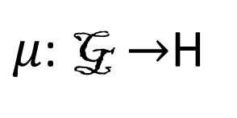
Naïve Projection
$μ$: G $→$H
G₁
H_{k}
$μ$(G₁)
G₂ = $μ$(G₂)

Slide 73



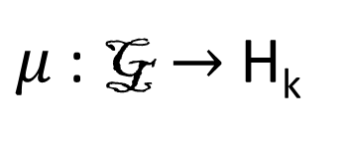

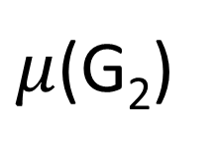
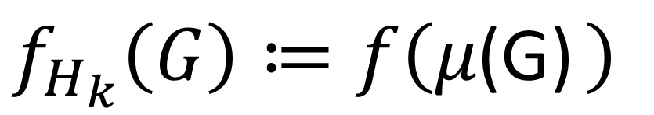
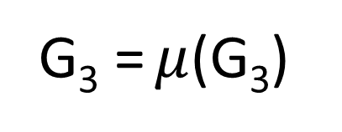
Naïve Attempt: Projection
$μ$: G $→$H_{k}
d
G₁
G₂
H_{k}
$$μ$$
$$μ$$
G₂ = $μ$(G₂)
$μ$(G₁)
$μ$(G₂)
$$≤c×d$$
G₃ = $μ$(G₃)
$f_{H_{k}}\left(G\right)≔f\left(μ\text{(}\text{G}\text{) }\right)$

Slide 74
Projection Lemma
Let : G H be a projection such that
For G  H, (G) = G, and
For G~G’, d((G), (G))  c
then f_{H}(G) = f((G)) satisfies:
For G  H, f_{H}(G) = f(G), and
GS_{fH}≤ c RS_{f}(H).
Works in the edge adjacency model!
Notes:
The first claim is trivial.

Slide 75
Naïve Attempt
Map close graphs to close graphs in H_{k}?
  Works for Edge Adjacency Model
Can’t Work! ☹ Why?
It would allow us to approximate d(G,H_{k}).
Claim: It is NP-hard to approximate d(G,H_{k}) to within any constant factor (reduction from set cover)

Slide 76
Reduction from Set Cover
…
Universe (n ≤ k items)
Sets (m ≤ k)
S₁
S₁
…
d(G,H_{k})= Size of Optimal Set Cover
…
…
…
S_{m}
S_{m}
Degree = k+1

Slide 77
A New Approach
f
Hypothesis (H)
f_{H}
Leverage Smooth Sensitivity!
Notes:
Relaxation: S_{f} may be large when we are far away from H

Slide 78
Privacy For All
Theorem: The mechanism
preserves differential privacy for =-/2 ln .

Slide 79
Goal: Accuracy For Some
For Local Profile Queries

Slide 80
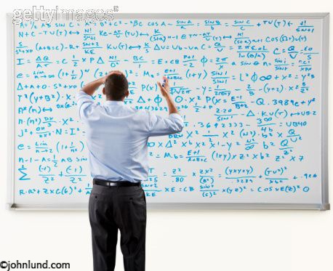
Warning!
Remaining slides are mathematically dense!

Slide 81
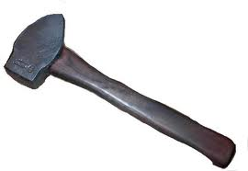

High Level Picture
Concept: c-Smooth Distance Estimation
Lemma
  Accuracy for Some
Constructing a 4-Smooth Distance Estimator
  LP Rounding

Slide 82
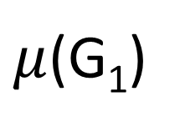
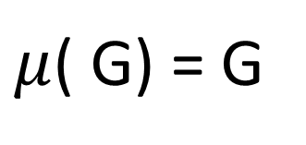
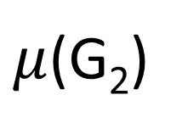
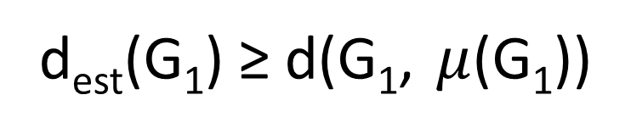
c-Smooth Distance Estimation
d
G₁
G₂
d_{est}(G₁) ≥ d(G₁, $μ$(G₁))
H_{2k}
≤ c d(G₁,H_{k})
H_{k}
≤ c d(G₁,H_{k})
$μ$(G₂)
$μ$(G₁)
$μ$( G) = G
d_{est}(G) = 0
C-smooth: |d_{est}(G₁)- d_{est}(G₂)| ≤ c d

Slide 83

c-Smooth Distance Estimation
Definition: Let $μ$: G $→$H_{2k} be an efficiently computable projection and let d_{est} be an efficiently computable function which satisfies
d_{est}(G) ≥ d(G, $μ$(G)), (upper bound)
d_{est}(G) = 0 for every G $∈$ H_{k}, and (identity)
|d_{est}(G)- d_{est}(G’)| ≤ c for G~G’, (smooth)
then d_{est} is a c-smooth distance estimator.
Notes:
Outline Slides

Slide 84
High Level Picture
Concept: c-Smooth Distance Estimation
Lemma
  Privacy for All, Accuracy for Some
Constructing a 4-Smooth Distance Estimator
  LP Rounding

Slide 85
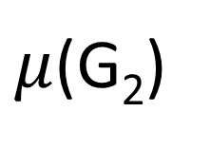
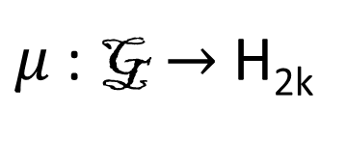
c-Smooth Distance Estimation
$μ$: G $→$ H_{2k}
1
G₁
G₂
d_{est}(G₁)
H_{2k}
d_{est}(G₂) ≤d_{est}(G₁) + c
≤ c d(G₁,H_{k})
$μ$(G₁)
$μ$(G₂)
≤ 2 d_{est}(G₁) + c + 1
Notes:
Intuition: The Local Sensitivity grows with distance from H_{k}. Graphs close to H_{k} have low sensitivity. Graphs with high sensitivity must be far away from

Slide 86
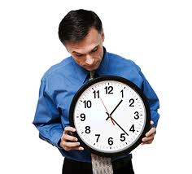
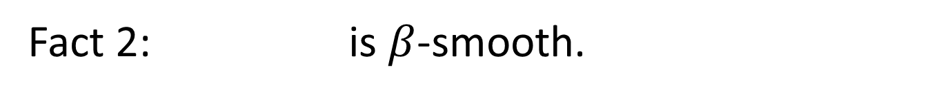
Smooth Sensitivity
Fact 1:
Fact 2: is $β$-smooth.
Fact 3:
Notes:
Fact 1 and 2 say that S is a valid smooth upper bound (privacy for all). Fact 3 satisfies accuracy for some.

Slide 87

c-Smooth Distance Estimation Lemma
Let $μ$: G $→$H_{2k} be a projection with a c-smooth distance estimator d_{est}, and let
$$f_{H_{k}}\left(G\right)≔f\left(μ\left(G\right)\right)$$
Then for every G $∈$ H_{k} $S_{f_{H_{k}},β}\left(G\right)=\tilde{O}\left(RSf\left(H_{k}\right)\right)$
Notes:
Furthermore, are both efficiently computable.

Slide 88
Smooth Upper Bound
Fact 1:
Notes:
Plug in d = d_{est}(G)
Exp(0) = 1
Apply the definition of restricted sensitivity
4. Apply fact about c-smooth projections: 2d_{est}(G)+c+1 >= d(G,G’)

Slide 89
Smooth Upper Bound
Fact 1:
Notes:
5. Simplify and apply definition of f_{H}
6. By definition of LS_{f}

Slide 90
Smooth Upper Bound
Fact 2: is -smooth.
Notes:
1. The maximum in the numerator is obtained at some value d*

Slide 91
Smooth Upper Bound
Fact 2: is -smooth.
Notes:
2. We can substitute d* into the denominator and obtain the following inequality

Slide 92
Smooth Upper Bound
Fact 2: is -smooth.
Notes:
3. Simply

Slide 93
Smooth Upper Bound
Fact 2: is -smooth.
Notes:
4. Simplify

Slide 94
Smooth Upper Bound
Fact 2: is -smooth.
Notes:
5. By definition of c-smoothness

Slide 95
Smooth Upper Bound
Fact 3:
Calculus
Where

Slide 96
Smooth Upper Bound
Fact 3:
Notes:
By c-smoothness for all G in H_{k} we have d_{est}(G) = 0.
Too much math

Slide 97
High Level Picture
Concept: c-Smooth Distance Estimation
Lemma
  Privacy for All, Accuracy for Some
Constructing a 4-Smooth Distance Estimator
  LP Rounding

Slide 98
c-Smooth Distance Estimation
$μ$: G $→$ H_{2k}
1
G₁
G₂
d_{est}(G₁)
H_{2k}
d_{est}(G₂) ≤d_{est}(G₁) + c
≤ c d(G₁,H_{k})
$μ$(G₁)
$μ$(G₂)
≤ 2 d_{est}(G₁) + c + 1
Notes:
Intuition: The Local Sensitivity grows with distance from H_{k}. Graphs close to H_{k} have low sensitivity. Graphs with high sensitivity must be far away from

Slide 99


c-Smooth Distance Estimation via LP
Integral Intuitions
d(G, H_{k})
Proof: Let v be the vertex such that G-v = G’-v.
Solve LP for G, and set
  x_{v}* =1
  x_{u}* =x_{u} for u$≠$v
Now x* is a feasible LP solution for G’.
Delete v?
(u,v) cannot be deleted unless u or v is deleted.
$μ$(G) $∈$ H_{k}
4-Smooth:
Notes:
keep

Slide 100
Rounding the LP
1 If x_{v} ≥ ¼
y_{v}=
0 o.w.
0 If x_{v} ≥ ¼
e_{u,v} =
0 If x_{u} ≥ ¼
1 o.w.
e_{u,v}=1
w_{u,v}≥½

Slide 101

Rounding the LP
1 If x_{v} ≥ ¼
y_{v}=
0 o.w.
0 If x_{v} ≥ ¼
e_{u,v} =
0 If x_{u} ≥ ¼
1 o.w.
e_{u,v}=1
w_{u,v}≥½
Keep edge ⬄ e_{u,v} = 1
Call the resulting graph $μ$(G).

Slide 102

Rounding Facts
So d_{est} is 4-smooth distance estimator for $μ$!

Slide 103

Reminder
Let $μ$: G $→$H_{2k} be a projection with a c-smooth distance estimator d_{est}, and let
Then for every G $∈$ H_{k}
Furthermore, are both efficiently computable.

Slide 104

Mission Accomplished
Theorem: The efficiently computable mechanism
preserves differential privacy for $β=\frac{−ε}{2\ln{δ}}$. Furthermore, for $G∈Hk$

Slide 105

Open Questions
Restricted sensitivity: Other relevant hypotheses H and associated constructions
Lipschitz extensions for $f:\text{G}→ℝn$
  Recent Work [RS2015]
Social network privacy: Alternative to vertex adjacency
  Too weak: Information about node A also in node B influenced by A

Slide 106
Summary
 | Adjacency | Hypothesis | Efficient? | Sensitivity of f_{H}
Alg 1 | Any | Any | No | RS_{f}(H)
Alg 2 | Edge | H_{k} | Yes | 3 RS_{f}(H_{k})
Alg 3 | Vertex | H_{k} | Yes | O(RS_{f}(H_{2k}))
 | Local Profile Query |  | Subgraph Counting Query (P)
Adjacency | Smooth | Restricted | Smooth | Restricted
Vertex | n | 2k+1 | O(n^{|P|-1}) | O(|P| k^{|P|-1})

Slide 107

Thanks for Listening!

