Slide 1



CASH:
A Cost Asymmetric Secure Hash Algorithm for Optimal Password Protection
Jeremiah Blocki (MSR/Purdue)
Anupam Datta (CMU)
CSF 2016

Slide 2

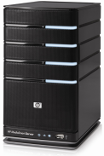



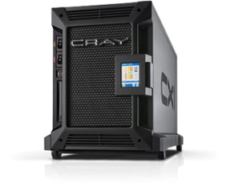

Motivation: Password Storage
jblocki, 123456
Username
jblocki
Salt
89d978034a3f6
Hash
85e23cfe0021f584e3db87aa72630a9a2345c062
SHA1(12345689d978034a3f6)=85e23cfe0021f584e3db87aa72630a9a2345c062
+
Notes:
Suppose that I register for an account at playstation.com

Slide 3








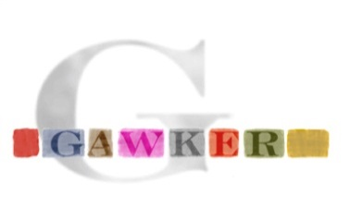


Offline Attacks: A Common Problem
Password breaches at major companies have affected millions of users.
Notes:
Unfortunately, offline dictionary attacks are quite common. Password breaches at major companies have affected millions of users.

Slide 4
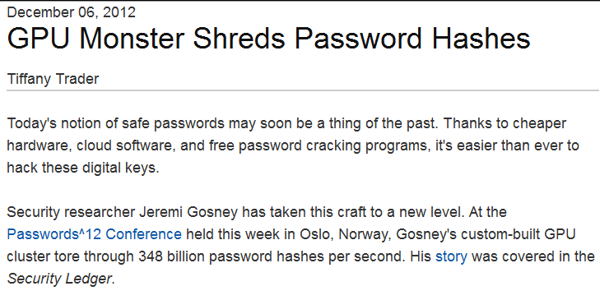
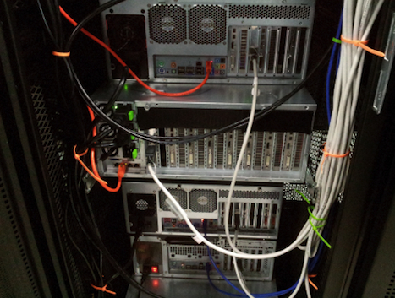
Notes:
Offline dictionary attacks are also very powerful. Some password hash functions can be evaluated at 348 billion hashes per second! How can we defend against these attacks?

Slide 5



Key Stretching
Hash Function | Cost: C
H
H^{k} | …
Memory Hard Functions
Hash Iteration

Slide 6




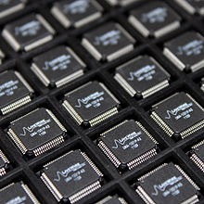
A Fundamental Tradeoff
Increased Costs for Honest Party
Notes:
One proposed defense is to intentionally make the cryptographic hash function more expensive to evaluate by using a cryptographic hash function like BRCRYPT or sCrypt. The tradeoff is that making the hash function more expensive to evaluate increases costs for the adversary and a legitimate server.
Note: This slide could be skipped if the presentation is too long.

Slide 7
A Fundamental Tradeoff
Is the extra effort worth it?
Notes:
One proposed defense is to intentionally make the cryptographic hash function more expensive to evaluate by using a cryptographic hash function like BRCRYPT or sCrypt. The tradeoff is that making the hash function more expensive to evaluate increases costs for the adversary and a legitimate server.
Note: This slide could be skipped if the presentation is too long.

Slide 8
A Fundamental Tradeoff
Can I tip the scales?
Notes:
One proposed defense is to intentionally make the cryptographic hash function more expensive to evaluate by using a cryptographic hash function like BRCRYPT or sCrypt. The tradeoff is that making the hash function more expensive to evaluate increases costs for the adversary and a legitimate server.
Note: This slide could be skipped if the presentation is too long.

Slide 9
Our Contributions
A Stackelberg Game Model
  Analyze Password Cracking
  Quantify: Security Gains from Key-Stretching.
Cost Asymmetric Secure Hash
  An optimal way to tip the scales
Empirical Evaluation
  Yahoo! and RockYou password frequency data
  50+% reduction in cracked-passwords in selected instances

Slide 10

A Key Observation
password
password 12345
letmein abc123
…. ……
unbreakable unbr3akabl3
…. ……
Most guesses are wrong

Slide 11
A Key Observation
unbr3akabl3
unbr3akabl3
unbr3akabl3
unbr3akabl3
….
unbr3akabl3
password
password 12345
letmein abc123
…. ……
unbreakable unbr3akabl3
…. ……
Most guesses are correct

Slide 12
A Key Observation
unbr3akabl3
unbr3akabl3
unbr3akabl3
unbr3akabl3
….
unbr3akabl3
password
password 12345
letmein abc123
…. ……
unbreakable unbr3akabl3
…. ……
Goal Asymmetry: COST > COST

Slide 13
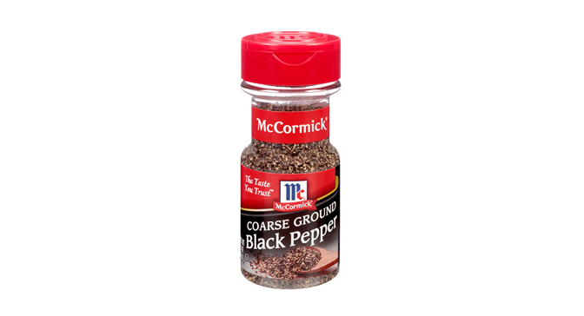
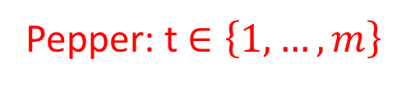
Pepper [Manber96]
Pepper: t $∈\left\{1,…,m\right\}$
jblocki, 123456
Username
jblocki
Salt
89d978034a3f
Hash
85e23cfe0021f584e3db87aa72630a9a2345c062
SHA1(12345689d978034a3f6)=85e23cfe0021f584e3db87aa72630a9a2345c062

Slide 14


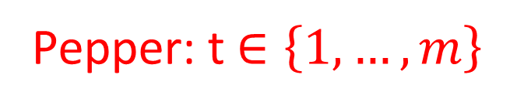
Pepper [Manber96]
jblocki, 123456
Pepper: t $∈\left\{1,…,m\right\}$
Username
jblocki
Salt
89d978034a3f
Hash
85e23cfe0021f584e3db87aa72630a9a2345c062
SHA1(12345689d978034a3f1)
SHA1(12345689d978034a3f2)
SHA1(12345689d978034a3f3)
….
SHA1(12345689d978034a3f6)

Slide 15
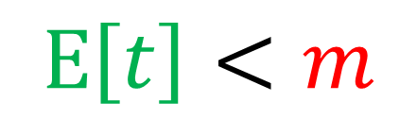
Pepper [Manber96]
jblocki, 1234567
Pepper: t $∈\left\{1,…,m\right\}$
Username
jblocki
Salt
89d978034a3f
Hash
85e23cfe0021f584e3db87aa72630a9a2345c062
$$E\left[t\right]<m$$
SHA1(123456789d978034a3f1)
SHA1(123456789d978034a3f2)
Correct Cost
Incorrect Cost
SHA1(123456789d978034a3f3)
….
SHA1(123456789d978034a3fm)

Slide 16
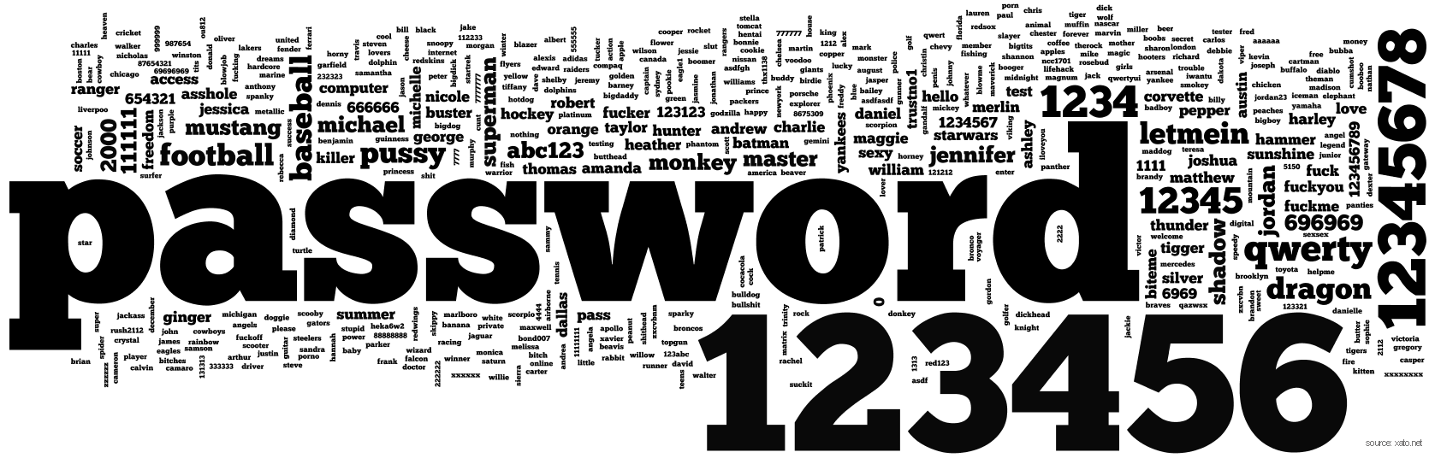


Stackelberg Game Model (Setup)
Known distribution $p_{1}≥p_{2}≥…≥p_{N}$ over N passwords pwd₁,…,pwd_{N}
Successful login rate ($α$)
  Probability that a user enters the correct password
Parameters fixed by nature
  Password Preferences
  Human Memory/Typo Rate

Slide 17

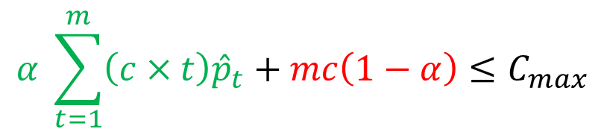
Stackelberg Game Model
Leader (Server)
  Selects pepper distribution $\left(\hat{p}1≥…≥\hat{p}m\right)$
  Selects hash cost parameter c
  Constrained by maximum server workload
    Amortized authentication costs ($Cmax$)
$$α \sum_{t=1}^{m}{{\left(c×t\right)\hat{p}}_{t}}+mc\left(1−α\right)≤C_{max}$$
Cost to reject pwd
Pr[wrong password]

Slide 18
Stackelberg Game Model (Defender)
Leader (Server)
  Selects pepper distribution $\left(\hat{p}1≥…≥\hat{p}m\right)$
  Selects hash cost parameter c
  Constrained by maximum server workload
    Amortized authentication costs ($Cmax$)
$$α \sum_{t=1}^{m}{{\left(c×t\right)\hat{p}}_{t}}+mc\left(1−α\right)≤C_{max}$$
Pr[right password]
Cost if secret
pepper value is t.
Probability pepper value is t.

Slide 19
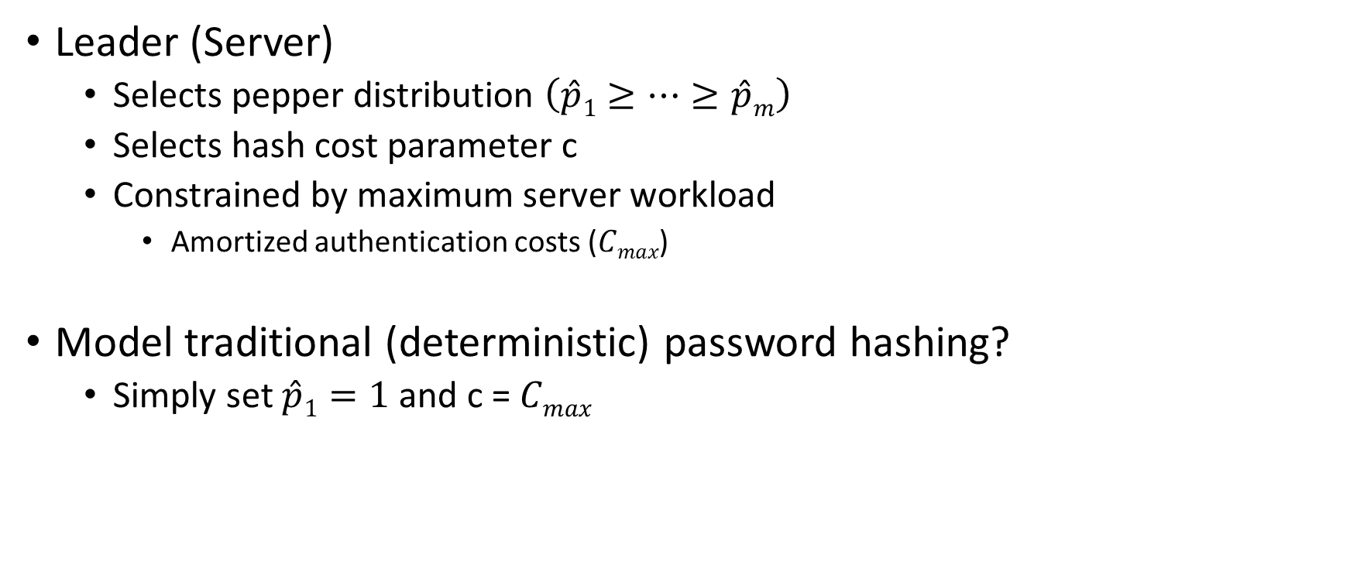
Stackelberg Game Model
Leader (Server)
  Selects pepper distribution $\left(\hat{p}1≥…≥\hat{p}m\right)$
  Selects hash cost parameter c
  Constrained by maximum server workload
    Amortized authentication costs ($Cmax$)
Model traditional (deterministic) password hashing?
  Simply set $\hat{p}1=1$ and c = $Cmax$

Slide 20

Stackelberg Game Model (Adversary)
Follower (Untargeted Adversary)
  Faces new distribution over (password,pepper) pairs
$$\left(π_{1},…,π_{Nm}\right)=SORT\left(\left\{p_{1},p_{2},…,p_{N}\right\}×\left\{\hat{p}1,…,\hat{p}m\right\}\right)$$
$$×$$

Slide 21
Stackelberg Game Model (Adversary)
Follower (Untargeted Adversary)
  Faces new distribution over (password,pepper) pairs
  Action: Selects a budget B
    Guess B most likely (password,pepper) values
$$\left(π_{1},…,π_{Nm}\right)=SORT\left(\left\{p_{1},p_{2},…,p_{N}\right\}×\left\{\hat{p}1,…,\hat{p}m\right\}\right)$$

Slide 22

Stackelberg Game (Adversary Rewards)
Adversary
  Expected Reward - Expected Guessing Cost
$$UA\left(B,c,\hat{p}\right)=v\sum_{i=1}^{B}{π_{i}−}\sum_{i=1}^{B}{{ π}_{i}\left(c×i\right)−}cB\left(1−\sum_{i=1}^{B}{{ π}_{i}}\right)$$
Probability i’th guess is correct
Adversary value for cracked password

Slide 23

Stackelberg Game (Adversary Rewards)
Adversary
  Expected Reward - Expected Guessing Cost
$$UA\left(B,c,\hat{p}\right)=v\sum_{i=1}^{B}{π_{i}−}\sum_{i=1}^{B}{{ π}_{i}\left(c×i\right)−}cB\left(1−\sum_{i=1}^{B}{{ π}_{i}}\right)$$
Cost if i’th
guess is correct
Probability adversary fails
Cost on Fail

Slide 24
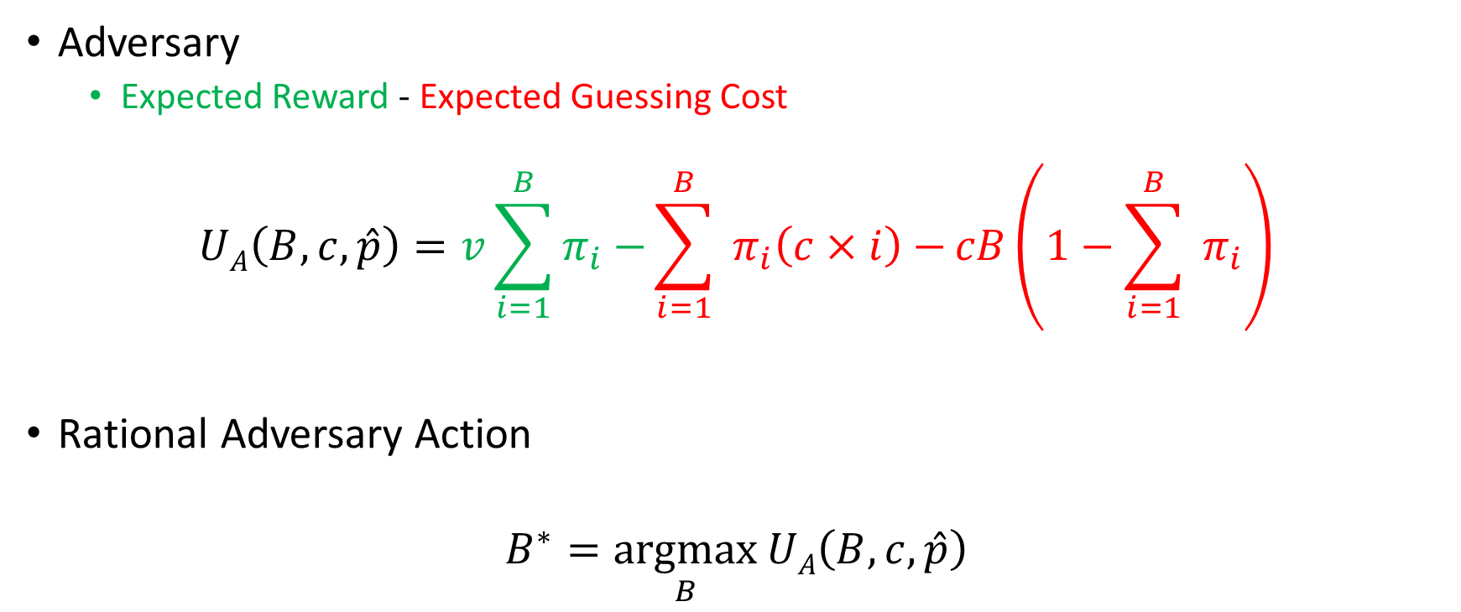
Stackelberg Game (Adversary Rewards)
Adversary
  Expected Reward - Expected Guessing Cost
$$UA\left(B,c,\hat{p}\right)=v\sum_{i=1}^{B}{π_{i}−}\sum_{i=1}^{B}{{ π}_{i}\left(c×i\right)−}cB\left(1−\sum_{i=1}^{B}{{ π}_{i}}\right)$$
Rational Adversary Action
$$B^{∗}=\underset{B}{argmax}{UA\left(B,c,\hat{p}\right)}$$
Fixed by defender in advance

Slide 25
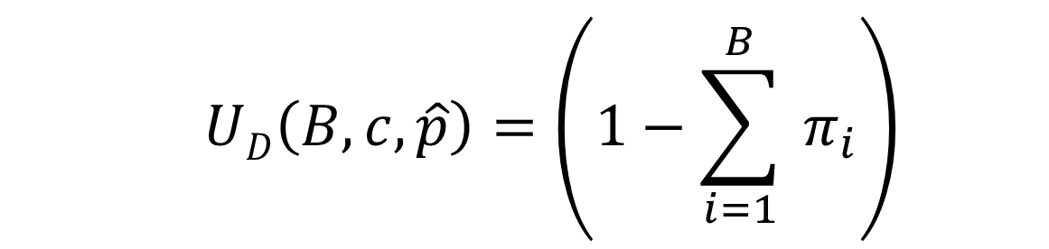
Stackelberg Game (Defender Rewards)
  $$UD\left(B,c,\hat{p}\right)=\left(1−\sum_{i=1}^{B}{{ π}_{i}}\right)$$
Probability adversary fails

Slide 26
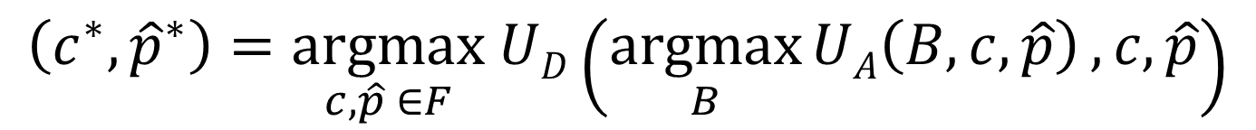
Stackelberg Game (Defender Rewards)
  $$UD\left(B,c,\hat{p}\right)=\left(1−\sum_{i=1}^{B}{{ π}_{i}}\right)$$
Feasible Defender Moves
Assume adversary responds optimally
Rational Defender Action:
$$\left(c^{∗},{\hat{p}}^{∗}\right)=\underset{c,\hat{p} ∈F}{argmax} UD\left(\underset{B}{argmax}{UA\left(B,c,\hat{p}\right)},c,\hat{p}\right)$$

Slide 27
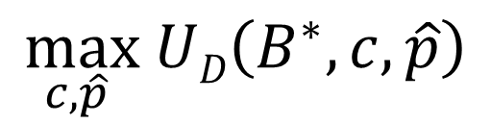
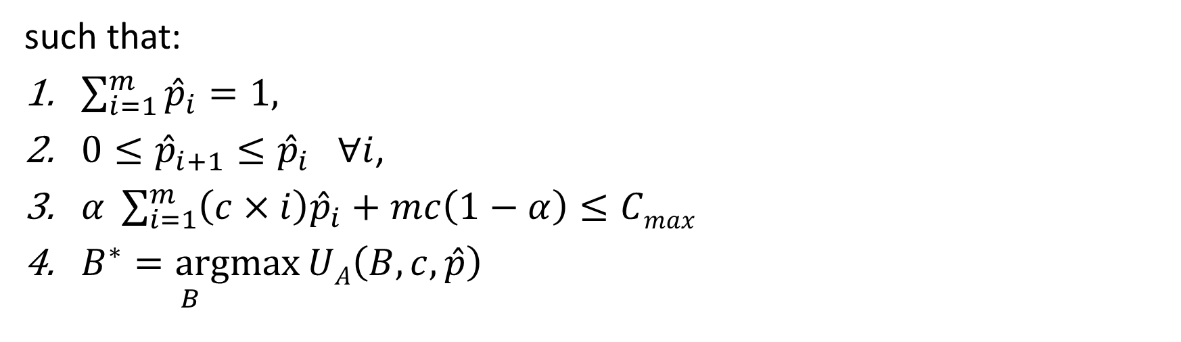
Problem Statement
$$\max_{c,\hat{p} } UD\left(B^{∗},c,\hat{p}\right)$$
such that:
$\sum_{i=1}^{m}{{\hat{p}}_{i}}=1,$
$0≤{\hat{p}}_{i+1}≤{\hat{p}}_{i} ∀i$,
$α \sum_{i=1}^{m}{{\left(c×i\right)\hat{p}}_{i}+mc\left(1−α\right)≤Cmax}$
$\underset{B}{B^{∗}=argmax}{UA\left(B,c,\hat{p}\right)}$
Valid pepper distribution
Amortized Authentication
Costs are Small Enough
Adversary plays rationally

Slide 28
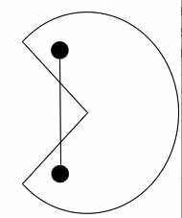

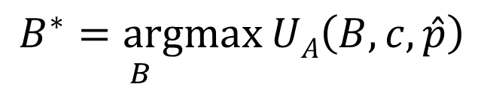
A Challenge
Optimization Problem is inherently non-convex
Culprit
Heuristic Relaxation:
  Assume we know the adversary budget B
  Can drop non-convex constraint, and solve.
$$\underset{B}{B^{∗}=argmax}{UA\left(B,c,\hat{p}\right)}$$

Slide 29
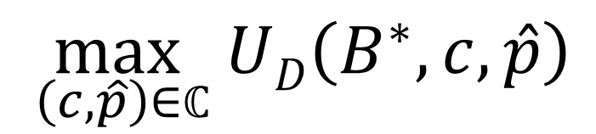


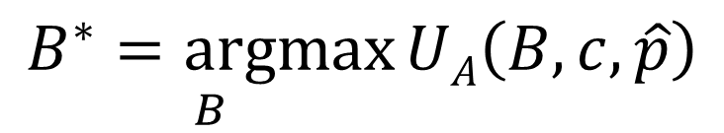
Heuristic Solution
Solve Relaxed Goal for many fixed budgets (B₁,B₂…,)
  Obtain Candidate Solutions:$ℂ=\left\{(c1,\hat{p}1)\text{, }\left(c2,\hat{p}\right),…\right\}$
  Pick the best candidate solution
$$\max_{ \left(c,\hat{p}\right)∈ℂ} UD\left(B^{∗},c,\hat{p}\right)$$
such that:
$$\underset{B}{B^{∗}=argmax}{UA\left(B,c,\hat{p}\right)}$$
Adversary plays rationally
Only need to check $\left|ℂ\right|$ possible solutions

Slide 30

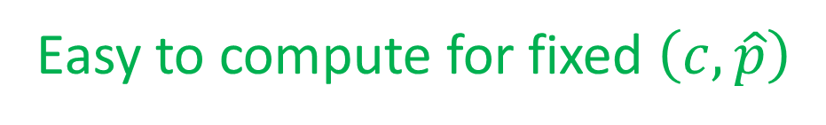
Heuristic Solution
Solve Relaxed Goal for many fixed budgets (B₁,B₂…,)
  Obtain Candidate Solutions:$ℂ=\left\{(c1,\hat{p}1)\text{, }\left(c2,\hat{p}\right),…\right\}$
  Pick the best candidate solution
$$\max_{ \left(c,\hat{p}\right)∈ℂ} UD\left(B^{∗},c,\hat{p}\right)$$
such that:
$$\underset{B}{B^{∗}=argmax}{UA\left(B,c,\hat{p}\right)}$$
Adversary plays rationally
Easy to compute for fixed $\left(c,\hat{p}\right)$

Slide 31

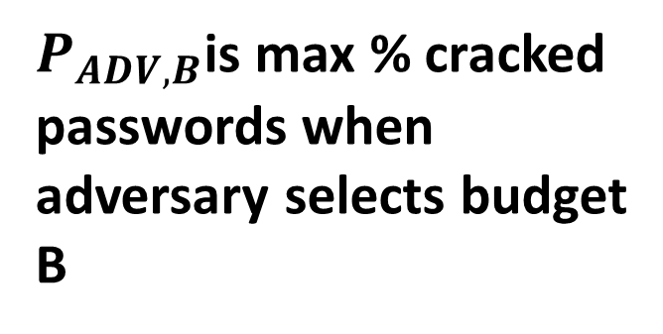

Heuristic Solution
Optimization Problem is inherently non-convex
Culprit
Heuristic Relaxation: $\max_{c,\hat{p} }\left(1−P_{ADV,B}\right)$
$$\underset{B}{B^{∗}=argmax}{UA\left(B,c,\hat{p}\right)}$$
Variable.
$∀S⊂\left\{p_{1},p_{2},…,p_{N}\right\}×\left\{\hat{p}1,…,\hat{p}m\right\}$ s.t. $\left|S\right|≤B$
$P_{ADV,B}$is max % cracked
passwords when
adversary selects budget
B
$$P_{ADV,B}≥\sum_{\left(p,\hat{p}\right)∈S}{p×\hat{p}}$$

Slide 32
Results
Yahoo! Frequency data [B12,BDB16]: https://figshare.com/articles/Yahoo_Password_Frequency_Corpus/2057937

Slide 33
Robustness

Slide 34
Our Contributions
A Stackelberg Game Model
  Analyze Password Cracking
  Quantify: Security Gains from Key-Stretching.
Cost Asymmetric Secure Hash
  An optimal way to tip the scales
Empirical Evaluation
  Yahoo! and RockYou password frequency data
  50+% reduction in cracked-passwords in selected instances

Slide 35

Thanks for Listening

