Slide 1


Differentially Private Integer Partitions and Their Applications
Jeremiah Blocki
MSR/Purdue
TPDP 2016
Notes:
Thanks for sticking around for the last session. Today I am going to tell you about differentiall private password frequency lists. Or…

Slide 2
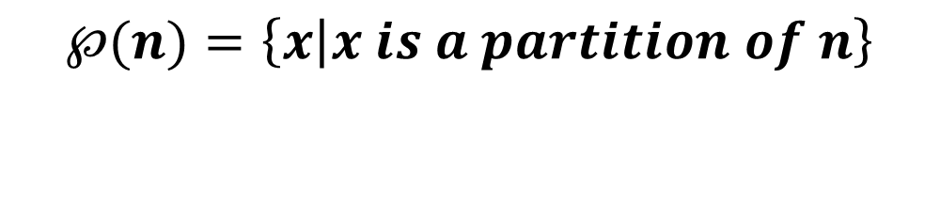

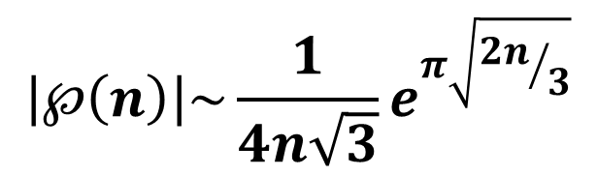
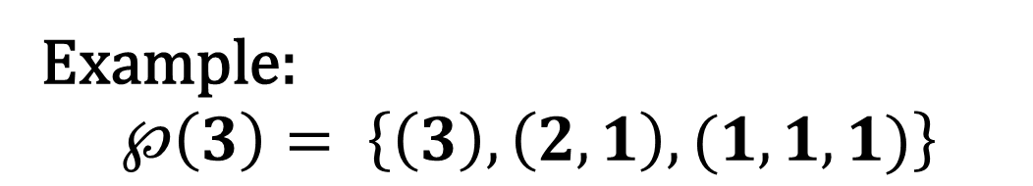
Integer Partition
Definition: A partition of an integer n > 0 is a non-increasing sequence of numbers $x_{1}≥x_{2}$ $≥⋯≥$0 such that:
$$x_{1}+x_{2}+⋯ =n.$$
$$℘(n)=\left\{x | x is a partition of n\right\}$$
Example:
$$℘\left(3\right)= \left\{\left(3\right),\left(2,1\right),(1,1,1)\right\}$$
$$\left|℘\left(n\right)\right|\sim \frac{1}{4n\sqrt{3}}e^{π\sqrt{{2n}/3}}$$
Fact[HR18]

Slide 3
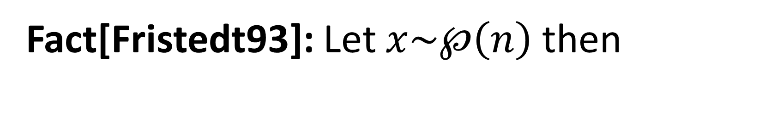

Integer Partition: Basic Facts
Fact[Fristedt93]: Let $x\sim ℘\left(n\right)$ then
$$Pr\left[x1≥\frac{\sqrt{6n}}{π}\left(t+\ln\left(\frac{\sqrt{6n}}{π}\right)\right)\right]≈e^{−t}$$

Slide 4


Differentially Private Password Frequency Lists
Or, How to release statistics from 70 million passwords (on purpose)
Jeremiah Blocki
MSR/Purdue
Anupam Datta
CMU
Joseph Bonneau
Stanford/EFF
Notes:
In other terminology how to release statistics from 70 million passwords…on purpose. This is joint work with Anupam Datta and Joseph Bonneau.

Slide 5




Analysis

Slide 6
Outline
Password Frequency List
Potential Security Concerns
Differential Privacy
A DP Algorithm with Minimal Distortion
Released Yahoo! Frequency List
Notes:
Brief outline of the talk. First I am going to tell you what a password frequency list is and why they are useful. Then we will discuss potential security involved in releasing this data, and how these concerns can be addresses using the notion of differential privacy. Finally, I will briefly describe our novel differentially private algorithm for releasing password frequency lists. The algorithm introdues minimal distortion. Finally, I will tell you how we used the algorithm to release password frequency lists for 70 million Yahoo! Passwords.

Slide 7




What is a Password Frequency List?
12345
password
abc123
abc123
Password Dataset:
(N users)
Histogram
2
Frequency
1
1
abc123
12345
password
Notes:
Suppose we have a dataset with N users. Alice picked 12345, Bob the builder selected password etc…Removing usernames we can represent this dataset as a histogram… I stress that this is not a password frequency list.

Slide 8
What is a Password Frequency List?
12345
password
abc123
abc123
Password Dataset:
(N users)
Histogram
Frequency List
2
2
Frequency
1
1
Frequency
1
1
abc123
12345
password
Most
Frequent
2nd Most
Frequent
3rd Most
Frequent
Notes:
To obtain the password frequqncy list we also replace the specific passwords that users selected with generiv plabes (most popular, second most popular etc…)

Slide 9
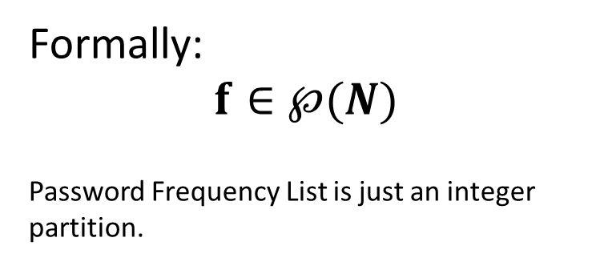
What is a Password Frequency List?
12345
password
abc123
abc123
Password Dataset:
(N users)
Histogram
Frequency List
Formally:
$$f∈℘(N)$$
Password Frequency List is just an integer partition.
2
2
Frequency
1
1
Frequency
1
1
abc123
12345
password
Most
Frequent
2nd Most
Frequent
3rd Most
Frequent
Notes:
More formally the password frequency list is a non-decreasing list of numbers f1, f2 etc… such that fi is the number of users who picked the ith most popular password.

Slide 10

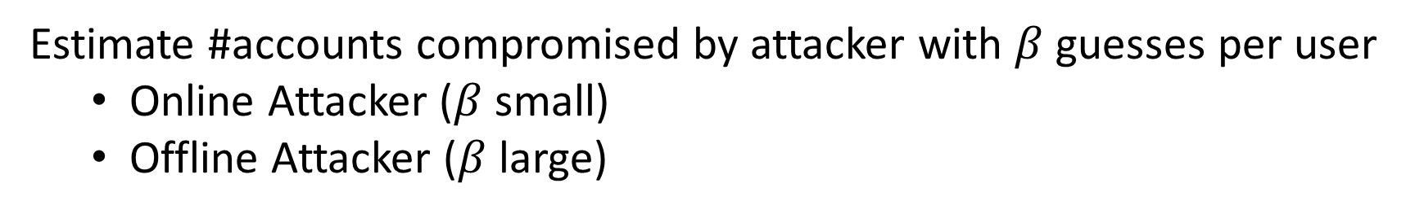
Password Frequency List (Example Use)
Estimate #accounts compromised by attacker with $β$guesses per user
  Online Attacker ($β$ small)
  Offline Attacker ($β$ large)
$$λβ=\sum_{i=1}^{β}{f_{i}}$$
Notes:
Why are password frequency lists useful? One immediate application is that it allows us to immediately estimate how many accounts could be broken by an adversary with a fixed budget beta per use.

Slide 11

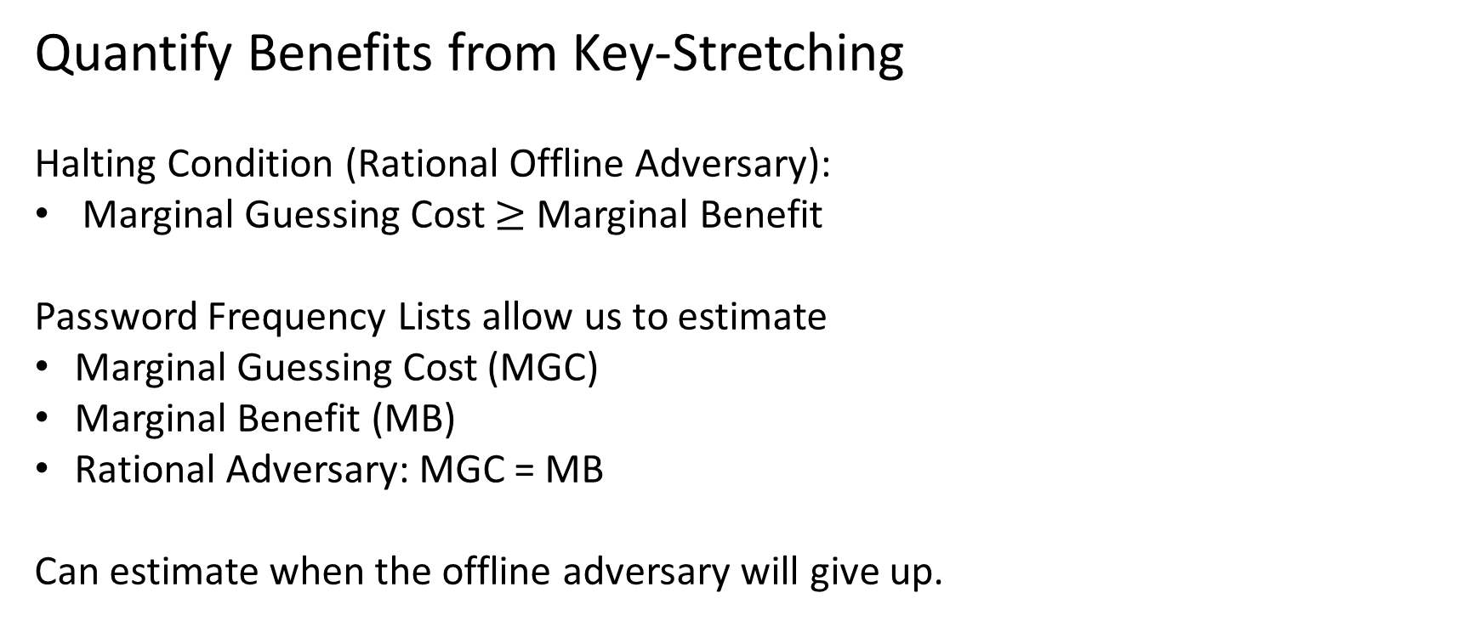
Password Frequency List (Application 2)
Quantify Benefits from Key-Stretching
Halting Condition (Rational Offline Adversary):
Marginal Guessing Cost $≥$ Marginal Benefit
Password Frequency Lists allow us to estimate
Marginal Guessing Cost (MGC)
Marginal Benefit (MB)
Rational Adversary: MGC = MB
Can estimate when the offline adversary will give up.
Notes:
A more advanced application: password freuqncy lists can help us understand the incentives of a password attacker. In particular, we can use a password frequency list to estimate the marginal cost and marginal benefit of one more password guess for the attacker. This allows us to predict when the adversary will give up, and how many accounts the adversary will break. This can help the organization to make more informed decisions about any defense that he might deploy.

Slide 12
Available Password Frequency Lists
Site | #User Accounts (N) | How Released
RockYou | 32.6 Million | Data Breach*
LinkedIn | 6 | Data Breach*
…. | … | …
Yahoo! [B12] | 70 Million | With Permission**
* entire frequency list available due to improper password storage
** frequency list perturbed slightly to preserve differential privacy.
Yahoo! Frequency data is now available online at:
https://figshare.com/articles/Yahoo_Password_Frequency_Corpus/2057937
Notes:
Ok, hopefully I have convinced you that password frequency lists are useful. Where can we obtain them? The unfortunate reality is that in the past we have had to wait for data from security breaches at hapless organizations like RockYou

Slide 13


Project Origin
Would it be possible to access the Yahoo! data? I am working on a cool new research project and the password frequency data would be very useful.

Slide 14

Project Origin
I would love to make the data public, but Yahoo! Legal has concerns about security and privacy. They won’t let me release it.

Slide 15
Project Origin
I would love to make the data public, but Yahoo! Legal has concerns about security and privacy. They won’t let me release it.

Slide 16
Available Password Frequency Lists
Site | #User Accounts (N) | How Released
RockYou | 32.6 Million | Data Breach*
LinkedIn | 6 | Data Breach*
…. | … | …
Yahoo! [B12] | 70 Million | With Permission**
* entire frequency list available due to improper password storage
** frequency list perturbed slightly to preserve differential privacy.
Yahoo! Frequency data is now available online at:
https://figshare.com/articles/Yahoo_Password_Frequency_Corpus/2057937
Notes:
I am excited to announce that we have released password frequency lists from 70 million Yahoo! Users. This frequency data was originally collect by Bonneau with Yahoo!s permission using tools from cryptography to protect users during the data collection phase.

Slide 17



Why not just publish the original frequency lists?
Heuristic Approaches to Data Privacy often break down when the adversary has background knowledge
  Massachusetts Group Insurance Medical Encounter Database [SS98]
    Background Knowledge: Voter Registration Record

Slide 18



Why not just publish the original frequency lists?
Heuristic Approaches to Data Privacy often break down when the adversary has background knowledge
  Massachusetts Group Insurance Medical Encounter Database [SS98]
    Background Knowledge: Voter Registration Record
  Netflix Prize Dataset[NS08]
    Background Knowledge: IMDB

Slide 19
Why not just publish the original frequency lists?
Heuristic Approaches to Data Privacy often break down when the adversary has background knowledge
  Netflix Prize Dataset[NS08]
    Background Knowledge: IMDB
  Massachusetts Group Insurance Medical Encounter Database [SS98]
    Background Knowledge: Voter Registration Record
  Many other attacks [BDK07,…]
In the absence of provable privacy guarantees Yahoo! was understandably reluctant to release these password frequency lists.

Slide 20

Security Risks (Example)
???
12345
abc123
abc123
Adversary Background Knowledge

Slide 21
Security Risks (Example)
???
12345
abc123
abc123
3
abc123
12345
other
2
2
2
2
1
1
1

Slide 22


Differential Privacy (Dwork et al)
Definition: An (randomized) algorithm A preserves $\left(ε,δ\right)$-differential privacy if for any subset S$⊆Range(A)$ of possible outcomes and any we have
Pr$\left[A(f)∈S\right]≤e^{ε}Pr\left[A(f′)∈S\right]+δ$
for any pair of adjacent password frequency lists f and f’,
${\left\|f−f′\right\|}_{1}=1$.
$${\left\|f−f′\right\|}_{1}≝\sum_{i}{\left|f_{i}−f_{i}′\right|}$$

Slide 23

Differential Privacy (Dwork et al)
Definition: An (randomized) algorithm A preserves $\left(ε,δ\right)$-differential privacy if for any subset S$⊆Range(A)$ of possible outcomes and any we have
Pr$\left[A(f)∈S\right]≤e^{ε}Pr\left[A(f′)∈S\right]+δ$
for any pair of adjacent password frequency lists f and f’,
${\left\|f−f′\right\|}_{1}=1$.
f – original password frequency list
f’ – remove Alice’s password from dataset

Slide 24
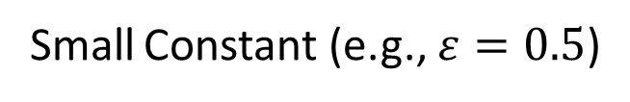
Differential Privacy (Dwork et al)
Definition: An (randomized) algorithm A preserves $\left(ε,δ\right)$-differential privacy if for any subset S$⊆Range(A)$ of possible outcomes and any we have
Pr$\left[A(f)∈S\right]≤e^{ε}Pr\left[A(f′)∈S\right]+δ$
for any pair of adjacent password frequency lists f and f’,
${\left\|f−f′\right\|}_{1}=1$.
Small Constant (e.g., $ε=0.5$)
f – original password frequency list
f’ – remove Alice’s password from dataset

Slide 25
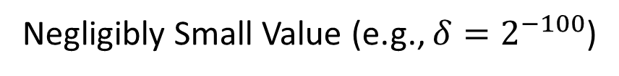
Differential Privacy (Dwork et al)
Definition: An (randomized) algorithm A preserves $\left(ε,δ\right)$-differential privacy if for any subset S$⊆Range(A)$ of possible outcomes and any we have
Pr$\left[A(f)∈S\right]≤e^{ε}Pr\left[A(f′)∈S\right]+δ$
for any pair of adjacent password frequency lists f and f’,
${\left\|f−f′\right\|}_{1}=1$.
Small Constant (e.g., $ε=0.5$)
Negligibly Small Value (e.g., ${δ=2}^{−100}$)
f – original password frequency list
f’ – remove Alice’s password from dataset

Slide 26

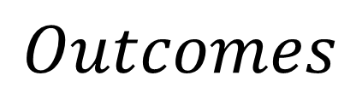
Differential Privacy (Example)
2
2
2
2
2
=
Subset S of all potentially
harmful outcomes to Alice
minus
1
f
f’
$$Outcomes$$
Notes:
Popup:Differential Privacy wrt Vertex Adjacency is a stronger privacy guarantee

Slide 27

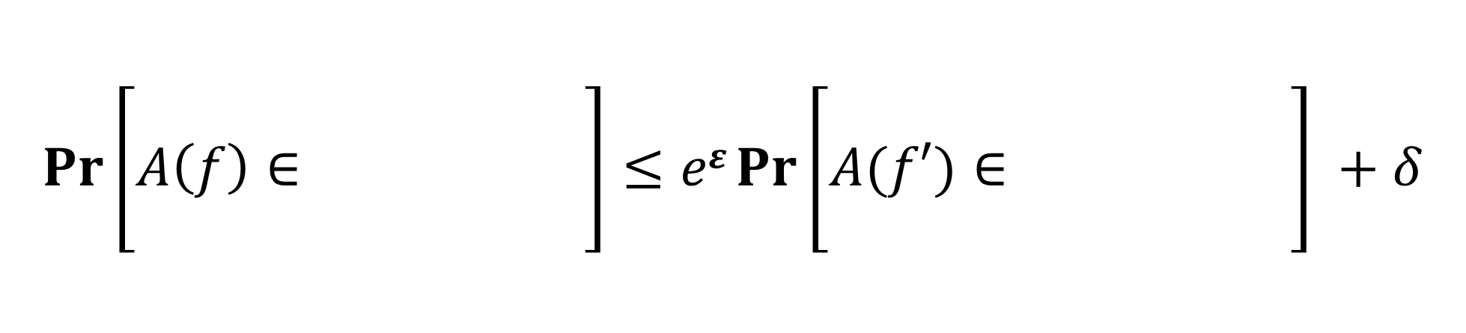
Differential Privacy (Example)
2
2
2
2
2
=
Subset S of all potentially
harmful outcomes to Alice
minus
1
f
f’
$$Pr\left[A\left(f\right)∈\begin{matrix} & & \\ & & \\ & & \end{matrix}\right]≤eε Pr⁡\left[A(f′)∈\begin{matrix} & & \\ & & \\ & & \end{matrix}\right] +δ$$
Notes:
Popup:Differential Privacy wrt Vertex Adjacency is a stronger privacy guarantee

Slide 28

Differential Privacy (Example)
Intuition: Alice won’t be harmed because her password
was included in the dataset.
$$Pr\left[A\left(f\right)∈\begin{matrix} & & \\ & & \\ & & \end{matrix}\right]≤eε Pr⁡\left[A(f′)∈\begin{matrix} & & \\ & & \\ & & \end{matrix}\right] +δ$$
Notes:
Popup:Differential Privacy wrt Vertex Adjacency is a stronger privacy guarantee

Slide 29


Main Technical Result
Theorem: There is a computationally efficient algorithm
$A:℘×℘→℘$ such that A preserves $\left(ε,δ\right)$-differential privacy and, except with probability $δ$, A(f) outputs $\tilde{f}$ s.t.
$$\frac{{\left\|f−\tilde{f}\right\|}_{1}}{N}≤O\left(\frac{1}{ε\sqrt{N}}+\frac{\ln\left(1/δ\right)}{εN}\right).$$
$$Time\left(A\right)=O\left(\frac{n\sqrt{n}+n\ln\left(1/δ\right)}{ε}\right)=Space(A)$$
$$℘=\bigcup_{n=1}^{∞}{℘\left(n\right)}$$

Slide 30

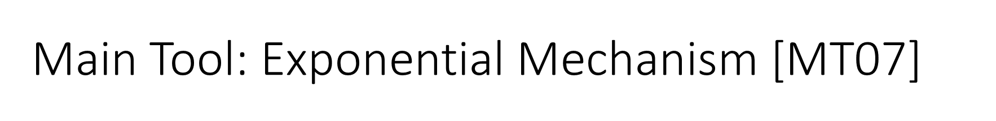
Main Tool: Exponential Mechanism [MT07]
Input: f
Output: $Pr\left[ℇ^{ε}\left(f\right)=\tilde{f}\right]∝e^{−\frac{{\left\|f−\tilde{f}\right\|}_{1}}{2ε}}$
Assigns very small probability to
inaccurate outcomes.

Slide 31
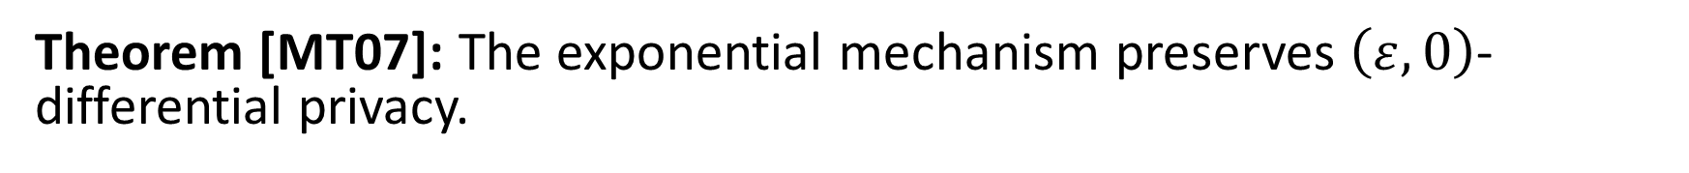
Main Tool: Exponential Mechanism [MT07]
Input: f
Output: $Pr\left[ℇ^{ε}\left(f\right)=\tilde{f}\right]∝e^{−\frac{{\left\|f−\tilde{f}\right\|}_{1}}{2ε}}$
Theorem [MT07]: The exponential mechanism preserves $\left(ε,0\right)$-differential privacy.

Slide 32
Analysis: Exponential Mechanism
Input: f
Output: $Pr\left[ℇ^{ε}\left(f\right)=\tilde{f}\right]∝e^{−\frac{{\left\|f−\tilde{f}\right\|}_{1}}{2ε}}$
Assigns very small probability to
inaccurate outcomes.
Theorem [HR18]: There are $e^{O\left(\sqrt{N}\right)}$ partitions of the integer N.

Slide 33
Analysis: Exponential Mechanism
Input: f
Output: $Pr\left[ℇ^{ε}\left(f\right)=\tilde{f}\right]∝e^{−\frac{{\left\|f−\tilde{f}\right\|}_{1}}{2ε}}$
Assigns very small probability to
inaccurate outcomes.
Theorem [HR18]: There are $e^{O\left(\sqrt{N}\right)}$ partitions of the integer N.
Union Bound → ${\left\|f−\tilde{f}\right\|}_{1}≤O\left(\frac{\sqrt{N}}{ε}\right)$ with high probability.

Slide 34
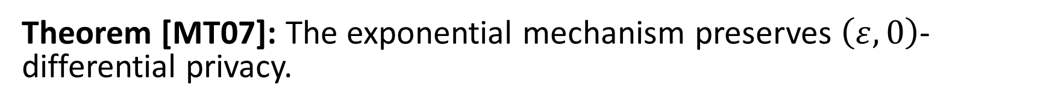
Analysis: Exponential Mechanism
Input: f
Output: $Pr\left[ℇ^{ε}\left(f\right)=\tilde{f}\right]∝e^{−\frac{{\left\|f−\tilde{f}\right\|}_{1}}{2ε}}$
Assigns very small probability to
inaccurate outcomes.
Theorem: $\frac{{\left\|f−\tilde{f}\right\|}_{1}}{N}≤O\left(\frac{1}{ε\sqrt{N}}\right)$ with high probability.
Theorem [MT07]: The exponential mechanism preserves $\left(ε,0\right)$-differential privacy.

Slide 35
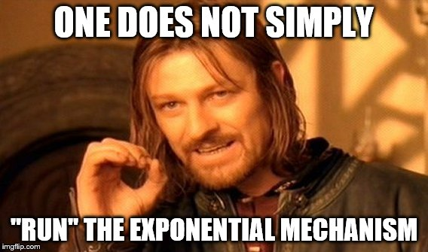
(e.g., [U13])

Slide 36
The Challenge --- Efficiency
Naïve Implementation: Exponential time (distribution assigns weights to infinitely many integer partitions)
Strong Evidence: Sampling from the exponential mechanism is computationally intractable in general (e.g., [U13]).

Slide 37
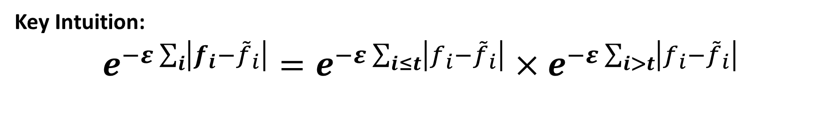

But, we did run the exponential mechanism
Theorem: There is an efficient algorithm A to sample from a distribution that is $δ$–close to the exponential mechanism $ℇ$ over integer partitions. The algorithm uses time and space
$$O\left(\frac{N\sqrt{N}+N ln\left(\frac{1}{δ}\right)}{ε}\right)$$
Key Intuition:
$$e^{−ε\sum_{i}{\left|f_{i}−{\tilde{f}}_{i}\right|}}=e^{−ε\sum_{i≤t}{\left|f_{i}−{\tilde{f}}_{i}\right|}}×e^{−ε\sum_{i>t}{\left|f_{i}−{\tilde{f}}_{i}\right|}}$$
Suggests Potential Recurrence Relationships

Slide 38
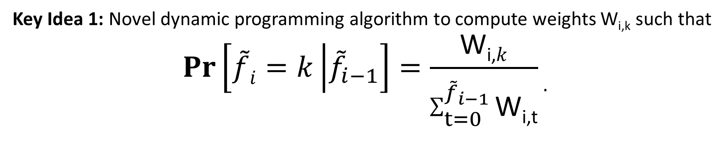
But, we did run the exponential mechanism
Theorem: There is an efficient algorithm A to sample from a distribution that is $δ$–close to the exponential mechanism $ℇ$ over integer partitions. The algorithm uses time and space
$$O\left(\frac{N\sqrt{N}+N ln\left(\frac{1}{δ}\right)}{ε}\right)$$
Key Idea 1: Novel dynamic programming algorithm to compute weights W_{i,k} such that
$$Pr\left[\tilde{f}i=k\left|{\tilde{f}}_{i−1}\right.\right]=\frac{\text{W}\text{i}\text{,}k}{\sum_{t=0}^{{\tilde{f}}_{i−1}}{\text{W}\text{i}\text{,}\text{t}}}.$$

Slide 39
But, we did run the exponential mechanism
Theorem: There is an efficient algorithm A to sample from a distribution that is $δ$–close to the exponential mechanism $ℇ$ over integer partitions. The algorithm uses time and space
$$O\left(\frac{N\sqrt{N}+N ln\left(\frac{1}{δ}\right)}{ε}\right)$$
Key Idea 1: Novel dynamic programming algorithm to compute weights W_{i,t}
Key Idea 2: Allow A to ignore a partition $\tilde{f}$ if ${\left\|f−\tilde{f}\right\|}_{1}$ very large.

Slide 40
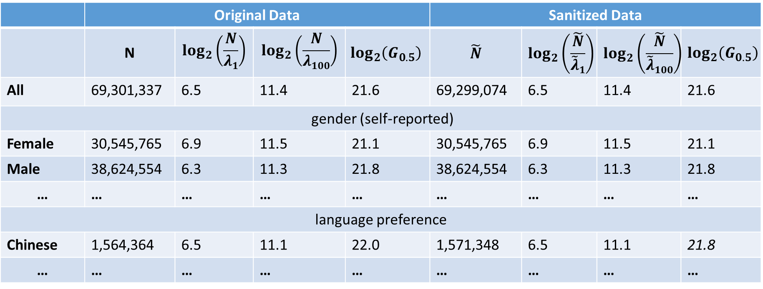
Yahoo! Results
 | Original Data |  |  |  | Sanitized Data
 | N | $$\log_{2}\left(\frac{N}{λ1}\right)$$ | $$\log_{2}\left(\frac{N}{λ100}\right)$$ | $$\log_{2}\left(G_{0.5}\right)$$ | $$\tilde{N}$$ | $$\log_{2}\left(\frac{\tilde{N}}{\tilde{λ}1}\right)$$ | $$\log_{2}\left(\frac{\tilde{N}}{\tilde{λ}100}\right)$$ | $$\log_{2}\left(G_{0.5}\right)$$
All | 69,301,337 | 6.5 | 11.4 | 21.6 | 69,299,074 | 6.5 | 11.4 | 21.6
gender (self-reported)
Female | 30,545,765 | 6.9 | 11.5 | 21.1 | 30,545,765 | 6.9 | 11.5 | 21.1
Male | 38,624,554 | 6.3 | 11.3 | 21.8 | 38,624,554 | 6.3 | 11.3 | 21.8
… | … | … | … | … | … | … | … | …
language preference
Chinese | 1,564,364 | 6.5 | 11.1 | 22.0 | 1,571,348 | 6.5 | 11.1 | 21.8
… | … | … | … | … | … | … | … | …
Yahoo! Frequency data is now available online at:
https://figshare.com/articles/Yahoo_Password_Frequency_Corpus/2057937

Slide 41
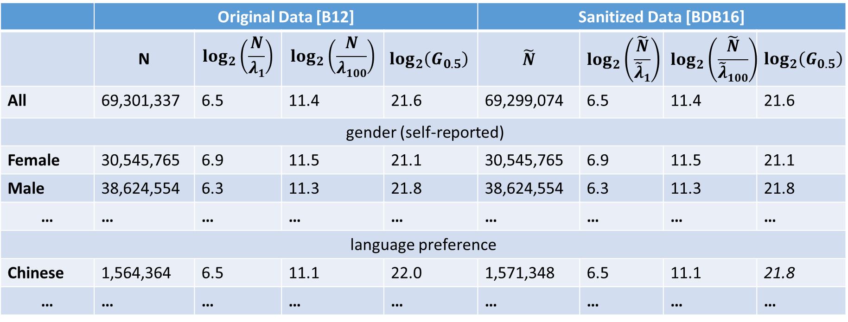
Yahoo! Results
 | Original Data [B12] |  |  |  | Sanitized Data [BDB16]
 | N | $$\log_{2}\left(\frac{N}{λ1}\right)$$ | $$\log_{2}\left(\frac{N}{λ100}\right)$$ | $$\log_{2}\left(G_{0.5}\right)$$ | $$\tilde{N}$$ | $$\log_{2}\left(\frac{\tilde{N}}{\tilde{λ}1}\right)$$ | $$\log_{2}\left(\frac{\tilde{N}}{\tilde{λ}100}\right)$$ | $$\log_{2}\left(G_{0.5}\right)$$
All | 69,301,337 | 6.5 | 11.4 | 21.6 | 69,299,074 | 6.5 | 11.4 | 21.6
gender (self-reported)
Female | 30,545,765 | 6.9 | 11.5 | 21.1 | 30,545,765 | 6.9 | 11.5 | 21.1
Male | 38,624,554 | 6.3 | 11.3 | 21.8 | 38,624,554 | 6.3 | 11.3 | 21.8
… | … | … | … | … | … | … | … | …
language preference
Chinese | 1,564,364 | 6.5 | 11.1 | 22.0 | 1,571,348 | 6.5 | 11.1 | 21.8
… | … | … | … | … | … | … | … | …
Yahoo! Frequency data is now available online at:
https://figshare.com/articles/Yahoo_Password_Frequency_Corpus/2057937

Slide 42

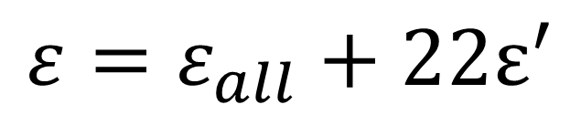
Yahoo! Results (Selecting Epsilon)
 | Original Data [B12] |  |  |  | Sanitized Data [BDB16]
 | N | $$\log_{2}\left(\frac{N}{λ1}\right)$$ | $$\log_{2}\left(\frac{N}{λ100}\right)$$ | $$\log_{2}\left(G_{0.5}\right)$$ | $$\tilde{N}$$ | $$\log_{2}\left(\frac{\tilde{N}}{\tilde{λ}1}\right)$$ | $$\log_{2}\left(\frac{\tilde{N}}{\tilde{λ}100}\right)$$ | $$\log_{2}\left(G_{0.5}\right)$$
All | 69,301,337 | 6.5 | 11.4 | 21.6 | 69,299,074 | 6.5 | 11.4 | 21.6
gender (self-reported)
Female | 30,545,765 | 6.9 | 11.5 | 21.1 | 30,545,765 | 6.9 | 11.5 | 21.1
Male | 38,624,554 | 6.3 | 11.3 | 21.8 | 38,624,554 | 6.3 | 11.3 | 21.8
… | … | … | … | … | … | … | … | …
language preference
Chinese | 1,564,364 | 6.5 | 11.1 | 22.0 | 1,571,348 | 6.5 | 11.1 | 21.8
… | … | … | … | … | … | … | … | …
Any individual participates in at most 23 groups (including All)
$$ε=ε_{all}+22ε^{′}$$

Slide 43

Yahoo! Results (Selecting Epsilon)
 | Original Data [B12] |  |  |  | Sanitized Data [BDB16]
 | N | $$\log_{2}\left(\frac{N}{λ1}\right)$$ | $$\log_{2}\left(\frac{N}{λ100}\right)$$ | $$\log_{2}\left(G_{0.5}\right)$$ | $$\tilde{N}$$ | $$\log_{2}\left(\frac{\tilde{N}}{\tilde{λ}1}\right)$$ | $$\log_{2}\left(\frac{\tilde{N}}{\tilde{λ}100}\right)$$ | $$\log_{2}\left(G_{0.5}\right)$$
All | 69,301,337 | 6.5 | 11.4 | 21.6 | 69,299,074 | 6.5 | 11.4 | 21.6
gender (self-reported)
Female | 30,545,765 | 6.9 | 11.5 | 21.1 | 30,545,765 | 6.9 | 11.5 | 21.1
Male | 38,624,554 | 6.3 | 11.3 | 21.8 | 38,624,554 | 6.3 | 11.3 | 21.8
… | … | … | … | … | … | … | … | …
language preference
Chinese | 1,564,364 | 6.5 | 11.1 | 22.0 | 1,571,348 | 6.5 | 11.1 | 21.8
… | … | … | … | … | … | … | … | …
$$ε_{all}=0.25$$
$$ε^{′}=\frac{ε_{all}}{22}$$
$$ε=ε_{all}+22ε^{′}$$

Slide 44
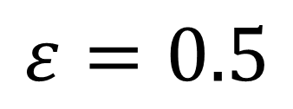
Yahoo! Results (Selecting Epsilon)
 | Original Data [B12] |  |  |  | Sanitized Data [BDB16]
 | N | $$\log_{2}\left(\frac{N}{λ1}\right)$$ | $$\log_{2}\left(\frac{N}{λ100}\right)$$ | $$\log_{2}\left(G_{0.5}\right)$$ | $$\tilde{N}$$ | $$\log_{2}\left(\frac{\tilde{N}}{\tilde{λ}1}\right)$$ | $$\log_{2}\left(\frac{\tilde{N}}{\tilde{λ}100}\right)$$ | $$\log_{2}\left(G_{0.5}\right)$$
All | 69,301,337 | 6.5 | 11.4 | 21.6 | 69,299,074 | 6.5 | 11.4 | 21.6
gender (self-reported)
Female | 30,545,765 | 6.9 | 11.5 | 21.1 | 30,545,765 | 6.9 | 11.5 | 21.1
Male | 38,624,554 | 6.3 | 11.3 | 21.8 | 38,624,554 | 6.3 | 11.3 | 21.8
… | … | … | … | … | … | … | … | …
language preference
Chinese | 1,564,364 | 6.5 | 11.1 | 22.0 | 1,571,348 | 6.5 | 11.1 | 21.8
… | … | … | … | … | … | … | … | …
$$ε=0.5$$

Slide 45
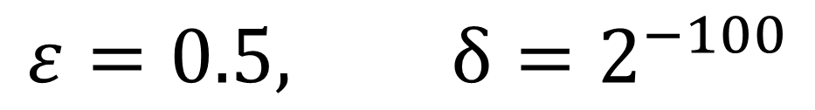
Yahoo! Results (Selecting Epsilon)
 | Original Data [B12] |  |  |  | Sanitized Data [BDB16]
 | N | $$\log_{2}\left(\frac{N}{λ1}\right)$$ | $$\log_{2}\left(\frac{N}{λ100}\right)$$ | $$\log_{2}\left(G_{0.5}\right)$$ | $$\tilde{N}$$ | $$\log_{2}\left(\frac{\tilde{N}}{\tilde{λ}1}\right)$$ | $$\log_{2}\left(\frac{\tilde{N}}{\tilde{λ}100}\right)$$ | $$\log_{2}\left(G_{0.5}\right)$$
All | 69,301,337 | 6.5 | 11.4 | 21.6 | 69,299,074 | 6.5 | 11.4 | 21.6
gender (self-reported)
Female | 30,545,765 | 6.9 | 11.5 | 21.1 | 30,545,765 | 6.9 | 11.5 | 21.1
Male | 38,624,554 | 6.3 | 11.3 | 21.8 | 38,624,554 | 6.3 | 11.3 | 21.8
… | … | … | … | … | … | … | … | …
language preference
Chinese | 1,564,364 | 6.5 | 11.1 | 22.0 | 1,571,348 | 6.5 | 11.1 | 21.8
… | … | … | … | … | … | … | … | …
$$ε=0.5, δ=2^{−100}$$

Slide 46

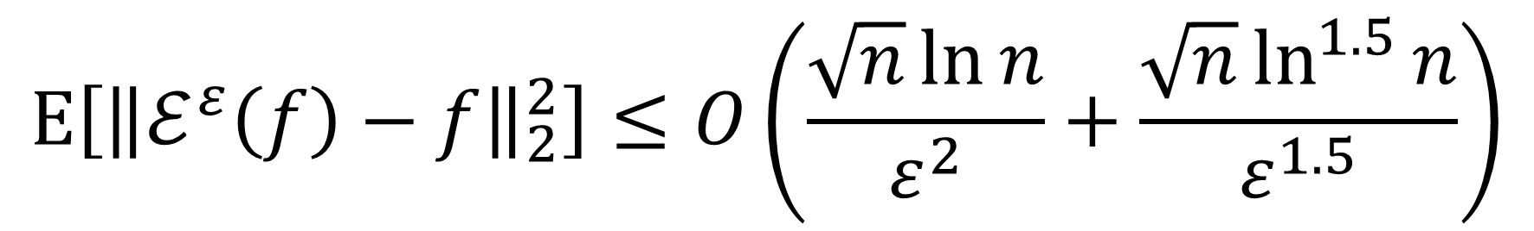

New Result #1 (Mean Squared Error)
Exponential Mechanism achieves good MSE:
$$E\left[{\left\|ℰ^{ε}\left(f\right)−f\right\|}_{2}^{2}\right]≤O\left(\frac{\sqrt{n}\ln{n}}{ε^{2}}+\frac{\sqrt{n}\ln^{1.5}{n}}{ε^{1.5}}\right)$$
Improves on [HMJ09] by $\left(\ln{n}\right)2$ factor if $\frac{1}{ε}≥\ln{n}$.
Improves on [HMJ09] by $\frac{{\left(\ln{n}\right)}^{1.5}}{\sqrt{ε}}$ factor.

Slide 47
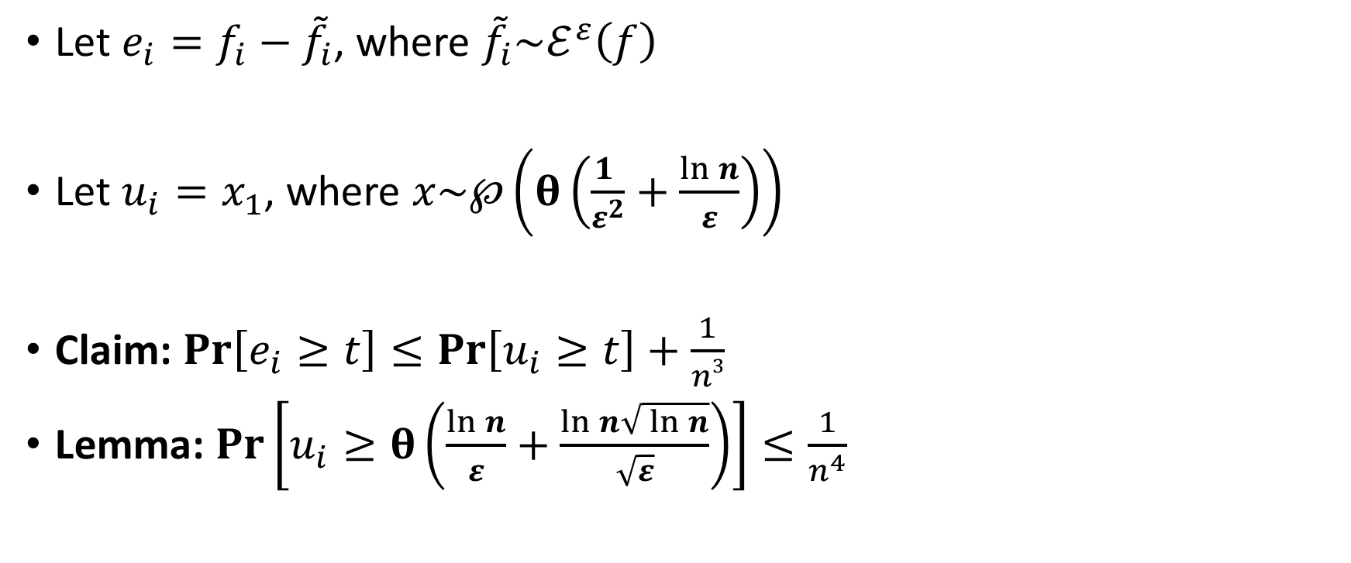
Proof Sketch
Let $e_{i}=f_{i}−{\tilde{f}}_{i}$, where ${\tilde{f}}_{i}\sim ℰ^{ε}\left(f\right)$
Let $u_{i}=x_{1}$, where $x\sim ℘\left(θ\left(\frac{1 }{ε^{2}}+\frac{\ln{n}}{ε}\right)\right)$
Claim: $Pr\left[e_{i}≥t\right]≤Pr\left[u_{i}≥t\right]+\frac{1}{n3}$
Lemma: $Pr\left[u_{i}≥θ\left(\frac{\ln{n}}{ε}+\frac{\ln{n}\sqrt{ \ln{n}}}{\sqrt{ε}}\right)\right]≤\frac{1}{n^{4}}$

Slide 48

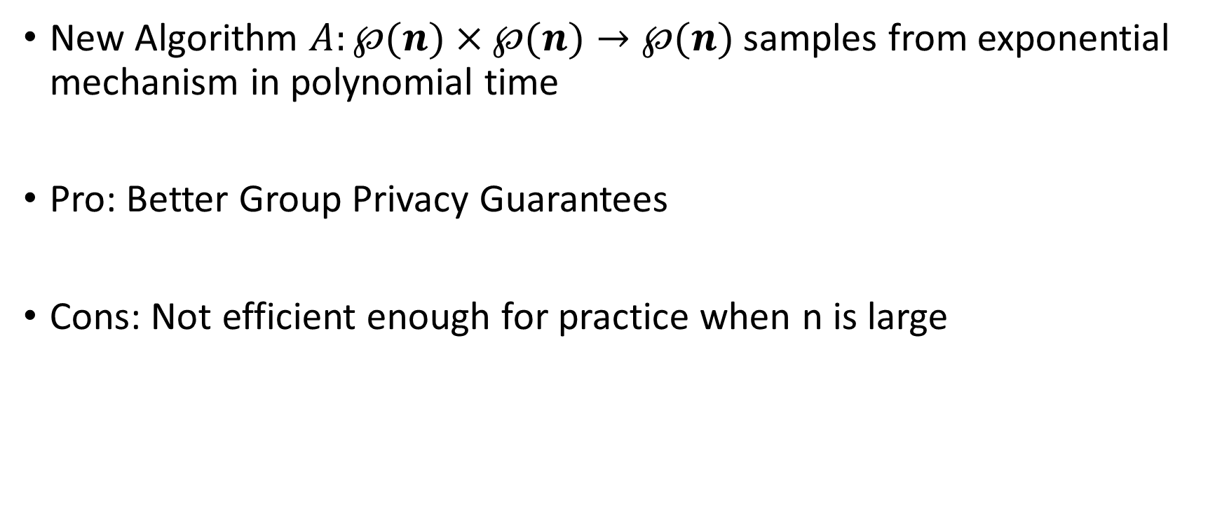
New Result #2 (pure-differential privacy)
New Algorithm $A:℘(n)×℘(n)→℘(n)$ samples from exponential mechanism in polynomial time
Pro: Better Group Privacy Guarantees
Cons: Not efficient enough for practice when n is large
$$Time\left(A\right)=O\left(n^{4}\right)=Space(A)$$

Slide 49


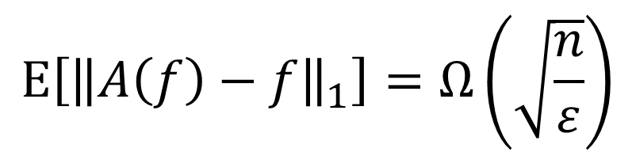






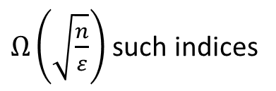



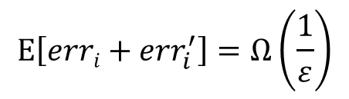
New Result #3 (Lower Bound L1 Error)
Theorem: For any differentially private $A:℘×℘→℘$ there exists a partition $f∈℘$s.t
$$E\left[{\left\|A\left(f\right)−f\right\|}_{1}\right]=Ω\left(\sqrt{\frac{n}{ε}}\right)$$
$$E\left[erri+{err}_{i}^{′}\right]=Ω\left(\frac{1}{ε}\right)$$
$$\frac{10}{ε}$$
…
$$\frac{6}{ε}$$
$$\frac{10}{ε}$$
…
…
$$\frac{4}{ε}$$
$Ω\left(\sqrt{\frac{n}{ε}}\right)$ such indices
…
…
…
…
…
$$f_{i−1}$$
$$f_{i}$$
$$f_{i+1}$$
$$f_{i−1}^{′}$$
$$f_{i}^{′}$$
$$f_{i+1}^{′}$$

Slide 50




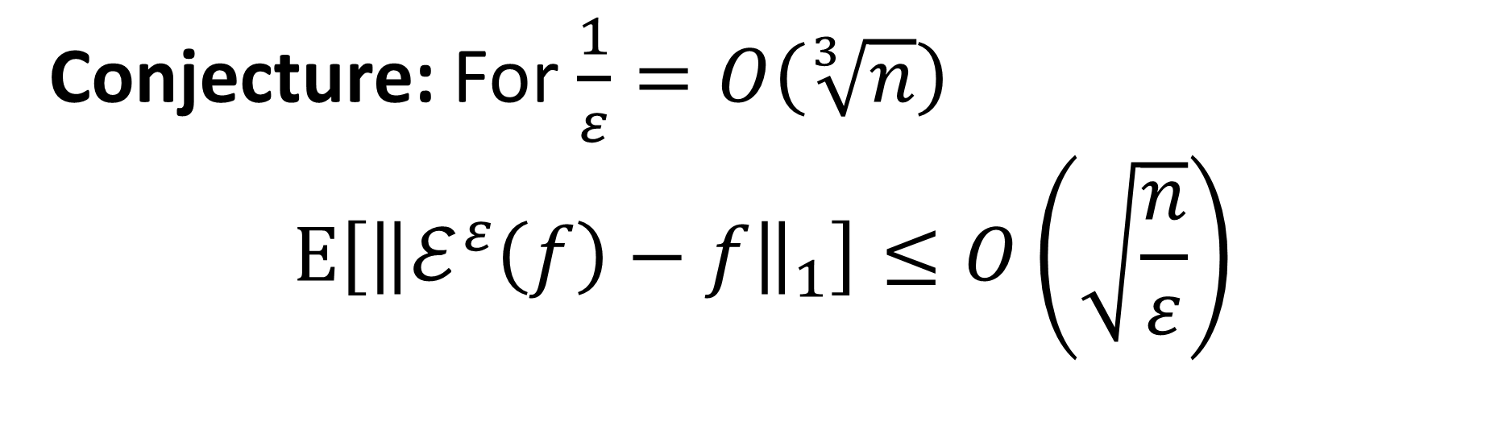
An Open Problem
Th
Conjecture: For $\frac{1}{ε}=O\left(\sqrt[3]{n}\right)$
$$E\left[{\left\|ℰ^{ε}\left(f\right)−f\right\|}_{1}\right]≤O\left(\sqrt{\frac{n}{ε}}\right)$$
Application to Social Networks: Degree Distribution with Node Privacy

Slide 51


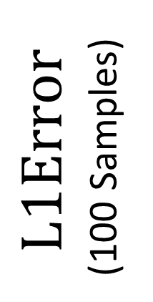
Empirical Evidence
$$L1Error$$
(100 Samples)
n=32.6 million users
$${\left(\sqrt{ε}\right)}^{−1}$$

Slide 52
Conclusions
Differential Privacy Enables Analysis of Sensitive Data
The exponential mechanism is not always intractable
  integer partitions
  Other practical settings?
Applications to Social Networks?

Slide 53

Thanks for Listening

