Slide 1





Bandwidth Hard Functions: Reductions and Lower Bounds
Jeremiah Blocki (Purdue)
Ling Ren (MIT)
Samson Zhou (Purdue→IU)
CCS 2018

Slide 2





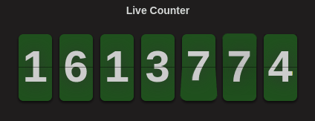

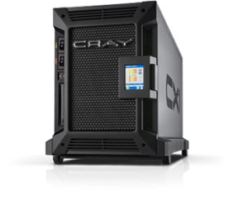


Motivation: Offline Attacks
jblocki, 123456
Username
jblocki
Salt
89d978034a3f6
Hash
85e23cfe0021f584e3db87aa72630a9a2345c062
SHA1(12345689d978034a3f6)
HASH(password89d978034a3f6)
HASH(p@$$w0rd89d978034a3f6)
+
….
HASH(12345689d978034a3f6)=85e23cfe0021f584e3db87aa72630a9a2345c062
Failed Login Attempts (jblocki,123456)
Notes:
Suppose that I register for an account at playstation.com

Slide 3

















Offline Attacks: A Common Problem
Password breaches at major companies have affected millions billions of user accounts.
Notes:
Unfortunately, such breaches are increasingly commonplace and have affected billions of user accounts. Shown below is an incomplete list of major breaches and I apologize if I forgot to include your competitor.

Slide 4




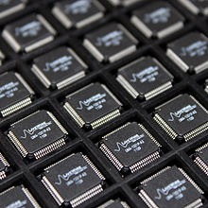
Desiderata: Moderately Hard Function
Fast on PC (single instance)
Too expensive to evaluate millions/billions of times (even on ASIC)
Notes:
This motivates the need for moderately hard functions. The basic idea is to build a password hash function that is moderately expensive to compute to limit the number of guesses that an adversary would be willing to try. An honest server only needs to compute the function once during a typical authentication session. However, the adversary potentially has an advantage in this game. While the honest server must typically evaluate the function on standard hardware, the adversary could use potentially reduce the cost per password guess by developing customized hardware (GPUs, FPGAs, ASICs) to evaluate the password hash function. Thus, we want to ensure that the cost to evaluate this function is equitable across platforms.

Slide 5
Moderately Hard Function: Desiderata
Egalitarian: Evaluation costs are not significantly lower on an ASIC
Computing millions/billions of instances is economically infeasible.
Feasible to compute function on a personal computer
  Applications: Password Hashing, Egalitarian Proofs of Work

Slide 6
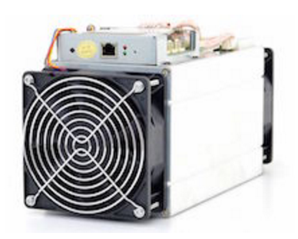
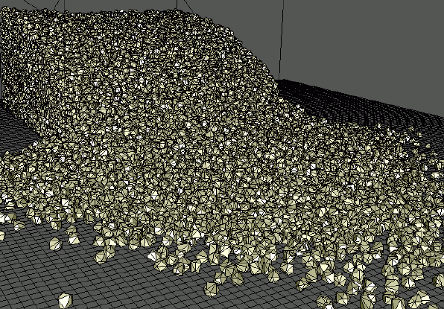
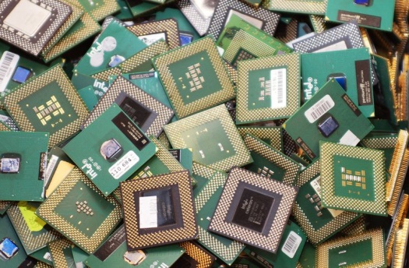

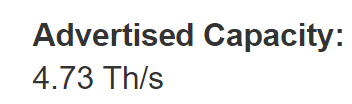
What is the ASIC Advantage?
>200,000x faster than
$$ per eval(): capital + electricity
# of lifetime eval()
Notes:
Bitcoin
CPU = 0.1 MH / J
ASIC = 4GH / J

Slide 7



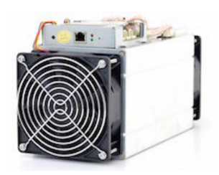
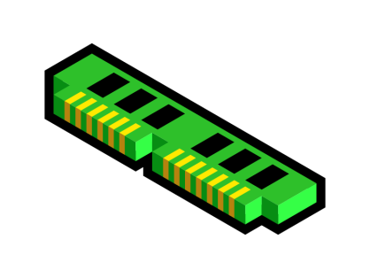



Reducing ASIC Advantage
(memory-hard)
(bandwidth-hard)
$$ per eval(): amortized capital + electricity

Slide 8
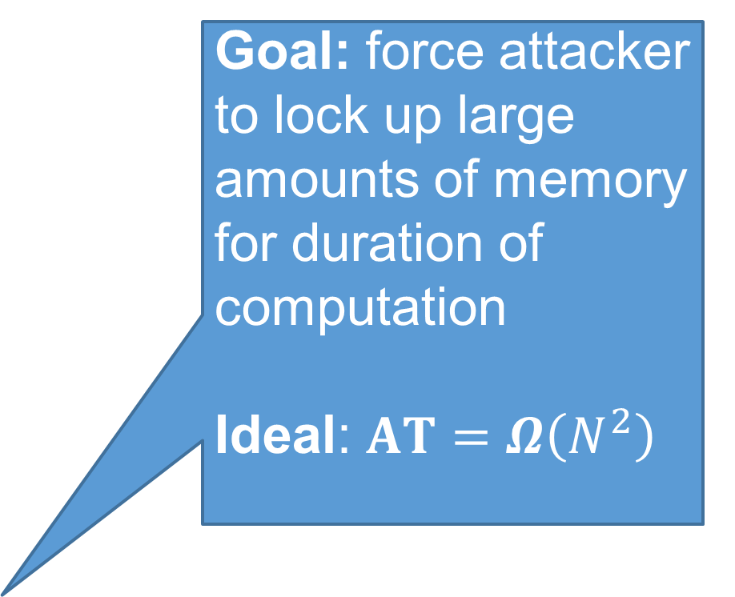
Reducing ASIC Advantage
Goal: force attacker to lock up large amounts of memory for duration of computation
Ideal: $AT=Ω\left(N^{2}\right)$
Area-Time Complexity
“A natural way to reduce the advantage provided by an attacker’s ability to construct highly parallel circuits is to increase the size of the circuit.” [Percival’ 09]
(memory-hard)
(bandwidth-hard)
$$ per eval(): amortized capital + electricity

Slide 9
Reducing ASIC Advantage
Lots of Work on Memory-Hardness:
Definitions: [Percival’09, AS15,ABH17,ABP18]
Password Hashing Competition: Argon2 (winner), Catena,….
Black Pebbling Reduction: [AS15]
Attacks on iMHFs: [AB16,AB17,BZ17,…]
Security Proof for dMHF SCRYPT: [ACPTR17]
Improved Constructions of iMHFs: [P09,BCS16,ABP17,ABH17]
(memory-hard)
(bandwidth-hard)
$$ per eval(): amortized capital + electricity

Slide 10
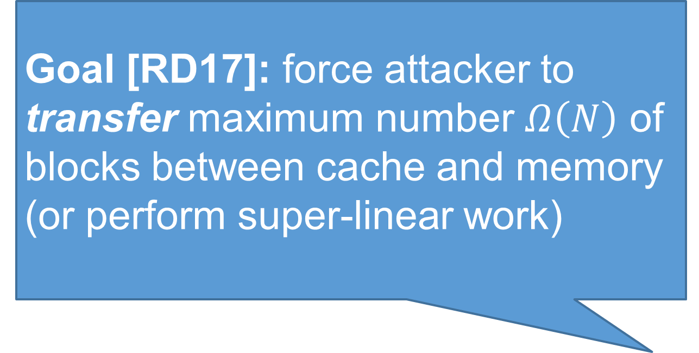
Reducing ASIC Advantage
Goal [RD17]: force attacker to transfer maximum number $Ω\left(N\right)$ of blocks between cache and memory (or perform super-linear work)
Many Open Problems
(memory-hard)
(bandwidth-hard)
$$ per eval(): amortized capital + electricity

Slide 11
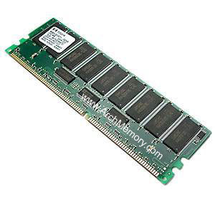




Data-Independent Memory Hard Function (iMHF)
Intuition: computation costs dominated by memory costs
vs.
Data Independent Memory Hard Function (iMHF)
  Memory access pattern should not depend on input
Notes:
In this work we study a special type of memory hard function called data-independent memory hard functions. As the name suggests the memory access pattern will not depend on the input making the functions resistant to side-channel attacks.

Slide 12

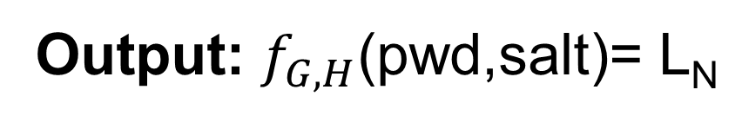
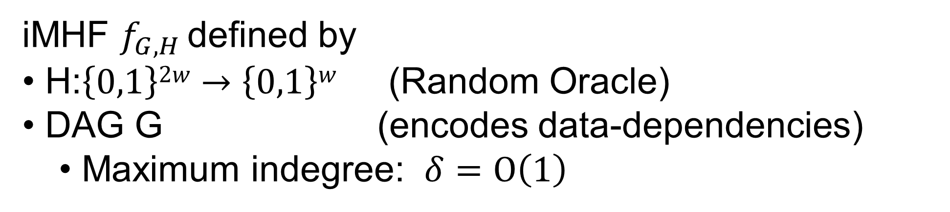

Data-Independent Labeling Function f_{G,H}
iMHF $f_{G,H}$ defined by
H:$\left\{0,1\right\}2w→\left\{0,1\right\}w$ (Random Oracle)
DAG G (encodes data-dependencies)
  Maximum indegree: $δ=O\left(1\right)$
Output: $f_{G,H}$(pwd,salt)= L_{N}
Input: pwd, salt
2
N=4
1
1
3
$$L1=H(1,pwd,salt)$$
$$L3=H(3,L2,L1)$$

Slide 13
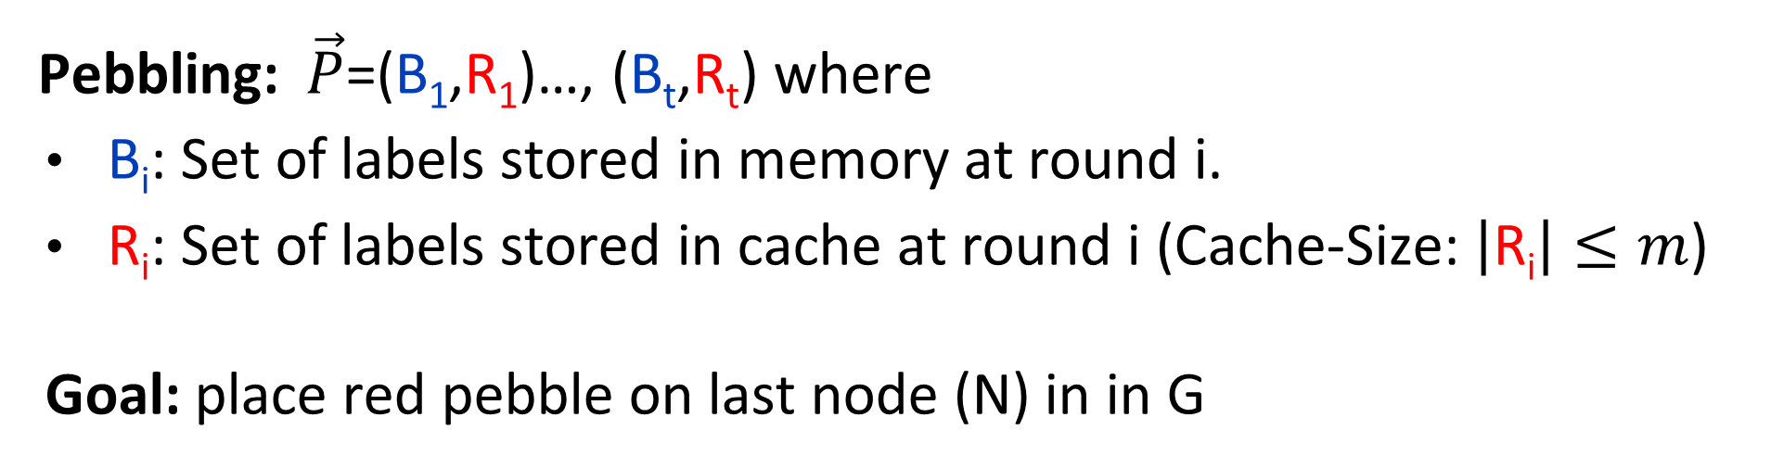


Evaluating an iMHF (red-blue pebbling)
2
N=4
Output: L_{N}
Input:
1
1
pwd, salt
3
$$L1=H(pwd,salt)$$
$$L3=H(L2,L1)$$
Pebbling: $\vec{P}$=(B₁,R₁)…, (B_{t},R_{t}) where
B_{i}: Set of labels stored in memory at round i.
R_{i}: Set of labels stored in cache at round i (Cache-Size: $\left|\text{R}\text{i}\right|≤m$)
Goal: place red pebble on last node (N) in in G
Notes:
We will describe our algorithms for evaluating an iMHF using the language of graph pebbling. Placing a pebble on a node corresponds to computing the corresponding label, and keeping a pebble on the graph corresponds to storing that label in memory. Of course we can only compute a label if we have all of the dependent labels. Thus, in a legal pebbling we cannot place a pebble on a node until we have pebbles on the parents of that node. If the adversary is parallel then we are allowed to place multiple pebbles on the graph in each round. We can remove pebbles from the graph at any point in time.

Slide 14
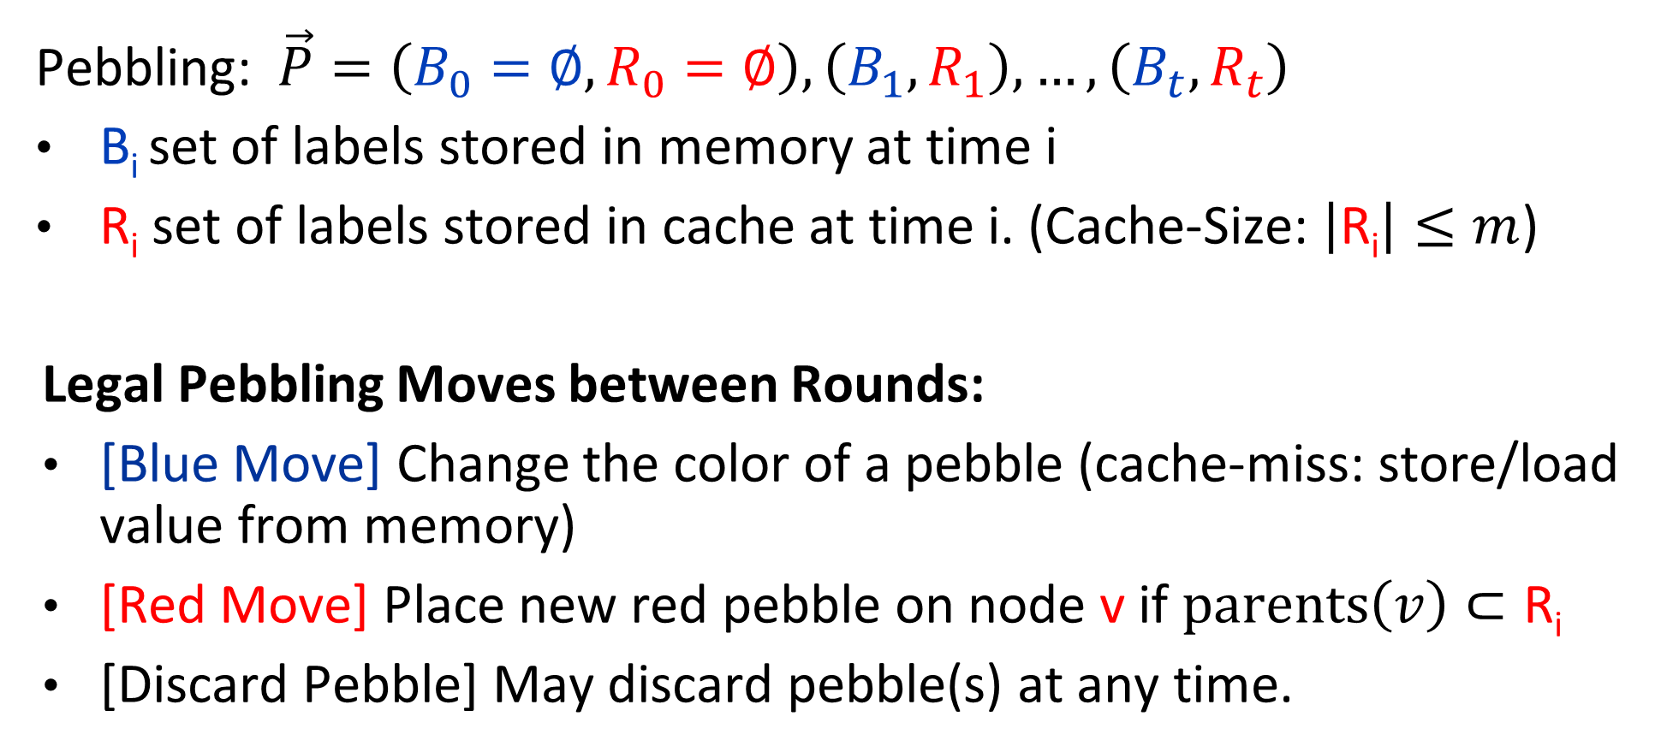
Evaluating an iMHF (red-blue pebbling)
Pebbling: $\vec{P}=\left(B_{0}=∅,R_{0}=∅\right),\left(B_{1},R_{1}\right),…,\left(B_{t},R_{t}\right)$
B_{i} set of labels stored in memory at time i
R_{i} set of labels stored in cache at time i. (Cache-Size: $\left|\text{R}\text{i}\right|≤m$)
Legal Pebbling Moves between Rounds:
[Blue Move] Change the color of a pebble (cache-miss: store/load value from memory)
[Red Move] Place new red pebble on node v if $parents\left(v\right)⊂\text{R}\text{i}$
[Discard Pebble] May discard pebble(s) at any time.
Notes:
We will describe our algorithms for evaluating an iMHF using the language of graph pebbling. Placing a pebble on a node corresponds to computing the corresponding label, and keeping a pebble on the graph corresponds to storing that label in memory. Of course we can only compute a label if we have all of the dependent labels. Thus, in a legal pebbling we cannot place a pebble on a node until we have pebbles on the parents of that node. If the adversary is parallel then we are allowed to place multiple pebbles on the graph in each round. We can remove pebbles from the graph at any point in time.

Slide 15
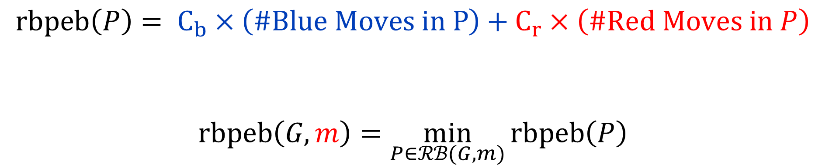
Red-Blue Pebbling Cost [RD17]
$$rbpeb\left(P\right)= C_{b}×\left(\#Blue Moves in P\right)+C_{r}×\left(\#Red Moves in P\right)$$
$$rbpeb\left(G,m\right)=\min_{P∈ℛℬ(G,m)}{rbpeb\left(P\right)}$$
Set of all legal red-blue pebblings of DAG G
with cache-size m.
Notes:
Red moves are much cheaper for the attacker. Because the attacker has different costs for red/blue moves then the honest party an attacker might choose to select a different pebbling strategy.

Slide 16
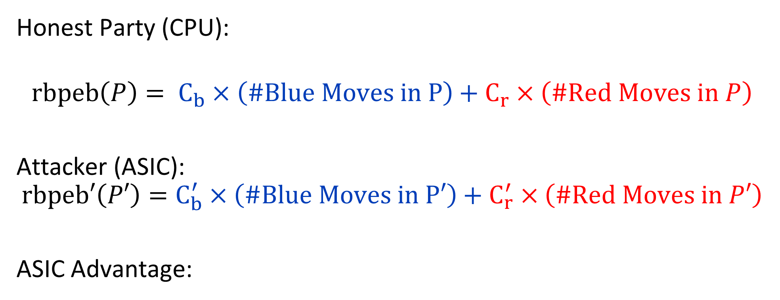
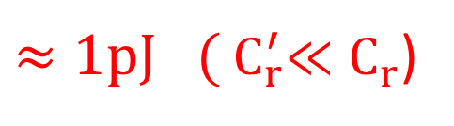

Red-Blue Pebbling Cost Inequity [RD17]
Honest Party (CPU):
$$rbpeb\left(P\right)= C_{b}×\left(\#Blue Moves in P\right)+C_{r}×\left(\#Red Moves in P\right)$$
Attacker (ASIC):
$$rbpeb′\left(P′\right)=C_{b}^{′}×\left(\#Blue Moves in P′\right)+{ C}_{r}^{′} ×\left(\#Red Moves in P′\right)$$
ASIC Advantage:
$$\text{1}\text{nJ}≈C_{b}^{′}≈ C_{b}≈C_{r}≈{10}^{−3}×{ C}_{r}^{′}$$
$≈1pJ ({ C}_{r}^{′}≪C_{r}$)
Notes:
Red moves are much cheaper for the attacker. Because the attacker has different costs for red/blue moves then the honest party an attacker might choose to select a different pebbling strategy.

Slide 17

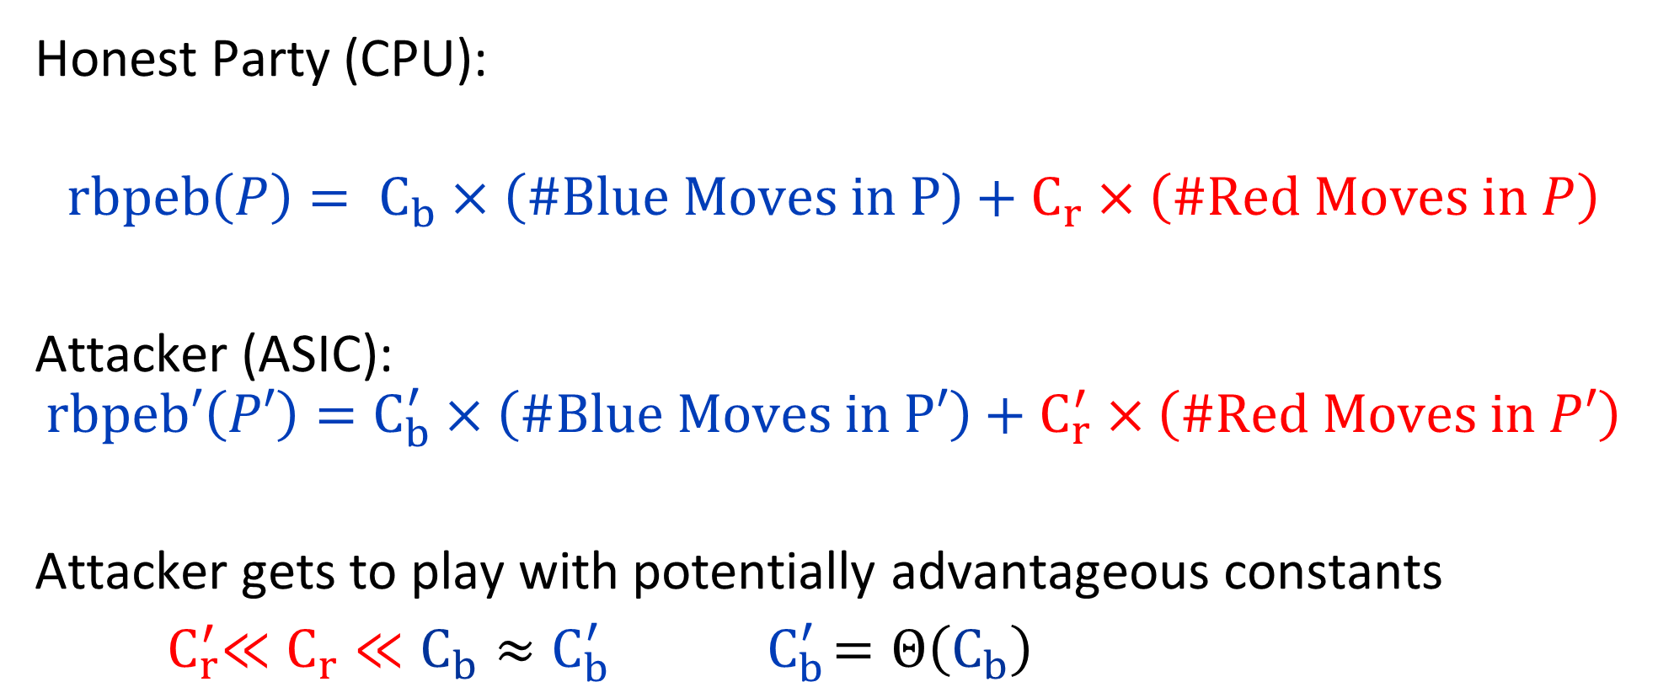
Red-Blue Pebbling Cost Inequity [RD17]
Honest Party (CPU):
$$rbpeb\left(P\right)= C_{b}×\left(\#Blue Moves in P\right)+C_{r}×\left(\#Red Moves in P\right)$$
Attacker (ASIC):
$$rbpeb′\left(P′\right)=C_{b}^{′}×\left(\#Blue Moves in P′\right)+{ C}_{r}^{′} ×\left(\#Red Moves in P′\right)$$
Attacker gets to play with potentially advantageous constants
${ C}_{r}^{′}≪C_{r}≪C_{b}≈C_{b}^{′}{ C}_{b}^{′}=Θ\left(C_{b}\right)$
How can I make sure that the function is energy intensive for the attacker as well?
Notes:
Red moves are much cheaper for the attacker. Because the attacker has different costs for red/blue moves then the honest party an attacker might choose to select a different pebbling strategy.

Slide 18
Memory Hard Function
Intuition: computation costs dominated by memory costs
vs.
High Capital Costs (Memory Hardness): force attacker to lock up large amounts of memory for duration of computation [Percival’09,AS15,…]
High Energy Cost (Bandwidth Hardness): Ensure that attacker must transfer lots of data between cache and memory [RD17].
Notes:
In this work we study a special type of memory hard function called data-independent memory hard functions. As the name suggests the memory access pattern will not depend on the input making the functions resistant to side-channel attacks.

Slide 19
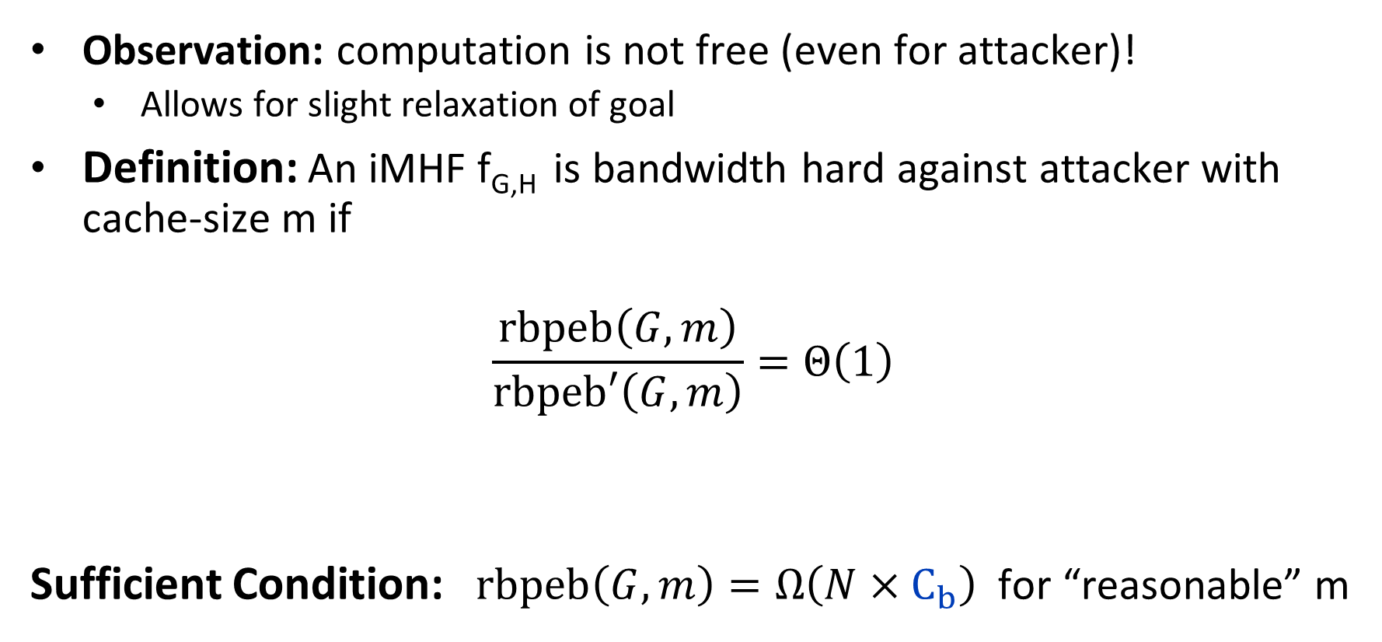
Bandwidth-hard functions [RD17]
Observation: computation is not free (even for attacker)!
  Allows for slight relaxation of goal
Definition: An iMHF f_{G,H} is bandwidth hard against attacker with cache-size m if
$$\frac{rbpeb\left(G,m\right)}{rbpeb′\left(G,m\right)}=Θ\left(1\right)$$
Sufficient Condition: $rbpeb\left(G,m\right)=Ω\left(N×C_{b}\right)$ for “reasonable” m
Best Red-Blue Pebbling for Honest Party
Best Red-Blue Pebbling for ASIC attacker

Slide 20
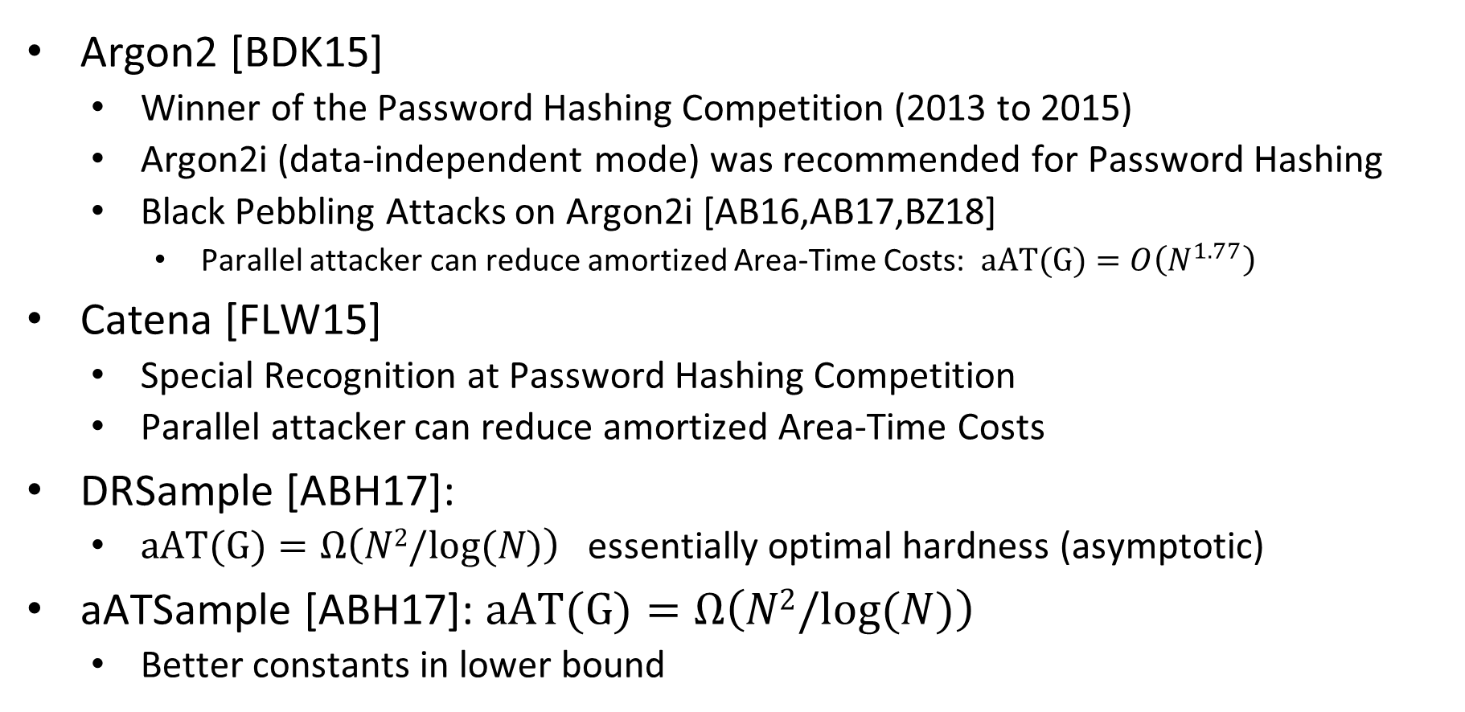
Candidate iMHFs
Argon2 [BDK15]
  Winner of the Password Hashing Competition (2013 to 2015)
  Argon2i (data-independent mode) was recommended for Password Hashing
  Black Pebbling Attacks on Argon2i [AB16,AB17,BZ18]
    Parallel attacker can reduce amortized Area-Time Costs: $aAT(G)=O\left(N^{1.77}\right)$
Catena [FLW15]
  Special Recognition at Password Hashing Competition
  Parallel attacker can reduce amortized Area-Time Costs
DRSample [ABH17]:
  $aAT(G)=Ω\left(N2/log⁡(N)\right)$ essentially optimal hardness (asymptotic)
aATSample [ABH17]: $aAT(G)=Ω\left(N2/log⁡(N)\right)$
  Better constants in lower bound

Slide 21
What iMHFs are maximally bandwidth hard?
Prior Results [RD17]:
  Catena-BRG [FLW15] and Balloon Hash [BCS16]
  Both iMHFs are maximally bandwidth Hard [RD17]
SCRYPT (dMHF)
  Maximally bandwidth hard *
  * against limited class of attackers
Our Results
  Argon2i, DRSample, aATSample are all maximally bandwidth hard
Any function with high cumulative memory complexity must also have high energy costs
→ SCRYPT lower bound for
(slightly weaker, but unconditional)

Slide 22
Pebbling Reduction?
Thm [AS15]: (informal) any algorithm A computing f_{G,H} in the parallel random oracle model (PROM) can be described by a parallel black pebbling strategy with comparable AT-cost.
Implication: Lower bounds in black pebbling game generalize to any PROM attacker.
iMHF Analysis: Focus on black pebbling game
Similar result for red-blue pebbling game?
Do lower bounds in red-blue pebbling game extend to any PROM attack?

Slide 23

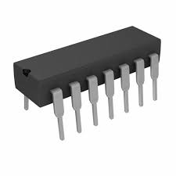
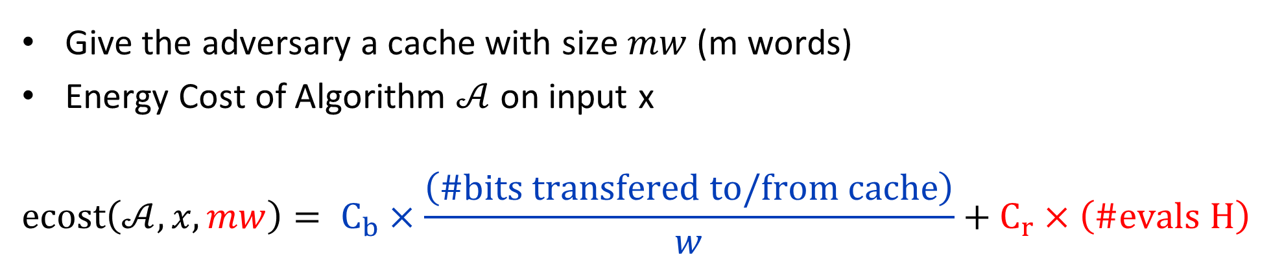
Energy Cost of an Algorithm
Give the adversary a cache with size $mw$ (m words)
Energy Cost of Algorithm $𝒜$ on input x
$$ecost\left(𝒜,x,mw\right)= C_{b}×\frac{\left(\#bits transfered to/from cache\right)}{w}+C_{r}×\left(\#evals H\right)$$
# bits in cache
H()

Slide 24
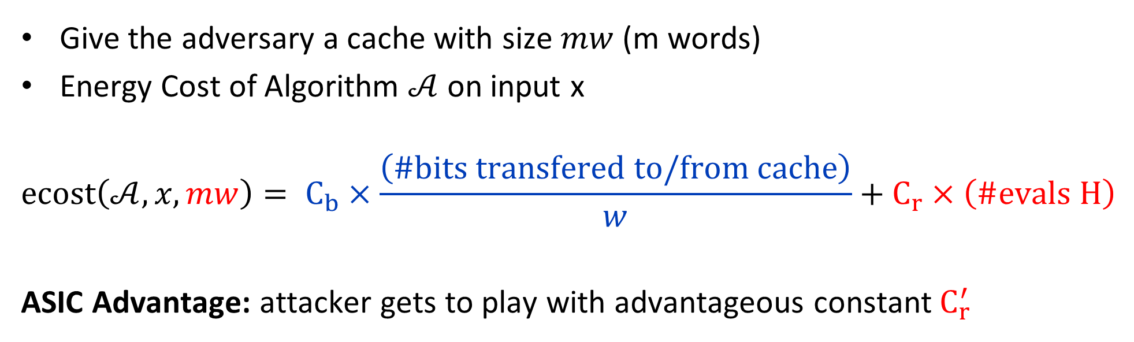
Energy Cost of an Algorithm
Give the adversary a cache with size $mw$ (m words)
Energy Cost of Algorithm $𝒜$ on input x
$$ecost\left(𝒜,x,mw\right)= C_{b}×\frac{\left(\#bits transfered to/from cache\right)}{w}+C_{r}×\left(\#evals H\right)$$
ASIC Advantage: attacker gets to play with advantageous constant${ C}_{r}^{′}$
$${ C}_{r}^{′}≪C_{r}≪C_{b} C_{b}^{′}=Θ\left(C_{b}\right)$$

Slide 25
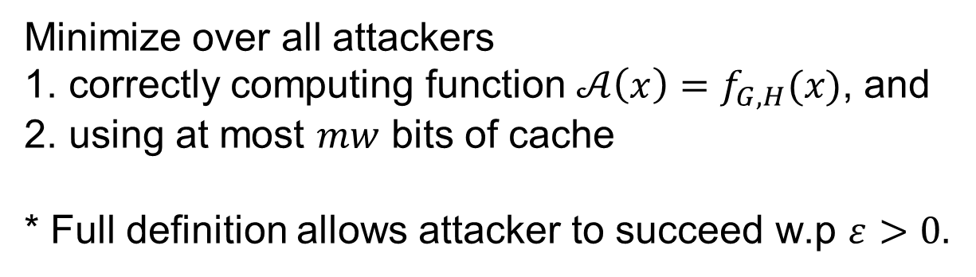

Energy Cost of a Function
Give the adversary a cache with size $mw$ (m words)
Energy Cost of a Function $f_{G,H}$
$$ecost\left(f_{G,H},mw\right)=\min_{𝒜,x}{E_{H}\left[ecost\left(𝒜,x,mw\right)\right]}$$
Minimize over all attackers
correctly computing function $𝒜\left(x\right)=f_{G,H}(x)$, and
using at most $mw$ bits of cache
* Full definition allows attacker to succeed w.p $ε>0.$

Slide 26


Pebbling Reduction
Goal: Compute $f_{G,H}$
minimize
$$ecost\left(f_{G,H},mw\right)$$
Goal: Pebble G
minimize
$rbpeb\left(G,O(m)\right)$
H()
2
N=4
1
1
3

Slide 27


Pebbling Reduction
Goal: Compute $f_{G,H}$
minimize
$$ecost\left(f_{G,H},mw\right)$$
Goal: Pebble G
minimize
$rbpeb\left(G,m\right)$
H()
2
N=4
1
1
Easy Direction
3

Slide 28

Pebbling Reduction
Goal: Compute $f_{G,H}$
minimize
$$ecost\left(f_{G,H},mw\right)$$
Goal: Pebble G
minimize
$rbpeb\left(G,O(m)\right)$
H()
2
N=4
1
1
Extractor Argument
(can’t compress
labels from RO)
3

Slide 29
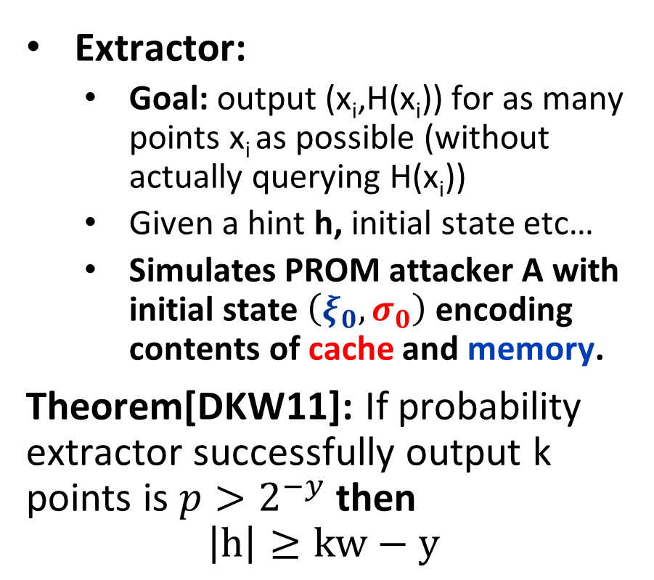
Pebbling Reduction Challenges
Extractor:
  Goal: output (x_{i},H(x_{i})) for as many points x_{i} as possible (without actually querying H(x_{i}))
  Given a hint h, initial state etc…
  Simulates PROM attacker A with initial state $\left(ξ_{0},σ_{0}\right)$ encoding contents of cache and memory.
Theorem[DKW11]: If probability extractor successfully output k points is $p>2^{−y}$ then
$$\left|h\right|≥kw−y$$
Challenge: A might stores labels in encrypted form
  Monitor A’s queries to H(.)
    Queries contain decrypted labels
    [AS15] Can infer what labels were stored in memory somewhere and extract legal black pebbling
  Monitor bits transferred to/from cache?
    Might be encrypted ☹

Slide 30
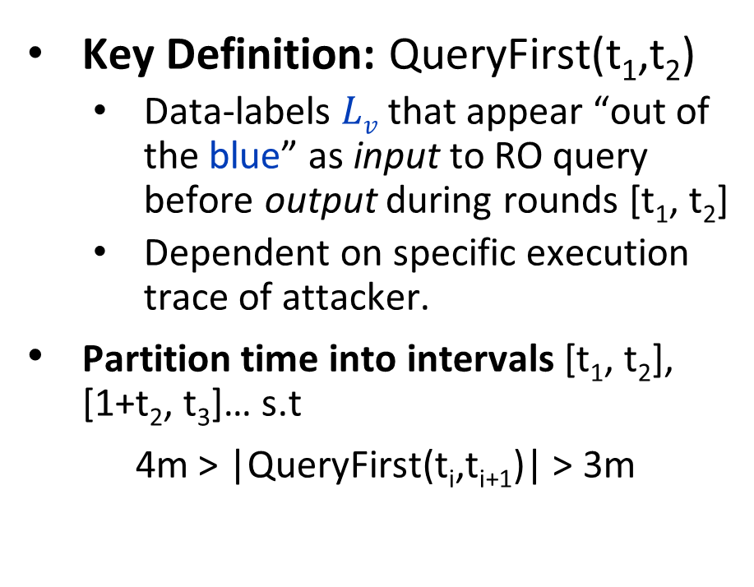
Pebbling Reduction: Random Oracle Model
Key Definition: QueryFirst(t₁,t₂)
  Data-labels $Lv$ that appear “out of the blue” as input to RO query before output during rounds [t₁, t₂]
  Dependent on specific execution trace of attacker.
  Partition time into intervals [t₁, t₂], [1+t₂, t₃]… s.t
  4m > |QueryFirst(t_{i},t_{i+1})| > 3m
Claim 1: (whp) Attacker must transfer at least mw bits to/from cache during each interval [1+t_{i},t_{i+1}]
Claim 2: (whp) Can find legal red-blue pebbling in which
  The number of blue moves during each interval [1+t_{i},t_{i+1}] is at most 4m
  We never use more than 8m red pebbles.

Slide 31
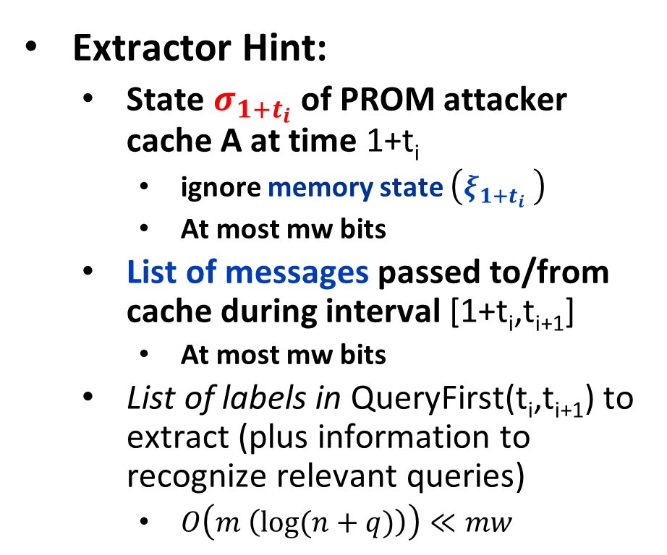
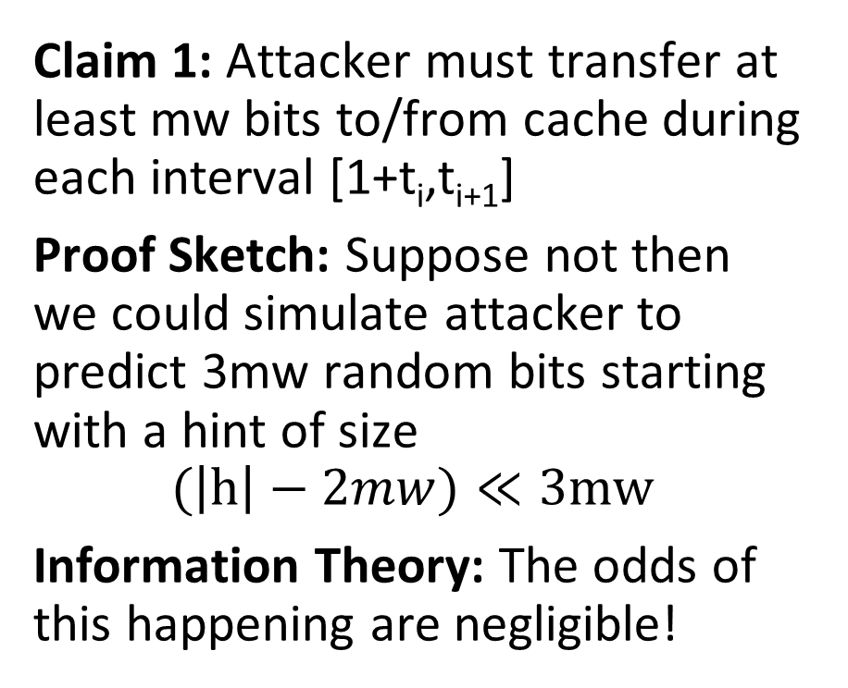
Pebbling Reduction
Claim 1: Attacker must transfer at least mw bits to/from cache during each interval [1+t_{i},t_{i+1}]
Proof Sketch: Suppose not then we could simulate attacker to predict 3mw random bits starting with a hint of size
$$(\left|h\right|−2mw)≪3mw$$
Information Theory: The odds of this happening are negligible!
Extractor Hint:
  State $σ_{{1+t}_{i}}$ of PROM attacker cache A at time 1+t_{i}
    ignore memory state $\left(ξ_{{1+t}_{i}} \right)$
    At most mw bits
  List of messages passed to/from cache during interval [1+t_{i},t_{i+1}]
    At most mw bits
  List of labels in QueryFirst(t_{i},t_{i+1}) to extract (plus information to recognize relevant queries)
    $O\left(m \left(\log{(n+q)}\right)\right)≪mw$

Slide 32
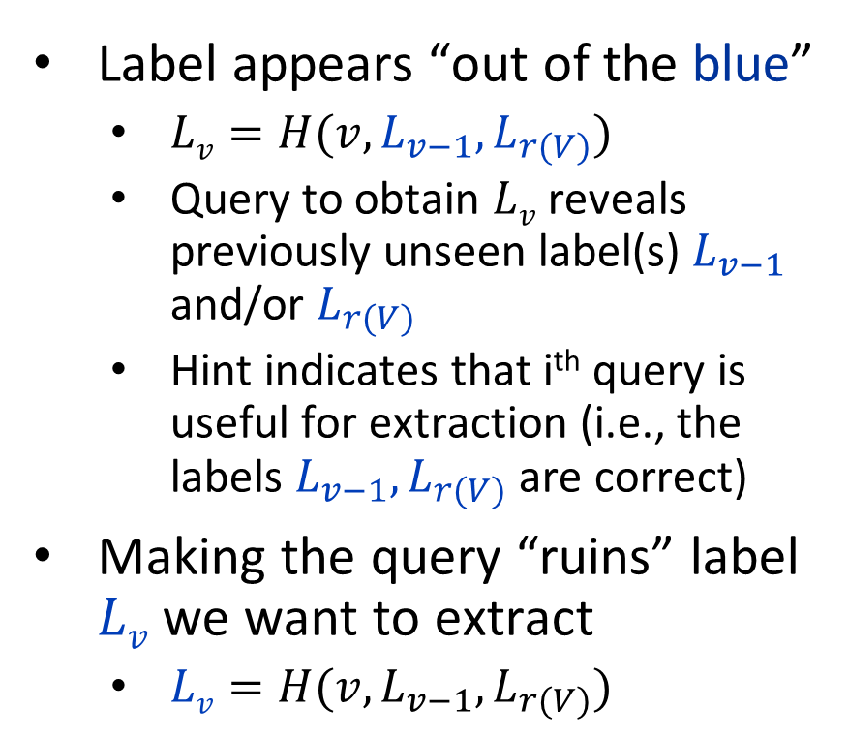
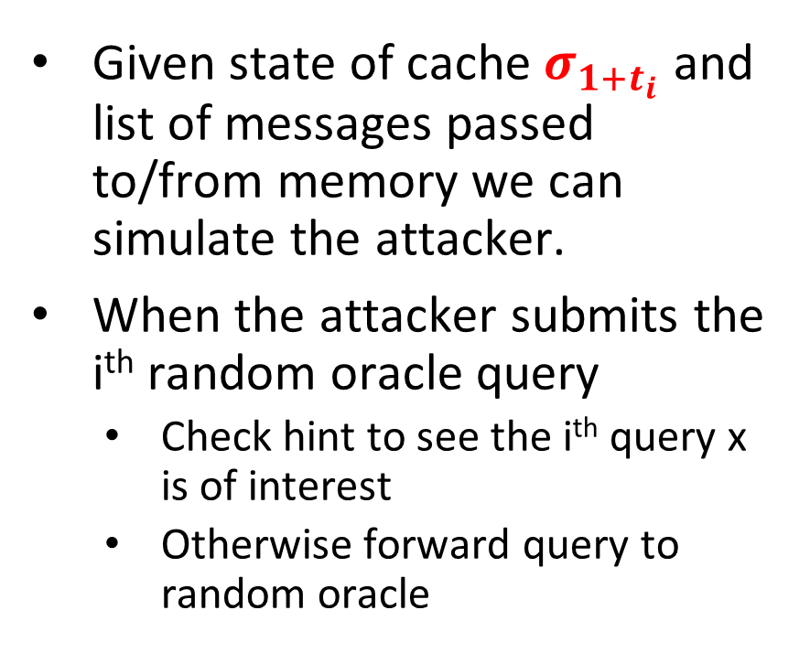
Extractor for Pebbling Reduction
Given state of cache $σ_{{1+t}_{i}}$ and list of messages passed to/from memory we can simulate the attacker.
When the attacker submits the i^{th} random oracle query
  Check hint to see the i^{th} query x is of interest
  Otherwise forward query to random oracle
Label appears “out of the blue”
  $Lv=H(v,L_{v−1},L_{r(V)})$
  Query to obtain $Lv$ reveals previously unseen label(s) $L_{v−1}$ and/or $L_{r(V)}$
  Hint indicates that i^{th} query is useful for extraction (i.e., the labels $L_{v−1},L_{r(V)}$ are correct)
Making the query “ruins” label $Lv$ we want to extract
  $Lv=H(v,L_{v−1},L_{r(V)})$

Slide 33
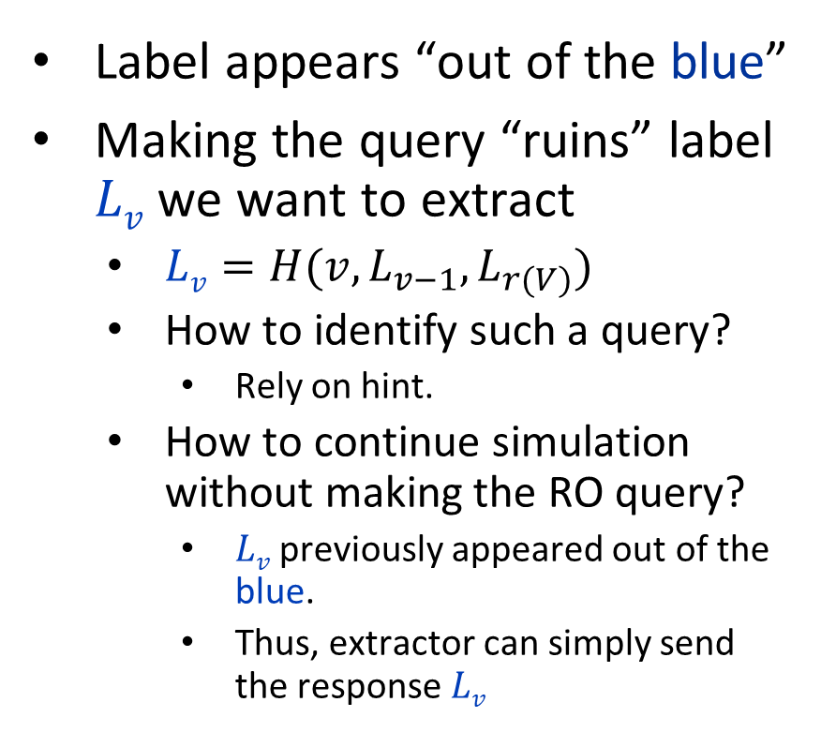
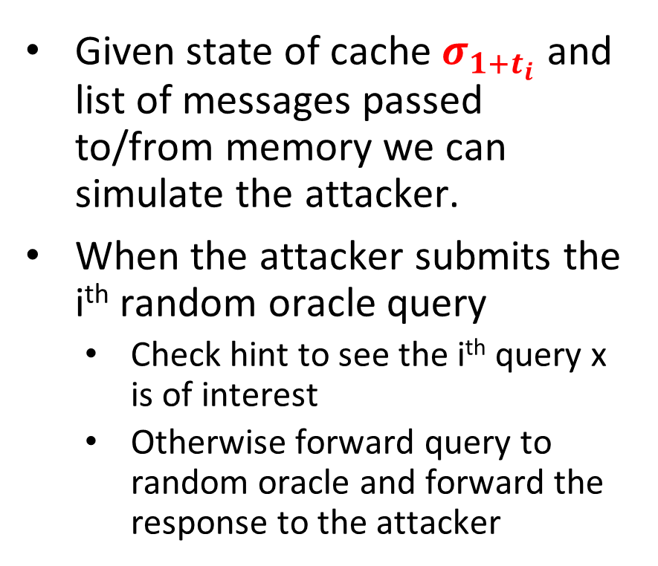
Extractor for Pebbling Reduction
Given state of cache $σ_{{1+t}_{i}}$ and list of messages passed to/from memory we can simulate the attacker.
When the attacker submits the i^{th} random oracle query
  Check hint to see the i^{th} query x is of interest
  Otherwise forward query to random oracle and forward the response to the attacker
Label appears “out of the blue”
Making the query “ruins” label $Lv$ we want to extract
  $Lv=H(v,L_{v−1},L_{r(V)})$
  How to identify such a query?
    Rely on hint.
  How to continue simulation without making the RO query?
    $Lv$ previously appeared out of the blue.
    Thus, extractor can simply send the response $Lv$

Slide 34
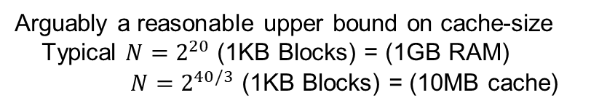
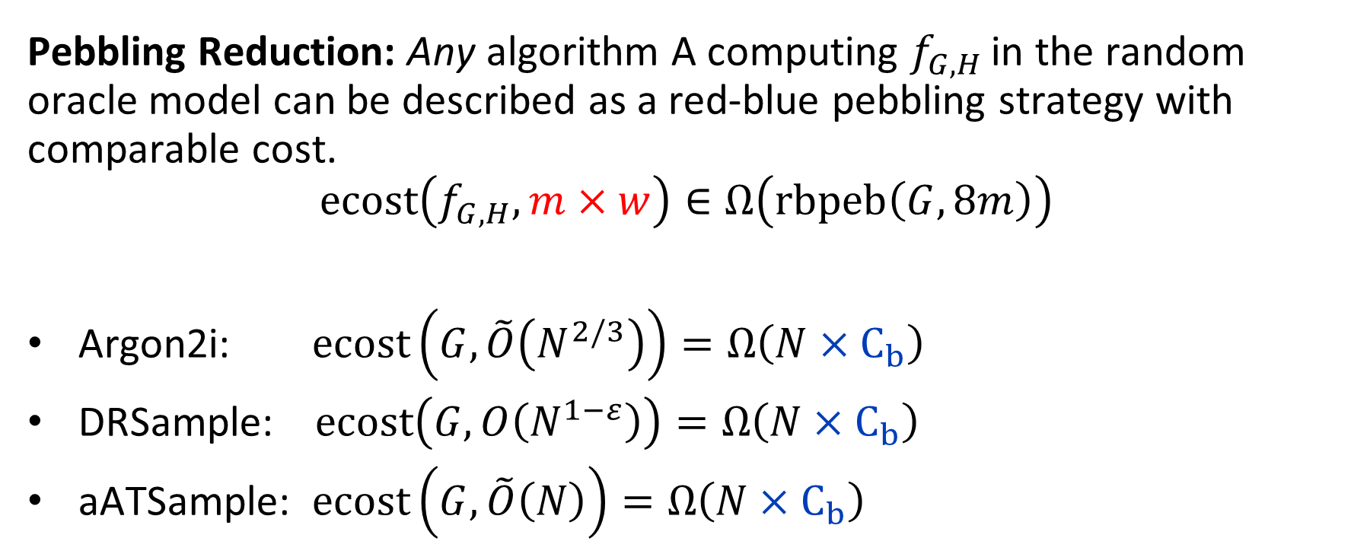
Pebbling Lower Bounds
Pebbling Reduction: Any algorithm A computing $f_{G,H}$ in the random oracle model can be described as a red-blue pebbling strategy with comparable cost.
$$ecost\left(f_{G,H},m×w\right)∈Ω\left(rbpeb\left(G,8m\right)\right)$$
Argon2i: $ecost\left(G, \tilde{O}\left(N^{2/3}\right)\right)=Ω\left(N×C_{b}\right)$
DRSample: $ecost\left(G, O\left(N^{1−ε}\right)\right)=Ω\left(N×C_{b}\right)$
aATSample: $ecost\left(G,\tilde{O}\left(N\right)\right)=Ω\left(N×C_{b}\right)$
Arguably a reasonable upper bound on cache-size
Typical $N=2^{20}$ (1KB Blocks) = (1GB RAM)
$N=2^{40/3}$ (1KB Blocks) = (10MB cache)
Stronger Result
(Tolerates Larger Cache-Size)

Slide 35
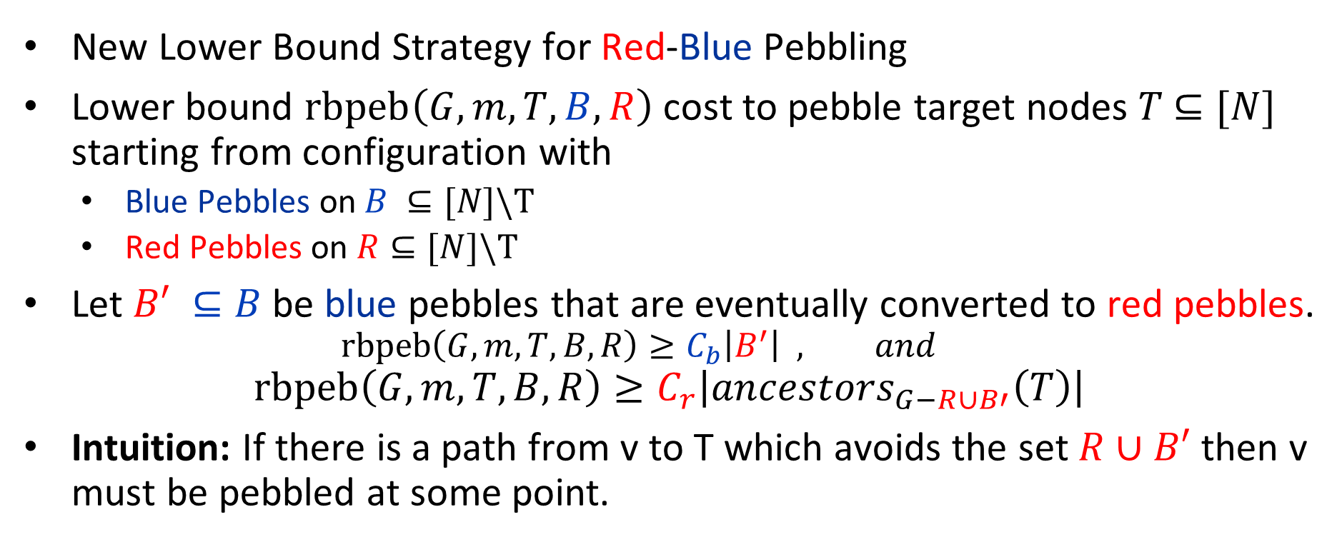
Bandwidth Hardness of Candidate iMHFs
New Lower Bound Strategy for Red-Blue Pebbling
Lower bound $rbpeb\left(G,m,T,B,R\right)$ cost to pebble target nodes $T$ $⊆[N]$ starting from configuration with
  Blue Pebbles on $B ⊆[N]\backslash T$
  Red Pebbles on $R⊆[N]\backslash T$
Let $B′ ⊆B$ be blue pebbles that are eventually converted to red pebbles.
    $$rbpeb\left(G,m,T,B,R\right)≥C_{b}\left|B^{′}\right| , and$$
$$rbpeb\left(G,m,T,B,R\right)≥C_{r}\left|{ancestors}_{G−R∪B′}\left(T\right)\right|$$
Intuition: If there is a path from v to T which avoids the set $R∪B′$ then v must be pebbled at some point.

Slide 36

Bandwidth Hardness of Candidate iMHFs
  Key Lemma (central to all lower bounds)
  Lemma: $∀T,B,R⊆[N]\backslash T$ s.t. $|R|≤m$
  $$rbpeb\left(G,m,T,B,R\right)≥\min_{B′ ⊆B}\left(C_{r}\left|{ancestors}_{G−R∪B′}\left(T\right)\right|+C_{b}\left|B′\right|\right)$$

Slide 37




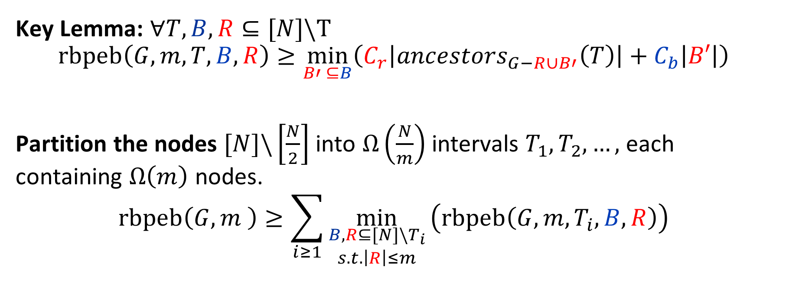






Bandwidth Hardness of Candidate iMHFs
  Key Lemma: $∀T,B,R⊆[N]\backslash T$
  $$rbpeb\left(G,m,T,B,R\right)≥\min_{B′ ⊆B}\left(C_{r}\left|{ancestors}_{G−R∪B′}\left(T\right)\right|+C_{b}\left|B′\right|\right)$$
Partition the nodes $[N]\backslash \left[\frac{N}{2}\right]$ into $Ω\left(\frac{N}{m}\right)$ intervals $T_{1},T_{2},…,$ each containing $Ω\left(m\right)$ nodes.
$$rbpeb\left(G,m \right)≥\sum_{i≥1}{\min_{\begin{aligned}B,R⊆[N]\backslash T_{i} \\ s.t. \left|R\right|≤m\end{aligned}}}\left(rbpeb\left(G,m,T_{i},B,R\right)\right)$$
$$T_{1}$$
$$T_{2}$$
$$T_{3}$$
$$…$$
$$1$$
$$B$$
$$\left|R\right|≤m$$
$$N$$
$$\frac{N}{2}$$
$Ω\left(m\right)$ nodes

Slide 38
Bandwidth Hardness of Candidate iMHFs
Allow attacker to start each interval T_{i} with arbitrary pebbling configuration
Allow attacker to start round Ti with arbitrary pebbling configuration
  Key Lemma: $∀T,B,R⊆[N]\backslash T$
  $$rbpeb\left(G,m,T,B,R\right)≥\min_{B′ ⊆B}\left(C_{r}\left|{ancestors}_{G−R∪B′}\left(T\right)\right|+C_{b}\left|B′\right|\right)$$
Partition the nodes $[N]\backslash \left[\frac{N}{2}\right]$ into $Ω\left(\frac{N}{m}\right)$ intervals $T_{1},T_{2},…,$ each containing $Ω\left(m\right)$ nodes.
$$rbpeb\left(G,m \right)≥\sum_{i≥1}{\min_{\begin{aligned}B,R⊆[N]\backslash T_{i} \\ s.t. \left|R\right|≤m\end{aligned}}}\left(rbpeb\left(G,m,T_{i},B,R\right)\right)$$
$$T_{1}$$
$$T_{2}$$
$$T_{3}$$
$$…$$
$$1$$
$$B$$
$$\left|R\right|≤m$$
$$N$$
$$\frac{N}{2}$$
$Ω\left(m\right)$ nodes

Slide 39
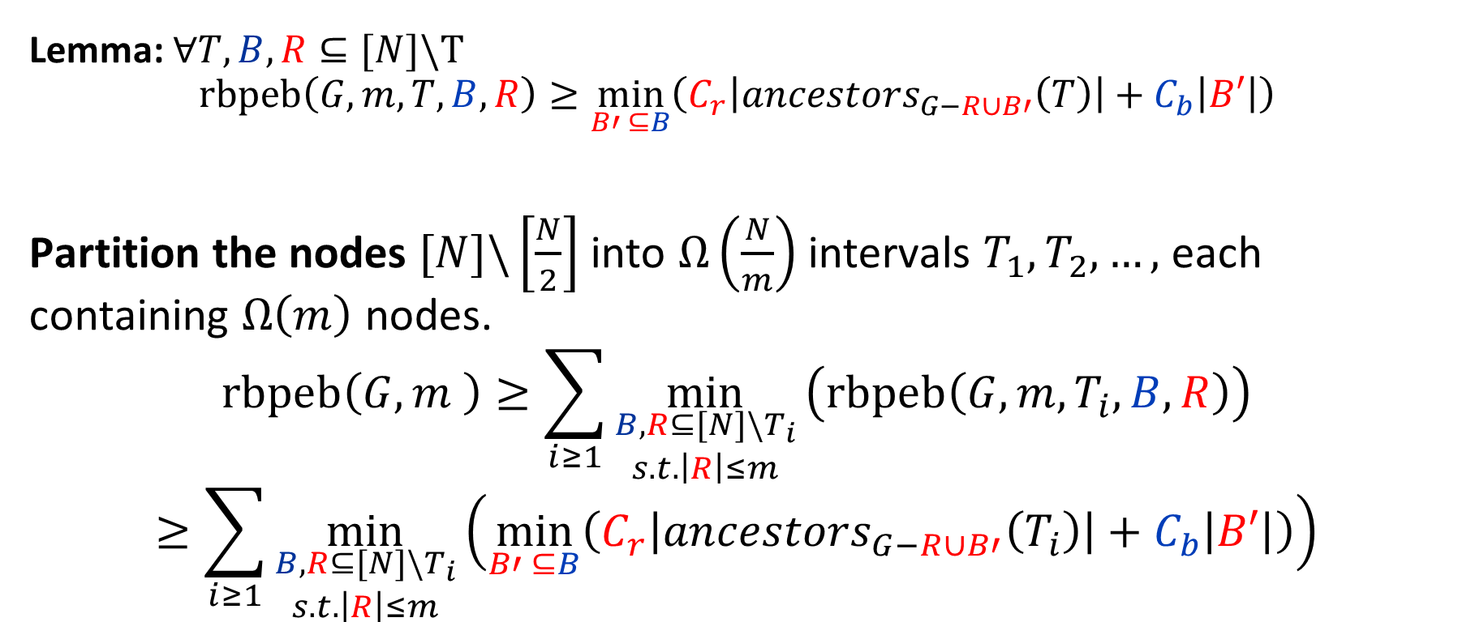
Bandwidth Hardness of Candidate iMHFs
  Lemma: $∀T,B,R⊆[N]\backslash T$
  $$rbpeb\left(G,m,T,B,R\right)≥\min_{B′ ⊆B}\left(C_{r}\left|{ancestors}_{G−R∪B′}\left(T\right)\right|+C_{b}\left|B′\right|\right)$$
Partition the nodes $[N]\backslash \left[\frac{N}{2}\right]$ into $Ω\left(\frac{N}{m}\right)$ intervals $T_{1},T_{2},…,$ each containing $Ω\left(m\right)$ nodes.
$$rbpeb\left(G,m \right)≥\sum_{i≥1}{\min_{\begin{aligned}B,R⊆[N]\backslash T_{i} \\ s.t. \left|R\right|≤m\end{aligned}}}\left(rbpeb\left(G,m,T_{i},B,R\right)\right)$$
$$≥\sum_{i≥1}{\min_{\begin{aligned}B,R⊆[N]\backslash T_{i} \\ s.t. \left|R\right|≤m\end{aligned}}}\left(\min_{B′ ⊆B}\left(C_{r}\left|{ancestors}_{G−R∪B′}\left(T_{i}\right)\right|+C_{b}\left|B′\right|\right)\right)$$
We lower bound this quantity for three iMHF candidates Argon2i, DRSample and aATSample

Slide 40
Conclusion
A Moderately Hard Function should ideally be both memory hard (amortized capital costs) and bandwidth hard (energy costs).
Pebbling Reductions shows that the Red-Blue pebbling game models the energy cost of an iMHF.
Argon2i, DRSample and aATSample are all bandwidth-hard.
  DRSample and aATSample are more memory-hard (asymptotically)
  Bandwidth Hard against attacker with larger cache
Any Memory Hard Function is at least somewhat Bandwidth-Hard (see paper)
Finding the optimal Red-Blue pebbling is NP-Hard.
New Construction: DRSample+Bit Reversal (https://eprint.iacr.org/2018/944)

Slide 41

Thanks for Listening

Slide 42
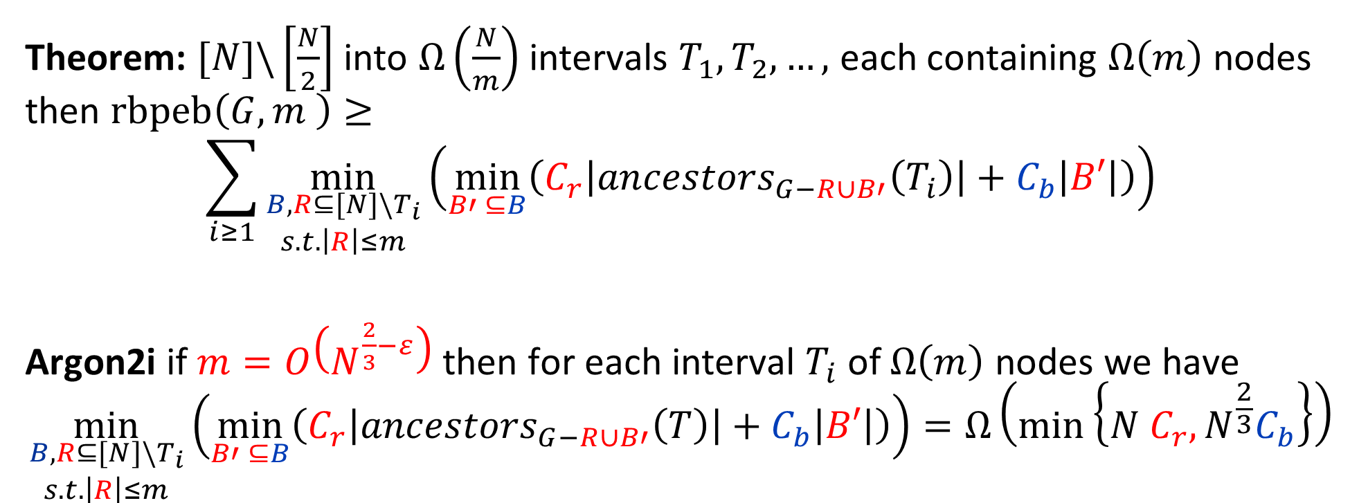
Bandwidth Hardness of Candidate iMHFs
Theorem: $[N]\backslash \left[\frac{N}{2}\right]$ into $Ω\left(\frac{N}{m}\right)$ intervals $T_{1},T_{2},…,$ each containing $Ω\left(m\right)$ nodes then $rbpeb\left(G,m \right)≥$
$$\sum_{i≥1}{\min_{\begin{aligned}B,R⊆[N]\backslash T_{i} \\ s.t. \left|R\right|≤m\end{aligned}}}\left(\min_{B′ ⊆B}\left(C_{r}\left|{ancestors}_{G−R∪B′}\left(T_{i}\right)\right|+C_{b}\left|B′\right|\right)\right)$$
Argon2i if $m=O\left(N^{\frac{2}{3}−ε}\right)$ then for each interval $T_{i}$ of $Ω\left(m\right)$ nodes we have
$$\min_{\begin{aligned}B,R⊆[N]\backslash T_{i} \\ s.t. \left|R\right|≤m\end{aligned}}\left(\min_{B′ ⊆B}\left(C_{r}\left|{ancestors}_{G−R∪B′}\left(T\right)\right|+C_{b}\left|B′\right|\right)\right)=Ω\left(min\left\{N C_{r},N^{\frac{2}{3}}C_{b}\right\}\right)$$

Slide 43
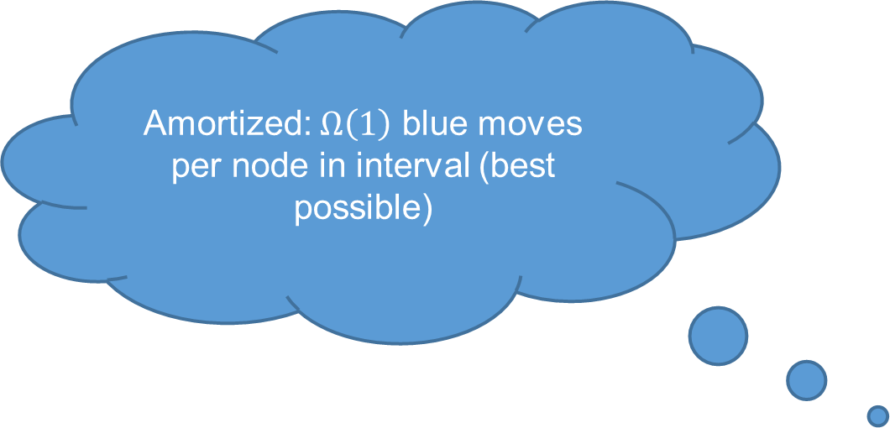
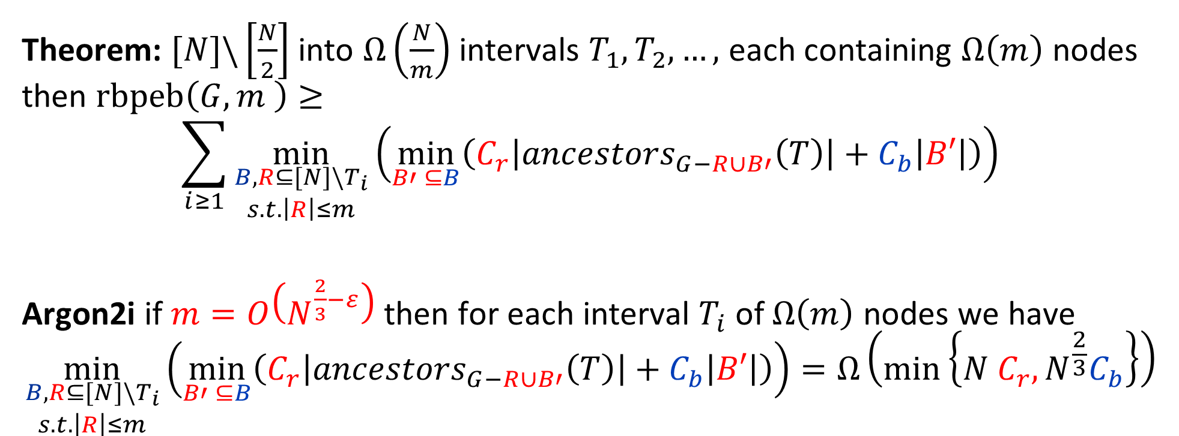
Bandwidth Hardness of Candidate iMHFs
Theorem: $[N]\backslash \left[\frac{N}{2}\right]$ into $Ω\left(\frac{N}{m}\right)$ intervals $T_{1},T_{2},…,$ each containing $Ω\left(m\right)$ nodes then $rbpeb\left(G,m \right)≥$
$$\sum_{i≥1}{\min_{\begin{aligned}B,R⊆[N]\backslash T_{i} \\ s.t. \left|R\right|≤m\end{aligned}}}\left(\min_{B′ ⊆B}\left(C_{r}\left|{ancestors}_{G−R∪B′}\left(T\right)\right|+C_{b}\left|B′\right|\right)\right)$$
Argon2i if $m=O\left(N^{\frac{2}{3}−ε}\right)$ then for each interval $T_{i}$ of $Ω\left(m\right)$ nodes we have
$$\min_{\begin{aligned}B,R⊆[N]\backslash T_{i} \\ s.t. \left|R\right|≤m\end{aligned}}\left(\min_{B′ ⊆B}\left(C_{r}\left|{ancestors}_{G−R∪B′}\left(T\right)\right|+C_{b}\left|B′\right|\right)\right)=Ω\left(min\left\{N C_{r},N^{\frac{2}{3}}C_{b}\right\}\right)$$
Amortized: $Ω\left(1\right)$ blue moves per node in interval (best possible)

Slide 44
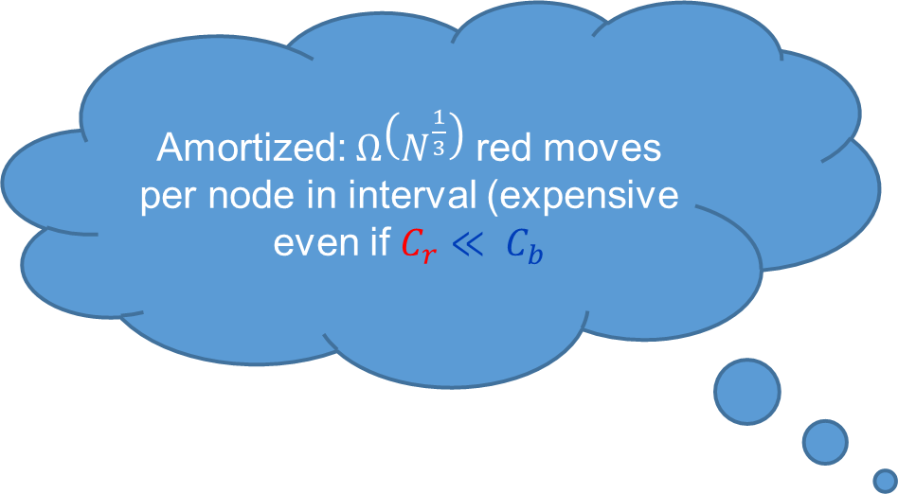
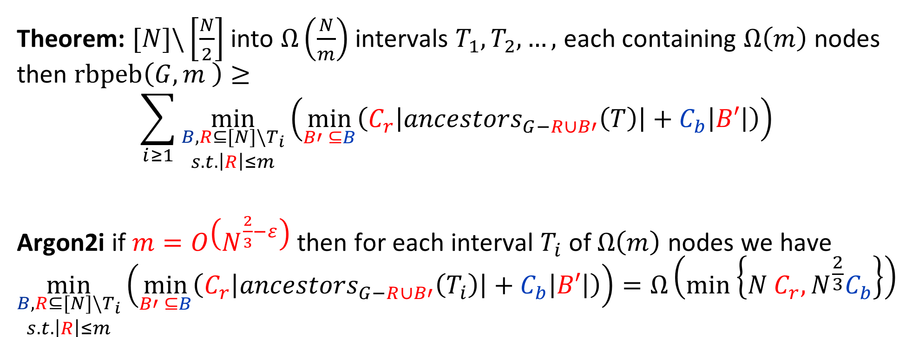
Bandwidth Hardness of Candidate iMHFs
Theorem: $[N]\backslash \left[\frac{N}{2}\right]$ into $Ω\left(\frac{N}{m}\right)$ intervals $T_{1},T_{2},…,$ each containing $Ω\left(m\right)$ nodes then $rbpeb\left(G,m \right)≥$
$$\sum_{i≥1}{\min_{\begin{aligned}B,R⊆[N]\backslash T_{i} \\ s.t. \left|R\right|≤m\end{aligned}}}\left(\min_{B′ ⊆B}\left(C_{r}\left|{ancestors}_{G−R∪B′}\left(T\right)\right|+C_{b}\left|B′\right|\right)\right)$$
Argon2i if $m=O\left(N^{\frac{2}{3}−ε}\right)$ then for each interval $T_{i}$ of $Ω\left(m\right)$ nodes we have
$$\min_{\begin{aligned}B,R⊆[N]\backslash T_{i} \\ s.t. \left|R\right|≤m\end{aligned}}\left(\min_{B′ ⊆B}\left(C_{r}\left|{ancestors}_{G−R∪B′}\left(T_{i}\right)\right|+C_{b}\left|B′\right|\right)\right)=Ω\left(min\left\{N C_{r},N^{\frac{2}{3}}C_{b}\right\}\right)$$
Amortized: $Ω\left(N^{\frac{1}{3}}\right)$ red moves per node in interval (expensive even if $C_{r}≪ C_{b}$

Slide 45

Bandwidth Hardness of Candidate iMHFs
Argon2i
$$\min_{\begin{aligned}B,R⊆[N]\backslash T_{i} \\ s.t. \left|R\right|≤m\end{aligned}}\left(\min_{B′ ⊆B}\left(C_{r}\left|{ancestors}_{G−R∪B′}\left(T_{i}\right)\right|+C_{b}\left|B′\right|\right)\right)=Ω\left(min\left\{N C_{r},N^{\frac{2}{3}}C_{b}\right\}\right)$$
We must pay this cost $Ω\left(\frac{N}{m}\right)$ times for each interval $T_{i}$
$$rbpeb\left(G,N^{\frac{2}{3}−ε}\right)=Ω\left(min\left\{N^{\frac{4}{3}}C_{r},NC_{b}\right\}\right)$$

Slide 46

Bandwidth Hardness of Candidate iMHFs
  Lemma: $∀T,B,R⊆[N]\backslash T$
  $$rbpeb\left(G,m,T,B,R\right)≥\min_{B′ ⊆B}\left(C_{r}\left|{ancestors}_{G−R∪B′}\left(T\right)\right|+C_{b}\left|B′\right|\right)$$
DRSample: For any constant $ρ<1$ if $m=O\left(N^{ρ}\right)$
$$\min_{\begin{aligned}B,R⊆[N]\backslash T_{i} \\ s.t. \left|R\right|≤m\end{aligned}}\left(\min_{B′ ⊆B}\left(C_{r}\left|{ancestors}_{G−R∪B′}\left(T_{i}\right)\right|+C_{b}\left|B′\right|\right)\right)=Ω\left(min\left\{N^{\frac{1}{2}+\frac{ρ}{2}}C_{r},N^{ρ}C_{b}\right\}\right)$$

Slide 47


Bandwidth Hardness of Candidate iMHFs
Amortized ($ρ=0.8)$: $Ω\left(N^{0.1}\right)$ red moves per node in interval (expensive even if $C_{r}≪ C_{b}$
  Lemma: $∀T,B,R⊆[N]\backslash T$
  $$rbpeb\left(G,m,T,B,R\right)≥\min_{B′ ⊆B}\left(C_{r}\left|{ancestors}_{G−R∪B′}\left(T\right)\right|+C_{b}\left|B′\right|\right)$$
DRSample: For any constant $ρ<1$ if$m=O\left(N^{ρ}\right)$
$$\min_{\begin{aligned}B,R⊆[N]\backslash T_{i} \\ s.t. \left|R\right|≤m\end{aligned}}\left(\min_{B′ ⊆B}\left(C_{r}\left|{ancestors}_{G−R∪B′}\left(T_{i}\right)\right|+C_{b}\left|B′\right|\right)\right)=Ω\left(min\left\{N^{\frac{1}{2}+\frac{ρ}{2}}C_{r},N^{ρ}C_{b}\right\}\right)$$

Slide 48

Bandwidth Hardness of Candidate iMHFs
Amortized: $Ω\left(1\right)$ blue moves per node in interval (best possible)
  Lemma: $∀T,B,R⊆[N]\backslash T$
  $$rbpeb\left(G,m,T,B,R\right)≥\min_{B′ ⊆B}\left(C_{r}\left|{ancestors}_{G−R∪B′}\left(T\right)\right|+C_{b}\left|B′\right|\right)$$
DRSample: For any constant $ρ<1$ if$m=O\left(N^{ρ}\right)$
$$\min_{\begin{aligned}B,R⊆[N]\backslash T_{i} \\ s.t. \left|R\right|≤m\end{aligned}}\left(\min_{B′ ⊆B}\left(C_{r}\left|{ancestors}_{G−R∪B′}\left(T_{i}\right)\right|+C_{b}\left|B′\right|\right)\right)=Ω\left(min\left\{N^{\frac{1}{2}+\frac{ρ}{2}}C_{r},N^{ρ}C_{b}\right\}\right)$$

Slide 49

Bandwidth Hardness of Candidate iMHFs
DRSample: For any constant $ρ<1$ if $m=O\left(N^{ρ}\right)$
$$\min_{\begin{aligned}B,R⊆[N]\backslash T_{i} \\ s.t. \left|R\right|≤m\end{aligned}}\left(\min_{B′ ⊆B}\left(C_{r}\left|{ancestors}_{G−R∪B′}\left(T_{i}\right)\right|+C_{b}\left|B′\right|\right)\right) =Ω\left(min\left\{N^{\frac{1}{2}+\frac{ρ}{2}}C_{r},N^{ρ}C_{b}\right\}\right)$$
If $m=O\left(N^{ρ}\right)$ must pay this cost $Ω\left(\frac{N}{N^{ρ}}\right)$ times
$$rbpeb\left(G,N^{ρ}\right)=Ω\left(min\left\{N^{\frac{3}{2}−\frac{ρ}{2}}C_{r},NC_{b}\right\}\right)$$

Slide 50


Comparison between Argon2i and DRSample
Argon2i is maximally bandwidth hard if attacker’s cache size is $m=o\left(N^{2/3}\right)$ ☺
  Arguably a reasonable assumption in practice
Argon2i is not maximally memory hard ☹
  But it does beat out other entrants in the Password Hashing Competition ☺
  DRSample is both maximally memory hard and maximally bandwidth hard ☺
  Even if attackers cache size is $m=O\left(N^{1−ε}\right)$
  aATSample is also maximally memory hard and maximally bandwidth hard ☺
  Even if attackers cache size is $m=O\left(\frac{N}{\log{N}}\right)$

