Slide 1
Advanced Cryptography
CS 655
Week 9:
SCRYPT (wrapup)
Proof of Sequential Work/Proof of Space
Spring 2023

Slide 2

Motivation: Online Exams during the Pandemic
² 19
2/19

Slide 3

Motivation: Online Exams during the Pandemic
² 19
2/19

Slide 4

Motivation: Online Exams during the Pandemic
² 19
2/19

Slide 5

Motivation: Online Exams during the Pandemic
² 19
2/19

Slide 6

Motivation: Online Exams during the Pandemic
² 19
2/19

Slide 7


Motivation: Online Exams during the Pandemic
² 19
2/19

Slide 8


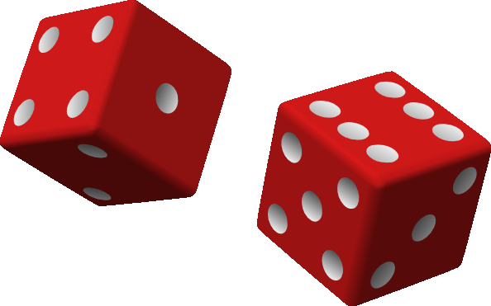
Proofs of Sequential Work
aka. Verifiable Delay Algorithm
Prover P Verifier V
χ ←
statement χ
Time T ∈ N

Slide 9
Proofs of Sequential Work
aka. Verifiable Delay Algorithm
H
Prover P
Verifier V
statement χ
χ ←
Time T ∈ N
τ = τ (χ, T )
verify(χ, T, τ ) ∈
accept/reject
Completeness and Soundness in the random oracle model:

Slide 10
Proofs of Sequential Work
aka. Verifiable Delay Algorithm
H
Prover P
Verifier V
statement χ
χ ←
Time T ∈ N
τ = τ (χ, T )
verify(χ, T, τ ) ∈
accept/reject
Completeness and Soundness in the random oracle model:
Completeness: τ (c, T ) can be computed making T queries to H
Soundness: Computing any τ ^{l} s.t. verify(χ, T, τ ^{l}) =accept for random χ requires almost T sequential queries to H

Slide 11
Proofs of Sequential Work
aka. Verifiable Delay Algorithm
H
Prover P
Verifier V
statement χ
χ ←
Time T ∈ N
τ = τ (χ, T )
verify(χ, T, τ ) ∈
accept/reject
Completeness and Soundness in the random oracle model:
Completeness: τ (c, T ) can be computed making T queries to H
Soundness: Computing any τ ^{l} s.t. verify(χ, T, τ ^{l}) =accept for random χ requires almost T sequential queries to H
massive parallelism useless to generate valid proof faster ⇒
prover must make almost T sequential queries ∼ T time

Slide 12
Three Basic Concepts
Depth-Robust Graphs (only [MMV’13])
DAG G = (V, E) is (e, d)
1 2 3 4 5 6
depth-robust if after removing any
e nodes a path of length d exists.
Graph Labelling
label £_{i} = H(£_{parents(i)}), e.g. £₄ = H(£₃, £₂)
Random Oracles are Sequential
H
H
queries y = H(x), y^{l} = H(x^{l}) where
y ⊆ x^{l} ⇒ query x^{l} was made after x
x y
_{y}l
_{x}l

Slide 13
H-Sequence

Slide 14
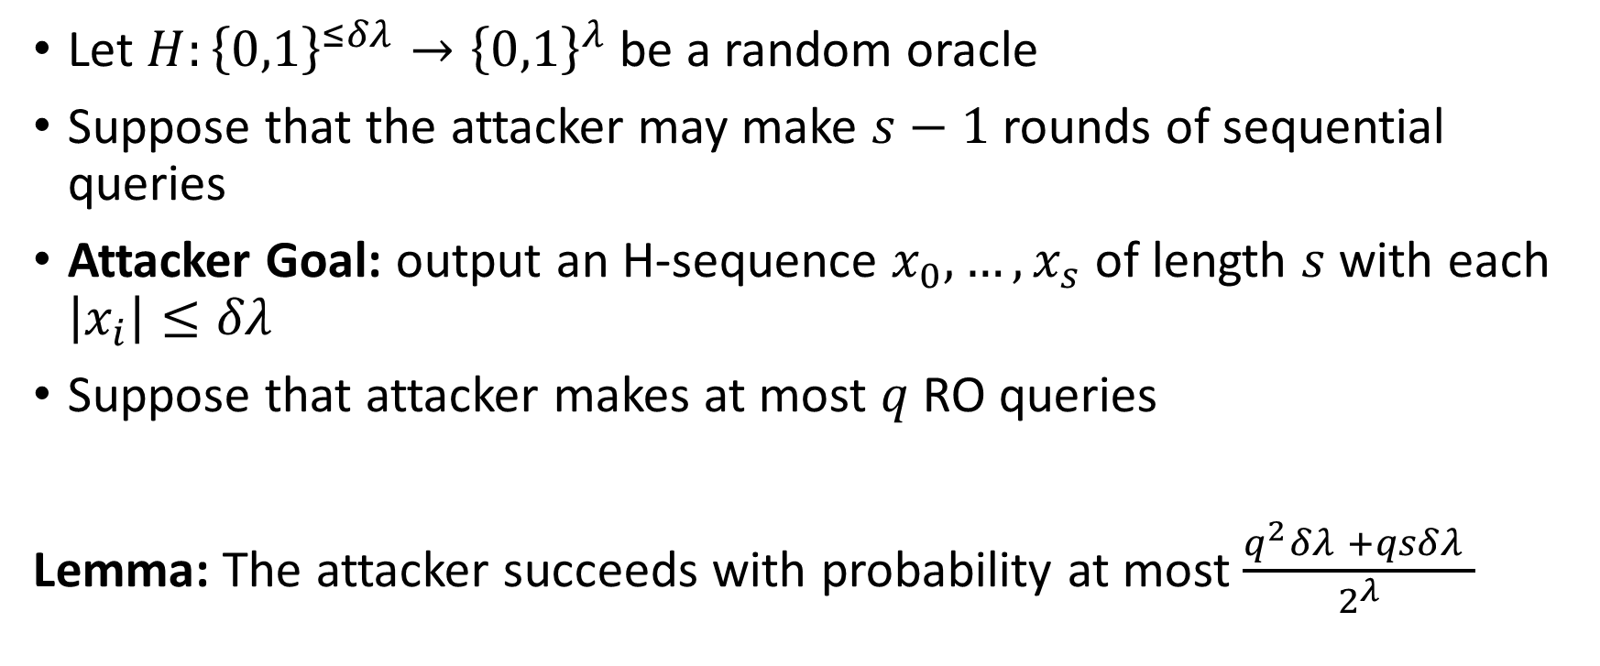
Random Oracles are Sequential
Let $H:{\left\{0,1\right\}}^{≤δλ}→{\left\{0,1\right\}}^{λ}$ be a random oracle
Suppose that the attacker may make $s−1$ rounds of sequential queries
Attacker Goal: output an H-sequence $x_{0},…,x_{s}$ of length $s$ with each $\left|x_{i}\right|≤δλ$
Suppose that attacker makes at most $q$ RO queries
Lemma: The attacker succeeds with probability at most $\frac{q^{2}δλ +qsδλ }{2^{λ}}$

Slide 15
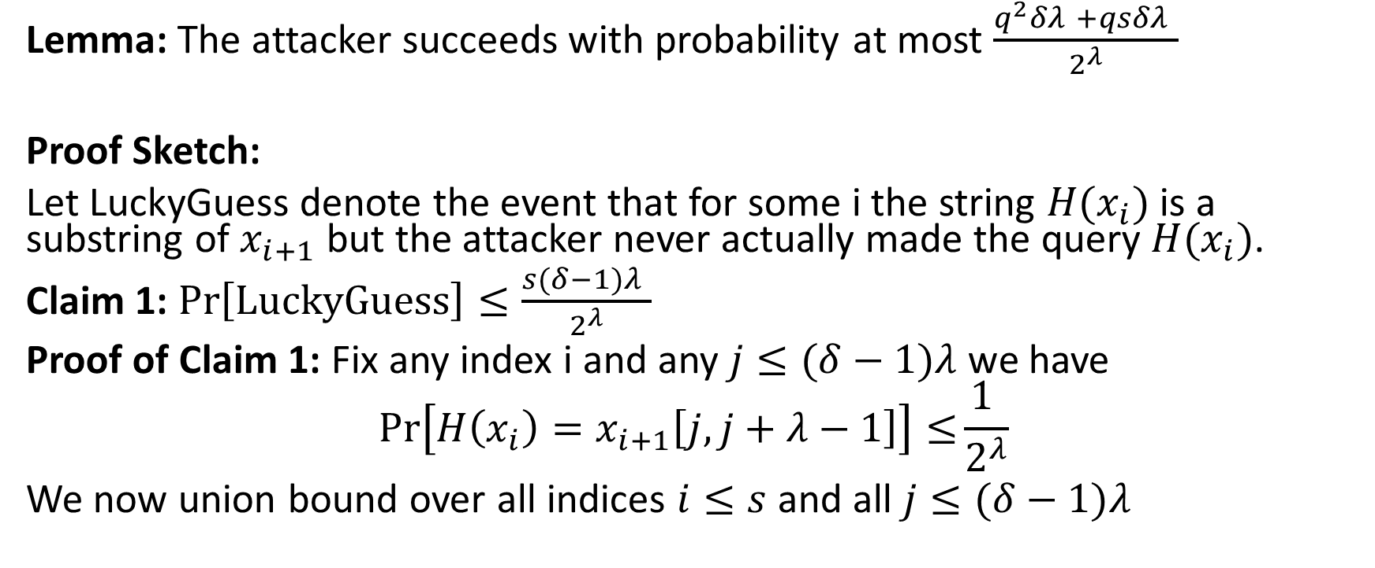
Random Oracles are Sequential
Lemma: The attacker succeeds with probability at most $\frac{q^{2}δλ +qsδλ }{2^{λ}}$
Proof Sketch:
Let LuckyGuess denote the event that for some i the string $H(x_{i})$ is a substring of $x_{i+1}$ but the attacker never actually made the query $H(x_{i})$.
Claim 1: $\operatorname{Pr}\left[LuckyGuess\right]≤\frac{s(δ−1)λ }{2^{λ}}$
Proof of Claim 1: Fix any index i and any $j≤(δ−1)λ$ we have
$$\operatorname{Pr}\left[H\left(x_{i}\right)=x_{i+1}\left[j,j+λ−1\right]\right]≤\frac{\text{1} }{2^{λ}}$$
We now union bound over all indices $i≤s$ and all $j≤(δ−1)λ$

Slide 16
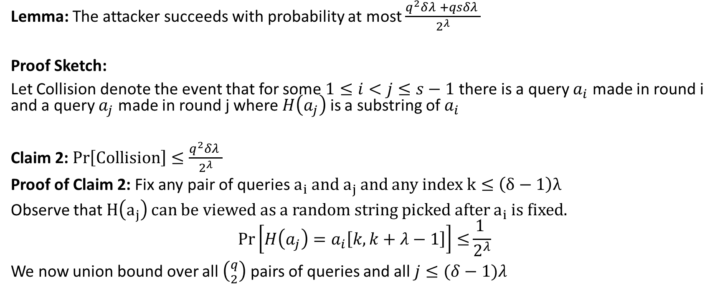
Random Oracles are Sequential
Lemma: The attacker succeeds with probability at most $\frac{q^{2}δλ +qsδλ }{2^{λ}}$
Proof Sketch:
Let Collision denote the event that for some $1≤i<j≤s−1$ there is a query $a_{i}$ made in round i and a query $a_{j}$ made in round j where $H\left(a_{j}\right)$ is a substring of $a_{i}$
Claim 2: $\operatorname{Pr}\left[Collision\right]≤\frac{q^{2}δλ }{2^{λ}}$
Proof of Claim 2: Fix any pair of queries $a_{i}$ and $a_{j}$and any index $k≤\left(δ−1\right)λ$
Observe that $H\left(a_{j}\right)$ can be viewed as a random string picked after $a_{i}$ is fixed.
$$\operatorname{Pr}\left[H\left(a_{j}\right)=a_{i}\left[k,k+λ−1\right]\right]≤\frac{\text{1} }{2^{λ}}$$
We now union bound over all $\left({q \atop 2}\right)$ pairs of queries and all $j≤(δ−1)λ$

Slide 17
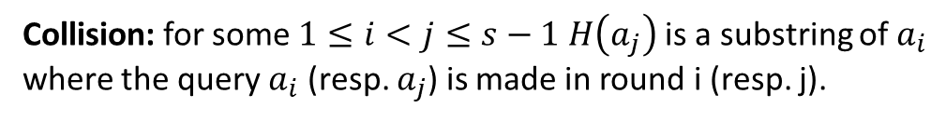
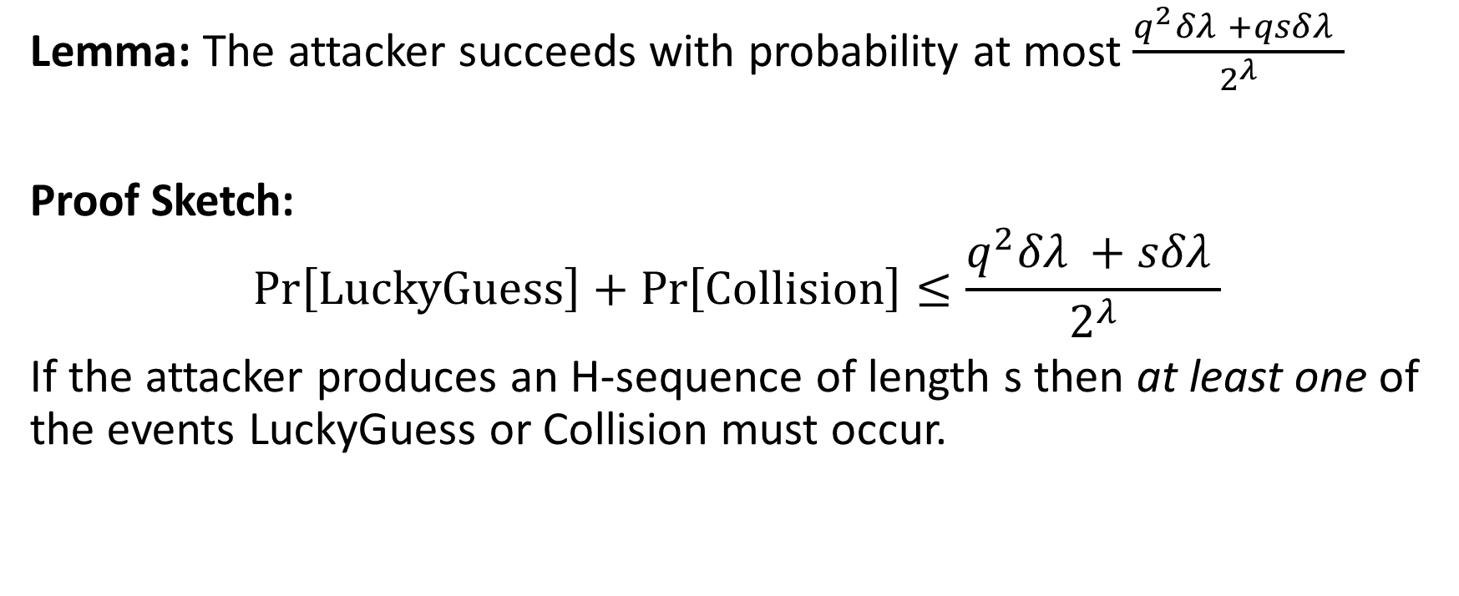
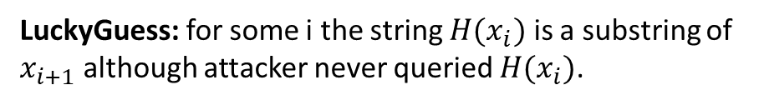
Random Oracles are Sequential
Lemma: The attacker succeeds with probability at most $\frac{q^{2}δλ +qsδλ }{2^{λ}}$
Proof Sketch:
$$\operatorname{Pr}\left[LuckyGuess\right]+\operatorname{Pr}\left[Collision\right]≤\frac{q^{2}δλ +sδλ }{2^{λ}}$$
If the attacker produces an H-sequence of length s then at least one of the events LuckyGuess or Collision must occur.
LuckyGuess: for some i the string $H(x_{i})$ is a substring of $x_{i+1}$ although attacker never queried $H(x_{i})$.
Collision: for some $1≤i<j≤s−1$ $H\left(a_{j}\right)$ is a substring of $a_{i}$ where the query $a_{i}$ (resp. $a_{j}$) is made in round i (resp. j).

Slide 18
The MMV’13 Construction
H
Prover P
Verifier V
statement χ
χ ←
Time T = 6
Protocol specifies depth-robust
DAG G on T nodes
£₁ £₂ £₃ £₄
£₅ £₆
Define “fresh” random oracle
H_{χ}(·) ≡ H(χ ·)
Compute labels of G using H_{χ}

Slide 19
The MMV’13 Construction
H
Prover P
Verifier V
statement χ
χ ←
Time T = 6
φ
Proof Sketch
G is (e, d) depth-robust
£l l l l l l
£₂ £₃ £₄ £₅ £₆
˜
l
1
i∈V
φ commits P to labels {£ }
i
i is bad if £^{l} /= H(£^{l}
)
i
parents(i)
φ
Case 1: ≥ e bad nodes ⇒ will fail opening phase whp.

Slide 20
The MMV’13 Construction
H
Prover P
Verifier V
statement χ
χ ←
Time T = 6
φ
Proof Sketch
G is (e, d) depth-robust
£l l l l l l
£₂ £₃ £₄ £₅ £₆
˜
l
1
i∈V
φ commits P to labels {£ }
i
i is bad if £^{l} /= H(£^{l}
)
i
parents(i)
φ
Case 1: ≥ e bad nodes ⇒ will fail opening phase whp.
Case 2: Less than e bad labels ⇒ ∃ path of good nodes (by (e, d) depth-robustness) ⇒ P˜ made d sequential queries (by sequantality of RO)

Slide 21
The New Construction
T = 15
For every leaf i add all edges (j, i) where j is left sibling of node on path i → root

Slide 22
The New Construction
T = 15
right sibling
left sibling
For every leaf i add all edges (j, i) where j is left sibling of node on path i → root

Slide 23
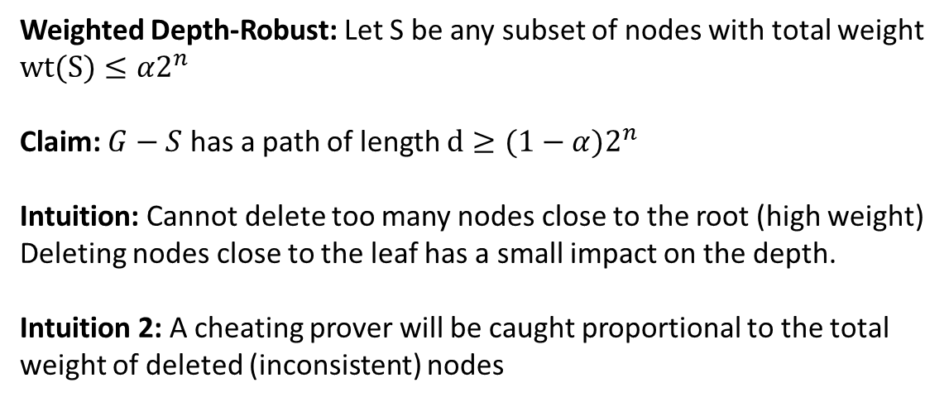
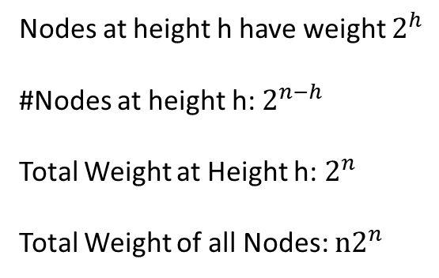
Weighted Depth-Robust
φ
T = 15
weight=8, height 3
weight=4, height 2
weight=2, height 1
weight=1, height 0
Weighted Depth-Robust: Let S be any subset of nodes with total weight $wt(S)≤α2^{n}$
Claim: $G−S$ has a path of length $d≥(1−α)2^{n}$
Intuition: Cannot delete too many nodes close to the root (high weight)
Deleting nodes close to the leaf has a small impact on the depth.
Intuition 2: A cheating prover will be caught proportional to the total weight of deleted (inconsistent) nodes
Nodes at height h have weight $2^{h}$
#Nodes at height h: $2^{n−h}$
Total Weight at Height h: $2^{n}$
Total Weight of all Nodes: $n2^{n}$

Slide 24

Weighted-Depth-Robustness
Suppose we delete S. Let $D_{S}$ be the set of nodes which are in S or below some node in S.
Claim: There is a directed path through all nodes in $V−D_{S}$

Slide 25
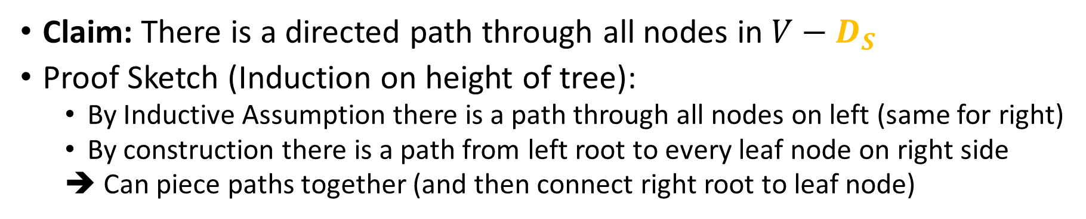
Weighted-Depth-Robustness
Claim: There is a directed path through all nodes in $V−D_{S}$
Proof Sketch (Induction on height of tree):
  By Inductive Assumption there is a path through all nodes on left (same for right)
  By construction there is a path from left root to every leaf node on right side
  ➔ Can piece paths together (and then connect right root to leaf node)
Left
Right

Slide 26
The New Construction
T = 15
For every leaf i add all edges (j, i) where j is left sibling of node on path i → root

Slide 27
The New Construction
T = 15
15
14
₃
₁ ₂
For every leaf i add all edges (j, i) where j is left sibling of node on path i → root
P computes labelling £_{i} = H(£_{parents(i)}) and sends root
label φ = £_{T} to V. Can be done storing only log(T ) labels.
V challenges P to open a subset of leaves and checks consistency (blue and green edges!)

Slide 28
The New Construction
φ
T = 15
Proof Sketch

Slide 29
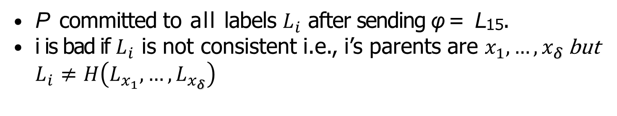
The New Construction
φ
T = 15
Proof Sketch
˜
P committed to all labels $L_{i}$ after sending φ = L₁₅.
i is bad if $L_{i}$ is not consistent i.e., i’s parents are $x_{1},…,x_{δ}$ but $L_{i}≠H\left(L_{x_{1}},…,L_{x_{δ}}\right)$

Slide 30
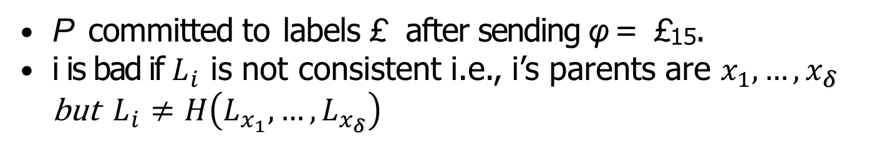
The New Construction
φ
T = 15
Proof Sketch
˜
l
P committed to labels £ after sending φ = £₁₅.
i is bad if $L_{i}$ is not consistent i.e., i’s parents are $x_{1},…,x_{δ}$ but $L_{i}≠H\left(L_{x_{1}},…,L_{x_{δ}}\right)$
i
Let S ⊂ V denote the bad nodes and all nodes below.

Slide 31
The New Construction
φ
T = 15
Proof Sketch
˜
l
P committed to labels £ after sending φ = £₁₅.
i
i is bad if £^{l} /= H(£^{l}
).
i
parents(i)
Let S ⊂ V denote the bad nodes and all nodes below.
Claim 1: ∃ path going through V − S (of length T − |S|).
Claim 2: P˜ can’t open |S|/T fraction of leafs.
Theorem: P˜ made only T (1 − c) sequential queries
⇒ will pass opening phase with prob. ≤ (1 − c)^{#of challenges}

Slide 32
Wei

Slide 33
Three Problems of the [MMV’13] PoSW
Space Complexity : Prover needs massive (linear in T)
space to compute proof.
Poor/Unclear Parameters due to usage of sophisticated combinatorial objects.
Uniqueness : Once an accepting proof is computed, many other valid proofs can be generated (not a problem for time-stamping, but for blockchains).

Slide 34
Three Problems of the [MMV’13] PoSW
Space Complexity : Prover needs massive (linear in T)
space to compute proof.
Poor/Unclear Parameters due to usage of sophisticated combinatorial objects.
Uniqueness : Once an accepting proof is computed, many other valid proofs can be generated (not a problem for time-stamping, but for blockchains).
New Construction
Prover needs only O(log(T )) (not O(T )) space, e.g. for
T = 2⁴² (≈ a day) that’s ≈ 10KB vs. ≈ 1P B.
Simple construction and proof with good concrete parameters.
Awesome open problem!

Slide 35
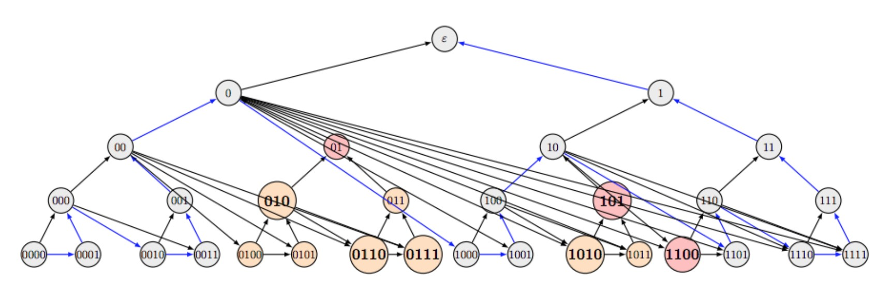
Construction and Proof Sketch

Slide 36
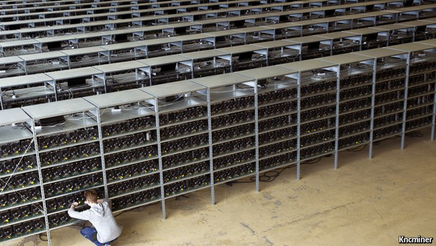
Mining Bitcoin (Proofs of Work)

Slide 37
Mining Bitcoin (Proofs of Work)
Ecological: Massive energy & hardware waste.
Economical: Requires high rewards ⇒
inflation and/or high transaction fees.
Security: E.g. buy old ASICs for 51%
attack.

Slide 38

Can we have a more “sustainable” Blockchain?

Slide 39
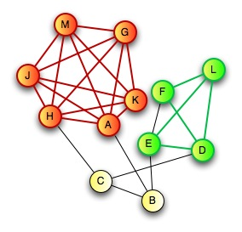
Zero-Knowledge Proof for all NP
CLIQUE
  Input: Graph G=(V,E) and integer k>0
  Question: Does G have a clique of size k?
CLIQUE is NP-Complete
  Any problem in NP reduces to CLIQUE
  A zero-knowledge proof for CLIQUE yields proof for all of NP via reduction
Prover:
  Knows k vertices v₁,…,v_{k} in G=(V,E) that form a clique

Slide 40

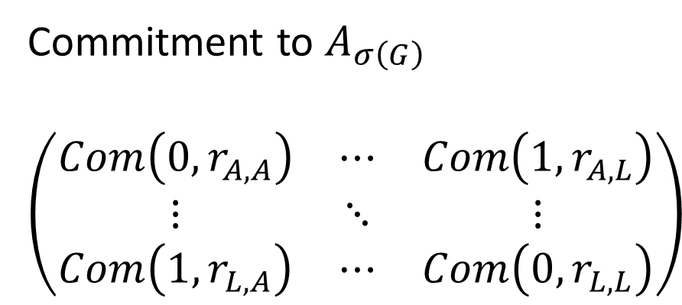
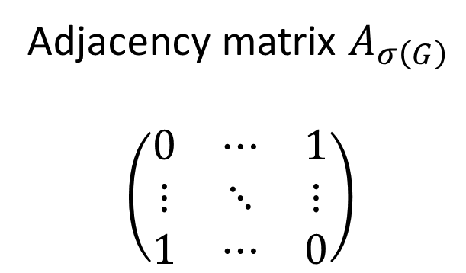
Zero-Knowledge Proof for all NP
C
D
$$σ\left(G\right)$$
E
H
G
A
F
B
J
I
L
K
Commitment to $A_{σ\left(G\right)}$
$$\left(\begin{matrix}Com\left(0,r_{A,A}\right) & ⋯ & Com\left(1,r_{A,L}\right) \\ ⋮ & ⋱ & ⋮ \\ Com\left(1,r_{L,A}\right) & ⋯ & Com\left(0,r_{L,L}\right)\end{matrix}\right)$$
Adjacency matrix $A_{σ\left(G\right)}$
$$\left(\begin{matrix}0 & ⋯ & 1 \\ ⋮ & ⋱ & ⋮ \\ 1 & ⋯ & 0\end{matrix}\right)$$
A
L
A
L
A
A
L
L

Slide 41
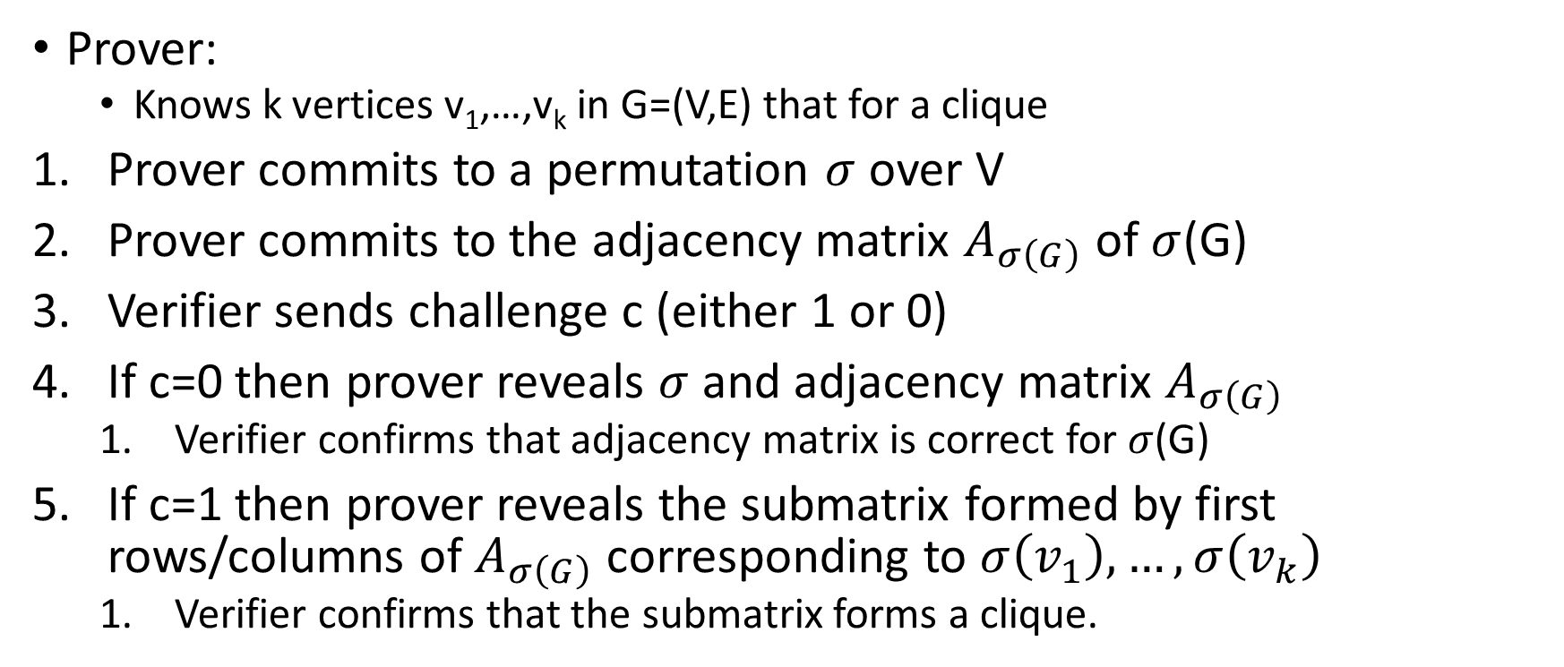
Zero-Knowledge Proof for all NP
C
D
E
H
G
A
F
B
J
Prover:
  Knows k vertices v₁,…,v_{k} in G=(V,E) that for a clique
Prover commits to a permutation $σ$ over V
Prover commits to the adjacency matrix $A_{σ\left(G\right)}$ of $σ$(G)
Verifier sends challenge c (either 1 or 0)
If c=0 then prover reveals $σ$ and adjacency matrix $A_{σ\left(G\right)}$
  Verifier confirms that adjacency matrix is correct for $σ$(G)
If c=1 then prover reveals the submatrix formed by first rows/columns of $A_{σ\left(G\right)}$ corresponding to $σ\left(v_{1}\right),…,σ\left(v_{k}\right)$
  Verifier confirms that the submatrix forms a clique.
I
L
K

Slide 42
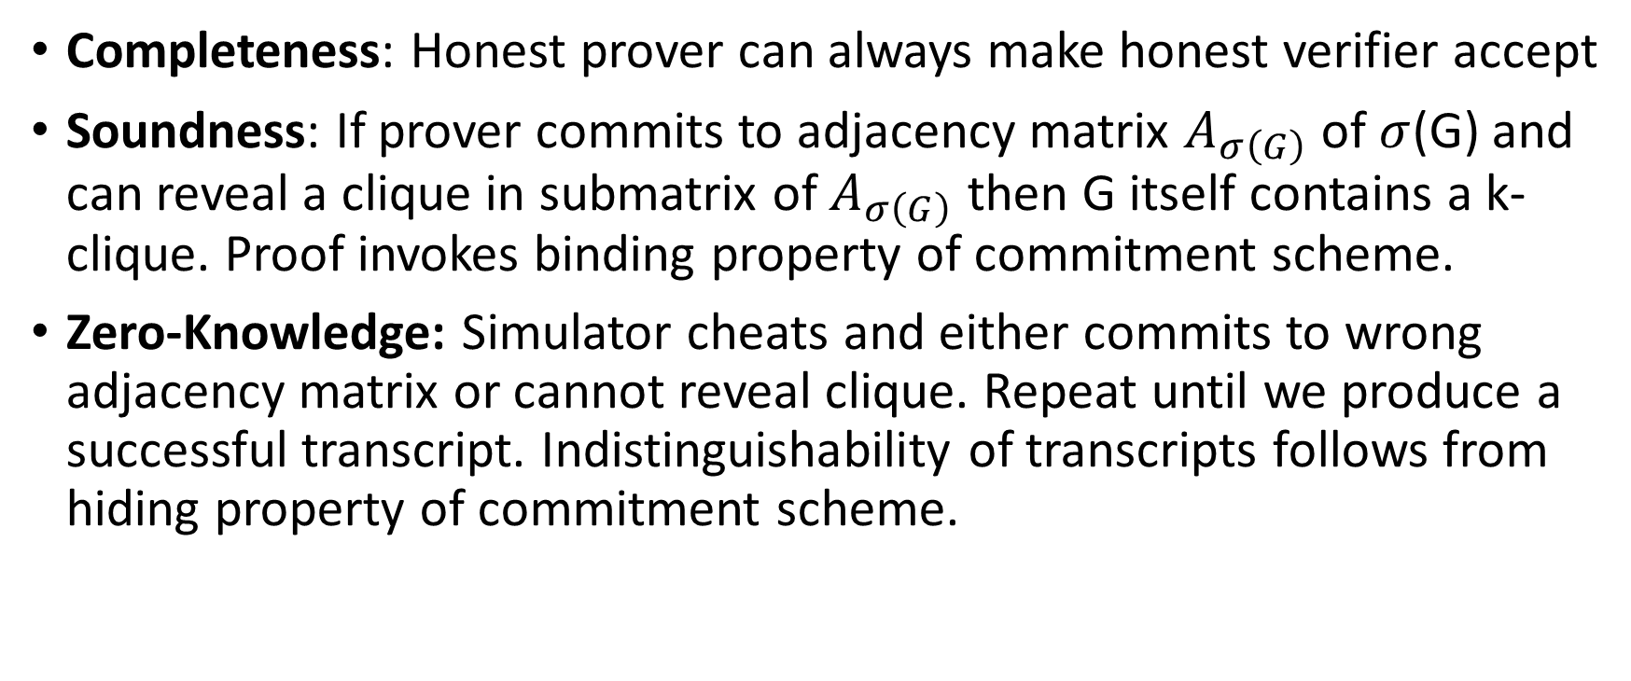
Zero-Knowledge Proof for all NP
Completeness: Honest prover can always make honest verifier accept
Soundness: If prover commits to adjacency matrix $A_{σ\left(G\right)}$ of $σ$(G) and can reveal a clique in submatrix of $A_{σ\left(G\right)}$ then G itself contains a k-clique. Proof invokes binding property of commitment scheme.
Zero-Knowledge: Simulator cheats and either commits to wrong adjacency matrix or cannot reveal clique. Repeat until we produce a successful transcript. Indistinguishability of transcripts follows from hiding property of commitment scheme.

Slide 43
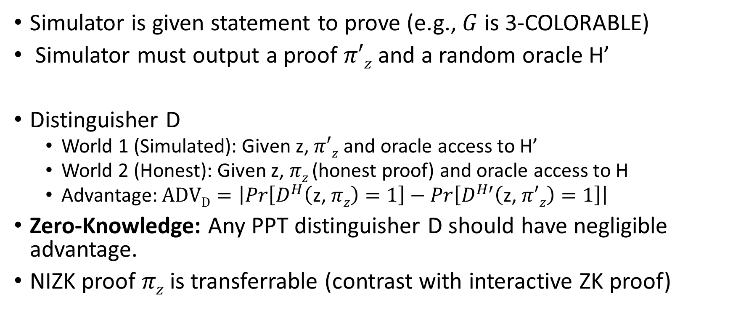
NIZK Security (Random Oracle Model)
Simulator is given statement to prove (e.g., $G$ is 3-COLORABLE)
Simulator must output a proof $π′z$ and a random oracle H’
Distinguisher D
  World 1 (Simulated): Given z, $π′z$ and oracle access to H’
  World 2 (Honest): Given z, $πz$(honest proof) and oracle access to H
  Advantage: $ADVD=\left|Pr\left[D^{H}\left(\text{z}\text{, }πz\right)=1\right]−Pr\left[D^{H′}\left(\text{z}\text{, }π′z\right)=1\right]\right|$
Zero-Knowledge: Any PPT distinguisher D should have negligible advantage.
NIZK proof $πz$ is transferrable (contrast with interactive ZK proof)

Slide 44
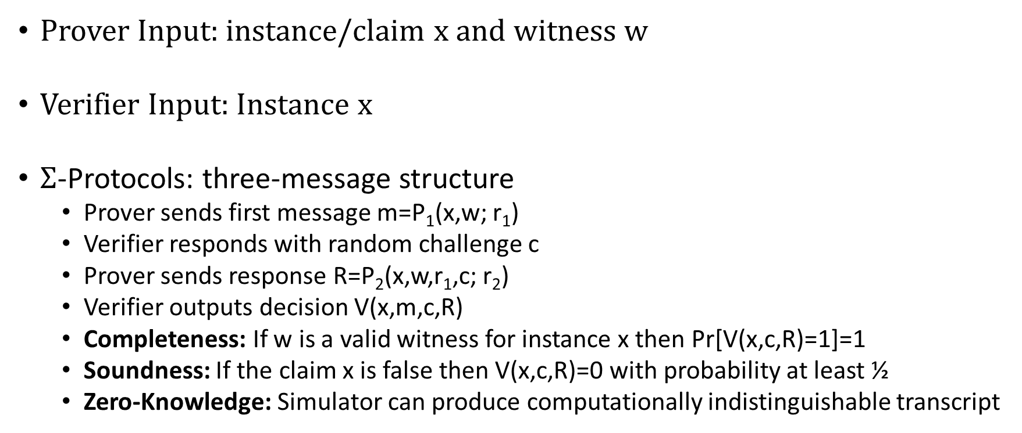
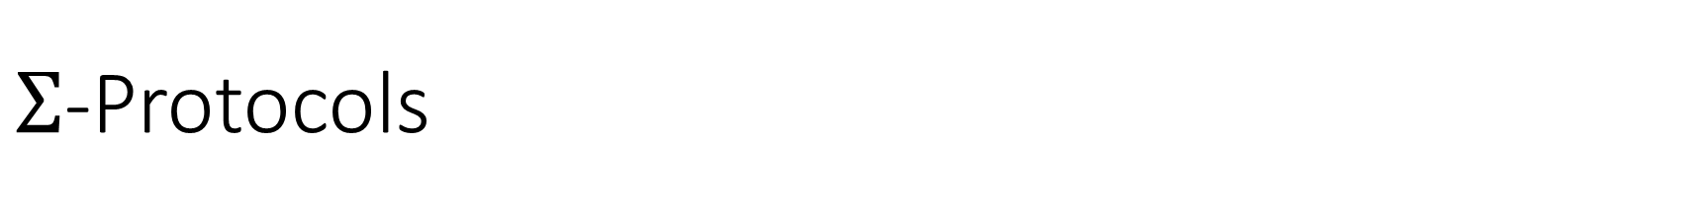
$Σ$-Protocols
Prover Input: instance/claim x and witness w
Verifier Input: Instance x
$Σ$-Protocols: three-message structure
  Prover sends first message m=P₁(x,w; r₁)
  Verifier responds with random challenge c
  Prover sends response R=P₂(x,w,r₁,c; r₂)
  Verifier outputs decision V(x,m,c,R)
  Completeness: If w is a valid witness for instance x then Pr[V(x,c,R)=1]=1
  Soundness: If the claim x is false then V(x,c,R)=0 with probability at least ½
  Zero-Knowledge: Simulator can produce computationally indistinguishable transcript

Slide 45
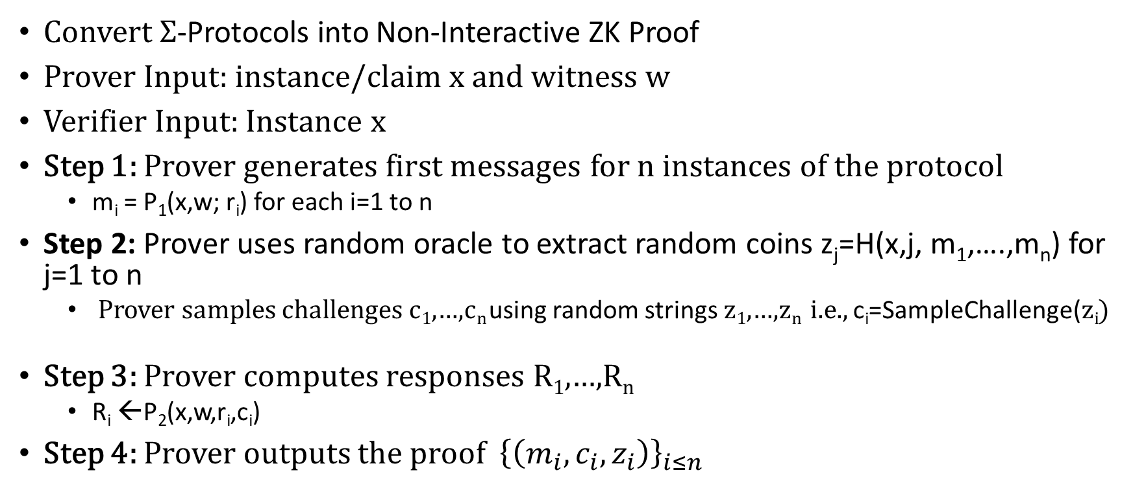
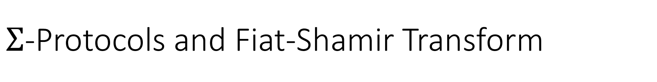
$Σ$-Protocols and Fiat-Shamir Transform
Convert $Σ$-Protocols into Non-Interactive ZK Proof
Prover Input: instance/claim x and witness w
Verifier Input: Instance x
Step 1: Prover generates first messages for n instances of the protocol
  m_{i} = P₁(x,w; r_{i}) for each i=1 to n
Step 2: Prover uses random oracle to extract random coins z_{j}=H(x,j, m₁,….,m_{n}) for j=1 to n
  Prover samples challenges c₁,…,c_{n} using random strings z₁,…,z_{n} i.e., c_{i}=SampleChallenge(z_{i})
Step 3: Prover computes responses R₁,…,R_{n}
  R_{i} ←P₂(x,w,r_{i},c_{i})
Step 4: Prover outputs the proof ${\left\{\left(m_{i},c_{i},z_{i}\right)\right\}}_{i≤n}$

Slide 46
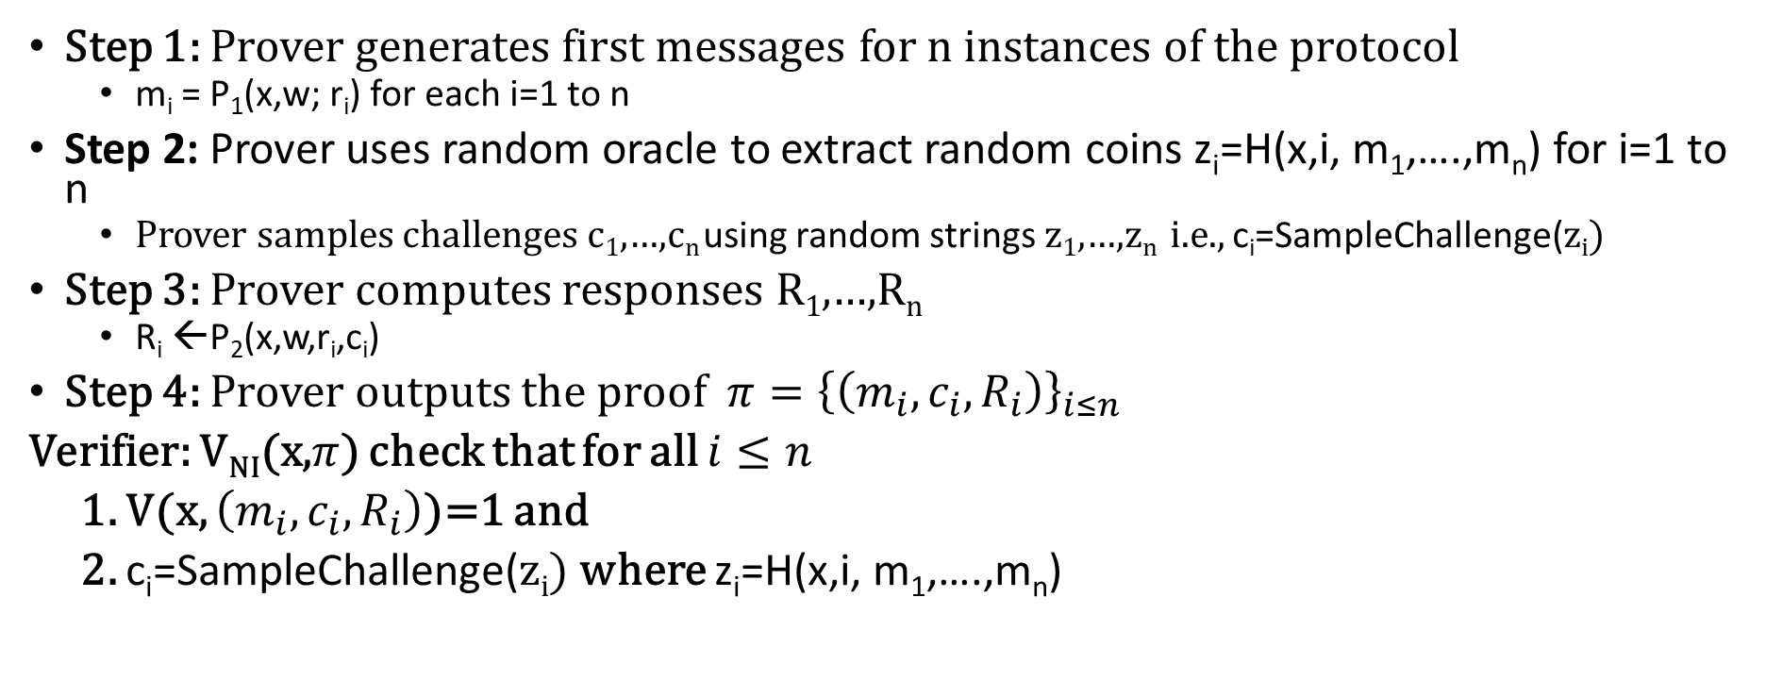
$Σ$-Protocols and Fiat-Shamir Transform
Step 1: Prover generates first messages for n instances of the protocol
  m_{i} = P₁(x,w; r_{i}) for each i=1 to n
Step 2: Prover uses random oracle to extract random coins z_{i}=H(x,i, m₁,….,m_{n}) for i=1 to n
  Prover samples challenges c₁,…,c_{n} using random strings z₁,…,z_{n} i.e., c_{i}=SampleChallenge(z_{i})
Step 3: Prover computes responses R₁,…,R_{n}
  R_{i} ←P₂(x,w,r_{i},c_{i})
Step 4: Prover outputs the proof ${π=\left\{\left(m_{i},c_{i},R_{i}\right)\right\}}_{i≤n}$
Verifier: V_{NI}(x,$π$) check that for all $i≤n$
1. V(x, $\left(m_{i},c_{i},R_{i}\right)$)=1 and
2. c_{i}=SampleChallenge(z_{i}) where z_{i}=H(x,i, m₁,….,m_{n})

Slide 47
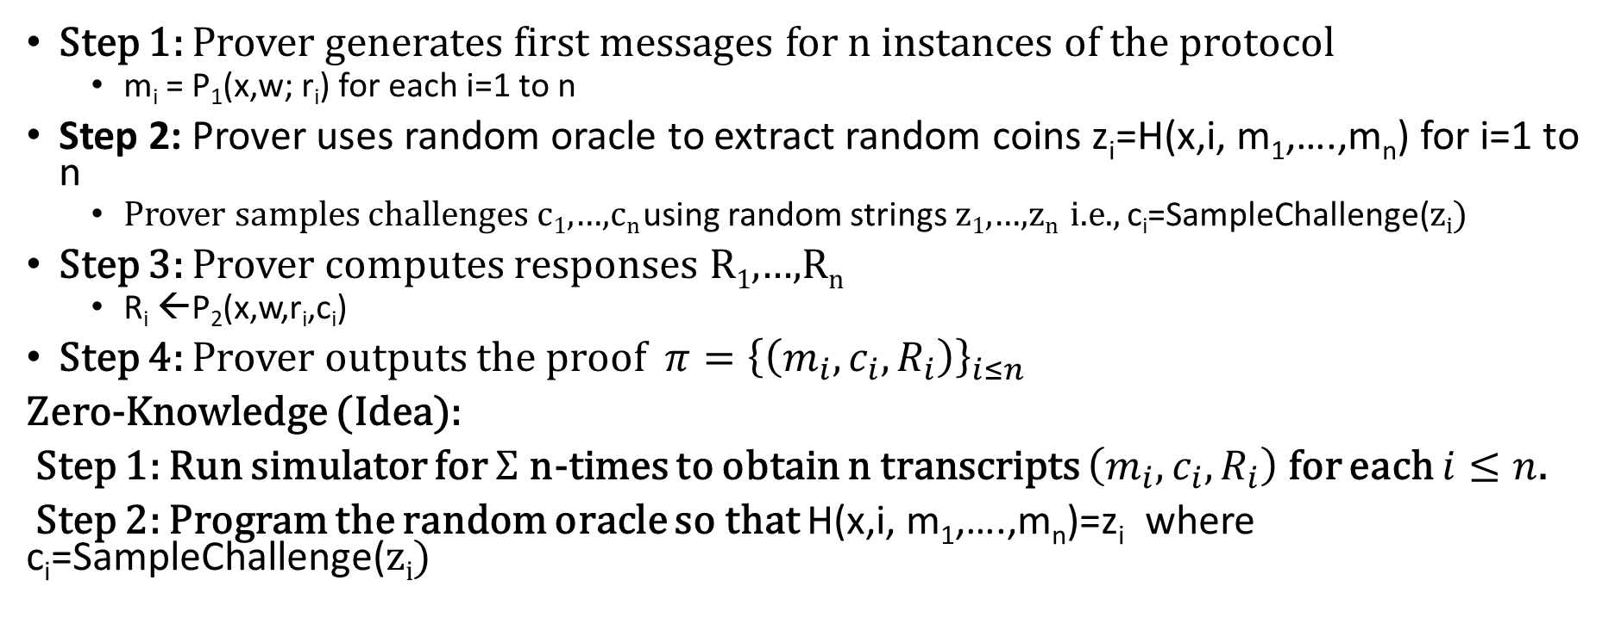
$Σ$-Protocols and Fiat-Shamir Transform
Step 1: Prover generates first messages for n instances of the protocol
  m_{i} = P₁(x,w; r_{i}) for each i=1 to n
Step 2: Prover uses random oracle to extract random coins z_{i}=H(x,i, m₁,….,m_{n}) for i=1 to n
  Prover samples challenges c₁,…,c_{n} using random strings z₁,…,z_{n} i.e., c_{i}=SampleChallenge(z_{i})
Step 3: Prover computes responses R₁,…,R_{n}
  R_{i} ←P₂(x,w,r_{i},c_{i})
Step 4: Prover outputs the proof ${π=\left\{\left(m_{i},c_{i},R_{i}\right)\right\}}_{i≤n}$
Zero-Knowledge (Idea):
Step 1: Run simulator for $Σ$ n-times to obtain n transcripts $\left(m_{i},c_{i},R_{i}\right)$ for each $i≤n$.
Step 2: Program the random oracle so that H(x,i, m₁,….,m_{n})=z_{i} where c_{i}=SampleChallenge(z_{i})

Slide 48
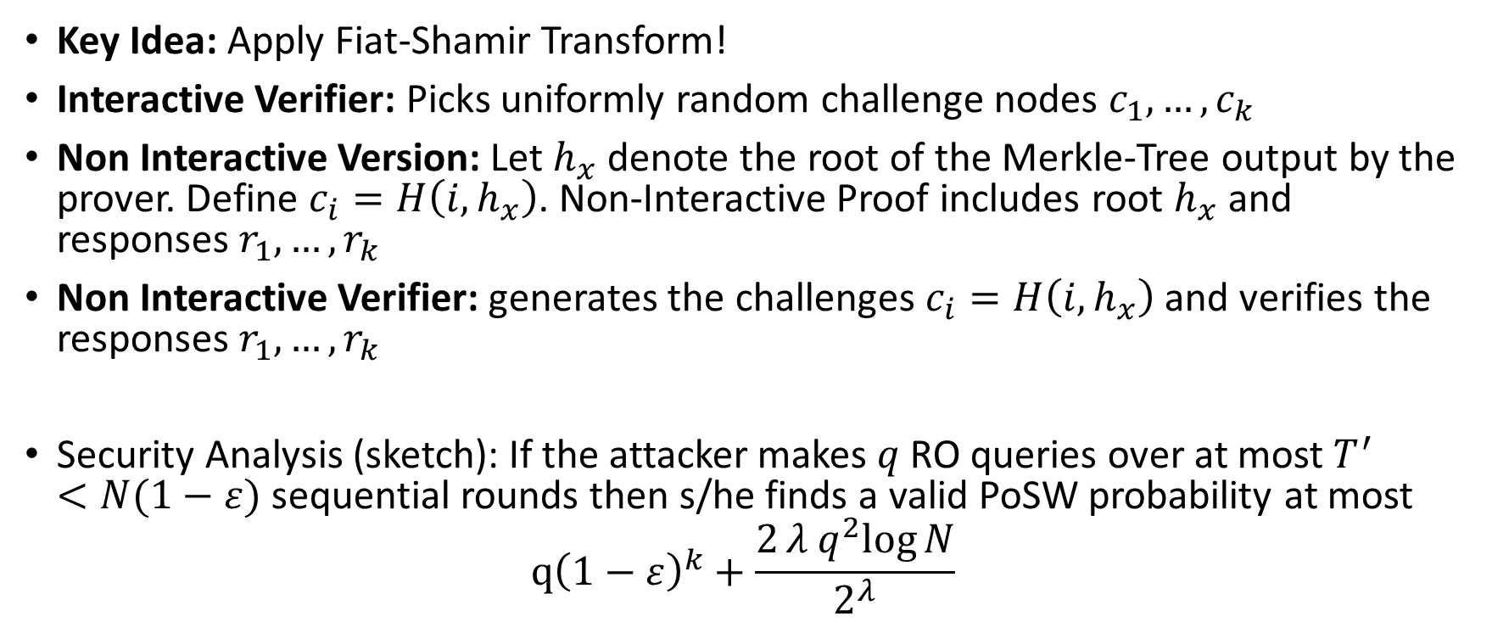
Non-Interactive Proof of Sequential Work
Key Idea: Apply Fiat-Shamir Transform!
Interactive Verifier: Picks uniformly random challenge nodes $c_{1},…,c_{k}$
Non Interactive Version: Let $h_{x}$ denote the root of the Merkle-Tree output by the prover. Define $c_{i}=H\left(i,h_{x}\right)$. Non-Interactive Proof includes root $h_{x}$ and responses $r_{1},…,r_{k}$
Non Interactive Verifier: generates the challenges $c_{i}=H\left(i,h_{x}\right)$ and verifies the responses $r_{1},…,r_{k}$
Security Analysis (sketch): If the attacker makes $q$ RO queries over at most $T^{′}<N(1−ε)$ sequential rounds then s/he finds a valid PoSW probability at most
$$q{\left(1−ε\right)}^{k}+\frac{2λ q^{2}log{N}}{2^{λ}}$$
Probability of finding ``lucky” challenges
Probability of finding an H-sequence longer than
T’

Slide 49
Verifiable Delay Functions
Dan Boneh, Joe Bonneau,
Benedikt Bünz, Ben Fisch
Crypto 2018

Slide 50


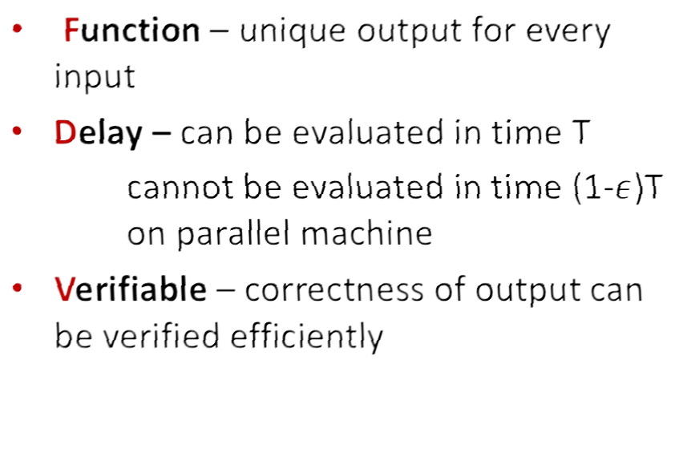











What is a VDF?
Verifier

Slide 51
What is a VDF?
Setup(λ, T) ⟶ public parameters pp
➢pp specify domain X and range Y
Eval(pp, x) ⟶ output y,
proof π
➢PRAM runtime T with polylog(T) processors
Verify(pp, x, y, π) ⟶
{ yes, no }
➢Time complexity at most polylog(T)

Slide 52
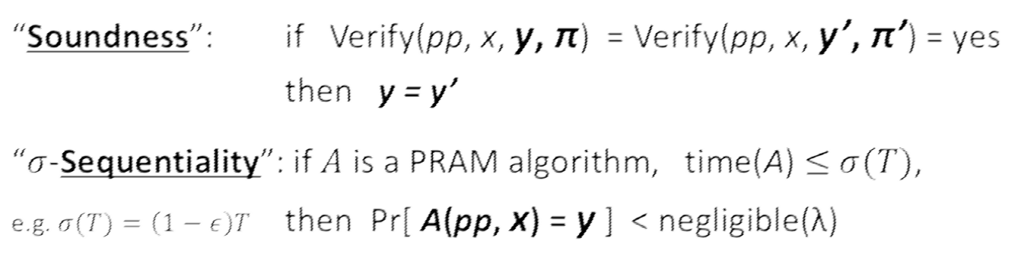
Security Properties (Informal)
Setup(λ, T) ⟶ public parameters pp
Eval(pp, x) ⟶ output y, proof π
(requires T steps)
Verify(pp, x, y, π) ⟶
{ yes, no }

Slide 53
Related Crypto Primitives
Time-lock puzzles [RSW’96, BN’00, BGJPVW’16]
  Trapdoor (secret key) setup per puzzle
  Not ``publicly verifiable”
Proof-of-sequential-work [MMV’13, CP’18]
  Publicly verifiable
  Not a function (output isn’t unique)

Slide 54
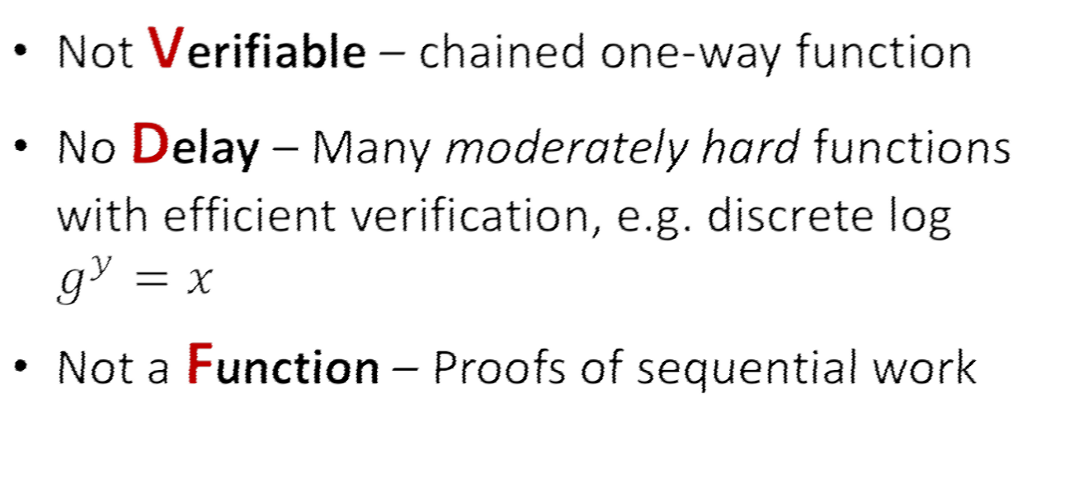
VDF minus any property is “easy”

Slide 55
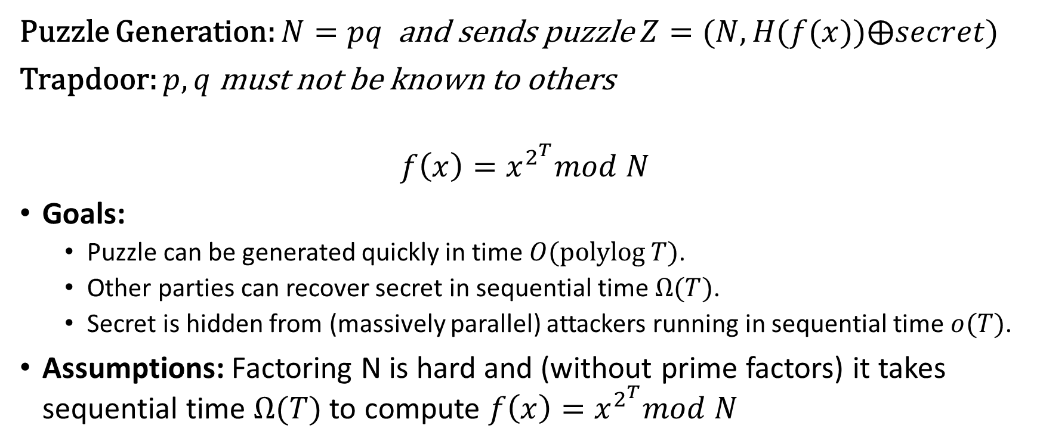
RSW Timelock Puzzle (Repeated Squaring)
Puzzle Generation: $N=pq$ and sends puzzle $Z=(N,H(f(x))⨁secret)$
Trapdoor: $p,q$ must not be known to others
$$f\left(x\right)=x^{2^{T}}mod N$$
Goals:
  Puzzle can be generated quickly in time $O(\operatorname{polylog}{T})$.
  Other parties can recover secret in sequential time $Ω(T)$.
  Secret is hidden from (massively parallel) attackers running in sequential time $o(T)$.
Assumptions: Factoring N is hard and (without prime factors) it takes sequential time $Ω(T)$ to compute $f\left(x\right)=x^{2^{T}}mod N$

Slide 56
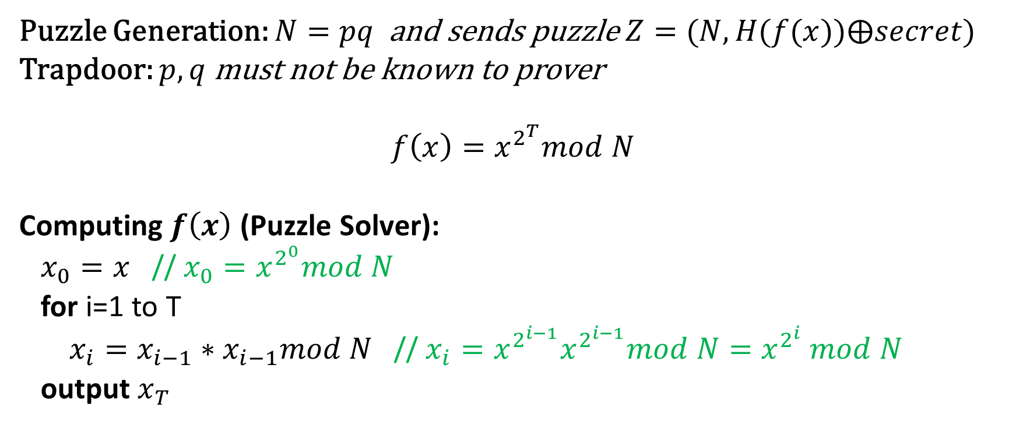
RSW Timelock Puzzle (Repeated Squaring)
Puzzle Generation: $N=pq$ and sends puzzle $Z=(N,H(f(x))⨁secret)$
Trapdoor: $p,q$ must not be known to prover
$$f\left(x\right)=x^{2^{T}}mod N$$
Computing $f\left(x\right)$ (Puzzle Solver):
$x_{0}=x$ // $x_{0}=x^{2^{0}}mod N$
for i=1 to T
$x_{i}=x_{i−1}∗x_{i−1}mod N$ // $x_{i}=x^{2^{i−1}}x^{2^{i−1}}mod N=x^{2^{i}} mod N$
output $x_{T}$

Slide 57
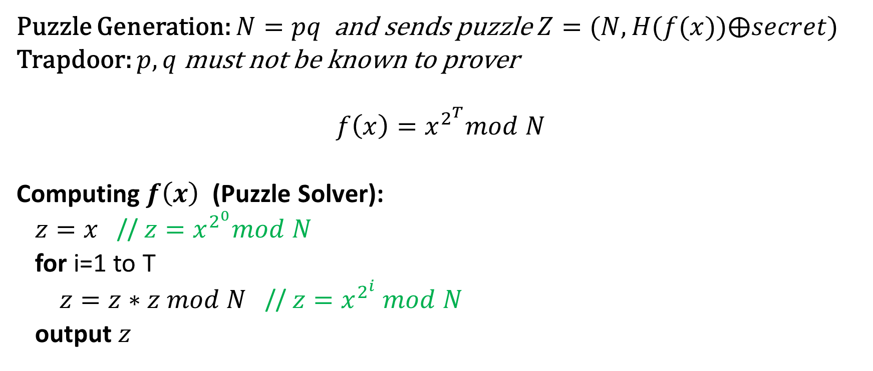
RSW Timelock Puzzle(Repeated Squaring)
Puzzle Generation: $N=pq$ and sends puzzle $Z=(N,H(f(x))⨁secret)$
Trapdoor: $p,q$ must not be known to prover
$$f\left(x\right)=x^{2^{T}}mod N$$
Computing $f\left(x\right)$ (Puzzle Solver):
$z=x$ // $z=x^{2^{0}}mod N$
for i=1 to T
$z=z∗z mod N$ // $z=x^{2^{i}} mod N$
output $z$

Slide 58

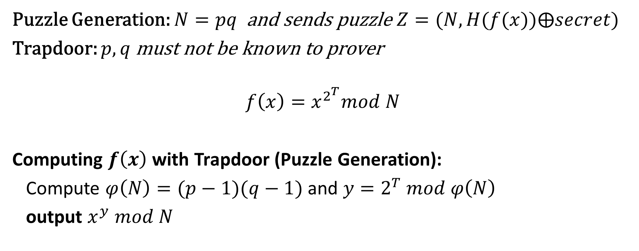
RSW Timelock Puzzle (Repeated Squaring)
Puzzle Generation: $N=pq$ and sends puzzle $Z=(N,H(f(x))⨁secret)$
Trapdoor: $p,q$ must not be known to prover
$$f\left(x\right)=x^{2^{T}}mod N$$
Computing $f\left(x\right)$ with Trapdoor (Puzzle Generation):
Compute $φ\left(N\right)=(p−1)(q−1)$ and $y=2^{T} mod φ\left(N\right)$
output $x^{y} mod N$
$O(\log{N)≪T}$ multiplication queries mod N

Slide 59
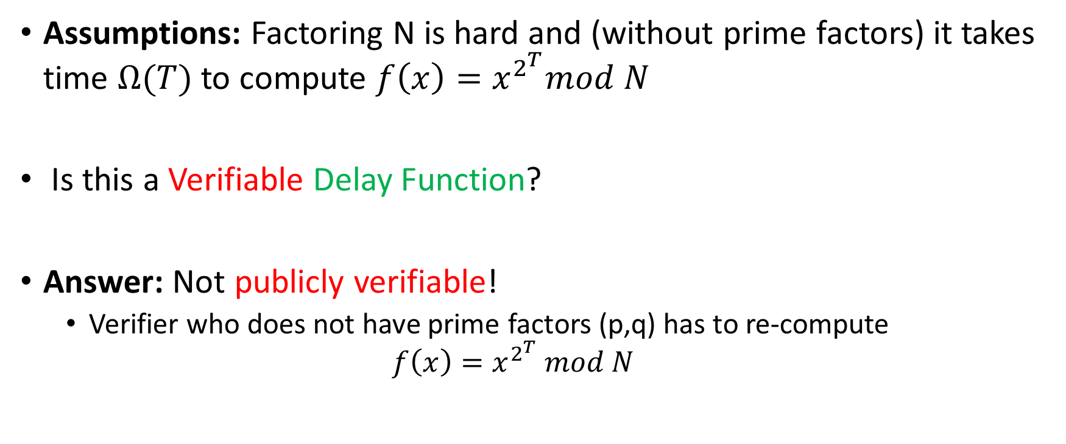
RSW Timelock Puzzle (Repeated Squaring)
Assumptions: Factoring N is hard and (without prime factors) it takes time $Ω(T)$ to compute $f\left(x\right)=x^{2^{T}}mod N$
Is this a Verifiable Delay Function?
Answer: Not publicly verifiable!
  Verifier who does not have prime factors (p,q) has to re-compute
  $$f\left(x\right)=x^{2^{T}} mod N$$

Slide 60
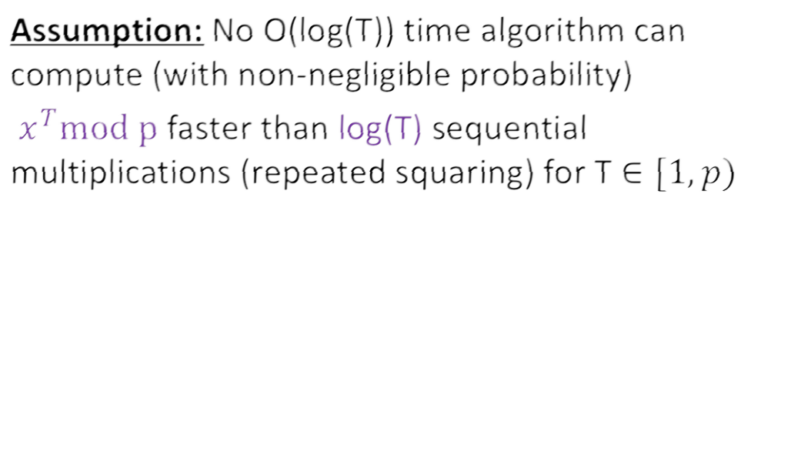
Modular square roots [DN’92, LW’15]

Slide 61
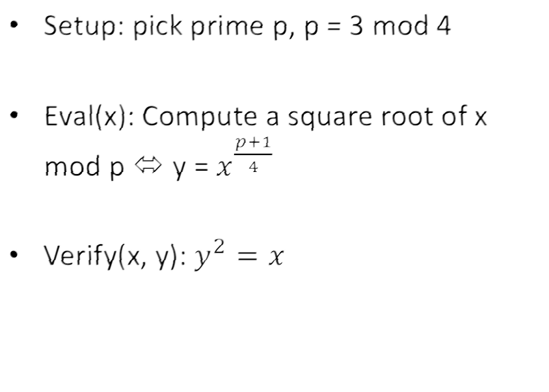







Modular square roots [DN’92, LW’15]
log(p)
squarings
1 squaring
proof size = log(p)

Slide 62


Modular square roots
A “proto-VDF”
  Eval time: log(p) * M(p)
  Verify time: M(p)
M(p) = time complexity of
multiplication mod p
Problem: Verify time not polylogarithmic in Eval time
10

Slide 63

Security Properties (Informal)
Setup(λ, T) ⟶ public parameters pp
Eval(pp, x) ⟶ output y, proof π
(requires T steps)
Verify(pp, x, y, π) ⟶
{ yes, no }

Slide 64
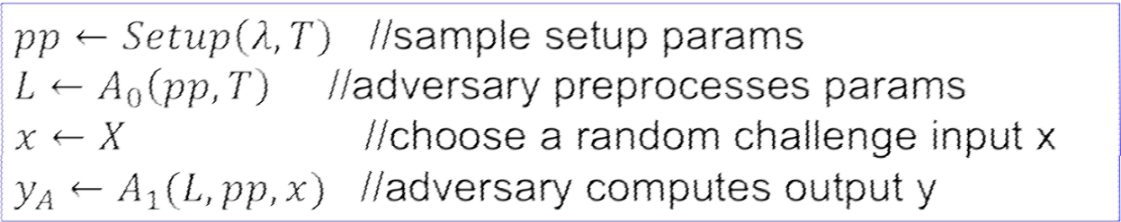
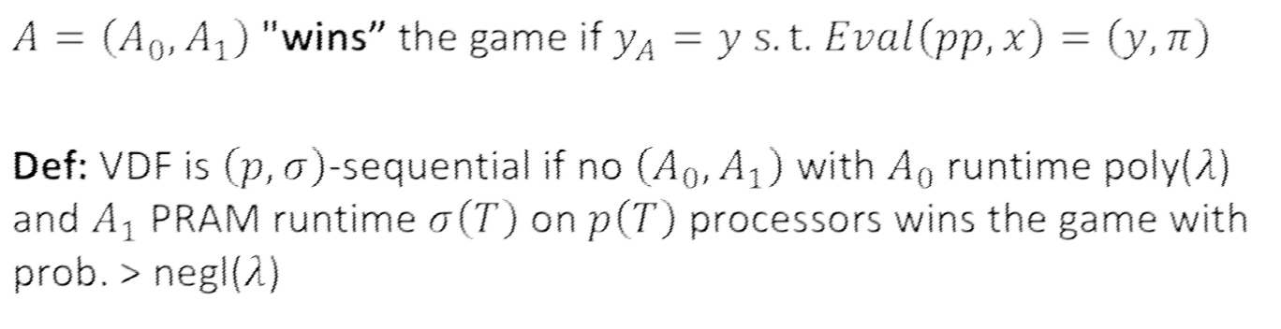
VDF security more formally…
Sequentiality Game

Slide 65

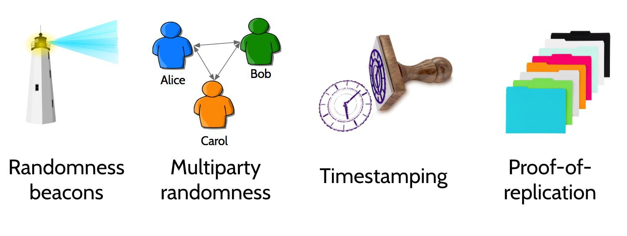

Part I: Applications of VDFs
Permissionless consensus

Slide 66
Randomness beacon
Rabin ‘83
An ideal service that regularly publishes random value which no party can predict or manipulate

Slide 67
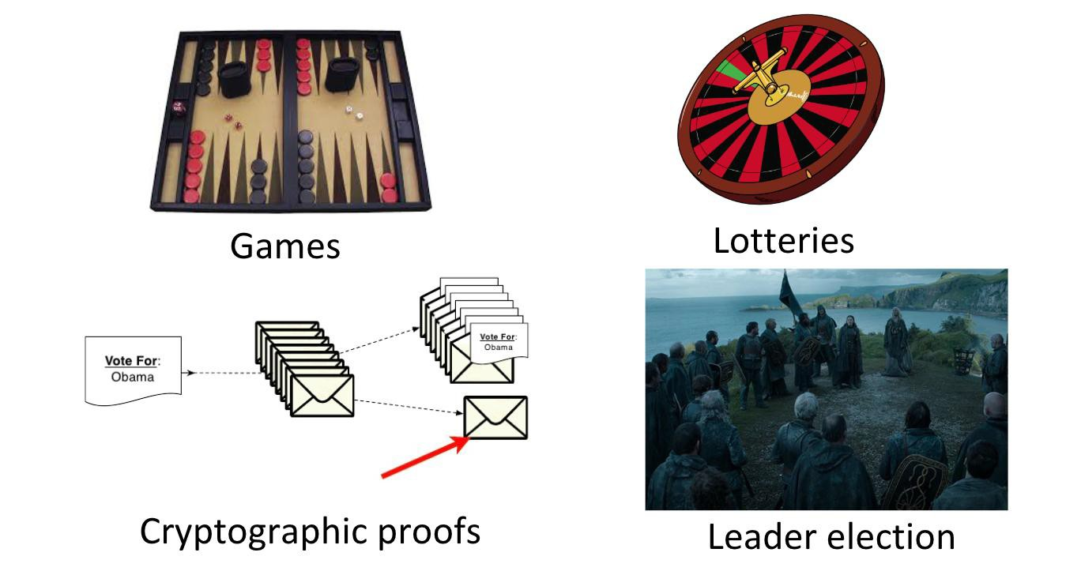
Many uses for random beacons

Slide 68
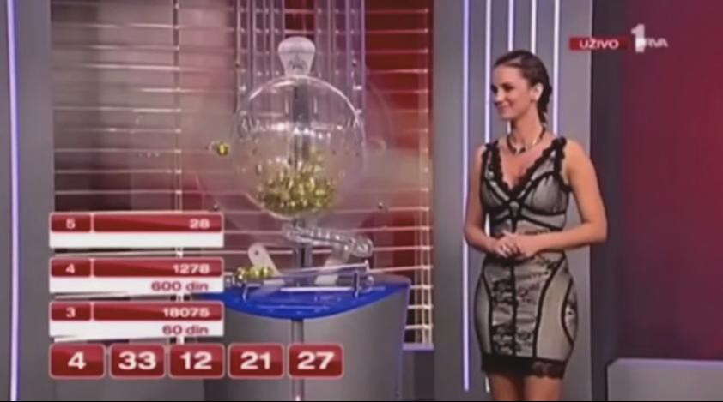


Randomness beacon
``Public displays” are easily corrupted

Slide 69
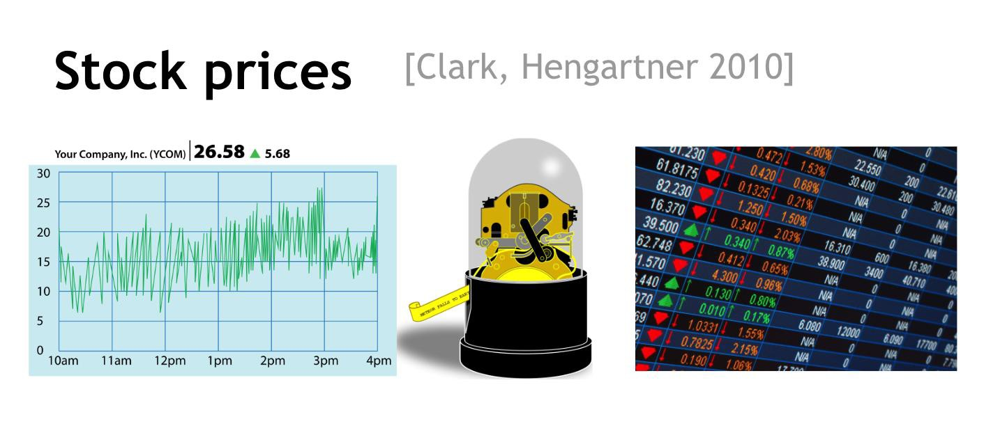
Public entropy source
Assumption:
(1) unpredictable,
(2) adversary cannot fix stock prices

Slide 70

Stock price manipulation

Slide 71












Stock price randomness beacon
Closing prices of 100 stocks:
The problem:
Once prices settle a minute before closing, attacker executes 20 last- minute trades to influence seed.
Attacker can predict outcome of trades and choose favorable trades to bias result
Hash(prices)
20 bits
extractor
128 bits
(seed)
pseudorandom
generator
Lots of bits

Slide 72











Solution: slow things down with a VDF
Hash(prices) 20 bits
extractor
128 bits
A solution: one hour VDF
Attacker cannot tell what trades to execute before market closes
Uniqueness: ensures no ambiguity about output
VDF
128 bits
, π
(seed)

Slide 73
















Simple Bulletin Board
Alice
Bob
Claire
Zoe
Mildly synchronous
r_{a}
r_{b}
r_{c}
r_{z}
Public Bulletin Board
output
seed = Hash(r_{a} || r_{b} || ⋯ || r_{z} ) ∈ {0,1}²⁵⁶
Problem: Zoe controls the final seed !!

Slide 74








Solution: slow things down with a VDF
[LW’15]
Alice
Bob
Claire
Zoe
r_{a}
r_{b}
r_{c}
r_{z}
Public Bulletin Board (blockchain)
Hash(r_{a} || r_{b} || ⋯ || r_{z} ) ∈ {0,1}²⁵⁶
VDF H seed, π

Slide 75


















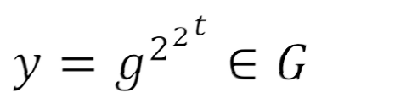
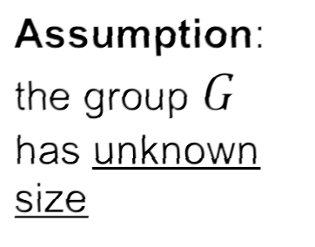


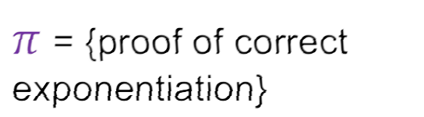
Part II: Constructions
I. _{x}
y
(reverse permutation)
This work
II.
Followup:
Pietrzak’18, Wesolowski’18

Slide 76
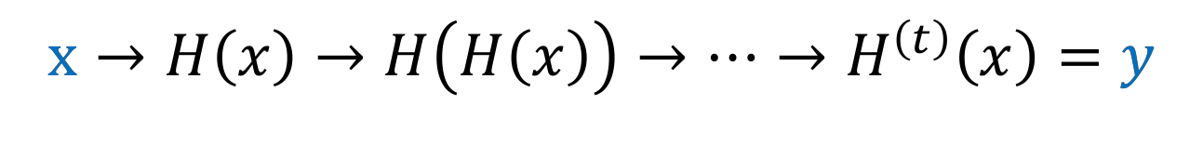

Hash Chain w/ Verifiable Computation
SNARK = “succinct non-interactive argument of knowledge”
[G’10,GGPR’13, BCIOP’13, BCCT’13]
STARK = “succinct transparent non-interactive argument of
knowledge” [M’00, BBHR’18]

Slide 77
Hash Chain w/ Verifiable Computation
Problem
Proof generation slower than hash chain, without massive parallelism

Slide 78
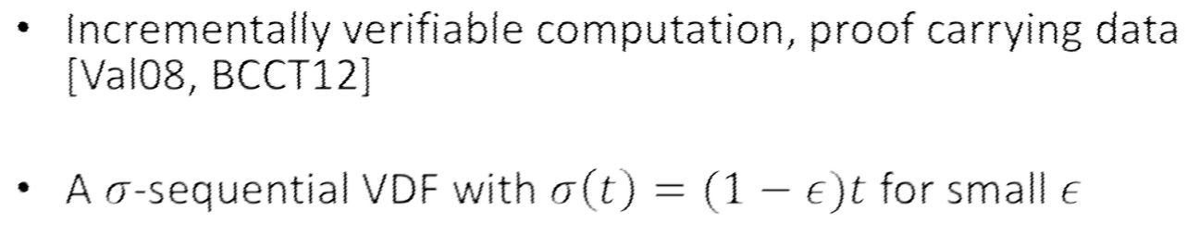









Incrementally Verifiable Computation
30

Slide 79









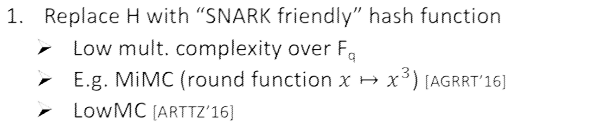
IVC SNARK Optimizations
31

Slide 80


























IVC SNARK Optimizations
x x
y y
Slow
Fast

Slide 81

IVC SNARK Optimizations
x x
y y
Slow
Fast

Slide 82

















































Square-roots vs SHA256
SHA256:
c
s
27,904 gates
Square-roots:
Coordinate swap
4 gates
c c
s
s
35

Slide 83







Better asymmetric permutations?
Slow
Fast
37

Slide 84








Permutation polynomials
Eval requires
d parallelism
d^{2.85} parallel. infeasible for
Adv.38

Slide 85








Permutation Polynomials Holy Grail
Exponentially large
Eval: O(d) PRAM steps
Exponential
gap!
Verify: O(log(d))

Slide 86











Permutation polynomials
Guralnick, Müler ’97

Slide 87


Permutation polynomials
Guralnick, Müler ’97

Slide 88
Construction | Summary
Verification | O(log(T)) SNARKs
Proof size | O(log(T))
Assumption | SNARK/STARK + Sqr. rts. or ideal perm. polynomial
Trusted setup | None w/ STARKs or using “slower” verification, sequentiality not broken
Quantum resistant | Possibly with STARKs
Simple | No

Slide 89




Newer VDFs [P’18, W’18]
Let G be a finite cyclic group with generator g ∈ G
G = {1, g, g², g³, … }
Assumption: the group G has unknown size
T squarings
pp = (G,
H: X ⟶ G)
Eval(pp, x): output
proof π = (proof of correct exponentiation)
[P’18, W’18]

Slide 90
THE END
https://eprint.iacr.org/2018/601
Survey of VDFs
https://eprint.iacr.org/2018/712.pdf
44

Slide 91
RSW Timelock Puzzle (Repeated Squaring)
Puzzle Generation: $N=pq$ and sends puzzle $Z=(N,H(f(x))⨁secret)$
Trapdoor: $p,q$ must not be known to others
$$f\left(x\right)=x^{2^{T}}mod N$$
Goals:
  Puzzle can be generated quickly in time $O(\operatorname{polylog}{T})$.
  Other parties can recover secret in sequential time $Ω(T)$.
  Secret is hidden from (massively parallel) attackers running in sequential time $o(T)$.
Assumptions: Factoring N is hard and (without prime factors) it takes sequential time $Ω(T)$ to compute $f\left(x\right)=x^{2^{T}}mod N$

Slide 92
RSW Timelock Puzzle (Repeated Squaring)
Puzzle Generation: $N=pq$ and sends puzzle $Z=(N,H(f(x))⨁secret)$
Trapdoor: $p,q$ must not be known to prover
$$f\left(x\right)=x^{2^{T}}mod N$$
Computing $f\left(x\right)$ (Puzzle Solver):
$x_{0}=x$ // $x_{0}=x^{2^{0}}mod N$
for i=1 to T
$x_{i}=x_{i−1}∗x_{i−1}mod N$ // $x_{i}=x^{2^{i−1}}x^{2^{i−1}}mod N=x^{2^{i}} mod N$
output $x_{T}$

Slide 93
RSW Timelock Puzzle(Repeated Squaring)
Puzzle Generation: $N=pq$ and sends puzzle $Z=(N,H(f(x))⨁secret)$
Trapdoor: $p,q$ must not be known to prover
$$f\left(x\right)=x^{2^{T}}mod N$$
Computing $f\left(x\right)$ (Puzzle Solver):
$z=x$ // $z=x^{2^{0}}mod N$
for i=1 to T
$z=z∗z mod N$ // $z=x^{2^{i}} mod N$
output $z$

Slide 94
RSW Timelock Puzzle (Repeated Squaring)
Puzzle Generation: $N=pq$ and sends puzzle $Z=(N,H(f(x))⨁secret)$
Trapdoor: $p,q$ must not be known to prover
$$f\left(x\right)=x^{2^{T}}mod N$$
Computing $f\left(x\right)$ with Trapdoor (Puzzle Generation):
Compute $φ\left(N\right)=(p−1)(q−1)$ and $y=2^{T} mod φ\left(N\right)$
output $x^{y} mod N$
$O(\log{N)≪T}$ multiplication queries mod N

Slide 95
RSW Timelock Puzzle (Repeated Squaring)
Assumptions: Factoring N is hard and (without prime factors) it takes time $Ω(T)$ to compute $f\left(x\right)=x^{2^{T}}mod N$
Is this a Verifiable Delay Function?
Answer: Not publicly verifiable!
  Verifier who does not have prime factors (p,q) has to re-compute
  $$f\left(x\right)=x^{2^{T}} mod N$$

Slide 96

Wesolowski’s VDF Construction
Public Parameter: $N=pq$ (Generated by trusted party/MPC)
Trapdoor Discarded: No one knows $p,q$
$$f\left(x\right)=x^{2^{T}}mod N$$
Prover: Computes $y=f\left(x\right)=x^{2^{T}}mod N$ and sends y to verifier
Verifier: picks random prime B
Prover: Computes $π=x^{\left\lfloor \frac{2^{T}}{B}\right\rfloor }mod N$ and sends $π$ to the verifier.
Verifier: Checks that $y=π^{B}x^{2^{T}mod B}mod N$
Soundness: For any number B we have $2^{T}=\left(2^{T}mod B\right)+B\left\lfloor \frac{2^{T}}{B}\right\rfloor$

Slide 97

Wesolowski’s VDF Construction
Prover: Computes $y=f\left(x\right)=x^{2^{T}}mod N$ and sends y to verifier
Verifier: picks random prime B
Prover: Computes $π=x^{\left\lfloor \frac{2^{T}}{B}\right\rfloor }mod N$ and sends $π$ to the verifier.
Verifier: Checks that $y=π^{B}x^{2^{T}mod B}mod N$
Completeness: For any number B we have $2^{T}=\left(2^{T}mod B\right)+B\left\lfloor \frac{2^{T}}{B}\right\rfloor$
$$π^{B}x^{2^{T}mod B}=x^{B\left\lfloor \frac{2^{T}}{B}\right\rfloor +(2^{T}mod B)}mod N=x^{2^{T}}mod N=f(x)$$

Slide 98

Wesolowski’s VDF Construction
Prover: Computes $y=f\left(x\right)=x^{2^{T}}mod N$ and sends y to verifier
Verifier: picks random prime B
Prover: Computes $π=x^{\left\lfloor \frac{2^{T}}{B}\right\rfloor }mod N$ and sends $π$ to the verifier.
Verifier: Checks that $y=π^{B}x^{2^{T}mod B}mod N$
Soundness:
  Assumption for any $z≠1$ it is hard to find $y$ such that $y^{B}=z mod N$ when $B$ is random.

Slide 99

Wesolowski’s VDF Construction
(Non-Interactive VDF)
Prover:
  Computes $y=f\left(x\right)=x^{2^{T}}mod N$ and sends y to verifier
  Sets random coins $R=H\left(f\left(x\right)\right) B=GenPrime(R)$
  Computes $π=x^{\left\lfloor \frac{2^{T}}{B}\right\rfloor }mod N$
  Output $(x,y=f\left(x\right),π)$
Verifier:
  Compute $B=GenPrime(H\left(y\right))$
  Checks that $y=π^{B}x^{2^{T}mod B}mod N$

Slide 100

Wesolowski’s VDF Construction
(Non-Interactive VDF)
Verifier:
  Compute $B=GenPrime(H\left(y\right))$
  Checks that $y=π^{B}x^{2^{T}mod B}mod N$
Efficiency:
  Proof Size: $π$ is very short (just O(log N) bits) ☺
  Prover Efficiency: extra $O(T)$ multiplications ☹
    $O(T/\log{T})$ multiplications 😐
  Verifier Efficiency: $O(\log{T})$ multiplications ☺

Slide 101

Pietrzak’s Construction [ITCS19]
Safe Prime: prime $p=2p^{′}+1$ such that $p^{′}$ is also prime
Assume $N=pq$ where $p=2p^{′}+1$ and $q=2q^{′}+1$
Quadratic Residues: ${QR}_{N}=\left\{z^{2} mod N | z∈ℤ_{N}^{∗}\right\}$
Signed Quadratic Residues
  Represent elements of ${ ℤ}_{N}^{∗}$ as $\left\{−\frac{N−1}{2},…,\frac{N−1}{2}\right\}$
  ${QR}_{N}^{+}=\left\{\left|x\right| | x∈{QR}_{N}\right\}$
  Fact: The map $\left|.\right|$ is an isomorphism from ${QR}_{N}$ to ${QR}_{N}^{+}$
  Fact: ${QR}_{N}^{+}$ is a cyclic group with operation$∘$defined as
  $$a∘b≔|ab mod N|$$
  Redefine Notation: $x∈{QR}_{N}^{+}$ ➔ $x^{i+1}≔x∘x^{i}$ e.g., $x^{2}≔x∘x$

Slide 102

Pietrzak’s Construction [ITCS19]
Safe Prime: prime $p=2p^{′}+1$ such that $p^{′}$ is also prime
Assume $N=pq$ where $p=2p^{′}+1$ and $q=2q^{′}+1$
Quadratic Residues: ${QR}_{N}=\left\{z^{2} | z∈ℤ_{N}^{∗}\right\}$
Signed Quadratic Residues
  Represent elements of ${ ℤ}_{N}^{∗}$ as $\left\{−\frac{N−1}{2},…,\frac{N−1}{2}\right\}$
  ${QR}_{N}^{+}=\left\{\left|x\right| | x∈{QR}_{N}\right\}$
  Fact: The map $\left|.\right|$ is an isomorphism from ${QR}_{N}$ to ${QR}_{N}^{+}$
  Fact: ${QR}_{N}^{+}$ is a cyclic group with operation$∘$defined as
  $$a∘b≔|ab mod N|$$
  Fact: Membership in ${QR}_{N}^{+}$ can be efficiently tested (unlike ${QR}_{N}$)
  Fact: If primes p and q are safe then ${QR}_{N}^{+}$ (and ${QR}_{N}^{}$) has not sub-group of small order.

Slide 103

Pietrzak’s Construction [ITCS19]
Prover: Given $x∈{QR}_{N}^{+}, N, T$
  Computes $f\left(x\right)=x^{2^{T}}$ (repeated squaring with operation $y^{2}≔y∘y$)
Question: Does repeated squaring assumption change now that we use ${QR}_{N}^{+}$?
Answer: Not significantly…
Observation 1: $\left|{QR}_{N}\right|≥\frac{|ℤ_{N}^{∗}|}{4}$ so a random element in $ℤ_{N}^{∗}$ is in ${QR}_{N}$ with probability at least $\frac{1}{4}$
  ➔ An algorithm that can compute $f\left(x\right)=x^{2^{T}}mod N$ correctly with probability at least $ε$ (over the selection of $x$ in ${QR}_{N}$) the same algorithm computes $f\left(x\right)=x^{2^{T}}mod N$ correctly with probability at least $\frac{ε}{4}$

Slide 104

Pietrzak’s Construction [ITCS19]
Prover: Given $x∈{QR}_{N}^{+}, N, T$
  Computes $f\left(x\right)=x^{2^{T}}$ (repeated squaring with operation $y^{2}≔y∘y$)
Does repeated squaring assumption change now that we use ${QR}_{N}^{+}$?
Observation 2: Computing over (${QR}_{N}^{+},$ $∘$) is not significantly easier than (${QR}_{N}^{},$ $×$)
  Suppose $x$ in ${QR}_{N}$ and $y=x^{2^{T}}mod N$
  Let $y^{′}=\left|y\right|$ and $x^{′}=|x|$ be the corresponding group elements in ${QR}_{N}^{+}$
  We have $y′={x′}^{2^{T}}$
  We have $y∈\{y^{′},N−y^{′}\}$
  Flip a coin and output $y^{′}$ or $N−y^{′}$ (correct with probability $\frac{1}{2}$)

Slide 105

Pietrzak’s Construction [ITCS19]
Prover: Given $x∈{QR}_{N}^{+}, N, T$
  Computes $f\left(x\right)=x^{2^{T}}$ (repeated squaring with operation $y^{2}≔y∘y$)
Does repeated squaring assumption change now that we use ${QR}_{N}^{+}$?
Observation 2: Computing over (${QR}_{N}^{+},$ $∘$) is not significantly easier than (${QR}_{N}^{},$ $×$)
  Suppose $x$ in ${QR}_{N}$ and $y=x^{2^{T}}mod N$
  Let $y^{′}=\left|y\right|$ and $x^{′}=|x|$ be the corresponding group elements in ${QR}_{N}^{+}$
  We have $y′={x′}^{2^{T}}$
  We have $y∈\{y^{′},N−y^{′}\}$
  Flip a coin and output $y^{′}$ or $N−y^{′}$ (correct with probability $\frac{1}{2}$)
  An algorithm that computes $f\left(x\right)=x^{2^{T}}$ over ${QR}_{N}^{+}$ with probability $δ$ (over the random choice of $x$ in ${QR}_{N}^{+}$) yields equally efficient (essentially) algorithm which computes $x^{2^{T}}mod N$ with probability $\frac{δ}{2}$ (over the random choice of $x$ in ${QR}_{N}^{}$)

Slide 106

Pietrzak’s Construction [ITCS19]
Prover: Given $x∈{QR}_{N}^{+}, N, T$
  Computes $f\left(x\right)=x^{2^{T}}$ (repeated squaring with operation $y^{2}≔y∘y$)
Does repeated squaring assumption change now that we use ${QR}_{N}^{+}$?
Observation 2: Computing over (${QR}_{N}^{+},$ $∘$) is not significantly easier than (${QR}_{N}^{},$ $×$)
  An algorithm that computes $f\left(x\right)=x^{2^{T}}$ over ${QR}_{N}^{+}$ with probability $δ$ (over the random choice of $x$ in ${QR}_{N}^{+}$) yields equally efficient (essentially) algorithm which computes $x^{2^{T}}mod N$ with probability $\frac{δ}{2}$ (over the random choice of $x$ in ${QR}_{N}^{}$)
Combining Observations: An algorithm that computes computes $f\left(x\right)=x^{2^{T}}$ over ${QR}_{N}^{+}$ with probability $δ$ (over the random choice of $x$ in ${QR}_{N}^{+}$) yields equally efficient (essentially) algorithm which computes $x^{2^{T}}mod N$ with probability $\frac{δ}{8}$ (over the random choice of $x$ in $ℤ_{N}^{∗}$)

Slide 107

Pietrzak’s Construction [ITCS19]
HalvingProtocol(N,x,T,y) // Honest Prover: ${y=x}^{2^{T}}$
  If T=1 then Verifier outputs accept if $x∘x=y$; otherwise reject
  Prover sends $μ=x^{2^{T/2}}$ to verifier
  If $μ∉{QR}_{N}^{+}$ then verifier outputs reject; otherwise verifier picks a random integer $r∈ℤ_{2^{λ}}^{}$ and sends it to the prover
  Sender/Prover compute $x^{′}≔x^{r}∘μ (=x^{r+2^{T/2}})$
  The sender/prover compute $y^{′}=μ^{r}∘y (=x^{r2^{T/2}+2^{T}})$
    If prover is honest then $x^{′}=x^{r+2^{T/2}}$ and $y^{′}={x′}^{2^{T/2}}$and $y^{′}∘y^{′}={x′}^{2^{2^{(1+\frac{T}{2})}}}$
  If T/2 is even the sender/prover run HalvingProtocol($N,x′,\frac{T}{2},y′)$
  If T/2 is odd the sender/prover run HalvingProtocol(N, $x^{′},\frac{T}{2}+1,y′∘y′$)

Slide 108

Pietrzak’s Construction [ITCS19]
Non-Interactive version via Fiat-Shamir
Efficiency of Halving Protocol
  Terminates after at most $O(\log{T})$ rounds
    T replaced by T/2 or (T+1)/2 at each level of recursion
  Naïve implementation:
    Prover requires $\frac{T}{2^{i}}+\log{λ}$ queries to $∘$ at ith level of recursion
    Total work $\sum_{i=1}^{\log{T}}{\left(\frac{T}{2^{i}}+\log{λ}\right)}=O(T+\log{T\log{λ}} )$
  Optimized Prover requires just $O(\sqrt{T}\log{T})$ additional queries to group operations $∘$
    Assume $T=2^{t}$ for simplicity
    Key idea: Store $μ_{i}=x^{2^{\left(\frac{T}{2^{i }}\right)}}$ for each $i≤t$ to avoid re-computation

Slide 109
Pietrzak’s Construction [ITCS19]

Slide 110
Proof

Slide 111
Proof of Theorem 1 (assuming Lemma 1)

Slide 115

Comparison for VDFs
Non-Interactive version via Fiat-Shamir
Pietrzak’s prover requires just $O(\sqrt{T}\log{T})$ additional $∘$ queries ☺
  Better than $O(T/\log{T})$ [Wesolowski]
Pietrzak’s proof size is $O(\log^{2}{T}\log{N})$
  Worse than $O(\log{N})$ [Wesolowski]
Verifier Efficiency is $O((λ+1)\log{T})$ queries to group operation $∘$
  Slightly worse than [Wesolowski] 😐

Slide 116

Thanks for Listening

