Slide 1
Advanced Cryptography
CS 655
Take Home Midterm (Released Thursday)
No Class on Thursday
Office Hours moved to 3-5PM
Week 8:
SCRYPT (wrapup)
Proof of Sequential Work/Proof of Space
Spring 2023

Slide 2
Scrypt is maximally
memory-hard
Joël
Alwen
Binyi
Chen
Krzysztof
Pietrzak
Leonid
Reyzin
Stefano
Tessaro
IST Austria
UCSB
IST Austria
Boston U.
UCSB
(work done at
IST Austria)

Slide 3
[Percival 2009]: scrypt
s₀
x₀
x₁
x₂
x₃
x₄
x₅
x₆
…
x_{n}
s₁
s₂
s₃
s₄
s₅
s₆
…
s_{n}
H: {0,1}* → {0,1}^{w} random oracle
Input: x₀
Data-Dependent Memory Access
➔ Pebbling Attacks Don’t apply
Repeat n times: x_{i}=H(x_{i-1})
s₀=x_{n}
Repeat n times: s_{i}=H(s_{i-1}⊕x_{j}) for j = s_{i-1} mod n
Output: s_{n}

Slide 4
Our Result
H: {0,1}* → {0,1}^{w} random oracle
x₀
x₁
x₂
x₃
x₄
x₅
x₆
…
x_{n}
s₁
s₂
s₃
s₄
s₅
s₆
…
s_{n}
Theorem: in the parallel RO model, cc(scrypt) = Ω (n²)
The first ever construction works!

Slide 5
How quickly can you play this game?
x₀
x_{n}
You have x₀ and whatever storage you want
I give you uniform challenge c from 1 to n
You return x_{c}
If you store nothing but x₀: n/2 H-queries per challenge

Slide 6
How quickly can you play this game?
x₀
x_{n}
You have x₀ and whatever storage you want
I give you uniform challenge c from 1 to n
You return x_{c}
If you store nothing but x₀: n/2 H-queries per challenge
If you store p hash values: n/(2p) H-queries per challenge
If you store something other than hash values?

Slide 7
Extracting labels from A’s memory
x₀
x_{n}
Imagine: run A on every possible challenge and record queries
…
c=23
c=24
c=25
c=26
…
x₅
x₁₄
x₅
x₁₄
x₂₁
x₁₂
x₃₀
x₅
x₆
x₁₅
x₆
x₁₅
x₂₂
x₁₃
x₃₁
x₆
x₆
x₁₅
x₆
x₁₅
x₁₃
x₂₆
x₇
x₁₆
x₇
x₁₆
x₁₄
x₂₂
x₂₂
x₇
x₂₃
x₂₃
x₈
x₂₃
x₂₄
x₂₄
x₂₅

Slide 8
memory pw ⇒ time ≥ n/(2p)
x₀
x_{n}
Mark blue any label whose earliest appearance is not from H
…
c=23
c=24
c=25
c=26
…
x₅
x₁₄
x₅
x₁₄
x₂₁
x₁₂
x₃₀
x₅
x₆
x₁₅
x₆
x₁₅
x₂₂
x₁₃
x₃₁
x₆
x₆
x₁₅
x₆
x₁₅
x₁₃
x₂₆
x₇
x₁₆
x₇
x₁₆
x₁₄
Lemma 1: all blue labels can be extracted from memory of A
without querying H (so |blue set| ≤ p)
Lemma 2: Time to answer c ≥ distance from nearest blue
Conclusion: storage pw ⇒ time ≥ n/(2p)

Slide 9
How to go from this…
H: {0,1}* → {0,1}^{w} random oracle
x₀
x₁
x₂
x₃
x₄
x₅
x₆
…
x_{n}
nw
1
Single random challenge: memory ≥
•
2
time

Slide 10
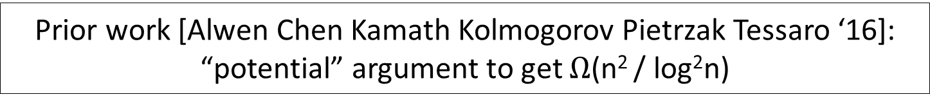
… to cc(n challenges)
H: {0,1}* → {0,1}^{w} random oracle
x₀
x₁
x₂
x₃
x₄
x₅
x₆
…
x_{n}
s₁
s₂
s₃
s₄
s₅
s₆
…
s_{n}
nw
1
Single random challenge: memory ≥
•
2
time
Know only that
orange is inversely
proportional to red
memory
Prior work [Alwen Chen Kamath Kolmogorov Pietrzak Tessaro ‘16]: “potential” argument to get $Ω$(n² / log²n)
t_{i} to compute s_{i}
time

Slide 11
… to cc(n challenges)
H: {0,1}* → {0,1}^{w} random oracle
x₀
x₁
x₂
x₃
x₄
x₅
x₆
…
x_{n}
s₁
s₂
s₃
s₄
s₅
s₆
…
s_{n}
nw
1
Single random challenge: memory ≥
•
2
time
Idea: apply bound k steps before s_{i-1} is known: purple
is inversely proportional to red+k
Know only that
orange is inversely
proportional to red
memory
k
t_{i-1} to compute s_{i-1}
t_{i} to compute s_{i}
time

Slide 12
… to cc(n challenges)
H: {0,1}* → {0,1}^{w} random oracle
x₀
x₁
x₂
x₃
x₄
x₅
x₆
…
x_{n}
s₁
s₂
s₃
s₄
s₅
s₆
…
s_{n}
nw
1
Single random challenge: memory ≥
•
2
time
Know only that
orange is inversely
proportional to red
memory
t_{i-1} to compute s_{i-1}
t_{i} to compute s_{i}
time

Slide 13
… to cc(n challenges)
H: {0,1}* → {0,1}^{w} random oracle
x₀
x₁
x₂
x₃
x₄
x₅
x₆
…
x_{n}
s₁
s₂
s₃
s₄
s₅
s₆
…
s_{n}
nw
1
Single random challenge: memory ≥
•
2
time
Know only that
orange is inversely
proportional to red
memory
t_{i-1} to compute s_{i-1}
t_{i} to compute s_{i}
time

Slide 14
… to cc(n challenges)
Adding up memory used during previous challenge:
nw
1
1
1
)
nw
(
…
+
+
+
≥ (ln (t_{i}+t_{i-1}) – ln t_{i})
2
t_{i}
t_{i}+1
t_{i} + t_{i-1}
2
nw
1
Single random challenge: memory ≥
•
2
time
Know only that
orange is inversely
proportional to red
memory
t_{i-1} to compute s_{i-1}
t_{i} to compute s_{i}
time

Slide 15
… to cc(n challenges)
Adding up memory used during previous challenge:
nw
1
1
1
)
nw
(
…
+
+
+
≥ (ln (t_{i}+t_{i-1}) – ln t_{i})
2
t_{i}
t_{i}+1
t_{i} + t_{i-1}
2
Adding up over all challenges i from 1 to n:
½nw ( ln (t₁+t₂) – ln t₂ + ln (t₂+t₃) – ln t₃+ … + ln (t_{n-1}+ t_{n}) – ln t_{n})
≥ ½nw (n ln 2)
≥ Ω(n²w)
memory
time

Slide 16
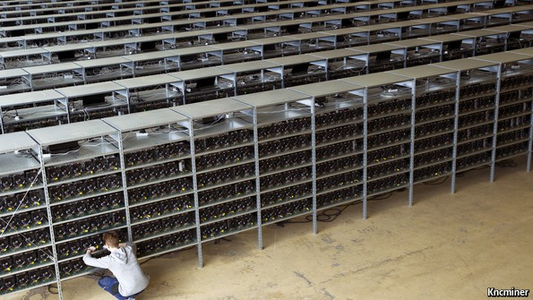
Mining Bitcoin (Proofs of Work)
Ecological: Massive energy & hardware waste.
Economical: Requires high rewards ⇒
inflation and/or high transaction fees.
Security: E.g. buy old ASICs for 51%
attack.

Slide 17
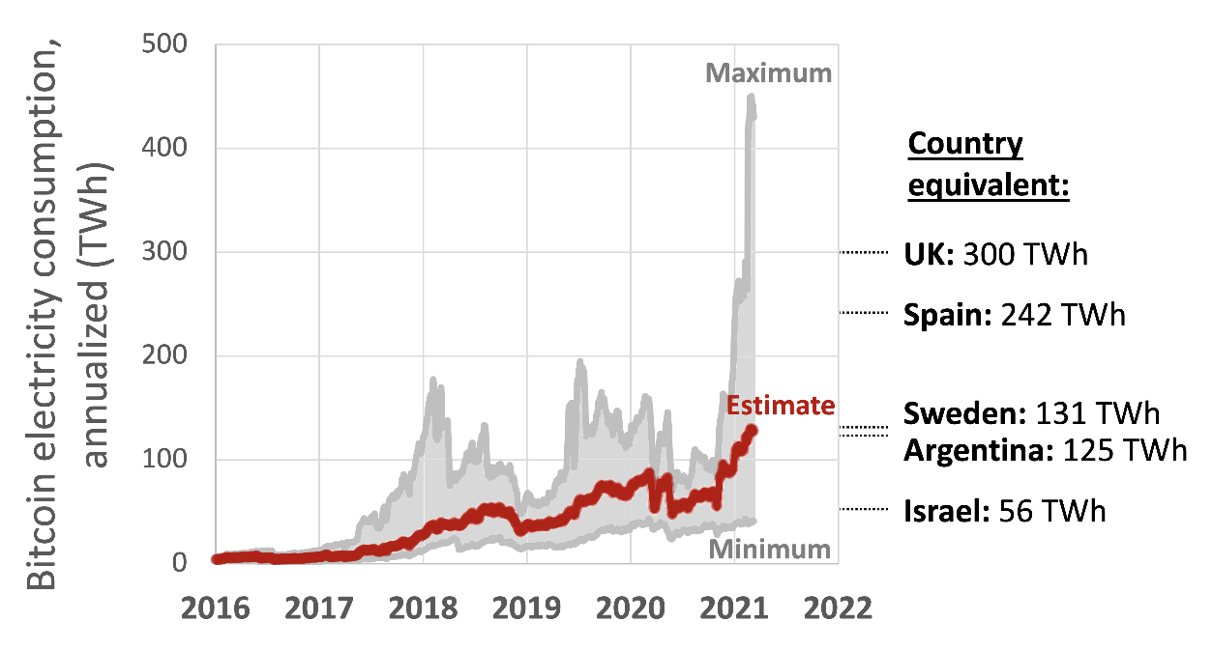

Proofs of Space
Proof of Work
  Energy Intensive
  Non-Egalitarian
    Original Vision for Bitcoin: anyone can mine with idle cycles on PC
Alternatives:
  Proof of Stake (Democratic?)
  Proof of Space
Proof of Space Applications:
  Distributed Consensus
  Proofs of (Replicated Storage)

Slide 18
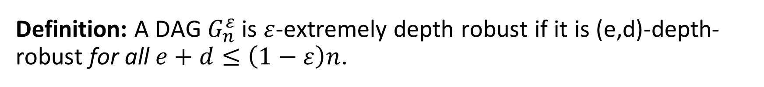
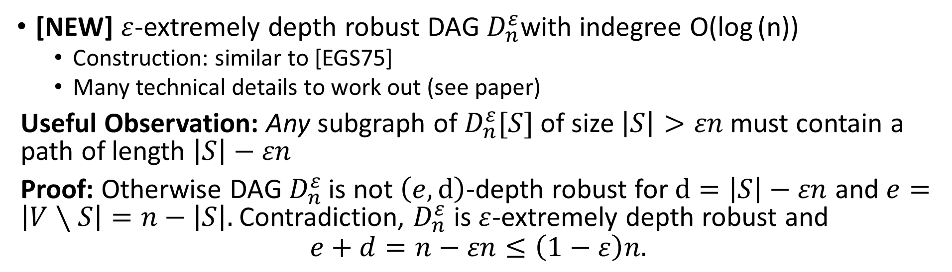
Technical Ingredient #2
Definition: A DAG $G_{n}^{ε}$ is $ε$-extremely depth robust if it is (e,d)-depth-robust for all $e+d≤\left(1−ε\right)n$.
[NEW] $ε$-extremely depth robust DAG $D_{n}^{ε}$with indegree O(log (n))
  Construction: similar to [EGS75]
  Many technical details to work out (see paper)
Useful Observation: Any subgraph of $D_{n}^{ε}[S]$ of size $\left|S\right|>εn$ must contain a path of length $\left|S\right|−εn$
Proof: Otherwise DAG${ D}_{n}^{ε}$ is not $\left(e,d\right)$-depth robust for $d=\left|S\right|−εn$ and $e=\left|V∖S\right|=n−\left|S\right|.$Contradiction, $D_{n}^{ε}$ is $ε$-extremely depth robust and
$$e+d=n−εn≤\left(1−ε\right)n.$$

Slide 19
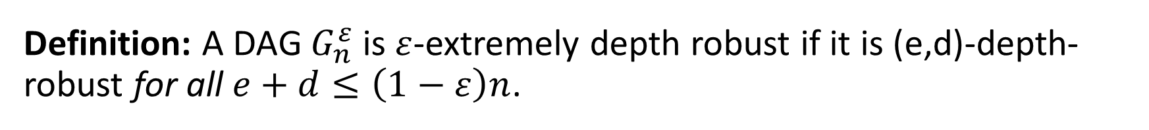
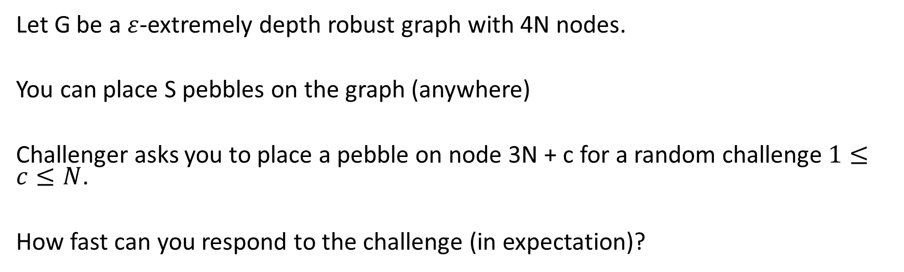
Let’s Play an (Extreme) Pebbling Game
Definition: A DAG $G_{n}^{ε}$ is $ε$-extremely depth robust if it is (e,d)-depth-robust for all $e+d≤\left(1−ε\right)n$.
Let G be a $ε$-extremely depth robust graph with 4N nodes.
You can place S pebbles on the graph (anywhere)
Challenger asks you to place a pebble on node 3N + c for a random challenge$1≤c≤N$.
How fast can you respond to the challenge (in expectation)?

Slide 20
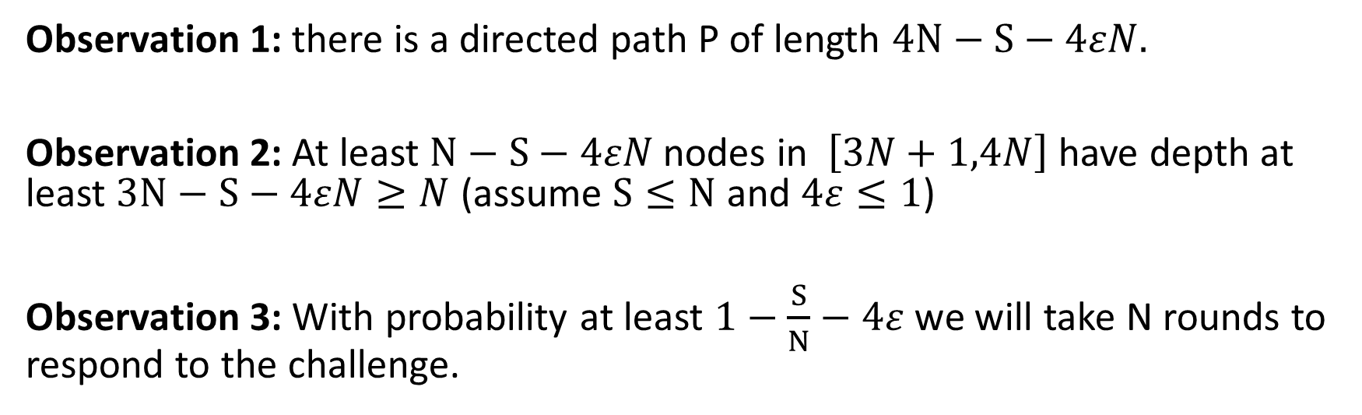
Let’s Play a (Pebbling) Game
Definition: A DAG $G_{n}^{ε}$ is $ε$-extremely depth robust if it is (e,d)-depth-robust for all $e+d≤\left(1−ε\right)n$.
Observation 1: there is a directed path P of length $4N−S−4εN.$
Observation 2: At least $N−S−4εN$ nodes in $\left[3N+1,4N\right]$ have depth at least $3N−S−4εN≥N$ (assume $S≤N$ and $4ε≤1$)
Observation 3: With probability at least $1−\frac{S}{N}−4ε$ we will take N rounds to respond to the challenge.

Slide 21
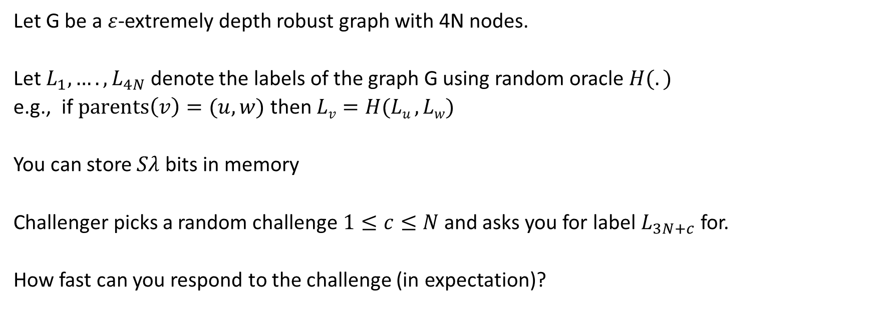
Non-Pebbling Game
Definition: A DAG $G_{n}^{ε}$ is $ε$-extremely depth robust if it is (e,d)-depth-robust for all $e+d≤\left(1−ε\right)n$.
Let G be a $ε$-extremely depth robust graph with 4N nodes.
Let $L_{1},….,L_{4N}$ denote the labels of the graph G using random oracle $H(.)$
e.g., if $parents\left(v\right)=(u,w)$ then $Lv=H(Lu ,Lw)$
You can store $Sλ$ bits in memory
Challenger picks a random challenge$1≤c≤N$ and asks you for label $L_{3N+c}$ for.
How fast can you respond to the challenge (in expectation)?

Slide 22
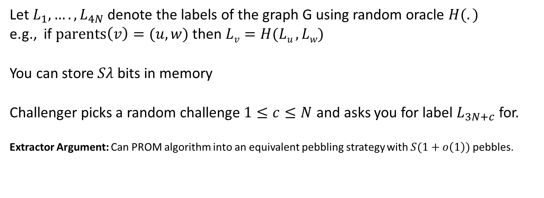
Non-Pebbling Game
Definition: A DAG $G_{n}^{ε}$ is $ε$-extremely depth robust if it is (e,d)-depth-robust for all $e+d≤\left(1−ε\right)n$.
Let $L_{1},….,L_{4N}$ denote the labels of the graph G using random oracle $H(.)$
e.g., if $parents\left(v\right)=(u,w)$ then $Lv=H(Lu ,Lw)$
You can store $Sλ$ bits in memory
Challenger picks a random challenge$1≤c≤N$ and asks you for label $L_{3N+c}$ for.
Extractor Argument: Can PROM algorithm into an equivalent pebbling strategy with $S(1+o\left(1\right))$ pebbles.

Slide 23
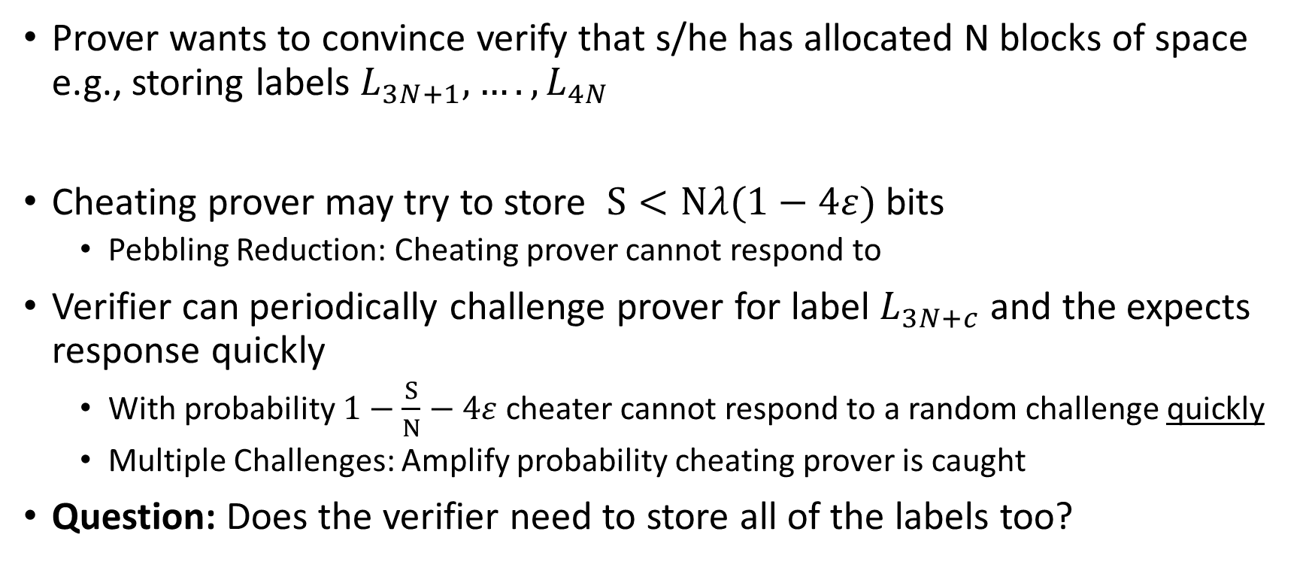
Proof of Space
Prover wants to convince verify that s/he has allocated N blocks of space e.g., storing labels $L_{3N+1},….,L_{4N}$
Cheating prover may try to store $S<Nλ(1−4ε)$ bits
  Pebbling Reduction: Cheating prover cannot respond to
Verifier can periodically challenge prover for label $L_{3N+c}$ and the expects response quickly
  With probability $1−\frac{S}{N}−4ε$ cheater cannot respond to a random challenge quickly
  Multiple Challenges: Amplify probability cheating prover is caught
Question: Does the verifier need to store all of the labels too?

Slide 24
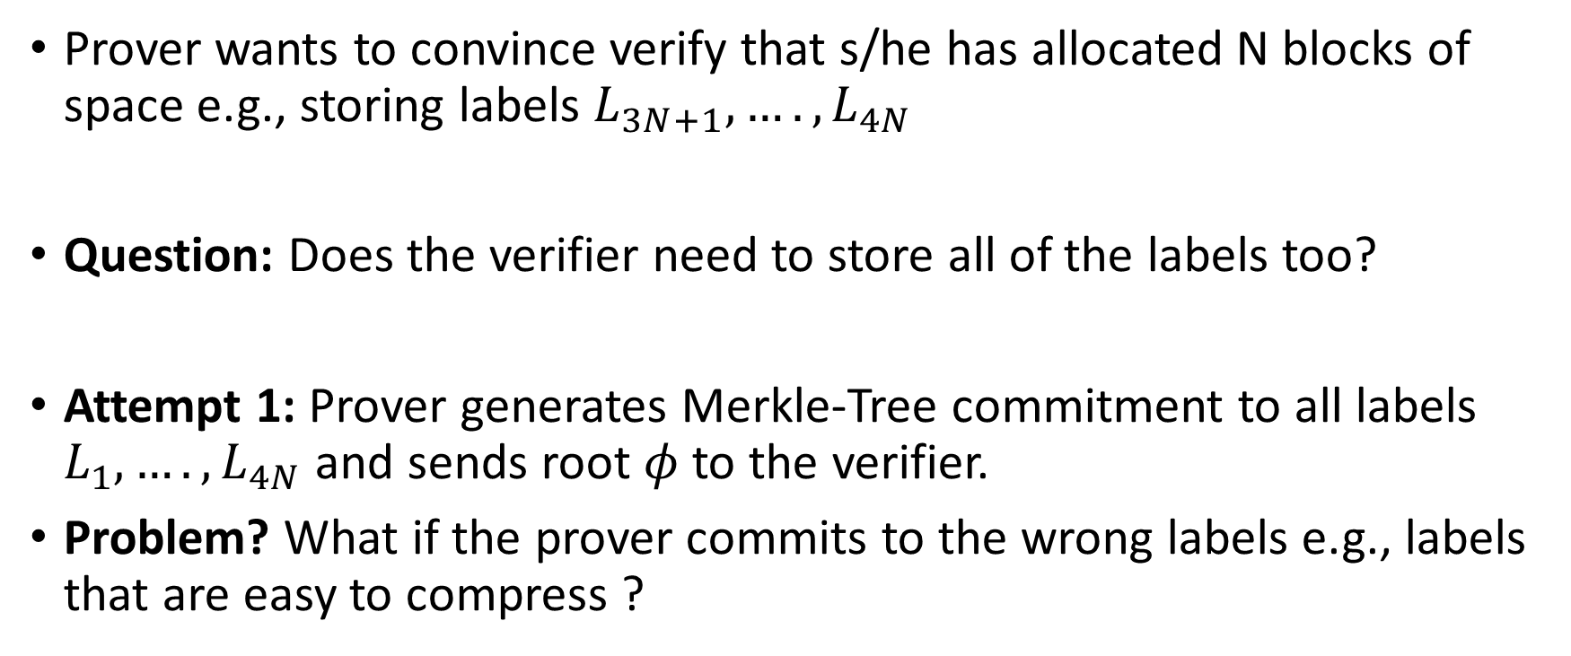
Proof of Space
Prover wants to convince verify that s/he has allocated N blocks of space e.g., storing labels $L_{3N+1},….,L_{4N}$
Question: Does the verifier need to store all of the labels too?
Attempt 1: Prover generates Merkle-Tree commitment to all labels $L_{1},….,L_{4N}$ and sends root $φ$ to the verifier.
Problem? What if the prover commits to the wrong labels e.g., labels that are easy to compress ?

Slide 25
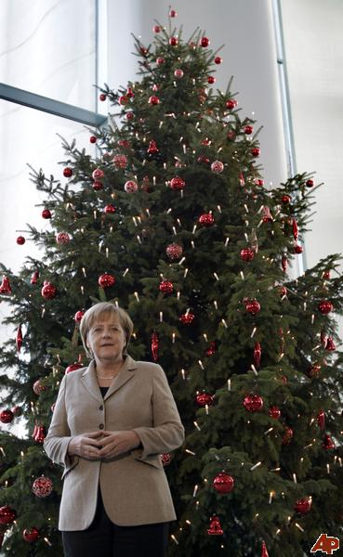
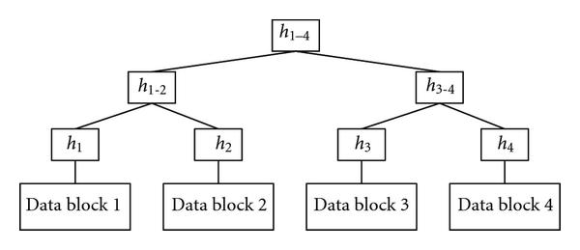



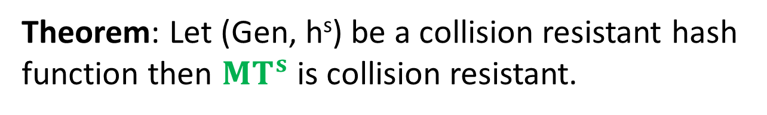
Merkle Trees
${MT}^{s}\left(x\right)≔\text{h}\text{s}\left(x\right)$
${MT}^{s}\left(x_{1},…,x_{2^{i}}\right)≔$
$\text{h}\text{s}\left({MT}^{s}\left(x_{1},…,x_{2^{i−1}}\right),{MT}^{s}\left(x_{2^{i−1}+1},…,x_{2^{i}}\right)\right)$
Theorem: Let (Gen, h^{s}) be a collision resistant hash function then ${MT}^{s}$ is collision resistant.
$$x_{1}$$
$$x_{2}$$

Slide 26
Merkle Trees
Proof of Correctness for data block 2
Verify that root matches
Proof consists of just log(n) hashes
  Verifier only needs to permanently store
  only one hash value

Slide 27
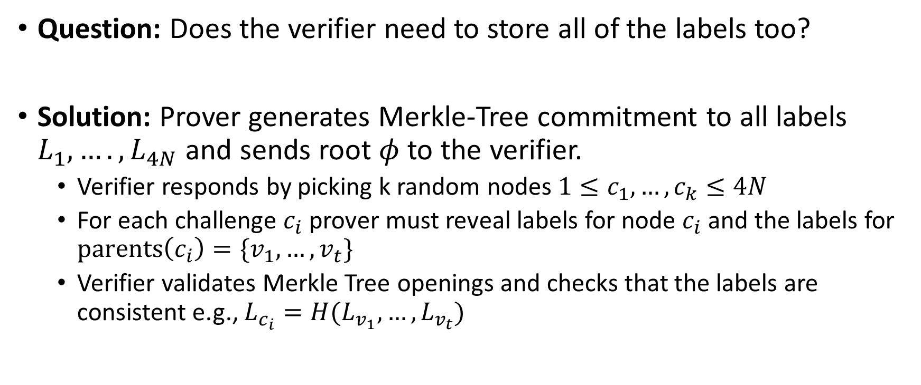
Proof of Space
Question: Does the verifier need to store all of the labels too?
Solution: Prover generates Merkle-Tree commitment to all labels $L_{1},….,L_{4N}$ and sends root $φ$ to the verifier.
  Verifier responds by picking k random nodes $1≤c_{1},…,c_{k}≤4N$
  For each challenge $c_{i}$ prover must reveal labels for node $c_{i}$ and the labels for $parents\left(c_{i}\right)=\{v_{1},…,v_{t}\}$
  Verifier validates Merkle Tree openings and checks that the labels are consistent e.g., $L_{c_{i}}=H(L_{v_{1}},…,L_{v_{t}})$

Slide 28
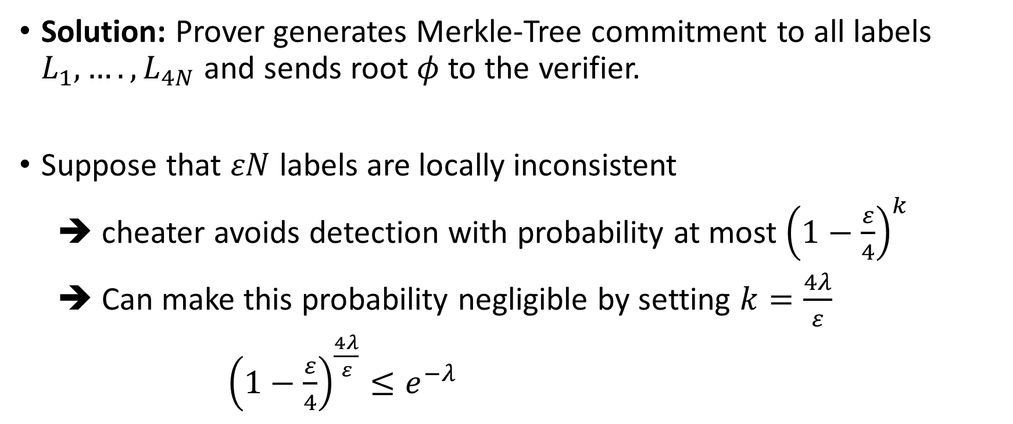
Proof of Space
Solution: Prover generates Merkle-Tree commitment to all labels $L_{1},….,L_{4N}$ and sends root $φ$ to the verifier.
Suppose that $εN$ labels are locally inconsistent
➔ cheater avoids detection with probability at most ${\left(1−\frac{ε}{4}\right)}^{k}$
➔ Can make this probability negligible by setting $k=\frac{4λ}{ε}$
${\left(1−\frac{ε}{4}\right)}^{\frac{4λ}{ε}}≤e^{−λ}$

Slide 29
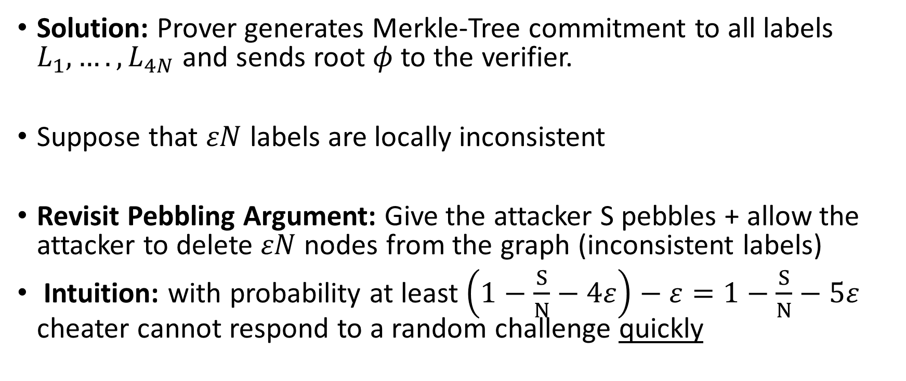
Proof of Space
Solution: Prover generates Merkle-Tree commitment to all labels $L_{1},….,L_{4N}$ and sends root $φ$ to the verifier.
Suppose that $εN$ labels are locally inconsistent
Revisit Pebbling Argument: Give the attacker S pebbles + allow the attacker to delete $εN$ nodes from the graph (inconsistent labels)
Intuition: with probability at least $\left(1−\frac{S}{N}−4ε\right)−ε=1−\frac{S}{N}−5ε$ cheater cannot respond to a random challenge quickly

Slide 30
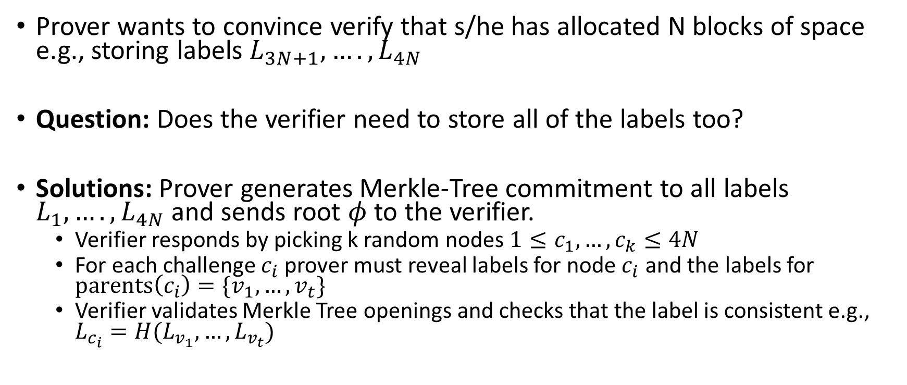
Proof of Space
Prover wants to convince verify that s/he has allocated N blocks of space e.g., storing labels $L_{3N+1},….,L_{4N}$
Question: Does the verifier need to store all of the labels too?
Solutions: Prover generates Merkle-Tree commitment to all labels $L_{1},….,L_{4N}$ and sends root $φ$ to the verifier.
  Verifier responds by picking k random nodes $1≤c_{1},…,c_{k}≤4N$
  For each challenge $c_{i}$ prover must reveal labels for node $c_{i}$ and the labels for $parents\left(c_{i}\right)=\{v_{1},…,v_{t}\}$
  Verifier validates Merkle Tree openings and checks that the label is consistent e.g., $L_{c_{i}}=H(L_{v_{1}},…,L_{v_{t}})$

Slide 31
Proof of Space

Slide 32
Proof of Catalytic Space
Catalyst: substance that increases rate of chemical reaction without itself undergoing any permanent chemical change
Idea: You have stored large 1TB dataset which you do not access regularly, but you should not delete.
Proof of Catalytic Space: Can participate in proof of work without permanently erasing dataset i.e., dataset can be recovered

Slide 33

Proof of Catalytic Space
Initial Input/Nonce: $χ$
File: $d=(d_{1},…,d_{N})$
Merkle-Tree Commitment to $d$
Using $H_{χ }\left(x\right)≔H(χ,x)$
Honest Prover Stores Red Labels
Can (slowly) recover file $d$
given red labels + nonce $χ$

Slide 34


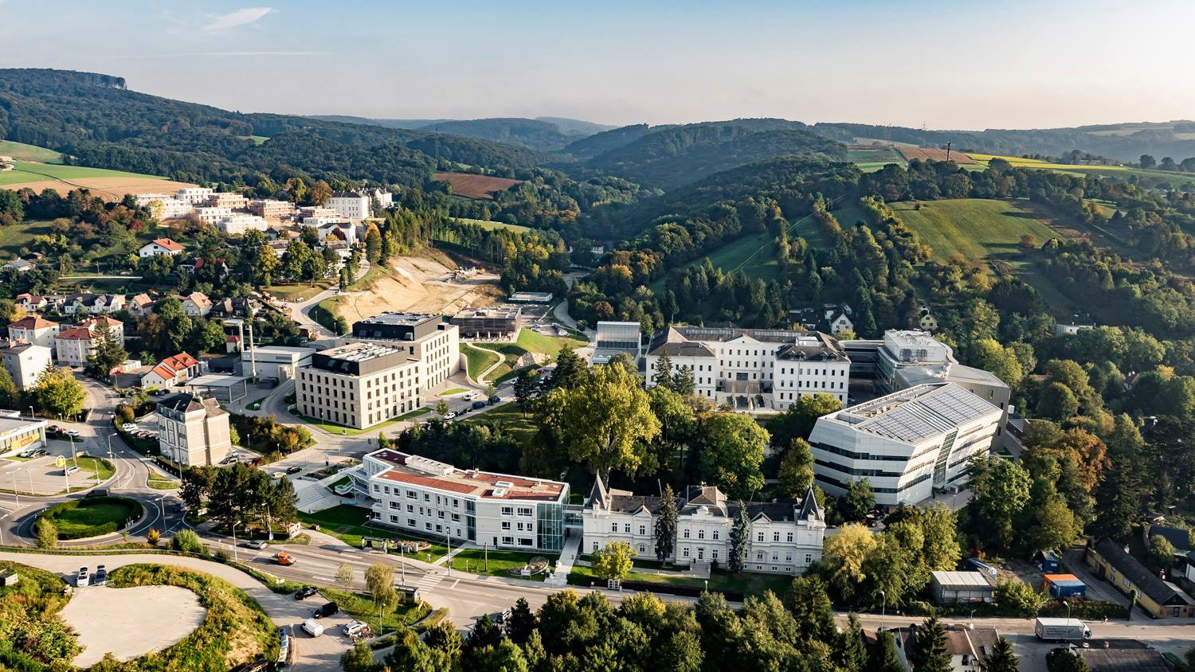

Simple Proofs of Sequential Work
Bram Cohen Krzysztof Pietrzak
Eurocrypt 2018, Tel Aviv, May 1st 2018

Slide 35
Outline
Proofs of Sequential Work Sketch of Construction & Proof Sustainable Blockchains
What
How
Why

Slide 36
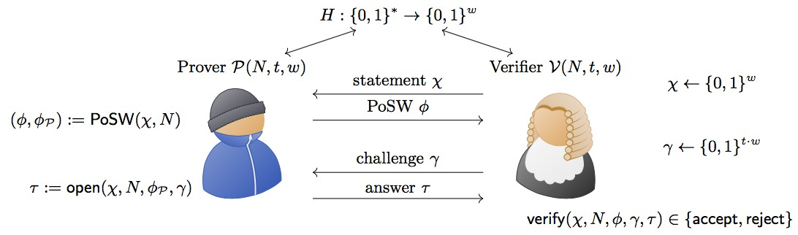
Outline
Proofs of Sequential Work Sketch of Construction & Proof Sustainable Blockchains
What
How
Why

Slide 37
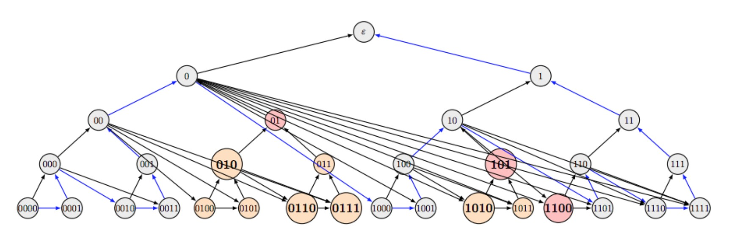
Outline
Proofs of Sequential Work Sketch of Construction & Proof Sustainable Blockchains
What
How
Why

Slide 38
Outline
Proofs of Sequential Work Sketch of Construction & Proof Sustainable Blockchains
What
How
Why
α_{i}
αi+1
β_{i}
βi+1
σ_{i}
τ_{i}
σi+1
τi+1

Slide 39
Proofs of Sequential Work

Slide 40
Time-lock puzzles and timed-release Crypto
Ronald L. Rivest*, Adi Shamir**, and David A . Wagner***
Revised March 10, 1996

Slide 41
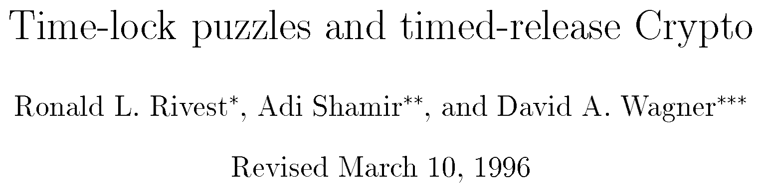
puzzle: (N = p · q, x, T ) , solution: x²
T
mod N
solution computed with two exponentiation given p, q:
e ← 2^{T}
mod φ(N ) ,
T
_{x}2
= x^{e} mod N
conjectured to require T sequential squarings given only N
2 T
x → x² → x² → . . . x²
mod N

Slide 42
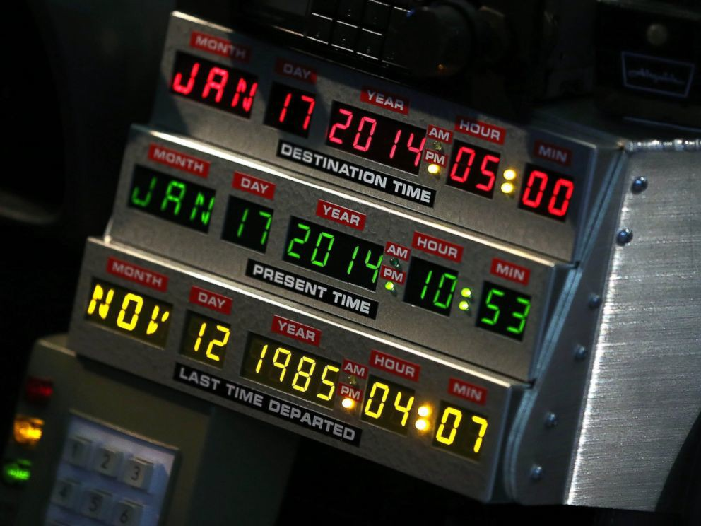
puzzle: (N = p · q, x, T ) , solution: x²
T
mod N
solution computed with two exponentiation given p, q:
e ← 2^{T}
mod φ(N ) ,
T
_{x}2
= x^{e} mod N
conjectured to require T sequential squarings given only N
2 T
x → x² → x² → . . . x²
sequential computation ∼
computation time ⇒
“send message to the future”
mod N

Slide 43
Publicly Verifiable Proofs of Sequential Work
Mohammad Mahmoody* Tal Morant Salil Vadhan+ February 18, 2013

Slide 44
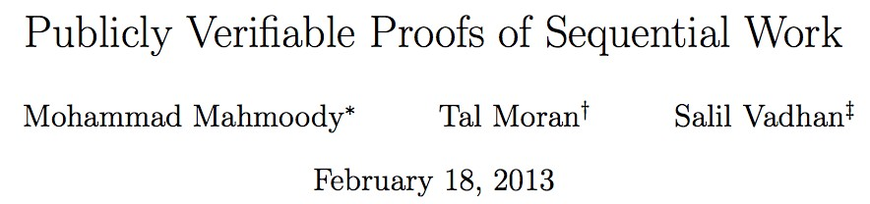
PoSW vs. Time-Lock Puzzles
Functionality
Prove that time has passed
Send message to the future
⇒ Non-interactive time-stamps

Slide 45
PoSW vs. Time-Lock Puzzles
Functionality
Prove that time has passed
Send message to the future
⇒ Non-interactive time-stamps
Assumption
Random oracle model or
Non-standard algebraic assumption
“sequential” hash-function

Slide 46
PoSW vs. Time-Lock Puzzles
Functionality
Prove that time has passed
Send message to the future
⇒ Non-interactive time-stamps
Assumption
Random oracle model or
Non-standard algebraic
“sequential” hash-function
assumption
Public vs. Private
Private-coin ⇒
Designated verifier
Public-coin ⇒
Publicly verfiable

Slide 47


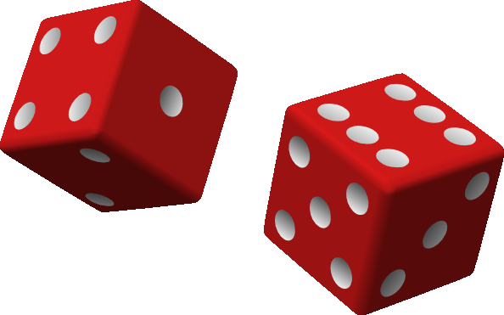
Proofs of Sequential Work
aka. Verifiable Delay Algorithm
Prover P Verifier V
statement χ
Time T ∈ N
χ ←

Slide 48
Proofs of Sequential Work
aka. Verifiable Delay Algorithm
Prover P Verifier V
statement χ
Time T ∈ N
τ = τ (χ, T )
χ ←
verify(χ, T, τ ) ∈
accept/reject

Slide 49
Proofs of Sequential Work
aka. Verifiable Delay Algorithm
H
Prover P
Verifier V
statement χ
χ ←
Time T ∈ N
τ = τ (χ, T )
verify(χ, T, τ ) ∈
accept/reject
Completeness and Soundness in the random oracle model:

Slide 50
Proofs of Sequential Work
aka. Verifiable Delay Algorithm
H
Prover P
Verifier V
statement χ
χ ←
Time T ∈ N
τ = τ (χ, T )
verify(χ, T, τ ) ∈
accept/reject
Completeness and Soundness in the random oracle model:
Completeness: τ (c, T ) can be computed making T queries to H
Soundness: Computing any τ ^{l} s.t. verify(χ, T, τ ^{l}) =accept for random χ requires almost T sequential queries to H

Slide 51
Proofs of Sequential Work
aka. Verifiable Delay Algorithm
H
Prover P
Verifier V
statement χ
χ ←
Time T ∈ N
τ = τ (χ, T )
verify(χ, T, τ ) ∈
accept/reject
Completeness and Soundness in the random oracle model:
Completeness: τ (c, T ) can be computed making T queries to H
Soundness: Computing any τ ^{l} s.t. verify(χ, T, τ ^{l}) =accept for random χ requires almost T sequential queries to H
massive parallelism useless to generate valid proof faster ⇒
prover must make almost T sequential queries ∼ T time

Slide 52
Three Problems of the [MMV’13] PoSW
Space Complexity : Prover needs massive (linear in T)
space to compute proof.
Poor/Unclear Parameters due to usage of sophisticated combinatorial objects.
Uniqueness : Once an accepting proof is computed, many other valid proofs can be generated (not a problem for time-stamping, but for blockchains).

Slide 53
Three Problems of the [MMV’13] PoSW
Space Complexity : Prover needs massive (linear in T)
space to compute proof.
Poor/Unclear Parameters due to usage of sophisticated combinatorial objects.
Uniqueness : Once an accepting proof is computed, many other valid proofs can be generated (not a problem for time-stamping, but for blockchains).
New Construction
Prover needs only O(log(T )) (not O(T )) space, e.g. for
T = 2⁴² (≈ a day) that’s ≈ 10KB vs. ≈ 1P B.
Simple construction and proof with good concrete parameters.
Awesome open problem!

Slide 54
Construction and Proof Sketch

Slide 55
Three Basic Concepts

Slide 56
Three Basic Concepts
Depth-Robust Graphs (only [MMV’13])
DAG G = (V, E) is (e, d)
1 2 3 4 5 6
depth-robust if after removing any
e nodes a path of length d exists.

Slide 57
Three Basic Concepts
Depth-Robust Graphs (only [MMV’13])
DAG G = (V, E) is (e, d)
1 2 3 4 5 6
is (2, 3) depth-robust
depth-robust if after removing any
e nodes a path of length d exists.

Slide 58
Three Basic Concepts
Depth-Robust Graphs (only [MMV’13])
DAG G = (V, E) is (e, d)
1 2 3 4 5 6
depth-robust if after removing any
e nodes a path of length d exists.
Graph Labelling
label £_{i} = H(£_{parents(i)}), e.g. £₄ = H(£₃, £₄)

Slide 59
Three Basic Concepts
Depth-Robust Graphs (only [MMV’13])
DAG G = (V, E) is (e, d)
1 2 3 4 5 6
depth-robust if after removing any
e nodes a path of length d exists.
Graph Labelling
label £_{i} = H(£_{parents(i)}), e.g. £₄ = H(£₃, £₄)
Random Oracles are Sequential
H
H
queries y = H(x), y^{l} = H(x^{l}) where
y ⊆ x^{l} ⇒ query x^{l} was made after x
x y
_{y}l
_{x}l

Slide 60
The MMV’13 Construction
H
Prover P
Verifier V
statement χ
χ ←
Time T = 6
Protocol specifies depth-robust
DAG G on T nodes
£₁ £₂ £₃ £₄
£₅ £₆
Define “fresh” random oracle
H_{χ}(·) ≡ H(χ ·)
Compute labels of G using H_{χ}

Slide 61
The MMV’13 Construction
H
Prover P
Verifier V
statement χ
χ ←
Time T = 6
φ
Proof Sketch
G is (e, d) depth-robust
£l l l l l l
£₂ £₃ £₄ £₅ £₆
˜
l
1
i∈V
φ commits P to labels {£ }
i
i is bad if £^{l} /= H(£^{l}
)
i
parents(i)
φ
Case 1: ≥ e bad nodes ⇒ will fail opening phase whp.

Slide 62
The MMV’13 Construction
H
Prover P
Verifier V
statement χ
χ ←
Time T = 6
φ
Proof Sketch
G is (e, d) depth-robust
£l l l l l l
£₂ £₃ £₄ £₅ £₆
˜
l
1
i∈V
φ commits P to labels {£ }
i
i is bad if £^{l} /= H(£^{l}
)
i
parents(i)
φ
Case 1: ≥ e bad nodes ⇒ will fail opening phase whp.
Case 2: Less than e bad labels ⇒ ∃ path of good nodes (by (e, d) depth-robustness) ⇒ P˜ made d sequential queries (by sequantality of RO)

Slide 63
The New Construction
T = 15
For every leaf i add all edges (j, i) where j is left sibling of node on path i → root

Slide 64
The New Construction
T = 15
right sibling
left sibling
For every leaf i add all edges (j, i) where j is left sibling of node on path i → root

Slide 65
The New Construction
T = 15
For every leaf i add all edges (j, i) where j is left sibling of node on path i → root

Slide 66
The New Construction
T = 15
15
14
₃
₁ ₂
For every leaf i add all edges (j, i) where j is left sibling of node on path i → root
P computes labelling £_{i} = H(£_{parents(i)}) and sends root
label φ = £_{T} to V. Can be done storing only log(T ) labels.
V challenges P to open a subset of leaves and checks consistency (blue and green edges!)

Slide 67
The New Construction
φ
T = 15
Proof Sketch

Slide 68
The New Construction
φ
T = 15
Proof Sketch
˜
l
P committed to labels £ after sending φ = £₁₅.
i
i is bad if £^{l} /= H(£^{l}
).
i
parents(i)

Slide 69
The New Construction
φ
T = 15
Proof Sketch
˜
l
P committed to labels £ after sending φ = £₁₅.
i
i is bad if £^{l} /= H(£^{l}
).
i
parents(i)
Let S ⊂ V denote the bad nodes and all nodes below.

Slide 70
The New Construction
φ
T = 15
Proof Sketch
˜
l
P committed to labels £ after sending φ = £₁₅.
i
i is bad if £^{l} /= H(£^{l}
).
i
parents(i)
Let S ⊂ V denote the bad nodes and all nodes below.
Claim 1: ∃ path going through V − S (of length T − |S|).
Claim 2: P˜ can’t open |S|/T fraction of leafs.
Theorem: P˜ made only T (1 − c) sequential queries
⇒ will pass opening phase with prob. ≤ (1 − c)^{#of challenges}

Slide 71
why we care
Sustainable Blockchains
α_{i}
αi+1
β_{i}
βi+1
σ_{i}
τ_{i}
σi+1
τi+1

Slide 72
Mining Bitcoin (Proofs of Work)

Slide 73
Mining Bitcoin (Proofs of Work)
Ecological: Massive energy & hardware waste.
Economical: Requires high rewards ⇒
inflation and/or high transaction fees.
Security: E.g. buy old ASICs for 51%
attack.

Slide 74

Can we have a more “sustainable” Blockchain?

Slide 75

Thanks for Listening

